Slide 1
Instance Based Social Network Representation
CSE 510: HCI
Spring 2010
Project final presentation
Yoav Artzi
Amit Levy

Slide 2
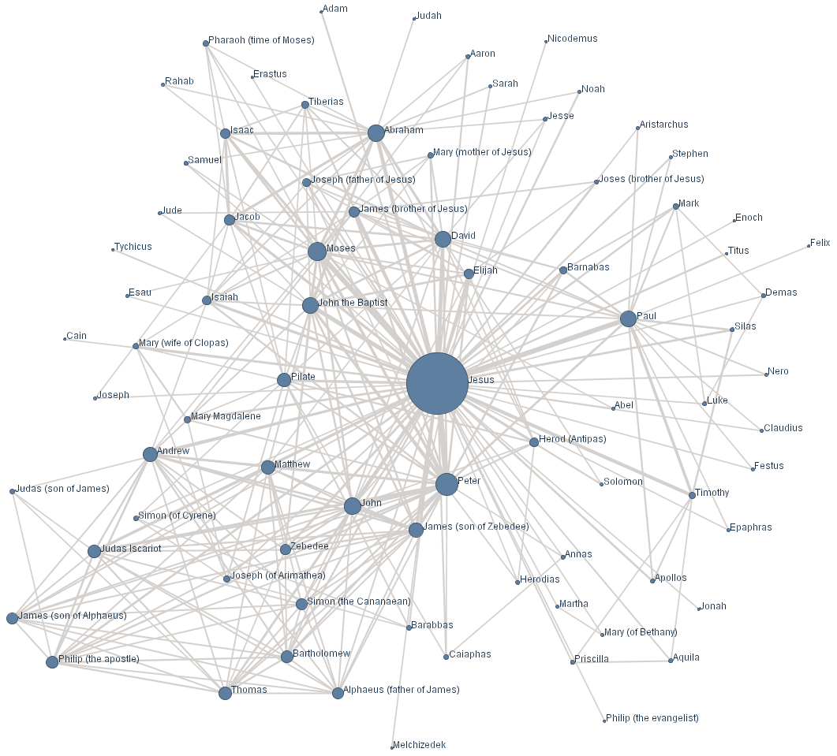
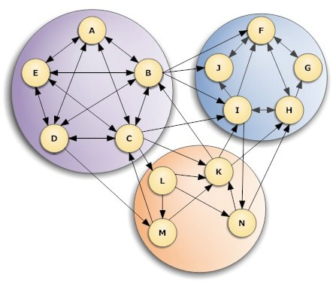

Instance Based Network Representation
Representing instances detection
Graph representation
Community detection
Notes:
We need to remind people what we do. So there are 3 slides here that should take care of it. They should take about 30 seconds.
So in a slightly more formal manner: we propose to represent social networks using a constant number of members. We first partition the network graph to a constant number of clusters and then select a single representing member for each cluster.
As we can see this problem generalizes to representing social networks using limited screen real estate and this is the direct problem we are going to deal with.

Slide 3
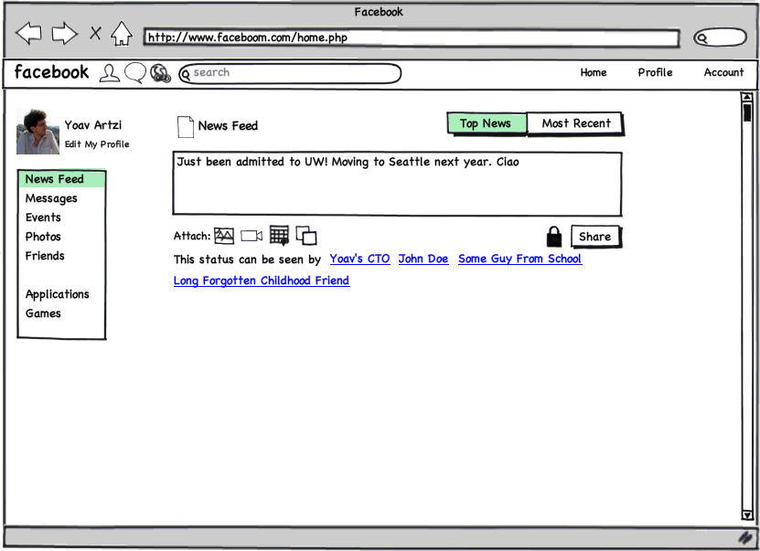
*This may or may not really happened
Notes:
For example, our approach can aid understanding privacy and exposure by listing a few representing members of the social network

Slide 4
My CTO? Oh, maybe I shouldn’t post it yet.
*This may or may not really happened
Notes:
to give the user intuition about who can see what.

Slide 5
Challenges
How to answer the central question?
Too many dimensions
Respect people’s privacy
Only a few chances to get it right
Notes:
Limitations of our results:
Technical problems
Too many dimensions
Reluctance of people to expose their FB account due to latest privacy blah blah blah
The difficulty of narrowing the problem to simple questions and the problem of measuring the effect on privacy

Slide 6
Approach
Ask user to associate individuals with clusters
Answering a higher level question
How do users intuitively perceive their network?
Evaluate if algorithm captures user’s perception of their social network

Slide 7
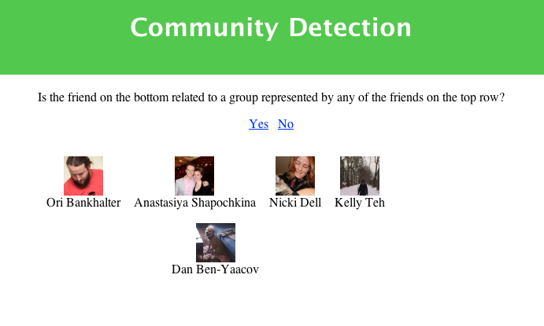
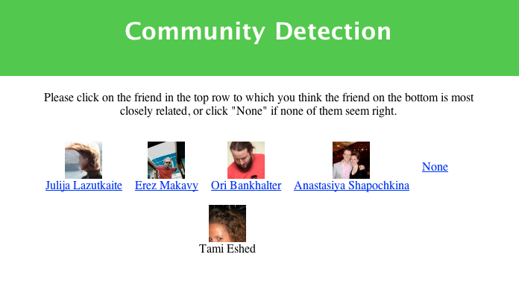
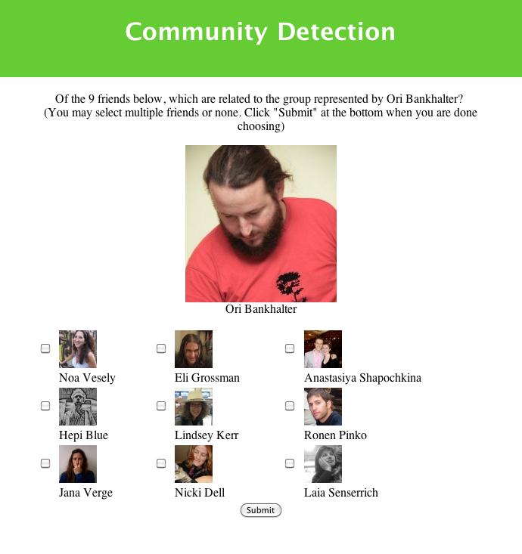
Our Experiment
3 question types
Composed using the user’s Facebook network
User gets 10 questions of a single type
Notes:
Facebook App
Gets users friends and mutual friends and constructs graph
Clusters friends based on combination of mutual friends, affiliation and location
Choose representative for each cluster
Each user was asked 10 questions in one of three formats
Collect only enough information
Only sensitive information was user id and answers

Slide 8
Our Experiment
Notes:
First question type:

Slide 9
Our Experiment
Notes:
We have to present our experiment. So we should:
Talk shortly about the platform
Show the questions through screenshots
Describe what a user gets

Slide 10
Our Experiment
Notes:
We have to present our experiment. So we should:
Talk shortly about the platform
Show the questions through screenshots
Describe what a user gets

Slide 11
Results
10
10
10
7
10
10
7
8
10
11
10
10
Notes:
Showing our results. In this slide we can show a table of the number of results we got. Or some graph…..
We can hint towards the small numbers due to people not favoring exposing their profile. But we should talk bout this later (under limitations and what we learned).

Slide 12
Results
43
42
43
Notes:
Show our conclusions from the results. We can show here our claim that our approach works or doesn’t work.

Slide 13
Limitations
Selection bias
Could not cover all variables
Representation algorithms left out
Binary use of affiliation and location
Limited data for analysis
For example, no friend count, only mutual friends, interactions, etc

Slide 14
What We Learned
Quiz-like possibilities for privacy configuration
Privacy matters and forgotten
“… it was really fun for me, this little game… “
“… scary, it brought up photos of friends that are accidently in my Facebook… Is that the goal? To show that half of them are not really connected to you?”
Notes:
We didn’t anticipate that people are not that keen about sharing their profile
It’s hard to get people’s attention
Other opportunities that this experiment exposed (games for privacy configuration) – I have a quote from a user for this
Feedback showed that our approach to privacy does hold promise – I have another quote for this one

Slide 15
What We Learned
People are worried about privacy on Facebook
They need to see who has access to their data
Algorithmic approaches might help communicate privacy
Notes:
We didn’t anticipate that people are not that keen about sharing their profile
It’s hard to get people’s attention
Other opportunities that this experiment exposed (games for privacy configuration) – I have a quote from a user for this
Feedback showed that our approach to privacy does hold promise – I have another quote for this one

Slide 16
Future Work
More of the same (gather more data)
Explore more personal variables
Relating success to network properties
Size, path lengths, clustering co-efficient
Use our approach to communicate privacy in Facebook
Evaluate “in the wild”
Explore other uses of social network clustering
Help create groups for privacy settings
Notes:
Talk about other dimensions to measure and other approaches for representing networks

