Slide 1

Multiprogramming a 64 kB Computer
Safely and Efficiently
Amit Levy† Brad Campbell* Branden Ghena‡ Daniel B. Giffin†
Pat Pannuto‡ Prabal Dutta‡ Philip Levis†
Stanford University† University of Virginia* U.C. Berkeley‡
SOSP ‘17, October 30th 2017

Slide 2

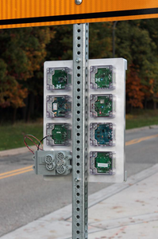

Microcontrollers Becoming Platforms
Low energy: μA sleep current
Low memory: ~64 kB RAM
USB authentication keys have multiple functions
  U2F, SSH, GPG, HOTP
Sensor networks run several experiments at once
Fitness watches support different activities
This should scare you!
Notes:
several in your laptop and phone, watches, smoke alarms, drone
Historically single purpose devices
But steadily become software platforms

Slide 3



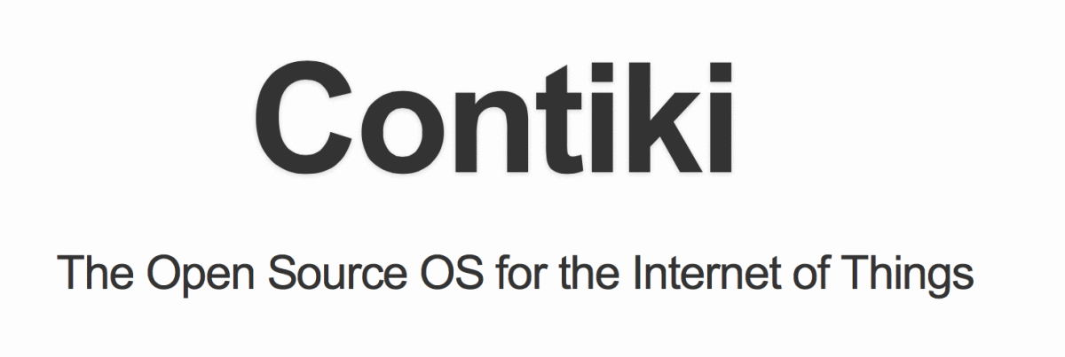

Embedded Software Isn’t Ready
Run all code in a single address space
Trust all code
Monolithic image
All or nothing recovery
  Watchdog timers
Notes:
Compiled together and run in single address space
Trust every line of code. Bug anywhere → system crash or worse, leaking secret key
Can’t update just one part, e.g. application
If any part fails, have to reboot whole thing
We know that writing software like this doesn’t end well
Already having an impact on end-users

Slide 4
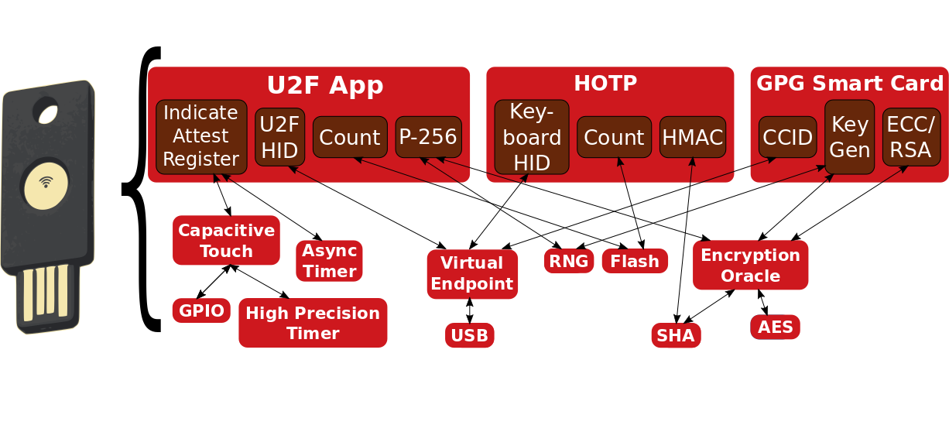
Example: USB Authentication Key
Multiple independent applications
No programmability in favor of security
Notes:
To use just one example: many of you probably…
Turns out pretty complex: several apps for different authentication & security functions.
This is exactly the kind of device want to program
Ultimately, barriers between components not strong enough

Slide 5
Microcontrollers need fault isolation for applications and OS services.
Notes:
So what we need is …. for microcontroller software
Don’t think this is controversial, but easier said than done

Slide 6
Fault Isolation on Microcontrollers
Traditional isolation techniques don’t apply
  With 64 kB, malloc a serious threat to system stability
  No virtual memory
  Still need to solve driver isolation
Moore’s Law won’t fix the problem
  Sleep current is limiting factor
  Memory capacity < 10x in 15 years
But new isolation tools available
  MPU: Protection bits for 8 memory regions
  Rust: a non-GC’d type safe systems language
  What are the operating systems abstractions?
Notes:
Traditional isolation techniques won’t work for low-memory
* Any kind of global heap allocation serious threat
* Drivers still a huge source of bugs → research isolating drivers, but too resource heavy for 64 kB of RAM
Unlike last time we had 64 kB…
The fact that MCU mem. capacity hasn’t grown is evidence
New hardware, new languages
How can OS use tools for safe multiprogramming on 64kB

Slide 7
Design Goals
Isolate drivers at no resource cost
  Rust type-system to prevent safety violations
Isolate applications
  Process isolation using MPU
  Must immediately reclaim upon termination
Support concurrent applications & I/O
  Need memory abstractions in lieu of heap
Notes:
Three things we want such an OS to do
Process… but again, such little mem. Have to be able to reclaim all resources when a process terminates
Turns out not so hard if single op at a time,

Slide 8
Tock: A Microcontroller OS
Kernel components in Rust
Type-safe API for safe drivers development
Processes abstraction with Memory Protection Unit
Grants: concurrency without a global heap
  Manages process-specific kernel heap
  Ensures resources can be freed immediately
Notes:
Today, I’m going to tell you about an OS for MCUs called Tock

Slide 9
Outline
Why Rust?
Security Model
Two Isolation Mechanisms
Grants
Case Study: Signpost
Limitations & Future Work
Notes:
OK, let’s start by asking “Why is Rust a useful tool for this problem?”

Slide 10
Why Rust?
Type and memory safe
  No buffer overflows, dangling pointers, type confusion…
Compile-time enforced type system
  No type artifacts at run time
No garbage collection
  Control over memory layout and execution
Runtime behavior similar to C
Notes:
Just like Java, Haskell and other type safe languages
Certain things we can’t do, like downcast a value, but all this type nonesense goes away after we compile the program
Rust is different from most…
Upshot: Once we compile a Rust program

Slide 11
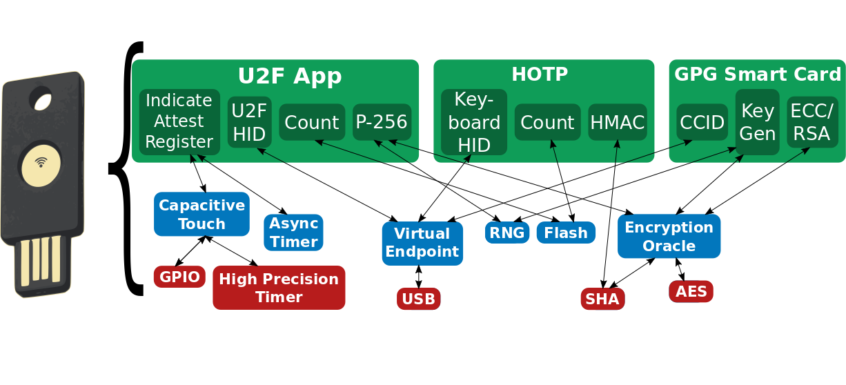
Security in a Multiprogrammable MCU
Notes:
Going back to authentication key example:
Problem was that we didn’t have isolation, but Tock provides isolation
Can ask: Who writes the software?

Slide 12
Platform Provider
Build the hardware
Responsible for TCB: core kernel, MCU-specific code
Trusted: complete control over firmware & hardware

Slide 13
Kernel Component Developers
Build most kernel functionality
  Device drivers, networking protocols, timers...
Platform provider select: audit but won’t catch all bugs
Notes:
Peripheral chip vendors build device drivers, OSS community …
Platform provides select components, and can audit them, but…

Slide 14
Application Developers
Implement end-user functionality
“Third-party” developers: unknown to board integrators
Modeled as malicious
Notes:
Malicious: compromise secrecy or integrity. Block system progress.

Slide 15


Tock’s Isolation Mechanisms
Capsules
Rust code linked into kernel
Isolation enforced at compile-time
Low overhead
Used for device drivers, protocols, timers...
Trusted for liveness, not safety
Processes
Standalone executable in any language
Isolation enforced at runtime
Higher overhead
Applications
Totally untrusted

Slide 16
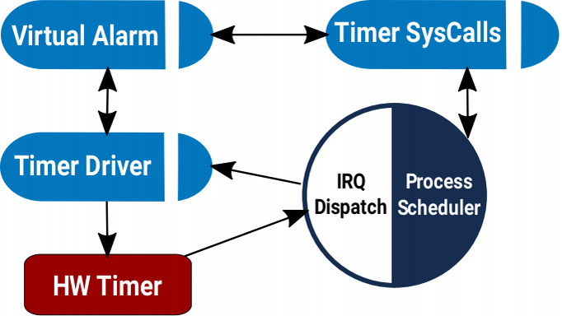
Capsules
A Rust module and structs
Event-driven execution with asynchronous I/O
Shared stack, no heap
Communicate via references & method calls
  Often inlined

Slide 17
Kernel Memory Consumption
Example 1: “blink”
 | ROM size (B) | RAM size (B)
Tock | 3208 | 916
TinyOS | 5296 | 72
FreeRTOS | 4848 | 2984
Example 2: Networked sensor
 | ROM size (B) | RAM size (B)
Tock | 41744 | 9704
TinyOS | 39604 | 10460

Slide 18
Capsule Isolation
struct DMAChannel {
length: u32,
base_ptr: *const u8,
}
impl DMAChannel {
fn set_dma_buffer(&self, buf: &'static [u8]) {
self.length = buf.len();
self.base_ptr = buf.as_ref();
}
}
Exposes the DMA base pointer and length as a Rust slice
Type-safety guarantees user has access to memory
Notes:
* Example of pretty rich isolation semantics
* From DMA capsule for one of the MCUs
* DMAChannel capsule sets length and base pointer in MMIO registers.
* Don’t want to expose this to clients
* Instead, fields are private, and clients sets buffer through a method that takes a Rust slice.
* Normally enforce this with specialized hardware

Slide 19
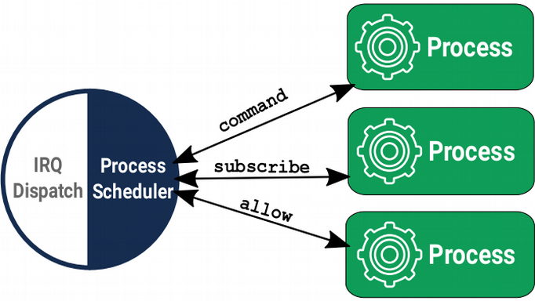
Processes
Hardware-isolated concurrent executions of programs
  MPU to protect memory regions without virtualization
  Independent stack, heap, static variables
Updated dynamically with position independent code
Scheduled preemptively
System calls & IPC for communication
Notes:
* Similar to processes in other systems
* Each process has dedicated block of memory for…
* Enforced with the hardware
* No virtual memory but compiled with PIC...
* Unlike capsules… scheduled preemptively… so
* Instead of methods & references…
* Compared to capsules...

Slide 20
Process Overhead
Dedicated memory region (at least a stack)
Context switch for communication (340 cycles)
Notes:
Processes can be updated at runtime and are totally untrusted, so can use for applications
But consume resources so have to use sparingly
In particular…
For operations, like quickly toggling a I/O pin, non-starter
For others, like sending a large string over serial, no biggie
11ms vs. 100us

Slide 21
How do capsules and processes interact?
Notes:
* So far, two isolation mechanisms, one kernel another for applications.
Capsules static and can’t dynamically allocate, processes totally dynamic.
How do they interact?

Slide 22
Working Example: Software Timer
Software Timer
Kernel
HW Alarm

Slide 23
Statically allocate timer state?
FAIL
Software Timer Driver
Static allocation must trade off memory efficiency and maximum concurrency

Slide 24
What About Dynamic Allocation?
Software Timer Driver

Slide 25
What About Dynamic Allocation?
Software Timer Driver

Slide 26
What About Dynamic Allocation?
Software Timer Driver

Slide 27
What About Dynamic Allocation?
Software Timer Driver
Notes:
We’ll, of course, do the same for other drivers

Slide 28
What About Dynamic Allocation?
FAIL
AES Driver
Software Timer Driver
Bluetooth Driver
Can lead to unpredictable shortages.
One process’s demands impacts capabilities of others.
Notes:
Lead to unpredictable shortages. Worse, the fault could happen anywhere, including…
Fundamental problem: broken isolation

Slide 29
Grants: Per-Process Kernel Heaps
Allocations for one process do not affect others
System proceeds if one grant section is exhausted
All process resources freed on process termination
Grant section
RAM
Heap
Process
Accessible
Memory
Data
Stack
Flash
Code
Notes:
Grants solve this problem by…
Kernel heap, called grant section, allocated in process memory, but can’t access

Slide 30
Grants:
Kernel heap safely borrowed from processes
Software Timer Driver
Grants balance safety and reliability of static allocation with flexibility of dynamic allocation
Notes:
* Process requests for timer => new grant allocated
* More than one request? more grants are allocated.
* Memory exhausted? kill the process, no affect on the rest of the system.
* And can restart process immediately
Recall, grant sections live in… but contain kernel data, so… need to make sure...

Slide 31
Grants use the type-system to ensure references only accessible when process is live
fn enter<'a, F>(&'a self, pid: ProcId, f: F) → where
F: for<'b> FnOnce(&'b mut T)
// Can’t operate on timer data here
timer_grant.enter(process_id, |timer| {
// Can operate on timer data here
if timer.expiration > cur_time {
timer.fired = true;
}
});
// timer data can’t escape here
Notes:
Capsules can’t store direct references to granted memory
Instead, the enter the grant section by passing in the id of the process.
Enter checks process is still alive, and executes a closure provided by capsule, passing in a reference to the actual data.
It’s important that this reference not escape, so use a feature of Rust, lifetimes, to enforce this property.

Slide 32
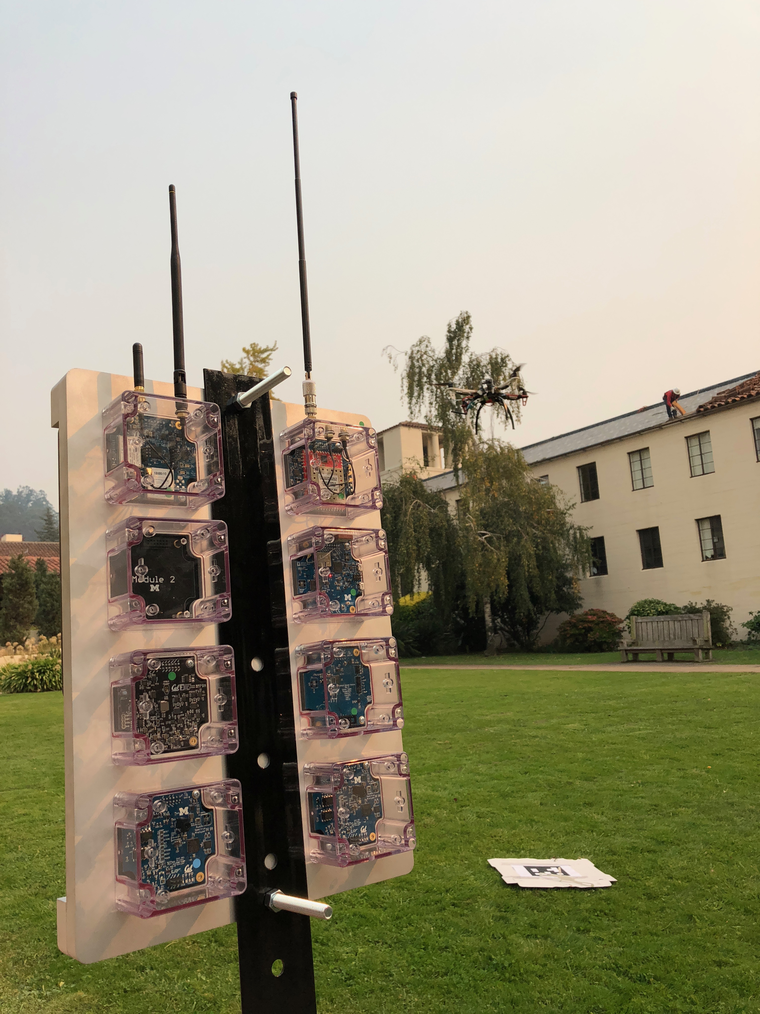
Case Study:
The Signpost Platform
Notes:
End by telling you about a deployed system that uses Tock, called Signpost

Slide 33
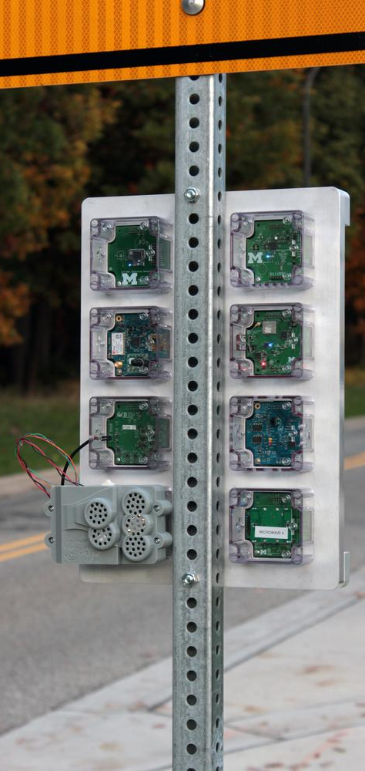
Signpost Overview
Modular city-scale sensing platform
  Ambient conditions tracking
  Pedestrian density
  Noise monitoring
8 pluggable modules
  Instead of deploying a new platform
  15 mA power budget
  Microcontroller + Sensors
Sensing applications
  Open research platform
  Mostly run on modules
  Several apps on the same module
Currently deployed @ U.C. Berkeley

Slide 34
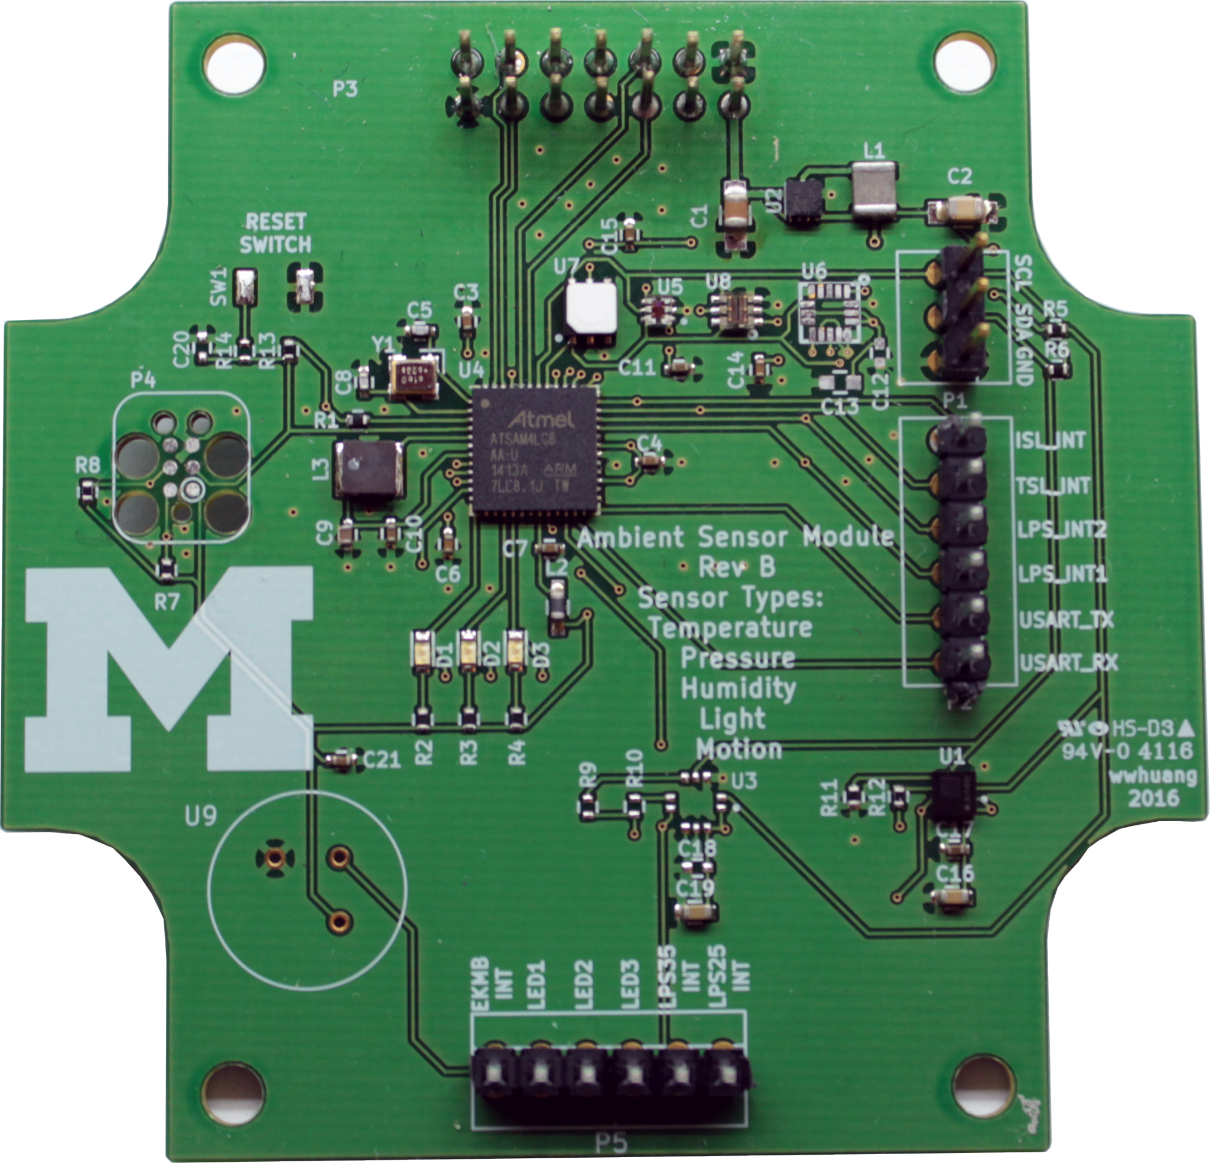
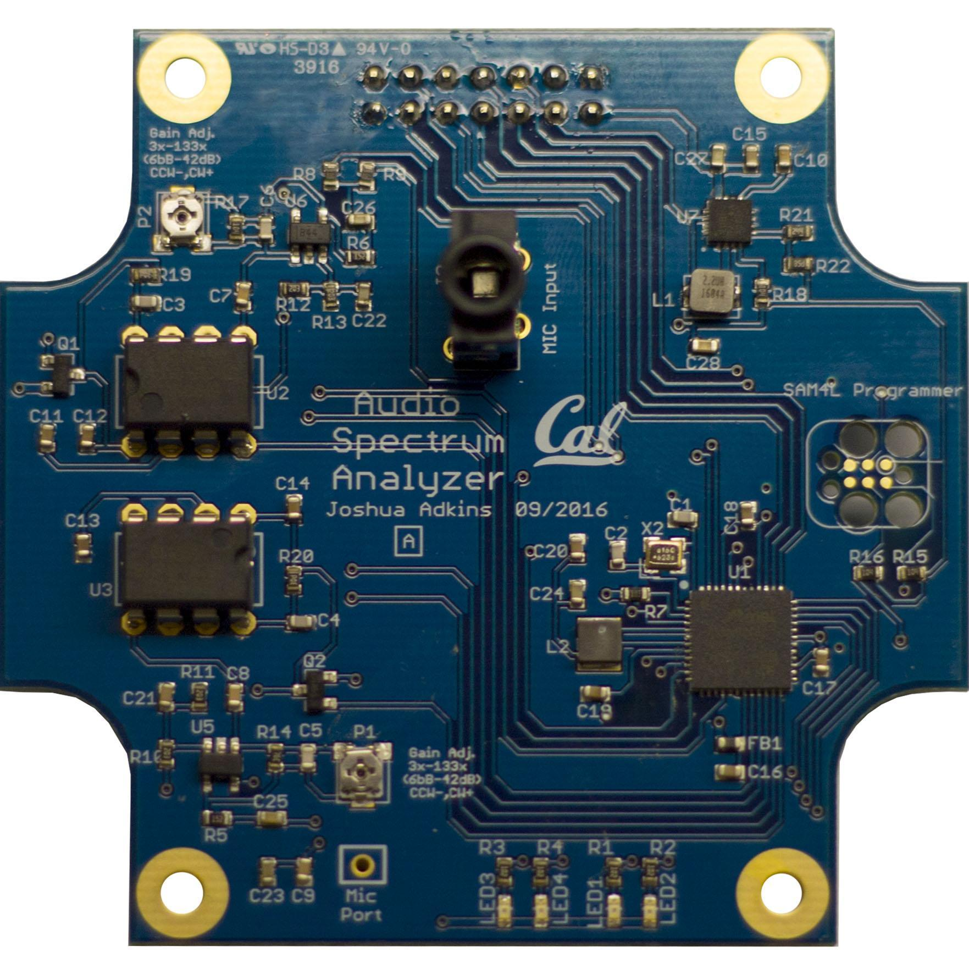
Tock on Signpost
Each Signpost module runs a Tock kernel
 | Ambient Module | Audio Module
Process LoC | 6990 | 6688
Capsules LoC | 4479 | 3985
Platform LoC | 3252 | 3244

Slide 35
Limitations & Future Work
Other kernels in Rust?
Relationship with verification
Higher level security abstractions
  e.g. Permissions? Capabilities? Naming?
Distributed operating system
Power management

Slide 36





Conclusion
Tock: Multiprogramming with 64 kB
Cheap kernel isolation with type-safe driver API in Rust
Process abstraction without page virtualization
Efficient concurrency without a kernel heap
https://tockos.org
github.com/helena-project/tock
@talkingtock
#tock on freenode
tock-dev@googlegroups.com
Thanks to the 40 (and growing) Tock contributers!

Slide 37
Grants Cost at Scale

