Slide 1
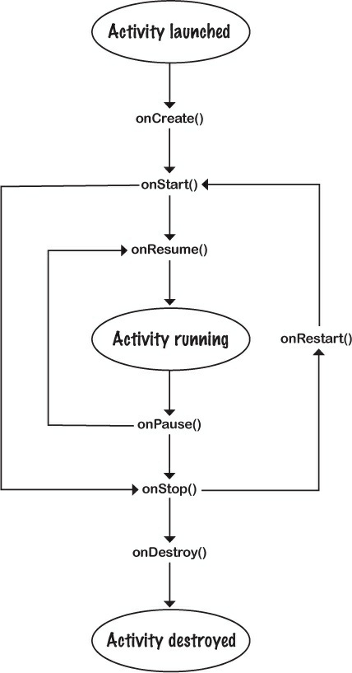
The Activity Lifecycle

Slide 2
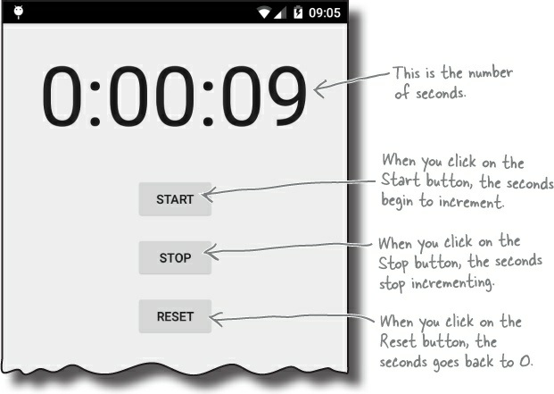

Slide 3
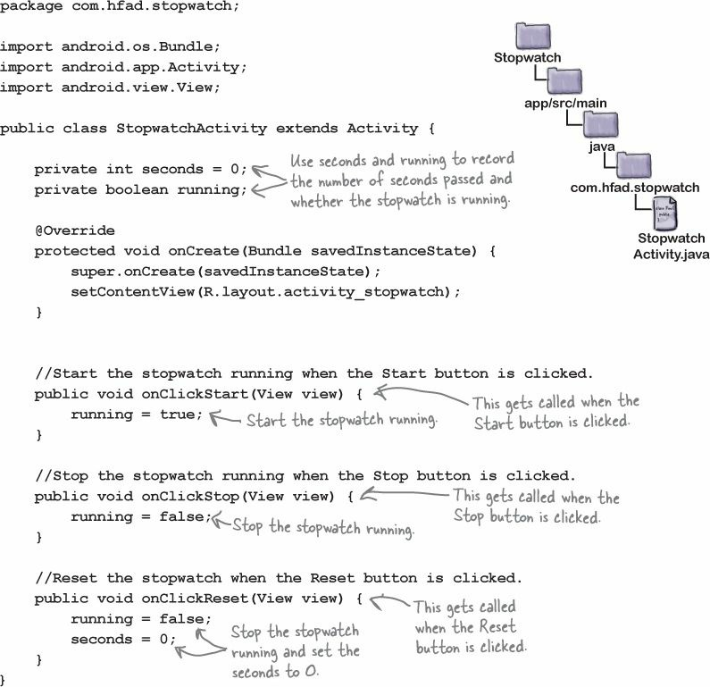

Slide 4
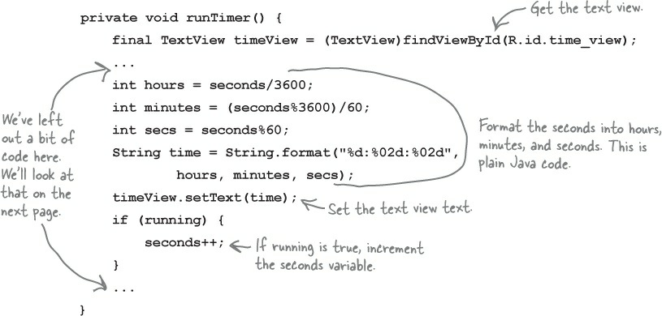

Slide 5
We need this code to keep looping so that it increments the seconds variable and updates the text view every second. We need to do this in such a way that we don’t block the main Android thread.
In non-Android Java programs, you can perform tasks like this using a background thread. In Android, this is a problem — only the main Android thread can update the user interface, and if any other thread tries to do so, you get a CalledFromWrongThreadException .
The solution is to use a Handler .

Slide 6
Handlers
A Handler is an Android class you can use to schedule code that should be run at some point in the future
You can also use it to post code that needs to run on a different thread

Slide 7
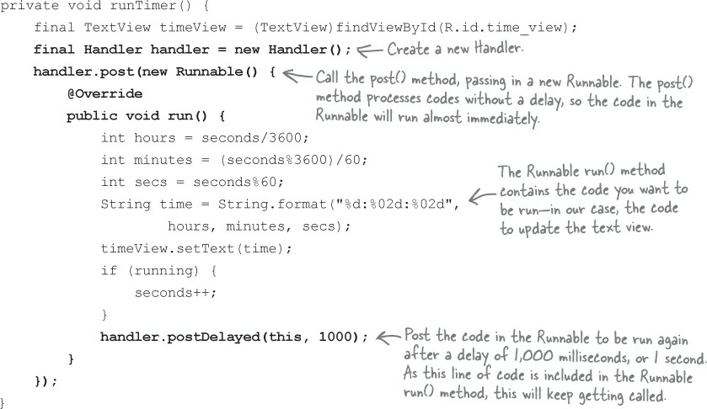

Slide 8
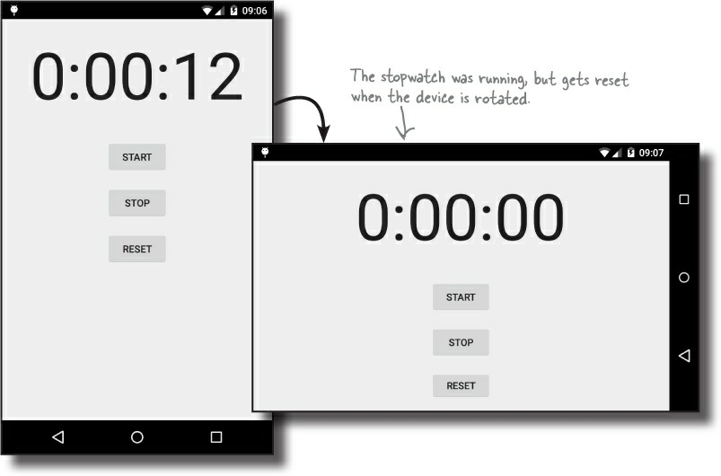
But there’s just one problem
Android sees that the screen orientation and screen size has changed, and it destroys the activity, including any variables used by the runTimer() method.

Slide 9
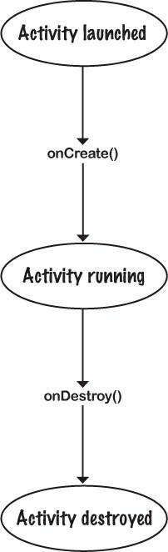
The activity lifecycle:

Slide 10
Rotating the screen changes the device configuration
The device configuration includes options specified by the user (such as the locale), and options relating to the physical device (such as the orientation and screen size). A change to any of these options results in the activity being destroyed and re-created.

Slide 11
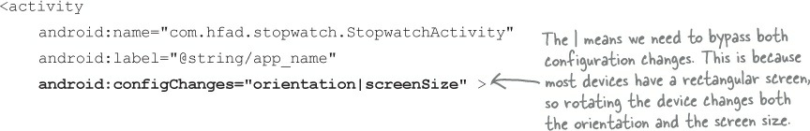
dealing with configuration changes
1- Bypass re-creating the activity
it’s usually not the best option. This is because when Android re-creates the activity, it makes sure it uses the right resources for the new configuration.
you may have to write a bunch of extra code to deal with the new configuration yourself.
AndroidManifest.xml
If Android encounters this type of configuration change, it makes a call to the onConfigurationChanged(Configuration) method instead of re-creating the activity:

Slide 12
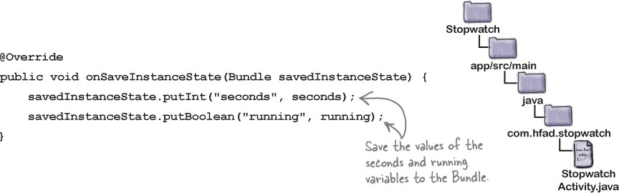
dealing with configuration changes
2- save the current state
The onSaveInstanceState() method gets called before the activity gets destroyed

Slide 13
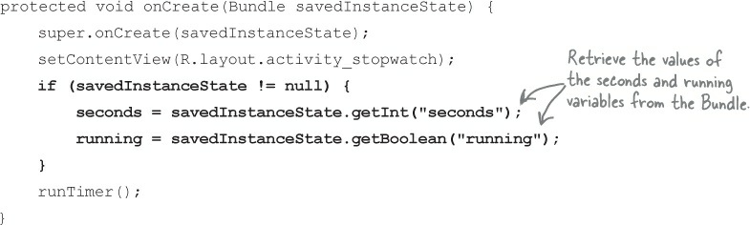
dealing with configuration changes
then restore the state in onCreate()

Slide 14
dealing with configuration changes
restore the state in onCreate()
onCreate() method takes one parameter, a Bundle . If the activity’s being created from scratch, this parameter will be null.
If the activity’s being re-created and there’s been a prior call to onSaveInstanceState(),the Bundle object will get passed to the activity

Slide 15
More to an activity’s life than create and destroy
suppose the stopwatch is running and you get a phone call.
Start, stop, and restart
@Override
protected void onStop() {
super.onStop();
running = false;
}
When you override an activity lifecycle method, you need to call the superclass method. If you don’t, you’ll get an exception.

Slide 16
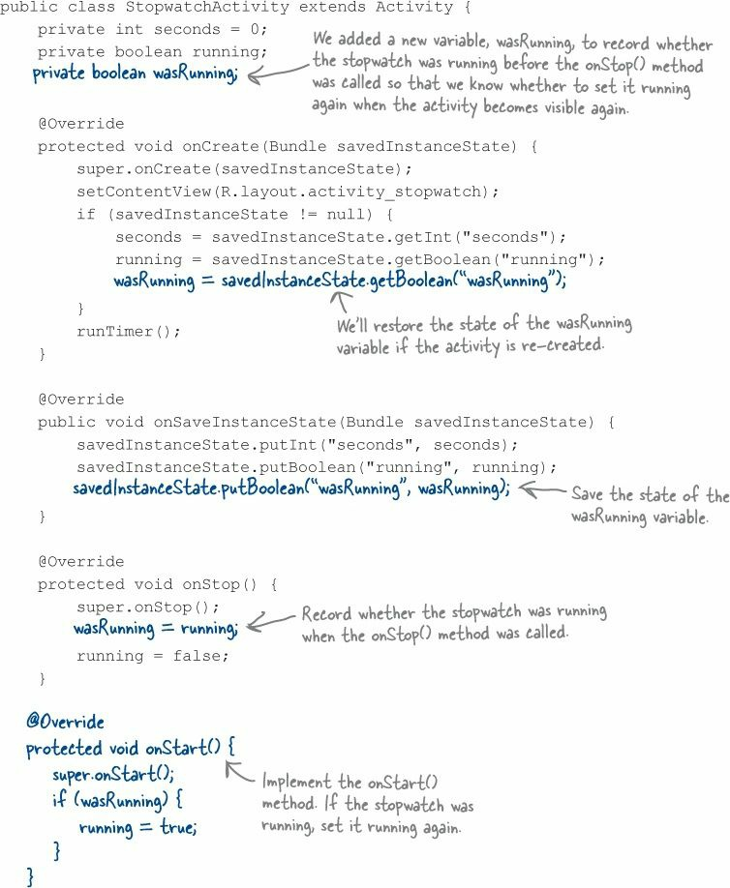

Slide 17
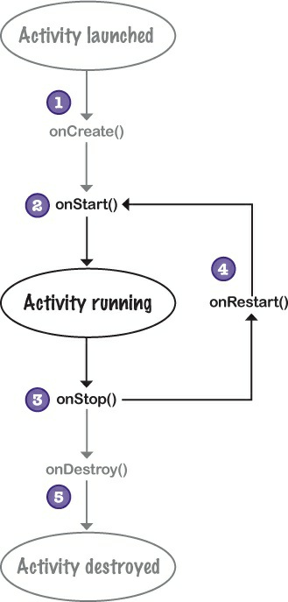

Slide 18
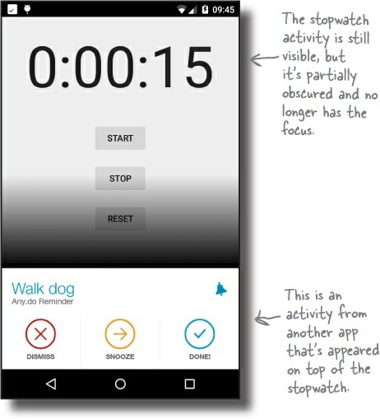
But what if an app is only partially visible?
There are two lifecycle
methods
onPause() and
onResume()

Slide 19
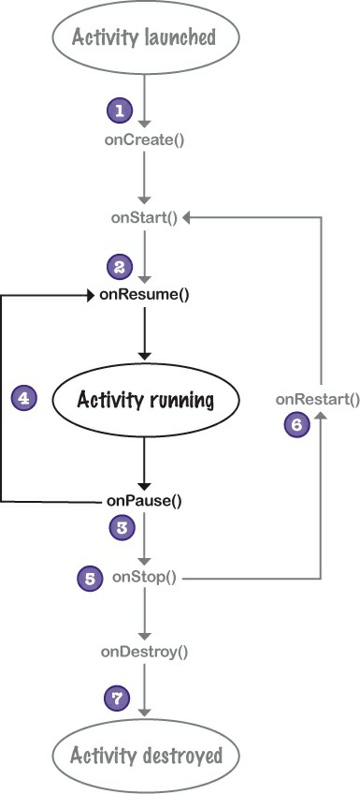

Slide 20
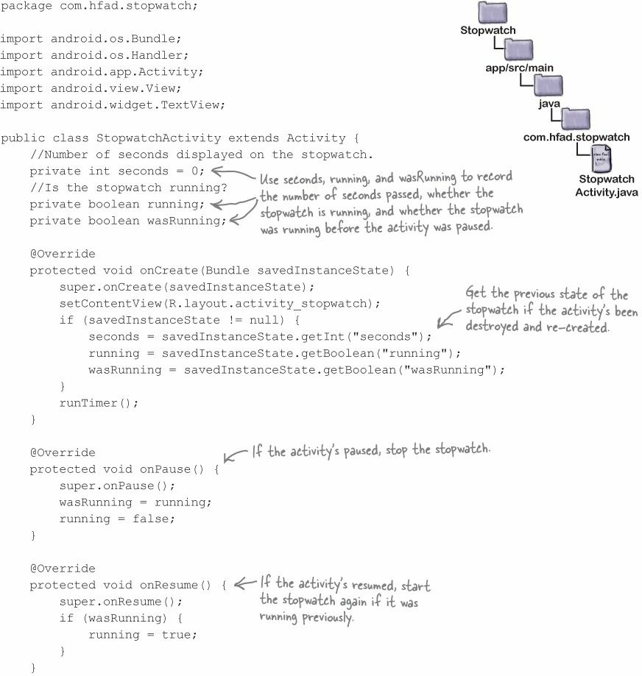

Slide 21
