Slide 1
send messages to other Application
1. Create an intent that specifies an action.
2. Allow the user to choose which app to use.
3. Intent intent = new Intent(action);
You can find out more about the sorts of activity actions you can use and the extra information
from : http://tinyurl.com/n57qb5.
Ex: Intent.ACTION_DIAL, Intent.ACTION_WEB_SEARCH, Intent.ACTION_SEND

Slide 2
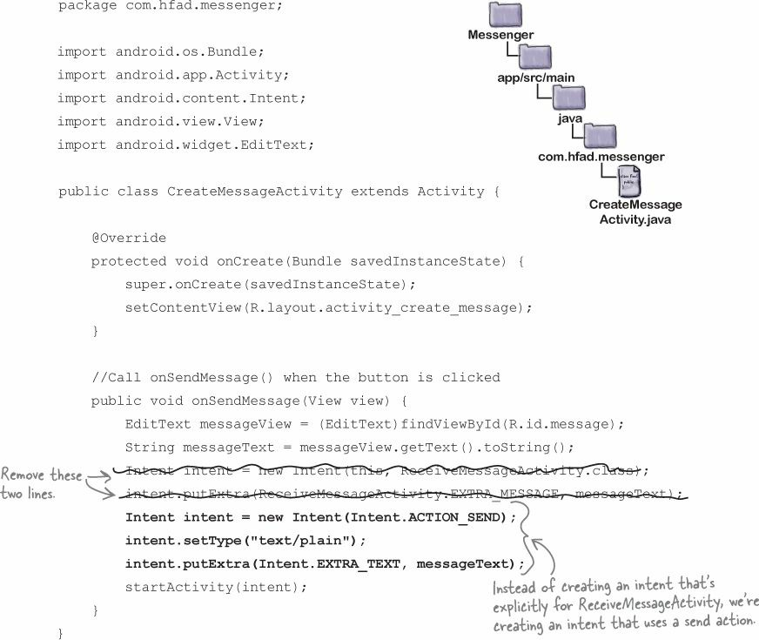

Slide 3

What happens when the code runs
If no actions are able to handle the intent, an ActivityNotFoundException is thrown.

Slide 4
The intent filter tells Android which activities can handle which actions
When Android is given an intent, it has to figure out which activity, or activities, are able to handle it. This process is known as intent resolution.
When you use an implicit intent, Android uses the information in the intent to figure out which components are able to receive it. It does this by checking the intent filters in every app’s copy of AndroidManifest.xml.

Slide 5
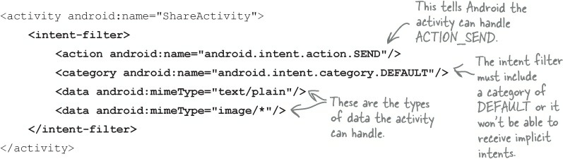

Slide 6
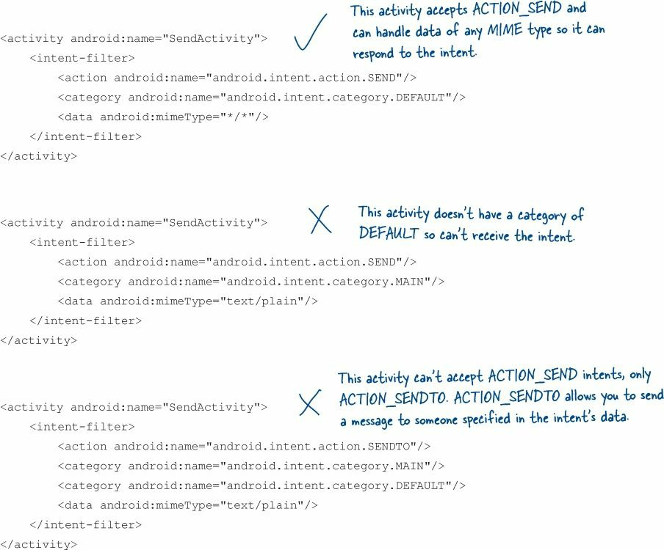

Slide 7
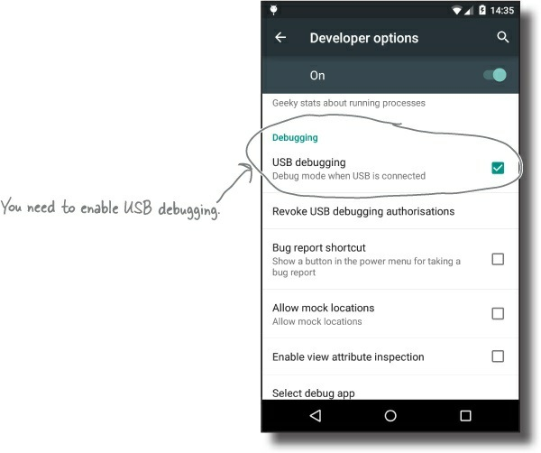
You need to run your app on a REAL device
Enable USB debugging on your device

Slide 8
2. Set up your system to detect your device
If you’re using a Mac, you can skip this step.
If you’re using Windows, you need to install a USB driver. You can find the latest instructions here:
http://developer.android.com/tools/extras/oem-usb.html
If you’re using Ubuntu Linux, you need to create a udev rules file. You can find the latest instructions on how to do this here:
http://developer.android.com/tools/device.html#setting-up

Slide 9
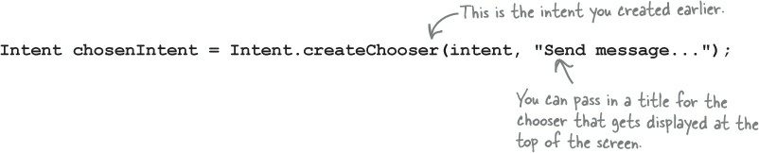
What if you ALWAYS want your users to choose an activity?

Slide 10
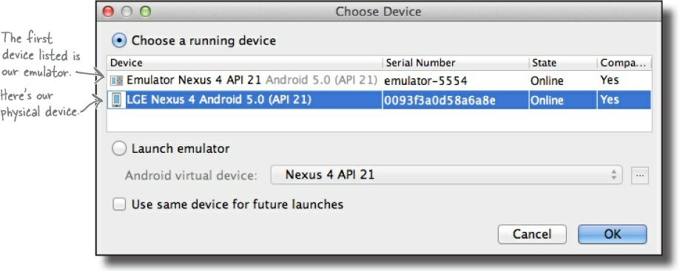
Plug your device into your computer with a USB cable
Run your app in Android Studio as normal

