Slide 1
Chapter 5. The User Interface

Slide 2
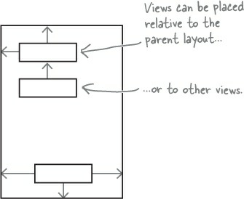
Three key layouts: relative, linear, and grid
RelativeLayout

Slide 3
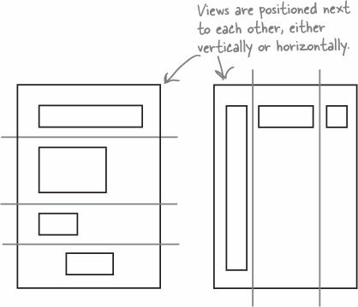
Three key layouts: relative, linear, and grid
LinearLayout

Slide 4
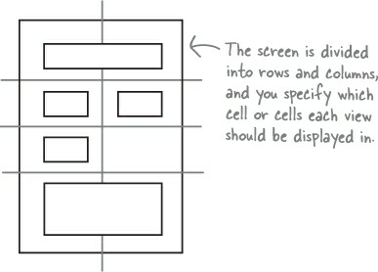
Three key layouts: relative, linear, and grid
GridLayout

Slide 5
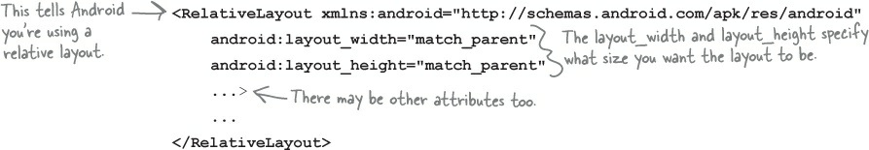
RelativeLayout displays views in relative positions
You MUST set the layout width and height

Slide 6
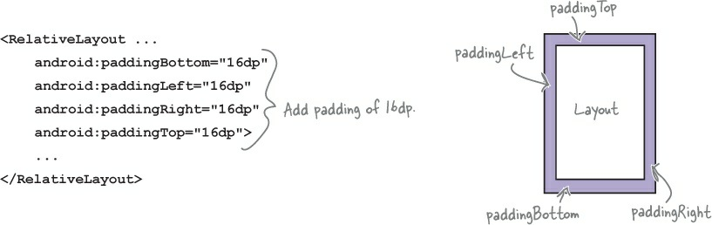
Adding padding
android:padding* attributes are optional, and you can use them with any layout or view.

Slide 7
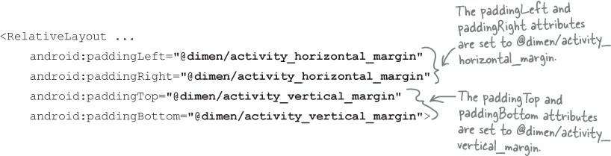

An alternative approach is to specify the padding in a dimension resource file instead
dimens.xml

Slide 8
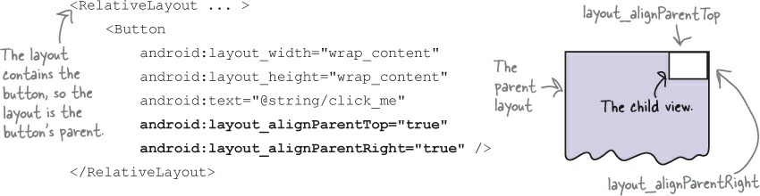
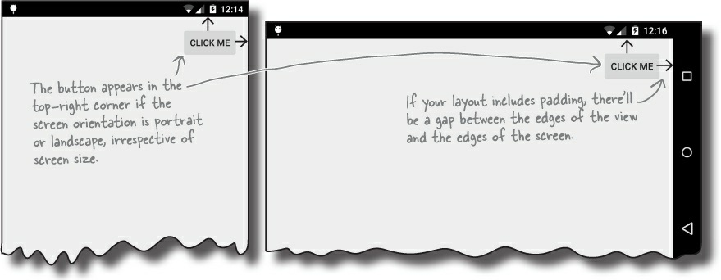
Positioning views relative to the parent layout

Slide 9
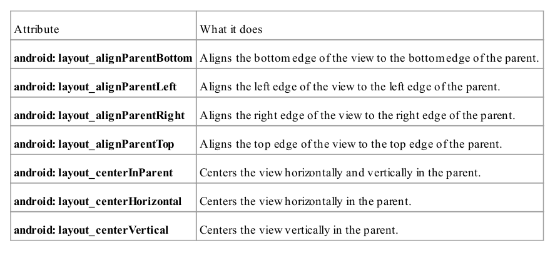
Attributes for positioning views relative to the parent layout

Slide 10
Positioning views relative to other views
n order to position a view relative to another view, the view you’re using as an anchor must be given an ID using the android:id attribute:
android:id="@+id/button_click_me"

Slide 11
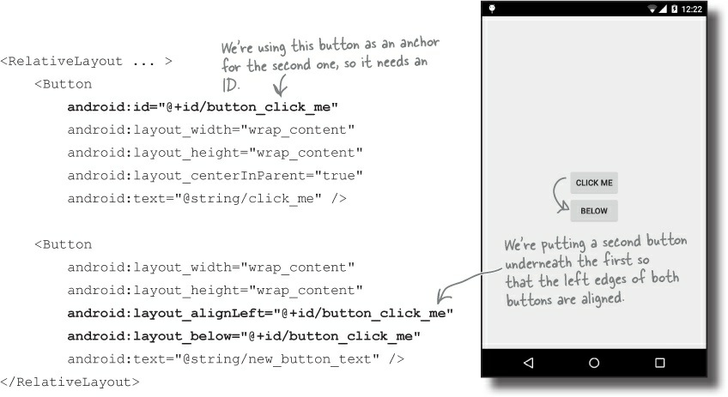

Slide 12
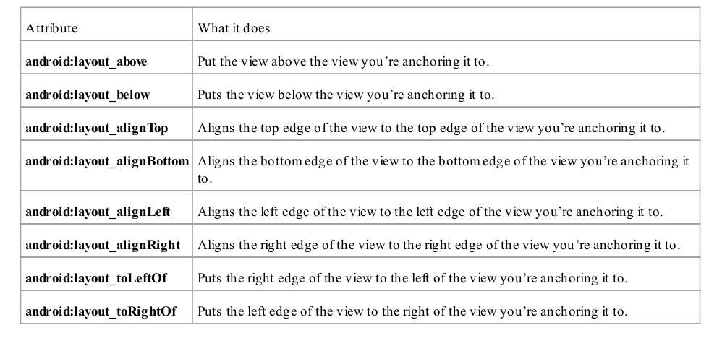
Attributes for positioning views relative to other views

Slide 13
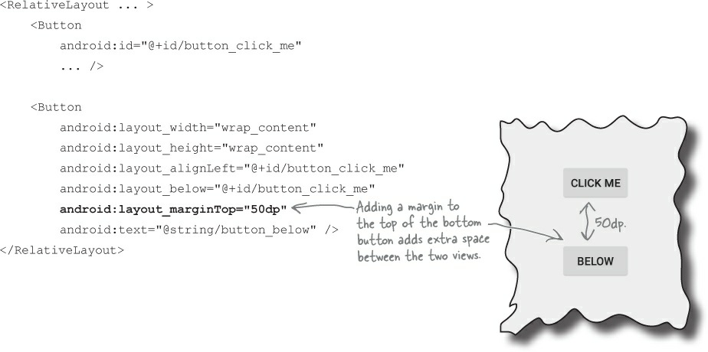
Use margins to add distance between views

Slide 14
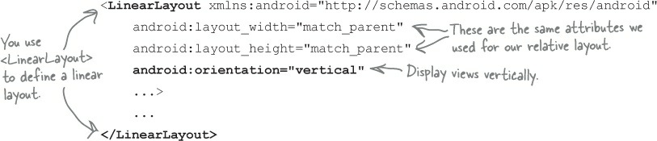
LinearLayout displays views in a single row or column
The android:layout_width , android:layout_height and android:orientation attributes are mandatory.

Slide 15
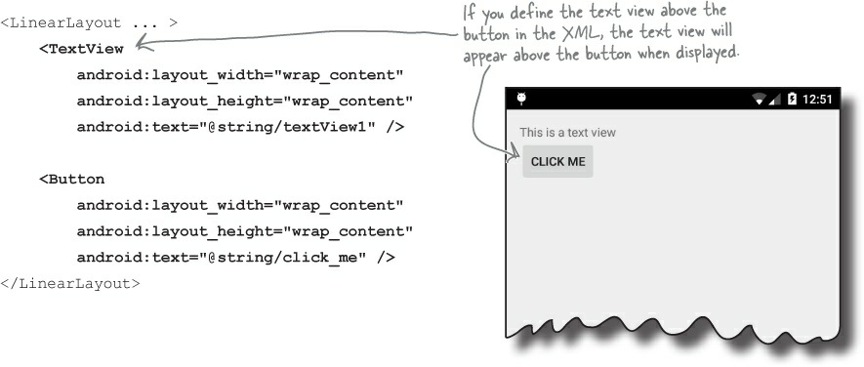

Slide 16
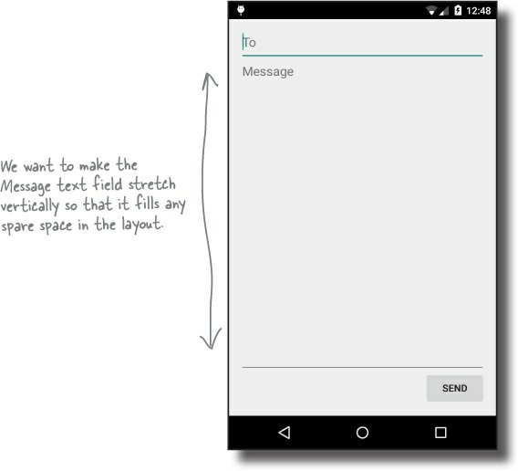
Make a view streeeeetch by adding weight
You assign weight to a view using
android:layout_weight="number"
where number is some number greater than 0.

Slide 17
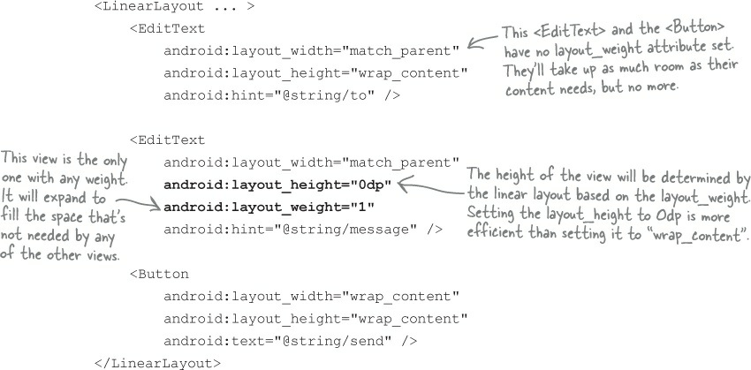
Giving the message editable text field a weight of 1 means that it takes up all of the extra space that’s not used by the other views in the layout.

Slide 18
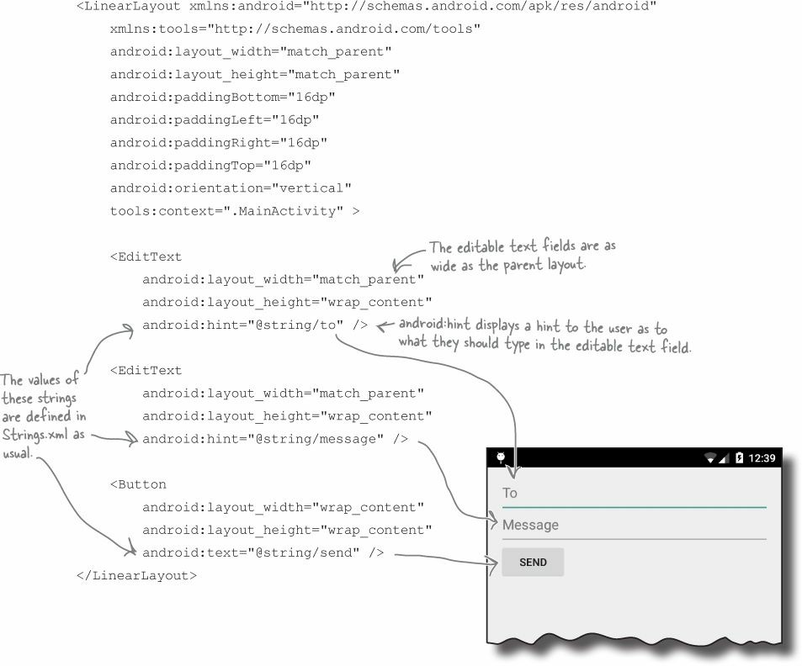

Slide 19
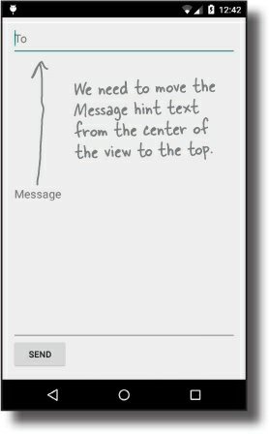
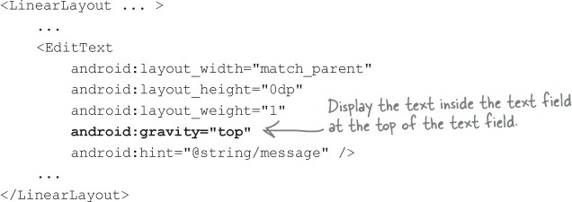
Use gravity to specify where text appears in a view

Slide 20
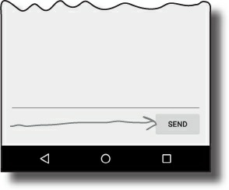
Move the button to the right with layout-gravity
android:layout_gravity="right"

