Slide 1

Testing Python Workflows
with Floci
Black-box tests, fault injection and coverage
Alex Au and Sky Ng
(Hong Kong Python User Group)
Notes:
Speaker: Sky Ng
Planned timing: 00:00–00:30
Spoken script
Hi everyone, I'm Sky, and I'm here with Alex. Today we will test a Python workflow across several services, including the things that go wrong between them. We will start with the business behaviour, then Alex will show how we run it locally, inject failures, and connect the coverage report back to the tests.
Presenter cues
Introduce the talk briefly. Move to the speaker introduction without listing the tools again.
Sources
https://www.linkedin.com/in/sky-ng-ab307b252/
https://www.linkedin.com/in/alex-au-cloudeng/

Slide 2
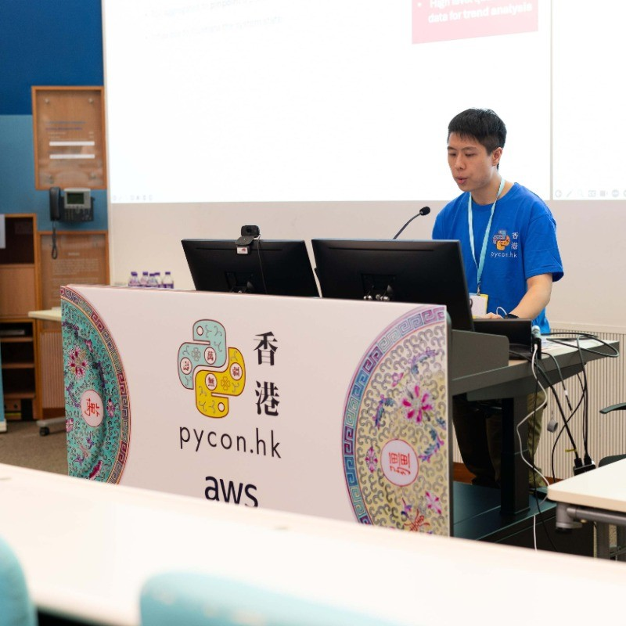
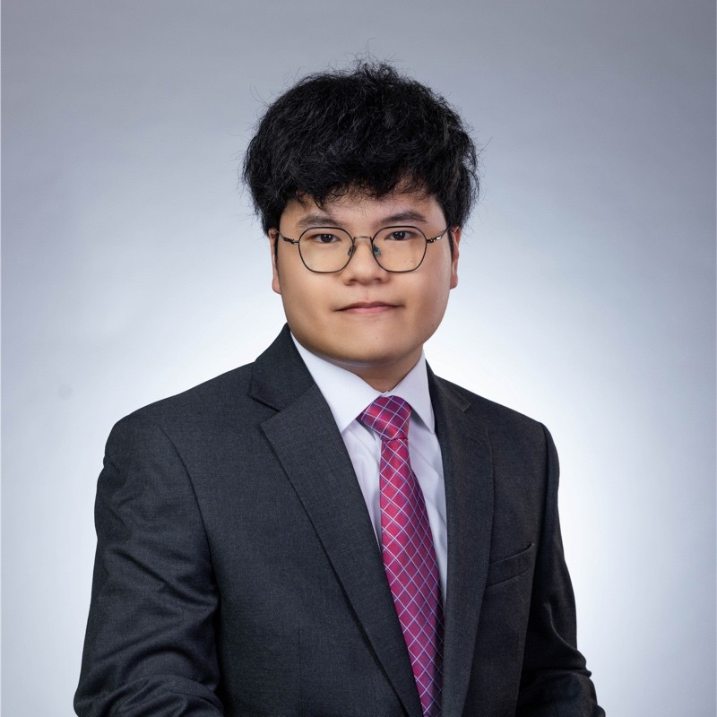
Who are we?
Alex Au
Sky Ng
Ex-Silicon Valley
Golden Kubestronaut
HK Python User Group Host
Cloud Engineer
Ex-AWS Cloud Club
Captain
Notes:
Speaker: Sky Ng
Planned timing: 00:30–01:15
Spoken script
I'm Sky, and Alex is the host of Hong Kong Python User Group. I will cover the first three sections: why we want these tests, the order workflow, and what a test looks like. Alex will then take us through the implementation and the results.
Presenter cues
Point to each speaker once. Keep personal introductions short; do not read every credential.
Sources
https://www.linkedin.com/in/sky-ng-ab307b252/
https://www.linkedin.com/in/alex-au-cloudeng/

Slide 3
SECTION 01
Can end-to-end tests be
faster and cheaper,
with useful 100% coverage?
Notes:
Speaker: Sky Ng
Planned timing: 01:15–01:35
Spoken script
End-to-end tests are useful when the pieces work separately but fail when connected. Can we make those tests practical to run during development? And if we reach 100% coverage, can we explain what that number actually tells us? Those are the two questions for today.
Presenter cues
Pause after the two questions, then continue to the local-testing motivation.
Sources

Slide 4
Local End-to-End Test
Reduce cloud deployments
Run the workflow and its services locally
without creating any AWS resources.
Speed up Testing
Avoid deploying infrastructure to AWS
to shorten the feedback loop.
Notes:
Speaker: Sky Ng
Planned timing: 01:35–02:15
Spoken script
A unit test runs a function with the input we give it. It does not show whether the workflow sends the right input, or whether the SDK and HTTP calls work together. We want to exercise those connections frequently. Running locally avoids creating a fresh AWS stack for every change. We can reuse containers and rerun an individual pytest case while developing. That removes repeated deployment work from the development loop.
Presenter cues
Emphasise the shorter development loop. Keep the detailed container setup for Alex.
Sources
/Users/alexau/Documents/HKPUG/aws-community-day-hk-2026-step-functions-testing/src/create_order.asl.json
/Users/alexau/Documents/HKPUG/aws-community-day-hk-2026-step-functions-testing/tests/fixtures/floci.py
/Users/alexau/Documents/HKPUG/aws-community-day-hk-2026-step-functions-testing/tests/fixtures/lambdas.py
/Users/alexau/Documents/HKPUG/aws-community-day-hk-2026-step-functions-testing/tests/fixtures/workflows.py
/Users/alexau/Documents/HKPUG/aws-community-day-hk-2026-step-functions-testing/tests/fixtures/stripe.py
/Users/alexau/Documents/HKPUG/aws-community-day-hk-2026-step-functions-testing/tests/fixtures/proxy.py

Slide 5
How much code coverage is enough?
90%? 95%? 99%? 99.9%?
100% execution coverage
still needs assertions
on business outcomes.
Which statement or branch can we leave untested?
100%
Every statement and branch
in the application’s Python code has run.
Notes:
Speaker: Sky Ng
Planned timing: 02:15–03:30
Spoken script
If 90% is enough, which remaining lines are we comfortable leaving untested? Would the answer change at 95% or 99%? For this application, we use 100% of the measured Python statements and branch outcomes as a way to expose those gaps. It gives us a concrete question about every uncovered path. But execution alone is not proof of correctness. We also want the test name and the assertions, so we can see which scenario ran that code and what result it checked.
Presenter cues
Pause at the percentage question. Point from the coverage target to the explanation of what it does and does not establish.
Sources
/Users/alexau/Documents/HKPUG/aws-community-day-hk-2026-step-functions-testing/pyproject.toml:31-54
/Users/alexau/Documents/HKPUG/aws-community-day-hk-2026-step-functions-testing/output/coverage.json

Slide 6
SECTION 02
What should happen to a purchase order?
Notes:
Speaker: Sky Ng
Planned timing: 03:30–03:45
Spoken script
Before we look at the testing tools, what should actually happen to an order? We need that expectation first, otherwise a successful workflow execution does not tell us whether the business result is right.
Presenter cues
Use this as the transition from testing goals to the purchase-order example.
Sources

Slide 7
Create and cancel an order (Happy Paths)
Order quantity: 2 units. Initial stock: 10.
Create order
Approved
Reserved
Paid
Await merchant
approval
Reserve
2 units
Charge
payment
Confirm
order
Stock: 10 → 8
Cancel order
Payment found
Refund confirmed
Stock: 8 → 10
Read paid
order
Refund
payment
Cancel order
Restore stock
Notes:
Speaker: Sky Ng
Planned timing: 03:45–04:45
Spoken script
We start with ten units in stock, and the customer orders two. First we wait for the merchant to approve. While we are waiting, we have neither reserved stock nor charged the customer. After approval, we reserve two units, take payment, and confirm the order. Stock is now eight. The second path cancels a paid order: find the payment, refund it, then cancel the order and restore the two units. These are the outcomes our tests will check later.
Presenter cues
Trace the creation flow, then the cancellation flow. Point out stock changing from ten to eight and then back to ten.
Sources
/Users/alexau/Documents/HKPUG/aws-community-day-hk-2026-step-functions-testing/src/create_order.asl.json
/Users/alexau/Documents/HKPUG/aws-community-day-hk-2026-step-functions-testing/src/cancel_order.asl.json
/Users/alexau/Documents/HKPUG/aws-community-day-hk-2026-step-functions-testing/src/workflows.md

Slide 8





AWS workflow architecture
Merchant
Our AWS application
DynamoDB
Orders + stock
Poll SQS
for approval request
+ task token
Read / write
SQS
Approval queue
Create
Reserve
Confirm
SendMessage
Orders
Lambda
Read / cancel
Worker
Payments
Lambda
create_order
Step Functions
cancel_order
Step Functions
SendTaskSuccess
+ task token
Refund
Charge
HTTP requests
Stripe API
(external)
Notes:
Speaker: Sky Ng
Planned timing: 04:45–06:15
Spoken script
Here is how those steps map to services. Inside our AWS application, Step Functions coordinates the work, and SQS carries the approval request and task token. The merchant's worker is outside that boundary. It reads the request, then calls SendTaskSuccess directly with the token to resume the waiting task. The two workflows share the Orders and Payments Lambda functions. Orders reads and writes DynamoDB; Payments calls the external Stripe API. That boundary matters because our tests must control the merchant's response and observe the payment result as well as the workflow.
Presenter cues
Use the replacement architecture slide. Trace application → SQS → merchant worker, then the direct callback to Step Functions. Point out Stripe as a separate external dependency.
Sources
/Users/alexau/Documents/HKPUG/aws-community-day-hk-2026-step-functions-testing/src/create_order.asl.json
/Users/alexau/Documents/HKPUG/aws-community-day-hk-2026-step-functions-testing/src/cancel_order.asl.json
https://docs.aws.amazon.com/step-functions/latest/dg/connect-sqs.html
/Users/alexau/Documents/HKPUG/aws-community-day-hk-2026-step-functions-testing/presentation/output/aws-workflow-architecture-single-slide.pptx

Slide 9
SECTION 03
How can we properly test
these AWS resources locally?
Notes:
Speaker: Sky Ng
Planned timing: 06:15–06:30
Spoken script
We now have a workflow that crosses several service interfaces. How do we exercise that whole path locally, while still making the same SDK and HTTP calls that the application normally makes?
Presenter cues
Pause on the question, then introduce Floci on the next slide.
Sources

Slide 10


Floci provides local AWS APIs
localstripe
Payment emulator
HTTP
boto3
Invoke
pytest
Step Functions
SQS
Orders /
Payments
GetItem /
StartExecution…
boto3
DynamoDB
Lambda API
HTTP port 4566
Notes:
Speaker: Sky Ng
Planned timing: 06:30–07:30
Spoken script
Floci gives us local AWS APIs for Step Functions, SQS, DynamoDB, and Lambda. The test starts the workflow through boto3. Our application Python runs in separate Lambda containers and makes its normal calls to those local services. Payments goes to localstripe, our payment emulator. This lets the test cross the workflow, event, SDK, and HTTP boundaries without importing a handler and calling it directly. Alex will show how the fixtures connect these containers and how OpenResty fits into the request path.
Presenter cues
Trace pytest → Floci → Orders/Payments → localstripe. Distinguish the Floci service emulator from the separate application containers.
Sources
/Users/alexau/Documents/HKPUG/aws-community-day-hk-2026-step-functions-testing/tests/fixtures/floci.py
/Users/alexau/Documents/HKPUG/aws-community-day-hk-2026-step-functions-testing/tests/fixtures/lambdas.py
/Users/alexau/Documents/HKPUG/aws-community-day-hk-2026-step-functions-testing/tests/fixtures/stripe.py
/Users/alexau/Documents/HKPUG/aws-community-day-hk-2026-step-functions-testing/tests/fixtures/docker.py
/Users/alexau/Documents/HKPUG/aws-community-day-hk-2026-step-functions-testing/tests/fixtures/proxy.py

Slide 11
What a black box test looks like…
Start the order workflow
Create order
test_order_lifecycle.py
Await merchant
approval
execution = sfn_client.start_execution(
stateMachineArn=create_order_machine,
Approved
input=json.dumps(order_input),
Check new stock
availability
Reserve
2 units
)["executionArn"]
# Wait for merchant approval
# No lookup of Lambda internal state
Stock: 10 → 8
assert order["status"] == {"S": "CONFIRMED"}
assert stock["Item"]["available"] == {"N": "8"}
Charge
payment
assert len(ledger["charges"]) == 1
ledger: check localstripe payment records
Notes:
Speaker: Sky Ng
Planned timing: 07:30–08:35
Spoken script
The test begins with StartExecution, just as a workflow client would. The full test then receives the approval request, sends the callback, waits for completion, and reads the results through the service APIs. At the end, we check three different things: the order is confirmed, stock fell from ten to eight, and the payment ledger contains one charge. We are checking what the system did, rather than inspecting a Python variable inside the handler. Alex will now show how we build the environment that makes this possible.
Presenter cues
Reveal Start the order workflow, then the ledger explanation. Point to the three assertions and hand over to Alex.
Sources
/Users/alexau/Documents/HKPUG/aws-community-day-hk-2026-step-functions-testing/tests/test_workflows/test_order_lifecycle.py:34-115
/Users/alexau/Documents/HKPUG/aws-community-day-hk-2026-step-functions-testing/tests/test_workflows/test_order_lifecycle.py:155-157

Slide 12
SECTION 04
What are the roles of
Floci, OpenResty and coverage.py
in our local e2e test?
Notes:
Speaker: Alex Au
Planned timing: 08:35–08:50
Spoken script
Thanks, Sky. We have seen what the test should prove. Now let's look at what the environment needs to provide: local service interfaces, a way to reach failure paths, and coverage from the Python process that actually runs the application.
Presenter cues
Take over here. Sections 4–7 remain with Alex; do not hand back to Sky after section 6.
Sources

Slide 13


Recall our requirements…
Specify boto3
AWS_ENDPOINT_URL
Emulate
AWS API
Use boto3 SDK
and HTTP calls
Local End-to-End Test
Specify
HTTP_PROXY
Inject custom
error responses
Decouple
dependencies
via env vars
Reach retry and
recovery paths
Enables testing
unhappy paths
Set test function name as
COVERAGE_CONTEXT
Annotate coverage
with test name
Accountability
of test results
Which test ran
this Python line?
coverage.py
Notes:
Speaker: Alex Au
Planned timing: 08:50–09:50
Spoken script
Each tool answers a requirement from the opening. Floci lets the application use AWS APIs locally. Environment variables supply the service addresses, so the handler does not need a separate local implementation. OpenResty sits in the HTTP path, where we can make a particular request fail and reach the recovery code. Finally, coverage.py runs inside the Lambda Python process. We give it the test function name as its context, so the report can tell us which test exercised a line. Let's build those connections one at a time.
Presenter cues
Follow the three requirement-to-mechanism paths. Use test function name consistently; do not introduce a separate test ID concept.
Sources
/Users/alexau/Documents/HKPUG/aws-community-day-hk-2026-step-functions-testing/src/lambdas/orders/handler.py
/Users/alexau/Documents/HKPUG/aws-community-day-hk-2026-step-functions-testing/src/lambdas/payments/handler.py
/Users/alexau/Documents/HKPUG/aws-community-day-hk-2026-step-functions-testing/tests/fixtures/lambdas.py
/Users/alexau/Documents/HKPUG/aws-community-day-hk-2026-step-functions-testing/tests/fixtures/proxy.py
/Users/alexau/Documents/HKPUG/aws-community-day-hk-2026-step-functions-testing/pyproject.toml

Slide 14
Start Floci with a Testcontainers fixture
tests/fixtures/floci.py
@pytest.fixture(scope="session")
def floci_container(
docker_network: Network, session_id: str
) -> Iterator[DockerContainer]:
name = f"floci-demo-{session_id}"
container = (
DockerContainer("floci/floci:2.3.0@sha256:...")
.with_name(name)
.with_network(docker_network)
# ...
)
with container:
Testcontainers manages
Floci startup and teardown
yield container
Notes:
Speaker: Alex Au
Planned timing: 09:50–10:30
Spoken script
The first connection is a pytest fixture that owns the Floci container. Session scope means we start it once for the suite. Testcontainers starts the container when we enter the with block, and pytest receives the running container at yield. After the tests finish, leaving the block performs teardown. The full fixture also waits for the service to become ready. That gives the tests a managed resource instead of relying on someone to start and stop Floci by hand.
Presenter cues
Point to session scope, with container, and yield. Reveal the Testcontainers lifecycle callout if it is animated.
Sources
/Users/alexau/Documents/HKPUG/aws-community-day-hk-2026-step-functions-testing/tests/fixtures/floci.py:17-47
/Users/alexau/Documents/HKPUG/aws-community-day-hk-2026-step-functions-testing/tests/fixtures/docker.py

Slide 15
Get Floci’s URL from its container
The Lambda needs Floci’s address on the Docker network.
tests/fixtures/floci.py
@pytest.fixture(scope="session")
def floci_internal_url(
Use this running
Floci container
floci_container: DockerContainer,
) -> str:
container = floci_container.get_wrapped_container()
return f"http://{container.name}:4566"
Put its name in the URL
Notes:
Speaker: Alex Au
Planned timing: 10:30–10:55
Spoken script
Next, another fixture takes that running container and builds its address on the Docker network. The Lambda container needs a name it can resolve from inside that network. By deriving the URL from the fixture's actual container, the dependency stays explicit: first create the container, then obtain its address, then pass that address to the application. We are not hard-coding a separate endpoint somewhere else in the test.
Presenter cues
Reveal the callouts in order: use this running container, then put its name in the URL.
Sources
/Users/alexau/Documents/HKPUG/aws-community-day-hk-2026-step-functions-testing/tests/fixtures/docker.py
/Users/alexau/Documents/HKPUG/aws-community-day-hk-2026-step-functions-testing/tests/fixtures/floci.py:56-59
/Users/alexau/Documents/HKPUG/aws-community-day-hk-2026-step-functions-testing/tests/fixtures/lambdas.py
/Users/alexau/Documents/HKPUG/aws-community-day-hk-2026-step-functions-testing/src/lambdas/orders/handler.py:23-36

Slide 16
Connect Lambda to Floci through OpenResty
tests/fixtures/lambdas.py
lambda_client.create_function(
# ...
boto3 sends requests to Floci
Environment={"Variables": {
"AWS_ENDPOINT_URL": floci_internal_url,
"HTTP_PROXY": fault_proxy_internal_url,
"AWS_MAX_ATTEMPTS": "1",
OpenResty can
inject failures
# ...
}},
)
Notes:
Speaker: Alex Au
Planned timing: 10:55–11:40
Spoken script
These settings have different jobs. AWS_ENDPOINT_URL tells boto3 that Floci is the destination. HTTP_PROXY sends the HTTP request through OpenResty on its way there. The application still makes an ordinary boto3 call, but the test can now intercept that call and return an error. AWS_MAX_ATTEMPTS is one so boto3 does not add its own retries underneath the workflow. Later, when we count attempts, we can see what Step Functions retried rather than mixing two retry policies together.
Presenter cues
Point to destination first, then proxy route, then AWS_MAX_ATTEMPTS. Avoid suggesting that AWS_ENDPOINT_URL itself is the proxy address.
Sources
/Users/alexau/Documents/HKPUG/aws-community-day-hk-2026-step-functions-testing/tests/fixtures/lambdas.py:111-120
/Users/alexau/Documents/HKPUG/aws-community-day-hk-2026-step-functions-testing/tests/fixtures/lambdas.py:148-155
/Users/alexau/Documents/HKPUG/aws-community-day-hk-2026-step-functions-testing/tests/fixtures/proxy.py
https://docs.aws.amazon.com/sdkref/latest/guide/feature-ss-endpoints.html

Slide 17
Demo
Floci fixtures and Lambda environment variables
open -a Zed \
tests/fixtures/floci.py \
tests/fixtures/lambdas.py
Notes:
Speaker: Alex Au
Planned timing: 11:40–12:25
Spoken script
Let's open the two files and follow the values through. In floci.py, this fixture creates the container, waits for it, and yields it to pytest. The URL fixture then uses that same container's name. In lambdas.py, the create_function call passes the URL and proxy settings into the Lambda environment. That is the connection from pytest's resources to the application's configuration. This is a code walkthrough; we do not need to start a test run here.
Presenter cues
From the project root, use the command shown to open tests/fixtures/floci.py and tests/fixtures/lambdas.py in Zed. Show floci_container, floci_internal_url, then create_function Environment. Use function names rather than relying on old line numbers. Return to the next runtime slide.
Sources
/Users/alexau/Documents/HKPUG/aws-community-day-hk-2026-step-functions-testing/tests/fixtures/floci.py:17-59
/Users/alexau/Documents/HKPUG/aws-community-day-hk-2026-step-functions-testing/tests/fixtures/lambdas.py:111-120

Slide 18
Not a simple command…
Coverage via pytest cannot trace the Lambda Python in Floci.
Lambda Python process
Floci
Runtime client package
Runtime API
Handler
awslambdaric
1 Poll for event
2 Event
3 Call handler
4 Return / raise
5 Post result / error
6 Poll again
Waiting for the next event
Notes:
Speaker: Alex Au
Planned timing: 12:25–13:20
Spoken script
There is one catch with measuring these tests: pytest and the Lambda code run in different Python processes. Coverage running beside pytest cannot see the code inside the Lambda container. On the right, the runtime client asks Floci for an event, calls our handler, and posts the result. Then it asks for another event. The handler has finished, but the Python process is still alive. That gives us two jobs: start coverage inside that process, and save its data before we remove the container.
Presenter cues
Follow the sequence from polling to the handler and back. Emphasize the final poll: handler return does not end the process. Move to the entrypoint implementation.
Sources
/Users/
/Documents/HKPUG/aws-community-day-hk-2026-step-functions-testing/tests/fixtures/lambdas.py:25-44
https://
/lambda/latest/dg/python-
/
/lambda/latest/dg/runtimes-

Slide 19
Run the Lambda runtime client under coverage.py
Use coverage.py to start
awslambdaric and measure
the code it executes.
Modify AWS Python Lambda image from public ECR
tests/fixtures/lambdas.py
ENTRYPOINT ["/var/lang/bin/python3", "-m", "coverage", "run",
"--rcfile=/build/pyproject.toml", "--save-signal=USR1", "-m",
"awslambdaric"]
Save coverage without exiting
Load this Lambda handler
CMD ["src.lambdas.orders.handler.handle"]
Notes:
Speaker: Alex Au
Planned timing: 13:20–14:15
Spoken script
We do that at the container entrypoint. Starting from the AWS Python image, we run the runtime client through coverage.py. The handler path still selects the same application handler; we have added measurement around its process. The important option here is save-signal. It lets coverage save its data when it receives SIGUSR1, without stopping the runtime. That matters because this process normally keeps waiting for more invocations. Next, we need pytest to collect those files before it cleans up the Lambda functions.
Presenter cues
Reveal the save-signal annotation, then the handler annotation. Do not read the entire command aloud. This is the local Docker setup; do not suggest sending signals to an AWS managed Lambda.
Sources
/Users/alexau/Documents/HKPUG/aws-community-day-hk-2026-step-functions-testing/tests/fixtures/lambdas.py:27-44
/Users/alexau/Documents/HKPUG/aws-community-day-hk-2026-step-functions-testing/tests/fixtures/lambdas.py:55-88
/Users/alexau/Documents/HKPUG/aws-community-day-hk-2026-step-functions-testing/mise.toml:35-43
https://coverage.readthedocs.io/en/7.16.2/subprocess.html#long-running-processes
https://docs.aws.amazon.com/lambda/latest/dg/python-image.html

Slide 20





Pytest saves coverage before deleting Lambda functions
Each Lambda container
Host running pytest
1 Send SIGUSR1
2 Save data
coverage.py
3 Copy with Docker
without exiting
.coverage.…
output/coverage/
4 Delete Lambda functions
After all tests: coverage combine, then export HTML report.
Notes:
Speaker: Alex Au
Planned timing: 14:15–15:05
Spoken script
The order of cleanup is important. After the test finishes its assertions, the fixture sends SIGUSR1 to its Lambda containers. Coverage writes the data inside each container, and pytest waits until that save has completed. Docker then copies the files back to the host. Only after that do we delete the Lambda functions. When the whole suite finishes, we combine the collected files and produce the HTML report. If we deleted the containers first, we could lose the very evidence we wanted to inspect.
Presenter cues
Trace the four numbered steps in order. Distinguish per-test collection from the suite-level combine and HTML generation.
Sources
/Users/alexau/Documents/HKPUG/aws-community-day-hk-2026-step-functions-testing/tests/fixtures/lambdas.py:55-88
/Users/alexau/Documents/HKPUG/aws-community-day-hk-2026-step-functions-testing/tests/fixtures/lambdas.py:122-126
/Users/alexau/Documents/HKPUG/aws-community-day-hk-2026-step-functions-testing/mise.toml:35-43
https://coverage.readthedocs.io/en/7.16.2/subprocess.html#long-running-processes

Slide 21
Show which test executed each line (1)
tests/fixtures/lambdas.py
lambda_client.create_function(
# ...
Environment={"Variables": {
# ...
"COVERAGE_CONTEXT": test_function_name,
# ...
}},
Use test function name
to correlate line hit
)
Notes:
Speaker: Alex Au
Planned timing: 15:05–15:40
Spoken script
We also want to know which test executed a line. When the fixture creates each Lambda function, it sets COVERAGE_CONTEXT to the test function name. Each test gets its own Orders and Payments functions, so that name can stay fixed for their lifetime. The name belongs to the test environment; our handler and business event do not need an extra field just for coverage.
Presenter cues
Point to test_function_name and the popup. Keep the explanation at the environment boundary; the next slide shows how coverage reads it.
Sources
/Users/alexau/Documents/HKPUG/aws-community-day-hk-2026-step-functions-testing/tests/fixtures/lambdas.py:111-120
/Users/alexau/Documents/HKPUG/aws-community-day-hk-2026-step-functions-testing/tests/fixtures/lambdas.py:148-155
/Users/alexau/Documents/HKPUG/aws-community-day-hk-2026-step-functions-testing/tests/fixtures/proxy.py
https://docs.aws.amazon.com/sdkref/latest/guide/feature-ss-endpoints.html

Slide 22
Show which test executed each line (2)
pyproject.toml
[tool.coverage.run]
context = "${COVERAGE_CONTEXT-}"
Tag lines with test function name
tests/fixtures/lambdas.py
ENTRYPOINT ["/var/lang/bin/python3", "-m", "coverage", "run",
"--rcfile=/build/pyproject.toml", "--save-signal=USR1", "-m",
"awslambdaric"]
Start awslambdaric with
the coverage context config
Notes:
Speaker: Alex Au
Planned timing: 15:40–16:15
Spoken script
This configuration connects that environment variable to coverage.py. The context setting reads COVERAGE_CONTEXT, and the entrypoint loads this configuration when measurement starts. From then on, the executed lines and branches carry that test function name. COVERAGE_CONTEXT is the name we chose for our configuration; the connection is this explicit setting. We can now collect data from separate Lambda processes while keeping the test name attached to it.
Presenter cues
Point from the context setting to --rcfile in the entrypoint. Avoid repeating the full entrypoint explanation.
Sources
/Users/alexau/Documents/HKPUG/aws-community-day-hk-2026-step-functions-testing/tests/fixtures/workflows.py:16-19
/Users/alexau/Documents/HKPUG/aws-community-day-hk-2026-step-functions-testing/tests/fixtures/lambdas.py:118
/Users/alexau/Documents/HKPUG/aws-community-day-hk-2026-step-functions-testing/pyproject.toml:31-54
/Users/alexau/Documents/HKPUG/aws-community-day-hk-2026-step-functions-testing/output/htmlcov
https://coverage.readthedocs.io/en/7.16.2/contexts.html

Slide 23


The test function name travels with coverage data
test_definitive_payment_rejection_releases_stock
pytest fixture
Lambda environment
Coverage file
HTML report
deploy
save
combine files
request.node.name
COVERAGE_CONTEXT
.coverage.…
Line 120
Name of this test function
Set when this test’s
Lambdas are created
Line 120 + function name
Recorded inside Lambda
Matching function name
Notes:
Speaker: Alex Au
Planned timing: 16:15–17:00
Spoken script
Here is the whole journey of that name. Pytest provides the test function name. The fixture puts it in the Lambda environment. Coverage records it alongside an executed line, and combining the files preserves it in the report. The same test can invoke a workflow more than once, so this identifies the test scenario rather than one particular workflow execution. That is enough to take us from a covered line back to the test whose assertions we should read.
Presenter cues
Follow the same test function name through the four stages. Parametrized cases retain their pytest parameter suffix.
Sources
/Users/alexau/Documents/HKPUG/aws-community-day-hk-2026-step-functions-testing/tests/fixtures/workflows.py:16-19
/Users/alexau/Documents/HKPUG/aws-community-day-hk-2026-step-functions-testing/tests/fixtures/lambdas.py:118
/Users/alexau/Documents/HKPUG/aws-community-day-hk-2026-step-functions-testing/tests/fixtures/lambdas.py:153
/Users/alexau/Documents/HKPUG/aws-community-day-hk-2026-step-functions-testing/pyproject.toml:31-54
https://coverage.readthedocs.io/en/7.16.2/contexts.html

Slide 24
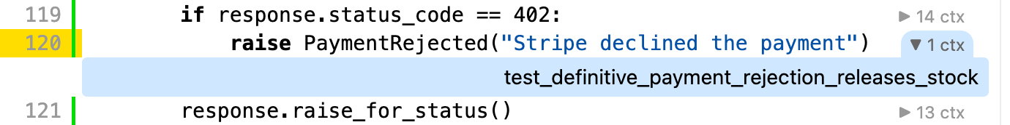
See which test function ran this line
Click “1 ctx” to see
the test function name
coverage.py HTML · src/lambdas/payments/client.py
Open HTML report
Notes:
Speaker: Alex Au
Planned timing: 17:00–17:30
Spoken script
This is the native HTML report. This line raises PaymentRejected when the payment service returns HTTP 402. Expanding the context shows the test function that reached it. We can then open that test and inspect what it checked about cancellation and restored stock. The report tells us that the line ran and which test ran it. The assertions tell us what result that test actually verified.
Presenter cues
Open the preserved HTML report and expand the context beside line 120. Point to the readable test function name.
Sources
/Users/alexau/Documents/HKPUG/aws-community-day-hk-2026-step-functions-testing/output/htmlcov/z_49b0d24487c97dbd_client_py.html#t120
/Users/alexau/Documents/HKPUG/aws-community-day-hk-2026-step-functions-testing/tests/test_workflows/test_payment_rejection.py
/Users/alexau/Documents/HKPUG/aws-community-day-hk-2026-step-functions-testing/pyproject.toml:31-54
/Users/alexau/Documents/HKPUG/aws-community-day-hk-2026-step-functions-testing/presentation/assets/demo-report-v39/index.html

Slide 25
Demo
Lambda coverage and test function names
open -a Zed \
tests/fixtures/lambdas.py \
pyproject.toml
Notes:
Speaker: Alex Au
Planned timing: 17:30–18:15
Spoken script
Let me show those pieces together in the code: the coverage entrypoint, the signal and file collection during cleanup, and the test function name passed through the Lambda environment into the coverage configuration. These are all in the test setup, so we can follow the measurement without changing the handler.
Presenter cues
Use the command on the slide to open tests/fixtures/lambdas.py and pyproject.toml. Show ENTRYPOINT, _collect_coverage, COVERAGE_CONTEXT, then the context configuration. Show code only; running the suite is optional. Return to section 5.
Sources
/Users/alexau/Documents/HKPUG/aws-community-day-hk-2026-step-functions-testing/tests/fixtures/lambdas.py:43-88
/Users/alexau/Documents/HKPUG/aws-community-day-hk-2026-step-functions-testing/tests/fixtures/lambdas.py:118
/Users/alexau/Documents/HKPUG/aws-community-day-hk-2026-step-functions-testing/pyproject.toml:38
/Users/alexau/Documents/HKPUG/aws-community-day-hk-2026-step-functions-testing/presentation/assets/demo-report-v37/z_49b0d24487c97dbd_client_py.html#t120

Slide 26
SECTION 05
Happy paths are ideal,
how about testing unhappy paths?
Notes:
Speaker: Alex Au
Planned timing: 18:15–18:30
Spoken script
So far, we can run the workflow and measure it. But many important branches only run when something goes wrong. How do we make those failures happen deliberately, at the point we want to test?
Presenter cues
Pause on the section question, then move to the failure cases.
Sources

Slide 27
The failure point changes the outcome
Situation | Workflow response
Merchant approval deadline expires | Catch: cancel the unpaid order
Temporary stock error | Retry the stock task
Payment is definitely rejected | Catch: restore stock and cancel order
Charge succeeds, reply is lost | Stop and check payment records
How can we test these errors?
Notes:
Speaker: Alex Au
Planned timing: 18:30–19:15
Spoken script
The failure point changes what the workflow should do. If approval expires, there is no payment or reserved stock to undo. A temporary stock error can be retried. A definite payment rejection means releasing the reserved stock and cancelling the order. But if the charge succeeds and its reply is lost, a timeout does not tell us whether money moved. We need to check the payment records before trying again. How can we reproduce these cases consistently? We will put a proxy in the request path and control what it does.
Presenter cues
Use the rows to contrast before-operation failure with a lost acknowledgement. Reveal 'How can we test these errors?' and pause briefly before the proxy slide.
Sources
/Users/alexau/Documents/HKPUG/aws-community-day-hk-2026-step-functions-testing/src/create_order.asl.json:39-101
/Users/alexau/Documents/HKPUG/aws-community-day-hk-2026-step-functions-testing/src/create_order.asl.json:120-150
/Users/alexau/Documents/HKPUG/aws-community-day-hk-2026-step-functions-testing/output/evidence/merchant-timeout.json
/Users/alexau/Documents/HKPUG/aws-community-day-hk-2026-step-functions-testing/output/evidence/payment-rejection.json
/Users/alexau/Documents/HKPUG/aws-community-day-hk-2026-step-functions-testing/output/evidence/lost-payment-acknowledgement.json

Slide 28

OpenResty returns HTTP 500 without calling Floci
Through OpenResty
Target: Floci
HTTP_PROXY
AWS_ENDPOINT_URL
HTTP request
Not forwarded
Lambda (boto3)
Local OpenResty
Proxy
Local AWS APIs
Lua fault injection
HTTP 500
InternalServerError
Notes:
Speaker: Alex Au
Planned timing: 19:15–19:50
Spoken script
Boto3 is still calling the Floci endpoint, but HTTP_PROXY sends the request through OpenResty first. Here, our Lua code stops the request at that proxy and returns HTTP 500 with an InternalServerError response. Floci never receives this request, so the attempted write has not happened. For requests we are not targeting, OpenResty forwards them normally. This gives us a precise failure before a database write, while the application still uses its normal SDK call.
Presenter cues
Follow the outbound request to the prohibition symbol, then the red return path to boto3. State the injected HTTP status and error type. Do not treat the grey destination line as a forwarded request.
Sources
/Users/alexau/Documents/HKPUG/aws-community-day-hk-2026-step-functions-testing/tests/fixtures/lambdas.py:111-120
/Users/alexau/Documents/HKPUG/aws-community-day-hk-2026-step-functions-testing/tests/fixtures/proxy.py
/Users/alexau/Documents/HKPUG/aws-community-day-hk-2026-step-functions-testing/tests/test_workflows/test_stock_reservation.py:183-192
https://docs.aws.amazon.com/sdkref/latest/guide/feature-ss-endpoints.html

Slide 29
Load this test’s Lua into OpenResty
Each test mounts its own /faults/fault.lua.
NGINX config · tests/fixtures/proxy.py
lua_package_path "/faults/?.lua;;";
1 Test writes fault.lua
location / {
access_by_lua_block {
require("fault")()
2 Restart OpenResty
to reload the Lua module
}
# ...
proxy_pass
http://$http_host$request_uri;
3 Wait for HTTP 200
from /health, then
start the workflow
}
AWS_MAX_ATTEMPTS=1: SDK retries off. Step Functions retries the task.
Notes:
Speaker: Alex Au
Planned timing: 19:50–20:30
Spoken script
Each test supplies its own fault.lua file to OpenResty. The NGINX access hook calls that Lua module before proxy_pass forwards the request. The test writes the script, restarts OpenResty to reload it, and waits for the health check before starting the workflow. That makes the failure setup part of the test. We also set AWS_MAX_ATTEMPTS to one, so the SDK does not hide retries underneath us. In this example, Step Functions will own the retries that we observe.
Presenter cues
Point to require('fault')(), then proxy_pass. Show the write, restart, health-check order. The shown fragment is NGINX configuration invoking Lua; identify both accurately.
Sources
/Users/alexau/Documents/HKPUG/aws-community-day-hk-2026-step-functions-testing/tests/fixtures/proxy.py
/Users/alexau/Documents/HKPUG/aws-community-day-hk-2026-step-functions-testing/tests/test_workflows/test_stock_reservation.py:180-204
https://github.com/openresty/lua-nginx-module#access_by_lua_block

Slide 30
Case 1: reject the first two stock transactions
Lua · fault.lua, written by test_stock_reservation.py
local remaining = 2
remaining = 0: NGINX forwards requests
return function()
if ngx.get_phase() ~= "access" then return end
local target = ngx.req.get_headers()["x-amz-target"]
if target == "DynamoDB_20120810.TransactWriteItems"
and remaining > 0 then
remaining = remaining - 1
Return 500 HTTP Error
ngx.status = 500
ngx.header.content_type = "application/x-amz-json-1.0"
ngx.say([[{"__type":"InternalServerError",
"message":"Temporary DynamoDB failure"}]])
return ngx.exit(500)
end
end
Notes:
Speaker: Alex Au
Planned timing: 20:30–21:25
Spoken script
This Lua module rejects the first two stock transactions. The counter lives outside the returned function, so it survives between requests in this worker. We match DynamoDB's TransactWriteItems operation, decrement the counter, and return an AWS-shaped HTTP 500 response before forwarding. Once the counter reaches zero, the hook returns normally and NGINX forwards the request. Step Functions can then retry the same task and reach the successful write. We have created a repeatable sequence: failure, failure, then normal service behavior. Later, we will check whether recovery produced the right business result.
Presenter cues
Point to remaining = 2, the operation guard, and ngx.exit(500). Reveal the remaining = 0 annotation last. MaxAttempts = 3 in ASL permits three retries; this scenario succeeds on its third total attempt.
Sources
/Users/alexau/Documents/HKPUG/aws-community-day-hk-2026-step-functions-testing/tests/test_workflows/test_stock_reservation.py:180-204
/Users/alexau/Documents/HKPUG/aws-community-day-hk-2026-step-functions-testing/src/create_order.asl.json:71-76
/Users/alexau/Documents/HKPUG/aws-community-day-hk-2026-step-functions-testing/tests/fixtures/proxy.py
/Users/alexau/Documents/HKPUG/aws-community-day-hk-2026-step-functions-testing/tests/fixtures/lambdas.py:117
https://github.com/openresty/lua-nginx-module#access_by_lua_block

Slide 31
Case 2: The charge succeeds before the client times out
Lua · test_payment_uncertainty.py
Create order
1. Charge succeeds
localstripe records it before the delay
Await merchant
approval
Approved
local response = ngx.location.capture(
Reserve
2 units
"/v1/payment_intents", {
method = ngx.HTTP_POST,
Stock: 10 → 8
body = ngx.req.get_body_data(),
})
Charge succeeds
1 charge
ngx.sleep(3.5)
2. Client times out after 2 s
OpenResty holds the reply for 3.5 s
Workflow: FAILED · charges: 1
Order: RESERVED · stock: 8
Reply timeout
2 s
Notes:
Speaker: Alex Au
Planned timing: 21:25–22:40
Spoken script
Now change the failure point. This code first forwards the payment request and gets a successful response: localstripe has recorded one charge. Only then does OpenResty hold the reply for 3.5 seconds. Our HTTP client gives up after two seconds. The workflow fails, while the order remains reserved and the stock is eight. A failed caller has not undone a successful charge. We deliberately do not retry this payment automatically; we check the payment records first. We have seen how to create these failures. Next, let us return to the stock case and ask what the recovery test should prove.
Presenter cues
Reveal successful charge first, then the delayed return and client timeout. The error marker belongs on the reply path after the charge. Show FAILED in red and RESERVED in green. This local emulator result does not verify real Stripe idempotency.
Sources
/Users/alexau/Documents/HKPUG/aws-community-day-hk-2026-step-functions-testing/tests/test_workflows/test_payment_uncertainty.py:237-255
/Users/alexau/Documents/HKPUG/aws-community-day-hk-2026-step-functions-testing/tests/fixtures/lambdas.py:151-153
/Users/alexau/Documents/HKPUG/aws-community-day-hk-2026-step-functions-testing/output/evidence/lost-payment-acknowledgement.json
https://github.com/openresty/lua-nginx-module#access_by_lua_block
https://github.com/adrienverge/localstripe/blob/v1.15.10/localstripe/server.py

Slide 32
SECTION 06
How do we know
the recovery worked?
Notes:
Speaker: Alex Au
Planned timing: 22:40–23:00
Spoken script
We can now create a failure on demand. How do we know that the recovery worked? A successful workflow status is only one observation. We also need to check the path it took, the stock it changed, and the payment it created. Let's return to the stock example and make those expectations explicit before we open the assertions.
Presenter cues
Pause after the section question. The next slide is the stock-result diagram, followed by the code demo.
Sources

Slide 33
Stock retry: the results we assert
create_order workflow. 2 units. Initial stock: 10.
Create order
ReserveStock
Approval
1. HTTP 500
Merchant
approves
Retry (1s)
2. HTTP 500
Retry (2s)
OpenResty blocks
first 2 writes
before DynamoDB
Reserved
3. Stock reserved
10 → 8 available
ChargePayment
1 charge
Paid
ConfirmOrder
CONFIRMED
Notes:
Speaker: Alex Au
Planned timing: 23:00–23:45
Spoken script
These are the results we expect this recovery test to check. The first two stock attempts fail before a write reaches DynamoDB. The third succeeds, leaving eight units available. Only then should the workflow charge the payment and confirm the order. We want one charge and one stock reservation for the two requested units. The history tells us how the workflow progressed. Reading the order, stock, and payment records separately tells us what it actually changed. Now let's see how the test checks those observations.
Presenter cues
Follow the two red failures, then the green reserve, charge, and confirmation. State that this is the before-write failure case; do not claim it proves payment idempotency or recovery after an unknown commit.
Sources
/Users/alexau/Documents/HKPUG/aws-community-day-hk-2026-step-functions-testing/output/evidence/order-transaction-retry.json
/Users/alexau/Documents/HKPUG/aws-community-day-hk-2026-step-functions-testing/tests/test_workflows/test_stock_reservation.py:285-314

Slide 34
Demo
Stock retry: one test and its coverage
case_name=test_order_transaction_retry_recovers_before_payment
COVERAGE_FAIL_UNDER=0 mise run test -- \
tests/test_workflows/test_stock_reservation.py::$case_name
open output/htmlcov/index.html
Notes:
Speaker: Alex Au
Planned timing: 23:45–25:05
Spoken script
Let's run that exact stock-retry test. Mise starts the local containers, injects two stock failures, runs the assertions, then collects coverage from the Lambda processes. When it finishes, I will open the HTML report. This report contains only this test's coverage, so some application lines remain unexecuted. That is expected. We can inspect which stock and payment lines this recovery scenario exercised. The next slide shows the separately saved full-suite result.
Presenter cues
Run the commands shown from the repository root. Confirm pytest collects exactly one item and the complete command exits successfully. Open the HTML report and inspect the stock and payment source pages. COVERAGE_FAIL_UNDER=0 permits partial coverage for this demo; the default mise run test still requires 100%. The exact test function name is the only recorded context.
Sources
/Users/alexau/Documents/HKPUG/aws-community-day-hk-2026-step-functions-testing/tests/test_workflows/test_stock_reservation.py:154-314
/Users/alexau/Documents/HKPUG/aws-community-day-hk-2026-step-functions-testing/mise.toml
/Users/alexau/Documents/HKPUG/aws-community-day-hk-2026-step-functions-testing/presentation/.build/demo-full-suite
/Users/alexau/Documents/HKPUG/aws-community-day-hk-2026-step-functions-testing/output/evidence/order-transaction-retry.json
https://mise.jdx.dev/tasks/task-arguments.html

Slide 35
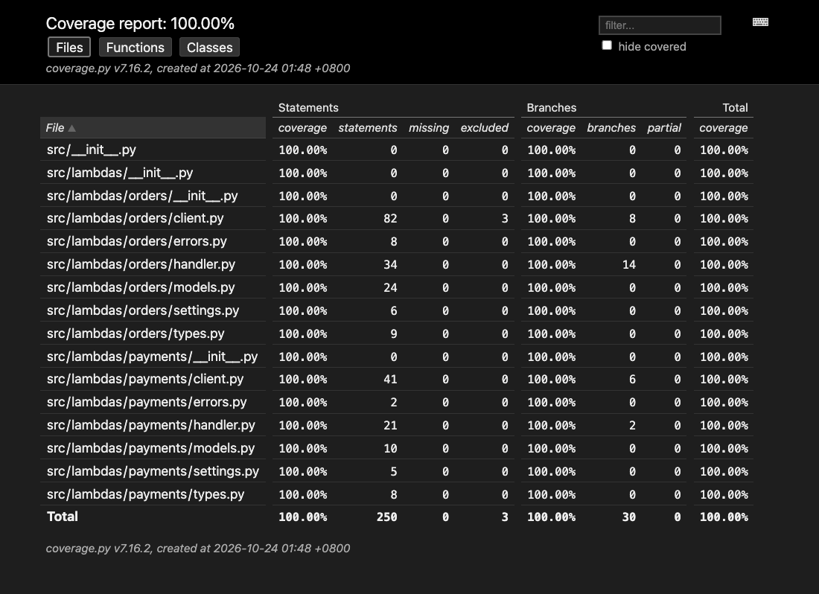
Coverage across all 36 tests
36 tests: workflow E2E + Lambda integrations
250 / 250
Python statement lines executed
30 / 30
Branch outcomes reached
Notes:
Speaker: Alex Au
Planned timing: 25:05–25:45
Spoken script
That was one scenario. This report covers the complete suite of 36 tests, which includes workflow end-to-end tests and direct integrations with the deployed Lambda functions. Together they executed all 250 measured Python statement lines and reached all 30 measured branch outcomes. This answers the execution-coverage question from the opening. The function-name contexts let us trace a covered line back to a test, and that test's assertions explain what was checked. We still need to ask how far results from this local environment can take us.
Presenter cues
Show the full-suite overview. Keep the scope clear: the stock demo alone does not produce 100%. Continue directly into section 7; Alex remains the speaker.
Sources
/Users/alexau/Documents/HKPUG/aws-community-day-hk-2026-step-functions-testing/output/coverage.json
/Users/alexau/Documents/HKPUG/aws-community-day-hk-2026-step-functions-testing/output/junit.xml
/Users/alexau/Documents/HKPUG/aws-community-day-hk-2026-step-functions-testing/output/htmlcov
/Users/alexau/Documents/HKPUG/aws-community-day-hk-2026-step-functions-testing/tests/test_workflows/test_payment_rejection.py
/Users/alexau/Documents/HKPUG/aws-community-day-hk-2026-step-functions-testing/presentation/assets/demo-report-v39/index.html

Slide 36
SECTION 07
What can we claim
from these results?
Notes:
Speaker: Alex Au
Planned timing: 25:45–25:55
Spoken script
We have checked specific business outcomes and measured the Python paths exercised by the suite. What can we claim from that evidence, and which behaviours still depend on the real services?
Presenter cues
Use this as the transition from local evidence to the remaining service checks.
Sources

Slide 37
Limits of local testing
Limitation | What to check after local e2e test
localstripe: no Idempotency-Key support | Payment retries in Stripe’s sandbox
Floci 2.3.0 accepts expired Step Functions task tokens | Token expiry on real AWS
Notes:
Speaker: Alex Au
Planned timing: 25:55–26:50
Spoken script
Our local tests depend on what the emulators implement. The pinned localstripe version does not implement Idempotency-Key, so this environment cannot establish Stripe's actual payment deduplication behaviour. We need that check in Stripe's sandbox. We also found that Floci accepts expired task tokens, so token-expiry behaviour needs a check on AWS. The local suite gives us fast, repeatable checks of our application's behaviour against these interfaces. These service differences tell us where to add the real-service checks. The bonus section shows a locally tested Durable Functions callback/replay flow.
Presenter cues
Use the two rows to connect each limitation to its next check. Separate the local callback proof from AWS compatibility claims. Avoid suggesting that the local suite verifies IAM or every AWS service contract.
Sources
/Users/alexau/Documents/HKPUG/aws-community-day-hk-2026-step-functions-testing/tests/test_merchant.py
/Users/alexau/Documents/HKPUG/aws-community-day-hk-2026-step-functions-testing/tests/fixtures/stripe.py
/Users/alexau/Documents/HKPUG/aws-community-day-hk-2026-step-functions-testing/architecture/testing-limits-slide.md
/Users/alexau/Documents/HKPUG/aws-community-day-hk-2026-step-functions-testing/src/workflows.md
https://github.com/adrienverge/localstripe/blob/v1.15.10/localstripe/server.py

Slide 38
100% of which code, exercised by which tests?
Coverage
Did the payment-rejection branch run?
Test context
Which test ran it?
Assertions
Order cancelled,
stock restored,
and no charge created?
Notes:
Speaker: Alex Au
Planned timing: 26:50–27:40
Spoken script
I would leave you with these three questions when reading a coverage result. Did the relevant line or branch run? Which test function exercised it? And what did that test assert about the business outcome? In our payment-rejection example, the last question means checking cancellation, restored stock, and the absence of a charge. A percentage, a test name, and an assertion each tell us something different. Reading them together makes the result useful when we change the application.
Presenter cues
Point once to Coverage, Test context, and Assertions. Continue to the optional Durable Functions bonus before Q&A.
Sources
/Users/alexau/Documents/HKPUG/aws-community-day-hk-2026-step-functions-testing/output/coverage.json
/Users/alexau/Documents/HKPUG/aws-community-day-hk-2026-step-functions-testing/tests/test_workflows/test_stock_reservation.py
/Users/alexau/Documents/HKPUG/aws-community-day-hk-2026-step-functions-testing/tests/test_workflows/test_payment_uncertainty.py

Slide 39
Bonus: Lambda Durable Functions
The same order flow, orchestrated in Python
The SDK checkpoints steps and waits for callbacks.
Create
order
Merchant
approves
Reserve
stock
Charge
payment
Confirm
order
Implemented: approval success + callback/replay
Failure recovery and Lambda coverage are not included in this bonus.
Notes:
Alex: This is an additional implementation of the same successful order flow. The orchestration is Python rather than an ASL state machine. The AWS SDK provides durable steps and callback waits. The smaller example covers less: rejection, retry, cancellation and coverage collection have not been ported.
Sources: bonus/durable/workflow.py; bonus/durable/README.md. AWS programming model: https://docs.aws.amazon.com/lambda/latest/dg/durable-functions.html

Slide 40
The approval wait is a Python call
bonus/durable/workflow.py
context.wait_for_callback(
request_approval,
name="AwaitMerchantApproval",
config=WaitForCallbackConfig(
timeout=Duration.from_seconds(120),
heartbeat_timeout=Duration.from_seconds(120),
retry_strategy=RetryPresets.none(),
),
)
request_approval sends the callback ID through SQS.
Notes:
Alex: This is the actual wait call from the implemented handler. request_approval sends an SQS message containing the order and callback ID. The wait suspends the first invocation. The test answers the callback as the merchant, and the execution resumes. Positive deadlines are explicit because MiniStack 1.5.32 interprets the SDK default zero differently from AWS. Scheduled submitter retries are disabled; that does not guarantee exactly-once message delivery if execution is interrupted before its checkpoint.
Sources: bonus/durable/workflow.py; pinned SDK 2.1.0; MiniStack compatibility notes in bonus/durable/README.md.

Slide 41
The callback resumes a second invocation
Invocation 1
Create order
Send approval
Suspend
Merchant callback
Invocation 2
Reuse checkpoints
Reserve → charge → confirm
 | Before callback | After resume
Order / stock | PENDING / 10 | CONFIRMED / 8
Charges | 0 | 1
CreateOrder + approval submission: one completed checkpoint each
Notes:
Alex: In the first invocation, creation and approval submission finish and are checkpointed. The execution suspends for the callback. The SDK replays from the beginning on the second invocation and reuses those stored results. Reserve, charge and confirm run after approval. The test reads paginated execution history plus DynamoDB and localstripe independently. The saved history contains two InvocationCompleted events, one CallbackSucceeded event, and each named step starts and succeeds once. This only proves replay of the completed creation and submission checkpoints; there is no post-payment suspension, so completed payment replay is not tested.
Sources: bonus/durable/tests/test_durable_order.py; output/durable/merchant-callback.json.

Slide 42
Demo: run the callback/replay test
MiniStack 1.5.32 · Python SDK 2.1.0 · Docker Lambda
mise run check-durable
mise run test-durable
1 integration test passed
History + order + stock + payment ledger
output/durable/merchant-callback.json
Notes:
Alex: Run these commands from the repository root with mise and Docker running. check-durable runs formatting, lint and strict type checks. test-durable builds the Lambda image, starts isolated MiniStack and localstripe containers, deploys a published function version, performs the real callback/replay test, writes evidence, and tears its resources down. MiniStack has documented compatibility gaps: it needs an Enabled wire extension; synchronous invoke returns PENDING at suspension; resume selects $LATEST. This local example keeps code and configuration unchanged after publication. The bonus does not yet collect Lambda coverage, so the earlier 100% coverage figures describe only the original Step Functions application.
Sources: mise.toml; bonus/durable/README.md; output/durable/junit.xml.
AWS invocation reference: https://docs.aws.amazon.com/lambda/latest/dg/durable-invoking.html

Slide 43
Q&A
Notes:
Speaker: Alex Au
Planned timing: 27:40–29:40
Spoken script
Thank you. What would you like us to go through in more detail? Sky and I are happy to take questions.
Presenter cues
Allow time for Q&A. Sky can join the discussion; Alex hosts this slide.
Sources
https://www.linkedin.com/in/sky-ng-ab307b252/
https://www.linkedin.com/in/alex-au-cloudeng/

Slide 44
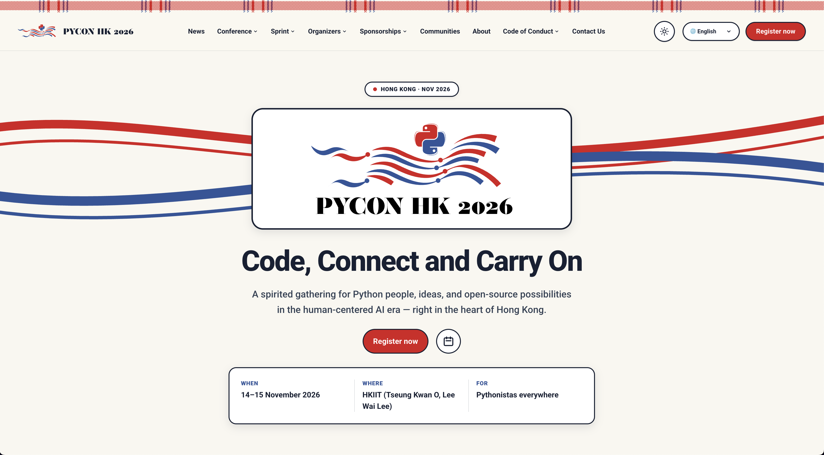
14th Nov – 15th Nov
See you in PyCon HK!
Notes:
Speaker: Alex Au
Planned timing: 29:40–30:00
Spoken script
And if you would like to continue the Python conversation, we hope to see you at PyCon Hong Kong on the fourteenth and fifteenth of November. Thank you for joining us today.
Presenter cues
Show the closing event slide briefly.
Sources
https://www.linkedin.com/in/sky-ng-ab307b252/
https://www.linkedin.com/in/alex-au-cloudeng/

