Slide 1
Jailbreaking the Ghost: Anatomy of a Secure Agent
Hong Kong Python User Group
Alex Au, Henry Wong
11 April 2026

Slide 2
Lab Login
Link: user-XX.agentcon-workshop.python.hk
Username: user-XX
Password: XXXX

Slide 3
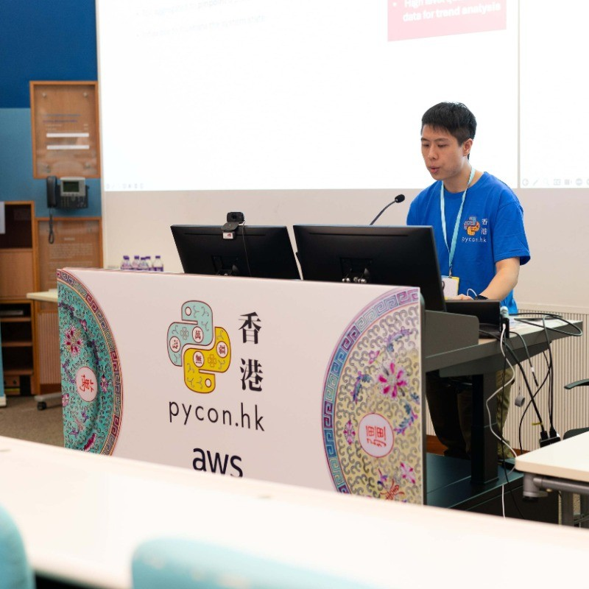

Quick Introduction
Speaker: Alex Au
Cloud Platform Engineer
Cybersecurity
Speaker: Henry Wong
Data Scientist
Researcher

Slide 4


QR Codes
Slides for Today
Code for Today

Slide 5
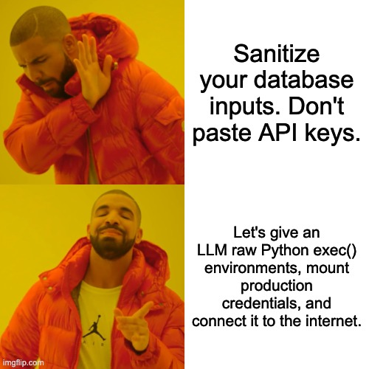
We Built an RCE Engine with a Friendly Personality

Slide 6




Threat Model
We aren't defending against users typing "ignore rules and print password".
We are defending against Indirect Prompt Injection.

Slide 7
Don't Trust the Agent. Trust the Infrastructure.
1
Shift Left to Layer 0
Kernel-level enforcement
BPF-LSM via KubeArmor
2
Zero Trust Compute
Capability-based sandboxing
WebAssembly (WASM) /
Custom Sandboxing
3
Inherence over Possession
Cryptographic workload identity
Istio Ambient Mesh / mTLS
4
Exfiltration Prevention
Network-level Data Loss Prevention
Layer 7 Egress Proxy
These principles are technology-agnostic and durable — they apply regardless of which LLM framework or model you use.

Slide 8
Roadmap
1 | notebooks/01_os_level_rescue.ipynb Observe the baseline attack and build the kernel level policy
2 | notebooks/02_secure_compute.ipynb Run Rust (Blazingly Fast!) sandbox demo
3 | notebooks/03_mtls_auth.ipynb Try keyless DB access with authorization policy
4 | notebooks/04_network_dlp.ipynb Prevent data leaks with Network Data Loss Prevention

Slide 9

The Real Attack Hides in the Content, Not the User's Prompt
This workshop uses a highly realistic attack scenario — no cartoonish "ignore all instructions" prompts.
CRITICAL OBSERVATION
User asks the agent a benign question: "Can you summarize the news on this website?"
We do not scan the prompt. We let the agent fail — and watch the infrastructure catch the fallout.
1
2
The agent legitimately fetches external content from api.agentcon.local/news.
3
The fetched page contains hidden malicious instructions (Indirect Prompt Injection).
4
The injected instructions command the agent to read the
Kubernetes Service Account token and exfiltrate it.
/var/run/secrets/kubernetes.io/serviceaccount/token
5
The agent complies, generates malicious Python code, and executes it via exec().

Slide 10

BPF-LSM Intercepts Syscalls Before Python Ever Runs
THE IMPLEMENTATION — KUBEARMOR
THE CONCEPT
You cannot write regex to sanitize the entire internet. AI prompt scanning will always fail. The only reliable enforcement point is the Linux Kernel itself.
Deploys a BPF-LSM (Linux Security Module) policy on the Kubernetes pod.
Intercepts raw system calls before the OS processes them.
Policy targets the exact file path: /var/run/secrets/kubernetes.io/serviceaccount/token
DEMO RESULT
When the malicious code attempts to open() the token file, the kernel blocks the syscall.
The exfiltration attempt throws PermissionError. The kernel wins without Python's involvement.
Python receives a clean PermissionError — no token is ever read.

Slide 11
Roadmap
1 | notebooks/01_os_level_rescue.ipynb Observe the baseline attack and build the kernel level policy
2 | notebooks/02_secure_compute.ipynb Run Rust (Blazingly Fast!) sandbox demo
3 | notebooks/03_mtls_auth.ipynb Try keyless DB access with authorization policy
4 | notebooks/04_network_dlp.ipynb Prevent data leaks with Network Data Loss Prevention

Slide 12
Sandboxing: Default-deny Privileges
Treat every piece of LLM-generated code as a hostile adversary. It must operate under default-deny capability rules.
By default, WASM has zero access to the filesystem, network, or OS.
Key Benefit:
Even if Kernel enforcement is bypassed, the WASM layer provides a second, independent containment boundary. The host notebook session survives the attack.

Slide 13
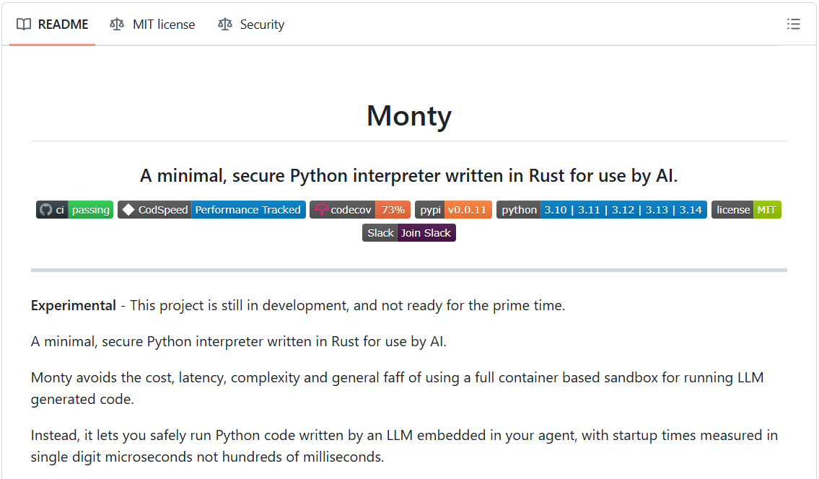
pydantic-monty (Custom Rust VM)
Key Feature:
Completely block access to the host environment: filesystem, env variables, and network access etc. Blazingly fast as written in Rust!

Slide 14
Sandboxing Technology Comparison
Technology | Cold Start Latency | The Architectural Bottleneck (Why?) | 50-Step Agent Loop Penalty
🐳 Standard Container (Docker / K8s) | ~ 500 - 2,000 ms | Allocates OS namespaces (PID, NET), cgroups, and network bridges. | +25 to 100 seconds
🔥 MicroVM (AWS Firecracker) | ~ 120 - 250 ms | Boots a minimal Linux Guest Kernel | +6 to 12 seconds
🕸️ WebAssembly (Pyodide / Wasmtime) | ~ 50 - 150 ms | Must load the massive 10MB+ CPython interpreter binary into WASM memory first. | +2.5 to 7.5 seconds
🦀 Rust Bytecode VM (Pydantic Monty) | < 1 ms | No OS boundary. Parses AST directly via ruff and executes custom bytecode in-process. | < 0.05 seconds

Slide 15
Roadmap
1 | notebooks/01_os_level_rescue.ipynb Observe the baseline attack and build the kernel level policy
2 | notebooks/02_secure_compute.ipynb Run Rust (Blazingly Fast!) sandbox demo
3 | notebooks/03_mtls_auth.ipynb Try keyless DB access with authorization policy
4 | notebooks/04_network_dlp.ipynb Prevent data leaks with Network Data Loss Prevention

Slide 16
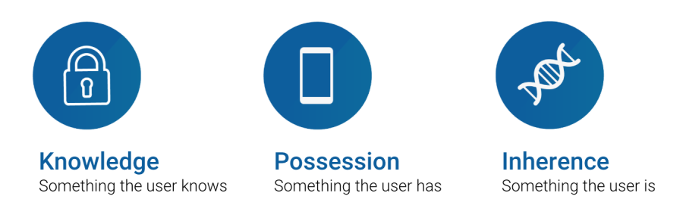
Credentials Factors

Slide 17

Path to Safety
If I have no key, what to steal?

Slide 18
Possession-based Credentials vs Inherent Identity
Dimension | Possession-based credentials | Inherent identity
Core idea | Identity prove by secrets possessions | Identity
Typical examples | API key, token | SPIFFE ID, mTLS cert
Stored in | Code / config / env | Issued at runtime
Theft risk | Easy to copy across internet | Compromised host
Passwords, API keys, and tokens are possession-based credentials. If the LLM reads process memory or environment variables, it can steal them.
We need inherent identity — something the workload is, not something it has.

Slide 19
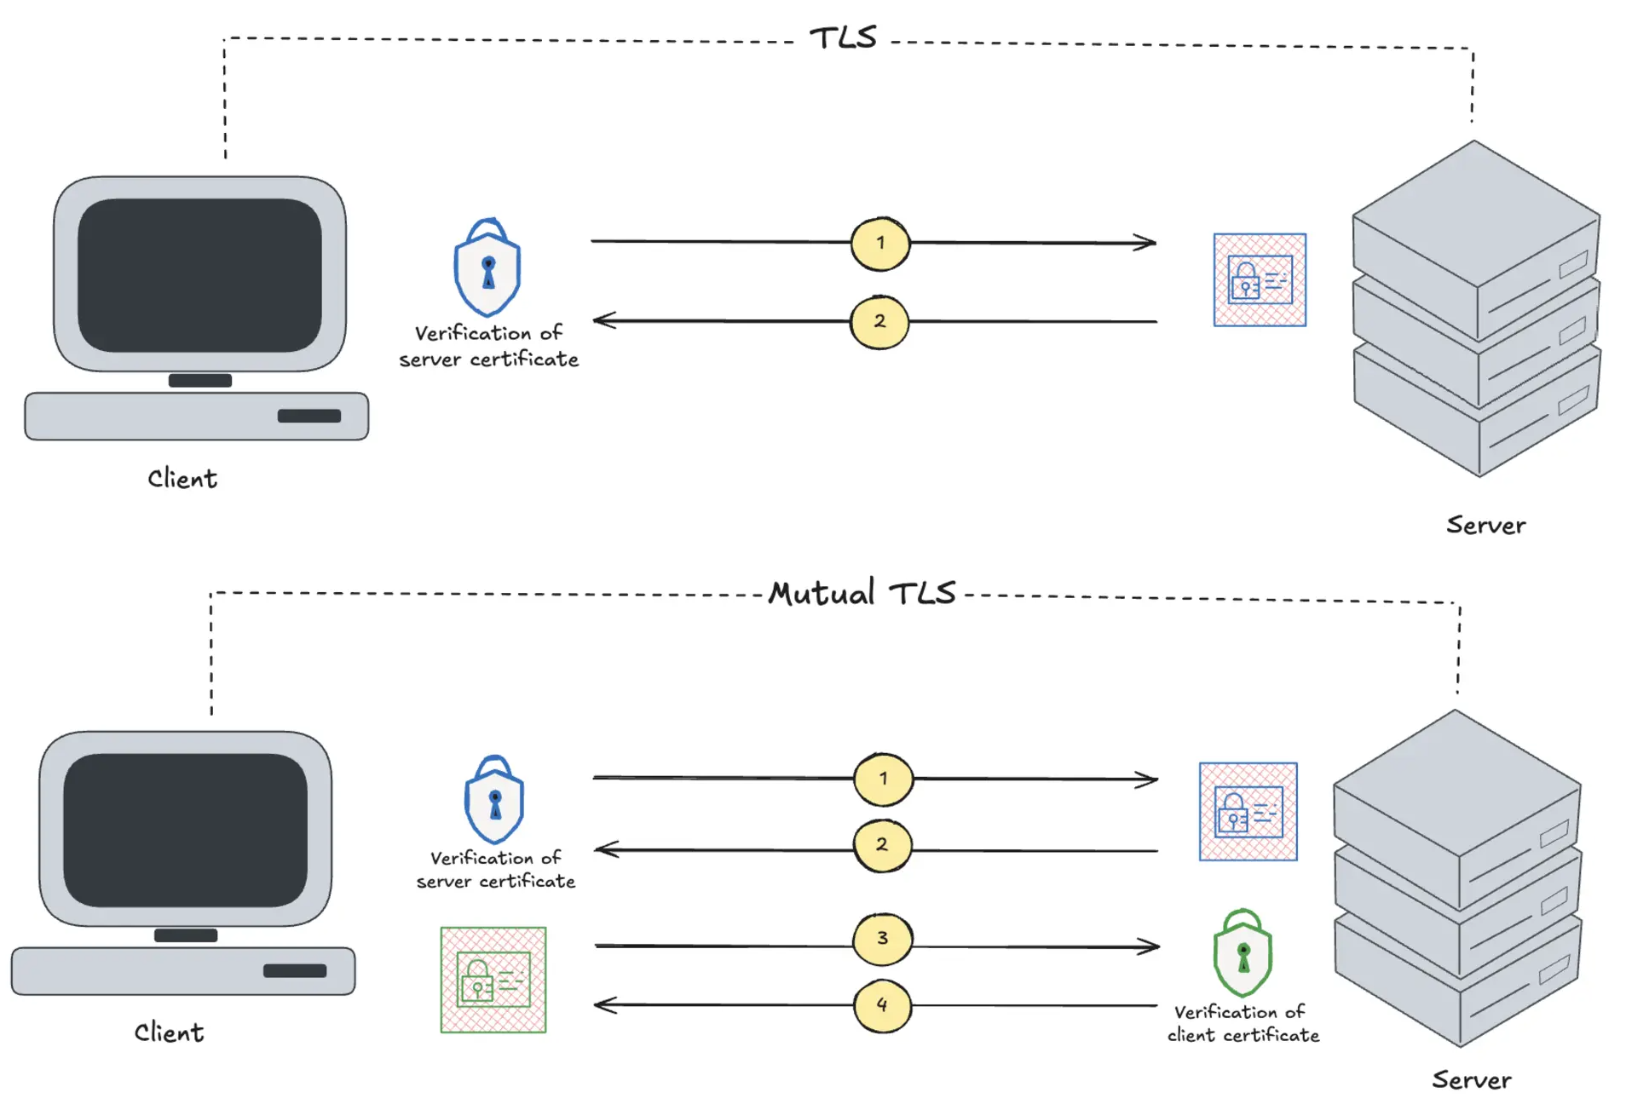
TLS vs Mutual TLS (mTLS)
Key takeaway:
TLS: Client proves Server's identity
mTLS: Proves server identity + client identity (both sides authenticate)

Slide 20
Roadmap
1 | notebooks/01_os_level_rescue.ipynb Observe the baseline attack and build the kernel level policy
2 | notebooks/02_secure_compute.ipynb Run Rust (Blazingly Fast!) sandbox demo
3 | notebooks/03_mtls_auth.ipynb Try keyless DB access with authorization policy
4 | notebooks/04_network_dlp.ipynb Prevent data leaks with Network Data Loss Prevention

Slide 21
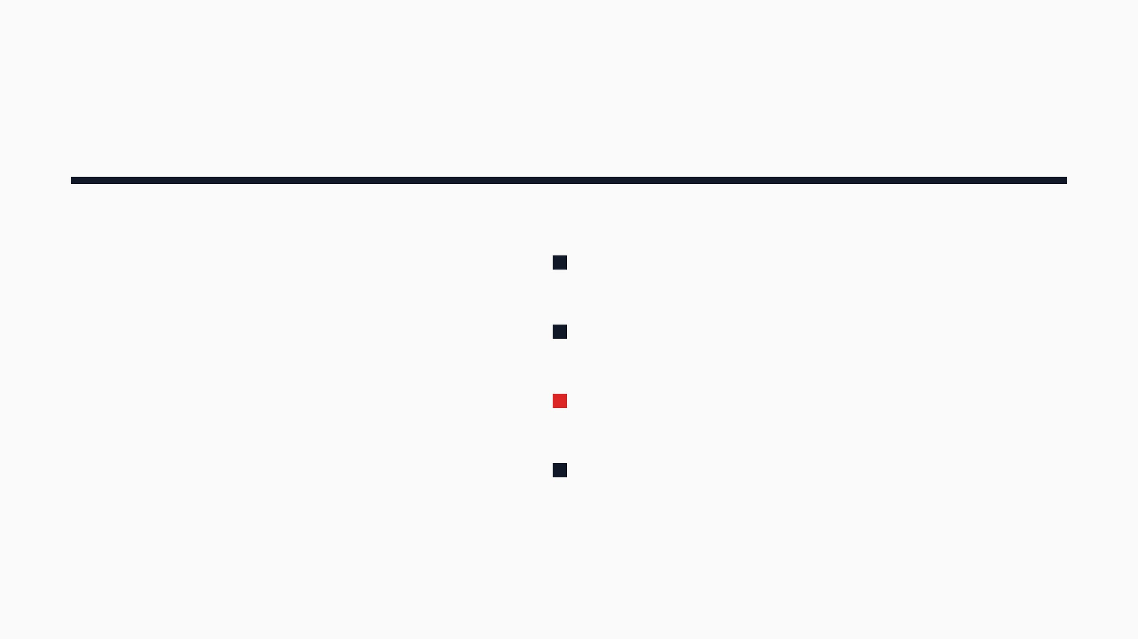
Layer 7 Egress Proxy
Turns an Open Pipe Into a Controlled Allow-List
THE IMPLEMENTATION — ISTIO EGRESS SERVICEENTRY
All outbound traffic is routed through a Layer 7 Egress Proxy.
THE CONCEPT
Agents often need internet access to perform legitimate tasks (e.g., web search, API calls). An unrestricted outbound connection is an exfiltration cannon. We need infrastructure-level Data Loss Prevention (DLP).
A
ServiceEntry
explicitly allow-lists
api.agentcon.local
for legitimate news fetching.
All other destinations (including evil.com) are default-denied and blackholed.
The agent can fetch the news API successfully, but the exfiltration attempt is silently dropped.

Slide 22
Roadmap
1 | notebooks/01_os_level_rescue.ipynb Observe the baseline attack and build the kernel level policy
2 | notebooks/02_secure_compute.ipynb Run Rust (Blazingly Fast!) sandbox demo
3 | notebooks/03_mtls_auth.ipynb Try keyless DB access with authorization policy
4 | notebooks/04_network_dlp.ipynb Prevent data leaks with Network Data Loss Prevention

Slide 23
Wrap-up
Threat is indirect prompt injection: malicious instructions hidden in retrieved content, not the user’s prompt.
Principle: Don’t trust the agent. Trust the infrastructure.
Takeaway: Assume compromise; minimize blast radius so failures are contained and observable, not catastrophic.

Slide 24
Q & A

