Slide 1
HeteroCL
An open-source, Python-based programming language designed for heterogeneous architecture
Intended to lower the high level of specialized knowledge needed to use these systems
Existing High-Level Synthesis (HLS) tools to accomplish this are not structured like normal programming languages and require detailed knowledge of the hardware
Notes:
1

Slide 2
Separating Out Optimization
Existing tools “entangle” algorithms and hardware-specific optimizations
This not only effects readability and ease of maintenance, but also hinders portability to new hardware
Does not allow the programmer to describe relationships between different optimizations, such as the amount of available buffer space and degree of parallelization
Notes:
2

Slide 3
DSLs
“Domain Specific Languages” or DSLs are being created to make optimization for specific fields easier
For example, Halide is a language for optimizing image and big data processing and TVM is a language for machine learning
HeteroCL is based on TVM and Halide with the goal of being a DSL for heterogeneous architectures
Notes:
3

Slide 4
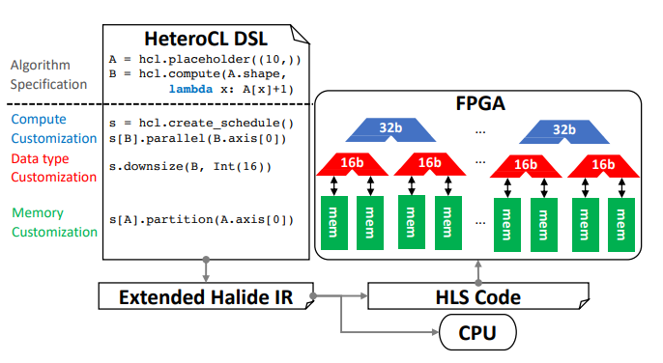
Compilation
HeteroCL code (syntax based on TVM) is compiled into an extended version Halide code (or another target language)
This code can then be targeted to a FPGA with a HLS compiler or a CPU
Notes:
4

Slide 5
TVM vs HeteroCL
TVM:
Compiles an execution graph that allows for a high level of parallelism
Decouples algorithm from execution timing, you tell the language what you need done, and it creates an execution schedule
HeteroCL adds:
Hardware optimization along 3 axes:
Computation
Data type
Memory layout
Notes:
5

Slide 6
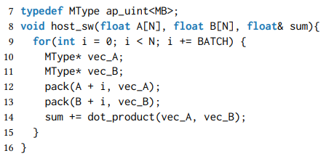
Example: The Dot Product!
Normal dot product: Iterate along vectors A and B, multiply the elements at each index and sum them
Optimization: Pack elements of the vectors into a single buffer of size BATCH, then compute them all with one Single Instruction Multiple Data (SIMD) instruction
Notes:
6

Slide 7
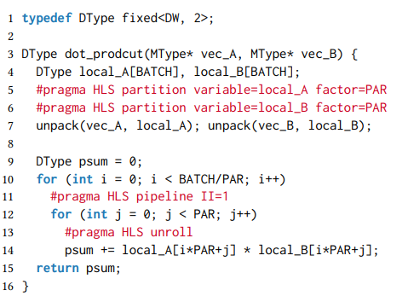
Go Even Farther Beyond!
We can use HLS for more detailed optimization
When packing the vectors, reduce the number of bits on the input data, trading off accuracy for less memory accesses (lines 4 and 7)
Partition packed vector into separate memory banks so they can be operated on in parallel (lines 5 and 6)
Notes:
7

Slide 8
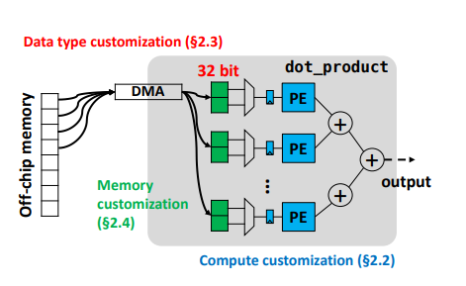
Go Even More Farther Beyond!
Separate the loop into blocks based on the batch size and the number of parallel executions (lines 10-13) and let them all run at once
Each parallel execution “thread” is called a Processing Element (PE)
Notes:
8

Slide 9
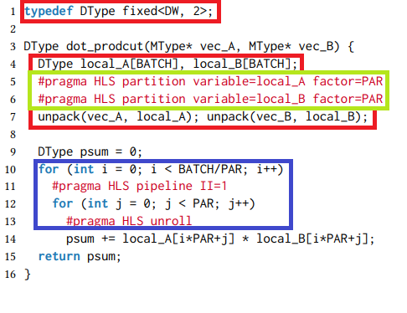
HeteroCL's Optimizations
Data type customization: using less bits
to save of memory accesses
Memory layout customization: using separate
data banks for each parallel PE
Computation customization: separate
operations into blocks and run on parallel
PEs. Also, we unroll the inner loop to save
on having to iterate j and check the loop
condition.
We used all 3 of HeteroCL's axes of optimization in this example:
Notes:
9

Slide 10
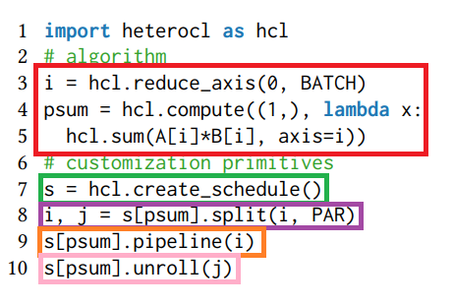
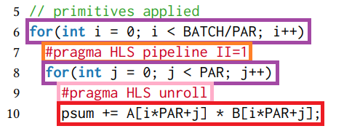
Computation Customization
Define an axis that operates on a subset of
Indices from 0 to the batch size. Define the
inner product operation to operate on that axis.
Create a scheduler object to execute our operation.
Split inner product operation by i (0-batch size)
and number of parallel PEs
Pipeline each iteration on i.
Unroll innermost loop on j.
To HLS code
Notes:
10

Slide 11
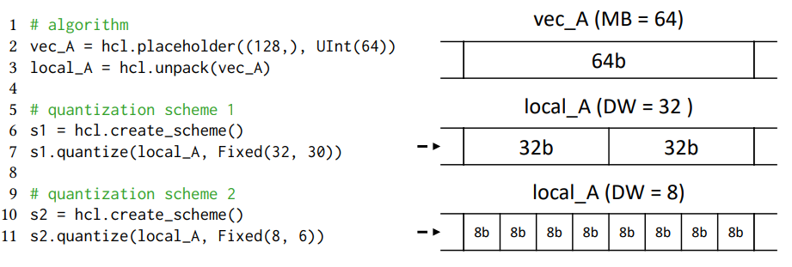
Data Type Customization
We transfer our 64-bit float input buffer, vec_A, into local memory as local_A
We can then change the quantization scheme, in this example we try both 32 and 8 bit floats
Notes:
11

Slide 12
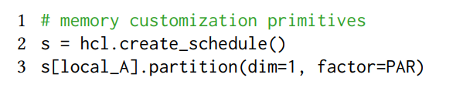

Memory Customization
Memory customization is essential for efficient memory sharing between PEs.
In this case, we use the schedule object to operate on the buffer to apply the partition by the number of parallel PEs.
Notes:
12

Slide 13
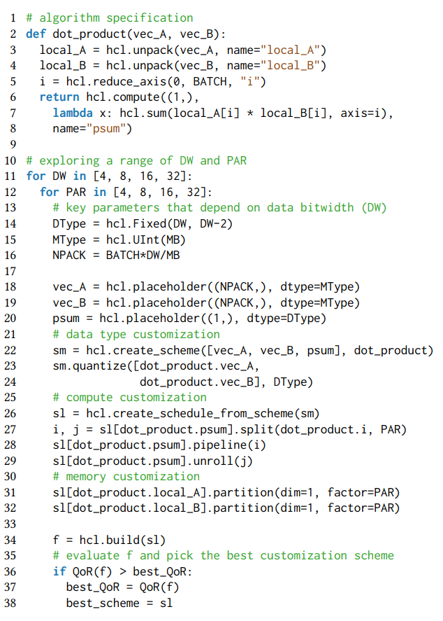
Putting It All Together
Algorithm implementation, note no
optimization details are present here
Iterates along possible bit-widths
and number of parallel PEs
From data type customization slide
From computation customization slide
From memory customization slide
Searches all optimization options for the
best “Quality of Results” metrics
Notes:
13

Slide 14
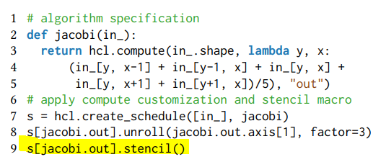
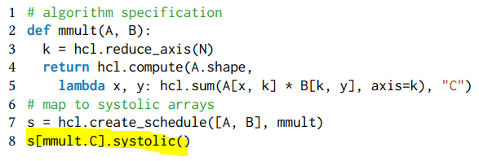
Spatial Architecture Techniques
There are several techniques that take advantage of the grid-based nature of a FPGA
Coercing normal HLS code to take advantage of these patterns is cumbersome
In HeteroCL its just a simple function call!
HeteroCL supports stencils (reading a fixed pattern from a 2-D array) and systolic arrays (where nodes read data from adjacent nodes)
Notes:
14

Slide 15
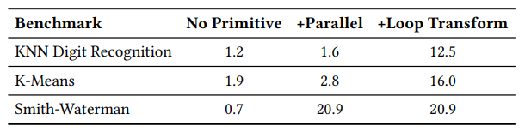
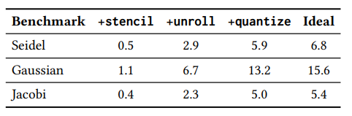
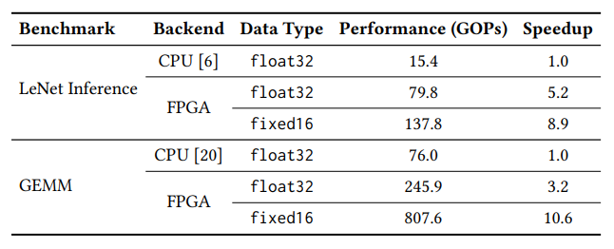
Performance
(Speedup with FPGA + HeteroCL over CPU)
General benchmarks:
Stencil:
Systolic arrays:
Notes:
15

Slide 16
Benefits of HeteroCL
Allows for high performance using heterogeneous architecture with readable code
Separation of optimizations and the algorithm allows for better portability, maintainability, and exploration of the design space
Well-known design patterns that take advantage of FPGA architecture are built in to HeteroCL, no specialized knowledge is needed
Combines both imperative and declarative programming, allowing programmers to leverage advantages of either/both in their applications
Notes:
16

Slide 17
Limitations of HeteroCL
Current implementation focuses on CPU + FPGA platforms, does not include GPU optimization
HeteroCL may lack more complex domain-specific structures that are highlighted in existing DSLs
Speedup is not guaranteed by using just one HeteroCL customization; multiple customizations may need to be implemented to see improvement
Primarily a proof-of-concept; would need more validation/reliability testing before using in large scale implementations
Notes:
17

Slide 18
What’s Next?
The HeteroCL framework is released as an open-source tool; infrastructure and docs/examples are publicly available
Opportunities to introduce new primitives, support data streaming to further optimize FPGA programming and application-specific interfaces
Integrate more spatial architecture templates, autotuning capabilities, and accurate QoR (quality of results) using ML techniques
Notes:
18

Slide 19
Questions?
Notes:
19

Slide 20
References
The Paper:
Lai, Yi-Hsiang, et al. "HeteroCL: A multi-paradigm programming infrastructure for software-defined reconfigurable computing." Proceedings of the 2019 ACM/SIGDA International Symposium on Field-Programmable Gate Arrays. 2019.
SAMPL YouTube Talk:
Lai, Yi-Hsiang. Decoupling Algorithm from Hardware Customizations for Software-Defined Reconfigurable Computing. YouTube, SAMPL, 3 Dec. 2021, https://www.youtube.com/watch?v=6F7cQN5pmbs. Accessed 4 Aug. 2022.
GitHub page:
“Heterocl: A Multi-Paradigm Programming Infrastructure for Software-Defined Heterogeneous Computing.” GitHub, https://github.com/cornell-zhang/heterocl.

