Slide 1

WES237B: Software for Embedded Systems
Pat Pannuto
Department of Computer Science and Engineering
University of California, San Diego
Summer Session 2022

Slide 2
Today
Morning
Performance & Optimization
Optimization in different levels (in the context of a single core)
Algorithmic (Cache Optimization), Compiler and Hardware
Memory Hierarchy
Afternoon
Lab session

Slide 3
Logistics
Assignment 1 due tomorrow
Assignment 2 released
Generally: First bit of assignment is lab portion, the rest is take-home
Finish the lab first if needed
Late policy?
1 week: 10% off
2 weeks: Last chance, 30% off
Email with any exceptional circumstances, we’ll work it out
Sign up for presentation slots!

Slide 4
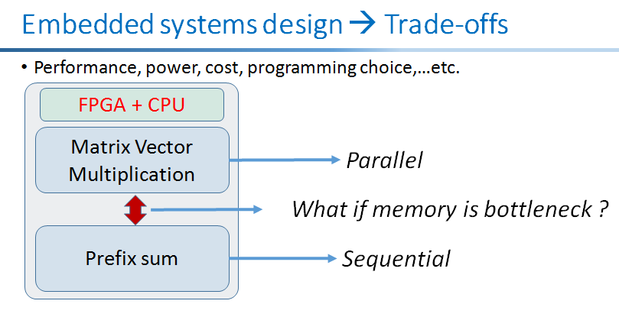
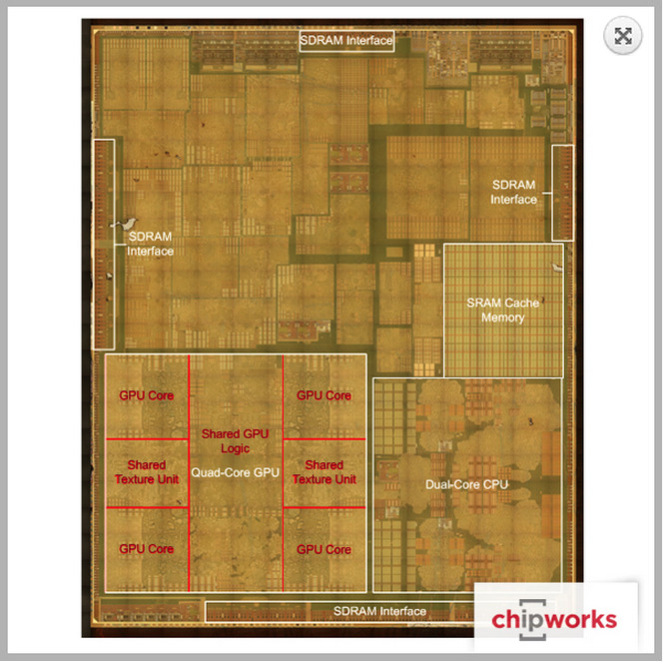
Recap
Embedded Systems (SoC) Design
ARM processor technology
ISA: ARMv4, ARMv5, ARMv6, ARMv7, ARMv8
Cortex-A5,6,7,…15
Processor Types
Microcontrollers, DSP, FPGA, GPU,…
Huffman Encoding

Slide 5
The guts of most interesting stuff is often ~this
void Foo(float* const A, float* const B, float* const C, const int M, const int N, const int K)
{
for (int m = 0; m < M; m++) {
for (int n = 0; n < N; n++) {
for (int k = 0; k < K; k++) {
C[m * M + n] += A[m * M + k] * B[k * K + n];
}
}
}
}
Notes:
Not literally these loops, but multi-dimensional math, which boils down to loops of basic op’s marching through arrays

Slide 6
Measuring Performance
Notes:
What are the goals of Software Optimization ?

Slide 7
The bottom line: Performance
Time to do the task
execution time, response time, latency
Tasks per day, hour, week, sec, ns. ..
throughput, bandwidth
Time to Bay Area
Speed
Passengers
Throughput (pmph)
Ferrari
3.1 hours
160 mph
2
320
Bus
7.7 hours
65 mph
60
3900

Slide 8
Measures of “Performance”
Execution Time
Throughput (operations/time)
Transactions/sec, queries/day, etc.
Frame Rate
Responsiveness
Performance / Cost
Performance / Power
Performance / Energy
Different Metrics for different folks
ET is standard responsiveness
Frame Rate – FPS/Media App
Throughput (Servers)
Responsiveness – similar to ET but can vary, think ipod/smartphone
Perf/Cost – Server farm / everyone
Perf/Power – power is expensive and causes thermal issues(cooling)
Perf/Energy – battery-based designs

Slide 9
Why Study Computer Performance?
In order to say X is n times faster than Y
Identify the benefits of running a program on a computer X, or bottlenecks of a program on a computer X
Embedded systems are too complex (CPU + FPGA + GPU) ➔ How to measure performance of system consisting of sequential and parallel parts ?
To understand common techniques to measure performance
To know what to measure & how to measure

Slide 10
Performance is Affected by,…

Slide 11
Performance is Affected by,…
Technology
Clock speed
Processor technology

Slide 12
Performance is Affected by,…
Technology
Clock speed
Processor technology
Organization
Single core. vs. multi core
Types of processors implementation (SIMD, out of order,..)
Heterogeneous (SoC)
Memory hierarchy & memory type
Type of I/O devices
,…

Slide 13
Performance is Affected by,…
Technology
Clock speed
Processor technology
Organization
Single core. Vs. multi core
Heterogeneous (SoC)
Types of processors (SIMD, out of order,..)
Memory hierarchy & memory type
Type of I/O devices
,…
Software
Quality of compilers & libraries & parallel processing frameworks
Operating system

Slide 14
Principles of Measuring Performance
Well defined metrics
Execution time = Time spent running a program on X computer
Reproducibility
Should get the same result when you are using the same program on same machine under same conditions (OS, compiler levels,…)
Standard Benchmarks
SPEC (https://www.spec.org/benchmarks.html)

Slide 15
Performance Metrics
Raw speed = peak performance
In practice, never attainable
Clock rate * #of floating point operations/cycle (E.g., 10 Gflops)
Execution time = time to execute a program from beginning to end
The sooner the better
Wall clock time/elapsed time: Time to complete task as seen by the user. Might include operating system overhead or interference with other applications
CPU Time: does not include time spent for IO, external sources
User CPU time: CPU time spent in the program
System CPU time: CPU time spent in the OS performing taks requested by program
Throughput = total amount of work completed in a given time
Frames per second (fps)., 30 fps
Transactions or packets per second
Indication of how well hardware resources are being used
Memory: Bandwidth & Latency

Slide 16
There are many ways to measure program execution time
$ time make # cargo build
Compiling hail v0.1.0 (/tock/boards/hail)
Finished release [optimized + debuginfo] target(s) in 19.96s
real 0m21.146s
user 0m30.388s
sys 0m2.032s
Program-reported time?
Wall-clock time?
user CPU time?
user + kernel CPU time?
Notes:
Well, it’s user+kernel cpu, for this class, because that’s what we can do something about.
But for the rest of the class, I’ll just say ET and you don’t have to think hard about what it means (ie, assume no other jobs, no stalls for disk, etc.)
Maybe: Note the ”time travel”. I.e. user > real in this example because of parallelism!
In case I forget: https://stackoverflow.com/questions/556405/what-do-real-user-and-sys-mean-in-the-output-of-time1
Real is wall clock time - time from start to finish of the call. This is all elapsed time including time slices used by other processes and time the process spends blocked (for example if it is waiting for I/O to complete).
User is the amount of CPU time spent in user-mode code (outside the kernel) within the process. This is only actual CPU time used in executing the process. Other processes and time the process spends blocked do not count towards this figure.
Sys is the amount of CPU time spent in the kernel within the process. This means executing CPU time spent in system calls within the kernel, as opposed to library code, which is still running in user-space. Like 'user', this is only CPU time used by the process. See below for a brief description of kernel mode (also known as 'supervisor' mode) and the system call mechanism.

Slide 17
Execution Time
Processor A is faster than the processor B
Relative performance: Performance of A is n times greater than B

Slide 18
How architects define Performance
1
Performance_{X} =
, for program X
Execution Time_{X}
Only has meaning in the context of a program or workload
Not very intuitive as an absolute measure, but most of the time we’re more interested in relative performance

Slide 19
Relative Performance
Can be confusing…
A runs in 12 seconds
B runs in 20 seconds
A/B = .6 , so A is 40% faster, or 1.4X faster, or B is 40% slower
B/A = 1.67, so A is 67% faster, or 1.67X faster, or B is 67% slower
Needs a precise definition
Notes:
The a/b , b/a thing is just to make the point that the language can be confusing, and have seen lots of performance claims that use faulty terminology. So we need to all agree on how we are going to talk about relative performance.

Slide 20
Relative Performance (Speedup), the Definition
Speedup
Performance_{X}
Execution Time_{Y}
(X/Y)
=
=
=
n
Performance_{Y}
Execution Time_{X}

Slide 21
Example
Machine A runs program C in 9 seconds.
Machine B runs the same program in 6 seconds.
What is the speedup we see if we move to Machine B from Machine A?
Notes:
I like to work problems in the class, with participation and help from the class. Now could also make this a “clicker question” or this quarter a “poll question”. But maybe better to do that on the second one after working the first.

Slide 22
What is Time?
CPU Execution Time = CPU clock cycles * Clock cycle time
Every conventional processor has a clock with an associated clock cycle time or clock rate
Every program runs in an integral number (whole number) of clock cycles
Cycle Time
MHz = millions of cycles/second, GHz = billions of cycles/second
X MHz = 1000/X nanoseconds cycle time
Y GHz = 1/Y nanoseconds cycle time

Slide 23
CPU time
CPU time is the time CPU is computing
Not including followings
Memory access time
IO access time
CPU time = Clock cycles * Clock Period
Clock period = 1/Clock frequency
100 MHz of clock frequency = 10 ns of clock period
1GHz of clock frequency = 1 ns of clock period

Slide 24
How many clock cycles?
Number of CPU clock cycles =
[Instruction count] * [Average Clock Cycles per Instruction (CPI)]
Exercise:
Computer A runs program C in 3.6 billion cycles.
Program C requires 2 billion dynamic instructions.
What is the CPI?
Notes:
After example, ask why it is okay that CPI is not an integer? What does this imply about instructions in this machine?

Slide 25
Clock Cycles Per Instruction (CPI)
CPI is the average number of clock cycles per instruction
Throughput metric
Component metric (not a measure of performance )
Different classes of instructions can have different CPIs
CPI for floating point operations
CPI for adders, branch instructions
CPU Clock Cycles = Number of Instructions (NI)* CPI
The CPI of i^{th} class
The number of instructions of i^{th} class

Slide 26
Putting it all together
CPU Execution Time = [CPU clock cycles] * [Clock cycle time]
CPU clock cycles = [Instruction count] * [Average Clock Cycles per Instruction (CPI)]
seconds
CPU Execution Time
Instruction Count
Clock Cycle Time
=
X
CPI
X
instructions
cycles/instruction
seconds/cycle
Notes:
Dimensional analysis

Slide 27
CPU Execution Time
CPU Execution Time = CPU Clock Cycles * Clock Period
= NI*CPI*Clock Period
Execution time depends on
Number of instructions : Determined by the ISA
Programmable hardware counters can be used to find NI
Profiling tools such as gprof, valgrind
CPI: determined by the ISA & Compiler & Organization (Parallel execution)
Can be determined in software using simulator
Clock period: Determined by the process technology and implementation

Slide 28
Cycle Time/Clock Rate is no longer fixed
Increasingly, modern processors can execute at multiple clock rates (cycle times).
Why?
However, the granularity at which we can change the cycle time tends to be fairly coarse, so all of these principles and formulas still apply.

Slide 29
Who Affects Performance? How?
CPU Execution Time
=
Instruction Count
X
CPI
X
Clock Cycle Time
programmer
compiler
instruction-set architect
machine architect
hardware designer
materials scientist/physicist/silicon engineer
Notes:
The perf slides and ET equation are key to the whole class.

Slide 30
Which programs are best, are “most fair”, to run when measuring performance?
peak throughput measures (simple programs)?
synthetic benchmarks (whetstone, dhrystone,...)?
Real applications
SPEC (best of both worlds, but with problems of their own)
System Performance Evaluation Cooperative
Provides a common set of real applications
Along with strict guidelines for how to run them
Provides a relatively unbiased means to compare machines.

Slide 31
Amdahl’s Law
The impact of a performance improvement is limited by the percent of execution time affected by the improvement
Make the common case fast!!
Execution time
after improvement
Execution Time Affected
=
+
Execution Time Unaffected
Amount of Improvement

Slide 32
Amdahl’s Law and Massive Parallelism
.9
.1
Notes:
I love this slide. If there is one other concept besides the ET equation I really want them to get, it is this. It explains why I spent most of my career using parallel hardware to make single thread performance fast.

Slide 33
Amdahl’s Law and Massive Parallelism
Speedup
1.0
.9
.1
1/.55 = 1.82
.45
.1

Slide 34
Amdahl’s Law and Massive Parallelism
Speedup
1.0
.9
.1
1/.55 = 1.82
.45
.1
.1
1/.325 = 3.07
.225

Slide 35
Amdahl’s Law and Massive Parallelism
Speedup
1.0
.9
.1
1/.55 = 1.82
.45
.1
.1
1/.325 = 3.07
.225
.1
< 10
Notes:
n.b. 1 / .19 = 5.26

Slide 36
Optimizations
Notes:
2021: 10:05 am

Slide 37
What to optimize on a CPU?
Program type
Compute-bound
I/O bound
 | Number of Instructions (NI) | CPI | Clock Frequency
Program | ☑
Compiler | ☑ | ☑
ISA | ☑ | ☑
Organization |  | ☑ | ☑
Technology |  |  | ☑
CPU Execution Time = CPU Clock Cycles * Clock Period
= NI*CPI*Clock Period
Reduce Clock Period ➔ Increase clock frequency
Decrease NI
Decrease CPI

Slide 38
Optimization is
hard
An application X ➔ optimize it on Y?
Where should I start?
When I know if I hit the target performance (or do I have a target performance)?
Both system level and low-level knowledge/experience is needed
system level ➔ Algorithmic, Compiler, Multi-core,…
Low-level→ Cache organization, compiler optimization,…

Slide 39
Optimization is hard (and getting harder…)
Must understand system as a whole to optimize
Software Application
Compiler
Hardware (A GPU)
Algorithmic Optimization
Big O(n2) → Big O(nlogn)
Arithmetic optimizations
Algorithmic changes that uses HW efficiently
..
Loop vectorization
Constant subexpression elimination
,…
Micro architectural design
Frequency/Clock cycles
Instruction level parallelism…
Cache optimization..
Possible #of total optimization space = #algorithms * compiler optimization* # hardware optimizations ➔ Optimization search space

Slide 41
Optimization is hard (and getting harder…)
Must understand system as a whole to optimize
Hardware (A GPU)
[ or TPU or …]
Hardware (A GPU)
Software Application
Compiler
Hardware (A GPU)
Algorithmic Optimization
Big O(n2) → Big O(nlogn)
Arithmetic optimizations
Algorithmic changes that uses HW efficiently
..
Loop vectorization
Constant subexpression elimination
,…
Micro architectural design,
Frequency/Clock cycles
Instruction level parallelism…
Cache optimization..
Heterogenous (or system with multiple hardware units) → optimization parameter search space is large

Slide 42
Optimizations in Different Levels
Optimization: Must optimize at multiple levels:
Algorithm level, data representations, procedures, compiler, and hardware,...
Software
Multithreading, Inline Assembly,
Blocking, Loop interchange,..etc.
Compiler level optimizations such
as dead code elimination, ..
ISA
Pipelining, out-of-order execution,
Branch prediction, superscalar,
Cache organization, multi-core,…
Hardware

Slide 43
Optimizations
Must understand system as a whole to optimize for performance
How programs are compiled and executed
How modern processors + memory systems operate
How to measure program performance and identify bottlenecks
How to improve performance without destroying code modularity and generality

Slide 44
Micro Architecture
Notes:
2021: 11:13 am

Slide 45
Instruction Level Parallelism
Need general understanding of modern processor design
Hardware can execute multiple instructions in parallel
Performance limited by data dependencies
Simple transformations can yield dramatic performance improvement
Compilers often (sometimes) cannot make these transformations
Bryant and O’Hallaron, Computer Systems: A Programmer’s Perspective; Third Edition

Slide 46
Superscalar processor
A superscalar processor can issue and execute multiple instructions in one cycle. The instructions are retrieved from a sequential instruction stream and are usually scheduled dynamically.
Benefit: without programming effort, superscalar processor can take advantage of the instruction level parallelism that most programs have
Most modern CPUs are superscalar
Intel: since Pentium (1993)
Bryant and O’Hallaron, Computer Systems: A Programmer’s Perspective; Third Edition

Slide 47
Pipelined Functional Units
​ | Time​
​ | 1​ | 2​ | 3​ | 4​ | 5​ | 6​ | 7​
Stage 1​ | a*b​ | a*c​ | ​ | ​ | p1*p2​ | ​ | ​
Stage 2​ | ​ | a*b​ | a*c​ | ​ | ​ | p1*p2​ | ​
Stage 3​ | ​ | ​ | a*b​ | a*c​ | ​ | ​ | p1*p2​
long mult_eg(long a, long b, long c) {
long p1 = a*b; long p2 = a*c; long p3 = p1 * p2;
return p3; }
Divide computation into stages
Pass partial computations from stage to stage
Stage i can start on new computation once values passed to i+1
E.g., complete 3 multiplications in 7 cycles, even though each requires 3 cycles
Stage 1
Stage 2
Stage 3
Bryant and O’Hallaron, Computer Systems: A Programmer’s Perspective; Third Edition

Slide 48
Haswell CPU
Multiple instructions can execute in parallel
2 load, with address computation
1 store, with address computation
4 integer
2 FP multiply
1 FP add
1 FP divide
Some instructions take > 1 cycle, but can be pipelined
Instruction Latency Cycles/Issue
Load / Store 4 1
Integer Multiply 3 1
Integer/Long Divide 3-30 3-30
Single/Double FP Multiply 5 1
Single/Double FP Add 3 1
Single/Double FP Divide 3-15 3-15
Bryant and O’Hallaron, Computer Systems: A Programmer’s Perspective; Third Edition

Slide 49
SIMD (Single Instruction Multiple Data)
SIMD Operations: Single Precision
Example AVX-512F (a subset of AVX-512) instructions (ARM case Neon)
zmm0 ...zmm31 are 512 bit registers; each can hold
16 single-precision (float of C; 32 bits) or
8 double-precision (double of C; 64 bits) ﬂoating point numbers
vaddsd %zmm0, %zmm1, %zmm1
%zmm0
+
+
+
+
+
+
+
+
%zmm1
Operation | Syntax
* | vmulps %zmm0,%zmm1,%zmm2
+ | vaddps %zmm0,%zmm1,%zmm2
 | ….
Float + | vfmadd132ps %zmm0,%zmm1,%zmm2
load | vmovups 256(%rax),%zmm0
Store | vmovups %zmm0,256(%rax)
SIMD Operations: Double Precision
vaddds %zmm0, %zmm1, %zmm1
%zmm0
+
+
+
+
%zmm1

Slide 50
ARM Matrix Multiplication with SIMD
https://developer.arm.com/documentation/102467/0100/Matrix-multiplication-example

Slide 51
The Memory Hierarchy

Slide 52
Random-Access Memory (RAM)
RAM is traditionally packaged as a chip
Basic storage unit is a cell(one bit)
Multiple RAM chips form a memory
Types: Static RAM, Dynamic RAM
DRAM/SRAM are volatile memories
 | Trans per bit | Access Time | Needs Refresh | Cost | Application
SRAM | 4/6 | 1X | No | 100X | Cache memories/Scratch pad
DRAM | 1 | 10X | Yes | 1X | Main memories, frame buffers
Bryant and O’Hallaron, Computer Systems: A Programmer’s Perspective; Third Edition

Slide 53
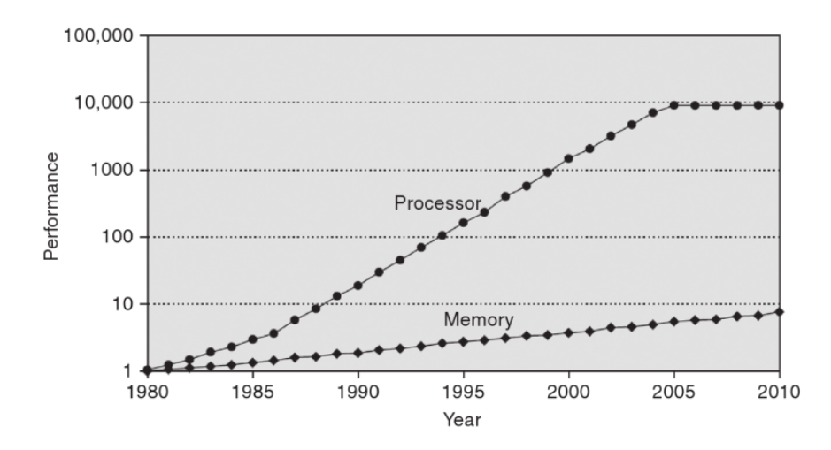
Processor and Memory Gap
HP, Computer Architecture A Quantitate Approach, 2011

Slide 54
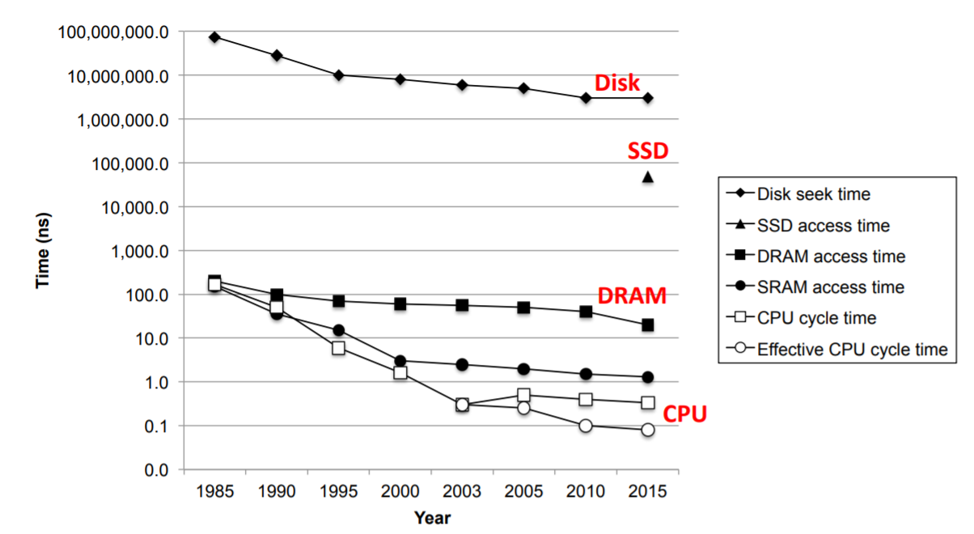
Processor and Memory Gap
Bryant and O’Hallaron, Computer Systems: A Programmer’s Perspective; Third Edition

Slide 55
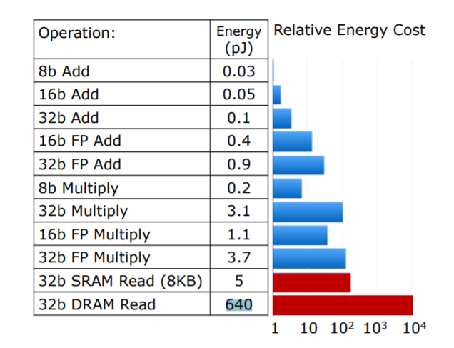
Processor and Memory Power Consumption
The energy consumption for various arithmetic operations and memory accesses in a 45 nm
process.
Sze, Vivienne, et al. "Efficient Processing of Deep Neural Networks." Synthesis Lectures on Computer Architecture 15.2 (2020): 1-341.

Slide 56
Slow memory, faster processor: What can we do?

Slide 57
Locality
Principle of Locality: Programs tend to use data and instructions with addresses near or equal to those they have used recently
Temporal locality:
Recently referenced items are likely to be referenced again in the near future
Spatial locality:
Items with nearby addresses tend to be referenced close together in time
Bryant and O’Hallaron, Computer Systems: A Programmer’s Perspective; Third Edition

Slide 58
Locality Example
sum = 0;
for (i = 0; i < n; i++)
sum += a[i];
return sum;

Slide 59
C Memory
C is row major order ==> Meaning that if you have 2D array ==> Row 0, Row 1, Row 2,…. Row N.

Slide 60
Locality Example
Does these functions have good locality with respect to array a[]?
int sum_array_rows(int a[M][N])
{
int i, j, sum = 0;
for (i = 0; i < M; i++)
for (j = 0; j < N; j++)
sum += a[i][j];
return sum;
}
int sum_array_cols(int a[M][N])
{
int i, j, sum = 0;
for (j = 0; j < N; j++)
for (i = 0; i < M; i++)
sum += a[i][j];
return sum;
}

Slide 61
Memory Hierarchies
Some fundamental and enduring properties of hardware and software:
Fast storage technologies cost more per byte, have less capacity, and require more power (heat!).
The gap between CPU and main memory speed is widening.
Well-written programs tend to exhibit good locality.
They suggest an approach (trade-off) for organizing memory and storage systems known as a memory hierarchy.
Trade-off

Slide 62
Memory Hierarchies
L0:
Regs
CPU registers hold words retrieved from the L1 cache.
Smaller,
faster,
and
costlier
(per byte)
storage
devices
L1:
L1 cache
(SRAM)
L1 cache holds cache lines retrieved from the L2 cache.
L2:
L2 cache
(SRAM)
L2 cache holds cache lines
retrieved from L3 cache
L3:
L3 cache
(SRAM)
L3 cache holds cache lines
retrieved from main memory.
Larger,
slower,
and
cheaper
(per byte)
storage
devices
L4:
Main memory
(DRAM)
Main memory holds disk blocks retrieved from local disks.
Bryant and O’Hallaron, Computer Systems: A Programmer’s Perspective; Third Edition
L5:
Local secondary storage
(local disks)
Local disks hold files retrieved from disks
on remote servers
L6:
Remote secondary storage
(e.g., Web servers)

Slide 63
A Modern Memory Hierarchy
Register File, 32 words, sub-nsec
L1 Cache, ~32 KB, ~nsecs
L2 cache, 512KB – 1 MB, ~nsecs
L3 Cache, ~ 10 nsecs
Main memory (DRAM), GB, ~100 ns
Disk, 100 GB, ~10 msec

Slide 64
Cache
(next time)

