Slide 1

WES237B: Software for Embedded Systems
Pat Pannuto
Department of Computer Science and Engineering
University of California, San Diego
Summer Session 2022

Slide 2
Today
Morning
SIMD recap
Parallel Programming with CUDA
Diving deep in CUDA, CUDA memory model & performance impact
Afternoon+
Lab session
GPU-accelerated image manipulation with CUDA
Assignment
GPU-acceleration of familiar algorithms (Sobel, BMM)

Slide 3
Logistics
Assignment 3 due tomorrow
Assignment 4 released
Generally: First bit of assignment is lab portion, the rest is take-home
Finish the lab first if needed
Late policy?
1 week: 10% off
2 weeks: Last chance, 30% off
Email with any exceptional circumstances, we’ll work it out

Slide 4
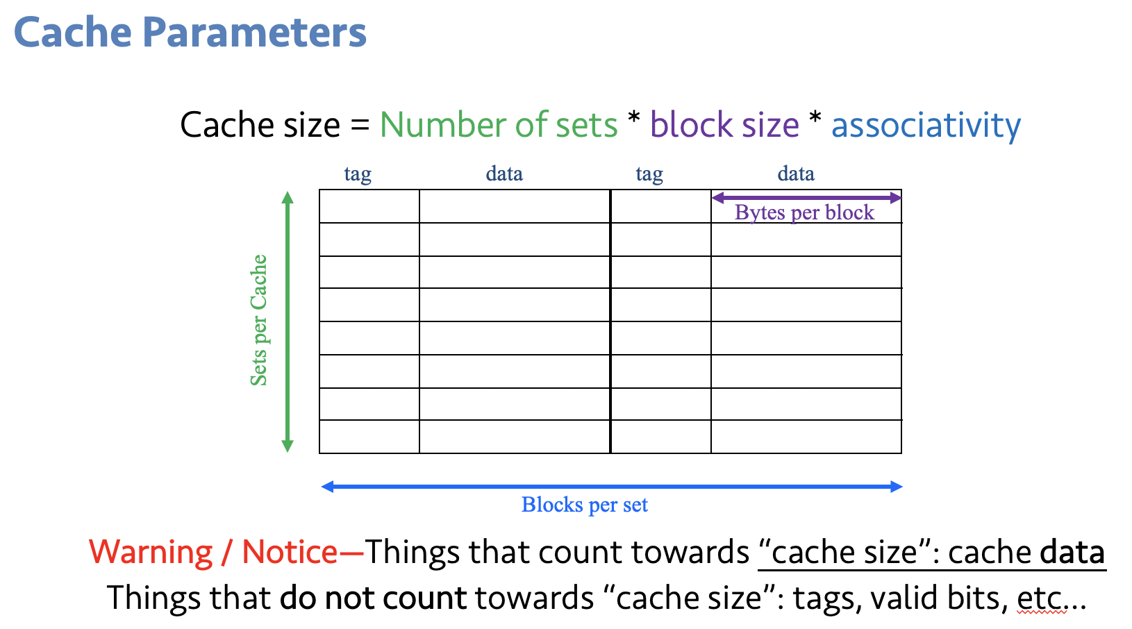
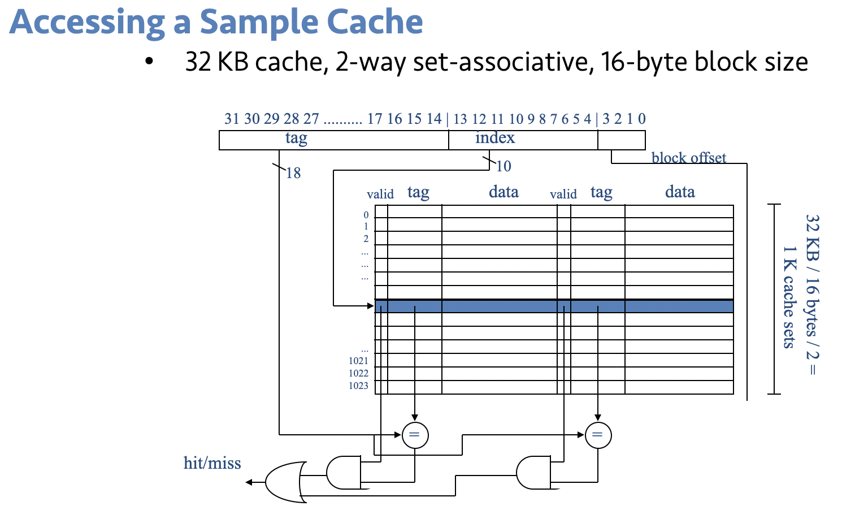
Recap
Caches!
Illusion of giant, fast memory
Hierarchical
Structure affects performance
Compiler Optimizations
The compiler can do the easier stuff, but more advanced optimizations are probably on you
Doesn’t understand algorithms
Big O

Slide 5
Limitations of Optimizing Compilers
Operate under fundamental constraint
Must not cause any change in program behavior
Except, possibly when program making use of nonstandard language features
Behavior that may be obvious to the programmer can be obfuscated by languages and coding styles
e.g., Data ranges may be more limited than variable types suggest
Most analysis is performed only within procedures
Whole-program analysis is too expensive in most cases
Newer versions of GCC do interprocedural analysis within individual files
But, not between code in different files
Most analysis is based only on static information
Compiler has difficulty anticipating run-time inputs
When in doubt, the compiler must be conservative​
Bryant and O'Hallaron, Computer Systems: A programmer's Perspective

Slide 6
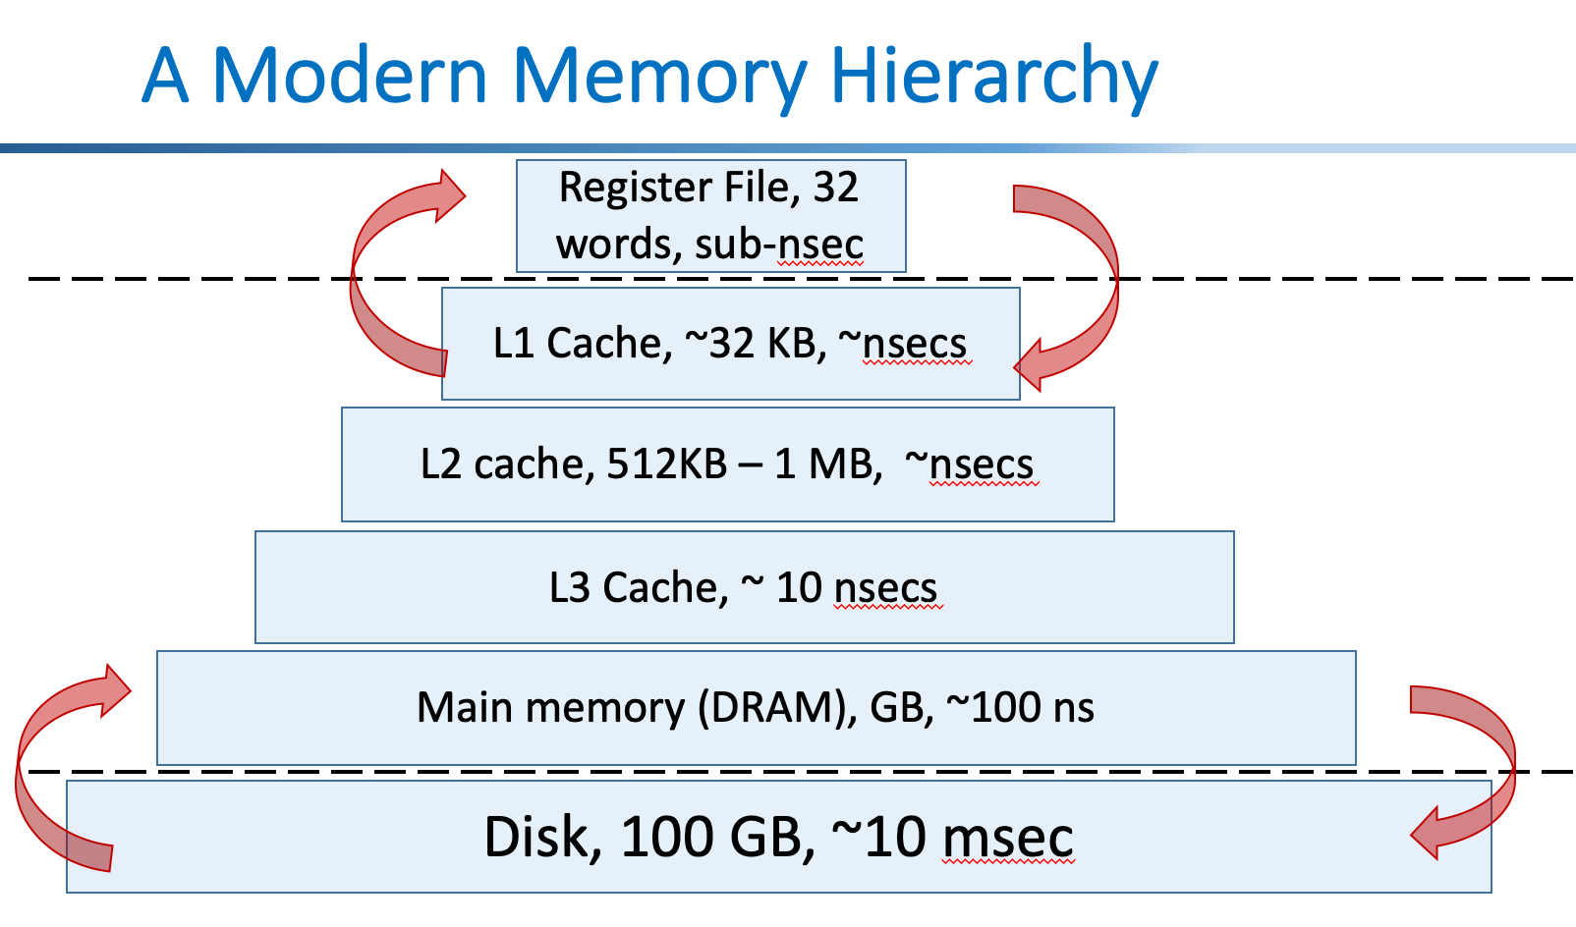
The guts of most interesting stuff is often ~this
void Foo(float* const A, float* const B, float* const C, const int M, const int N, const int K)
{
for (int m = 0; m < M; m++) {
for (int n = 0; n < N; n++) {
for (int k = 0; k < K; k++) {
C[m * M + n] += A[m * M + k] * B[k * K + n];
}
}
}
}
Lab2: image.tif
480x640 pixels * 4 bytes/float ~= 1.3 MB (greyscale!)
And these are huge
Notes:
Not literally these loops, but multi-dimensional math, which boils down to loops of basic op’s marching through arrays

Slide 7
SIMD

Slide 8
Flynn Taxonomy
 |  | Data Stream
 |  | Single | Multi
Instruction Stream | Single | SISD (Single-Core Processors) | SIMD (GPUs, Intel SSE/AVX extensions, …)
 | Multi | MISD (Dataflow architectures, Systolic Arrays [debatably], …) | MIMD (VLIW, Parallel Computers)

Slide 9
SIMD Basics
SIMD: Single instruction multiple data
A SIMD register (or a vector register) can hold many values (2 - 16 values or more) of a single type
Each value in a SIMD register is called a SIMD lane
SIMD instructions can operate on several (typically all) values on a SIMD register

Slide 10
SIMD
SIMD Opertions: Single Precison
Some example AVX-512F (a subset of AVX-512) instructions
Syntax
zmm0 ...zmm31 are 512 bit registers; each can hold 16 single-precision (float of C; 32 bits) or 8 double-precision (double of C; 64 bits) ﬂoating point numbers
vaddsd %ymm0, %ymm1, %ymm1
%ymm0
+
+
+
+
+
+
+
+
%ymm1
SIMD Opertions: Double Precison
vaddpd %ymm0, %ymm1, %ymm1
vaddpd %ymm0, %ymm1, %ymm1
%ymm0
%ymm0
+
+
+
+
+
+
+
+
%ymm1
%ymm1

Slide 11
SIMD
SIMD is good at parallelizing computations doing almost exactly the same series of instructions on contiguous data
⇒ generally, main targets are simple loops whose index values can be easily identified
Original loops:
for(i=0; i<N; i++){
S(i)
}
Original loops:
for(i=0; i<N; i+=L){
S(I;i+L)
}

Slide 12
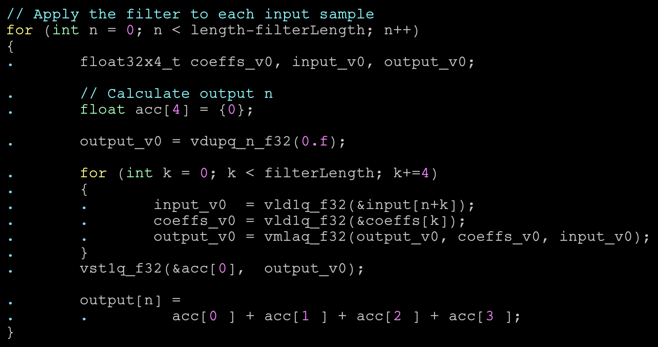
Programming SIMD
Auto vectorization
loop vectorization
Language extensions/directives for SIMD
SIMD directives for loops/functions (OpenMP 4.0)
Domain Specific Languages (Halide)
Vector types
GCC vector extensions
Intrinsics
Assembly programming
Which vector registers is this using??

Slide 13
Auto Vectorization
Write a loop-based code and hope compiler does (figure out) the vectorization
Int len_vec=128;
void vec_add(float *vec_A, float *vec_B, float *vec_C, int len_vec) {
int i;
for (i=0; i<len_vec; i++) {
vec_C[i] = vec_A[i] + vec_B[i];
}
}
Automatically performs 4 adds on
Neon extension (Neon simd register is 128 bit)
armclang --target=aarch64-arm-none-eabi -g -c -O1 vec_add.c
gcc -o simd_auto -march=native -O3 vec_add.c
https://www.doulos.com/knowhow/arm/using_your_c_compiler_to_exploit_neon/Resources/using_your_c_compiler_to_exploit_neon.pdf

Slide 14
OpenMP SIMD
OpenMP simd pragma
allows an explicit vectorization of for loops
int len_vec=128;
void vec_add(float *vec_A, float *vec_B, float *vec_C, int len_vec) {
int i;
#pragma omp simd
for (i=0; i<len_vec; i++) {
vec_C[i] = vec_A[i] + vec_B[i];
}
}

Slide 15
GCC Vector Types
Gcc allows to define a vector types
typedef float floatv attribute ((vector size(64),aligned(sizeof(float))));
You can define operations on vector types
floatv x, y, z;
z += x * y;
You can mix scalars with vector types
float a, b;
floatv x, y;
y = a * x + b;

Slide 16
GCC Vector Types
for (long i = 0; i < n; i++) {
y[i] = a * x[i];
}
typedef float floatv attribute ((vector size(64),aligned(sizeof(float))));
#define V(lv) *((floatv*)&(lv))
for (long i = 0; i < n; i += L) {
V(y[i]) = a * V(x[i]);
}
Notes:
Compiler-native types: most portable, can be least performant

Slide 17
Intrinsics
Processor/platform-specific functions and types
For example, ARM Neon instrinsics
#include <arm_neon.h>
int16x4_t vadd_s16(int16x4_t a, int16x4_t b) {
int16x4_t c;
for (int i = 0; i < 4; i++) {
c[i] = a[i] + b[i];
}
return c;
}
https://developer.arm.com/documentation/dht0002/a/Introducing-NEON/Developing-for-NEON/Intrinsics
Notes:
Platform-native types/intrinsics: less portable, more performant – can still be beat by hand-optimized assembly in certain cases

Slide 18
Why (auto) vectorization fails?
Potential aliasing makes auto vectorization difficult/impossible
Complex control flows make vectorization impossible or less profitable
Non-contiguous data accesses make vectorization impossible or less profitable
Giving hints to the compiler sometimes (not always) addresses the problem

Slide 19
How do I know if my code is vectorized?
Most compilers provide tools to get a report
Compiler | Report options
gcc | -fopt-info-vec-{optimized,missed}
clang | -Rpass=vectorize
Add a trick to assembly (gss –S)
enclose loops with inline assembler comments
asm volatile ("# xxxxxx loop begins");
for (i = 0; i < n; i++) {
... /∗ loop to be vectorized ∗/
}
asm volatile ("# xxxxxx loop ends");

Slide 20
How do I know if my code is vectorized?
clang -O3 -Rpass=loop-vectorize -S add_vec.c -o /dev/null
add_vec.c:4:5: remark:
vectorized loop (vectorization factor: 4, unrolling interleave factor: 2)
void difficult_function_to_vecorize(int *A, int *B, int Length) {
for (int i = 0; i < Length; i++)
A[B[i]]++;
}
clang -O3 -Rpass=loop-vectorize -S difficult_to_vectorize.c -o /dev/null
difficult_to_vectorize.c:3:5: remark:
loop not vectorized: cannot identify array bounds
for (int i = 0; i < Length; i++)
^

Slide 21
List of Optimizations & Parallel Programming

Slide 22
Optimizations & Parallel Programming
Compiler Level Optimizations
Loop Optimizations
Loop fission
Loop fusion
Loop interchange
Loop invariant code motion
Loop unrolling
…
Data Flow Optimizations
Common subexpression elimination
Constant folding and propagation
Dead store elimination
…
Code Generation Optimization
Register Allocation
Instruction Scheduling
Instruction Selection
Reordering computations
,…
Locality
Blocking
Inline assembly
Fixed point arithmetic
SIMD NEON
Multi threading
GPU/CUDA programming

Slide 23
Parallel Programming
And introduction to CUDA

Slide 24
Flynn Taxonomy + CUDA?
1.1.1. CUDA Programming Model
The CUDA Toolkit targets a class of applications whose control part runs as a process on a general purpose computing device, and which use one or more NVIDIA GPUs as coprocessors for accelerating single program, multiple data (SPMD) parallel jobs.
 |  | Data Stream
 |  | Single | Multi
Instruction Stream | Single | SISD (Single-Core Processors) | SIMD (GPUs, Intel SSE/AVX extensions, …)
 | Multi | MISD (Dataflow architectures, Systolic Arrays [debatably], …) | MIMD (VLIW, Parallel Computers)

Slide 25
General Purpose GPUS (GPGPUs)
GPU
Highly parallel
Multithreaded
Manycore processor
GeForce 8800 GPU that supports a new programming language
CUDA (Compute Unified Device Architecture)
Run your computational expensive modules (“kernels”) on the GPU processor
Host + Device
Host → CPU that issues kernels
Device → Runs the kernels
They are multithreaded SIMD architectures (SIMT: Single instruction, multiple thread )

Slide 26
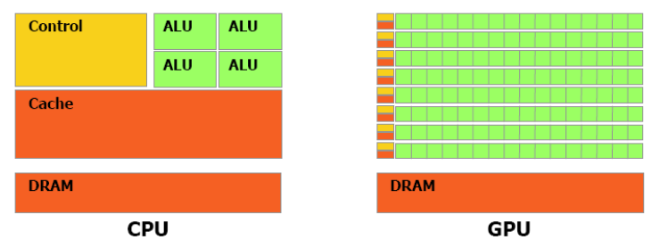
CPU (Latency) vs. GPU (Throughput)
Powerful ALU
Reduced operation latency
Large caches
Convert long latency memory accesses to short latency cache accesses
Sophisticated control
Branch prediction for reduced branch latency
Data forwarding for reduced data latency
Small caches
To boost memory throughput
Simple control
No branch prediction
No data forwarding
Energy efficient ALUs
Many, long latency but heavily pipelined for high throughput
Require massive number of threads to tolerate latencies
Threading logic
Thread state

Slide 27
GPU vs. CPU
GPU is well suited for data-parallel computations
More transistors to data processing
Lower requirement for control flow (executed many data parallel elements)
CPU is well suited for control-centric

Slide 28
CUDA Programming Model
Since 2006, CUDA has been used to program GPUs.
CUDA (Compute Unified Device Architecture)
Scalable
Lower learning curve
Scalable parallel programming model extends C and C++
Since its inception 2006, many applications are designed: Matrix solvers, sorting, face detection, seismic data processing, computational chemistry, deep learning…
Map the application into a serial and a parallel part
Host + GPU kernels
Host →CPU that launches kernels
Kernels run the parallel part (on GPUs)

Slide 29
CUDA
CUDA C extends C
Thread groups
Shared memories
Barrier synchronization
CUDA provides
Fine-grained data parallelism and thread parallelism
Coarse-grained data parallelism and task parallelism

Slide 30
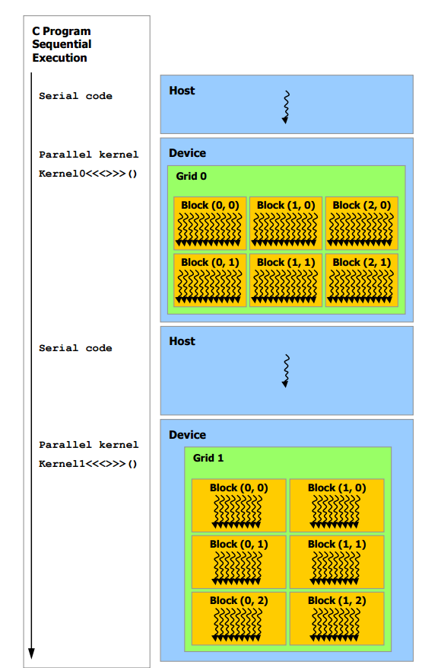
CUDA Programming Model
Application
Serial Code
Parallel Code
Serial Code
Parallel Code

Slide 31
CUDA Programming Model
Kernel: A C program or C function for one thread
Defined using __global__ keyword
<<<…>>> execution configuration syntax
Thread blocks: A set of concurrent threads that execute the same thread program and may cooperate to compute a result
Grid: A set of thread blocks that execute the same kernel
Programmer must specify
the number of threads per block
The number of blocks for a grid
Each thread has a private local memory
Each thread block has a shared memory
All threads have access to global memory

Slide 32
CUDA Programming Model
CUDA provides three key abstractions:
A hierarchy of thread groups
Shared memories
Barrier synchronization

Slide 33
Data Parallelism - Vector Addition Example
vector A
A[0]
A[1]
A[2]
…
A[N-1]
vector B
B[0]
B[1]
B[2]
…
B[N-1]
+
+
+
+
vector C
C[0]
C[1]
C[2]
…
C[N-1]

Slide 34
Vector Addition – Traditional C Code
// Compute vector sum C = A + B
void vecAdd(float *h_A, float *h_B, float *h_C, int n)
{
int i;
for (i = 0; i<n; i++) h_C[i] = h_A[i] + h_B[i];
}
int main()
{
// Memory allocation for h_A, h_B, and h_C
// I/O to read h_A and h_B, N elements
…
vecAdd(h_A, h_B, h_C, N);
}

Slide 35
GPU
#include <cuda.h>
void vecAdd(float *h_A, float *h_B, float *h_C, int n)‏ {
int size = n* sizeof(float);
float *d_A, *d_B, *d_C;
// Part 1
// Allocate device memory for A, B, and C
// Copy A and B to device memory
// Part 2
// Kernel launch code – the device performs the actual vector addition
// Part 3
// Copy C from the device memory
// Free device vectors
}
Part 1
Part 2
Host Memory
Device Memory
CPU
GPU
Part 3

Slide 36
Partial Overview of CUDA Memories
(Device) Grid
Device code can:
R/W per-thread registers
R/W all-shared global memory
Host code can
Transfer data to/from per grid global memory
Block (0, 0)
Block (0, 1)
Thread (0, 0)
Thread (0, 1)
Thread (0, 0)
Thread (0, 1)
Registers
Registers
Registers
Registers
Host
Global
Memory

Slide 37
Partial Overview of CUDA Memories
(Device) Grid
cudaMalloc()
Allocates an object in the device global memory
Two parameters
Address of a pointer to the allocated object
Size of allocated object in terms of bytes
cudaFree()
Frees object from device global memory
One parameter
Pointer to freed object
Block (0, 0)
Block (0, 1)
Thread (0, 0)
Thread (0, 1)
Thread (0, 0)
Thread (0, 1)
Registers
Registers
Registers
Registers
Host
Global
Memory

Slide 38
Partial Overview of CUDA Memories
(Device) Grid
cudaMemcpy()
memory data transfer
Requires four parameters
Pointer to destination
Pointer to source
Number of bytes copied
Type/Direction of transfer
Transfer to device is asynchronous
Block (0, 0)
Block (0, 1)
Thread (0, 0)
Thread (0, 1)
Thread (0, 0)
Thread (0, 1)
Registers
Registers
Registers
Registers
Host
Global
Memory

Slide 39
Partial Overview of CUDA Memories
void vecAdd(float *h_A, float *h_B, float *h_C, int n) {
int size = n * sizeof(float); float *d_A, *d_B, *d_C;
// Host -> Device
cudaMalloc((void **) &d_A, size);
cudaMemcpy(d_A, h_A, size, cudaMemcpyHostToDevice);
cudaMalloc((void **) &d_B, size);
cudaMemcpy(d_B, h_B, size, cudaMemcpyHostToDevice);
cudaMalloc((void **) &d_C, size);
// Kernel invocation code – to be shown later
// Device -> Host
cudaMemcpy(h_C, d_C, size, cudaMemcpyDeviceToHost);
cudaFree(d_A); cudaFree(d_B); cudaFree (d_C);
}
(Device) Grid
Block (0, 0)
Block (0, 1)
Thread (0, 0)
Thread (0, 1)
Thread (0, 0)
Thread (0, 1)
Registers
Registers
Registers
Registers
Host
Global
Memory

Slide 40
Short memory rules
Memory Management
Host and device memory are separate entities
Device pointers point to GPU memory
May be passed to/from host code
May not be dereferenced in host code
Host pointers point to CPU memory
May be passed to/from device code
May not be dereferenced in device code
Simple CUDA API for handling device memory
cudaMalloc(), cudaFree(), cudaMemcpy()
Similar to the C equivalents malloc(), free(), memcpy()
Slide adapted from: https://www.nvidia.com/docs/IO/116711/sc11-cuda-c-basics.pdf

Slide 41
CUDA Arrays of Parallel Threads
A CUDA kernel is executed by a grid (array) of threads
All threads in a grid run the same kernel code (Single Program Multiple Data)‏
Each thread has indexes that it uses to compute memory addresses and make control decisions
0
1
2
254
255
…
i = blockIdx.x * blockDim.x + threadIdx.x;
C[i] = A[i] + B[i];
D[i] = A[i] * B[i];
…

Slide 42
CUDA Arrays of Parallel Threads
Thread Block 0
Thread Block 1
Thread Block N-1
0
1
2
254
255
0
1
2
254
255
0
1
2
254
255
…
…
…
i = blockIdx.x * blockDim.x + threadIdx.x;
C[i] = A[i] + B[i];
D[i] = A[i] * B[i];
i = blockIdx.x * blockDim.x + threadIdx.x;
C[i] = A[i] + B[i];
D[i] = A[i] * B[i];
i = blockIdx.x * blockDim.x + threadIdx.x;
C[i] = A[i] + B[i];
D[i] = A[i] * B[i];
…
…
…
Divide thread array into multiple blocks
Threads within a block cooperate via shared memory and barrier synchronization
Threads in different blocks do not interact

Slide 43
CUDA Programming Model
// Kernel definition
// __global__ is a CUDA keyword, indicates function that:
// - Runs on the device
// - Is called from host code
__global__ void VecAdd(float* A, float* B, float* C) {
int i = threadIdx.x;
C[i] = A[i] + B[i];
}
int main() {
... // memory allocation, etc
// Kernel invocation with `N` threads
// <<<…>>> is “kernel launch”; call from host to device
VecAdd<<<1, N>>>(A, B, C);
... // memory return, cleanup
}
Notes:
- Each of N threads that execute VecAdd performs one pair-wise addition

Slide 44
1000 size vector addition
Thread Block 0
Thread Block 1
Thread Block N-1
0
1
2
254
255
0
1
2
254
255
0
1
2
254
255
…
…
…
i = blockIdx.x * blockDim.x + threadIdx.x;
C[i] = A[i] + B[i];
D[i] = A[i] * B[i];
i = blockIdx.x * blockDim.x + threadIdx.x;
C[i] = A[i] + B[i];
D[i] = A[i] * B[i];
i = blockIdx.x * blockDim.x + threadIdx.x;
C[i] = A[i] + B[i];
D[i] = A[i] * B[i];
…
…
…
What is the X?

Slide 45
Example Vector Addition: Device Code
// Compute vector sum C = A + B
// Each thread performs one pair-wise addition
__global__ void vecAddKernel(float* A, float* B, float* C, int n) {
int i = threadIdx.x + blockDim.x * blockIdx.x;
if (i < n) {
C[i] = A[i] + B[i];
}
}

Slide 46
Host Code
void vecAdd(float* h_A, float* h_B, float* h_C, int n) {
// d_A, d_B, d_C allocations and copies omitted
vecAddKernel<<<4,256>>>(d_A, d_B, d_C, n);
}

Slide 47
Complete example
void vecAdd(float* h_A, float* h_B, float* h_C, int n) {
// d_A, d_B, d_C allocations and copies omitted
vecAddKernel<<<4,256>>>(d_A, d_B, d_C, n);
}
// Compute vector sum C = A + B
// Each thread performs one pair-wise addition
__global__ void vecAddKernel(float* A, float* B, float* C, int n) {
int i = threadIdx.x + blockDim.x * blockIdx.x;
if (i < n) {
C[i] = A[i] + B[i];
}
}

Slide 48
More on CUDA Function Declarations
Executed on the:
Only callable from the:
__device__ float DeviceFunc()‏
device
device
__global__ void KernelFunc()‏
device
host
__host__ float HostFunc()‏
host
host
__global__ defines a kernel function
A kernel function must return void
__host__ is optional if used alone
__host__ __device__ float someFunc() is an option
Generates two copies of the function! (One for each execution environment)

Slide 49
Compiling CUDA Programs
Integrated C programs with CUDA extensions
NVCC Compiler
Host Code
Device Code (PTX)
Host C Compiler/ Linker
Device Just-in-Time Compiler
Heterogeneous Computing Platform with
CPUs, GPUs, etc.

Slide 50
Compiling CUDA Programs
Integrated C programs with CUDA extensions
NVCC Compiler
Host Code
Device Code (PTX)
Host C Compiler/ Linker
Device Just-in-Time Compiler
Heterogeneous Computing Platform with
CPUs, GPUs, etc.
Side note: This is wild if you think about it for a moment, and gets worse as you abstract further, e.g. shaders:
https://www.cs.cornell.edu/~asampson/media/papers/opengl-snapl2017-preprint.pdf

Slide 51














CUDA Accelerated Libraries
Linear Algebra
FFT, BLAS,
SPARSE, Matrix
NVIDIA
cuFFT,
cuBLAS,
cuSPARSE
Numerical & Math
RAND, Statistics
NVIDIA
Math Lib
NVIDIA cuRAND
Data Struct. & AI
Sort, Scan, Zero Sum
GPU AI – Board Games
GPU AI – Path Finding
Visual Processing
Image & Video
NVIDIA
Video Encode
NVIDIA
NPP
https://developer.nvidia.com/gpu-accelerated-libraries

Slide 52
Memory in CUDA/GPU

Slide 53
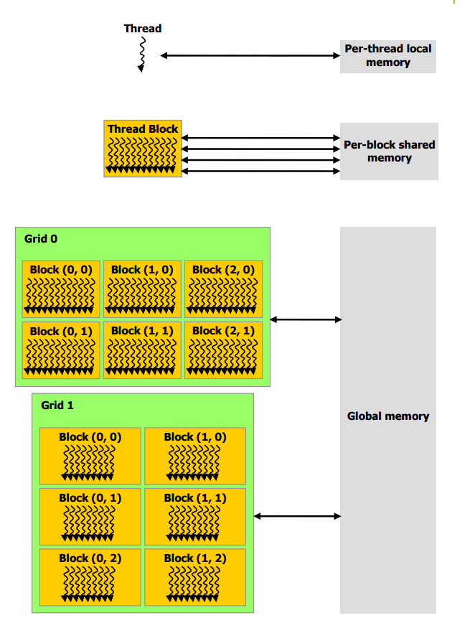
Memory Hierarchy
Each thread has its own set of registers
Group of 32 threads called a warp
All threads in a warp execute the same instruction (SIMD)
A block (aka Threadblock, CTA) is a set of warps
A grid is a set of blocks launched as part of one kernel
All threads in a block have fast on chip shared memory
Threads in different block communicate via shared slow global memory
Notes:
Thread = single thread.
Warp = set of threads (32) where all threads work in a lockstep (SIMD) fashion
Block = Threadblock = CTA = a set of warps
Grid = set of threadsblock launched in one kernel
Kernel = you can think of a kernel as a large parallel loop, where each thread executes one iteration
All the above are software abstractions. The real hardware contains multiple cores. These cores are split across multiple SMs (streaming multiprocessors). Threadblocks execute on the SMs.
https://www.quora.com/What-is-the-definition-of-Thread-Block-Grid-Wrap-CTA-and-SM-in-CUDA

Slide 54
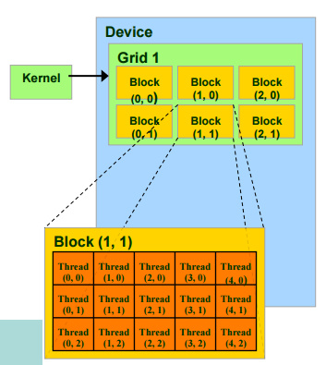
Thread and Block Hierarchy
dim3 DimGrid(3, 2); // 6 thread blocks
dim3 DimBlock(3,5,1) // 15 threads / block
Kernel <<<DimGrid, DimBlock>>> (…parallist…) ;

Slide 55
Thread and Block Hierarchy
dim3 DimGrid(3, 2); // 6 thread blocks
dim3 DimBlock(3,5,1) // 15 threads / block
Kernel <<<DimGrid, DimBlock>>> (…parallist…) ;
Blocks and Threads are 3 dimensional
dim3 blockIdx; //Block index within a grid
dim3 threadIdx; // Thread index within a block
On modern GPUs thread block may contain up to 1024 threads
Total number of threads = Number of threads per block * Number of blocks

Slide 56
Thread and Block Hierarchy
gridDim, blockDim reflects the dimensions of the grid and block.
gridDim.x, grdimDim.y and gridDim.z are 1 to 65,536
Total number of threads in block is up to 1024
The grid can be higher dimension than its blocks and vice versa
host
device
Grid 1
Block (0, 0)
Block (0, 1)
Kernel 1
Block (1, 0)
Block (1, 1)
Block (1,0)
Grid 2
(1,0,0)
(1,0,1)
(1,0,2)
(1,0,3)
Thread
(0,0,0)
Thread
(0,0,1)
Thread
(0,0,2)
Thread
(0,0,3)
Thread
(0,0,0)
Thread
(0,1,0)
Thread
(0,1,1)
Thread
(0,1,2)
Thread
(0,1,3)

Slide 57
Memory and Data Locality

Slide 58
Objective
To learn to effectively use the CUDA memory types in a parallel program
Importance of memory access efficiency
Registers, shared memory, global memory
Scope and lifetime

Slide 59
How abut Performance on a GPU
All threads access global memory for their input matrix elements
One memory accesses (4 bytes) per floating-point addition
4B/s of memory bandwidth/FLOPS
Assume a GPU with
Peak floating-point rate 1,600 GFLOPS with 600 GB/s DRAM bandwidth
4*1,600 = 6,400 GB/s required to achieve peak FLOPS rating
The 600 GB/s memory bandwidth limits the execution at 150 GFLOPS
This limits the execution rate to 9.3% (150/1600) of the peak floating-point execution rate of the device!
Need to drastically cut down memory accesses to get close to the 1,600 GFLOPS
Grid
Block (0, 0)
Block (1, 0)
Shared Memory
Shared Memory
Registers
Registers
Registers
Registers
Thread (0, 0)
Thread (1, 0)
Thread (0, 0)
Thread (1, 0)
Host
Global Memory
Constant Memory

Slide 60
Example: Matmul
N
WIDTH
M
P
BLOCK_WIDTH
Row
WIDTH
BLOCK_WIDTH
WIDTH
WIDTH
Col

Slide 61
Example: Matmul
N_{0,0}
N_{0,1}
Block(0,0)
Block(0,1)
Thread(0,1)
N_{1,0}
N_{1,1}
Thread(0,0)
P_{0,0}
P_{0,1}
P_{0,2}
P_{0,3}
N_{2,0}
N_{2,1}
BLOCK_WIDTH = 2
Thread(1,0)
P_{1,0}
P_{1,1}
P_{1,2}
P_{1,3}
N_{3,0}
N_{3,1}
Thread(1,1)
P_{2,0}
P_{2,1}
P_{2,2}
P_{2,3}
P_{3,0}
P_{3,1}
P_{3,2}
P_{3,3}
M_{0,0}
M_{0,1}
M_{0,2}
M_{0,3}
P_{0,0}
P_{0,1}
P_{0,1}
M_{1,0}
M_{1,1}
M_{1,2}
M_{1,3}
P_{1,0}
P_{1,1}
Block(1,0)
Block(1,1)

Slide 62
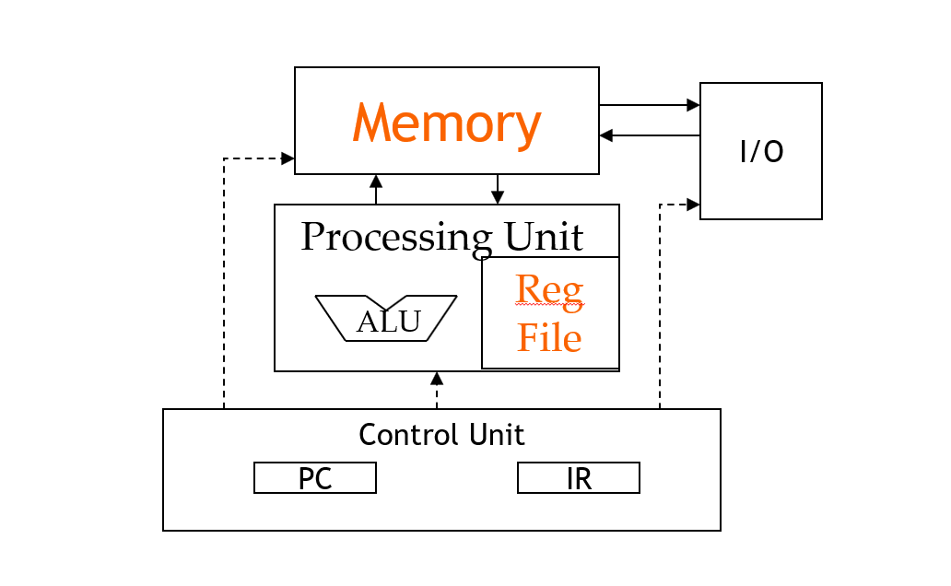
Memory and Registers in the Von-Neumann Model

Slide 63
Declaring CUDA variables
Variable declaration | Memory | Scope | Lifetime
int LocalVar; | register | thread | thread
__device__ __shared__ int SharedVar; | shared | block | block
__device__ int GlobalVar; | global | grid | application
__device__ __constant__ int ConstantVar; | constant | grid | application
__device__ is optional when used with __shared__, or __constant__
Automatic variables reside in a register
Except per-thread arrays that reside in global memory
void blurKernel(unsigned char * in, unsigned char * out, int w, int h)
{
__shared__ float ds_in[TILE_WIDTH][TILE_WIDTH];
…
}

Slide 64
Where to declare variables?
Can host access it?
Outside of any Function
In the kernel
global
constant
register
shared

Slide 65
Shared Memory in CUDA
A special type of memory whose contents are explicitly defined and used in the kernel source code
One in each Streaming Multiprocessor (SM)
Accessed at much higher speed (in both latency and throughput) than global memory
Scope of access and sharing - thread blocks
Lifetime – thread block, contents will disappear after the corresponding thread finishes terminates execution
Accessed by memory load/store instructions
A form of scratchpad memory in computer architecture
https://developer.nvidia.com/blog/using-shared-memory-cuda-cc/ has pointers to examples and details
We’re not going to delve too deep into this particular optimization
We start with focus on the device/host memory motion (as opposed to intra-device memory motion)

Slide 66
Memory Locality: Tiling/Blocking

Slide 67
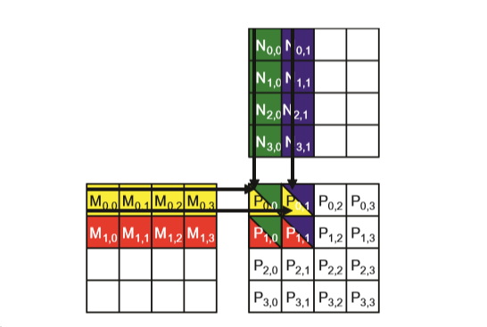
Matrix Mul
Block(0,0)
Block(0,1)
Thread(0,1)
Thread(0,0)
P_{0,0}
P_{0,1}
P_{0,2}
P_{0,3}
BLOCK_WIDTH = 2
Thread(1,0)
P_{1,0}
P_{1,1}
P_{1,2}
P_{1,3}
Thread(1,1)
P_{2,0}
P_{2,1}
P_{2,2}
P_{2,3}
P_{3,0}
P_{3,1}
P_{3,2}
P_{3,3}
Block(1,0)
Block(1,1)

Slide 68
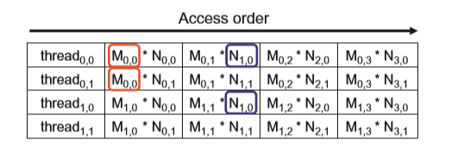
Matrix Mul
Each thread accesses four elements of M and four elements of N during execution.
Among the four threads highlighted, a significant overlap occurs in the M and N elements they access. For instance, both thread_{0,0} and thread_{0,1} access M_{0,0} and the rest of row 0 of M. Similarly, both thread_{0,1} and thread_{1,1} access N_{0,1} and the rest of column 1 of N.

Slide 69
Global Memory Access
Global Memory Access Pattern of Matrix Multiplication
Global Memory
…
Thread 1
Thread 2

Slide 70
Tiling/Blocking
Tiling/blocking to reduce global memory access
Global Memory
On-chip Memory
…
Thread 1
Thread 2
Divide the global memory content into tiles
Focus the computation of threads on one or a small number of tiles at each point in time

Slide 71
Tiling/Blocking
Tiling/blocking to reduce global memory access
Global Memory
On-chip Memory
…
Thread 1
Thread 2
Divide the global memory content into tiles
Focus the computation of threads on one or a small number of tiles at each point in time

Slide 72
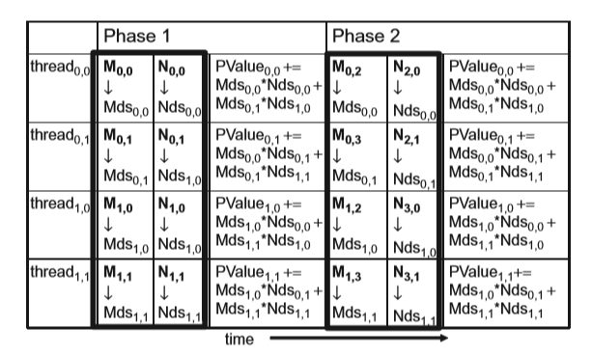
Tiling/Blocking

Slide 73
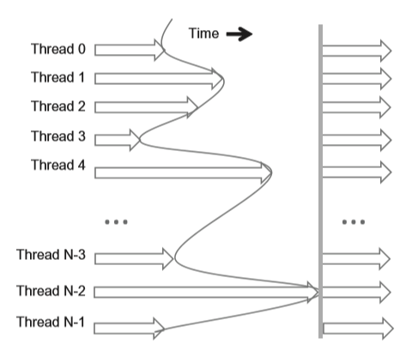
Barrier Synchronization For Tiling
void __syncthreads();
Synchronizes all threads within a block
All threads must reach the barrier
In conditional code, the condition must be uniform across the block

Slide 74
Summary of Tiling
Identify a tile of global memory contents that are accessed by multiple threads
Load the tile from global memory into on-chip memory
Use barrier synchronization to make sure that all threads are ready to start the phase
Have the multiple threads to access their data from the on-chip memory
Use barrier synchronization to make sure that all threads have completed the current phase
Move on to the next tile

Slide 75
SM and Warps in Detail

Slide 76
Objective
To learn how a CUDA kernel utilizes hardware execution resources
Assigning thread blocks to execution resources
Capacity constraints of execution resources
Zero-overhead thread scheduling
Reference: GPU Teaching Kit from Nvidia

Slide 77
Transparent Scalability
Device
Device
Thread grid
Block 0
Block 1
Block 2
Block 3
Block 0
Block 1
Block 2
Block 3
Block 0
Block 1
time
Block 4
Block 5
Block 2
Block 3
Block 6
Block 7
Block 4
Block 5
Block 6
Block 7
Block 4
Block 5
Block 6
Block 7
Each block can execute in any order relative to others.
Hardware is free to assign blocks to any processor at any time
A kernel scales to any number of parallel processors
Reference: GPU Teaching Kit from Nvidia

Slide 78
Example Executing Thread Blocks
Threads are assigned to Streaming Multiprocessors (SM) in block granularity
In Volta GPU, up to 32 blocks to each SM as resource allows
Volta SM can take up to 2048 threads
Could be 256 (threads/block) * 8 blocks
Or 512 (threads/block) * 4 blocks, etc.
SM maintains thread/block idx (s)
SM manages/schedules thread execution
SM
t0 t1 t2 … tm
SP
Blocks
Shared
Memory
Reference: GPU Teaching Kit from Nvidia

Slide 79
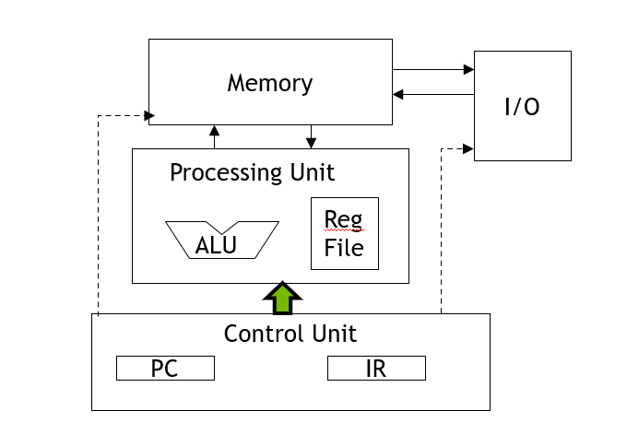
The Von-Neumann Model
Reference: GPU Teaching Kit from Nvidia

Slide 80
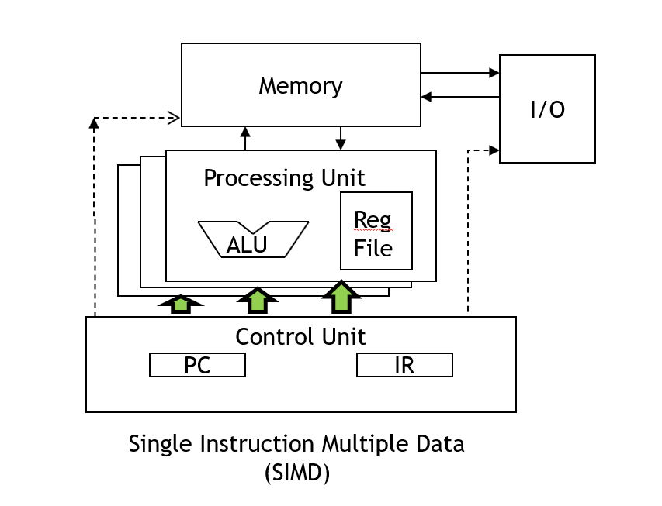
The Von-Neumann Model with SIMD units
Reference: GPU Teaching Kit from Nvidia

Slide 81
Warps as Scheduling Units
Each Block is executed as 32-thread Warps
An implementation decision, not part of the CUDA programming model
Warps are scheduling units in SM
Threads in a warp execute in SIMD
Future GPUs may have different number of threads in each warp
Reference: GPU Teaching Kit from Nvidia

Slide 82
Warp Example
If 3 blocks are assigned to an SM and each block has 256 threads, how many Warps are there in an SM?
Each Block is divided into 256/32 = 8 Warps
There are 8 * 3 = 24 Warps
SM implements zero-overhead warp scheduling
Warps whose next instruction has its operands ready for consumption are eligible for execution
Eligible Warps are selected for execution based on a prioritized scheduling policy
All threads in a warp execute the same instruction when selected
…
Block 0 Warps
…
Block 1 Warps
…
…
…
Block 2 Warps
…
t0 t1 t2 … t31
t0 t1 t2 … t31
t0 t1 t2 … t31
Register File
L1
Shared Memory
Reference: GPU Teaching Kit from Nvidia

Slide 83
Block Granularity Considerations
For Matrix Multiplication using multiple blocks, should each block have 4X4, 8X8 or 30X30 threads for Volta?
For 4X4, we have 16 threads per Block. Each SM can take up to 2048 threads, which translates to 128 Blocks. However, each SM can only take up to 32 Blocks, so only 512 threads will go into each SM!
For 8X8, we have 64 threads per Block. Since each SM can take up to 2048 threads, it can take up to 32 Blocks and achieve full capacity unless other resource considerations overrule.
For 30X30, we would have 900 threads per Block. Only two blocks could fit into an SM for Volta, so only 1800/2048 of the SM thread capacity would be utilized.
Reference: GPU Teaching Kit from Nvidia

Slide 84
Next Time
Parallel Programming Patterns
Streaming Programming Patterns
Deep Learning (Lite)

