Slide 1
How Glassdoor is using SQL Server Always Encrypted to protect sensitive user data
Alex Bochkov
Database Architect
glassdoor.com

Slide 2

Alex
Bochkov
Database Architect
I've been working with databases for literally half my life.
I joined Glassdoor almost six years ago.
glassdoor.com
https://github.com/alex-bochkov
alex.bochkov@glassdoor.com

Slide 3
Content
Glassdoor environment and why did we choose Always Encrypted?
How does Always Encrypted work?
15 challenges we’ve faced.
Our solution for a key management.
Production rollout scenarios.
Key rotation process.
Change management considerations.

Slide 4
What is Glassdoor?
“to help people everywhere find a job and company they love”
Leading platform for Employer Branding
Hundreds of millions unique visitors every year
Decent amount of sensitive personal data: emails, names, resumes, demographics, etc.
User anonymity is crucial for our business model

Slide 5
Glassdoor Database Environment
Major databases are using SQL Server 2019 Enterprise Edition
On average ~50k requests/second to databases with personal data,
spikes up to 100k requests/second in rush hours
15 years of code development with a lot of legacy code
24/7, no downtime allowed
Most client apps are JAVA-based, some are in Node.js, internal automation mostly in PowerShell
Everything is in AWS

Slide 6
Why Do We Need to Protect Data?
User anonymity is important for user trust. We must protect user identity even from ourselves.
GDPR and CCPA compliance
Doesn't require encryption as such
Requires reasonable approach
Very significant data breach penalties

Slide 7
What Was in Place Before Always Encrypted?
TLS enforcement to encrypt traffic between the app and the database
TDE to encrypt database files on Windows level
Volume encryption on the storage level
Database backups are encrypted with a separate certificate
Dynamic Data Masking in some cases
We needed a way to additionally protect sensitive values and hide it from super users (DBAs, Domain Admins, etc.) and more importantly prevents accidental data exposure.
We looked at several different Java-based options:
using existing encryption libraries and approaches
something totally custom tailored for our environment
Dynamic Data Masking - the security team wasn’t happy about it
While we do have talent to create something totally custom, we were afraid that it might become a black box – cost of mistake will be significant, and we may end up losing data if there are bugs in the encryption process.

Slide 8
Why Did We Choose Always Encrypted?
We own SQL Server licenses, Always Encrypted comes with no additional costs
Very easy to roll-out
driver does all the work for you behind the scene
very little changes on the application side
Easy to maintain
Simple key generation process
Easy to rotate
Flexible - each column can be encrypted separately
You can use separate keys for separate columns when there are different kinds of apps are working with the same db
You can pick between DETERMINISTIC and RANDOMIZED encryption for each column
Harder to make a mistake in general:
SQL Server itself enforces correct encryption
Keys metadata (including the certificate thumbprint) is stored in the database
You can easily tell which certificate is used where

Slide 9
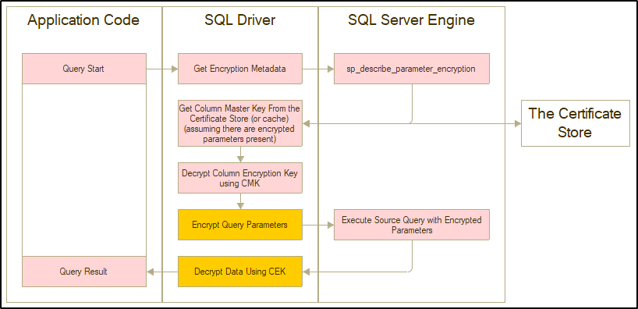
How Does Always Encrypted Work?

Slide 10
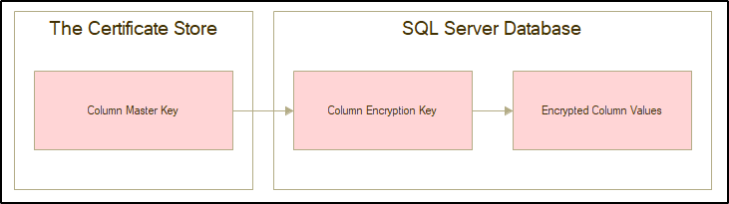
How Does Always Encrypted Work?
Two keys approach
Column Master Key
Stored outside of the database
Windows Certificate Store / Keystore File / Azure Key Vault
Used to encrypt the Column Encryption Key only, not involved into data encryption
Column Encryption Key
Stored within the database itself
Used to encrypt actual values in the column
Key itself is encrypted with the Column Master key

Slide 11
How Does Always Encrypted Work?
Happens transparently to the application
By default, enabled by adding “Column Encryption Setting=Enabled;” into the connection string
Encryption and decryption operations are performed by the driver itself
Values are encrypted before parameters are sent to SQL Server
Values are decrypted before the result-set is returned by the driver to the app
Supported by official drivers:
Drivers that support Always Encrypted
Microsoft JDBC Driver for SQL Server
Microsoft SqlClient Data Provider for SQL Server (.NET)
Microsoft ODBC Driver for SQL Server
Python pyodbc community driver
Drivers that do not support Always Encrypted
Python pymssql
jTDS (JAVA)
…

Slide 12
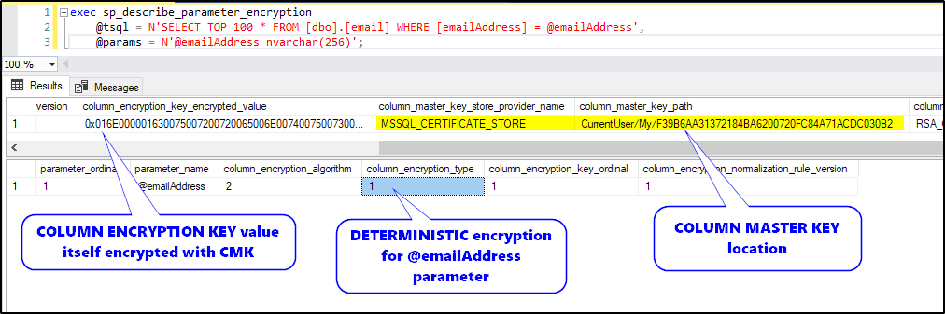
How Does Always Encrypted Work?
Extra call to detect the parameters encryption metadata - sp_describe_parameter_encryption
By default, when the column encryption is enabled, the driver requests the parameter encryption metadata before executing every single query
Analyzes the specified Transact-SQL statement and its parameters, to determine which parameters correspond to database columns that are protected by using the Always Encrypted feature. Returns encryption metadata for the parameters that correspond to encrypted columns.
The sproc result contains encrypted column names and the Column Encryption Key itself (or two, when there is a rotation in process)
This happens for every query regardless of whether encrypted columns are included

Slide 13
[1/15] Challenges - Accept the Change
You need to setup your org to accept the change - things and approaches that worked before won't be possible.
“No, you can’t query this column manually anymore…”
“No, you can’t search or analyze data in this column anymore…”
…

Slide 14
[2/15] Challenges - Column Master Key Management is Tricky
You can store Column Master Keys in
.NET is using Windows Certificate store
JAVA is using the key-store
(easy) multi-platform use only with Azure Key Vault
(harder) Implement custom key store provider - what we ended up doing
First two approaches are not quite flexible
How to distribute keys to each server safely?
How to make it work in a hybrid Windows / Linux / Mac environment?

Slide 15
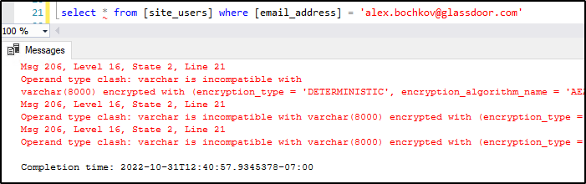
[3/15] Challenges - Query Parameterization Strictly Required
All queries must be parameterized, plain-text values embedded into the query text are not supported.
SSMS has a built-in feature to support auto-parameterization
SQL drivers with Always Encrypted support automatically encrypt query parameters

Slide 16
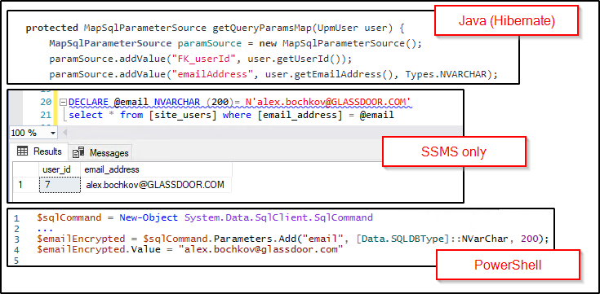
[3/15] Challenges - Query Parameterization Strictly Required
Examples:

Slide 17
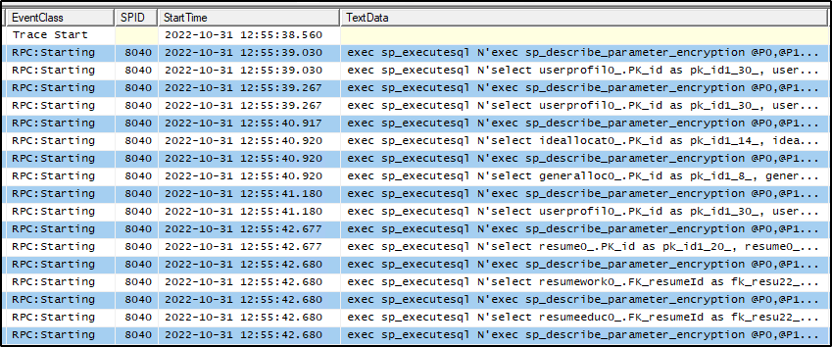
[4/15] Challenges - Performance Implications
Significant performance impact (at least in scenarios with no encryption metadata cache)
Round trip for each query by default
Increased network traffic and CPU utilization

Slide 18
[4/15] Challenges - Performance Implications
You can fine-tune it on the query level but that was not foreseeable in our environment
Column Encryption Setting -> Disabled
SqlCommandColumnEncryptionSetting.Enabled for individual queries that have any parameters that need to be encrypted
SqlCommandColumnEncryptionSetting.ResultSet for queries that do not have any parameters requiring encryption, but retrieve data from encrypted columns.
Doc: Setting Always Encrypted at the query level https://learn.microsoft.com/en-us/sql/relational-databases/security/encryption/develop-using-always-encrypted-with-net-framework-data-provider#setting-always-encrypted-at-the-query-level

Slide 19
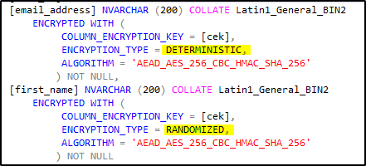
[5/15] Challenges - Choosing an Encryption Type
Encryption limits data manipulation options:
DETERMINISTIC
=, <>, (unique) indexs, aggregation
RANDOMIZED- can’t really do anything

Slide 20
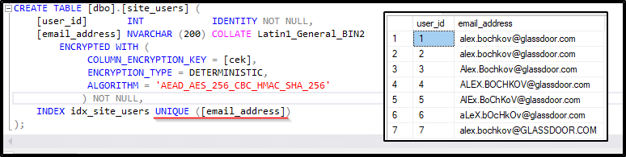
[6/15] Challenges - Encrypted Strings are Case-sensitive
Enforce uniform shape for all strings where you need uniqueness, for example, lower-case all emails on the app side before it is inserted into the database or used as a parameter in SELECT query.
Failure to do so will result in a corrupted data-set.

Slide 21
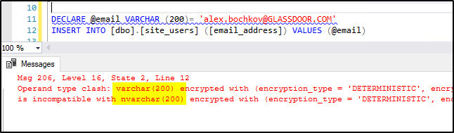
[7/15] Challenges - Strict Data Type Check
Types that are normally interchangeable are not compatible when you encrypt them:
NVARCHAR and VARCHAR
FLOAT, FLOAT2 and NUMERIC
DATETIME and DATETIME2
etc
Apps must pass parameters using exact data types as they defined in the database.

Slide 22
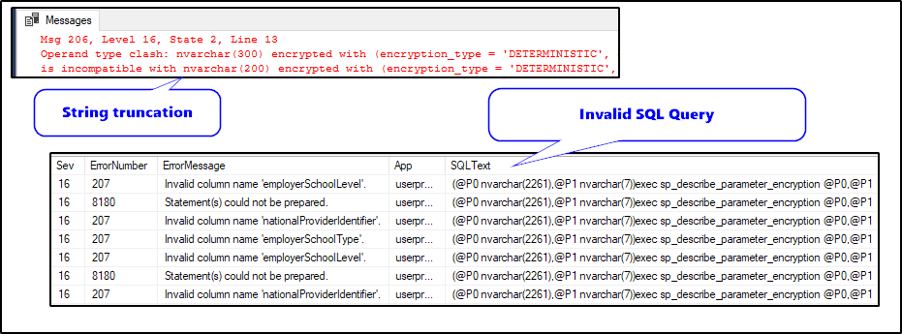
[8/15] Challenges - Harder to Diagnose Errors
Errors are hidden on SQL Server side, columns not shown, hard to debug.
Generic error messages in some cases
No source query
For example, syntax errors are hard to find because it fails on the parameter encryption metadata sproc where actual query text is passed as a parameter and not visible in logs. It is impossible to say what is wrong with the query without looking into the app error log.

Slide 23
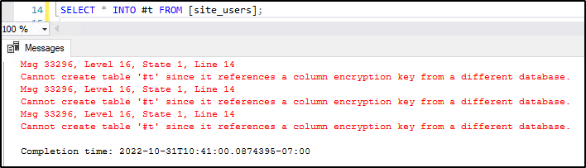
[9/15] Challenges - Encrypted Values Can’t Leave The Database
temp tables don't work
cross-database data move doesn't work - doesn't matter if the same key is present there
Need to move the data? The easiest option is to re-encrypt it

Slide 24
[10/15] Challenges - BCP Doesn’t Support Always Encrypted
BCP can’t decrypt data, also I wasn’t able to make it move encrypted values in binary form properly
How to change binary data directly?
This is helpful for cases when data needs to be moved between databases, but an encryption key is not provided.
Data is not decrypted/encrypted on the client-side, so no risks of exposure.
-- allow
ALTER USER [dataExport] WITH ALLOW_ENCRYPTED_VALUE_MODIFICATIONS = ON;
-- remove permission
ALTER USER [dataExport] WITH ALLOW_ENCRYPTED_VALUE_MODIFICATIONS = OFF;
Doc: Copying Encrypted Data using SqlBulkCopy https://learn.microsoft.com/en-us/sql/relational-databases/security/encryption/develop-using-always-encrypted-with-net-framework-data-provider#copying-encrypted-data-using-sqlbulkcopy

Slide 25
[11/15] Challenges - No Transactional Replication
“The following features don't work on encrypted columns:
Transactional, merge, or snapshot replication”
No CDC as well
Doc: Feature details https://learn.microsoft.com/en-us/sql/relational-databases/security/encryption/always-encrypted-database-engine#feature-details

Slide 26
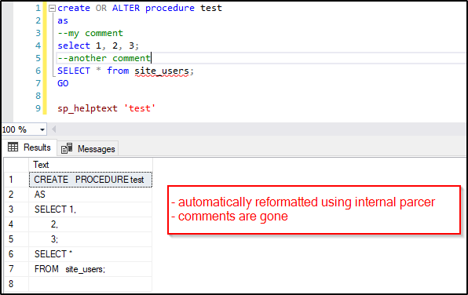
[12/15] Challenges - Code is Reformatted
Code is reformatted in SSMS when you push code changes while column encryption is enabled.

Slide 27
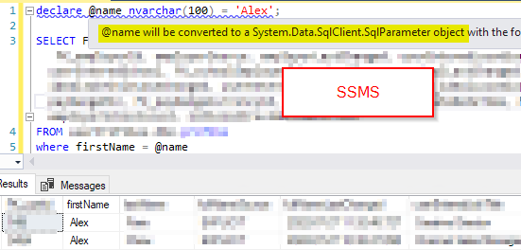
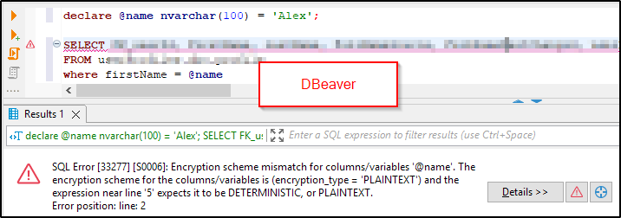
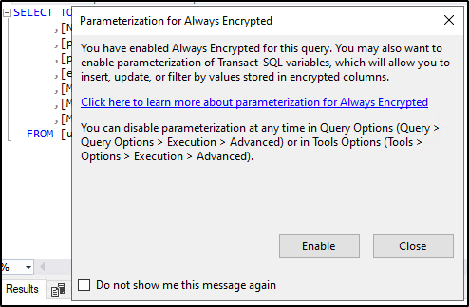
[13/15] Challenges - Limited SQL Client Options
There are limited SQL Client options that can work with encrypted columns properly.
Most SQL Clients can decrypt data fine when it is using proper drivers and can reach the certificate store.
Only SSMS can use encrypted query parameters because this has been built separately into SSMS app itself.

Slide 28
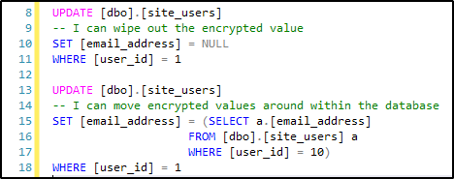
[14/15] Challenges - Limited Data Modification Options
You can’t really modify encrypted values on the database side (sprocs, triggers, adhoc queries), but at least you can NULL-out values and move them within the database.
No computed columns, no constraints, etc.
No FOR XML, FOR JSON.

Slide 29
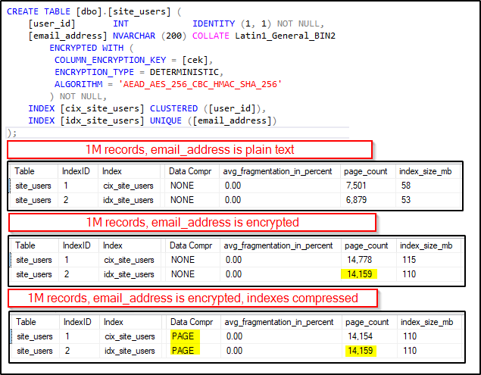
[15/15] Challenges - Data Size
Encrypted values take more space, compression is useless

Slide 30
How We Made It Work in Our Environment?
Keys are generated in SSMS or PowerShell as usual, originally stored in the Windows Certificate store
Use custom key store provider in JAVA:
Pretending to be the default MSSQL_CERTIFICATE_STORE key store provider
Use the given key path to get actual value from our secrets store
Benefits:
Works well with our-own secrets store
Centralized key storage and tight security around who can access it
Works in Hybrid environment without Azure Key Vault
Extra complexity makes it a bit harder to access data:
Glassdoor specific shared java library must be used to access encrypted data
Lesser chances to leak data by mistake
Doc: Implementing a custom column master key store provider https://learn.microsoft.com/en-us/sql/relational-databases/security/encryption/develop-using-always-encrypted-with-net-framework-data-provider#implementing-a-custom-column-master-key-store-provider

Slide 31
Production Rollout - A High-Level Plan
Convert existing key values into uniform shape
make sure apps are reading/writing values consistently
Enable encryption support and assess performance impact
Generate encryption keys and make sure apps can consume it
We usually create a test table with encrypted column in each database
The app won’t start if it can’t read/write from/to the test table
Encrypt existing data while keeping in mind roll-back plan

Slide 32
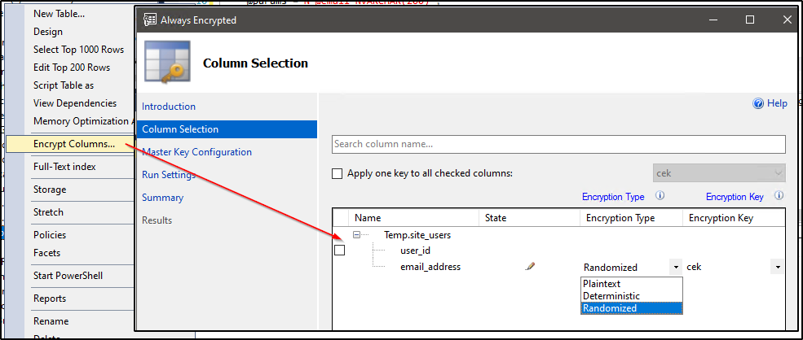
[1/4] Production Rollout Scenarios - The Easiest Case
mostly for small tables or when you can tolerate a long encryption process
No app code changes needed*. Data can be encrypted via SSMS.
the table will be blocked while encryption is in process
Rollback is easy – you decrypt data using the same UI

Slide 33
[2/4] Production Rollout Scenarios - a Simple Case With No Downtime
For large insert-only tables (no updates)
No app code changes needed*
create a new encrypted column
start copying data via PowerShell script
pick a time and flip columns when everything is encrypted
Code Example: https://github.com/alex-bochkov/pass-summit-2022-always-encrypted/tree/main/prod-rollout/option-2

Slide 34
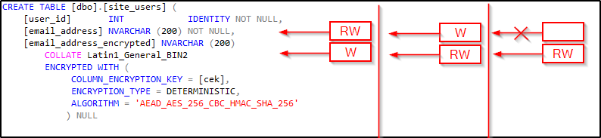
[3/4] Production Rollout Scenarios - Leave It Up To The App Devs
Less risky but way more people involved - let application team handle it all:
create a new encrypted column
map that column in the application code, start writing data there
encrypt historical records via PowerShell
start reading from the new column
unmap the old column from the app code, drop the old column from the database

Slide 35
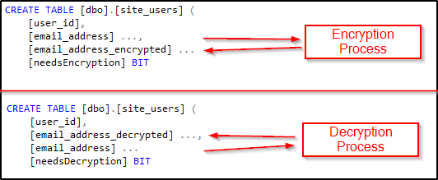
[4/4] Production Rollout Scenarios - a Full Example
4th approach using a trigger – a big bang but DBAs are in full control
No app code changes are needed*
use a trigger to detect modified records
encrypt all historical records and newly modified values
flip columns when everything is ready
continue decrypting values to support instant rollback
Code Example: https://github.com/alex-bochkov/pass-summit-2022-always-encrypted/tree/main/prod-rollout/option-4

Slide 36
Key Rotation
Column Master Key - easy
Generate new key and start rotation
Client apps will be getting both keys at the same time, may have performance impact
Restart all connected apps
Cleanup the old key
Column Encryption Key - hard
Need to physically re-encrypt all data
Doc: Rotate Always Encrypted keys using SQL Server Management Studio https://learn.microsoft.com/en-us/sql/relational-databases/security/encryption/rotate-always-encrypted-keys-using-ssms

Slide 37
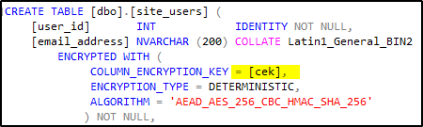
Development and change management
The CEK is referenced by name when you define a new encrypted column
Give the key the same name in all environments.
Key name can’t be changed
If you are building your non-prod from prod copies:
You may need to rotate the keys twice to persist the name (because the keys are not renamable)
You also need to regenerate the Column Encryption Key! otherwise, your prod data will be compromised even without knowing the prod Column Master Key
Large tables with encrypted values may need to truncated because re-encrypting is a long process

Slide 38
Secure Enclaves
Intended to solve DML limitations by operating with plain-text values in secure memory
Need hardware and software support (not only SQL Server involved)
More or less easy to set up in Azure and on-prem
Harder in AWS
Very significant performance impact, wasn't useful for us
You need to enable ADR to avoid long recovery times if process crashed during secure computation process

Slide 39
Conclusion
Always Encrypted is a great and reliable way to further protect sensitive data.
as long as you are okay with its limitations
Microsoft is actively developing it (but mostly for secure enclaves), things are changing
use the most recent driver versions
Secure Enclaves are not easy to use
you need good Windows Admin expertise

