Slide 1

Reinforcement Learning Uses in Video Games
BSPS4 – Tinouert Alexandre
Supervised by PhD stdt. Parvin Emami

Slide 2
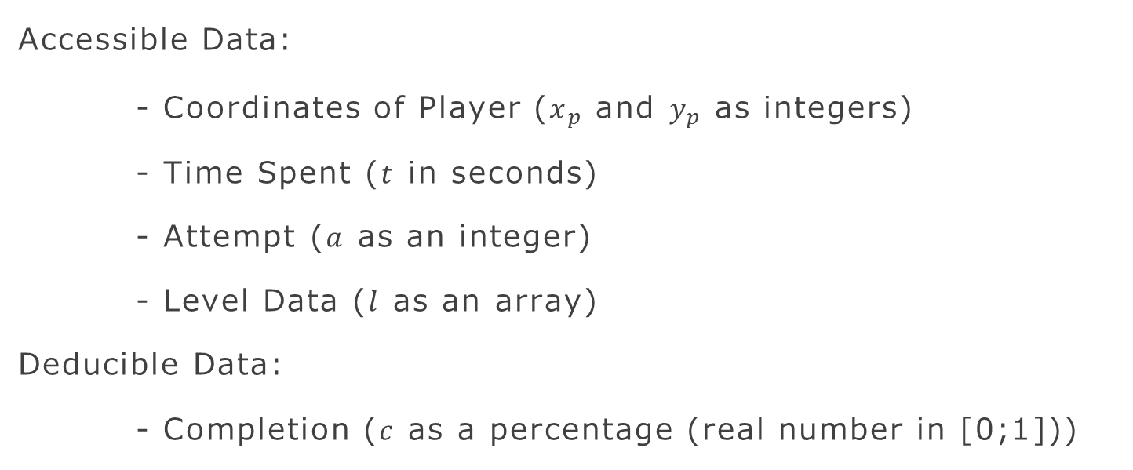
Design - Setup
Accessible Data:
- Coordinates of Player ($x_{p}$ and $y_{p}$ as integers)
- Time Spent ($t$ in seconds)
- Attempt ($a$ as an integer)
- Level Data ($l$ as an array)
Deducible Data:
- Completion ($c$ as a percentage (real number in [0;1]))

Slide 3









Production - Approach
Markov Decision Process:
$$Agent$$
$Game$🎮
$$Plays$$
$$Reward$$
$$Completion$$
$$Interpreter 🖥️$$
$$State$$

Slide 4
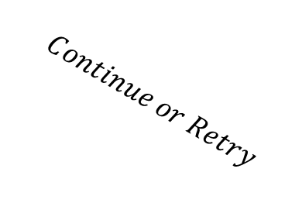




Production - Approach
Markov Decision Process (at a time $t$):
$$Agent$$
$Game$🎮
$$Click ∪ ∅$$
$$Reward$$
$$Percentage$$
$$Attempt$$
$$Interpreter 🖥️$$
$$Continue or Retry$$

Slide 5

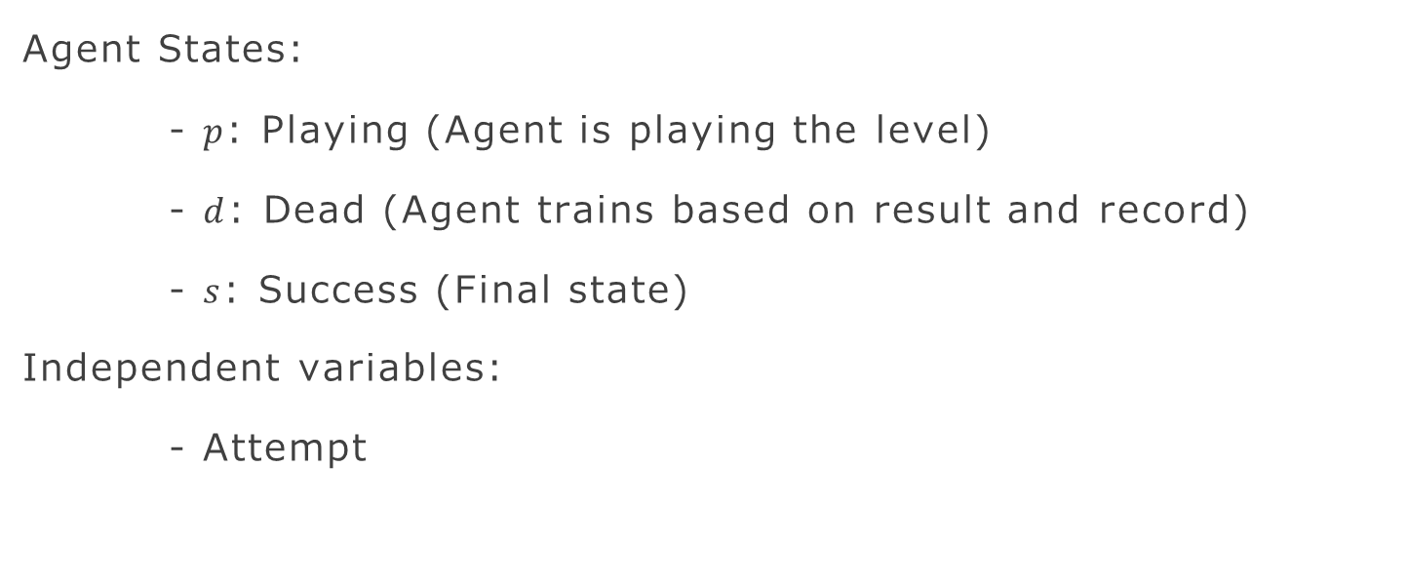
Production - Approach
$$Agent$$
Agent States:
- $p$: Playing (Agent is playing the level)
- $d$: Dead (Agent trains based on result and record)
- $s$: Success (Final state)
Independent variables:
- Attempt

Slide 6
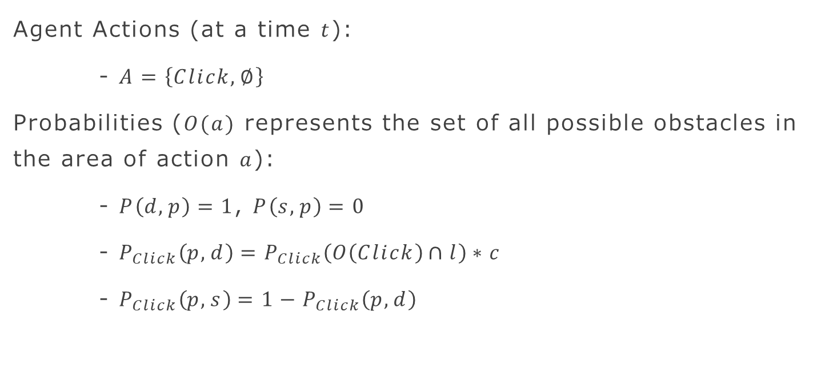
Production - Approach
$$Agent$$
Agent Actions (at a time $t$):
- $A=\left\{Click, ∅\right\}$
Probabilities ($O(a)$ represents the set of all possible obstacles in the area of action $a$):
- $P\left(d, p\right)=1$, $P\left(s, p\right)=0$
- $P_{Click}\left(p, d\right)=P_{Click}\left(O\left(Click\right)∩l\right)∗c$
- $P_{Click}\left(p, s\right)=1−P_{Click}\left(p, d\right)$

Slide 7
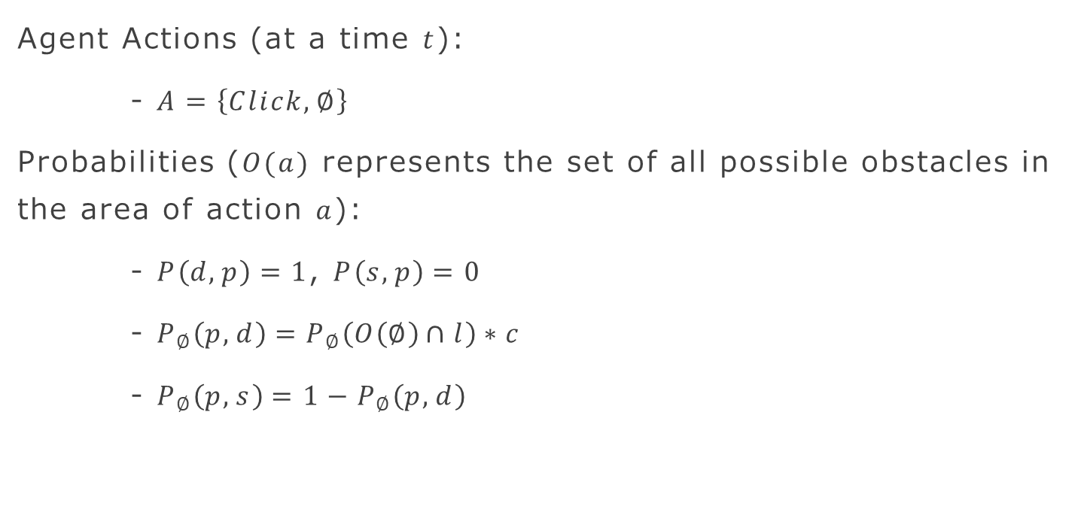
Production - Approach
$$Agent$$
Agent Actions (at a time $t$):
- $A=\left\{Click, ∅\right\}$
Probabilities ($O(a)$ represents the set of all possible obstacles in the area of action $a$):
- $P\left(d, p\right)=1$, $P\left(s, p\right)=0$
- $P_{∅}\left(p, d\right)=P_{∅}\left(O\left(∅\right)∩l\right)∗c$
- $P_{∅}\left(p, s\right)=1−P_{∅}\left(p, d\right)$

Slide 8

Production - Approach
$$Agent$$
Agent Reward (at a time $t$ and $t^{′}$ instantly following $t$):
- Let $c_{t}$ and $c_{t′}$ the completion respectively at $t$ and $t′$
- $R\left(p, d\right)=R\left(d, p\right)=−1$
- $R\left(p, s\right)=1$
- $R_{t,t′}\left(p, p′\right)=c_{t′} −c_{t}$

Slide 9

Production - Approach
$$Agent$$
Agent Policy (at a time $t)$:
- $π :A×S→\left[0,1\right]$
- $π\left(a,s\right)=P\left(A_{t}=a \right| S_{t}=s)$
- $π\left(a,s\right)=argmax_{a} Q^{∗}(s,a)$
Ideal Case:
- $P\left(Click,p\right)=1$ if $(O\left(∅\right)∩l≠\{\})$ else 0
- $P\left(∅,p\right)=1 \text{if} (O\left(Click\right)∩l≠\{\}) \text{else} \text{0}$

Slide 10
Production - Deep Q-Learning

Slide 11
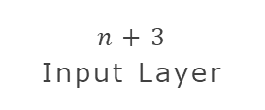
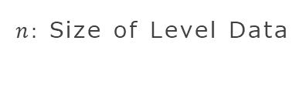



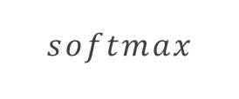










Production - DQN Structure
$n:$ Size of Level Data
$${ x}_{p}$$
$$h_{0}$$
$$o_{0}$$
$${ y}_{p}$$
$tanh$
$softmax$
$${ c}_{t}$$
$${ l}_{1}$$
$$l$$
$${ l}_{n}$$
$$h_{29}$$
$$o_{29}$$
$n+3$ Input Layer
$30$ Hidden Layer
$30$ Output Layer

