Slide 1
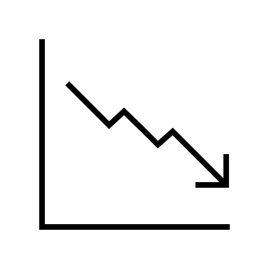
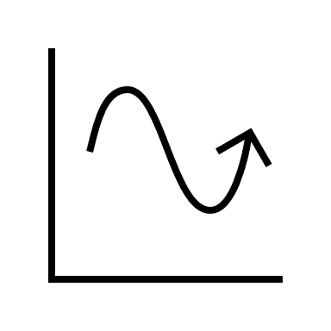
Optimization Project
Particle swarm optimization and some applications
Alex Costanzino
Ay 2020-2021

Slide 2
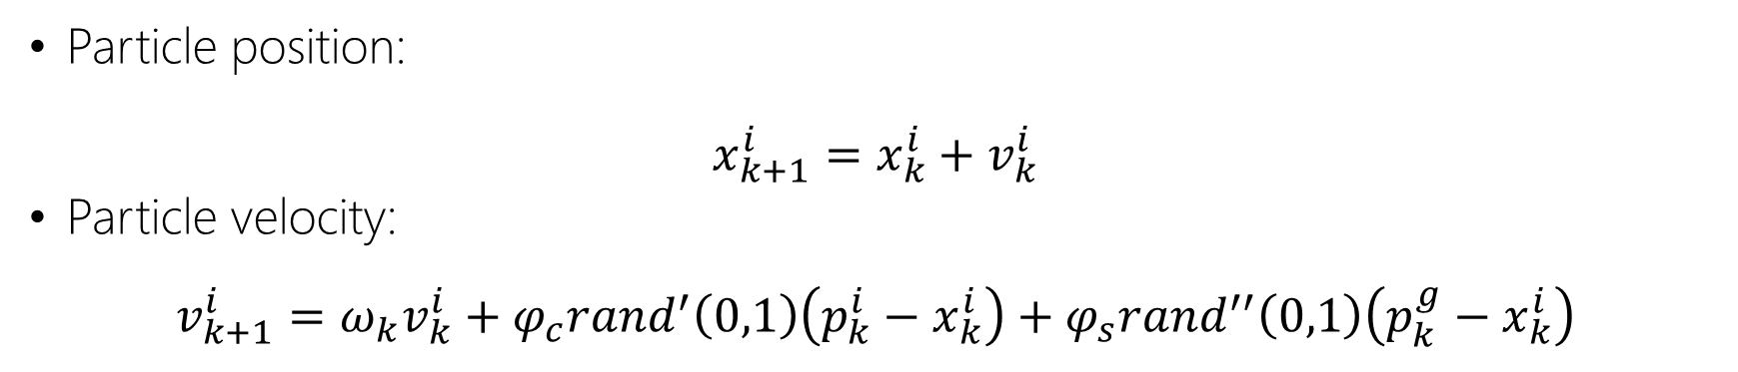
The idea
Set a swarm of particles (a population of tentative configurations) and move them through simple mathematical formulas (in the configuration space).
Particle position:
$x_{k+1}^{i}=x_{k}^{i}+v_{k}^{i}$
Particle velocity:
$$v_{k+1}^{i}=ω_{k}v_{k}^{i}+φ_{c}{rand}^{′}\left(0,1\right)\left(p_{k}^{i}−x_{k}^{i}\right)+φ_{s}{rand}^{′′}\left(0,1\right)\left(p_{k}^{g}−x_{k}^{i}\right)$$
Inertia
Cognitive component
Social component
Constant balance between these components that pull each particle.
The search is guided by the means of a fitness function $f∶ℝ^{n}⟶ℝ$.
Alex Costanzino
1
Notes:
Greater ω greater global search ability.
Smaller ω, greater local search activity.

Slide 3

The idea
These components are weighted by their constants and randomly perturbed. This leads to two main behaviours:
Inertia
Cognitive component
(particle direction)
Particle
New direction
Social component
(swarm direction)
Scenario I – high energy particle: the inertia and the cognitive component overpower the swarm influence and the particle will continue exploring the search space rather than follow the swarm (diversification).
Alex Costanzino
2

Slide 4
The idea
These components are weighted by their constants and randomly perturbed. This leads to two main behaviours:
Inertia
Cognitive component
(particle direction)
New direction
Particle
Social component
(swarm direction)
Scenario II – low energy particle: the swarm influence overpowers the inertia and cognitive component, forcing the particle towards the swarm (intensification).
Alex Costanzino
3
Notes:
This will result in a faster convergence, at the expense of not fully exploring the search space and potentially finding a better solution.

Slide 5
High-level algorithm
Step I – Initialization: set constants and and randomly initialize the velocity of each particle of the swarm (wrt a normal distribution) and the position (user-defined);
Step II – Optimization: evaluate the fitness function at each particle position. If the fitness function it’s better, update the individual best positions and the global best position. Repeat;
Step III – Terminate: when some criteria are met (time-out, memory-out, maximum number of iterations, minimum improvement, etc…).
Alex Costanzino
4

Slide 6
High-level algorithm
Pros
Cons
Simple implementation;
Derivative free;
High efficiency.
Require an accurate parameter tuning;
Requires memory to update velocity.
Possible improvements: adaptative particle swarm optimization, more termination condition, hybridization with other algorithms,…
Alex Costanzino
5

Slide 7
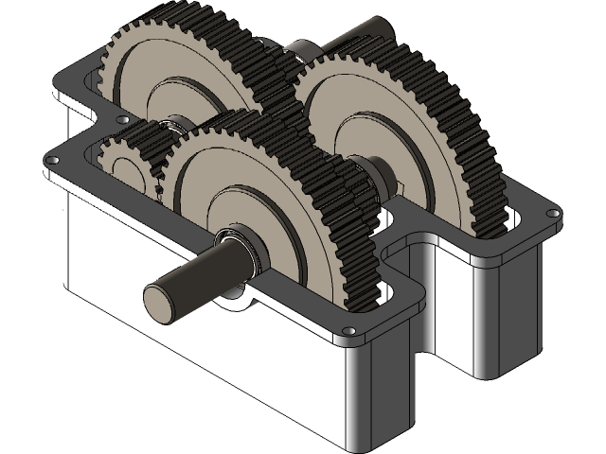

Proposed problems
Problem 1: unconstrained optimization of several test functions (Rastrigin, Beale, Ackley, Rosenbrock, etc…);
Problem 2: design of a speed reducer (constrained optimization with penalty functions method, seven variables, eleven constraints);
Problem 3: design of a spring (constrained optimization with penalty functions method, three variables, four constraints).
Alex Costanzino
6

