Slide 1


Image Processing and Computer Vision
Visual inspection of motorcycle connecting rods
Alex Costanzino
Ay 2021-2022

Slide 2
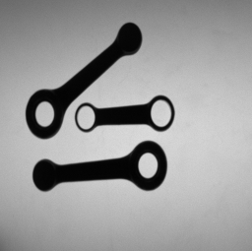
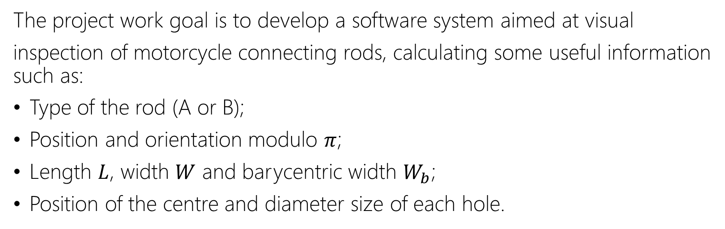
The goals
The project work goal is to develop a software system aimed at visual
inspection of motorcycle connecting rods, calculating some useful information such as:
Type of the rod (A or B);
Position and orientation modulo $π$;
Length $L$, width $W$ and barycentric width $W_{b}$;
Position of the centre and diameter size of each hole.
Alex Costanzino
1

Slide 3
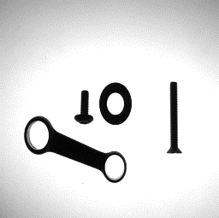

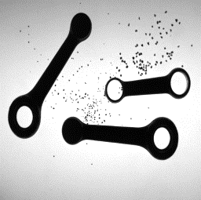
The problems
The main task aim is calculating some statistics using images taken with backlighting techniques. Within the second task other complication are added, such as:
Presence of distractors
Touching rods
Impulsive noise
Alex Costanzino
2

Slide 4
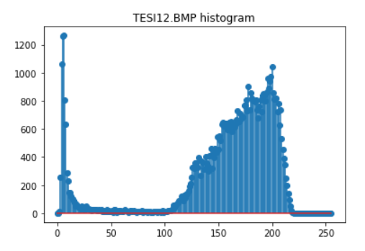
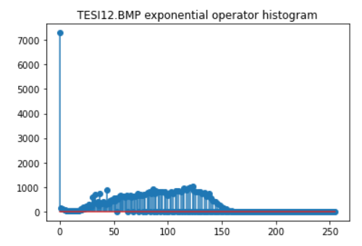
The pipeline – Step 1
At beginning the histogram of each image has been inspected and an exponential operator has been applied to provide a better baseline for the binarization:
Alex Costanzino
3

Slide 5
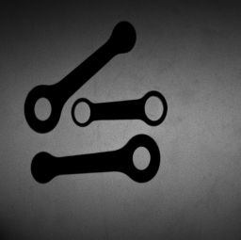

The pipeline – Step 2
Then, a percentile thresholding has been applied to accomplish binarization:
Before exponential operator
After exponential operator
After percentile thresholding
Alex Costanzino
4

Slide 6
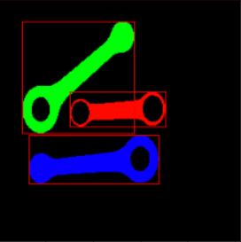
The pipeline – Step 3
Afterwards, a connected component analysis has been done in order to extract useful information on the blobs:
Alex Costanzino
5

Slide 7
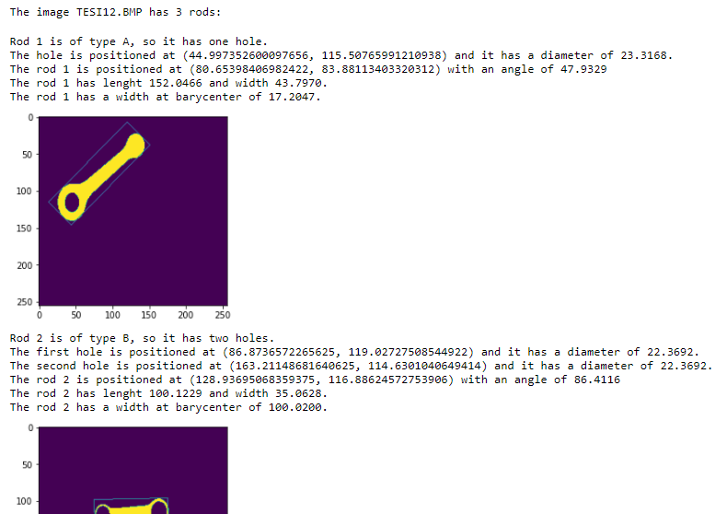
The pipeline – Step 4
Finally, the information about the rods have been calculated:
Excerpt of statistics calculator
Alex Costanzino
6

Slide 8
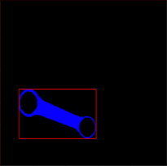
Complications resolution – Task 1
Presence of distractors: the presence of distractors has been removed simply by filtering the components smaller than a certain parametrized amount of pixels:
Alex Costanzino
7

Slide 9




Complications resolution – Task 3
Impulsive noise: to remove the salt and pepper noise a repeated median filter has been applied as first operation. After the binarization also an opening operator has been applied in order to restore the image and remove the last “grains” of noise:
Before median filter
After median filter
After percentile binarization
After opening operator
Alex Costanzino
8

Slide 10
Complications resolution – Task 2
Touching rods: an attempt to solve the touching rods has been done by means of morphological operators, in order to detach the rods. To improve the image an Otsu thresholding has been endeavoured, nevertheless the rods have become too degraded to be further analyzed.
Alex Costanzino
9

