Slide 1

The Language of the culture wars
Alex Douglas

Slide 2
What Are the Culture Wars?
conflict between opposing value systems/world views
example issues:
egalitarianism | race | political correctness
feminism | immigration | multiculturalism

Slide 3
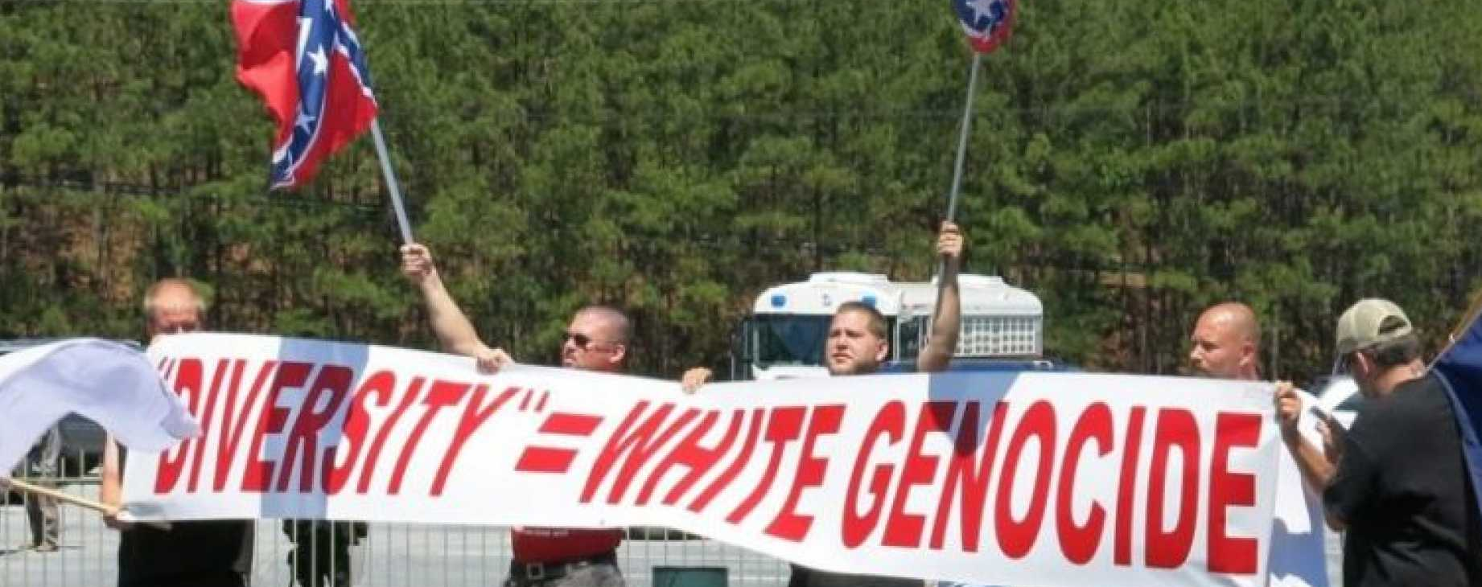
The alt-right

Slide 4
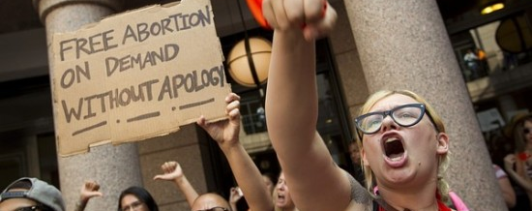
The Social justice left

Slide 5
The Alt-Right
origins in online communities and forums such as 4chan
beliefs:
white nationalism
anti-feminism
anti-Semitism
political incorrectness

Slide 6
The Social justice left
young, tech-savvy members of the American Left
beliefs:
LGBTQ rights
feminism
multiculturalism
political correctness

Slide 7
The language of the culture wars
Objectives:
Examine the sentiment of discussion
Identify important topics
Gather Comments
Clean Comments
Sentiment Analysis
Topic Clustering

Slide 8
process OVERVIEW
Query Disqus API for website comments
Clean comments
Apply NLP analysis:
Sentiment analysis
Comment clustering (topic identification)

Slide 9
websites
Alt-Right
Breitbart
American Renaissance
Altright
Social Justice Left
Alternet
Crooks and Liars
Gopocalypse
Towleroad

Slide 10
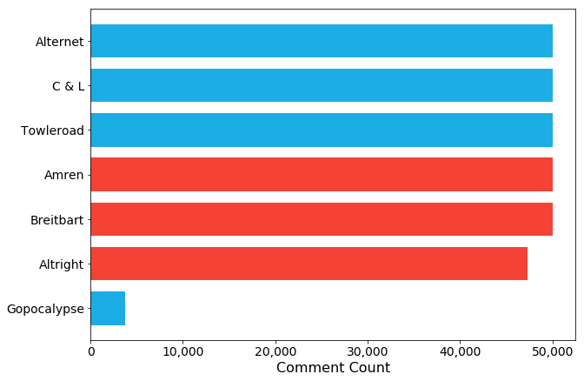
websites

Slide 11
DATA Cleaning
Remove short comments
Convert to lowercase
Remove links
Remove punctuation (except appropriately used apostrophes /dashes)
Remove foreign / non-standard characters
Lemmatize
Original
CLEANED
Some short text
Wow!! That doesn't sound fascist at all! 😕
Some short text
wow that doesn't sound fascist at all 😕
wow!! that doesn't sound fascist at all! 😕
wow that do not sound fascist at all
wow that doesn't sound fascist at all

Slide 12
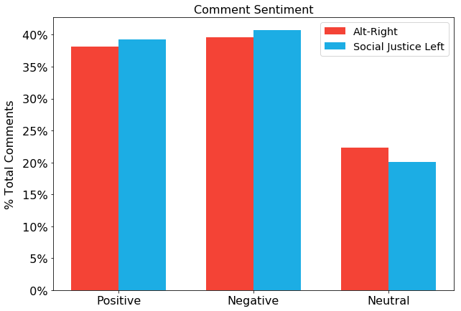
NLP – Sentiment Analysis
NLTK vader
classify comments as:
positive
negative
neutral

Slide 13
NLP – Sentiment Analysis
Social Justice Left most positive:
“I love dogs! Love, love, love 😃”
Alt-Right most negative:
“No, no, no NO! Disgusting! Barf!”

Slide 14
NLP – Sentiment Analysis
Alt-Right most positive:
“Ha Ha Ha Ha Ha Ha Ha Ha Ha Ha Ha Ha Ha Ha Ha Ha. Thanks, I needed a good laugh.”
Social Justice Left most negative:
“Insane loser marries loser shock”

Slide 15
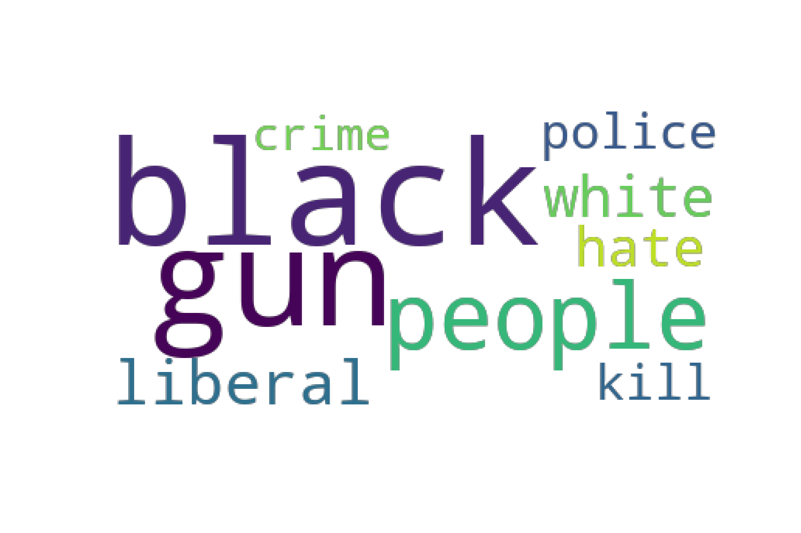
NLP – Comment Clustering
topic identification
LDA, LSA (SVD and NMF)
comment clustering
K-Means, hierarchical

Slide 16
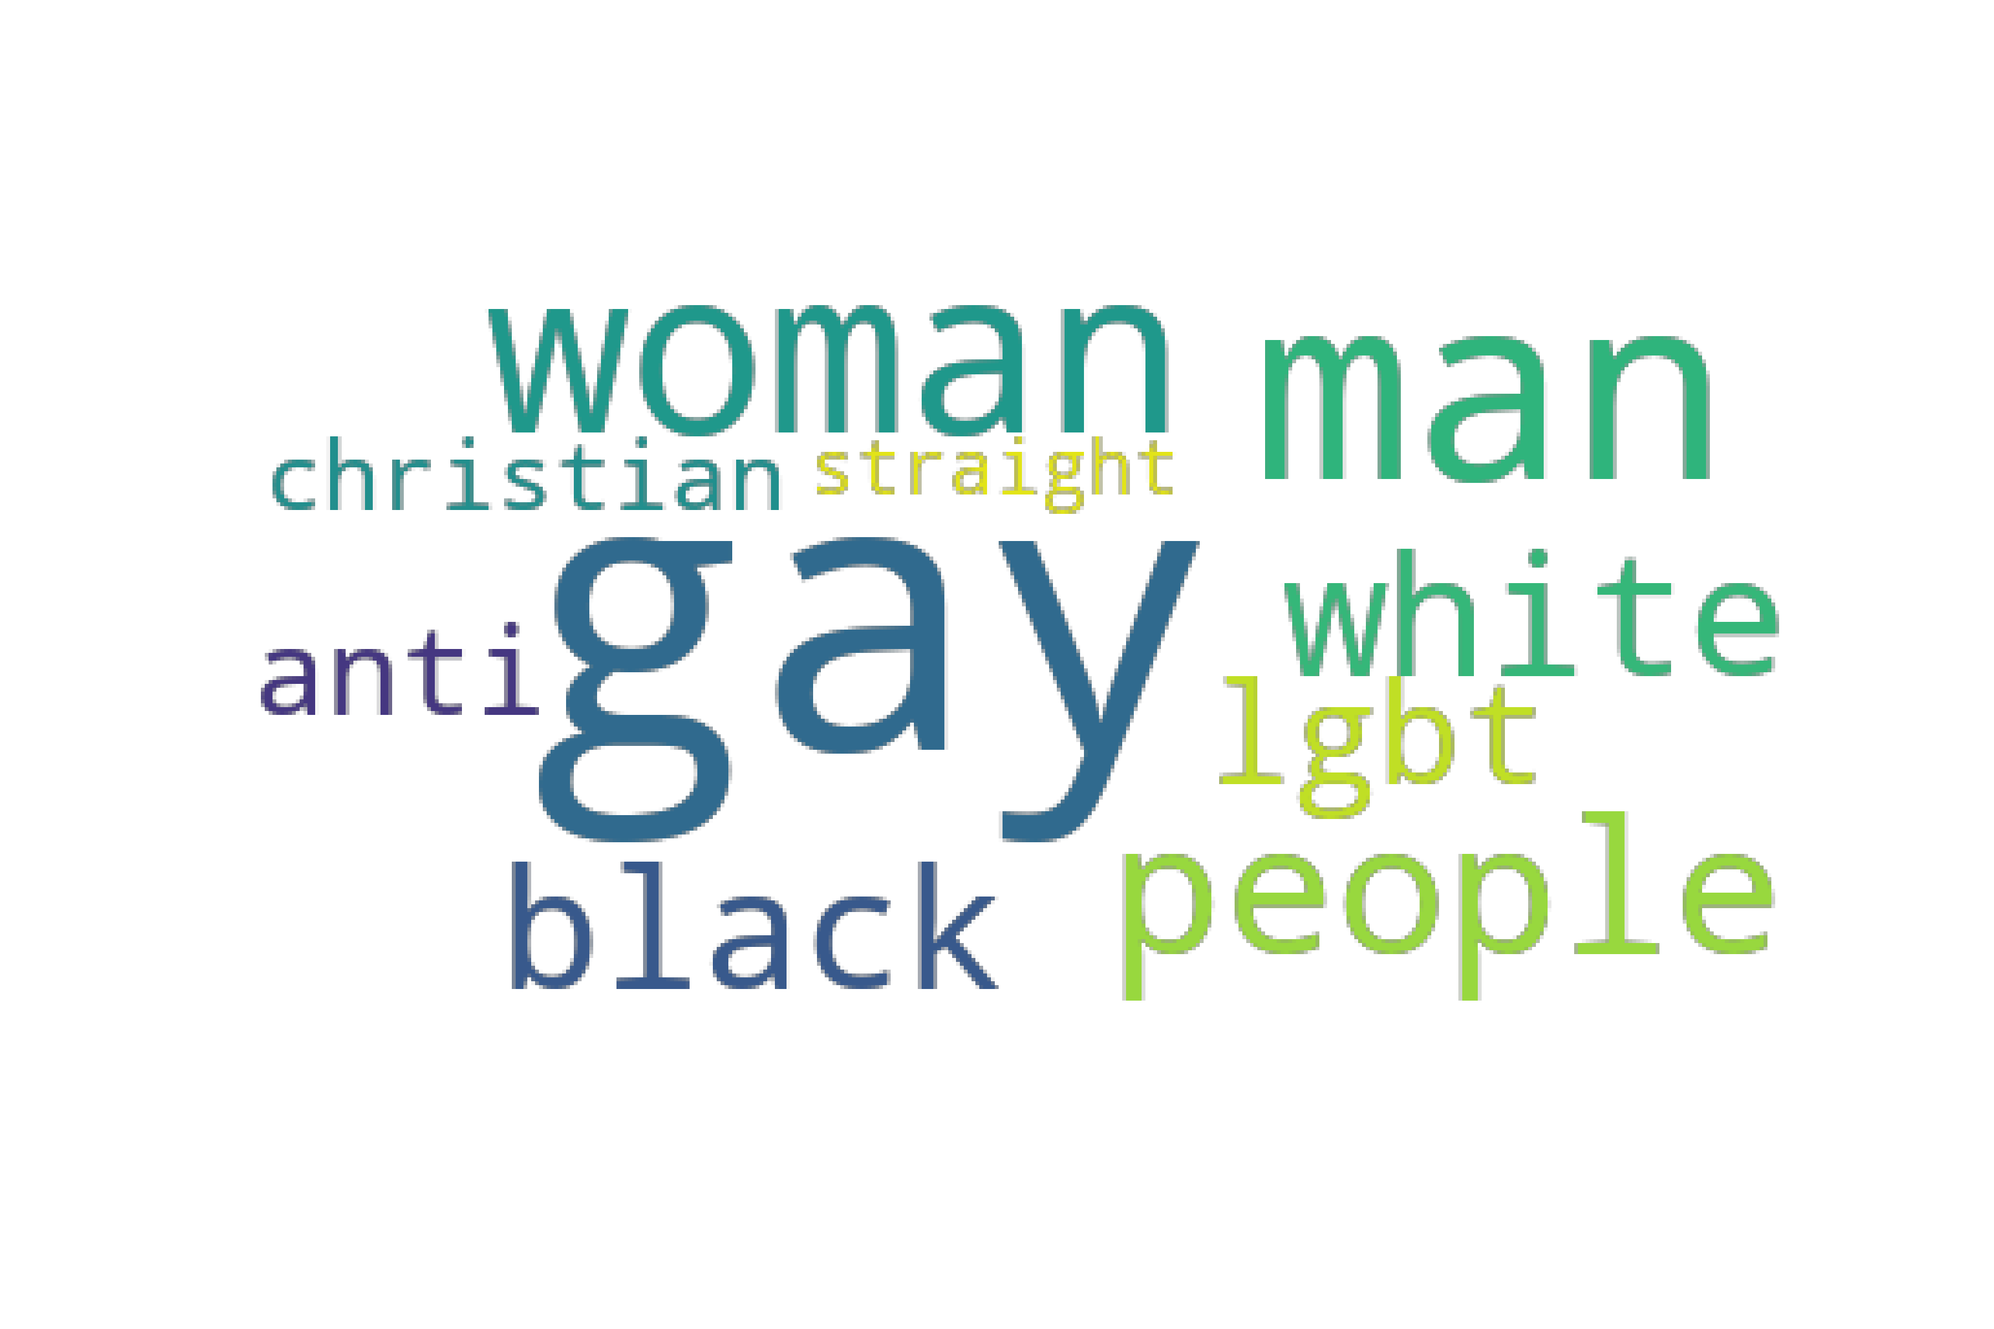
NLP – Comment Clustering
topic identification
LDA, LSA (SVD and NMF)
comment clustering
K-Means, hierarchical

Slide 17
NLP – Comment Clustering
Alt-Right
presidential election
American macro issues
African Americans & the police
white nationalism
religion (Islam)
Social Justice Left
presidential election
domestic economics
BLM & the police
Donald Trump
LGBTQ rights
right-wing issues

Slide 18
NLP – Comment Clustering
Social Justice Left (LGBTQ rights cluster):
“Did you read any of the links? See especially the last one, it is about state sponsored gay hate and killing in Africa, because of American Christian evangelism.”

Slide 19
NLP – Comment Clustering
Alt-Right (white nationalism cluster):
“White = European
Slavs are smart enough to resist mass immigration for now, but it seems likely that globalists will keep trying to force it on them.”

Slide 20
Conclusion
nothing too insightful from sentiment analysis
both sides have their important topics, though there is some overlap

Slide 21
additional exploration
eliminate articles / comments not directly relevant to the culture wars
even more data cleaning
custom sentiment library for politics / political groups
deeper dive into a specific topic – how does discussion of same topic differ between groups?

Slide 22



Thank you
alex.douglas4545@gmail.com
@ar_douglas
github.com/alex-douglas

