Slide 1

Reliably Significant Factors of Home Sale Prices
Presented by:
Alexandra Durec

Slide 2



Agenda
Data Exploration
Reliable Factors
Unreliable Factors
Recommendations

Slide 3




Introduction
We will be exploring factors that drive home sale prices in order to make recommendations on how to allocate dollars earmarked for investment into mortgage-backed securities.

Slide 4

Data Exploration
Considerations for Recommendations

Slide 5
Data Exploration
Goals and Findings
Factors Related to Quality include:
Looking for factors that will show consistently high increases from the average home sale price of $180,921
Factors related to quality showed potentially significant differences in initial exploration
Exterior Quality
Kitchen Quality
Overall Quality
Basement Quality
Heating Quality
Fireplace Quality
Garage Quality

Slide 6
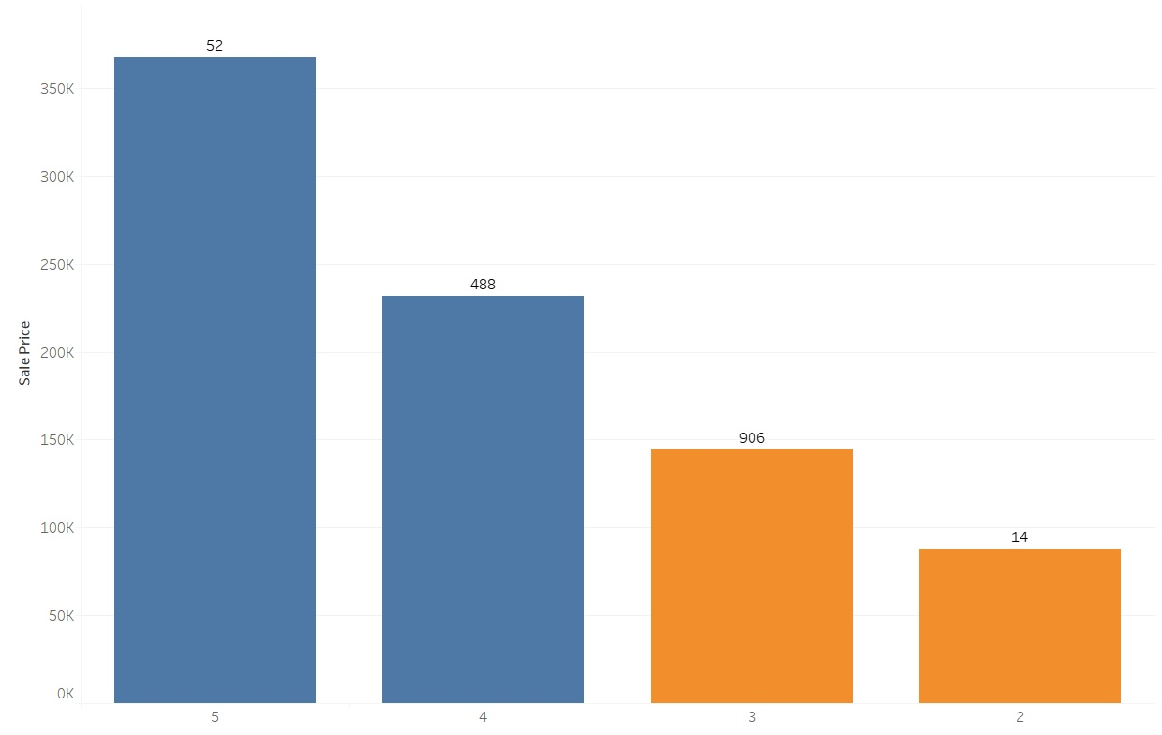

Exterior Quality

Slide 7
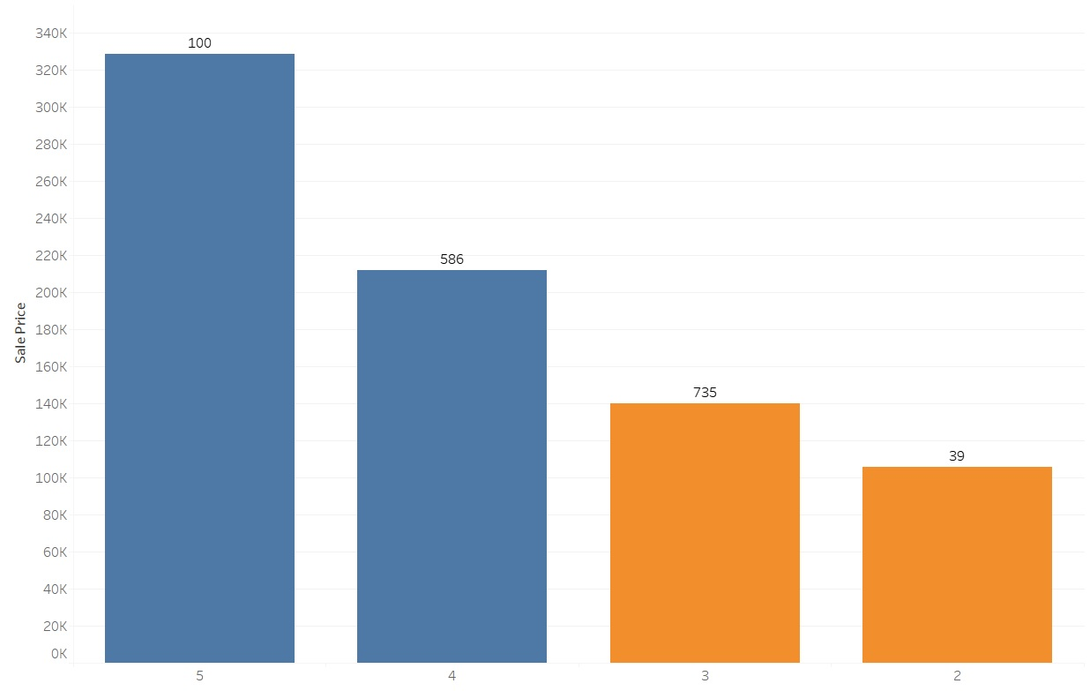

Kitchen Quality

Slide 8
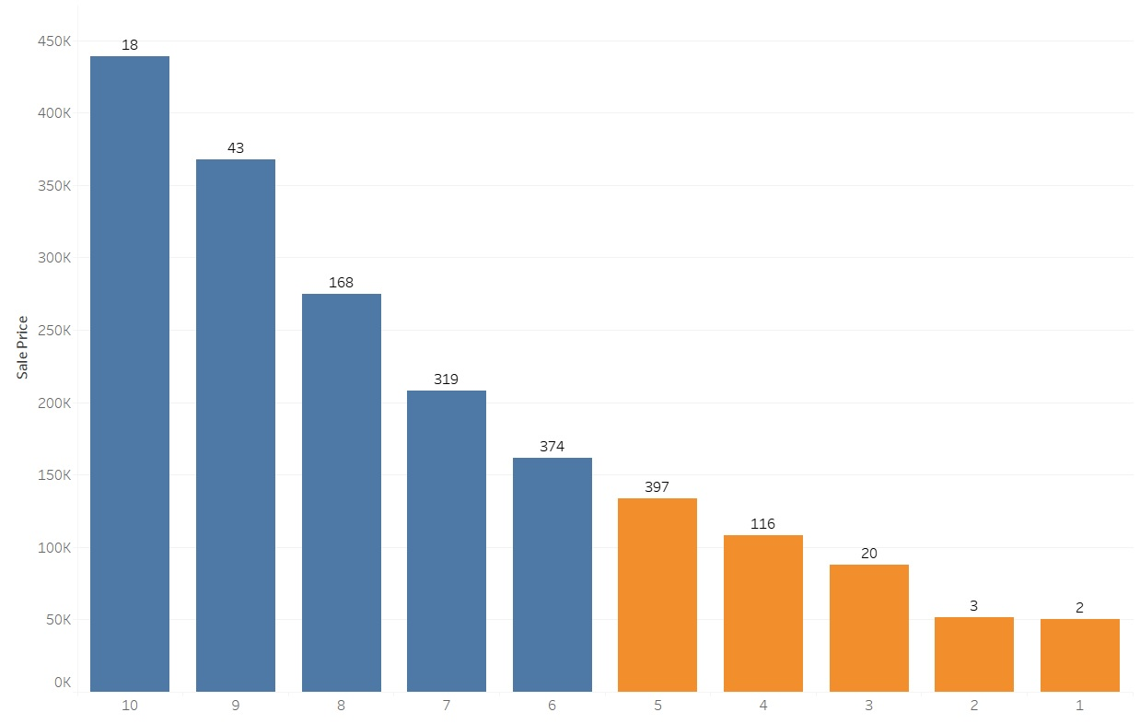

Overall Quality

Slide 9
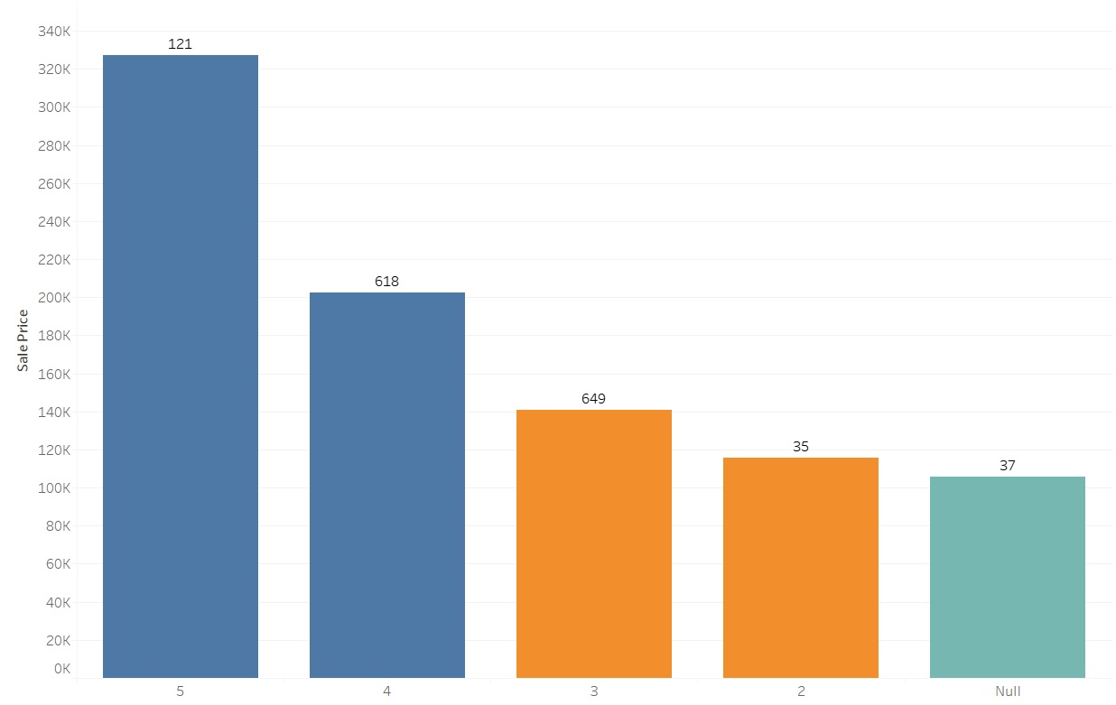
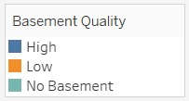
Basement Quality

Slide 10
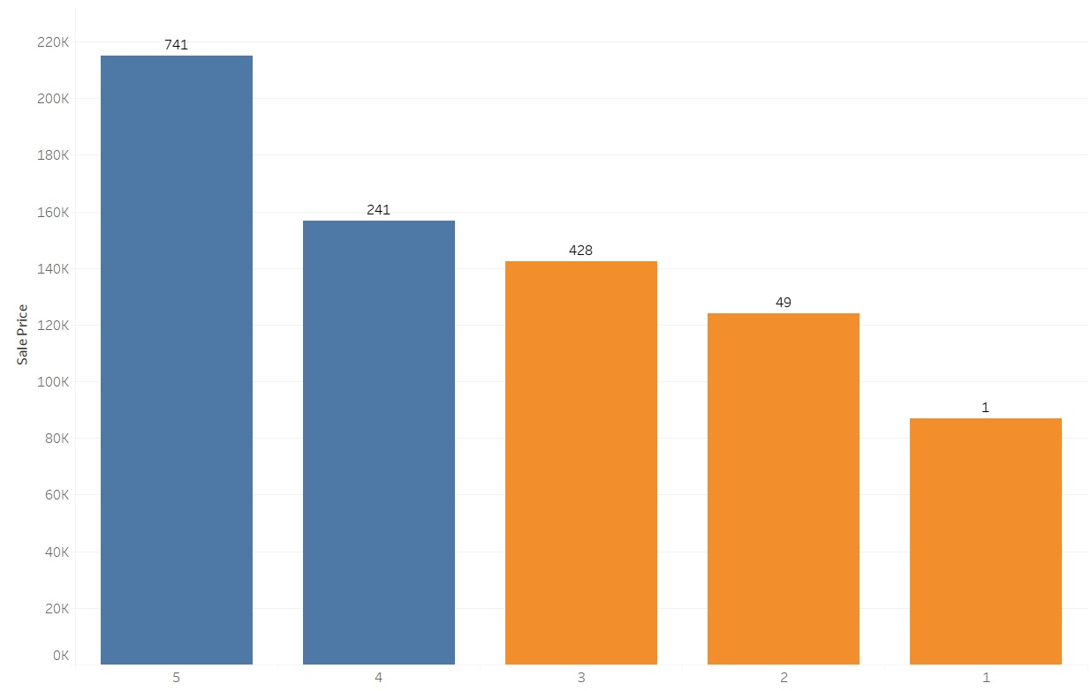

Heating Quality

Slide 11
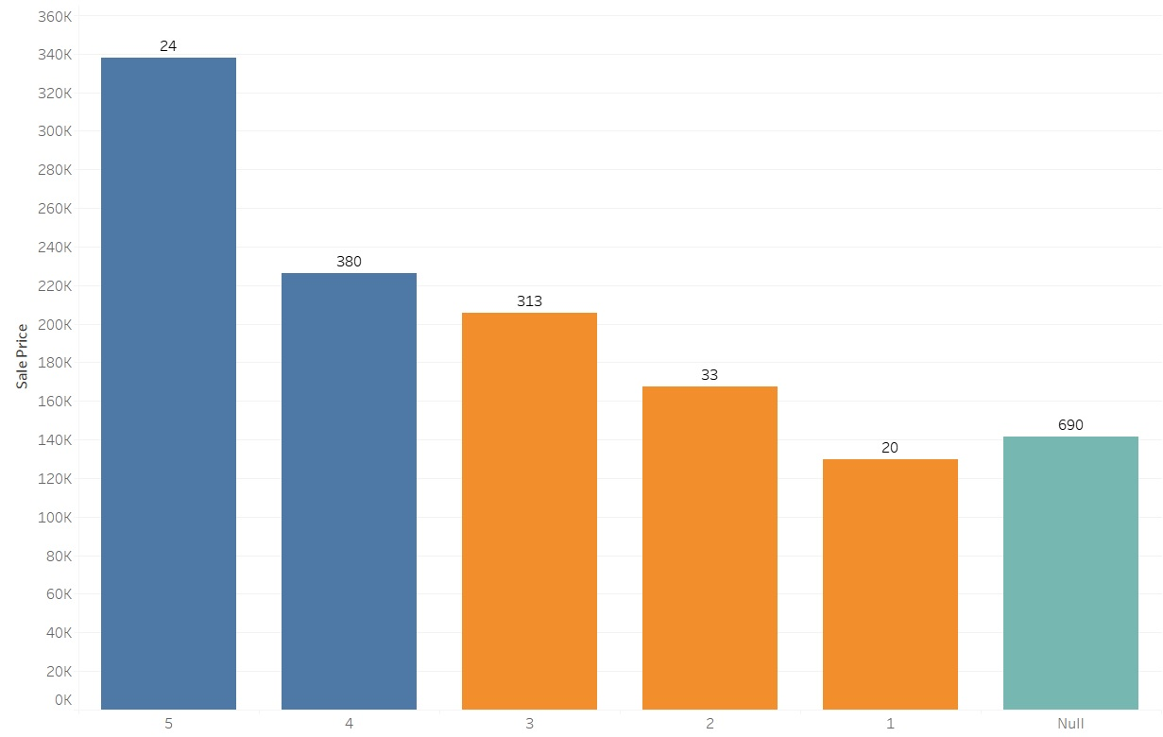
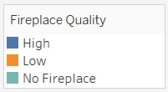
Fireplace Quality

Slide 12
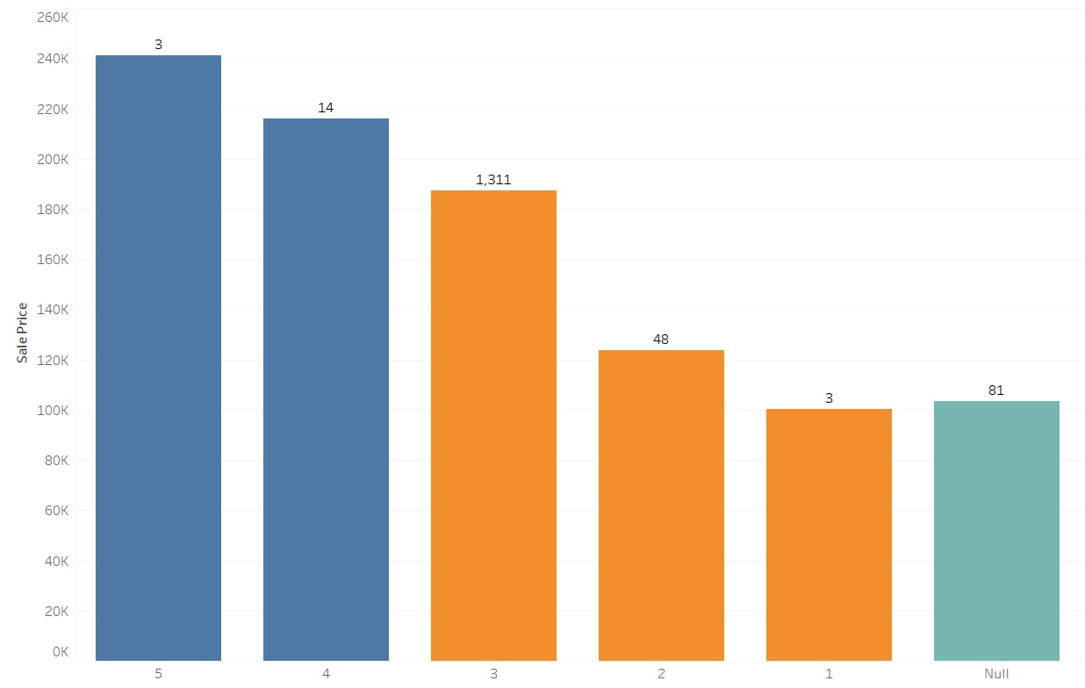
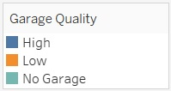
Garage Quality

Slide 13
Reliable Factors in Predicting Home Sale Prices
Factors with Statistically Significant Results

Slide 14
Exterior Quality
Exterior quality represents a 56% increase of the average home sale price of $180,921
With 95% confidence the difference in average home sale price is between $93,407 and $109,033
Reject the null hypothesis that there is no difference between the population means of High and Average/Low Quality Home Sales Prices
Difference is statistically significant (p << 0.05)

Slide 15
Kitchen Quality
Kitchen quality represents a 50% increase of the average home sale price of $180,921
With 95% confidence the difference in average home sale price is between $83,879 and $97,842
Reject the null hypothesis that there is no difference between the population means of High and Average/Low Quality Home Sales Prices
Difference is statistically significant (p << 0.05)

Slide 16
Overall Quality
Overall quality represents a 48% increase of the average home sale price of $180,921
With 95% confidence the difference in average home sale price is between $81,679 and $93,420
Reject the null hypothesis that there is no difference between the population means of High and Average/Low Quality Home Sales Prices
Difference is statistically significant (p << 0.05)

Slide 17
Basement Quality
Basement quality represents a 46% increase of the average home sale price of $180,921
With 95% confidence the difference in average home sale price is between $76,697 and $90,447
Reject the null hypothesis that there is no difference between the population means of High and Average/Low Quality Home Sales Prices
Difference is statistically significant (p << 0.05)

Slide 18
Heating Quality
Heating quality represents a 33% increase of the average home sale price of $180,921
With 95% confidence the difference in average home sale price is between $53,515 and $67,105
Reject the null hypothesis that there is no difference between the population means of High and Average/Low Quality Home Sales Prices
Difference is statistically significant (p << 0.05)

Slide 19
Fireplace Quality
Fireplace quality represents a 19% increase of the average home sale price of $180,921
With 95% confidence the difference in average home sale price is between $53,515 and $67,105
Only 53% of homes have a fireplace so additional exploration was warranted
Reject the null hypothesis that there is no difference between the population means of High and Average/Low Quality Home Sales Prices
Difference is statistically significant (p << 0.05)

Slide 20
Homes with and without Fireplaces
Having a fireplace represents a 41% increase of the average home sale price of $180,921
With 95% confidence the difference in average home sale price is between $68,088 and $82,044
Reject the null hypothesis that there is no difference between the population means of Home Sales Prices for Homes with and without Fireplaces
Difference is statistically significant (p << 0.05)

Slide 21
Unreliable Factors in Predicting Home Sale Prices
Factors without Statistically Significant Results

Slide 22
Garage Quality
Cannot reject the null hypothesis that there is no difference between the population means of High and Average/Low Quality Home Sales Prices

Slide 23

Recommendations
Given the findings during statistical analysis I recommend factors of quality be weighed in the following order:
High Exterior Quality
High Kitchen Quality
High Overall Quality
High Basement Quality
Homes with Fireplaces
High Heating Quality
Fireplace Quality

Slide 24


Thank You
Alexandra Durec
AlexandraDurec@gmail.com
alex-durec on LinkedIn and GitHub

