Slide 1

Adaptive Meta-Learning
Girish Joshi
CSL
University of Illinois Urbana-Champaign

Slide 2
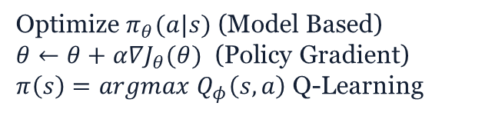
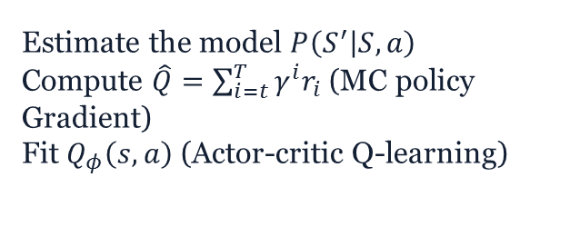
Which part of RL is slow?
Fit the Model/Estimate the return
Estimate the model $P\left(S^{′} | S,a\right)$
Compute $\hat{Q}=\sum_{i=t}^{T}{γ^{i}r_{i}}$(MC policy Gradient)
Fit $Q_{φ}\left(s,a\right)$ (Actor-critic Q-learning)
Real World agent, 1x real time.
Until we invent time travel
Expensive but non trivial to parallelize
Generate the Samples
OpenAI gym/Mujoco simulation Env
Upto 10000x time faster
Optimize $π_{θ}(a|s)$ (Model Based)
$θ←θ+α∇J_{θ}(θ)$ (Policy Gradient)
$π\left(s\right)=argmax Q_{φ}\left(s,a\right)$ Q-Learning
Improve the policy
Trivial, nothing to do!
[CS294-Deep RL Sergey Levine]

Slide 3
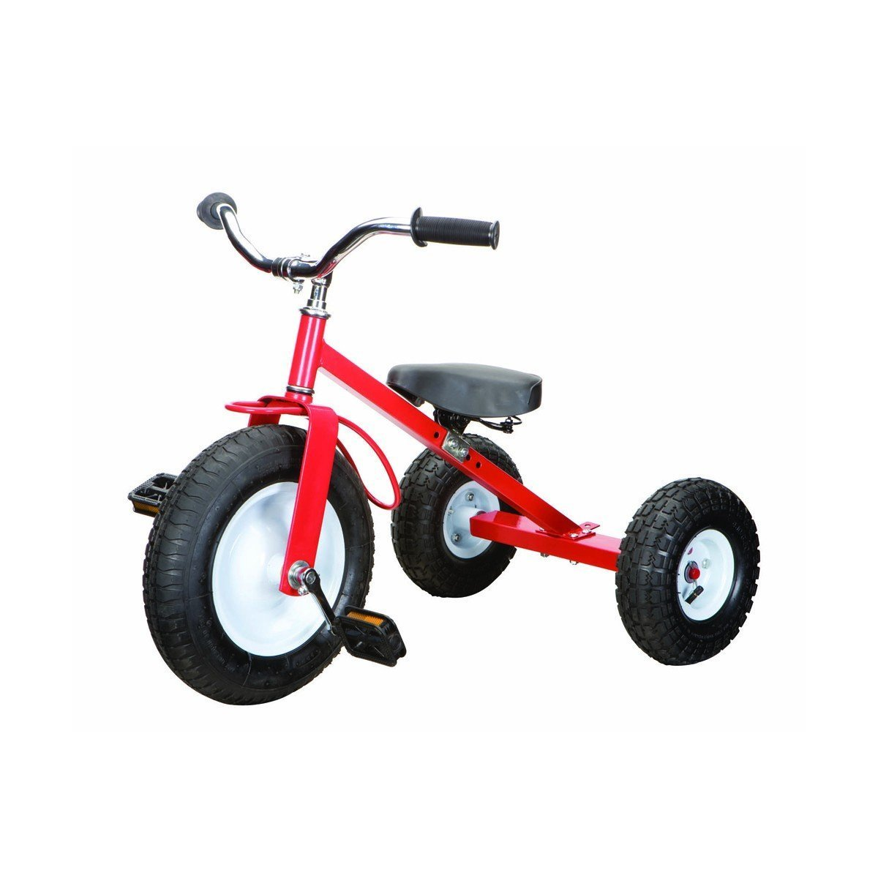

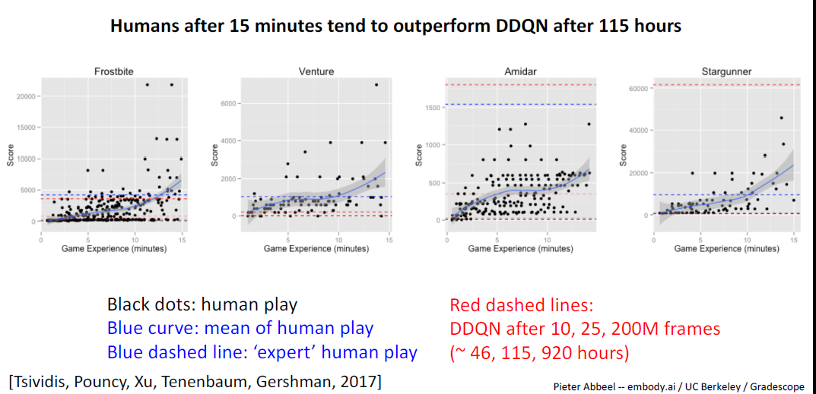
How we Learn?
Pedal and Steer
Brakes
Gears
Clutch, Accelerator…

Slide 4
Supervised Learning vs RL vs AML
ML Optimization
Supervised learning = Reduction training Loss
Reinforcement learning
Unsupervised learning: Favoring actions which give higher total reward
AML
Mixture of supervised and unsupervised learning
Make those policies more likely which produces higher total reward
Optimize the policy reducing training loss wrto a reference trajectory

Slide 5
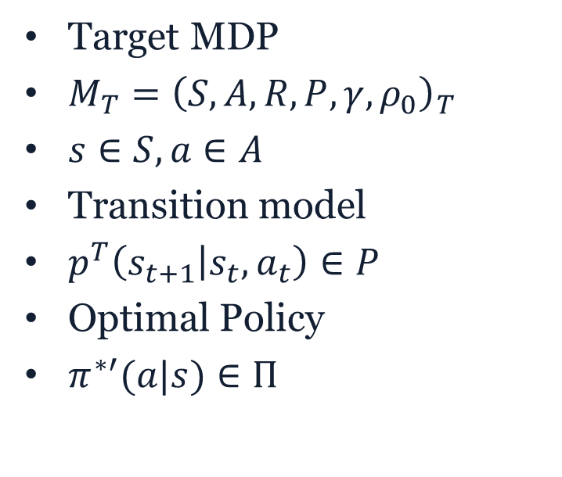
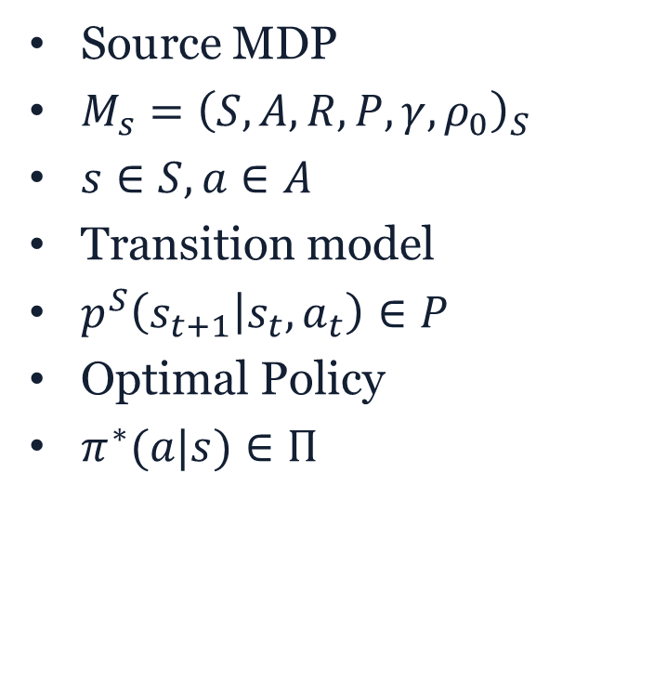
Adaptive Meta-Learner
Source MDP
$M_{s}={\left(S,A, R, P, γ,ρ_{0}\right)}_{S}$
$s∈S, a∈A$
Transition model
$p^{S}\left(s_{t+1} | s_{t}, a_{t}\right)∈P$
Optimal Policy
$π^{∗}(a|s)∈Π$
Target MDP
$M_{T}={\left(S,A, R, P, γ,ρ_{0}\right)}_{T}$
$s∈S, a∈A$
Transition model
$p^{T}\left(s_{t+1} | s_{t}, a_{t}\right)∈P$
Optimal Policy
$π^{∗′}(a|s)∈Π$
Above two MDP’s only differ in their transition model,
If two transition model are close enough can we use source optimal policy in target
Can a adaptive policy be found, which can make two transition model behave similarly

Slide 6
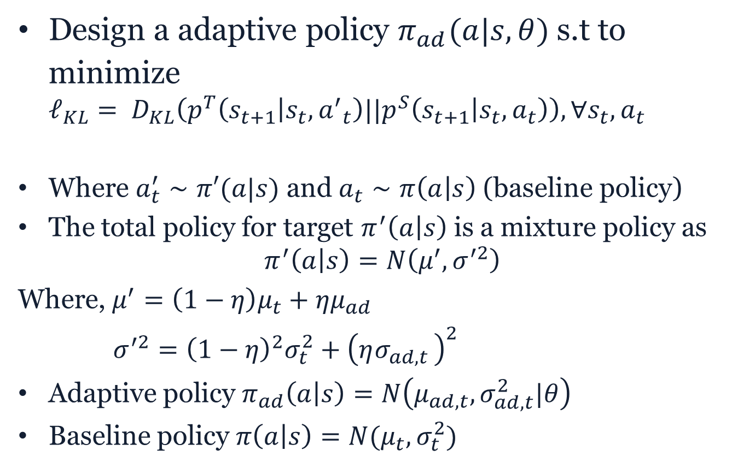
AML-Adaptive policy
Design a adaptive policy $π_{ad}(a|s, θ)$ s.t to minimize $ℓ_{KL}= D_{KL}\left(p^{T}\left(s_{t+1} | s_{t},{a^{′}}_{t}\right)||p^{S}\left(s_{t+1} | s_{t},a_{t}\right)\right), ∀s_{t}, a_{t}$
Where $a_{t}^{′}∼π′(a|s)$ and $a_{t}∼π\left(a | s\right)$ (baseline policy)
The total policy for target $π^{′}\left(a | s\right)$ is a mixture policy as
$$π^{′}\left(a | s\right)=N\left(μ^{′},σ^{′2}\right)$$
Where, ${μ^{′}=\left(1−η\right)μ}_{t}+ημ_{ad}$
$σ^{′2}={\left(1−η\right)}^{2}σ_{t}^{2}+{\left(ησ_{ad,t }\right)}^{2}$
Adaptive policy $π_{ad}\left(a | s\right)=N\left(μ_{ad,t}, σ_{ad,t}^{2}|θ\right)$
Baseline policy $π\left(a | s\right)=N(μ_{t}, σ_{t}^{2})$

Slide 7
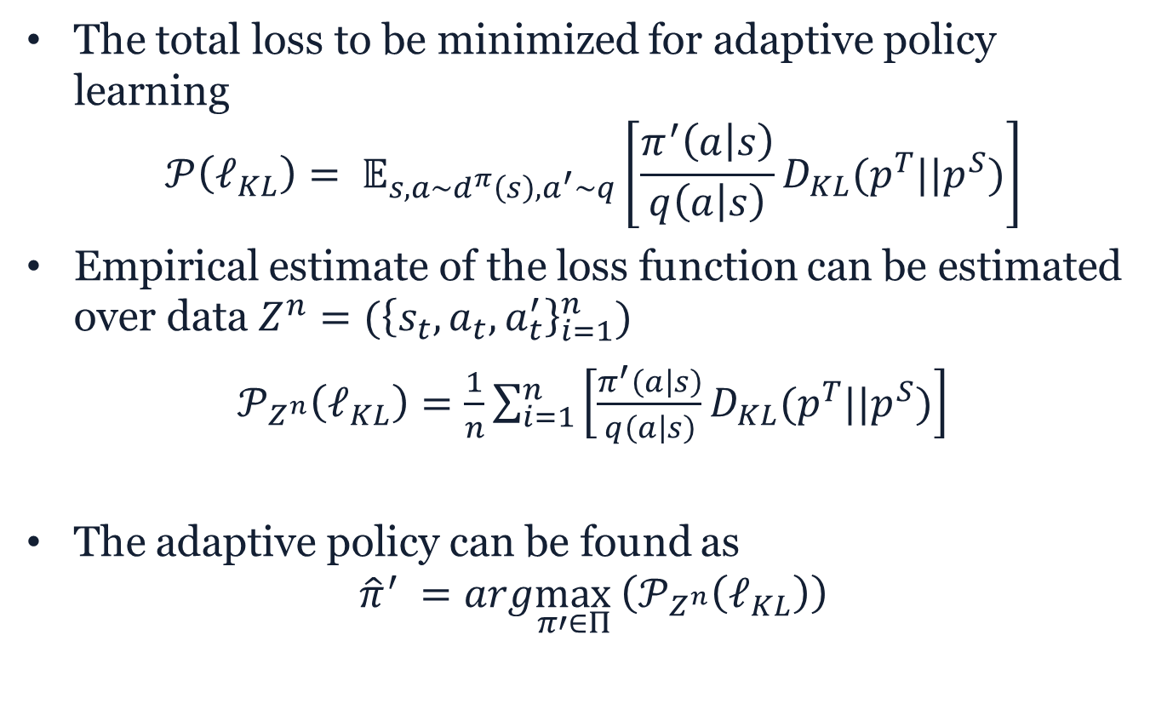
AML-Adaptive policy
The total loss to be minimized for adaptive policy learning
$$𝒫\left(ℓ_{KL}\right)= 𝔼_{s,a∼d^{π}\left(s\right), a^{′}∼q}\left[\frac{π^{′}\left(a | s\right)}{q\left(a | s\right)}D_{KL}(p^{T}||p^{S})\right]$$
Empirical estimate of the loss function can be estimated over data $Z^{n}=({\left\{s_{t},a_{t},a_{t}^{′}\right\}}_{i=1}^{n})$
$𝒫_{Z^{n}}\left(ℓ_{KL}\right)=\frac{1}{n}\sum_{i=1}^{n}{\left[\frac{π^{′}\left(a | s\right)}{q\left(a | s\right)}D_{KL}(p^{T}||p^{S})\right]}$
The adaptive policy can be found as
$${\hat{π}}^{′} =arg\max_{π′∈Π }\left(𝒫_{Z^{n}}\left(ℓ_{KL}\right)\right)$$

Slide 8
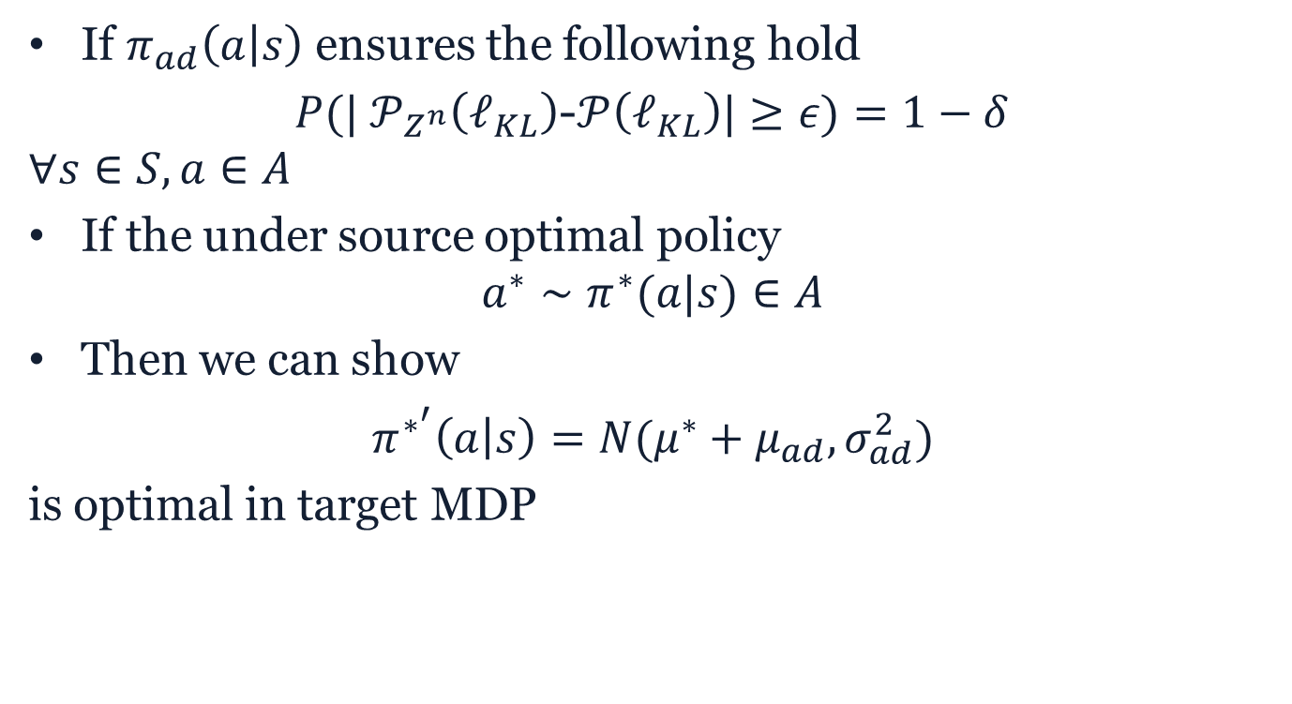
AML-Adaptive policy
If $π_{ad}\left(a | s\right)$ ensures the following hold
$P({| 𝒫}_{Z^{n}}\left(ℓ_{KL}\right)$-$𝒫\left(ℓ_{KL}\right)|≥ε)=1−δ$
$$∀s∈S, a∈A$$
If the under source optimal policy
$$a^{∗}∼π^{∗}(a|s)∈A$$
Then we can show
$π^{∗^{′}}\left(a | s\right)=N(μ^{∗}+μ_{ad}, σ_{ad}^{2})$
is optimal in target MDP

Slide 9
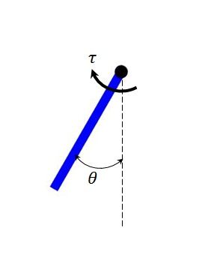
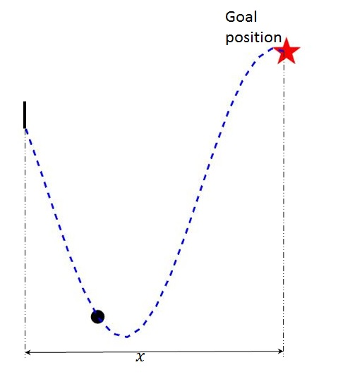
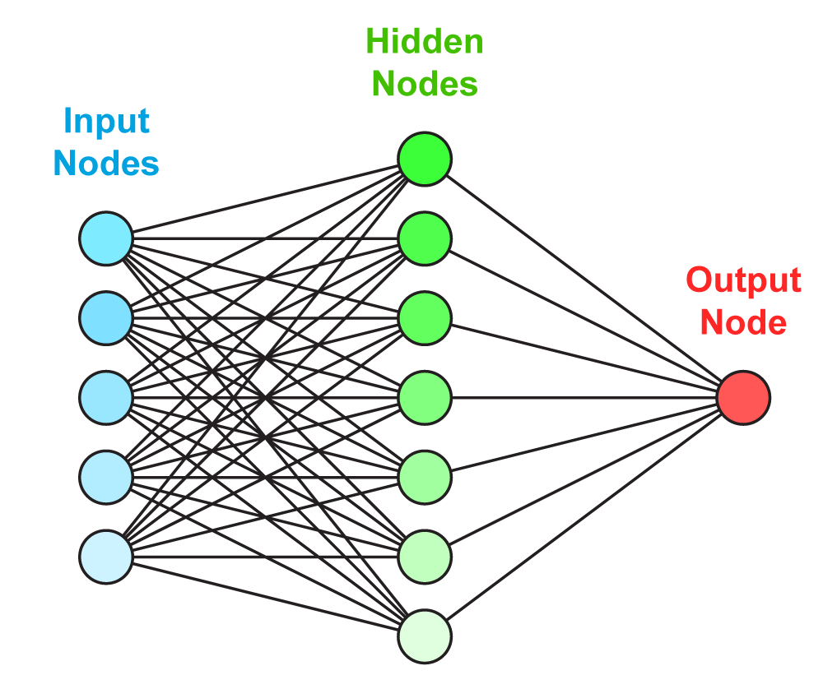
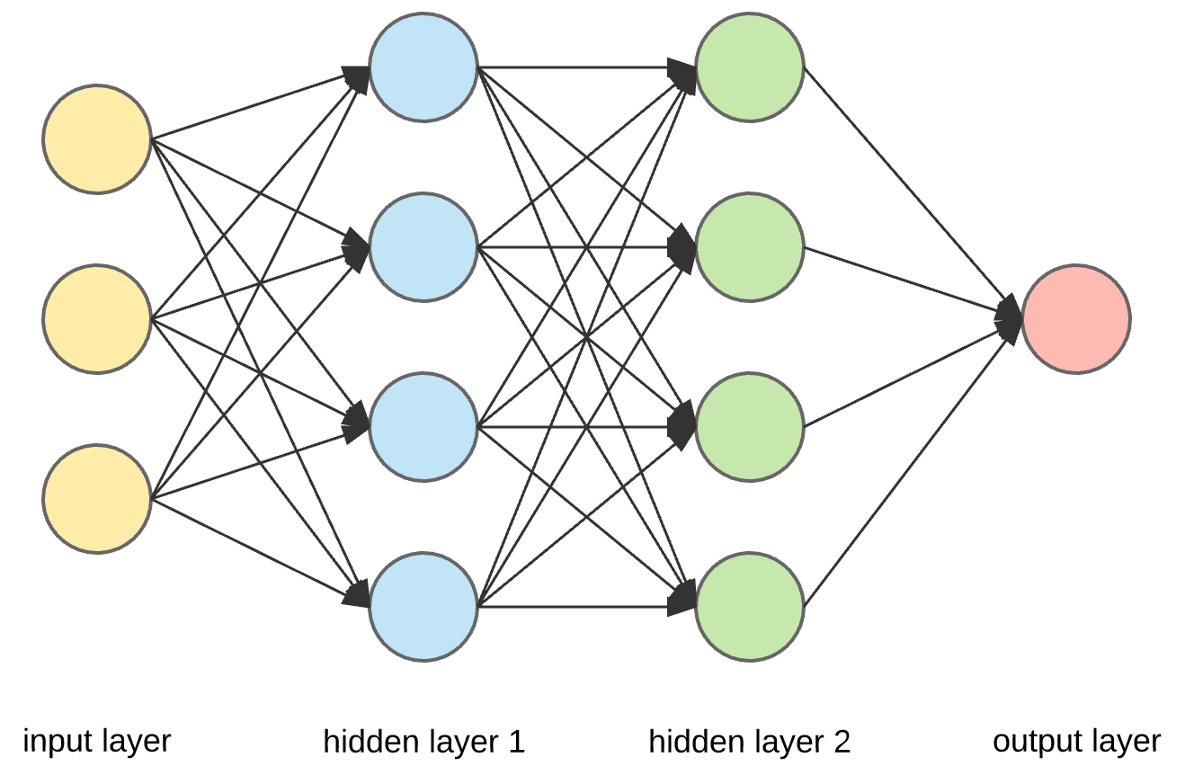

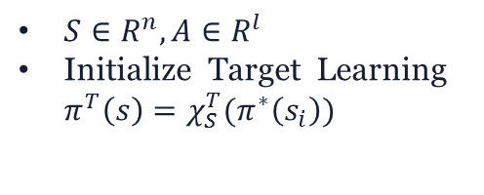
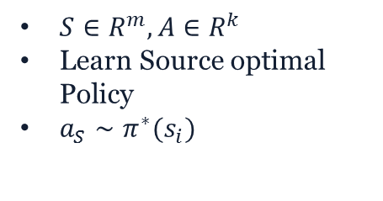





Transfer through Initialized RL [Wang et.al 2010]
Source Task
Target Task
$S∈R^{m}, A∈R^{k}$
Learn Source optimal Policy
$a_{S}∼π^{∗}(s_{i})$
$S∈R^{n}, A∈R^{l}$
Initialize Target Learning $π^{T}\left(s\right)=χ_{S}^{T}(π^{∗}\left(s_{i}\right))$
[A General Framework for Manifold Alignment
Wang & Mahadevan 2009 AAAI]
Manifold
Alignment
$$s_{T}$$
$$χ_{T}^{S}$$
$$a_{s}$$
$$a_{T}$$
$$χ_{S}^{T}$$
$$s_{s}$$

Slide 10
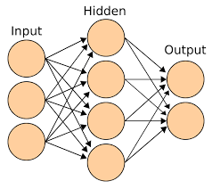


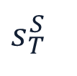

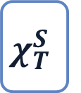

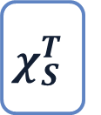



Transfer in RL through Policy Adaptation
Total Policy for Target Task
$$s_{T}^{S}$$
$$a_{T}∼χ\left(π^{∗}\left(S_{S}\right)\right)+Kπ_{ad}\left(s_{T}\right)$$
$$χ_{T}^{S}$$
$$χ_{S}^{T}$$
+
$$a_{s}^{∗}$$
K
$$s_{T}^{}$$
$$P_{S}^{T}(s_{t+1}|s_{t},a_{t})$$
$$S_{t}$$
$$S_{t+1}$$
-
$$a_{S}^{T}$$
Adaptive Policy

Slide 11
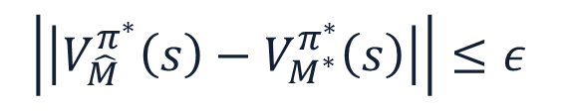
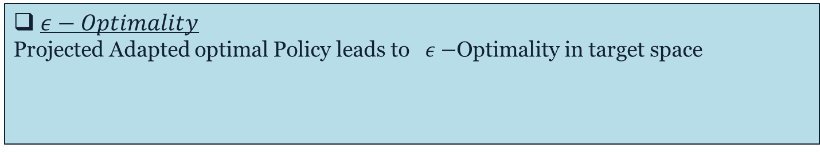
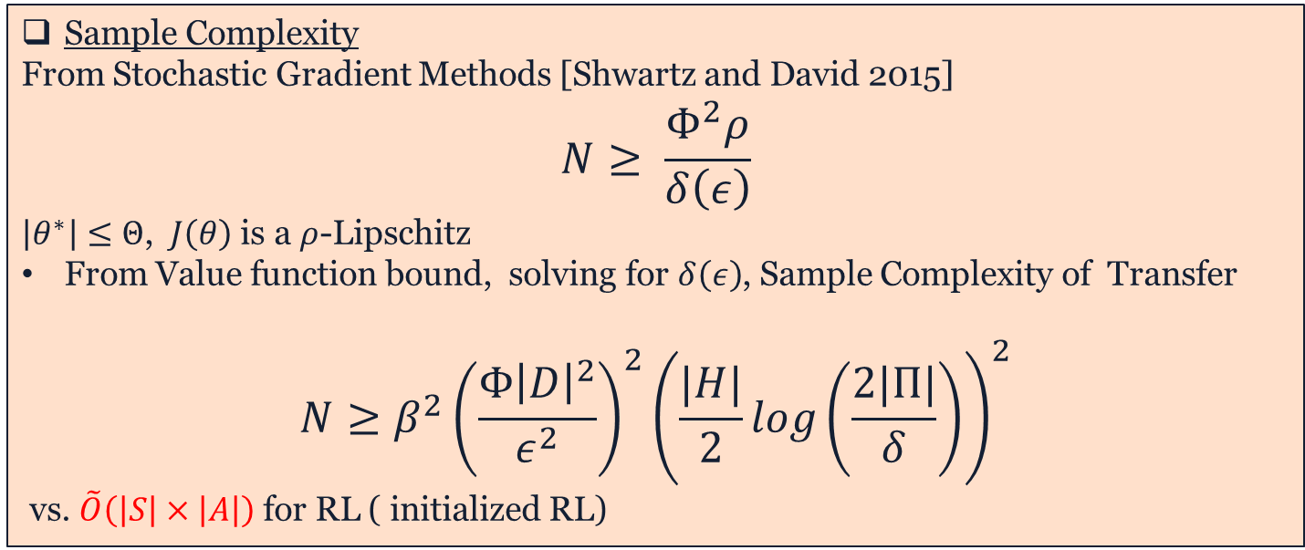
$ε−Optimality$
Projected Adapted optimal Policy leads to $ε−$Optimality in target space
$$\left|\left|V_{\hat{M}}^{π^{∗}}\left(s\right)−V_{M^{∗}}^{π^{∗}}\left(s\right)\right|\right|≤ε$$
Sample Complexity
From Stochastic Gradient Methods [Shwartz and David 2015]
$$N≥ \frac{Φ^{2}ρ}{δ\left(ε\right)}$$
$\left|θ^{∗}\right|≤Θ$, $J\left(θ\right)$ is a $ρ$-Lipschitz
From Value function bound, solving for $δ\left(ε\right)$, Sample Complexity of Transfer
$$N≥β^{2}{\left(\frac{Φ{\left|D\right|}^{2}}{ε^{2}}\right)}^{2}{\left(\frac{|H|}{2}log\left(\frac{2|Π|}{δ}\right)\right)}^{2}$$
vs. $\tilde{O}\left(\left|S\right|×\left|A\right|\right)$ for RL ( initialized RL)

Slide 12
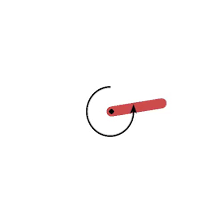
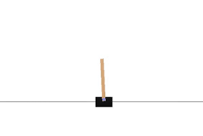
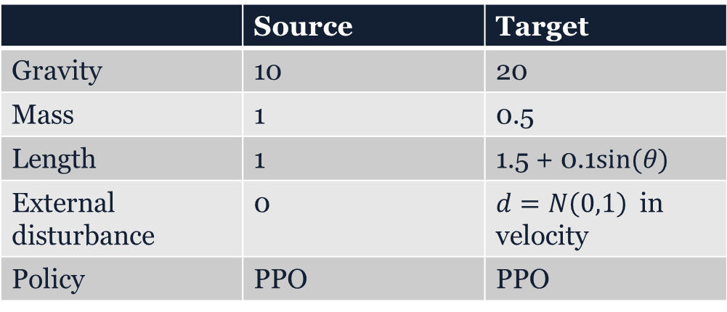
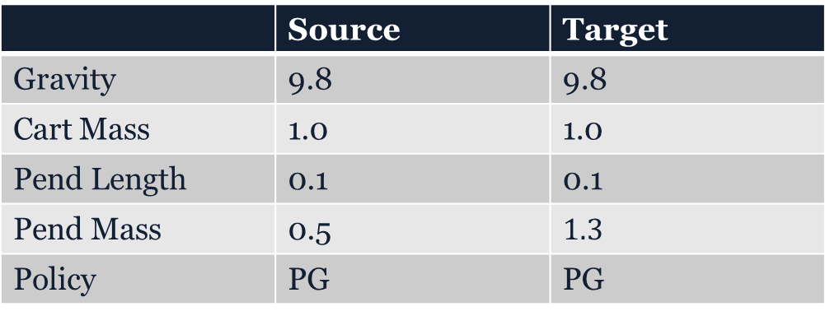
Pendulum-v0
 | Source | Target
Gravity | 10 | 20
Mass | 1 | 0.5
Length | 1 | 1.5 + 0.1$sin⁡(θ)$
External disturbance | 0 | $d=N\left(0,1\right)$ in velocity
Policy | PPO | PPO
 | Source | Target
Gravity | 9.8 | 9.8
Cart Mass | 1.0 | 1.0
Pend Length | 0.1 | 0.1
Pend Mass | 0.5 | $$1.3$$
Policy | PG | PG
CartPole-v0

Slide 13
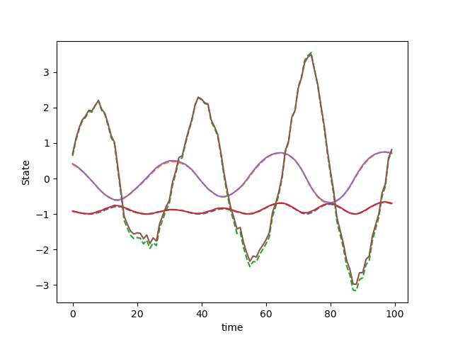
State Trajectory following under Adaptive Policy (Pendulum-v0)

Slide 14
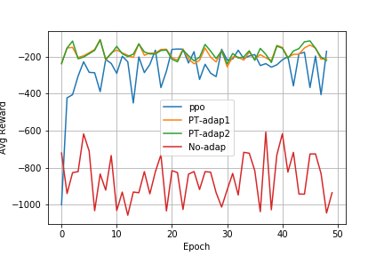
AML-Policy Transfer using PPO pendulum-v0

Slide 15
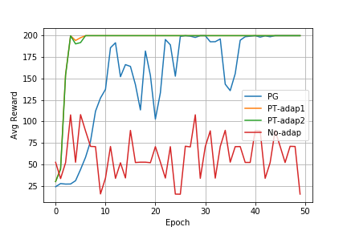
AML-Policy Transfer using PG Cartpole-v0

Slide 16
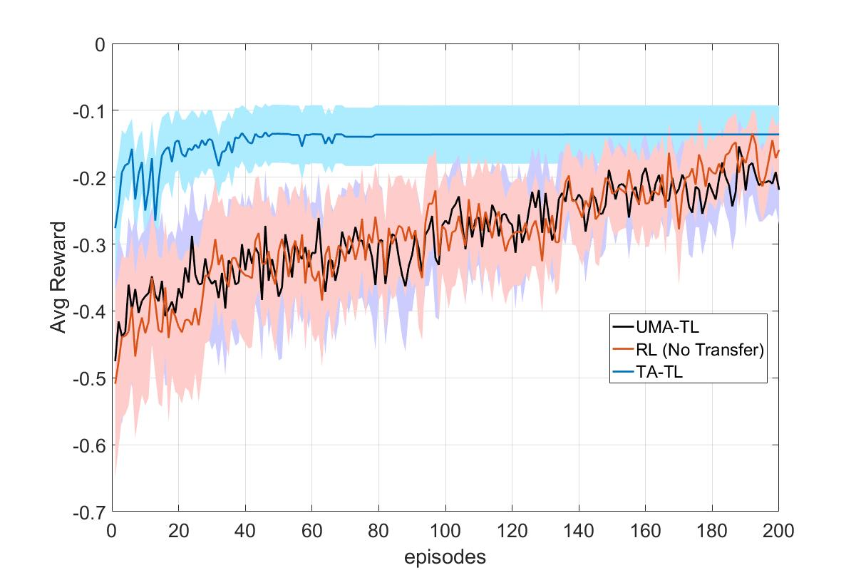
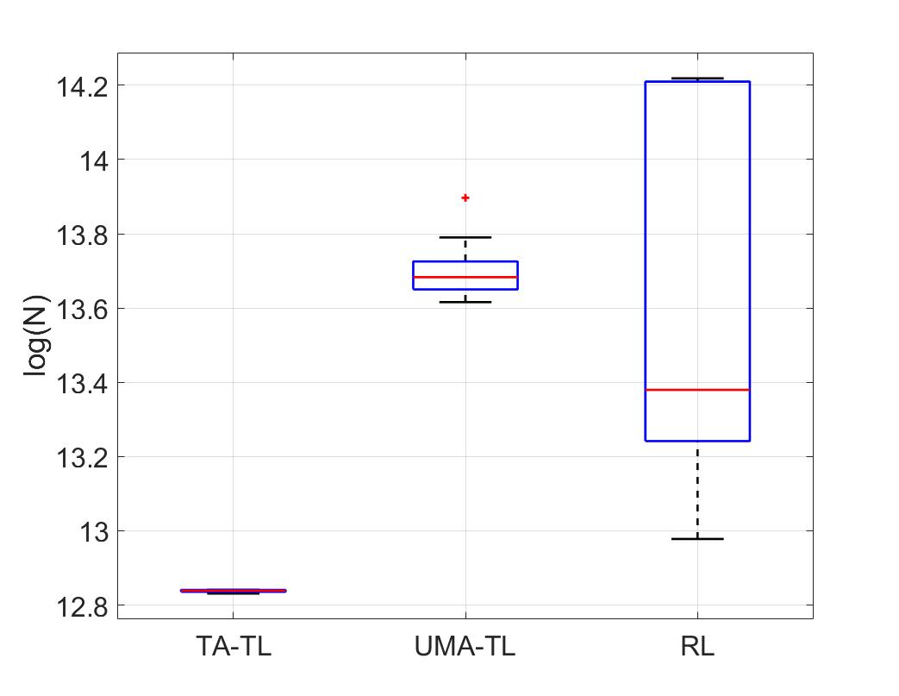
Mountain Car to Inverted Pendulum
Transfer using Policy Adaptation
Achieves faster transfer
Performs Asymptotically better than UMA-TL and RL

Slide 17
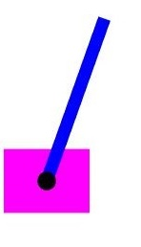
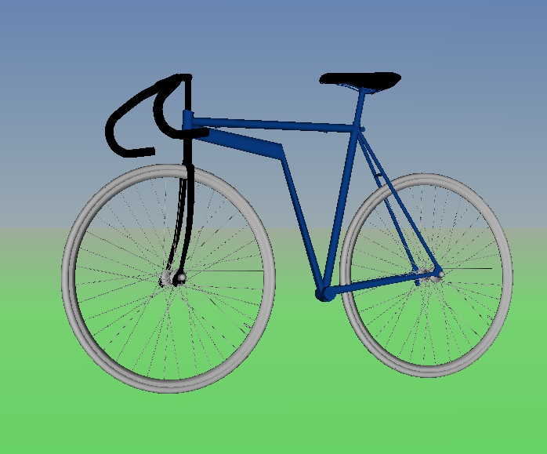
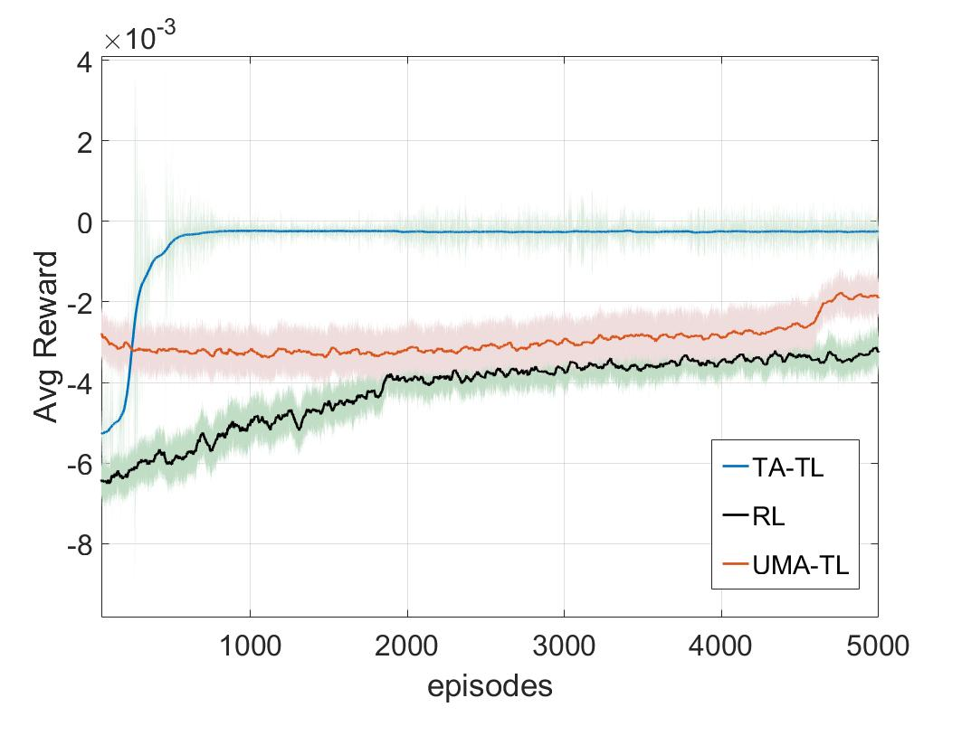
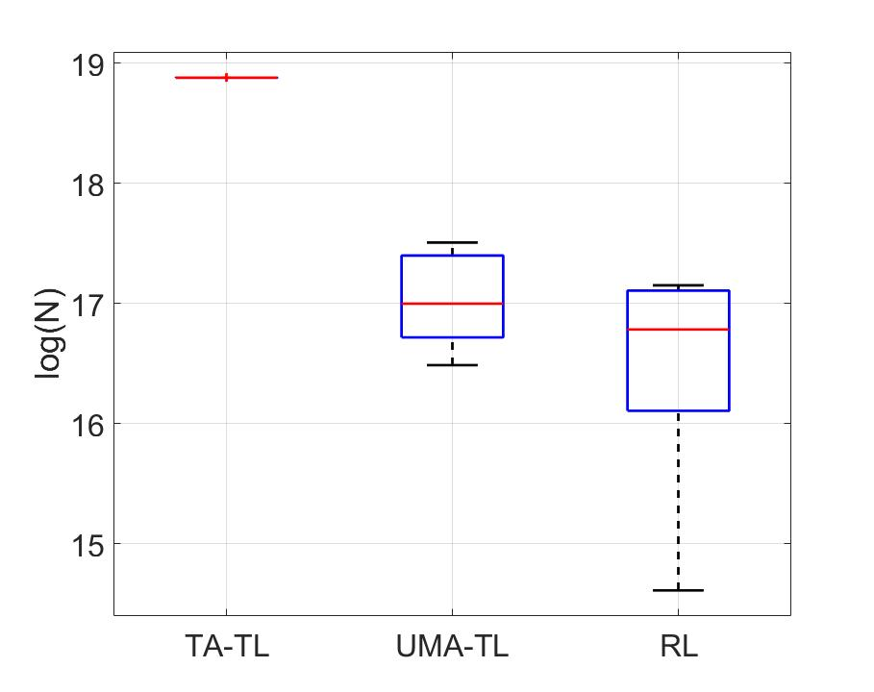
Cart-Pole to Bicycle
Simulation time for which agent was able to balance bicycle while training

