Slide 1
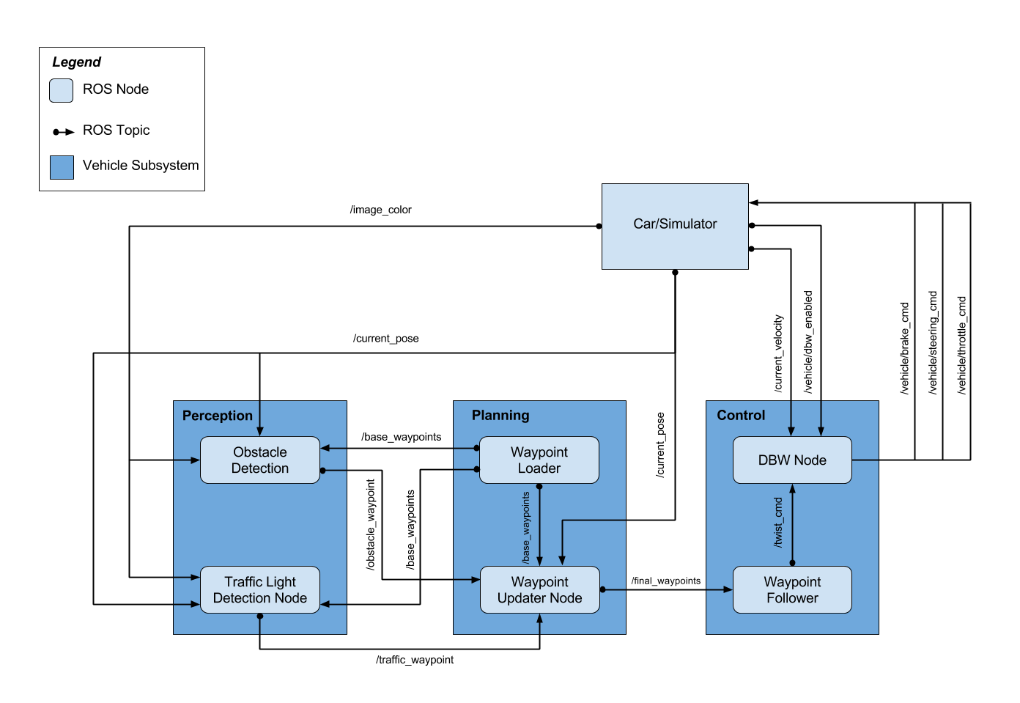
Toggle by click “manual”
Units Torque (N*m). 700 = Stop
Values:0-1
50Hz
Pid.py + lowpass.py + yaw_controller.py are implemented
List of all waypoints: 1 time publish
waypoints currently ahead of the vehicle: 50hz
Twist_controller.py
TensorFlow 1.3.0
First
Second
Acc max = 10m/s^2
Jerk max = 10m/s^2
For training: /vehicle/traffic_lights
Third
Optional

