Slide 1
Intermediate Statistics
Lecture 9: Introduction to Causal Inference and Matching
March 20, 2024
HAD5772 • Alex Hoagland, Ph.D.
Notes:
Add slides on how to evaluate an RCT (simple example?)

Slide 2
Last Time
How do we evaluate a regression?
What do we need for causal inference?
Propensity score matching
This Time
Survival Analysis: evaluating dynamics (time since/until events)
Mixed Methods: integrating quantitative + qualitative research

Slide 3
Survival Analysis

Slide 4
**Slide 4: Kaplan-Meier Estimator**
- **Key Features:**
- Estimates survival probability over time.
- Suitable for censored data.
- **Formula:**
- \( S(t) = \prod_{t_i < t} (1 - \frac{d_i}{n_i}) \)
- Where \(d_i\) is the number of events at time \(t_i\) and \(n_i\) is the number of subjects at risk just before time \(t_i\).
---
**Slide 5: Example of Kaplan-Meier Curve**
- *Insert a graph illustrating the Kaplan-Meier survival curve.*
- **Interpretation:** The curve represents the estimated probability of survival over time.
---
**Slide 6: Cox Proportional Hazards Model**
- **Assumptions:**
- Proportional hazards assumption.
- Linear relationship between covariates and log-hazard.
- **Formula:**
- \( h(t|x) = h_0(t) \cdot e^{\beta_1x_1 + \beta_2x_2 + ... + \beta_px_p} \)
---
**Slide 7: Cox Proportional Hazards Model (Contd.)**
- **Interpretation:**
- \(h(t|x)\): Hazard at time \(t\) for a subject with covariates \(x\).
- \(h_0(t)\): Baseline hazard function.
- \(x_1, x_2, ..., x_p\): Covariates.
- \(\beta_1, \beta_2, ..., \beta_p\): Coefficients.
---
**Slide 8: Parametric Survival Models**
- **Key Points:**
- Assumes a specific distribution for survival times (e.g., exponential, Weibull).
- Requires fewer assumptions if the chosen distribution fits the data well.
---
**Slide 9: Application in Health Systems Research**
- **Example:**
- Assessing the effectiveness of a new treatment on cancer patient survival rates.
- Predicting the time to readmission after a surgical procedure.
- Analyzing factors influencing the time to recovery from a disease outbreak.
---
**Slide 10: Considerations in Survival Analysis**
- **Censoring:**
- Types of censoring (right, left, interval).
- Methods to handle censoring (Kaplan-Meier, Cox regression).
- **Variable Selection:**
- Choosing relevant covariates.
- Avoiding overfitting.
Notes:
We’re gonna touch on more threats to internal validity now.

Slide 5
What is Survival Analysis?
What if our outcome isn’t an event, but how long it takes for an event to occur?
Patient survival
Effectiveness of treatment (time until symptoms reappear)
Disease progression
Etc.
Notes:
We’re gonna touch on more threats to internal validity now.

Slide 6
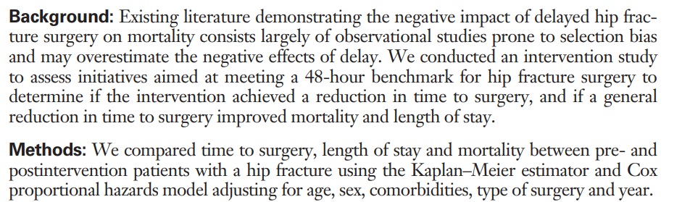
What is Survival Analysis?
So what’s the research question?

Slide 7
What is Survival Analysis?
Why is this setting important?
Following fracture, mortality ranges from 4% at 1 month3 to 33% at 1 year, with approximately 70% of deaths at 1 year attributed to the hip fracture.
This is 7000 deaths annually!
Most important ways to handle this: prevention and timely surgery (48 hours)
Notes:
What does this paper do? Adds causal evidence using an RCT (adequately powered)

Slide 8
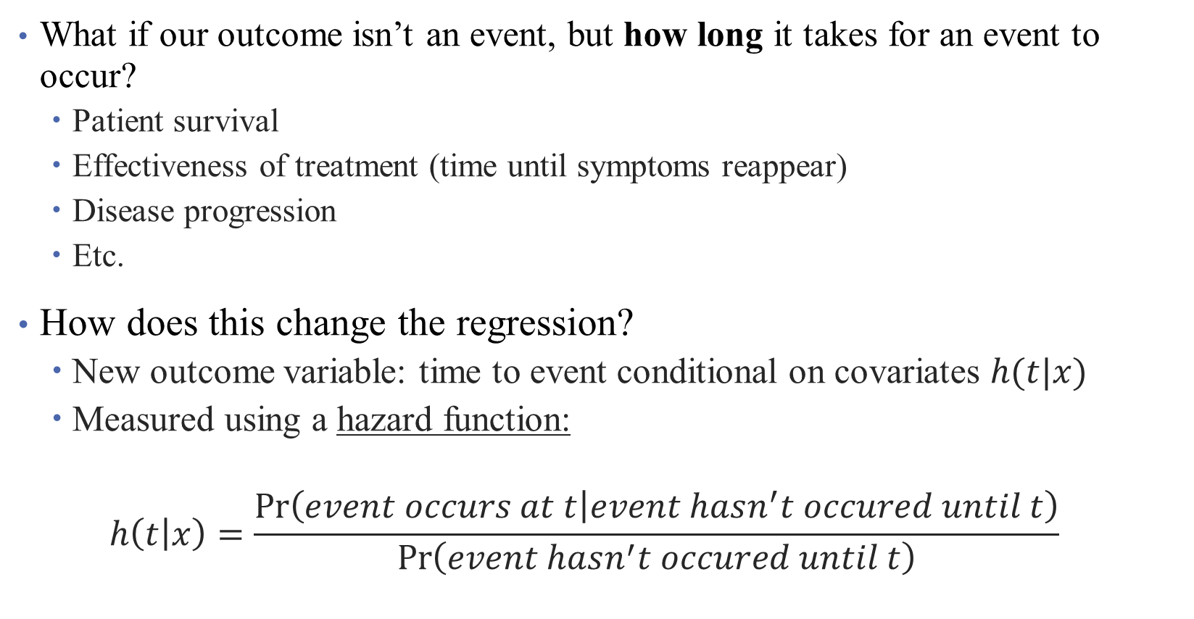
What is Survival Analysis?
What if our outcome isn’t an event, but how long it takes for an event to occur?
Patient survival
Effectiveness of treatment (time until symptoms reappear)
Disease progression
Etc.
How does this change the regression?
New outcome variable: time to event conditional on covariates $h(t|x)$
Measured using a hazard function:
$$h\left(t | x\right)=\frac{\operatorname{Pr}\left(event occurs at t | event hasn^{′}t occured until t\right)}{\operatorname{Pr}\left(event hasn^{′}t occured until t\right)}$$
Notes:
We’re gonna touch on more threats to internal validity now.

Slide 9
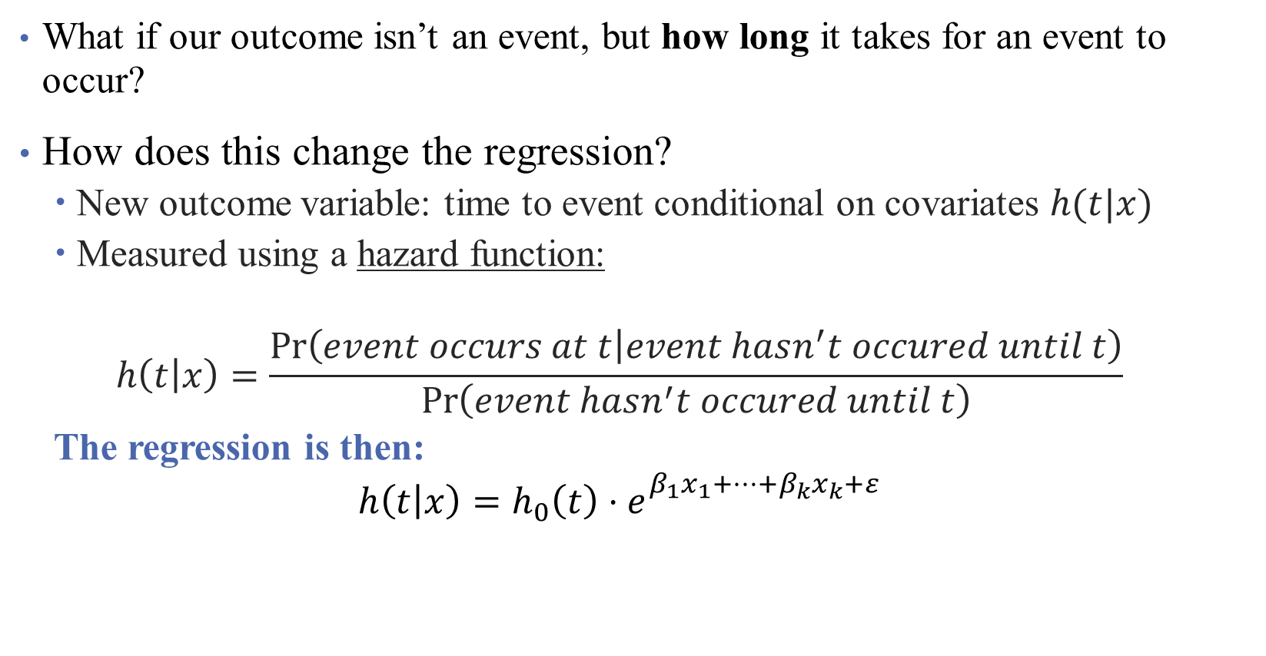
What is Survival Analysis?
What if our outcome isn’t an event, but how long it takes for an event to occur?
How does this change the regression?
New outcome variable: time to event conditional on covariates $h(t|x)$
Measured using a hazard function:
$$h\left(t | x\right)=\frac{\operatorname{Pr}\left(event occurs at t | event hasn^{′}t occured until t\right)}{\operatorname{Pr}\left(event hasn^{′}t occured until t\right)}$$
The regression is then:
$$h\left(t | x\right)=h_{0}\left(t\right)⋅e_{}^{β_{1}x_{1}+…+β_{k}x_{k}+ε}$$
Notes:
Notice that this is a little different, but what if we take logs? Now we’re back to a linear regression! How do we interpret the coefficients here?

Slide 10
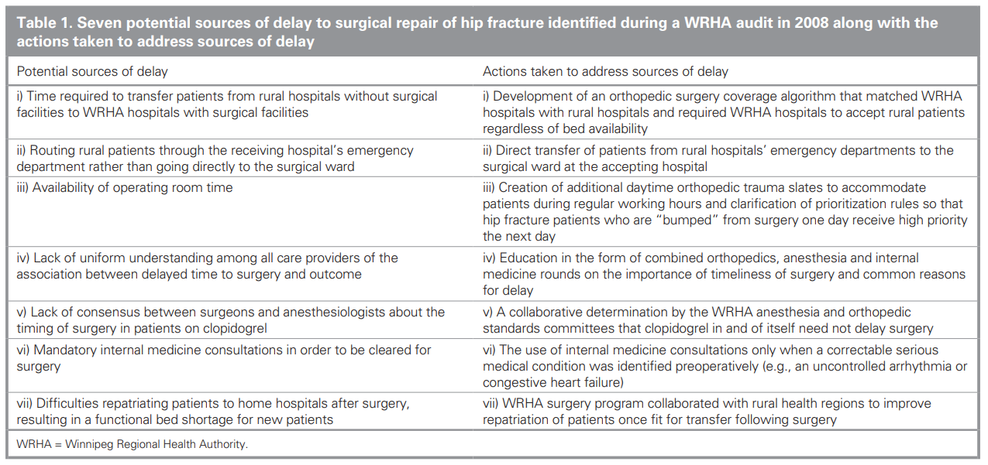
Research Setting: Intervention and Context
2008 intervention to improve time to surgery in Winnipeg:

Slide 11
Research Setting: Intervention and Context
Inclusion Criteria:
Patients 50 and older
Admitted in the WRHA
Admitted for a hip fracture
Notes:
WRHA: Winnipeg. (Is this generalizable?)
How do we think about the external validity of this regression given these features?

Slide 12
Research Setting: Intervention and Context
Comparison Group:
Jan. 1, 2004 through Dec. 31, 2007
Inclusion Criteria:
Patients 50 and older
Admitted in the WRHA
Admitted for a hip fracture
Exclusion Criteria:
Jan. 1, 2008 through Dec. 31, 2008
Treatment Group:
Jan. 1, 2009 through Dec. 31, 2012
Notes:
What do we think about this? What might be missing?

Slide 13
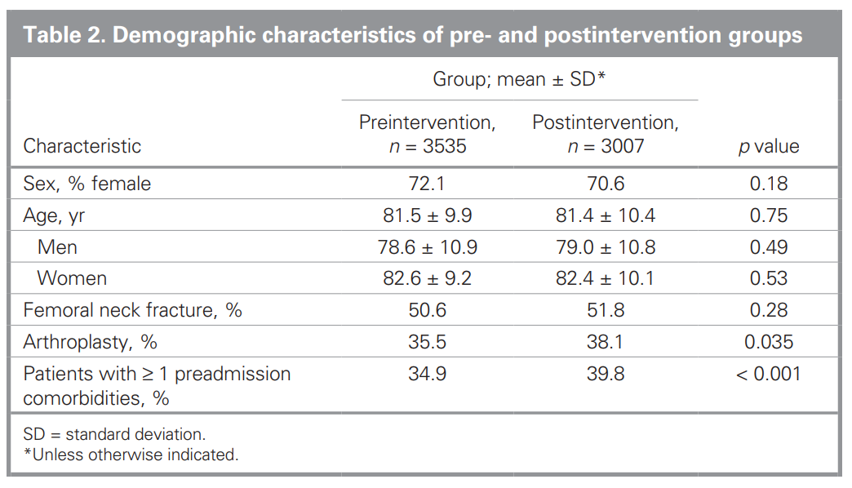
Assessing Internal Validity
Notes:
What is this telling us? Is it convincing?

Slide 14
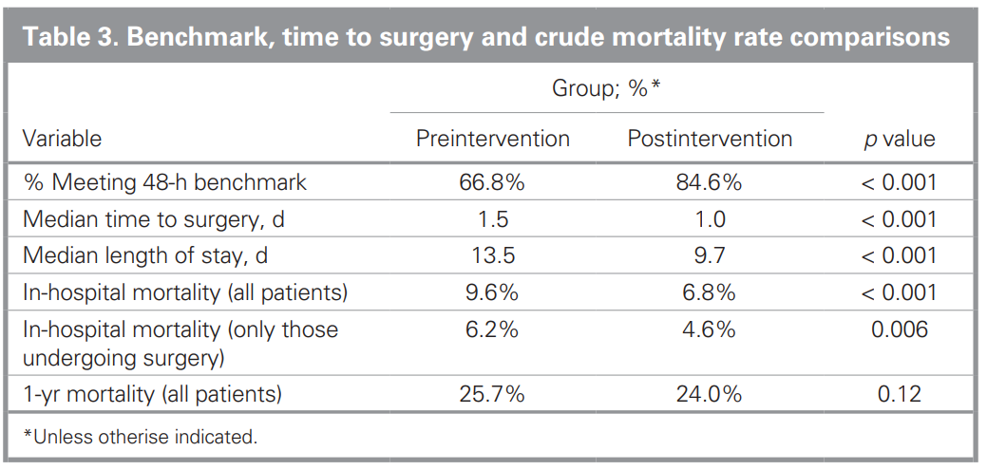
Assessing “First Stage”
Notes:
What is this telling us? Is it convincing? “The trend toward improved mortality still did not reach statistical significance”

Slide 15
Assessing “First Stage”
What is this? “The trend toward improved mortality still did not reach statistical significance”
Notes:
What is this telling us? Is it convincing? “The trend toward improved mortality still did not reach statistical significance”

Slide 16
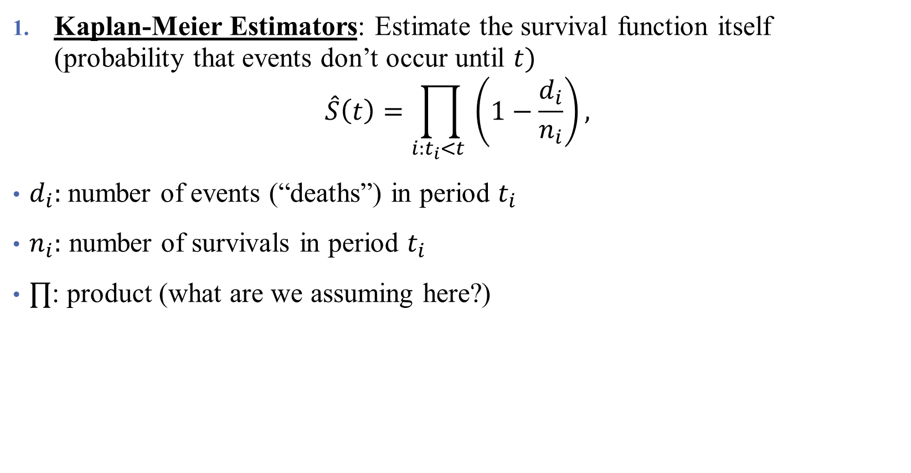
Types of Survival Analysis
Kaplan-Meier Estimators: Estimate the survival function itself (probability that events don’t occur until $t)$
$$\hat{S}\left(t\right)=\prod_{i:t_{i}<t }{\left(1−\frac{d_{i}}{n_{i}}\right)},$$
$d_{i}:$number of events (“deaths”) in period $t_{i}$
$n_{i}:$ number of survivals in period $t_{i}$
$∏$: product (what are we assuming here?)
Notes:
Assuming independence across periods (is this a valid assumption)?

Slide 17
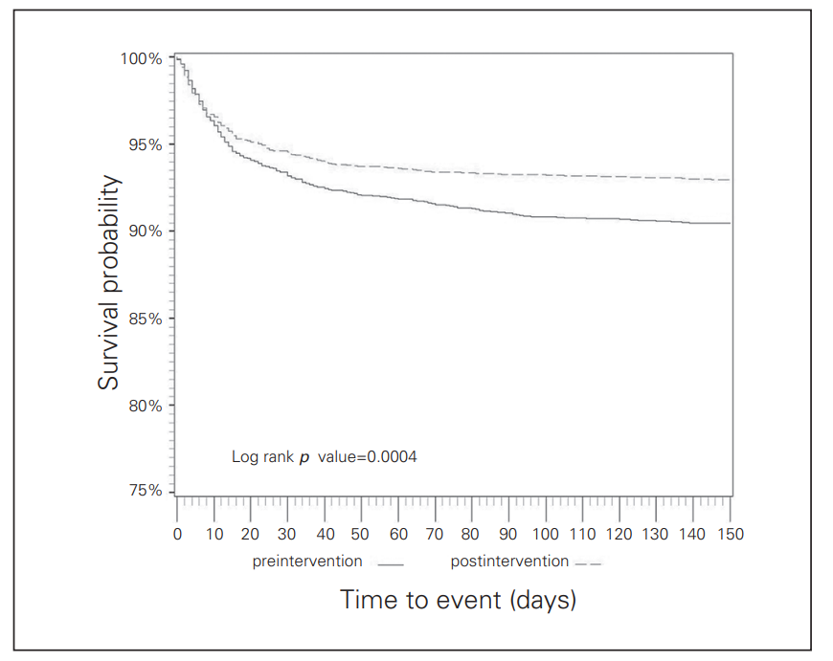

Types of Survival Analysis
Kaplan-Meier Estimators: Estimate the survival function itself (probability that events don’t occur until $t)$
post-op mortality
Log-rank p value: test the null hypothesis of no difference between groups
How big are the differences, and how likely are they given the baseline outcomes?
Notes:
Assuming independence across periods (is this a valid assumption)?

Slide 18
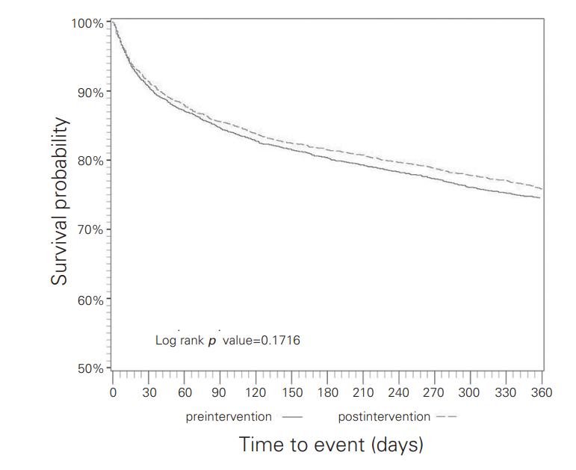

Types of Survival Analysis
Kaplan-Meier Estimators: Estimate the survival function itself (probability that events don’t occur until $t)$
- overall 1-year mortality
Notes:
Assuming independence across periods (is this a valid assumption)?

Slide 19

Types of Survival Analysis
Kaplan-Meier Estimators: Estimate the survival function itself (probability that events don’t occur until $t)$
Cox Proportional Hazard Models: Estimate the effect of covariates on survival time.
Can include covariates (age, sex, type of surgery and presence of comorbidities)
Centred year of surgery variable (time fixed effect)
Notes:
We’re gonna touch on more threats to internal validity now.

Slide 20
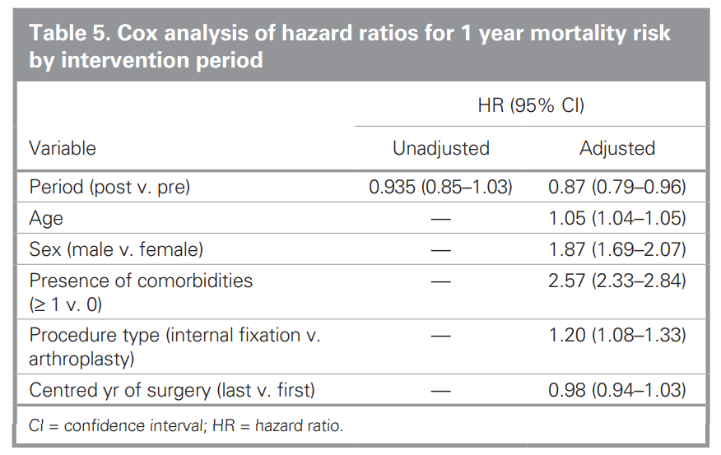

Types of Survival Analysis
Kaplan-Meier Estimators: Estimate the survival function itself (probability that events don’t occur until $t)$
Cox Proportional Hazard Models: Estimate the effect of covariates on survival time.
- overall 1-year mortality
- can be combined with regression
adjustment

Slide 21
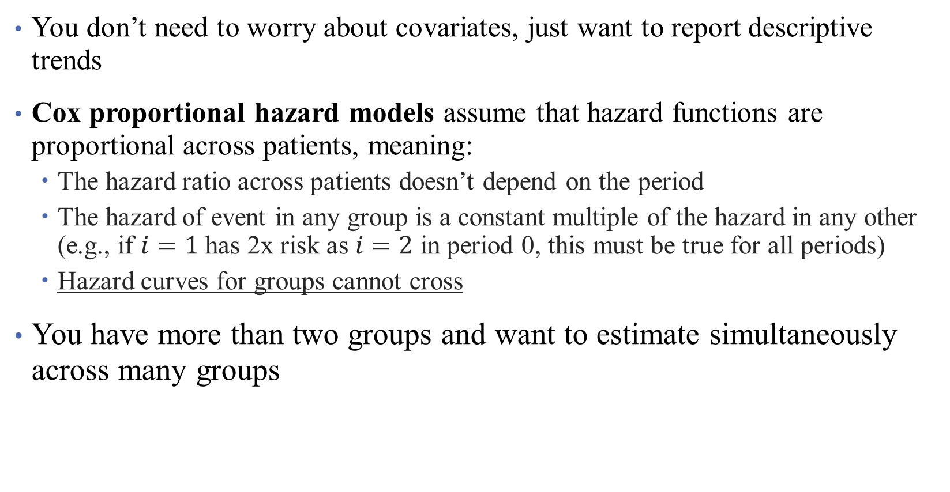
Why Choose (1) over (2)?
You don’t need to worry about covariates, just want to report descriptive trends
Cox proportional hazard models assume that hazard functions are proportional across patients, meaning:
The hazard ratio across patients doesn’t depend on the period
The hazard of event in any group is a constant multiple of the hazard in any other (e.g., if $i=1$ has 2x risk as $i=2$ in period 0, this must be true for all periods)
Hazard curves for groups cannot cross
You have more than two groups and want to estimate simultaneously across many groups

Slide 22
What do we need for causality?
Same model-based assumptions we have used so far (what are these?)
No selection across groups (design-based) (are these met?)
No interference across groups (what does this mean?)
Additionally: correct specification of the hazard function
Some common issues:
Time origin (what is the starting point? What is the end point?)
Censoring data (am I truly observing the population?)

Slide 23
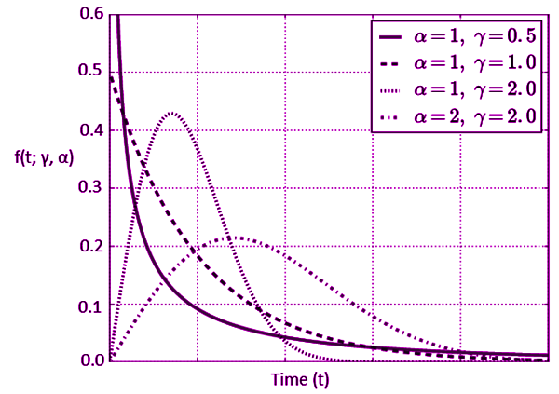

Types of Survival Analysis
Kaplan-Meier Estimators: Estimate the survival function itself (probability that events don’t occur until $t)$
Cox Proportional Hazard Models: Estimate the effect of covariates on survival time.
Parametric Models: take stronger stances on survival times (e.g., exponential, Weibull distributions).
Notes:
We’re gonna touch on more threats to internal validity now.

Slide 24
Interpretation and Limitations of Analysis
What worked well in this analysis?
What was lacking?
What are the takeaways for you?
What might limit the takeaways? What hinders your approach to thinking of this as causal?
Any other thoughts?
Notes:
I don’t think they did a super good job dealing with this. Their limitations are all “fake” limitations.

Slide 25
Thoughts?
“We are aware of 3 other studies that incorporated a control group to study the effectiveness of similar interventions. These studies were limited by small sample sizes and did not detect an effect on mortality.”
“Finally, it is not possible for us to say with certainty which of our intervention initiatives ultimately led to the observed improvements, or to measure the effect of other unrecognized changes on the improvements. It is possible that at least part of the observed reduction in LOS is attributable to improved repatriation of patients to their home hospitals after surgery. Nonetheless, our findings of reduced adjusted risk of death in those patients undergoing surgery within 48 hours, regardless of time period, underscore the role of timely surgery in reducing mortality.”
Papers to consider:
https://www.ncbi.nlm.nih.gov/pmc/articles/PMC3653612/
https://arxiv.org/pdf/2307.11971.pdf
Notes:
What are these saying?

Slide 26
Mixed Methods

