Slide 1
Intermediate Statistics
Lecture 9: Introduction to Causal Inference and Matching
March 20, 2024
HAD5772 • Alex Hoagland, Ph.D.
Notes:
Add slides on how to evaluate an RCT (simple example?)

Slide 2
Last Time
How do we evaluate a regression?
What do we need for causal inference?
Propensity score matching
This Time
Survival Analysis: evaluating dynamics (time since/until events)
Mixed Methods: integrating quantitative + qualitative research

Slide 3
Survival Analysis

Slide 4
What is Survival Analysis?
What if our outcome isn’t an event, but how long it takes for an event to occur?
Patient survival
Effectiveness of treatment (time until symptoms reappear)
Disease progression
Etc.
Notes:
We’re gonna touch on more threats to internal validity now.

Slide 5
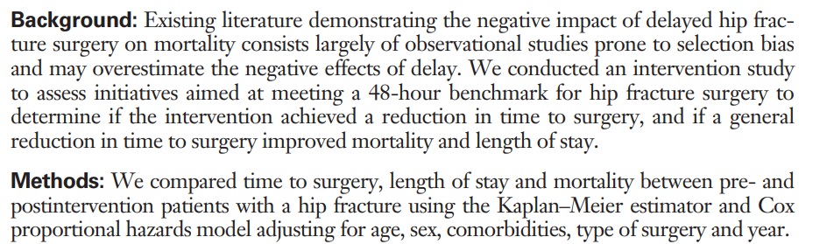
What is Survival Analysis?
So what’s the research question?

Slide 6
What is Survival Analysis?
Why is this setting important?
Following fracture, mortality ranges from 4% at 1 month3 to 33% at 1 year, with approximately 70% of deaths at 1 year attributed to the hip fracture.
This is 7000 deaths annually!
Most important ways to handle this: prevention and timely surgery (48 hours)
Notes:
What does this paper do? Adds causal evidence using an RCT (adequately powered)

Slide 7
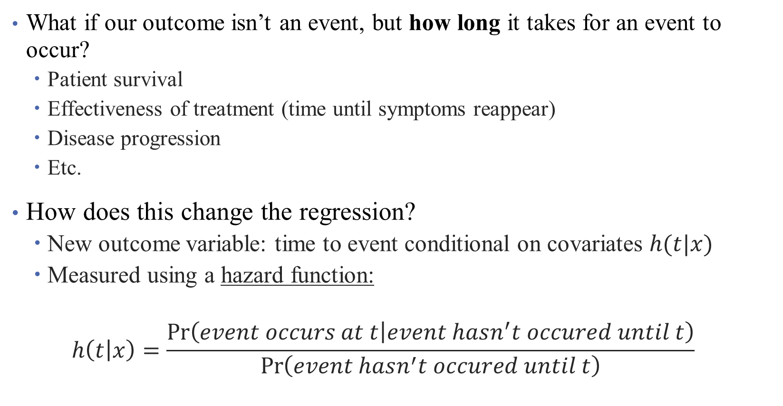
What is Survival Analysis?
What if our outcome isn’t an event, but how long it takes for an event to occur?
Patient survival
Effectiveness of treatment (time until symptoms reappear)
Disease progression
Etc.
How does this change the regression?
New outcome variable: time to event conditional on covariates $h(t|x)$
Measured using a hazard function:
$$h\left(t | x\right)=\frac{\operatorname{Pr}\left(event occurs at t | event hasn^{′}t occured until t\right)}{\operatorname{Pr}\left(event hasn^{′}t occured until t\right)}$$
Notes:
We’re gonna touch on more threats to internal validity now.

Slide 8
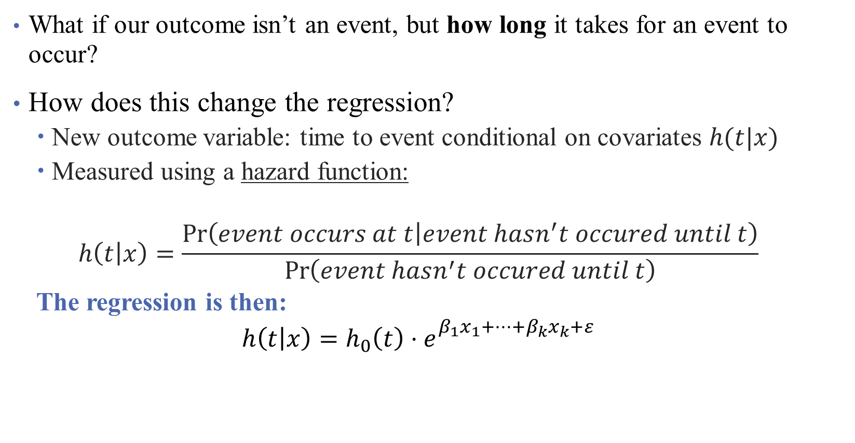
What is Survival Analysis?
What if our outcome isn’t an event, but how long it takes for an event to occur?
How does this change the regression?
New outcome variable: time to event conditional on covariates $h(t|x)$
Measured using a hazard function:
$$h\left(t | x\right)=\frac{\operatorname{Pr}\left(event occurs at t | event hasn^{′}t occured until t\right)}{\operatorname{Pr}\left(event hasn^{′}t occured until t\right)}$$
The regression is then:
$$h\left(t | x\right)=h_{0}\left(t\right)⋅e_{}^{β_{1}x_{1}+…+β_{k}x_{k}+ε}$$
Notes:
Notice that this is a little different, but what if we take logs? Now we’re back to a linear regression! How do we interpret the coefficients here?

Slide 9
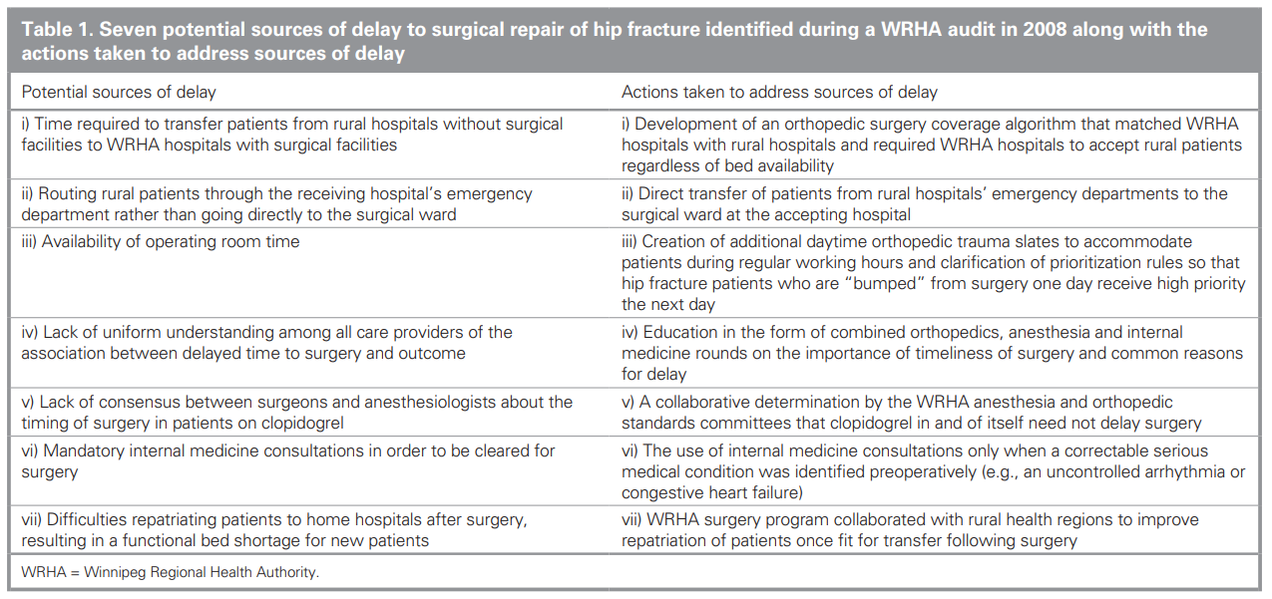
Research Setting: Intervention and Context
2008 intervention to improve time to surgery in Winnipeg:

Slide 10
Research Setting: Intervention and Context
Inclusion Criteria:
Patients 50 and older
Admitted in the WRHA
Admitted for a hip fracture
Notes:
WRHA: Winnipeg. (Is this generalizable?)
How do we think about the external validity of this regression given these features?

Slide 11
Research Setting: Intervention and Context
Comparison Group:
Jan. 1, 2004 through Dec. 31, 2007
Inclusion Criteria:
Patients 50 and older
Admitted in the WRHA
Admitted for a hip fracture
Exclusion Criteria:
Jan. 1, 2008 through Dec. 31, 2008
Treatment Group:
Jan. 1, 2009 through Dec. 31, 2012
Notes:
What do we think about this? What might be missing?

Slide 12
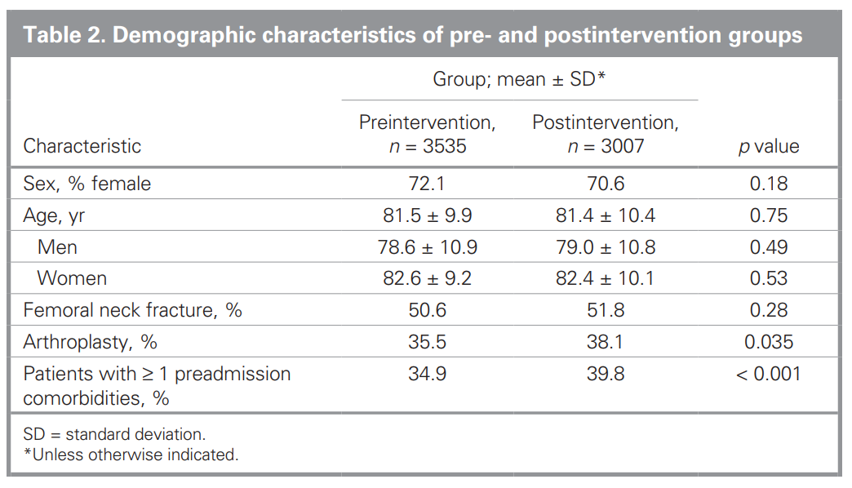
Assessing Internal Validity
Notes:
What is this telling us? Is it convincing?

Slide 13
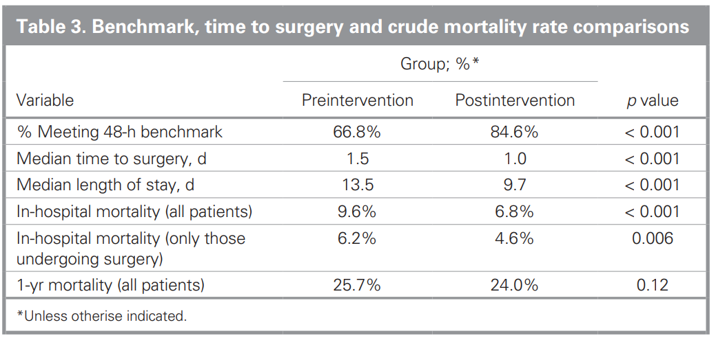
Assessing “First Stage”
Notes:
What is this telling us? Is it convincing? “The trend toward improved mortality still did not reach statistical significance”

Slide 14
Assessing “First Stage”
What is this? “The trend toward improved mortality still did not reach statistical significance”
Notes:
What is this telling us? Is it convincing? “The trend toward improved mortality still did not reach statistical significance”

Slide 15
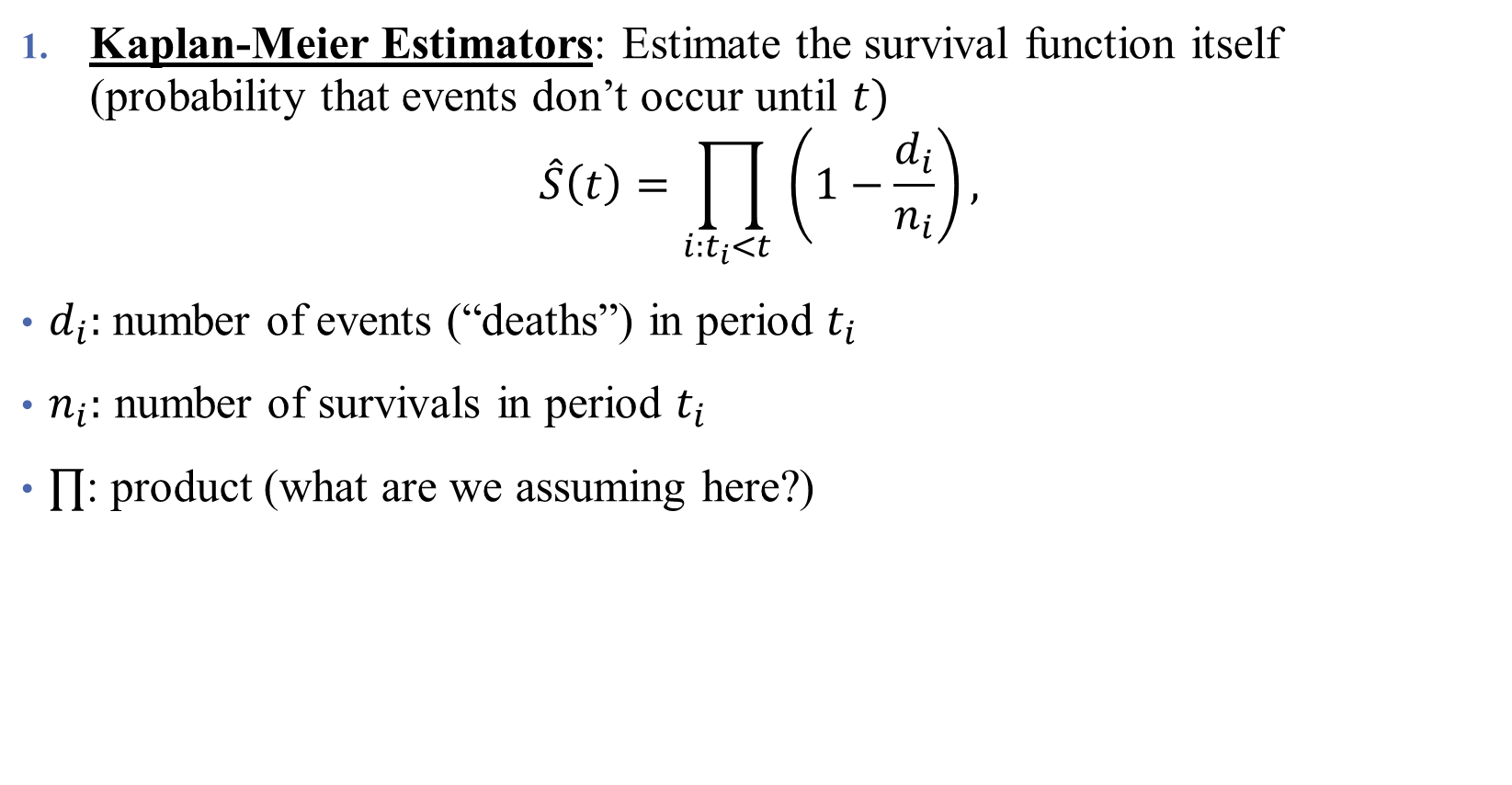
Types of Survival Analysis
Kaplan-Meier Estimators: Estimate the survival function itself (probability that events don’t occur until $t)$
$$\hat{S}\left(t\right)=\prod_{i:t_{i}<t }{\left(1−\frac{d_{i}}{n_{i}}\right)},$$
$d_{i}:$number of events (“deaths”) in period $t_{i}$
$n_{i}:$ number of survivals in period $t_{i}$
$∏$: product (what are we assuming here?)
Notes:
Assuming independence across periods (is this a valid assumption)?

Slide 16
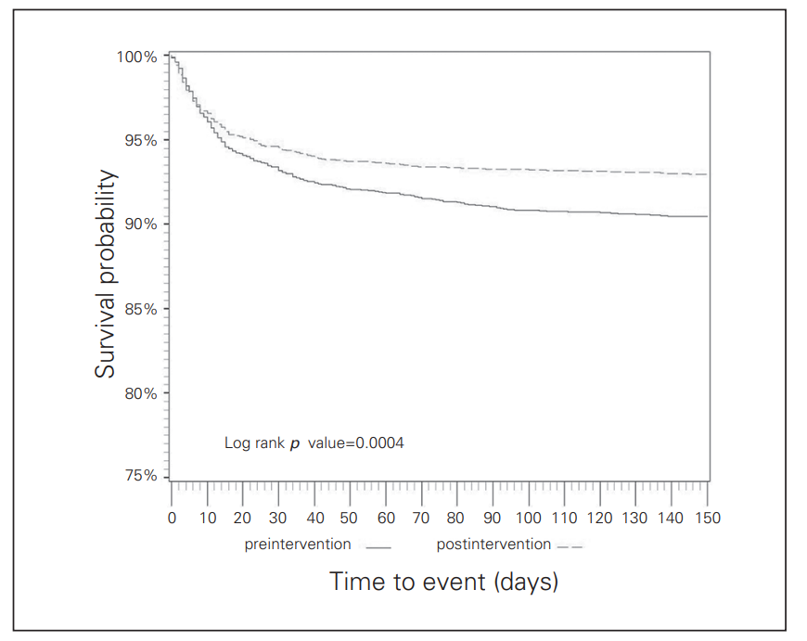

Types of Survival Analysis
Kaplan-Meier Estimators: Estimate the survival function itself (probability that events don’t occur until $t)$
post-op mortality
Log-rank p value: test the null hypothesis of no difference between groups
How big are the differences, and how likely are they given the baseline outcomes?
Notes:
Assuming independence across periods (is this a valid assumption)?

Slide 17
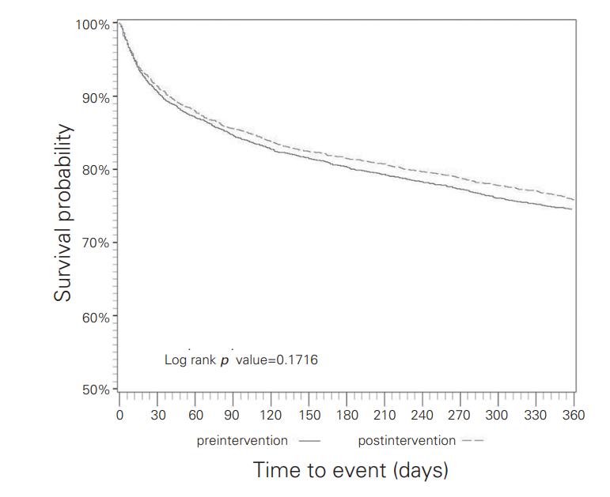

Types of Survival Analysis
Kaplan-Meier Estimators: Estimate the survival function itself (probability that events don’t occur until $t)$
- overall 1-year mortality
Notes:
Assuming independence across periods (is this a valid assumption)?

Slide 18

Types of Survival Analysis
Kaplan-Meier Estimators: Estimate the survival function itself (probability that events don’t occur until $t)$
Cox Proportional Hazard Models: Estimate the effect of covariates on survival time.
Can include covariates (age, sex, type of surgery and presence of comorbidities)
Centred year of surgery variable (time fixed effect)
Notes:
We’re gonna touch on more threats to internal validity now.

Slide 19
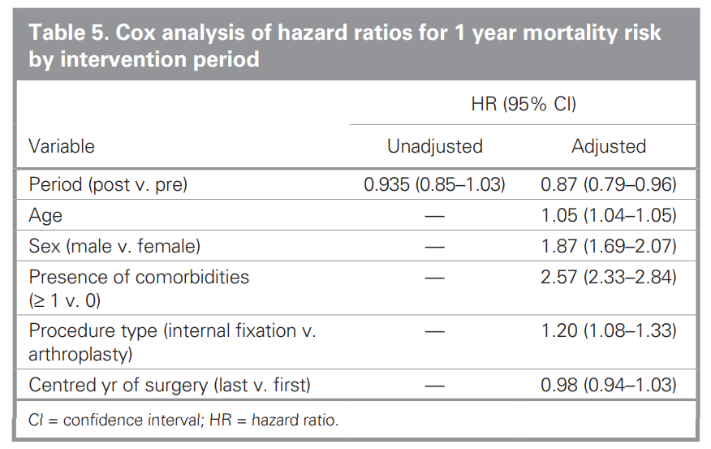

Types of Survival Analysis
Kaplan-Meier Estimators: Estimate the survival function itself (probability that events don’t occur until $t)$
Cox Proportional Hazard Models: Estimate the effect of covariates on survival time.
- overall 1-year mortality
- can be combined with regression
adjustment

Slide 20
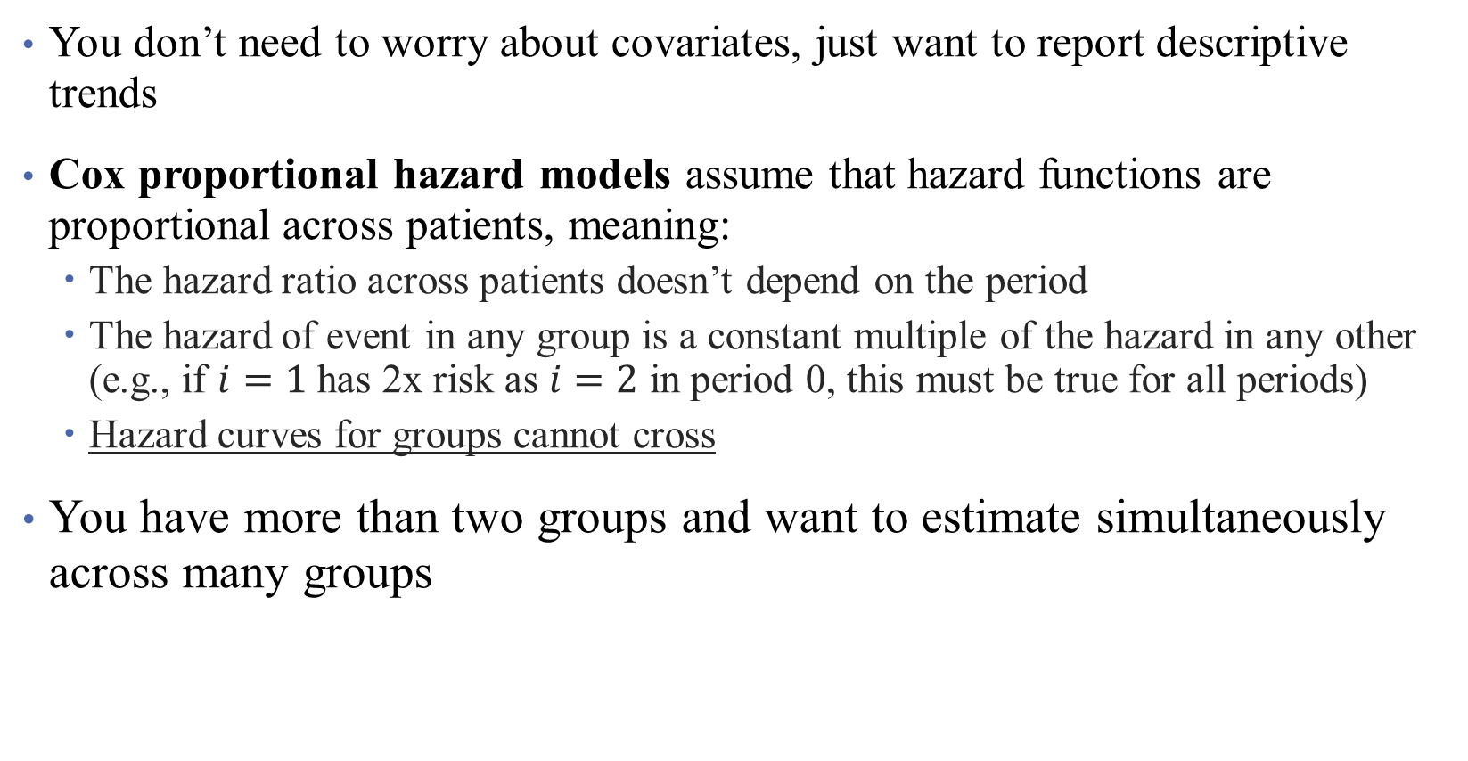
Why Choose (1) over (2)?
You don’t need to worry about covariates, just want to report descriptive trends
Cox proportional hazard models assume that hazard functions are proportional across patients, meaning:
The hazard ratio across patients doesn’t depend on the period
The hazard of event in any group is a constant multiple of the hazard in any other (e.g., if $i=1$ has 2x risk as $i=2$ in period 0, this must be true for all periods)
Hazard curves for groups cannot cross
You have more than two groups and want to estimate simultaneously across many groups

Slide 21
What do we need for causality?
Same model-based assumptions we have used so far (what are these?)
No selection across groups (design-based) (are these met?)
No interference across groups (what does this mean?)
Additionally: correct specification of the hazard function
Some common issues:
Time origin (what is the starting point? What is the end point?)
Censoring data (am I truly observing the population?)

Slide 22
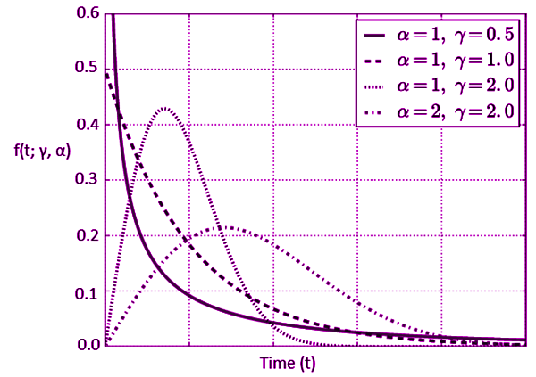

Types of Survival Analysis
Kaplan-Meier Estimators: Estimate the survival function itself (probability that events don’t occur until $t)$
Cox Proportional Hazard Models: Estimate the effect of covariates on survival time.
Parametric Models: take stronger stances on survival times (e.g., exponential, Weibull distributions).
Notes:
We’re gonna touch on more threats to internal validity now.

Slide 23
Interpretation and Limitations of Analysis
What worked well in this analysis?
What was lacking?
What are the takeaways for you?
What might limit the takeaways? What hinders your approach to thinking of this as causal?
Any other thoughts?
Notes:
I don’t think they did a super good job dealing with this. Their limitations are all “fake” limitations.

Slide 24
Thoughts?
“We are aware of 3 other studies that incorporated a control group to study the effectiveness of similar interventions. These studies were limited by small sample sizes and did not detect an effect on mortality.”
“Finally, it is not possible for us to say with certainty which of our intervention initiatives ultimately led to the observed improvements, or to measure the effect of other unrecognized changes on the improvements. It is possible that at least part of the observed reduction in LOS is attributable to improved repatriation of patients to their home hospitals after surgery. Nonetheless, our findings of reduced adjusted risk of death in those patients undergoing surgery within 48 hours, regardless of time period, underscore the role of timely surgery in reducing mortality.”
Papers to consider:
https://www.ncbi.nlm.nih.gov/pmc/articles/PMC3653612/
https://arxiv.org/pdf/2307.11971.pdf
Notes:
What are these saying?

Slide 25
Mixed Methods
Bridging the gap between quantitative and qualitative research

Slide 26
**Slide 9: Data Analysis**
- Quantitative analysis:
- Statistical methods (e.g., regression analysis)
- Qualitative analysis:
- Thematic analysis
- Grounded theory
- Content analysis
**Slide 10: Triangulation**
- Definition: the use of multiple methods to corroborate findings
- Types of triangulation:
- Data triangulation
- Investigator triangulation
- Methodological triangulation
**Slide 11: Challenges in Mixed Methods Research**
- Integration of quantitative and qualitative data
- Time and resource-intensive
- Ensuring validity and reliability across methods
**Slide 12: Ethical Considerations**
- Informed consent for both quantitative and qualitative components
- Protection of participant confidentiality
- Ethical handling of sensitive data
**Slide 13: Reporting and Dissemination**
- Importance of transparent reporting
- Integration of quantitative and qualitative findings in dissemination efforts
- Publication guidelines for mixed methods research
**Slide 14: Examples of Successful Mixed Methods Studies in Health Systems Research**
- Highlight a few notable studies and their impact on healthcare policy and practice
**Slide 15: Future Directions**
- Advancements in mixed methods research methodologies
- Integration of technology in data collection and analysis
- Importance of interdisciplinary collaboration
**Slide 16: Conclusion**
- Recap of the benefits of mixed methods in health systems research
- Encouragement for researchers to consider mixed methods approaches in future studies

Slide 27
What do we mean by mixed methods?
1. Quantitative Research: regressions, hypothesis tests, etc.
2. Qualitative Research: interviews, case-studies, focus groups, etc.
Combining these can give a more detailed view of complex phenomena!
Why might you want to incorporate both? What kinds of settings?

Slide 28
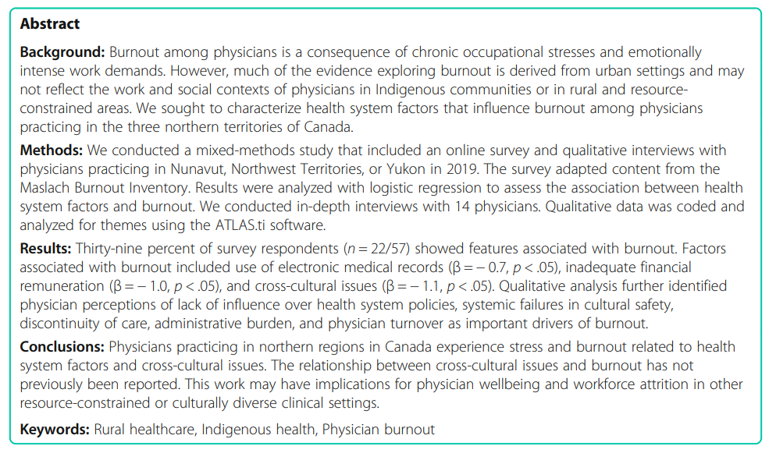
Mixed Methods in Context

Slide 29
Mixed Methods in Context
Why should we care about this? (How is the study motivated?)
What’s the motivation for mixed methods research?

Slide 30
Mixed Methods in Context
Why should we care about this? (How is the study motivated?)
Burnout can include substance use, insomnia, and depression
Burnout can lead to poor patient outcomes, in some cases doubling the risk of medical error and increasing recovery times for hospitalized patients.
Burnout also has broader consequences for health systems ($$$) as a contributor to reduced productivity and staff turnover.
This study moves beyond urban data to look at rural areas (why?)
What’s the motivation for mixed methods research?
“Populations in rural and remote contexts are often small, yet the findings of research conducted in these settings remain important and should not be hindered by an inability to generate large statistical power.”

Slide 31
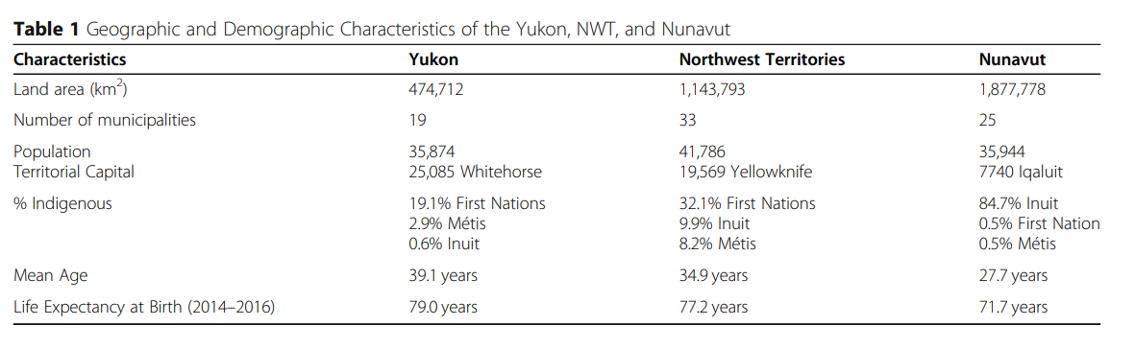
Mixed Methods in Context
0.3% of national population
So how can we motivate this further?
Notes:
What does Table 1 here tell us?

Slide 32
Mixed Methods in Context

Slide 33
How do we design a mixed methods study?
Need two types of data:
Sequential design:
Quantitative data collected first, followed by qualitative data
Concurrent design:
Both quantitative and qualitative data collected simultaneously
3. Transformative design: (responsive)
Integrates quantitative and qualitative data throughout the research process
Notes:
What did they do here?

Slide 34
How do we design a mixed methods study?
Need two types of data:
Sequential design:
Quantitative data collected first, followed by qualitative data
Concurrent design:
Both quantitative and qualitative data collected simultaneously
3. Transformative design: (responsive)
Integrates quantitative and qualitative data throughout the research process
Notes:
What did they do here?

Slide 35
Mixed Methods in Context

Slide 36
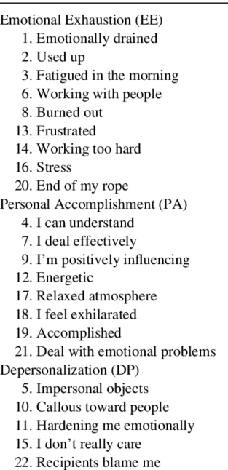
Data Collection: Quantitative
Maslach Burnout Inventory (MBI)
“Scores on these subscales are then used to categorize participants into one of five distinct profiles: engaged, ineffective, overextended, disengaged, and burnout.”
What does this mean in terms of context validity?
Notes:
What did they do here?

Slide 37
Is this useful?
For example, an engaged profile would characterize a worker with minimal exhaustion and cynicism, and a strong sense of efficacy; this pattern describes a positive experience of work without signs of burnout. All other profiles involve different degrees and manifestations of burnout
Notes:
What did they do here?

Slide 38
Data Collection: Quantitative
Maslach Burnout Inventory (MBI)
“Scores on these subscales are then used to categorize participants into one of five distinct profiles: engaged, ineffective, overextended, disengaged, and burnout.”
What does this mean in terms of context validity?
Limitations of the MBI:
Proprietary nature
Lack of an established cutoff for burnout
Observed cutoffs do not correlate with all negative outcomes
Categories do not translate into target areas for interventions
Notes:
What did they do here?

Slide 39
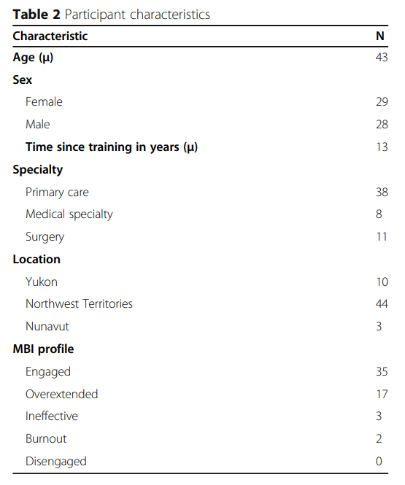
Data Collection: Quantitative
Notes:
What did they do here?

Slide 40
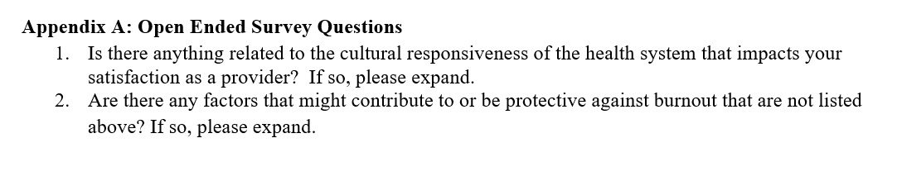
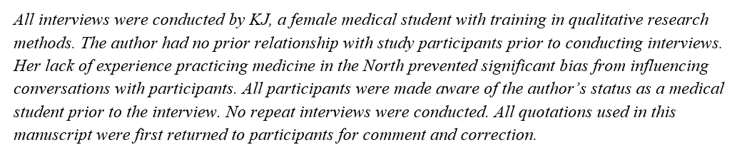
Data Collection: Interviews
Notes:
Comes from supplement, go over in a little bit of detail

Slide 41
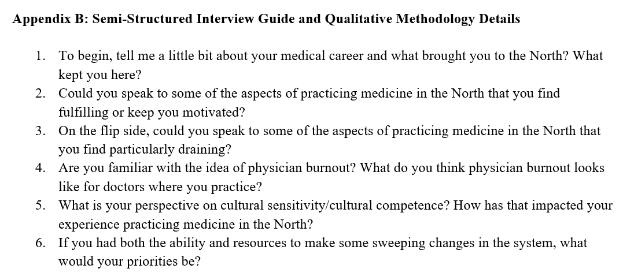
Data Collection: Interviews
Notes:
Comes from supplement, go over in a little bit of detail

Slide 42
Analysis: Quantitative
What are the authors doing here? Is it appropriate?
Due to the high number of predictors and low number of observations, several structural factors were removed prior to regression analysis. Pearson correlation was used to determine degree of relatedness of factors; factors with a correlation coefficient > 0.3 were flagged, and two authors decided which factors to exclude based on statistical correlation and contextual significance. In total, 18 factors were excluded.

Slide 43
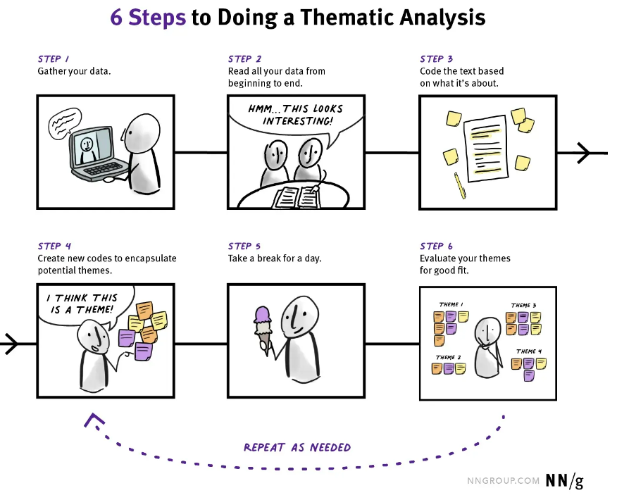
Analysis: Qualitative (Thematic Analysis)
How is this different/similar to quant work?
How do you feel about it?
What are potential strengths and weaknesses?
Notes:
What did they do here?

Slide 44
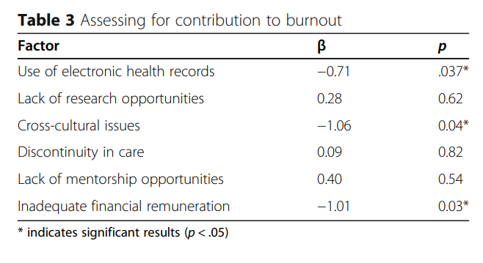
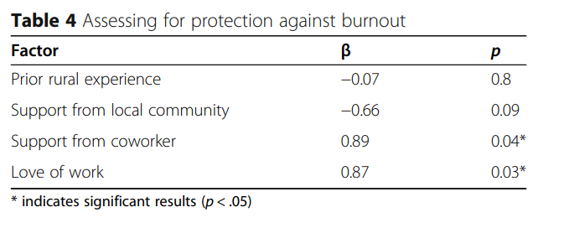
Results: Quantitative
Is this a good table?
What do the coefficients mean? Are they reasonable?
Notes:
Recall n=57. The likelihood here is “being engaged” but the table/text treats it differently. Confusing!

Slide 45
Results: Qualitative
Major themes:
Contributing factors
Mitigating factors
“Double-edged swords”

Slide 46
Results: Qualitative
Major themes:
Contributing factors
Lack of influence on policy
Systemic failures in cultural safety (“[The health system] feeds into the colonial system of mistrust”)
Discontinuity of care (too many patients per provider)
Upshifting of tasks (EMR)
Physician turnover
Lack of systemic supports
Mitigating factors
“Double-edged swords”

Slide 47
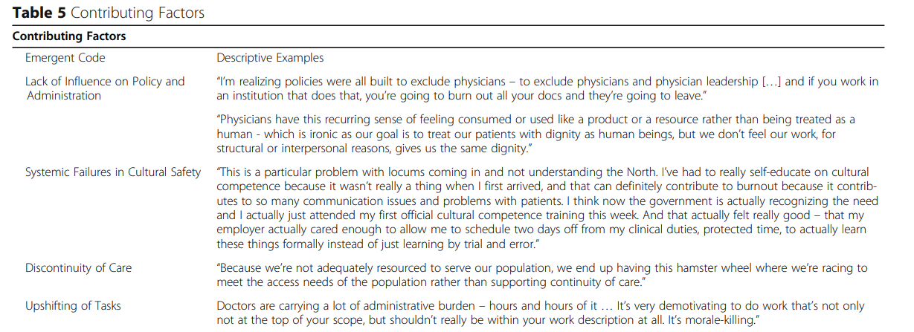
Results: Qualitative

Slide 48
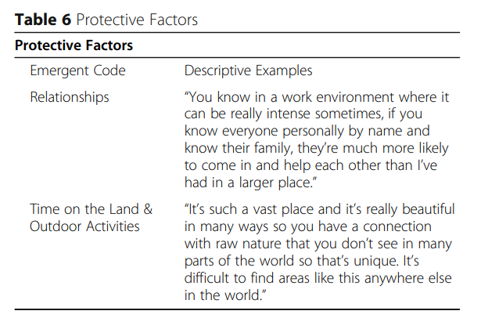
Results: Qualitative
Major themes:
Contributing factors
Mitigating factors
Relationships
Time on the Land & Outdoor Activities
“Double-edged swords”

Slide 49
Results: Qualitative
Major themes:
Contributing factors
Mitigating factors
“Double-edged swords”
Scope of Practice (lots to do; engaging, but also overwhelming)
Blurring Boundaries (integral role in the community, but you’re always “on”)
Time Away (“Though vacation time emerged as a protective factor, providers argued it is used as a post hoc solution to issues of overscheduling”)

Slide 50
Interpretation and Limitations of Analysis
What worked well in this analysis?
What was lacking?
What are the takeaways for you?
What might limit the takeaways? What hinders your approach to thinking of this as causal?
Any other thoughts?
Notes:
I don’t think they did a super good job dealing with this. Their limitations are all “fake” limitations.

