Slide 1
Quant Methods for HSR I
Lecture 3: Multivariate OLS Regression
September 28, 2026
HAD5744 • Alex Hoagland, Ph.D.
Notes:
Remind students that assignment 1 is due next week. Also ask about project teams and homework groups.

Slide 2
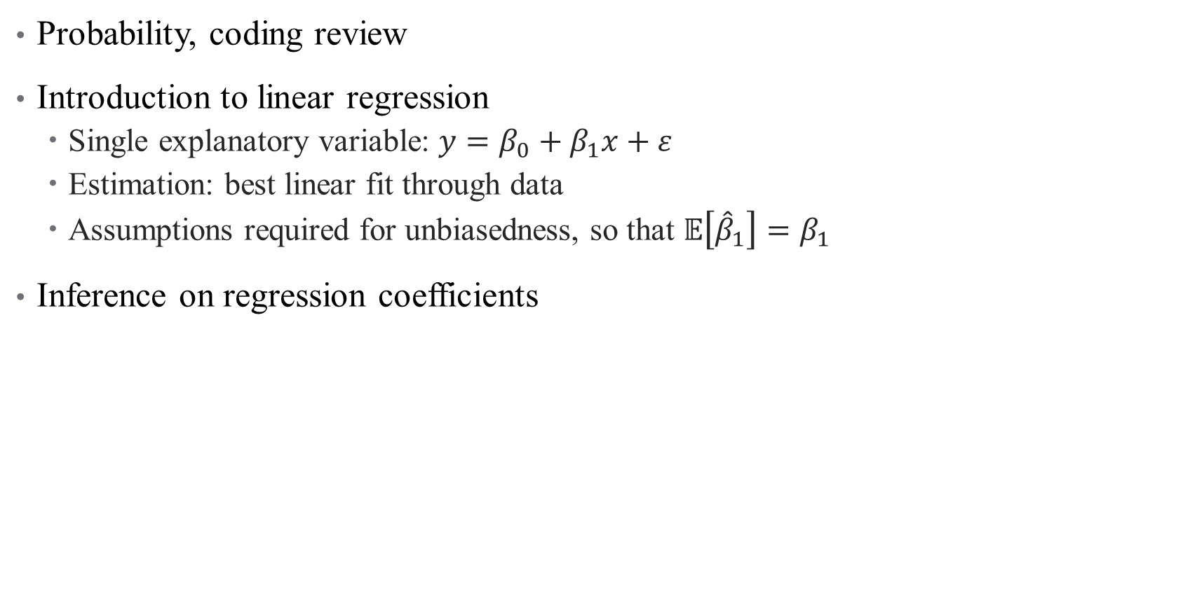
Last time:
Probability, coding review
Introduction to linear regression
  Single explanatory variable: $y=β_{0}+β_{1}x+ε$
  Estimation: best linear fit through data
  Assumptions required for unbiasedness, so that $𝔼\left[{\hat{β}}_{1}\right]=β_{1}$
Inference on regression coefficients

Slide 3
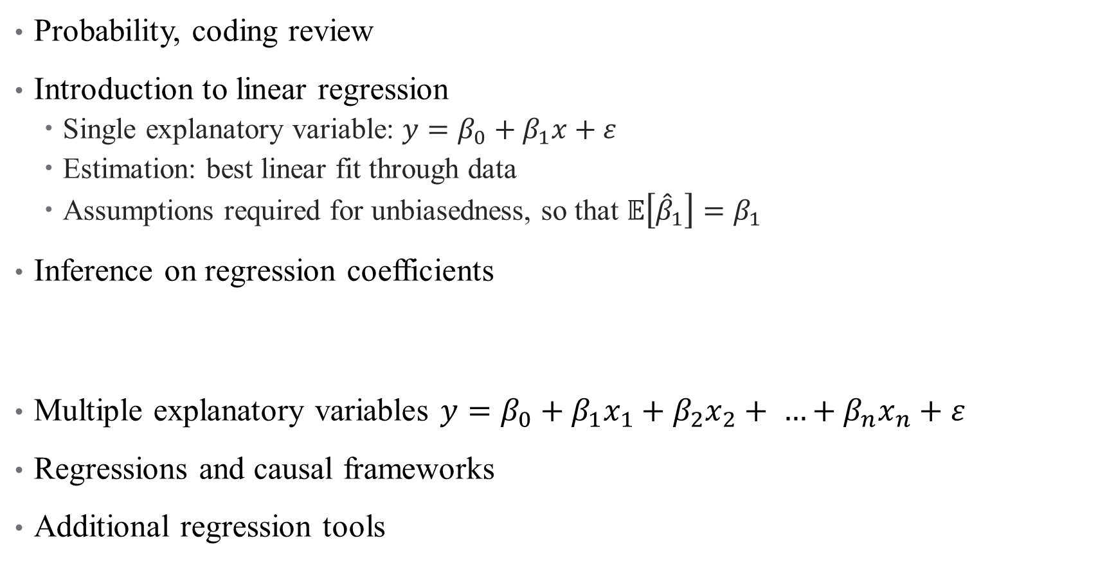
Last time:
Probability, coding review
Introduction to linear regression
  Single explanatory variable: $y=β_{0}+β_{1}x+ε$
  Estimation: best linear fit through data
  Assumptions required for unbiasedness, so that $𝔼\left[{\hat{β}}_{1}\right]=β_{1}$
Inference on regression coefficients
Multiple explanatory variables $y=β_{0}+β_{1}x_{1}+β_{2}x_{2}+ …+β_{n}x_{n}+ε$
Regressions and causal frameworks
Additional regression tools
This time:
Notes:
What we don’t finish today will be covered next time as well

Slide 4
Multivariate Regression

Slide 5
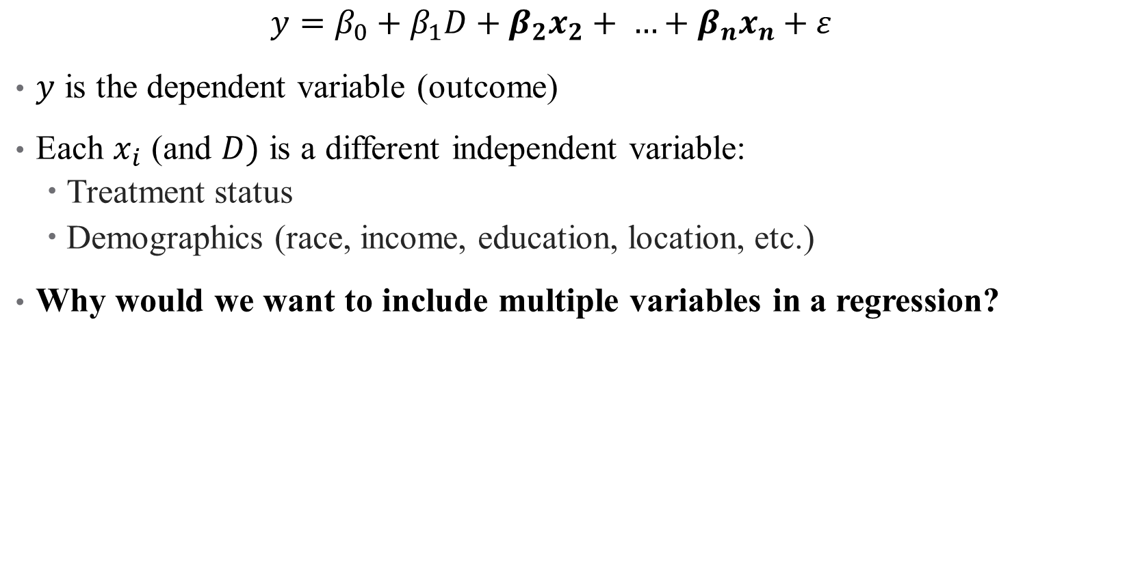
Population Model: Multiple Variables
  $$y=β_{0}+β_{1}D+β_{2}x_{2}+ …+β_{n}x_{n}+ε$$
$y$ is the dependent variable (outcome)
Each $x_{i}$ (and $D)$ is a different independent variable:
  Treatment status
  Demographics (race, income, education, location, etc.)
Why would we want to include multiple variables in a regression?
Notes:
This is not a trick question – think back to our frameworks!

Slide 6



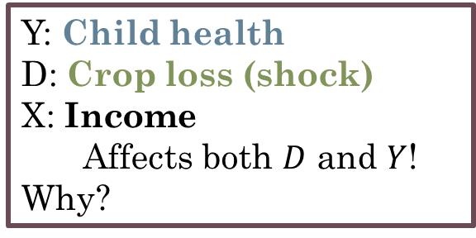
Population Model: Multiple Variables
  $$y=β_{0}+β_{1}D+β_{2}x_{2}+ …+β_{n}x_{n}+ε$$
$y$ is the dependent variable (outcome)
Each $x_{i}$ (and $D)$ is a different independent variable:
  Treatment status
  Demographics (race, income, education, location, etc.)
Why would we want to include multiple variables in a regression?
Y: Child health
D: Crop loss (shock)
X: Income
Affects both $D$ and $Y$! Why?
$$D$$
$$Y$$
$$X$$

Slide 7

Controlling for Variables
  $$y=β_{0}+β_{1}D+β_{2}X+ε$$
We are curious about the effect of $D$ on $Y$
  We know that $D→Y$, but there’s another open channel: $D←X→Y$
  To close this channel, we want to “control for” income
Visualizing this with a DAG
Notes:
I recommend looking at this site in more detail – we’ll cover the high points here. Videos from Andrew can be opened full screen, talk through when we control for things in a DAG.

Slide 8
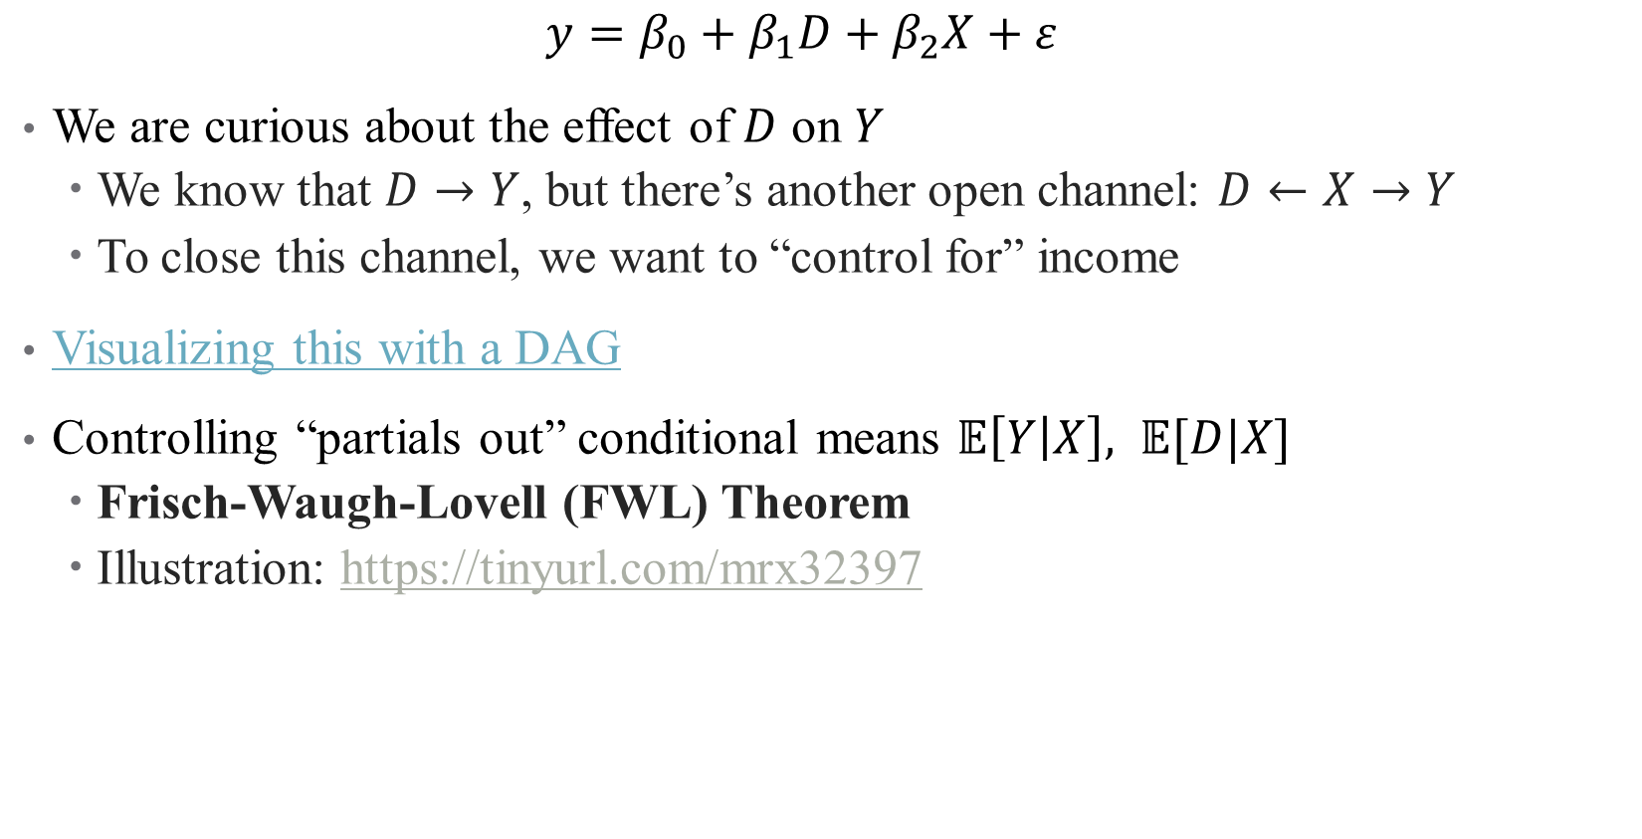
Controlling for Variables
  $$y=β_{0}+β_{1}D+β_{2}X+ε$$
We are curious about the effect of $D$ on $Y$
  We know that $D→Y$, but there’s another open channel: $D←X→Y$
  To close this channel, we want to “control for” income
Visualizing this with a DAG
Controlling “partials out” conditional means $𝔼\left[Y | X\right], 𝔼[D|X]$
  Frisch-Waugh-Lovell (FWL) Theorem
  Illustration: https://tinyurl.com/mrx32397
Notes:
I recommend looking at this site in more detail – we’ll cover the high points here. Videos from Andrew can be opened full screen, talk through when we control for things in a DAG.

Slide 9
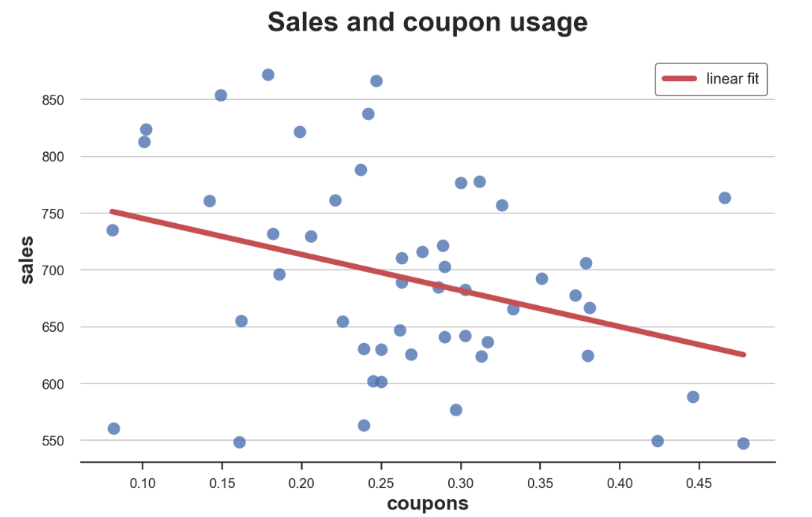

Controlling for Variables
  $$y=β_{0}+β_{1}D+β_{2}X+ε$$
Notes:
Let’s walk through this example, even though it has little to do with health. Simple question: does the marketing strategy of coupons improve sales?
What does the line mean? What confounders might we be interested in here?

Slide 10
Controlling for Variables
  $$y=β_{0}+β_{1}D+β_{2}X+ε$$
How would income pose an open backdoor to this question?
Notes:
Let’s walk through this example, even though it has little to do with health. What does the line mean? What confounders might we be interested in here?

Slide 11
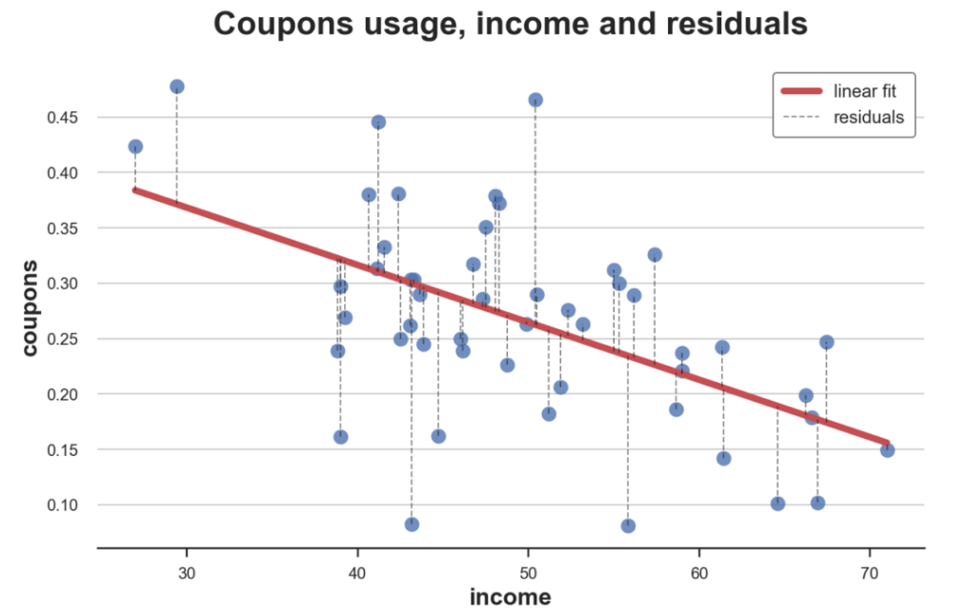
Controlling for Income
Notes:
Note – there’s a strong relationship here! (Does it make sense? What does it tell you?) What does that mean for our initial assessment? We have violated the assumption that E(eps|x)=0 given that we relegated income to epsilon

Slide 12
Controlling for Income
Controlling for education removes this linear trend, leaving only the residuals
Notes:
Note – there’s a strong relationship here! (Does it make sense? What does it tell you?) What does that mean for our initial assessment? We have violated the assumption that E(eps|x)=0 given that we relegated income to epsilon

Slide 13
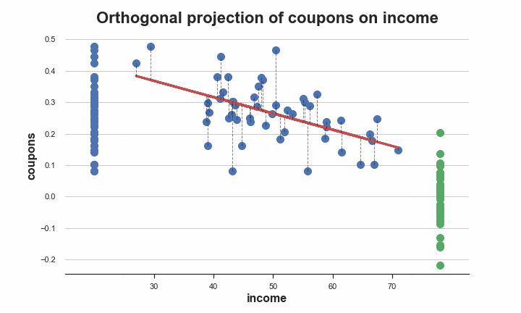
“Partialling” out Income

Slide 14
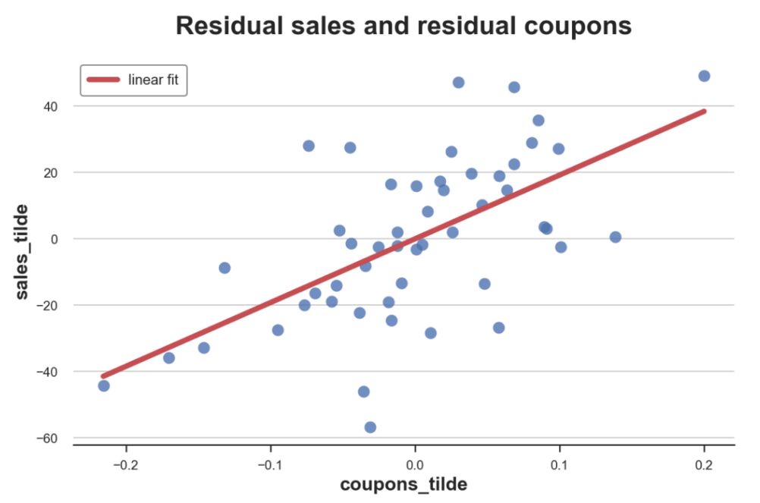

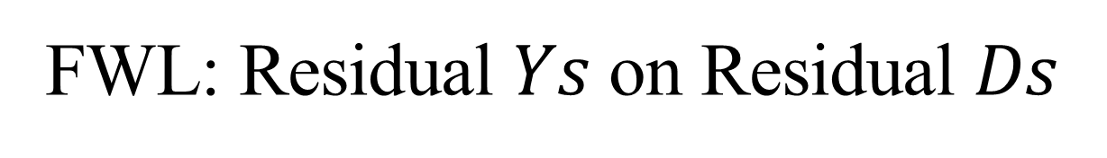
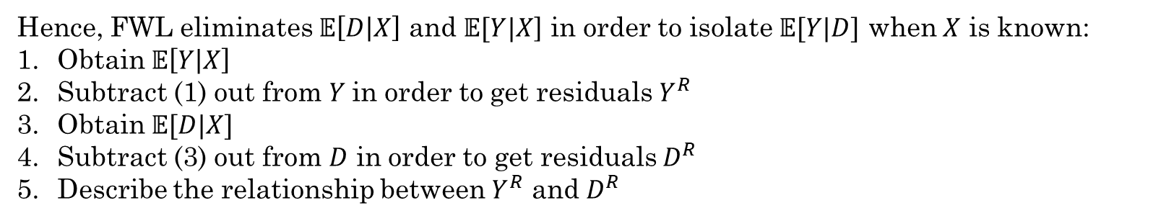
FWL: Residual $Ys$ on Residual $Ds$
Hence, FWL eliminates $𝔼\left[D | X\right]$ and $𝔼[Y|X$] in order to isolate $𝔼[Y|D]$ when $X$ is known:
Obtain $𝔼\left[Y | X\right]$
Subtract (1) out from $Y$in order to get residuals $Y^{R}$
Obtain $𝔼[D|X]$
Subtract (3) out from $D$ in order to get residuals $D^{R}$
Describe the relationship between $Y^{R}$ and $D^{R}$
Notes:
Let’s see how this works in R

Slide 15
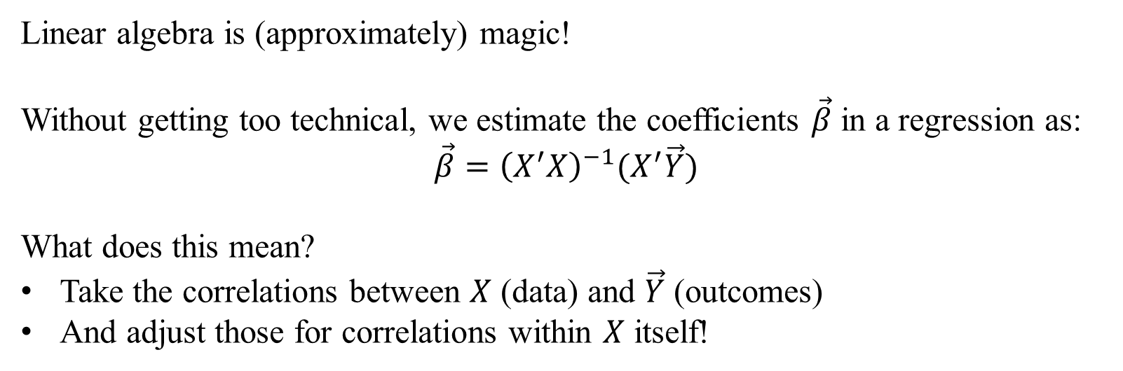
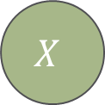

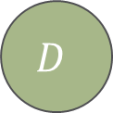
How does multivariate regression work?
Linear algebra is (approximately) magic!
Without getting too technical, we estimate the coefficients $\vec{β}$ in a regression as:
$$\vec{β}={\left(X^{′}X\right)}^{−1}(X^{′}\vec{Y})$$
What does this mean?
Take the correlations between $X$ (data) and $\vec{Y}$ (outcomes)
And adjust those for correlations within $X$ itself!
$$D$$
$$Y$$
$$X$$

Slide 16
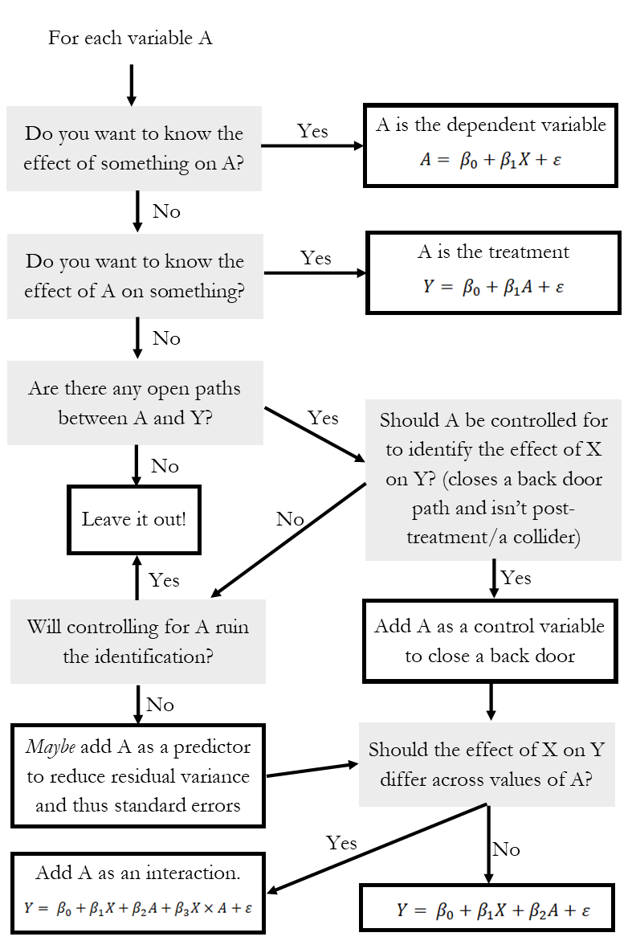
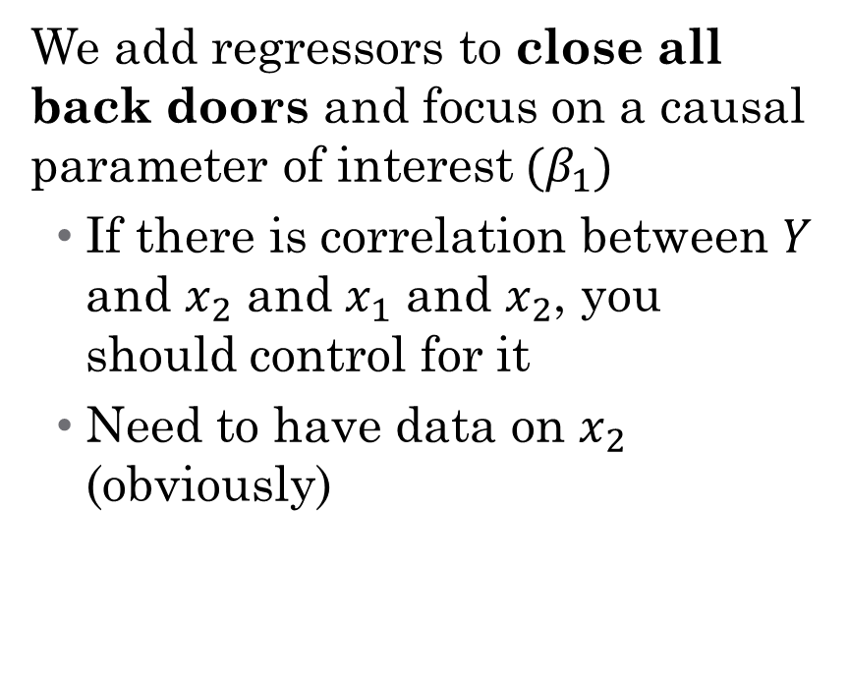
So what do I control for?
We add regressors to close all back doors and focus on a causal parameter of interest$(β_{1})$
If there is correlation between $Y$ and $x_{2}$ and $x_{1}$ and $x_{2}$, you should control for it
Need to have data on $x_{2}$ (obviously)
Notes:
Talk through this – what is a collider/post-treatment (something like controlling for occupation to assess gender wage gap). Also focus on the leave it out options – this is important! You don’t want to control for unnecessary things (even if statistically significant).

Slide 17
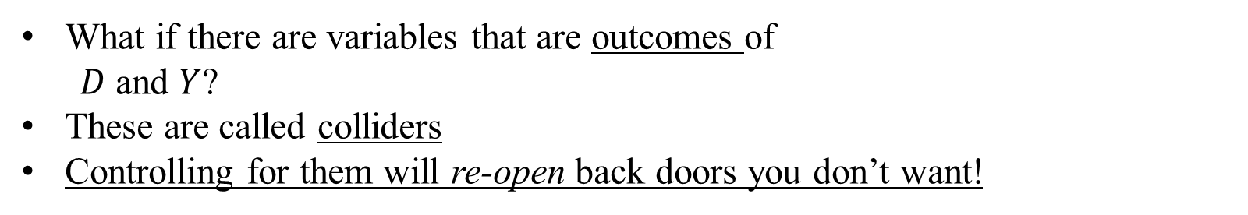



What should you not control for? Colliders
What if there are variables that are outcomes of
  $D$ and $Y$?
These are called colliders
Controlling for them will re-open back doors you don’t want!
$$D$$
$$Y$$
$$X$$
Notes:
BP: For example, a person may observe that fast food restaurants which serve good hamburgers tend to serve bad fries and vice versa; but because they would likely not eat anywhere where both were bad, they fail to allow for the large number of restaurants in this category which would weaken or even flip the correlation.
Attrition example: Study comparing 2 Mediterranean diets and a control diet in participants at high cardiovascular risk, cognitive function was improved with both dietary interventions. However, loss to follow-up was higher in the control group (33%) as compared with the Mediterranean diet groups (16% and 23%). Differential loss to follow-up can introduce collider bias because the analysis is restricted to patients who are not lost to follow-up. If participants assigned to one of the Mediterranean diets were less likely to be lost to follow-up than those in the control group and participants with poor cognitive function were independently more likely to be lost to follow-up, restricting the analysis to those not lost to follow-up could result in a spurious or noncausal association between diet and cognitive function.

Slide 18
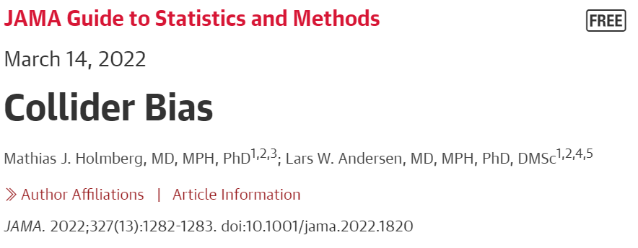
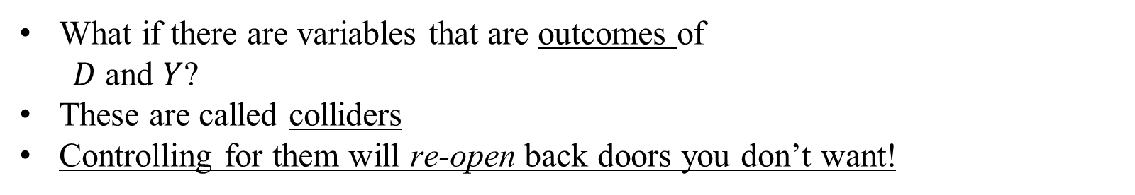
What should you not control for? Colliders
What if there are variables that are outcomes of
  $D$ and $Y$?
These are called colliders
Controlling for them will re-open back doors you don’t want!
$$D$$
$$Y$$
$$X$$
Lots of examples of this:
Berkson’s paradox
Sample selection in economics
Differential attrition across groups
Notes:
BP: For example, a person may observe that fast food restaurants which serve good hamburgers tend to serve bad fries and vice versa; but because they would likely not eat anywhere where both were bad, they fail to allow for the large number of restaurants in this category which would weaken or even flip the correlation.
Attrition example: Study comparing 2 Mediterranean diets and a control diet in participants at high cardiovascular risk, cognitive function was improved with both dietary interventions. However, loss to follow-up was higher in the control group (33%) as compared with the Mediterranean diet groups (16% and 23%). Differential loss to follow-up can introduce collider bias because the analysis is restricted to patients who are not lost to follow-up. If participants assigned to one of the Mediterranean diets were less likely to be lost to follow-up than those in the control group and participants with poor cognitive function were independently more likely to be lost to follow-up, restricting the analysis to those not lost to follow-up could result in a spurious or noncausal association between diet and cognitive function.

Slide 19
What should you not control for? Colliders
What if there are variables that are outcomes of
  $D$ and $Y$?
These are called colliders
Controlling for them will re-open back doors you don’t want!
$$D$$
$$Y$$
$$X$$
What is the collider bias here?
“In an observational study of 4480 patients with confirmed COVID-19 published in JAMA, Fosbøl et al⁴ found no increase in mortality among patients using angiotensin-converting enzyme inhibitors (ACEIs) or angiotensin receptor blockers (ARBs).
Notes:
Collider bias: The possibility of collider bias should be considered in interpreting this result because the study was restricted to patients with COVID-19, and COVID-19 might represent a collider associated with drug treatment and mortality. – both drug treatment and mortality affect the likelihood of COVID-19. So D is drug treatment and Y is mortality, both of which affect COVID-19 (However, it has been hypothesized that ACEI or ARB use could result in increased susceptibility to COVID-19).

Slide 20
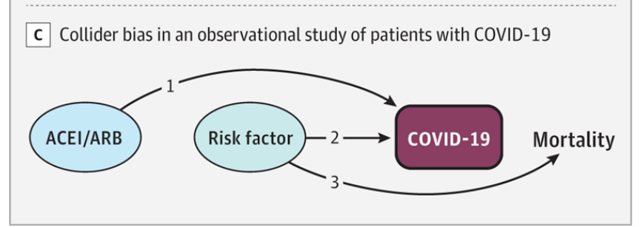
What should you not control for? Colliders
What if there are variables that are outcomes of
  $D$ and $Y$?
These are called colliders
Controlling for them will re-open back doors you don’t want!
$$D$$
$$Y$$
$$X$$
What is the collider bias here?
“In an observational study of 4480 patients with confirmed COVID-19 published in JAMA, Fosbøl et al⁴ found no increase in mortality among patients using angiotensin-converting enzyme inhibitors (ACEIs) or angiotensin receptor blockers (ARBs).
Notes:
Collider bias: The possibility of collider bias should be considered in interpreting this result because the study was restricted to patients with COVID-19, and COVID-19 might represent a collider associated with drug treatment and mortality. – both drug treatment and mortality affect the likelihood of COVID-19. So D is drug treatment and Y is mortality, both of which affect COVID-19 (However, it has been hypothesized that ACEI or ARB use could result in increased susceptibility to COVID-19).

Slide 21
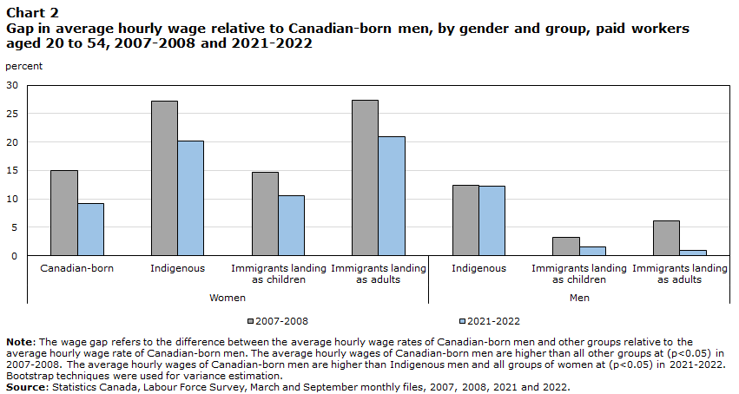
What should you not control for?
Selecting on an Outcome
Another very common mistake is when you control for something that occurred after the outcome (this introduces either collider bias or mediator bias)
Notes:
Suppose that we wanted to ascertain the gender wage gap and the impact of discrimination on that gap. You hear things like “59 cents on the dollar,” which has now decreased substantially. But you also hear arguments like “the gap disappears once you adjust for observable characteristics including occupation.” Why is this mediator bias (because gender causes occuptation causes wages – where is the discrimination? Do we want to control for this?)? What can be done about this? (Work by Claudia Goldin, for example, that looks at variation within an occupation but also occupational sorting over time).

Slide 22
Case Study:
Children at Risk: The Effect of Crop Loss on Child Health in Rural Mexico
RUHR Economic Working Paper (2012)
Notes:
We’re going in and out of what’s actually in the paper, but we’re going to use it to frame all of the things we talk about today.

Slide 23
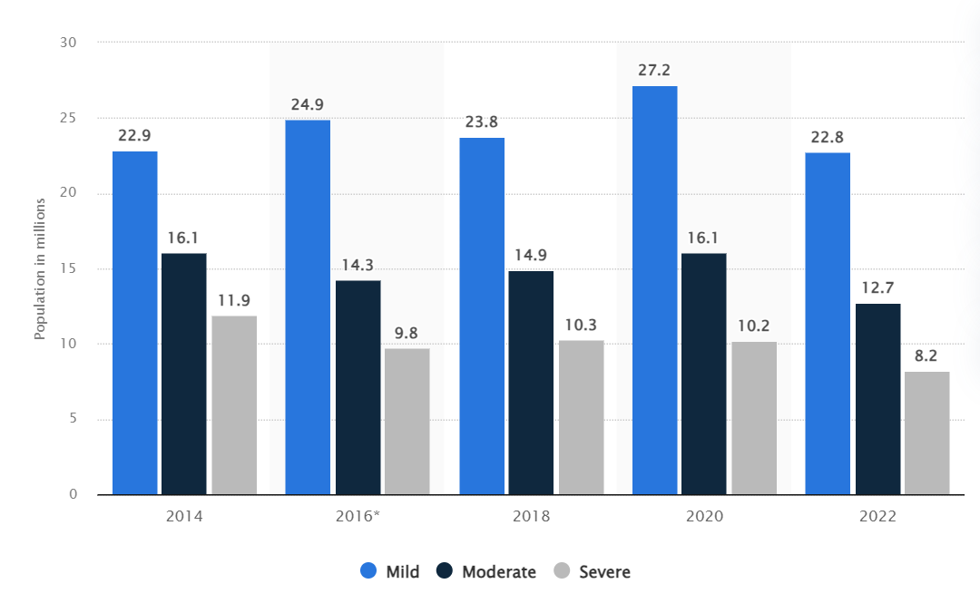
Motivation and Research Design
What is the setting of the paper?
What is the causal question?
Why is this an important question?
Notes:
We care a lot about malnutrition; this paper focuses particularly on its long-run effects.

Slide 24
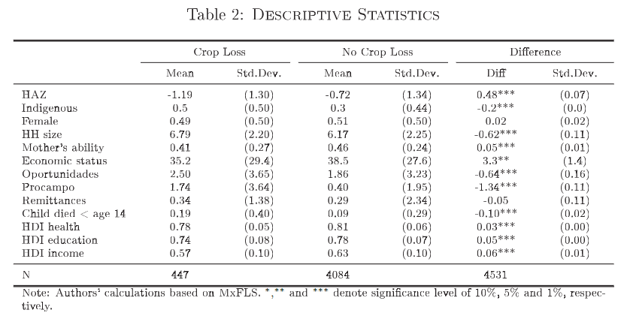
Motivation and Research Design
What makes their causal inference possible – that is, what is their research design?
How does it deal with this table?
Notes:
We’re going to talk a lot more about research designs in the coming lecture. For now, we are only using model-based inference, so they would have to control for a bunch. But they rely on the fact that crop loss is exogenous to children; what does that mean?

Slide 25
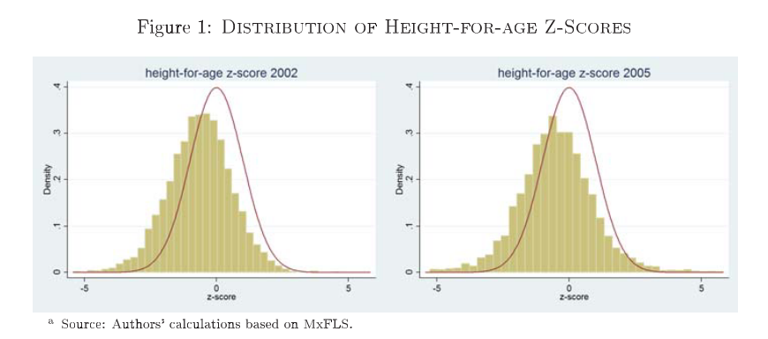
Case Study: descriptive evidence
Notes:
Here, we are taking each child’s height and comparing it to a reference population (matching based on age), then standardizing. So what are the final units? How do we interpret these graphs? Importantly, how will this affect our regression coefficients?

Slide 26
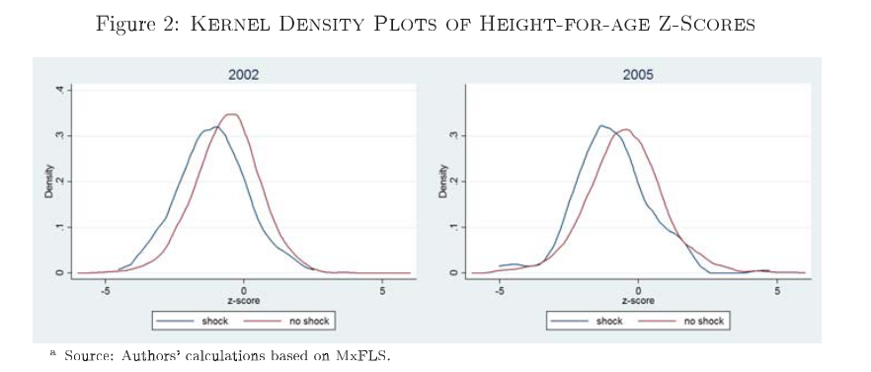
Case study: descriptive evidence
Notes:
Do not underestimate descriptive evidence! This is huge!

Slide 27
Case study: controls
What do the authors control for? What would they like to control for?
Notes:
What do the authors control for? (note: they dropped ~1/3 of data for age not matching up across survey waves, which makes their estimates lower bounds. Why?). Note that they would like to control for income but they can’t

Slide 28
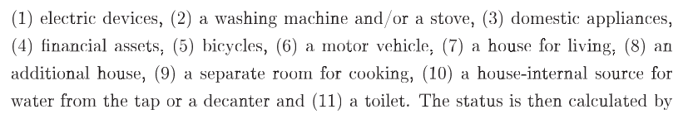
Case study: controls
Income: categorized based on whether households have specific assets
Participation in government programs (Opportunidades)
Indigenous origin
Number of household members
Mother’s cognitive ability (why?)
Remittances from household members
Notes:
Note on the income: does this make any sense at all? Add them up and then multiply by the correlation coefficient on that variable and happiness; then converted to percentages and then deciles. See table 2 on the previous slides – let’s look at those descriptive stats again.

Slide 29
Types of Control Variables
Notes:
Break here?

Slide 30

Types of Control Variables: Sliders and Switches
Notes:
Continuous and discrete – we’ll talk about different interpretation of effects here, and more next time. Examples of discrete variables: Racial, ethnic, gender group identification
Years of education, marriage, etc.

Slide 31
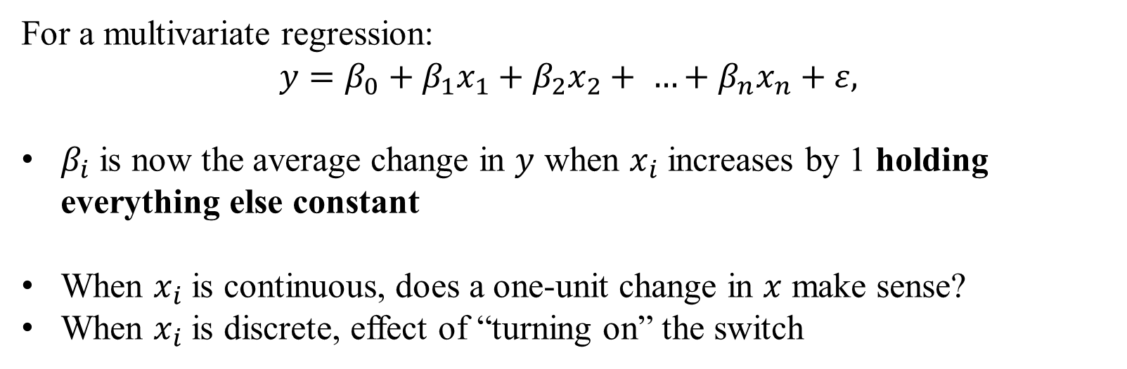
How does interpretation change?
For a multivariate regression:
$$y=β_{0}+β_{1}x_{1}+β_{2}x_{2}+ …+β_{n}x_{n}+ε,$$
$β_{i}$ is now the average change in $y$ when $x_{i}$ increases by 1 holding everything else constant
When $x_{i}$ is continuous, does a one-unit change in $x$ make sense?
When $x_{i}$ is discrete, effect of “turning on” the switch
Notes:
Interpretation now relies on holding everything else in the regression constant – if this doesn’t work for what you want to know, need to rethink the design of the regression (e.g., interactions). Also think about causality in the context of FWL – we aren’t identifying causal pathways, we’re closing back doors! (This is model-based inference at its best, the whole regression focuses on one pathway in the DAG that you want).

Slide 32
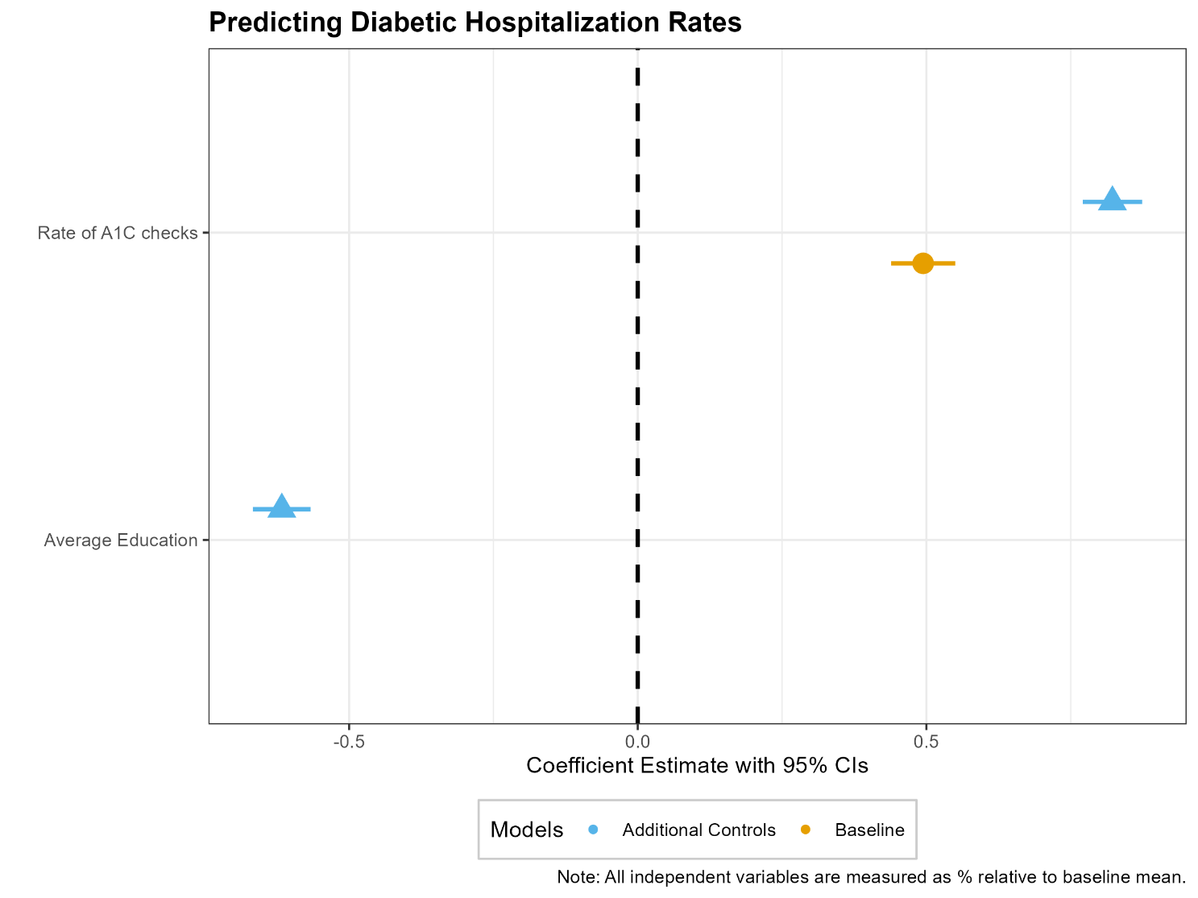

Estimating and Visualizing our Regressions
  $$y=β_{0}+β_{1}x_{1}+β_{2}x_{2}+ …+β_{n}x_{n}+ε$$
How can we visualize the information in such a complicated regression?

Slide 33
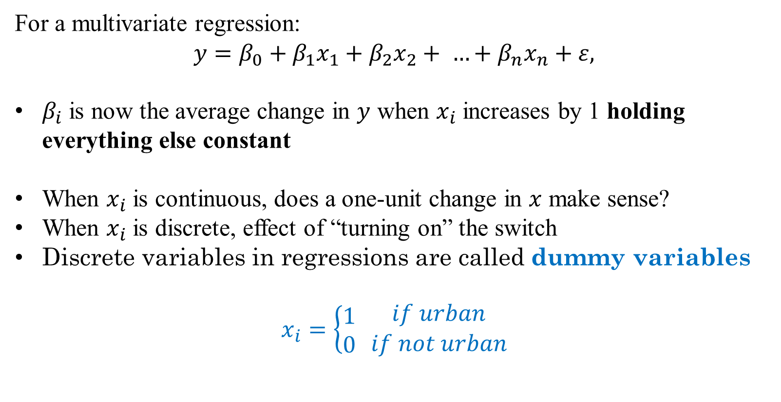
How does interpretation change?
For a multivariate regression:
$$y=β_{0}+β_{1}x_{1}+β_{2}x_{2}+ …+β_{n}x_{n}+ε,$$
$β_{i}$ is now the average change in $y$ when $x_{i}$ increases by 1 holding everything else constant
When $x_{i}$ is continuous, does a one-unit change in $x$ make sense?
When $x_{i}$ is discrete, effect of “turning on” the switch
Discrete variables in regressions are called dummy variables
$$x_{i}=\left\{\begin{aligned}1 \\ 0\end{aligned} \right.\begin{matrix}if urban \\ if not urban\end{matrix}$$

Slide 34
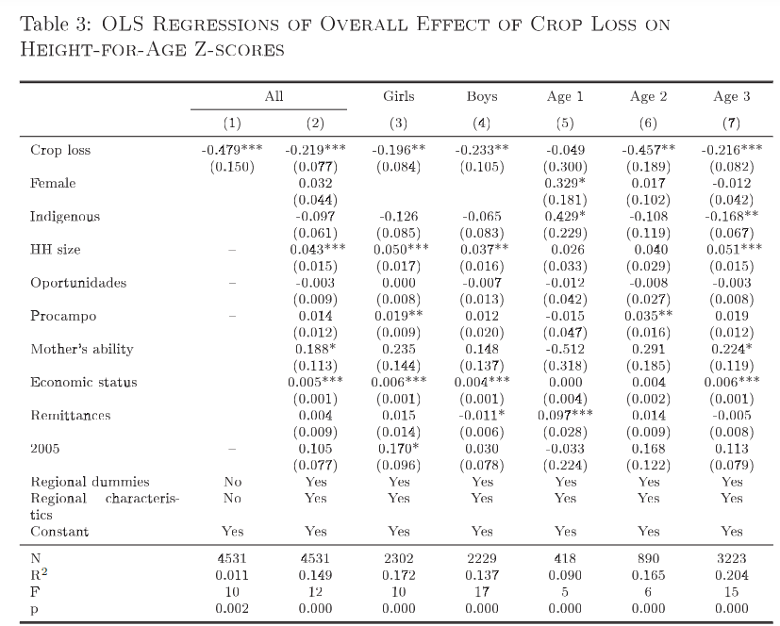
Case study: Interpreting a regression
Notes:
What do we see here? How do we interpret it? Do we need to go through each coefficient here? What is causal and what is not?

Slide 35

Discrete Regressors
Suppose we are modeling the demand for health services:
$$y_{i}=β_{0}+β_{1}x_{i1}+β_{2}x_{i2}+αU_{i}+ε_{i},$$
where $U_{i}$ indicates residing in an urban region
How do we interpret $α$ (if it’s a coefficient of interest)?
Notes:
Talk about subscripts here

Slide 36
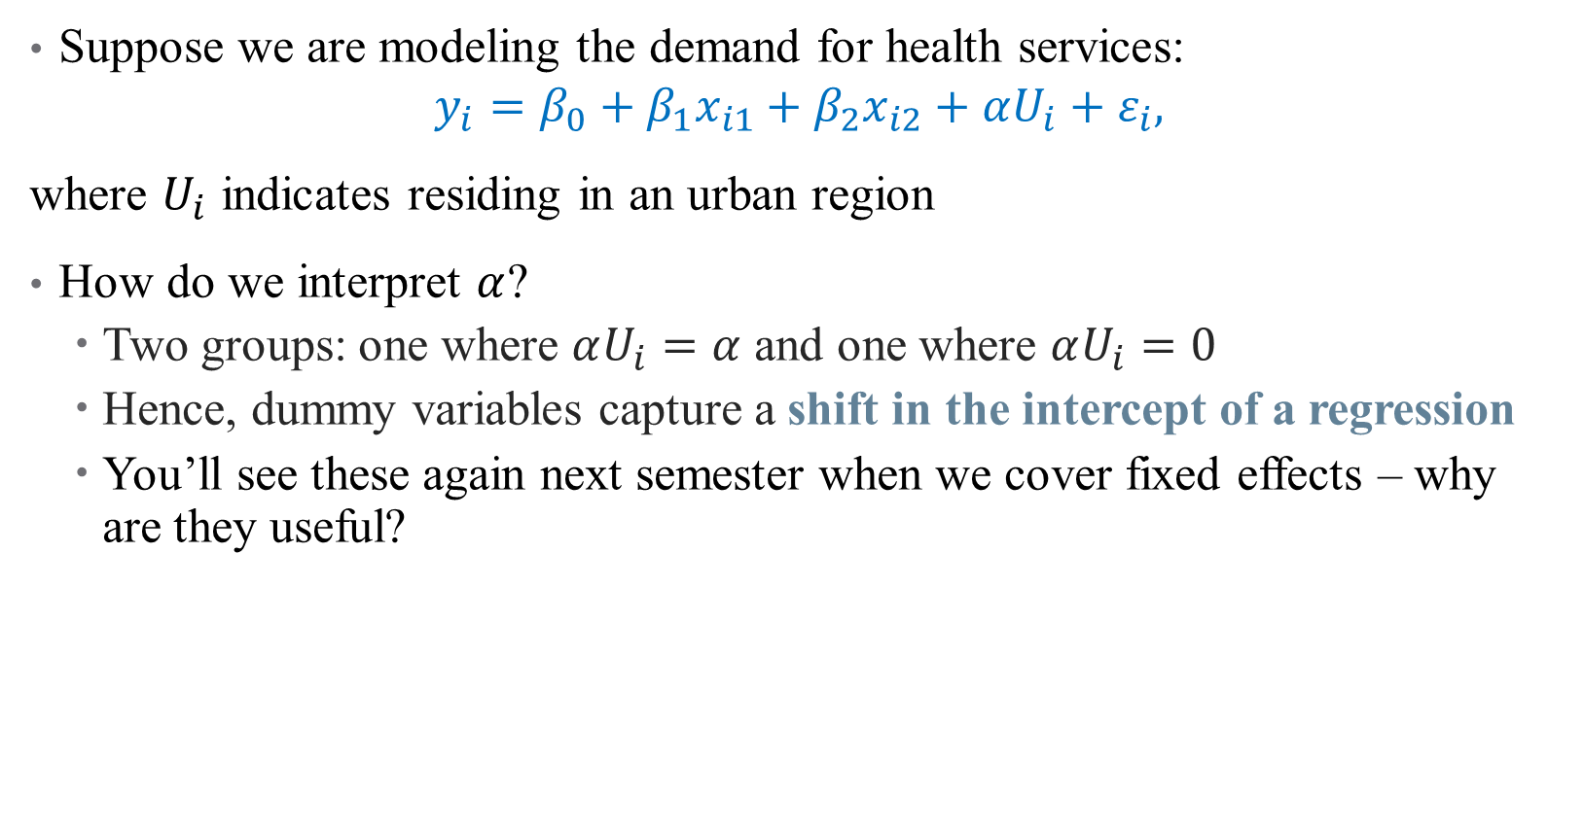
Discrete Regressors
Suppose we are modeling the demand for health services:
$$y_{i}=β_{0}+β_{1}x_{i1}+β_{2}x_{i2}+αU_{i}+ε_{i},$$
where $U_{i}$ indicates residing in an urban region
How do we interpret $α$?
  Two groups: one where $αU_{i}=α$ and one where $αU_{i}=0$
  Hence, dummy variables capture a shift in the intercept of a regression
  You’ll see these again next semester when we cover fixed effects – why are they useful?
Notes:
Talk about subscripts here. Useful because they capture differences across groups (with high-frequency panel data, can consider using these in a more granular way, that’s what a FE is)

Slide 37
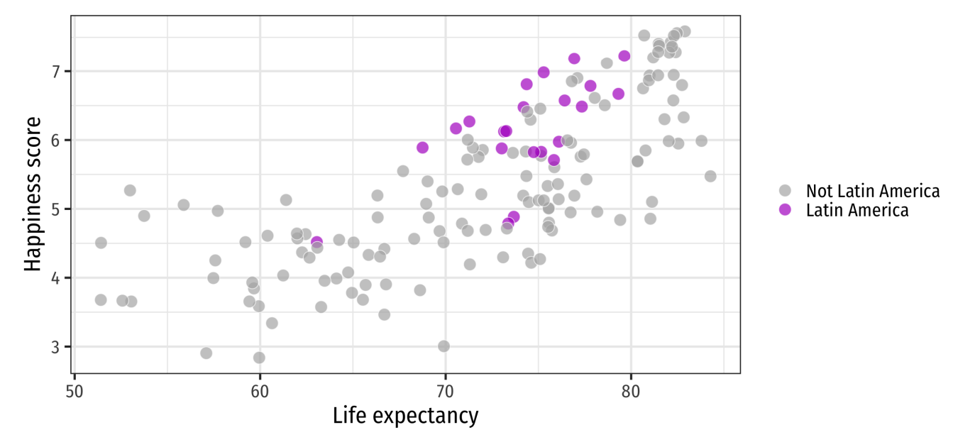
Discrete Regressors

Slide 38
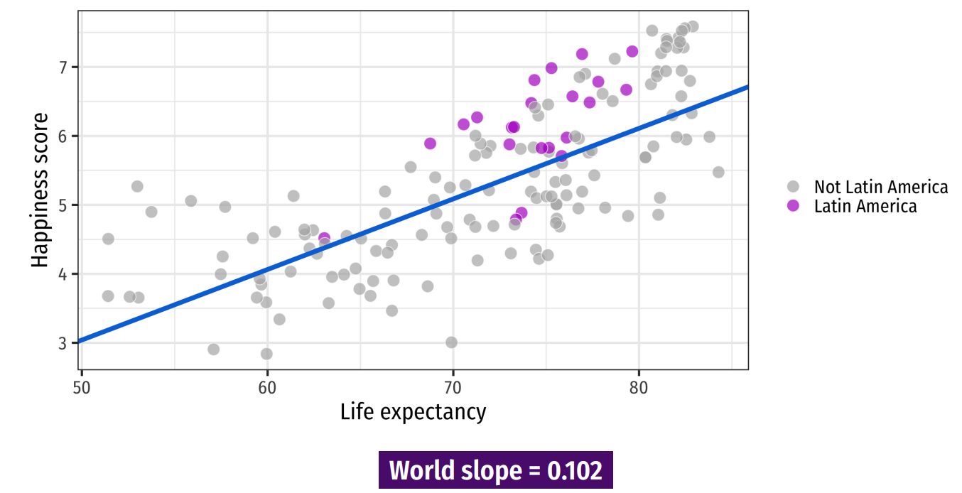
Discrete Regressors
Notes:
Here’s the world slope – does it seem to go through the points for Latin America? No! If we were to run a separate regression just on those points we’d get a different intercept.

Slide 39
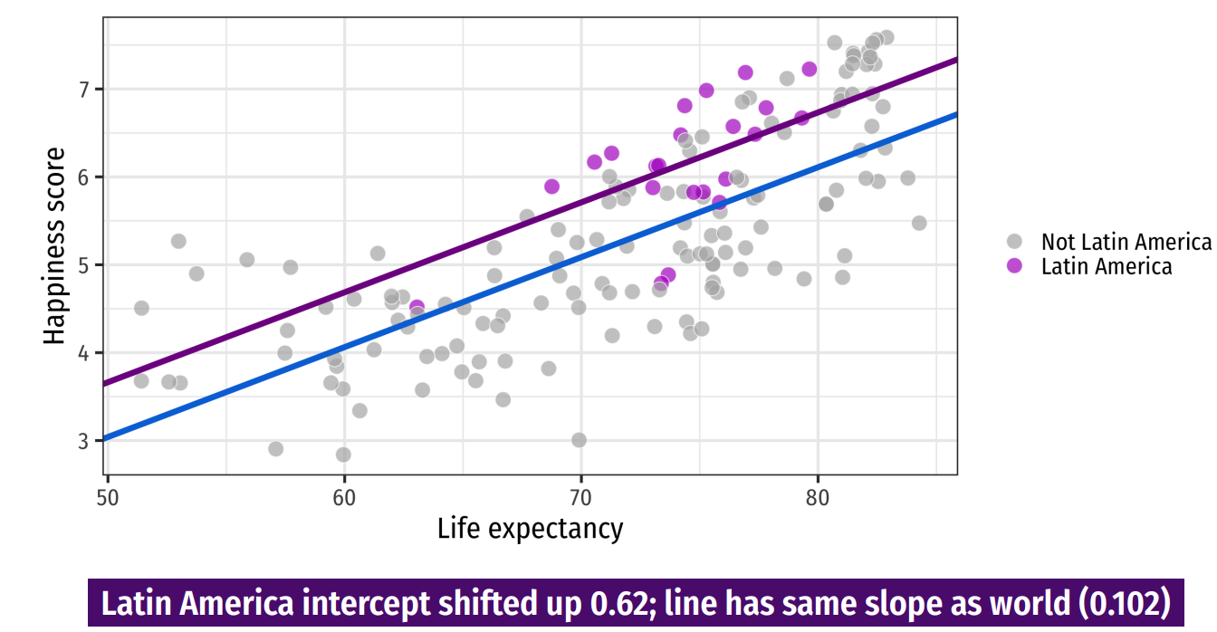
Discrete Regressors
Notes:
So add a dummy intercept! What’s the interpretation? Next time – talk about if we want the slope to vary across groups

Slide 40

The Dummy Variable Trap
Suppose we define a new variable
$R_{i}=\left\{\begin{aligned}1 if rural \\ 0 if urban \end{aligned}\right.$
and include both $R_{i}$ and $U_{i}$ in a regression model.
What would happen?
Notes:
Perfect Multicolinearity = multiple solutions (if true coefficient is +5 for urban, then could be +7, -2, or -10-,-15, etc.)

Slide 41
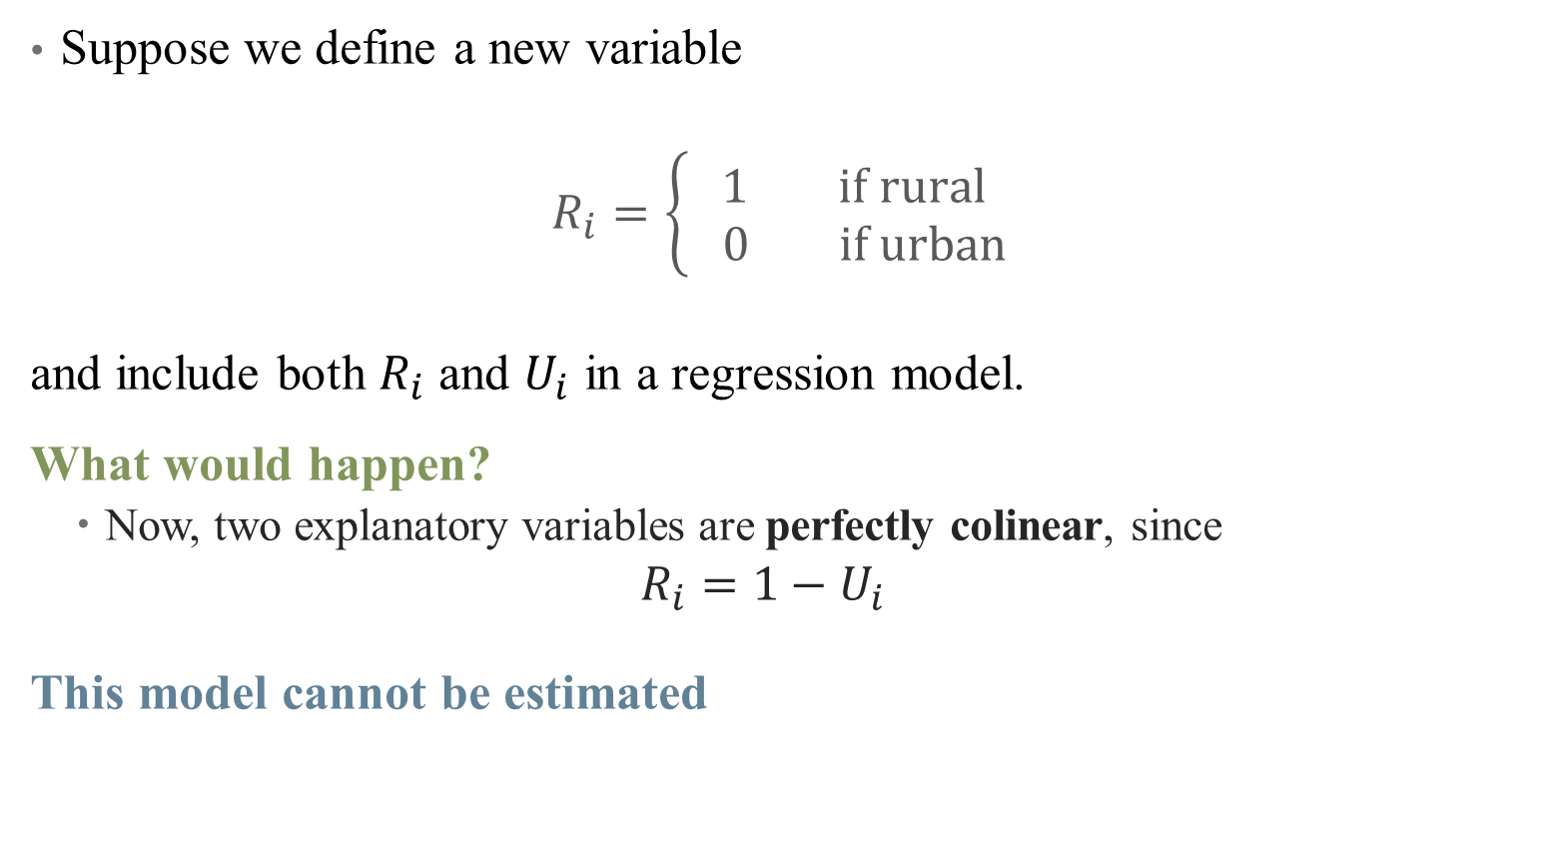
The Dummy Variable Trap
Suppose we define a new variable
$R_{i}=\left\{\begin{aligned}1 if rural \\ 0 if urban \end{aligned}\right.$
and include both $R_{i}$ and $U_{i}$ in a regression model.
What would happen?
  Now, two explanatory variables are perfectly colinear, since
  $$R_{i}=1−U_{i}$$
This model cannot be estimated
Notes:
Perfect Multicolinearity = multiple solutions (if true coefficient is +5 for urban, then could be +7, -2, or -10-,-15, etc.)

Slide 42
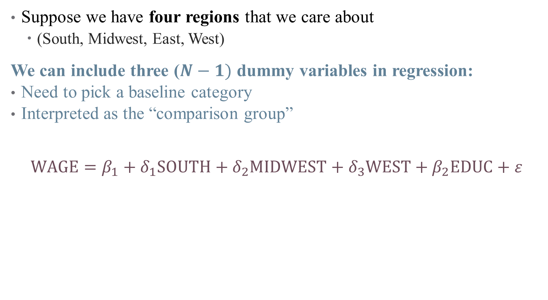
Avoiding the Dummy Variable Trap
Suppose we have four regions that we care about
  (South, Midwest, East, West)
We can include three ($N−1)$ dummy variables in regression:
Need to pick a baseline category
Interpreted as the “comparison group”
$$WAGE=β_{1}+δ_{1}SOUTH+δ_{2}MIDWEST+δ_{3}WEST+β_{2}EDUC+ε$$
Notes:
Talk about subscripts here

Slide 43
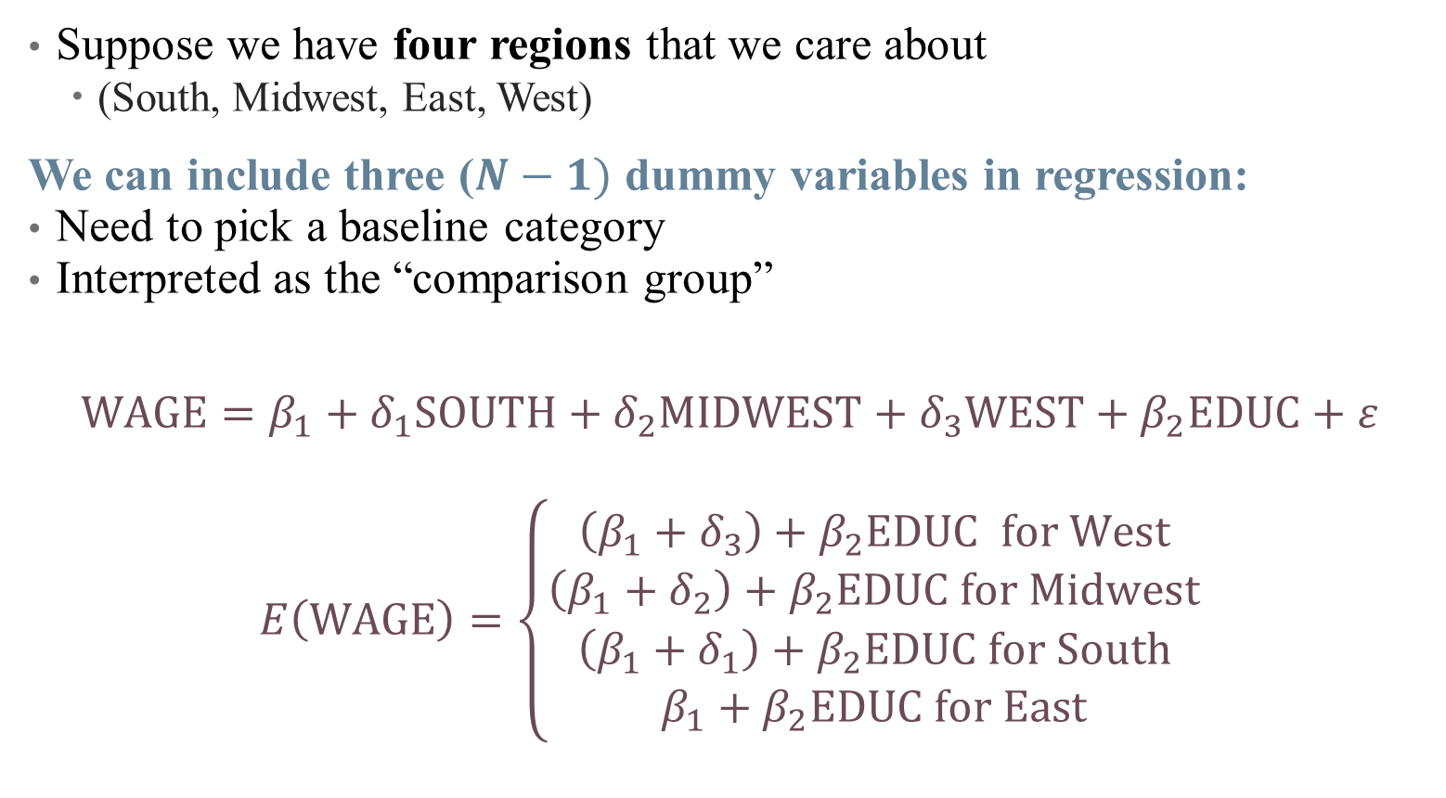
Avoiding the Dummy Variable Trap
Suppose we have four regions that we care about
  (South, Midwest, East, West)
We can include three ($N−1)$ dummy variables in regression:
Need to pick a baseline category
Interpreted as the “comparison group”
$$WAGE=β_{1}+δ_{1}SOUTH+δ_{2}MIDWEST+δ_{3}WEST+β_{2}EDUC+ε$$
$$E\left(WAGE\right)=\left\{\begin{aligned}\left(β_{1}+δ_{3}\right)+β_{2}EDUC for West \\ \left(β_{1}+δ_{2}\right)+β_{2}EDUC for Midwest \\ \left(β_{1}+δ_{1}\right)+β_{2}EDUC for South \\ β_{1}+β_{2}EDUC for East\end{aligned}\right.$$
Notes:
Interpretation – start from bottom with “reference category”

Slide 44
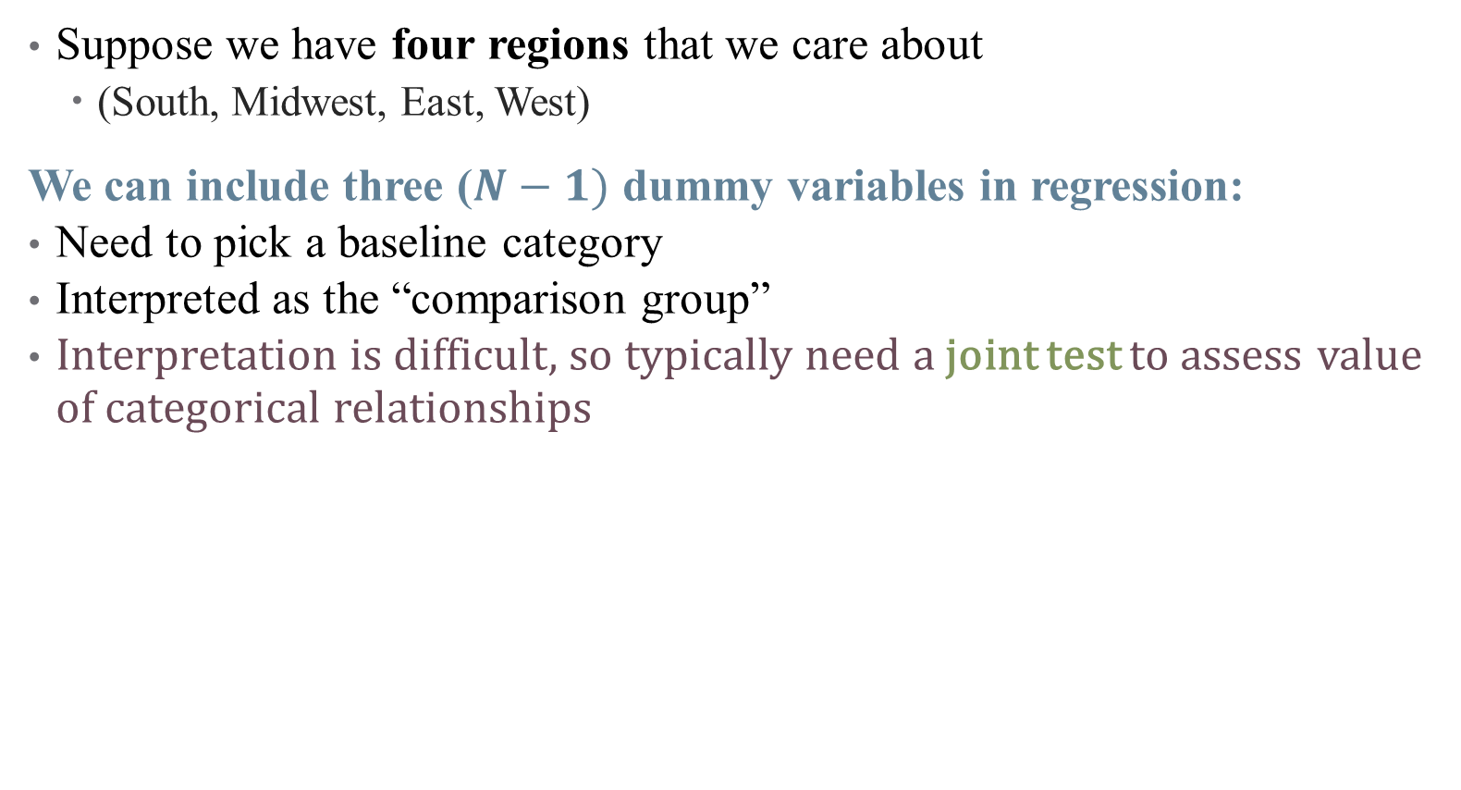
Avoiding the Dummy Variable Trap
Suppose we have four regions that we care about
  (South, Midwest, East, West)
We can include three ($N−1)$ dummy variables in regression:
Need to pick a baseline category
Interpreted as the “comparison group”
Interpretation is difficult, so typically need a joint test to assess value of categorical relationships
Notes:
We’re about to talk about significance in next section, so we can return to this.

Slide 45
Case study: Interpreting a regression
Notes:
How do the coefficients on female/indigenous have a different interpretation than HH size?

Slide 46
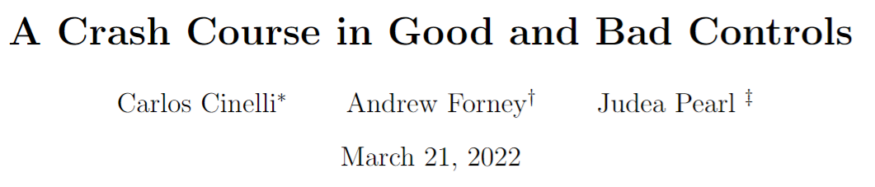
So What do I Control For (again?)
If you are doing model-based inference, your choice of controls really matters!
Notes:
Skip through these examples (but recommend the paper). Go to the crash course below.

Slide 47
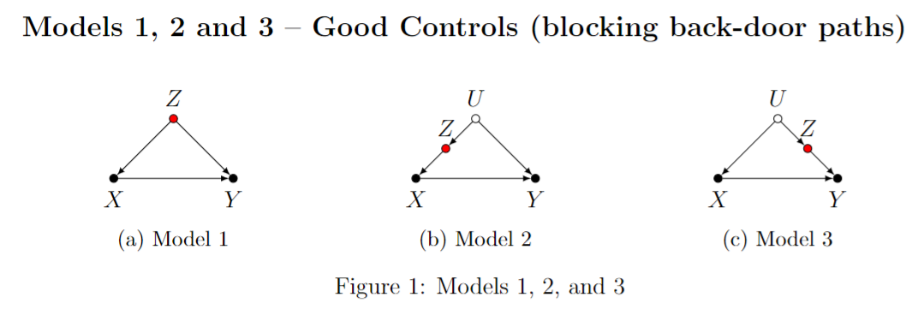
So What do I Control For (again?)
If you are doing model-based inference, your choice of controls really matters!
Notes:
What are some examples here?

Slide 48
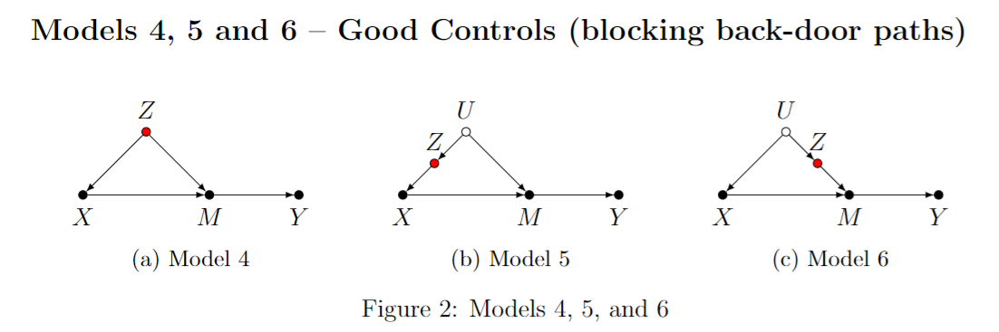
So What do I Control For (again?)
If you are doing model-based inference, your choice of controls really matters!
Notes:
What are some examples here?

Slide 49
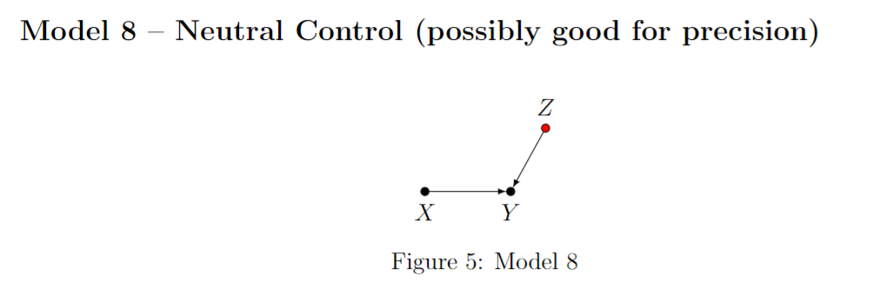
So What do I Control For (again?)
If you are doing model-based inference, your choice of controls really matters!
Notes:
What are some examples here?

Slide 50
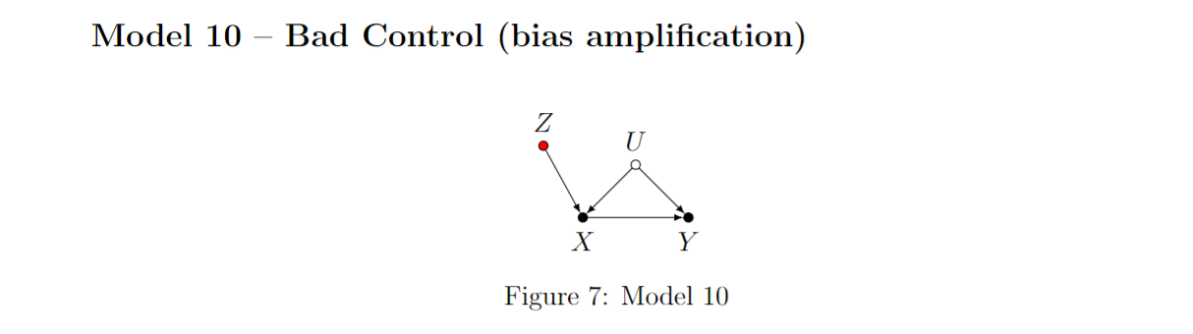
So What do I Control For (again?)
If you are doing model-based inference, your choice of controls really matters!
Notes:
What are some examples here?

Slide 51

So What do I Control For (again?)
If you are doing model-based inference, your choice of controls really matters!
Notes:
The birth-weight paradox (Hern ́andez-D ́ıaz et al., 2006). Infants born to smokers were found to have higher risks of mortality than infants born to non-smokers. However, among infants with low birth-weight (LBW), this relationship was reversed. This reversal of effects has created many controversies in epidemiology—does it mean that maternal smoking is beneficial for LBW infants? A plausible reason for such a finding could simply be collider stratification bias, as shown in Model 16. Here X is maternal smoking, Y infant mortality, Z birth-weight, and U stands for unobserved risk-factors (such as birth-defects and malnutrition), that could also affect birth-weight. Note that stratifying the analysis by birth-weight would induce a spurious association between smoking and mortality due to the competing risk-factors. LBW infants of non-smokers need to have alternative causes for their LBW (such as malnutrition), and such causes could also lead to higher mortality.

Slide 52

Mini Referee Report
What do you think about these papers?
  Any concerns?
  Anything clever?
  What would you extend?
Notes:
Do we have good controls here? Do we have good external/internal validity? What do/don’t you like about this paper? Do you like what they do beyond the main model?

Slide 53
Practical Regression Tips
Notes:
As we move into each method, I’ll try to give a “like the pros” section that talks about practical tips (coding, data structure, what goes in the paper, etc.)

Slide 54
Table 2 Fallacy:
Notes:
Note – the actual paper is very careful not to do this, but suppose we thought that the coefficients on HH size were causal. What would this look like in a paper? Are there less absurd examples of this happening?

Slide 55

Reading & Constructing a Regression Table
Concise way to present multiple regressions
What should you look for when reading a table?
  Key differences across models
  Identify parameter authors care about
  Look for changes across columns

Slide 56
Reading & Constructing a Regression Table
Concise way to present multiple regressions
What should you look for when reading a table?
  Key differences across models
  Identify parameter authors care about
  Look for changes across columns
Other notes:
  Asterisks and standard errors
Notes:
Think carefully about what type of standard errors you have. Tables should be self-contained, so that there are notes explaining what each model is, the types of Ses, etc.

Slide 57
Reading & Constructing a Regression Table
Concise way to present multiple regressions
What should you look for when reading a table?
  Key differences across models
  Identify parameter authors care about
  Look for changes across columns
Other notes:
  Asterisks and standard errors
  N

Slide 58
Reading & Constructing a Regression Table
Concise way to present multiple regressions
What should you look for when reading a table?
  Key differences across models
  Identify parameter authors care about
  Look for changes across columns
Other notes:
  Asterisks and standard errors
  N
  Overall model performance

Slide 59
Reading & Constructing a Regression Table
Interpreting Results
Think “A 1-unit change in x…”
Economic vs. statistical significance
Causality or association?
Notes:
Note: generally don’t interpret incidental coefficients on control variables – these don’t have a causal interpretation in your approach! You wrote a regression to identify a certain causal pathway, so the parameter you get on a backdoor path isn’t the causal effect of that path (see Hunermund and Louw in Github repo).

Slide 60
Reading & Constructing a Regression Table
Interpreting Results
Think “A 1-unit change in x…”
Economic vs. statistical significance
Causality or association?
How do you make the table?

Slide 61

Reading & Constructing a Regression Table

Slide 62
What do my results mean?
Types of causal validity
Notes:
We’re gonna talk about some types of “causal validity” – not R-squared but when the link between regression and model is strong enough. Let’s think about these in the context of the example paper.

Slide 63

What do my results mean?
Types of causal validity
Construct validity: are we measuring what we want to measure?
  How is the outcome variable measured?
  Are we capturing the right spot in the distribution (mean, median, etc.?)
Notes:
This is also known as the street light effect – researchers shine the light just on the street, miss what’s to the side. Are you asking the right questions? An example: a program hopes to improve commitment to school, and boasts that it improves test scores -- does that measure the outcome you want (teacher performance, kid happiness, etc.?) or does it just measure how good kids are at taking tests. Data limitations play a big role here (in health, think quality measurements, or metrics of risk/equity/etc.)
- example: are we actually measuring health effects when we throw out 1/3 of the sickest children?

Slide 64
What do my results mean?
Types of causal validity
Construct validity: are we measuring what we want to measure?
Statistical validity: are your statistics correct?
  Do you have enough statistical power to get the results that you want?
  Are all of your required assumptions met?
  Was there any p-hacking involved in getting the answer you published?
  Are your associations causal or spurious correlation?
Notes:
These are questions that are nearly impossible to answer in a paper or project (okay, you can do a power calculation – ish). But you still need to think carefully about each of these.
example: what about how the authors adjust for income? Good enough?

Slide 65

Statistical Power
Notes:
If you sample a small group repeatedly, you get a lot of different answers. But if you sample a large group even fewer times, your effects are more noticeable. Power calculations can tell you something about what the sample size should be (going out the window with big data)

Slide 66

How do I report my results and assumptions?
The TRIPOD Checklist has useful structure on what you should be watching out for
Notes:
Also includes things like – what limitations should be noted, what should go in a discussion, etc. We’ll try to talk more about this with each method we cover.

Slide 67

Are my results hacked? Are they spurious?
Notes:
For p-hacking, remember the website: https://projects.fivethirtyeight.com/p-hacking/. Did you correct for multiple testing? Did you perform 20 tests and report the one significant result?

Slide 68

Aggregate p-hacking: Publication Bias
Notes:
Distribution of p-values in research – what does this tell you? (Note that the z-stat is the test statistic, the inverse of the p-value)

Slide 69
What do my results mean?
Types of causal validity
Construct validity: are we measuring what we want to measure?
Statistical validity: are your statistics correct?
Internal validity: are your mechanisms correct?
  Did you pick up the causal pathway you wanted?
  Lots of threats!
  Selection, omitted variable bias, attrition, seasonality, measurement error, spillovers
  Each of these can affect your results
Notes:
Economists call internal validity “identification” You might not even have seen all the threats if your DAG is incomplete or wrong. A good econometrician is trained to try to pick at all the potential threats to identification / internal validity here. The best way to get around these is to think about as many as you can and then present your work as much as you can – people will help you see what you’re missing.
- Example here: are crop losses truly exogenous to the household? Can you see any reason why they might not be?

Slide 70

Example of Selection Bias: Marriage and Happiness
Notes:
Cover this example if you have time.

Slide 71

Example of Selection Bias: Marriage and Happiness
Notes:
Cover this example if you have time. Comparison between age of marriage and reported happiness (note: think about construct validity here too, with happiness scores). The selection is those choosing to be married in time sample, but could there be other threats?

Slide 72

Example of Selection Bias: Marriage and Happiness
Notes:
What threats are there to this (selection into early marriage, etc.)

Slide 73

Example of Selection Bias: Marriage and Happiness
Notes:
The authors tried to compare based on relative years around marriage, but look: happiness ticks up before marriage – so it can’t be from marriage! Of course, there are problems with this design (end of semester).
We will talk about more internal validity threats next time as well.

Slide 74
What do my results mean?
Types of causal validity
Construct validity: are we measuring what we want to measure?
Statistical validity: are your statistics correct?
Internal validity: are your mechanisms correct?
External validity: are your findings generalizable?
  Are your results a fluke of a limited sample?
Notes:
We’ll talk about more threats to internal validity throughout the course, particularly next time. If you want to think about multiple threats to IV, just think about nutrition research (they’re everywhere!)
- example: does this apply to Latin America? Current Mexico? How should we think about this?

Slide 75

Example of External Validity
Notes:
Um what? Don’t trust the headlines, or the lay media.

Slide 76

Example of Selection Bias: Marriage and Happiness
Notes:
True story: this was a study published about mice! But read the text summarizing the study.

Slide 77

What do my results mean?
Types of causal validity
Construct validity: are we measuring what we want to measure?
Statistical validity: are your statistics correct?
Internal validity: are your mechanisms correct?
External validity: are your findings generalizable?
  Are your results a fluke of a limited sample?
  Does your data match the population?
Notes:
Particularly of concern with surveys or even clinical trials

Slide 78
Summary
Regression is a very powerful tool (use it well)
Importance of controlling for colliders/covariates
Inference and uncertainty of a regression
Interpreting regression coefficients and tables
Presenting your results
Next time: getting fancier with regression
Types of variables you can use
Interaction effects
(Some) Nonlinear models

