Slide 1
Quant Methods for HSR I
Lecture 4: Getting Fancier with Regression
October 5, 2026
HAD5744 • Alex Hoagland, Ph.D.
Notes:
Mention: Next week’s class will be about data cleaning and research designs (broadly), so please come with your research questions at least half-baked, so we can talk specifics. Project proposal ideas coming up in 3 weeks. Also make sure to watch the correct (old) version of the video so we can talk about this (only need to watch parts 1 through 3).
What do you do if you don’t have a question? Read through the data dictionaries here, then do some descriptive work! And also watch the video for next week, thinking about your questions!

Slide 2
Other Options with Regressions
There are multiple other things that can be done with a regression
Regression is a very flexible tool
In class, we’ll cover:
  Options for variables (scaling & transformations)
  Interactions
  Nonlinear effects which are linear in parameters (if there’s time)
  Notes on standard errors
  Notes on interpreting regressions with covariates as causal
Later, we’ll cover more nonlinear regression options:
  Binary outcome variables (probit/logit)
  General nonparametric approaches

Slide 3
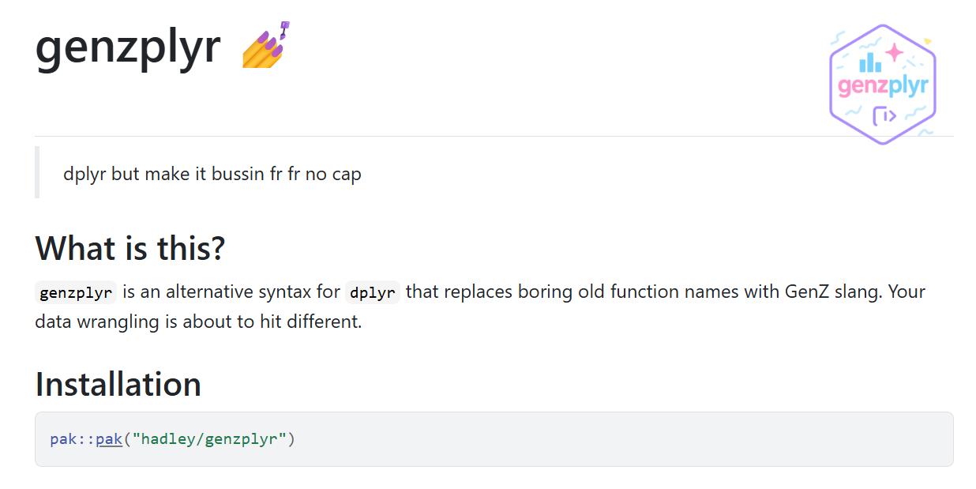
But first…
Notes:
Move this to beginning of another lecture for next time. Link here: https://hadley.github.io/genzplyr/.

Slide 4
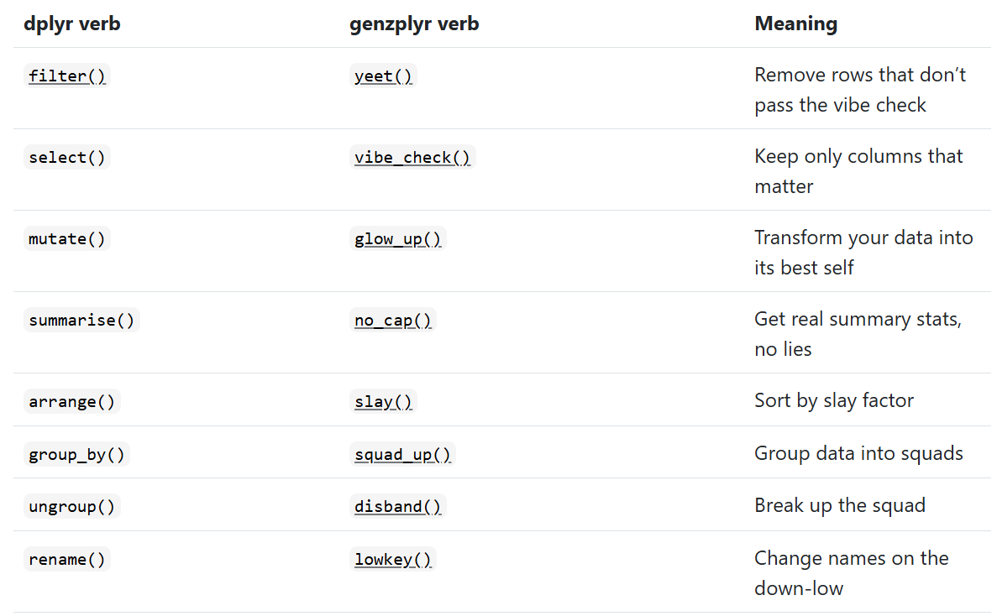
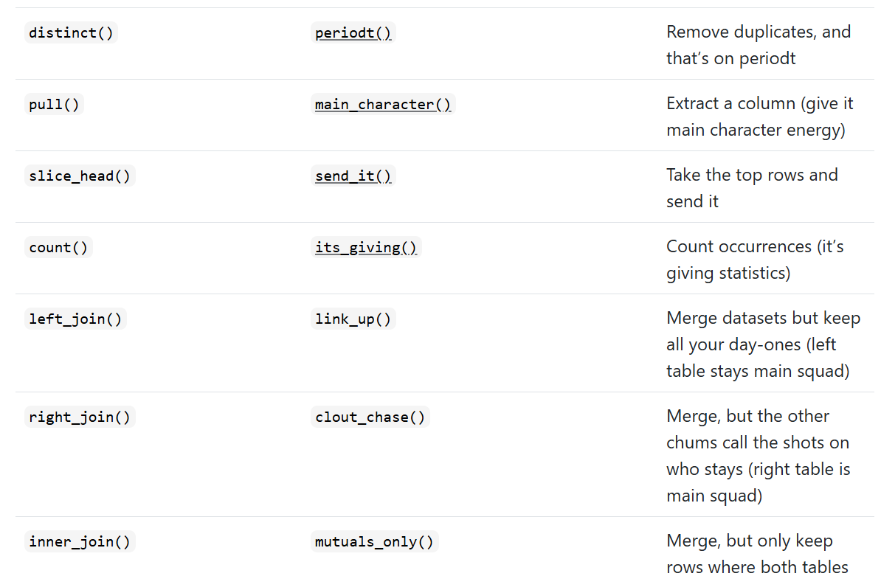
But first…

Slide 5
Case Study:
“Observational Studies of the Effect of Medicaid on Health:
Controls Are Not Enough”
Seth Freedman, Andrew Goodman-Bacon, and Noah Hammarlund
Journal of Labor Economics, 2021
Notes:
We’re going in and out of what’s actually in the paper, but we’re going to use it to frame all of the things we talk about today.

Slide 6
What is the setting of this paper? Why is it important?
Notes:
We care about whether government policy actually affects health. Example here: Medicaid in the US. These results matter because Medicaid costs half a trillion dollars per year and is among the most expensive items in federal and state budgets

Slide 7
What is the setting of this paper? Why is it important?
What is this paper arguing?

Slide 8
What is the setting of this paper? Why is it important?
What is this paper arguing?
Cross-sectional studies have found a lot of different results
Some argue Medicaid patients have worse outcomes compared to nonrecipients
Others use “plausibly exogenous” changes in Medicaid coverage and find benefits
Are there RCTs? What did they find?
Notes:
We care about whether government policy actually affects health. Example here: Medicaid in the US.

Slide 9
What is the setting of this paper? Why is it important?
What is this paper arguing?
Why is it difficult to find a good causal effect?
What are the identification threats here?
What is needed to identify a causal effect using only controls?
What is this paper going to show (broad strokes)?
Notes:
The primary one is selection across treatment and any plausible “control” group. Conditional on income (qualifying for Medicaid), those who have worse health are more likely to actually enrol. So you’re not comparing apples and oranges to look at recipients and nonrecipients.
- Other problems include missing data in your admin datasets (income, like last time), and private information to participants that we don’t have.
“To interpret the adjusted differences as causal effects, the control variables must completely account for factors that make patients less healthy and lead them to qualify for and take up Medicaid coverage.” (the last bit is the hardest to control for)
The paper will replicate a big finding of the day, toy with the model (add more controls), and then examine how selection could contribute to this difference.

Slide 10
Variable Selection: Transformations
Notes:
First, let’s introduce a few more ideas.

Slide 11

Scaling Regressors
What if we want to change the measurement of $x_{i}$?
Consider a change by dividing 𝑥 by some constant 𝑐. Then, the regression must require the coefficient of 𝑥 must be multiplied by 𝑐:
$$y=β_{1}+β_{2}x+e=β_{1}+\left(cβ_{2}\right)\left(\frac{x}{c}\right)+e$$
What happens if we change 𝑥 from dollars to thousands of dollars?
Notes:
This is directly related to the idea that if beta is the ME of 1, then the ME of 100 is 100*beta. May come in useful for your homework assignment – feel free to rescale variables as desired.

Slide 12
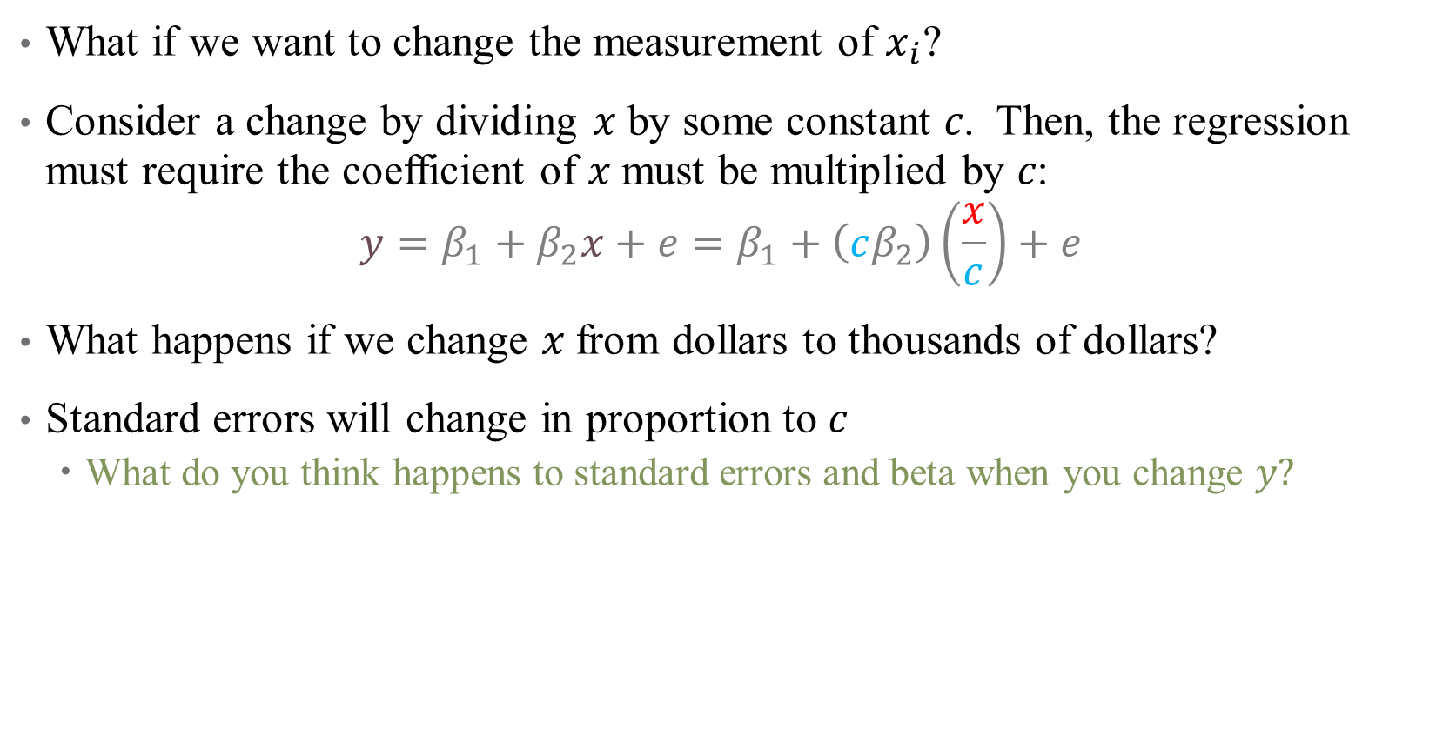
Scaling Regressors
What if we want to change the measurement of $x_{i}$?
Consider a change by dividing 𝑥 by some constant 𝑐. Then, the regression must require the coefficient of 𝑥 must be multiplied by 𝑐:
$$y=β_{1}+β_{2}x+e=β_{1}+\left(cβ_{2}\right)\left(\frac{x}{c}\right)+e$$
What happens if we change 𝑥 from dollars to thousands of dollars?
Standard errors will change in proportion to $c$
  What do you think happens to standard errors and beta when you change $y?$
Notes:
They all change by the same amount

Slide 13
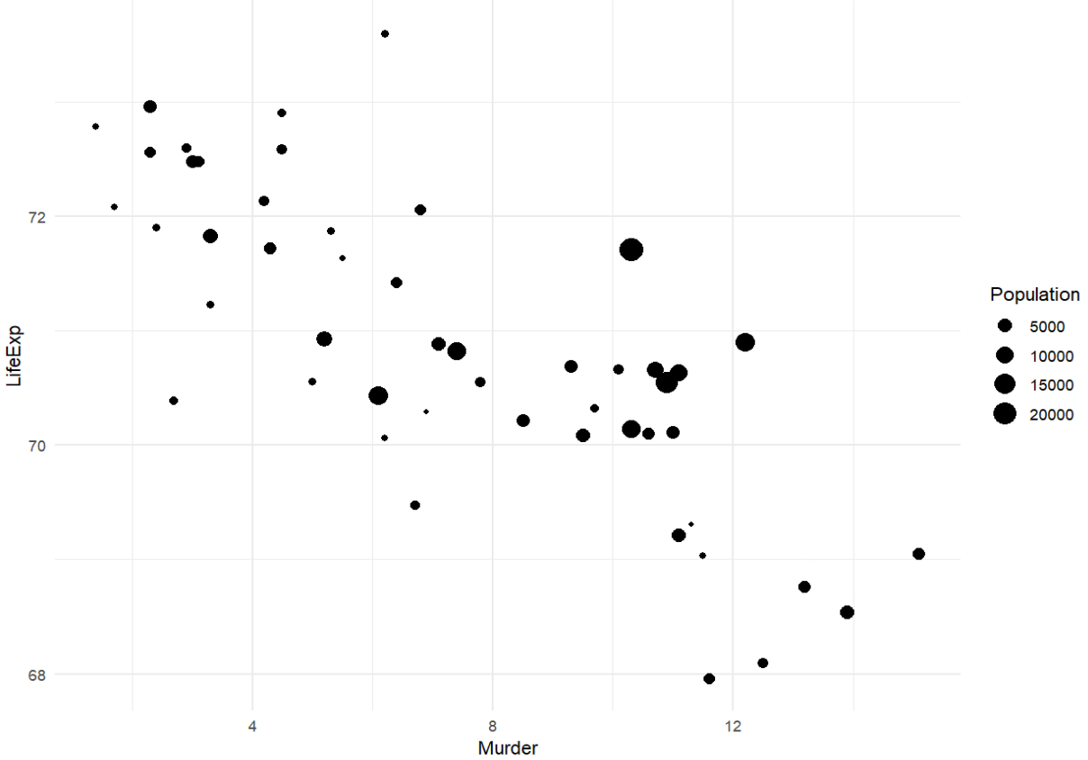
Scaling Observations
Should every observation count the same?
Food insecurity
Notes:
Briefly mention scaling regressors, which we talked about last time. Here, each point is a state in the US; do we want all states to be counted equally in our regression?

Slide 14
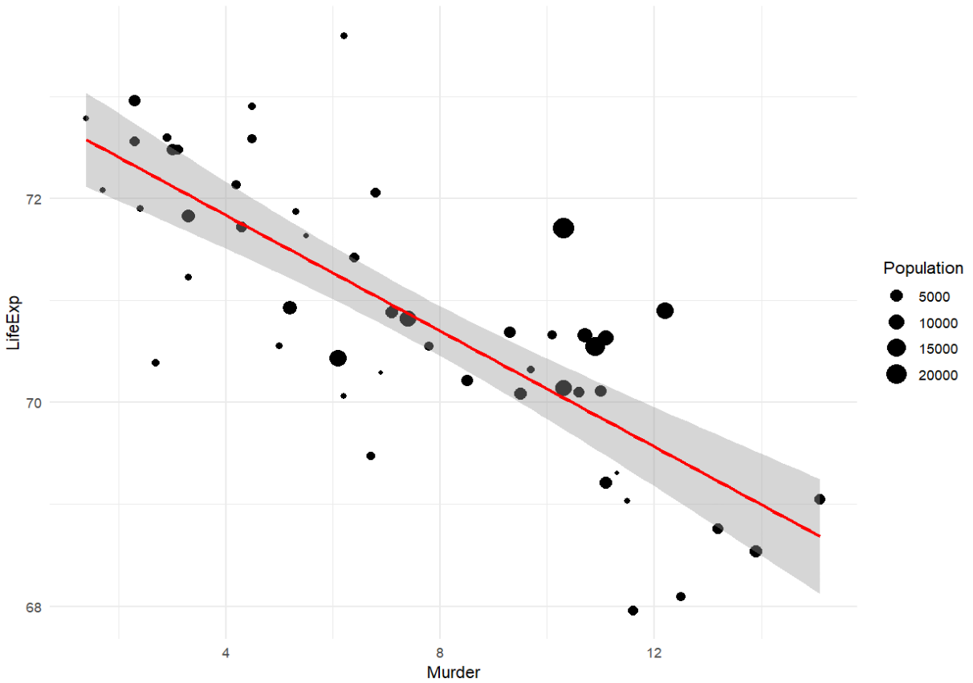
Scaling Observations
What if instead, we want to weight our observations differently?
Food insecurity
Notes:
This is without smoothing

Slide 15
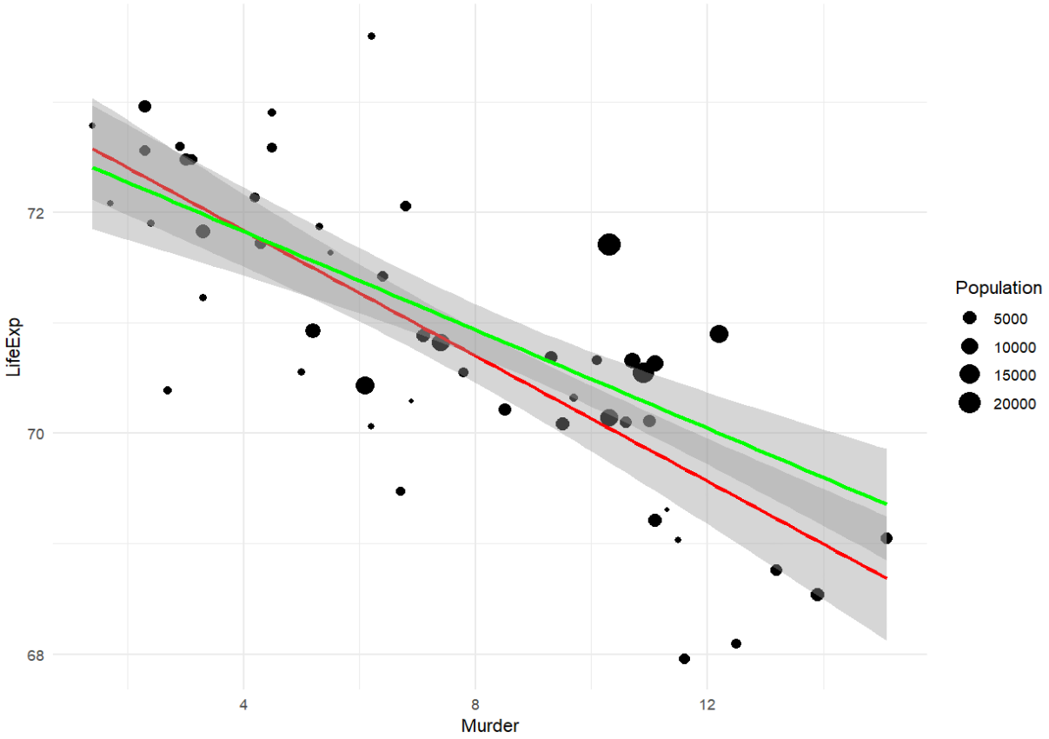

Scaling Observations
What if instead, we want to weight our observations differently?
Food insecurity
Notes:
So what is the difference? Are we over-stating or under-stating the true effect here without the weighting (overstating, the line is steeper)
What causes the differences here?
Note: does our case study use weighting? Yes! By the NIS provided discharge weight to make procedures nationally representative.

Slide 16

Nonlinear Transformations
Scaling regressors is a form of a linear transformation
  Since our regression is linear, transformations are mathematically redundant
It might also make sense to make a nonlinear transformation:
$$y=β_{0}+β_{1}x_{1}+β_{2}ln\left(x_{2}\right)+ε$$
Where ln($x_{2})$ is the natural log or log base “$e$”
Notes:
We talked about this last week

Slide 17
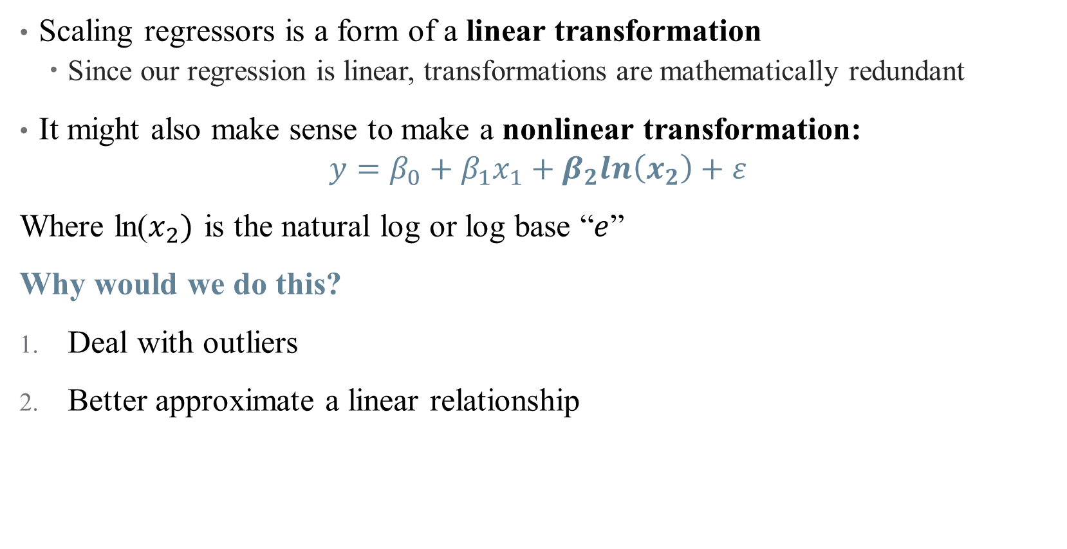
Nonlinear Transformations
Scaling regressors is a form of a linear transformation
  Since our regression is linear, transformations are mathematically redundant
It might also make sense to make a nonlinear transformation:
$$y=β_{0}+β_{1}x_{1}+β_{2}ln\left(x_{2}\right)+ε$$
Where ln($x_{2})$ is the natural log or log base “$e$”
Why would we do this?
Deal with outliers
Better approximate a linear relationship

Slide 18
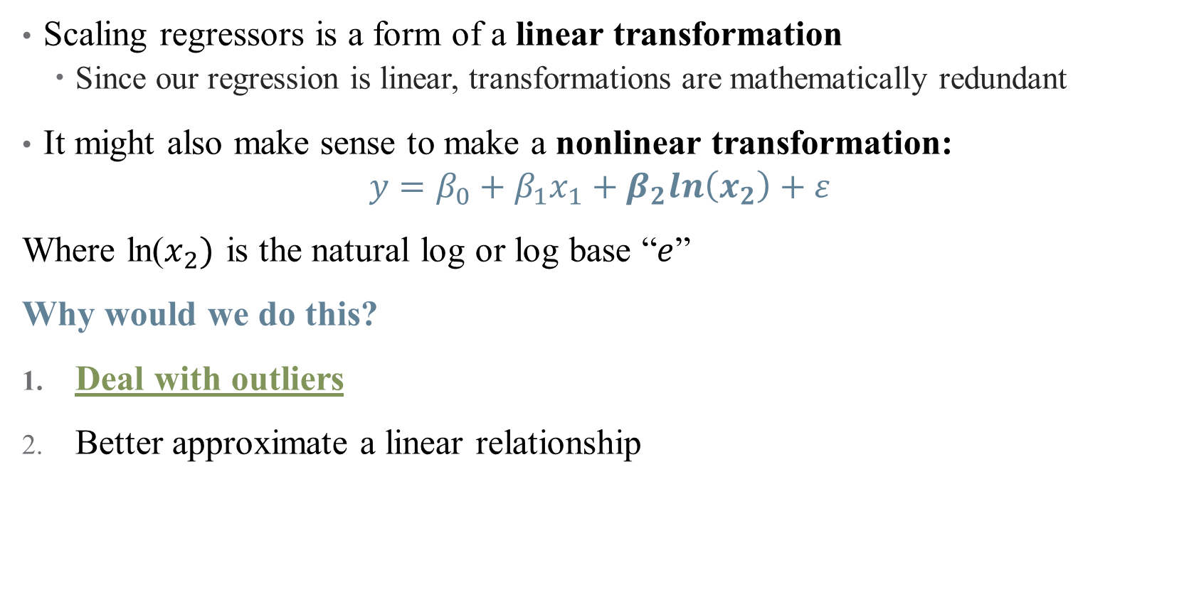
Nonlinear Transformations
Scaling regressors is a form of a linear transformation
  Since our regression is linear, transformations are mathematically redundant
It might also make sense to make a nonlinear transformation:
$$y=β_{0}+β_{1}x_{1}+β_{2}ln\left(x_{2}\right)+ε$$
Where ln($x_{2})$ is the natural log or log base “$e$”
Why would we do this?
Deal with outliers
Better approximate a linear relationship

Slide 19
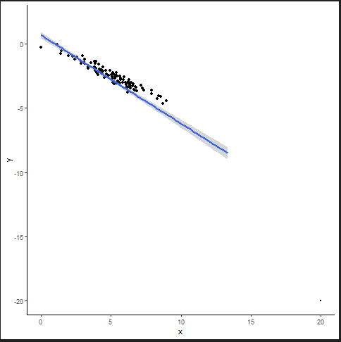

Nonlinear Transformations: Outliers
Data may be highly skewed, or influenced by the presence of outliers
These nonlinearities generate large variations in the estimate of a $β_{i}$
Notes:
Example: income distribution

Slide 20
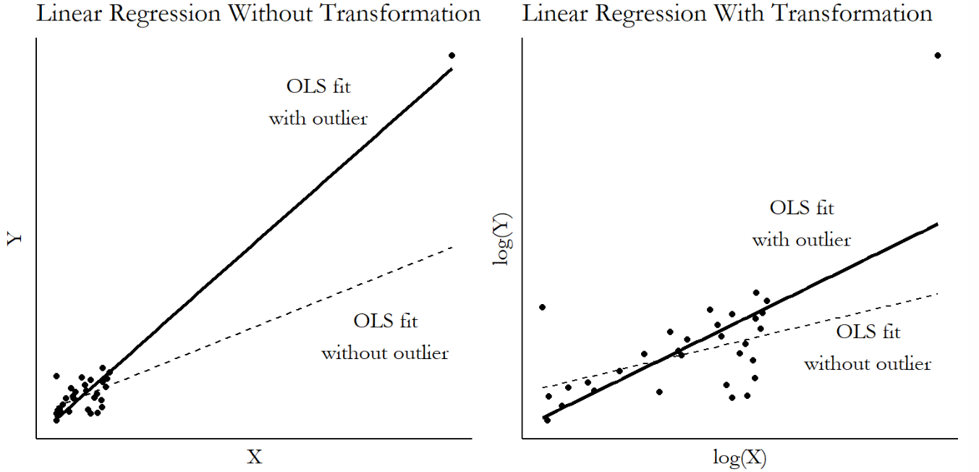

Nonlinear Transformations: Outliers
Data may be highly skewed, or influenced by the presence of outliers
These outliers generate large variations in the estimate of a $β_{i}$
  Option 1: throw them out
  Option 2: “scrunch them down”
Notes:
What does it mean to get selective with your data? That’s a bold move.

Slide 21
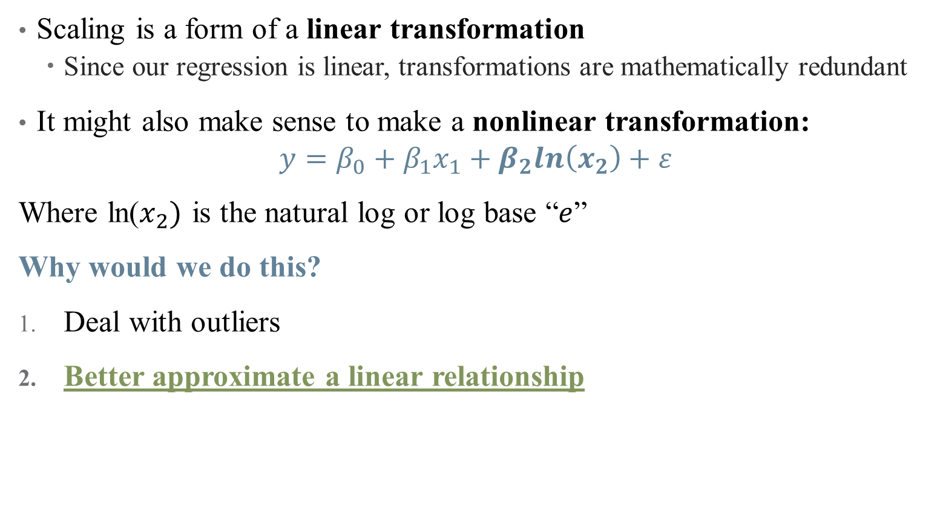
Nonlinear Transformations
Scaling is a form of a linear transformation
  Since our regression is linear, transformations are mathematically redundant
It might also make sense to make a nonlinear transformation:
$$y=β_{0}+β_{1}x_{1}+β_{2}ln\left(x_{2}\right)+ε$$
Where ln($x_{2})$ is the natural log or log base “$e$”
Why would we do this?
Deal with outliers
Better approximate a linear relationship
Notes:
This is all about interpretation – what does it mean to interpret a single marginal effect if the distribution is wonky? Change from 10000 to 20000 annually versus change from 200000 to 210000

Slide 22

Nonlinear Transformations: Achieving “Linearity” (?)
Remember that OLS only fits linear relationships (in parameters)
  So what kind of model are you trying to fit?
Should a 1-unit increase in $x$ correspond to a $β_{1}$-unit increase in $y$? (levels)
Or should a 1-unit increase in $x$ correspond to a $β_{1}$% increase in $y$?
Or should a 1% increase in $x$ correspond to a $β_{1}$% increase in $y$?

Slide 23
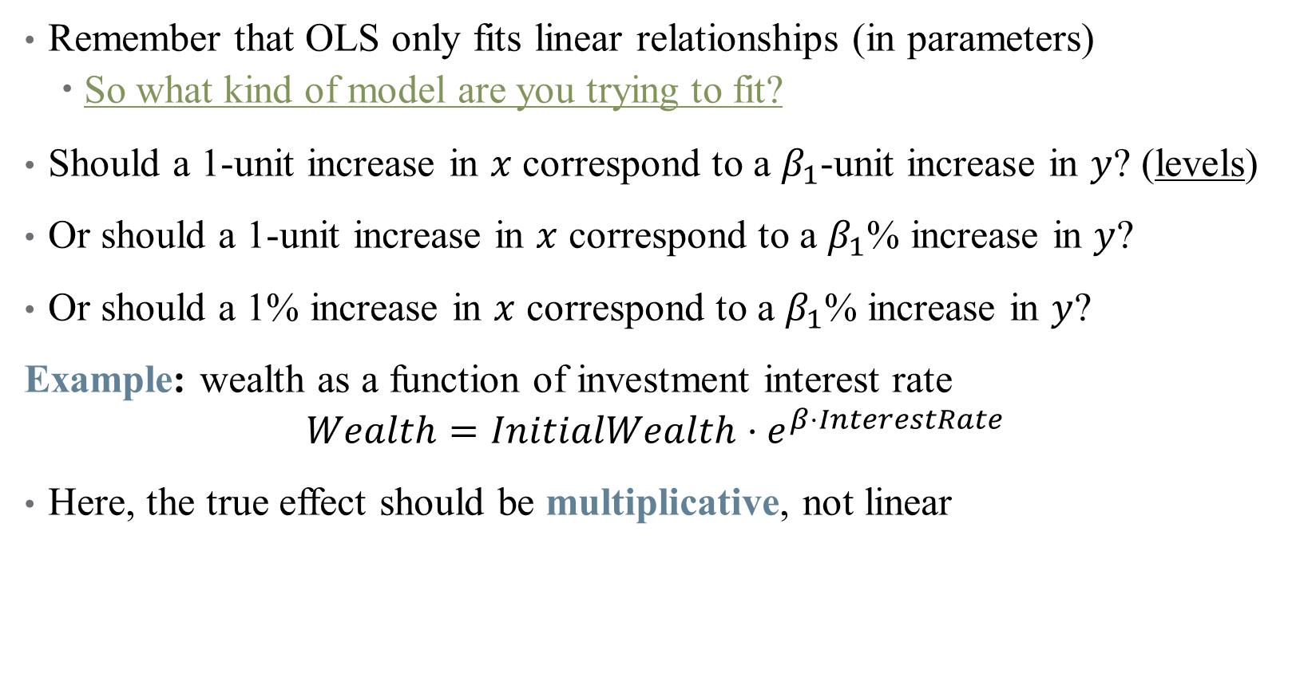
Nonlinear Transformations: Achieving “Linearity” (?)
Remember that OLS only fits linear relationships (in parameters)
  So what kind of model are you trying to fit?
Should a 1-unit increase in $x$ correspond to a $β_{1}$-unit increase in $y$? (levels)
Or should a 1-unit increase in $x$ correspond to a $β_{1}$% increase in $y$?
Or should a 1% increase in $x$ correspond to a $β_{1}$% increase in $y$?
Example: wealth as a function of investment interest rate
$$Wealth=InitialWealth⋅e^{β⋅InterestRate}$$
Here, the true effect should be multiplicative, not linear
Notes:
How to get this in a regression? Use the natural log! Do this on the board.

Slide 24
What kinds of transformations exist?
See “The Effect” for a (more) exhaustive list (pg. 214)
Natural Log – tried and true
  But, recall that ln(0) is undefined – what if we have zero-valued data?

Slide 25

What kinds of transformations exist?
See “The Effect” for a (more) exhaustive list (pg. 214)
Natural Log – tried and true
  But, recall that ln(0) is undefined – what if we have zero-valued data?
The Cheater: $ln\left(x+1\right)$
  Common workaround, but loses some useful properties of the log
Notes:
If x is large, log(x+1) \approx. log(x). So this works for like health spending or income data, and is defined for 0s. Hence, percentages don’t really work for small x.
There are others, sinh^{-1}, square root, etc. (coming up in a few slides)

Slide 26

How to interpret coefficients on transformed variables?
Let’s focus on $ln⁡(x)$ for now: $y=β_{0}+β_{1}\ln\left(x_{1}\right)+ε$
  If $\ln\left(x_{1}\right)$ goes up by $1$, then $y$ increases by $β_{1}$
  Okay, but what does it mean for ln$\left(x_{1}\right)$ to change by a certain amount?
  It’s helpful to think about percentage changes in $x_{1}$

Slide 27
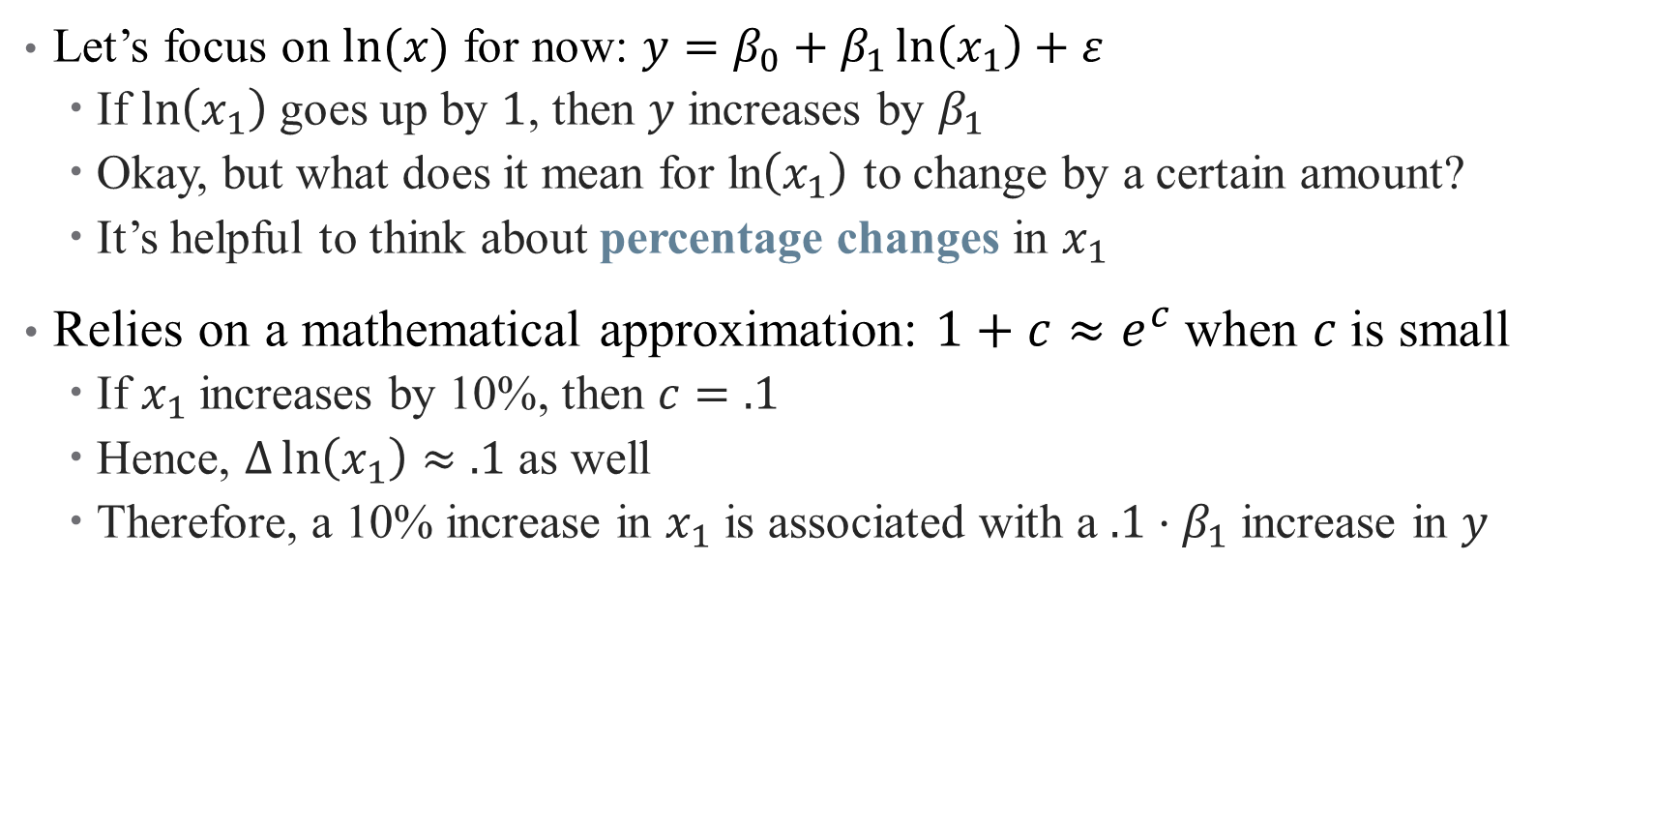
How to interpret coefficients on transformed variables?
Let’s focus on $ln⁡(x)$ for now: $y=β_{0}+β_{1}\ln\left(x_{1}\right)+ε$
  If $\ln\left(x_{1}\right)$ goes up by $1$, then $y$ increases by $β_{1}$
  Okay, but what does it mean for ln$\left(x_{1}\right)$ to change by a certain amount?
  It’s helpful to think about percentage changes in $x_{1}$
Relies on a mathematical approximation: $1+c≈e^{c}$when $c$is small
  If $x_{1}$ increases by 10%, then $c=.1$
  Hence, $Δ\ln\left(x_{1}\right)≈.1$ as well
  Therefore, a 10% increase in $x_{1}$ is associated with a $.1⋅β_{1}$ increase in $y$

Slide 28
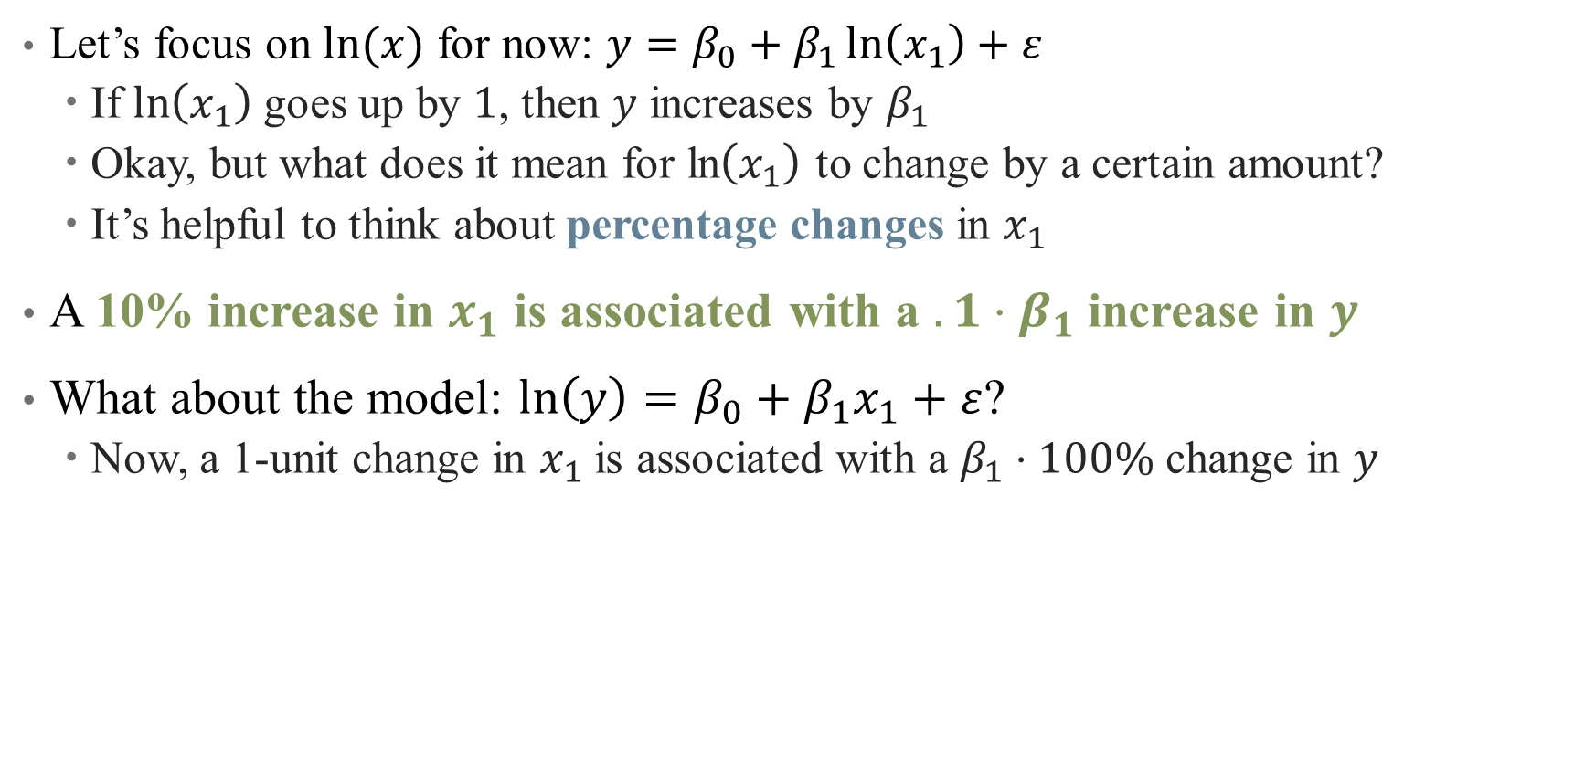
How to interpret coefficients on transformed variables?
Let’s focus on $ln⁡(x)$ for now: $y=β_{0}+β_{1}\ln\left(x_{1}\right)+ε$
  If $\ln\left(x_{1}\right)$ goes up by $1$, then $y$ increases by $β_{1}$
  Okay, but what does it mean for ln$\left(x_{1}\right)$ to change by a certain amount?
  It’s helpful to think about percentage changes in $x_{1}$
A 10% increase in $x_{1}$ is associated with a $.1⋅β_{1}$ increase in $y$
What about the model: $ln\left(y\right)=β_{0}+β_{1}x_{1}+ε$?
  Now, a 1-unit change in $x_{1}$ is associated with a $β_{1}⋅100\%$ change in $y$
Notes:
Just the same as before, but one of the variables is in percent and one is in levels – just depends which one you want

Slide 29
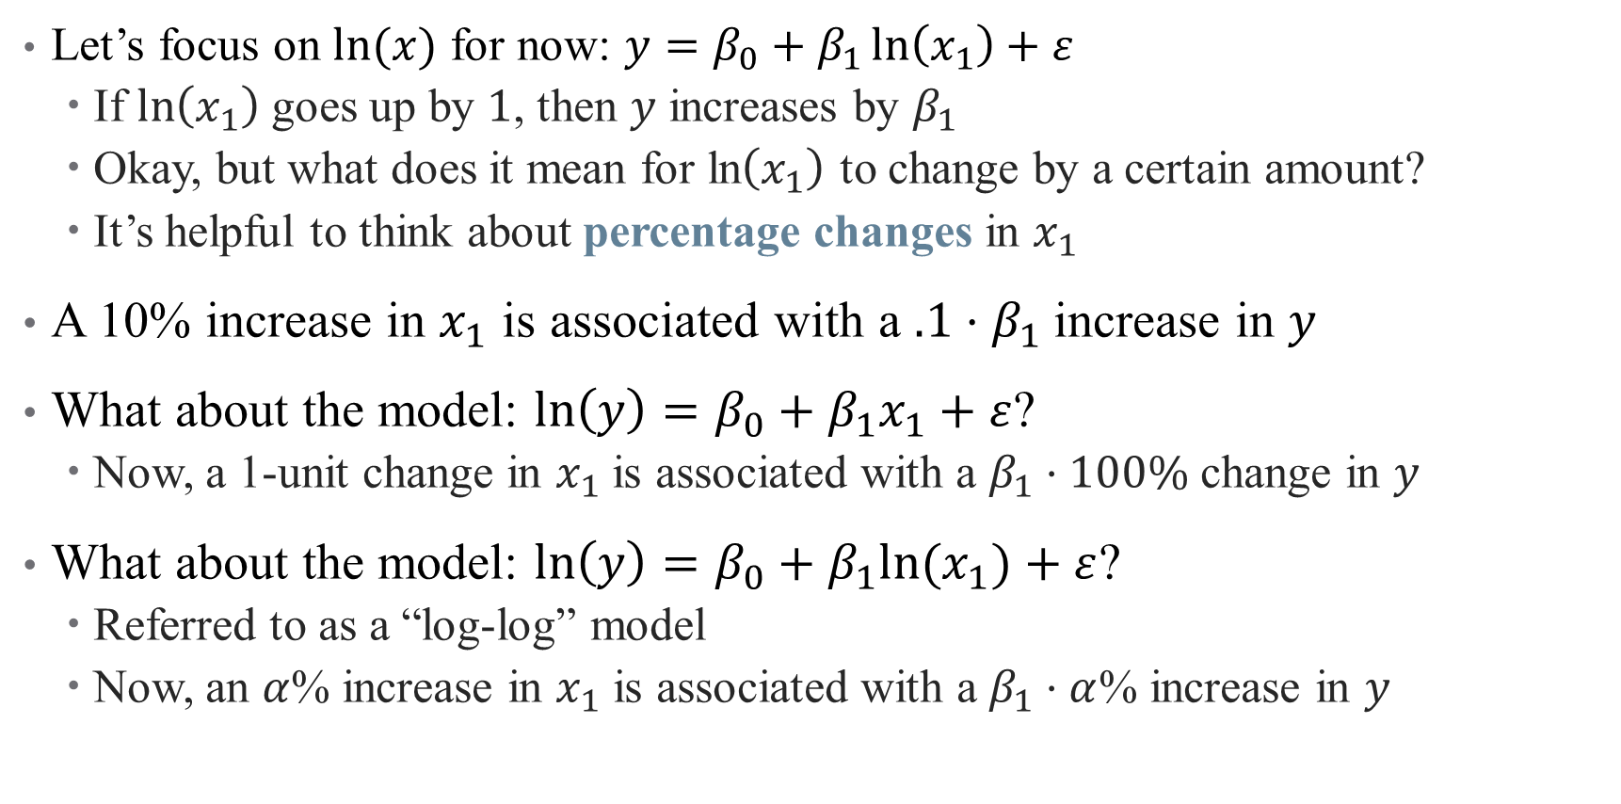
How to interpret coefficients on transformed variables?
Let’s focus on $ln⁡(x)$ for now: $y=β_{0}+β_{1}\ln\left(x_{1}\right)+ε$
  If $\ln\left(x_{1}\right)$ goes up by $1$, then $y$ increases by $β_{1}$
  Okay, but what does it mean for ln$\left(x_{1}\right)$ to change by a certain amount?
  It’s helpful to think about percentage changes in $x_{1}$
A 10% increase in $x_{1}$ is associated with a $.1⋅β_{1}$ increase in $y$
What about the model: $ln\left(y\right)=β_{0}+β_{1}x_{1}+ε$?
  Now, a 1-unit change in $x_{1}$ is associated with a $β_{1}⋅100\%$ change in $y$
What about the model: $ln\left(y\right)=β_{0}+β_{1}{ln⁡(x}_{1})+ε$?
  Referred to as a “log-log” model
  Now, an $α$% increase in $x_{1}$ is associated with a $β_{1}⋅α$% increase in $y$
Notes:
This is the version where both are in percentages.
Quick example on logs: suppose we do
y=bx, where b=5. Then how do we interpret?
Y=b*log(x) where b = 5. Then a 1% increase in x corresponds to a 5*.01 = 0.05 unit increase in y
Log(y) = b*x where b = 5. Then a 1 unit increase in x corresponds to a 500% (5-fold increase) in y
Log(y) = b*log(x). Then a 1% increase in x corresponds to a 0.05 increase in log(y), so roughly a 5% increase in y.

Slide 30
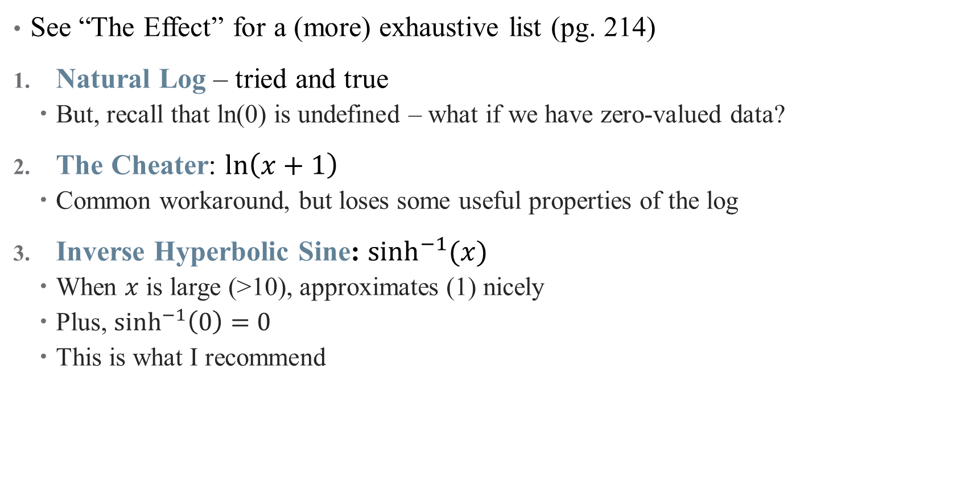
What kinds of transformations exist?
See “The Effect” for a (more) exhaustive list (pg. 214)
Natural Log – tried and true
  But, recall that ln(0) is undefined – what if we have zero-valued data?
The Cheater: $ln\left(x+1\right)$
  Common workaround, but loses some useful properties of the log
Inverse Hyperbolic Sine: $\sinh^{−1}{(x)}$
  When $x$ is large (>10), approximates (1) nicely
  Plus, $\sinh^{−1}\left(0\right)=0$
  This is what I recommend
Notes:
This is the hipster one – do it and you’re cool. Can also handle negative numbers if you need

Slide 31
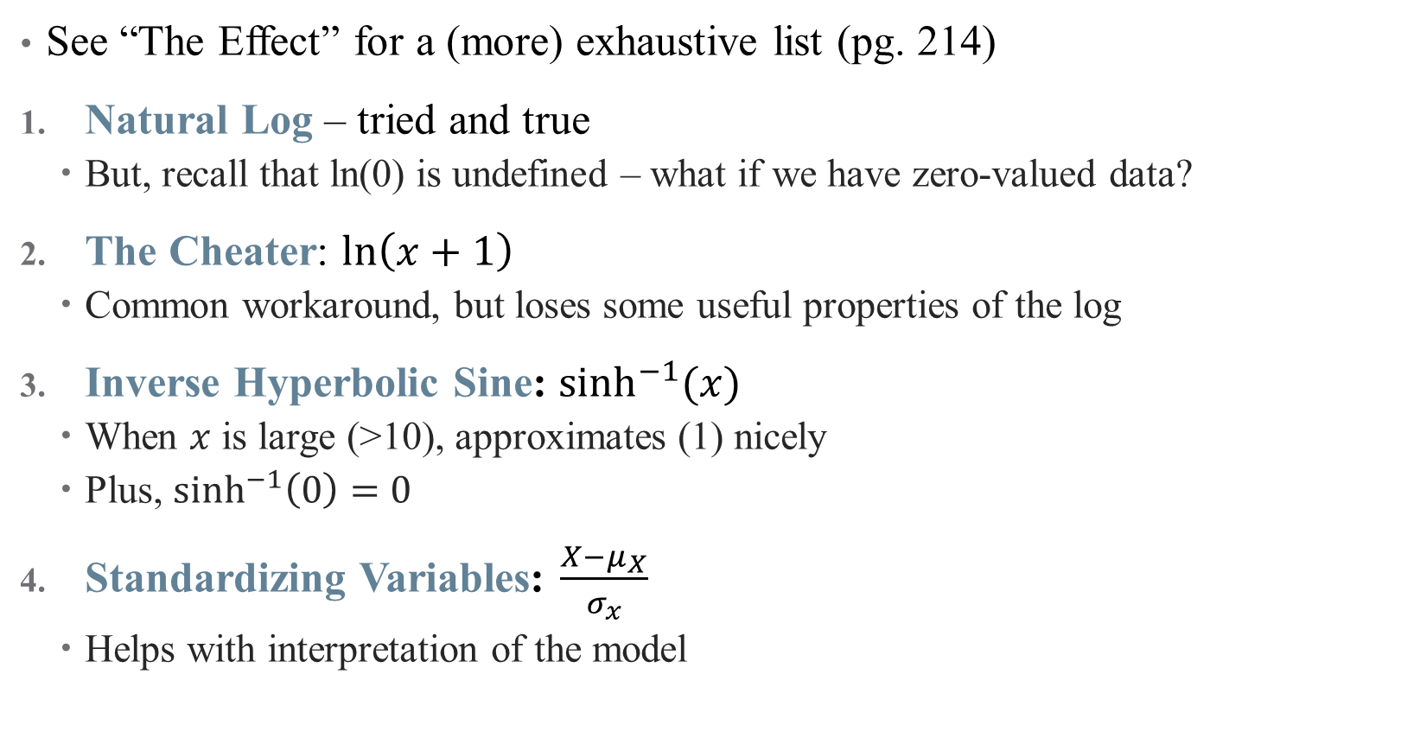
What kinds of transformations exist?
See “The Effect” for a (more) exhaustive list (pg. 214)
Natural Log – tried and true
  But, recall that ln(0) is undefined – what if we have zero-valued data?
The Cheater: $ln\left(x+1\right)$
  Common workaround, but loses some useful properties of the log
Inverse Hyperbolic Sine: $\sinh^{−1}{(x)}$
  When $x$ is large (>10), approximates (1) nicely
  Plus, $\sinh^{−1}\left(0\right)=0$
Standardizing Variables: $\frac{X−μ_{X}}{σ_{x}}$
  Helps with interpretation of the model
What does our case study from last time use?
Notes:
This is a common practice if the units are already weird (e.g., points on a happiness scale), and moves to more data-driven units. (another not shown is square root)

Slide 32
Interaction Effects

Slide 33

What is an Interaction?
Suppose we want to know the effect of $X$ on $Y$ specific to groups $Z$
Notes:
Example: what is the effect of radiology on survival? Well that depends on different groups of cancer patients

Slide 34

What is an Interaction?
Suppose we want to know the effect of $X$ on $Y$ specific to groups $Z$
We want to flexibly model how a relationship between two variables may depend on the levels of a third
$$Y=β_{0}+β_{1}X+β_{2}Z+β_{3}\left(X⋅Z\right)+ε$$
Notes:
We add what’s called an interaction term – here, X is the effect of radiation, and Z is an indicator variable for different type of cancer. What do each of the coefficients mean?

Slide 35

What is an Interaction?
Suppose we want to know the effect of $X$ on $Y$ specific to groups $Z$
We want to flexibly model how a relationship between two variables may depend on the levels of a third
$$Y=β_{0}+β_{1}X+β_{2}Z+β_{3}\left(X⋅Z\right)+ε$$
Main question: how do we interpret interaction terms?
Notes:
We can interpret coefs 1 and 2 easily, what about 3?

Slide 36
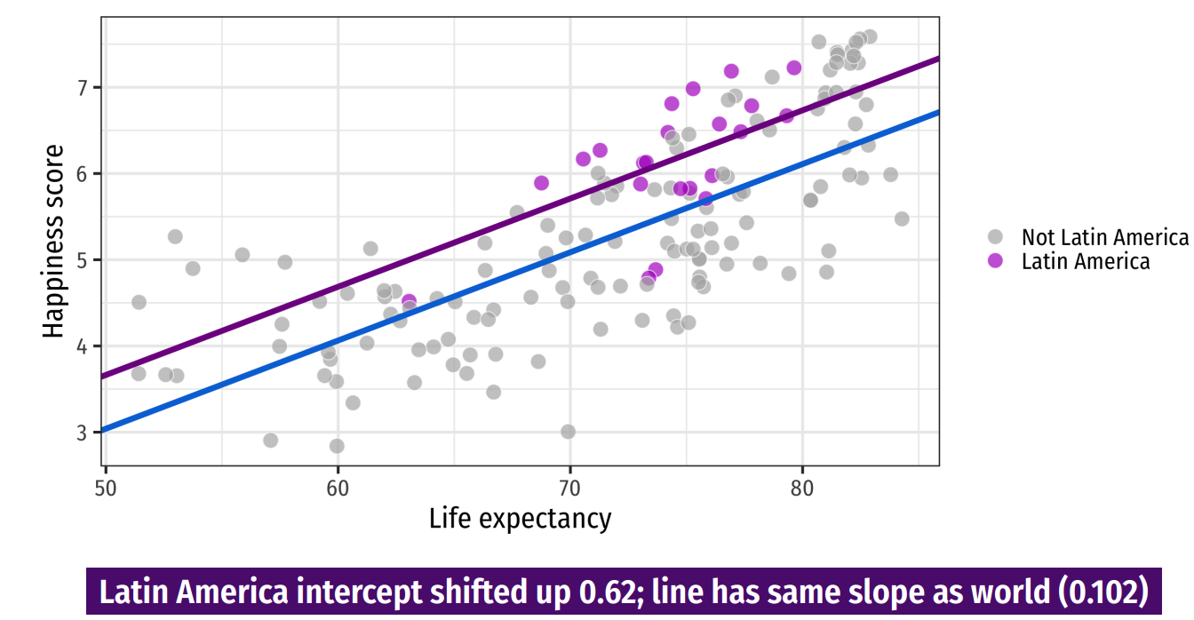
Discrete Regressors
Notes:
We don’t have an interaction model in our case study (what might it be?) so let’s circle back there. This is from last time – the impact of including a dummy is an intercept shift

Slide 37
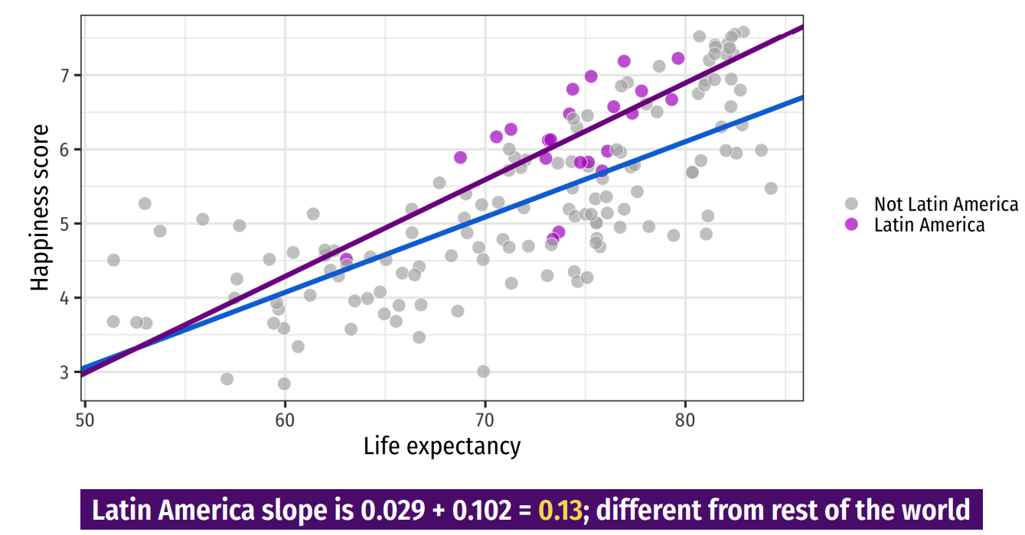
Discrete Regressors
Notes:
An interaction is a change in slope for two groups – here, we estimate happiness as a function of life expectancy * (latin America) to get separate slopes for each region. Show on board that we really have to do both.

Slide 38
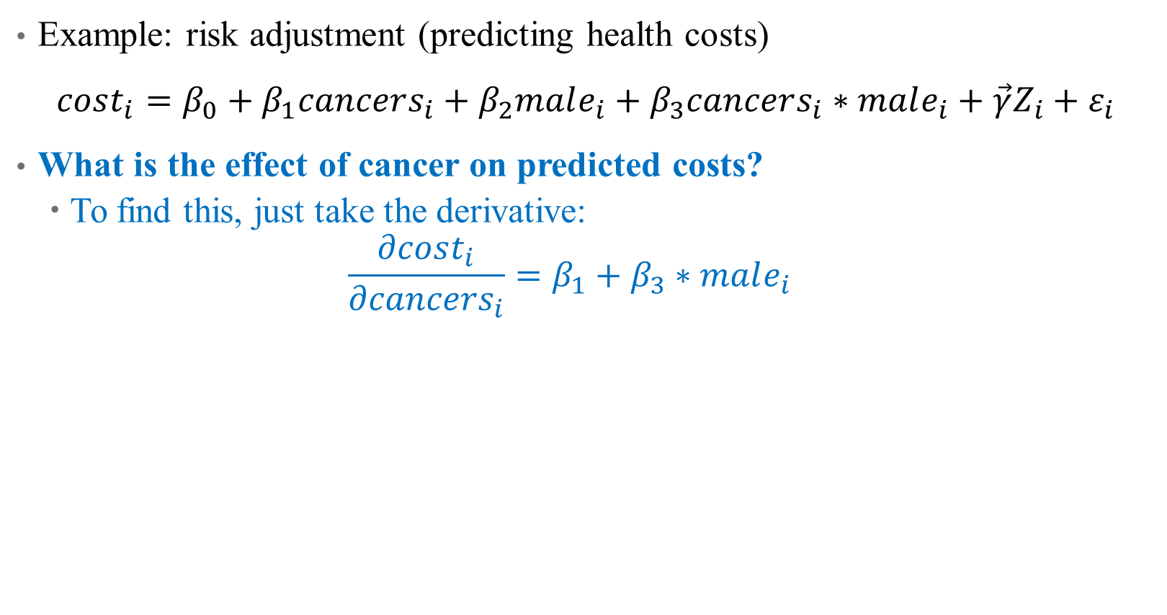
How do we Interpret Interaction Terms?
Example: risk adjustment (predicting health costs)
$cost_{i}=β_{0}+β_{1}cancers_{i}+β_{2}male_{i}+β_{3}cancers_{i}∗male_{i}+\vec{γ}Z_{i}+ε_{i}$
What is the effect of cancer on predicted costs?
  To find this, just take the derivative:
  $$\frac{∂cost_{i}}{∂cancers_{i}}=β_{1}+β_{3}∗male_{i}$$
Notes:
Interaction terms are everywhere in risk adjustment!

Slide 39
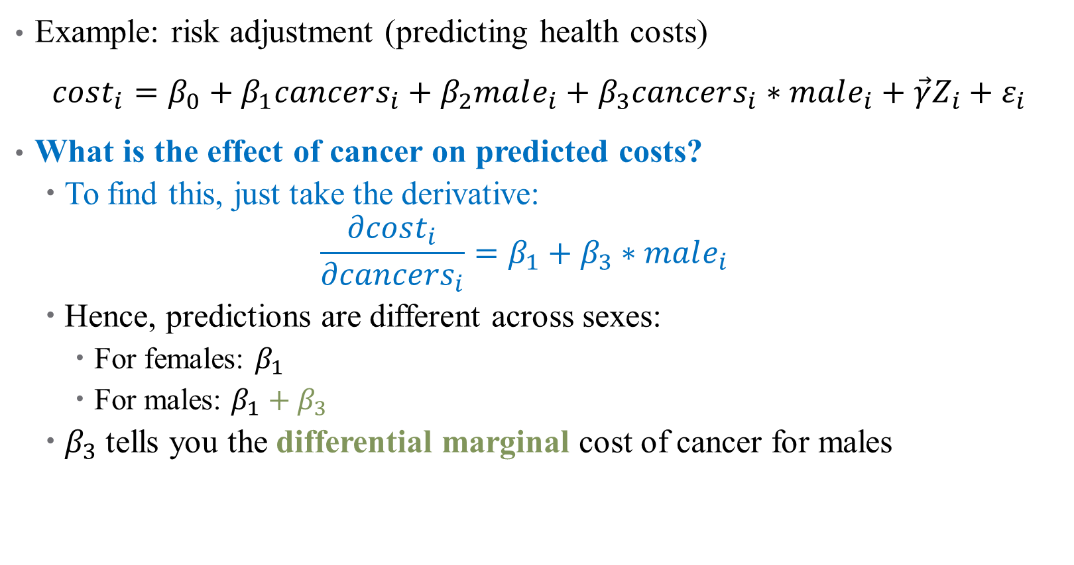
How do we Interpret Interaction Terms?
Example: risk adjustment (predicting health costs)
$cost_{i}=β_{0}+β_{1}cancers_{i}+β_{2}male_{i}+β_{3}cancers_{i}∗male_{i}+\vec{γ}Z_{i}+ε_{i}$
What is the effect of cancer on predicted costs?
  To find this, just take the derivative:
  $$\frac{∂cost_{i}}{∂cancers_{i}}=β_{1}+β_{3}∗male_{i}$$
  Hence, predictions are different across sexes:
    For females: $β_{1}$
    For males: $β_{1}+β_{3}$
  $β_{3}$ tells you the differential marginal cost of cancer for males
Notes:
Not just a level shift, but different margin here.

Slide 40
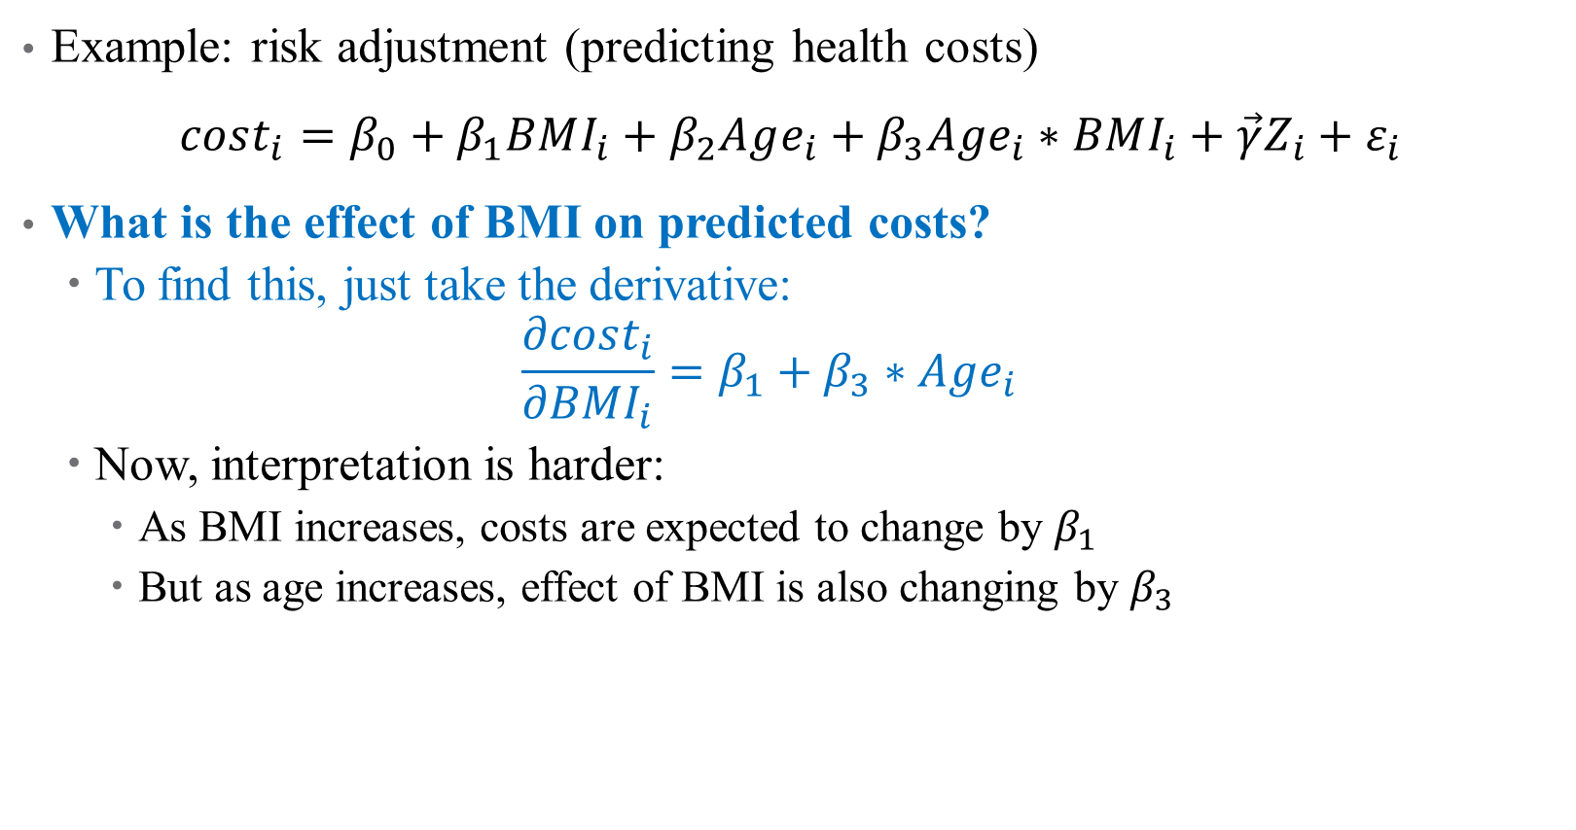
What about Continuous Interactions?
Example: risk adjustment (predicting health costs)
$cost_{i}=β_{0}+β_{1}BMI_{i}+β_{2}Age_{i}+β_{3}Age_{i}∗BMI_{i}+\vec{γ}Z_{i}+ε_{i}$
What is the effect of BMI on predicted costs?
  To find this, just take the derivative:
  $$\frac{∂cost_{i}}{∂BMI_{i}}=β_{1}+β_{3}∗Age_{i}$$
  Now, interpretation is harder:
    As BMI increases, costs are expected to change by $β_{1}$
    But as age increases, effect of BMI is also changing by $β_{3}$
Notes:
Typically, interactions make more sense when one of the variables is categorical, but you can estimate this. For interpretation, you would generally “pin down” a comparison (e.g., say the change in marginal effect of BMI on costs for a 50-yo to a 60-yo)

Slide 41
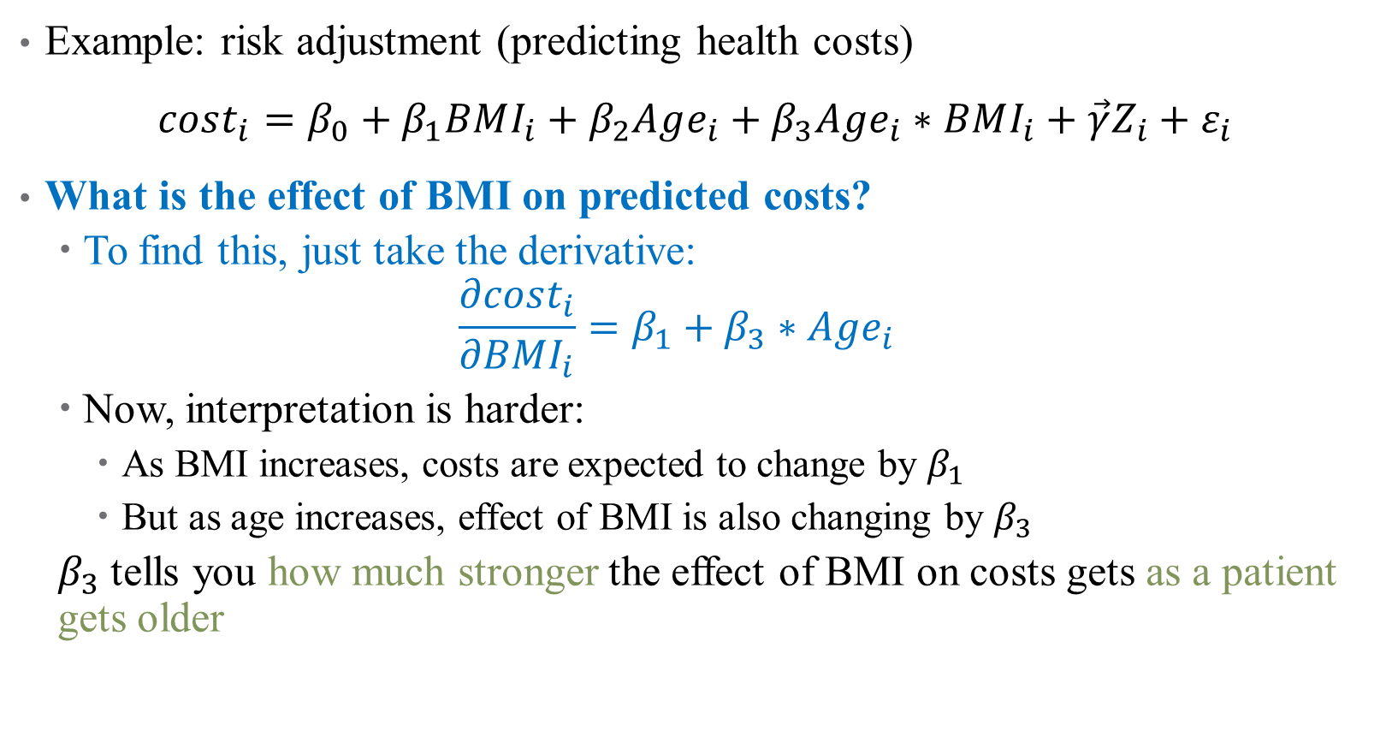
What about Continuous Interactions?
Example: risk adjustment (predicting health costs)
$cost_{i}=β_{0}+β_{1}BMI_{i}+β_{2}Age_{i}+β_{3}Age_{i}∗BMI_{i}+\vec{γ}Z_{i}+ε_{i}$
What is the effect of BMI on predicted costs?
  To find this, just take the derivative:
  $$\frac{∂cost_{i}}{∂BMI_{i}}=β_{1}+β_{3}∗Age_{i}$$
  Now, interpretation is harder:
    As BMI increases, costs are expected to change by $β_{1}$
    But as age increases, effect of BMI is also changing by $β_{3}$
  $β_{3}$ tells you how much stronger the effect of BMI on costs gets as a patient gets older

Slide 42
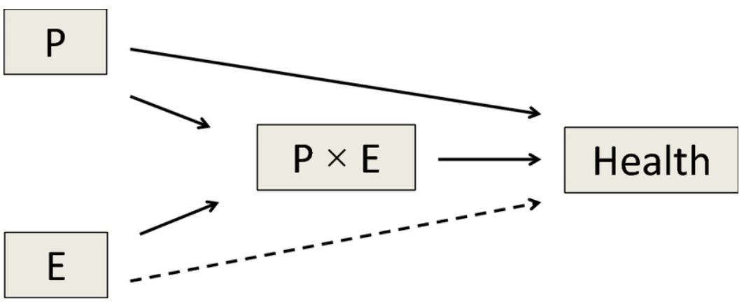
Interactions in Practice
Always include all pieces of an interaction in the full model
  Much harder to interpret
Have a strong theoretical reason to justify inclusion
  Too easy to get false positives
Effects are generally noisy
  You’re exploiting variation across 2 noisy variables already
  Will need large sample size
Notes:
Note on 1 – R will mostly do this for you, but don’t leave it up to chance. You have to do this to not keep open back doors (DAG) Note on 2: if we let the data do whatever it wants, we’ll find results that don’t mean much.

Slide 43
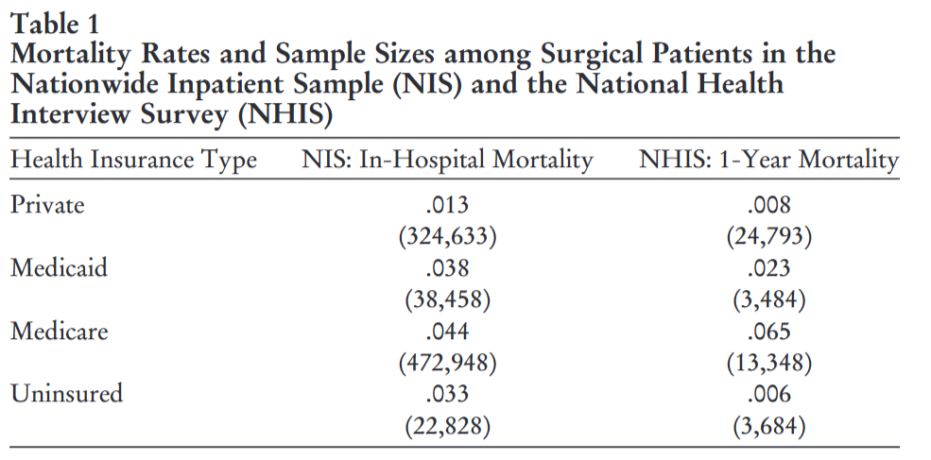
Case study: what controls are included?
Notes:
Let’s start with some descriptives here – what does this tell you? Who are these groups? Who is the adequate control group (the benchmark study they replicate uses the private insurance group, is that the right control group?)?

Slide 44
Case study: what controls are included?
Outcome: dummy variable for surgical mortality (what does this mean for context validity?)
BASE covariates include:
  (linear) age
  Gender
  elective operative status
  quartiles of mean zip code income
  hospital geographic region
  teaching hospital status
  type of surgical operation
  primary payer status
  Comorbidities
Notes:
We’re going to ignore the logit bit for now and just focus on coefficient sizes.

Slide 45
Case study: what controls are included?
Outcome: dummy variable for surgical mortality (what other outcomes are studied in the replication?)
New covariates tested by the authors include:
  “Full” set of ethnicity and race categories
  Continuous ages
  Year “fixed effects”
  Citizenship status, college completion, employment status, poverty status, marital status, and smoking status
  LASSO models
  Weekend admission (a proxy for an unavoidable hospital visit)
  “high” disease severity or mortality risk
Notes:
These include indicators for height below the25th percentile for age and sex, diabetes diagnosis before age 18, smoking initiation before age 16, current or past homelessness, and reported current mental health difficulty.

Slide 46
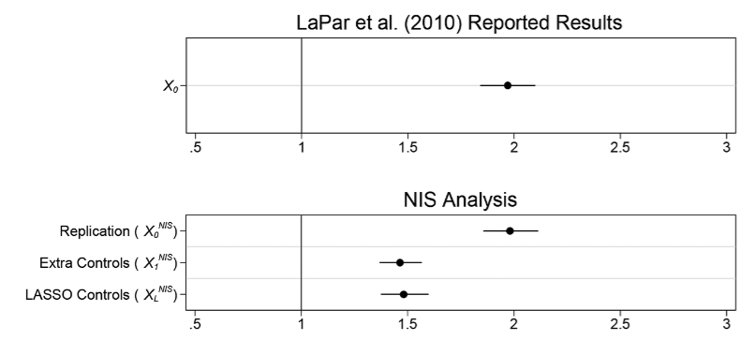
What do they find?
Notes:
Here just focusing on one of the datasets for brevity. This is just the main replication, where Medicaid patients are roughly twice as likely to die compared to privately-insured patients. The bottom panel is what happens when the authors add their controls. Why might that be true?

Slide 47
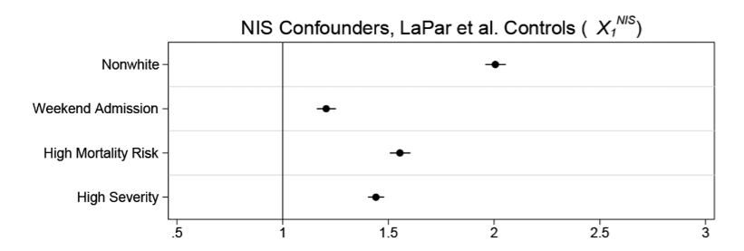
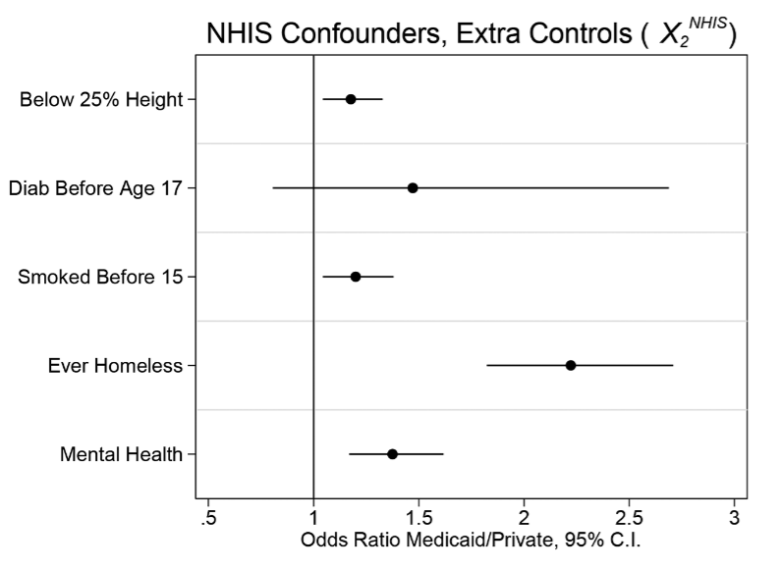
Is the comparison good?
Notes:
But the two groups aren’t even comparable after adjusting for observable covariates! What does this tell us?

Slide 48
Notes on Causality and Bias
Notes:
Quick example on logs: suppose we do
y=bx, where b=5. Then how do we interpret?
Y=b*log(x) where b = 5. Then a 1% increase in x corresponds to a 5*.01 = 0.05 unit increase in y
Log(y) = b*x where b = 5. Then a 1 unit increase in x corresponds to a 500% (5-fold increase) in y
Log(y) = b*log(x). Then a 1% increase in x corresponds to a 0.05 increase in log(y), so roughly a 5% increase in y.

Slide 49
Interpreting your results causally (One more time)
Remember that causality is hard!
Even after specifying your model, other things could go wrong:
Omitted Variables: missing data can bias your estimates
Measurement Error: mismeasured data can bias your estimates
Collinearity: correlation between variables can limit inferences
Notes:
We’re gonna touch on more threats to internal validity now.

Slide 50


Omitted Variables
Maybe you didn’t have data on a specific variable $z$
But if $Corr\left(x,z\right)≠0$, then omitting $z$ means $E\left(ε|x\right)≠0$
X
D
$$Y$$
R
Notes:
Leaving a back door open is a big problem in design-based inference. We’ve talked about this a lot, let’s look at some math real quick.

Slide 51


Omitted Variables
Maybe you didn’t have data on a specific variable $z$
But if $Corr\left(x,z\right)≠0$, then omitting $z$ means $E\left(ε|x\right)≠0$
This leads to bias in your estimates:
$$bias\left(\hat{β_{1}}\right)=𝔼\left[\hat{β_{1}}\right]−β_{1}$$
$$=Corr\left(x,z\right)\frac{σ_{ε}}{σ_{x}}$$

Slide 52
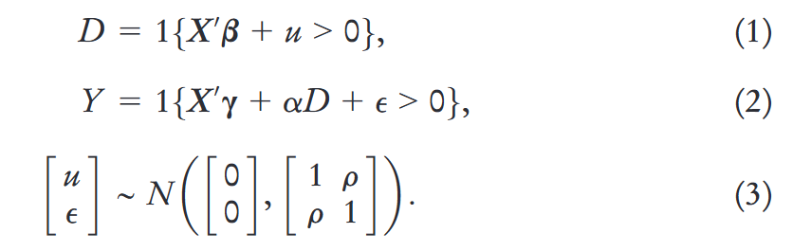
Case study: how does the correlation cause biased estimates?
Let’s think about this a different way. Suppose that we have a model predicting who gets Medicaid, and then the main regression model:
Notes:
- What is the parameter of interest? Alpha.
What goes in u? Respondents could have high values of u if they spend down their assets to qualify for Medicaid, if they have large medical bills that grant them medically needy status, if they lack employer-sponsored insurance, or if they anticipate costly health problems in the future.
What unobserved confounders are in epsilon?
What is the “identifying assumption” here in math? That error term is uncorrelated with regressors, which here means that u and epsilon are not correlated (that is, that rho = 0). Can you imagine a circumstance where “taste” for Medicaid affects mortality risk? Of course! The example in the paper is job loss.

Slide 53

Case study: how does the correlation cause biased estimates?
Let’s think about this a different way. Suppose that we have a model predicting who gets Medicaid, and then the main regression model:
Since this is observational, we can’t directly measure $ρ$. What do the authors do instead? A partial identification approach!
Notes:
Specifically, let’s assume that rho varies and recalculate our estimates adjusting for the OVB. There is more in the paper but this is about all we have time for today.

Slide 54
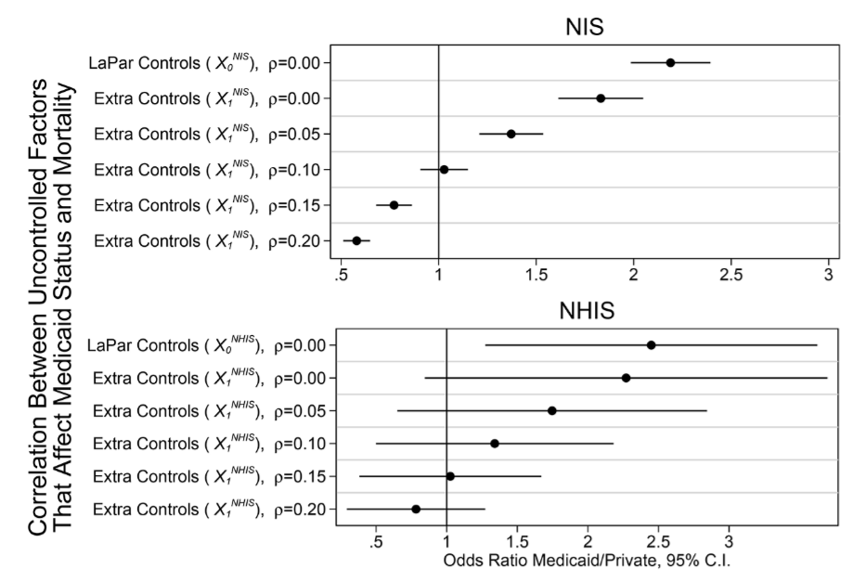
Case study: how does the correlation cause biased estimates?
Notes:
What’s the takeaway? Even small correlation = complete uninterpretability!
- Another result that is in the paper that we can’t discuss here: unobservables (like income) needed to vary only by 16%–28% as much as the observables to explain the cross-sectional relationship between Medicaid and mortality.

Slide 55

Measurement Error
Imprecision in your data also leads to biased estimates
Suppose that we don’t observe $x$, but rather $\tilde{x}=x+ζ$, where $ζ∼N(0,1)$
  In this (classical) sense, this kind of error attenuates a regression coefficient
Notes:
Attenuation is a common refrain in published papers, but measurement error is more complicated than that!

Slide 56
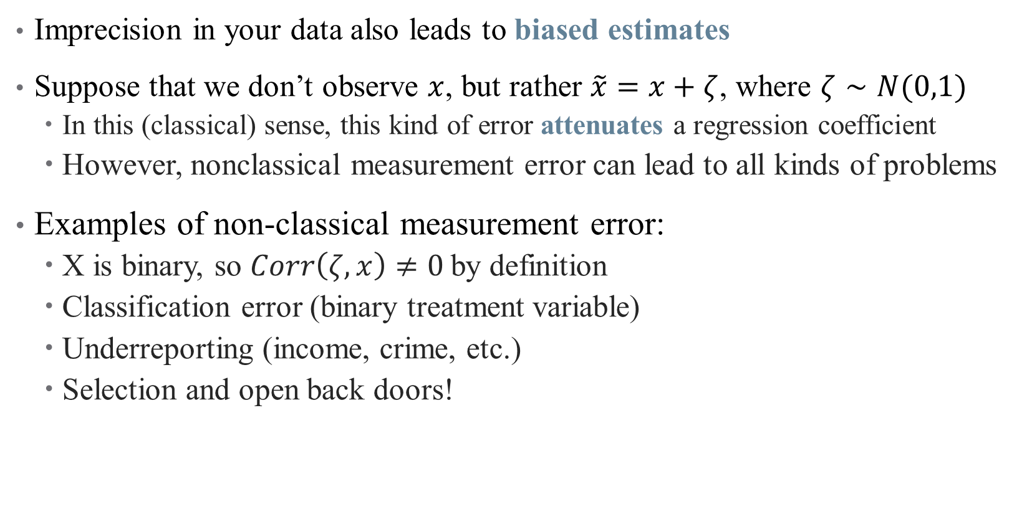
Measurement Error
Imprecision in your data also leads to biased estimates
Suppose that we don’t observe $x$, but rather $\tilde{x}=x+ζ$, where $ζ∼N(0,1)$
  In this (classical) sense, this kind of error attenuates a regression coefficient
  However, nonclassical measurement error can lead to all kinds of problems
Examples of non-classical measurement error:
  X is binary, so $Corr\left(ζ, x\right)≠0$by definition
  Classification error (binary treatment variable)
  Underreporting (income, crime, etc.)
  Selection and open back doors!
Notes:
What might be mismeasured in this data? The authors focus specifically on income, and show that measurement error alone could explain the results in LaPar et al.!

Slide 57
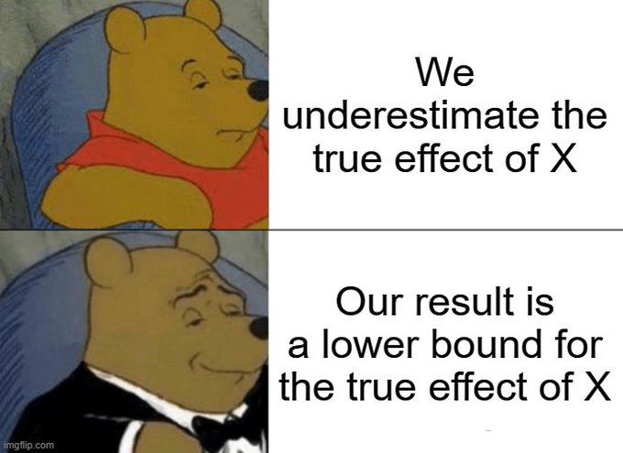
Classical Measurement Error
Notes:
But when is it really classical?

Slide 58
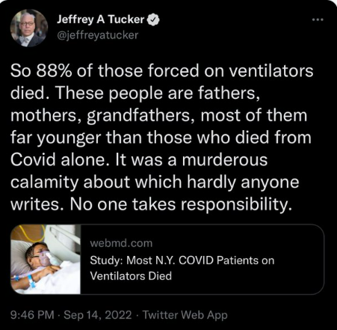
Non-Classical Measurement Error: Examples
Notes:
Measurement error can be the result of an open back door, or selection – what health examples are there?

Slide 59
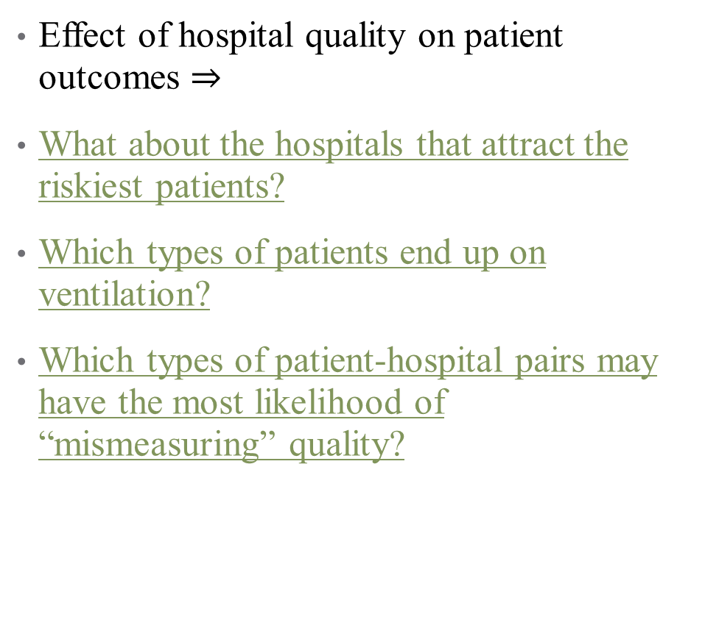
Non-Classical Measurement Error: Examples
Effect of hospital quality on patient outcomes $⇒$
What about the hospitals that attract the riskiest patients?
Which types of patients end up on ventilation?
Which types of patient-hospital pairs may have the most likelihood of “mismeasuring” quality?
Notes:
A whole literature on risk adjustment exists to (try to) solve this issue!

Slide 60
Case Study example
What is the problem with how income is measured in the original Medicaid study (La Par et al., 2010)?
It’s a group-level average! This means that it necessarily groups a core average (observed) and an individual-level deviation from that average (unobserved)
The authors show that in publicly-available data, the ratio of these is:
  4 times larger for unobserved deviations when using state-level data
  0.3 using state, race, sex, and education categories
  0.24 when we use national family income quartiles
  Anything over 0.16-0.28 is likely sufficient to generate a fully spurious result
Notes:
A whole literature on risk adjustment exists to (try to) solve this issue!

Slide 61

Collinearity and Causality
Some (explanatory) variables are highly correlated, complicating inference
Notes:
If I include age and height in a regression to close back doors, how do I know what is explained by age and what is explained by height? Here, this might not matter (we just care about “growth” as the causal pathway) but what if we could consider a policy that would randomly make people taller. Would that help health? Shrugh

Slide 62

Collinearity and Causality
Some (explanatory) variables are highly correlated, complicating inference
  Inclusion of irrelevant variables tends to inflate the SEs for other estimates
  What’s more, if variables are too highly correlated, their effects are indistinguishable
We’ve already run into the problem of perfect collinearity (where?)
  A much harder problem is near-collinearity, where $\left|ρ\left(x_{1},x_{2}\right)\right|≈1$
  This is especially problematic when we care about $β_{1}$or $β_{2}$, but not both
Notes:
Where have we seen perfect collinearity? Dummy variable trap?

Slide 63

Collinearity and Causality
Some (explanatory) variables are highly correlated, complicating inference
  Inclusion of irrelevant variables tends to inflate the SEs for other estimates
  What’s more, if variables are too highly correlated, their effects are indistinguishable
We’ve already run into the problem of perfect collinearity
  A much harder problem is near-collinearity, where $\left|ρ\left(x_{1},x_{2}\right)\right|≈1$
  This is especially problematic when we care about $β_{1}$or $β_{2}$, but not both
How to diagnose this?
  Look at correlation matrix of independent variables
  Think about which correlations mess with your DAG
Notes:
Think about how much it really matters – collinearity is a problem if it messes with the causal parameter of interest, but doesn’t matter if age and height are both controls. What would this mean in the case study?
- Main point: when thinking about a causal regression, collinearity is an identification/data problem much more than it is a fixable one. If your main parameter is colinear with another covariate, then you can’t separate out which is causing the main effect, and that’s a fundamentally unfixable problem. The VIF adjustments, etc., aren’t helpful here. You need exogenous variation!

Slide 64
Mini Referee Report
What is the main contribution of this paper?
What does it do well?
What did it miss? What did you wish was included?
Does this paper argue that Medicaid has no effect on health?

Slide 65
Getting the “Right” Standard Errors

Slide 66

Standard Errors
Even after ensuring that the model is correctly specified, we need an idea of how precise our estimates are
Recall that $se(\hat{β_{1}})$ tells us something about sampling distribution:
  Range of plausible estimates,
  Confidence intervals,
  Statistical significance
  Eliminating certain DGPs

Slide 67

Standard Errors
Even after ensuring that the model is correctly specified, we need an idea of how precise our estimates are
Recall that $se(\hat{β_{1}})$ tells us something about sampling distribution:
  Range of plausible estimates,
  Confidence intervals,
  Statistical significance
  Eliminating certain DGPs
But the assumptions we made about $ε$ to get $se(\hat{β_{1})}$ aren’t necessarily good ones!
  Key assumption: $ε_{i}$ is independent and identically distributed (i.i.d.)

Slide 68

Are my error terms i.i.d.?
Autocorrelation: “Shock” of today is correlated with “shock” from yesterday
Notes:
This is less of a problem in our data, because we rarely use time series data (which is different from panel). We’ll come back to this a little next semester – takeaway is that beta is still unbiased and inconsistent, but we will tend to overestimate significance (we need to inflate our standard errors to account for correlation)

Slide 69


Are my error terms i.i.d.?
Heteroskedasticity: Variance of distribution depends on $x$
Notes:
This is a big one for us!

Slide 70

Are my error terms i.i.d.?
Autocorrelation: Today’s “shock” today is correlated with yesterday’s
Heteroskedasticity: Variance of distribution depends on $x$
Others: Correlation within groups, multiple testing, sampling errors, etc.
Failure of $ε$ to be i.i.d. means that $se\left(\hat{β_{1}}\right)≠\sqrt{\frac{σ^{2}}{var\left(x\right)n}}$
Notes:
Multiple testing – we’ve talked about this.

Slide 71

Are my error terms i.i.d.?
Autocorrelation: Today’s “shock” today is correlated with yesterday’s
  Heteroskedasticity- and autocorrelation-consistent (HAC) standard errors
  Newey-West estimator, adjusts $se(\hat{β_{1}})$ based on lagged variable outcomes
Heteroskedasticity: Variance of distribution depends on $x$
Others: Correlation within groups, multiple testing, sampling errors, etc.
Failure of $ε$ to be i.i.d. means that $se\left(\hat{β_{1}}\right)≠\sqrt{\frac{σ^{2}}{var\left(x\right)n}}$

Slide 72

Are my error terms i.i.d.?
Autocorrelation: Today’s “shock” today is correlated with yesterday’s
  Heteroskedasticity- and autocorrelation-consistent (HAC) standard errors
  Newey-West estimator, adjusts $se(\hat{β_{1}})$ based on lagged variable outcomes
Heteroskedasticity: Variance of distribution depends on $x$
  Heteroskedasticity-robust sandwich estimators
  Huber-White estimator, adjusts $se(\hat{β_{1}})$ with weights for observations with large residuals
Others: Correlation within groups, multiple testing, sampling errors
Failure of $ε$ to be i.i.d. means that $se\left(\hat{β_{1}}\right)≠\sqrt{\frac{σ^{2}}{var\left(x\right)n}}$

Slide 73

Are my error terms i.i.d.?
Autocorrelation: Today’s “shock” today is correlated with yesterday’s
  Heteroskedasticity- and autocorrelation-consistent (HAC) standard errors
  Newey-West estimator, adjusts $se(\hat{β_{1}})$ based on lagged variable outcomes
Heteroskedasticity: Variance of distribution depends on $x$
  Heteroskedasticity-robust sandwich estimators
  Huber-White estimator, adjusts $se(\hat{β_{1}})$ with weights for observations with large residuals
Others: Correlation within groups, multiple testing, sampling errors
  Clustered standard errors
  Bootstrapped standard errors
Failure of $ε$ to be i.i.d. means that $se\left(\hat{β_{1}}\right)≠\sqrt{\frac{σ^{2}}{var\left(x\right)n}}$
Notes:
We’ll introduce robust errors – what we will usually use more is clustered robust.

Slide 74
Clustered Standard Errors
Errors might be correlated in a hierarchical structure
  Example: effect of a health intervention across villages in rural area?
  Different village structures mean people in same village have similar “shocks”
  Errors might be correlated within villages
Notes:
Once again, we need to inflate our Ses to deal with this.

Slide 75

Clustered Standard Errors
Errors might be correlated in a hierarchical structure
  Example: effect of a health intervention across villages in rural area?
  Different village structures mean people in same village have similar “shocks”
  Errors might be correlated within villages
There is a sandwich estimator that lets $X$ interact w/ other $Xs$ in the same group
  Flexibly handles clustered standard errors!
  But need to be careful how you choose the clusters
  Good rule to remember: cluster at the level of the treatment
Notes:
Sandwich estimator is an econometrician’s fav thing. What do they do with standard errors in this paper? (trick question cause they don’t do anything)

Slide 76


Clustered Standard Errors
Notes:
When Should You Adjust Standard Errors for Clustering? Alberto Abadie, Susan Athey, Guido W. Imbens, and Jeffrey Wooldridge (metrics avengers)

Slide 77


Clustered Standard Errors
Notes:
How do you choose what to cluster?

Slide 78


Clustered Standard Errors
Notes:
Main takeaways – cluster at the highest level (e.g., state, not county), but carefully consider when you should cluster (a Type II error is just as bad as a Type I). One rule when you should cluster: fixed effects + treatment heterogeneity.

Slide 79

Bootstrapped Standard Errors
One of the most powerful tools in statistics!
If we want to learn something about the sampling distribution, why not just take a bunch of samples and see how our estimates vary?
These are very useful for estimating $se(\hat{β_{1}})$ in unusual cases!
A couple caveats
Needs large sample sizes to work well
Can’t completely handle autocorrelation

Slide 80
Bootstrapped Standard Errors
One of the most powerful tools in statistics!
Start with a data set with observations.
Randomly sample observations from that data set, allowing the same observation to be drawn more than once. This is a “bootstrap sample.”
Estimate our statistic of interest using the bootstrap sample.
Repeat steps 1-3 a whole bunch of times.
Look at the distribution of estimates from across all the times we repeated steps 1-3. The standard deviation of that distribution is the standard error of the estimate. The 2.5th and 97.5th percentiles show the 95% confidence interval, and so on.

Slide 81
Nonlinear Models (pt. 1)
Notes:
Skip this bit if you want – or defer to appendix for future slides.

Slide 82

Nonlinearities
Sometimes, a linear model isn’t enough (even after transformations)

Slide 83
Could we transform this data?
When data can be transformed to accommodate linear relationships, do it
Otherwise, add polynomial terms!

Slide 84

Choosing a Functional Form
OLS can accommodate regressions of the form:
$$y=β_{0}+β_{1}x+β_{2}x^{2}+β_{3}x^{3}+ …+\vec{γ}Z+ε$$
Still linear in parameters
As in interaction terms, never omit an intermediate power
  That is, don’t add a cubic term without a quadratic one
Notes:
Remember, OLS is linear in parameters (not necessarily in data) – it just depends how you plan to interpret the parameters of the funky data you’re giving OLS

Slide 85

Choosing a Functional Form
OLS can accommodate regressions of the form:
$$y=β_{0}+β_{1}x+β_{2}x^{2}+β_{3}x^{3}+ …+\vec{γ}Z+ε$$
Still linear in parameters
As in interaction terms, never omit an intermediate power
  That is, don’t add a cubic term without a quadratic one
Changing functional forms may yield a better fit, but also changes interpretation of the coefficients.

Slide 86

How do we Interpret Coefficients?
OLS can accommodate regressions of the form:
$$y=β_{0}+β_{1}x+β_{2}x^{2}+β_{3}x^{3}+ …+\vec{γ}Z+ε$$
Changing functional forms may yield a better fit, but also changes interpretation of the coefficients.
$$\frac{∂y}{∂x}=β_{1}+2β_{2}⋅x+3β_{3}⋅x^{2}+ …$$
Now, marginal effects depend on levels of $x$
Notes:
So what exactly do you do here? Have to generally pick a level of x (mean, for example) for this to make sense.

Slide 87

How do we Interpret Coefficients?
OLS can accommodate regressions of the form:
$$y=β_{0}+β_{1}x+β_{2}x^{2}+β_{3}x^{3}+ …+\vec{γ}Z+ε$$
Changing functional forms may yield a better fit, but also changes interpretation of the coefficients.
$$\frac{∂y}{∂x}=β_{1}+2β_{2}⋅x+3β_{3}⋅x^{2}+ …$$
Now, marginal effects depend on levels of $x$
Another caution: overfitting
  How much randomness in the data do we want to add to our model?
  How much complication in our marginal effects are we willing to tolerate?
  See discussion on LASSO, etc. for automated inclusion

