Slide 1
Quantitative Methods for HSR I
Lecture 5: Working with Data and Designing Research Questions
October 19, 2026
HAD5744 • Alex Hoagland, Ph.D.
Notes:
Logistics notes:
don’t worry about citing packages in your assignments (do worry about these for referee reports and final paper)
I have uploaded a sample referee report to Github – note that your research question + teams are due in two weeks (with an outline due two weeks after that), so you should commit by then to one of the two options. Referee reports start being available next week with consistency!

Slide 2
Session Outline
Where to find data
How to work with data (data cleaning, visualization)
How to design good research questions (target trial emulation)
Research designs: where we’re headed
Notes:
If you’re still uncommitted to research paper/referee report, maybe let me try to convince you to do a research project!

Slide 3
Finding good data
Notes:
- let’s take a second and discuss, briefly, some of the research questions you’re considering. We’ll make a list on the board so we can be talking through them.

Slide 4
Answers are only as good as your data!
Immediately Available Datasets
High-quality census/health data in the US and internationally: https://www.ipums.org/
https://sebastiantellotrillo.com/resources/primer-where-to-find-data
Canadian Community Health Survey (ODESI)
https://datacentre.chass.utoronto.ca/
Lots of others!
Good Dissertation Datasets
ICES (Ontario-level claims)
PCPOP (BC-level data, links to a lot of useful demographic data)
CIHI
Medicare FFS (US; need a sponsor)
Lots of others!
Notes:
For this class, try to find a bridge between publicly available data and the data you hope to use for your thesis (for MSc students, maybe think about these datasets for your thesis)
What do you do if you don’t have a question? Read through the data dictionaries here, then do some descriptive work!

Slide 5
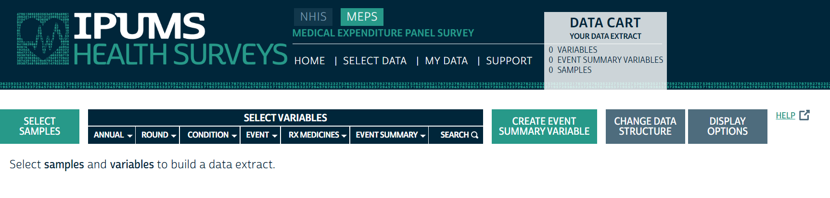
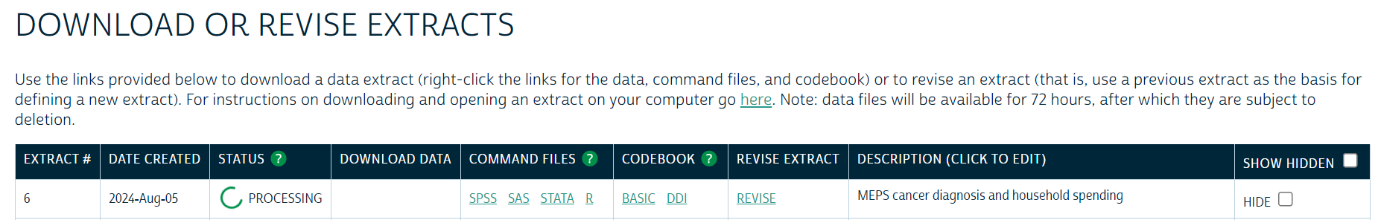
Example Cohort: MEPS (Link)
Notes:
Let’s take a sample research question for today: what are the impacts of health shocks on your own spending and your spouse’s? Walk through what kinds of variables we want.

Slide 6
Working with data

Slide 7
Flow of a Research Project
Main data
Supplemental Data
Cleaned data
Analytic Cohort 1
Analytic Cohort 2
Analytic Cohort 3
Paper!
Notes:
No project is unique! But here are some of the broad overviews for what you need to know.

Slide 8

Flow of a Research Project
Main data
1. Data cleaning
Supplemental Data
Cleaned data
Analytic Cohort 1
Analytic Cohort 2
Analytic Cohort 3
Paper!
Notes:
What does this entail? Going through variables, looking at descriptive characteristics, etc.

Slide 9
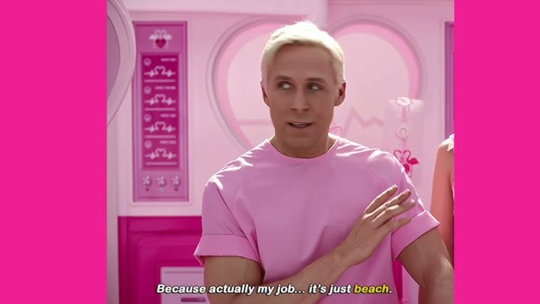
Data cleaning
Notes:
What does this entail? Going through variables, looking at descriptive characteristics, etc.

Slide 10
Other Data Cleaning Resources
Reading in datasets, initializing new variables, and other useful tips: Data Management Overview
Dealing with different data types: https://datasciencebox.org/course-materials/_slides/u2-d10-data-types/u2-d10-data-types.html#1
Notes:
You can really get bogged down in data cleaning. Use copilot, google, your old code, your friends, me…
IN R: - Removing missing data - Recoding variables - Creating new variables - Summarizing variables - Creating descriptive figures

Slide 11
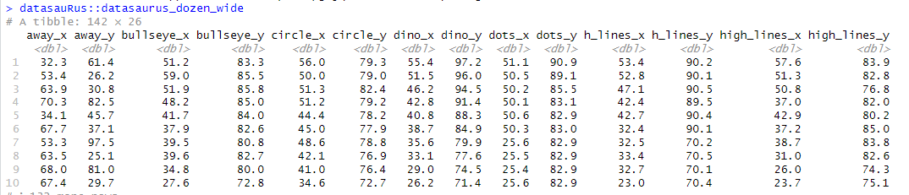
Always visualize your data!
Notes:
One good way to make sure your data is cleaned – poke around a lot! What does this data tell us? If I didn’t have variable names, not much!

Slide 12
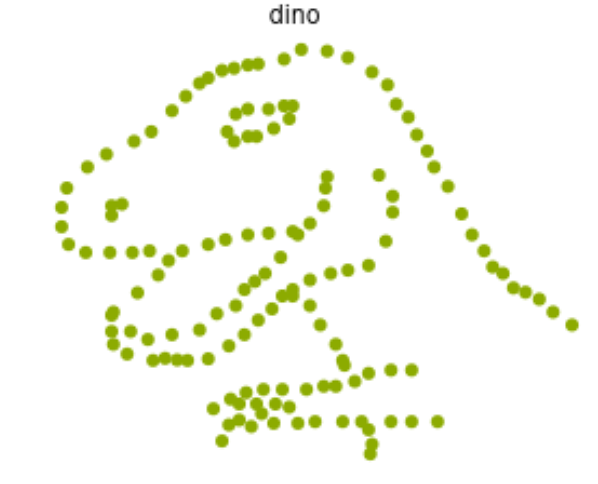
Always visualize your data!
Notes:
Look at the gif here: https://blog.revolutionanalytics.com/2017/05/the-datasaurus-dozen.html.

Slide 13
Flow of a Research Project
Main data
2. Data merging
Supplemental Data
Cleaned data
Analytic Cohort 1
Analytic Cohort 2
Analytic Cohort 3
Paper!
Notes:
Takes a surprising amount of time!

Slide 14
Flow of a Research Project
Main data
Supplemental Data
Cleaned data
3. Cohort Creation
Analytic Cohort 1
Analytic Cohort 2
Analytic Cohort 3
Paper!
Notes:
Takes a surprising amount of time!

Slide 15
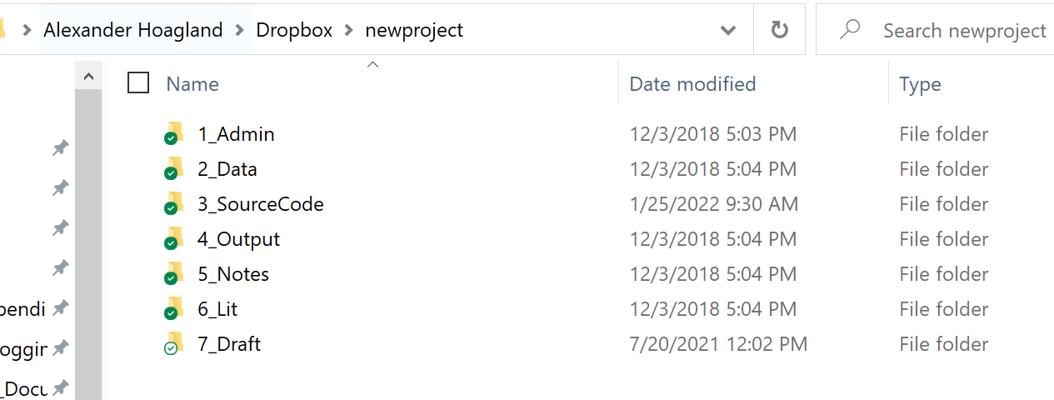
Prelude: Some Coding Organization
Project file structure
File template
  Headers
  Comment, comment, comment!
Notes:
Notes on folders – don’t overwrite your data! How can you construct this? How do we think about replicability?
Master.do file
GitHub
All results should run together (use the “here” library, for example)
Lots of comments!
Curious about more? See here: https://julianreif.com/guide/ (this is for Stata)

Slide 16
Flow of a Research Project
Main data
Supplemental Data
Cleaned data
Analytic Cohort 1
Analytic Cohort 2
Analytic Cohort 3
4. Analysis Reporting
Paper!
Notes:
We’ll skip over the main analysis – and likely skip over a lot of the real reporting here as well. This is where we will spend all our time moving forward!

Slide 17
Pre-Analysis Plans in Quantitative Research
Should I specify a pre-analysis plan (PAP) for my project?
Not as straightforward as you think!
PAPs are useful to reduce cherry picking, p-hacking, etc., and increase transparency
You typically specify:
  Hypothesis/research question
  Primary and secondary outcomes
  Statistical models
  Subgroup analyses
  What makes this complicated?
Notes:
Different strokes for different folks. Discussion here.

Slide 18
Pre-Analysis Plans in Quantitative Research
Should I specify a pre-analysis plan (PAP) for my project?
Pros: Increase transparency, meet the “genre” of your field if needed. Also helpful to box yourself in a bit!
Cons: Limits flexibility when new questions arise (what are the mechanisms) or when you are in a field that preempts referee reports (e.g., additional analysis expected prior to submission).
Notes:
Different strokes for different folks. Discussion here.

Slide 19
Pre-Analysis Plans in Quantitative Research
Should I specify a pre-analysis plan (PAP) for my project?
Pros: Increase transparency, meet the “genre” of your field if needed. Also helpful to box yourself in a bit!
Cons: Limits flexibility when new questions arise (what are the mechanisms) or when you are in a field that preempts referee reports (e.g., additional analysis expected prior to submission).
Field expectations: This is far less common in observational research compared to RCTs, but there is some overlap.
What I recommend: Have a flexible PAP that specifies:
  Hypothesis/research question
  Primary and some secondary outcomes
  Statistical models → research design and identification (this won’t change)
  Some Subgroup analyses
Notes:
Different strokes for different folks. Discussion here.

Slide 20
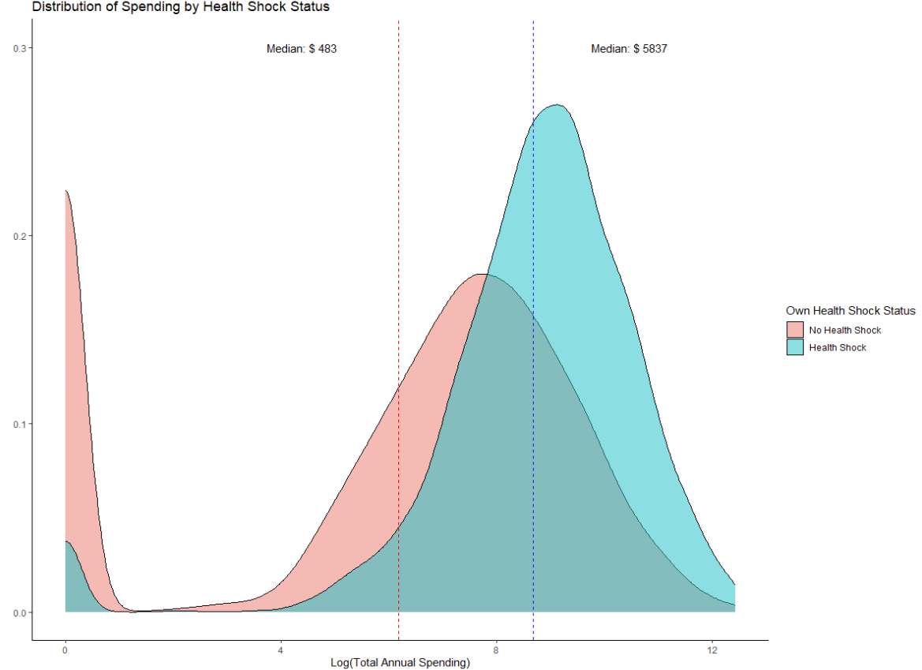
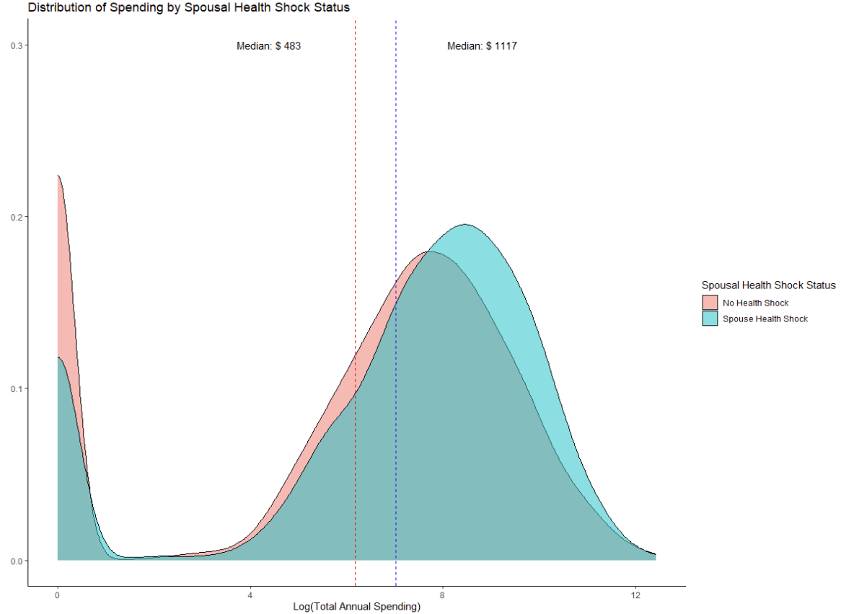
How do we interpret results?
Notes:
Obviously we don’t have everything here. But what *do* we have?

Slide 21
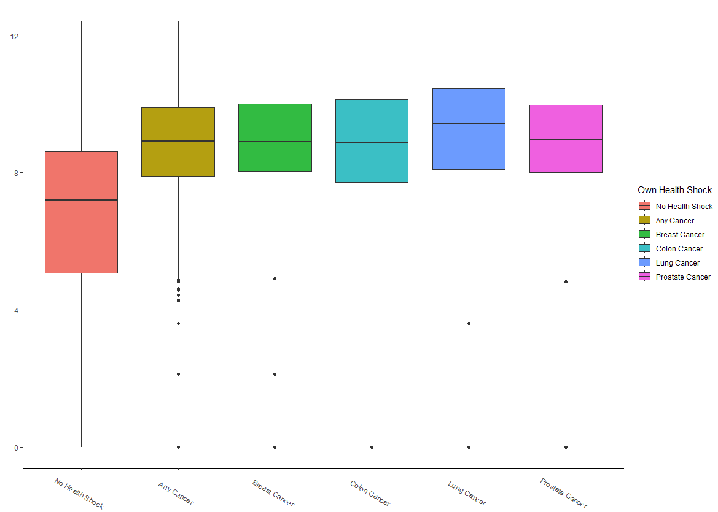
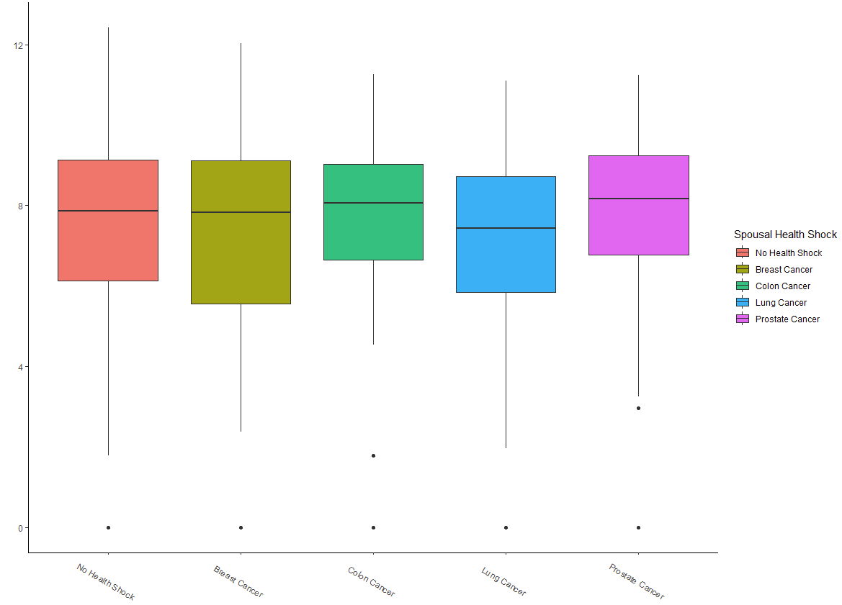
How do we interpret results?
Notes:
Obviously we don’t have everything here. But what *do* we have? Where would we go next?
Discussion question: what do you do when you have a negative result here? When do you give up and move on to the next idea?
Think about identification and potential selection. Do you expect the story to be clearer if you adjust for something? Is there a high opportunity cost of poking around more?

Slide 22
Organizing a Project
Notes:
Cover this quickly only unless you’re super behind.

Slide 23
How do we structure a project?
File organization
Clean code
Robustness checks
Writing!

Slide 24
What is Clean Code?
Code that is easy to understand, easy to modify, and hence easy to debug
Some sources:
  The Clean Coder, by Robert C. Martin
  Code and Data for the Social Sciences: A Practitioner's Guide, by Gentzkow and Shapiro
  Tyler Ransom’s (Oklahoma University) slides: https://raw.githack.com/OU-PhD-Econometrics/fall-2022/master/LectureNotes/01a-CleanCode/01aslides.html#2
Notes:
Clean code saves you and your collaborators time! You will always make a mistake while coding -- what makes good programmers great is their ability to quickly identify and correct mistakes.

Slide 25
Principles of Clean Code
Automation
Version control
Abstraction
Documentation
Time / task management
Test-driven development (unit testing, profiling, refactoring)
Pair programming
Notes:
Clean code saves you and your collaborators time! You will always make a mistake while coding -- what makes good programmers great is their ability to quickly identify and correct mistakes.

Slide 26
Principles of Clean Code
Automation – automate everything (that can be)!
Version control
Abstraction
Documentation
Time / task management
Test-driven development (unit testing, profiling, refactoring)
Pair programming
Notes:
You should have a single script that runs all of your chunks from beginning to end – this is for reproducibility and efficiency (it’s like showing your work)

Slide 27
Principles of Clean Code
Automation
Version control – Github, Dropbox, Overleaf!
Abstraction
Documentation
Time / task management
Test-driven development (unit testing, profiling, refactoring)
Pair programming
Notes:
Use collaborative software that tracks versions of your code! easily undo changes, test out new specifications, and more

Slide 28
Principles of Clean Code
Automation
Version control
Abstraction – use functions to reduce complexity of code!
Documentation
Time / task management
Test-driven development (unit testing, profiling, refactoring)
Pair programming
Notes:
e.g. A dishwasher -- all I need to know is how to put dirty dishes in and which button, not how the electrical wiring works. Define a function once also makes it more reliable if you use it multiple times. You should abstract to eliminate redundancy and improve clarity (but not otherwise – can make code impenetrable!)
Can you have one file that adjusts all your variables for inflation, or one file that runs regressions on multiple outcomes, etc.?

Slide 29
Principles of Clean Code
Automation
Version control
Abstraction
Documentation – make code readable! (Variable names, comments)
Time / task management
Test-driven development (unit testing, profiling, refactoring)
Pair programming
Notes:
Use names that people can understand (make code readable). Of course, don’t document if you aren’t going to update the documentation!

Slide 30
Principles of Clean Code
Automation
Version control
Abstraction
Documentation
Time / task management – think carefully about when you code
Test-driven development (unit testing, profiling, refactoring)
Pair programming
Notes:
Coding is time intensive, and too many breaks or a strained/tired mental state will come back to bite you
Schedule long blocks of time (1.5 hours - 3 hours) to work on coding where you eliminate distractions (email, social media, etc.)
Stop coding when you feel that your focus or energy is dissipating

Slide 31
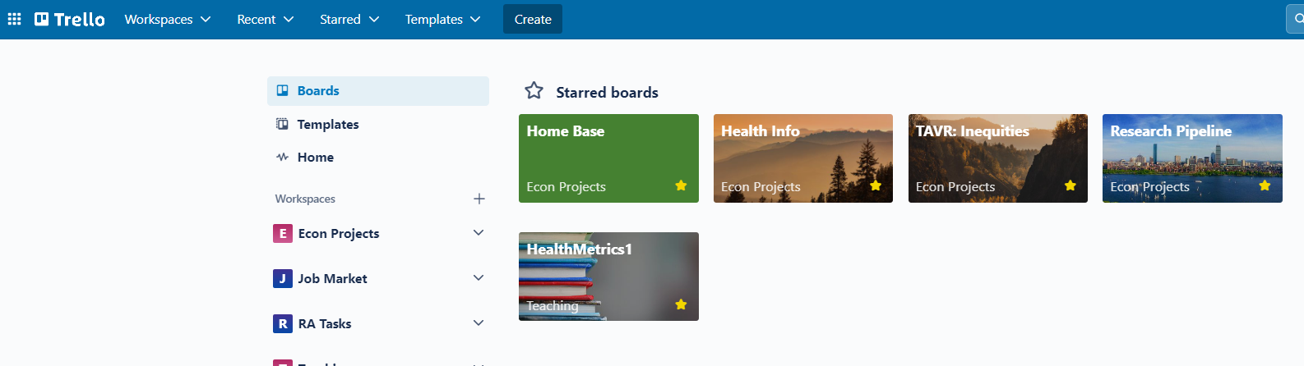
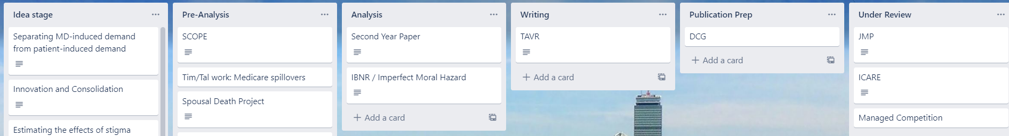
Principles of Clean Code: Task Management Software
Notes:
Trello is a great organizer for tasks. Don’t use email/slack, but rather a shared space just for the project. Another good one is Github Issues.

Slide 32
Principles of Clean Code
Automation
Version control
Abstraction
Documentation
Time / task management
Test-driven development (unit testing, profiling, refactoring) –
  The only way to know that your code works is to test it!
Pair programming
Notes:
Test-driven development (TDD) consists of a suite of tools for writing code that can be automatically tested
Unit testing: checking that each piece of code works as you move through the structure. I recommend the testthat package for this
Profiling: how many resources does it take to run my code? Can I speed things up, make it faster, etc.?
Refactoring: can I make the code more readable / less redundant?

Slide 33
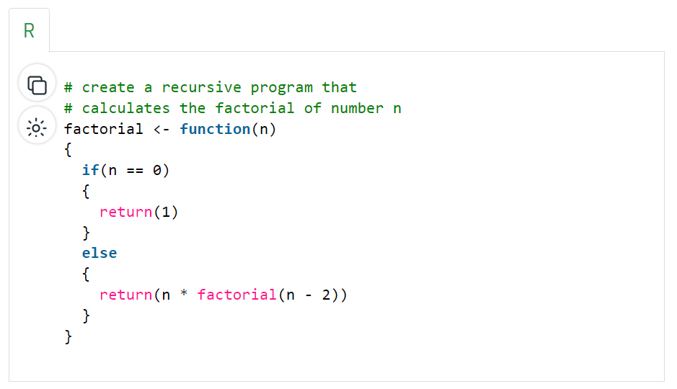
Unit Testing
Notes:
Suppose we have a function like this – we want to make sure that the function works for a set of values

Slide 34
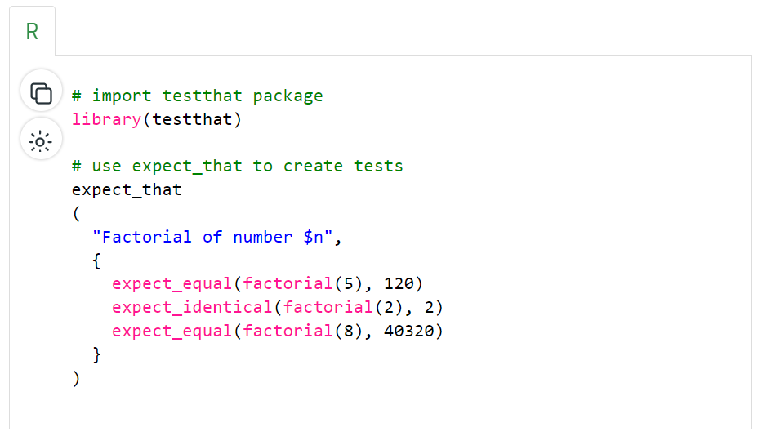
Unit Testing
Notes:
This package will test that!

Slide 35
Principles of Clean Code
Automation
Version control
Abstraction
Documentation
Time / task management
Test-driven development (unit testing, profiling, refactoring)
Pair programming – have people look at your code!
Notes:
Some people literally mean pair programming as in two people writing code together (one writes, another reviews simultaneously). But at any case, more than one set of eyes should look over all code (it’s definitely a learned skill to read code)

Slide 36
Designing a Project
Notes:
A little bit of backwards induction here.

Slide 37
Answers are only as good as your data…and your question!
Where to find data
How to work with data (data cleaning)
How to design good research questions
Research designs: where we’re headed

Slide 38

Framework: Everything is a Remix
Notes:
There are remixes of this but I actually like the original here. We’ll talk about an example here in a minute.

Slide 39
Framework: Everything is a Remix
Sampling (in music, not statistics)
Notes:
Remixing may seem like copying, but it’s actually something much more – it can empower you to be more creative.

Slide 40
Framework: Everything is a Remix
Sampling (in music, not statistics)
Research uses the same language, structure, paragraphs, etc.
This is a case of “genre setting” – everything you produce has a genre, including your proposal, your dissertation, and your papers. You will even have to do the work of translating these across formats (e.g., when you take a dissertation chapter and make it a publishable paper).
What does this look like? Why do we do this?
Notes:
Monomyth structure (your own “academic hero’s journey”): academics/policy makers have been talking about X for a long time. They’ve thought about it in these ways. Thing X is important because of Y and Z. However, academics have either been wrong about X in this way or have missed this important question about X. Answering that question (call it X’) will help discussions in ways Y’ and Z’. To answer X’, I need to do something new – I need new data, new methods, a new model, or all three. I will therefore be thinking about X’ in this way. I will be using this data to address X’. I will be using these methods to analyze my data. Then I will present my results and interpret them in the context of X, Y’, and Z’.

Slide 41
Framework: Everything is a Remix
Sampling (in music, not statistics)
Research uses the same language, structure, paragraphs, etc.
This is a case of “genre setting” – everything you produce has a genre, including your proposal, your dissertation, and your papers. You will even have to do the work of translating these across formats (e.g., when you take a dissertation chapter and make it a publishable paper).
Why do we do this? 90% to improve (efficient) readability, 10% to signal you’re legit
So what is the line between sampling and copying (Led Zeppelin)? Covers vs. knockoffs?

Slide 42
Framework: Everything is a Remix
Part 1: Sampling (in music, not statistics)
Research uses the same language, structure, paragraphs, etc.
This is a case of “genre setting” – everything you produce has a genre, including your proposal, your dissertation, and your papers. You will even have to do the work of translating these across formats (e.g., when you take a dissertation chapter and make it a publishable paper).
Why do we do this? 90% to improve (efficient) readability, 10% to signal you’re legit
So what is the line between sampling and copying (Led Zeppelin)? Covers vs. knockoffs?
  Your contributions should be your own (novel mix of question, data, methods, model, and interpretation)
  Each individual piece can be adapted, but the lines should be clear.
  Plagiarism is still a sin
Notes:
So what makes a good contribution? Some papers take on all of these and do them well, but most don’t – they have some novelty and are standing on the shoulders of giants. We’ll cover an example in a minute.
Related question – what’s a knock-off? If you take a paper you love and only change one thing (update the data set, add a single control), you haven’t remixed. But the optimal isn’t reinvent the wheel.

Slide 43
Framework: Everything is a Remix
Part 2: film and fiction
Let’s talk about the mechanics of a (HSR research) remix
Does “original” need to spring to mind when people think about your research? Yes and no
Remember that genre – you want to use standard elements and appropriate, transform, and subvert them as needed
Example: Star Wars
  Your dissertation chapter follows the academic monomyth structure
  There’s incredible value, though, in combining elements (soft wipes, Westerns + Kurosawa films, opening titles) – what does this look like for you?
  Creation requires influence! Originality doesn’t require isolation.
Notes:
Monomyth structure: academics have been talking about X for a long time. They’ve thought about it in these ways. Thing X is important because of Y and Z. However, academics have either been wrong about X in this way or have missed this important question about X. Answering that question (call it X’) will help discussions in ways Y’ and Z’. To answer X’, I need to do something new – I need new data, new methods, a new model, or all three. I will therefore be thinking about X’ in this way. I will be using this data to address X’. I will be using these methods to analyze my data. Then I will present my results and interpret them in the context of X, Y’, and Z’.
Places for novel integration: data sources, descriptive stats, storytelling, merging two fields of the literature (e.g., these people have thought about provider-side moral hazard and these people have thought about patient-side moral hazard, but that’s been in isolation. What if we integrate them?)
Adapting means knowing the methods, data, and questions being used in adjacent spaces to you. You should read research in your own field, but also read research adjacent to you (what do I do?) and news to get novel questions. If you create an echo chamber of your own work, you’ll lose your contribution.

Slide 44
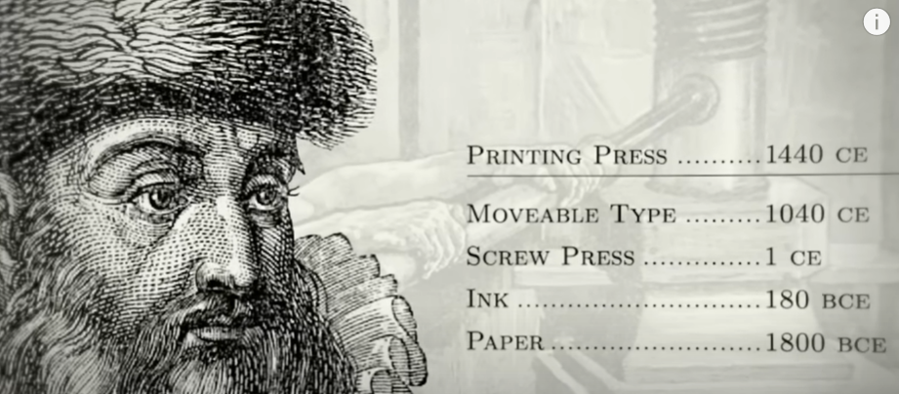
Framework: Everything is a Remix
Part 2: film and fiction
Let’s talk about the mechanics of a (HSR research) remix
Does “original” need to spring to mind when people think about your research? Yes and no
Remember that genre – you want to use standard elements and appropriate, transform, and subvert them as needed
Example: Star Wars
  Your dissertation chapter follows the academic monomyth structure
  There’s incredible value, though, in combining elements (soft wipes, Westerns + Kurosawa films, opening titles) – what does this look like for you?
  Creation requires influence! Originality doesn’t require isolation.
Notes:
All of the elements for your great idea may already exist – combining is a contribution! See example on earlier slide notes

Slide 45
Framework: Everything is a Remix
Part 3: copying and the elements of creativity
We can’t introduce anything new until we’re fluent in the language of our domain. Copying (emulation) is how we learn!
Your first dozen or more research ideas will likely be “derivative work” or “cover songs” (but do you really need to retype the Great Gatsby to get the feel of a novel?)
What can you do when generating ideas?
Notes:
Produce lots of mini-proposals! Work your way through bad ideas and see the flaws. You won’t always see them until you write them down or talk it through with a peer or supervisror.

Slide 46
Framework: Everything is a Remix
Part 3: copying and the elements of creativity
We can’t introduce anything new until we’re fluent in the language of our domain. Copying (emulation) is how we learn!
Your first dozen or more research ideas will likely be “derivative work” or “cover songs” (but do you really need to retype the Great Gatsby to get the feel of a novel?)
What can you do when writing?
Read good papers, and try to write like them!
Investigate the structure of their arguments – what level of detail? What order? What is assumed and what is explained?
Investigate the structure of their writing: “Table X presents the results. We do X, then Y, then Z. The results suggest X1 and Y1. …”
Your paper should not read like an op-ed, or a novel, or even a psychology article!
Notes:
Produce lots of mini-proposals! Work your way through bad ideas and see the flaws. You won’t always see them until you write them down or talk it through with a peer or supervisror.

Slide 47
Framework: Everything is a Remix
Part 3: copying and the elements of creativity
We can’t introduce anything new until we’re fluent in the language of our domain. Copying (emulation) is how we learn!
Your first dozen or more research ideas will likely be “derivative work” or “cover songs” (but do you really need to retype the Great Gatsby to get the feel of a novel?)
What can you do when building a dissertation?
Then you can start combining your own ideas with the genre and the literature
Like the Macintosh, can copy key elements while combining the computer with household appliances
Notes:
Here we’re skipping the part about scooping (although this is very interesting!)

Slide 48
An HSR Remix Example
Notes:
Let’s consider this framing using a simple research question as an example: what is the effect of public coverage on health?

Slide 49
Framework: Everything is a Remix
Why do we care about this question? What outcomes are important?
Notes:
One particular concern is moral hazard: over-utilization.

Slide 50
Framework: Everything is a Remix
1987: Rand Health Insurance Experiment
RCT assigning families to different plans with cost-sharing (shows that facing costs lowers demand for care, provides a rational for public coverage)
Notes:
Health outcomes improved particularly for the poorest and sickest (notably for blood pressure and vision)

Slide 51
Framework: Everything is a Remix
1987: Rand Health Insurance Experiment
RCT assigning families to different plans with cost-sharing (shows that facing costs lowers demand for care, provides a rational for public coverage)
This led to US states taking different approaches to expanding coverage (e.g., Medicaid managed care with some cost-sharing)
Initial work
Currie and Gruber (1996, QJE) – leveraged that variation in simple regressions to look at children’s health outcomes and utilization (difference in differences)
Hanratty (1996, AER) – studied the same question (infant health outcomes) in Canada with a different population and identifying variation (staggered adoption of NHI)
Grootendorst, O’Brien & Anderson (1997, Medical Care) – rather than infant/child health, use the new ODB to study effect on seniors (what’s the new variation?)
Notes:
So here, the first research questions in this space take shape. Note that at first we used federalism as identifying variation, but then Paul and his coauthors look at age cutoff as a separate variation (this is before RD even existed)
What are the issues with this work? What questions remain open? Selection (in health) and potentially endogenous policy formation – also this variation doesn’t exist forever and you can’t study a policy change 10 years later after people have had time to adjust to it. So where do we go from here? The main question is: utilization effects are robust (law of demand) but health effects are still unclear except for very targeted populations. Does coverage actually improve health on average?

Slide 52
Copying and Transforming Additional Work
Initial work
Notes:
Let’s look at copying, combining, and transforming. From data, outcomes, theoretical modeling, and methods standpoints.

Slide 53
Copying and Transforming Additional Work
Initial work
Copying
Tamblyn et al., JAMA (2001) looking at QC adding cost-sharing to Rx coverage
Grossman et al. copied in Taiwan (never published)
Kozyrskyj et al., (2001, CMAJ) did the same thing in Manitoba
Finkelstein (2007, QJE) used introduction of Medicare in US (same method but new variation based on pre-Medicare insurance coverage)
Card, Dobkin, and Maestas (2008, QJE) do the same as Grootendorst but in the US
Notes:
Copying: literature suggests utilization effects are larger than initially thought while health effects are smaller (except in some populations). Amy’s novel take on the question that moved this forward: what about general equilibrium effects? Showed that expanding Medicare led to substantial new hospital entry and increased adoption of technology – all of which drive up spending by more than just price changes on the demand side.

Slide 54
Copying and Transforming Additional Work
Initial work
Copying
Tamblyn et al., JAMA (2001) looking at QC adding cost-sharing to Rx coverage
Grossman et al. copied in Taiwan (never published)
Kozyrskyj et al., (2001, CMAJ) did the same thing in Manitoba
Finkelstein (2007, QJE) used introduction of Medicare in US (same method but new variation based on pre-Medicare insurance coverage)
Card, Dobkin, and Maestas (2008, QJE) do the same as Grootendorst but in the US
Combining
Baicker et al. (2013, NEJM) used the Oregon HIE with biomarkers to more directly measure health effects
Stabile (2001, CJE) examined how government subsidies to private insurance led to takeup and moral hazard:
  Unique spin
  IV drawn from public/labor econ
Miller et al., (2021 QJE) linked ACA expansion data to death records to track long-run mortality effects
Notes:
Combining: Baicker added BP, cholesterol, HbA1c to OHIE random lottery assignment of Medicaid slots, similar to the RAND HIE (other papers link this to household finance data, etc.). Stabile’s was dissertation work (I think) – his IV was variation in tax subsidies across households. Miller finds some health effects may only appear in the long run (how does that change the research question – makes it even harder to assess!). How do you answer these really hard questions? More (novel) remixing! Movers paper borrowed from other literatures and was a clever way to assess whether moral hazard effects are driven by supply-side or demand-side.

Slide 55
Copying and Transforming Additional Work
Initial work
Copying
Tamblyn et al., JAMA (2001) looking at QC adding cost-sharing to Rx coverage
Grossman et al. copied in Taiwan (never published)
Kozyrskyj et al., (2001, CMAJ) did the same thing in Manitoba
Finkelstein (2007, QJE) used introduction of Medicare in US (same method but new variation based on pre-Medicare insurance coverage)
Card, Dobkin, and Maestas (2008, QJE) do the same as Grootendorst but in the US
Combining
Baicker et al. (2013, NEJM) used the Oregon HIE with biomarkers to more directly measure health effects
Stabile (2001, CJE) examined how government subsidies to private insurance led to takeup and moral hazard:
  Unique spin
  IV drawn from public/labor econ
Miller et al., (2021 QJE) linked ACA expansion data to death records to track long-run mortality effects
Transforming
Novel methodology (Hattab et al., 2024 use causal ML; Borusyak and Hull (WP) counterfactual shocks)
Finkelstein, Gentzkow, and Williams (2016 QJE) used patient migration within US to decompose effects (more supply than demand)
Developing theory to explain this (a whole lot)
Grossman, Tello Trillo, and Willage (WP) study spillovers within households
Next set of policy-relevant questions: so many
Notes:
Transforming: more than we can likely cover, since this literature has sparked lots of others. Some of the transformations have been methodological, some have sparked new questions (spillovers, decomposition), some are theoretical. All are developing in tandem with new policy questions. A (not so short) list:
How does coverage provide financial protections to households facing debt?
How does reducing the uninsurance rate affect hospitals and supply-side financial performance?
How does it affect other social science outcomes (fertility, crime, mental health, housing stability)?
In Canada, how does public coverage affect wait times, and how do you optimally “ration” care using wait times when prices are off the table?
How do we encourage provider participation in public plans (what are supply side effects in Canada)?
What are the equity/distributional impacts (needed better methodology before we could get here)?
Does public coverage reduce issues of job lock?
How can we identify actual “flat of the curve” medicine?
And so on.

Slide 56
Selecting a Research Design
Target Trial Emulation
Notes:
With this framework of remixing and thinking about your estimand in mind, let’s talk about how to pick a research design?

Slide 57
What kinds of methods will we cover?
Matching
What if I don’t have a good natural control group for estimation?
Instrumental Variables
Difference-in-differences
Synthetic Controls
“Applied OLS”: Logit, Poisson, fixed-effects, quantile regression, etc.
Next semester: regression discontinuity, event studies, and more!
Notes:
There are a whole lot more too!

Slide 58
What kinds of methods will we cover?
Matching
What if the behavior I’m trying to measure is “manipulable” (endogenous)?
Instrumental Variables
Difference-in-differences
Synthetic Controls
“Applied OLS”: Logit, Poisson, fixed-effects, quantile regression, etc.
Next semester: regression discontinuity, event studies, and more!
Notes:
There are a whole lot more too!

Slide 59
What kinds of methods will we cover?
Matching
How can I measure differences arising from policy changes?
Instrumental Variables
Difference-in-differences
Synthetic Controls
“Applied OLS”: Logit, Poisson, fixed-effects, quantile regression, etc.
Next semester: regression discontinuity, event studies, and more!
Notes:
There are a whole lot more too! Lots of spins on this we will cover

Slide 60
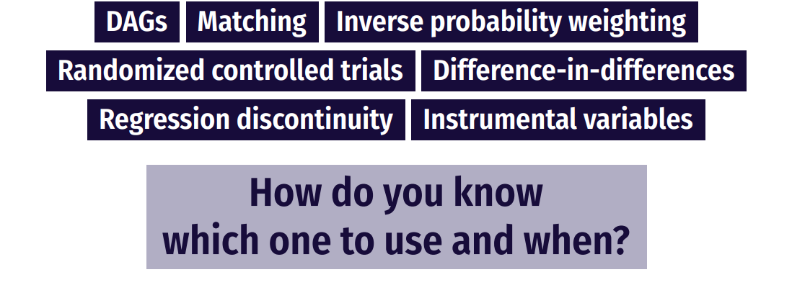
How do you pick a method?
Notes:
So in the proposal, next week you need to tell me what your question is and your team – not your method! Unless you have a good idea of one. But you do need to select a method by Nov. 1, and if you want to do a DD for example, you will need to look at the code ahead of time. I recommend talking to me about your method choices in this context! (I know there’s a tradeoff here in that you have to look ahead at resources we haven’t covered quite yet, but the value is that you get to practice applying the method most relevant to your research question).

Slide 61
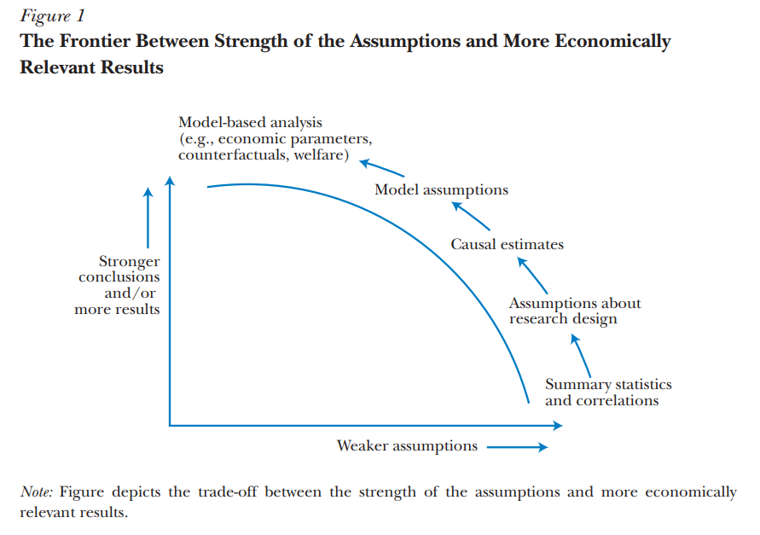
How do you pick a method?
Source: Mahoney (2022)

Slide 62
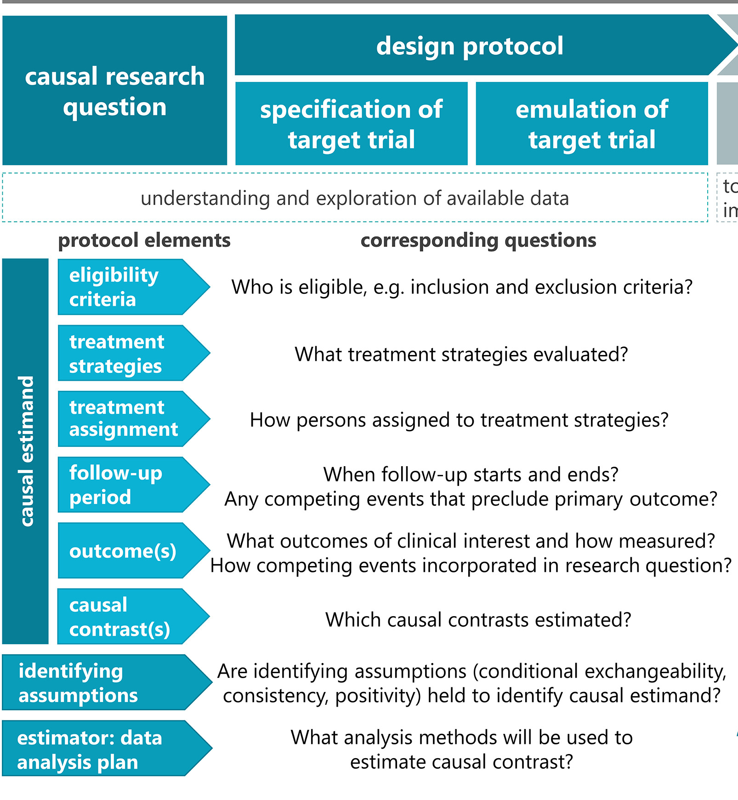
One approach: target trial emulation
A good approach is clear about:
The causal questions posed,
the approach taken, and
the assumptions on which inferences rest
In essence, you’re asking “what’s the experiment I would run?”

Slide 63
Target Trial Emulation
Think about this in two steps:
Articulate the target trial (“A macabre thought experiment…”)
  This should be as specific as possible! What would be eligibility criteria, treatment assignment, exposure definition, outcomes, etc.?
Then, match that trial to data in a research design.
  Construct the sample accordingly
  Define key issues (such as when a person is considered “in the sample” or “treated”)
  Choose a design that mimics random exposure to the treatment
  Measure outcomes consistently and map into a clear estimation strategy

Slide 64
Why the complexity?
Answering causal questions with observational data requires fixing some obvious biases (e.g., selection into a program) and some less obvious ones
Example: Immortal Time Bias: did you accidentally design the study so that comparisons are invalid?
Consider a simple 2x2 design
Treated – before | Treated – after
Control – before | Control -- after
Notes:
Immortal time bias is where you design a study so that in some cases, one group simply cannot receive the outcome, so your comparisons are off.
Some common problems:
You may have imposed a survival requirement (for either the treatment or control group) by which there can be no outcomes in the pre-period. E.g., if you want to compare effects of a diagnosis on mortality, have you required that the treatment group survive to older ages, on average, than the control group (because they have to live until they get a diagnosis, but the control group has competing risk of deaths from other sources).
Alternatively, you may inadvertently set it up so the control group can’t experience the outcome after the exposure – this is what happens in our case study!

Slide 65
Case study: Cancer Screening and Diagnoses
Cancer screening is a surprisingly hot topic!
For our case study, can you give me:
The motivation – why do we need this study?
The observational component – why can’t this be a clinical trial?
The simple design – why does this fail? Why do we need something like a TTE?
Notes:
Then, on the next slide, we will talk about what they did and why it’s different.

Slide 66
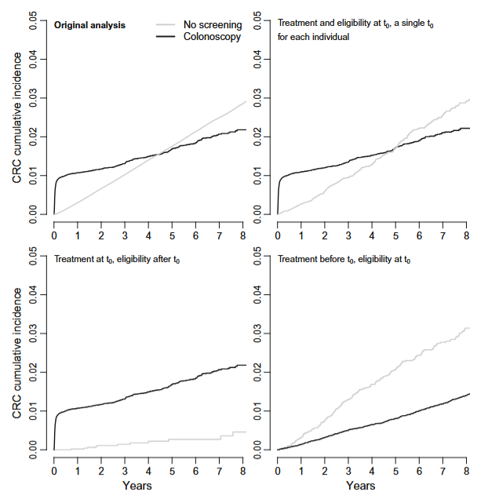
Addressing immortal time bias
Notes:
What were the 4 approaches? What was the one that they did follow as the TTE and why was it different?

Slide 67
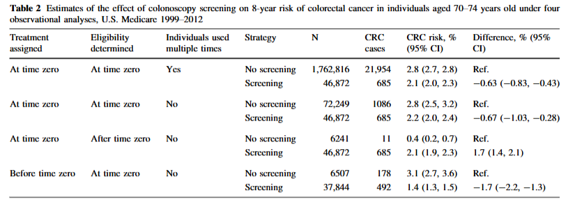
Addressing immortal time bias
Notes:
What were the 4 approaches? What was the one that they did follow as the TTE and why was it different?

Slide 68
Conclusion
Notes:
We’re going to talk about different approaches to approximating an experiment throughout the rest of the term. This will primarily be focused on how to deal with selection/sample construction + estimation, combined with identifying assumptions that will allow us to move beyond observational data and into design-based inference.

Slide 69
So where do you find questions?
Reading papers is a good start, but not everything!
  You don’t want to get caught in an echo chamber
Come to seminars!
  Go see the big names when they come in (look at other departments too)
  But also go see the works in progress, what your peers are working on, your faculty, etc.
  Try to go to talks outside your field
Subscribe to newsletters
  Academic journals, sure
  But also things like: Axios Vitals, Postcall, etc.
Notes:
Others include KFF morning briefing (US) and Healthy Debate (Canada)

Slide 70
Choosing an Empirical Strategy
Your empirical strategy consists of two (related) components:
Estimation strategy: what is estimated, how, inference, etc.
  Put equations in your papers!
Identification strategy: what allows making a causal statement?
  Do you have experimental variation?
  Balance?
  Is there endogeneity in your design?
    (reverse causality, heterogeneity, measurement/omitted error)
  This will require your (untestable) identifying assumptions to move from randomized to quasi-experimental data!
Notes:
Don’t be scared of regression equations – in fact, formalizing them will help you see threats to identification and improve your estimation approach. We are going to spend lots of time now on identifying assumptions (the bridge between TTE and truly causal work)

Slide 71
Where do we get the identification?
So what are the specific data and circumstances we need to answer a question?
The method you use will depend on the variation you have
  Variation across units?
  Across time?
  Policy changes
  Weird policy rules?
  Instruments?
Notes:
You’ll develop an intuition for this over time. Talk to lots of people about your thoughts!

Slide 72
Stages of Research
Follow the genre!
Motivate your question
Descriptive evidence (don’t underestimate its importance!)
Give us a framework to think about your results (model, an ideal experiment, etc.)
Clearly present your data sources + methods
Focus on identification assumptions, threats, and robustness in methods
Then present and discuss results
Notes:
Setting the stage appropriately can be incredibly powerful. Recall our earlier slides on this.

Slide 73
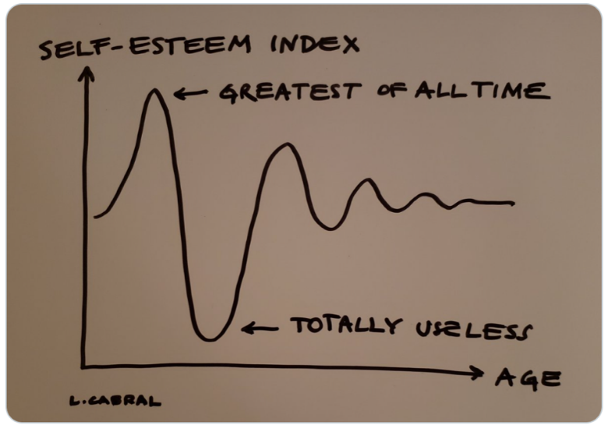
Stages of Research
Notes:
This is the truth about all projects!

Slide 74
Appendix
Notes:
(skip this section if needed for time). Your figures and tables are valuable real estate! Treat them as such.

Slide 75
Model vs. Design-based Approaches
Approaches either rest on you having a DAG (model-based) or a good source of exogenous variation to identify data generating processes (design-based)
Examples of model-based: matching, controlling, IPW
  Requires a big assumption about your DAG (and selection on unobservables)
  Can go as far as structural model approaches
Examples of design-based: RCT, DID, IV
  Need a specific set of data and circumstances (policy change, instrument)
  Still making assumptions about an underlying model! But minimizing the set of assumptions and making them more transparent
  Typically relies on what’s referred to as quasi-random variation
  This is where we’re headed

Slide 76
Why models? Why not models?
Economic studies almost always have a “working model”
  Can be as complicated as a formal microeconomic theory model
  Or as simple as an OLS regression equation
But this framework specifies:
  Whose behavior we are modeling
  Under what constraints
  With what sets of endogenous and exogenous variables (for now, choices vs. circumstances)
  With what set of observed data
Working models require “suspension of disbelief” and narrowing of focus (no model is perfect!) but must also capture the question at hand
Notes:
Source: David Card’s lectures https://davidcard.berkeley.edu/lectures/woytinsky.pdf.

Slide 77
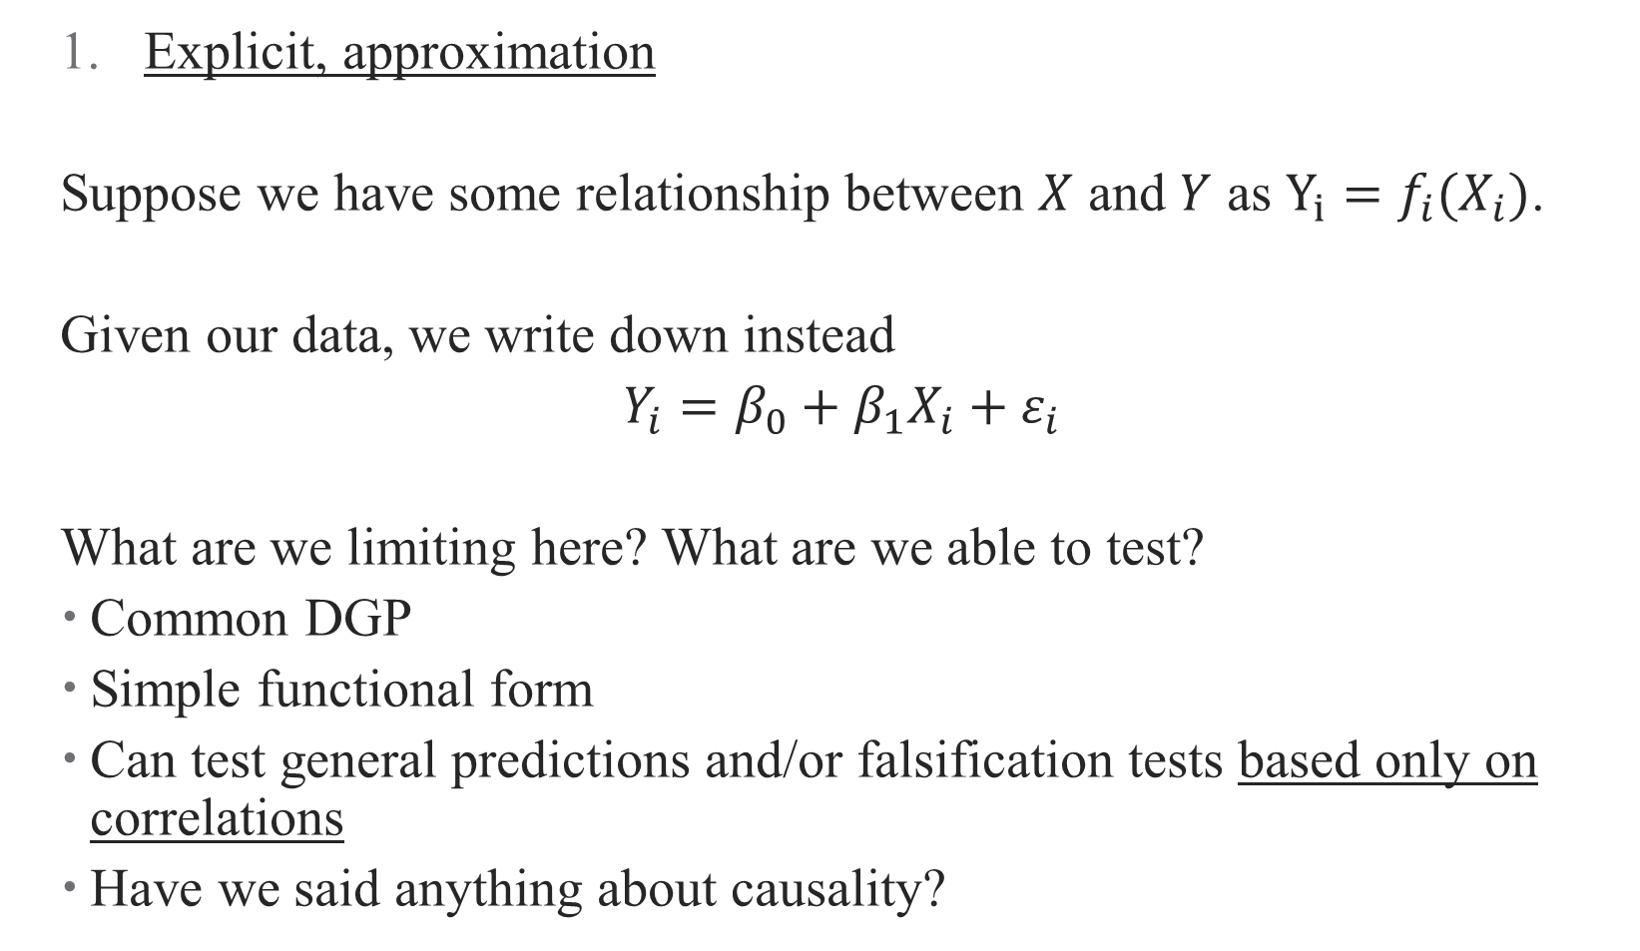
Three Examples of Models
  Explicit, approximation
  Suppose we have some relationship between $X$ and $Y$ as $Y_{i}=f_{i}(X_{i})$.
  Given our data, we write down instead
  $Y_{i}=β_{0}+β_{1}X_{i}+ε_{i}$
  What are we limiting here? What are we able to test?
  Common DGP
  Simple functional form
  Can test general predictions and/or falsification tests based only on correlations
  Have we said anything about causality?
Notes:
Source: David Card’s lectures https://davidcard.berkeley.edu/lectures/woytinsky.pdf.

Slide 78
Three Examples of Models
  Explicit, approximation
  Explicit, (more) exact
  We could go to the other extreme, and set a full model (e.g., structural model)
  Specify the complete data generating process (e.g., all utility functions for each individual-outcome pair + unobserved heterogeneity in tastes)
  Doing so yields a fully-specified (over-specified) demand system that identifies many parameters
  Estimation is extremely complicated
  Each identified parameter requires a unique identifying assumption – strong set of assumptions!
Notes:
Source: David Card’s lectures https://davidcard.berkeley.edu/lectures/woytinsky.pdf.

Slide 79

Relying on Theoretical Frameworks
Almost all frameworks are theories of change (causal pathways)
But how can a framework motivate a design?
  Write your research question as explicitly as possible
  Draw a DAG! Take time thinking about open back- and front-doors
  Maybe build the DAG into a theoretical model
  DAG + model $⇒$ Regressions, assumptions, even identification!
Notes:
Building a model may require some calculus to solve it, but provides useful insights into relative comparative statics, what the real parameter of interest is (hint: usually a first/second derivative). Can embed these even further into a structural approach (more on this in a separate course, if there is demand?)

Slide 80
Three Examples of Models – why design-based?
  Explicit, approximation
  Explicit, (more) exact
  Implicit
  So frequently, we do something that’s more in the middle
  Rather than specify a behavioral model explicitly, we focus on a single causal relationship and identify it using quasi-exogenous variation:
  What is the effect of job training on employment/income? Find a state that randomized people to take job training and evaluate their outcomes relative to a control state
  What are the advantages/disadvantages of this?
Notes:
Source: David Card’s lectures https://davidcard.berkeley.edu/lectures/woytinsky.pdf. Limited extrapolation/external validity for one. No understanding of underlying behavior either. Example: what’s the effect of a health shock? What is the quasi-exogenous variation we are using? What’s the one-equation model?

Slide 81
So what do we get from design-based inference?
  Counterfactuals and causality
  In many ways, the identification becomes the research design
  It defines the counterfactual estimation when the design is credible
  Descriptive + Causal Evidence
  Without a full structural approach, many papers become “storytelling”
  You present a set of descriptive + causal evidence, sometimes under the umbrella of a formal model (“applied theory”) and sometimes just as a narrative
  Replicability
  Credible replication of your own results
  Credible replication of results in other contexts/data/etc.
Notes:
Source: David Card’s lectures https://davidcard.berkeley.edu/lectures/woytinsky.pdf. Example: what’s the effect of a health shock? What is the quasi-exogenous variation we are using? What’s the counterfactual?

Slide 82
Communicating Findings
Notes:
(skip this section if needed for time). Your figures and tables are valuable real estate! Treat them as such.

Slide 83
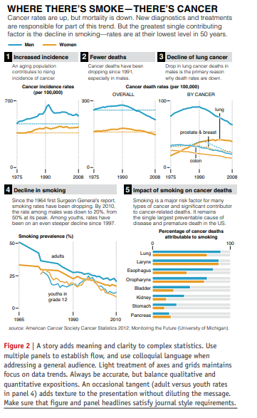
Data Viz
Schwabish (2014):
Show the data
Reduce the clutter
Integrate the text and the graph
See some helpful slides and examples here
Notes:
Figures are the most important thing about a paper – no, really. I think this is why TWFE took off more than anything else – the figures. Read this article in Github repo. How does the data viz stack up to some of these principles

Slide 84
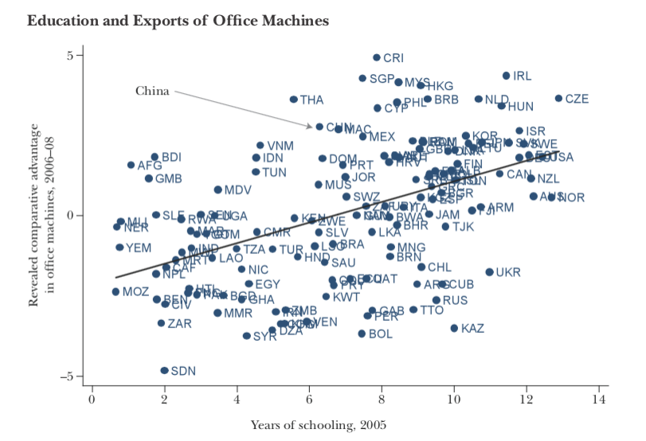
Data Viz: Before (1/2)
Notes:
What are some problems with this? This graph is super easy to make in R – but it pays to take the tmie to clean it up.

Slide 85
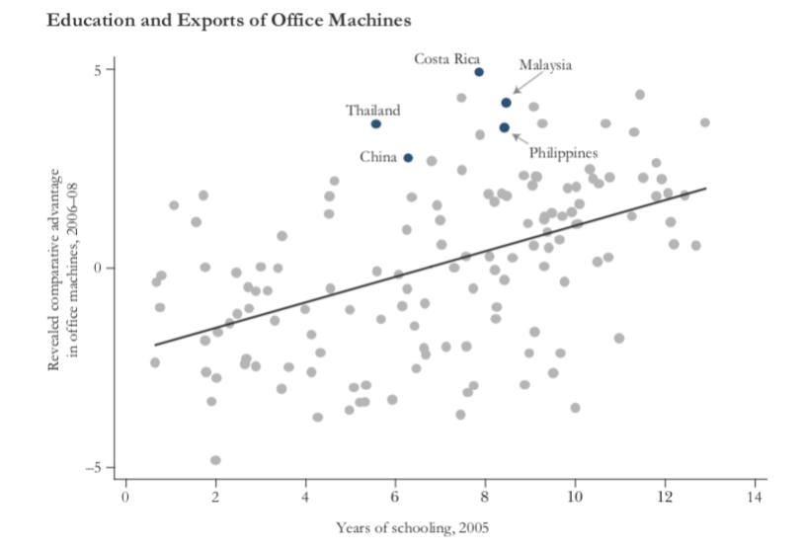
Data Viz: After (1/2)
Notes:
How is this better/ What does it tell us about the paper without reading it?

Slide 86
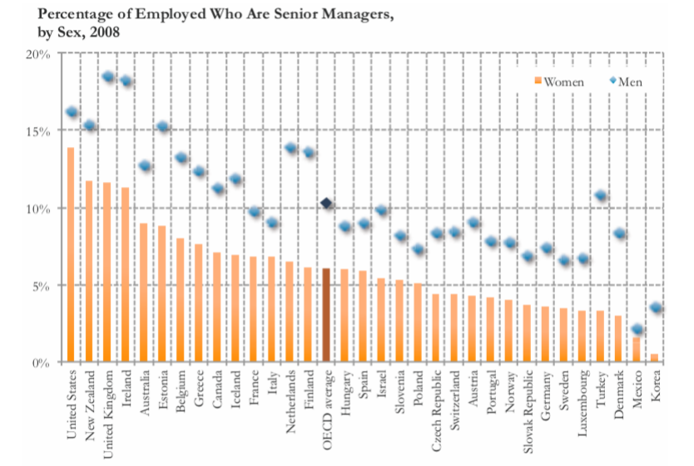
Data Viz: Before (2/2)
Notes:
This chart just doesn’t tell the story we want it to!

Slide 87
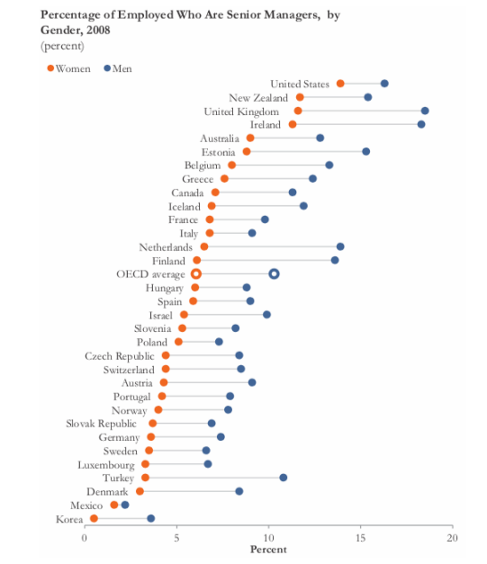
Data Viz: After (2/2)
Notes:
Now what’s the takeaway?

Slide 88

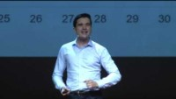
Data Storytelling and Making Good Charts
Notes:
If there’s time, data storytelling ted talks (probably will have to skip). Start with #1 if time.
* Ideas should be simple, and you should focus on one. People think I do this, but really I do this (start at 6minutes)

Slide 89
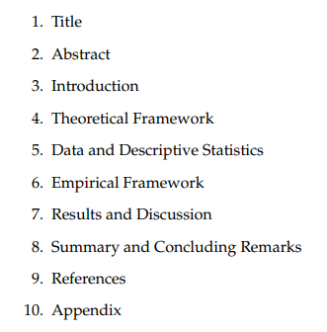
Writing a Paper
Academic writing is formulaic – take advantage of that!
Notes:
Follow the outlines!

Slide 90
Writing a Paper
Academic writing is formulaic – take advantage of that!
Copy good writers
Prioritize good writing – it will make your papers more successful
Some other good sources:
  Marc Bellemare “How to Write an Applied Economics Paper”
  Neil Mahoney “Principles for Combining Descriptive and Model-Based Analysis in Applied Microeconomics Research”
Notes:
What’s more, just copy structures of papers you think are good (literally – table 1 does X, etc.) This both makes your writing better and makes it easier for reviewers.

