Slide 1
Quantitative HSR I
Lecture 7 (Day 1 of 2): Endogeneity & Instrumental Variables
November 2, 2026
HAD5744 • Alex Hoagland, Ph.D.
Notes:
Notes:
we have 2 case studies here, but there’s also a lot of new ideas here so we will go through multiple examples
Also, there won’t be that much coding (it’s easy to implement in the code we already have!) the important things we’ll cover are (a) how to come up with an instrument and defend it and (b) the role of robustness checks/ancillary evidence/descriptive results as support for this approach.
I added another referee paper to the list

Slide 2
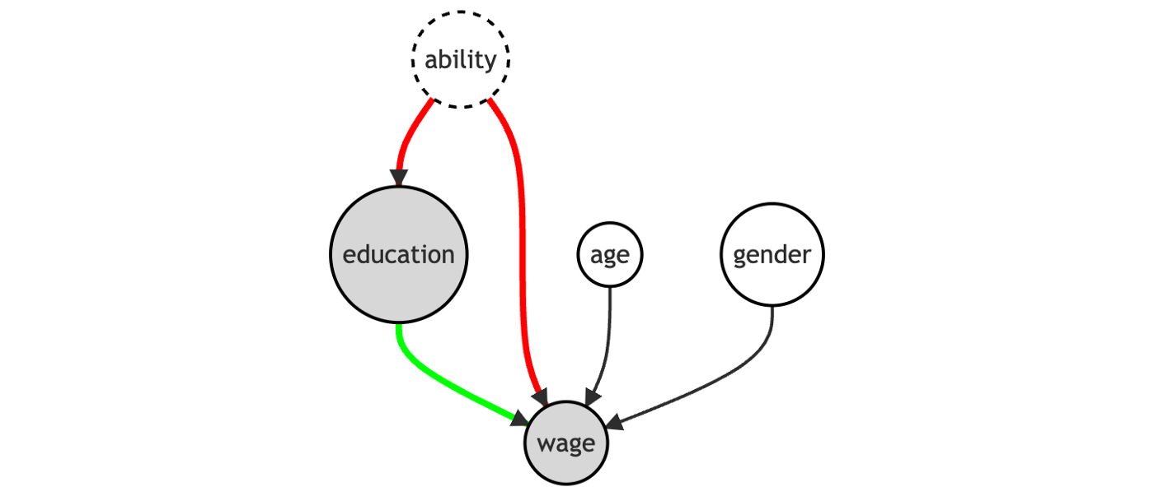
Last Time: Matching Approaches
  Matching methods help to deal with imbalanced data
  Helps you argue that your comparisons really are apples-to-apples
  Matching relies on selection on observables
  Propensity score, nearest neighbor techniques
Notes:
So far, we’ve focused on the backdoor criterion – can we close paths that stand in our way? Matching and controlling for covariates are two primary approaches.

Slide 3
Last Time: Matching Approaches
  Matching methods help to deal with imbalanced data
  Helps you argue that your comparisons really are apples-to-apples
  Matching relies on selection on observables
  Propensity score, nearest neighbor techniques
So can we ever really get at causality?
Notes:
“Model-based” vs. “design-based”

Slide 4

Causal Inference: From Back Doors to Front
We can also isolate variation coming only through $X$
This is called a front door approach – mimics an experiment
Notes:
This dag cannot be addressed fully with a back-door approach (how do we ever measure ability)? The front door finds an instrument M such that there is no back door between education and M, and education blocks the only open back-door between M and wage (ability). This is an open door! Example of M: quarter of birth (Angrist and Kreuger, 1991). M goes behind education and connects to it.

Slide 5

Open up the (Right) Gates!
Notes:
Lots of frozen in our house these days, so I want this playing in all of our heads.

Slide 6
Case Stud(ies)

Slide 7
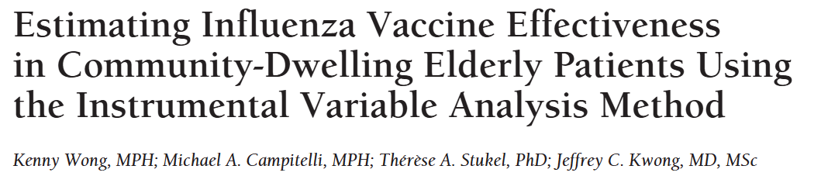
Example: causal effect of vaccines
Why would estimating the effect of a vaccine be hard in observational data?
If you looked at a “naïve” estimate of vaccine effectiveness, what direction would you expect it to be biased? Why?
Notes:
Recommend looking at the related invited commentary as well to get a sense of this better. https://jamanetwork.com/journals/jamainternalmedicine/article-abstract/1108791

Slide 8
Example: causal effect of vaccines
Why would estimating the effect of a vaccine be hard in observational data?
If you looked at a “naïve” estimate of vaccine effectiveness, what direction would you expect it to be biased? Why?
“Even after statistical control for various demographic variables and other medical conditions, elderly patients who receive the vaccine appear to be much healthier than apparently comparable unvaccinated patients. Strong evidence of this bias comes from an important epidemiologic study by Jackson et al² in which the authors reported that a large beneficial effect of the vaccine is apparent before the influenza season begins.”
Notes:
Recommend looking at the related invited commentary as well to get a sense of this better. https://jamanetwork.com/journals/jamainternalmedicine/article-abstract/1108791

Slide 9
Example: causal effect of vaccines
Why would estimating the effect of a vaccine be hard in observational data?
If you looked at a “naïve” estimate of vaccine effectiveness, what direction would you expect it to be biased? Why?
What does this study look at (outcomes, population)?
What is the selection problem that they are addressing? Why is this endogeneity?
Note: abstract says “uses logistic regression IV to remove the effect of selection bias” is not correct. Also says “IV methods control for overt and hidden biases in observational studies.” This is also not correct
What we are doing is approximating a quasi-experiment and identifying a causal effect if that approximation is done correctly
Notes:
Note: if you want the correct way to talk about this, you need to read an economics paper. Like the dialysis one. Very careful with language even though everyone else hates us for it.

Slide 10
Endogeneity
Notes:
This is the right way to discuss IV: what things directly lead to the outcome on their own (exogenous), and what things are jointly determined in a more complex system (endogenous)?

Slide 11
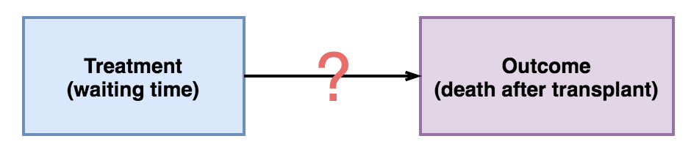
Example: Waiting Times and Transplantation Outcomes
Notes:
Let’s start with just part of the story: the effect of shortening waiting times for transplants on positive outcomes. We can’t randomize this (why?)
But we also can’t just use observational data in a simple regression (why? – selection! patients who are more likely to have poor outcomes may also have different waiting times)

Slide 12
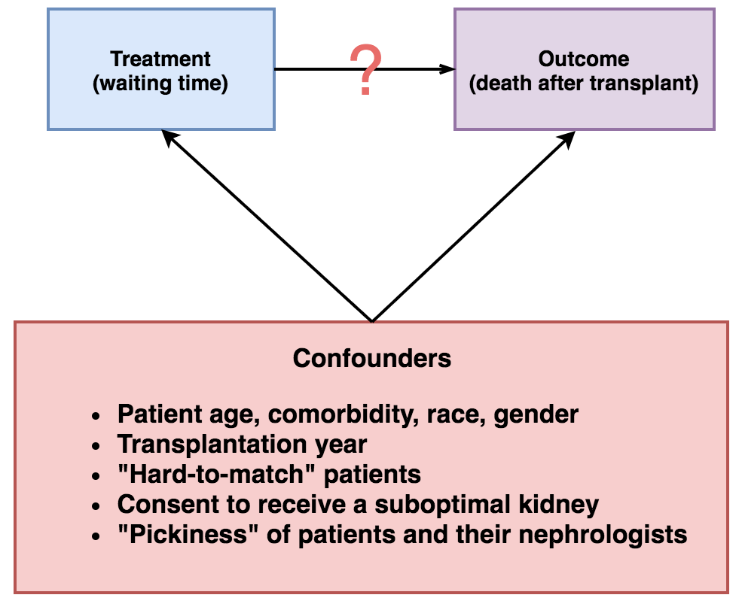
Example: Waiting Times and Transplantation Outcomes
Notes:
Examples of selection – note that not all of these confounders are things we can deal with.

Slide 13
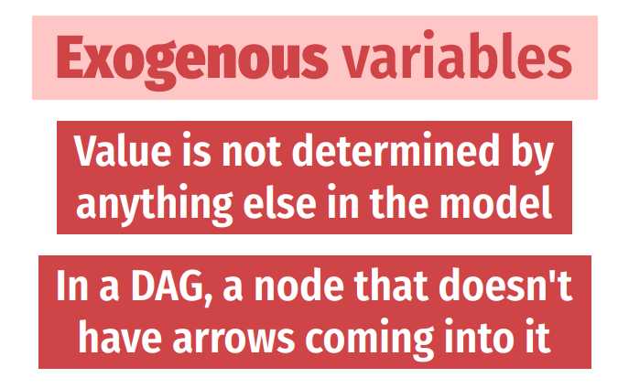
Exogeneity + Endogeneity
Notes:
Exogenous variables: age, demographics. What about education? Whether or not you need a transplant in the first place? This starts to become a gray area quickly.

Slide 14
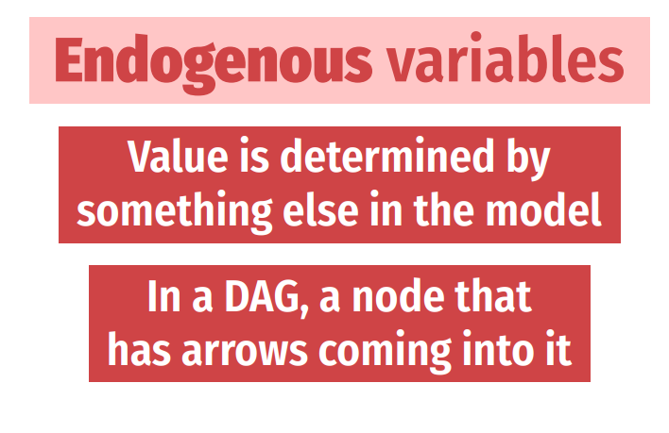
Exogeneity + Endogeneity
Notes:
Things that are almost surely endogenous: health outcomes, decision to seek care, etc. (any y of interest also). Really, endogenous things are DAG-determined and *they can’t be controlled for*

Slide 15

Endogeneity
What is the consequence of ignoring backdoors?
C$onsider regression y=β_{0}+β_{1}x_{1}+…+β_{k}x_{k}+ε$
If an endogenous regressor $w$is ignored, $Cov\left(x_{j},ε\right)≠0$ for some $x_{j}$
Notes:
One version of endogeneity is OVB with an unmeasurable variable --- others include jointly determined variables, or strategic selection.

Slide 16
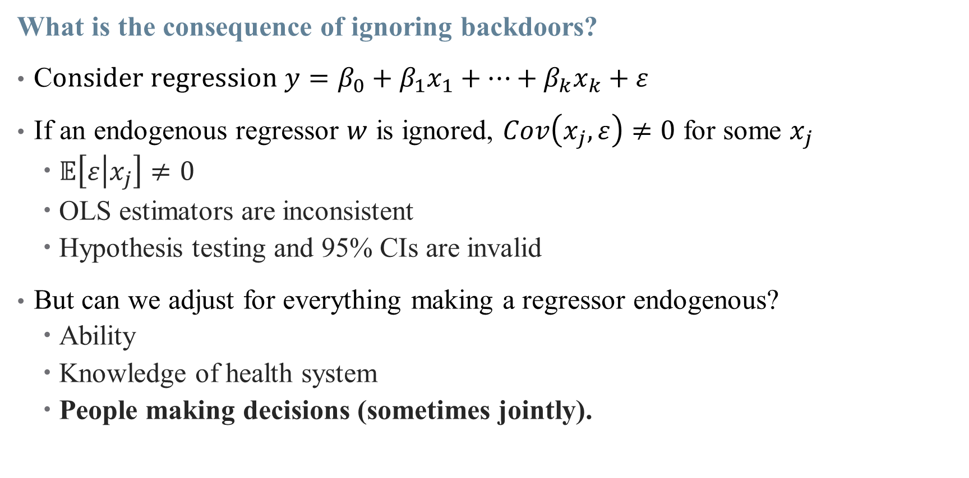
Endogeneity
What is the consequence of ignoring backdoors?
C$onsider regression y=β_{0}+β_{1}x_{1}+…+β_{k}x_{k}+ε$
If an endogenous regressor $w$ is ignored, $Cov\left(x_{j},ε\right)≠0$ for some $x_{j}$
  $𝔼\left[ε | x_{j}\right]≠0$
  OLS estimators are inconsistent
  Hypothesis testing and 95% CIs are invalid
But can we adjust for everything making a regressor endogenous?
  Ability
  Knowledge of health system
  People making decisions (sometimes jointly).
Notes:
Moving health knowledge out of the error term could make decision to seek care an exogenous variable – but how do we measure that? But not all back doors can be closed! Without perfect data or randomization, we can’t make everything exogenous by shutting down a backdoor.

Slide 17
Endogeneity
What is the consequence of ignoring backdoors?
C$onsider regression y=β_{0}+β_{1}x_{1}+…+β_{k}x_{k}+ε$
If an endogenous regressor $w$ is ignored, $Cov\left(x_{j},ε\right)≠0$ for some $x_{j}$
  $𝔼\left[ε | x_{j}\right]≠0$
  OLS estimators are inconsistent
  Hypothesis testing and 95% CIs are invalid
But can we adjust for everything making a regressor endogenous?
  Ability
  Knowledge of health system
  People making decisions (sometimes jointly).
This isn’t just a problem of not having the right variables in your data set, you can’t control for this stuff!
Notes:
Moving health knowledge out of the error term could make decision to seek care an exogenous variable – but how do we measure that? But not all back doors can be closed! Without perfect data or randomization, we can’t make everything exogenous by shutting down a backdoor.

Slide 18
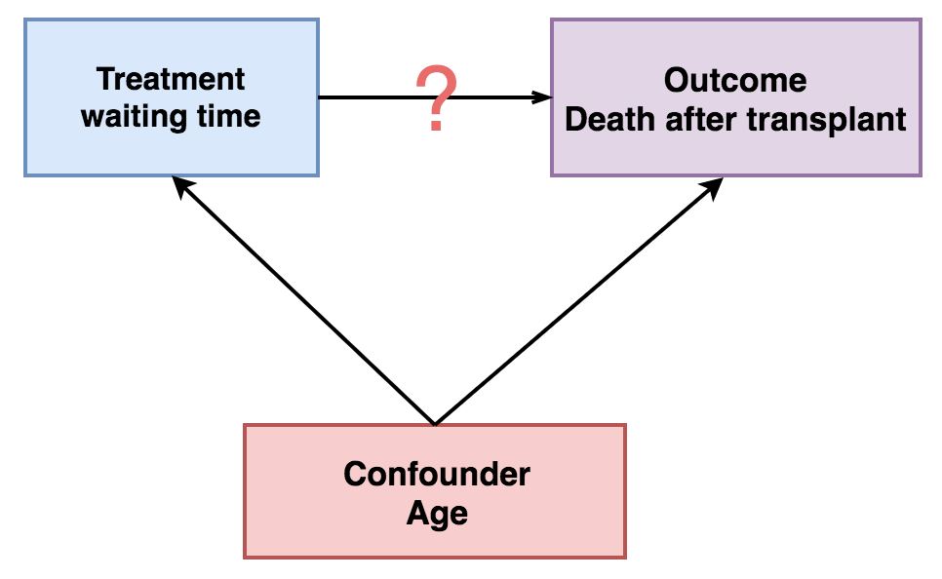

Exogeneity Example: Age
Age is correlated with both waiting time ($W)$ and outcome ($D$)
  $D$is impacted by both $W$ and Age
  Without closing back door, $\hat{β_{W}}≠β_{W}$

Slide 19
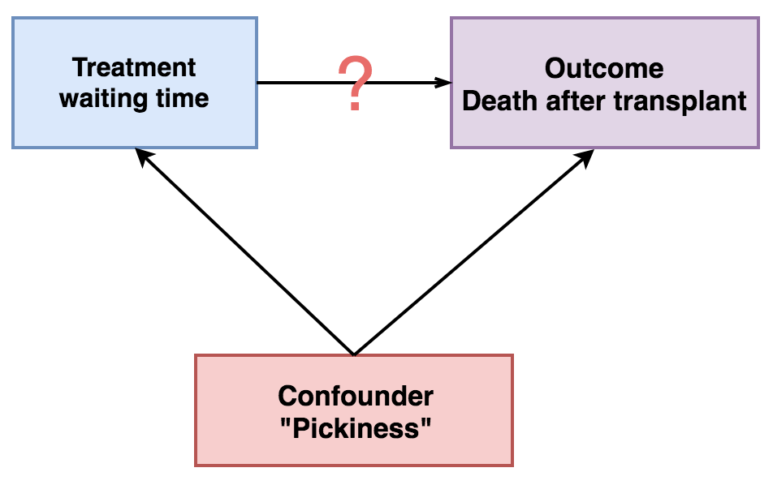

Endogeneity Example: “Pickiness”
Other variables are harder to control for
How “picky” a patient is may increase $W$ and $D$
Notes:
What do we do when endogeneity threatens our main treatment of interest? Our approach today is what we resort to when we can’t close all backdoors – we take a front door approach and simulate randomization

Slide 20
Endogeneity Example: “Pickiness”
Other variables are harder to control for
How “picky” a patient is may increase $W$ and $D$
What’s the endogeneity in our case study?
Notes:
Walk through this one more time for both case studies (a good and bad IV). Why are vaccines and PCIs endogenous?
For vaccines, it was vaccination rates of those around you
For PCIs, exogenous variation came from differential distance: how much farther is it from you to a PCI hospital than it is from you to your closest hospital.

Slide 21
Exploiting
Quasi-Random Variation
Notes:
Without quasi-random variation, you are pretty much up a creek for this kind of endogeneity.

Slide 22
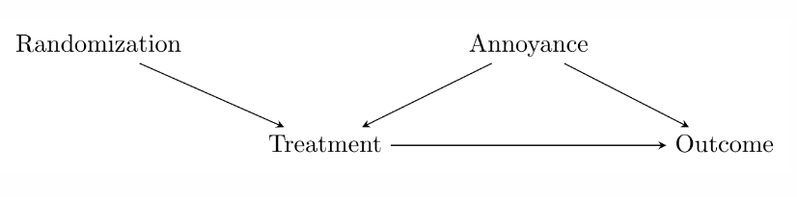
Causal Inference: From Back Doors to Front
Back door variation stands in the way of causal inference
But we can avoid that through careful randomization
Notes:
In an experiment, we generate variation (random assignment) and then just isolate the part of the treatment driven by that random variation (we compare across treatment and control groups). IV does the same, except isolating the part of the treatment driven by quasi-random, natural circumstances – the instrument.

Slide 23
Causal Inference: From Back Doors to Front
Back door variation stands in the way of causal inference
What if we didn’t assign randomization? Can we simulate it somehow?
Instrumental Variables looks for real-world (quasi)-randomization

Slide 24

Causal Inference: From Back Doors to Front
Note: (even perfect) randomization doesn’t absolve us of closing back doors!
But it does move the criterion from $Treatment$ to $Randomization$
  This is usually easier to satisfy in practice
Notes:
So we: (1) use the instrument to explain the treatment, (2) focus only on the part of the treatment explained by the instrument, and (3) use that to look at the instrument-explained part of the outcome. Basically, we’re splitting the effect of treatment into its endogenous and exogenous parts, and isolating just the exogenous part.

Slide 25

Instrumenting for an Endogenous Variable
We are particularly concerned when our $Treatment$ variable is endogenous
How can we randomize?
  Pick a suitable variable which is an instrument for randomization
  Mimics an RCT

Slide 26
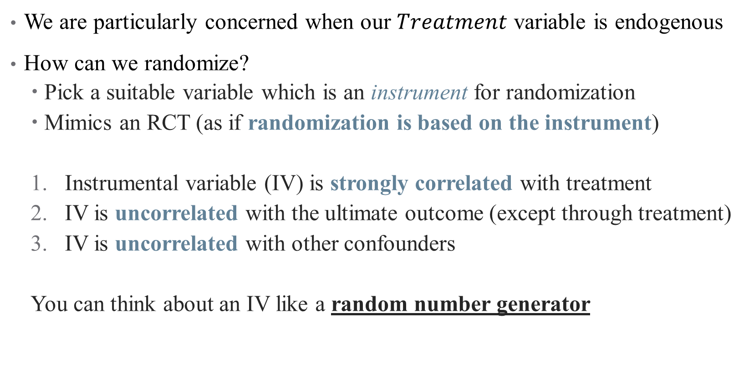
Instrumenting for an Endogenous Variable
We are particularly concerned when our $Treatment$ variable is endogenous
How can we randomize?
  Pick a suitable variable which is an instrument for randomization
  Mimics an RCT (as if randomization is based on the instrument)
  Instrumental variable (IV) is strongly correlated with treatment
  IV is uncorrelated with the ultimate outcome (except through treatment)
  IV is uncorrelated with other confounders
  You can think about an IV like a random number generator
Notes:
First condition is called relevance; second and third are validity – essentially that there are no open back doors of Z

Slide 27
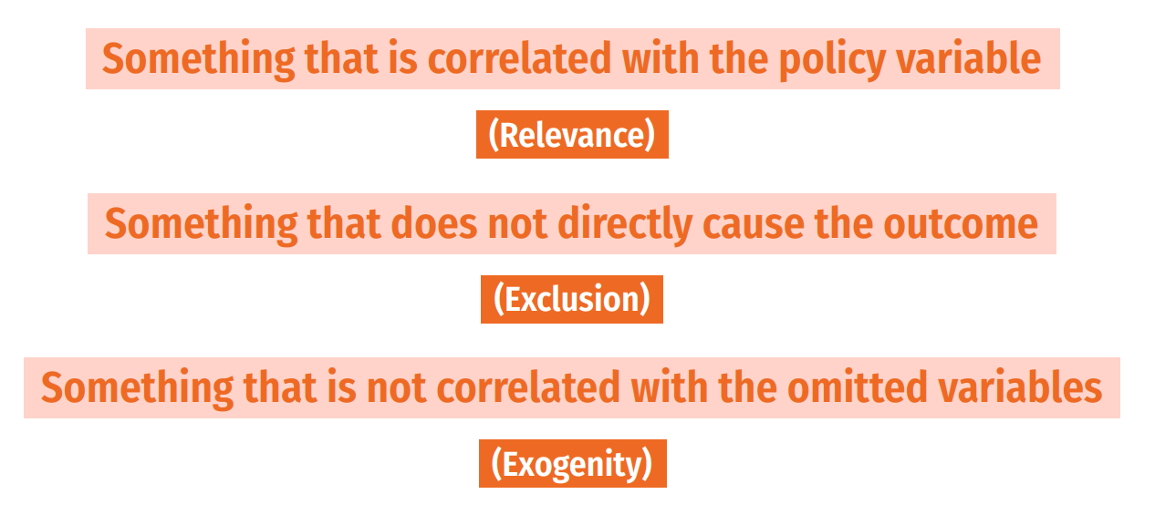
Instrumental Variables
Notes:
Another way to think about it

Slide 28
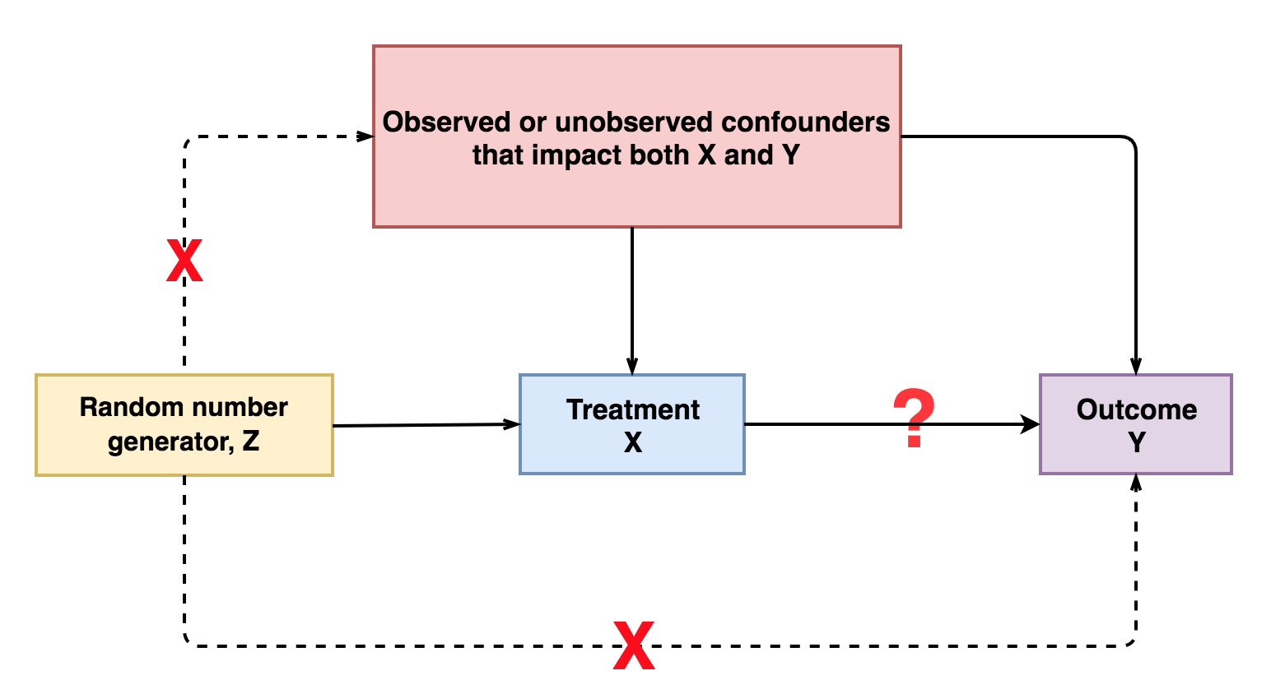
Notes:
Think first about just a random number generator. If that generator is used to assign treatment, then assumption 1 holds. If that random number isn’t used for anything else, then Z only affects Y through X (it doesn’t determine your pickiness or your age).

Slide 29
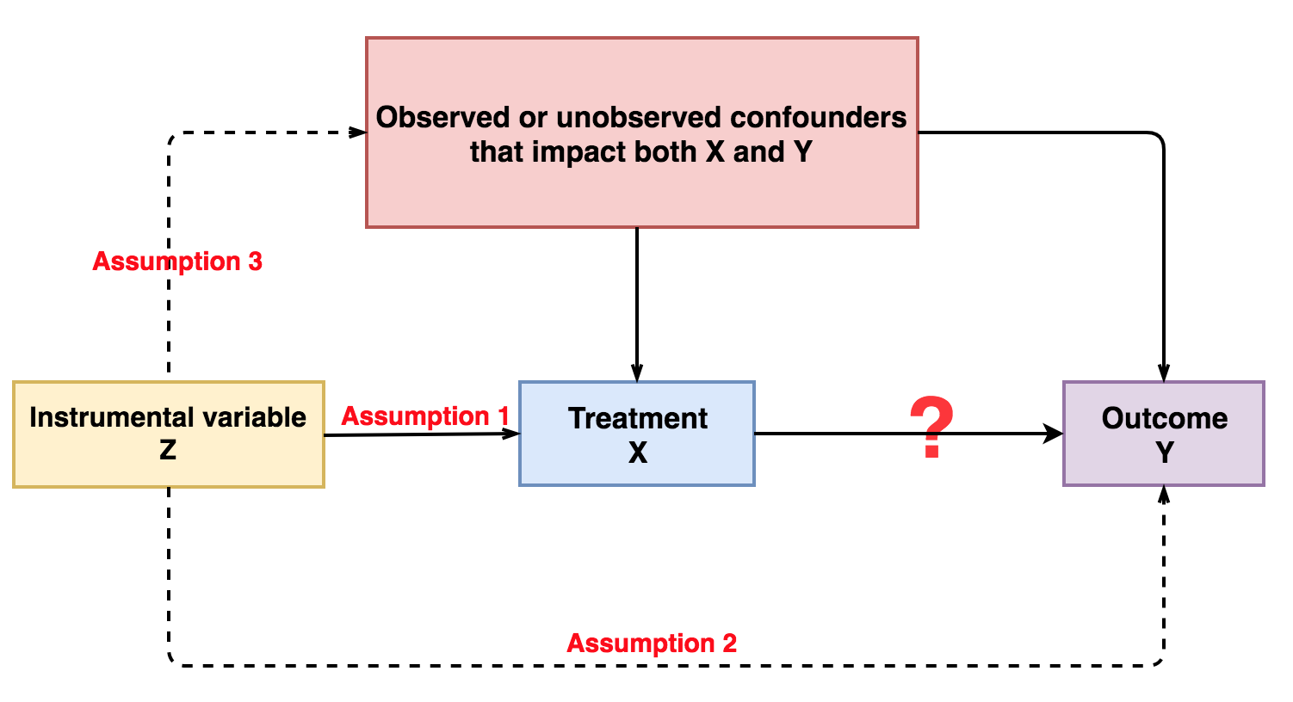
Notes:
So we want a variable like a random number generator. this is kind of the opposite of controlling for a variable: when we control for W, we use W to explain X and Y and remove those parts (to close a back door). But here, we are going to use Z as an instrument and remove the unexplained parts.

Slide 30
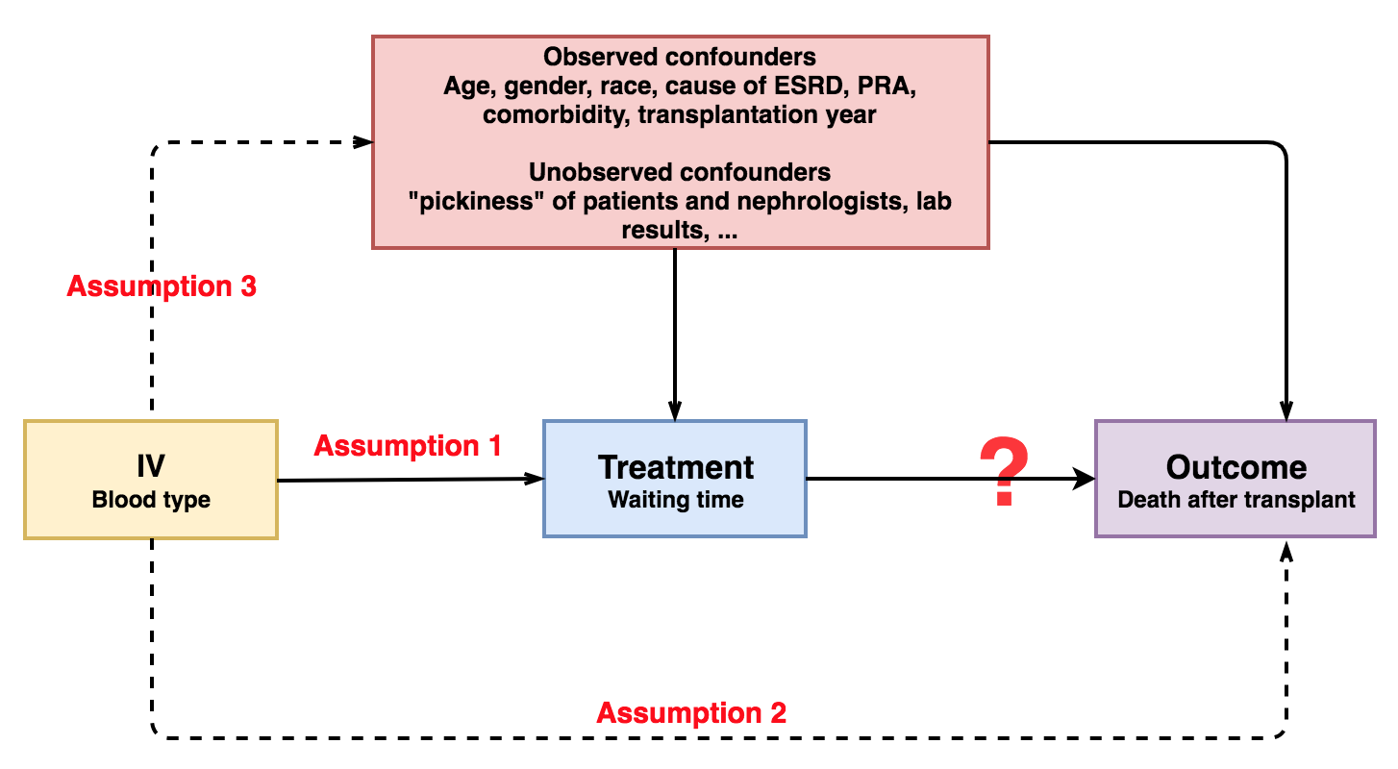
Example: Transfusions and Waiting Time
Consider blood type as a potential IV for waiting time
Notes:
Using our blood type example: Why is each assumption satisfied? Do we think this works? Can you think of any threats?

Slide 31
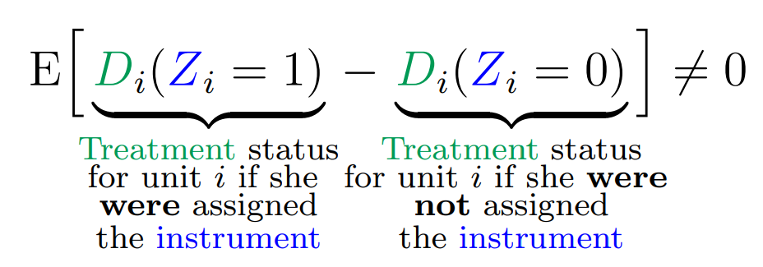
Instrumental Variables: Relevance
Notes:
Note: these come from really useful paper by Felton and Stewart. Now just for pedagogy, let’s do a completely different example and walk through it again. What is the effect of going back home (vs. moving) on recidivism. What is the open door? What are potential instruments? (ask this q even though it’s hard so that people can see the challenges of finding an IV)
Example of relevance: effect of going back home after prison on recidivism – use Hurricane Katrina in LA (does that change your decision to go home or not?)

Slide 32
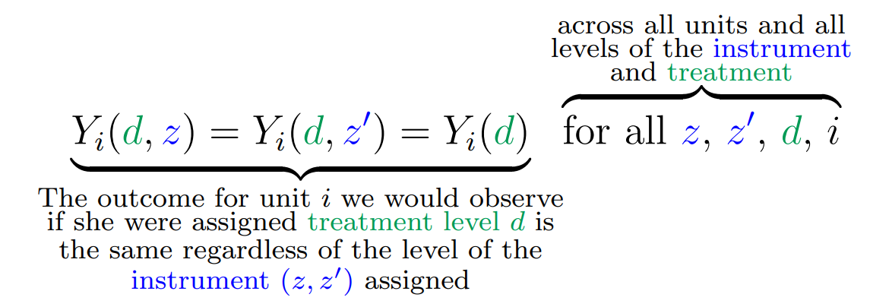
Instrumental Variables: Exclusion
Notes:
Example of exclusion: hurricane katrina can’t have affected recidivism in any other way except through residence change (can you think of violations to this?)

Slide 33
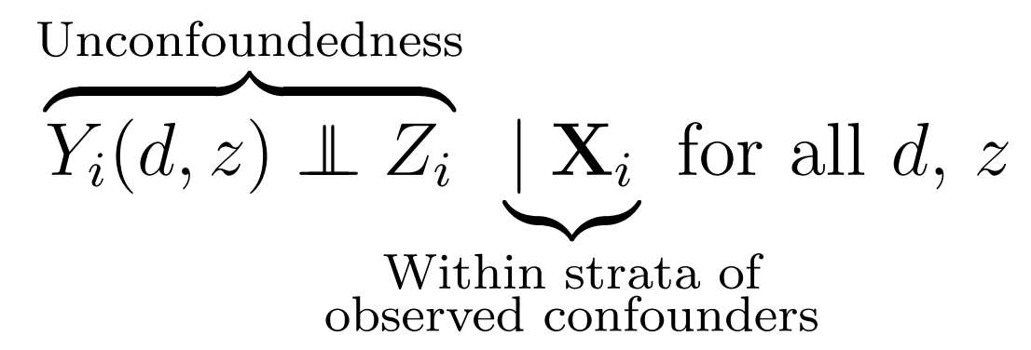
Instrumental Variables: Exogeneity
Notes:
Also called unconfoundedness. Note – treatment is confounded (that’s why we need IV in the first place) but hopefully IV isn’t. So if residence and recidivism are correlated (why would they be? Past history? Networks?), then Hurricane Katrina shouldn’t care about any of that

Slide 34
Using IVs in Regression

Slide 35

Using IVs to back out treatment effects
With an IV $z$, we can calculate:
  Effect of $z$ on $y=($effect of z on $x)$ * (effect of x on $y)$
  Hence: effect of $x$ on $y=($effect of z on $y)$ / (effect of z on x$)$

Slide 36

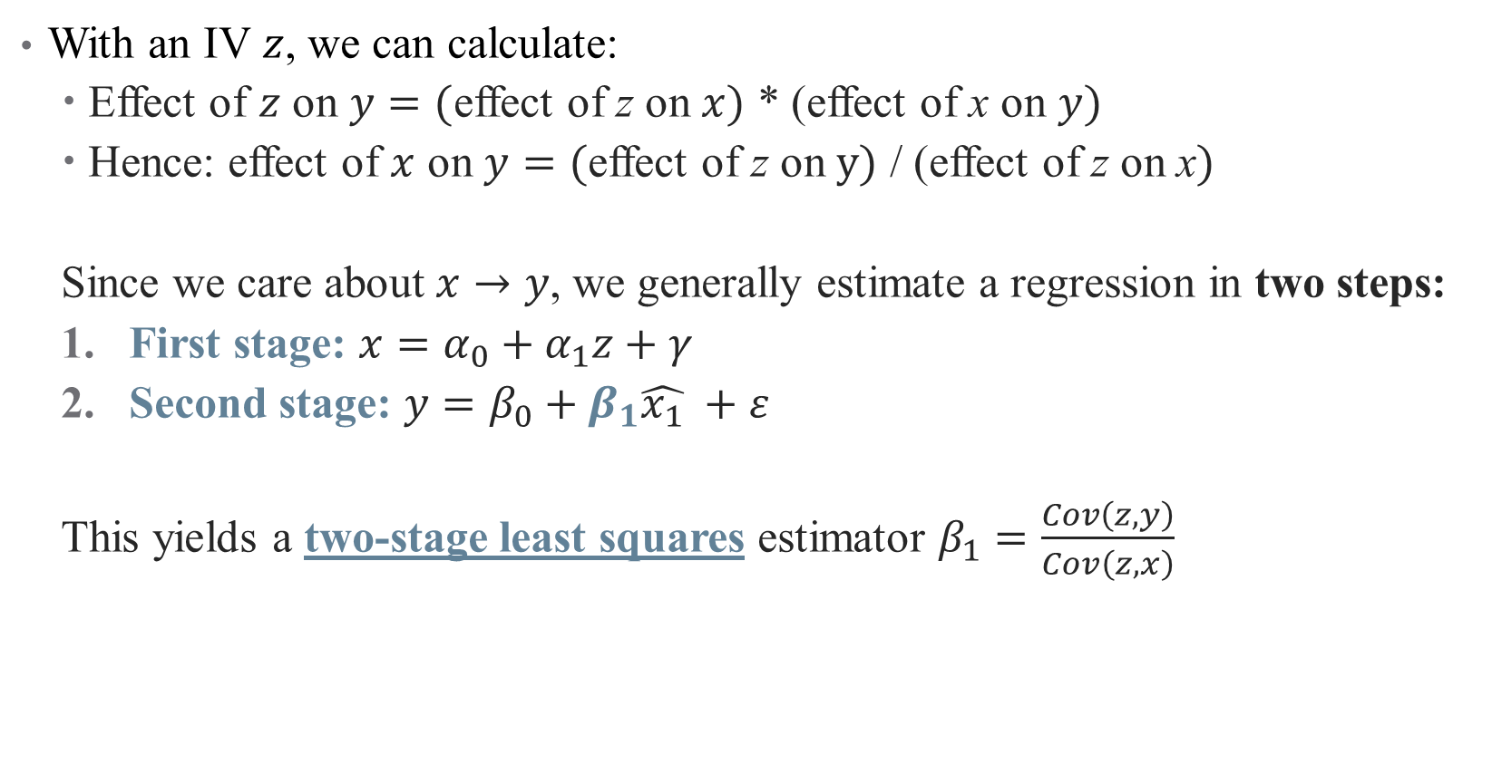
Using IVs to back out treatment effects
With an IV $z$, we can calculate:
  Effect of $z$ on $y=($effect of z on $x)$ * (effect of x on $y)$
  Hence: effect of $x$ on $y=($effect of z on $y)$ / (effect of z on x$)$
  Since we care about $x→y$, we generally estimate a regression in two steps:
  First stage: $x=α_{0}+α_{1}z+γ$
  Second stage: $y=β_{0}+β_{1}\hat{x_{1}} +ε$
  This yields a two-stage least squares estimator $β_{1}=\frac{Cov\left(z,y\right)}{Cov\left(z,x\right)}$
Notes:
Here, you can see why we need relevance condition; if Cov(z,x) = 0, then the 2sls doesn't return anything useful. Even if cov is small, we have problems (we'll return to this).

Slide 37
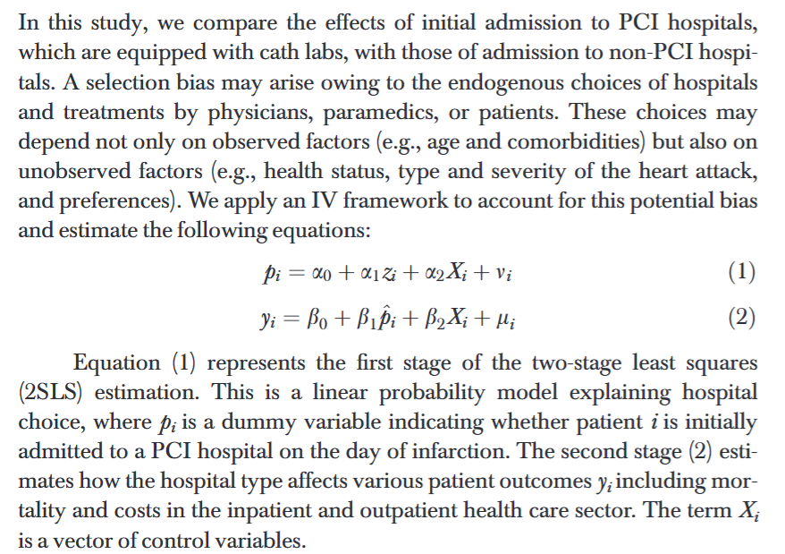
Using IVs to back out treatment effects

Slide 38
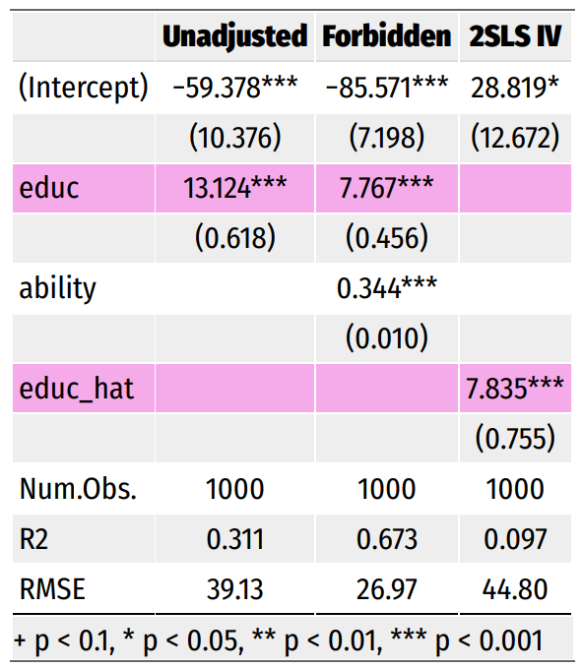

IV Regression: Illustration
Suppose we are after:
$$Earnings_{i}=β_{0}+β_{1}Education_{i}+ε_{i}$$
Why is this endogenous?
Notes:
Why is this endogenous? (We don’t have ability)

Slide 39

IV Regression: Illustration
Suppose we are after:
$$Earnings_{i}=β_{0}+β_{1}Education_{i}+ε_{i}$$
Why is this endogenous?
Suppose we had good data on ability
Is this enough?
Notes:
Yes, this is enough! We just can’t do this in the real world

Slide 40
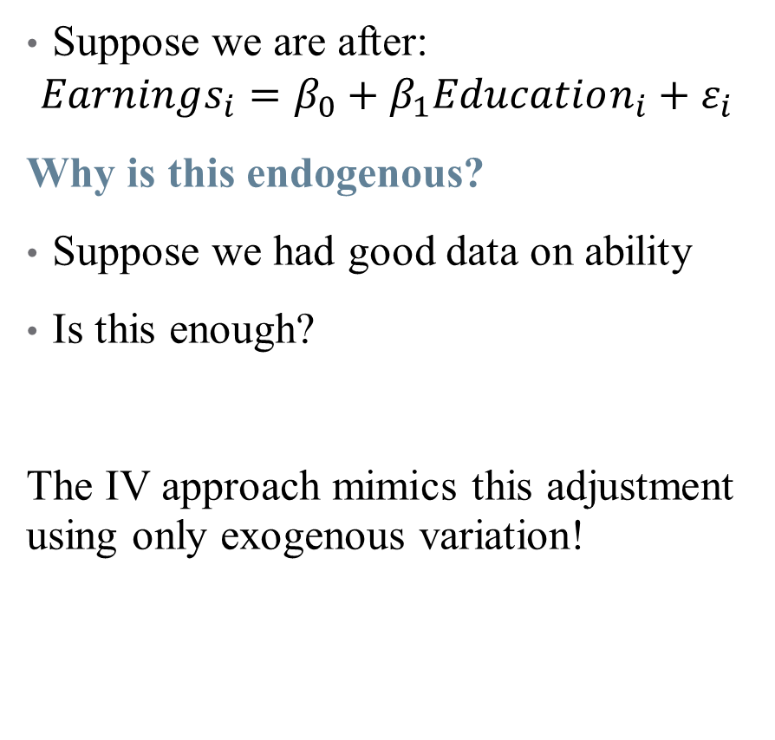
IV Regression: Illustration
Suppose we are after:
$$Earnings_{i}=β_{0}+β_{1}Education_{i}+ε_{i}$$
Why is this endogenous?
Suppose we had good data on ability
Is this enough?
The IV approach mimics this adjustment using only exogenous variation!
Notes:
In this case, the IV is your father’s education (a common but slightly dubious instrument – can talk about why if time). Note that the coefficient is the same sign but smaller (adjusting for positive selection into treatment). There are also cases where the coefficient may be opposite signed, especially if there is negative selection into a treatment with a positive treatment effect (as in the case study).

Slide 41
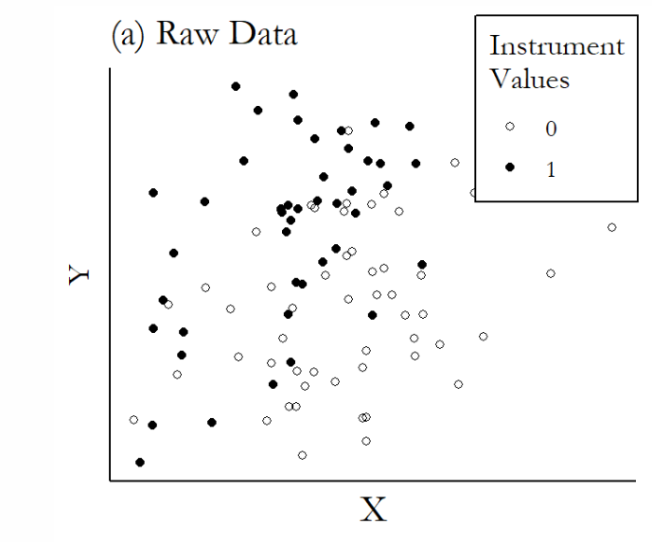
Graphical Illustration of IVs
Notes:
You can do these kind of quickly

Slide 42
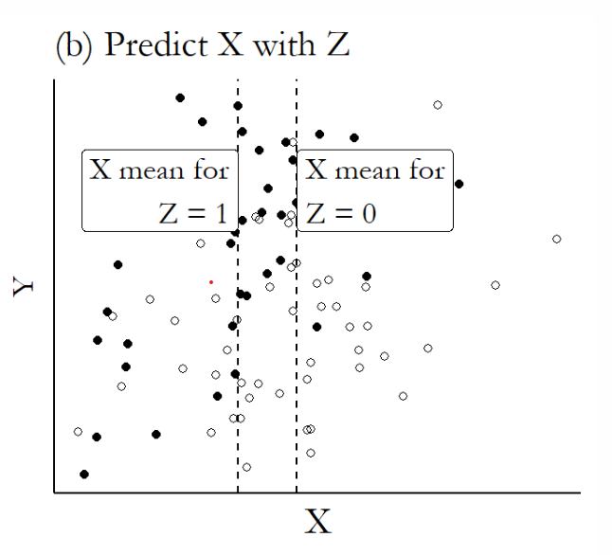
Graphical Illustration of IVs

Slide 43
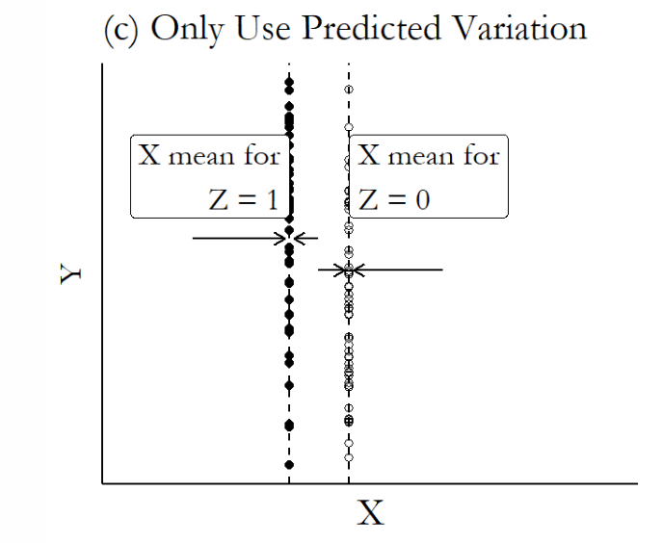
Graphical Illustration of IVs

Slide 44
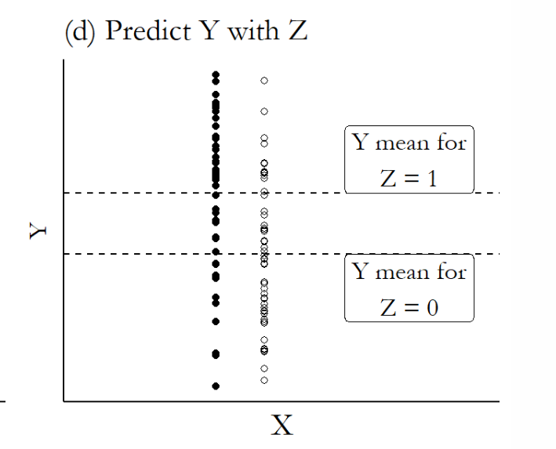
Graphical Illustration of IVs

Slide 45
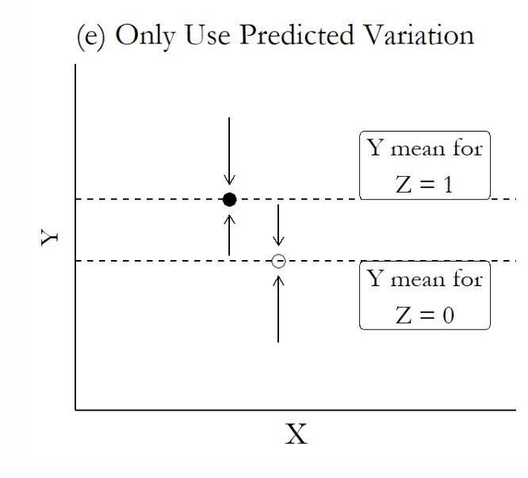
Graphical Illustration of IVs

Slide 46
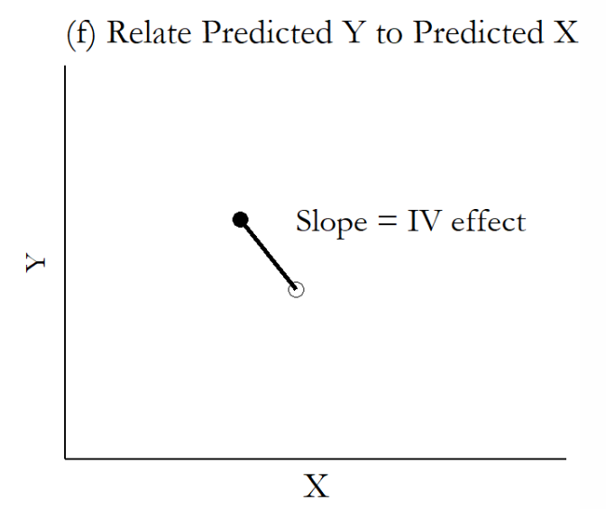
Graphical Illustration of IVs

Slide 47
Case study (again)
Notes:
Let’s wrap this up with a discussion of the vaccine paper.

Slide 48
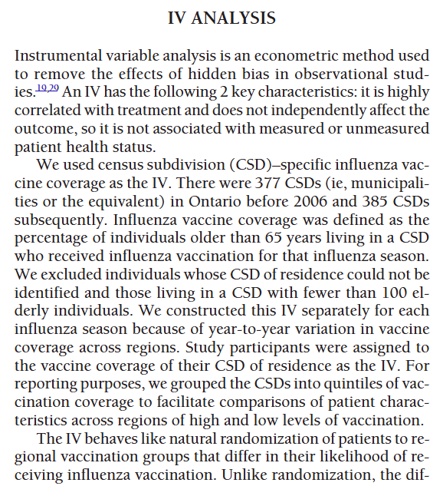
Instrumental Variable in our Example(s)
What did the authors of our case study use as their IV?
What’s the intuition? What variation is this picking up?
How does it “stack up” for you against the assumptions?
How would you evaluate this paper?
Notes:
This one is likely imperfect – what do you think? Can you use storytelling here (for or against)?
- Go through text in detail here. Talk through assumptions, etc. Model on board. Critique.

Slide 49
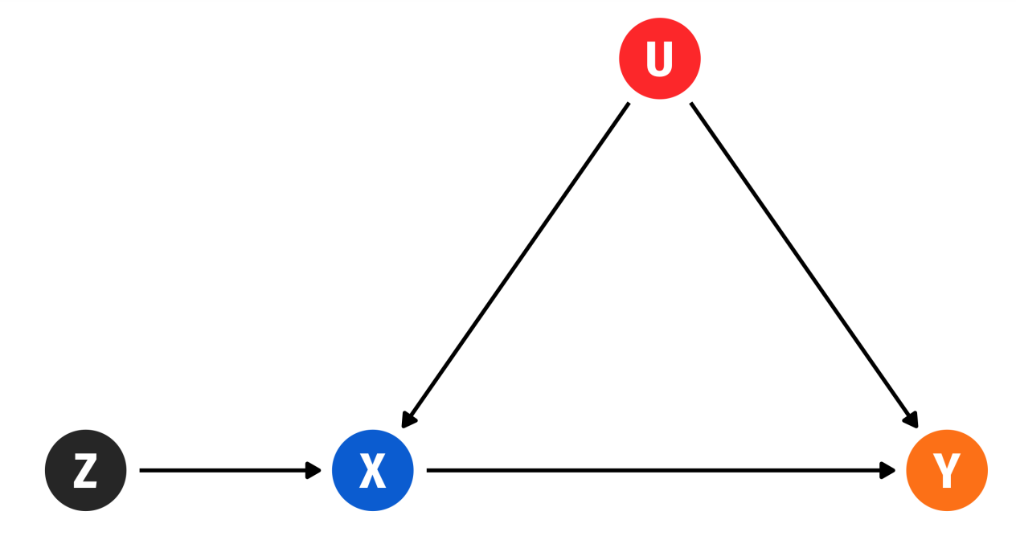
Other Popular IVs
Other popular IVs in the health literature (not exhaustive):
  Distance (or differential distance) to hospital to account for patient-physician matching (Lee & Basu, 2025) – we’ll cover this next time!
  Quasi-random assignment to some providers (ambulances, ED docs, etc.; Doyle et al., 2015)
  Differences in provider/physician preferences in treatment choices (sometimes called a “judge fixed effects” or leniency design)
  Other policy changes (e.g., to OOP cost-sharing and negotiated insurer-provider prices; Dunn 2015; pharma SOP expansion as an IV for physician visits)
  Genetic variants/Mendelian Randomization (Dixon et al, 2020; covered in biostats!)
Notes:
The basic DAG of an IV setup – can we pick one and walk me through it?

Slide 50
Other Example Papers and Instruments
The Effect of Evictions on Opioid Mortality (Bradford and Bradford, Health Services Research 2020)
Other popular (and more generalizable) IV approaches:
Lotteries: experiment with voluntary participation
  Oregon Medicaid Experiment: Finkelstein, Amy, Sarah Taubman, Bill Wright, Mira Bernstein, Jonathan Gruber, Joseph P. Newhouse, Heidi Allen, and Katherine Baicker. 2012. “The Oregon Health Insurance Experiment: Evidence from the First Year.” Quarterly Journal of Economics 127 (3): 1057–1106.
  Baicker, Katherine, Sarah L. Taubman, Heidi L. Allen, Mira Bernstein, Jonathan Gruber, Joseph Newhouse, Eric Schneider, Bill Wright, Alam Zaslavsky, and Amy Finkelstein. 2013. “The Oregon Experiment – Effects of Medicaid on Clinical Outcomes.” New England Journal of Medicine 368 (May): 1713–22.
Notes:
Example from 1: in the 2000s, Oregon chose to expand its Medicaid program for poor adults by making it more generous. They used a lottery – this randomization can be an IV to back out LATE from ITT.

Slide 51
Other Example Papers and Instruments
The Effect of Evictions on Opioid Mortality (Bradford and Bradford, Health Services Research 2020)
Other popular (and more generalizable) IV approaches:
2. Judge Fixed Effects (also called leniency designs)
  Narrow pipeline through which all individuals must pass
  Individuals are randomly assigned a decision-maker
  Decision-maker has discretion over final outcome
Then, random "judge" assignment can be used to instrument for outcomes
What are some health policy examples of this? Are they valid?
Bakx, Wouterse, van Doorslaer, and Wong (2020, JHE): "Better off at home? Effects of nursing home eligibility on costs, hospitalizations and survival"
Notes:
This is just really popular with judges, doesn't have to be criminal. Possible examples: FDA approval, physician decision-making. Some concerns: is assignment truly random? Is the pipeline really narrow? Can the discretion be chosen by the patient/entity? Paper uses differences in nursing home eligibility assessors to find that access to nursing homes lowers use of other kinds of care, but does not affect health spending or mortality meaningfully. Plenty of opportunities to implement this design more meaningfully.

Slide 52
Other Example Papers and Instruments
The Effect of Evictions on Opioid Mortality (Bradford and Bradford, Health Services Research 2020)
Other popular (and more generalizable) IV approaches:
3. Bartik/Shift-Share Instruments
A type of instrument which measures change in a region’s labor demand due to changes in the national demand for different industries’ products
Created by interacting initial “shares” of geographic regions with national growth rates (in immigration, manufacturing employment, etc.)
Example: Currie, Jin, and Schnell (2019): "U.S. Employment and Opioids: Is there a Connection?," Working paper.
Notes:
This is most useful when looking at regional market differences in health questions.

Slide 53
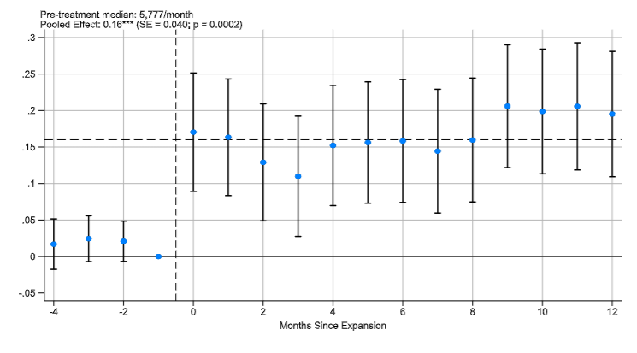
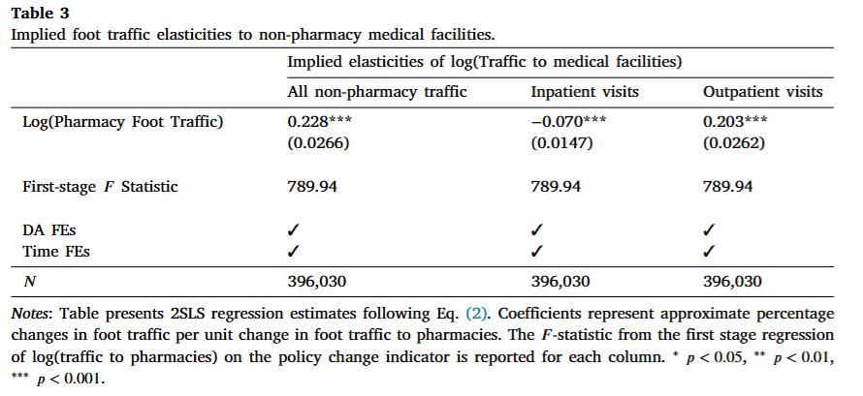
Other Example Papers and Instruments
4. Policies can be an IV (under certain conditions!)
Example: policy expanding pharmacist scope of practice as an IV for foot traffic to outpatient/emergency care
First stage
Second stage
Notes:
https://www.sciencedirect.com/science/article/pii/S0167629625000864?via%3Dihub

Slide 54

This Time: Introducing IV
  Endogeneity/exogeneity
  Key assumptions for an IV
  Estimation of 2SLS Regressions
  Next time:
  Interpreting 2SLS results
  How do you come up with and defend an IV in practice?
  Additional examples

