Slide 1
Quantitative HSR I
Lecture 8 (Day 2 of 2): Endogeneity & Instrumental Variables
November 9, 2026
HAD5744 · Alex Hoagland, Ph.D.

Slide 2
Last Time: Introducing IV
  Endogeneity/exogeneity
  Key assumptions for an IV
  Estimation of 2SLS Regressions
  This time:
  Interpreting 2SLS results
  How do you come up with and defend an IV in practice?
  Additional examples

Slide 3
Case Stud(ies)
Notes:
Today we have 2 to help round this out

Slide 4
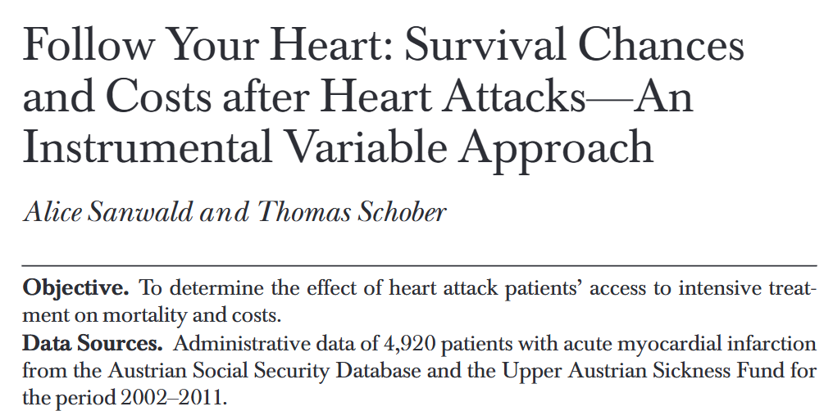
Another example: causal effect of surgical interventions
Same questions (and biases) likely apply to this setting as last time (what were they?)
But why is this an important question? What is the experiment and the naïve comparison, and why might it be wrong?

Slide 5
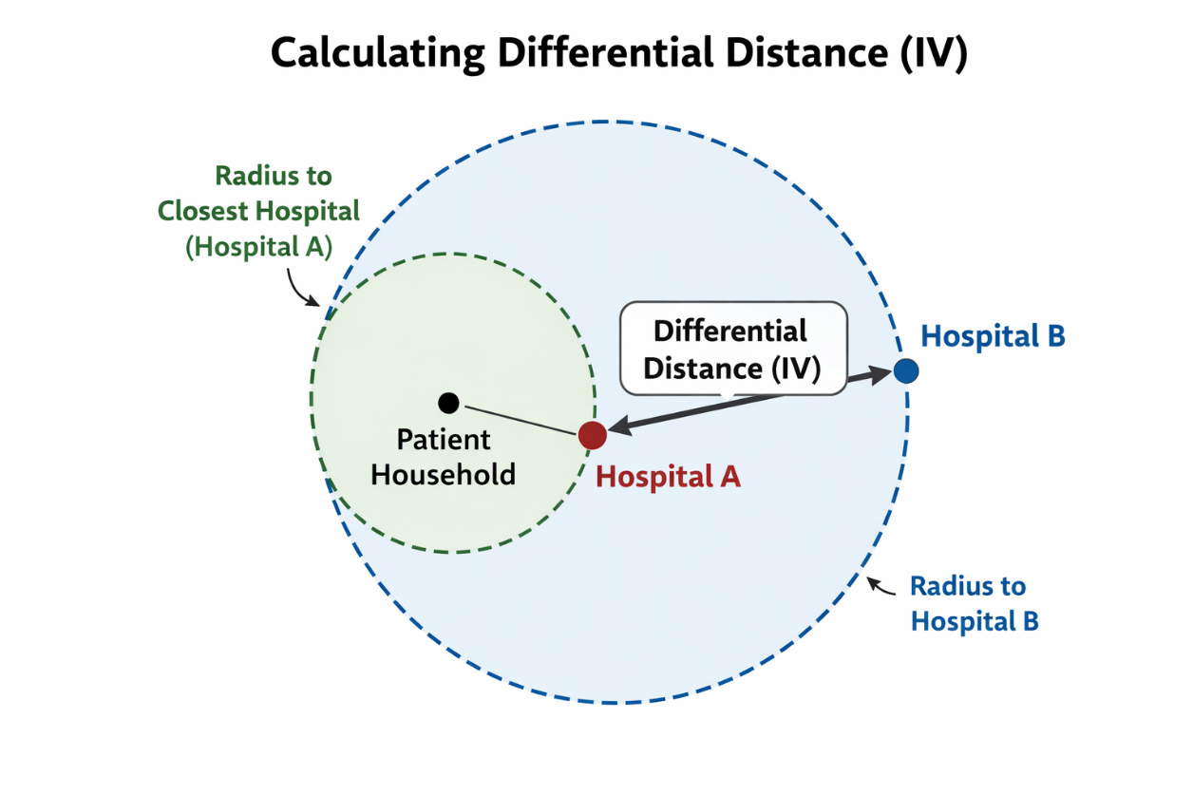
Instrumental Variable in our Example(s)
What makes an IV compelling?
For vaccines, it was vaccination rates of those around you
For PCIs, exogenous variation came from differential distance: how much farther is it from you to a PCI hospital than it is from you to your closest hospital.
What is it for the dialysis paper?
Notes:
Short version of the story here: we’re worried that FFS payments are making physicians overuse anemia drugs as a part of dialysis. In fact, OLS estimates of the effectiveness of these medicines suggest that anemia drugs make patients worse off! But there could be endogeneity in the physician use of dialysis. The IV the authors suggest is altitude, which is correlated with needing these drugs but not correlated with underlying physician decisions. They combine this with a DD to get at effects of a payment reform here. (We’ll talk about this in more detail through the semester).
Let’s walk through the assumptions here. Start with outcome variable (2), then exposure (bundled payment/use of drugs), then IV (altitude + post-bundle indicator). What endogeneity are they dealing with (strategic decision-making on the part of the doctors). Are the assumptions satisfied? (1. abstract says yes, altitude affects drug use; 2. altitude shouldn’t affect mortality or transfusion rates; 3. altitude shouldn’t affect strategy). Note that they use two IVs to get around this.
** This also shows that IVs can be (but don’t have to be!) scary **

Slide 6
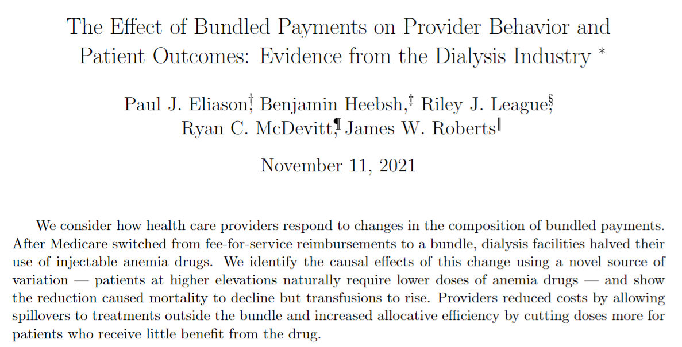
Example: Waiting Times and Transplantation Outcomes
Notes:
Note: look how long it took this paper to publish! Okay, so what’s the open back door? What’s the DAG here? What is the “natural experiment” they are exploiting? We’ll talk about why this works (maybe). Start with outcome variable (2), then exposure (bundled payment/use of drugs), then IV (altitude + post-bundle indicator). What endogeneity are they dealing with (strategic decision-making on the part of the doctors).

Slide 7
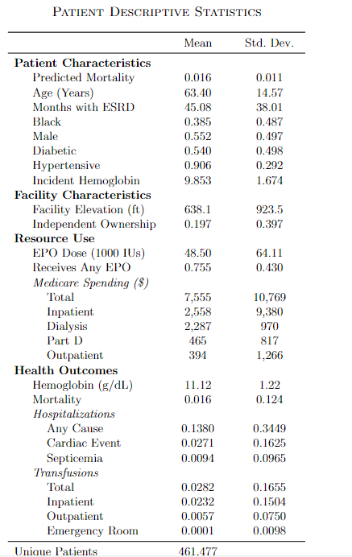
Case study: what is the reform?
Data and summary statistics
  U.S. Renal Data System: Medicare claims, treatment histories, patient attributes, and annual facility surveys
Notes:
Yay for descriptive evidence!

Slide 8
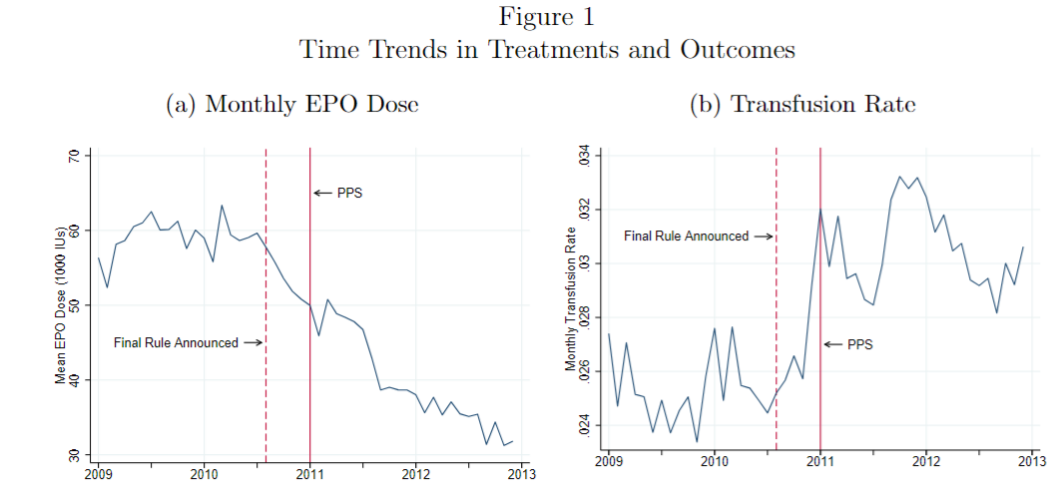
Case study: what is the reform?
Data and summary statistics
  U.S. Renal Data System: Medicare claims, treatment histories, patient attributes, and annual facility surveys
Reform bundled Medicare payments for dialysis sessions and injectable drugs
Notes:
Yay for descriptive evidence! There are other panels to Figure 1 not pictured. For example, dialysis doesn’t change. What is the hypothesis? Figure EPOs lead to more transfusions, since EPO doses and transfusions are used to treat anemia

Slide 9
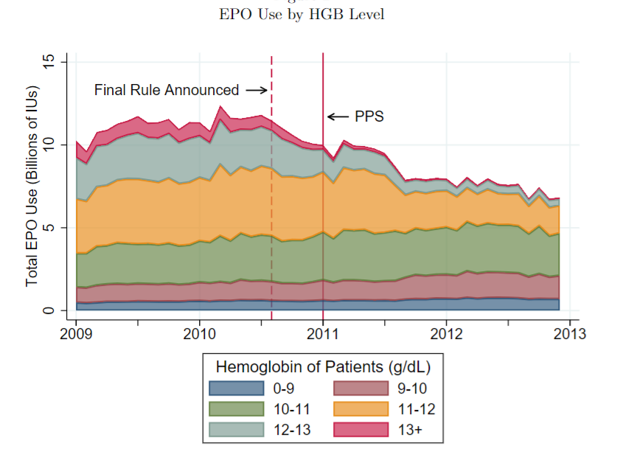
Case study: what is the reform?
Notes:
Declines are largest for those with the highest hemoglobin patients (least anemic). Does this make sense? What’s the story? “Allocative efficiency may have improved following the bundle as providers concentrated the decrease in EPO among patients who were previously receiving doses that put their HGB levels above the recommended range” (what does this mean in non-econ speak?)

Slide 10
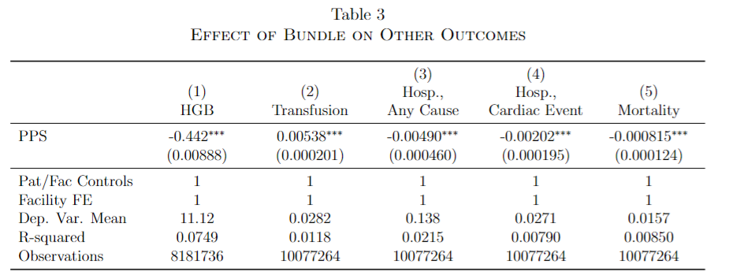
Case study: what is the reform?
But what if EPO doses are endogenously chosen by facilities/patients?
Notes:
What does the OLS say? Why are we worried about endogeneity here? Larger EPO doses should raise hemoglobin, that’s the point!

Slide 11
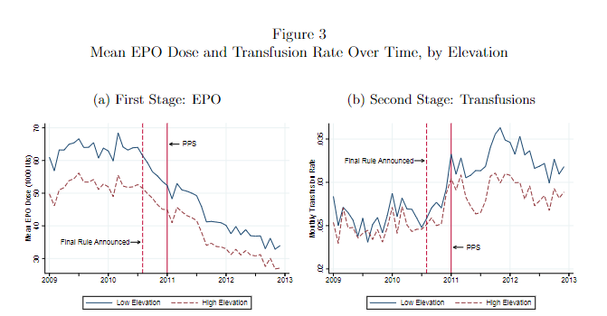
Notes:
Here’s the story of their two Ivs (why do they have a second one?)

Slide 12
Interpreting and Implementing IV
Notes:
Note: our case study gives you a light overview, but there is more here (which is why we will likely go through the dialysis paper in more depth)

Slide 13
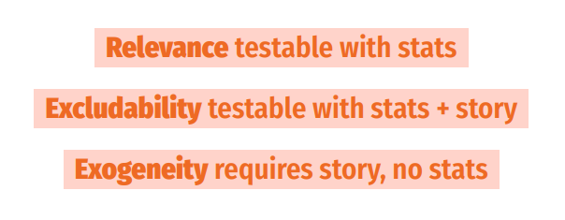
Using an IV: Testing Assumptions
Notes:
Review: what are the assumptions? We will go through these in both case studies.

Slide 14
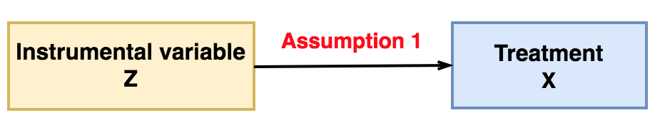
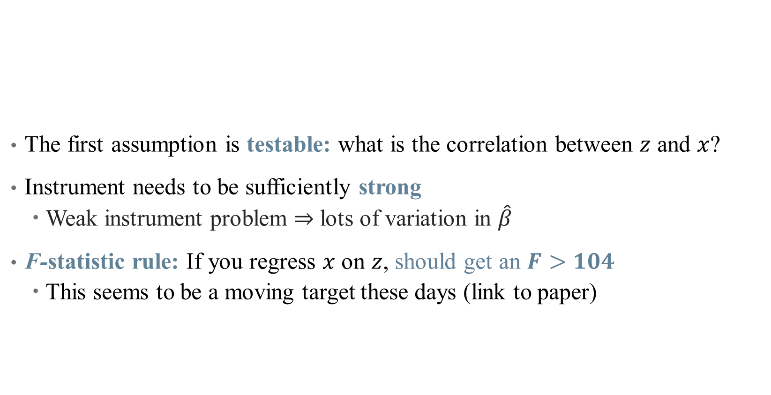
Using an IV: Testing Assumptions
The first assumption is testable: what is the correlation between $z$ and $x$?
Instrument needs to be sufficiently strong
  Weak instrument problem $⇒$ lots of variation in $\hat{β}$
F-statistic rule: If you regress $x$ on $z$, should get an $F>104$
  This seems to be a moving target these days (link to paper)
Notes:
You’ll have to talk about what an F stat is and how it relates to a t stat. See Felton and Stewart for what a weak IV can do, but basically exacerbates three problems: identification bias (parameter isn’t centered around truth), estimation bias (2SLS is “contaminated” by the confounding inherent in OLS, so 2SLS estimator gets “pulled” towards OLS estimator and away from truth), and Type M-error (publication bias – you have to have a super strong effect to have it show up significant with a weak IV; then, since insignificant estimates don’t get published, looking only at published work convinces you that the effect is *much* stronger than it really is)

Slide 15
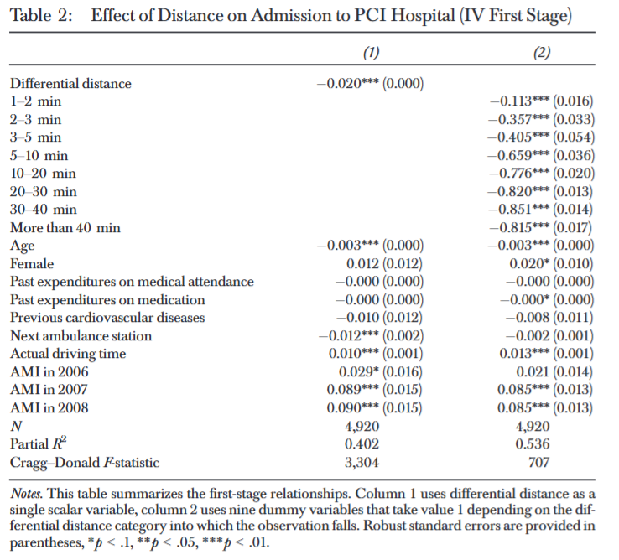
Example of a First Stage Test
Why these two models? Why the controls?
What’s happening in this regression? What do we need to see?

Slide 16
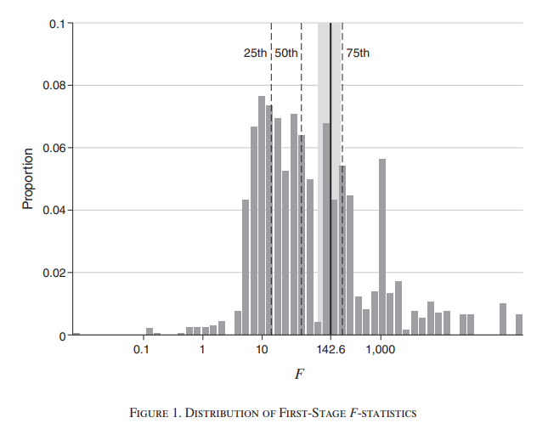
Current Research Alert: First-Stage Tests
Notes:
This comes from Lee et al, just published in AER this month. Here’s a log scale of the F-stats for IV papers in top econ journals (note scale is log). Most (75%) are bigger than 10, but not a lot get up to the new standard (here it’s slightly different). Thankfully, there is research linking the t stat with the F stat.

Slide 17
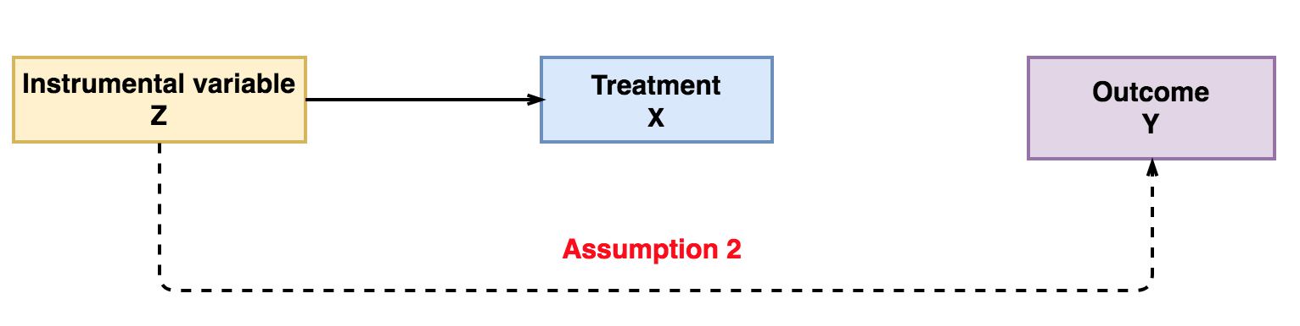

Using an IV: Testing Assumptions
The second assumption is not testable:
  Why can’t we just regress $y$ on $z$ (even if we condition on x)?
Instead, need to argue something about randomness
What is the exclusion restriction in our case study?
Notes:
Differential distance must not correlate with the unobserved factors influencing mortality and follow-up costs. Our dataset provides important information on patient characteristics, but we cannot observe the actual severity and type of heart attack. These circumstances also determine the treatment and chance of survival. However, it seems a plausible assumption that the severity and type of heart attack are conditionally unrelated to patients’ residence and differential distance is therefore a valid instrument. (talk about the strategy here: focus on one (big) threat)
The exclusion restriction also reveals why we refrain from using specific medical treatments as endogenous variables. A cardiac cath lab offers the possibility of several invasive treatments being frequently applied sequentially to the same patient. Moreover, there are unobserved factors, such as the availability of specialized staff, which might affect mortality independently from the actual treatment. These individual components of health care are jointly affected by the instrument and cannot be properly disentangled in the IV framework. We therefore focus on the initial admission to a PCI hospital as our explanatory variable of interest. (note: limits of differential distance Ivs discussed here: https://jamanetwork.com/journals/jamanetworkopen/fullarticle/2837216)

Slide 18
Descriptive/Suggestive Evidence for Exclusion
What evidence do the authors give in favor of the exclusion restriction?
Notes:
What does this show? No real change in EPO doses (constant gap across elevation over time in panel (a)). Panel (b) shows larger effects for lower elevation for the payment reform.

Slide 19
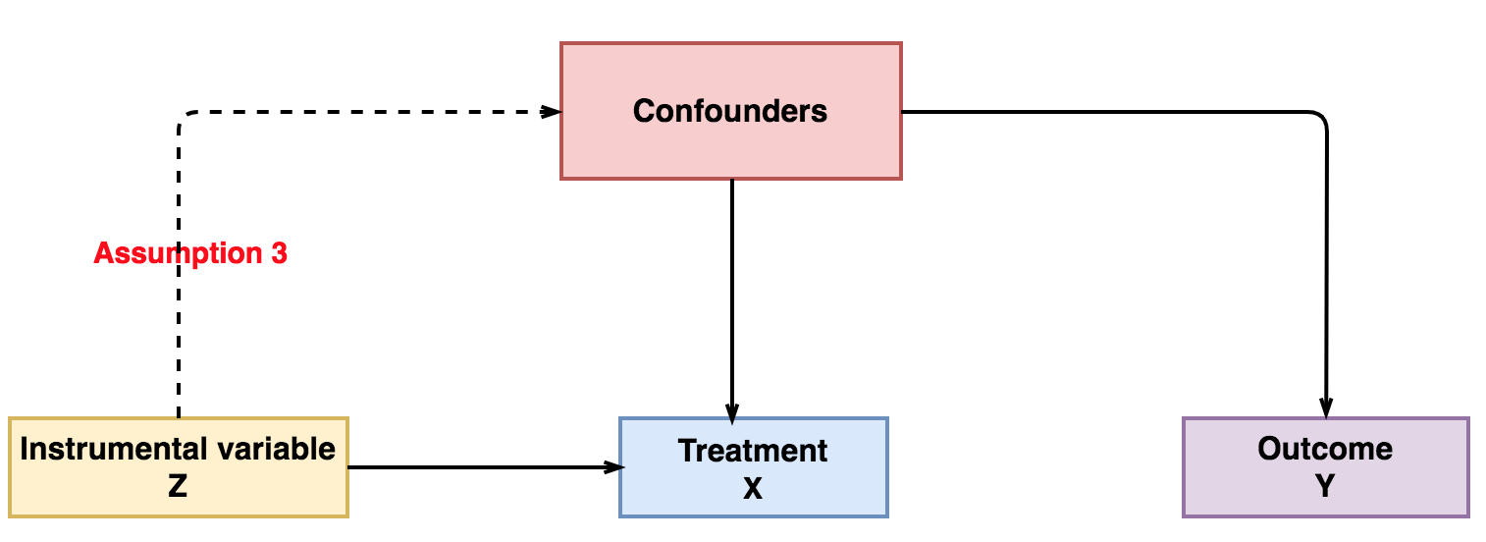
Using an IV: Testing Assumptions
The third assumption is not testable:
  No data on confounders in the first place!
Again, based on argument about why this assumption is satisfied
Notes:
This is what they did in robustness checks (to test for this – note that this is really common):
What if high risk patients choose to live close to hospitals? Can look at this by (a) limiting sample to non-movers or (b) looking at first heart shocks. Results are qualitatively similar.
Other confounders that might be related with distance: urban/rural, SES, comorbidities. No real change (and have one nice clean robustness table!)

Slide 20
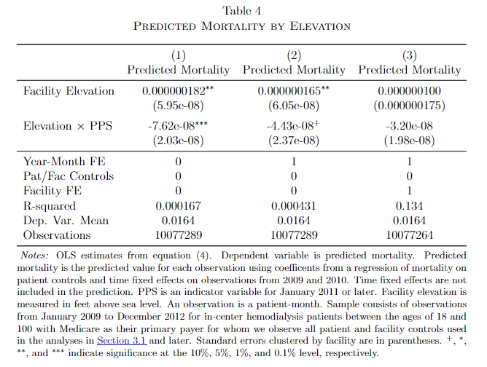
Descriptive/Suggestive Evidence for Exogeneity
What evidence do the authors give in favor of the exogeneity restriction?
  Difference-in-differences results for EPO doses and transfusions
  Do omitted variables change disproportionately over time? (Look at OLS regression for “predicted mortality” variation across elevation before/after payment reform).
Notes:
Do these address your concerns? “Shows that predicted mortality doesn’t change across elevations, so that a changing mix of patients across elevations is unlikely to confound our estimates.” What else might there be?

Slide 21
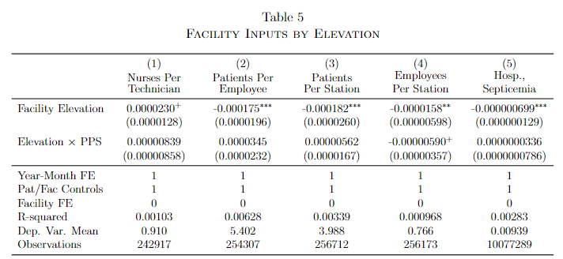
Descriptive/Suggestive Evidence for Exogeneity
What evidence do the authors give in favor of the exogeneity restriction?
  Difference-in-differences results for EPO doses and transfusions
  Do omitted variables change disproportionately over time? (Look at OLS regression for “predicted mortality” variation across elevation before/after payment reform).
  What if facilities reinvest additional profits from administering less EPO post-reform into quality-improving outcomes?
Notes:
Do these address your concerns? What else might there be?

Slide 22
Negative Control Tests: Falsifying Your IV
A negative control is a check where you already know the honest answer should be “no effect.” [akin to a placebo test]
Logic: if the instrument appears to “work” somewhere it causally cannot, your exclusion or exogeneity assumption is in doubt.
Two common forms:
  Negative-control outcome: the instrument should not move an outcome it cannot reach through the treatment.
  Negative-control population/period: the instrument should not predict pre-determined characteristics.
Passing does not prove validity — but it makes the design more credible.
Notes:
Frame negative controls as falsification tests: we look for effects where there should be none.

Slide 23
Negative-Control Outcome (distance example)
Setup: instrument = differential distance to a PCI-capable hospital; treatment = receiving a PCI; outcome = cardiac mortality.
Distance to a hospital should not affect an outcome through PCI if PCI cannot change that outcome (e.g., death from an unrelated cause (cancer, accidental injury) in the same window.)
Run the reduced form: regress the placebo outcome on distance (+ controls). Expect a precise null.
A significant “effect” on the placebo suggests distance is proxying for something else (rurality, SES, access) — an exclusion violation.
Notes:
Ask students: what would a non-null here tell us about the exclusion restriction?

Slide 24
Negative-Control Population / Balance (distance example)
A credible instrument is as-good-as-random with respect to pre-determined patient characteristics.
Balance test: regress baseline covariates (age, prior comorbidities, pre-period spending) on distance. Expect no systematic gradient.
Alternative: apply the IV to patients who would never get a PCI regardless (never-takers) — distance should not predict their outcomes.
Imbalance flags that distance tracks confounders — an exogeneity concern; may require conditioning on geography or SES.
Notes:
This mirrors the covariate-balance table you would show for an RCT.

Slide 25
What Negative Controls Buy You (and their limits)
Passing bolsters the claim that the instrument affects the outcome only through the treatment.
Failing can help locate the problem (which assumption? which confounder?) and suggest fixes (add controls, redefine the instrument, restrict the sample).
Can we come up with an example for this for the dialysis paper? The vaccine paper?
Caveat: a passed negative control is necessary, not sufficient — it cannot rule out every violation.
Notes:
Tie the falsification logic back to the vaccine instrument from Day 1.

Slide 26
Interpreting IV Results
Notes:
Today we have 2 to help round this out

Slide 27
Using an IV: How do I interpret an IV?
Recall that we use an IV as our identification strategy and 2SLS as our estimation approach – what’s the difference?
What is an IV intending to approximate? That is, where does our identifying variation come from?
This affects how we interpret the regression coefficients!
IV's capture local average treatment effects (LATEs)
Notes:
Here’s a visualization of a LATE for a specific type of IV regression (fuzzy RDD, will do next semester). LATEs are just weighted ATEs that tell you something about a specific subset of the population (not the full pop)

Slide 28
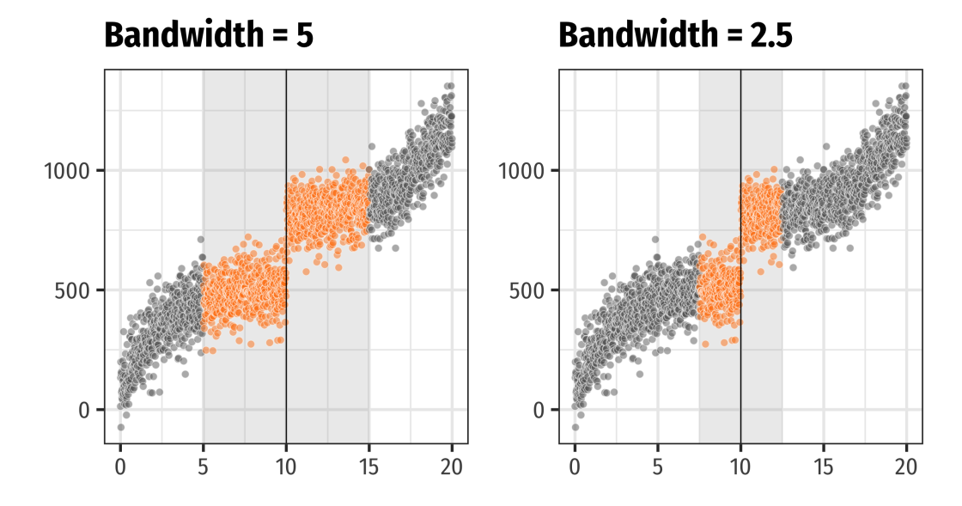
Using an IV: How do I interpret an IV?
IV's capture local average treatment effects (LATEs)
Notes:
Here’s a visualization of a LATE for a specific type of IV regression (fuzzy RDD, will do next semester). LATEs are just weighted ATEs that tell you something about a specific subset of the population (not the full pop)

Slide 29
Using an IV: How do I interpret an IV?
IV's capture local average treatment effects (LATEs)
Easiest to understand in the case of a binary instrument
 |  | Treated?
 |  | No | Yes
Instrumented? | No | Never-takers + Compliers | Always-takers + Defiers
 | Yes | Never-takers + Defiers | Always-takers + Compliers

Slide 30
Using an IV: How do I interpret an IV?
IV's capture local average treatment effects (LATEs)
  The LATE from an IV is for compliers
  Specifically, those influenced by the instruments you selected
  Hence, LATE is instrument-specific
Notes:
So what is the LATE in our case study? Do we like it? Is it policy relevant?

Slide 31
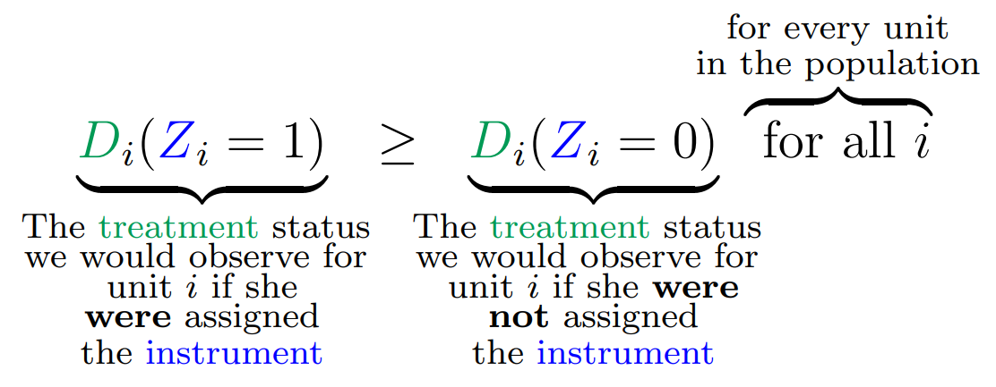
Using an IV: How do I interpret an IV?
IV's capture local average treatment effects (LATEs)
Easiest to understand in the case of a binary instrument:
  IV identifies the treatment effect on those affected by the instrument
  This does reduce the amount of variation/data used in identification
  Identification rests on an assumption: no defiers (also called monotonicity)
  Also, have to consider: is the LATE policy relevant? (ex: blood type)
Notes:
Monotonicity just means that the instrument moved people towards/away from treatment in the same way (an IV can't both incentivize treatment for one person and discourage it for another). Example of third child – is monotonicity satisfied here? Wrapped up in heterogeneous treatment effects.

Slide 32
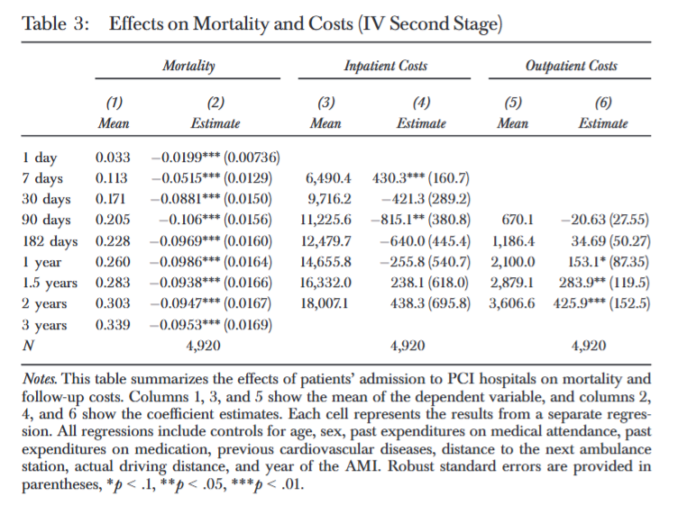
IV Results
Notes:
Would have been nice to see (and typically best practice) this compared to OLS. Why?
They look at heterogeneity by age (what do they find?)

Slide 33
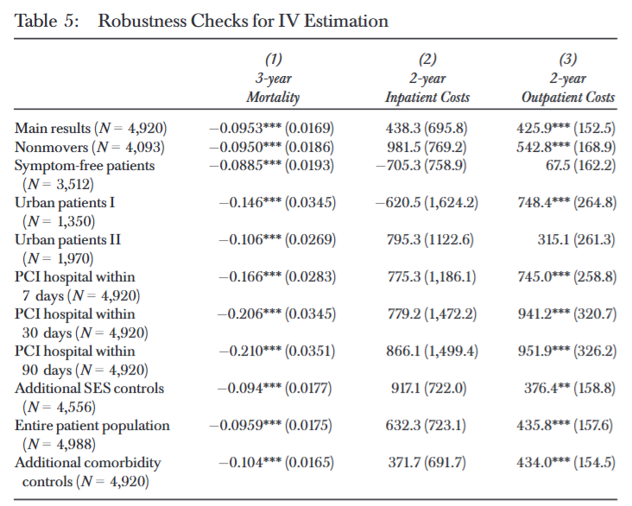
IV Results
Notes:
This table is really nice – what would have helped is a descriptive figure or table that told the story more?

Slide 34
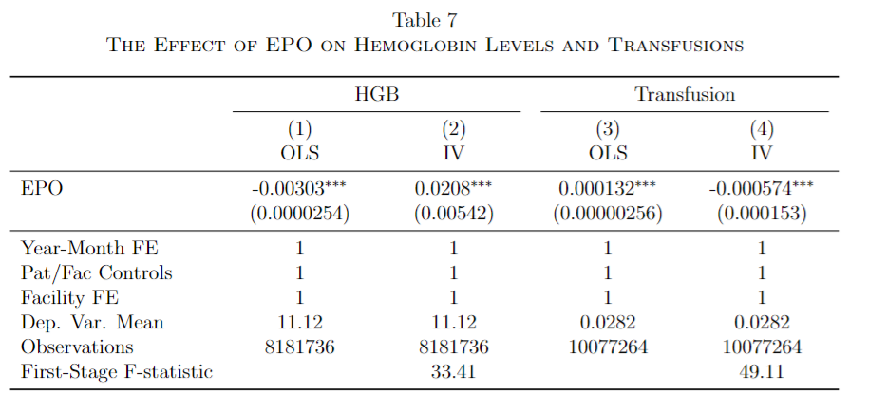
IV Results
Notes:
Larger EPO doses should raise hemoglobin, that’s the point! So that’s a good check here. (Note the dependent variable mean to help put these into context). Now also more EPO doses have a declining effect on transfusions, which is in line with medical advice.

Slide 35
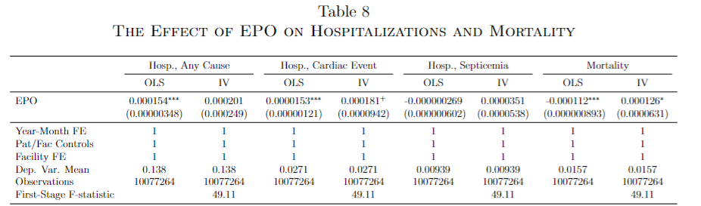
IV Results
Who are the people affected by this treatment effect? (What is the LATE? Who are the compliers?)
Notes:
What do we see here? Very limited effects on anything (some increases in mortality). the compliers — those patients whose EPO doses changed as a result of the instrument — had a 4.8% higher death rate during the pre-bundle period from excessive EPO doses. Note that power is low because of the potentially weak IV + few compliers in the sample. The number of observations here is generally a little misleading for 2SLS.
- Note that this is related to EPO doses, not the policy effect.

Slide 36
Some IV Best Practices

Slide 37
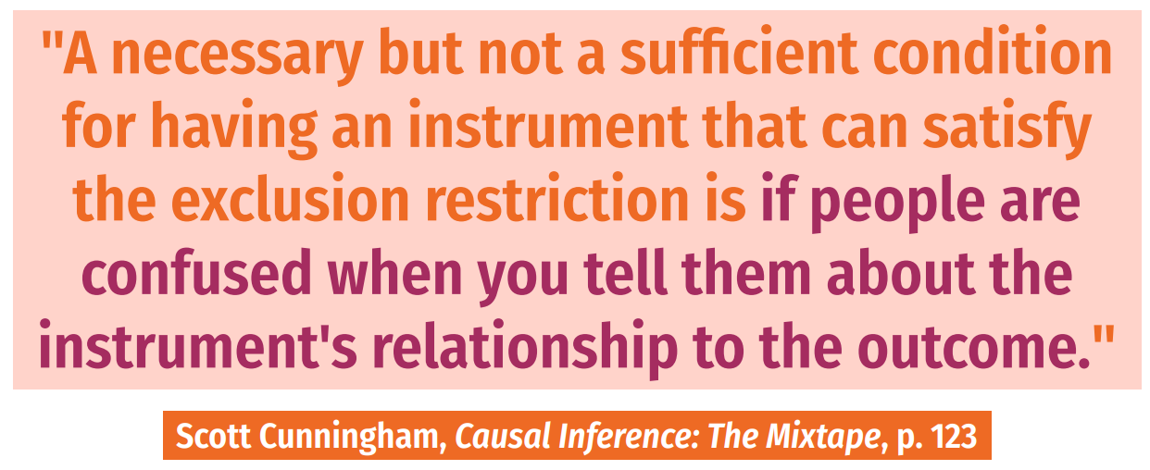
Using an IV: How do I come up with an IV?
Notes:
Instruments have to be weird!

Slide 38
Using an IV: How do I come up with an IV?
It is unlikely that any personal characteristic can be used as a strong instrumental variable
Most good instruments come from:
  Real randomization (blood type)
  “Mendelian randomization”: parent genes produce "random" children
  Unexpected correlations – a variable you would never expect had anything to do with assigning treatment ("a good instrument should feel weird")
Think about regional characteristics (unemployment rate), policies (blood type; cigarette tax), “natural” features (proximity)
Clever instruments are likely to be extremely context-dependent!
Notes:
Example for Mendelian randomization: the sex of first two children determines whether parents are more likely to have a third child.

Slide 39
Using an IV: How do I defend an IV?
Report relevance:
  Used to be F > 10, now is F > 104.7
Notes:
Large F stat is just for correcting t-tests for relationship between X and Y and X and Z – your CIs will be a tiny bit wrong. Generally, a large F will work (although closer to 10 still gives you problems). Remember that this is a scale, since we're concerned about weak instruments

Slide 40

Using an IV: How do I defend an IV?
Report relevance:
  Used to be F > 10, now is F > 104.7
Correct for weak instrument problems
  There are bias correction tests and methods
  These corrections aren't universally accepted
  Generally, they blow up your standard errors too much to be useful anyway
Notes:
Skip code if time?

Slide 41
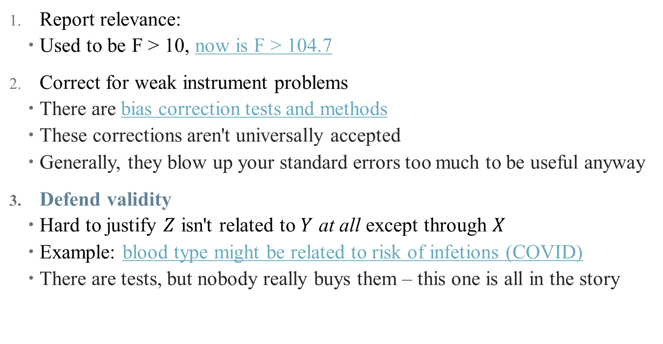
Using an IV: How do I defend an IV?
Report relevance:
  Used to be F > 10, now is F > 104.7
Correct for weak instrument problems
  There are bias correction tests and methods
  These corrections aren't universally accepted
  Generally, they blow up your standard errors too much to be useful anyway
Defend validity
  Hard to justify $Z$ isn't related to $Y$ at all except through $X$
  Example: blood type might be related to risk of infetions (COVID)
  There are tests, but nobody really buys them – this one is all in the story
Notes:
Difficulty with defending validity just means that we need to be choosy, not give up on IV altogether. It's just like trying to convince a room your DAG is right! And bulk of evidence helps, here (many studies with different approaches)

Slide 42
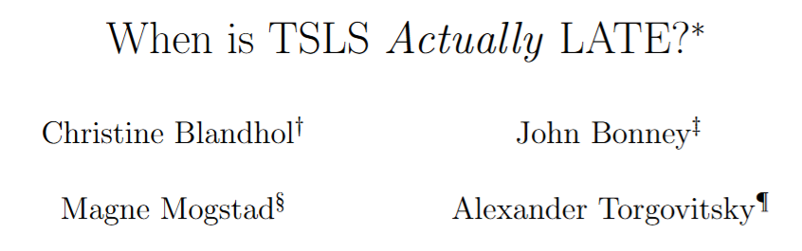
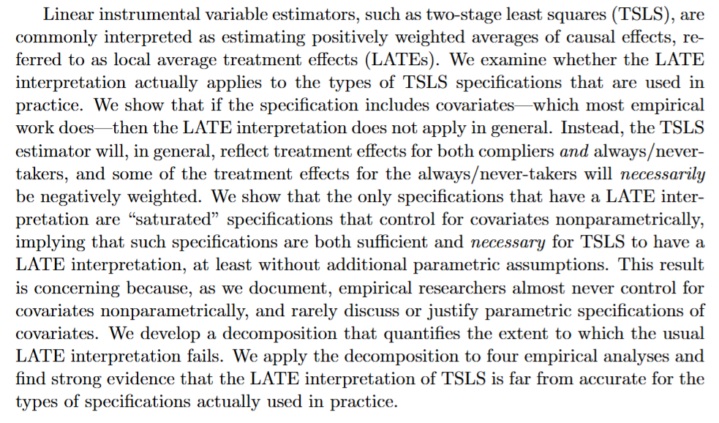
What about covariates?
Notes:
This is cutting-edge research here – if you need to include controls, there is a “right” way to do that that is “fully saturated” with the controls included nonparametrically in both the first and second stage (which has its own tradeoff: many instrument bias). This isn’t done commonly in practice! May help to know about this and show robustness to both options.

Slide 43
Using an IV: What if I can’t defend my IV?
Many quasi-experimental approaches are very assumption dependent
IV is no exception!
Notes:
Come from Felton and Stewart (they call IV “fragile” – I don’t like that, it’s just kind of a “you get what you put into it” kind of thing – we’re doing QE variation with observational data, so there are limitations. Just need to be aware of them and report them honestly)

Slide 44
Using an IV: What if I can’t defend my IV?
Many quasi-experimental approaches are very assumption dependent
IV is no exception!
Some things to be aware of:
  IV is (more) biased if you condition on post-instrument variables
  IV must match measured treatments, not true treatment
  Weak IVs can exacerbate even trivial assumption violations!
  Small sample bias – your assumptions might be statistically violated at random
Notes:
Examples: can’t control for changes in employment post Hurricane Katrina (downstream outcome; we’ll talk about this one a lot in the course). Coarsened treatments are another example – if you have an IV that changes how people behave in Toronto but not North York, but then you only observe data for the whole GTA, this won’t work

Slide 45
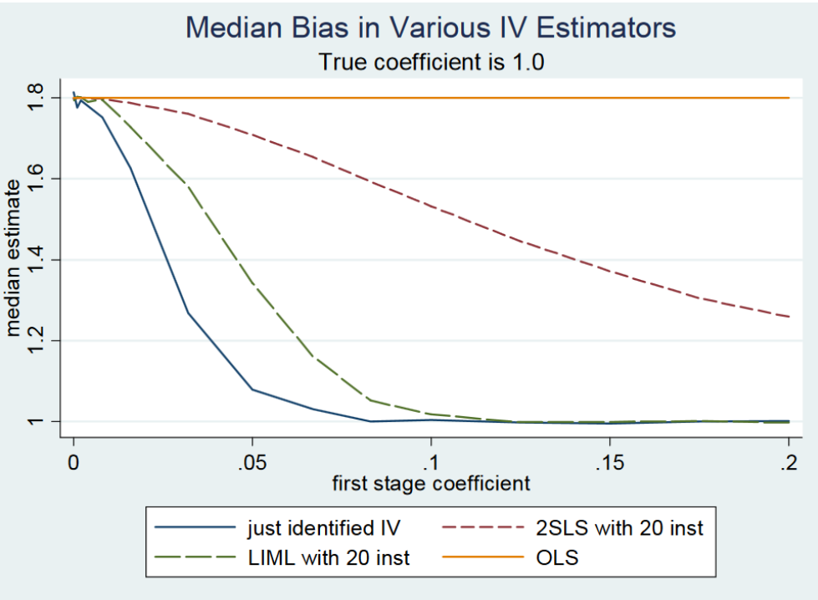
Weak IV Bias
Notes:
Cover this if you have time. Results from a Monte Carlo survey (sorry for gross blue background). Suppose we have 20 IVS but only one is useful. If true coefficient is 1, these are bias of different approaches (note you’re better off just using the one true coefficient!)

Slide 46
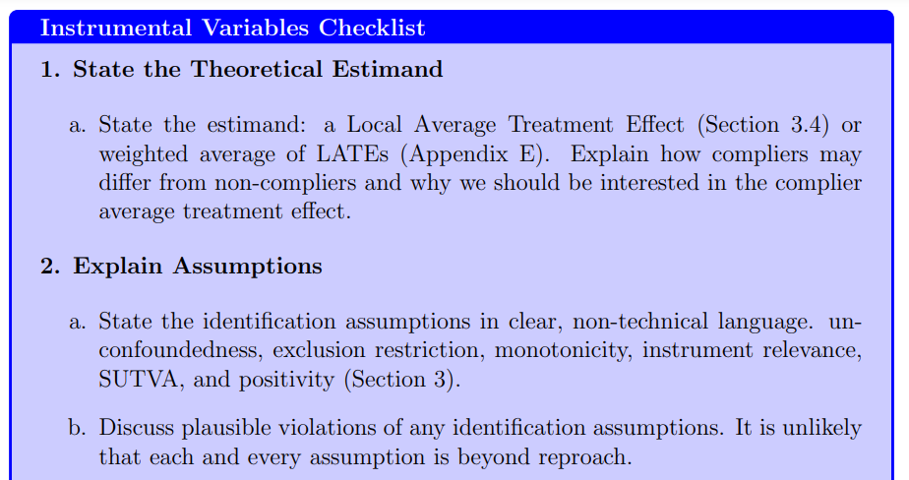
Using an IV: Best Practices
Notes:
Cover this if you have time. From Felton and Stewart (2022). One not on here: always use packages to get standard errors right

Slide 47
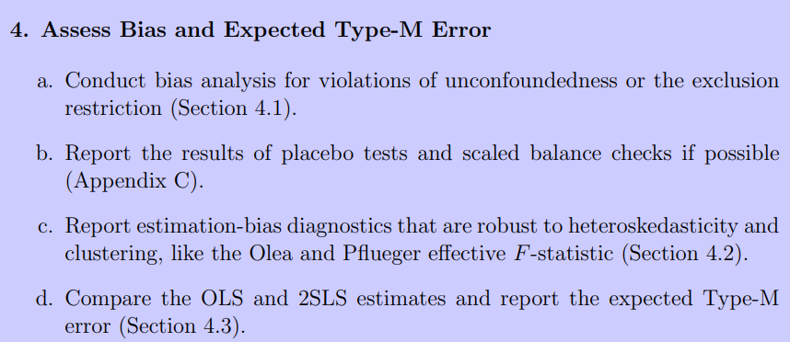
Using an IV: Best Practices
Notes:
Skipping over 3 because I don’t believe it (it says to assume the most conservative SE and report multiple Ses – I think you should pick your choice theoretically and use that one)

Slide 48
Conclusion
IV is a powerful design when data suffer from selection on unobservables.
Good front door approach!
Has limitations:
  First, it only identifies the LATE, which may or may not be policy relevant
  IV has up to five (untestable) assumptions!
  IV tends to be less credible generally (too many unknowns)
But IV is an important strategy and sometimes the opportunity to use it will come along!
Build in-depth knowledge of institutional details -- familiarity is how you find instruments!
Notes:
This is most useful when looking at regional market differences in health questions.

