Slide 1
Quant Methods in HSR I
Lecture 11: Difference-in-Differences 2
November 30, 2026
HAD5744 • Alex Hoagland, Ph.D.
Notes:
You won’t be able to cover all 3 of these this semester, will need to pick (DDD, Fadlon Nielsen, SC)

Slide 2
Latest Research Designs Used in Working Papers
Title | Authors | Research Question | Research design
Who gets what in education: can school matching improve student achievement? | Atila Abdulkadiroglu, Parag A. Pathak, and Christopher R. Walters | What affects student achievement: changing who gets to go to existing schools or closures/reconstitution? | OLS + selection on observables (with a lot of theory)
When Incentives Aren't Enough: Evidence on Inattention and Imperfect Memory from HIV Medication Adherence | Hang Yu ⓡ Jared Stolove ⓡ Dean Yang ⓡ James Riddell IV ⓡ Arlete Mahumane | Are financial incentives effective in encouraging positive health behaviors? | Lab experiment (RCT) of price effects + reminder effects
"Feel" as a Determinant of College Choice: Evidence from Campus Tour Weather | Olivia Feldman, Joshua M. Hyman, and Matthew L. McGann | Is the impression that students get about a particular college an important determinant of their applications? | IV using weather on tour day!
The Micro-Geography of Persuasion: Randomized Peer Exposure and Legislative Outcomes | Lauren Cohen and Bo Li | How do your neighbors and face-to-face interactions with other senators affect your own voting? | Simple probit with quasi-experiment + ML
The heterogeneous earnings impact of job loss across workers, establishments, and markets | Susan Athey Lisa K. Simon Oskar Nordström Skans Johan Vikström Yaroslav Yakymovych | How do earnings losses after job displacement vary with observable characteristics that may be relevant for targeting policy interventions for workers? | Causal machine learning for heterogeneous effects
Market feedback about emerging technologies | Sean S. Cao Itay Goldstein Jie He Yabo Zhao | Do firms adjust AI/green investments in response to market reactions to announcements of other investment plans? | Lagged specification + fixed effects (using high-frequency financial data)
When Teachers Break the Rules: Imitation, Reciprocity, and Community Structure in the Transmission of Ethical Behavior | Victor Lavy and Moses Shayo | Does teacher cheating affect student cheating? | Fixed effects regression
Notes:
Let’s start with all the applied micro papers that did not use difference in differences (you’ve covered almost all of these!) Where are the matching papers? What kinds of questions are these?
Full table is on Github

Slide 3
Latest Research Designs Used in Working Papers
Title | Authors | Research question | Research design
Mergers and Non-contractible Benefits: The Employees' Perspective | Wei Cai, Andrea Prat, and Jiehang Yu | If your firm is acquired, are your workers affected in non-contractible experiences (satisfaction, etc.) | Quasi-random acquisitions
Reducing Waste through Anti-Fraud Enforcement: Evidence from Hospital Admission Cases | David H. Howard and Jetson Leder-Luis | Do anti-fraud laws actually control waste or do they impose unfair limits on providers? | Staggered "rollout" of anti-fraud litigation against hospitals
Pricing Protection: Credit Scores, Disaster Risk, and Home Insurance Affordability | Joshua Blonz, Mallick Hossain, Benjamin J. Keys, Philip Mulder & Joakim A. Weill | credit scores impact homeowners insurance premiums as much as disaster risk. Homeowners with low credit pay 24% more for identical coverage than high–credit score homeowners. | Natural experiment using a temporary ban on the use of credit scores to set insurance prices
From Complaint to Action: Technology-Enabled Quality Improvement from Consumer Reviews | Guangyu Cao, Shenghao He, and Ginger Zhe Jin | how adopting an automated review monitoring system (ARMS) allows restaurants to translate consumer feedback into operational quality improvements. | Staggered rollout of ARMS
RESTORING NATURE, CREATING WEALTH: EVIDENCE FROM RURAL HOUSEHOLDS IN AFRICA | Geoffrey Heal Claudio Rizzi Simon Xu | What are the economic returns to restoring nature? | Staggered rollout of TREES program incentivizing improved ecological practices in sub-saharan Africa
THE EFFECTS OF A SUDDEN STOP IN LOW-SKILLED IMMIGRATION: EVIDENCE FROM KOREA’S GUEST WORKER PROGRAM | Jongkwan Lee Giovanni Peri Hee-Seung Yang | We examine what happens when low-skill labor supply is abruptly reduced, exploiting South Korea’s sudden suspension of its low-skilled guest worker program following the 2020 COVID-19 border closure. | Regional variation in employment shares of EPS workers based on quotas * post-January 2020 shock
The Market Value of Reproductive Rights: Evidence from U.S. Housing Markets | Daniel L. Dench, Kelly Lifchez, Jason M. Lindo, and Jancy Ling Liu | How do US housing markets "capitalize" the value of reproductive rights? | Synthetic DD based on Dobbs decision
Notes:
Now look at all the difference in differences papers! Roughly ½ of today’s papers used this design. Talk about what kind of quasi-experiments can exist!
Formal polices
Shocks happening at “random” times (what does random mean?)
Randomized rollout within a province, etc.
Others?

Slide 4
Last Time: Differences-in-differences
We can frequently see a policy implemented, and want to know its effect
In the wild, we have two types of “quasi-random variation” we can use:
  Cross-sectional variation: differences across observed units attributable to differences in their characteristics
  Time variation: how a particular event changed the trajectory within a unit of observation
This requires a notion of panel data (repeated observations w/in a unit)
Difference-in-differences is a method to exploit both types of variation simultaneously
This time: variations on a theme

Slide 5
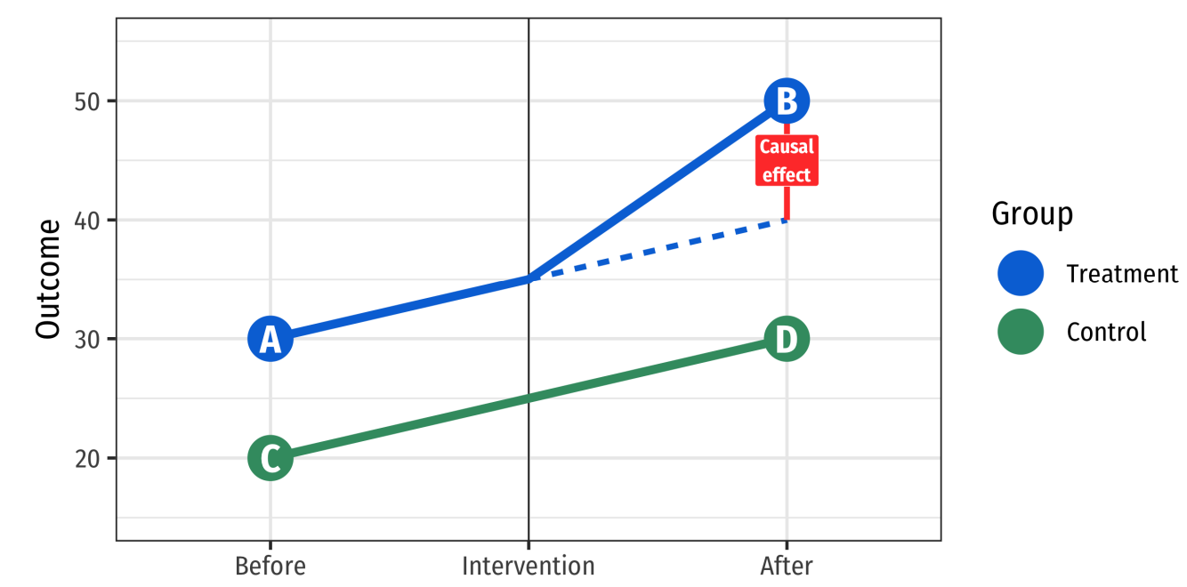
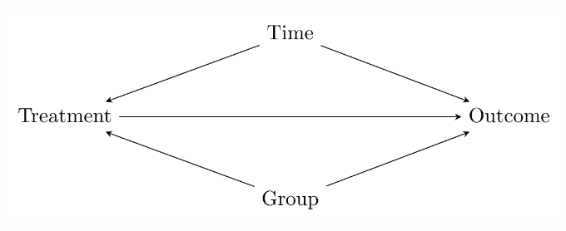
DID in Graph Form
Notes:
What would be the example here for line 5? What is the control group?

Slide 6
Differences- in-
Differences- in-
Differences
(oh my!)
Notes:
Cover this section only if you’re good on time. It’s only 5 slides.

Slide 7

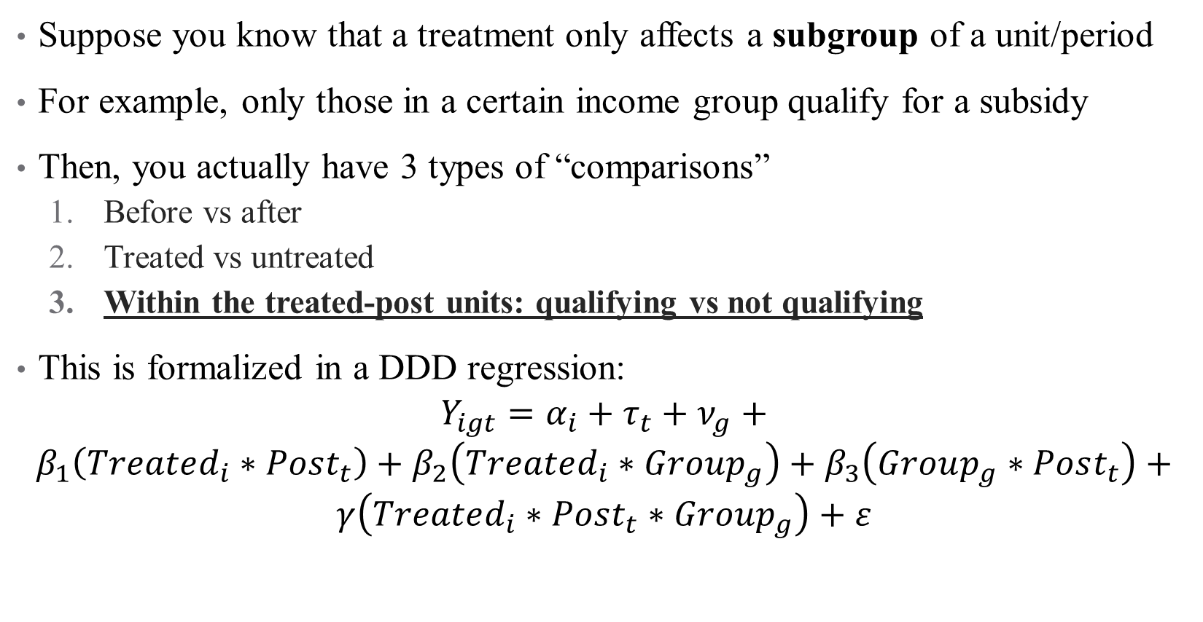
Leveraging Policy Characteristics Can Improve your Estimates
Suppose you know that a treatment only affects a subgroup of a unit/period
For example, only those in a certain income group qualify for a subsidy
Then, you actually have 3 types of “comparisons”
  Before vs after
  Treated vs untreated
  Within the treated-post units: qualifying vs not qualifying
This is formalized in a DDD regression:
$$Y_{igt}=α_{i}+τ_{t}+ν_{g}+$$
$$β_{1}\left(Treated_{i}∗Post_{t}\right)+β_{2}\left(Treated_{i}∗Group_{g}\right)+β_{3}\left(Group_{g}∗Post_{t}\right)+$$
$$γ\left(Treated_{i}∗Post_{t}∗Group_{g}\right)+ε$$
Notes:
Why all of the interaction terms? What is the parameter of interest? What do we learn from the others (for example, what do we learn from \beta_1)?

Slide 8


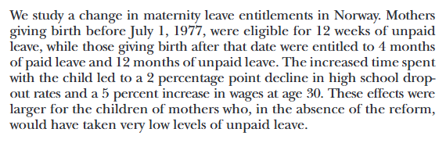

What does a DDD look like in practice?
Notes:
So we have a DD (what is the effect of the policy?) and then a triple DDD to explore heterogeneity among targeted groups

Slide 9
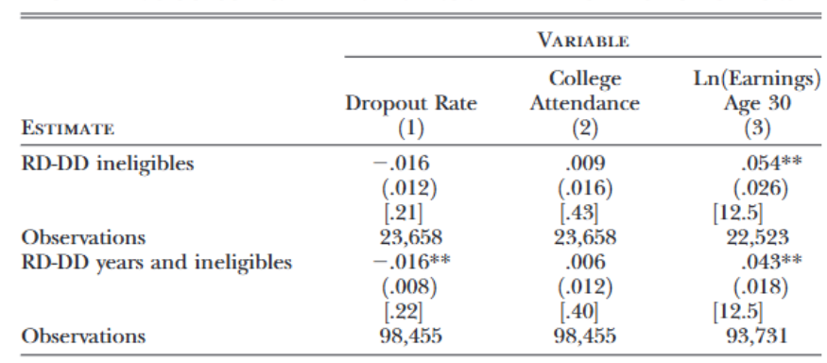
What does a DDD look like in practice?
Effects of policy change on children’s outcomes (DD)
Notes:
Can’t go into detail, obviously, but recommend reading this paper

Slide 10
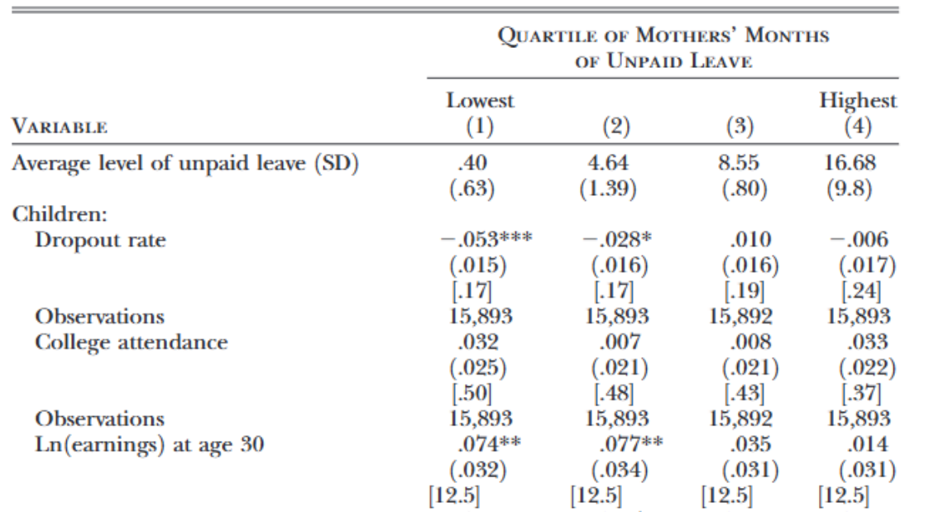
What does a DDD look like in practice?
Notes:
Now stratified by quartile of unpaid leave (Table 9 shows how the impact of the reform on mothers’ and children’soutcomes varies according to the quartiles of unpaid leave taken by themother. In principle, this variable should be affected by the reform, andtherefore, we should not condition on it. In practice, we see that thereform had no effect on unpaid leave. If the ranking of mothers in termsof unpaid leave does not depend on the reform, we can interpret theseestimates as the effects of the reform on mothers who would have takendifferent levels of unpaid leave in the absence of the reform and on theirchildren.)

Slide 11
What to Know When Implementing a DDD
Has the identifying assumption changed? Yes and no!
  Formally, the identifying assumption is that “the differential in the outcomes of group A and group B in the treatment state trend similarly to the differential in the outcomes of group A and group B in the control state, in the absence of treatment.”
  See Olden and Moen (2022) for a helpful review of DDD theory/practice
How is this different than heterogeneity?
  This should typically be a treatment/control split, not a “intensity” measure
  Be explicit: what is the third margin of variation and why is it exogenous or economically meaningful? (Subpopulations should experience the same policy shock except for one extra feature)
This one can be more difficult to present dynamic treatment effects for (unless one of the two groups shouldn’t have an effect at all)
Can be a useful way to test for spurious effects/run placebo tests!
Notes:
Not so scary, is it?

Slide 12
Alternative Approaches
Notes:
Cover only if you have time. Walk through how to generate placebo control groups

Slide 13
What if I don’t have a good control group (part 1)?
Suppose that we want to assess a treatment effect, but we don’t think that the “untreated” group looks the same as the “treated” group:
  The impact of health shocks on health outcomes
  The impact of continuing medical education on health providers’ behaviors.
What can we do?
Notes:
Here, the variation in event timing that plagued staggered adoption designs is actually a good thing for us!

Slide 14
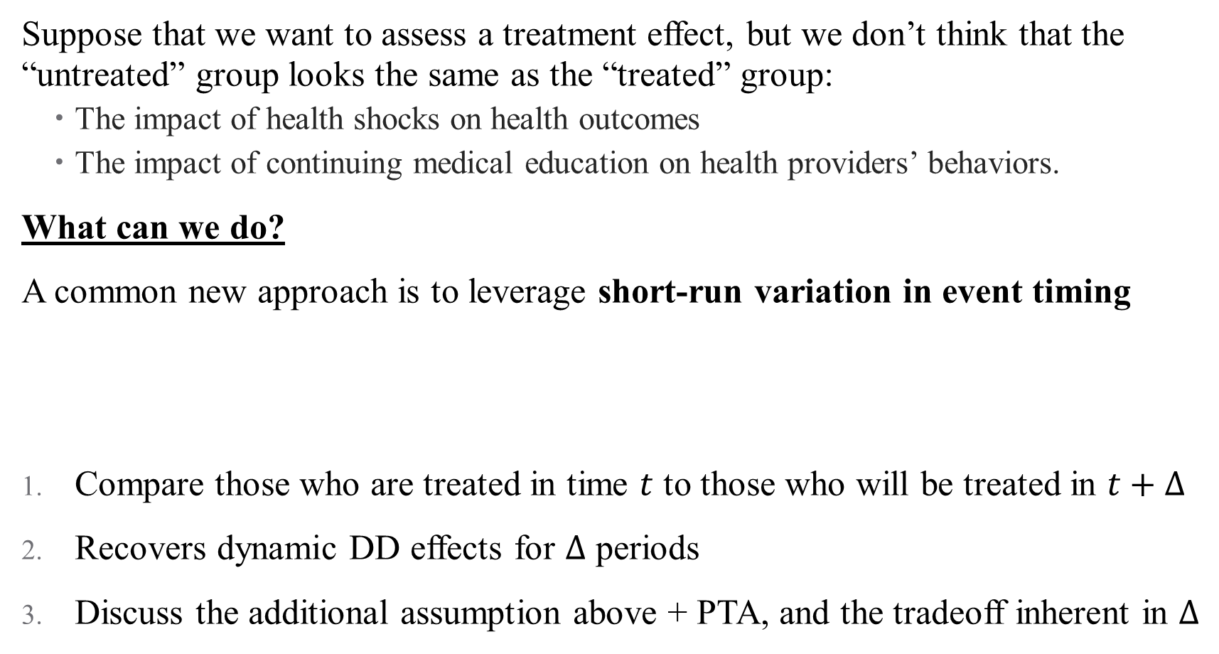
What if I don’t have a good control group (part 1)?
Suppose that we want to assess a treatment effect, but we don’t think that the “untreated” group looks the same as the “treated” group:
  The impact of health shocks on health outcomes
  The impact of continuing medical education on health providers’ behaviors.
What can we do?
A common new approach is to leverage short-run variation in event timing
Compare those who are treated in time $t$ to those who will be treated in $t+Δ$
Recovers dynamic DD effects for $Δ$ periods
Discuss the additional assumption above + PTA, and the tradeoff inherent in $Δ$
Conditional on having a treatment, the exact timing of the treatment is random in the short-run, not endogenous
Notes:
Here, the variation in event timing that plagued staggered adoption designs is actually a good thing for us! Suppose you can make this assumption, what do you get? When would this be a good assumption, and when would it be a bad one?

Slide 15
Placebo control groups [add Fadlon and Nielsen here]

Slide 16
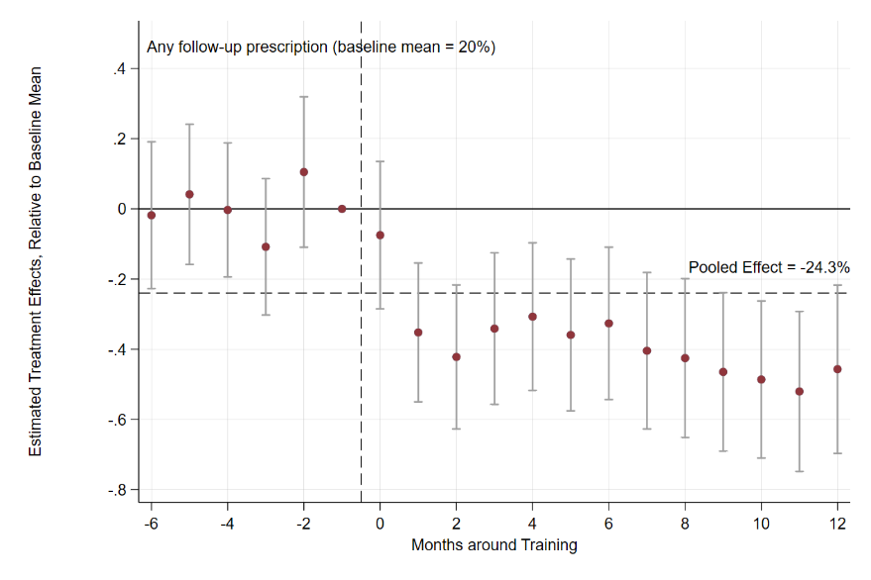
What if I don’t have a good control group (part 1)?
Conditional on having a treatment, the exact timing of the treatment is random in the short-run, not endogenous
Notes:
Talk through design here

Slide 17
Conclusion

Slide 18
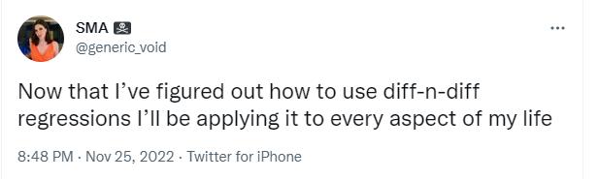
Conclusion:
A good DD paper:
Lays out the causal question directly
Has a clean estimating equation, identifying assumption statement, and discussion of the relevant control group (and why it’s credible!)
Discuss and test potential threats to identification, robustness checks, placebos, etc.
When presenting results, think about meaningful heterogeneity, dynamics, and ways to test/provide support for possible mechanisms
Notes:
What if the control group isn’t credible? Can combine with other approaches (briefly mention matching if you have time)

Slide 19
Conclusion:
There are so many quasi-experiments to explore!
DID is flexible, and its assumptions aren’t too strong:
  Parallel trends
  Homogeneous treatment effects (in at least one dimension)
Can puts lots of bells and whistles on it (with caveats)
Next time:
  Can we build our own control group? (Synthetic controls)
  Can we recover heterogeneous treatment effects? (Quantile regression)
Notes:
Could also add in something about DDD here.

Slide 20
Synthetic Controls
Notes:
Some people say synthetic control, but I like the plural – reminds me of the construction of the control group

Slide 21
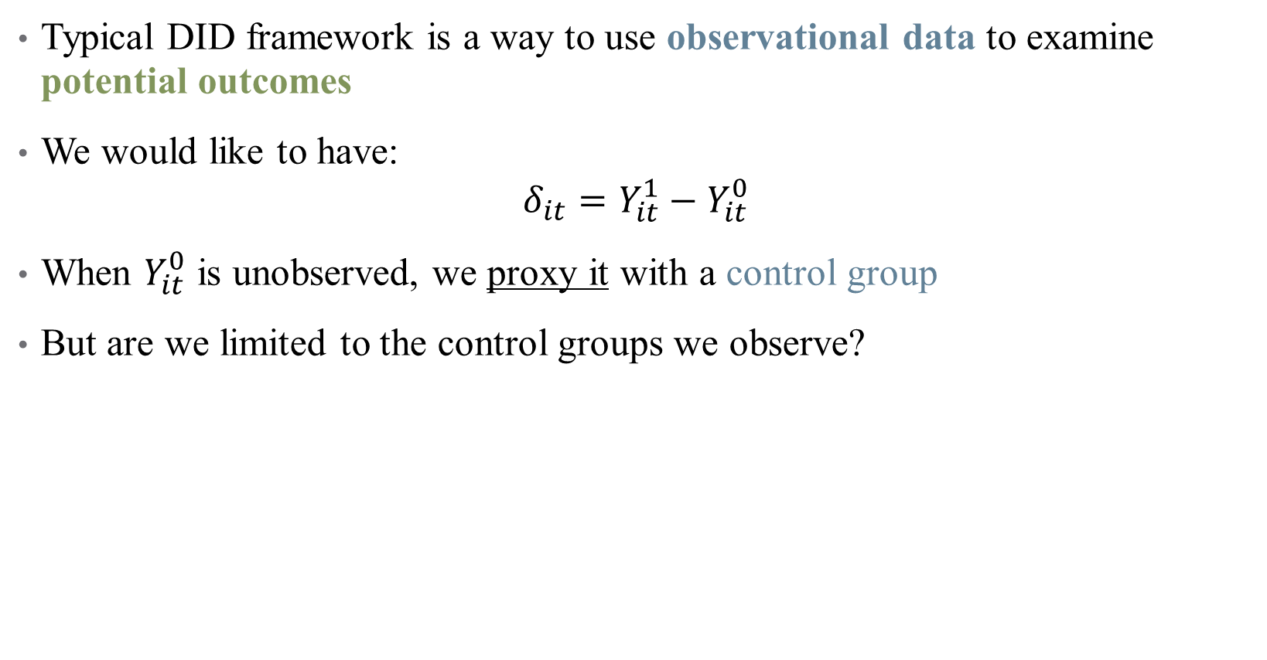
What are we DIDing?
Typical DID framework is a way to use observational data to examine potential outcomes
We would like to have:
$$δ_{it}=Y_{it}^{1}−Y_{it}^{0}$$
When $Y_{it}^{0}$ is unobserved, we proxy it with a control group
But are we limited to the control groups we observe?
Notes:
Lots of reason to assume that other control regions might not be satisfactory (what do you think?)

Slide 22
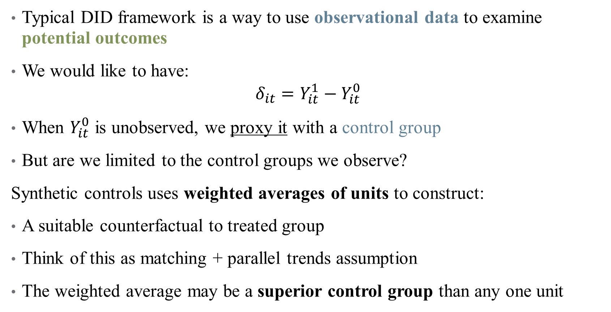
What are we DIDing?
Typical DID framework is a way to use observational data to examine potential outcomes
We would like to have:
$$δ_{it}=Y_{it}^{1}−Y_{it}^{0}$$
When $Y_{it}^{0}$ is unobserved, we proxy it with a control group
But are we limited to the control groups we observe?
Synthetic controls uses weighted averages of units to construct:
A suitable counterfactual to treated group
Think of this as matching + parallel trends assumption
The weighted average may be a superior control group than any one unit
Notes:
We are matching on any covariates and on pre-trends (so that the parallel trends assumption is satisfied). If the weighted average were just one unit, it would be simple DID. What would it have to be for synthetic control to mimic generalized DID?
Note also: the method is different from matching because we are trying to close gaps, not account for propensity of treatment! Explicitly more involved than matching

Slide 23
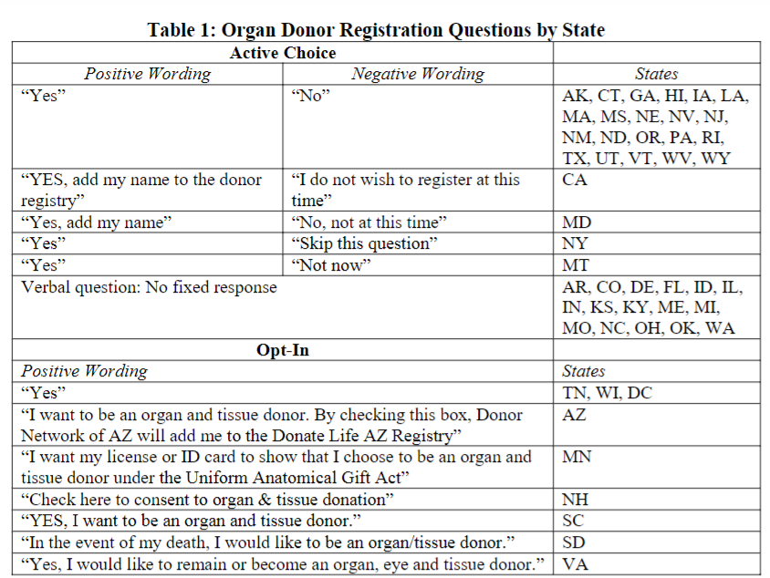
Example: Organ Donation Rates
Main question: what is the effect of active choice on organ donation rates? Uses CA as the treatment group
How would you go about setting up a DD here?
Which states are the right control group?
Are your results robust to choosing different control groups?

Slide 24
Intuition: Building a Synthetic CA
None of the other states look like CA does here
But some look closer than others (active choice)
Can we build a weighted average of these other states that (1) satisfy the pre-trends assumption and (2) don’t have their own treatments?

Slide 25
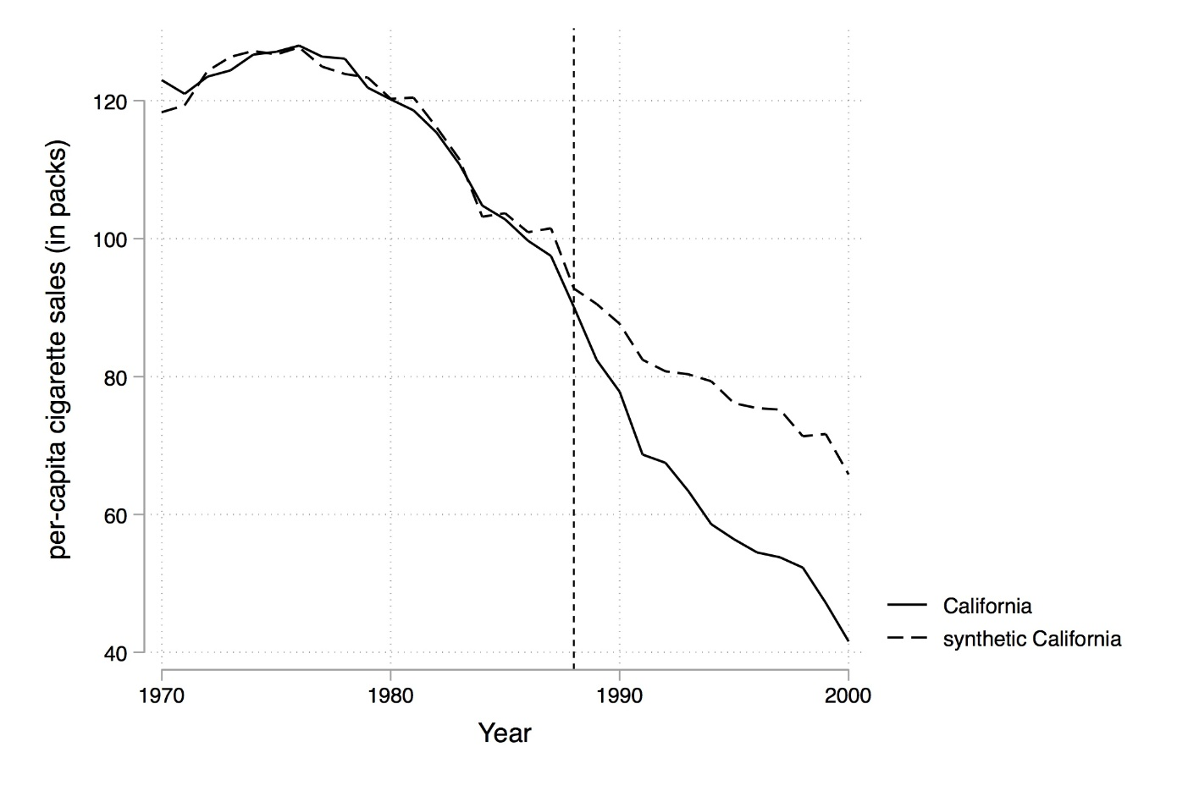
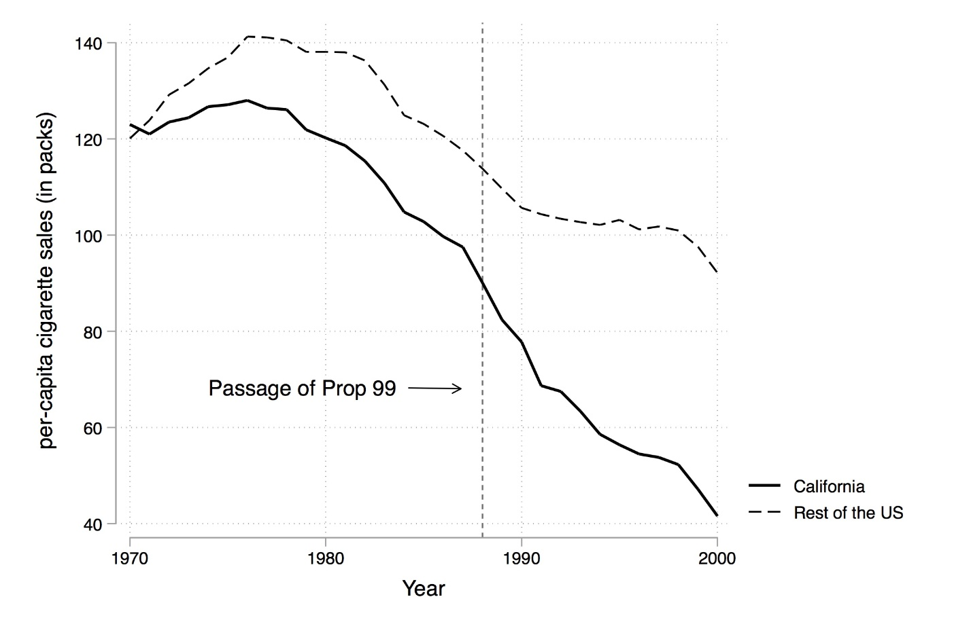
Synthetic Control
Notes:
We want to go from this to this. How?

Slide 26
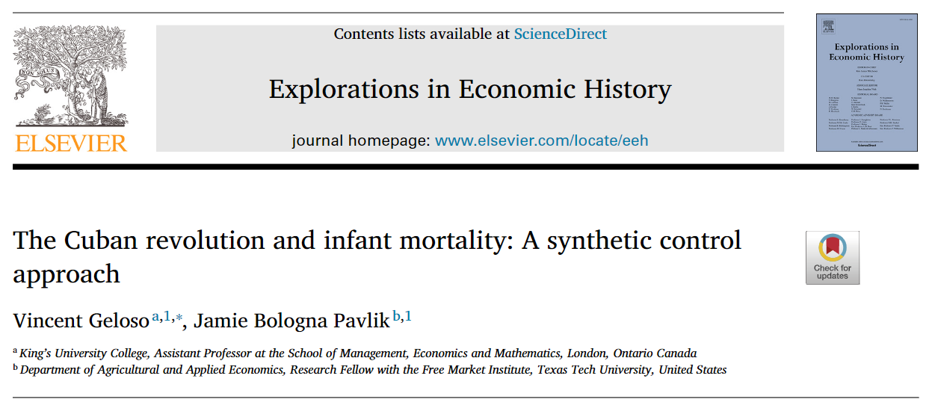
Case Study
Notes:
What’s our question here?

Slide 27
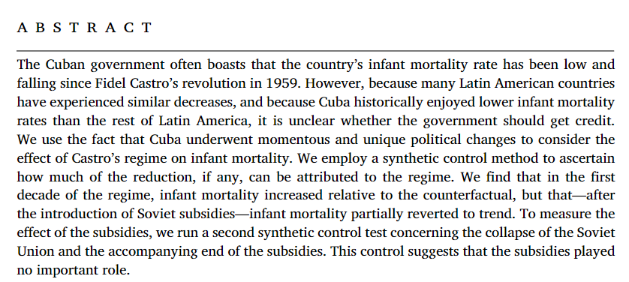
What’s the research question? What’s the identification?

Slide 28
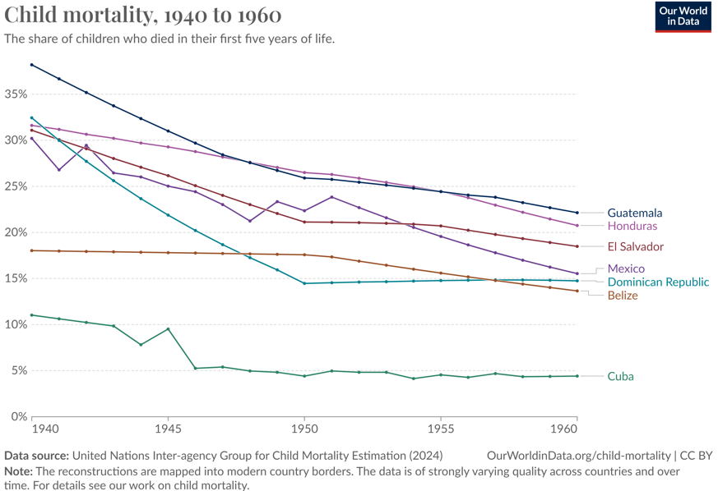
Example: Infant Mortality in Central America/Carribean
Notes:
What does this tell us about our ideal control group?

Slide 29
Example: Infant Mortality in Central America/Caribbean
2 big questions:
Should the government of Cuba get credit for this?
How can we answer that question from an empirical perspective? Who do we compare Cuba to?
Notes:
What does this tell us about our ideal control group?

Slide 30
So how do we construct Synthetic Cuba?
Choose a donor pool – which observation units (e.g., countries) are minimally acceptable as a comparator to Cuba?
  Who would work well here? Who wouldn’t?
Our goal is to “force” the parallel trends assumption through weighting these observations
  So we choose variables to match on
  These include pre-trends themselves! And also other covariates.
Notes:
What does this tell us about our ideal control group?

Slide 31
So how do we construct Synthetic Cuba?
Choose a donor pool – which observation units (e.g., countries) are minimally acceptable as a comparator to Cuba?
  Who would work well here? Who wouldn’t?
Our goal is to “force” the parallel trends assumption through weighting these observations
  So we choose variables to match on
  These include pre-trends themselves! And also other covariates.
When can you use SCM?
1. No unit in the donor pool can have a similar policy change (single treatment)
2. The treatment cannot affect the outcome in donor pool (SUTVA)
3. No anticipation effects! (Why?)
4. The values of the predictors for the treated unit should be near or inside the convex hull of the values for the donor pool (more on this in a couple of slides).
Notes:
What does this tell us about our ideal control group?

Slide 32
Step 1: Selection of “Donor Pool” & Matching Variables
To get around the problem: throw in the kitchen sink! (this time it’s okay)
Main advantage: data-driven way to construct weighted average
  Researcher doesn’t choose weights
Researcher chooses:
  Donor pool: possible states for control group (algorithm may assign weight 0)
  Matching variables: should include pre-treatment trends + any other covariates
  McClelland and Gault has a nice guide to how to implement this
Notes:
Add guide to synthetic controls to papers in folder (McClelland and Gault). In machine learning, this is called the “training” of the synthetic control. Note that training the model takes a minute to run so start it and come back to subsequent slides.

Slide 33
Step 1 Example: Case Study
Unit of observation: Measure at the country-year level (panel data!)
Match from 1946 (first year of data) to 1958 (last year pre-treatment)
Exclude countries without “similar economic processes” to Cuba (what does this mean? What do you think about how they handle it?)
  Two sets of controls: Latin American countries and all Western countries (why?)
What variables are included?
Notes:
Who’s the donor pool here? What variables: GDPper capita, education, and urbanization (and lagged infant mortality)

Slide 34
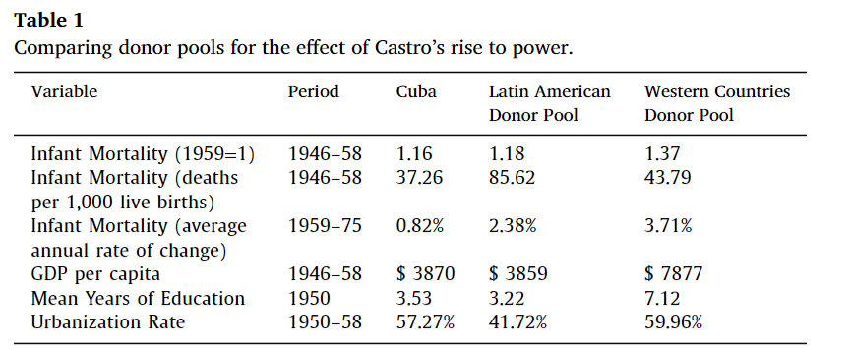
Step 1 Example: Case Study
Unit of observation: Measure at the country-year level (panel data!)
Match from 1946 (first year of data) to 1958 (last year pre-treatment)
Exclude countries without “similar economic processes” to Cuba (what does this mean? What do you think about how they handle it?)
  Two sets of controls: Latin American countries and all Western countries (why?)
What variables are included?
Notes:
Who’s the donor pool here? What variables: GDPper capita, education, and urbanization (and lagged infant mortality)

Slide 35
Step 2: Construction of Synthetic Cuba
Synthetic Cuba is generated from a convex hull of control states
  Requires some amount of comparability (can’t compare Cuba to Mars)
  Weighted average of bad controls will still be…bad controls
Notes:
Synthetic controls precludes extrapolation by using interpolation instead: the estimated effect is based on a comparison between some outcome in a given year and a counterfactual in the same year. Use the next slide for intuition here

Slide 36
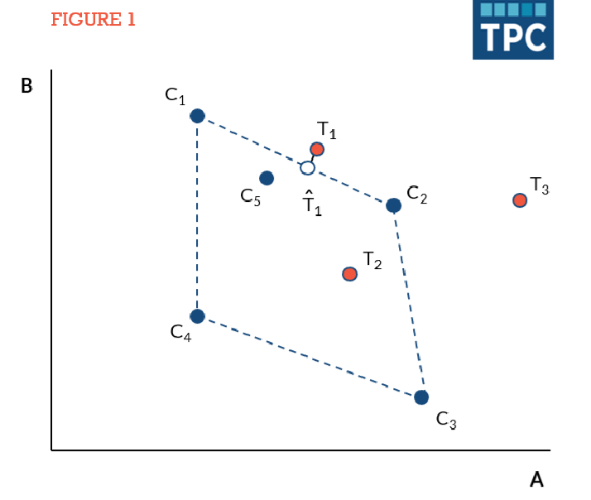
The Convex Hull
Notes:
What is the convex hull? We are going to assign weights to our control units – these weights have to sum to 1, and the weighted average should be “close” to the true treatment group.
Blue dots are the donor pool – notice the outer envelope is the convex hull
When is SCM useful? When is it not? Note that it is *most* useful (this is a bit technical) when the treated units aren’t always perfectly within the convex hull (then you’re sort of back to a diff-in-diff state).

Slide 37
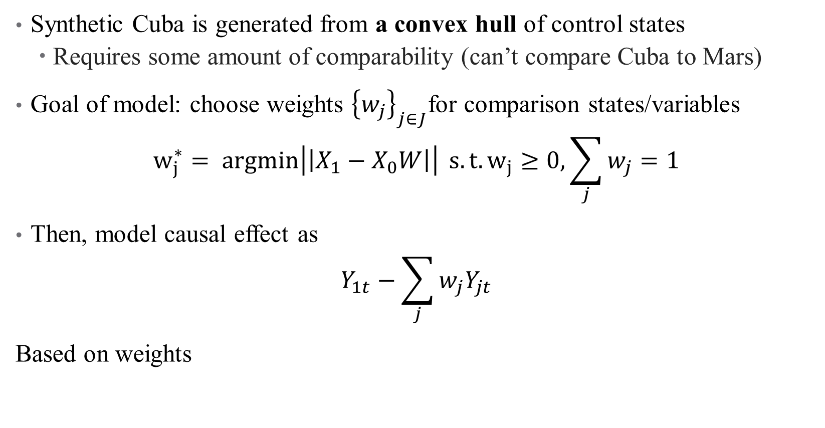
Step 2: Construction of Synthetic Cuba
Synthetic Cuba is generated from a convex hull of control states
  Requires some amount of comparability (can’t compare Cuba to Mars)
Goal of model: choose weights ${\left\{w_{j}\right\}}_{j∈J}$for comparison states/variables
$$w_{j}^{∗}= argmin\left|\left|X_{1}−X_{0}W\right|\right| s.t. w_{j}≥0, \sum_{j}{w_{j}=1}$$
Then, model causal effect as
$$Y_{1t}−\sum_{j}{w_{j}Y_{jt}}$$
Based on weights
Notes:
Weight constraints: nonnegative weights and sum to 1. What does this mean? The pictures tell the whole story!

Slide 38
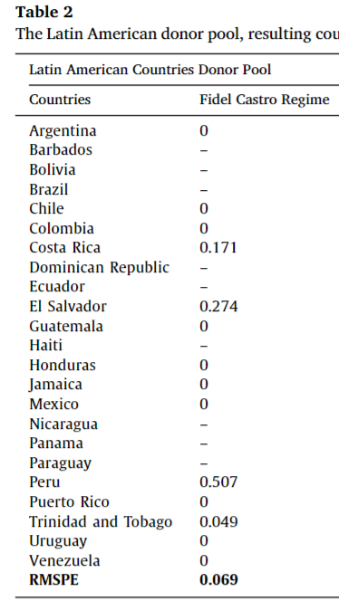
Step 2: Construction of
Synthetic Cuba
Notes:
What are the differences between the 0s and the dashes? Talk about the RMSPE here – how can we do inference on this? “To gauge the meaningfulness of our results, we use these reported RMSPE against those that emerge from placebo tests. These tests repeat the synthetic exercise for each country in our donor pools using 1959 as the treatment year. We then calculate the ratio of post-treatment RMSPE to pretreatment RMSPE and expecting it to be smaller for donor countries than for Cuba given that these other countries experience no treatment”

Slide 39
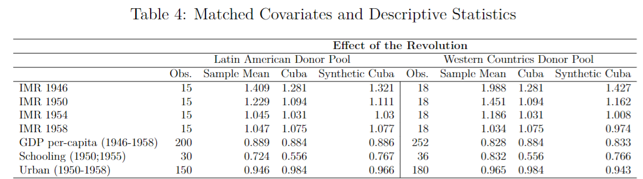
Step 2: Construction of Synthetic Cuba
Balance table! Compare with before. Where are the matches the best/worst?
Notes:
Just like in matching, want to show balance in covariates as well – especially for the lagged DV outcomes (see McClelland and Gault)

Slide 40
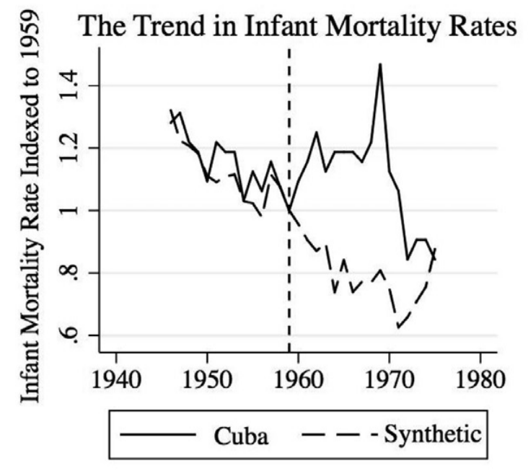
Results: OH vs. Synthetic OH
Notes:
Look at pre-trends, then differences following policy enforcement.

Slide 41
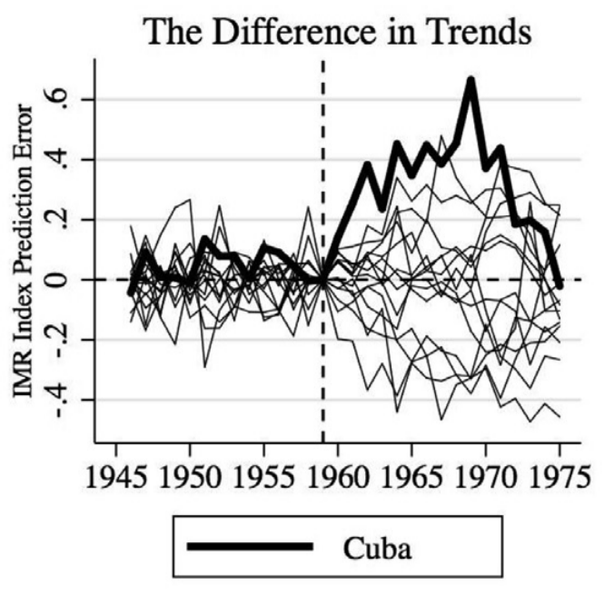
Results: OH vs. Synthetic OH
Estimated (dynamic)
treatment effect
Notes:
Look at pre-trends, then differences following policy enforcement. What’s the treatment effect here? How do we interpret it?

Slide 42
Inference: Are these results significant?
These results aren’t like others we’ve been focusing on
  Where are the stars?
We can still do inference! Using randomization-based inference
  Relies heavily on placebo tests: how does estimate change if I introduce sampling variation?
Notes:
RBI is a whole topic, happy to explore that in more detail with students who are interested (see Nick/Scott’s textbooks). It’s like bootstrapping.

Slide 43
Inference: Are these results significant?
These results aren’t like others we’ve been focusing on
  Where are the stars?
We can still do inference! Using randomization-based inference
  Relies heavily on placebo tests – how does my estimate change if I introduce sampling variation?
In the context of synthetic control:
Pretend that each unit in the “donor pool” is treated, compare effects
Vary the timing of treatment, compare effects
Notes:
For (1), you drop your actually treated observation and work only with the other donor pool states. Construct a new synthetic OR, WV, DC, etc. Then check what percentile your actual effect is in the “null distribution” you have created. Obviously, these work better if you have many units in the donor pool.

Slide 44
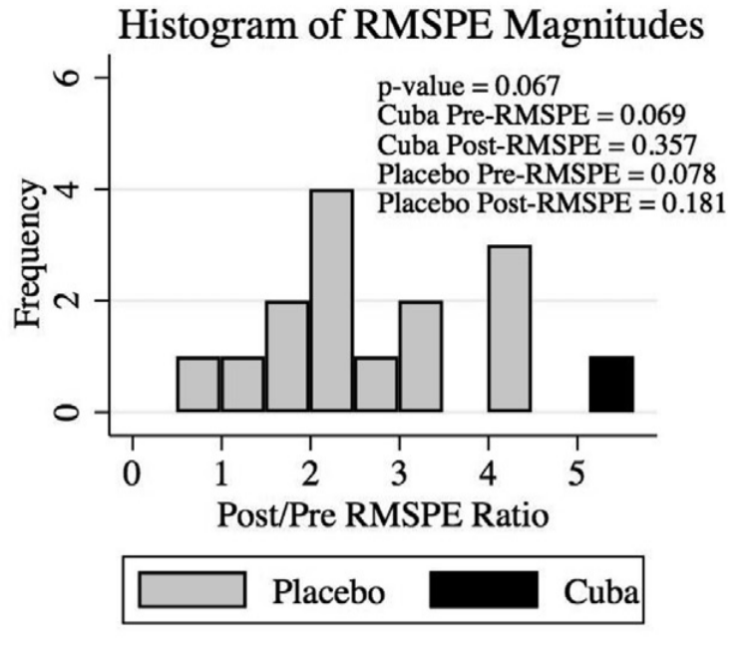
Inference: Are these results significant?
Notes:
Running this is why the code before took a while – other placebos are mentioned in the code. How do we interpret this figure?

Slide 45
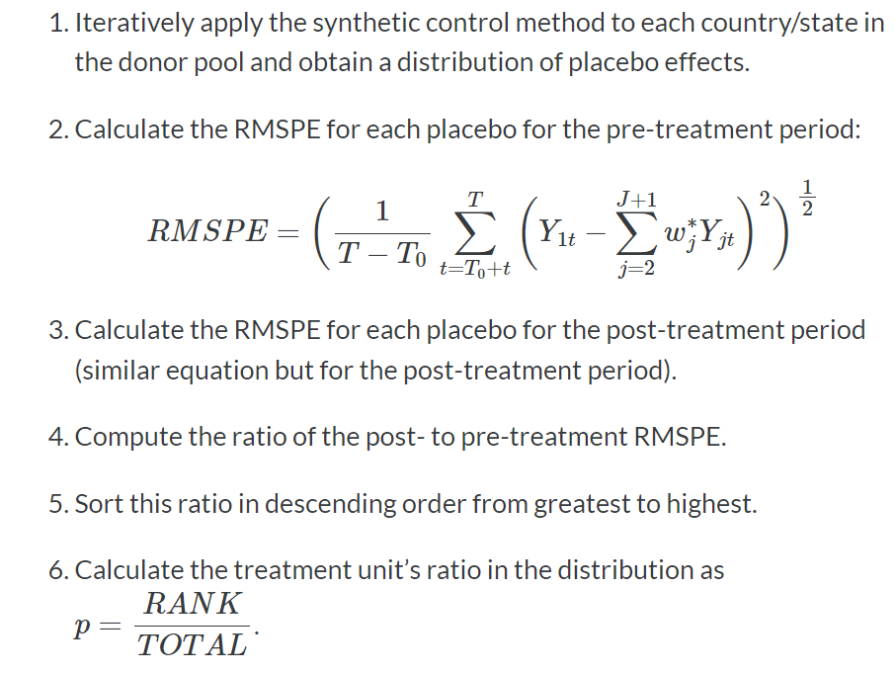
From Figure to Test Statistic: Are the results significant?
Notes:
This is the essence of randomization inference – no code, can you figure this out yourself? Basically, how much does the post-treatment stand out from the pre-treatment fit?

Slide 46
Synthetic Control in Practice
Relies on a long pre-treatment time series to establish good control
Follow guidelines in McClelland and Gault (2017)
Want solid economic argument for which donor states you include
  At the least, your results should be robust to slight changes in donor pool
Current developments (augmented SC, etc.) deal with some strict requirements (fit on pre-treatment trends, etc.)
Some drawbacks of the method:
Tends to overfit any noise in the outcome variable
Matching on the outcome variable – is that allowed?
Notes:
A note on matching on outcome: Plus, other methods like difference-in-differences also use information about pre-treatment outcomes to produce their estimate. They just do so in less obvious ways.

Slide 47

Additional Help
Nice Journal of Economic Literature guide
Video presentation: https://www.youtube.com/watch?v=nKzNp-qpE-I&ab_channel=BradyNeal-CausalInference

Slide 48
Mini Referee Report
What do you like about the paper?
What about the field experiments? Value added?
Major concerns, etc.?
This hasn’t been published – why do you think that is?

