Slide 1
Quant Methods in HSR I
Lecture 12: Causal Machine Learning for HSR
December 7, 2026
HAD5744 • Alex Hoagland, Ph.D.

Slide 2
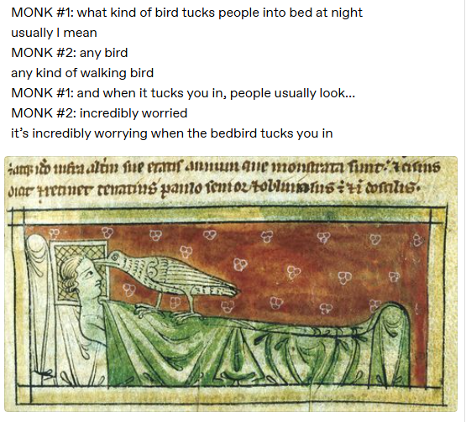
Notes:
https://the-toast.net/2015/04/01/two-medieval-monks-invent-bestiaries/

Slide 3
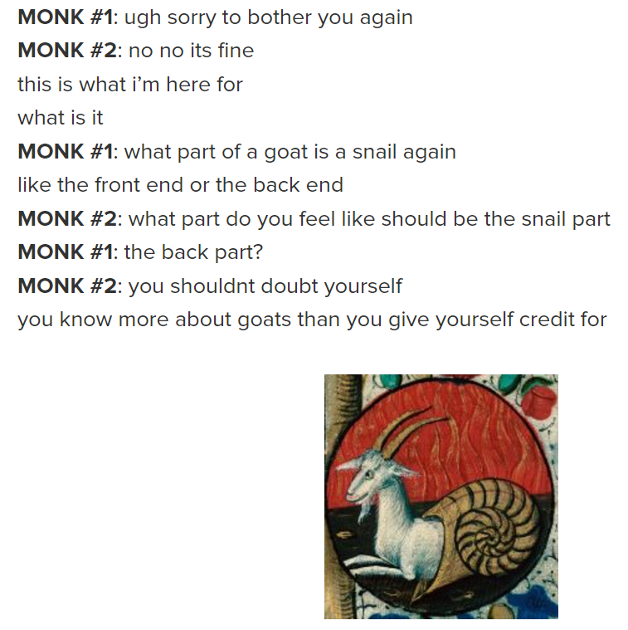
Notes:
https://the-toast.net/2015/04/01/two-medieval-monks-invent-bestiaries/

Slide 4
ML in Causal/Descriptive HSR Research:
A Short Primer
Notes:
Note: although comps papers can now be quant in nature (and should be!) you can also do review papers. I thought this was a really well-done review paper, what did you think?

Slide 5
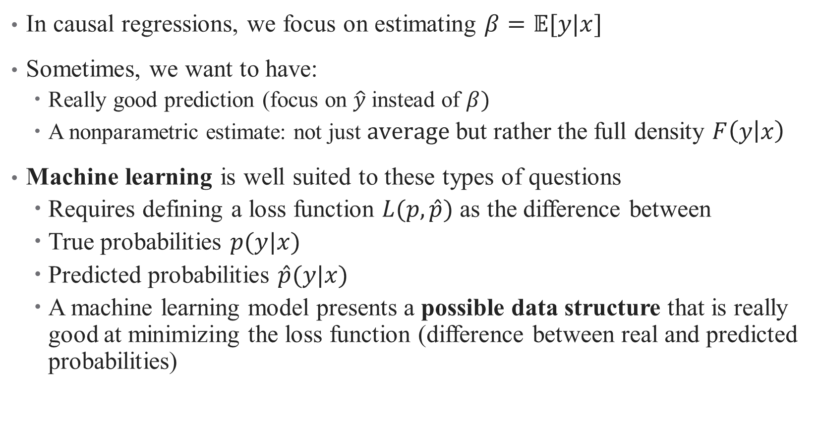
Conditional Density Estimation
In causal regressions, we focus on estimating $β=𝔼[y|x]$
Sometimes, we want to have:
  Really good prediction (focus on $\hat{y}$ instead of $β)$
  A nonparametric estimate: not just $average$but rather the full density $F\left(y | x\right)$
Machine learning is well suited to these types of questions
  Requires defining a loss function $L(p,\hat{p})$ as the difference between
  True probabilities $p(y|x)$
  Predicted probabilities $\hat{p}(y|x)$
  A machine learning model presents a possible data structure that is really good at minimizing the loss function (difference between real and predicted probabilities)

Slide 6
What is ML good for? What is it not good for?
Advantages:
  Really great at prediction
  Can be useful in building out descriptive stats
  Can also be useful for decomposition analyses
Disadvantages:
  Cannot handle deep assumptions about the structure of the DGP
  For example, cannot model selection bias or endogeneity without ex-ante assumptions by researcher (which defeats purpose of ML)
  On its own, then, generally insufficient for causal questions
  Can be combined with other methods to get causality (double debiased ML + IV)
Notes:
Going to show you brief intuition for both of these approaches; others in the sample paper.

Slide 7
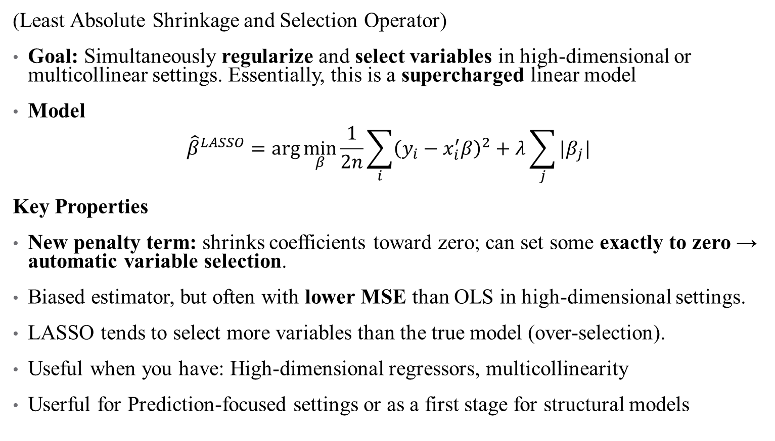
Option 1: LASSO
(Least Absolute Shrinkage and Selection Operator)
Goal: Simultaneously regularize and select variables in high-dimensional or multicollinear settings. Essentially, this is a supercharged linear model
Model
$${\hat{β}}^{LASSO}=\arg{\min_{β}{\frac{1}{2n}\sum_{i}{{\left(y_{i}−x_{i}^{′}β\right)}^{2}+λ\sum_{j}{|β_{j}|}}}}$$
Key Properties
New penalty term: shrinks coefficients toward zero; can set some exactly to zero → automatic variable selection.
Biased estimator, but often with lower MSE than OLS in high-dimensional settings.
LASSO tends to select more variables than the true model (over-selection).
Useful when you have: High-dimensional regressors, multicollinearity
Userful for Prediction-focused settings or as a first stage for structural models
Notes:
Other similar options: elastic net/ridge regression. Lets you build a model that includes millions of covariates.

Slide 8

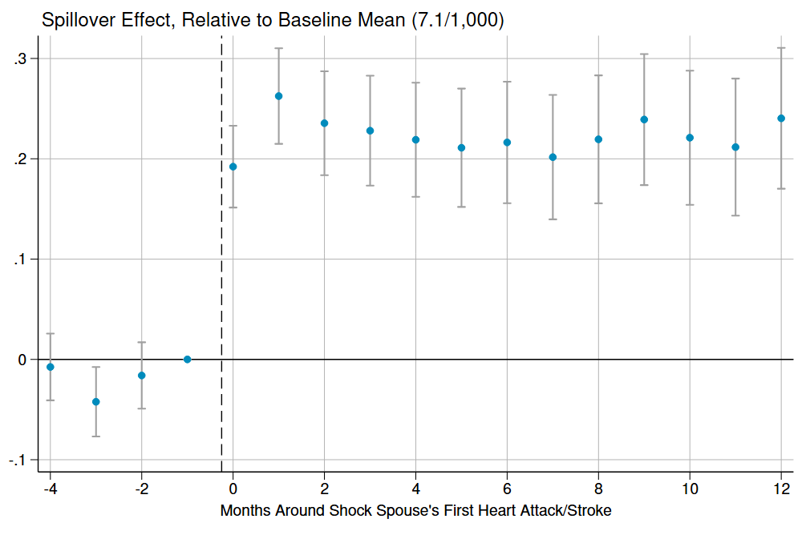
A LASSO example
The question: how does losing access to a source of informal care affect takeup of formal care among the elderly?
Research design: Dynamic difference in differences using quasi-exogenous variation in when shocks occurred to households
Notes:
Email me for R or stata code – this is always changing. Main question here: what is the effect of a partner’s health shock on takeup of formal eldercare? But there are two possible channels: a health effect and a substitution effect

Slide 9
A LASSO example
The question: how does losing access to a source of informal care affect takeup of formal care among the elderly?
Research design: Dynamic difference in differences using quasi-exogenous variation in when shocks occurred to households
Mechanisms: What could drive this effect? On the one hand, you might have a substitution effect: simply can’t get informal care, so you need formal care
Notes:
Email me for R or stata code – this is always changing. Main question here: what is the effect of a partner’s health shock on takeup of formal eldercare? But there are two possible channels: a health effect and a substitution effect

Slide 10
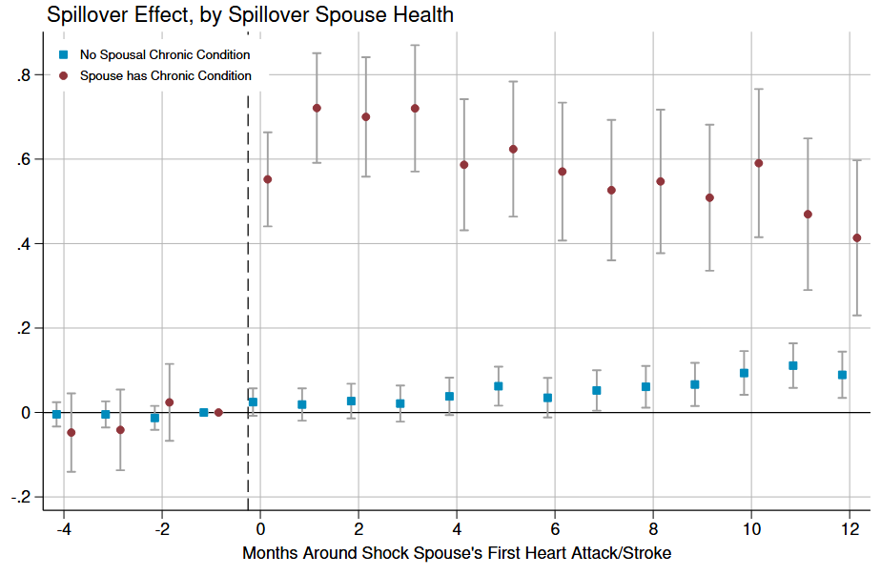
Formal Care Effects Larger for Spouses Requiring Care
Outcome spouse has a chronic condition
Outcome spouse does not have a chronic condition
Notes:
Chronic conditions include ADRD, cancer (colorectal, lung, or prostate), chronic kidney disease, COPD,hip fractures, and strokes

Slide 11
A LASSO example
The question: how does losing access to a source of informal care affect takeup of formal care among the elderly?
Research design: Dynamic difference in differences using quasi-exogenous variation in when shocks occurred to households
Mechanisms: What could drive this effect? On the one hand, you might have a substitution effect: simply can’t get informal care, so you need formal care. On the other hand, you might have health effects: especially things like “heartbreak effect”
Notes:
Email me for R or stata code – this is always changing. Main question here: what is the effect of a partner’s health shock on takeup of formal eldercare? But there are two possible channels: a health effect and a substitution effect

Slide 12
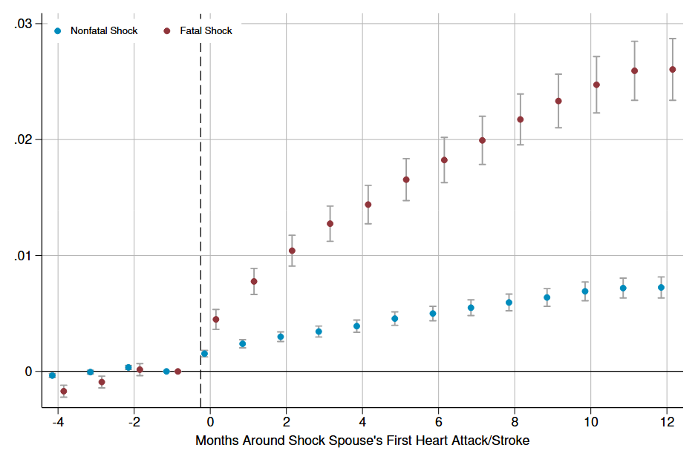
Health Effects: Mortality

Slide 13
A LASSO example
The question: how does losing access to a source of informal care affect takeup of formal care among the elderly?
Research design: Dynamic difference in differences using quasi-exogenous variation in when shocks occurred to households
Mechanisms: What could drive this effect? On the one hand, you might have a substitution effect: simply can’t get informal care, so you need formal care. On the other hand, you might have health effects: especially things like “heartbreak effect”
Main role for ML: how can we decompose the relative effects here?

Slide 14
Decomposition
Data requirement: All SNF stays must be preceded by hospitalization to qualify for Medicare payment. We have rich administrative data here we can exploit!
Theoretical motivation: SNF effect could come from 2 sources:
  Normal “flow” of hospitalizations shift from discharge home to discharge to SNF in absence of spouse (substitution effect)
  New hospitalizations = more SNF stays (health effect)
Use ML prediction (LASSO) at hospitalization level to predict the underlying probability of being discharged to a SNF
  Based on patient demographics and hospitalization clinical characteristics
Notes:
* So a hospitalization for fever can still happen at the same rates, but without a spouse, you’re more likely to go to a SNF
* However, if your hospitalizations happen more often or for more complex reasons, your predicted probability of SNF discharge would go up in LASSO model (health effects)

Slide 15
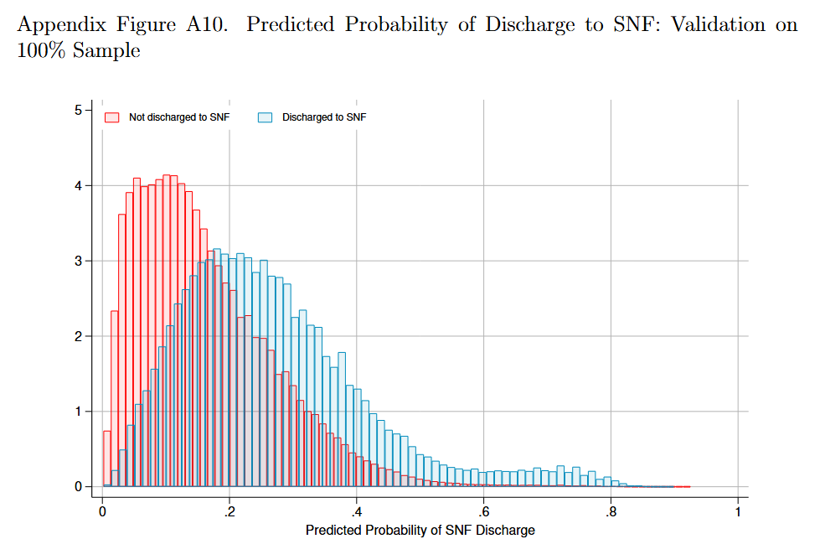
Decomposition
Notes:
What do you see here?

Slide 16
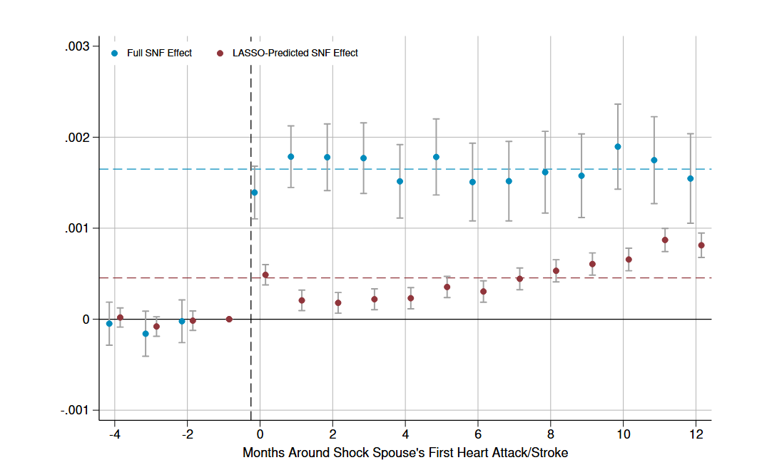
Change in Predicted Pr(SNF Discharge)
Notes:
Roughly 28% health effects, majority (72%) substitution!

Slide 17
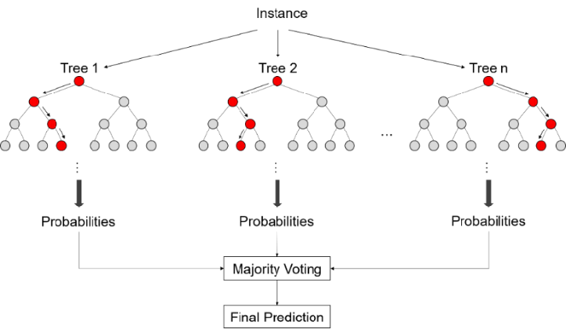
Option 2: Random Forests
A more explicitly prediction approach to regression
  Rather than coefficient estimation based on averages of errors,
  Split data into trees based on “cut-points” in data
  Trees are chosen in order to maximize predictive power of data
Forests: bootstrapping over the trees!
  There is new terminology here: bagging, boosting, etc. But the concepts are similar
These methods were applied best as predictive methods, so causality is not always apparent
  But causal methods are being developed; see papers in Github repo
  Sometimes we care about prediction too! (e.g., risk adjustment)
Notes:
Cut-points – rules for how to bin data in order to assign prediction (e.g., if we’re predicting expenses, at what age do expenses go down (2?) and then up again (50?). Once we’ve done that cut, what’s the next best way to cut – by sex (older men versus older women)? And so on.)

Slide 18
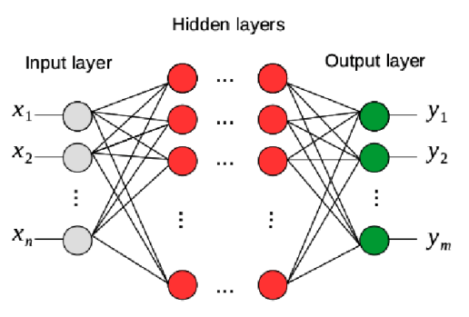
Option 3: Neural Networks
Random forests are a collection of individual decision trees
Neural networks are a group of connected “neurons”
  These neurons process data in “layered” steps
  These layers can be unidirectional (feedforward NN) or circular (feedback NN)
  Ultimately, the neurons “learn” complex functions/DGPs using many nonlinear transformations of data
Advantages: extremely flexible, Capture complicated nonlinearities & interactions automatically.
Drawbacks: Require extremely large data sets, have many hyperparameters that need tuning, prone to overfitting
  Makes training these more of an “art”
Notes:
Neurons are similar to trees

Slide 19
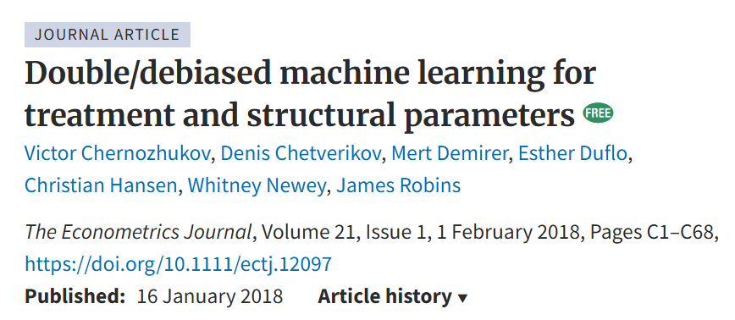
Can this ever be causal?
Many econometricians (and others) are working on developing causal methods for machine learning
One place where this is really promising: learning coefficients on endogenous regressors with a combination of IV methods.
Intuition: ML models can help generate a stronger instrument (first stage is all about prediction) and can then be jointly/nonlinearly embedded into a 2SLS regression
Notes:
Neurons are similar to trees

Slide 20
An example: in progress
Suppose we care about the effect of child maltreatment investigations on household wellbeing (why?)
The DAG looks something like this
Caseworker variation (leniency design)
Investigation
Outcome
Selection
Notes:
What’s the structure here?

Slide 21
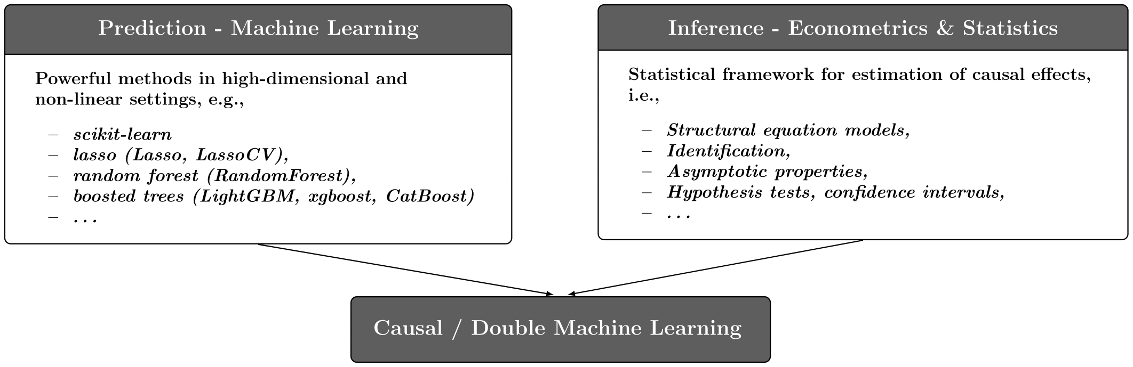
An example: in progress
A prediction model can use rich demographics on both the endogenous treatment (investigation) and outcomes to boost the IV’s power:
Use a LASSO/other model to predict investigations based on both the instrument and observables
Use another LASSO/ML model to predict outcomes (e.g., graduation rates)
Take the residuals from both predictions (double ML)
Estimate 2SLS on these residuals
Notes:
Example: in BC, there’s this early-learning development instrument.

Slide 22
Choosing the “Right” research design

Slide 23
How do I pick the “right” research design?
You don’t!
There are no perfect research designs, everything is a tradeoff
Example: running an RCT vs. using quasi-experimental data to investigate vaccine takeup/effectiveness
Notes:
Talk about CTR as a motivating example – is there only one right choice?
Let’s talk about some of your research questions – what kinds of questions are you interested in or already studying?

Slide 24
How do I pick the “right” research design?
Your research design helps you be clear about:
Your estimand (what parameter am I trying to recover)?
Your assumptions (what am I already seeing about the data)?
Your policy relevance (where will my results be useful, and where won’t they)?

Slide 25
A starting point: what is the right experiment?
Quantitative research is all about identifying a data generating process
Better understanding of this process means better policy design!
If we could design any experiment or collect any ideal data to answer your question, what would it be?
Notes:
“a macabre thought experiment”

Slide 26
3 Types of Quantitative questions
Descriptive
Predictive
Causal
Notes:
What kinds of questions are you asking? Generally your question falls into one of these three categories.
Go through each of these with an example. We’re going to think about their relative strengths and weaknesses with an example: escape rooms

Slide 27
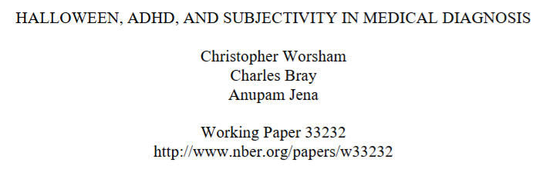
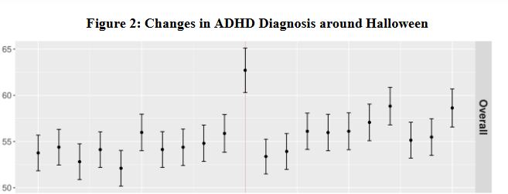
What design do I pick? What’s my variation?
Notes:
Example: Halloween and ADHD diagnoses. Think about (1) approximating an experiment using (2) identifying variation you know and can exploit. Questions to consider:
Is there a natural policy change I can use?
Is there a staggered rollout? Is there heterogeneity in the population’s level of exposure to my exposure (lol) and can I use that as exogenous in some way?
What behaviors are endogenous and what are exogenous? [Sometimes writing or drawing a simple model may help]
Are there “off the shelf” methods I can use or remix? IVs? What has the literature already identified as problematic or useful here?

Slide 28
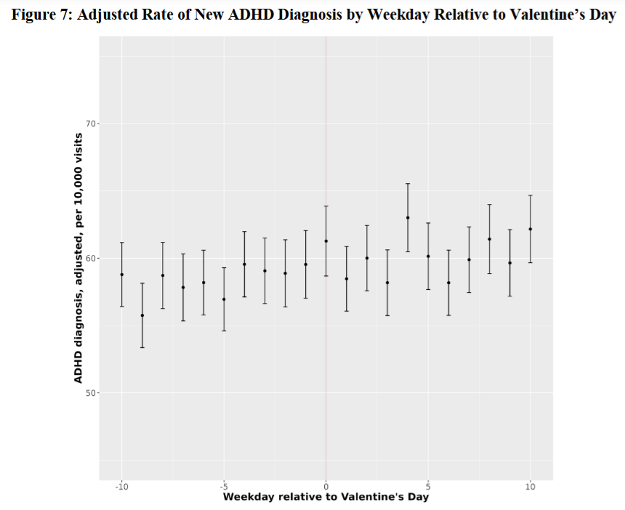
What design do I pick? What’s my variation?
Notes:
Useful to have insight to tell your story robustlessly too (robustness checks and descriptive stats count almost as much as identification!)

Slide 29

Choosing the Right Method
1. What is your research question? What is your ideal experiment?
2. Do you want to describe, predict, or explain?
3. What data and variation do you have?
4. What assumptions can you justify?
5. What is the policy goal?
Notes:
Note – you will also go through a lot of bad or underbaked ideas before you get the right bake

