Slide 1
Quantitative Methods for HSR I
Lecture 5: Working with Data and Designing Research Questions
October 11, 2024
HAD5744 • Alex Hoagland, Ph.D.
Notes:
What do you do if you don’t have a question? Read through the data dictionaries here, then do some descriptive work!

Slide 2
Session Outline
Where to find data
How to work with data (data cleaning)
How to design good research questions
Research designs: where we’re headed

Slide 3
Finding good data
Notes:
Logistic notes:
don’t worry about citing packages or the AI appendix in your assignments (do worry about these for referee reports and final paper)
I have uploaded a sample referee report to Github – note that your research question + teams are due in two weeks (with an outline due two weeks after that), so you should commit by then to one of the two options

Slide 4
Answers are only as good as your data!
Immediately Available Datasets
High-quality census/health data in the US and internationally: https://www.ipums.org/
https://sebastiantellotrillo.com/resources/primer-where-to-find-data
Canadian Community Health Survey
https://datacentre.chass.utoronto.ca/
Lots of others!
Good Thesis Datasets
ICES (Ontario-level claims)
PCPOP (BC-level data, links to a lot of useful demographic data)
CIHI
Medicare FFS (US; need a sponsor)
Lots of others!
Notes:
For this class, try to find a bridge between publicly available data and the data you hope to use for your thesis (for MSc students, maybe don’t think about these datasets anyway)

Slide 5
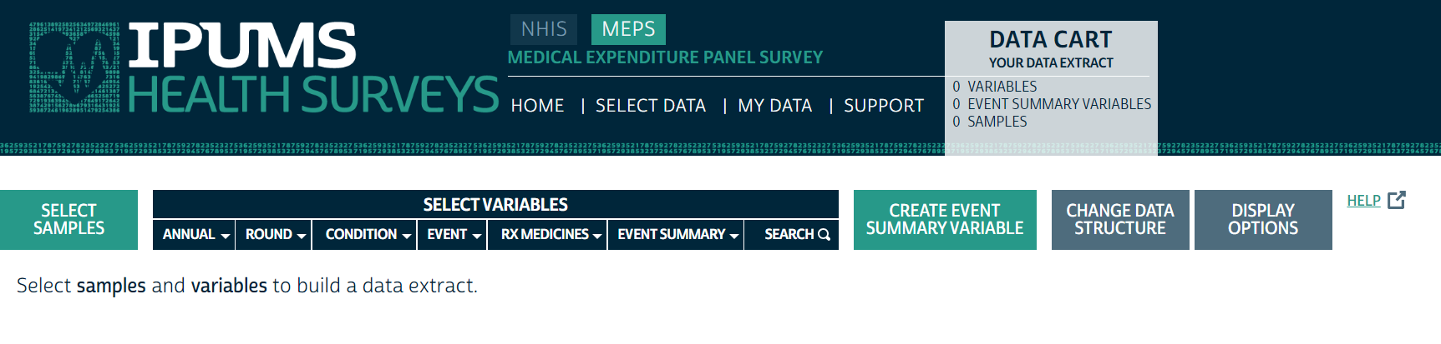
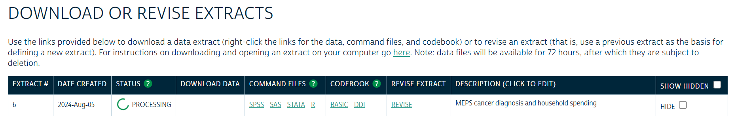
Example Cohort: MEPS (Link)
Notes:
Let’s take a sample research question for today: what are the impacts of health shocks on your own spending and your spouse’s? Walk through what kinds of variables we want.

Slide 6
Working with data

Slide 7
Flow of a Research Project
Main data
Supplemental Data
Cleaned data
Analytic Cohort 1
Analytic Cohort 2
Analytic Cohort 3
Paper!
Notes:
No project is unique! But here are some of the broad overviews for what you need to know.

Slide 8

Flow of a Research Project
Main data
1. Data cleaning
Supplemental Data
Cleaned data
Analytic Cohort 1
Analytic Cohort 2
Analytic Cohort 3
Paper!
Notes:
What does this entail? Going through variables, looking at descriptive characteristics, etc.

Slide 9
Other Data Cleaning Resources
Reading in datasets, initializing new variables, and other useful tips: Data Management Overview
Dealing with different data types: https://datasciencebox.org/course-materials/_slides/u2-d10-data-types/u2-d10-data-types.html#1
Notes:
You can really get bogged down in data cleaning. Use copilot, google, your old code, your friends, me…

Slide 10
Flow of a Research Project
Main data
2. Data merging
Supplemental Data
Cleaned data
Analytic Cohort 1
Analytic Cohort 2
Analytic Cohort 3
Paper!
Notes:
Takes a surprising amount of time!

Slide 11
Flow of a Research Project
Main data
Supplemental Data
Cleaned data
3. Cohort Creation
Analytic Cohort 1
Analytic Cohort 2
Analytic Cohort 3
Paper!
Notes:
Takes a surprising amount of time!

Slide 12
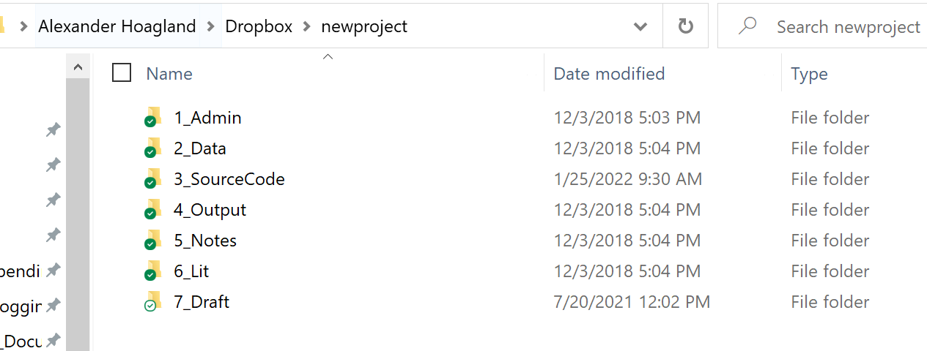
Prelude: Some Coding Organization
Project file structure
File template
Headers
Comment, comment, comment!
Notes:
Notes on folders – don’t overwrite your data! How can you construct this? How do we think about replicability?
Master.do file
GitHub
All results should run together (use the “here” library, for example)
Lots of comments!
Curious about more? See here: https://julianreif.com/guide/ (this is for Stata)

Slide 13
Flow of a Research Project
Main data
Supplemental Data
Cleaned data
Analytic Cohort 1
Analytic Cohort 2
Analytic Cohort 3
4. Analysis Reporting
Paper!
Notes:
We’ll skip over the main analysis – and likely skip over a lot of the real reporting here as well.

Slide 14
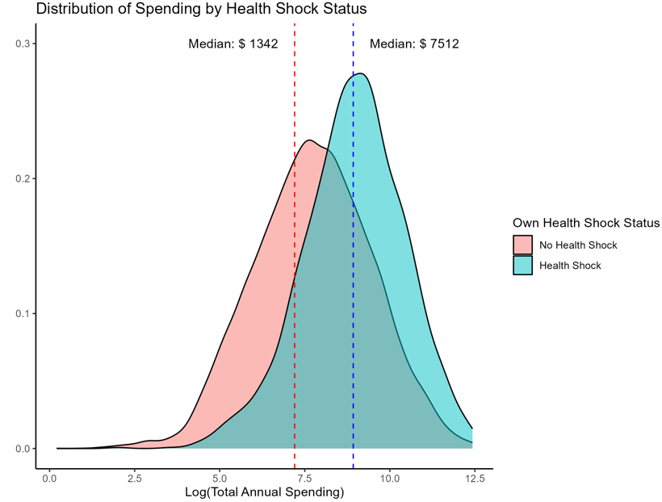
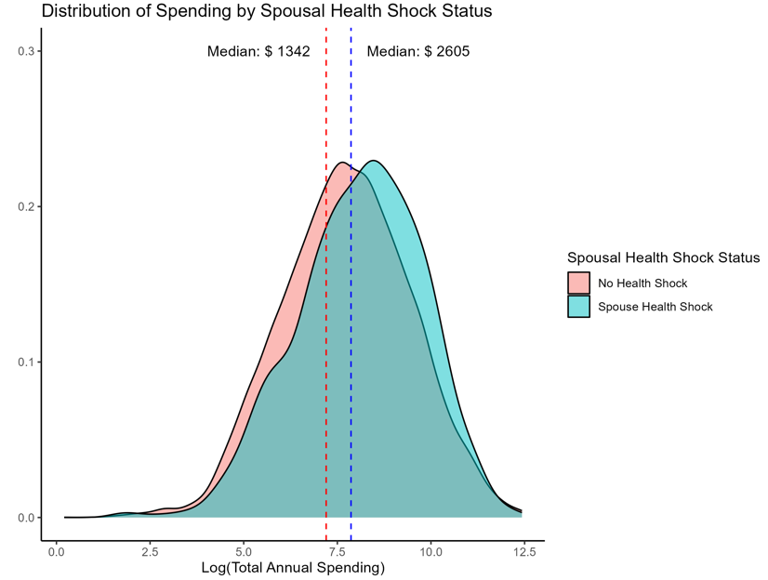
How do we interpret results?
Notes:
Obviously we don’t have everything here. But what *do* we have?

Slide 15
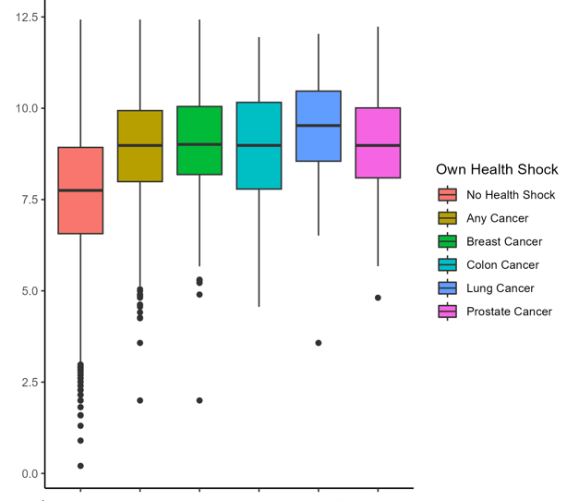
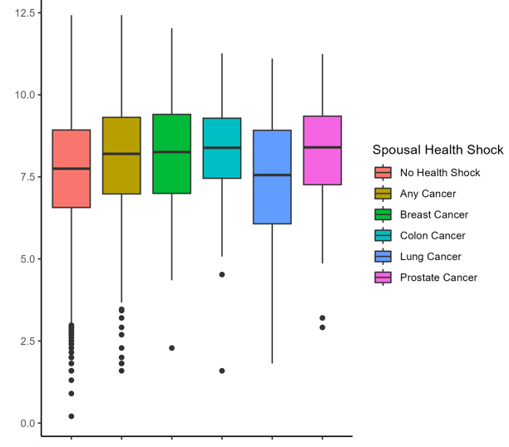
How do we interpret results?
Notes:
Obviously we don’t have everything here. But what *do* we have? Where would we go next?

Slide 16
Organizing a Project
Notes:
Only do this section if we have time – otherwise, defer it as resources for students to use

Slide 17
How do we structure a project?
File organization
Clean code
Robustness checks
Writing!

Slide 18
What is Clean Code?
Code that is easy to understand, easy to modify, and hence easy to debug
Some sources:
The Clean Coder, by Robert C. Martin
Code and Data for the Social Sciences: A Practitioner's Guide, by Gentzkow and Shapiro
Tyler Ransom’s (Oklahoma University) slides: https://raw.githack.com/OU-PhD-Econometrics/fall-2022/master/LectureNotes/01a-CleanCode/01aslides.html#2
Notes:
Clean code saves you and your collaborators time! You will always make a mistake while coding -- what makes good programmers great is their ability to quickly identify and correct mistakes.

Slide 19
Principles of Clean Code
Automation
Version control
Abstraction
Documentation
Time / task management
Test-driven development (unit testing, profiling, refactoring)
Pair programming
Notes:
Clean code saves you and your collaborators time! You will always make a mistake while coding -- what makes good programmers great is their ability to quickly identify and correct mistakes.

Slide 20
Principles of Clean Code
Automation – automate everything (that can be)!
Version control
Abstraction
Documentation
Time / task management
Test-driven development (unit testing, profiling, refactoring)
Pair programming
Notes:
You should have a single script that runs all of your chunks from beginning to end – this is for reproducibility and efficiency (it’s like showing your work)

Slide 21
Principles of Clean Code
Automation
Version control – Github, Dropbox, Overleaf!
Abstraction
Documentation
Time / task management
Test-driven development (unit testing, profiling, refactoring)
Pair programming
Notes:
Use collaborative software that tracks versions of your code! easily undo changes, test out new specifications, and more

Slide 22
Principles of Clean Code
Automation
Version control
Abstraction – use functions to reduce complexity of code!
Documentation
Time / task management
Test-driven development (unit testing, profiling, refactoring)
Pair programming
Notes:
e.g. A dishwasher -- all I need to know is how to put dirty dishes in and which button, not how the electrical wiring works. Define a function once also makes it more reliable if you use it multiple times. You should abstract to eliminate redundancy and improve clarity (but not otherwise – can make code impenetrable!)

Slide 23
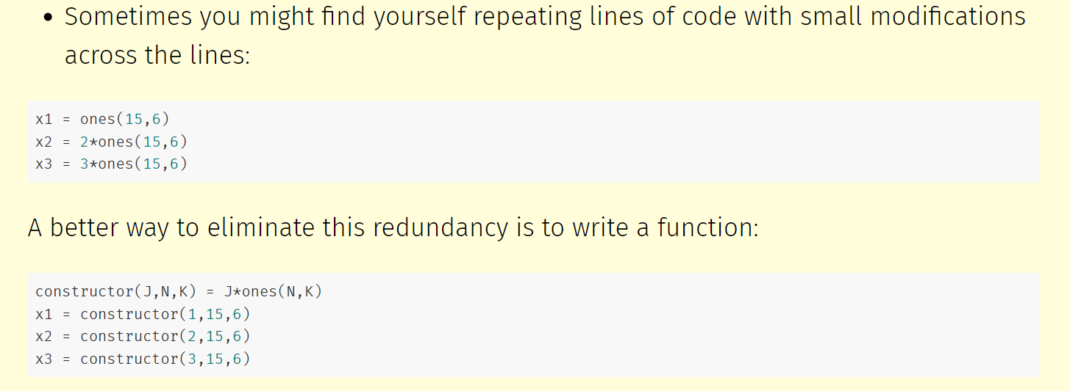
Example of Abstraction
Notes:
Now if I need to adjust the constructor() function, I only have to modify one line of code instead of three. This approach also minimizes typos in copy-pasting lines that are largely similar.

Slide 24
Principles of Clean Code
Automation
Version control
Abstraction
Documentation – make code readable! (Variable names, comments)
Time / task management
Test-driven development (unit testing, profiling, refactoring)
Pair programming
Notes:
Use names that people can understand (make code readable). Of course, don’t document if you aren’t going to update the documentation!

Slide 25
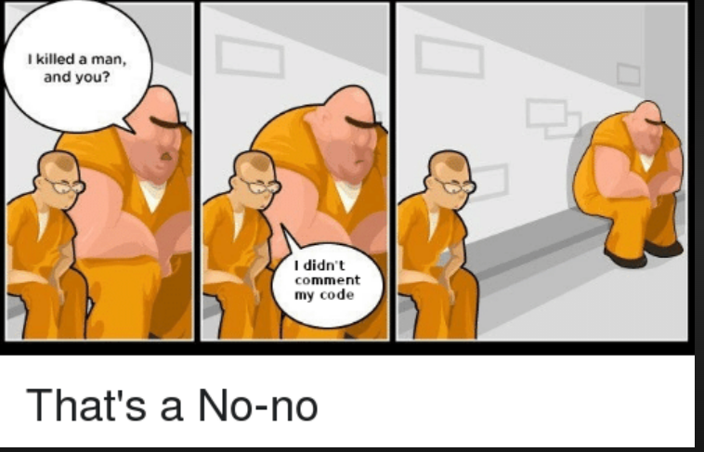
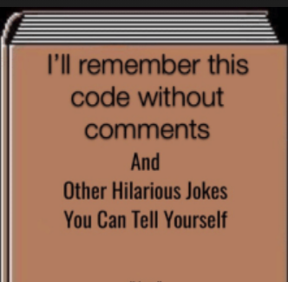
Principles of Clean Code: Comment Your Code!
Automation
Version control
Abstraction
Documentation – make code readable! (Variable names, comments)
Time / task management
Test-driven development (unit testing, profiling, refactoring)
Pair programming

Slide 26
Principles of Clean Code
Automation
Version control
Abstraction
Documentation
Time / task management – think carefully about when you code
Test-driven development (unit testing, profiling, refactoring)
Pair programming
Notes:
Coding is time intensive, and too many breaks or a strained/tired mental state will come back to bite you
Schedule long blocks of time (1.5 hours - 3 hours) to work on coding where you eliminate distractions (email, social media, etc.)
Stop coding when you feel that your focus or energy is dissipating

Slide 27
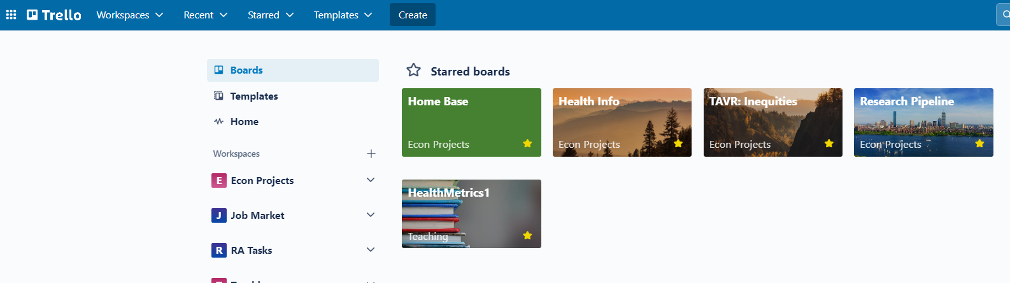
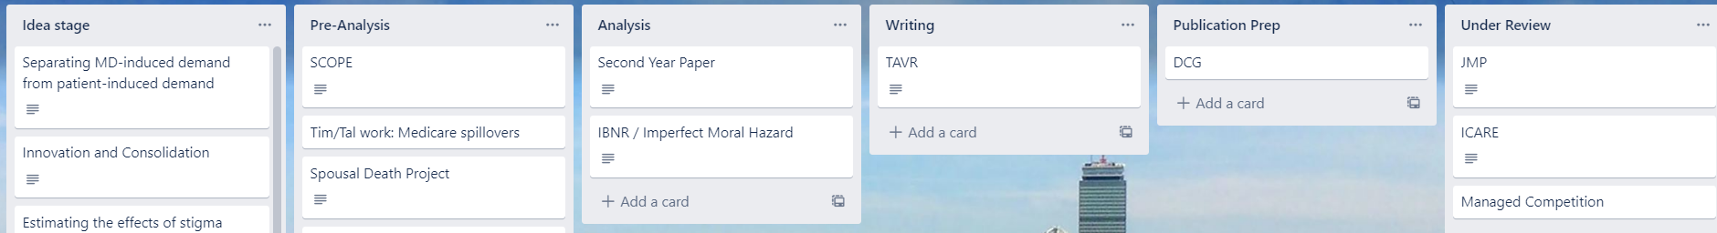
Principles of Clean Code: Task Management Software
Notes:
Trello is a great organizer for tasks. Don’t use email/slack, but rather a shared space just for the project. Another good one is Github Issues.

Slide 28
Principles of Clean Code
Automation
Version control
Abstraction
Documentation
Time / task management
Test-driven development (unit testing, profiling, refactoring) –
The only way to know that your code works is to test it!
Pair programming
Notes:
Test-driven development (TDD) consists of a suite of tools for writing code that can be automatically tested
Unit testing: checking that each piece of code works as you move through the structure. I recommend the testthat package for this
Profiling: how many resources does it take to run my code? Can I speed things up, make it faster, etc.?
Refactoring: can I make the code more readable / less redundant?

Slide 29
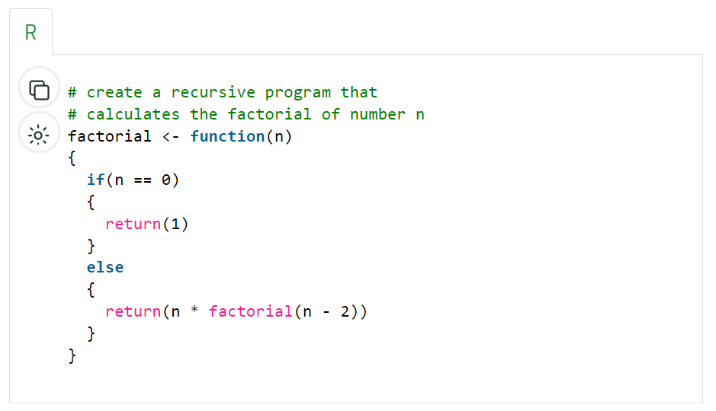
Unit Testing
Notes:
Suppose we have a function like this – we want to make sure that the function works for a set of values

Slide 30
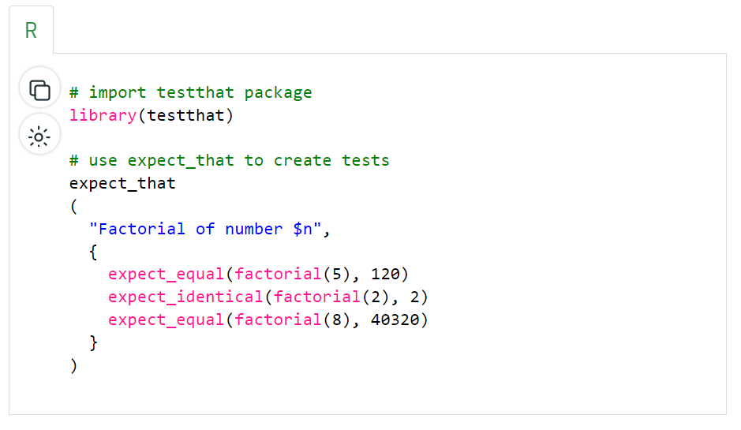
Unit Testing
Notes:
This package will test that!

Slide 31
Principles of Clean Code
Automation
Version control
Abstraction
Documentation
Time / task management
Test-driven development (unit testing, profiling, refactoring)
Pair programming – have people look at your code!
Notes:
Some people literally mean pair programming as in two people writing code together (one writes, another reviews simultaneously). But at any case, more than one set of eyes should look over all code (it’s definitely a learned skill to read code)

Slide 32
What are we Estimating?
Notes:
One of the most important things to remember from this course – what is your estimand, and is it useful? How? We need to be good stewards of our data and research, and talk accurately about how our research designs give us causal pathways.

Slide 33
Types of causal validity
Construct validity: are we measuring what we want to measure?
Notes:
What do we have in our data? Is it what we want to measure? What could we do to fix this? (what if we had a panel where we could see initial diagnosis – would that help? Why or why not?)

Slide 34
Types of causal validity
Construct validity: are we measuring what we want to measure?
Statistical validity: are your statistics correct?
Notes:
Are we doing the data cleaning appropriately? What about the log transform? The top-coding? How do we think about those?

Slide 35
Types of causal validity
Construct validity: are we measuring what we want to measure?
Statistical validity: are your statistics correct?
Internal validity: are your mechanisms correct?
Did you pick up the causal pathway you wanted?
Lots of threats!
Selection, omitted variable bias, attrition, seasonality, measurement error, spillovers
Each of these can affect your results
Notes:
Here is where we will spend the rest of our time this semester – did we deal with bias appropriately? What kind of confounding would exist in our study?
Not on this slide is external validity – what is/is not externally valid about our sample?

Slide 36
Answers are only as good as your data…and your question!
Where to find data
How to work with data (data cleaning)
How to design good research questions
Research designs: where we’re headed

Slide 37
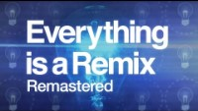
Framework: Everything is a Remix
Notes:
Thoughts? Some of my notes from this time around (not as huge a fan as the remix of the remix):
Part 1 (hip-hop and rap) Bass lines have been sampled hundreds of time – what does this mean? (write in the same language as prominent papers, use same robustness checks, don’t reinvent the wheel)
Lol to a whole new way to refer to “sampling” in this class
Remixing may seem like copying, but it’s actually something much more – it can empower you to be more creative.
But what is the difference between remixing and copying? “more of the same but different” – there is value in being familiar (but answering new questions, or the same questions with new ways). We don’t need to reinvent the wheel (monomyth).
What’s the monomyth for us? A good question + good data + good literature + good methods + good robustness checks. All written in the right package/style.
Part 2 (movies): borrowing from outside your genre – what field are you writing in? What methods from adjacent fields can you take (econ is great at this, in some ways). Into the Spiderverse was a good example (what’s original here? The combination of a lot of things!)
Watching the beginning of part 3 if possible might be good. (copy [apple] + combine [ford, printing press] + transform)
I miss the star wars bit! Can watch it here if interested.

Slide 38
So where do you find questions?
Reading papers is a good start, but not everything!
You don’t want to get caught in an echo chamber
Come to seminars!
Go see the big names when they come in
But also go see the works in progress, what your peers are working on, your faculty, etc.
Try to go to talks outside your field
Subscribe to newsletters
Academic journals, sure
But also things like: Axios Vitals, Postcall, etc.

Slide 39
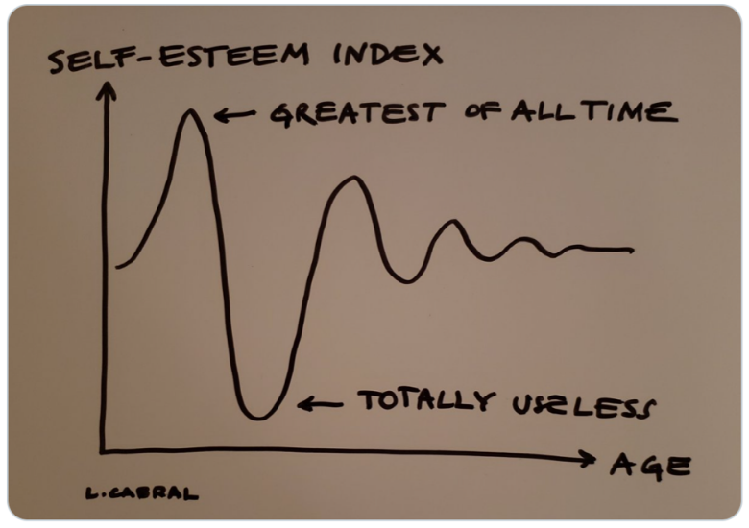
Stages of Research
Notes:
This is the truth about all projects!

Slide 40
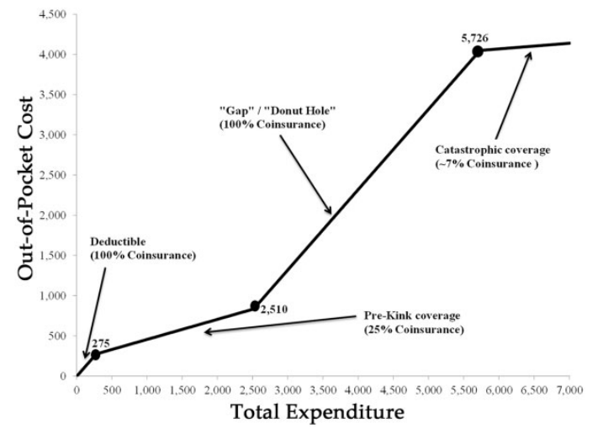
Descriptive Statistics are Your Friend!
1. Tell us something about the “story” you have in mind
Notes:
Update these slides since they are now in Lecture 2. Answer the question: what kind of descriptive evidence should I produce? What does exploratory analysis look like? See “Mere description” in the folder. Even though we’re after a causal pathway, a solid set of descriptive stats (or better, a single descriptive figure that tells your story) helps you to sell your work before it begins. By descriptives we mean just looking at patterns in the data, not trying to recover causal pathways.
Example: donut hole in Medicare (subsidies before/after a region, but a middle part where you have to pay 100% of expenses) (Einav, Finkelstein, and Schrimpf 2015)

Slide 41
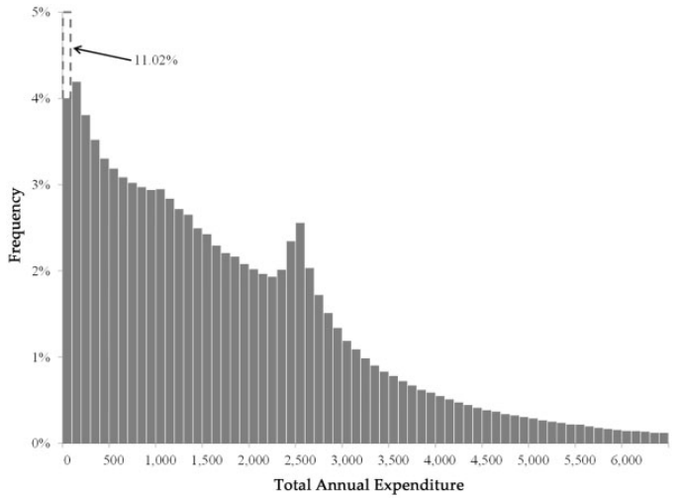
Descriptive Statistics are Your Friend!
Tell us something about the “story” you have in mind
You can argue the variation you’re exploiting in fact exists!
Notes:
In this case, the variation is bunching at the kink of the donut hole. Here we’re trying to move beyond just summary stats and into the key variation in your data (is it over time? Over geography? Over people?)

Slide 42
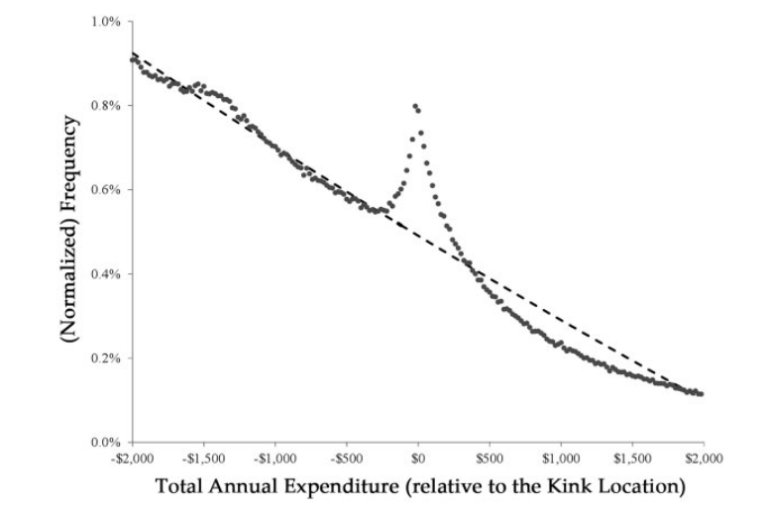
Descriptive Statistics are Your Friend!
Tell us something about the “story” you have in mind
You can argue the variation you’re exploiting in fact exists!
Notes:
In this case, the variation is bunching at the kink of the donut hole

Slide 43
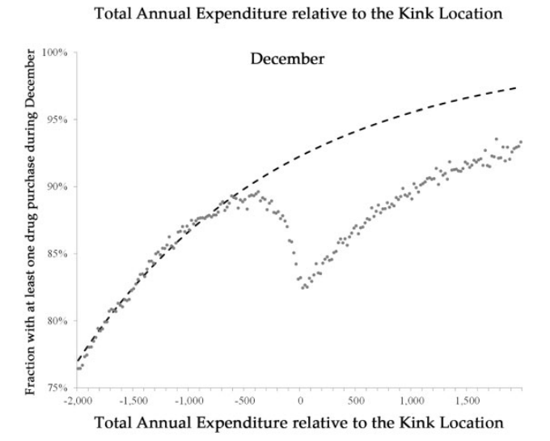
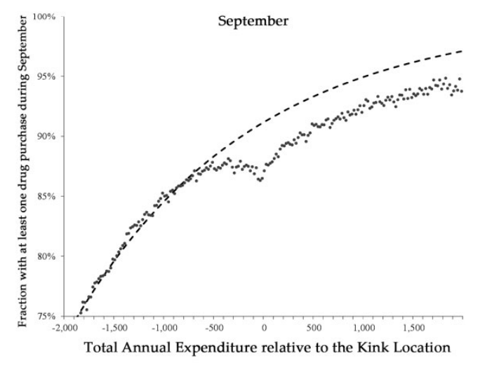
Descriptive Statistics are Your Friend!
Tell us something about the “story” you have in mind
You can argue the variation you’re exploiting in fact exists!
Informs and motivates your model
Notes:
In this case, show that consumers respond before the end of the year, but less than they do at the end of the year (so consumers aren’t fully forward looking). The descriptives provide evidence of a kink, but don’t allow you to quantify it without a causal model – ding ding ding you have a paper!

Slide 44
Descriptive Statistics are Your Friend!
Tell us something about the “story” you have in mind
You can argue the variation you’re exploiting in fact exists!
Informs and motivates your model
Don’t forget to say something about whom your sample is representative
Medicare Part D enrollees
Subject to the donut hole
Close to the kink point (since they are using a bunching strategy)
How does/doesn’t this generalize?
Notes:
Who are we looking at in this case? Seniors with Part D coverage – does that expand to other populations? Maybe, maybe not.

Slide 45
Selecting a Research Design
Notes:
With this framework of remixing and thinking about your estimand in mind, let’s talk about how to pick a research design?

Slide 46
Answers are only as good as your data…and your question!
Where to find data
How to work with data (data cleaning)
How to design good research questions
Research designs: where we’re headed

Slide 47
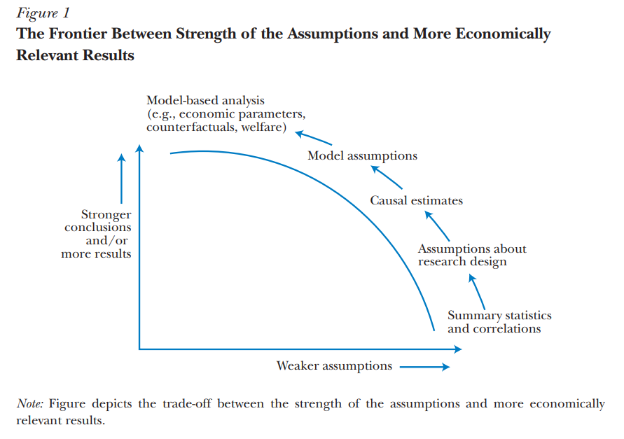
How do you pick a method?
Source: Mahoney (2022)

Slide 48
Model vs. Design-based Approaches
Approaches either rest on you having a DAG (model-based) or a good source of exogenous variation to identify data generating processes (design-based)
Examples of model-based: matching, controlling, IPW
Requires a big assumption about your DAG (and selection on unobservables)
Can go as far as structural model approaches
Examples of design-based: RCT, DID, IV
Need a specific set of data and circumstances (policy change, instrument)
Still making assumptions about an underlying model! But minimizing the set of assumptions and making them more transparent
Typically relies on what’s referred to as quasi-random variation
This is where we’re headed

Slide 49
Why models? Why not models?
Economic studies almost always have a “working model”
Can be as complicated as a formal microeconomic theory model
Or as simple as an OLS regression equation
But this framework specifies:
Whose behavior we are modeling
Under what constraints
With what sets of endogenous and exogenous variables (for now, choices vs. circumstances)
With what set of observed data
Working models require “suspension of disbelief” and narrowing of focus (no model is perfect!) but must also capture the question at hand
Notes:
Source: David Card’s lectures https://davidcard.berkeley.edu/lectures/woytinsky.pdf.

Slide 50
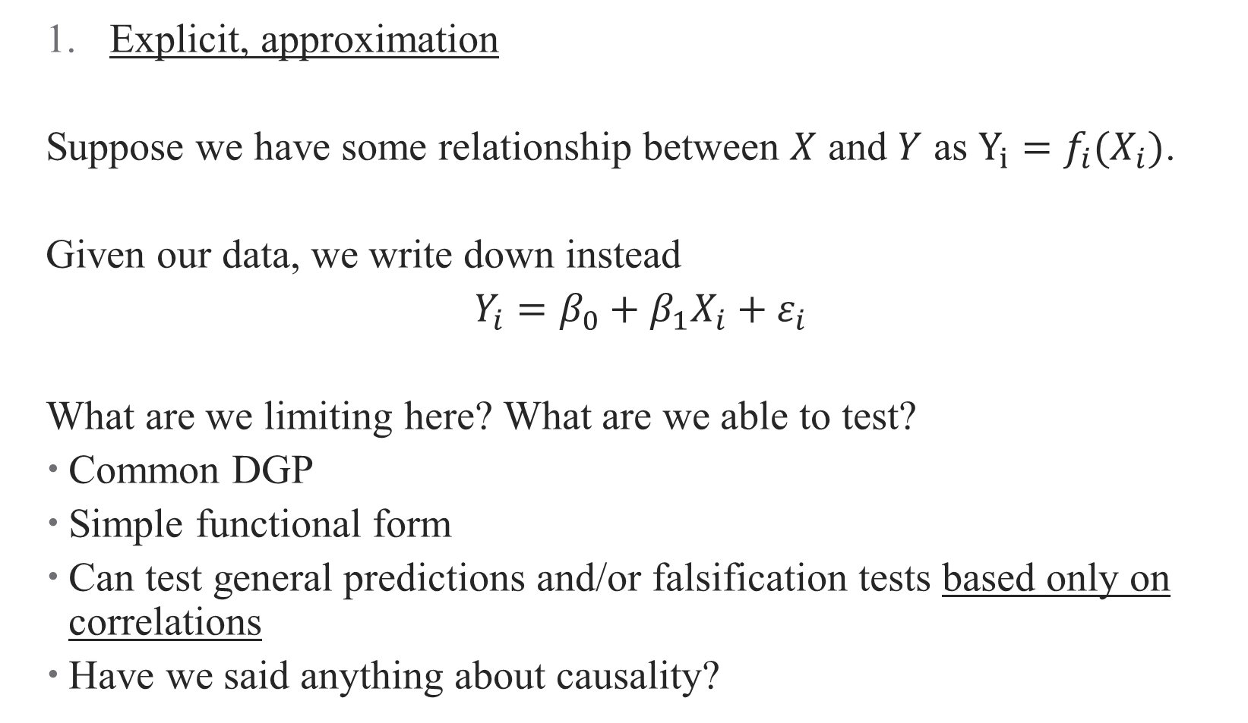
Three Examples of Models
Explicit, approximation
Suppose we have some relationship between $X$ and $Y$ as $Y_{i}=f_{i}(X_{i})$.
Given our data, we write down instead
$Y_{i}=β_{0}+β_{1}X_{i}+ε_{i}$
What are we limiting here? What are we able to test?
Common DGP
Simple functional form
Can test general predictions and/or falsification tests based only on correlations
Have we said anything about causality?
Notes:
Source: David Card’s lectures https://davidcard.berkeley.edu/lectures/woytinsky.pdf.

Slide 51
Three Examples of Models
Explicit, approximation
Explicit, (more) exact
We could go to the other extreme, and set a full model (e.g., structural model)
Specify the complete data generating process (e.g., all utility functions for each individual-outcome pair + unobserved heterogeneity in tastes)
Doing so yields a fully-specified (over-specified) demand system that identifies many parameters
Estimation is extremely complicated
Each identified parameter requires a unique identifying assumption – strong set of assumptions!
Notes:
Source: David Card’s lectures https://davidcard.berkeley.edu/lectures/woytinsky.pdf.

Slide 52

Relying on Theoretical Frameworks
Almost all frameworks are theories of change (causal pathways)
But how can a framework motivate a design?
Write your research question as explicitly as possible
Draw a DAG! Take time thinking about open back- and front-doors
Maybe build the DAG into a theoretical model
DAG + model $⇒$ Regressions, assumptions, even identification!
Notes:
Building a model may require some calculus to solve it, but provides useful insights into relative comparative statics, what the real parameter of interest is (hint: usually a first/second derivative). Can embed these even further into a structural approach (more on this in a separate course, if there is demand?)

Slide 53
Three Examples of Models – why design-based?
Explicit, approximation
Explicit, (more) exact
Implicit
So frequently, we do something that’s more in the middle
Rather than specify a behavioral model explicitly, we focus on a single causal relationship and identify it using quasi-exogenous variation:
What is the effect of job training on employment/income? Find a state that randomized people to take job training and evaluate their outcomes relative to a control state
What are the advantages/disadvantages of this?
Notes:
Source: David Card’s lectures https://davidcard.berkeley.edu/lectures/woytinsky.pdf. Limited extrapolation/external validity for one. No understanding of underlying behavior either. Example: what’s the effect of a health shock? What is the quasi-exogenous variation we are using? What’s the one-equation model?

Slide 54
So what do we get from design-based inference?
Counterfactuals and causality
In many ways, the identification becomes the research design
It defines the counterfactual estimation when the design is credible
Descriptive + Causal Evidence
Without a full structural approach, many papers become “storytelling”
You present a set of descriptive + causal evidence, sometimes under the umbrella of a formal model (“applied theory”) and sometimes just as a narrative
Replicability
Credible replication of your own results
Credible replication of results in other contexts/data/etc.
Notes:
Source: David Card’s lectures https://davidcard.berkeley.edu/lectures/woytinsky.pdf. Example: what’s the effect of a health shock? What is the quasi-exogenous variation we are using? What’s the counterfactual?

Slide 55
What kinds of methods will we cover?
Matching
What if I don’t have a good natural control group for estimation?
Instrumental Variables
Difference-in-differences
Synthetic Controls
“Applied OLS”: Logit, Poisson, fixed-effects, quantile regression, etc.
Next semester: regression discontinuity, event studies, and more!
Notes:
There are a whole lot more too!

Slide 56
What kinds of methods will we cover?
Matching
What if the behavior I’m trying to measure is “manipulable” (endogenous)?
Instrumental Variables
Difference-in-differences
Synthetic Controls
“Applied OLS”: Logit, Poisson, fixed-effects, quantile regression, etc.
Next semester: regression discontinuity, event studies, and more!
Notes:
There are a whole lot more too!

Slide 57
What kinds of methods will we cover?
Matching
How can I measure differences arising from policy changes?
Instrumental Variables
Difference-in-differences
Synthetic Controls
“Applied OLS”: Logit, Poisson, fixed-effects, quantile regression, etc.
Next semester: regression discontinuity, event studies, and more!
Notes:
There are a whole lot more too! Lots of spins on this we will cover

Slide 58
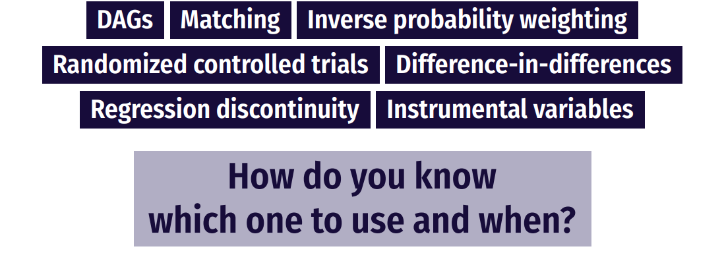
How do you pick a method?
Notes:
So in the proposal, next week you need to tell me what your question is and your team – not your method! Unless you have a good idea of one. But you do need to select a method by Nov. 1, and if you want to do a DD for example, you will need to look at the code ahead of time. I recommend talking to me about your method choices in this context! (I know there’s a tradeoff here in that you have to look ahead at resources we haven’t covered quite yet, but the value is that you get to practice applying the method most relevant to your research question).

Slide 59
Choosing an Empirical Strategy
Your empirical strategy consists of two (related) components:
Estimation strategy: what is estimated, how, inference, etc.
Put equations in your papers!
Identification strategy: what allows making a causal statement?
Do you have experimental variation?
Balance?
Is there endogeneity in your design?
(reverse causality, heterogeneity, measurement/omitted error)
Notes:
Don’t be scared of regression equations – in fact, formalizing them will help you see threats to identification and improve your estimation approach.

Slide 60
Where do we get the identification?
So what are the specific data and circumstances we need to answer a question?
The method you use will depend on the variation you have
Variation across units?
Across time?
Policy changes
Weird policy rules?
Instruments?
Notes:
You’ll develop an intuition for this over time. Talk to lots of people about your thoughts!

Slide 61
Communicating Findings

Slide 62
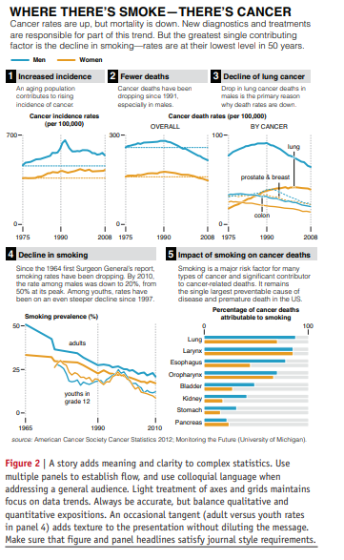
Data Viz
Schwabish (2014):
Show the data
Reduce the clutter
Integrate the text and the graph
See some helpful slides and examples here
Notes:
Figures are the most important thing about a paper – no, really. I think this is why TWFE took off more than anything else – the figures. Read this article in Github repo. How does the data viz stack up to some of these principles

Slide 63
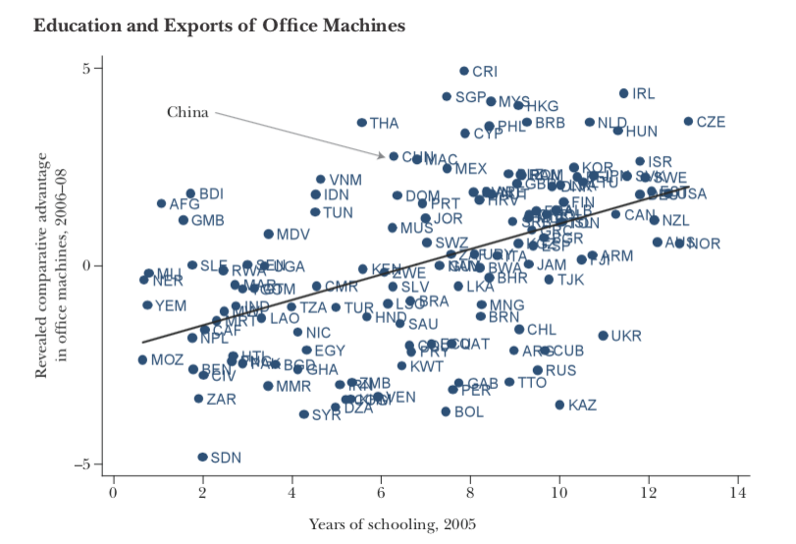
Data Viz: Before (1/2)
Notes:
What are some problems with this? This graph is super easy to make in R – but it pays to take the tmie to clean it up.

Slide 64
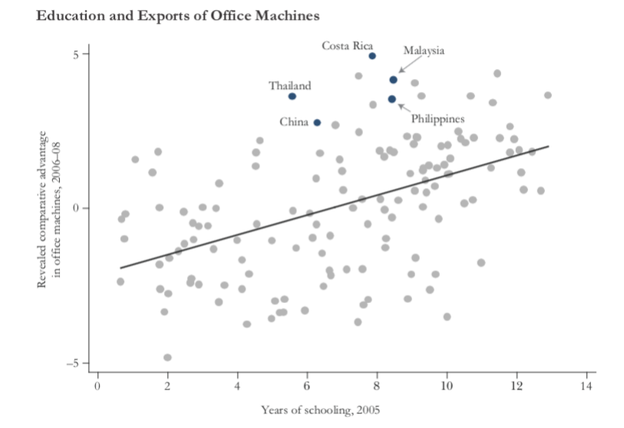
Data Viz: After (1/2)
Notes:
How is this better/ What does it tell us about the paper without reading it?

Slide 65
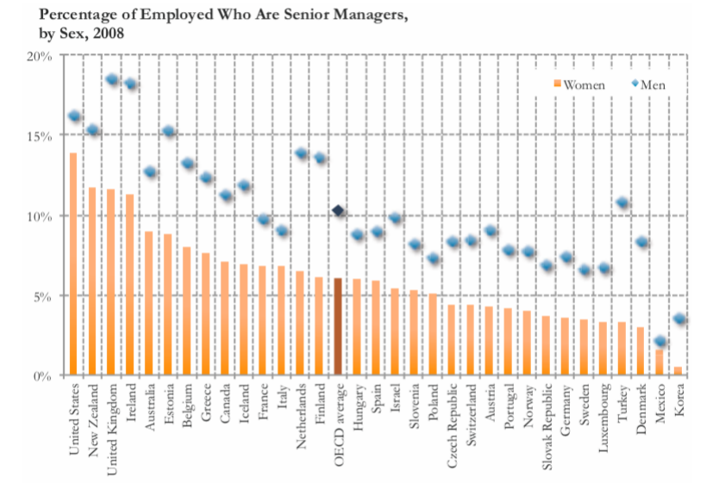
Data Viz: Before (2/2)
Notes:
This chart just doesn’t tell the story we want it to!

Slide 66
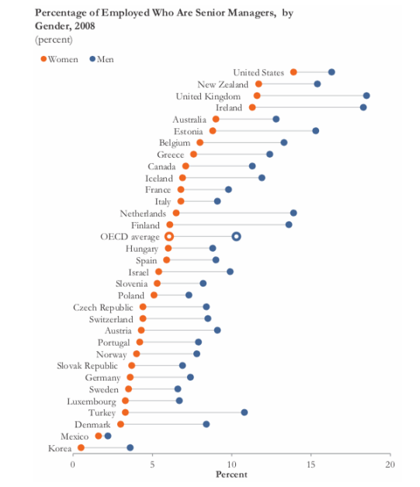
Data Viz: After (2/2)
Notes:
Now what’s the takeaway?

Slide 67

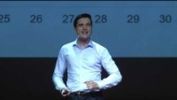
Data Storytelling and Making Good Charts
Notes:
If there’s time, data storytelling ted talks (probably will have to skip). Start with #1 if time.
* Ideas should be simple, and you should focus on one. People think I do this, but really I do this (start at 6minutes)

Slide 68
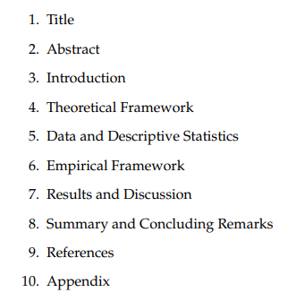
Writing a Paper
Academic writing is formulaic – take advantage of that!
Notes:
Follow the outlines!

Slide 69
Writing a Paper
Academic writing is formulaic – take advantage of that!
Copy good writers
Prioritize good writing – it will make your papers more successful
Some other good sources:
Marc Bellemare “How to Write an Applied Economics Paper”
Neil Mahoney “Principles for Combining Descriptive and Model-Based Analysis in Applied Microeconomics Research”
Notes:
What’s more, just copy structures of papers you think are good (literally – table 1 does X, etc.) This both makes your writing better and makes it easier for reviewers.

