Slide 1
Quant Methods in HSR I
Lecture 11: Causal Machine Learning for HSR
March 30, 2026
HAD5744 • Alex Hoagland, Ph.D.

Slide 2
ML in Causal/Descriptive HSR Research:
A Short Primer
Notes:
Note: although comps papers can now be quant in nature (and should be!) you can also do review papers. I thought this was a really well-done review paper, what did you think?

Slide 3
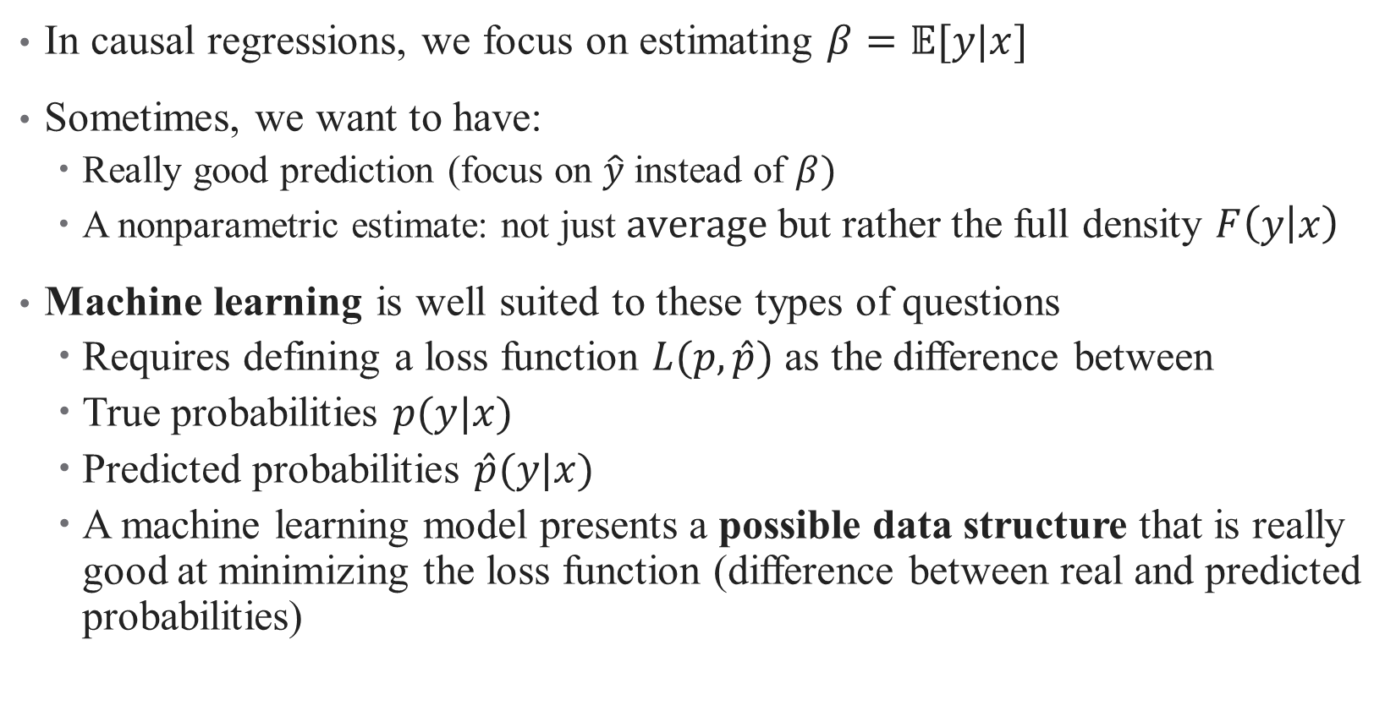
Conditional Density Estimation
In causal regressions, we focus on estimating $β=𝔼[y|x]$
Sometimes, we want to have:
  Really good prediction (focus on $\hat{y}$ instead of $β)$
  A nonparametric estimate: not just $average$but rather the full density $F\left(y | x\right)$
Machine learning is well suited to these types of questions
  Requires defining a loss function $L(p,\hat{p})$ as the difference between
  True probabilities $p(y|x)$
  Predicted probabilities $\hat{p}(y|x)$
  A machine learning model presents a possible data structure that is really good at minimizing the loss function (difference between real and predicted probabilities)

Slide 4
What is ML good for? What is it not good for?
Advantages:
  Really great at prediction
  Can be useful in building out descriptive stats
  Can also be useful for decomposition analyses
Disadvantages:
  Cannot handle deep assumptions about the structure of the DGP
  For example, cannot model selection bias or endogeneity without ex-ante assumptions by researcher (which defeats purpose of ML)
  On its own, then, generally insufficient for causal questions
  Can be combined with other methods to get causality (double debiased ML + IV)
Notes:
Going to show you brief intuition for both of these approaches; others in the sample paper.

Slide 5
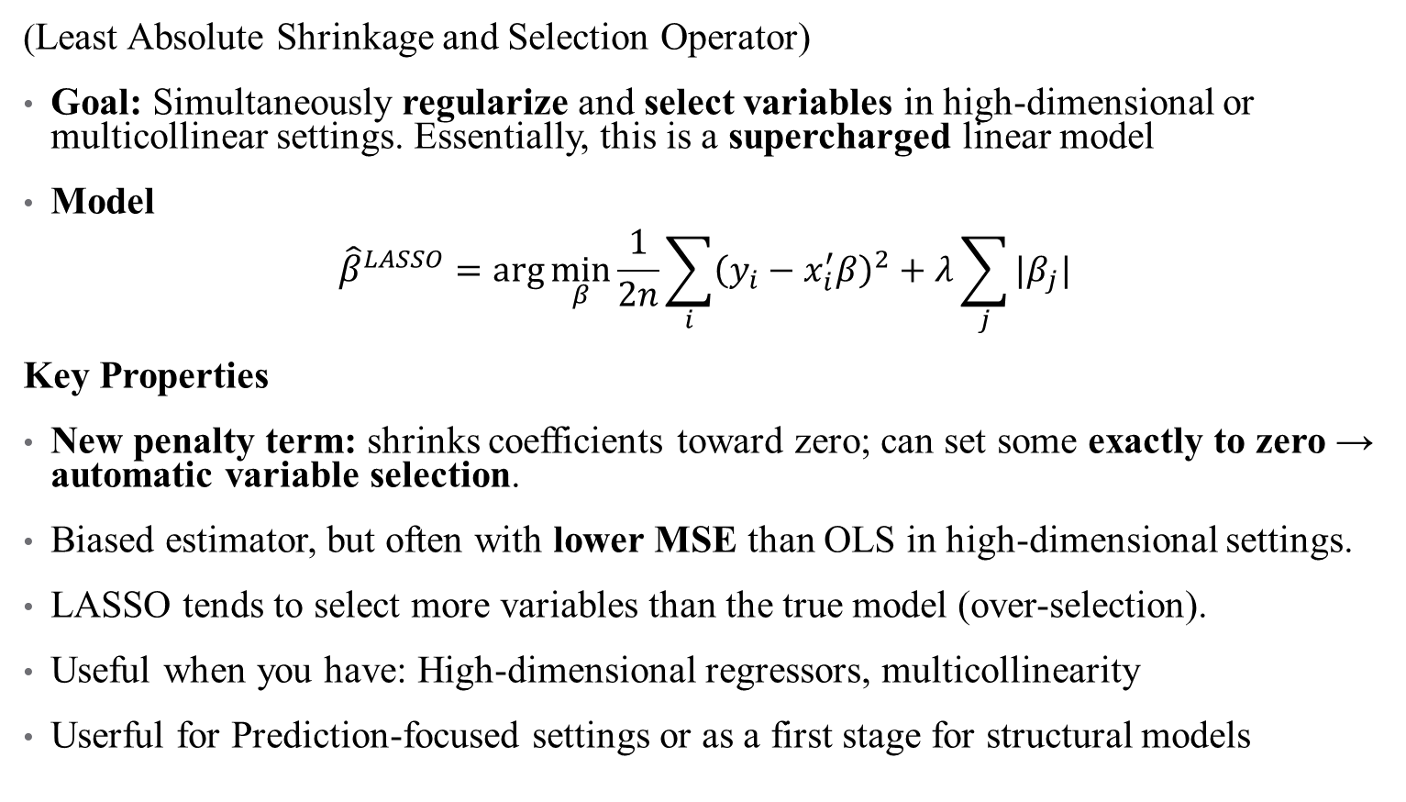
Option 1: LASSO
(Least Absolute Shrinkage and Selection Operator)
Goal: Simultaneously regularize and select variables in high-dimensional or multicollinear settings. Essentially, this is a supercharged linear model
Model
$${\hat{β}}^{LASSO}=\arg{\min_{β}{\frac{1}{2n}\sum_{i}{{\left(y_{i}−x_{i}^{′}β\right)}^{2}+λ\sum_{j}{|β_{j}|}}}}$$
Key Properties
New penalty term: shrinks coefficients toward zero; can set some exactly to zero → automatic variable selection.
Biased estimator, but often with lower MSE than OLS in high-dimensional settings.
LASSO tends to select more variables than the true model (over-selection).
Useful when you have: High-dimensional regressors, multicollinearity
Userful for Prediction-focused settings or as a first stage for structural models
Notes:
Other similar options: elastic net/ridge regression. Lets you build a model that includes millions of covariates.

Slide 6

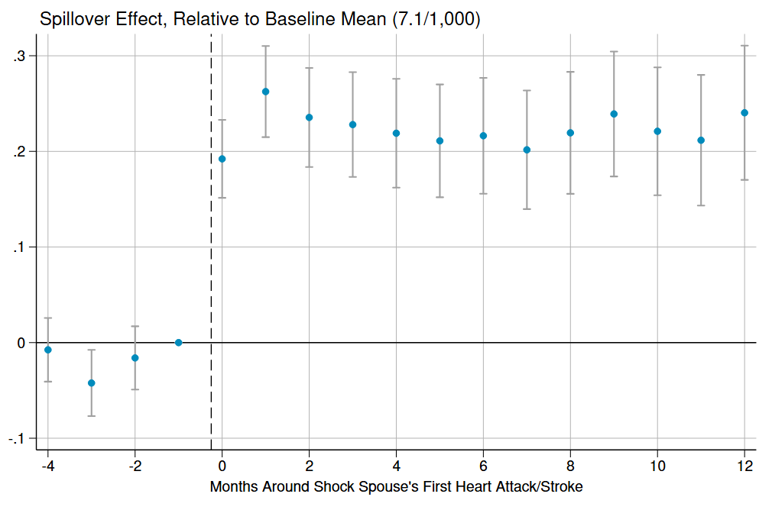
A LASSO example
The question: how does losing access to a source of informal care affect takeup of formal care among the elderly?
Research design: Dynamic difference in differences using quasi-exogenous variation in when shocks occurred to households
Notes:
Email me for R or stata code – this is always changing. Main question here: what is the effect of a partner’s health shock on takeup of formal eldercare? But there are two possible channels: a health effect and a substitution effect

Slide 7
A LASSO example
The question: how does losing access to a source of informal care affect takeup of formal care among the elderly?
Research design: Dynamic difference in differences using quasi-exogenous variation in when shocks occurred to households
Mechanisms: What could drive this effect? On the one hand, you might have a substitution effect: simply can’t get informal care, so you need formal care
Notes:
Email me for R or stata code – this is always changing. Main question here: what is the effect of a partner’s health shock on takeup of formal eldercare? But there are two possible channels: a health effect and a substitution effect

Slide 8
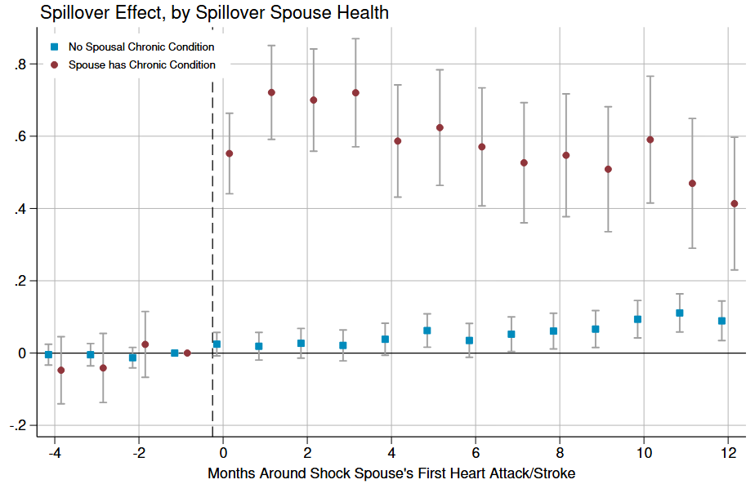
Formal Care Effects Larger for Spouses Requiring Care
Outcome spouse has a chronic condition
Outcome spouse does not have a chronic condition
Notes:
Chronic conditions include ADRD, cancer (colorectal, lung, or prostate), chronic kidney disease, COPD,hip fractures, and strokes

Slide 9
A LASSO example
The question: how does losing access to a source of informal care affect takeup of formal care among the elderly?
Research design: Dynamic difference in differences using quasi-exogenous variation in when shocks occurred to households
Mechanisms: What could drive this effect? On the one hand, you might have a substitution effect: simply can’t get informal care, so you need formal care. On the other hand, you might have health effects: especially things like “heartbreak effect”
Notes:
Email me for R or stata code – this is always changing. Main question here: what is the effect of a partner’s health shock on takeup of formal eldercare? But there are two possible channels: a health effect and a substitution effect

Slide 10
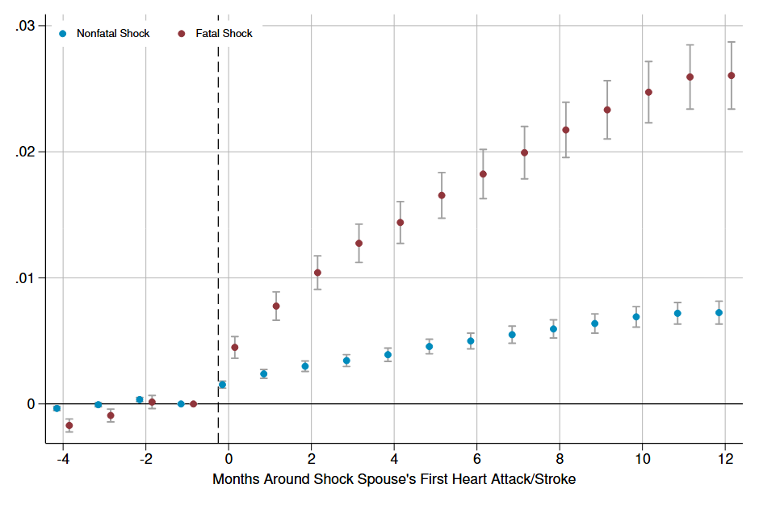
Health Effects: Mortality

Slide 11
A LASSO example
The question: how does losing access to a source of informal care affect takeup of formal care among the elderly?
Research design: Dynamic difference in differences using quasi-exogenous variation in when shocks occurred to households
Mechanisms: What could drive this effect? On the one hand, you might have a substitution effect: simply can’t get informal care, so you need formal care. On the other hand, you might have health effects: especially things like “heartbreak effect”
Main role for ML: how can we decompose the relative effects here?

Slide 12
Decomposition
Data requirement: All SNF stays must be preceded by hospitalization to qualify for Medicare payment. We have rich administrative data here we can exploit!
Theoretical motivation: SNF effect could come from 2 sources:
  Normal “flow” of hospitalizations shift from discharge home to discharge to SNF in absence of spouse (substitution effect)
  New hospitalizations = more SNF stays (health effect)
Use ML prediction (LASSO) at hospitalization level to predict the underlying probability of being discharged to a SNF
  Based on patient demographics and hospitalization clinical characteristics
Notes:
* So a hospitalization for fever can still happen at the same rates, but without a spouse, you’re more likely to go to a SNF
* However, if your hospitalizations happen more often or for more complex reasons, your predicted probability of SNF discharge would go up in LASSO model (health effects)

Slide 13
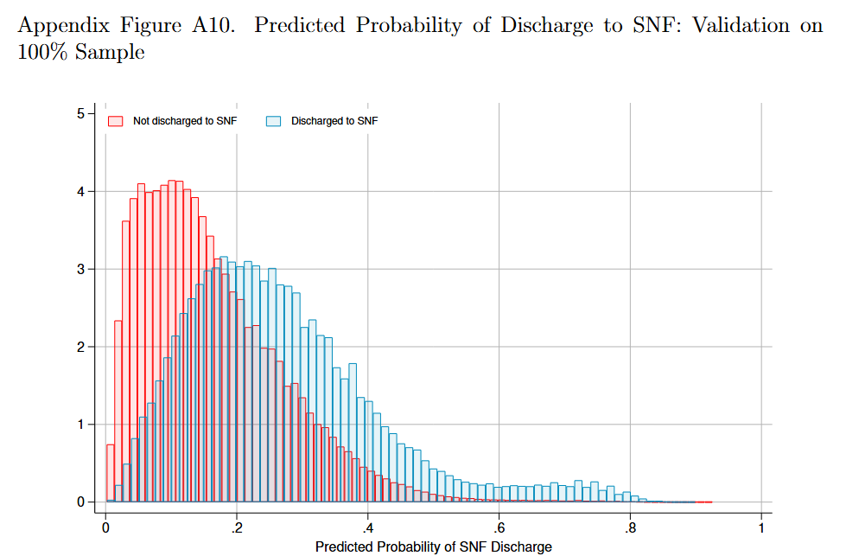
Decomposition
Notes:
What do you see here?

Slide 14
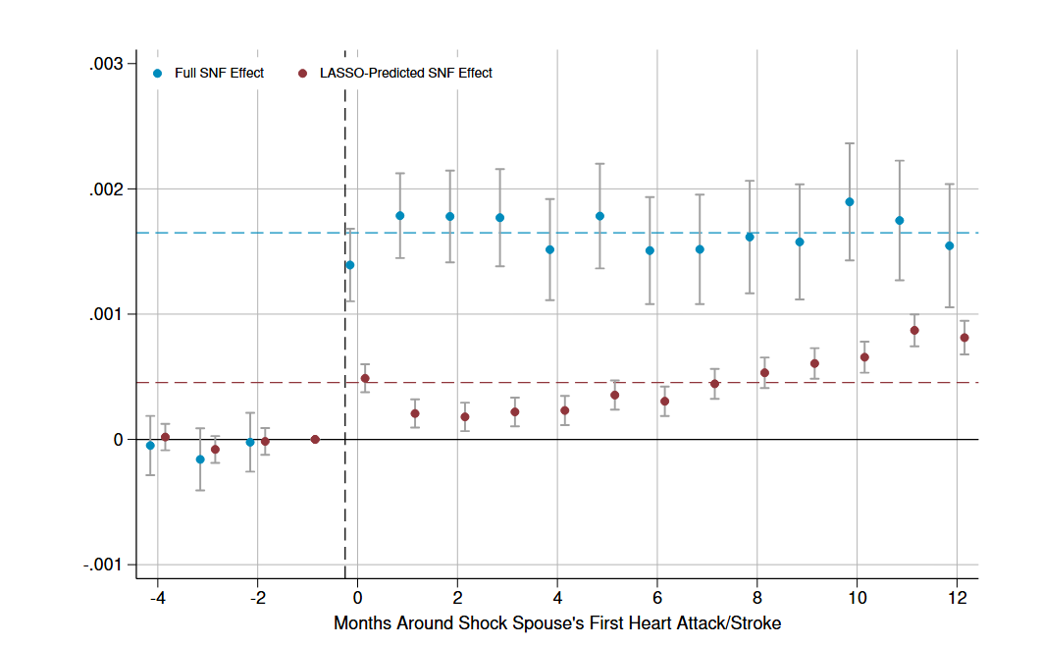
Change in Predicted Pr(SNF Discharge)
Notes:
Roughly 28% health effects, majority (72%) substitution!

Slide 15
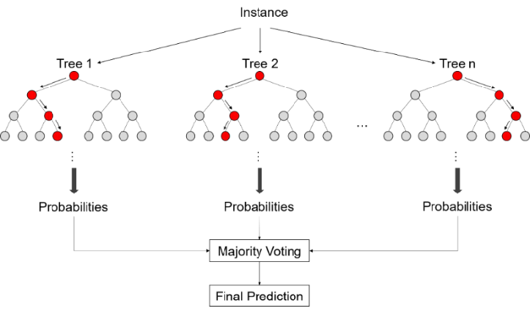
Option 2: Random Forests
A more explicitly prediction approach to regression
  Rather than coefficient estimation based on averages of errors,
  Split data into trees based on “cut-points” in data
  Trees are chosen in order to maximize predictive power of data
Forests: bootstrapping over the trees!
  There is new terminology here: bagging, boosting, etc. But the concepts are similar
These methods were applied best as predictive methods, so causality is not always apparent
  But causal methods are being developed; see papers in Github repo
  Sometimes we care about prediction too! (e.g., risk adjustment)
Notes:
Cut-points – rules for how to bin data in order to assign prediction (e.g., if we’re predicting expenses, at what age do expenses go down (2?) and then up again (50?). Once we’ve done that cut, what’s the next best way to cut – by sex (older men versus older women)? And so on.)

Slide 16
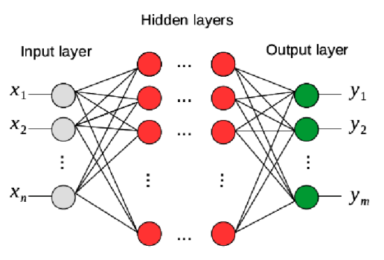
Option 3: Neural Networks
Random forests are a collection of individual decision trees
Neural networks are a group of connected “neurons”
  These neurons process data in “layered” steps
  These layers can be unidirectional (feedforward NN) or circular (feedback NN)
  Ultimately, the neurons “learn” complex functions/DGPs using many nonlinear transformations of data
Advantages: extremely flexible, Capture complicated nonlinearities & interactions automatically.
Drawbacks: Require extremely large data sets, have many hyperparameters that need tuning, prone to overfitting
  Makes training these more of an “art”
Notes:
Neurons are similar to trees

Slide 17
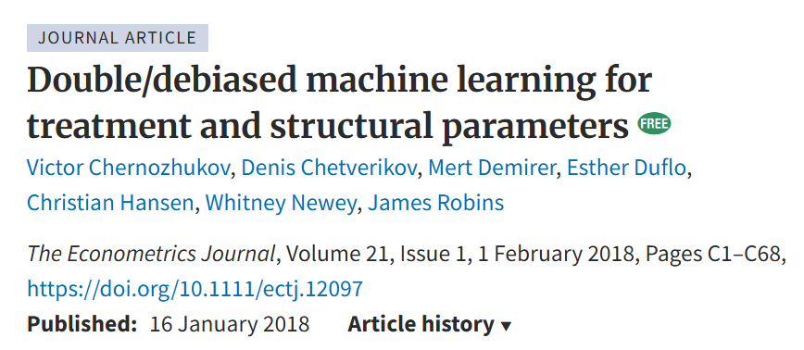
Can this ever be causal?
Many econometricians (and others) are working on developing causal methods for machine learning
One place where this is really promising: learning coefficients on endogenous regressors with a combination of IV methods.
Intuition: ML models can help generate a stronger instrument (first stage is all about prediction) and can then be jointly/nonlinearly embedded into a 2SLS regression
Notes:
Neurons are similar to trees

Slide 18
An example: in progress
Suppose we care about the effect of child maltreatment investigations on household wellbeing (why?)
The DAG looks something like this
Caseworker variation (leniency design)
Investigation
Outcome
Selection
Notes:
What’s the structure here?

Slide 19
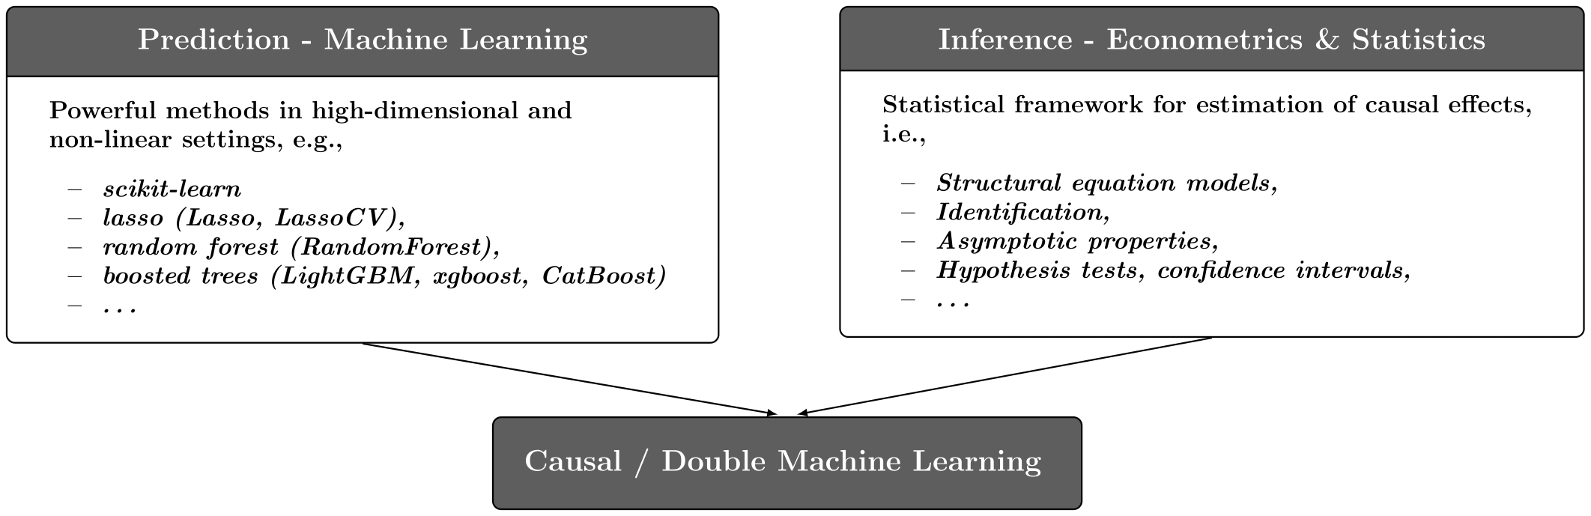
An example: in progress
A prediction model can use rich demographics on both the endogenous treatment (investigation) and outcomes to boost the IV’s power:
Use a LASSO/other model to predict investigations based on both the instrument and observables
Use another LASSO/ML model to predict outcomes (e.g., graduation rates)
Take the residuals from both predictions (double ML)
Estimate 2SLS on these residuals
Notes:
Example: in BC, there’s this early-learning development instrument.

Slide 20
Choosing the “Right” research design

Slide 21

How do I pick the “right” research design?
You don’t!
There are no perfect research designs, everything is a tradeoff
Example: running an RCT vs. using quasi-experimental data to investigate vaccine takeup/effectiveness
Notes:
Talk about CTR as a motivating example – is there only one right choice?
Let’s talk about some of your research questions – what kinds of questions are you interested in or already studying?

Slide 22
How do I pick the “right” research design?
Your research design helps you be clear about:
Your estimand (what parameter am I trying to recover)?
Your assumptions (what am I already seeing about the data)?
Your policy relevance (where will my results be useful, and where won’t they)?

Slide 23
A starting point: what is the right experiment?
Quantitative research is all about identifying a data generating process
Better understanding of this process means better policy design!
If we could design any experiment or collect any ideal data to answer your question, what would it be?
Notes:
“a macabre thought experiment”

Slide 24
3 Types of Quantitative questions
Descriptive
Predictive
Causal
Notes:
What kinds of questions are you asking? Generally your question falls into one of these three categories.
Go through each of these with an example. We’re going to think about their relative strengths and weaknesses with an example: escape rooms

Slide 25
Descriptive Questions
What is happening?
Quantify and summarize data
Foundation for further analysis
Notes:
This is the stage of *looking for clues* in an escape room.
Example questions: What is the prevalence of diabetes in Ontario? What is prevalence across regions, groups, etc.?
How has hospital readmission changed over 10 years?
What are the demographics of patients accessing telehealth?
How are two variables correlated or related (not necessarily in a causal way)?

Slide 26

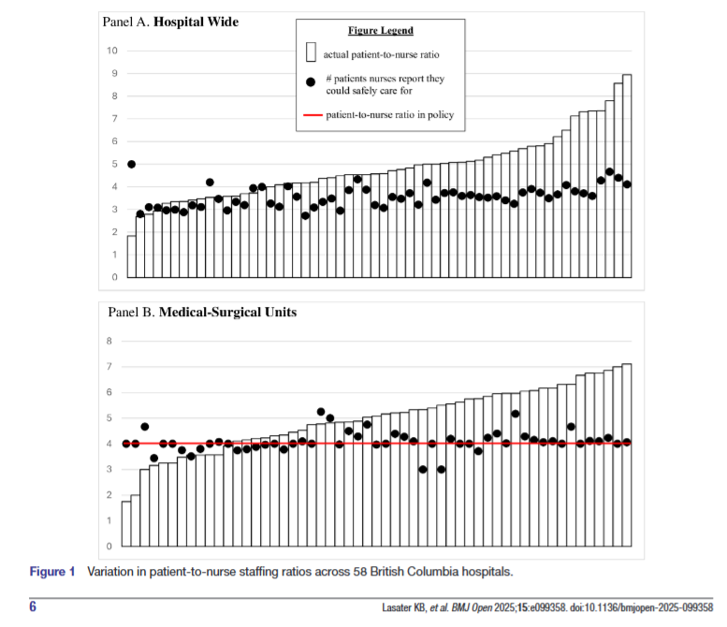
Descriptive papers are storytelling
Summary statistics (mean, median, rates)
Cross-tabulations
Time trends and line plots
Histograms and bar charts
Geospatial mapping
Notes:
Source: https://doi.org/10.1136/bmjopen-2025-099358
Focus on summarizing patterns – think about descriptive papers as storytelling. There are no modeling assumptions required so you’re not filling in the whole picture (nothing on what is causing this or what its effects are on patient outcomes), but you are illustrating patterns in the data. A good figure is really all you need.

Slide 27
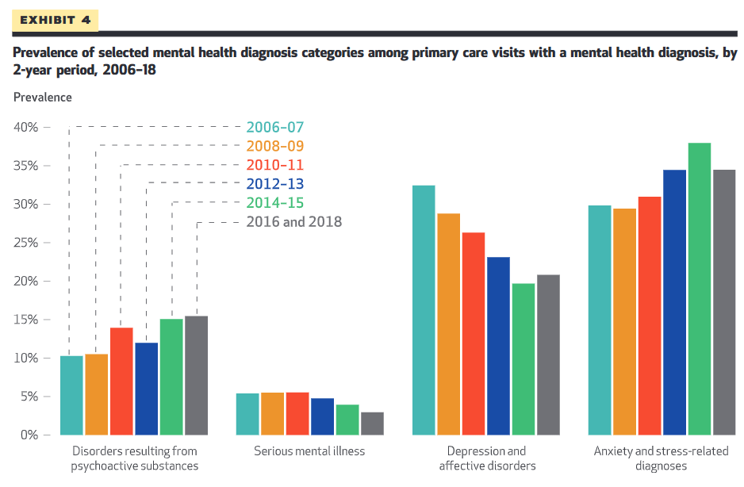
Descriptive papers are storytelling
Summary statistics (mean, median, rates)
Cross-tabulations
Time trends and line plots
Histograms and bar charts
Geospatial mapping
Notes:
Source: https://www.healthaffairs.org/doi/10.1377/hlthaff.2022.00705
Focus on summarizing patterns – think about descriptive papers as storytelling. There are no modeling assumptions required so you’re not filling in the whole picture, but you are illustrating patterns in the data. A good figure is really all you need.

Slide 28
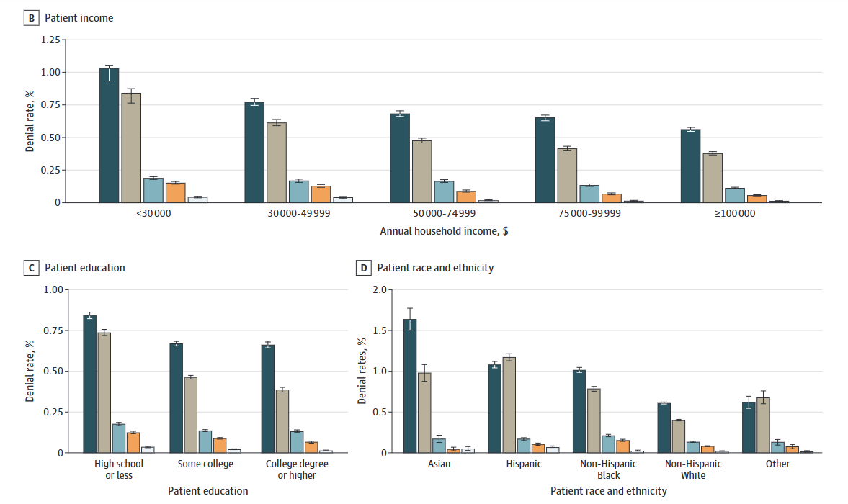
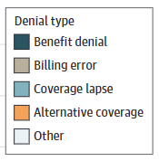
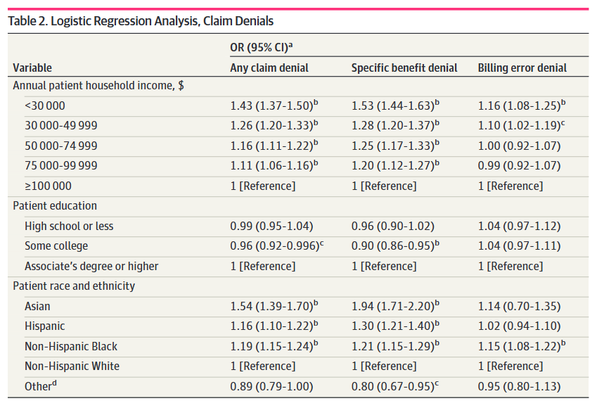
What about fancier methods?
Notes:
Once you tell the story, then you can incorporate regression adjustment , time trends, etc. But the methods here are secondary to the patterns in the data, so these papers are more about asking the right questions and cutting the data in the right way (like an escape room – what details are you *noticing*)?
Note: what are the pitfalls and assumptions here? Representative sample
Accurate measurement
Clear definitions (e.g., prevalence)
Avoid overgeneralization
Source: https://jama.jamanetwork.com/article.aspx?doi=10.1001/jamanetworkopen.2024.33316&utm_campaign=articlePDF%26utm_medium=articlePDFlink%26utm_source=articlePDF%26utm_content=jamanetworkopen.2024.33316

Slide 29
Predictive Questions
What will happen?
Estimate future outcomes
Focus on accuracy, not causality
Notes:
This is the stage of the escape room where you start to tie the clues together. You don’t move all the way to causality but you notice something like, “If I move to this corner of the room, this light starts flashing.” And you start to identify (predict) which clues are important.
Prediction is about forecasting, not about understanding mechanisms. We explicitly don’t model pathways.
Some example questions: Which patients are at risk of hospital readmission?
Can we predict opioid overdose using EHR data?
What factors predict high-cost patients?

Slide 30
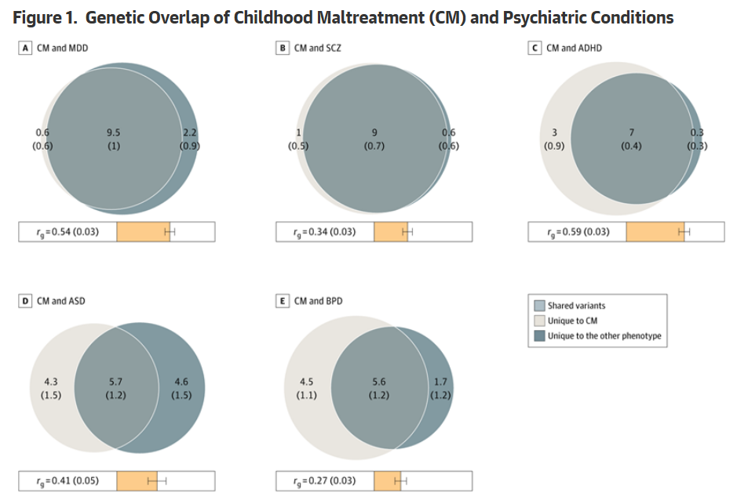
Methods for predictive modeling
Logistic/linear regression
Decision trees, random forests
Gradient boosting
Neural networks
Notes:
Basically all AI here!
Discuss trade-offs: interpretability vs accuracy
Importance of validation
Source: https://jamanetwork.com/journals/jamapsychiatry/fullarticle/2833167. Main question: can we predict those at risk of maltreatment based on phenotype profiles (here using psychiatric conditions)?
Figure notes: “Venn diagrams showing MiXeR results of the estimated number of phenotype variants shared between CM and psychiatric conditions. Circles represent shared variants, variants unique to CM, and variants unique to the other phenotype. The number of shared variants (and SEs) are shown in thousands. The size of the circles reflects the polygenicity of each phenotype, with larger circles corresponding to greater polygenicity. The estimated genetic correlation (r_{g}) between CM and each phenotype is shown below the corresponding Venn diagram, with an accompanying scale (−1 to +1) with orange representing a positive genetic correlation. ”

Slide 31
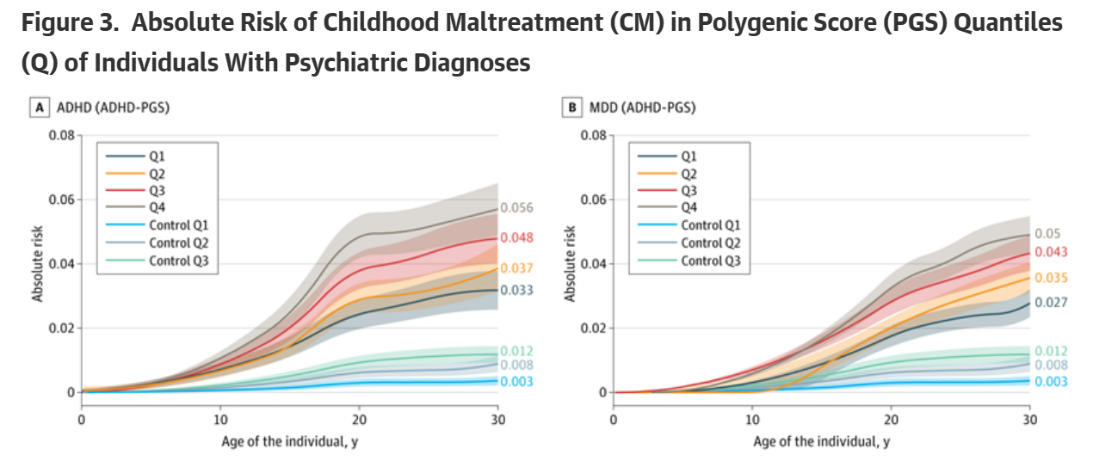
Methods for predictive modeling
Focus is on accuracy, interpretability, and validation
Rigorous methods to avoid overfitting and identify a (stable) data-generating process
No need for causal assumptions but you lose the “story” a bit (e.g., no temporality)
Notes:
Assumptions and rules here:
Stable data-generating process
No need for causal assumptions
Avoid overfitting
Use AUC, RMSE, calibration plots
Biggest thing: not a causal question here
Source: https://jamanetwork.com/journals/jamapsychiatry/fullarticle/2833167

Slide 32
Causal Questions
What is the effect of X on Y?
What mechanisms explain this effect?
How would policy influencing X affect Y?
Notes:
This is the stage of *using the clues* in an escape room.
Example questions: What is the effect of Medicaid expansion on ER visits?
Does a sugar tax reduce soda consumption?
How does telemedicine affect follow-up adherence?

Slide 33
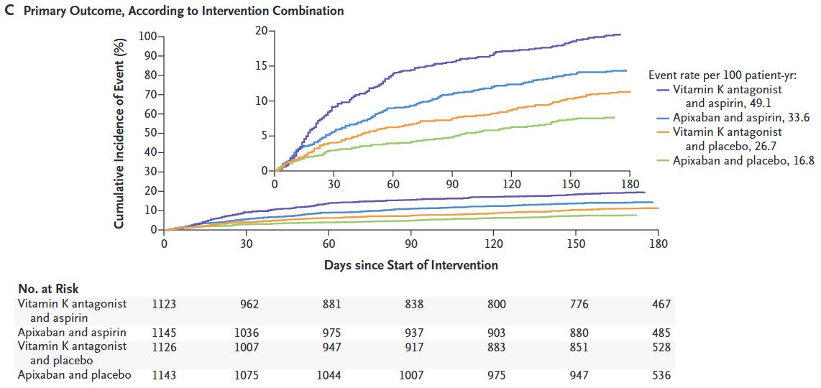
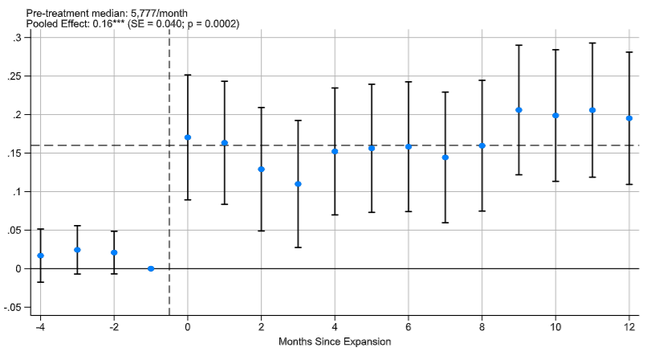
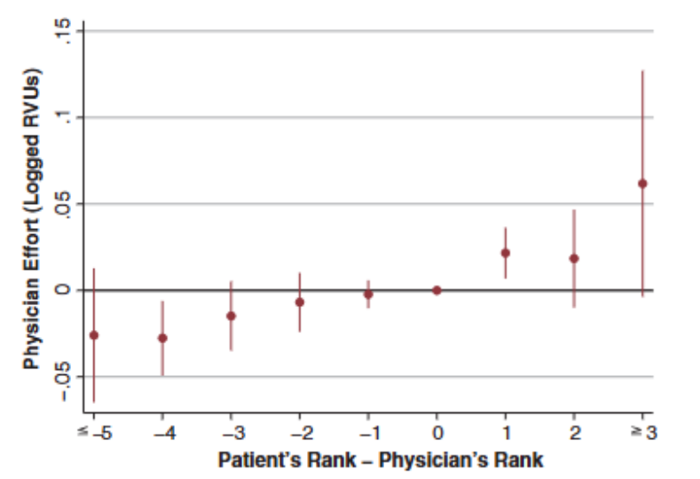
Causal: Methods
Notes:
These questions tend to take up the most space, and so there are a LOT of methods to think about here. I’ve highlighted three here: matching, IV, and DD. But we also have RCTs, RD, synthetic control, a whole lot of others.
The important thing is that here your estimand and your assumptions become really important.
Quasi-experimental variation: what is it about your data that you can exploit? What is it about your setting that you are the expert on, that you can use to find identifying variation?
Sources:
Appropriate antithrombotic regimens for patients with atrial fibrillation who have an acute coronary syndrome or have undergone percutaneous coronary intervention. https://doi.org/10.1056/NEJMoa1817083.
Role of military rank (“power”) on physician effort: https://www.science.org/doi/epdf/10.1126/science.adl3835.
3. Pharma SOP expansion in Ontario https://doi.org/10.1016/j.jhealeco.2025.103051.

Slide 34
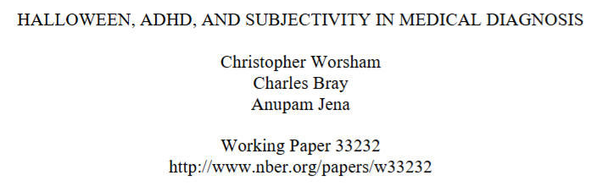
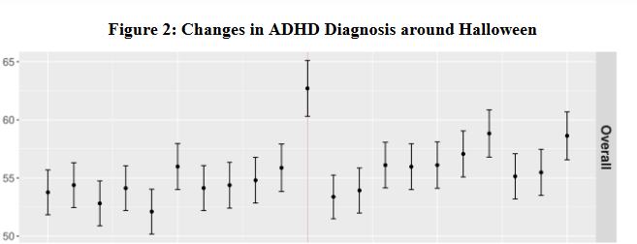
What design do I pick? What’s my variation?
Notes:
Example: Halloween and ADHD diagnoses. Think about (1) approximating an experiment using (2) identifying variation you know and can exploit. Questions to consider:
Is there a natural policy change I can use?
Is there a staggered rollout? Is there heterogeneity in the population’s level of exposure to my exposure (lol) and can I use that as exogenous in some way?
What behaviors are endogenous and what are exogenous? [Sometimes writing or drawing a simple model may help]
Are there “off the shelf” methods I can use or remix? IVs? What has the literature already identified as problematic or useful here?

Slide 35
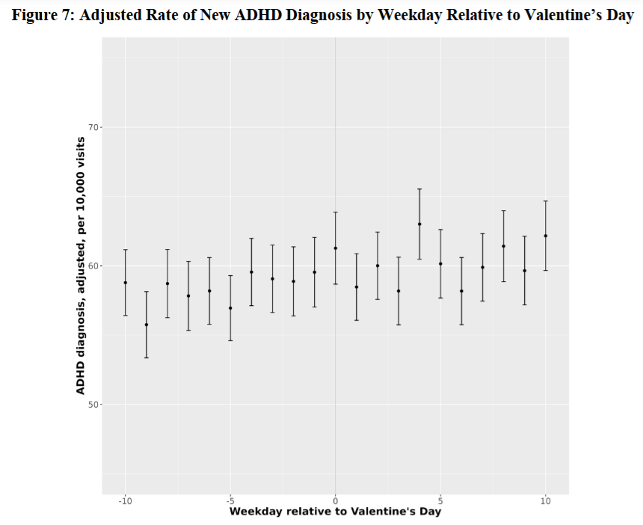
What design do I pick? What’s my variation?
Notes:
Useful to have insight to tell your story robustlessly too (robustness checks and descriptive stats count almost as much as identification!)

Slide 36
Causal results are powerful but fragile
Causal strategies are useful to:
Estimate average treatment effects
Support causal claims for policy
Conduct counterfactual analysis and even welfare calculations
However, they:
Require untestable (and sometimes strong) assumptions
Generally recover treatment effects for a specific group – premium on internal validity over external validity
Need for robustness checks

Slide 37
Choosing the Right Method
1. What is your research question? What is your ideal experiment?
2. Do you want to describe, predict, or explain?
3. What data and variation do you have?
4. What assumptions can you justify?
5. What is the policy goal?
Notes:
Note – you will also go through a lot of bad or underbaked ideas before you get the right bake

