Slide 1
Health Econometrics I
Lecture 6: Matching Methods
October 25, 2024
HAD5744 • Alex Hoagland, Ph.D.
Notes:
Things to mention:
Case studies
Format for Assignment 2
Upcoming seminar series (job talks)
Final paper/referee reports questions + timelines
Marking and Notes on Assignment 1: default grade for everything is an A (not an A+, which I rarely give out). In general, your grade will be an A- or an A unless you do really well or really poorly – think about what you want from graduate marks and how that might get in the way of your learning.
With interaction term, make sure you include the levels and the transformation if appropriate. Highlight #9 in particular, talk about colliders in the DAGs maybe? Are people working together? Cite your teams if so – and also do work together! Some code cross-pollination is a good thing

Slide 2
Where were we? Multivariate OLS
Flexibility of regression:
Options for variables (binary variables, scaling, transformations)
Interactions
Nonlinear effects which are linear in parameters
Standard errors:
Heteroskedasticity
Autocorrelation
Clustering
Other features:
Omitted Variable Bias
Measurement Error
Collinearity

Slide 3
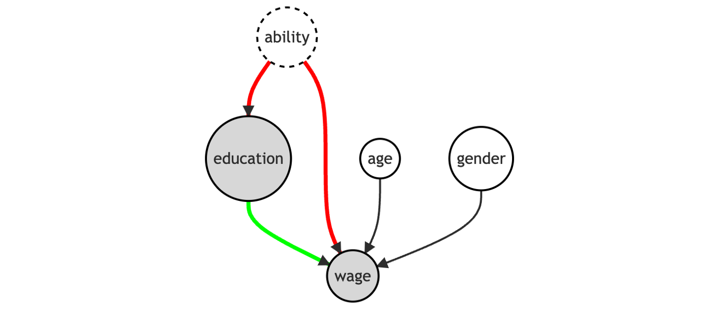

Causal Inference: Satisfying the Backdoor Criterion
If we want the effect of $X$ on $Y$, we need to satisfy the backdoor criterion
Notes:
We could throw everything into a regression, but what if we can’t close all back doors?

Slide 4
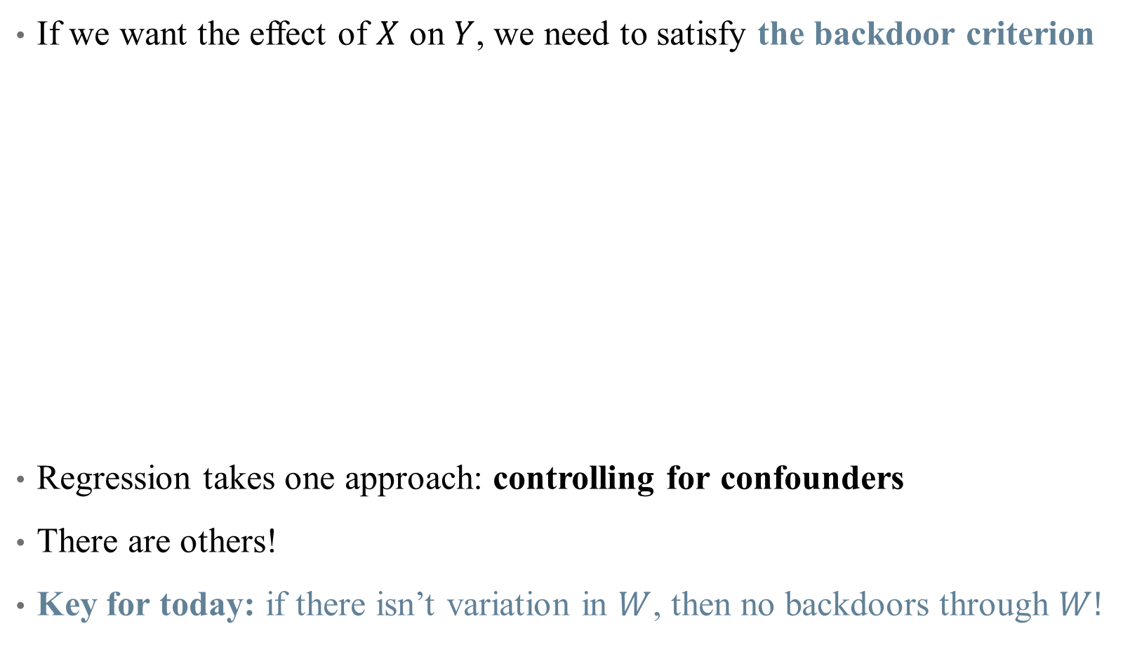
Causal Inference: Satisfying the Backdoor Criterion
If we want the effect of $X$ on $Y$, we need to satisfy the backdoor criterion
Regression takes one approach: controlling for confounders
There are others!
Key for today: if there isn’t variation in $W$, then no backdoors through $W!$
Notes:
Draw this DAG on the whiteboard – erase links between ability and education (removes omitted variable bias)

Slide 5


Causal Inference: Satisfying the Backdoor Criterion
If we want the effect of $X$ on $Y$, we need to satisfy the backdoor criterion
Key for today: if there isn’t variation in $W$, then no backdoors through $W!$
Notes:
This is the magic of randomization! It’s what makes an RCT so powerful – here, we will approximate it (design-based inference) by selecting a subset of our data where individuals look similar (including in ability), but where treatment is quasi-randomly assigned.

Slide 6
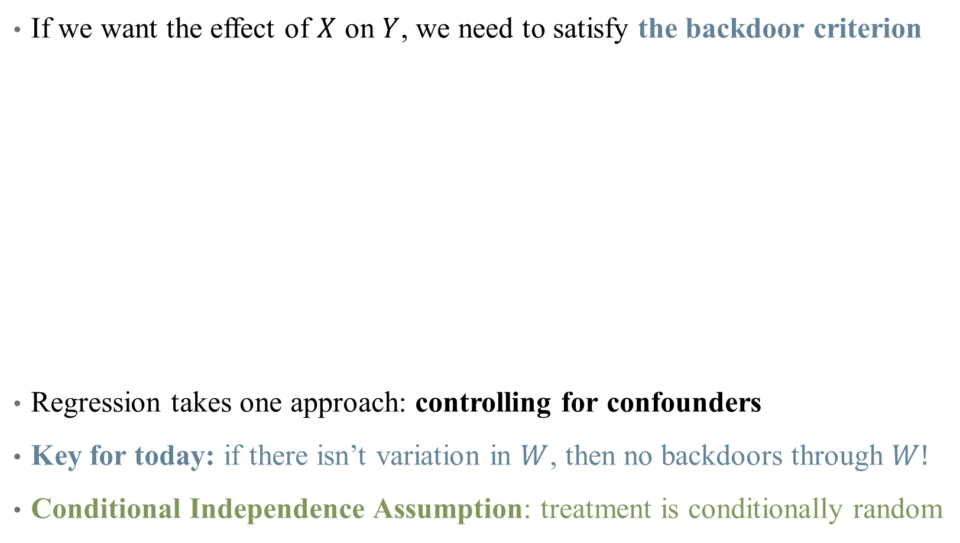
Causal Inference: Satisfying the Backdoor Criterion
If we want the effect of $X$ on $Y$, we need to satisfy the backdoor criterion
Regression takes one approach: controlling for confounders
Key for today: if there isn’t variation in $W$, then no backdoors through $W!$
Conditional Independence Assumption: treatment is conditionally random
Notes:
Here, conditionally random is conditional on regression controls, but on matching.

Slide 7
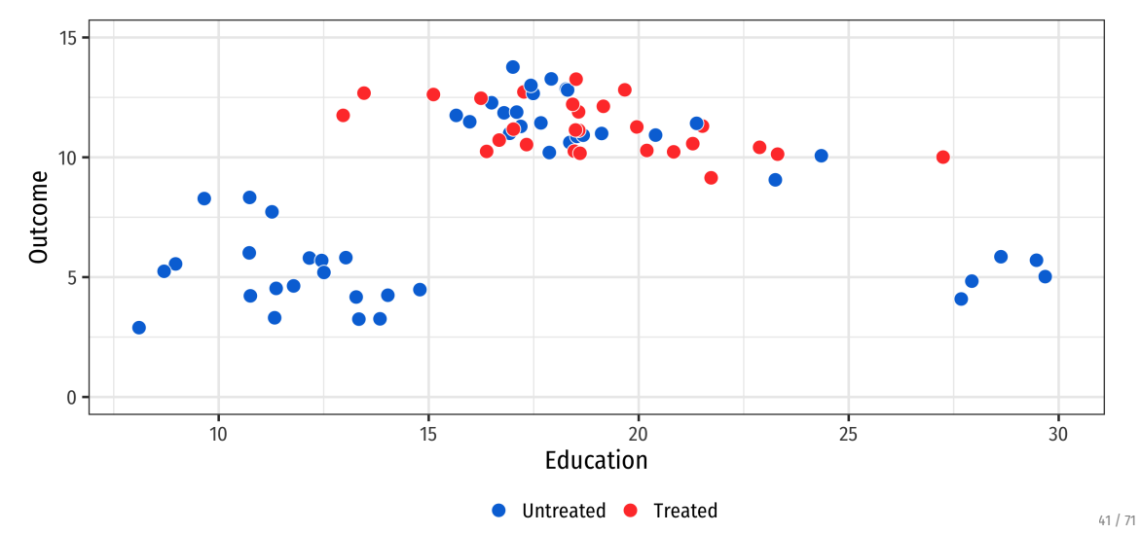
Matching reduces model dependence
Notes:
Why is just controlling for education here not enough? You’re still using the data! In health, suppose you want to compare how a heart attack affects a family – if you just throw in controls for age/sex/risk/etc., you’re still using data on the triathlon runners against the heart attack families.
Reducing model dependence means that researcher discretion is limited – you’re really comparing apples to apples. Suppose we have this data and want a treatment effect

Slide 8
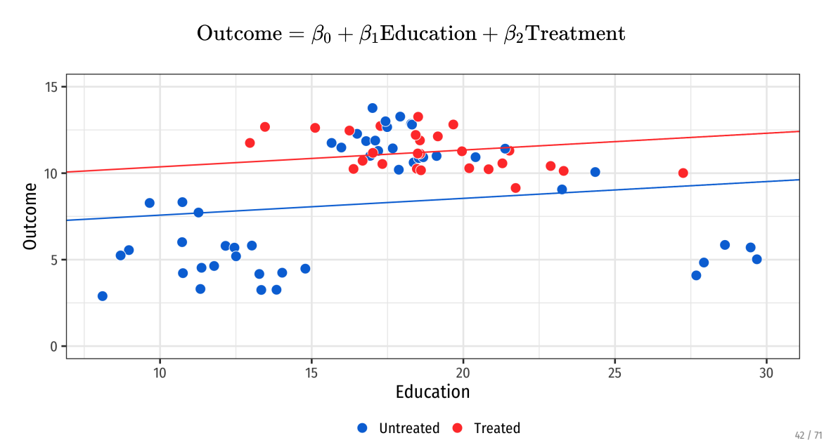
Matching reduces model dependence
Notes:
This is what happens if you pool all data. We can try either a linear regression (what’s the treatment effect)

Slide 9
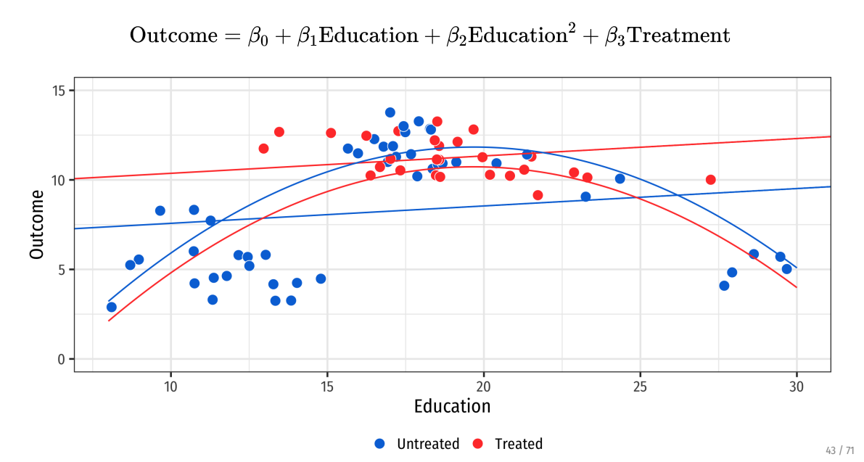
Matching reduces model dependence
Notes:
Or we try a quadratic fit – now the ATE is flipped? Which is correct?
Can anyone see what the problem is (we have untreated outliers that are skewing regressions – we don’t want these observations because they aren’t comparable to treated group)

Slide 10
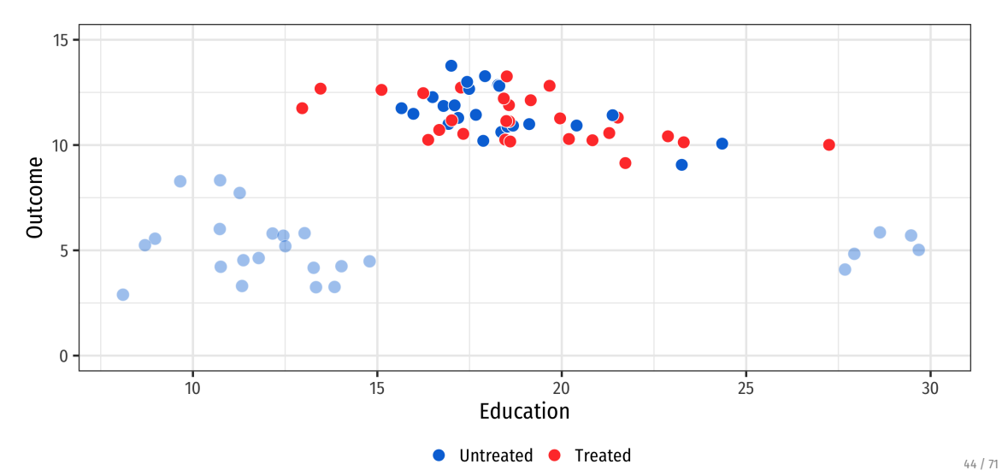
Matching reduces model dependence
Notes:
So drop these observations – now line and quadratic tell similar stories

Slide 11
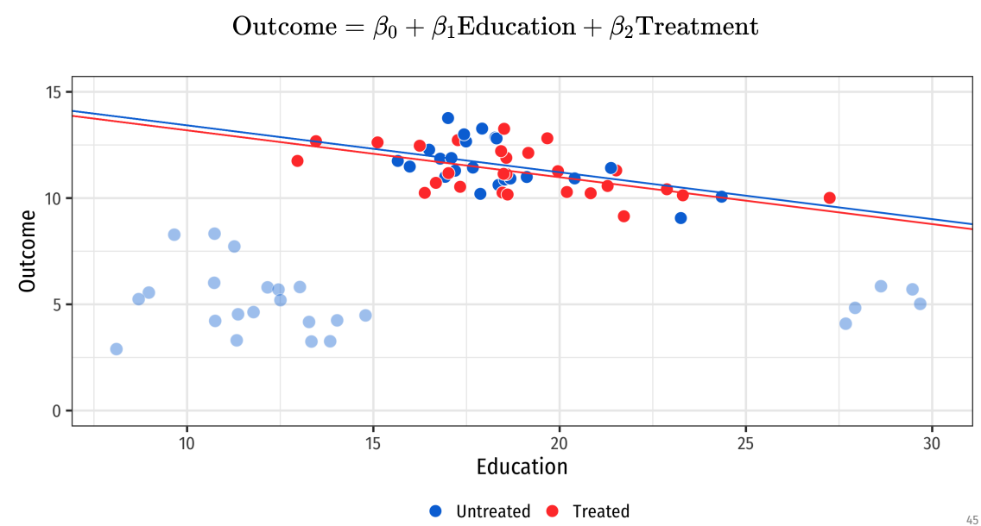
Matching reduces model dependence
Notes:
So drop these observations – now line and quadratic tell similar stories

Slide 12
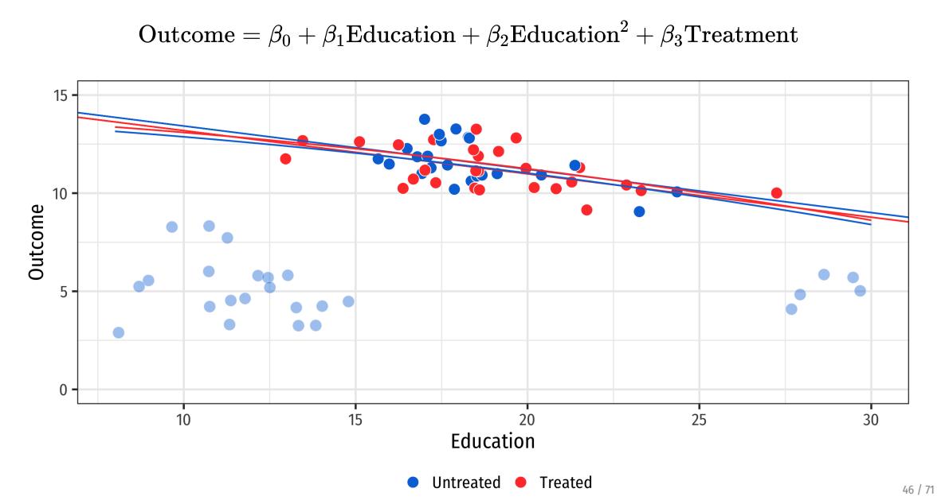
Matching reduces model dependence
Notes:
Without need to fit the poorly matching observations, models tell a story that reflects the data we care about. (That’s the kicker philosophically here – is there data we can say we “care more about”)?

Slide 13
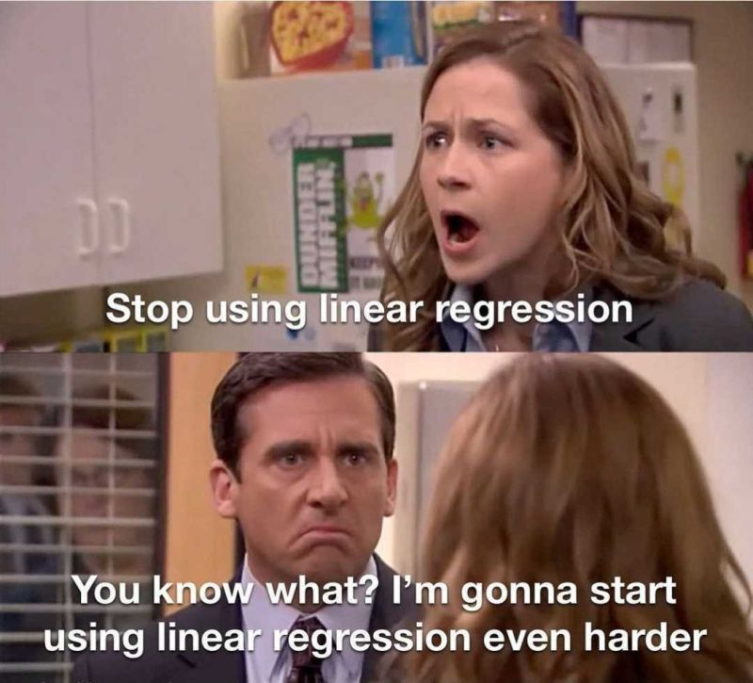
Matching combines well with regression!
Notes:
Really, it’s not matching or regression – it’s matching + regression! Appropriate data selection + model selection can be your friend.

Slide 14
Today: Matching
Matching methods are used to balance groups along observable characteristics
Matching in Concept
Single-Variable Matching Strategies:
Subclassification
Exact matching
Approximate matching
Multiple Matching Variables
Propensity score matching
Assumptions and Caveats

Slide 15
Example: The Effect of Unemployment Benefits on Health
Shahidi et al., 2019 Social Science and Medicine

Slide 16
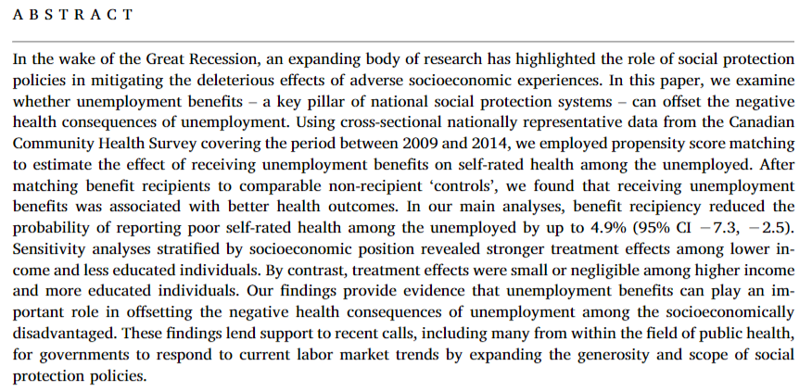
Matching combines well with regression!
Notes:
Note: still using association. Why? What might be imperfect about matching?
Discussion questions:
What is the importance of this question? (deteriorating labor market conditions will produce adverse effects on the health of socioeconomically vulnerable population)
What are the outcomes? What is the independent and dependent variable here? How are they defined and is it okay? (unemployment benefit recipiency on self-rated health)
Why can’t we do an RCT here?
What is the comparison without matching? What are the open back doors we need to close? (main problem: selection into unemployment based on health; secondary: recipients of unemployment benefits tend to exhibit a more favourable socioeconomic profile than their nonrecipient counterparts.)

Slide 17
Matching combines well with regression!
Notes:
Note: still using association. Why? What might be imperfect about matching?
Discussion questions:
What is the importance of this question? (deteriorating labor market conditions will produce adverse effects on the health of socioeconomically vulnerable population)
What are the outcomes? What is the independent and dependent variable here? How are they defined and is it okay? (unemployment benefit recipiency on self-rated health)
Why can’t we do an RCT here?
What is the comparison without matching? What are the open back doors we need to close? (main problem: selection into unemployment based on health; secondary: recipients of unemployment benefits tend to exhibit a more favourable socioeconomic profile than their nonrecipient counterparts.)

Slide 18
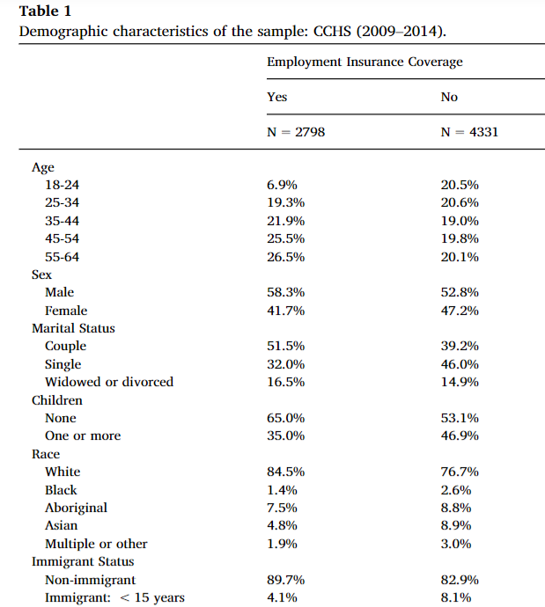
Why do we need matching?
Notes:
Balance tables! How do we interpret these?

Slide 19
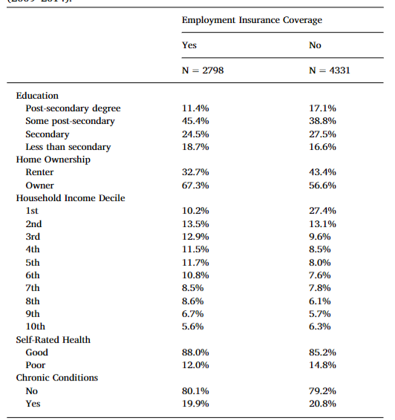
Why do we need matching?
Notes:
Balance tables! How do we interpret these?

Slide 20
Matching in Concept

Slide 21

What do we want to do with matching?
Example: what is the effect of unemployment benefits on health outcomes?
Let’s look at a simple regression
What could contribute to differences in expenses?
Initial health state
Education
Income
Etc.
Matching helps to “balance out” these covariates
Notes:
Want to do some visualizations in R to look at and replicate (ish) the “unbalance” table

Slide 22
Step 1: Preprocessing (matching) data
Main matching algorithm
We want to match treated observations to similar control observations
What will our matching criteria be? (what is “similar”?)
Are we assigning matches or weights?
How many matches will we select?
How will weights decay with distance?
What is the worst acceptable match?
Notes:
Preprocessing should be informed by the causal model you have in mind (you guess something about what is non-random in treatment assignment and fix it)

Slide 23
Step 2: Estimation
The matched sample becomes our new analytical sample
Once we establish balance, we can mimic the analysis of an RCT!
Calculate difference in means
Can build out a more complicated model, but generally the matching is the hard part
Notes:
Note: what is the regression to identify difference in means between two groups?

Slide 24
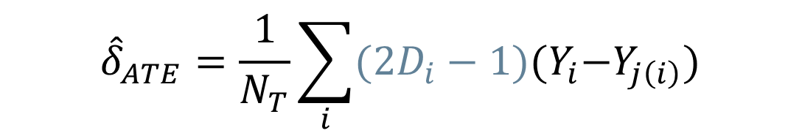
Step 2: Estimation
The matched sample becomes our new analytical sample
Once we establish balance, we can mimic the analysis of an RCT!
Calculate difference in means
Can build out a more complicated model, but generally the matching is the hard part
Then, the pairwise matching estimator is:
$${\hat{δ}}_{ATE}=\frac{1}{N_{T}}\sum_{i}{(2D_{i}−1){(Y}_{i}−Y_{j\left(i\right)})}$$
Notes:
Estimator notes – want difference in means across groups (treated and control). If D = 1 , then we want the positive difference; if D = 0, then we want the reverse (because Y_i is control and Y_j(i) is treated). Always want treated – control for each pair.

Slide 25
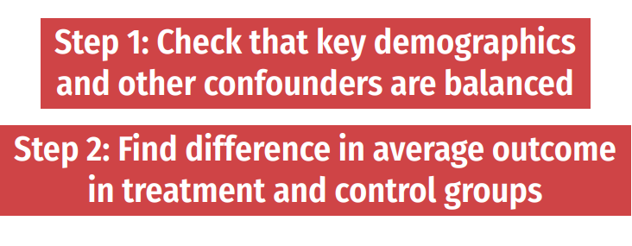
Analyzing a (truly) random experiment
If your treatment is truly randomized, analysis is easy!
Notes:
So if you are analyzing data from an RCT, you really just have to look at differences in means (maybe adjusting the SE s or adjusting for multiple hypothesis testing). You don’t even need controls! (Why? No confounding) Our goal today: can we simulate an RCT in the real world?

Slide 26

How is this different than controlling in OLS?
Intuitively, differences lie in how we deal with backdoor paths:
Regression removes all variation in $X→Y$ associated with variation in $W$
Matching chooses a sample in which there is no variation in $W$

Slide 27
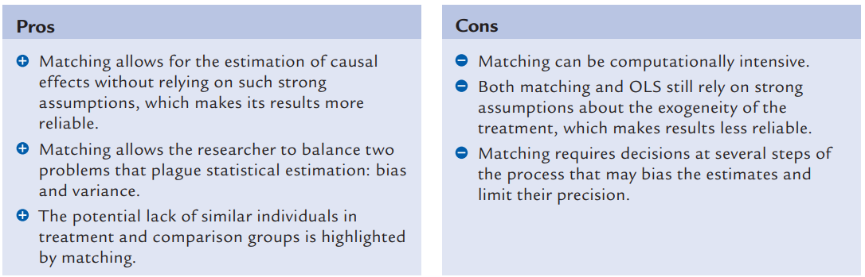

How is this different than controlling in OLS?
Intuitively, differences lie in how we deal with backdoor paths:
Regression removes all variation in $X→Y$ associated with variation in $W$
Matching chooses a sample in which there is no variation in $W$
Pros and cons of matching (Black 2015)
Notes:
Also note that the OLS assigns weights to observations that may bias your estimate of ATE or ATT, particularly if (1) probability of treatment varies with x and (2) E(Y_1-Y_0|x) varies in x

Slide 28
Matching Techniques: Single Variable
Notes:
You want to go through this section quickly – just to build intuition.

Slide 29
Subclassification
We are worried about differences in health status affecting our estimates
In practice, the treatment and control groups are not balanced
Subclassification is a matching strategy to “smooth out” differences:
Notes:
Subclassification is a simplistic form of matching, used to give intuition here.

Slide 30
Subclassification
We are worried about differences in health status affecting our estimates
In practice, the treatment and control groups are not balanced
Subclassification is a matching strategy to “smooth out” differences:
Create bins (for example, based on patient age)
In each bin, identify the “treatment effect” of unemployment benefits
Construct strata-specific weights:
Likelihood of being in each bin across treatment/control groups
Calculate the weighted average effect of unemployment benefits
Notes:
Weights are determined by the frequency of data – how likely is it that you see someone in a certain quantile of BMI

Slide 31
Subclassification
We are worried about differences in health status affecting our estimates
Subclassification is a matching strategy to “smooth out” differences:
Create bins (for example, based on patient age)
In each bin, identify the “treatment effect” of unemployment benefits
Construct strata-specific weights:
Likelihood of being in each bin across treatment/control groups
Calculate the weighted average effect of unemployment benefits
A note on packages in R
Notes:
**update this to use MatchIt** Packages: good, but make sure you know what is happening under the hood! If you can code up your own estimator, do. Otherwise, cite your packages (show the citations in RMD, don’t go through code)
MatchIt method
Mention that Stata really is better than R when it comes to matching.

Slide 32
Curse of Dimensionality
Subclassification works great when you are stratifying with few cells
Few variables, or binary variables
How do you pick what the cells should be?
What happens if you want to stratify with too many cells?
Sparsity problems: observations may not match effectively
Many cells may contain either only treatment units or only control units
Notes:
What might some examples be here? What are some problems with subclassification? How many classifications?

Slide 33
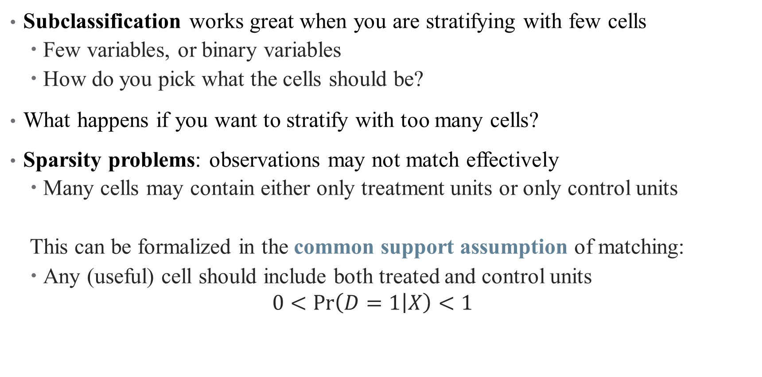
Curse of Dimensionality
Subclassification works great when you are stratifying with few cells
Few variables, or binary variables
How do you pick what the cells should be?
What happens if you want to stratify with too many cells?
Sparsity problems: observations may not match effectively
Many cells may contain either only treatment units or only control units
This can be formalized in the common support assumption of matching:
Any (useful) cell should include both treated and control units
$$0<\operatorname{Pr}\left(D=1 | X\right)<1$$
Notes:
We typically assume away sparsity problems (or use a different strategy if we have this problem – then matching doesn’t get rid of the selection (they’re still apples and oranges after matching))

Slide 34
Matching Techniques: Multiple Variables
Notes:
Exact matching should be covered quickly, want to get to approximate matches

Slide 35
Exact Matching
Matching with multiple variables quickly runs into curse of dimensionality
Can’t manually define cells with sufficient observations
But can we still form a one-to-one comparison across observations?

Slide 36
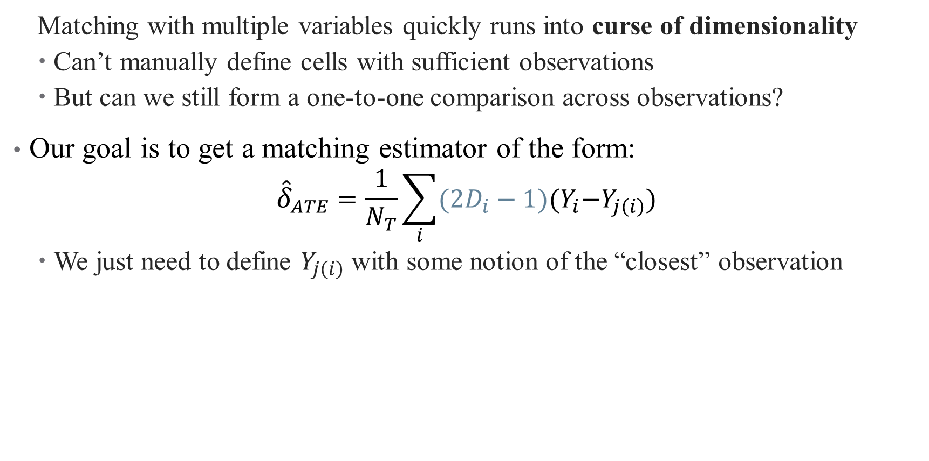
Exact Matching
Matching with multiple variables quickly runs into curse of dimensionality
Can’t manually define cells with sufficient observations
But can we still form a one-to-one comparison across observations?
Our goal is to get a matching estimator of the form:
$${\hat{δ}}_{ATE}=\frac{1}{N_{T}}\sum_{i}{(2D_{i}−1){(Y}_{i}−Y_{j\left(i\right)})}$$
We just need to define $Y_{j\left(i\right)}$ with some notion of the “closest” observation

Slide 37
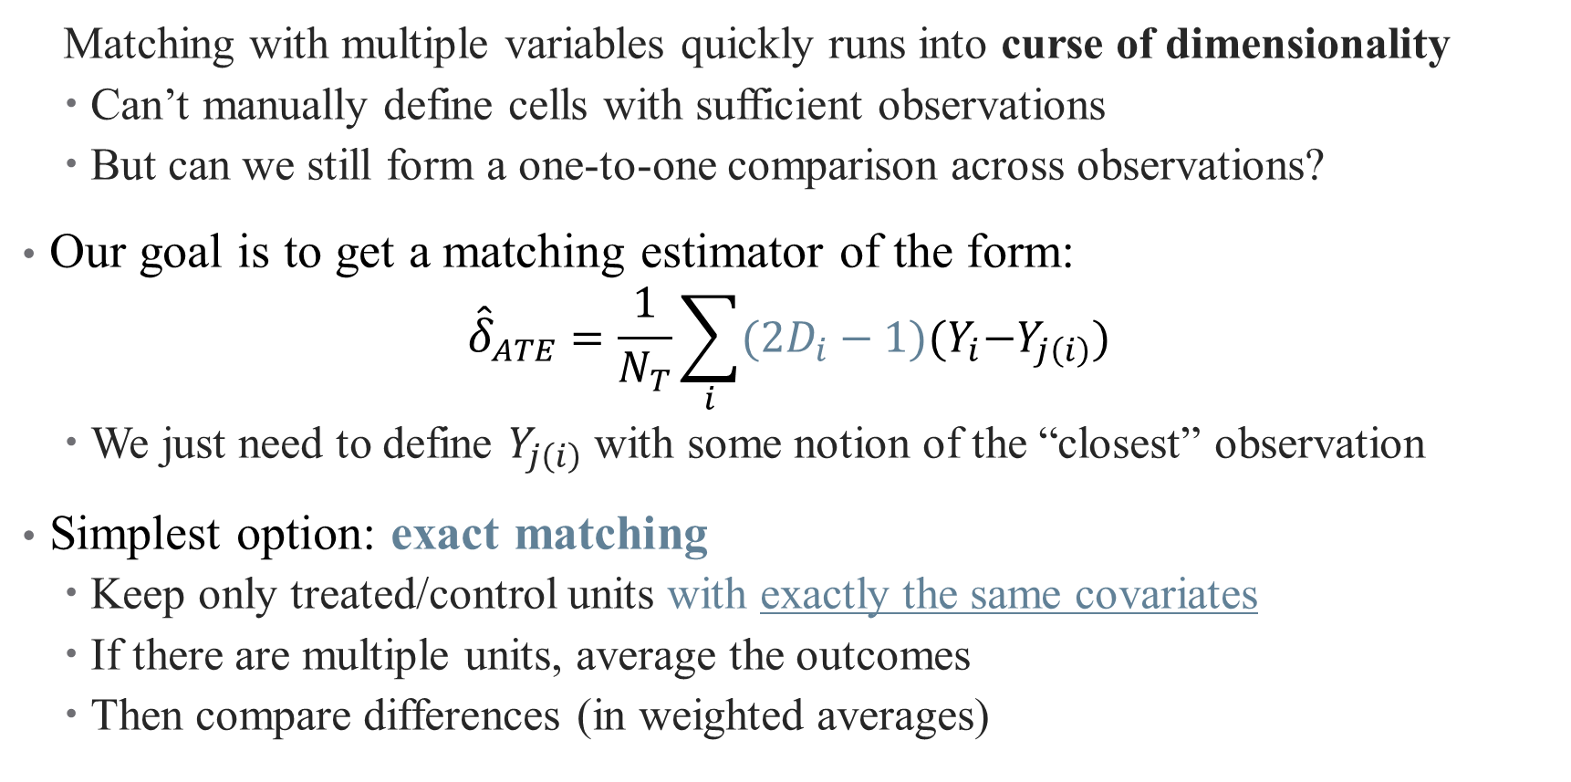
Exact Matching
Matching with multiple variables quickly runs into curse of dimensionality
Can’t manually define cells with sufficient observations
But can we still form a one-to-one comparison across observations?
Our goal is to get a matching estimator of the form:
$${\hat{δ}}_{ATE}=\frac{1}{N_{T}}\sum_{i}{(2D_{i}−1){(Y}_{i}−Y_{j\left(i\right)})}$$
We just need to define $Y_{j\left(i\right)}$ with some notion of the “closest” observation
Simplest option: exact matching
Keep only treated/control units with exactly the same covariates
If there are multiple units, average the outcomes
Then compare differences (in weighted averages)
Notes:
Skip over the code for exact matching, don’t need it?

Slide 38
Exact Matching: Problems
Exact matching has its own problems:
Small sample sizes (few matches)
Continuous matching variables
Inconsistent averages over a few observations (within cells)
What if the people you are throwing out matter?
Generalize again! This time to approximate matching:
Nearest Neighbor Methods (NN)
Propensity Score Matching (PSM)
Inverse Probability Weighting (IPW)

Slide 39
Approximate Matching: Nearest Neighbor
When exact matches aren’t possible, rely on collection of neighbors
What does it mean to be a neighbor with multiple variables?
Notes:
This is the way most matching actually happens these days!

Slide 40
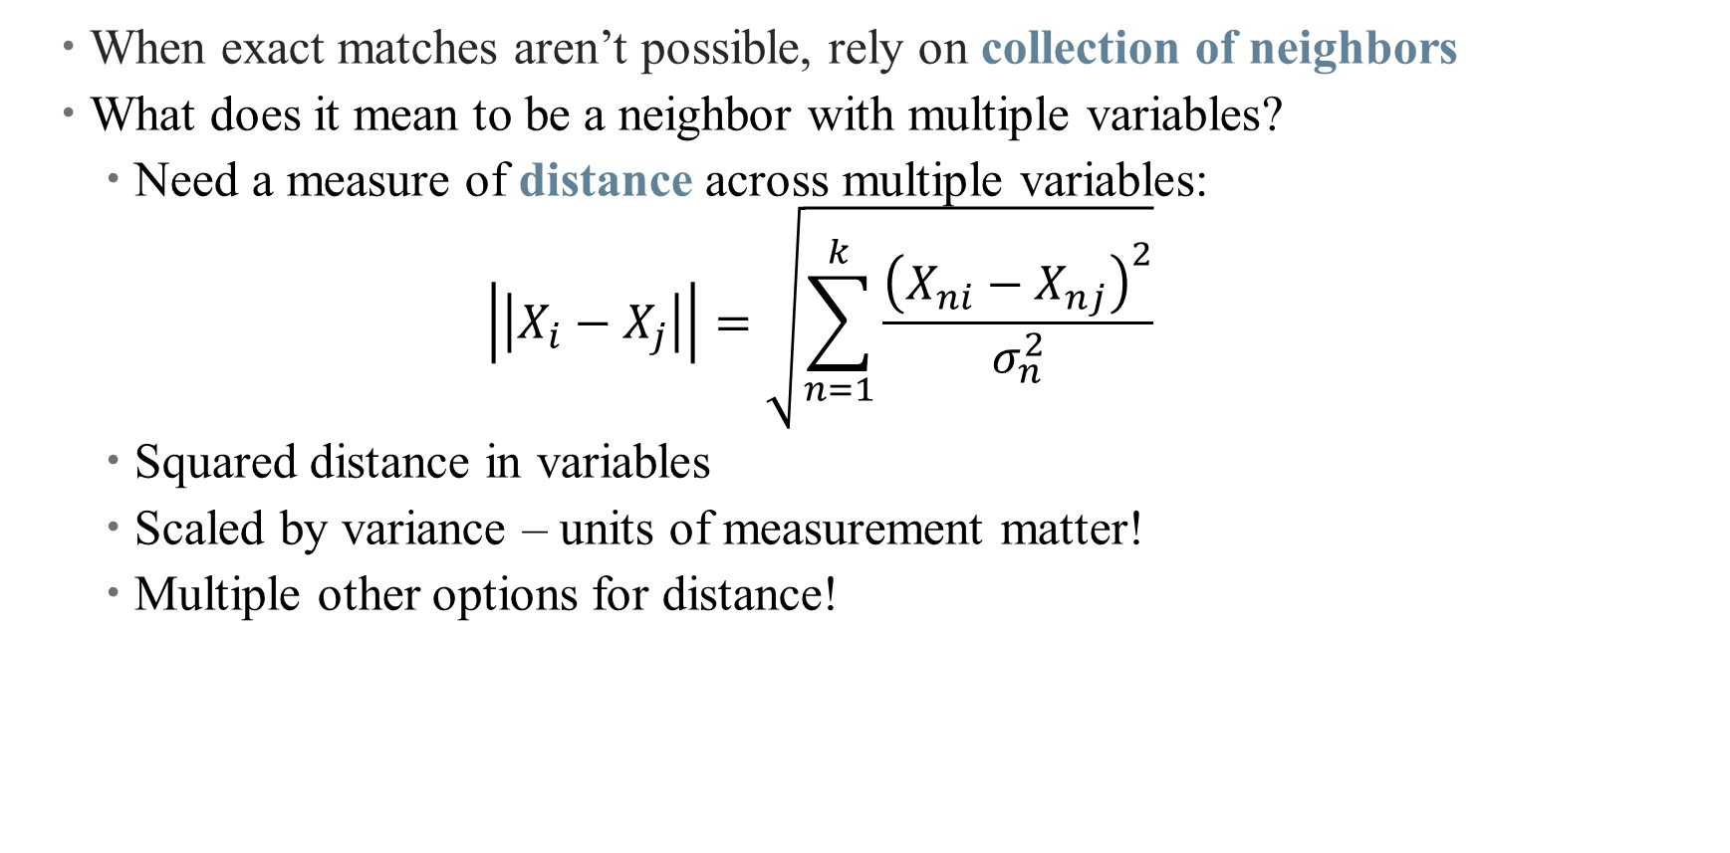
Approximate Matching: Nearest Neighbor
When exact matches aren’t possible, rely on collection of neighbors
What does it mean to be a neighbor with multiple variables?
Need a measure of distance across multiple variables:
$$\left|\left|X_{i}−X_{j}\right|\right|=\sqrt{\sum_{n=1}^{k}{\frac{{\left(X_{ni}−X_{nj}\right)}^{2}}{σ_{n}^{2}}}}$$
Squared distance in variables
Scaled by variance – units of measurement matter!
Multiple other options for distance!
Notes:
Subscript notes: I and j are people, n is covariate (age, sex, bmi, married, etc.)

Slide 41
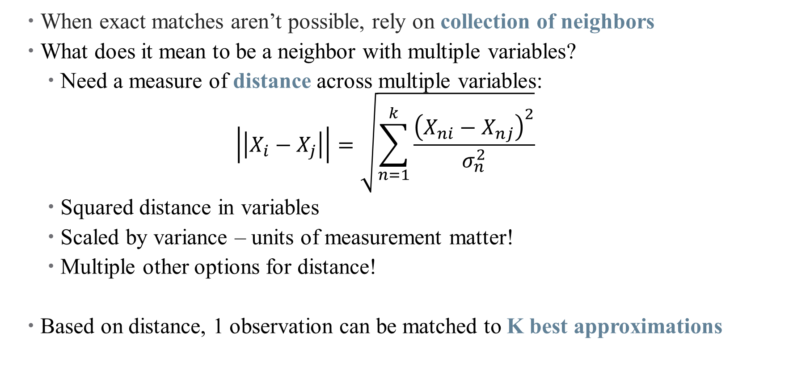
Approximate Matching: Nearest Neighbor
When exact matches aren’t possible, rely on collection of neighbors
What does it mean to be a neighbor with multiple variables?
Need a measure of distance across multiple variables:
$$\left|\left|X_{i}−X_{j}\right|\right|=\sqrt{\sum_{n=1}^{k}{\frac{{\left(X_{ni}−X_{nj}\right)}^{2}}{σ_{n}^{2}}}}$$
Squared distance in variables
Scaled by variance – units of measurement matter!
Multiple other options for distance!
Based on distance, 1 observation can be matched to K best approximations
Notes:
You have to choose k

Slide 42
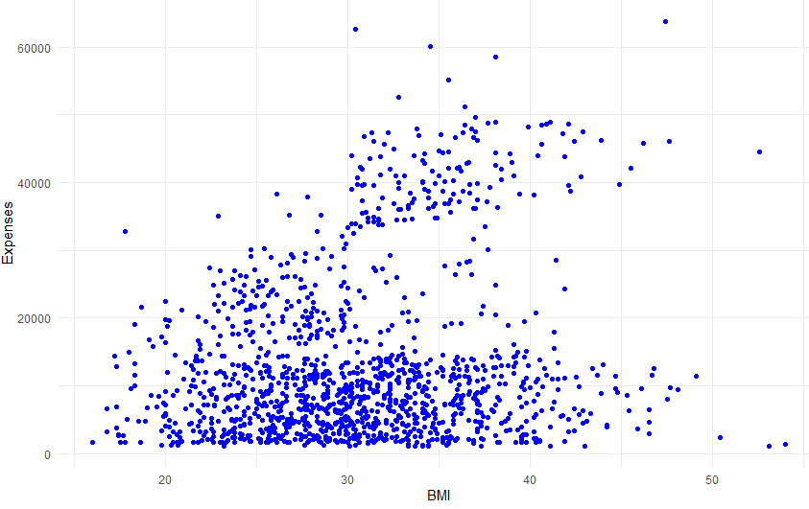
Nearest Neighbor Matching

Slide 43
Nearest Neighbor Matching
Notes:
So what are the neighbors of this guy?

Slide 44
Nearest Neighbor Matching
Notes:
How do we choose k?

Slide 45
Nearest Neighbor Matching

Slide 46
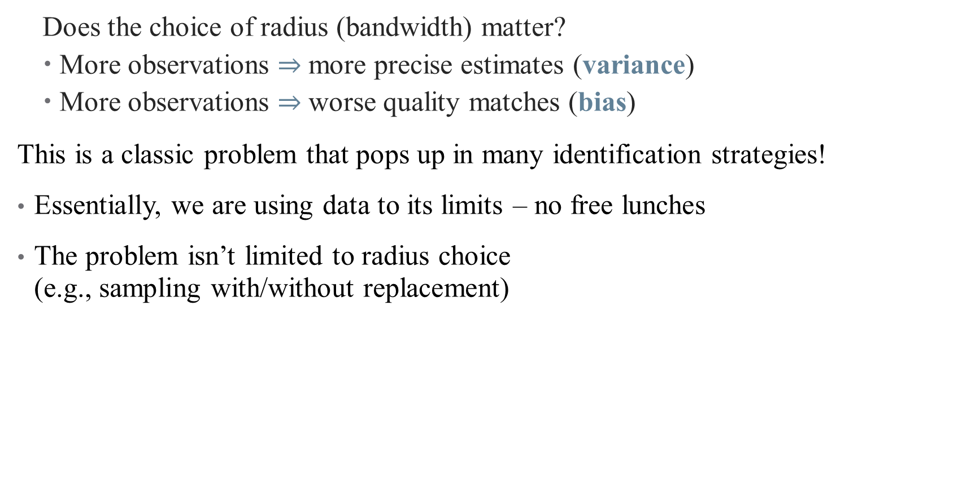
The Bias/Variance Tradeoff
Does the choice of radius (bandwidth) matter?
More observations $⇒$ more precise estimates (variance)
More observations $⇒$ worse quality matches (bias)
This is a classic problem that pops up in many identification strategies!
Essentially, we are using data to its limits – no free lunches
The problem isn’t limited to radius choice (e.g., sampling with/without replacement)
Notes:
Is there a better way to solve these problems? Can we beat the curse of dimensionality? Is there an optimal bandwidth?

Slide 47

Nearest Neighbor Matching in Practice
Estimate propensity score for each individual:
$$Pr⁡(Benefit{s)}_{i}=\vec{β}X_{i}+ε_{i}$$
What goes in $X_{i}$? Are they good controls? Bad controls?
Is there anything missing that should be included?
Notes:
Section 2.4 in the case study. What goes in X? age(years), sex (male versus female), marital status (couple, single, or widowed/divorced), whether there are children living in the household, self-reported race/ethnicity (white, black, Aboriginal, Asian, or multiple/other), immigrant status (non-immigrant, immigrant less than 15years, or immigrant 15 years or more), geographical region (Atlantic, Central, or Western), urbanicity (urban versus rural), education (less than secondary, secondary degree, some post-secondary, post-secondary degree), home ownership (owner versus renter), and survey year.
Note: should we really be controlling for home ownership? Why or why not?
What are we missing? Income! Why do they exclude it?

Slide 48
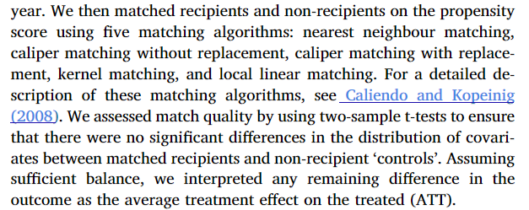

Nearest Neighbor Matching in Practice
Estimate propensity score for each individual:
$$Pr⁡(Benefit{s)}_{i}=\vec{β}X_{i}+ε_{i}$$
What goes in $X_{i}$? Are they good controls? Bad controls?
Is there anything missing that should be included?
Notes:
Someone turn this into plain English – what are we doing here?

Slide 49
Nearest Neighbor Matching in Practice
Estimate propensity score for each individual:
$$Pr⁡(Benefit{s)}_{i}=\vec{β}X_{i}+ε_{i}$$
What goes in $X_{i}$? Are they good controls? Bad controls?
Is there anything missing that should be included?
Match size of k neighbors
How were neighbors defined? Predicted Propensity score
How are the propensity scores used?
Closest propensity scores within the “caliper”
Matching without replacement
Notes:
Someone turn this into plain English – what are we doing here?

Slide 50
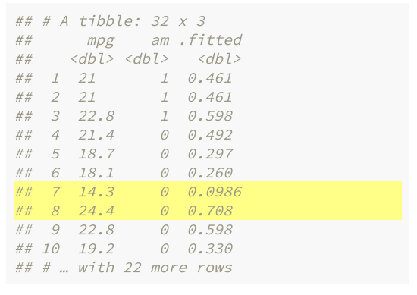

Propensity Score Matching
Goal: predict treatment status of each observation based on covariates
Use a nonlinear method (logit, probit, etc.)
This “first stage” regression predicts $\hat{y} (or \hat{D})$, not $\hat{β}$
This is the propensity score: $Pr⁡(D=1|X)$
Predicted treatment status gives you a single dimension on which to match
Notes:
We haven’t covered logit or probit yet, will in future lectures. If I have two observations with similar propensities but only one is treated, then differences across those observations are more likely to be treatment related, right? But the true propensity score is (of course) unknown

Slide 51
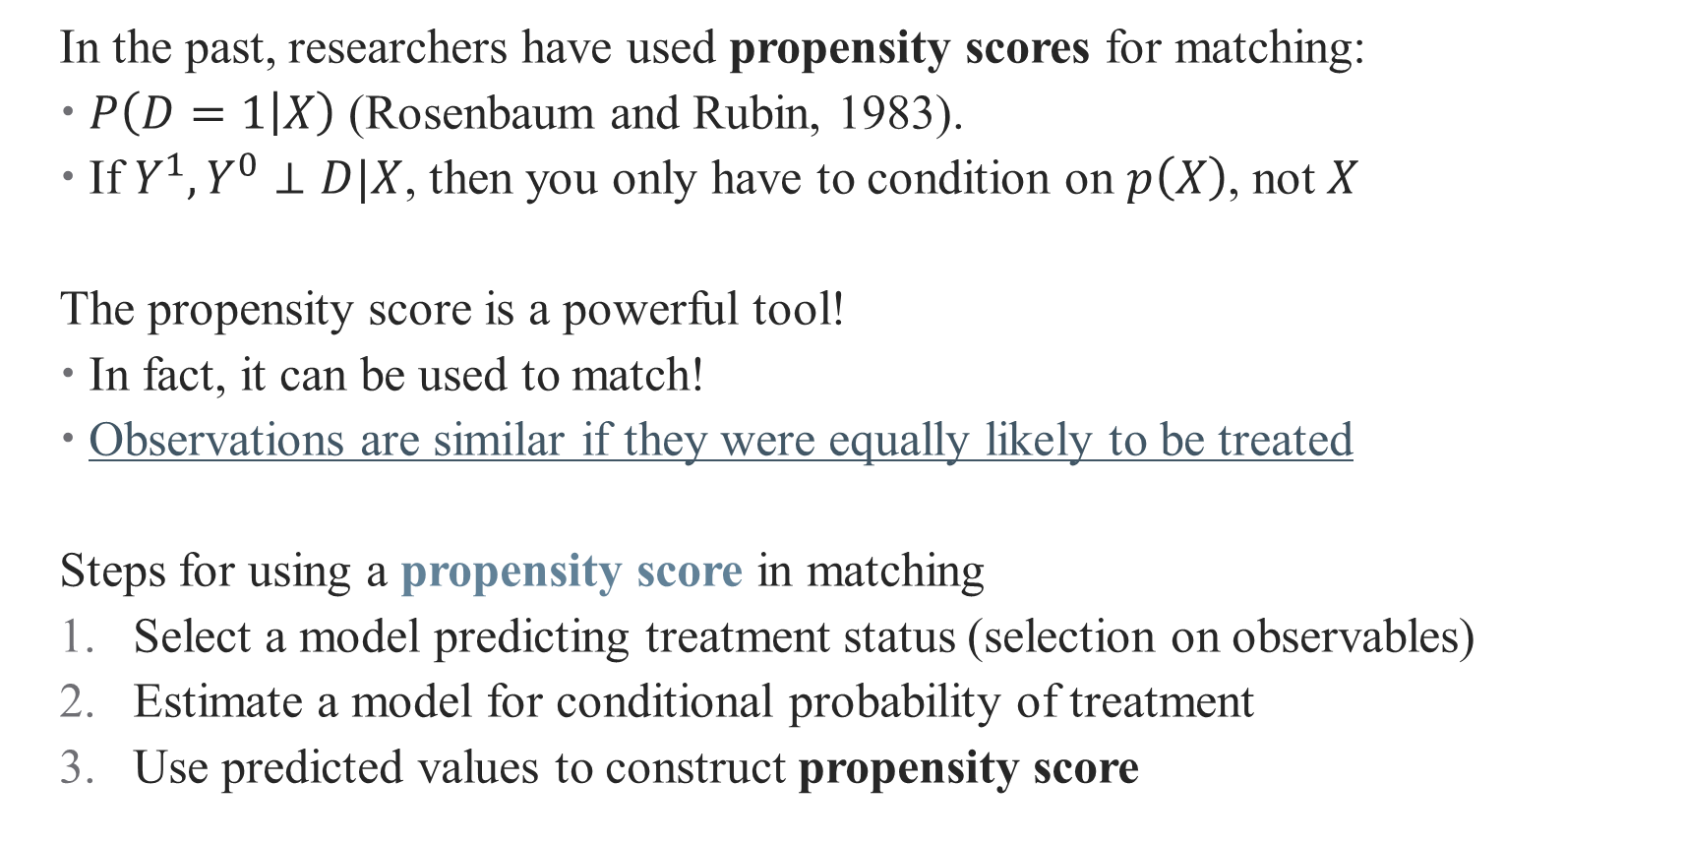
Approximate Matching: Propensity Score Matching
In the past, researchers have used propensity scores for matching:
$P\left(D=1 | X\right)$ (Rosenbaum and Rubin, 1983).
If $Y^{1},Y^{0}⊥D|X$, then you only have to condition on $p\left(X\right)$, not $X$
The propensity score is a powerful tool!
In fact, it can be used to match!
Observations are similar if they were equally likely to be treated
Steps for using a propensity score in matching
Select a model predicting treatment status (selection on observables)
Estimate a model for conditional probability of treatment
Use predicted values to construct propensity score
Notes:
In a true RCT, this is just the probability of the coin flip (e.g., 0.5) But in a non-RCT, there are lots of ways your treatment probabilities could change (e.g., remember that this is why we cluster?)
What’s the logic for using this in matching? If you and I have the same probability of being treated, but only one of us is actually treated, then we’re pretty similar in the counterfactual worlds, right?
Plus this is pretty easy to implement!

Slide 52
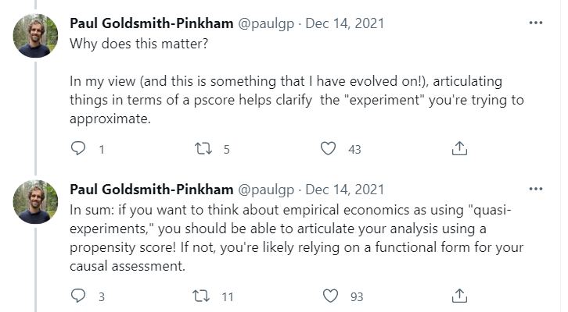
Alternative: Weighting Matched Observations
Notes:
Matching (and regression, and all design-based approaches) are approximating an RCT – what kind of RCT are you comfortable with?

Slide 53
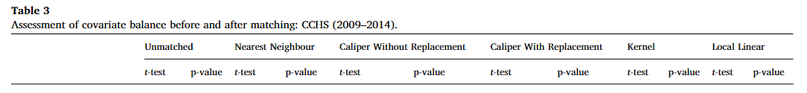
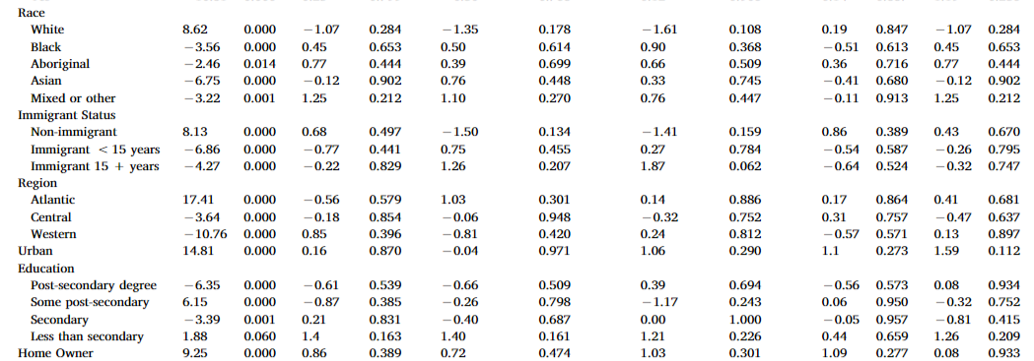
What happens after we match?
Notes:
Balance tables! Can look at the full one here: https://www.sciencedirect.com/science/article/pii/S0277953619301200?casa_token=3sZ0ALXMOo8AAAAA:uB1kjnETLu-dhuvYmrUzTkvSr1DGtpUXDn1dtMb44fKQKt97v7Exe4HX0kEjveHIk4dsl2uftsw#appsec1.
How do we interpret these? How do we decide if the match is good enough?

Slide 54
Getting your Effect
Notes:
So then what?

Slide 55
Analyzing a (truly) random experiment
If your treatment is truly randomized, analysis is easy!
Notes:
So if you are analyzing data from an RCT, you really just have to look at differences in means (maybe adjusting the SE s or adjusting for multiple hypothesis testing). You don’t even need controls! (Why? No confounding) Our goal today: can we simulate an RCT in the real world? (You can add adjustment if you need to).

Slide 56
Step 2: Estimation
The matched sample becomes our new analytical sample
Once we establish balance, we can mimic the analysis of an RCT!
Calculate difference in means, potentially with regression adjustment
Notes:
Here, what is the regression? What is the main coefficient of interest?

Slide 57
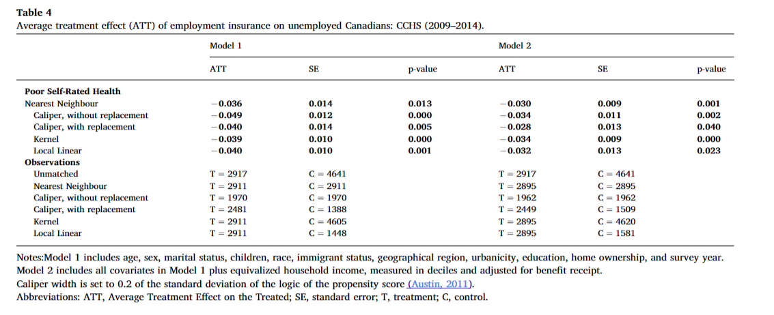
What do you do after you’ve matched?
Notes:
How do we interpret these results?

Slide 58
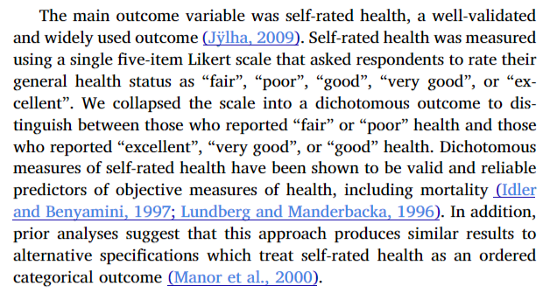
Outcome Measurement Concerns
How do these affect the reported results? How do they affect what you think of the paper?

Slide 59
Identification Concerns and Interpretation/Policy Implications
What did they do about income?
What did they do about labour force participation?
What about stratification? Where are the effects strongest?
How do these affect the reported results? How do they affect what you think of the paper?
Notes:
The problem: income is the main way that you get the benefits, but its also the way benefits are meant to affect health. They (i) adjusted the measure of income and (ii) ran a second model where recipients and non-recipients were also matched on household income, in addition to the original set of covariates, to ascertain whether our results were sensitive to this analytic decision. However, to address the aforementioned challenge, we calculated a revised measure of household income in which the average annual EI benefit amount($8246) was subtracted from the reported income values of individuals in the recipient group. This mitigated some of the concern around including income in the model, since after accounting for benefit receipt, income should be independent of treatment assignment. To calculate the annual average benefit amount, we multiplied the average duration of EI benefits by the average weekly benefit level over the study period– 21.7 weeks and $380, respectively (Statistics Canada, 2015). We included a second model in which recipients and non-recipients were matched on this revised household income measure.
To address thischallenge, we treated chronic conditions as a proxy for labor marketdisadvantage – albeit a limited one – and ran a supplementary set ofmodels in which we restricted our analysis to the subset of individualswho reported having no chronic conditions.
Strongest in bottom five deciles (lol) – this is convincing though.

Slide 60
Interpretation and Limitations of Analysis
What worked well in this analysis?
What was lacking?
What are the takeaways for you?
What might limit the takeaways? What hinders your approach to thinking of this as causal?
Any other thoughts?
Notes:
I don’t think they did a super good job dealing with this. Their limitations are all “fake” limitations.

Slide 61
Matching Best Practices
Notes:
Exact matching should be covered quickly, want to get to approximate matches

Slide 62
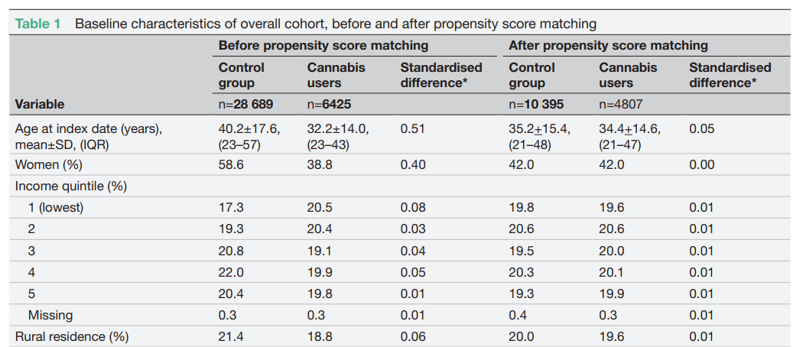
Some Matching Best Practices
Show balance after matching (balance table)
Source: Vozoris et al., 2022

Slide 63
Some Matching Best Practices
Show balance after matching (balance table)
Check if observations with similar propensity scores are balanced (stratification tests)
Show common support is valid in your setting

Slide 64
Some Matching Best Practices
Show balance after matching (balance table)
Check if observations with similar propensity scores are balanced (stratification tests)
Show common support is valid in your setting
Propensity scores close to 0 or 1 give large weights – trim data set
Try (and report) multiple bandwidths/approaches/replacement
You will need to argue CIA holds convincingly
Some more tips: blogs.worldbank/what-do-you-need-do-make-matching-estimator-convincing

Slide 65
Other Caveats
Economists tend to be more (not totally!) skeptical of matching methods
Highly sensitive to both variables included and analysis sample used (Smith and Todd 2001, 2005)
Matching methods are also highly sensitive to omitted variable bias
We’re still shook from the PSM debaucle
You may be throwing away data and still left with biased estimates if imbalance remains
This is substantive of a larger critique: can we ever achieve the CIA with observational data?
Are we more worried about selection on observables? Or unobservables?
Notes:
If you can’t match on, say, ability, your matching might be making things worse.
PSM had its heyday, now we have problems with it.

Slide 66
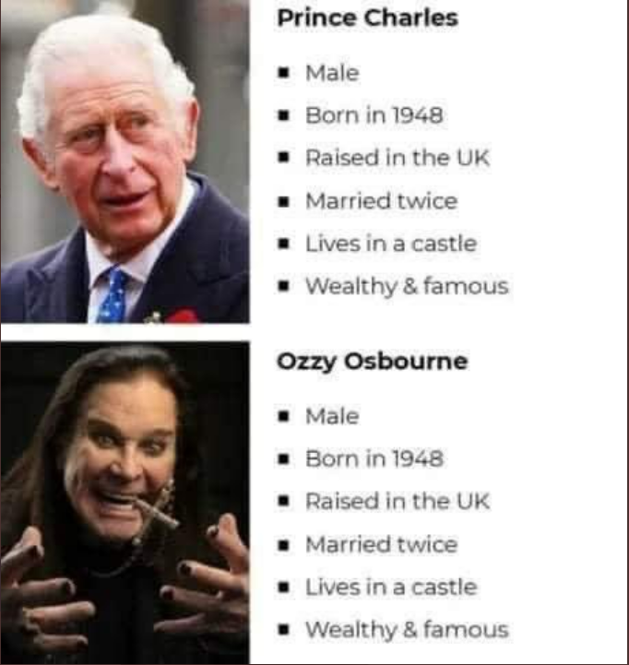
Problems of Unobservables
King
Notes:
Had to update the slide here.

Slide 67
Problems of Unobservables
King

Slide 68
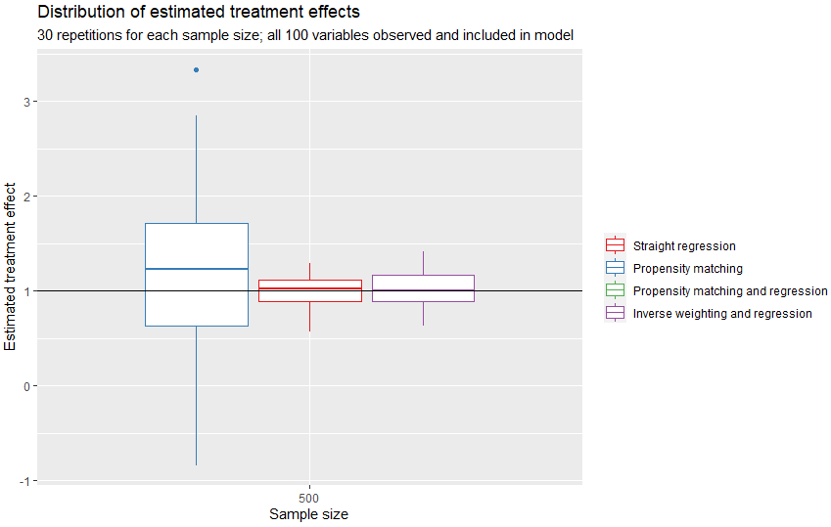
Matching Estimators with Omitted Covariates
An illustration: https://tinyurl.com/2dpkpad9
Notes:
Results of a MC simulation with different treatment effects (no omitted covariates) – note the performance of regression and IPW against PSM

Slide 69
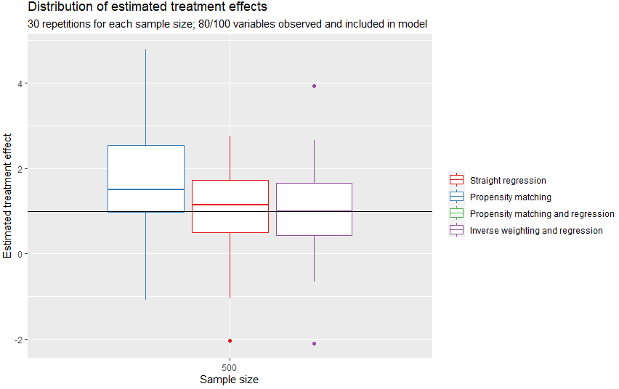
Matching Estimators with Omitted Covariates
An illustration: https://tinyurl.com/2dpkpad9
Notes:
If you leave out covariates, this gets worse (particularly for PSM – I trimmed out PSM with regression because there’s so much variation it’s impossible to see others)

Slide 70
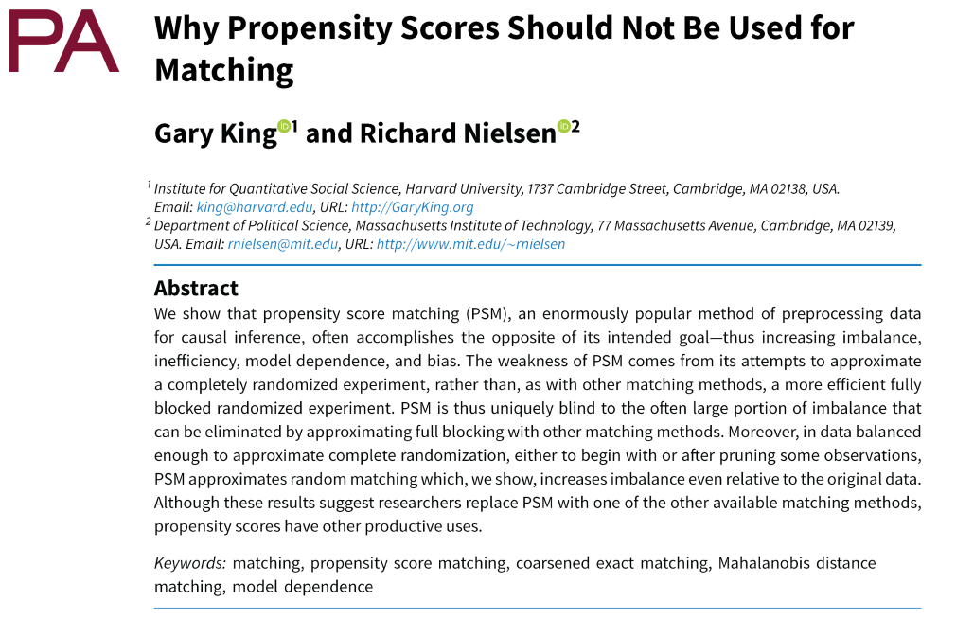



Propensity Score Matching: Identification Problems
Notes:
PSM isn’t a great matching technique, because it’s trying to randomize in the wrong way. PSM wants to fully randomize the experiment by collapsing all covariates into a single estimator – you’re better off doing a blocked experiment by matching on multiple variables without collapsing them. This takes us back to NN matching.

Slide 71
Propensity Score Matching: Punching Back
"The statistician who adjusts for observed covariates in an
ornate and obscure way does no service, particularly if
ornate obscurity erects barriers to success in the step
from association to causation.“ – Rubin and Rosenbaum 2022
Notes:
Machine learning might not be quite the right way to learn which observations are similar, depending on your philosophy .

Slide 72
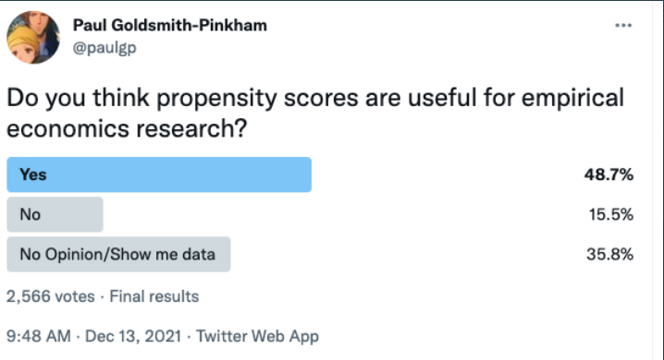
Propensity Score Matching: Punching Back
"The statistician who adjusts for observed covariates in an
ornate and obscure way does no service, particularly if
ornate obscurity erects barriers to success in the step
from association to causation.“ – Rubin and Rosenbaum 2022
Plus, propensity scores really are everywhere in econometrics – we just don’t always look at them head on
Notes:
In addition, PS are everywhere, even in OLS – the only difference is that OLS adds assumptions to PS, just like PSM does.

Slide 73
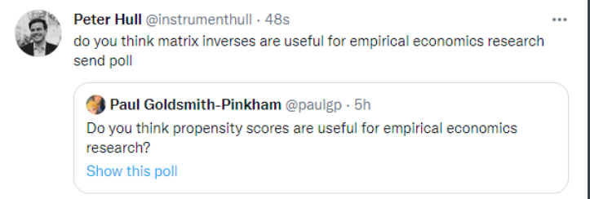
Propensity Score Matching: Punching Back
"The statistician who adjusts for observed covariates in an
ornate and obscure way does no service, particularly if
ornate obscurity erects barriers to success in the step
from association to causation.“ – Rubin and Rosenbaum 2022
Plus, propensity scores really are everywhere in econometrics – we just don’t always look at them head on: https://tinyurl.com/h7sdwjh6
Notes:
Here’s the rub (on board): assume that $Y^{1},Y^{0}⊥D|X$, then you only have to condition on $p\left(X\right)$, not $X$. For OLS, we just assume X enters linearly and control for it in a regression Y = b + bD + bX. Is this good? Not necessarily – what if p(X) = x + x^2 + x^3? So instead, we add in f(X) as our control, not bX – but then, FWL shows that the “inner” regression of D on f(X) is exactly E[D|X]. OLS already uses PS, but assumes linear model—hence, there’s no reason PSM should be worse than OLS (although it might be worse than NN)

Slide 74
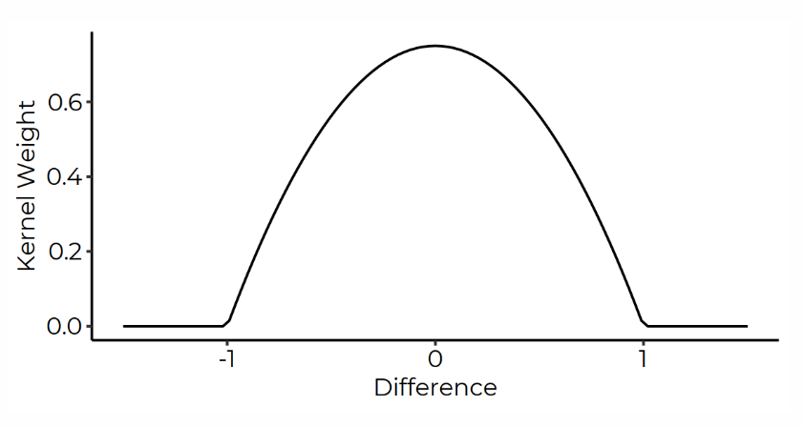
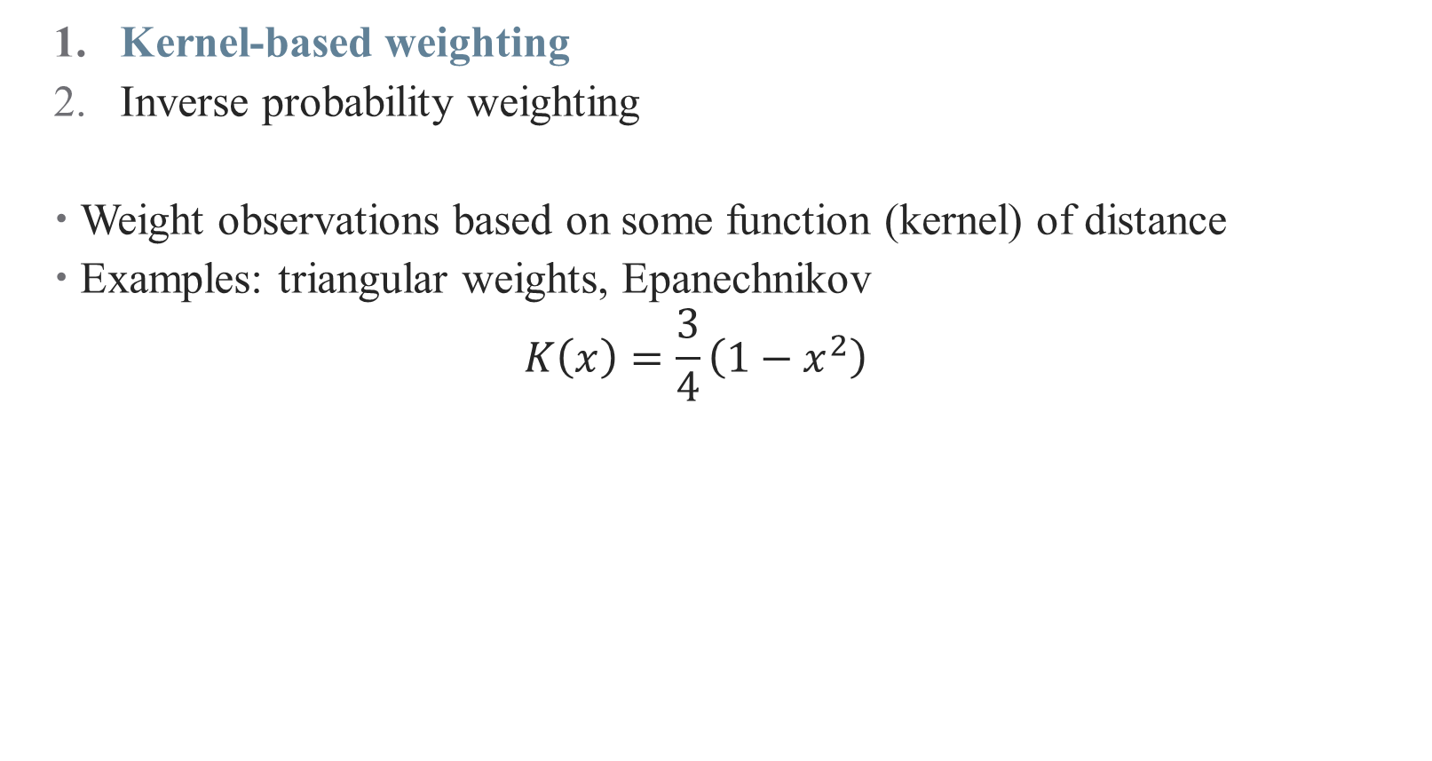
Alternative: Weighting Matched Observations
Kernel-based weighting
Inverse probability weighting
Weight observations based on some function (kernel) of distance
Examples: triangular weights, Epanechnikov
$$K\left(x\right)=\frac{3}{4}\left(1−x^{2}\right)$$
Notes:
Even though NN matching can be greedy (meaning low quality matches), PSM doesn’t work as well. A better approach is to weight your matches. Either pre-specify a kernel (lots of random functions like this) or …

Slide 75
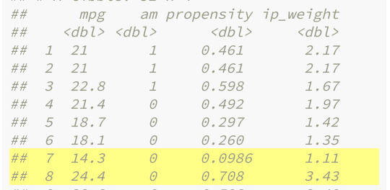
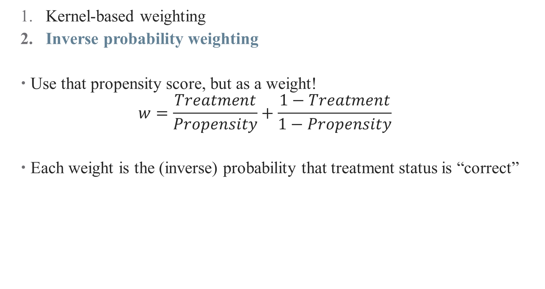
A Note on Weighting Matched Observations
Kernel-based weighting
Inverse probability weighting
Use that propensity score, but as a weight!
$$w=\frac{Treatment}{Propensity}+\frac{1−Treatment}{1−Propensity}$$
Each weight is the (inverse) probability that treatment status is “correct”
Notes:
… use the propensity score! (note that this is *not* using the PSM for matching). You’re weighting by how “weird” treatment assignment is (more weird → more weight) Why? Cause that’s the interesting stuff!

Slide 76
Conclusion
Matching methods help to deal with imbalanced data
Helps you argue that your comparisons really are apples-to-apples
Matching relies on selection on observables –
Doesn’t help you if you don’t observe what’s driving the differences!
Propensity scores have deep roots

Slide 77
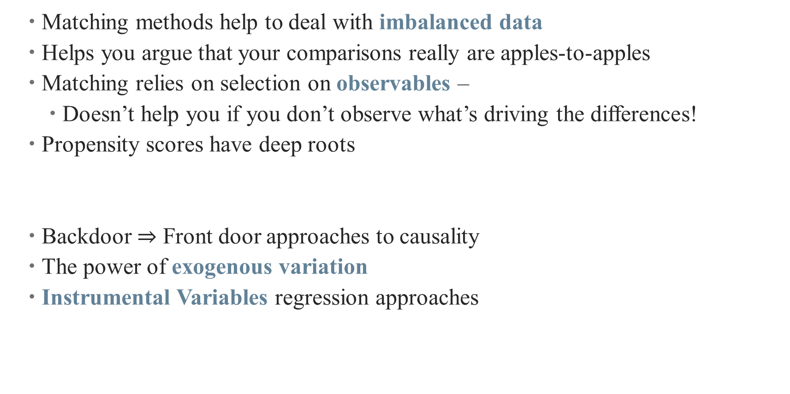
Conclusion
Matching methods help to deal with imbalanced data
Helps you argue that your comparisons really are apples-to-apples
Matching relies on selection on observables –
Doesn’t help you if you don’t observe what’s driving the differences!
Propensity scores have deep roots
Backdoor $⇒$ Front door approaches to causality
The power of exogenous variation
Instrumental Variables regression approaches
Next Time

