Slide 1
Health Econometrics I
Lecture 8: Regressions with Limited Dependent Variables
November 4, 2022
HAD5744 • Alex Hoagland, Ph.D.
Notes:
This will take two lectures (and/or, be a catch-up day).

Slide 2
Quick Note on Proposals
Notes:
This is taken from one of my own ongoing projects.

Slide 3
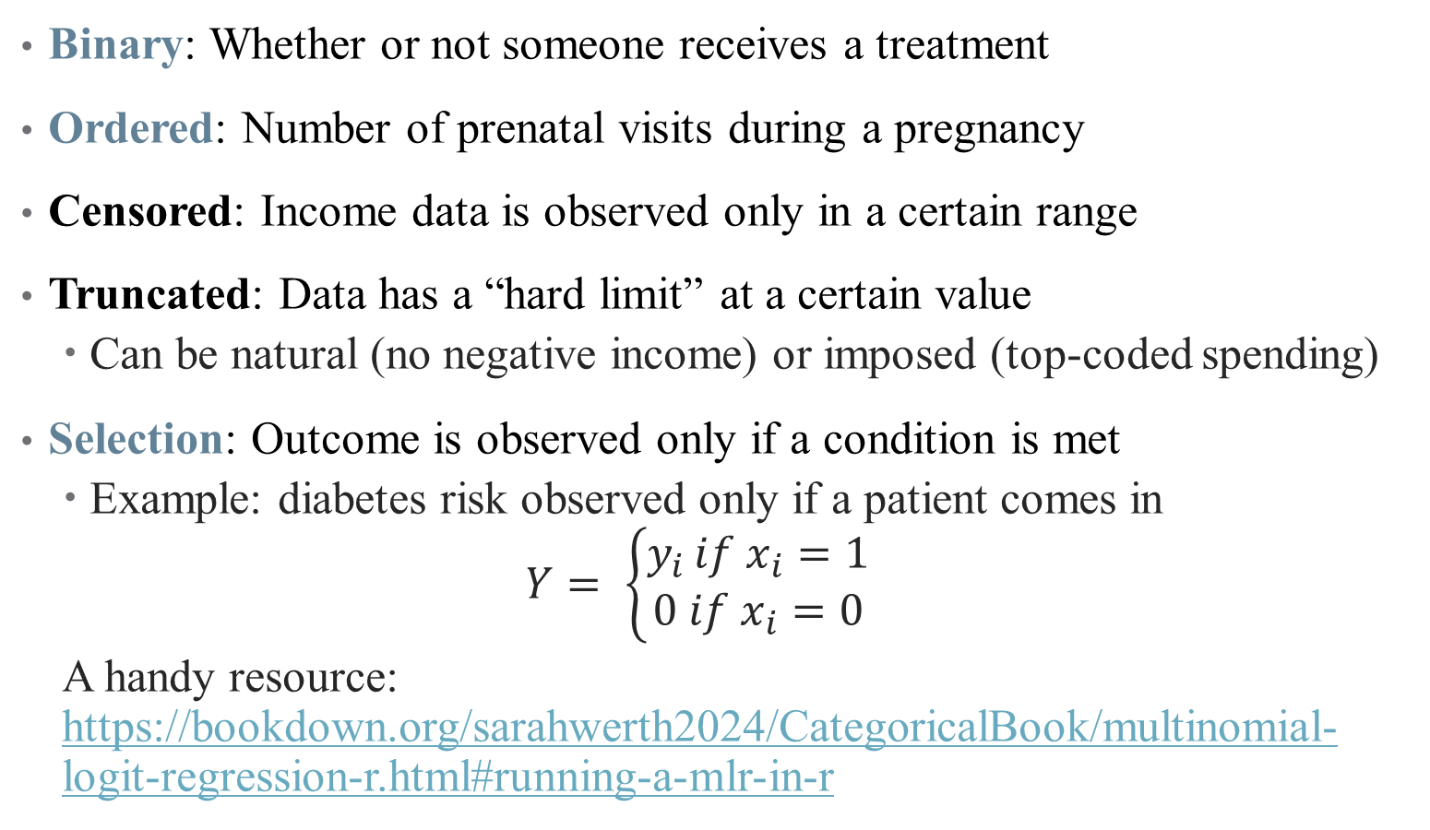
Examples of Limited Dependent Variables
Binary: Whether or not someone receives a treatment
Ordered: Number of prenatal visits during a pregnancy
Censored: Income data is observed only in a certain range
Truncated: Data has a “hard limit” at a certain value
Can be natural (no negative income) or imposed (top-coded spending)
Selection: Outcome is observed only if a condition is met
Example: diabetes risk observed only if a patient comes in
$$Y= \left\{\begin{aligned}y_{i }if x_{i}=1 \\ 0 if x_{i}=0\end{aligned}\right.$$
A handy resource: https://bookdown.org/sarahwerth2024/CategoricalBook/multinomial-logit-regression-r.html#running-a-mlr-in-r
Notes:
Focusing only on these three for today. Also will include an extension of ordered that highlights choices between competing options.

Slide 4
Count Data: Poisson Regression

Slide 5
Examples of Count Data in Health Policy
Number of visits
Number of prescriptions filled
Number of hospital mergers, closures, etc.
There’s a lot

Slide 6
Examples of Count Data in Health Policy
Number of visits
Number of prescriptions filled
Number of hospital mergers, closures, etc.
There’s a lot
When an event is relatively rare (counts are small), data tend to be far from normally distributed
We use Poisson regression to handle this

Slide 7
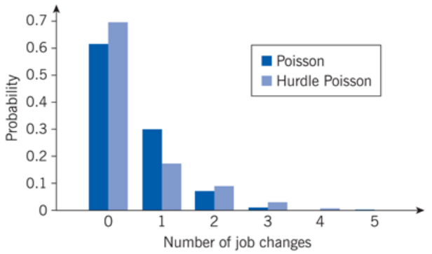
Examples of Count Data: Job Changes
Notes:
Main feature: low counts, far from normal. Hurdle Poisson takes into account the fact that we may not see people with 0 job changes in our data. We’ll get to that.

Slide 8
The Poisson Distribution
We can use GLM again to handle this non-normality
We just need a link function that approximates shape of data
Notes:
Draw Poisson distribution over data in class

Slide 9
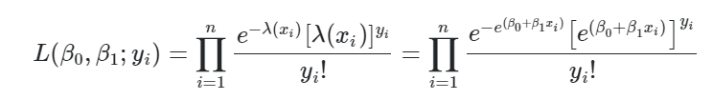
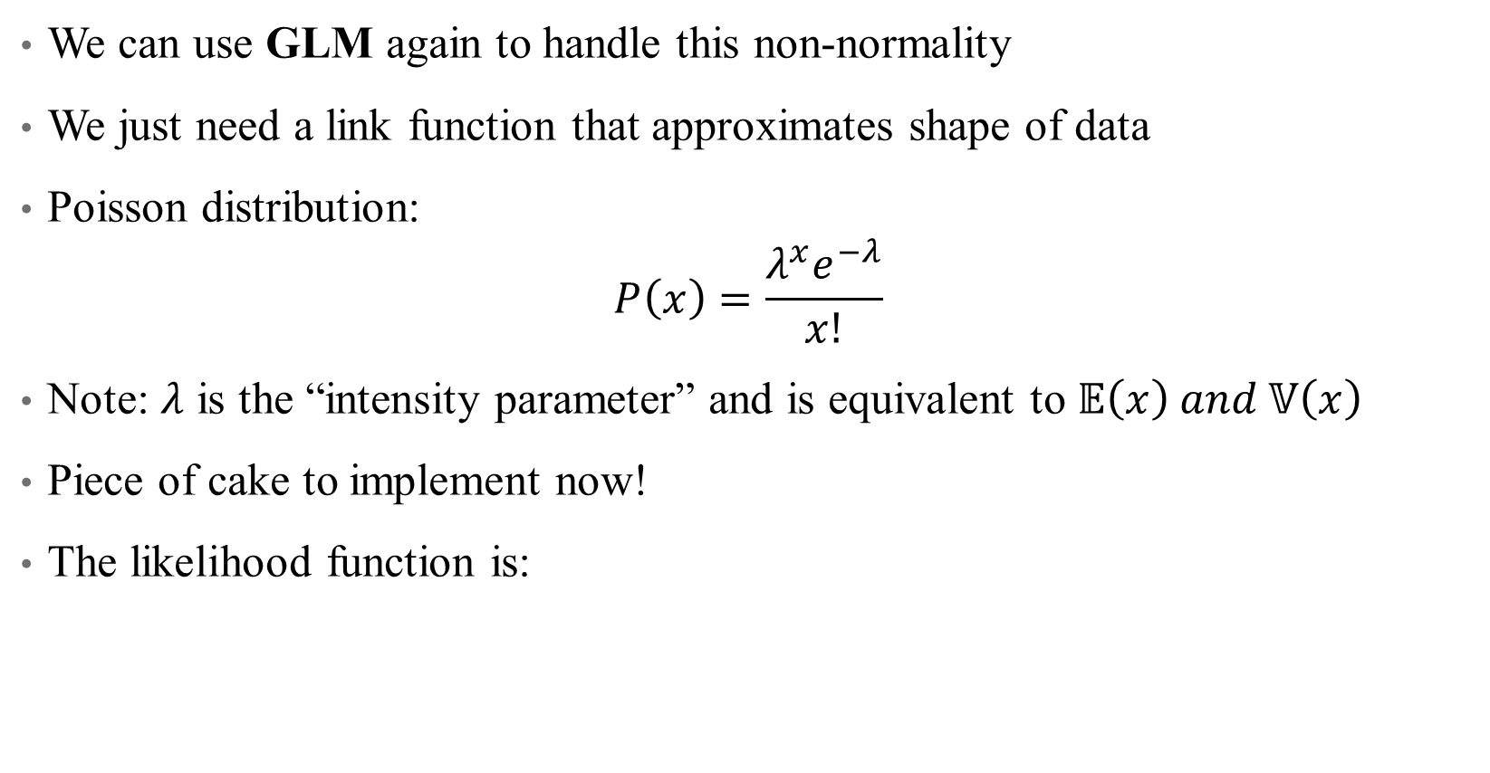
The Poisson Distribution
We can use GLM again to handle this non-normality
We just need a link function that approximates shape of data
Poisson distribution:
$$P\left(x\right)=\frac{λ^{x}e^{−λ}}{x!}$$
Note: $λ$ is the “intensity parameter” and is equivalent to $𝔼\left(x\right) and 𝕍\left(x\right)$
Piece of cake to implement now!
The likelihood function is:

Slide 10



The Poisson Distribution
We can use GLM again to handle this non-normality
We just need a link function that approximates shape of data
Poisson distribution:
$$P\left(x\right)=\frac{λ^{x}e^{−λ}}{x!}$$
Note: $λ$ is the “intensity parameter” and is equivalent to $𝔼\left(x\right) and 𝕍\left(x\right)$
Piece of cake to implement now!
We can take logs as our link function to get:

Slide 11
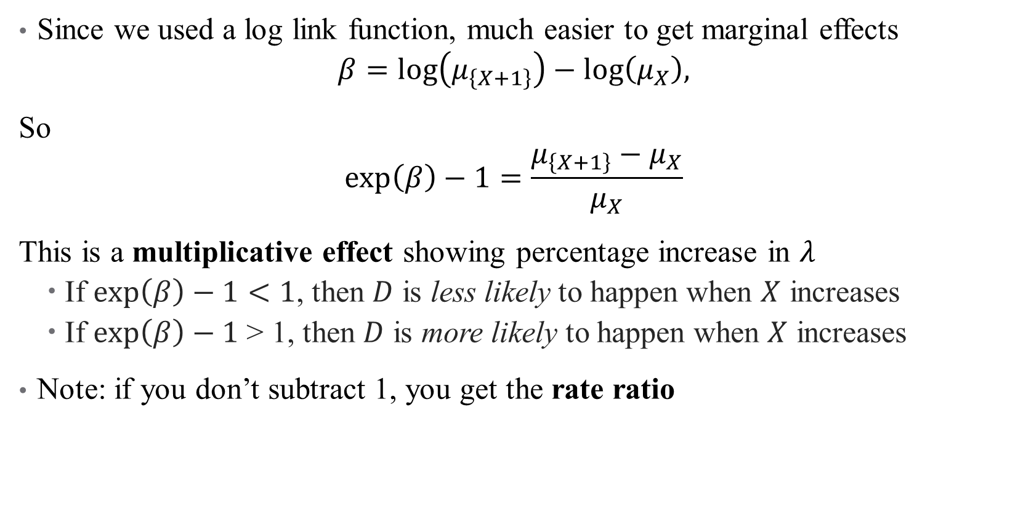
Poisson Regressions in Practice: Interpretation
Since we used a log link function, much easier to get marginal effects
$$β=log\left(μ_{\left\{X+1\right\}}\right)−log\left(μ_{X}\right),$$
So
$$\exp\left(β\right)−1=\frac{μ_{\left\{X+1\right\}}−μ_{X}}{μ_{X}}$$
This is a multiplicative effect showing percentage increase in $λ$
If $\exp\left(β\right)−1<1$, then $D$ is less likely to happen when $X$ increases
If $\exp\left(β\right)−1$ > 1, then $D$ is more likely to happen when $X$ increases
Note: if you don’t subtract 1, you get the rate ratio
Notes:
Here it really is percent increase, not percentage points! Recall lambda is expected counts. Rate ratio is X times more/less likely than count.

Slide 12

Poisson Regressions in Practice: Dispersion
One key assumption in a Poisson model is that $λ=𝔼\left(x\right)=𝕍\left(x\right)$
Essentially, this tests if you chose the right link function
It’s very possible (especially with lots of heterogeneity in your data) that you have overdispersion: $𝕍\left(x\right)>𝔼(x)$
This doesn’t affect bias, but does lead to imprecision in your estimates
Notes:
Overdispersion is likely since we know e(x) is small – otherwise, why would be doing poisson in the first place?

Slide 13
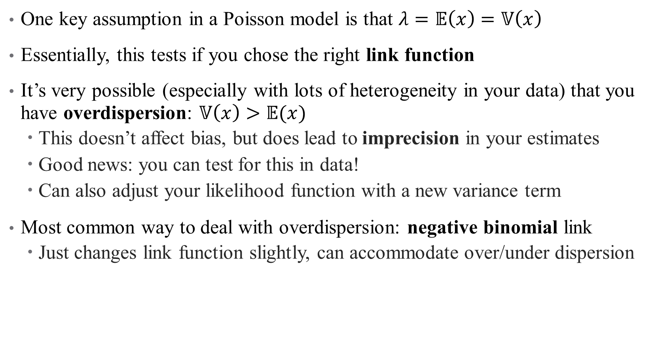
Poisson Regressions in Practice: Dispersion
One key assumption in a Poisson model is that $λ=𝔼\left(x\right)=𝕍\left(x\right)$
Essentially, this tests if you chose the right link function
It’s very possible (especially with lots of heterogeneity in your data) that you have overdispersion: $𝕍\left(x\right)>𝔼(x)$
This doesn’t affect bias, but does lead to imprecision in your estimates
Good news: you can test for this in data!
Can also adjust your likelihood function with a new variance term
Most common way to deal with overdispersion: negative binomial link
Just changes link function slightly, can accommodate over/under dispersion
Notes:
Negative binomial adds an additional variance parameter. Doesn’t really matter unless you are doing a complicated model and need to reduce parameters.

Slide 14
Poisson in Practice: Comparison to Log-Linear Model
Add paragraph from Horn et al. here
Look also at your Poisson work
Notes:
Negative binomial adds an additional variance parameter. Doesn’t really matter unless you are doing a complicated model and need to reduce parameters.

Slide 15
Example: How do hospital closures affect access?
Context
Research Methods
Data (with summary stats)
Outline of results (don’t focus on non-Poisson)
Notes:
Negative binomial adds an additional variance parameter. Doesn’t really matter unless you are doing a complicated model and need to reduce parameters.

Slide 16
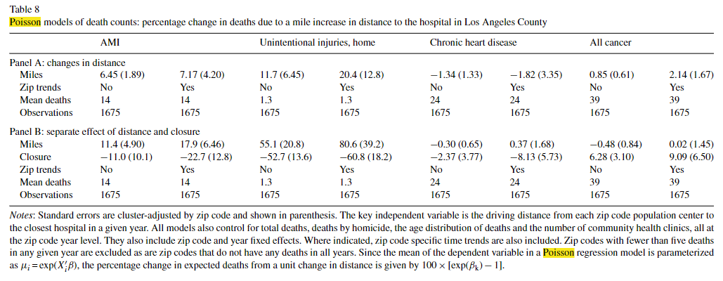
Poisson results: How do hospital closures affect access?
Notes:
How do we interpret these results?

Slide 17
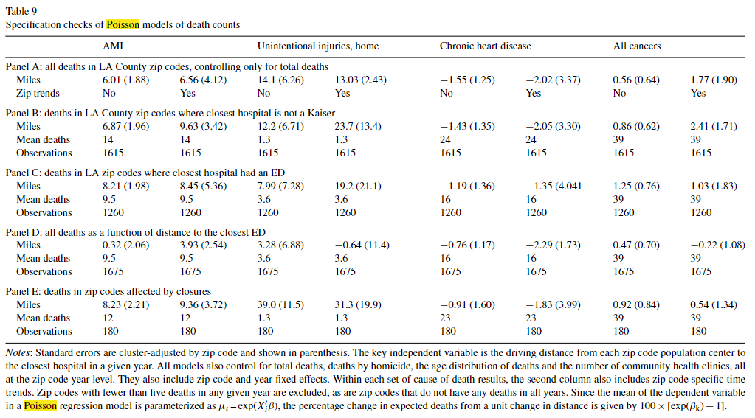
Poisson results: How do hospital closures affect access?
Notes:
How do we interpret these results? Specification/robustness checks: what concerns are we addressing here?

Slide 18
Mini Referee Report
What do you think about this paper? Any concerns? Anything clever?

Slide 19
Hurdle Models

Slide 20
A unique form of excess dispersion: Zeros
A common violation of Poisson assumptions is having too many 0s in data
Especially true in HCP: people don’t go to doctor, don’t fill scrips, etc.
What drives the excess? Different model processes for 0/positive visits
Notes:
Examples of different processes: have to decide first time whether to go, based on location, lack of relationship, uncertainty about cost, etc. After I go once, number of visits is more related to actual medical needs (and easier due to physician relationship, automatic appointments, etc.)

Slide 21
A unique form of excess dispersion: Zeros
A common violation of Poisson assumptions is having too many 0s in data
Especially true in HCP: people don’t go to doctor, don’t fill scrips, etc.
What drives the excess? Different model processes for 0/positive visits
Can model these separately with a hurdle model, which has 2 steps:
Decision about whether number of visits will be positive or 0.
If number of visits >0 (if hurdle is crossed), how many visits take place?
Notes:
Examples of different processes: have to decide first time whether to go, based on location, lack of relationship, uncertainty about cost, etc. After I go once, number of visits is more related to actual medical needs (and easier due to physician relationship, automatic appointments, etc.)
Note: stage 1 is a logit, stage 2 is a truncated poisson (one that doesn’t allow 0s)

Slide 22
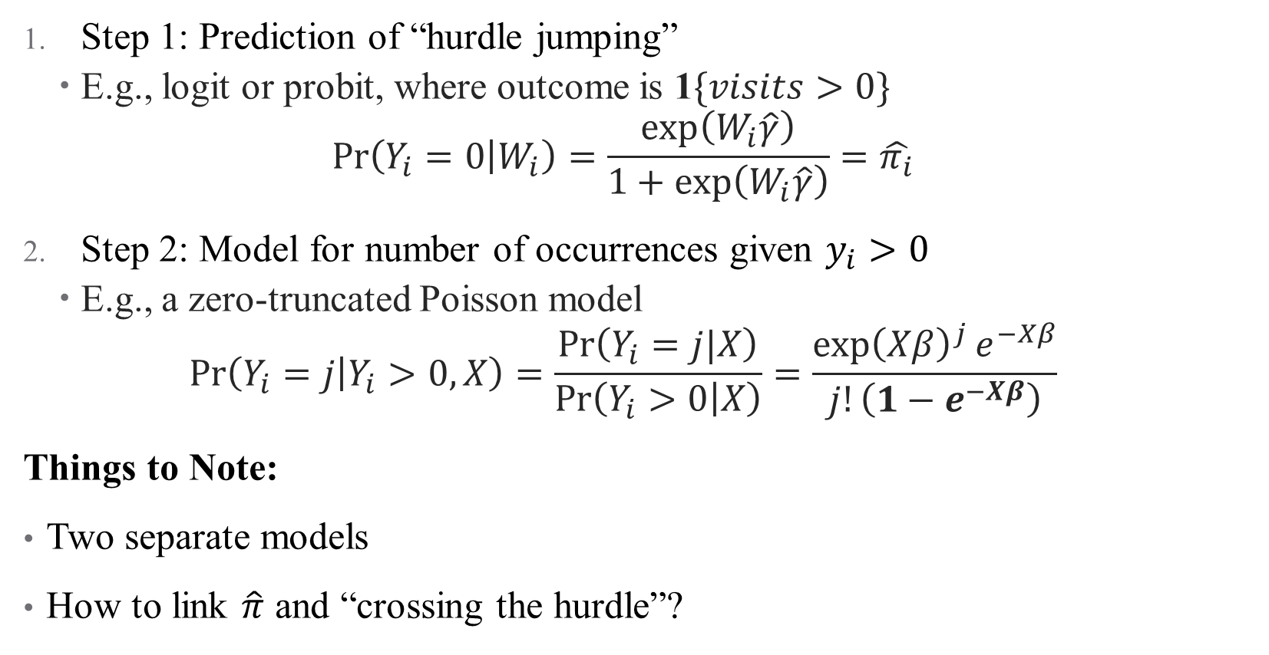
Hurdle Models
Step 1: Prediction of “hurdle jumping”
E.g., logit or probit, where outcome is 1$\{visits>0\}$
$$\operatorname{Pr}\left(Y_{i}=0 | W_{i}\right)=\frac{\exp\left(W_{i}\hat{γ}\right)}{1+\exp\left(W_{i}\hat{γ}\right)}=\hat{π_{i}}$$
Step 2: Model for number of occurrences given $y_{i}>0$
E.g., a zero-truncated Poisson model
$$\operatorname{Pr}\left(Y_{i}=j | Y_{i}>0,X\right)=\frac{\operatorname{Pr}\left(Y_{i}=j|X\right)}{\operatorname{Pr}\left(Y_{i}>0 | X\right)}=\frac{{\exp\left(Xβ\right)}^{j}e^{−Xβ}}{j!\left(1−e^{−Xβ}\right)}$$
Things to Note:
Two separate models
How to link $\hat{π}$ and “crossing the hurdle”?
Notes:
Notice that W and X have different variables and coefficients—not restricted to be the same. Equation for Poisson is same as pdf, except for bolded part which is 1-f(0) (rescales distribution). Pi is linked to hurdle based on data—hurdle package pins down exact number of 0s at those observed in data (so pi_overbar is a “moment” that matches the data

Slide 23
Is a Hurdle Model Appropriate?
Hurdle models are great if there really are two processes in your data
If the decisions driving one DGP are different from another
Applications to behavioral econ galore!
But hurdle models can’t help you if your problem isn’t a separate DGP:
Selection (we don’t observe data for some people for some reason)
Data are censored/error in measurement
Any reason the 0s in your data aren’t actually 0s
In these cases, a two-part model will be biased
These issues are addressed another way: a technique called Heckit
Notes:
E.g., differences in planned versus realized choice, insurance plan choice verus follow-up years, etc. Heckit is named after James Heckman. I’ll give a brief overview of Heckit but not its implementation—basically if you’re working with crummy data, you’re already losing a big chunk of the battle so best not to focus on this too much.

Slide 24
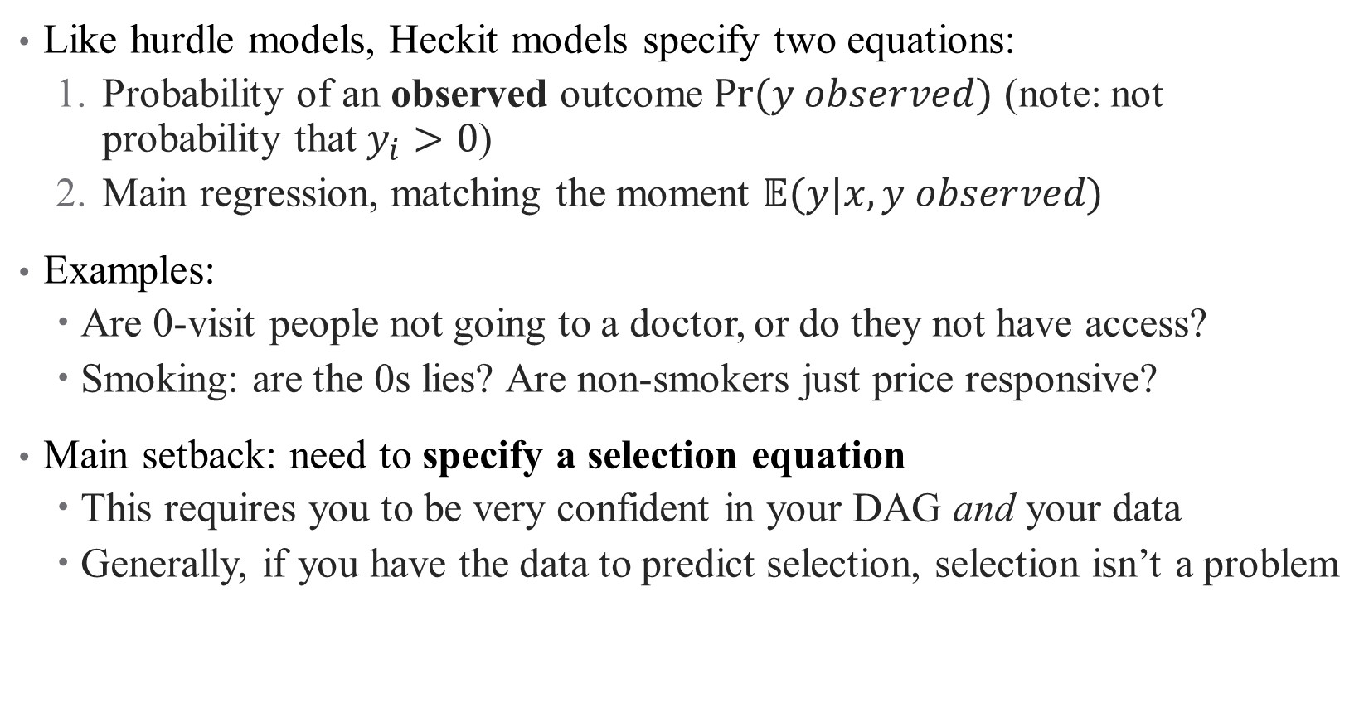
Heckit: A brief overview
Like hurdle models, Heckit models specify two equations:
Probability of an observed outcome $Pr⁡(y observed)$ (note: not probability that $y_{i}>0$)
Main regression, matching the moment $𝔼(y|x,y observed)$
Examples:
Are 0-visit people not going to a doctor, or do they not have access?
Smoking: are the 0s lies? Are non-smokers just price responsive?
Main setback: need to specify a selection equation
This requires you to be very confident in your DAG and your data
Generally, if you have the data to predict selection, selection isn’t a problem
Notes:
The main difference between heckit and hurdle is that hurdle deals with 0s in the actual outcome, while heckit deals with potential outcomes (e.g., the potential outcome is latent, so we stick a 0). So in the PCP example, the potential number of visits for some people isn’t observed because they don’t have access – that’s a selection problem (not someone who chose not to go to a doctor they had access to, that’s an actual outcome). The problem is that you have to specify a model predicting who didn’t have access—stronger identification issues.

Slide 25
Mini Referee Report
What do you think about this paper? Any concerns? Anything clever?

Slide 26
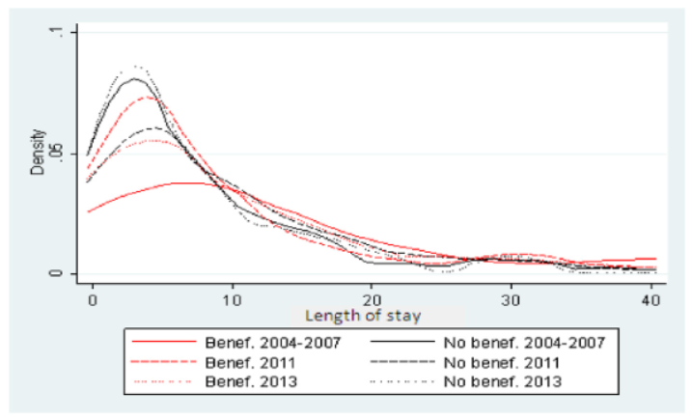
Side Note: Figures
What is this?
Notes:
Don’t do this! What’s wrong with it?

Slide 27
Multinomial Choice Logit

Slide 28
Multinomial Choice Logit: When Choices Matter (More)
What if our data is on choices between N different options?
E.g., type of insurance coverage, treatment (surgery, medication, etc.)
This is actually more similar to logit than you think!
Notes:
Choice of specialty: choosing to be a surgeon vs. in IM or PCP. We can think about logit as a binary choice – did the patient choose treatment or not? Now we’re extending that, in data speak, to N choices instead of 2.

Slide 29
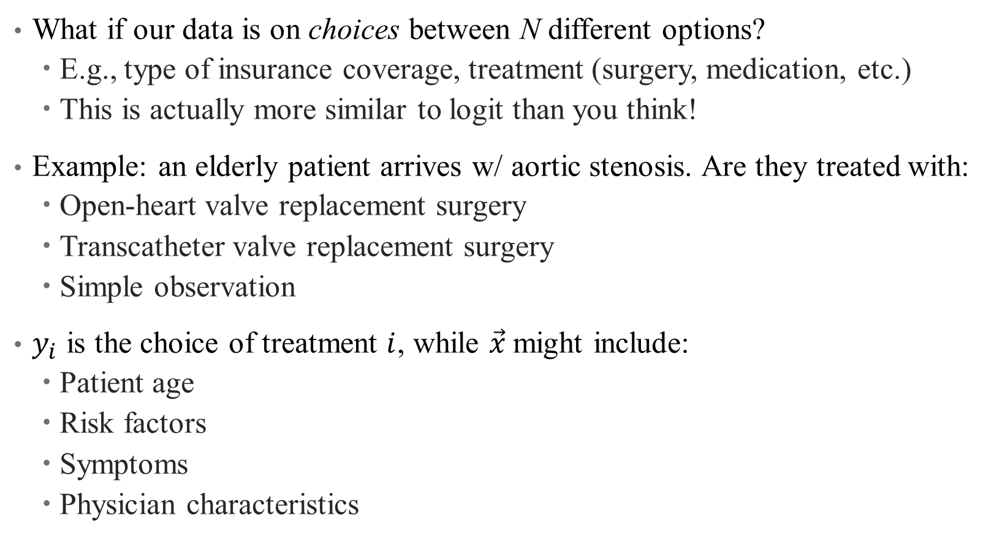
Multinomial Choice Logit: When Choices Matter (More)
What if our data is on choices between N different options?
E.g., type of insurance coverage, treatment (surgery, medication, etc.)
This is actually more similar to logit than you think!
Example: an elderly patient arrives w/ aortic stenosis. Are they treated with:
Open-heart valve replacement surgery
Transcatheter valve replacement surgery
Simple observation
$y_{i}$ is the choice of treatment $i$, while $\vec{x}$might include:
Patient age
Risk factors
Symptoms
Physician characteristics
Notes:
In this example, pretend that these are the only 3 possible choices.

Slide 30
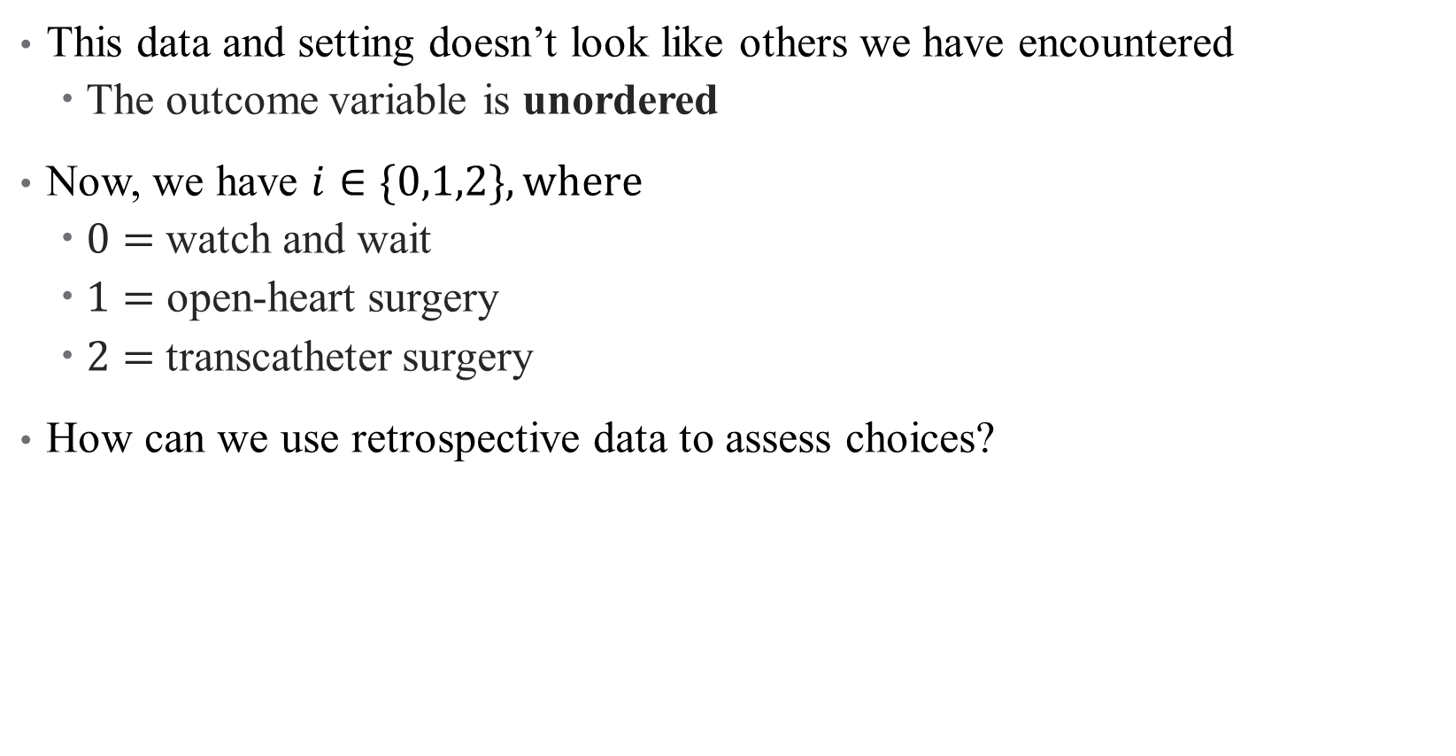
What makes this setting unique?
This data and setting doesn’t look like others we have encountered
The outcome variable is unordered
Now, we have $i∈\{0,1,2\}, where$
$0=$watch and wait
$1=$ open-heart surgery
$2=$transcatheter surgery
How can we use retrospective data to assess choices?
Notes:
How would order surgical choices? If these were RHS variables could just have a lot of dummies but we want one single regression evaluating choice across all alternatives on LHS.

Slide 31
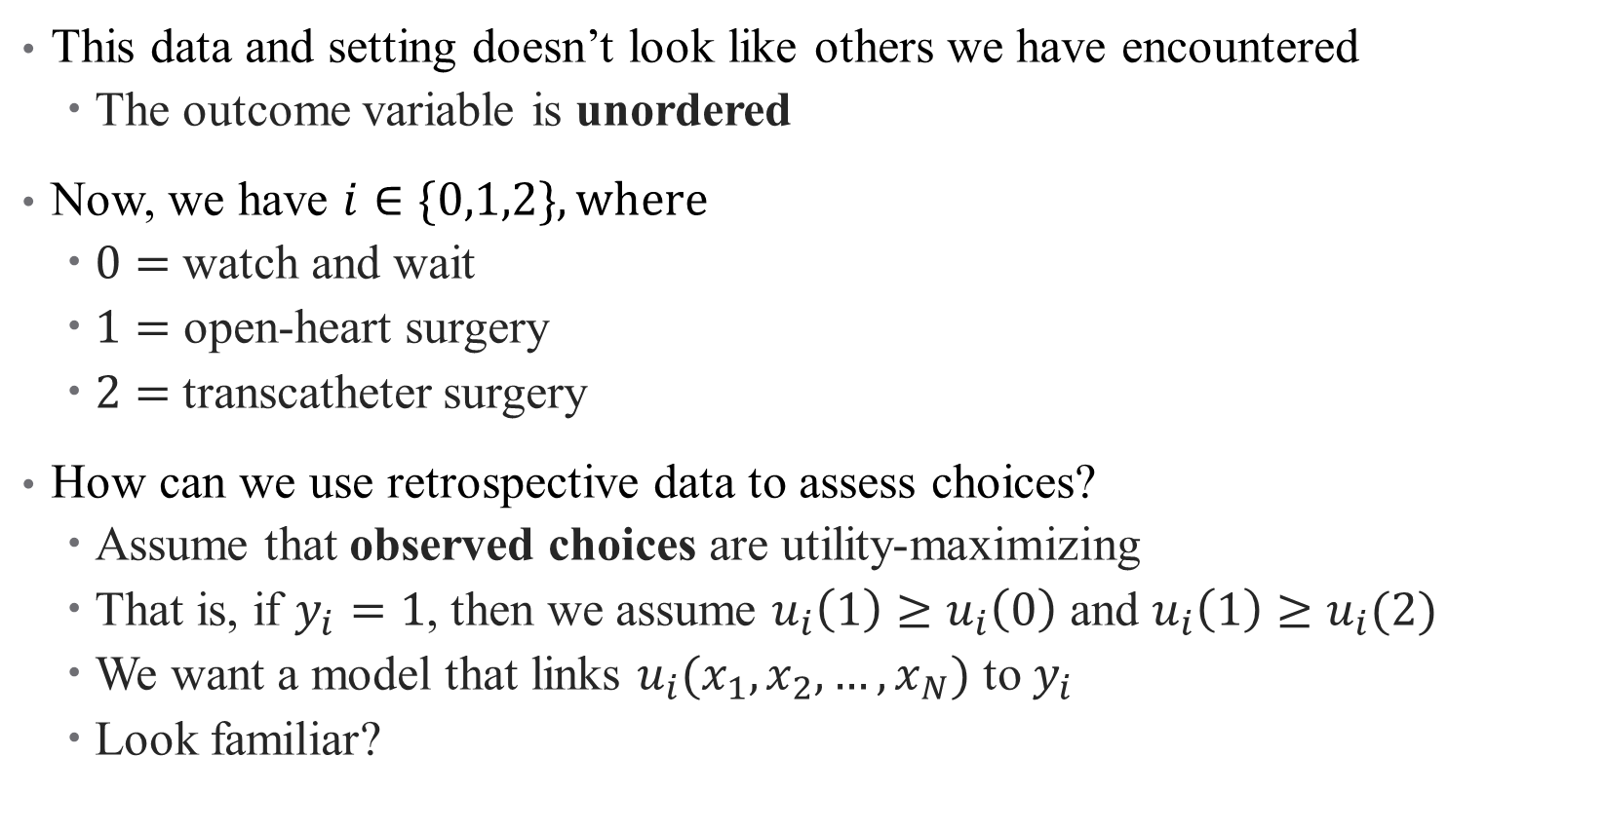
What makes this setting unique?
This data and setting doesn’t look like others we have encountered
The outcome variable is unordered
Now, we have $i∈\{0,1,2\}, where$
$0=$watch and wait
$1=$ open-heart surgery
$2=$transcatheter surgery
How can we use retrospective data to assess choices?
Assume that observed choices are utility-maximizing
That is, if $y_{i}=1$, then we assume $u_{i}\left(1\right)≥u_{i}\left(0\right)$ and $u_{i}\left(1\right)≥u_{i}(2)$
We want a model that links $u_{i}(x_{1},x_{2},…, x_{N})$ to $y_{i}$
Look familiar?
Notes:
We assume a “latent utility-maximizing framework”. Now we have a new link function (utility)! The difference here is that it’s not a known distribution, but rather we are interested in the characteristics of that link function.

Slide 32
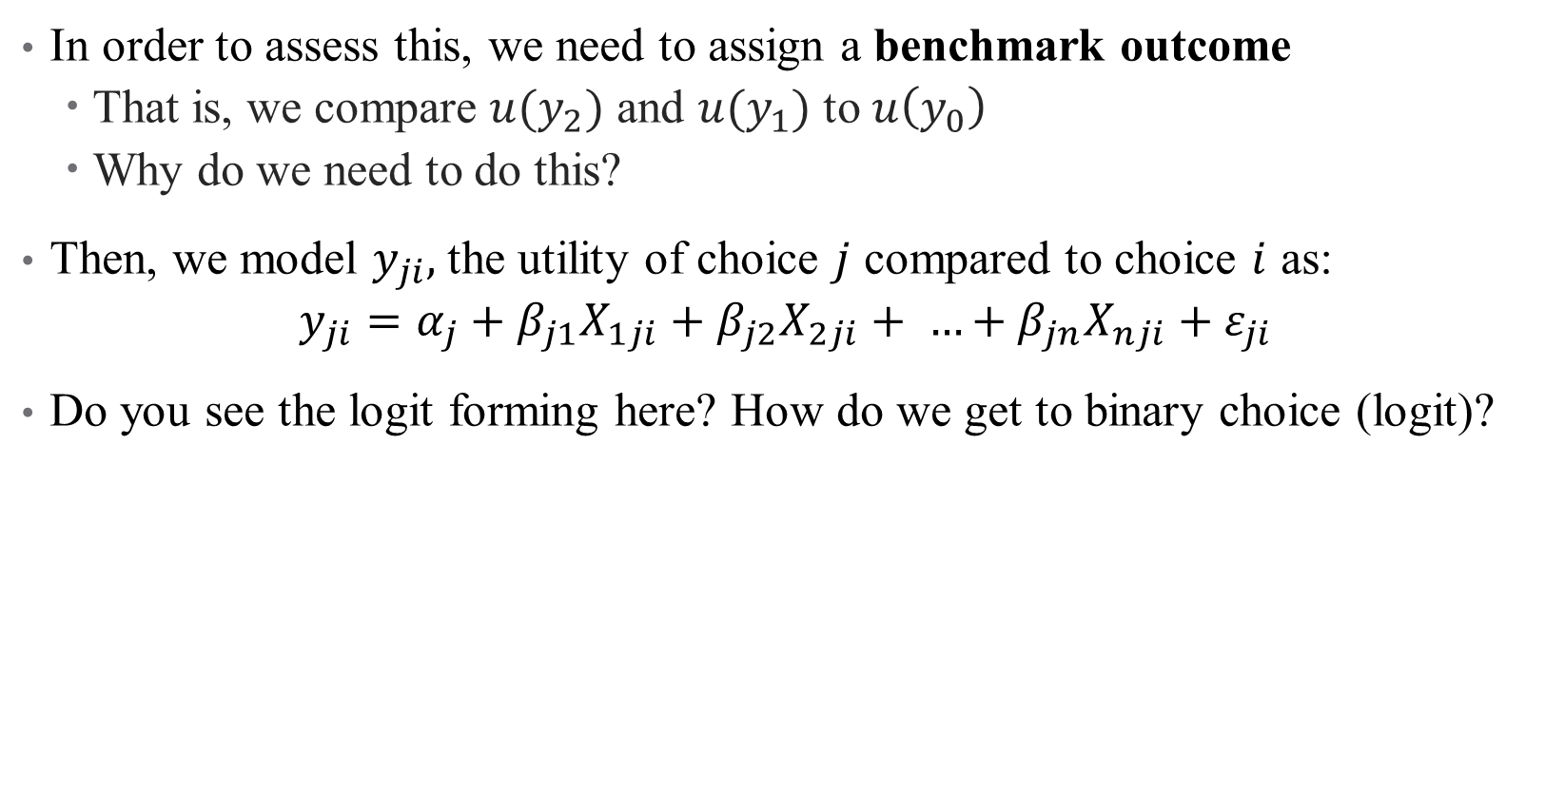
Multinomial Logit: Setup
In order to assess this, we need to assign a benchmark outcome
That is, we compare $u(y_{2})$ and $u(y_{1})$ to $u\left(y_{0}\right)$
Why do we need to do this?
Then, we model $y_{ji},$the utility of choice $j$ compared to choice $i$ as:
$$y_{ji}=α_{j}+β_{j1}X_{1ji}+β_{j2}X_{2ji}+ …+β_{jn}X_{nji}+ε_{ji}$$
Do you see the logit forming here? How do we get to binary choice (logit)?
Notes:
We need a benchmark because utility is an ordinal concept – it only has meaning as a comparison across states. (40 utils doesn’t get me anywhere). What does it mean if y_ji > 0 verus y_ji < 0?

Slide 33
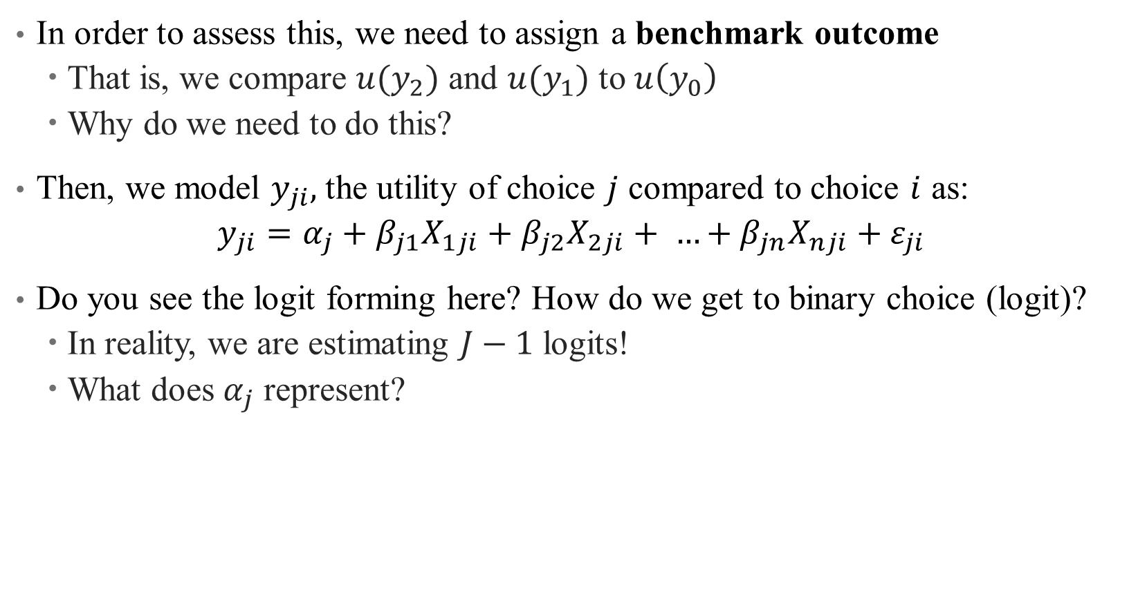
Multinomial Logit: Setup
In order to assess this, we need to assign a benchmark outcome
That is, we compare $u(y_{2})$ and $u(y_{1})$ to $u\left(y_{0}\right)$
Why do we need to do this?
Then, we model $y_{ji},$the utility of choice $j$ compared to choice $i$ as:
$$y_{ji}=α_{j}+β_{j1}X_{1ji}+β_{j2}X_{2ji}+ …+β_{jn}X_{nji}+ε_{ji}$$
Do you see the logit forming here? How do we get to binary choice (logit)?
In reality, we are estimating $J−1$ logits!
What does $α_{j}$ represent?
Notes:
alpha_j represents level differences in utility across options. Note that the notation x_ji helps convey that demographics can vary across choices or individuals (kind of an abuse of notation). Generally, your covariates will not vary in both dimensions at once.

Slide 34
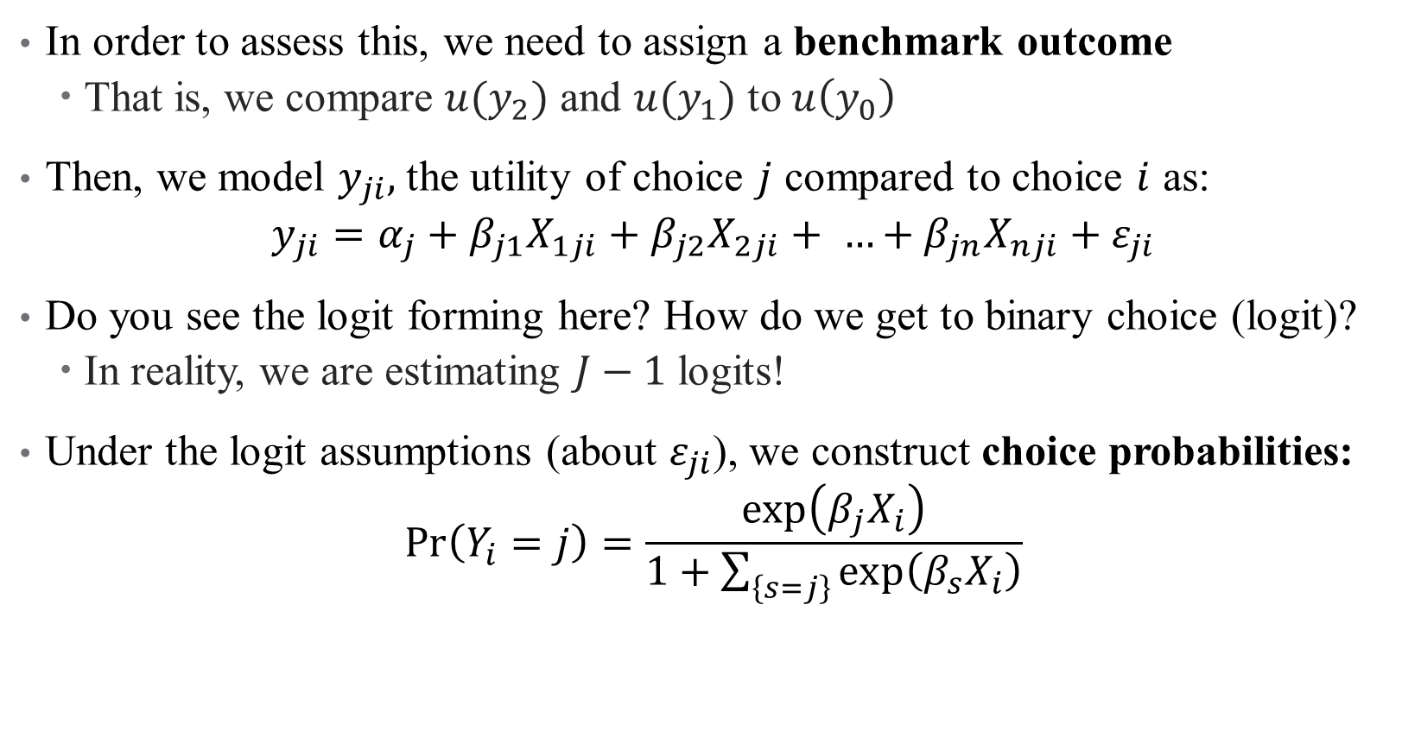
Multinomial Logit: Setup
In order to assess this, we need to assign a benchmark outcome
That is, we compare $u(y_{2})$ and $u(y_{1})$ to $u\left(y_{0}\right)$
Then, we model $y_{ji},$the utility of choice $j$ compared to choice $i$ as:
$$y_{ji}=α_{j}+β_{j1}X_{1ji}+β_{j2}X_{2ji}+ …+β_{jn}X_{nji}+ε_{ji}$$
Do you see the logit forming here? How do we get to binary choice (logit)?
In reality, we are estimating $J−1$ logits!
Under the logit assumptions (about $ε_{ji}$), we construct choice probabilities:
$$\operatorname{Pr}\left(Y_{i}=j\right)=\frac{\exp\left(β_{j}X_{i}\right)}{1+\sum_{\left\{s=j\right\}}{\exp\left(β_{s}X_{i}\right)}}$$
Notes:
We assume that varepsilon is T1EV. The choice probabilities show the relative value of the individual characteristics (weighted by beta) across all choices. Why exponentiated? Because of the logit formula (log(p/1-p)). Why is there a 1 in the denominator? Because we have J-1 regressions comparing the alternatives to the benchmark, and then one (unestimated) regression comparing the benchmark to itself .

Slide 35
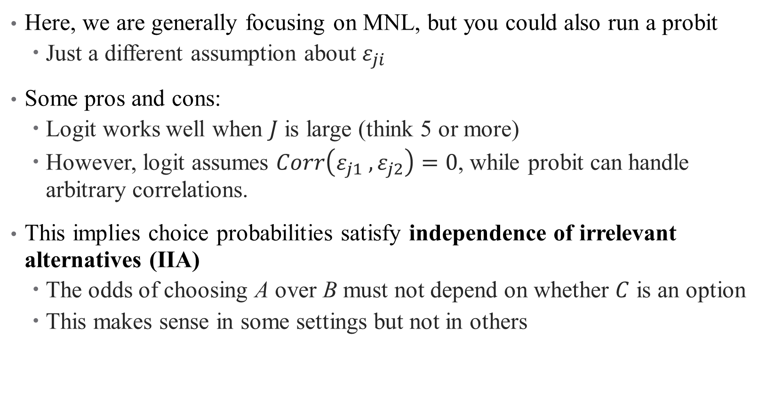
A quick note: multinomial probit versus logit
Here, we are generally focusing on MNL, but you could also run a probit
Just a different assumption about $ε_{ji}$
Some pros and cons:
Logit works well when $J$ is large (think 5 or more)
However, logit assumes $Corr\left(ε_{j1} ,ε_{j2}\right)=0$, while probit can handle arbitrary correlations.
This implies choice probabilities satisfy independence of irrelevant alternatives (IIA)
The odds of choosing A over B must not depend on whether $C$ is an option
This makes sense in some settings but not in others
Notes:
If you have a small choice set and care about the correlations in choice, probit may work better.
Example of IIA: if you have car or bus and then add a bike lane, maybe you should pull equally from both (go from 50% and 50% to 40%, 40%, and 20%). But if you have a car and a red bus, and then add a blue bus, you wouldn’t expect this.

Slide 36
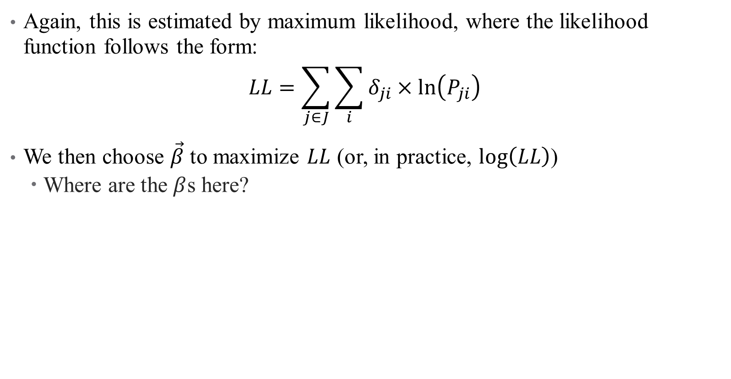
Multinomial Logit: Estimation
Again, this is estimated by maximum likelihood, where the likelihood function follows the form:
$$LL=\sum_{j∈J}{\sum_{i}{δ_{ji}×ln\left(P_{ji}\right) }}$$
We then choose $\vec{β}$ to maximize $LL$ (or, in practice, $log\left(LL\right)$)
Where are the $β$s here?
Notes:
A simplistic version of the likelihood function. Delta is an indicator for which j I chose. P_ji is I’s choice probability of j – note that we had lots of exponentials, so we take the logs – this has the logit structure as it is the ratio of exponentials (doesn't quite all cancel out).
Once the LL is specified, we choose the betas to maximize LL. Where are the betas here? Hidden inside of the P’s

Slide 37
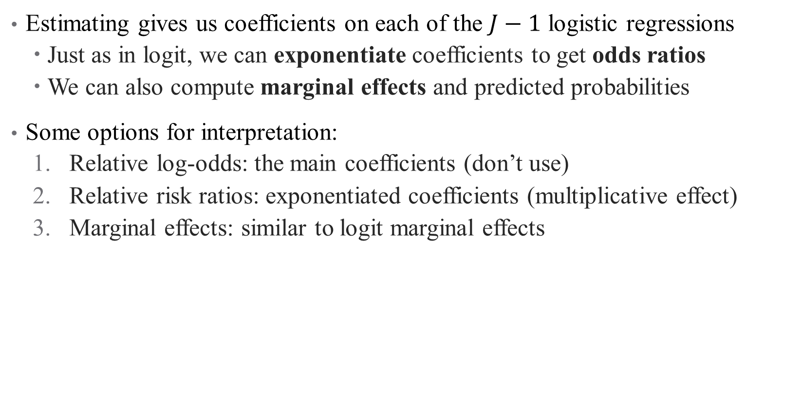
Multinomial Logit: Interpretation
Estimating gives us coefficients on each of the $J−1$ logistic regressions
Just as in logit, we can exponentiate coefficients to get odds ratios
We can also compute marginal effects and predicted probabilities
Some options for interpretation:
Relative log-odds: the main coefficients (don’t use)
Relative risk ratios: exponentiated coefficients (multiplicative effect)
Marginal effects: similar to logit marginal effects
Notes:
A note on relative risk ratios: odds ratios are relative and hence depend on baseline levels (e.g., a 1.5 times increase from 1 is 1.5 but from 100 is 150). This plays a critical role in the economic significance of your results.
Evaluating a complicated model in econometric analysis becomes more and more about story-telling – the more complicated your model is, the more certain your assumptions are wrong. How useful is your model?

Slide 38
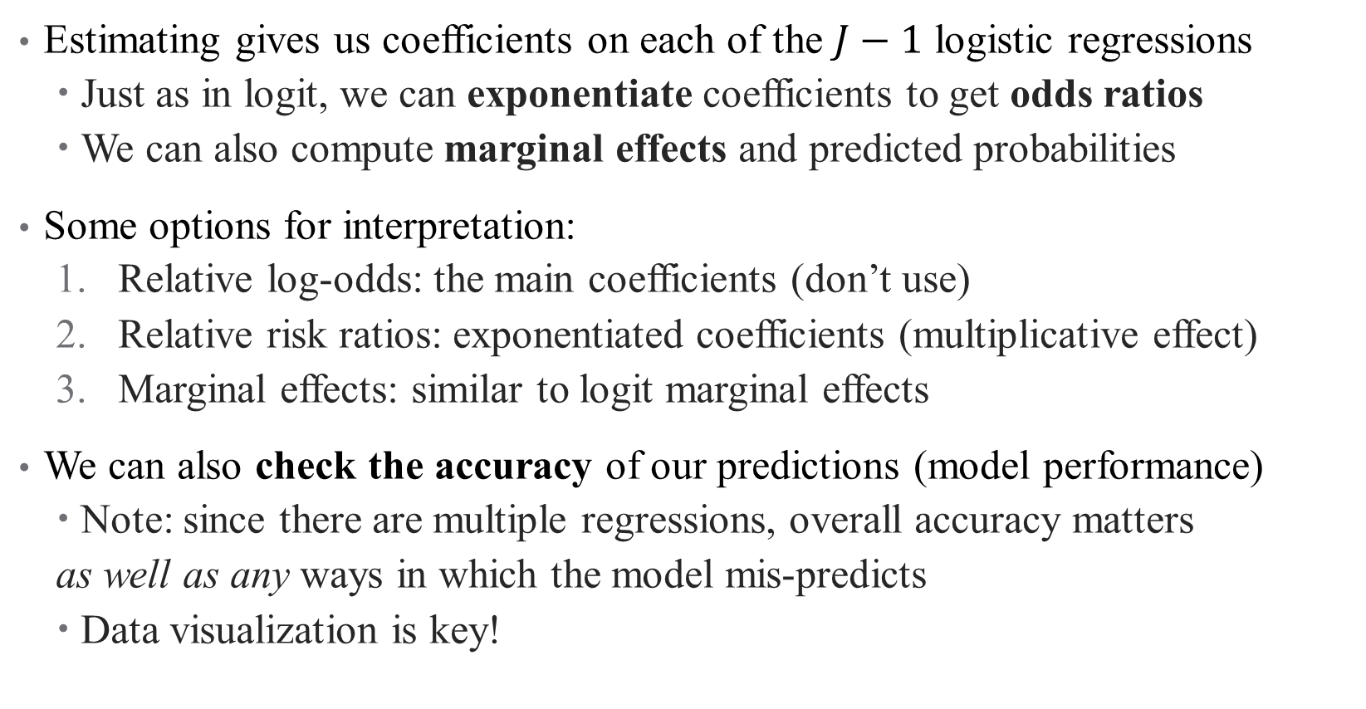
Multinomial Logit: Interpretation
Estimating gives us coefficients on each of the $J−1$ logistic regressions
Just as in logit, we can exponentiate coefficients to get odds ratios
We can also compute marginal effects and predicted probabilities
Some options for interpretation:
Relative log-odds: the main coefficients (don’t use)
Relative risk ratios: exponentiated coefficients (multiplicative effect)
Marginal effects: similar to logit marginal effects
We can also check the accuracy of our predictions (model performance)
Note: since there are multiple regressions, overall accuracy matters
as well as any ways in which the model mis-predicts
Data visualization is key!
Notes:
A note on relative risk ratios: odds ratios are relative and hence depend on baseline levels (e.g., a 1.5 times increase from 1 is 1.5 but from 100 is 150). This plays a critical role in the economic significance of your results.
Evaluating a complicated model in econometric analysis becomes more and more about story-telling – the more complicated your model is, the more certain your assumptions are wrong. How useful is your model?

Slide 39
Mini Referee Report
What do you think about this paper? Any concerns? Anything clever?

Slide 40
Conclusion: Limited Dependent Variables
Binary: LPM, Logit, Probit
Ordered: Poisson, Negative Binomial, possibly truncated
Selection: Hurdle Models, Heckit
Choices: Multinomial Logit models
Notes:
Focusing only on these three for today

