Slide 1
Health Econometrics I
Lecture 6: Endogeneity & Instrumental Variables
October 14, 2022
HAD5744 • Alex Hoagland, Ph.D.

Slide 2
Last Time: Matching Approaches
Matching methods help to deal with imbalanced data
Helps you argue that your comparisons really are apples-to-apples
Matching relies on selection on observables
Propensity score, nearest neighbor techniques

Slide 3
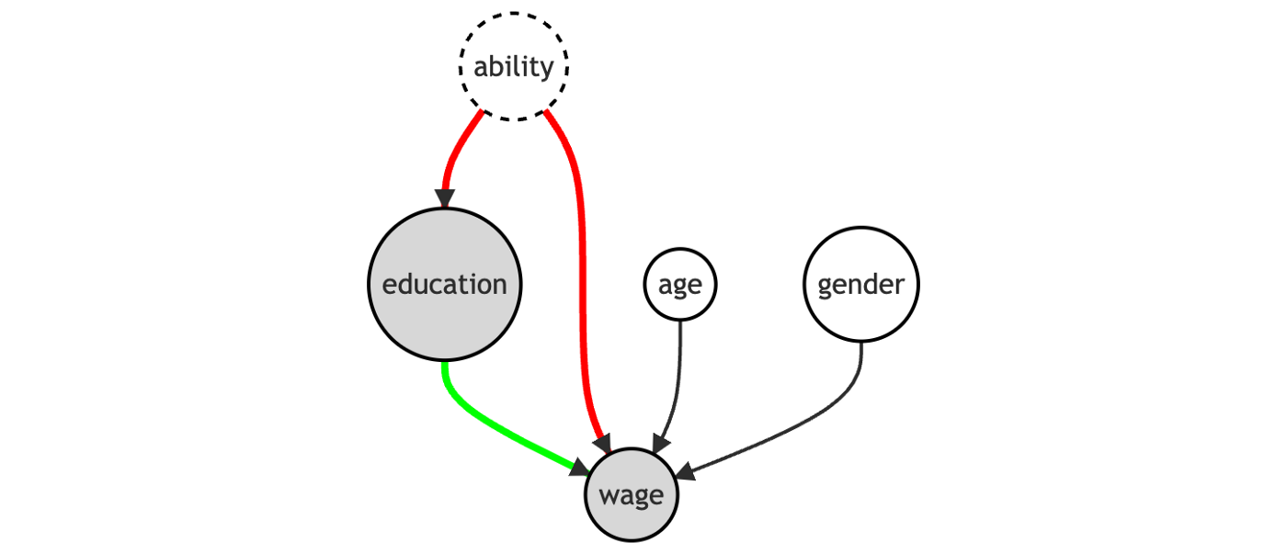
Causal Inference: From Back Doors to Front
So far, we have focused on the backdoor criterion

Slide 4

Causal Inference: From Back Doors to Front
So far, we have focused on the backdoor criterion
We can also isolate variation coming only through $X$
This is called a front door approach – mimics an experiment

Slide 5
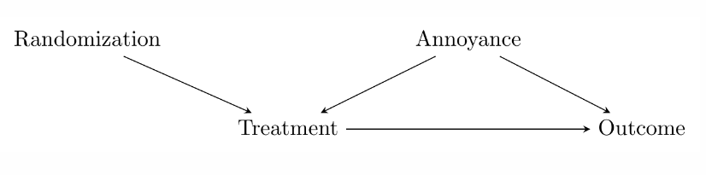
Causal Inference: From Back Doors to Front
Back door variation stands in the way of causal inference
But we can avoid that through careful randomization
Notes:
In an experiment, we generate variation (random assignment) and then just isolate the part of the treatment driven by that random variation (we compare across treatment and control groups). IV does the same, except isolating the part of the treatment driven by quasi-random, natural circumstances – the instrument.

Slide 6
Causal Inference: From Back Doors to Front
Back door variation stands in the way of causal inference
What if we didn’t assign randomization? Can we simulate it somehow?
Instrumental Variables looks for real-world (quasi)-randomization

Slide 7

Causal Inference: From Back Doors to Front
Note: (even perfect) randomization doesn’t absolve us of closing back doors!
But it does move the criterion from $Treatment$ to $Randomization$
This is usually easier to satisfy in practice
Notes:
So we: (1) use the instrument to explain the treatment, (2) focus only on the part of the treatment explained by the instrument, and (3) use that to look at the instrument-explained part of the outcome.

Slide 8
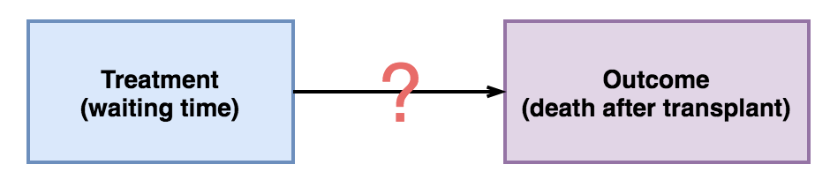
Example: Waiting Times and Transplantation Outcomes

Slide 9
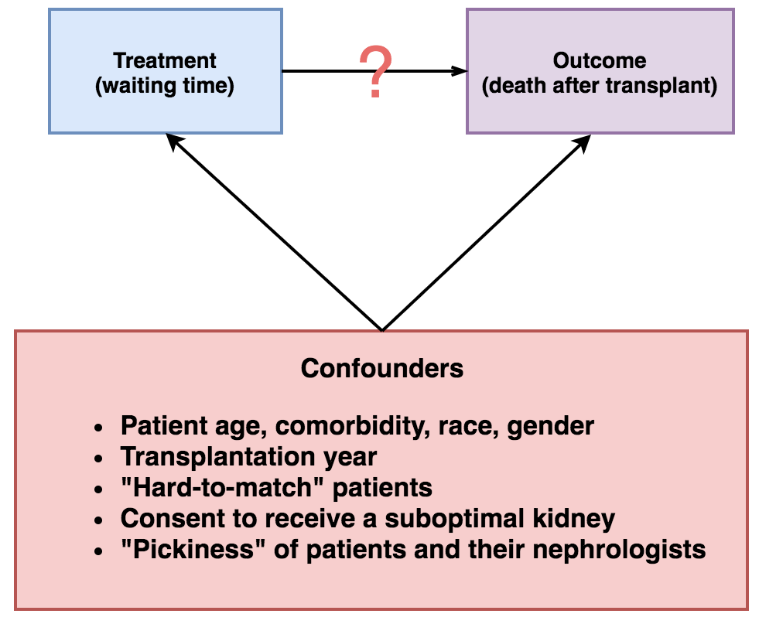
Example: Waiting Times and Transplantation Outcomes

Slide 10
Example: Waiting Times and Transplantation Outcomes
Why can’t we do an experiment?

Slide 11
Example: Waiting Times and Transplantation Outcomes
Why can’t we do an experiment?
RCT is usually impossible to do logistically/ethically
Confounders are unknown / not measurable
Direction of effect is unknown (reverse causality)
Health vs. income
Cancer vs. depression
Earning vs. years of schooling

Slide 12

Endogeneity
What is the consequence of ignoring backdoors?
C$onsider regression y=β_{0}+β_{1}x_{1}+…+β_{k}x_{k}+ε$
If a backdoor $w$is ignored, $Cov\left(x_{j},ε\right)≠0$ for some $x_{j}$

Slide 13
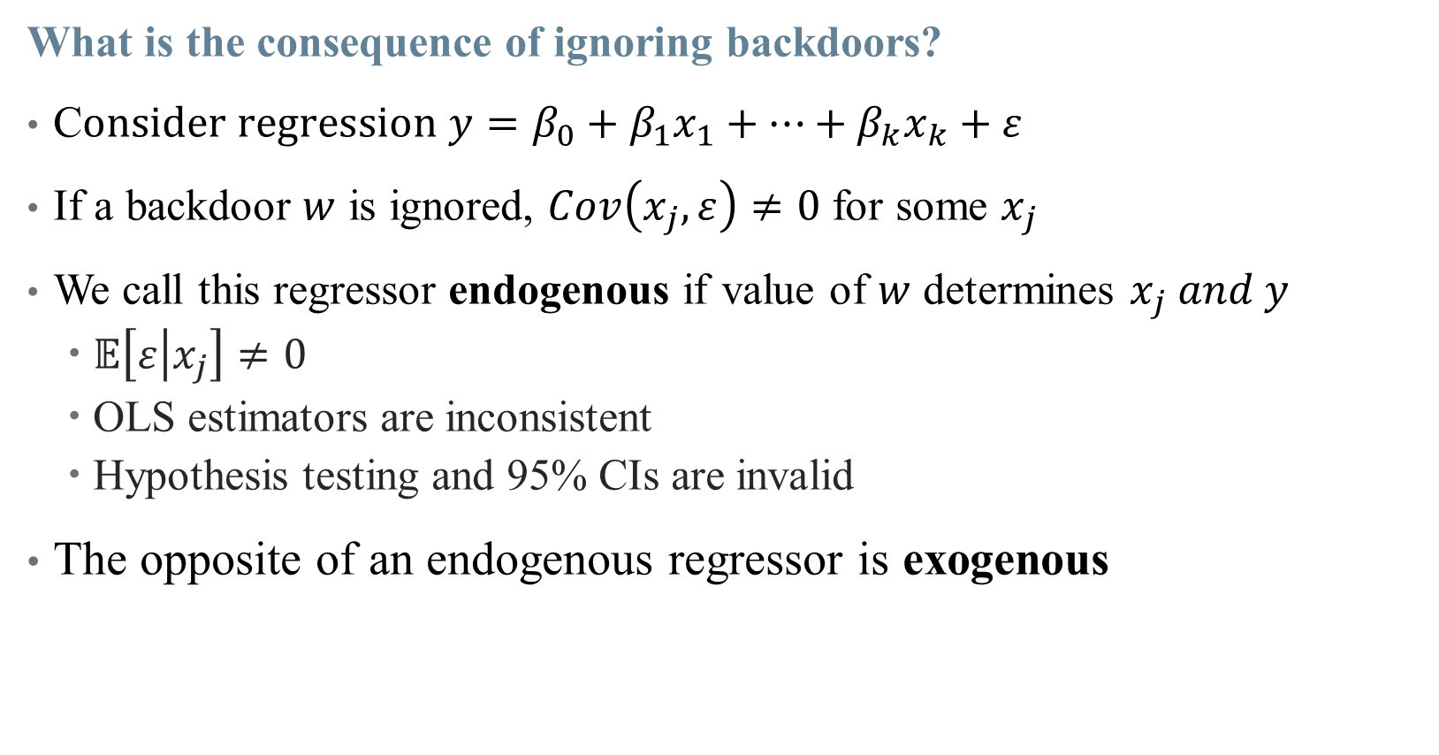
Endogeneity
What is the consequence of ignoring backdoors?
C$onsider regression y=β_{0}+β_{1}x_{1}+…+β_{k}x_{k}+ε$
If a backdoor $w$ is ignored, $Cov\left(x_{j},ε\right)≠0$ for some $x_{j}$
We call this regressor endogenous if value of $w$ determines $x_{j} and y$
$𝔼\left[ε | x_{j}\right]≠0$
OLS estimators are inconsistent
Hypothesis testing and 95% CIs are invalid
The opposite of an endogenous regressor is exogenous

Slide 14
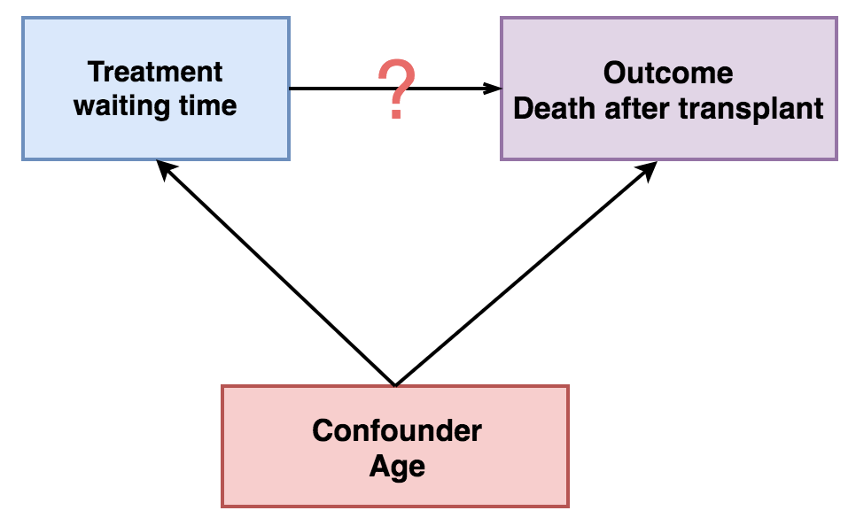

Endogeneity Example: Age
Age is correlated with both waiting time ($W)$ and outcome ($D$)
$D$is impacted by both $W$ and Age
Without closing back door, $\hat{β_{W}}≠β_{W}$
$W$ is endogenous

Slide 15
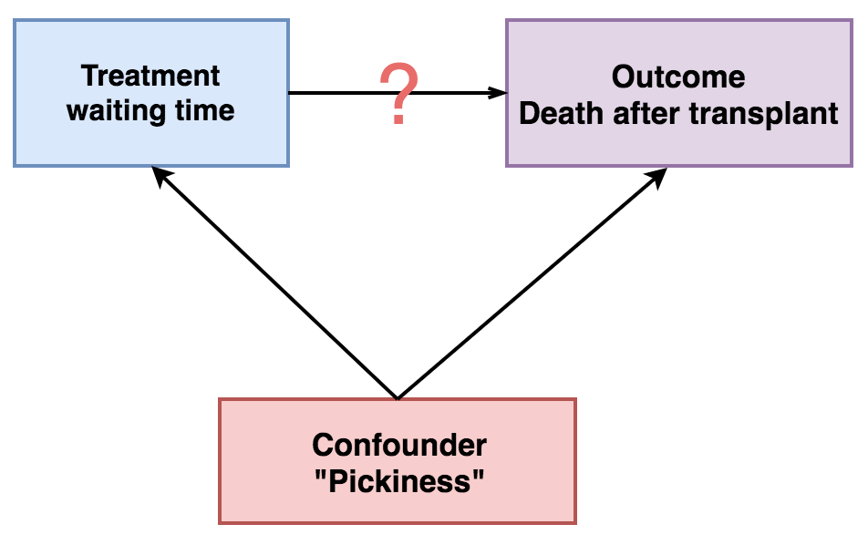

Endogeneity Example: Age
Other variables are harder to control for
How “picky” a patient is may increase $W$ and $D$

Slide 16
Exploiting Quasi-Random Variation

Slide 17

Instrumenting for an Endogenous Variable
We are particularly concerned when our $Treatment$ variable is endogenous
How can we randomize?
Pick a suitable variable which is an instrument for randomization
Mimics an RCT

Slide 18
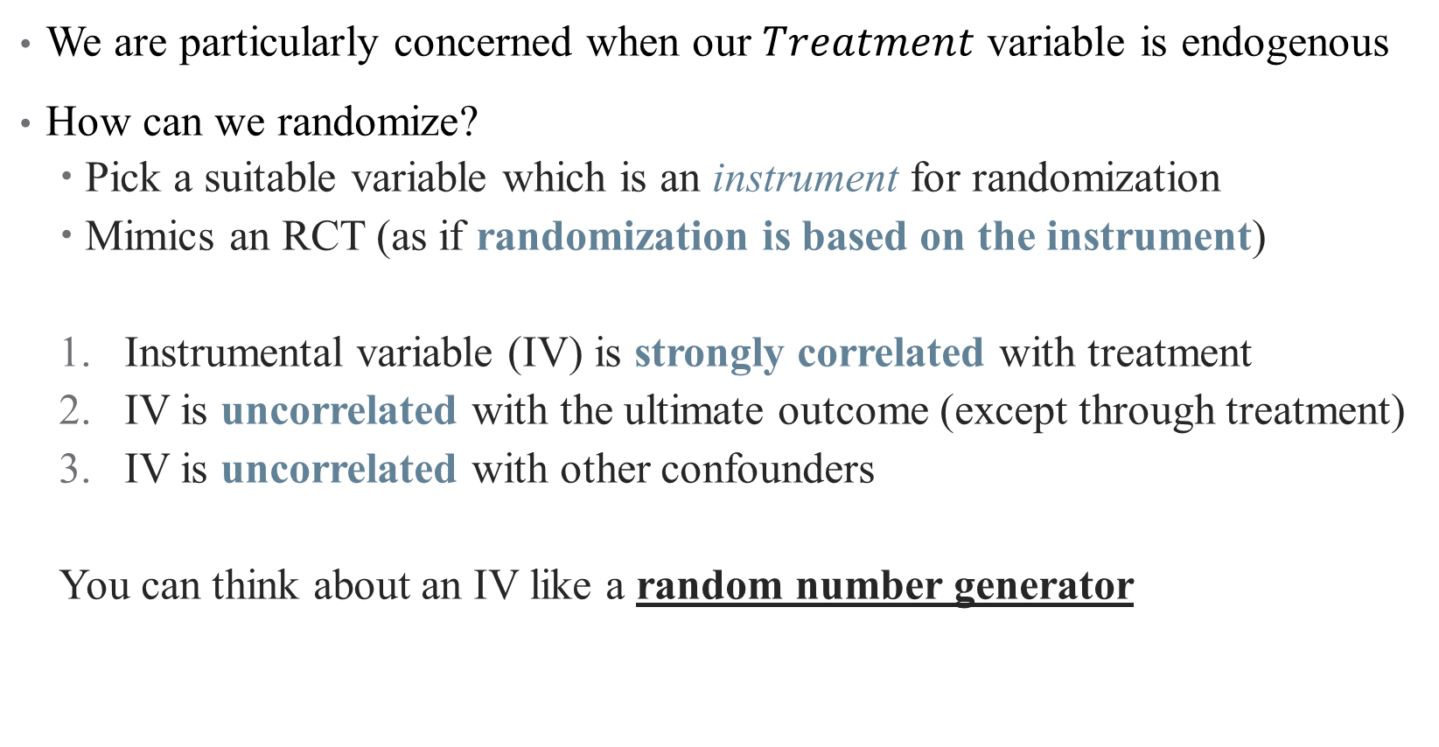
Instrumenting for an Endogenous Variable
We are particularly concerned when our $Treatment$ variable is endogenous
How can we randomize?
Pick a suitable variable which is an instrument for randomization
Mimics an RCT (as if randomization is based on the instrument)
Instrumental variable (IV) is strongly correlated with treatment
IV is uncorrelated with the ultimate outcome (except through treatment)
IV is uncorrelated with other confounders
You can think about an IV like a random number generator
Notes:
First condition is called relevance; second and third are validity – essentially that there are no open back doors of Z

Slide 19
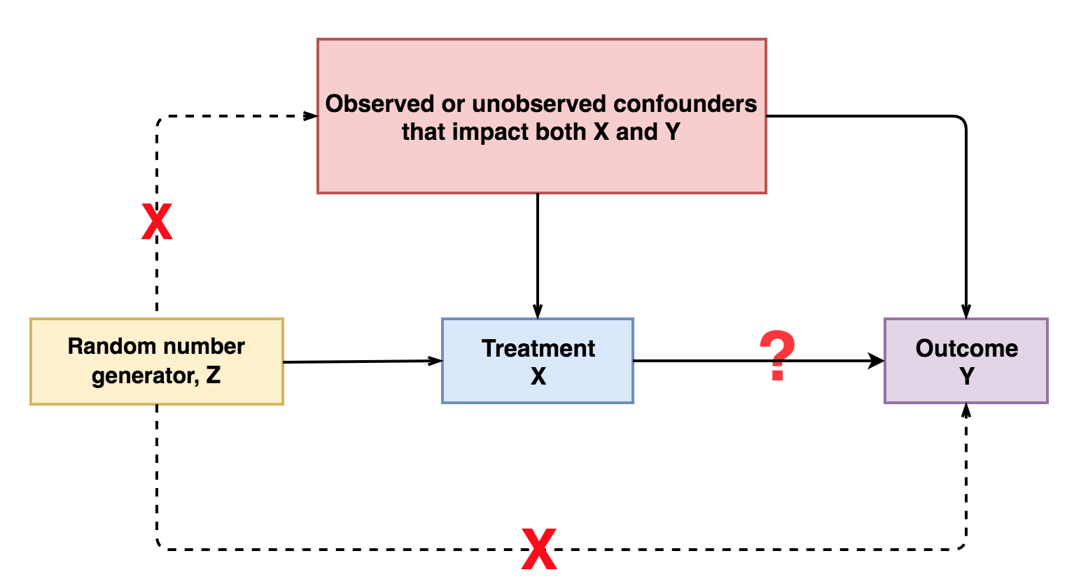

Slide 20
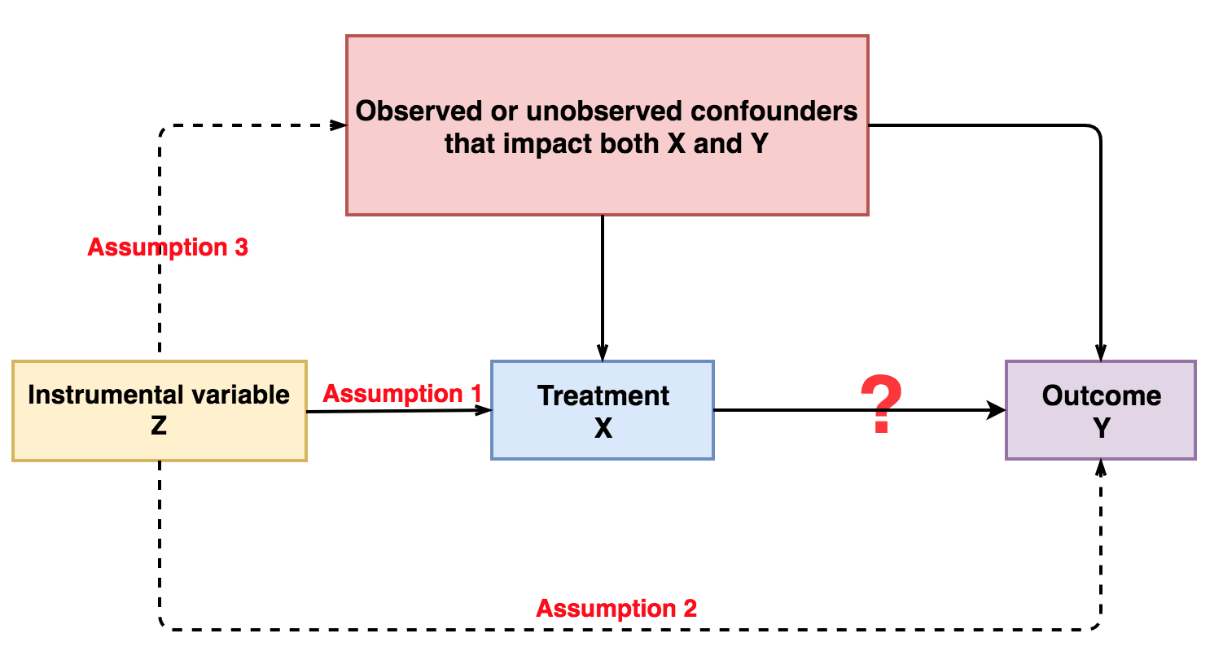
Notes:
So this is kind of the opposite of controlling for a variable: when we control for W, we use W to explain X and Y and remove those parts (to close a back door). But here, we are going to use Z as an instrument and remove the unexplained parts.

Slide 21
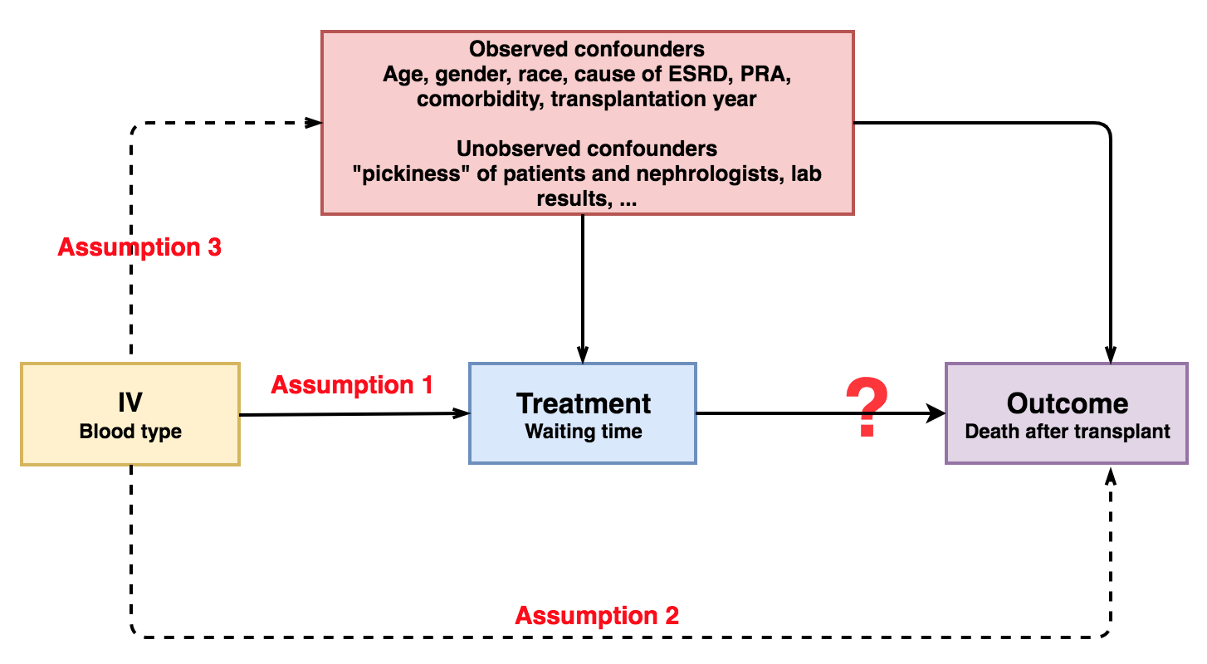
Example: Transfusions and Waiting Time
Consider blood type as a potential IV for waiting time

Slide 22

Example: Transfusions and Waiting Time
Consider blood type as a potential IV for waiting time
Other popular IVs in the literature:
Cigarette tax as an IV to smoking $→$ physical function (Leigh and Schembri, 2003)
Prison overcrowding for prison populations $→$ crime rates (Levitt, 1997)
Electoral cycles in police hiring for police $→$ crime (Levitt, 1997)

Slide 23

Using IVs to back out treatment effects
With an IV $z$, we can calculate:
Effect of $z$ on $y=($effect of z on $x)$ * (effect of x on $y)$
Hence: effect of $x$ on $y=($effect of z on $y)$ / (effect of z on x$)$

Slide 24

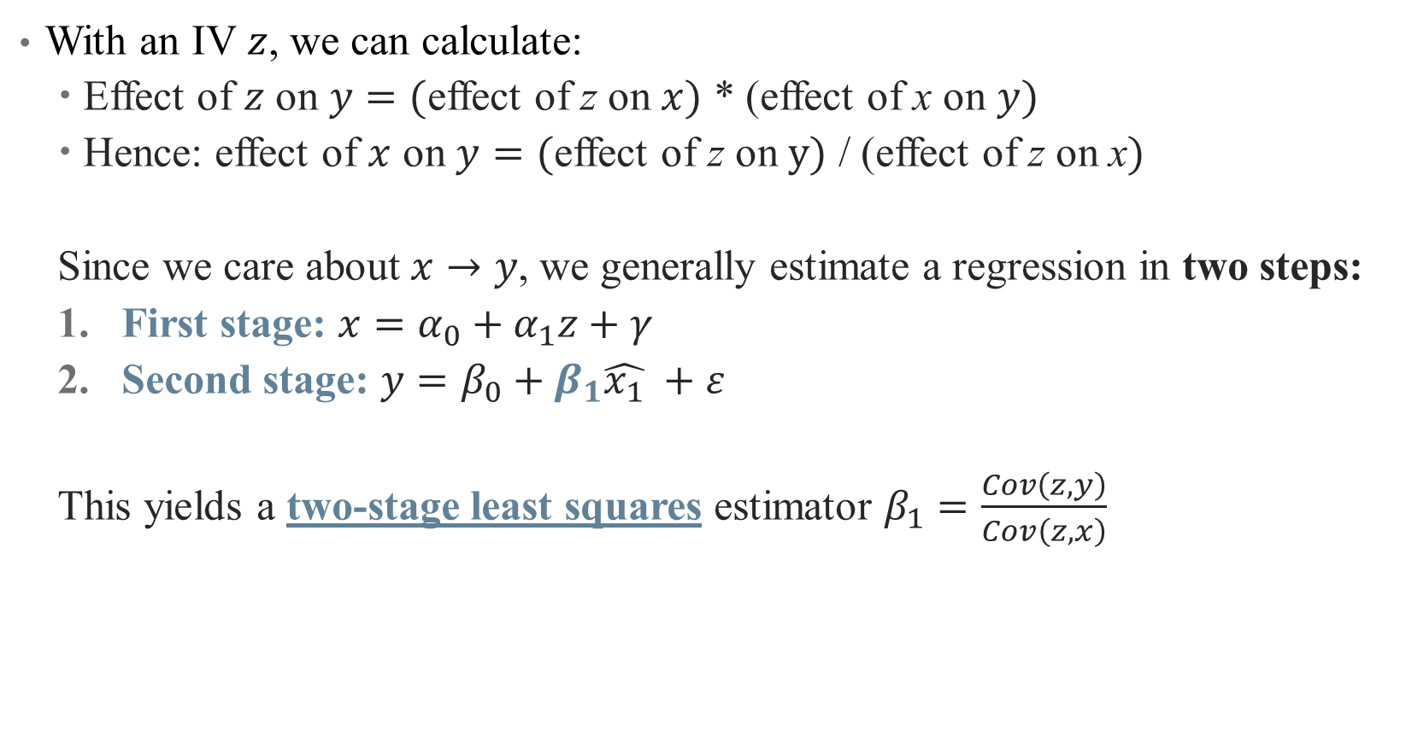
Using IVs to back out treatment effects
With an IV $z$, we can calculate:
Effect of $z$ on $y=($effect of z on $x)$ * (effect of x on $y)$
Hence: effect of $x$ on $y=($effect of z on $y)$ / (effect of z on x$)$
Since we care about $x→y$, we generally estimate a regression in two steps:
First stage: $x=α_{0}+α_{1}z+γ$
Second stage: $y=β_{0}+β_{1}\hat{x_{1}} +ε$
This yields a two-stage least squares estimator $β_{1}=\frac{Cov\left(z,y\right)}{Cov\left(z,x\right)}$
Notes:
Here, you can see why we need relevance condition; if Cov(z,x) = 0, then the 2sls doesn't return anything useful. Even if cov is small, we have problems (we'll return to this).

Slide 25
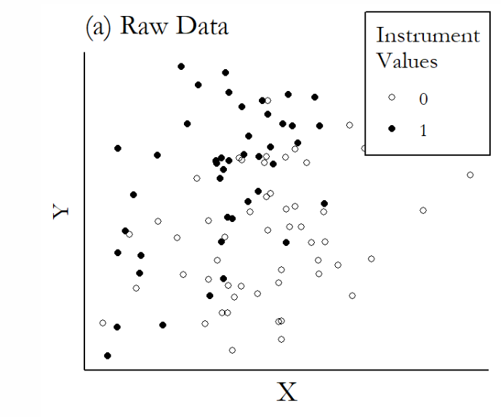
Graphical Illustration of IVs

Slide 26
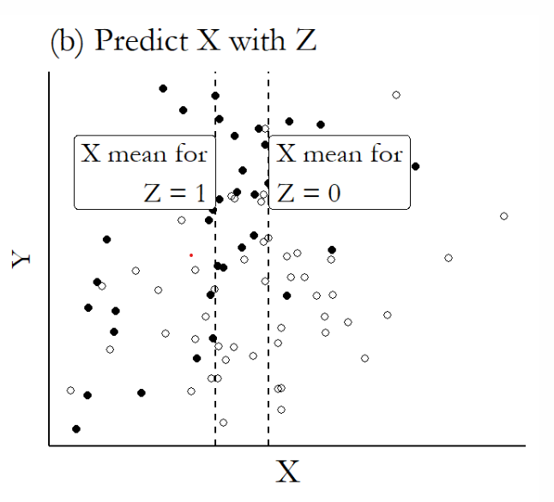
Graphical Illustration of IVs

Slide 27
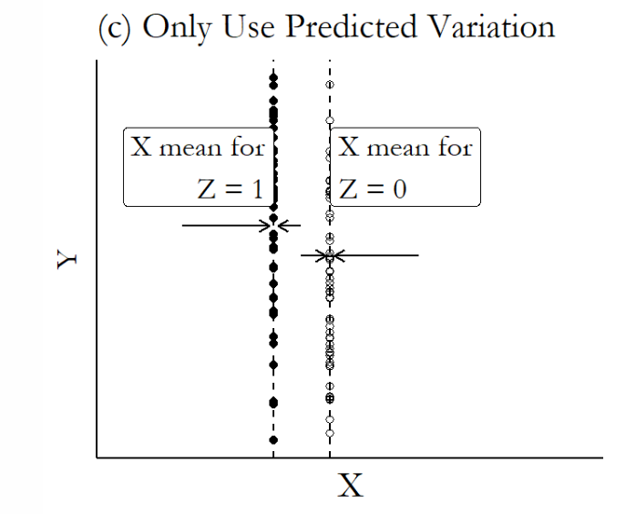
Graphical Illustration of IVs

Slide 28
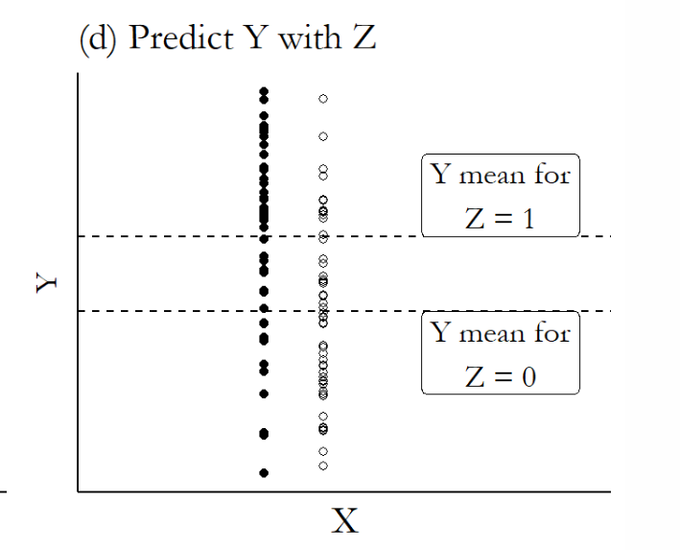
Graphical Illustration of IVs

Slide 29
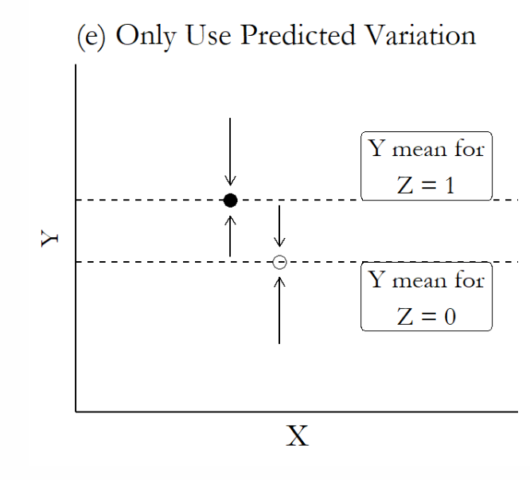
Graphical Illustration of IVs

Slide 30
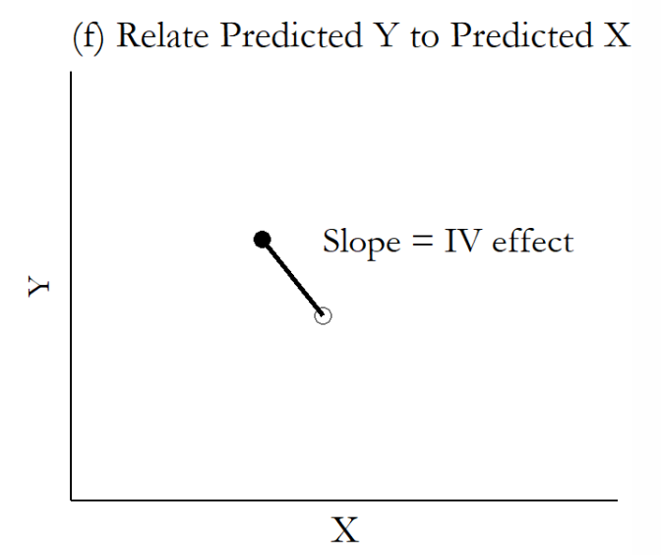
Graphical Illustration of IVs

Slide 31
Interpreting and Implementing IV

Slide 32
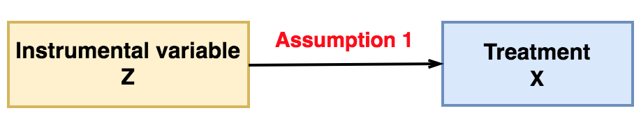
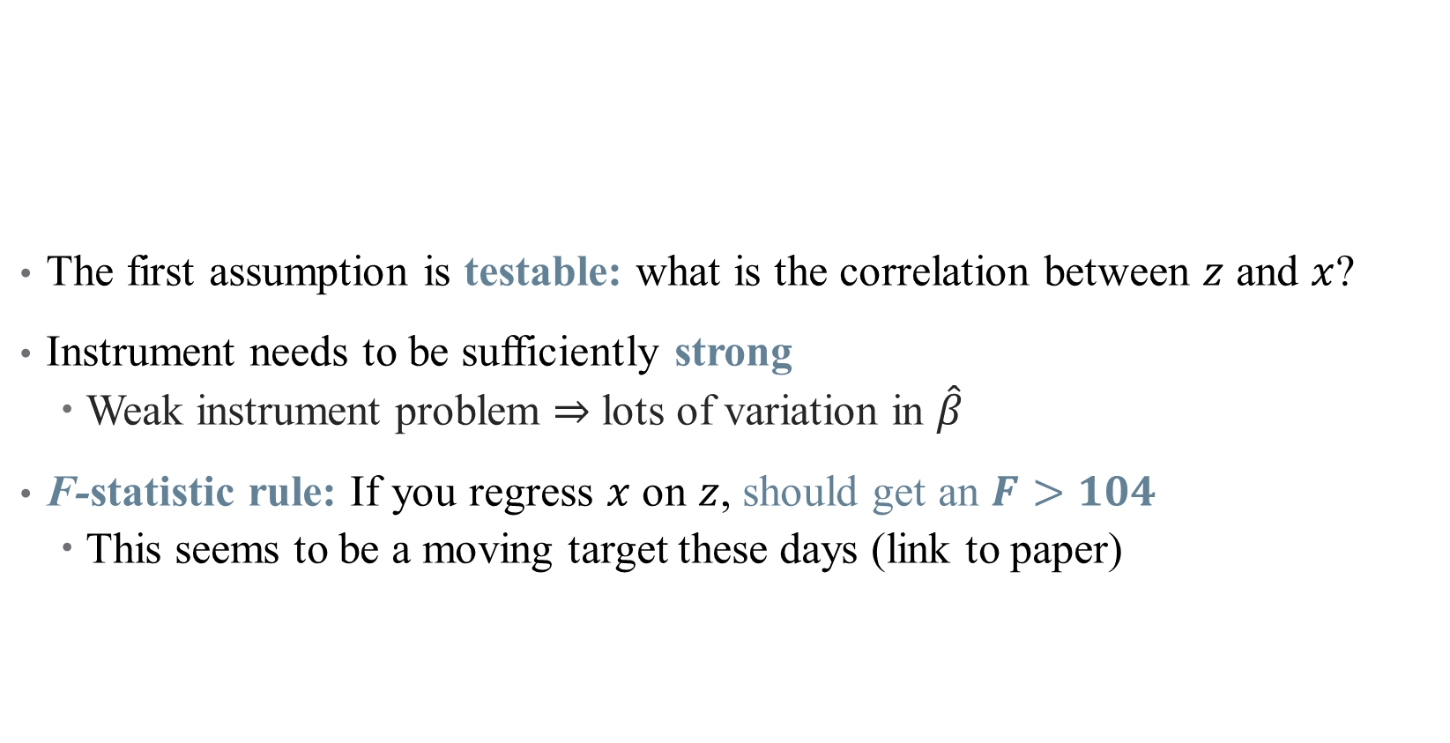
Using an IV: Testing Assumptions
The first assumption is testable: what is the correlation between $z$ and $x$?
Instrument needs to be sufficiently strong
Weak instrument problem $⇒$ lots of variation in $\hat{β}$
F-statistic rule: If you regress $x$ on $z$, should get an $F>104$
This seems to be a moving target these days (link to paper)

Slide 33
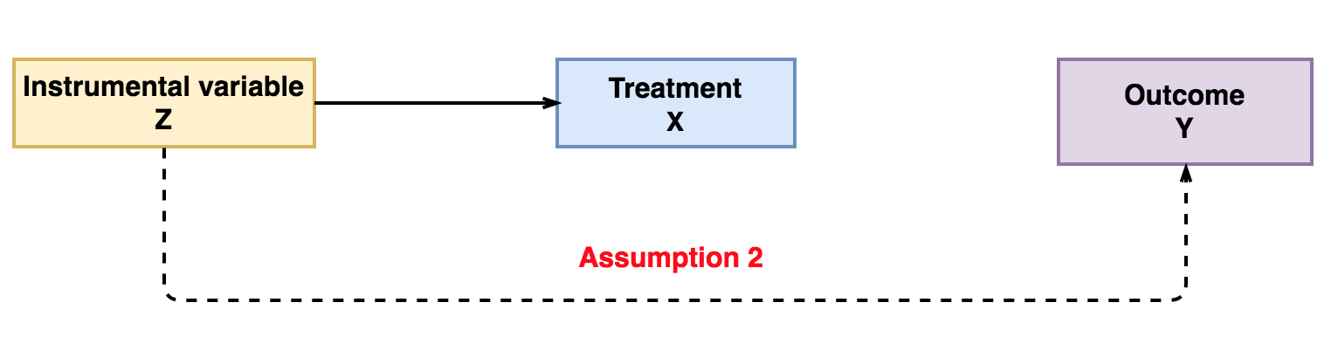

Using an IV: Testing Assumptions
The second assumption is not testable:
Why can’t we just regress $y$ on $z$?
Instead, need to argue (e.g., based on previous work) something about randomness
This is harder and harder to do!

Slide 34
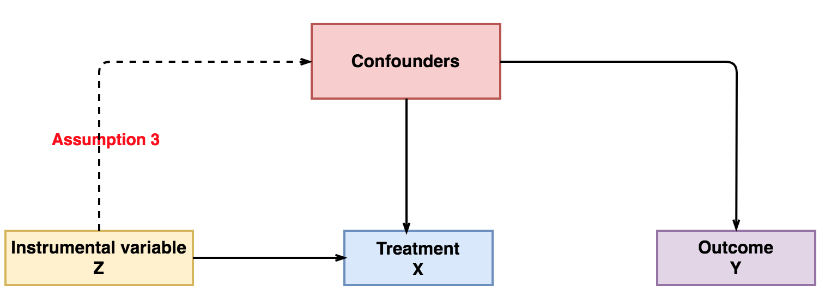
Using an IV: Testing Assumptions
The third assumption is not testable:
No data on confounders in the first place!
Again, based on argument about why this assumption is satisfied

Slide 35
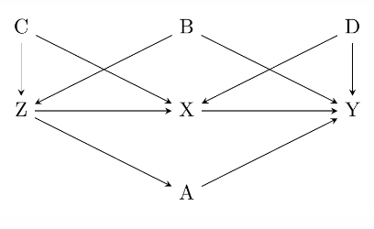
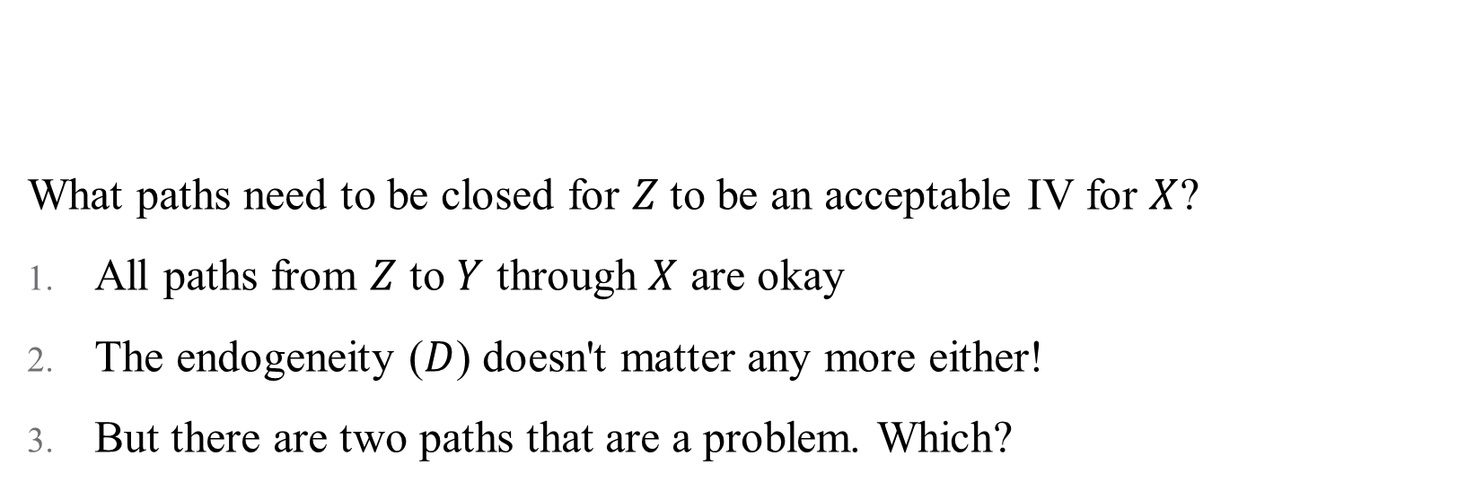
Visualizing Validity
What paths need to be closed for $Z$to be an acceptable IV for $X$?
All paths from $Z$ to $Y$ through $X$ are okay
The endogeneity ($D$) doesn't matter any more either!
But there are two paths that are a problem. Which?
Notes:
Note: we might not think Z – A – Y is a problem typically, but when Z is an IV, this confounds the effect of X on Y and the effect of A on Y! Can just control for A and B in order to close these paths.

Slide 36
Using an IV: How do I come up with an IV?
It is unlikely that any personal characteristic can be used as a strong instrumental variable
Most good instruments come from:
Real randomization (blood type)
"Mendelian randomization," where combining parent genes produces "random" children
Unexpected correlations – a variable you would never expect had anything to do with assigning treatment ("a good instrument should feel weird")
Think about regional characteristics (unemployment rate), policies (blood type; cigarette tax), “natural” features (proximity)
Clever instruments are likely to be extremely context-dependent!
Notes:
Example for Mendelian randomization: the sex of first two children determines whether parents are more likely to have a third child.

Slide 37
Using an IV: How do I defend an IV?
Report relevance:
Used to be F > 10, now is F > 104.7
Notes:
Large F stat is just for correcting t-tests for relationship between X and Y and X and Z – your CIs will be a tiny bit wrong. Generally, a large F will work (although closer to 10 still gives you problems). Remember that this is a scale, since we're concerned about weak instruments

Slide 38
Using an IV: How do I defend an IV?
Report relevance:
Used to be F > 10, now is F > 104.7
Correct for weak instrument problems
There are bias correction tests and methods
These corrections aren't universally accepted
Generally, they blow up your standard errors too much to be useful anyway

Slide 39
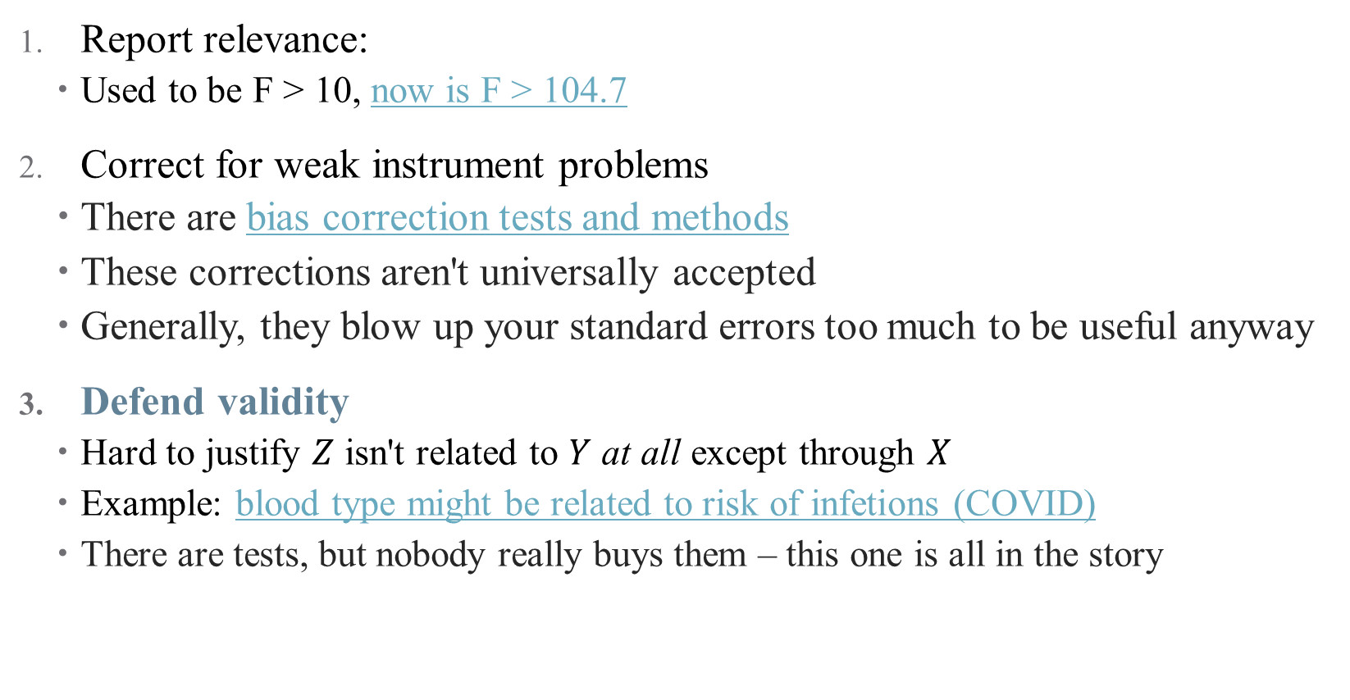
Using an IV: How do I defend an IV?
Report relevance:
Used to be F > 10, now is F > 104.7
Correct for weak instrument problems
There are bias correction tests and methods
These corrections aren't universally accepted
Generally, they blow up your standard errors too much to be useful anyway
Defend validity
Hard to justify $Z$ isn't related to $Y$ at all except through $X$
Example: blood type might be related to risk of infetions (COVID)
There are tests, but nobody really buys them – this one is all in the story
Notes:
Difficulty with defending validity just means that we need to be choosy, not give up on IV altogether. It's just like trying to convince a room your DAG is right! And bulk of evidence helps, here (many studies with different approaches)

Slide 40
Using an IV: Best Practices
Use packages to help get the standard errors right
Always report first-stage, and thoroughly discuss validity and monotonicity (next slide) assumptions
It's a good idea to just act as though your IV is weak
Really, this just means increasing your standard errors
Notes:
Rationale for small sample bias: validity is going to be statistically violated at random

Slide 41
Using an IV: Best Practices
Use packages to help get the standard errors right
Always report first-stage, and thoroughly discuss validity and monotonicity (next slide) assumptions
It's a good idea to just act as though your IV is weak
Really, this just means increasing your standard errors
Other issues:
Small sample size can bias your estimates
Notes:
Rationale for small sample bias: validity is going to be statistically violated at random

Slide 42
Using an IV: How do I interpret an IV?
IV's capture local average treatment effects (LATEs)
The estimated effects are also instrument-specific (change the IV, change the LATE)
In general, we say that IV identifies the ATE for compliers

Slide 43
Using an IV: How do I interpret an IV?
IV's capture local average treatment effects (LATEs)
The estimated effects are also instrument-specific (change the IV, change the LATE)
In general, we say that IV identifies the ATE for compliers
Easiest to understand in the case of a binary instrument
 |  | Treated?
 |  | No | Yes
Instrumented? | No | Never-takers + Compliers | Always-takers + Defiers
 | Yes | Never-takers + Defiers | Always-takers + Compliers

Slide 44
Using an IV: How do I interpret an IV?
IV's capture local average treatment effects (LATEs)
The estimated effects are also instrument-specific (change the IV, change the LATE)
In general, we say that IV identifies the ATE for compliers
Easiest to understand in the case of a binary instrument:
IV identifies the treatment effect on those affected by the instrument (makes sense)
This does reduce the amount of variation/data used in identification
Identification rests on an assumption: no defiers (also called monotonicity)
Also, have to consider: is the LATE policy relevant? (ex: blood type)
Notes:
Monotonicity just means that the instrument moved people towards/away from treatment in the same way (an IV can't both incentivize treatment for one person and discourage it for another). Example of third child – is monotonicity satisfied here? Wrapped up in heterogeneous treatment effects.

Slide 45
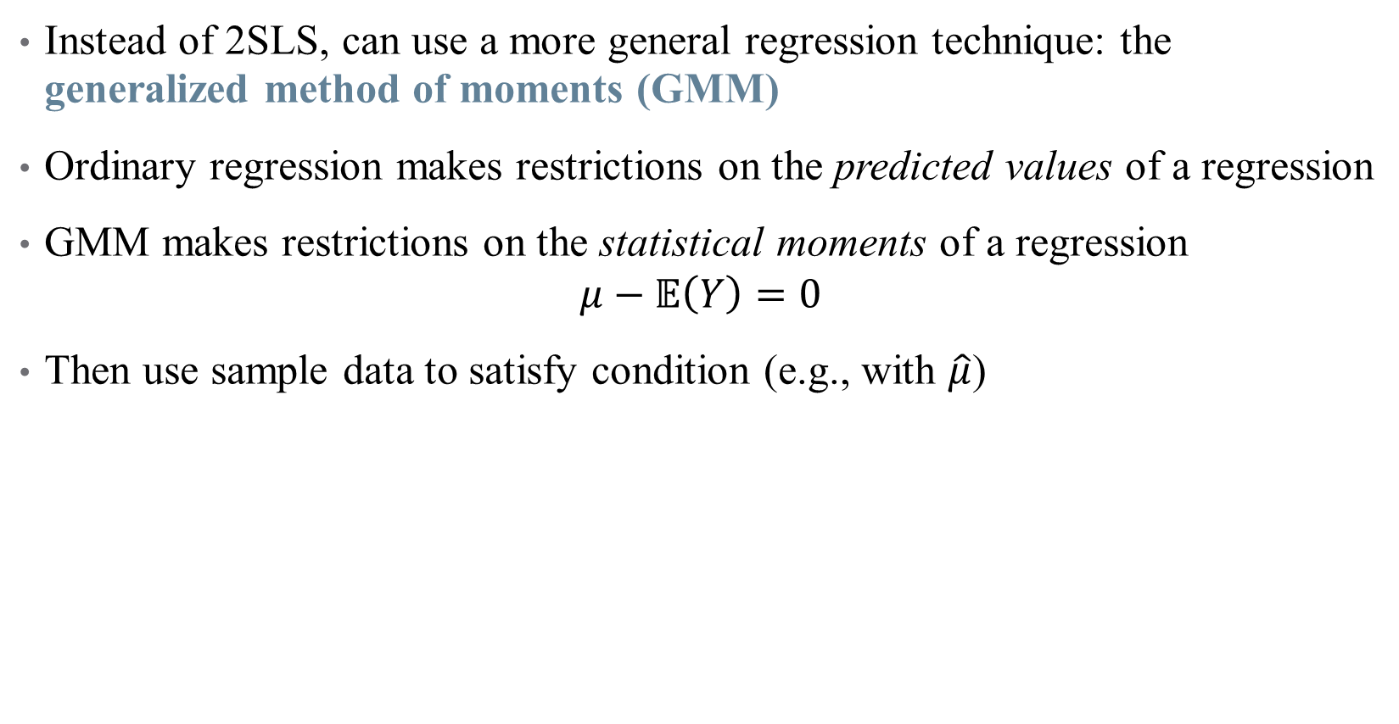
Another Estimation Technique: GMM
Instead of 2SLS, can use a more general regression technique: the generalized method of moments (GMM)
Ordinary regression makes restrictions on the predicted values of a regression
GMM makes restrictions on the statistical moments of a regression
$$μ−𝔼\left(Y\right)=0$$
Then use sample data to satisfy condition (e.g., with $\hat{μ}$)

Slide 46
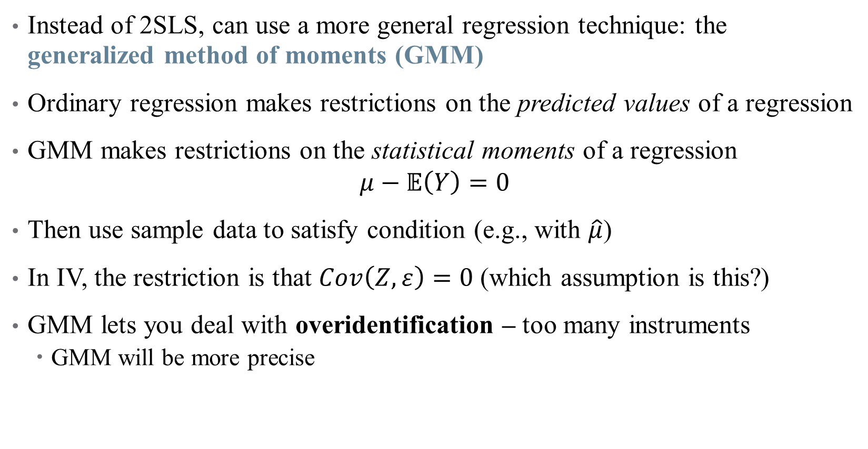
Another Estimation Technique: GMM
Instead of 2SLS, can use a more general regression technique: the generalized method of moments (GMM)
Ordinary regression makes restrictions on the predicted values of a regression
GMM makes restrictions on the statistical moments of a regression
$$μ−𝔼\left(Y\right)=0$$
Then use sample data to satisfy condition (e.g., with $\hat{μ}$)
In IV, the restriction is that $Cov\left(Z,ε\right)=0$ (which assumption is this?)
GMM lets you deal with overidentification – too many instruments
GMM will be more precise

Slide 47
Other Example Papers and Instruments
The Effect of Evictions on Opioid Mortality (Bradford and Bradford, Health Services Research 2020)
Notes:
Kind of a standard IV paper, good clinical journal style to read and mimic

Slide 48
Other Example Papers and Instruments
The Effect of Evictions on Opioid Mortality (Bradford and Bradford, Health Services Research 2020)
Other popular (and more generalizable) IV approaches:
Lotteries: experiment with voluntary participation
Oregon Medicaid Experiment: Finkelstein, Amy, Sarah Taubman, Bill Wright, Mira Bernstein, Jonathan Gruber, Joseph P. Newhouse, Heidi Allen, and Katherine Baicker. 2012. “The Oregon Health Insurance Experiment: Evidence from the First Year.” Quarterly Journal of Economics 127 (3): 1057–1106.
Baicker, Katherine, Sarah L. Taubman, Heidi L. Allen, Mira Bernstein, Jonathan Gruber, Joseph Newhouse, Eric Schneider, Bill Wright, Alam Zaslavsky, and Amy Finkelstein. 2013. “The Oregon Experiment – Effects of Medicaid on Clinical Outcomes.” New England Journal of Medicine 368 (May): 1713–22.
Notes:
Example from 1: in the 2000s, Oregon chose to expand its Medicaid program for poor adults by making it more generous. They used a lottery – this randomization can be an IV to back out LATE from ITT.

Slide 49
Other Example Papers and Instruments
The Effect of Evictions on Opioid Mortality (Bradford and Bradford, Health Services Research 2020)
Other popular (and more generalizable) IV approaches:
2. Judge Fixed Effects (also called leniency designs)
Narrow pipeline through which all individuals must pass
Individuals are randomly assigned a decision-maker
Decision-maker has discretion over final outcome
Then, random "judge" assignment can be used to instrument for outcomes
What are some health policy examples of this? Are they valid?
Bakx, Wouterse, van Doorslaer, and Wong (2020, JHE): "Better off at home? Effects of nursing home eligibility on costs, hospitalizations and survival"
Notes:
This is just really popular with judges, doesn't have to be criminal. Possible examples: FDA approval, physician decision-making. Some concerns: is assignment truly random? Is the pipeline really narrow? Can the discretion be chosen by the patient/entity? Paper uses differences in nursing home eligibility assessors to find that access to nursing homes lowers use of other kinds of care, but does not affect health spending or mortality meaningfully. Plenty of opportunities to implement this design more meaningfully.

Slide 50
Other Example Papers and Instruments
The Effect of Evictions on Opioid Mortality (Bradford and Bradford, Health Services Research 2020)
Other popular (and more generalizable) IV approaches:
3. Bartik/Shift-Share Instruments
A type of instrument which measures change in a region’s labor demand due to changes in the national demand for different industries’ products
Created by interacting initial “shares” of geographic regions with national growth rates (in immigration, manufacturing employment, etc.)
Example: Currie, Jin, and Schnell (2019): "U.S. Employment and Opioids: Is there a Connection?," Working paper.
Notes:
This is most useful when looking at regional market differences in health questions.

Slide 51
Conclusion
IV is a powerful design when data suffer from selection on unobservables.
Good front door approach!
Has many limitations:
First, it only identifies the LATE under heterogeneous treatment effects, and that may or may not be a policy relevant variable.
IV has up to five (untestable) assumptions!
IV tends to be less credible
But IV is an important strategy and sometimes the opportunity to use it will come along!
Build in-depth knowledge of institutional details -- familiarity is how you find instruments!
Notes:
This is most useful when looking at regional market differences in health questions.

