Slide 1
Health Econometrics I
Lecture 1: Econometric Frameworks
September 9, 2022
HAD5744 • Alex Hoagland, Ph.D.
Notes:
Things I can add if there are fewer than 30 slides:
Figure 1 on SC ,page 7 – correlation and causation

Slide 2

Introduction & Syllabus

Slide 3
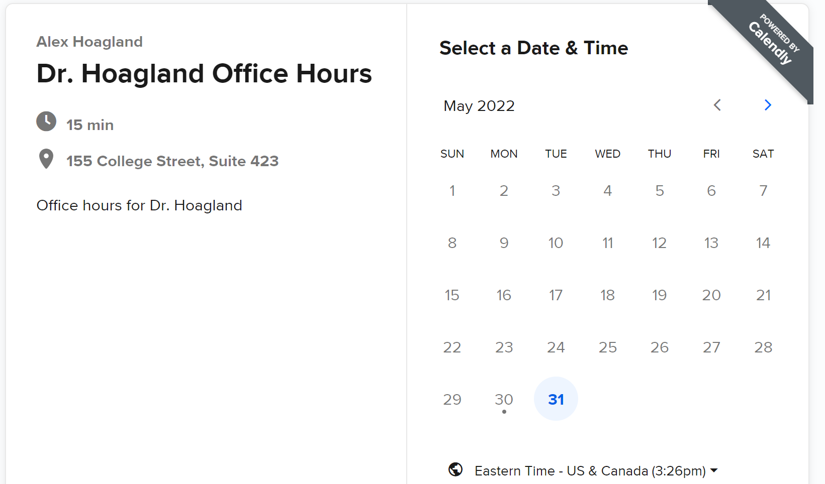
Introduction & Syllabus
Booking office hours: calendly.com/Hoagland-office-hours/had5744-2022f
In-person and Zoom options
Notes:
Click on link to go through software here

Slide 4
Introduction & Syllabus
Evaluation Criteria
Assignments: 3 assignments, each worth 20% of the final grade.
Must be submitted via email in pdf format (that shows code and output)
Please submit before class on the due date
Late assignments will be penalized at the rate of 10% per day.
Please include “Assignment #X_Econometrics” in the subject line.

Slide 5
Introduction & Syllabus
Evaluation Criteria
Assignments: 3 assignments, each worth 20% of the final grade.
Major Paper: worth 40% of the final grade.
Major paper:
Investigation of a research question of their own choosing
Students are expected to pair up in groups of either two or three to produce a paper.
Outline of major paper due October 21st :
Brief introduction
Literature review
Description of data, variables
Methods
Results
Discussion
Conclusion.
The paper should be presented in the form of a journal manuscript (econ or policy)
Final paper is due December 8

Slide 6

Introduction & Syllabus
Software.
We will use R:
You are welcome to use other software (textbooks cover STATA/Python examples)
R is free! Download R here and an interface RStudio here
Learning R can be frustrating! Ask for help!
We typically will use the “Tidyverse” and “Dplyr” packages/structure
Training sessions: September 16 (R) and September 23 (STATA)
Github repo
Contains all relevant course materials
Sample papers
Discussion boards
Notes:
Lots of online resources – I’m going to try to cover things in real time, as that has been the most helpful way I’ve learned R. Group work is encouraged, Github discussions, office hours, etc.

Slide 7


Introduction & Syllabus
Notes:
Cheap, great resource, online version available. Highly recommend for all applied quant researchers.

Slide 8

One Pet Peeve:
Introduction & Syllabus
Notes:
There are no real-time emergencies in a university class setting – send me an email, and please be respectful of my time. Likewise, I will be respectful of yours.

Slide 9
Econometric Frameworks
Notes:
Things I can add if there are fewer than 30 slides:
Figure 1 on SC ,page 7 – correlation and causation

Slide 10

Goal of Econometric Analysis
Causal Inference: Identification of causal relationships
Build understanding of:
Causal pathways (X $→$ Y)
Directionality (not Y $→X)$
Mechanisms (X $→$ A $→$ Y)
Key question: when can we say a relationship is causal?
Notes:
Our goal is to understand a DGP – what gives rise to the data we see in the world? In order to have good policy, need to understand these channels (babies in the river story)

Slide 11
All that glitters is an RCT?
Can we only believe randomized control trials?
RCTs are useful in some settings, but what are some problems with them?
Notes:
Gol standard of med research is RCT – is that all we can use?

Slide 12
All that glitters is an RCT?
Can we only believe randomized control trials?
RCTs are useful in some settings, but what are some problems with them?
Not always feasible
Implicit biases
Can’t always detect negative side effects
Problems with external validity, scaling, etc.
Econometric analysis helps identify real world patterns from real world data
Notes:
Decades of research goes into understanding how real data can give us (some) real answers. There are more assumptions and some limits on the parameters you return, but that’s a tradeoff worth taking.

Slide 13
Econometric approach
Observational data: retrospective, “real-world” data
Not collected in a lab (or lab setting)
Surveys, claims, tax records, etc.
What created that data?
Data Generating Process: what unique collection of characteristics, events, and randomness coalesced to form the data we are looking at?
Our objective is to use the data available to try and establish the nature of the true DGP.
But many different DGPs are possible, and many may yield very similar patterns!

Slide 14
Econometric approach
Observational data: retrospective, “real-world” data
Not collected in a lab (or lab setting)
Surveys, claims, tax records, etc.
What created that data?
Data Generating Process: what unique collection of characteristics, events, and randomness coalesced to form the data we are looking at?
Our objective is to use the data available to try and establish the nature of the true DGP.
But many different DGPs are possible, and many may yield very similar patterns!
Example: Suppose we are making a diagnosis:
How helpful is knowing a patient has a fever?
Must consider all symptoms together

Slide 15
What’s a model?
Goal: understand relation between:
Outcome (Y)
Treatment (D)
Covariate (X),
We must specify in detail the mechanisms between these features
This is our model. Model testing involves comparing several plausible hypotheses
Why do we have to do this in detail?
Correlation is not causation
Different variables may move in tandem without there being causal relations among them

Slide 16
DGPs as DAGs
Directed Acyclic Graphs (DAGs):
Graphical relationship of a chain of causal effects
Represented as random variables (nodes) and influencing events (arrows)
D
Y
X

Slide 17
DGPs as DAGs
Directed Acyclic Graphs (DAGs):
Graphical relationship of a chain of causal effects
Represented as random variables (nodes) and influencing events (arrows)
Example: Improving Physician Quality
Y: Outcome of interest (Level of care)
D: Treatment (Information about cost-effective treatment)
X: Covariates (MD demographics, region, specialty)
Why would X contribute to D?
D
Y
X

Slide 18
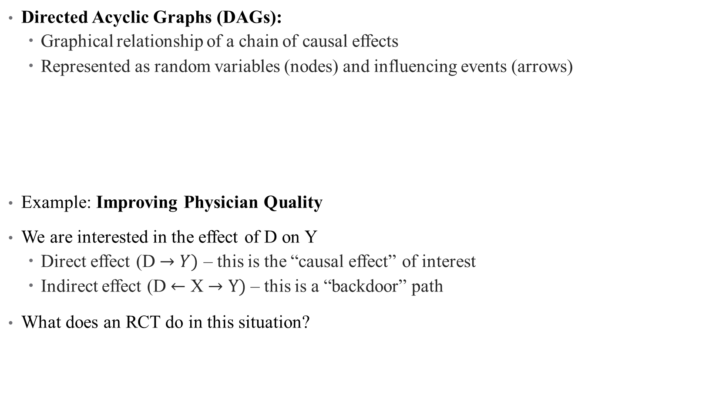
DGPs as DAGs
Directed Acyclic Graphs (DAGs):
Graphical relationship of a chain of causal effects
Represented as random variables (nodes) and influencing events (arrows)
Example: Improving Physician Quality
We are interested in the effect of D on Y
Direct effect (D $→Y)$ – this is the “causal effect” of interest
Indirect effect (D $←$ X $→Y)$ – this is a “backdoor” path
What does an RCT do in this situation?
D
Y
X

Slide 19

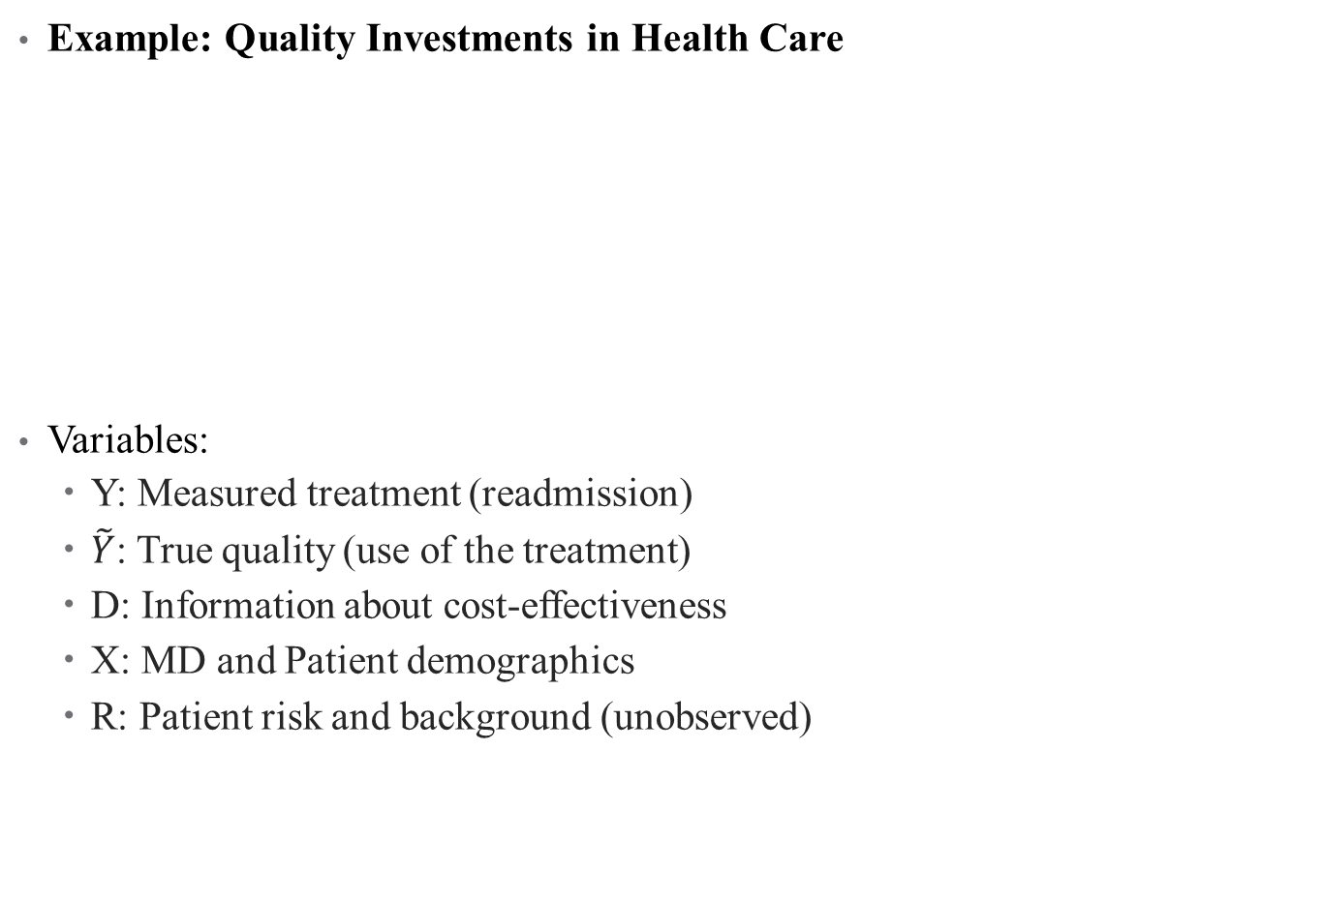
A More Involved DAG
Example: Quality Investments in Health Care
Variables:
Y: Measured treatment (readmission)
$\tilde{Y}$: True quality (use of the treatment)
D: Information about cost-effectiveness
X: MD and Patient demographics
R: Patient risk and background (unobserved)
X
D
$$\tilde{Y}$$
Y
R

Slide 20
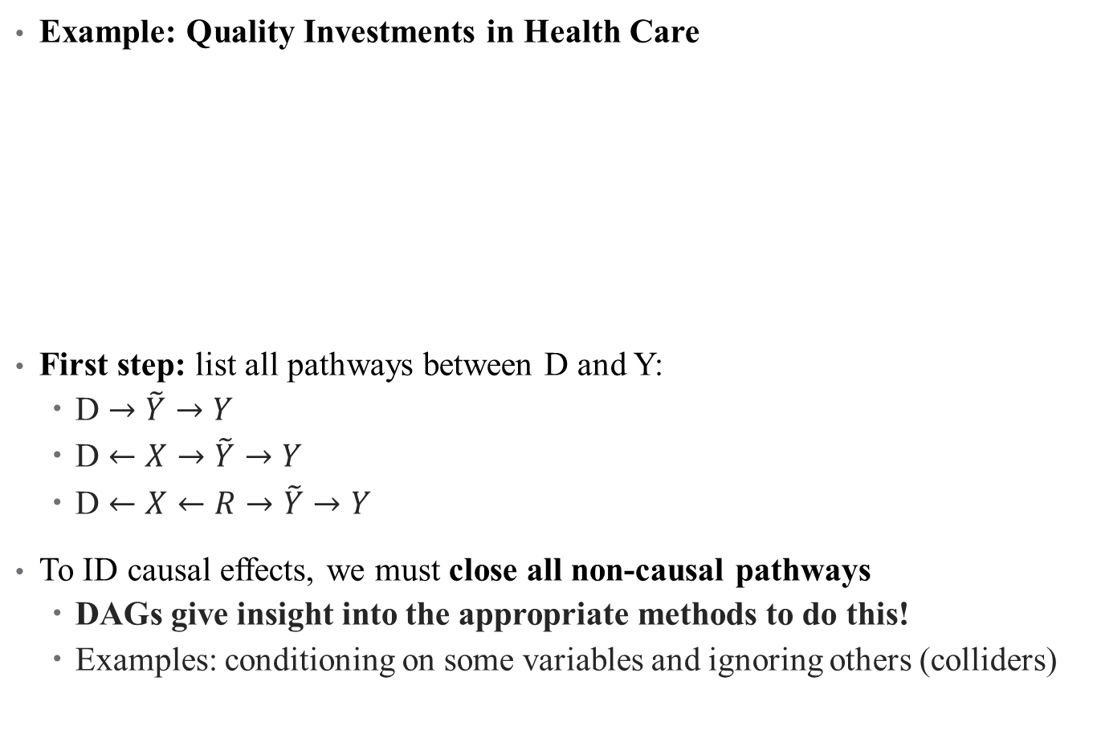
A More Involved DAG
Example: Quality Investments in Health Care
First step: list all pathways between D and Y:
D $→\tilde{Y}→Y$
D $←X→\tilde{Y}→Y$
D $←X←R→\tilde{Y}→Y$
To ID causal effects, we must close all non-causal pathways
DAGs give insight into the appropriate methods to do this!
Examples: conditioning on some variables and ignoring others (colliders)
X
D
$$\tilde{Y}$$
Y
R

Slide 21
DGPs as DAGs
Drawbacks of DAGs:
Causality runs in one direction (simultaneity and reverse causality usually better represented with potential outcomes framework)
Where does the DAG come from?
How could this DAG be more complicated?
X
D
$$\tilde{Y}$$
Y
R

Slide 22
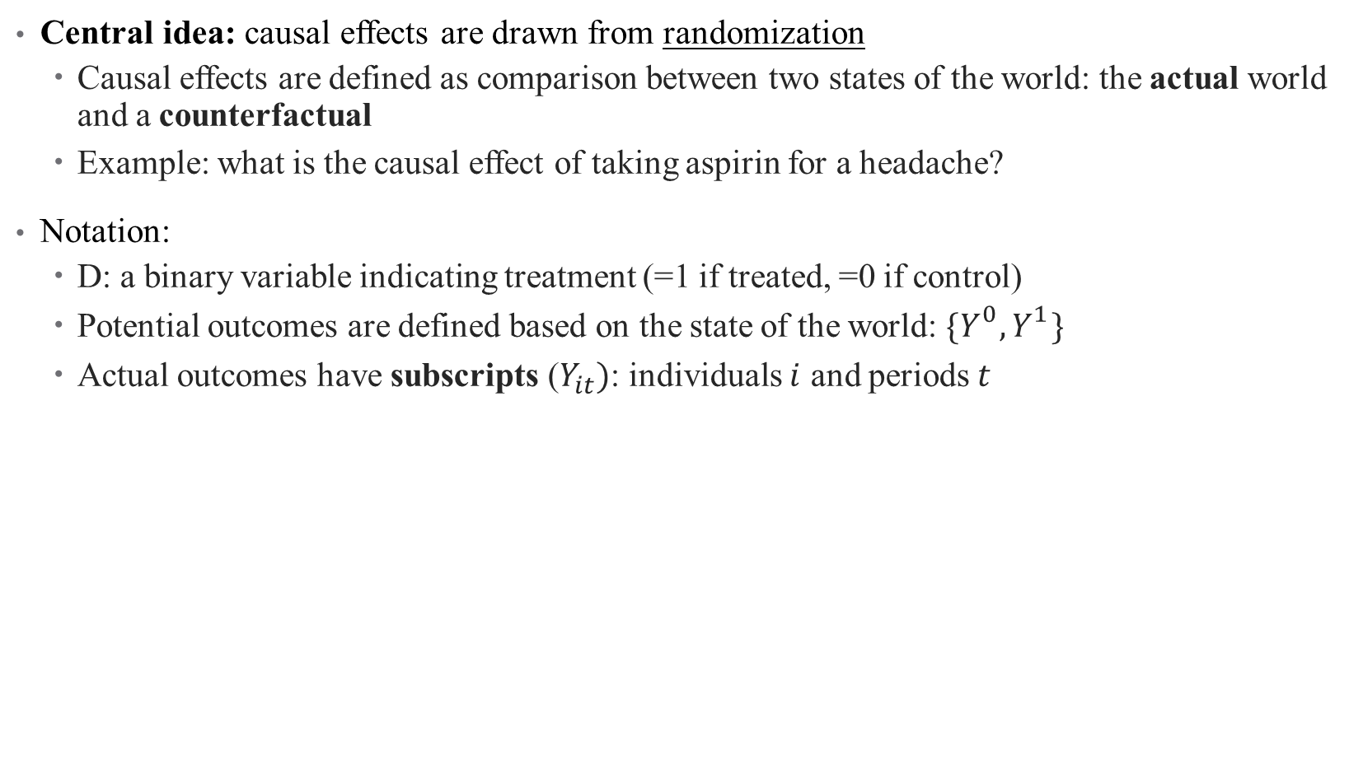
Another approach: Potential Outcomes
Central idea: causal effects are drawn from randomization
Causal effects are defined as comparison between two states of the world: the actual world and a counterfactual
Example: what is the causal effect of taking aspirin for a headache?
Notation:
D: a binary variable indicating treatment (=1 if treated, =0 if control)
Potential outcomes are defined based on the state of the world: ${\{Y}_{}^{0},Y_{}^{1}\}$
Actual outcomes have subscripts ($Y_{it})$: individuals $i$ and periods $t$

Slide 23
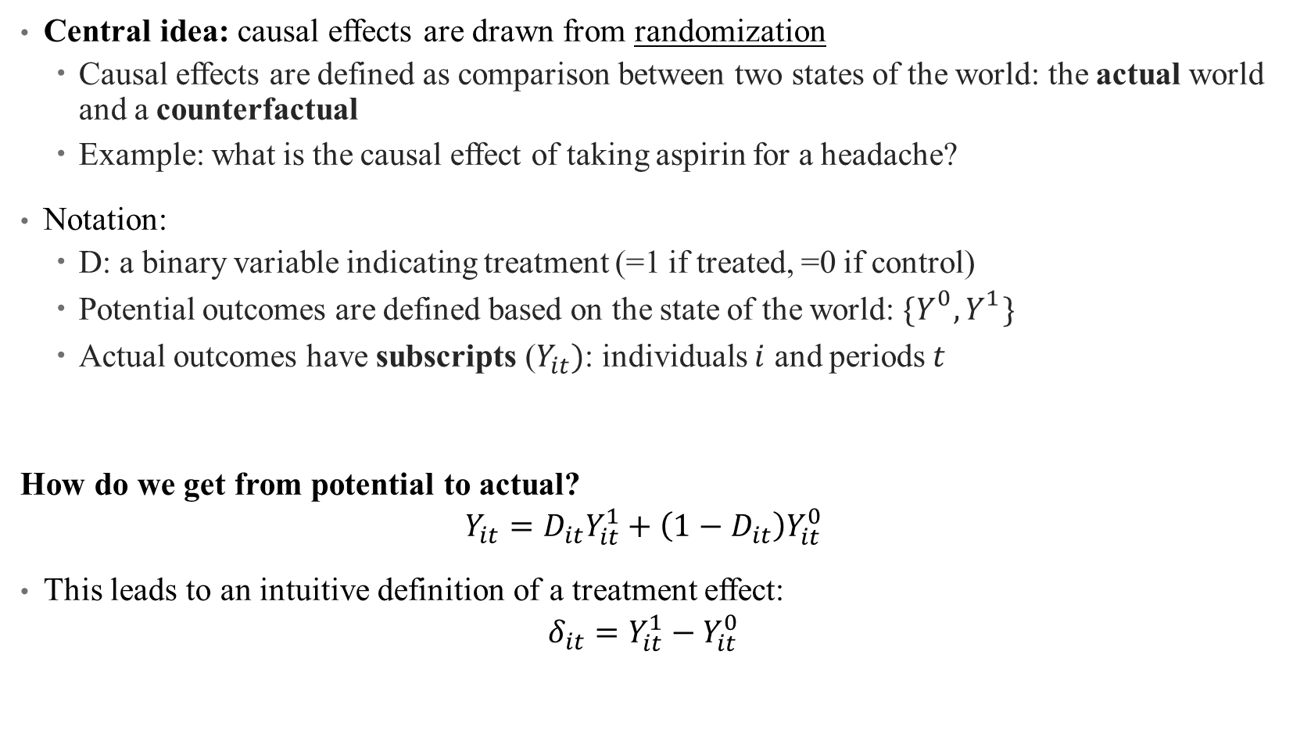
Another approach: Potential Outcomes
Central idea: causal effects are drawn from randomization
Causal effects are defined as comparison between two states of the world: the actual world and a counterfactual
Example: what is the causal effect of taking aspirin for a headache?
Notation:
D: a binary variable indicating treatment (=1 if treated, =0 if control)
Potential outcomes are defined based on the state of the world: ${\{Y}_{}^{0},Y_{}^{1}\}$
Actual outcomes have subscripts ($Y_{it})$: individuals $i$ and periods $t$
How do we get from potential to actual?
$$Y_{it}=D_{it}Y_{it}^{1}+\left(1−D_{it}\right)Y_{it}^{0}$$
This leads to an intuitive definition of a treatment effect:
$$δ_{it}=Y_{it}^{1}−Y_{it}^{0}$$

Slide 24

Average Treatment Effects
The main research parameter of interest is usually an average treatment effect (ATE):
$$ATE=𝔼[δ_{it}]=𝔼[Y_{it}^{1}]−{𝔼[Y}_{it}^{0}]$$
Sometimes, we also care about the average treatment effect specifically for the treated group (ATT):
$$ATT=𝔼[δ_{it}|D_{it}=1]=𝔼[Y_{it}^{1}|D_{it}=1]−{𝔼[Y}_{it}^{0}|D_{it}=1]$$
Do we see any problems here?

Slide 25
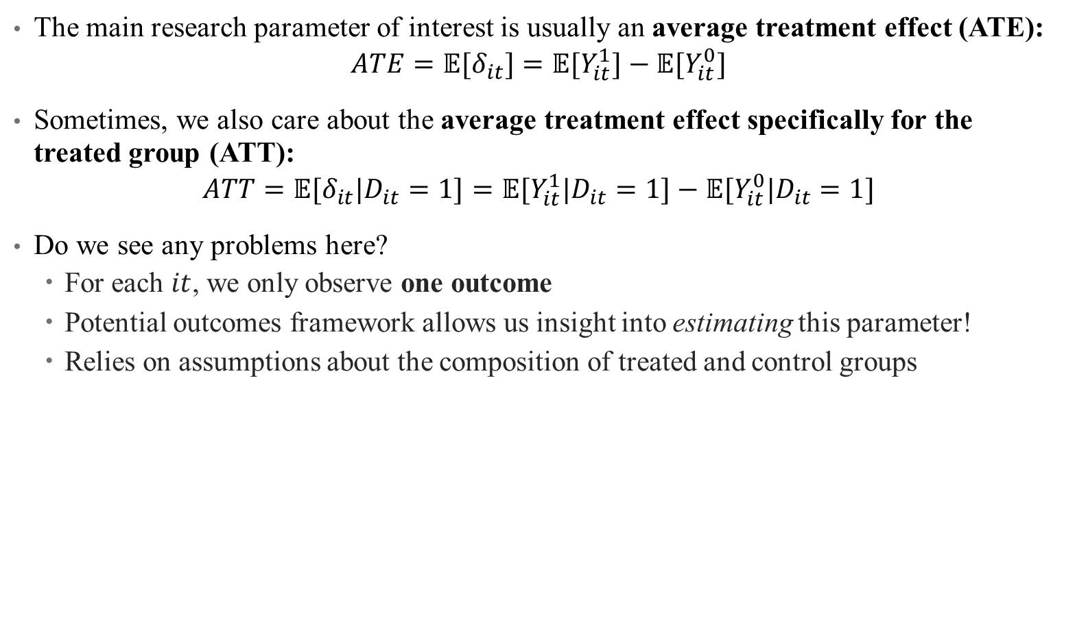
Average Treatment Effects
The main research parameter of interest is usually an average treatment effect (ATE):
$$ATE=𝔼[δ_{it}]=𝔼[Y_{it}^{1}]−{𝔼[Y}_{it}^{0}]$$
Sometimes, we also care about the average treatment effect specifically for the treated group (ATT):
$$ATT=𝔼[δ_{it}|D_{it}=1]=𝔼[Y_{it}^{1}|D_{it}=1]−{𝔼[Y}_{it}^{0}|D_{it}=1]$$
Do we see any problems here?
For each $it$, we only observe one outcome
Potential outcomes framework allows us insight into estimating this parameter!
Relies on assumptions about the composition of treated and control groups

Slide 26
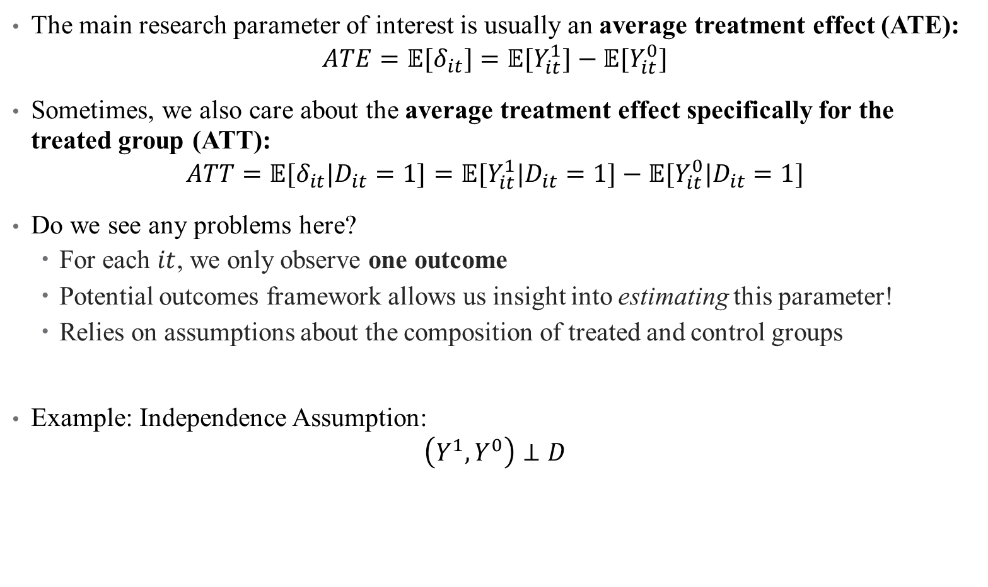
Average Treatment Effects
The main research parameter of interest is usually an average treatment effect (ATE):
$$ATE=𝔼[δ_{it}]=𝔼[Y_{it}^{1}]−{𝔼[Y}_{it}^{0}]$$
Sometimes, we also care about the average treatment effect specifically for the treated group (ATT):
$$ATT=𝔼[δ_{it}|D_{it}=1]=𝔼[Y_{it}^{1}|D_{it}=1]−{𝔼[Y}_{it}^{0}|D_{it}=1]$$
Do we see any problems here?
For each $it$, we only observe one outcome
Potential outcomes framework allows us insight into estimating this parameter!
Relies on assumptions about the composition of treated and control groups
Example: Independence Assumption:
$$\left(Y^{1},Y^{0}\right)⊥D$$

Slide 27
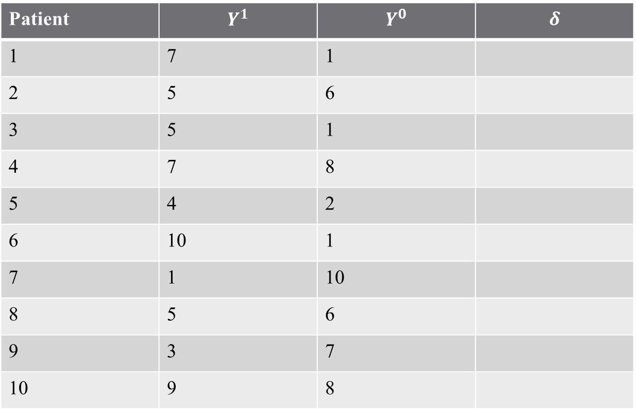
Example: Treatment Outcomes
How effective is a medical treatment?
Patient | $$Y^{1}$$ | $$Y^{0}$$ | $$δ$$
1 | 7 | 1
2 | 5 | 6
3 | 5 | 1
4 | 7 | 8
5 | 4 | 2
6 | 10 | 1
7 | 1 | 10
8 | 5 | 6
9 | 3 | 7
10 | 9 | 8

Slide 28
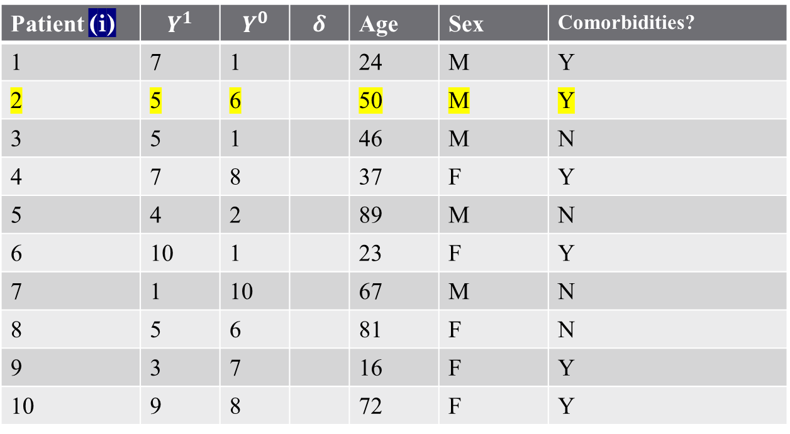
Example: Treatment Outcomes (sidenote: the structure of data)
Covariates
Patient (i) | $$Y^{1}$$ | $$Y^{0}$$ | $$δ$$ | Age | Sex | Comorbidities?
1 | 7 | 1 |  | 24 | M | Y
2 | 5 | 6 |  | 50 | M | Y
3 | 5 | 1 |  | 46 | M | N
4 | 7 | 8 |  | 37 | F | Y
5 | 4 | 2 |  | 89 | M | N
6 | 10 | 1 |  | 23 | F | Y
7 | 1 | 10 |  | 67 | M | N
8 | 5 | 6 |  | 81 | F | N
9 | 3 | 7 |  | 16 | F | Y
10 | 9 | 8 |  | 72 | F | Y
Observation

Slide 29
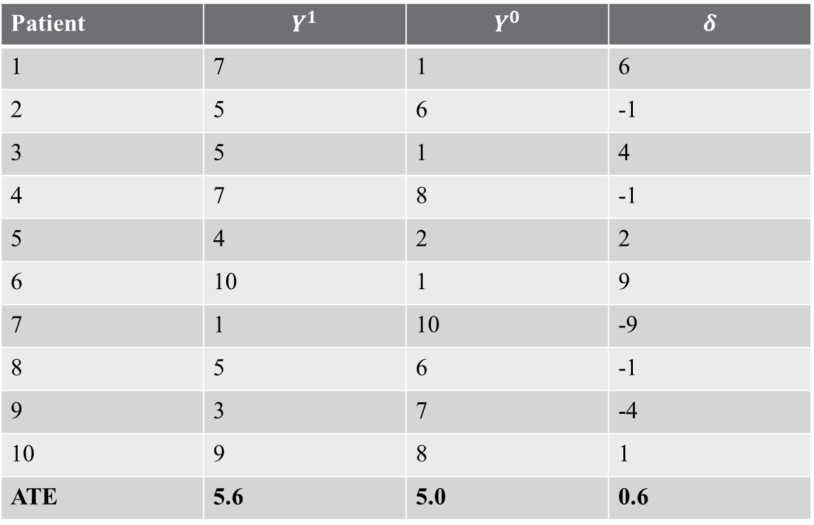
Example: Treatment Outcomes
How effective is a medical treatment?
Patient | $$Y^{1}$$ | $$Y^{0}$$ | $$δ$$
1 | 7 | 1 | 6
2 | 5 | 6 | -1
3 | 5 | 1 | 4
4 | 7 | 8 | -1
5 | 4 | 2 | 2
6 | 10 | 1 | 9
7 | 1 | 10 | -9
8 | 5 | 6 | -1
9 | 3 | 7 | -4
10 | 9 | 8 | 1
ATE | 5.6 | 5.0 | 0.6

Slide 30
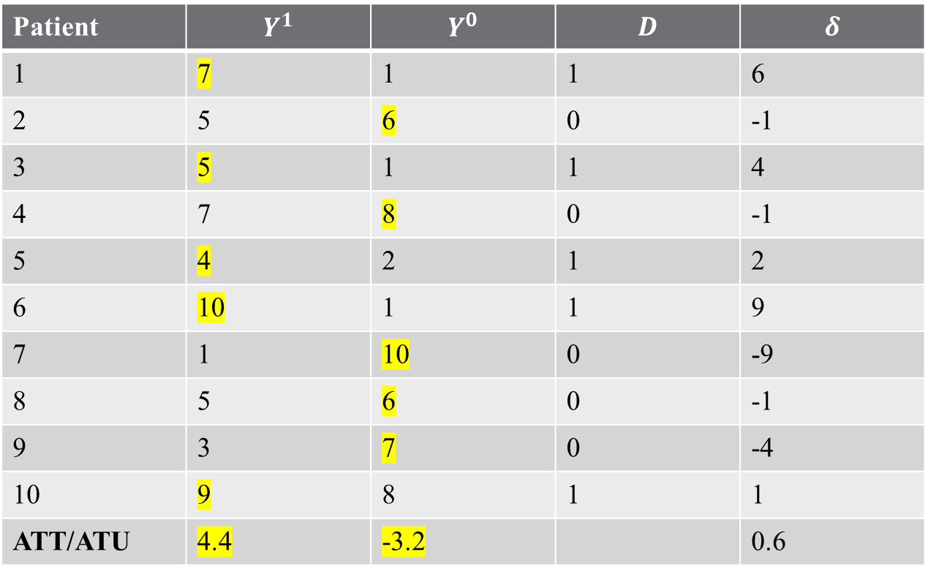
Example: Treatment Outcomes
Imagine a “perfect doctor” assigns best treatment available:
Patient | $$Y^{1}$$ | $$Y^{0}$$ | $$D$$ | $$δ$$
1 | 7 | 1 | 1 | 6
2 | 5 | 6 | 0 | -1
3 | 5 | 1 | 1 | 4
4 | 7 | 8 | 0 | -1
5 | 4 | 2 | 1 | 2
6 | 10 | 1 | 1 | 9
7 | 1 | 10 | 0 | -9
8 | 5 | 6 | 0 | -1
9 | 3 | 7 | 0 | -4
10 | 9 | 8 | 1 | 1
ATT/ATU | 4.4 | -3.2 |  | 0.6

Slide 31
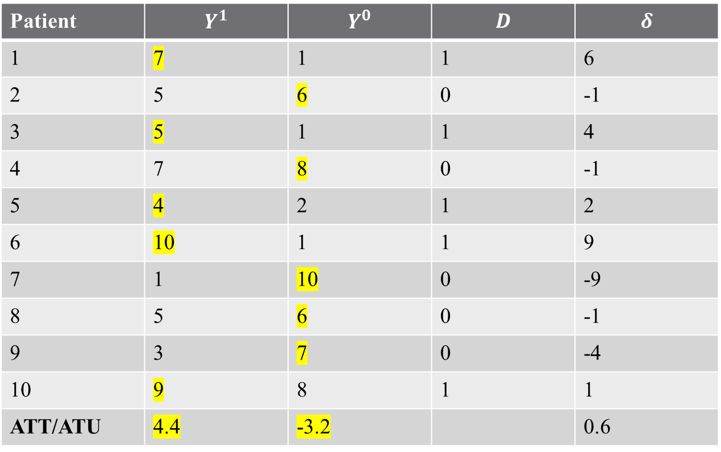
Example: Treatment Outcomes
Imagine a “perfect doctor” assigns best treatment available:
The ATE is the weighted average of the ATT and ATU!
Patient | $$Y^{1}$$ | $$Y^{0}$$ | $$D$$ | $$δ$$
1 | 7 | 1 | 1 | 6
2 | 5 | 6 | 0 | -1
3 | 5 | 1 | 1 | 4
4 | 7 | 8 | 0 | -1
5 | 4 | 2 | 1 | 2
6 | 10 | 1 | 1 | 9
7 | 1 | 10 | 0 | -9
8 | 5 | 6 | 0 | -1
9 | 3 | 7 | 0 | -4
10 | 9 | 8 | 1 | 1
ATT/ATU | 4.4 | -3.2 |  | 0.6

Slide 32
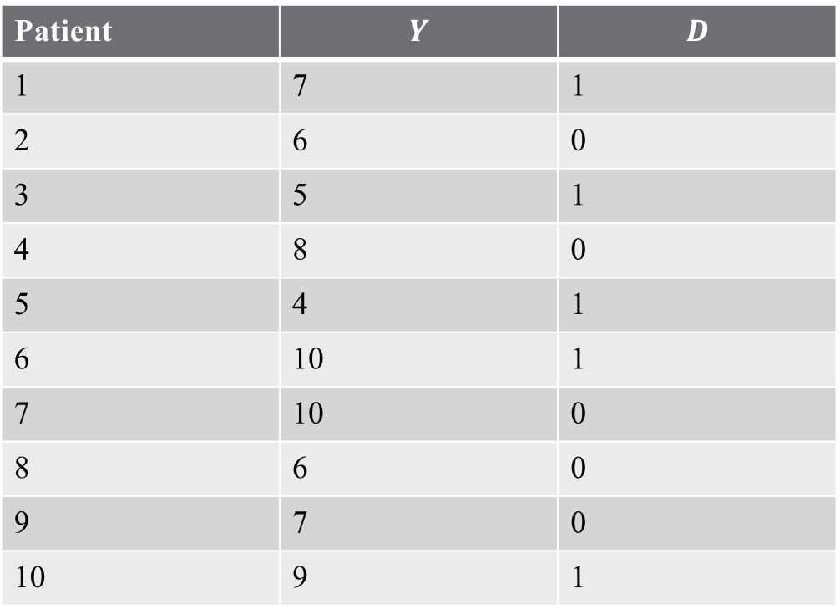
Example: Treatment Outcomes
Problem: We don’t observe two states for each individual!
Can we estimate the ATE?
Patient | $$Y$$ | $$D$$
1 | 7 | 1
2 | 6 | 0
3 | 5 | 1
4 | 8 | 0
5 | 4 | 1
6 | 10 | 1
7 | 10 | 0
8 | 6 | 0
9 | 7 | 0
10 | 9 | 1

Slide 33
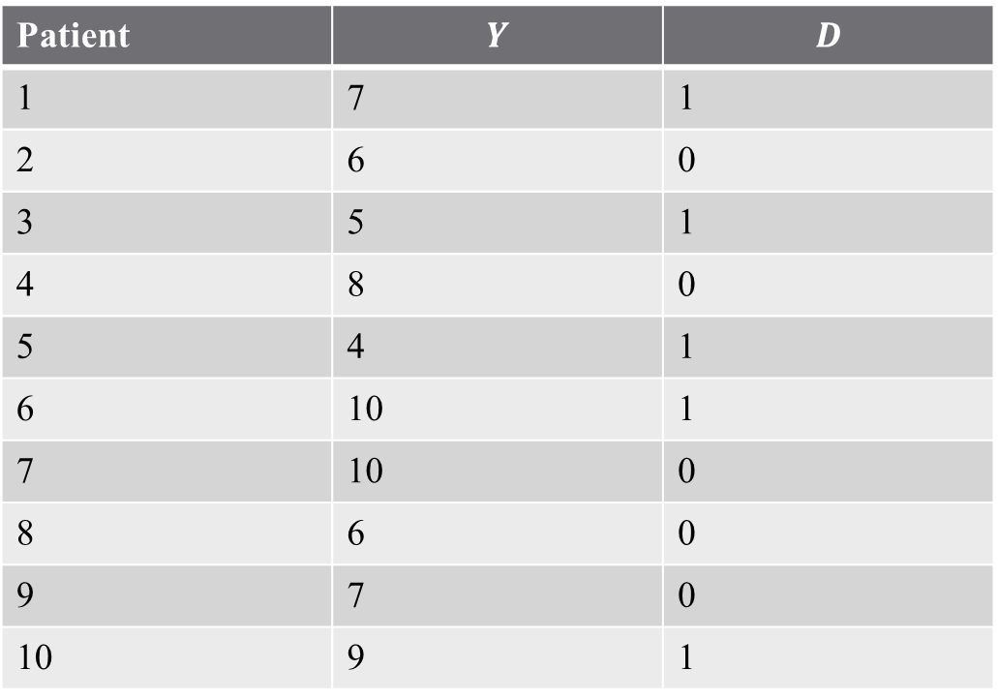

Example: Treatment Outcomes
Estimate ATE as $𝔼\left[Y^{1} | D=1\right]−𝔼\left[Y^{0} | D=0\right]$
$$\hat{ATE}=7−7.4=−0.4$$
Patient | $$Y$$ | $$D$$
1 | 7 | 1
2 | 6 | 0
3 | 5 | 1
4 | 8 | 0
5 | 4 | 1
6 | 10 | 1
7 | 10 | 0
8 | 6 | 0
9 | 7 | 0
10 | 9 | 1

Slide 34
Estimating an ATE
What does the estimated ATE mean?
Does this mean surgery has a negative effect?

Slide 35
Estimating an ATE
What does the estimated ATE mean?
Does this mean surgery has a negative effect?
This statistic suffers from “selection bias” arising from sorting
This is why assumptions are so important for econometrics!

Slide 36
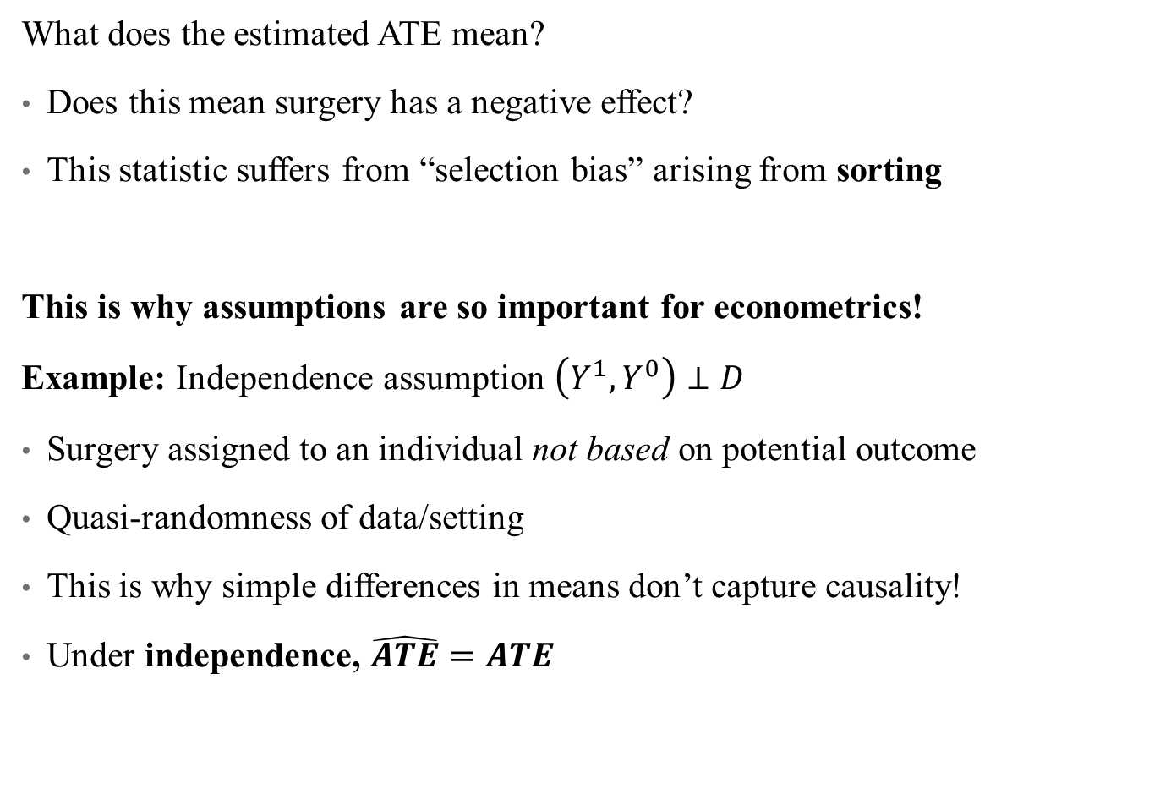
Estimating an ATE
What does the estimated ATE mean?
Does this mean surgery has a negative effect?
This statistic suffers from “selection bias” arising from sorting
This is why assumptions are so important for econometrics!
Example: Independence assumption $\left(Y^{1},Y^{0}\right)⊥D$
Surgery assigned to an individual not based on potential outcome
Quasi-randomness of data/setting
This is why simple differences in means don’t capture causality!
Under independence, $\hat{ATE}=ATE$

Slide 37
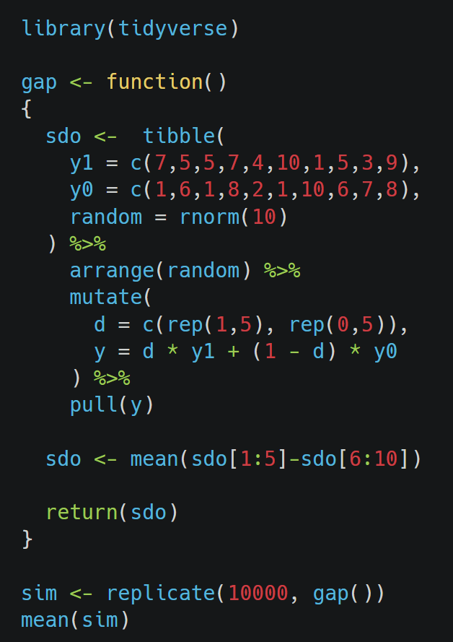

Monte Carlo Simulation
Under independence, $\hat{ATE}=ATE$
Notes:
Proof for this is on page 137 of SC

Slide 38

Independence Assumption
Independence implies:$𝔼\left[Y^{1} | D=1\right]−𝔼\left[Y^{1} | D=0\right]=0$
Does not imply: $𝔼\left[Y^{1} | D=1\right]−𝔼\left[Y^{0} | D=0\right]=0$
Nor does it imply: $𝔼\left[Y^{1} | D=1\right]−𝔼\left[Y^{0} | D=1\right]=0$
How realistic is this in data?
Notes:
Proof for this is on page 137 of SC

Slide 39
Model Testing
Model testing is not looking for evidence for your preferred model
It is easy to find evidence in support of your model
Especially when you developed the model after looking at the data
Confirmation bias is one of the most common problems in the health policy literature.
Good statistical practice should be thought of as a process through which you try to prove that your preferred model is wrong.
The econometric approach to model testing focuses on the various things which should lead you to reject your favorite hypothesis.
Alternative models
Causal inference assumptions
Only when your model has survived a battery of tests can we place on it a reasonably high probability of being correct.

Slide 40
Concluding thoughts
Econometrics is powerful, but must be applied carefully
There are no shortcuts to analyzing health data.
We must:
Consider all possible DGPs:
Formulate at least one of them as a model
Make sure that we understand the implications of the structure
Test the model against the data
Hunt for flaws in it.
Only when we have done all of that can we gain confidence in our findings
Next time: math, coding review and intro to regression

