Slide 1
Health Econometrics I
Lecture 3: Multivariate OLS Regression
September 23, 2022
HAD5744 • Alex Hoagland, Ph.D.

Slide 2

Last time:
Probability, coding review
Introduction to linear regression
Single explanatory variable: $y=β_{0}+β_{1}x+ε$
Estimation: best linear fit through data
Assumptions required for unbiasedness, so that $𝔼\left[{\hat{β}}_{1}\right]=β_{1}$

Slide 3
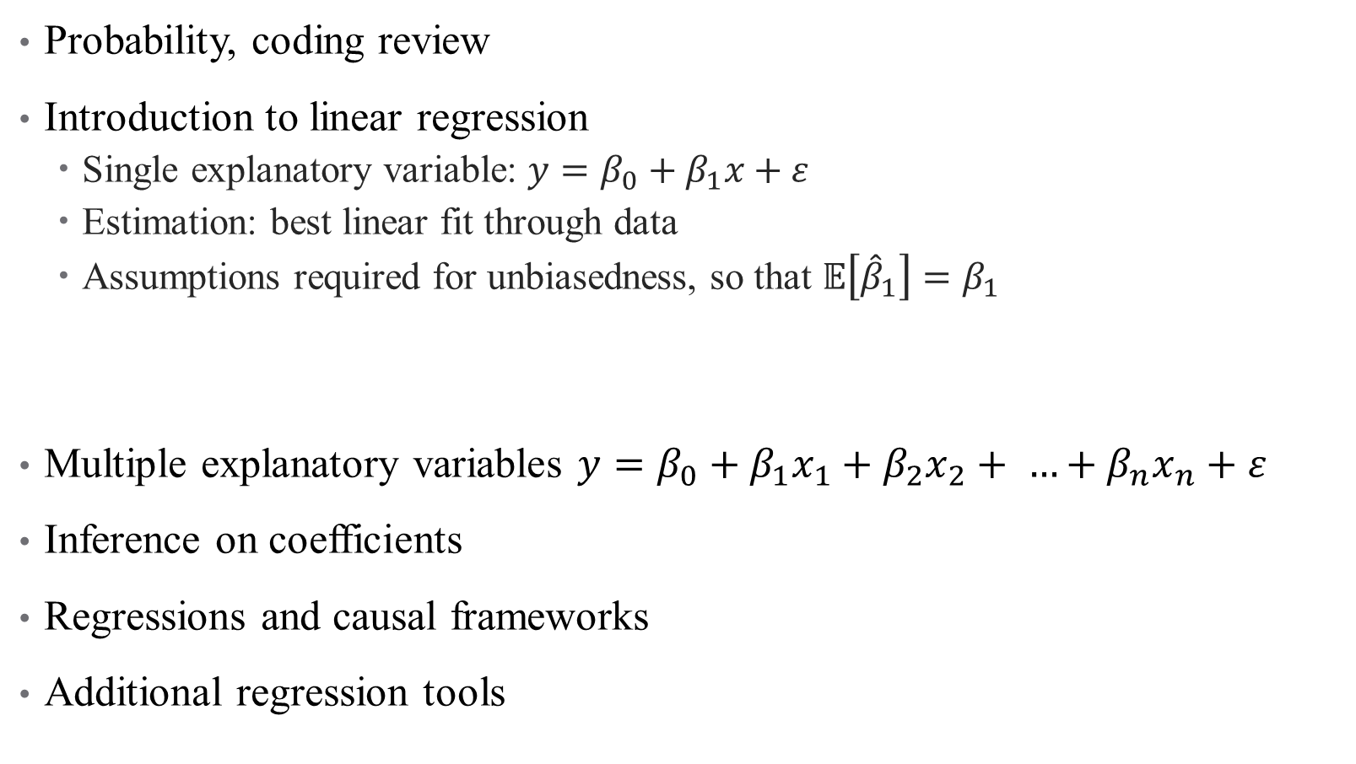
Last time:
Probability, coding review
Introduction to linear regression
Single explanatory variable: $y=β_{0}+β_{1}x+ε$
Estimation: best linear fit through data
Assumptions required for unbiasedness, so that $𝔼\left[{\hat{β}}_{1}\right]=β_{1}$
Multiple explanatory variables $y=β_{0}+β_{1}x_{1}+β_{2}x_{2}+ …+β_{n}x_{n}+ε$
Inference on coefficients
Regressions and causal frameworks
Additional regression tools
This time:

Slide 4
Multivariate Regression

Slide 5
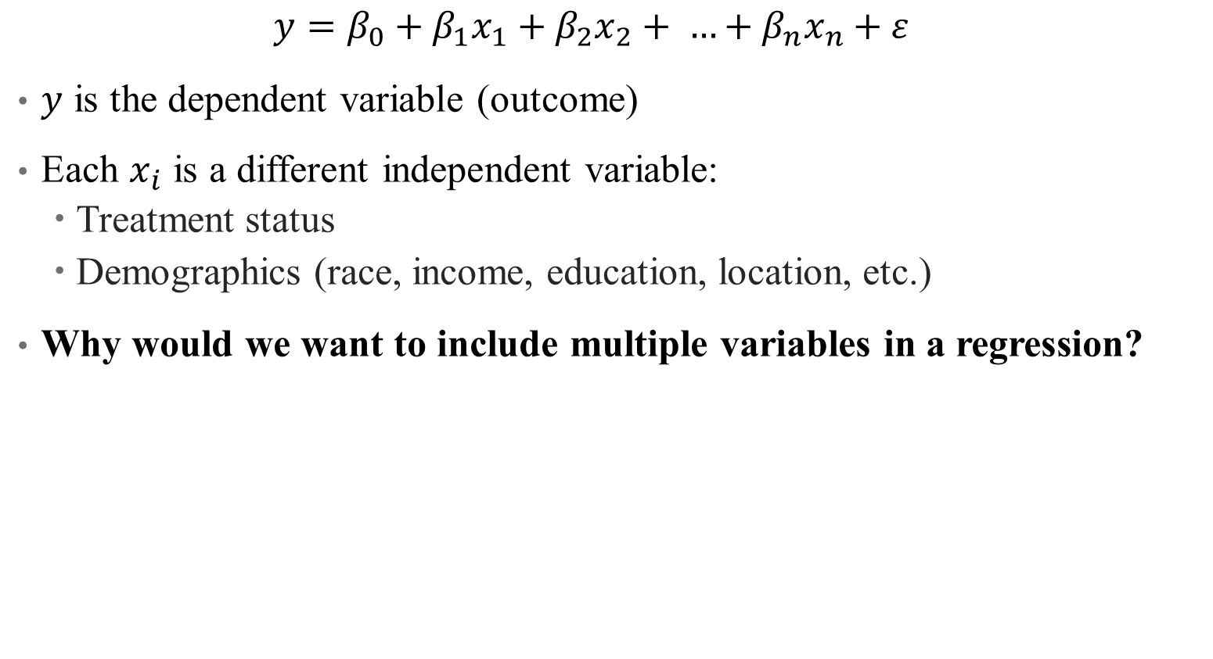
Population Model: Multiple Variables
$$y=β_{0}+β_{1}x_{1}+β_{2}x_{2}+ …+β_{n}x_{n}+ε$$
$y$ is the dependent variable (outcome)
Each $x_{i}$ is a different independent variable:
Treatment status
Demographics (race, income, education, location, etc.)
Why would we want to include multiple variables in a regression?
Notes:
This is not a trick question – think back to our frameworks!

Slide 6

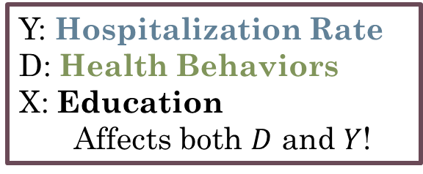


Population Model: Multiple Variables
$$y=β_{0}+β_{1}x_{1}+β_{2}x_{2}+ …+β_{n}x_{n}+ε$$
$y$ is the dependent variable (outcome)
Each $x_{i}$ is a different independent variable:
Treatment status
Demographics (race, income, education, location, etc.)
Why would we want to include multiple variables in a regression?
Y: Hospitalization Rate
D: Health Behaviors
X: Education
Affects both $D$ and $Y$!
$$D$$
$$Y$$
$$X$$

Slide 7
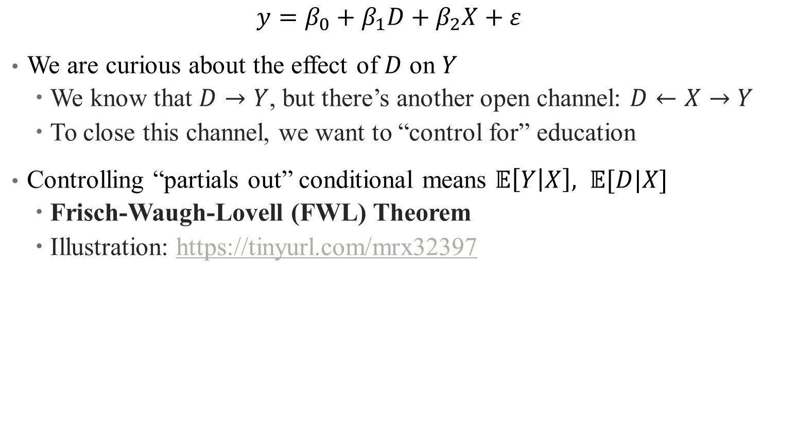
Controlling for Variables
$$y=β_{0}+β_{1}D+β_{2}X+ε$$
We are curious about the effect of $D$ on $Y$
We know that $D→Y$, but there’s another open channel: $D←X→Y$
To close this channel, we want to “control for” education
Controlling “partials out” conditional means $𝔼\left[Y | X\right], 𝔼[D|X]$
Frisch-Waugh-Lovell (FWL) Theorem
Illustration: https://tinyurl.com/mrx32397
Notes:
I recommend looking at this site in more detail – we’ll cover the high points here

Slide 8
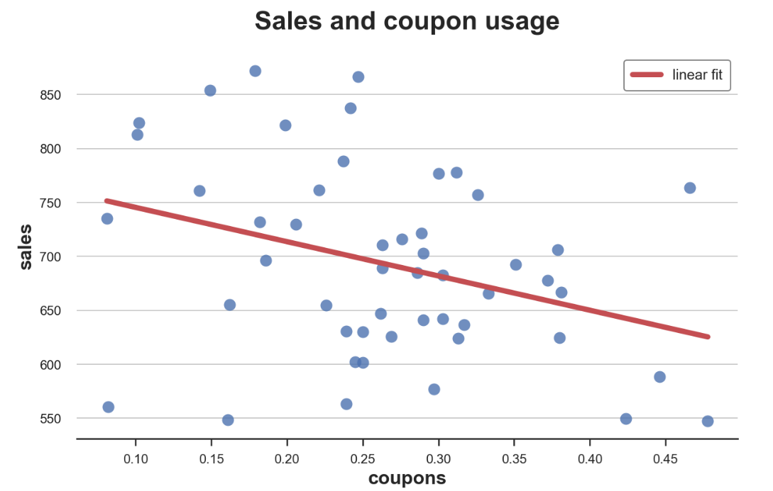

Controlling for Variables
Hospitalizations and Health Behavior (A1C check)
$$y=β_{0}+β_{1}D+β_{2}X+ε$$
Total Annual Diabetes Hospitalizations,
Regional Level
Rate of A1C checks per 1,000 diabetics
Notes:
Note – I’ve “health-ized” the example in the website here. Data here is a local physician’s practice, or health market. What does the line mean? What confounders might we be interested in here?

Slide 9
Controlling for Variables
Hospitalizations and Health Behavior (A1C check)
$$y=β_{0}+β_{1}D+β_{2}X+ε$$
But what about education? What drives health behaviors?
Total Annual Diabetes Hospitalizations,
Regional Level
Rate of A1C checks per 1,000 diabetics

Slide 10
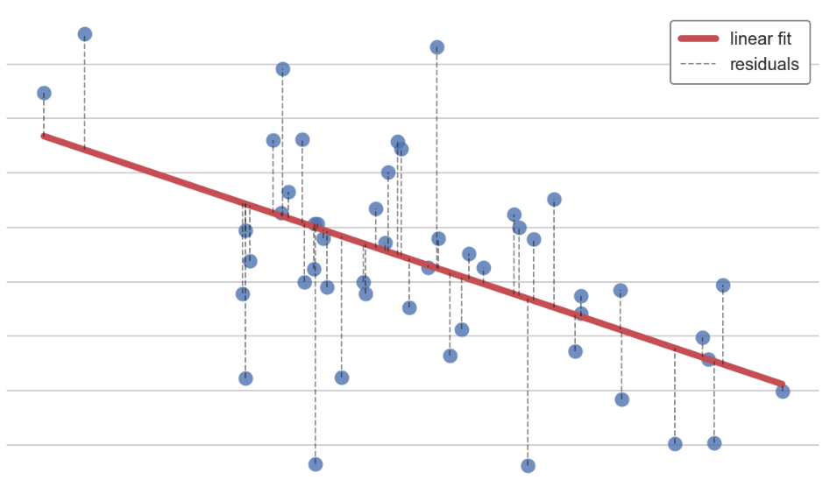

Controlling for Variables: A1Cs and Education
Health Behavior (A1C check) and Education
$$y=β_{0}+β_{1}D+β_{2}X+ε$$
Rate of A1C Checks per 1,000 Diabetics
Average Education in Region
Notes:
Note – there’s a strong relationship here! What does that mean for our initial assessment? We have violated the assumption that E(eps|x)=0 given that we relegated education to epsilon

Slide 11
Controlling for Variables: A1Cs and Education
Health Behavior (A1C check) and Education
$$y=β_{0}+β_{1}D+β_{2}X+ε$$
Rate of A1C Checks per 1,000 Diabetics
Controlling for education removes this linear trend, leaving only the residuals
Average Education in Region
Notes:
We move education out of the error term and correct for this correlation

Slide 12
Partialling out Education
Notes:
Ignore the axes here.

Slide 13
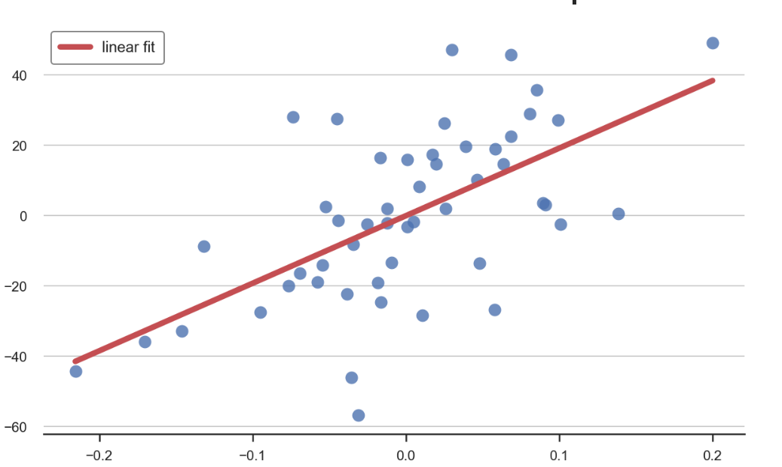

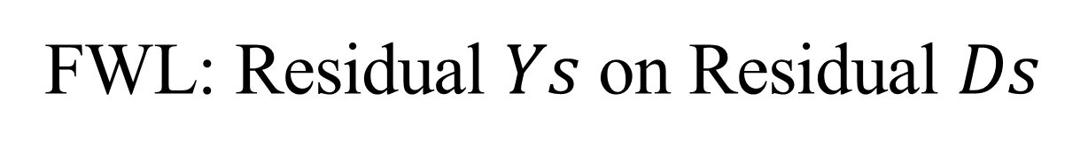
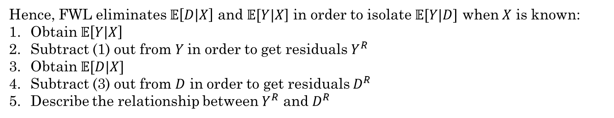
FWL: Residual $Ys$ on Residual $Ds$
Hence, FWL eliminates $𝔼\left[D | X\right]$ and $𝔼[Y|X$] in order to isolate $𝔼[Y|D]$ when $X$ is known:
Obtain $𝔼\left[Y | X\right]$
Subtract (1) out from $Y$in order to get residuals $Y^{R}$
Obtain $𝔼[D|X]$
Subtract (3) out from $D$ in order to get residuals $D^{R}$
Describe the relationship between $Y^{R}$ and $D^{R}$
Hospitalizations and Health Behavior (A1C check)
Residual Hospitalizations
Residual Rate of A1C checks
Notes:
Let’s see how this works in R

Slide 14
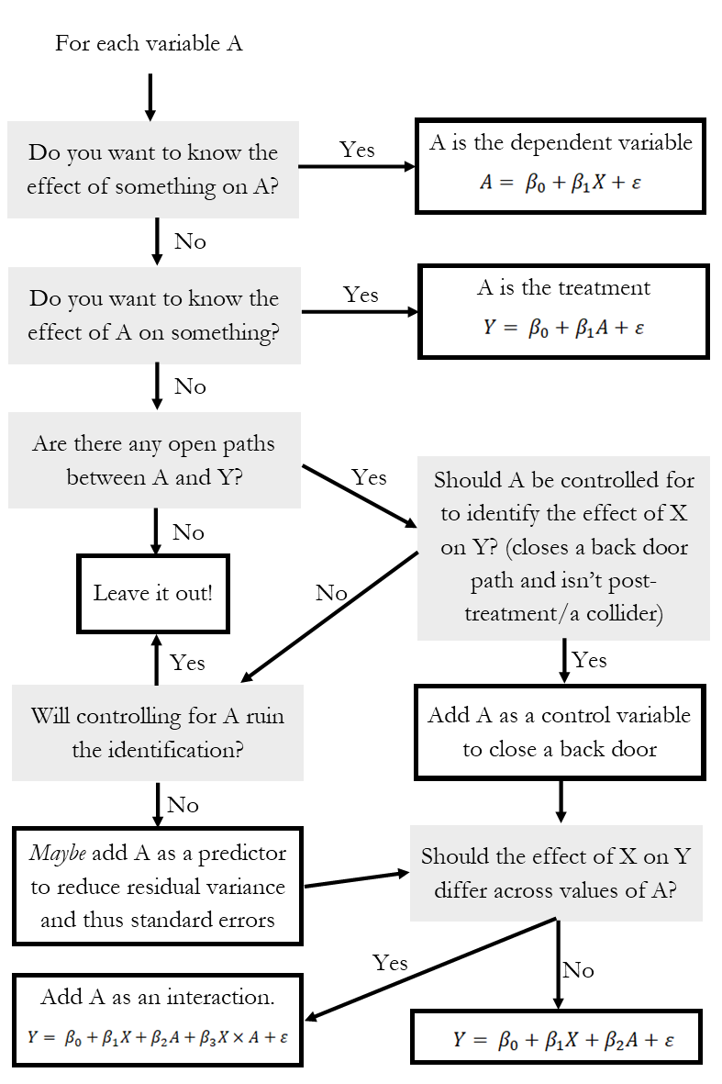
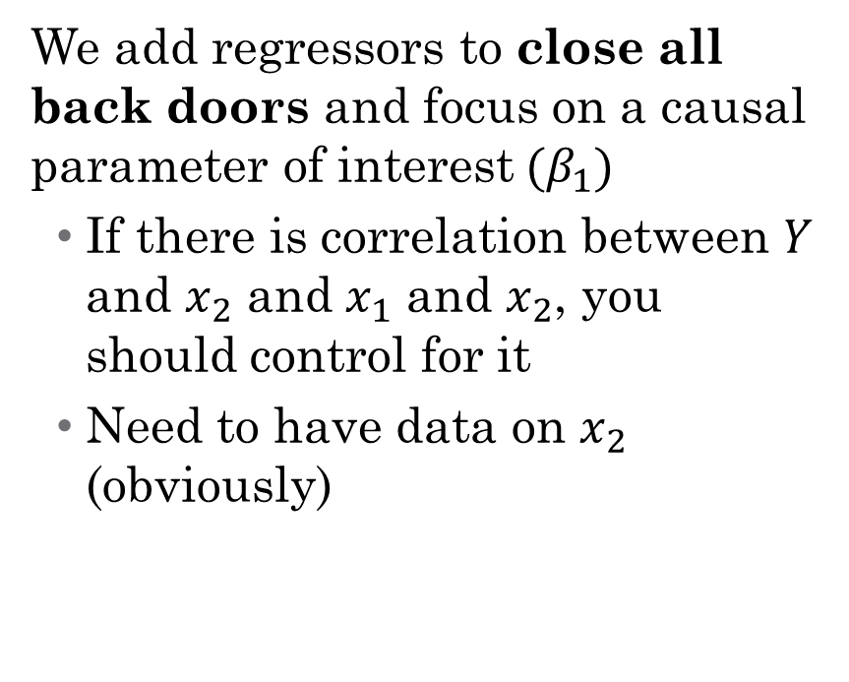
So what do I control for?
We add regressors to close all back doors and focus on a causal parameter of interest$(β_{1})$
If there is correlation between $Y$ and $x_{2}$ and $x_{1}$ and $x_{2}$, you should control for it
Need to have data on $x_{2}$ (obviously)
Notes:
Talk through this – what is a collider/post-treatment (something like controlling for occupation to assess gender wage gap)

Slide 15

Types of Control Variables: Sliders and Switches
Notes:
Continuous and discrete – we’ll talk about different interpretation of effects here

Slide 16
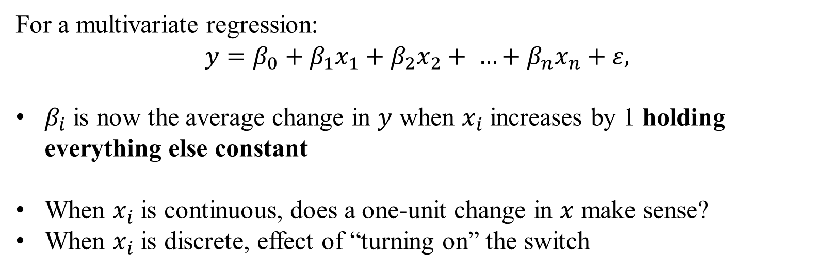
How does interpretation change?
For a multivariate regression:
$$y=β_{0}+β_{1}x_{1}+β_{2}x_{2}+ …+β_{n}x_{n}+ε,$$
$β_{i}$ is now the average change in $y$ when $x_{i}$ increases by 1 holding everything else constant
When $x_{i}$ is continuous, does a one-unit change in $x$ make sense?
When $x_{i}$ is discrete, effect of “turning on” the switch
Notes:
Interpretation now relies on holding everything else in the regression constant – if this doesn’t work for what you want to know, need to rethink the design of the regression (e.g., interactions)

Slide 17
Inference on Regression Coefficients
Notes:
Here are two examples where assumption $E\left(ε|x\right)=0$, is violated.
Effect of Addiction on health (confounding): Here$E\left(ε|x\right)≠0$where there may be factors that are omitted that correlate with the included explanatory variables.
Censored data: Treatment effectiveness, Number of physician visits in claims data (sample selection): Wherein the observations on the explanatory variables may be correlated with the error term as a selection rule must be satisfied for observations to be observed.

Slide 18
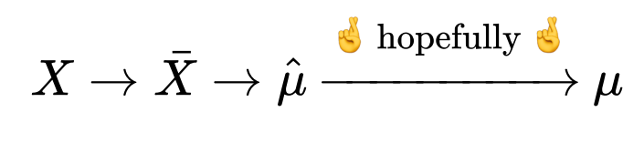
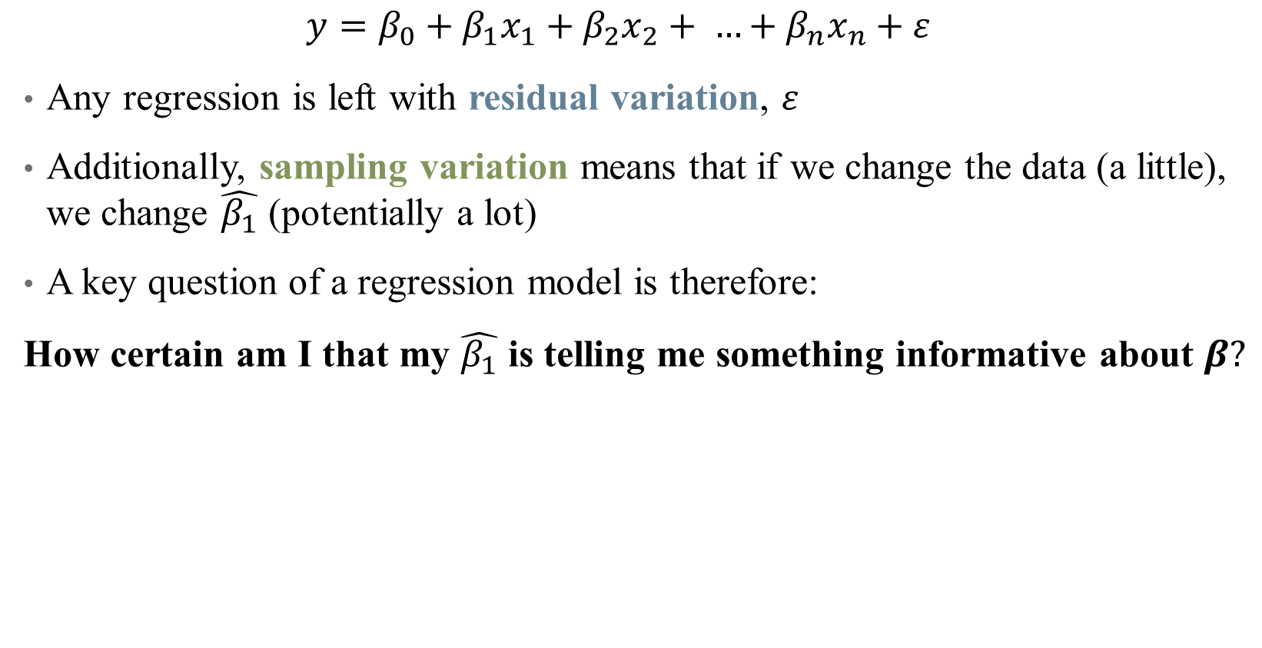
Inference: How well does our data answer our question?
$$y=β_{0}+β_{1}x_{1}+β_{2}x_{2}+ …+β_{n}x_{n}+ε$$
Any regression is left with residual variation, $ε$
Additionally, sampling variation means that if we change the data (a little), we change $\hat{β_{1}}$ (potentially a lot)
A key question of a regression model is therefore:
How certain am I that my $\hat{β_{1}}$ is telling me something informative about $β?$
Notes:
Hopefully, the law of large numbers kicks in – how do we know it does? Think back to our MC simulation from last time.

Slide 19
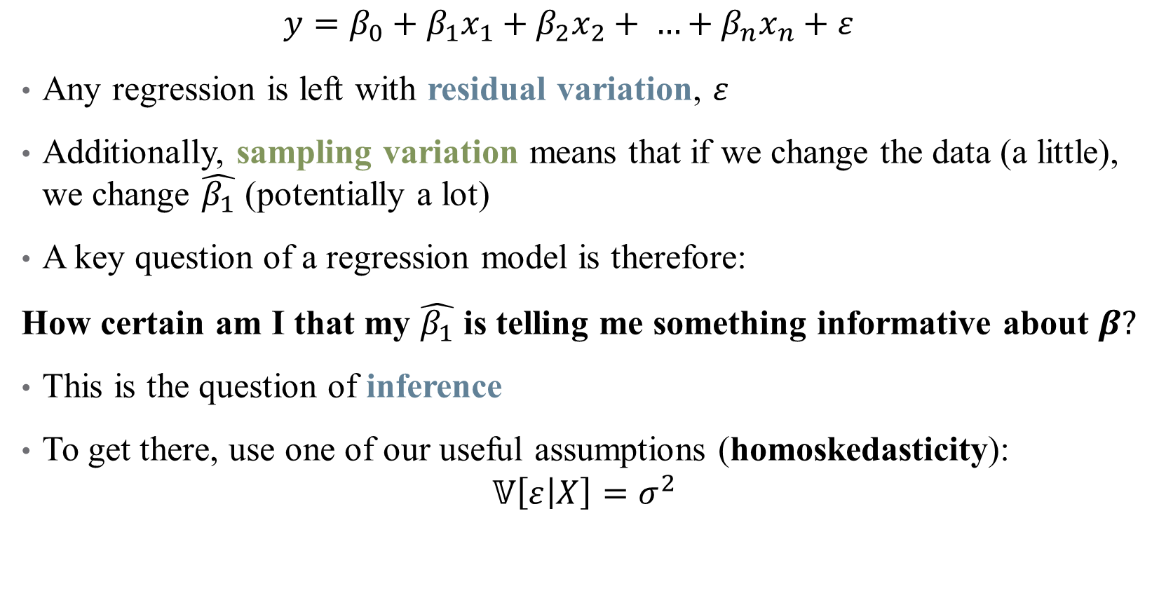
Inference: How well does our data answer our question?
$$y=β_{0}+β_{1}x_{1}+β_{2}x_{2}+ …+β_{n}x_{n}+ε$$
Any regression is left with residual variation, $ε$
Additionally, sampling variation means that if we change the data (a little), we change $\hat{β_{1}}$ (potentially a lot)
A key question of a regression model is therefore:
How certain am I that my $\hat{β_{1}}$ is telling me something informative about $β?$
This is the question of inference
To get there, use one of our useful assumptions (homoskedasticity):
$$𝕍\left[ε | X\right]=σ^{2}$$

Slide 20
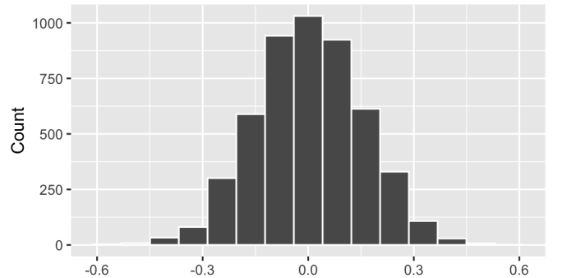

A Simulation Example
The intuition for inference (and standard errors, p-values, etc.) is based on simulations of a null world
Randomly shuffle the A1C checks and hospitalizations columns $↑$5,000 times, compare results
Notes:
What is a null world like in our example? A1Cs don’t affect hospitalizations at all. Each simulation is a random draw of data in a null world – no effect exists.

Slide 21
A Simulation Example
The intuition for inference (and standard errors, p-values, etc.) is based on simulations of a null world
Randomly shuffle the A1C checks and hospitalizations columns $↑$5,000 times, compare results
Notes:
If this is our estimated slope (after controlling) – this is unlikely given a bunch of random null worlds (the exact level of unlikeliness is the p-value)

Slide 22

Sampling Distribution of $\hat{β_{i}}$
$$y=β_{0}+β_{1}x_{1}+β_{2}x_{2}+ …+β_{n}x_{n}+ε$$
Under homoskedasticity, there is a nice sampling distribution for any coefficient
$$\hat{β_{i}}∼𝒩 \left(β,\frac{σ^{2}}{\sum_{\left\{i=1\right\}}^{n}{{\left(x_{i}−\overline{x}\right)}^{2}}}\right)=𝒩\left(β,\frac{σ^{2}}{SST_{x}}\right)$$
Notes:
Language here – normally distributed with a mean and variance. Note that variance diminishes with N

Slide 23
Sampling Distribution of $\hat{β_{i}}$
$$y=β_{0}+β_{1}x_{1}+β_{2}x_{2}+ …+β_{n}x_{n}+ε$$
Under homoskedasticity, there is a nice sampling distribution for any coefficient
$$\hat{β_{i}}∼𝒩 \left(β,\frac{σ^{2}}{\sum_{\left\{i=1\right\}}^{n}{{\left(x_{i}−\overline{x}\right)}^{2}}}\right)=𝒩\left(β,\frac{σ^{2}}{SST_{x}}\right)$$
Unbiasedness
Notes:
As our data grows, our estimate is centered around the truth – the more data, the more precise that estimate is.

Slide 24
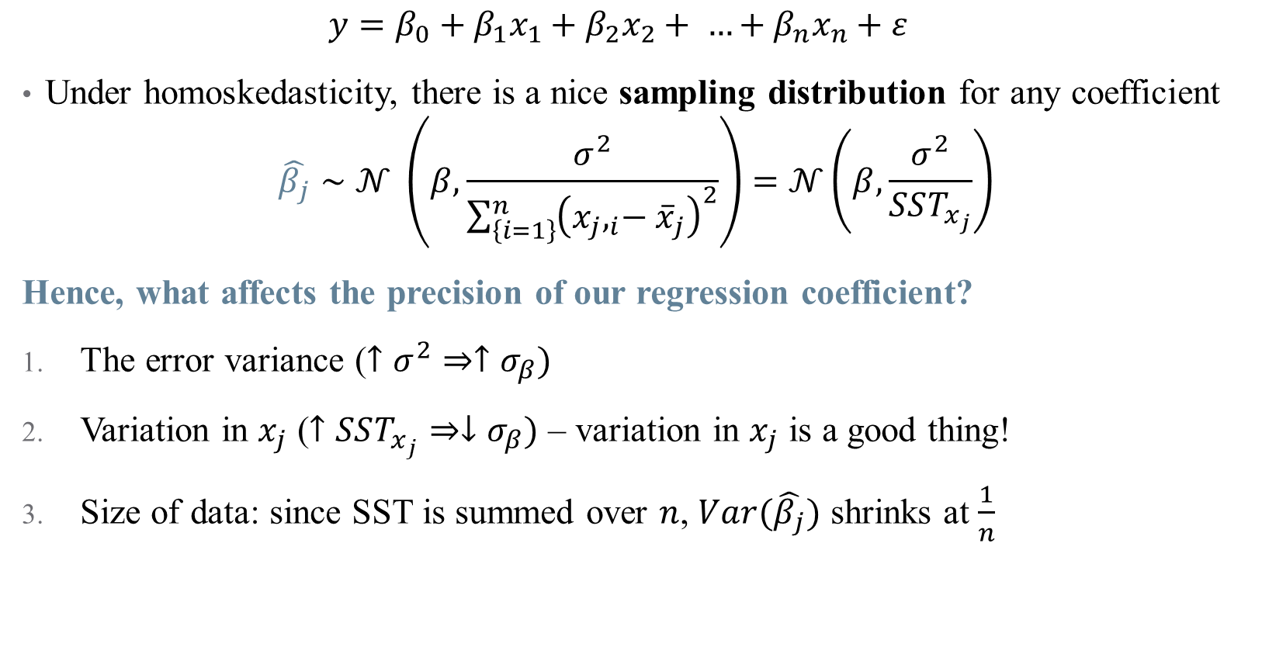
Sampling Distribution of $\hat{β_{i}}$
$$y=β_{0}+β_{1}x_{1}+β_{2}x_{2}+ …+β_{n}x_{n}+ε$$
Under homoskedasticity, there is a nice sampling distribution for any coefficient
$$\hat{β_{j}}∼𝒩 \left(β,\frac{σ^{2}}{\sum_{\left\{i=1\right\}}^{n}{{\left({x_{j},}_{i}−{\overline{x}}_{j}\right)}^{2}}}\right)=𝒩\left(β,\frac{σ^{2}}{SST_{x_{j}}}\right)$$
Hence, what affects the precision of our regression coefficient?
The error variance ($↑σ^{2}⇒↑σ_{β})$
Variation in $x_{j}$ ($↑SST_{x_{j}}⇒↓σ_{β})$ – variation in $x_{j}$ is a good thing!
Size of data: since SST is summed over $n$, $Var(\hat{β_{j}})$ shrinks at $\frac{1}{n}$

Slide 25

Standard Errors
$$y=β_{0}+β_{1}D+β_{2}X+ε$$
The standard deviation of an estimator is referred to as a standard error
Standard errors allow you to use what you observe in a regression to test hypotheses about the (unobserved) data generating process

Slide 26
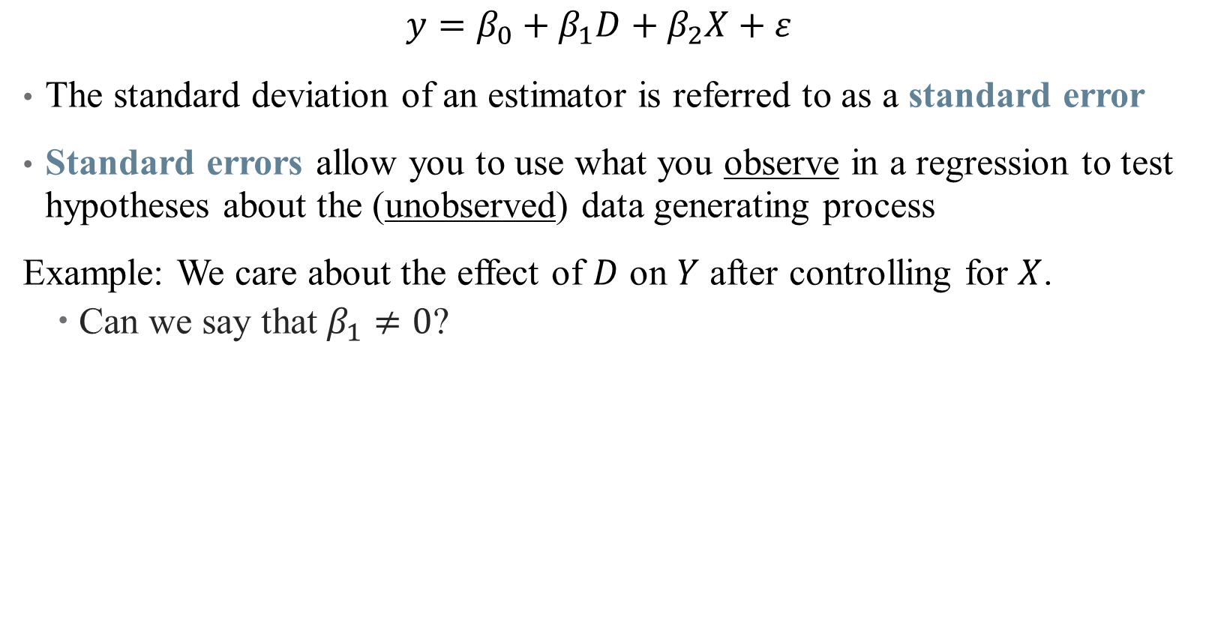
Standard Errors
$$y=β_{0}+β_{1}D+β_{2}X+ε$$
The standard deviation of an estimator is referred to as a standard error
Standard errors allow you to use what you observe in a regression to test hypotheses about the (unobserved) data generating process
Example: We care about the effect of $D$ on $Y$ after controlling for $X$.
Can we say that $β_{1}≠0$?

Slide 27
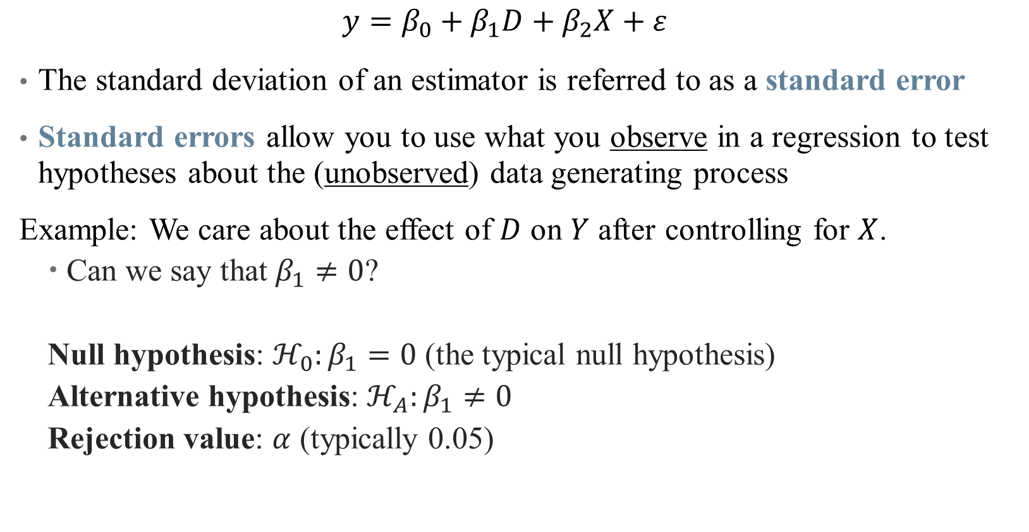
Standard Errors
$$y=β_{0}+β_{1}D+β_{2}X+ε$$
The standard deviation of an estimator is referred to as a standard error
Standard errors allow you to use what you observe in a regression to test hypotheses about the (unobserved) data generating process
Example: We care about the effect of $D$ on $Y$ after controlling for $X$.
Can we say that $β_{1}≠0$?
Null hypothesis: $ℋ_{0}:β_{1}=0$ (the typical null hypothesis)
Alternative hypothesis: $ℋ_{A}:β_{1}≠0$
Rejection value: $α$ (typically 0.05)
Notes:
The null hypothesis is our simulated world.

Slide 28
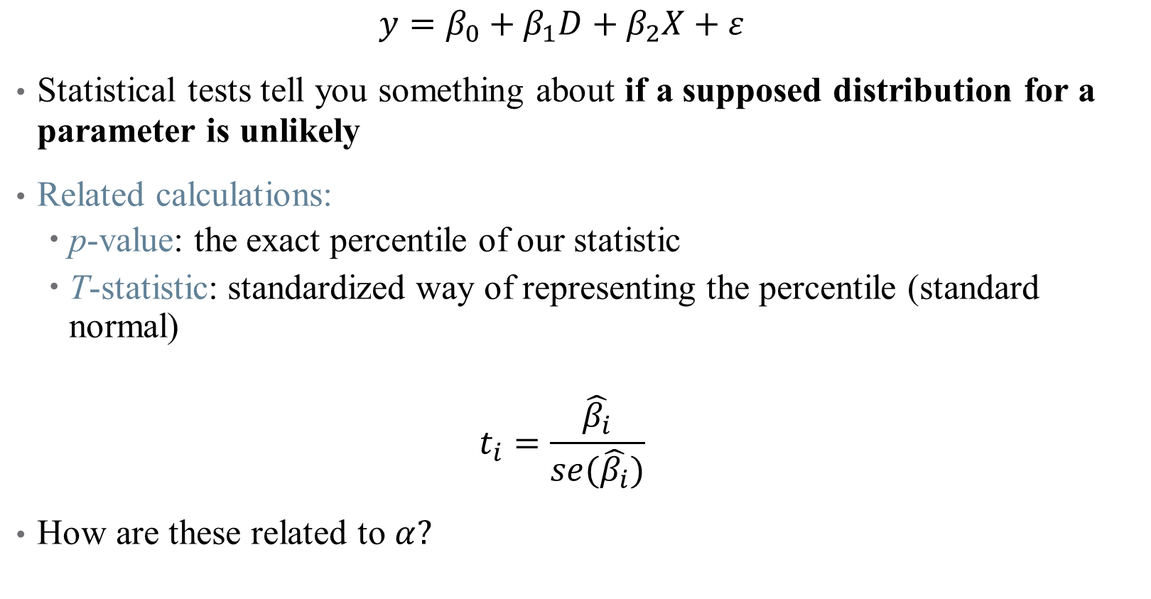
Statistical Tests on Coefficients
$$y=β_{0}+β_{1}D+β_{2}X+ε$$
Statistical tests tell you something about if a supposed distribution for a parameter is unlikely
Related calculations:
p-value: the exact percentile of our statistic
T-statistic: standardized way of representing the percentile (standard normal)
$$t_{i}=\frac{\hat{β_{i}}}{se(\hat{β_{i}})}$$
How are these related to $α?$

Slide 29
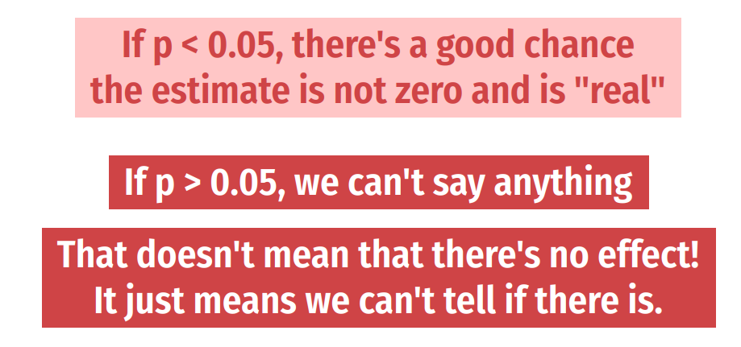
Statistical Significance
Notes:
We’ll talk more about this in a minute after regression tables.

Slide 30
Practical Regression Tips
Notes:
As we move into each method, I’ll try to give a “like the pros” section that talks about practical tips (coding, data structure, what goes in the paper, etc.)

Slide 31
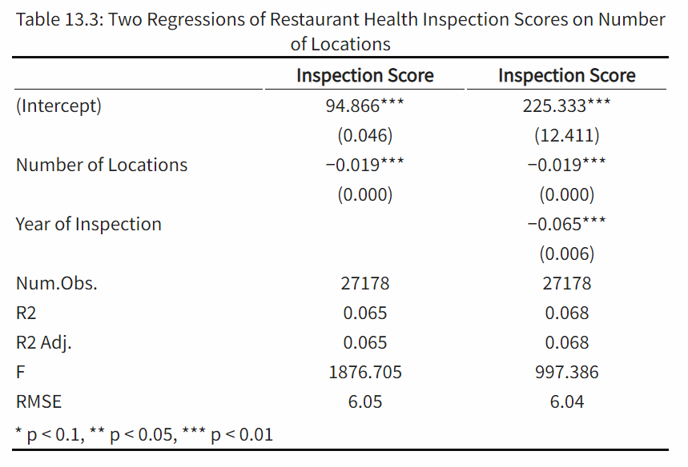
Reading & Constructing a Regression Table
Concise way to present multiple regressions
What should you look for when reading a table?
Key differences across models
Identify parameter authors care about
Look for changes across columns

Slide 32
Reading & Constructing a Regression Table
Concise way to present multiple regressions
What should you look for when reading a table?
Key differences across models
Identify parameter authors care about
Look for changes across columns
Other notes:
Asterisks and standard errors

Slide 33
Reading & Constructing a Regression Table
Concise way to present multiple regressions
What should you look for when reading a table?
Key differences across models
Identify parameter authors care about
Look for changes across columns
Other notes:
Asterisks and standard errors
N

Slide 34
Reading & Constructing a Regression Table
Concise way to present multiple regressions
What should you look for when reading a table?
Key differences across models
Identify parameter authors care about
Look for changes across columns
Other notes:
Asterisks and standard errors
N
Overall model performance

Slide 35
Reading & Constructing a Regression Table
Interpreting Results
Think “A 1-unit change in x…”
Economic vs. statistical significance
Causality or association?

Slide 36
Reading & Constructing a Regression Table
Interpreting Results
Think “A 1-unit change in x…”
Economic vs. statistical significance
Causality or association?
How do you make the table?

Slide 37
Types of Significance
What does significance mean?
Something that isn’t significant isn’t wrong – just insignificant
Precise nulls are of research interest
A model should never be modified ex-post to obtain significant results!
One test is rarely sufficient to come to a conclusion
This is why economics papers are typically 50+ pages plus appendix
Notes:
New thing to hit here: economic versus statistical significance – a p-value is all well and good, but what is the takeaway? What’s the story?

Slide 38
Types of Significance
What does significance mean?
Something that isn’t significant isn’t wrong – just insignificant
Precise nulls are of research interest
A model should never be modified ex-post to obtain significant results!
One test is rarely sufficient to come to a conclusion
This is why economics papers are typically 50+ pages plus appendix
Difference between statistical significance and economic significance
What does your result mean?
What does it mean to be statistically significant in this context?
What does the estimated coefficient imply about policy? Welfare? Etc.?
Notes:
New thing to hit here: economic versus statistical significance – a p-value is all well and good, but what is the takeaway? What’s the story?

Slide 39

What do my results mean?
Types of causal validity
Construct validity: are we measuring what we want to measure?
How is the outcome variable measured?
Are we capturing the right spot in the distribution (mean, median, etc.?)
Notes:
This is also known as the street light effect – researchers shine the light just on the street, miss what’s to the side. Are you asking the right questions? An example: a program hopes to improve commitment to school, and boasts that it improves test scores -- does that measure the outcome you want (teacher performance, kid happiness, etc.?) or does it just measure how good kids are at taking tests. Data limitations play a big role here (in health, think quality measurements, or metrics of risk/equity/etc.)

Slide 40
What do my results mean?
Types of causal validity
Construct validity: are we measuring what we want to measure?
Notes:
There are example papers of these in the github repo

Slide 41
What do my results mean?
Types of causal validity
Construct validity: are we measuring what we want to measure?
Statistical validity: are your statistics correct?
Do you have enough statistical power to get the results that you want?
Are all of your required assumptions met?
Was there any p-hacking involved in getting the answer you published?
Are your associations causal or spurious correlation?
Notes:
These are questions that are nearly impossible to answer in a paper or project (okay, you can do a power calculation – ish). But you still need to think carefully about each of these.

Slide 42
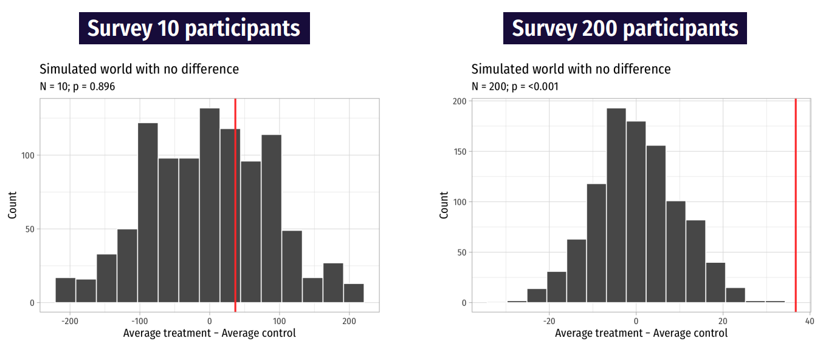
Statistical Power
Notes:
If you sample a small group repeatedly, you get a lot of different answers. But if you sample a large group even fewer times, your effects are more noticeable. Power calculations can tell you something about what the sample size should be (going out the window with big data)

Slide 43
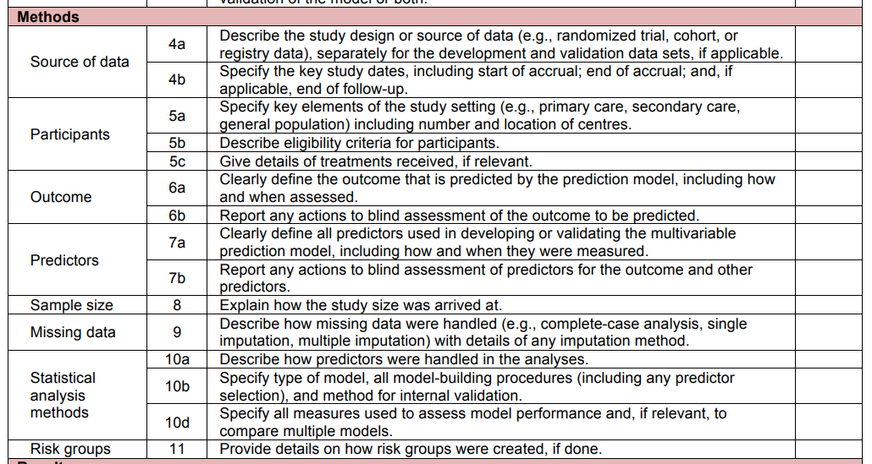
How do I report my results and assumptions?
The TRIPOD Checklist has useful structure on what you should be watching out for
Notes:
Also includes things like – what limitations should be noted, what should go in a discussion, etc. We’ll try to talk more about this with each method we cover.

Slide 44
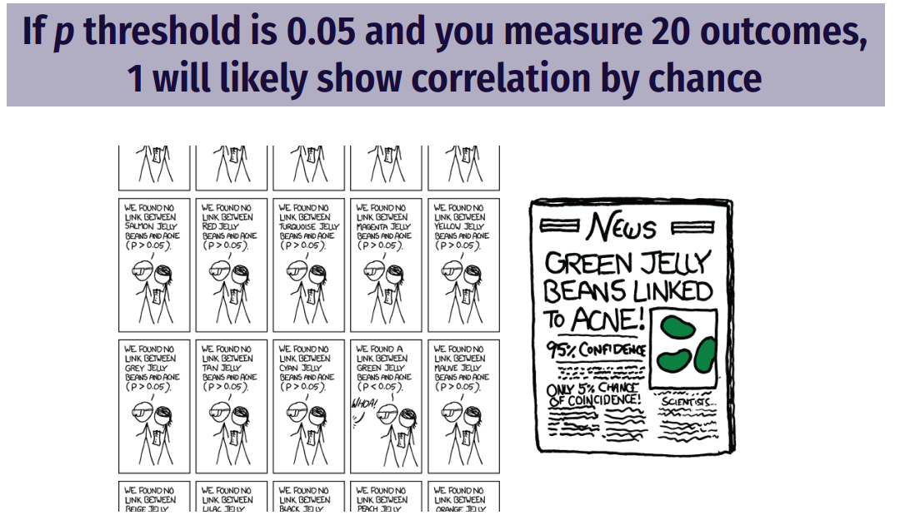
Are my results hacked? Are they spurious?
Notes:
For p-hacking, remember the website: https://projects.fivethirtyeight.com/p-hacking/. Did you correct for multiple testing? Did you perform 20 tests and report the one significant result?

Slide 45
What do my results mean?
Types of causal validity
Construct validity: are we measuring what we want to measure?
Statistical validity: are your statistics correct?
Internal validity: are your mechanisms correct?
Did you pick up the causal pathway you wanted?
Lots of threats!
Selection, omitted variable bias, attrition, seasonality, measurement error, spillovers
Each of these can affect your results
Notes:
Economists call internal validity “identification” You might not even have seen all the threats if your DAG is incomplete or wrong. A good econometrician is trained to try to pick at all the potential threats to identification / internal validity here. The best way to get around these is to think about as many as you can and then present your work as much as you can – people will help you see what you’re missing.

Slide 46
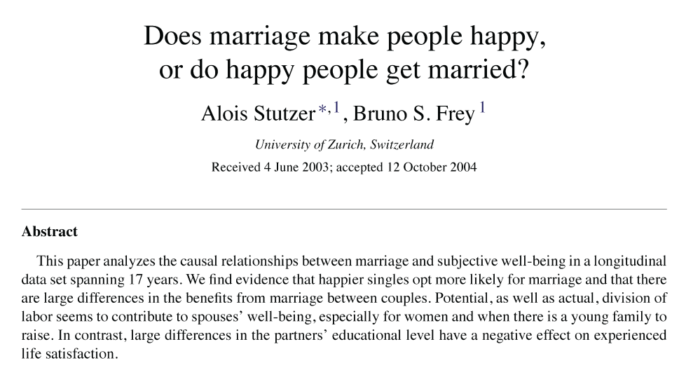
Example of Selection Bias: Marriage and Happiness
Notes:
Cover this example if you have time.

Slide 47
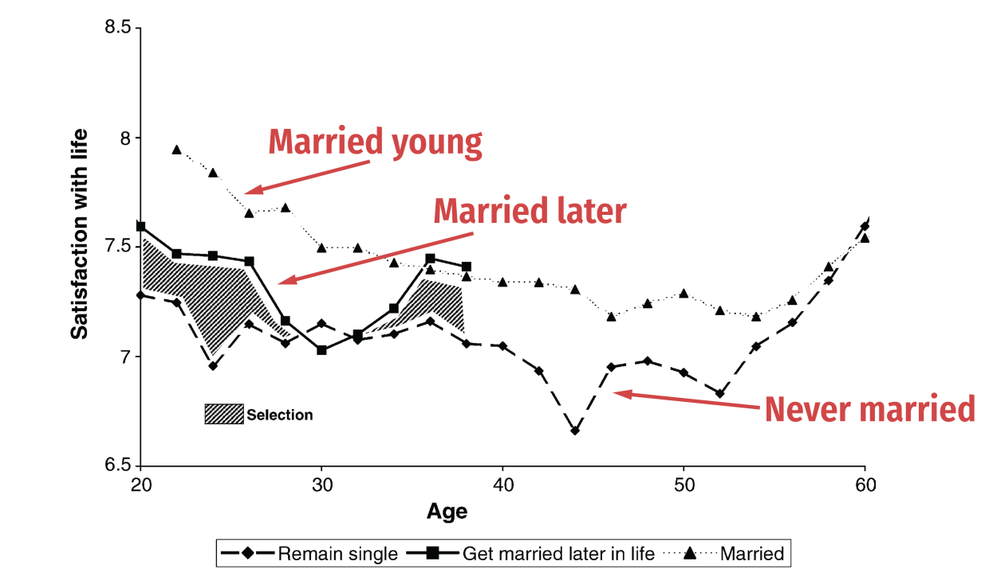
Example of Selection Bias: Marriage and Happiness
Notes:
Cover this example if you have time. Comparison between age of marriage and reported happiness (note: think about construct validity here too?)

Slide 48
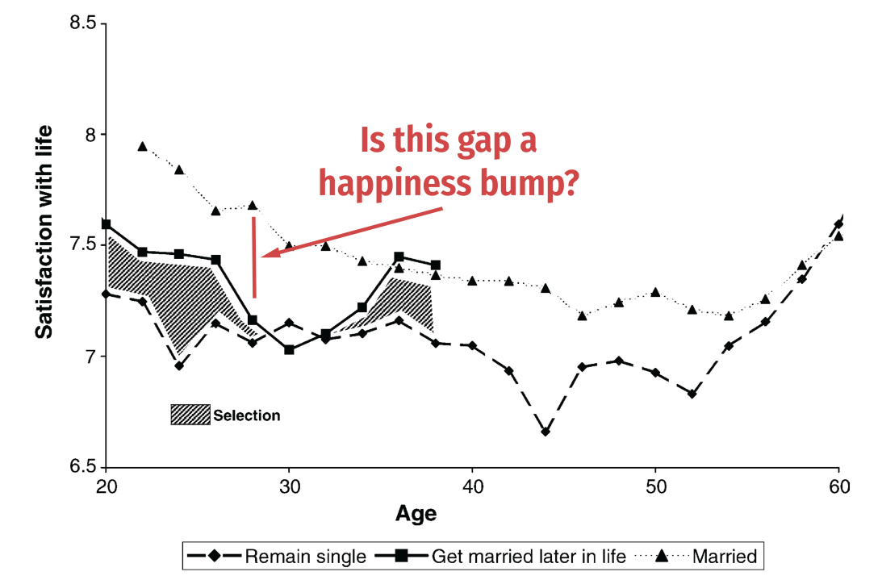
Example of Selection Bias: Marriage and Happiness
Notes:
Cover this example if you have time. Comparison between age of marriage and reported happiness (note: think about construct validity here too?)

Slide 49
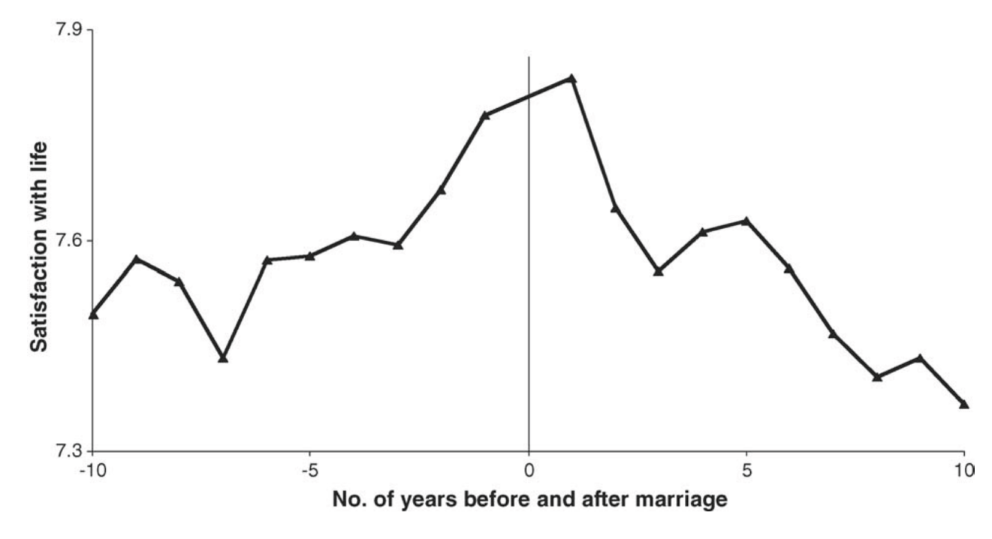
Example of Selection Bias: Marriage and Happiness
Notes:
The authors tried to compare based on relative years around marriage to see happiness ticks up before marriage – so it can’t be from marriage! Of course, there are problems with this design (end of semester)

Slide 50
What do my results mean?
Types of causal validity
Construct validity: are we measuring what we want to measure?
Statistical validity: are your statistics correct?
Internal validity: are your mechanisms correct?
External validity: are your findings generalizable?
Are your results a fluke of a limited sample?
Notes:
We’ll talk about more threats to internal validity throughout the course, particularly next time. If you want to think about multiple threats to IV, just think about nutrition research (they’re everywhere!)

Slide 51

Example of External Validity

Slide 52

Example of Selection Bias: Marriage and Happiness
Notes:
True story: this was a study published about mice!

Slide 53
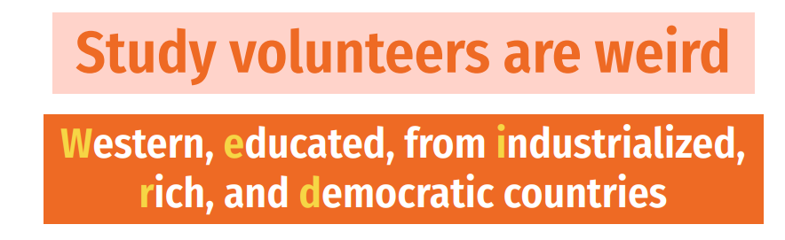
What do my results mean?
Types of causal validity
Construct validity: are we measuring what we want to measure?
Statistical validity: are your statistics correct?
Internal validity: are your mechanisms correct?
External validity: are your findings generalizable?
Are your results a fluke of a limited sample?
Does your data match the population?
Notes:
Particularly of concern with surveys or even clinical trials

Slide 54
Summary
Regression is a very powerful tool (use it well)
Importance of controlling for colliders/covariates
Inference and uncertainty of a regression
Interpreting regression coefficients and tables
Presenting your results
Next time: getting fancier with regression
Types of variables you can use
Interaction effects
(Some) Nonlinear models

