Slide 1
Health Econometrics I
Lecture 11: New Developments in Staggered Adoption Designs
November 25, 2022
HAD5744 • Alex Hoagland, Ph.D.

Slide 2
Two Way Fixed Effects
Allows us to recover dynamic treatment effects
Lets us pool multiple treated units potentially with differential timing of treatment (staggered adoption)
Very commonly used!
Notes:
26 of 100 most cited 2015-2019 AER papers estimate TWFE

Slide 3
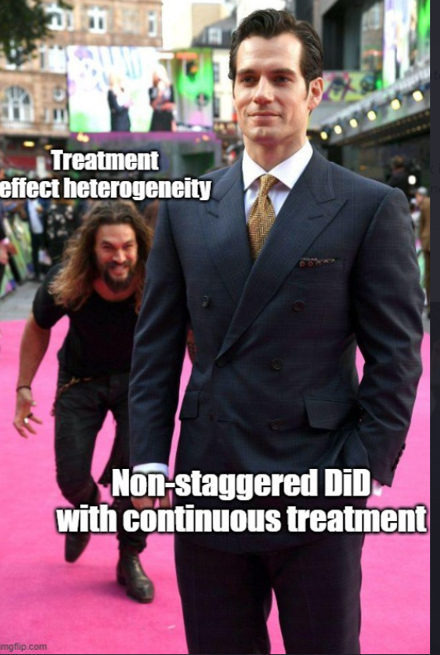
Two Way Fixed Effects
Allows us to recover dynamic treatment effects
Lets us pool multiple treated units potentially with differential timing of treatment (staggered adoption)
Very commonly used…incorrectly

Slide 4
Session Outline
TWFE with Staggered Adoption: Review
Goodman-Bacon Decomposition
Notes on identifying time fixed effects
Santanna and others?
Wooldridge Nonlinear
Triple Differences?

Slide 5
Contamination in TWFE
Notes:
Some people say synthetic control, but I like the plural – reminds me of the construction of the control group

Slide 6

Remember: Quasi-Experimental Variation
Notes:
In DiD we talked about exploiting time. The tricky thing here is that with federalism, things happen slowly over time

Slide 7
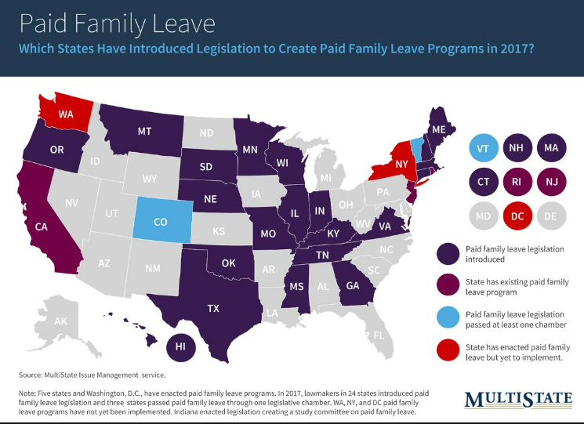
Remember: Quasi-Experimental Variation
Notes:
Each policy looks different and is enacted at different times. But we want power, right! Want to generalize and have external validity as well? These are good reasons for stacking.

Slide 8
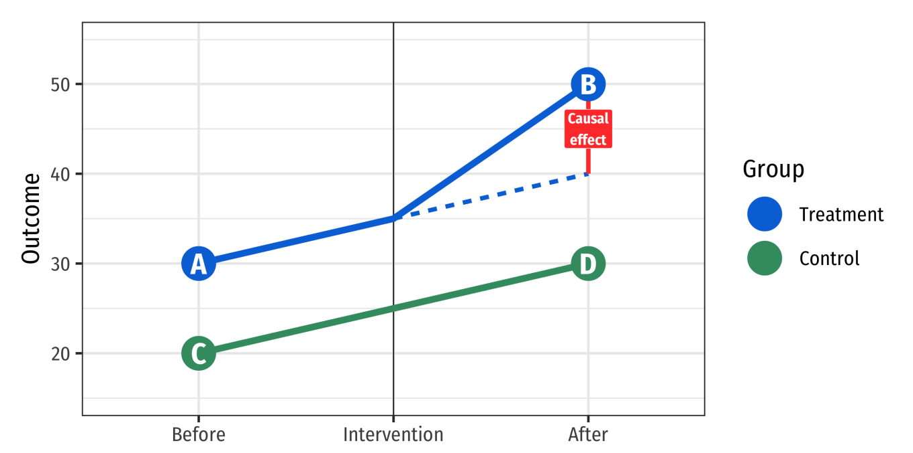
The Strategy Behind Difference-in-Differences (DID)
Notes:
General DID strategy – comparison and treatment

Slide 9

TWFE Regressions
$$y_{gt}=α_{g}+τ_{t}+{γ_{t}\sum_{t}{Treated_{g}×E_{t}}}_{}+ε_{gt}$$
Some estimation notes:
$E_{t}$ is a dummy variable for each (relative) time dummy
When can we say that TWFE = DID?

Slide 10
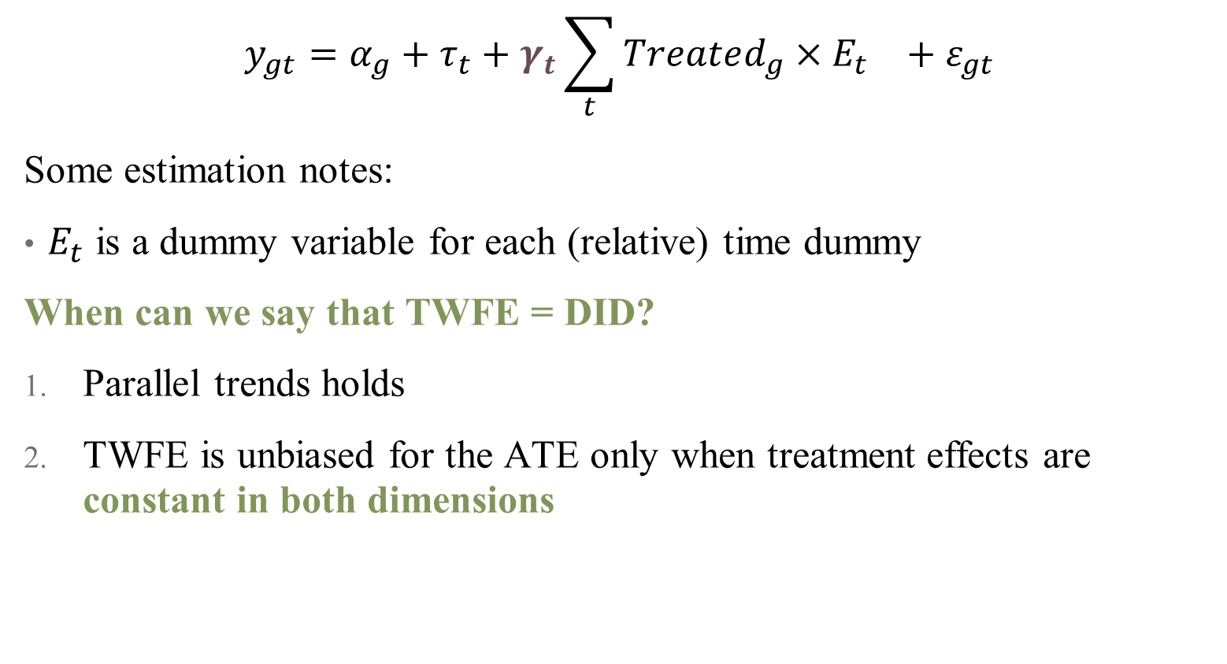
TWFE Regressions
$$y_{gt}=α_{g}+τ_{t}+{γ_{t}\sum_{t}{Treated_{g}×E_{t}}}_{}+ε_{gt}$$
Some estimation notes:
$E_{t}$ is a dummy variable for each (relative) time dummy
When can we say that TWFE = DID?
Parallel trends holds
TWFE is unbiased for the ATE only when treatment effects are constant in both dimensions
Notes:
Number 2 is frequently implausible!

Slide 11
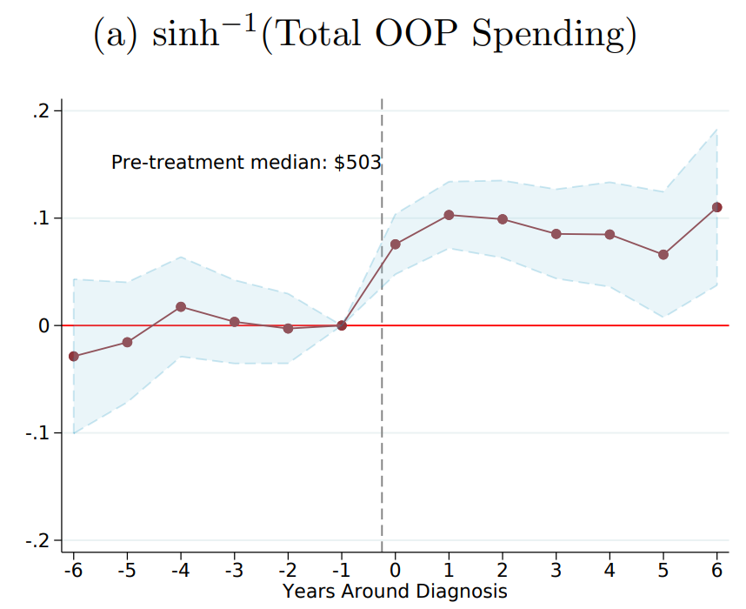
Dynamic Treatment Effects in TWFE
Notes:
This is what we hope to see when we run a TWFE – you can see why this is appealing (pre- and post-trend; tells you how long an effect sticks around, etc. )

Slide 12
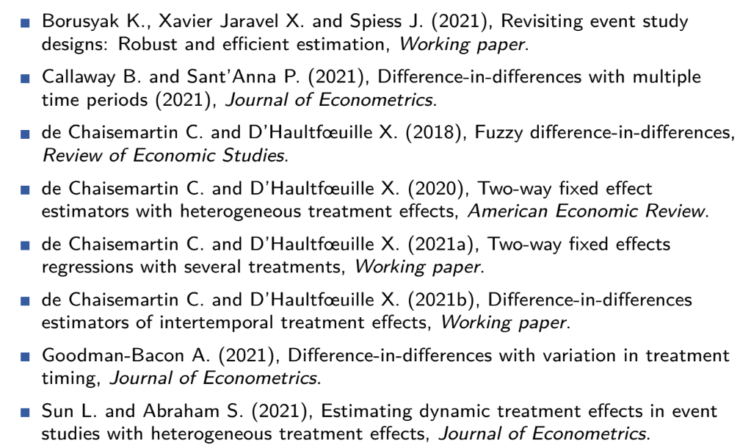
TWFE: A Flurry of Problems (2021)
Notes:
Lots of recent work on the problems of TWFE!

Slide 13
TWFE: A Flurry of Problems (2022)
Add in 2022 papers here.

Slide 14

Primary Problem: Weighting
Event studies are pooling multiple DiDs
At their core, each individual DiD can be framed as a 2-by-2 comparison
TWFE takes each comparison and weights them
$$𝔼\left[{\hat{β}}_{fe}\right]=𝔼[\sum_{g,t}{W_{g,t} TE_{g,t}]}$$

Slide 15

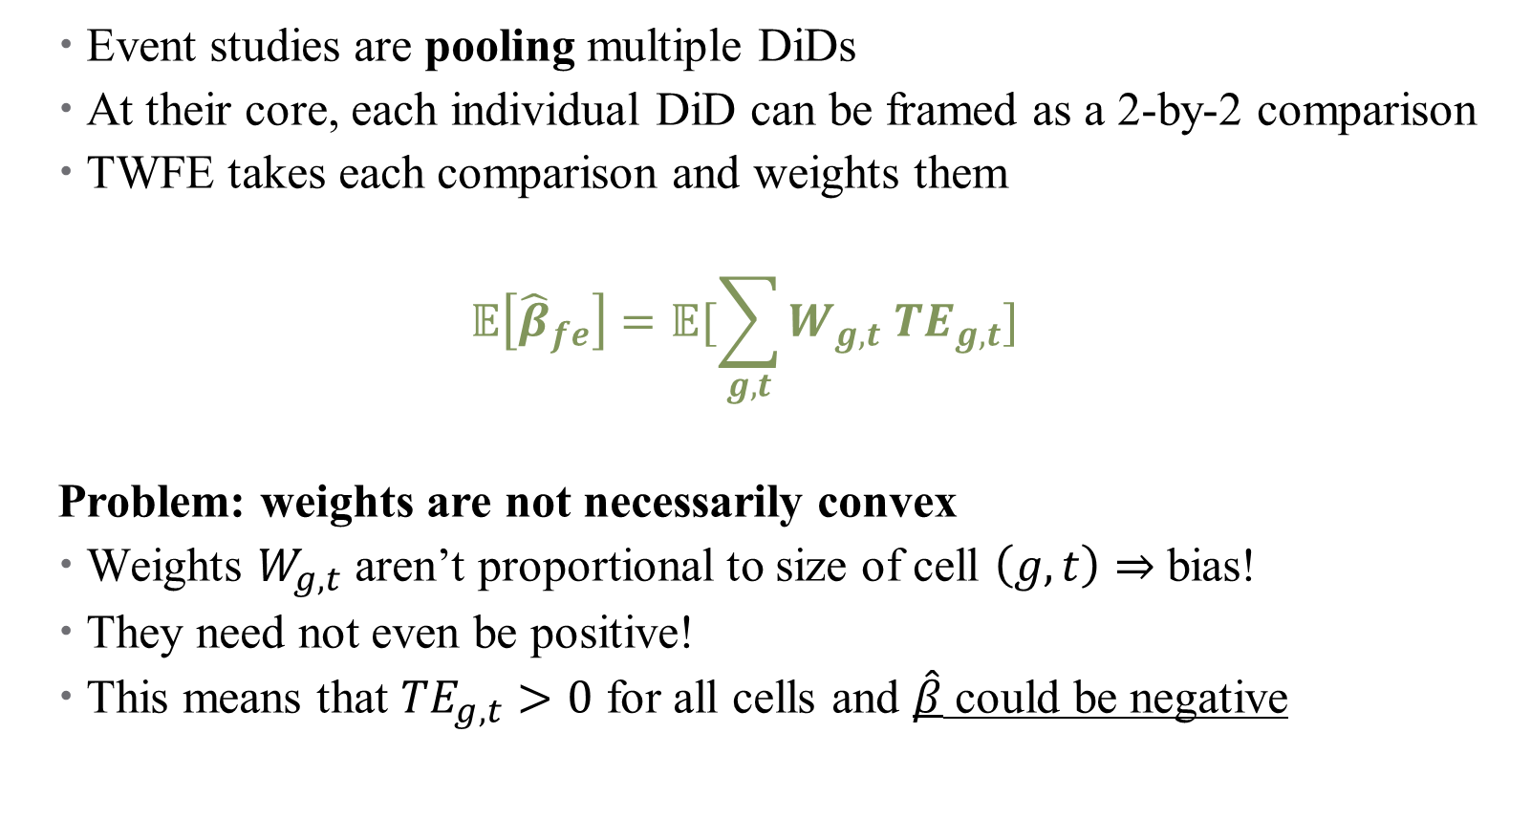
Primary Problem: Weighting
Event studies are pooling multiple DiDs
At their core, each individual DiD can be framed as a 2-by-2 comparison
TWFE takes each comparison and weights them
$$𝔼\left[{\hat{β}}_{fe}\right]=𝔼[\sum_{g,t}{W_{g,t} TE_{g,t}]}$$
Problem: weights are not necessarily convex
Weights $W_{g,t}$ aren’t proportional to size of cell $\left(g,t\right)⇒$ bias!
They need not even be positive!
This means that $TE_{g,t}>0$ for all cells and $\hat{β}$ could be negative
Notes:
Weights kind of come out of nowhere – they don’t match cell sizes, and they aren’t even “weights” in a sense of the word

Slide 16
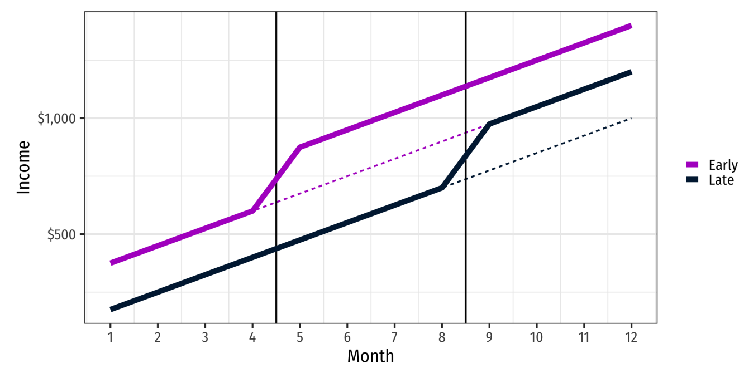
TWFE and Weighting Problems
Notes:
Suppose we have two treated units – one early and one late. Notice that the effect looks the same (and positive) for both groups

Slide 17
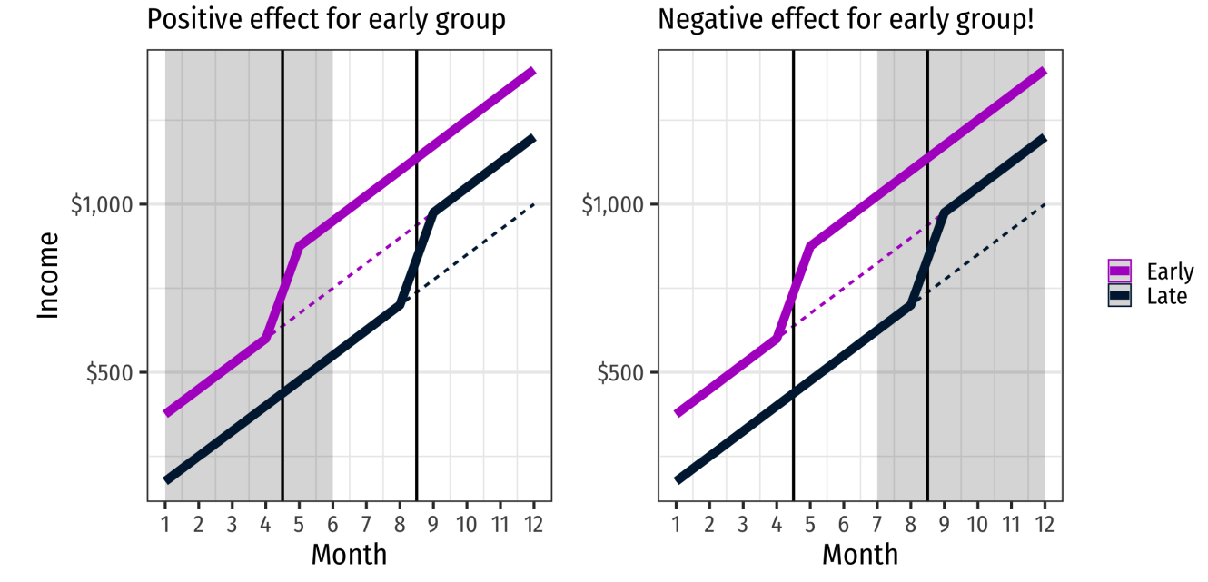
TWFE and Weighting Problems
Notes:
Here, in initial months around treatment for early group, we see positive increase, as expected; but if we look at dynamic treatment effects, then when late “turns on” it will look like early has gone down – what will the ES plot look like here?

Slide 18
Where do Negative Weights Come From?
Goodman-Bacon (2021) shows that event studies conflate two types of two-period DiDs:
Comparing a switching group to an unswitched group (untreated)
Comparing a switching group to an already treated unswitched group
This is where the negative weights come from!
Notes:
Remember each comparison is a 2-by-2 cell, so only two time periods and one control group. .

Slide 19
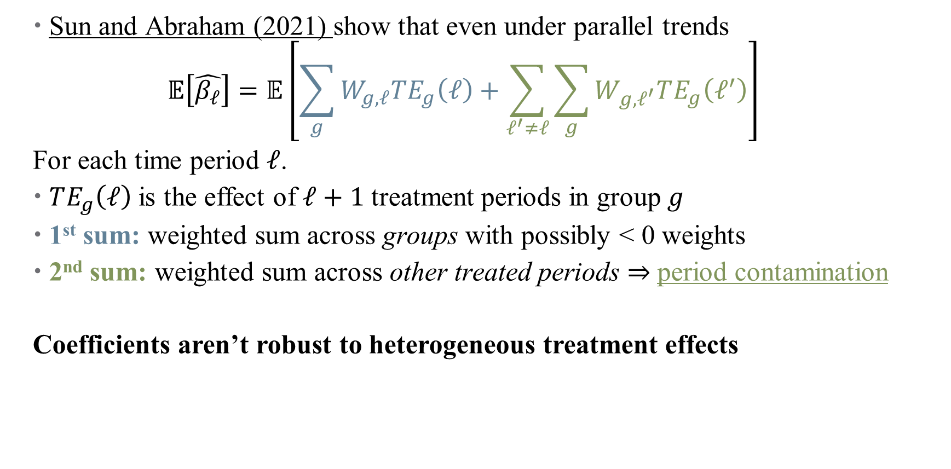
Another Problem: Heterogeneous Treatment Effects
Sun and Abraham (2021) show that even under parallel trends
$$𝔼\left[\hat{β_{ℓ}}\right]=𝔼\left[\sum_{g}{W_{g,ℓ}TE_{g}\left(ℓ\right)+\sum_{ℓ^{′}≠ℓ}{\sum_{g}{W_{g,ℓ^{′}}TE_{g}\left(ℓ^{′}\right)}}}\right]$$
For each time period $ℓ$.
$TE_{g}\left(ℓ\right)$ is the effect of $ℓ+1$ treatment periods in group $g$
1st sum: weighted sum across groups with possibly < 0 weights
2nd sum: weighted sum across other treated periods $⇒$ period contamination
Coefficients aren’t robust to heterogeneous treatment effects
Notes:
Sorry to switch from t to l here. Why ell + 1 – reference group category. This is true even for our pre-trend coefficients. There’s a package here just for Stata (eventstudyweights)

Slide 20
Doubly-Robust Estimation
Notes:
Some people say synthetic control, but I like the plural – reminds me of the construction of the control group

Slide 21
Nonlinear DiD
Notes:
Some people say synthetic control, but I like the plural – reminds me of the construction of the control group

