Slide 1
Health Econometrics I
Lecture 5: Matching Methods
October 7, 2022
HAD5744 • Alex Hoagland, Ph.D.

Slide 2
Last Time: Multivariate OLS and Specification Issues
Flexibility of regression:
Options for variables (binary variables, scaling, transformations)
Interactions
Nonlinear effects which are linear in parameters
Standard errors:
Heteroskedasticity
Autocorrelation
Clustering
Bootstrapping
Other features:
Omitted Variable Bias
Measurement Error
Collinearity

Slide 3
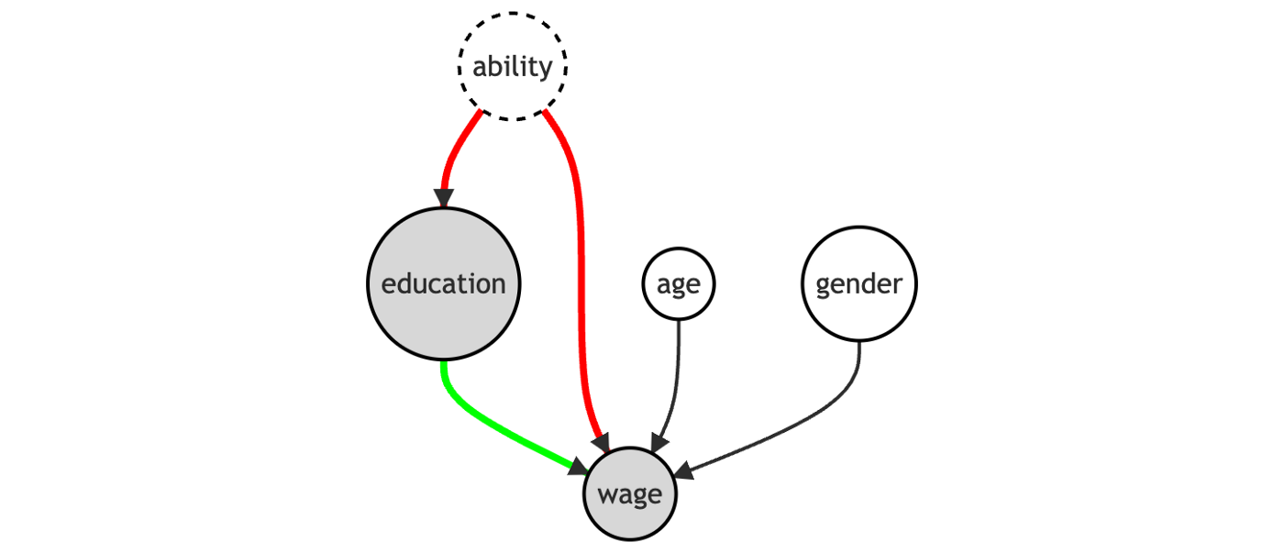

Causal Inference: Satisfying the Backdoor Criterion
If we want the effect of $X$ on $Y$, we need to satisfy the backdoor criterion

Slide 4
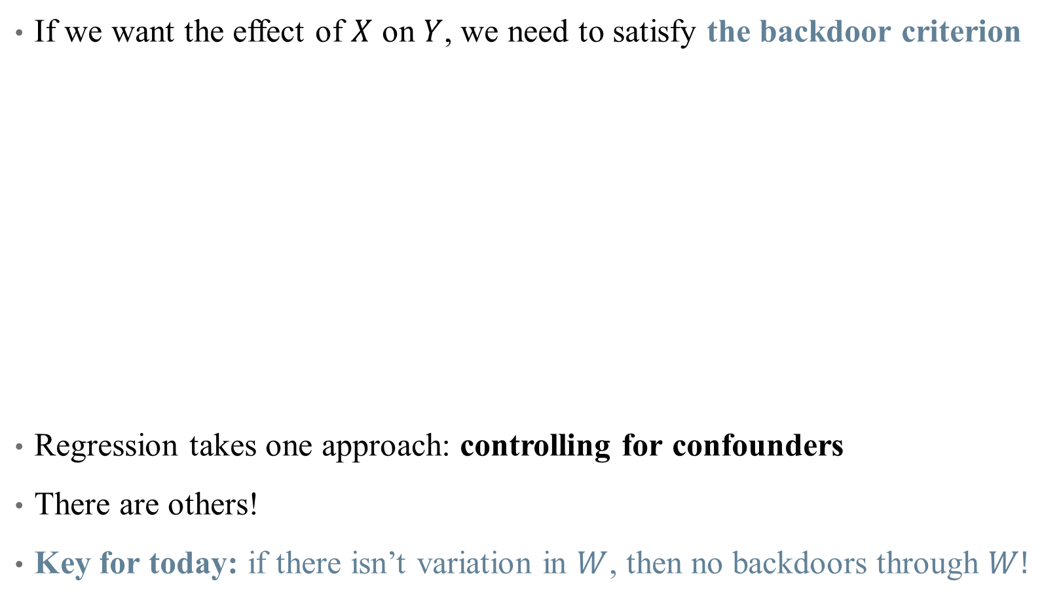
Causal Inference: Satisfying the Backdoor Criterion
If we want the effect of $X$ on $Y$, we need to satisfy the backdoor criterion
Regression takes one approach: controlling for confounders
There are others!
Key for today: if there isn’t variation in $W$, then no backdoors through $W!$
Notes:
Draw this DAG on the whiteboard – on next slide, erase the links between ability and education (removes omitted variable bias)

Slide 5


Causal Inference: Satisfying the Backdoor Criterion
If we want the effect of $X$ on $Y$, we need to satisfy the backdoor criterion
Key for today: if there isn’t variation in $W$, then no backdoors through $W!$
Notes:
This is the magic of randomization! It’s what makes an RCT so powerful

Slide 6
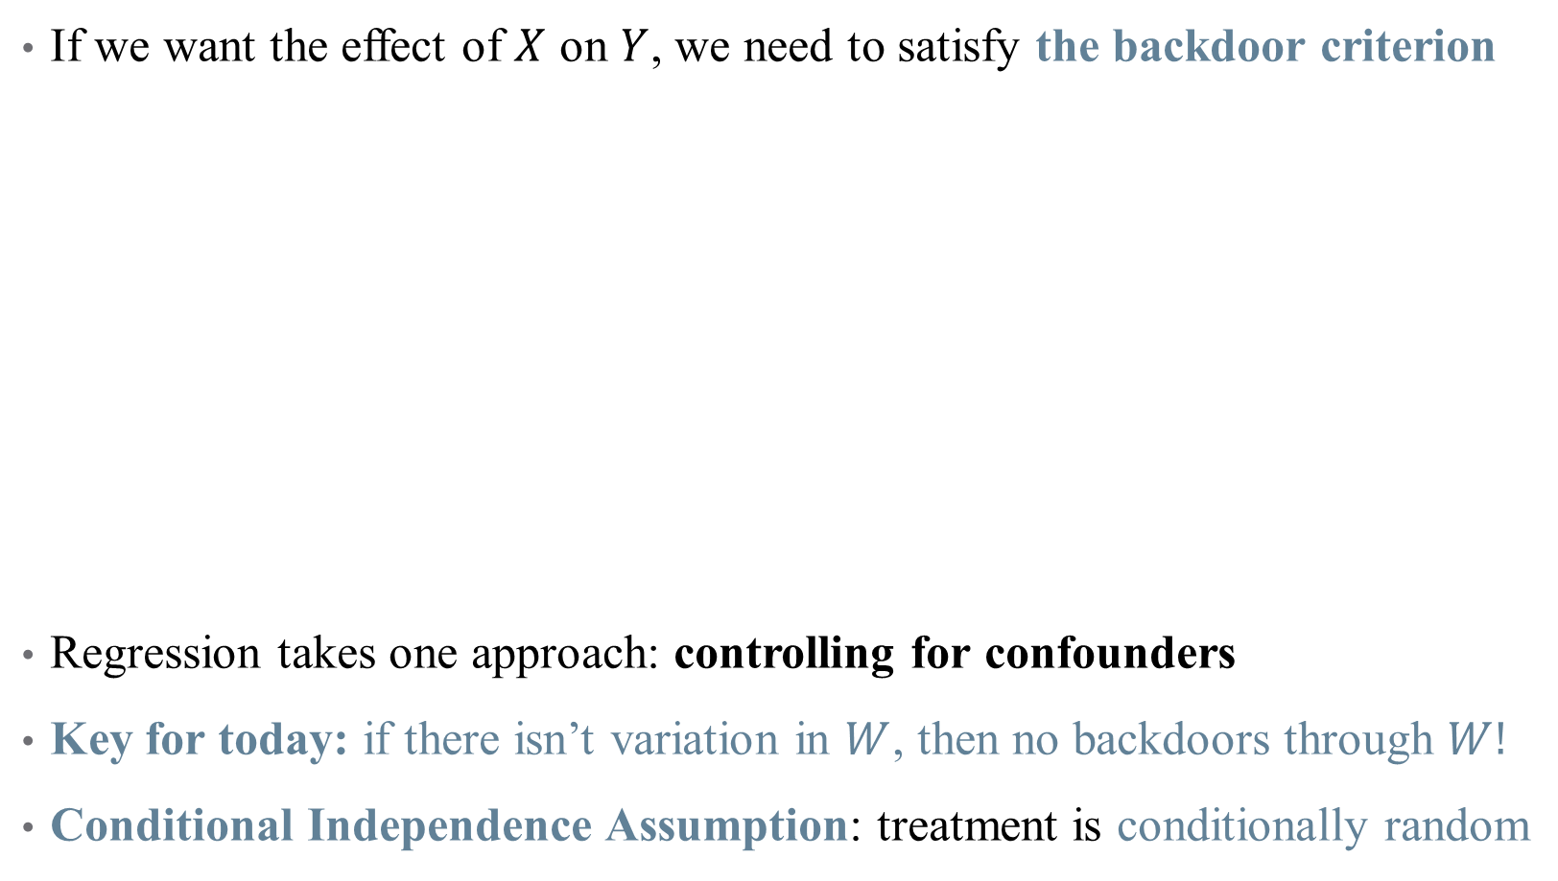
Causal Inference: Satisfying the Backdoor Criterion
If we want the effect of $X$ on $Y$, we need to satisfy the backdoor criterion
Regression takes one approach: controlling for confounders
Key for today: if there isn’t variation in $W$, then no backdoors through $W!$
Conditional Independence Assumption: treatment is conditionally random

Slide 7
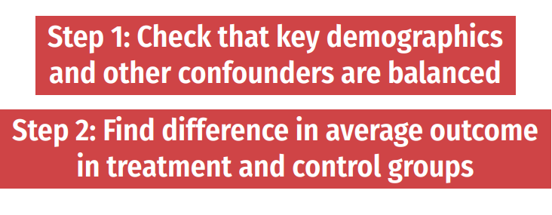
Analyzing a (truly) random experiment
If your treatment is truly randomized, analysis is easy!
Notes:
So if you are analyzing data from an RCT, you really just have to look at differences in means (maybe adjusting the SE s or adjusting for multiple hypothesis testing). You don’t even need controls! (Why? No confounding) Our goal today: can we simulate an RCT in the real world?

Slide 8
Today: Matching
Matching methods are used to balance groups along observable characteristics
Notes:
We are trying to simulate an RCT in the real world

Slide 9
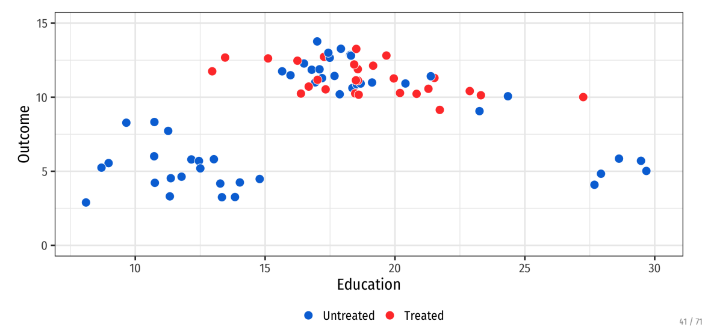
Matching reduces model dependence
Notes:
Reducing model depdence means that researcher discretion is limited – you’re really comparing apples to apples. Suppose we have this data and want a treatment effect

Slide 10
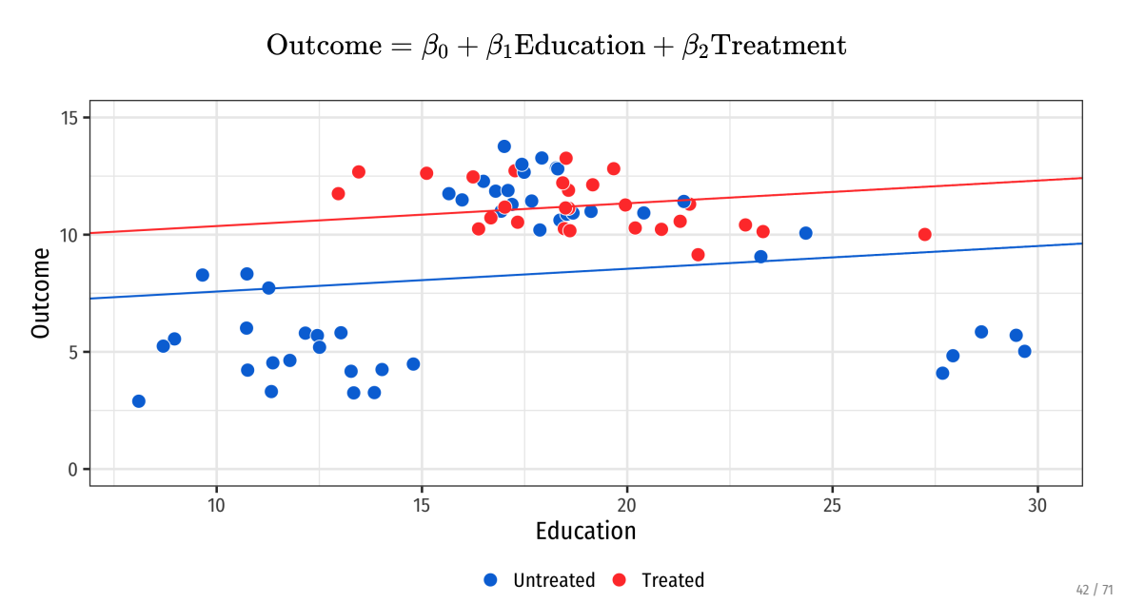
Matching reduces model dependence
Notes:
We can try either a linear regression (what’s the treatment effect)

Slide 11
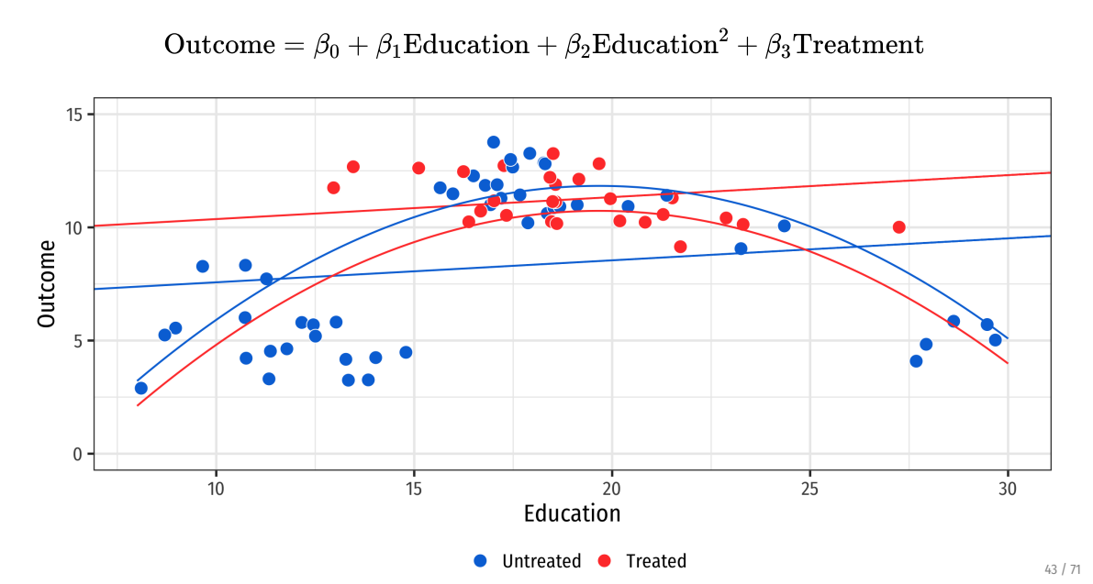
Matching reduces model dependence
Notes:
Or we try a quadratic fit – now the ATE is flipped? Which is correct?
Can anyone see what the problem is (we have untreated outliers that are skewing regressions – we don’t want these observations because they aren’t comparable to treated group)

Slide 12
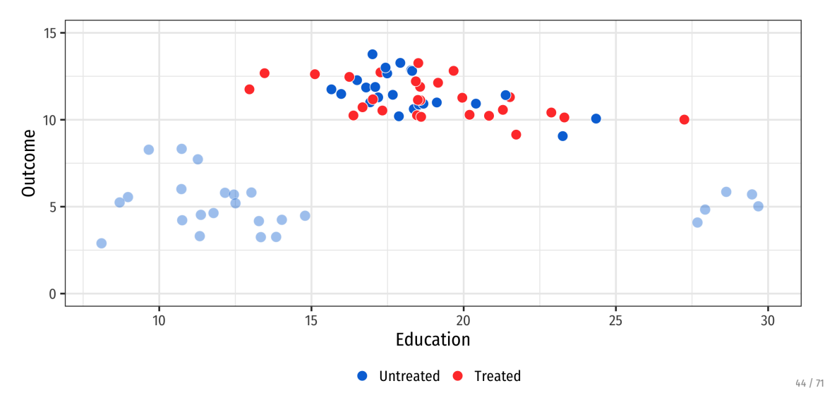
Matching reduces model dependence
Notes:
So drop these observations – now line and quadratic tell similar stories

Slide 13
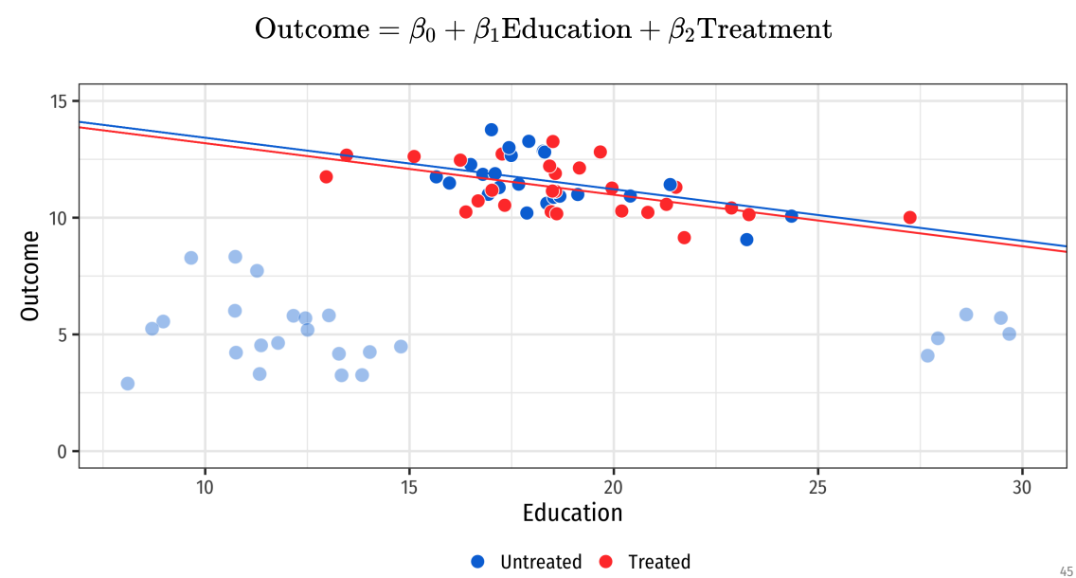
Matching reduces model dependence
Notes:
So drop these observations – now line and quadratic tell similar stories

Slide 14
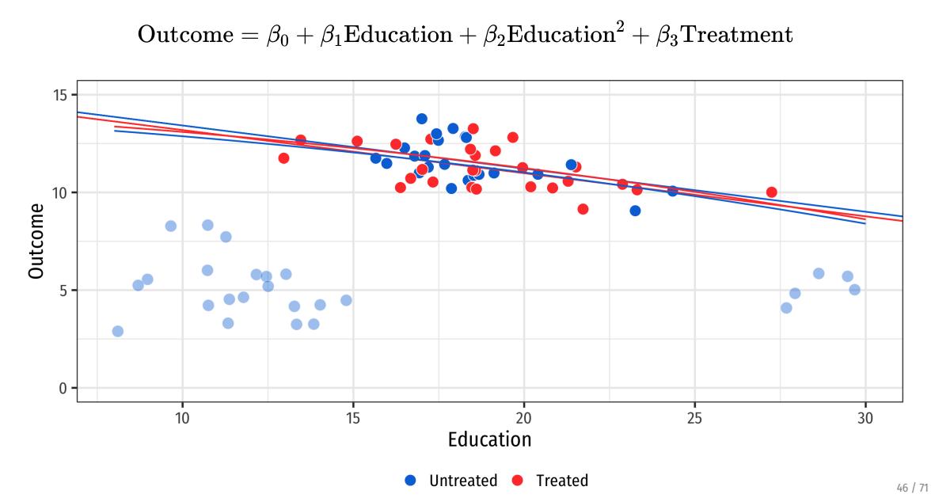
Matching reduces model dependence
Notes:
Without need to fit the poorly matching observations, models tell a story that reflects the data we care about. (That’s the kicker philosophically here – is there data we can say we “care more about”)?

Slide 15
Today: Matching
Matching methods are used to balance groups along observable characteristics
Matching in Concept
Single-Variable Matching Strategies:
Subclassification
Exact matching
Approximate matching
Multiple Matching Variables
Propensity score matching
Assumptions and Caveats

Slide 16
Matching in Concept

Slide 17

What do we want to do with matching?
Example: what is the effect of health insurance take-up on health outcomes?
Specifically, how does having health insurance affect expenditures?
Let’s look at a simple regression
What could contribute to differences in expenses?

Slide 18
What do we want to do with matching?
Example: what is the effect of health insurance take-up on health outcomes?
Specifically, how does having health insurance affect expenses?
Let’s look at a simple regression
What could contribute to differences in expenses?
Initial health state
Education
Income
Etc.
Matching helps to “balance out” these covariates

Slide 19
Step 1: Preprocessing (matching) data
Main matching algorithm
We want to match treated observations to similar control observations
What will our matching criteria be? (what is similar?)
Are we assigning matches or weights?
How many matches will we select?
How will weights decay with distance?
What is the worst acceptable match?
Notes:
Preprocessing should be informed by the causal model you have in mind (you guess something about what is non-random in treatment assignment and fix it)

Slide 20
Step 2: Estimation
The matched sample becomes our new analytical sample
Once we establish balance, we can mimic the analysis of an RCT!
Calculate difference in means
Can build out a more complicated model, but generally the matching is the hard part
Notes:
Preprocessing should be informed by the causal model you have in mind (you guess something about what is non-random in treatment assignment and fix it)

Slide 21

How is this different than controlling in OLS?
Intuitively, differences lie in how we deal with backdoor paths:
Regression removes all variation in $X→Y$ associated with variation in $W$
Matching chooses a sample in which there is no variation in $W$

Slide 22
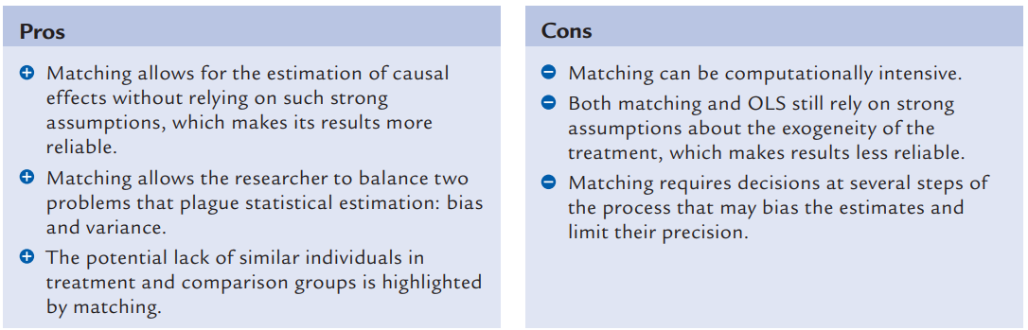

How is this different than controlling in OLS?
Intuitively, differences lie in how we deal with backdoor paths:
Regression removes all variation in $X→Y$ associated with variation in $W$
Matching chooses a sample in which there is no variation in $W$
Pros and cons of matching (Black 2015)
Notes:
Also note that the OLS assigns weights to observations that may bias your estimate of ATE or ATT, particularly if (1) probability of treatment varies with x and (2) E(Y_1-Y_0|x) varies in x

Slide 23
Matching Techniques: Single Variable
Notes:
You want to go through this section quickly – just to build intuition.

Slide 24
Subclassification
We are worried about differences in health status affecting our estimates
In practice, the treatment and control groups are not balanced
Subclassification is a matching strategy to “smooth out” differences:
Notes:
Subclassification is a simplistic form of matching, used to give intuition here.

Slide 25
Subclassification
We are worried about differences in health status affecting our estimates
In practice, the treatment and control groups are not balanced
Subclassification is a matching strategy to “smooth out” differences:
Create bins (based on BMI)
In each bin, identify the “treatment effect” of insurance
Construct strata-specific weights:
Likelihood of being in each bin across treatment/control groups
Calculate the weighted average effect of insurance using weights in (3)

Slide 26
Subclassification
We are worried about differences in health status affecting our estimates
Subclassification is a matching strategy to “smooth out” differences:
Create bins (based on BMI)
In each bin, identify the “treatment effect” of insurance
Construct strata-specific weights:
Likelihood of being in each bin across treatment/control groups
Calculate the weighted average effect of insurance using weights in (3)
A note on packages in R
Notes:
Packages: good, but make sure you know what is happening under the hood! If you can code up your own estimator, do. Otherwise, cite your packages!

Slide 27
Curse of Dimensionality
Subclassification works great when you are stratifying with few cells
Few variables, or binary variables
What happens if you want to stratify with too many cells?
Sparsity problems: observations may not match effectively
Many cells may contain either only treatment units or only control units

Slide 28
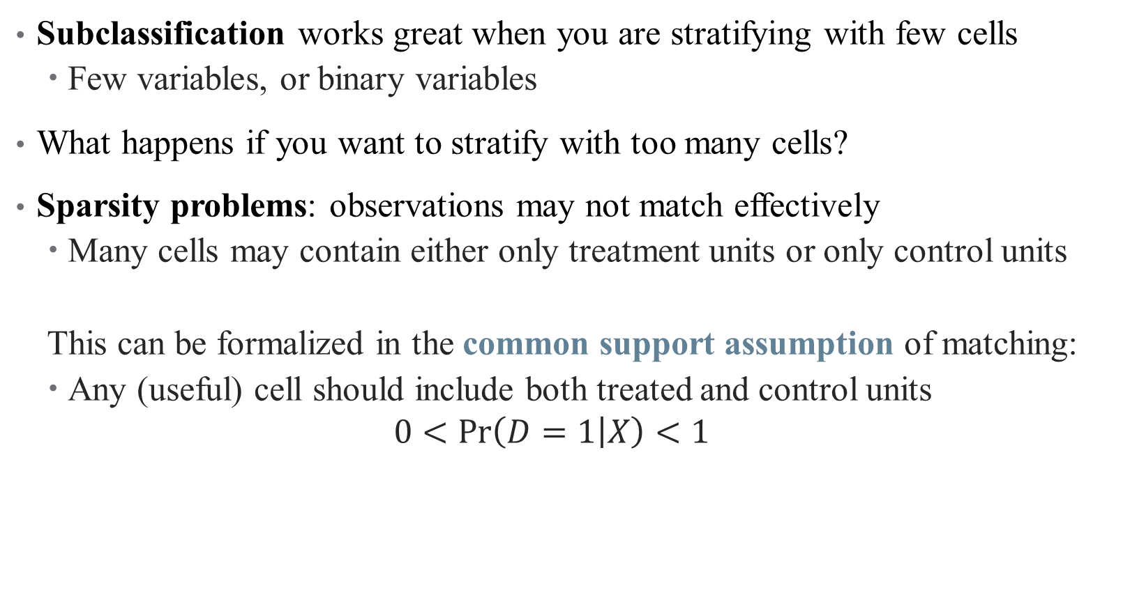
Curse of Dimensionality
Subclassification works great when you are stratifying with few cells
Few variables, or binary variables
What happens if you want to stratify with too many cells?
Sparsity problems: observations may not match effectively
Many cells may contain either only treatment units or only control units
This can be formalized in the common support assumption of matching:
Any (useful) cell should include both treated and control units
$$0<\operatorname{Pr}\left(D=1 | X\right)<1$$

Slide 29
Matching Techniques: Multiple Variables
Notes:
Exact matching should be covered quickly, want to get to approximate matches

Slide 30
Exact Matching
Matching with multiple variables quickly runs into curse of dimensionality
Can’t manually define cells with sufficient observations
But can we still form a one-to-one comparison across observations?

Slide 31
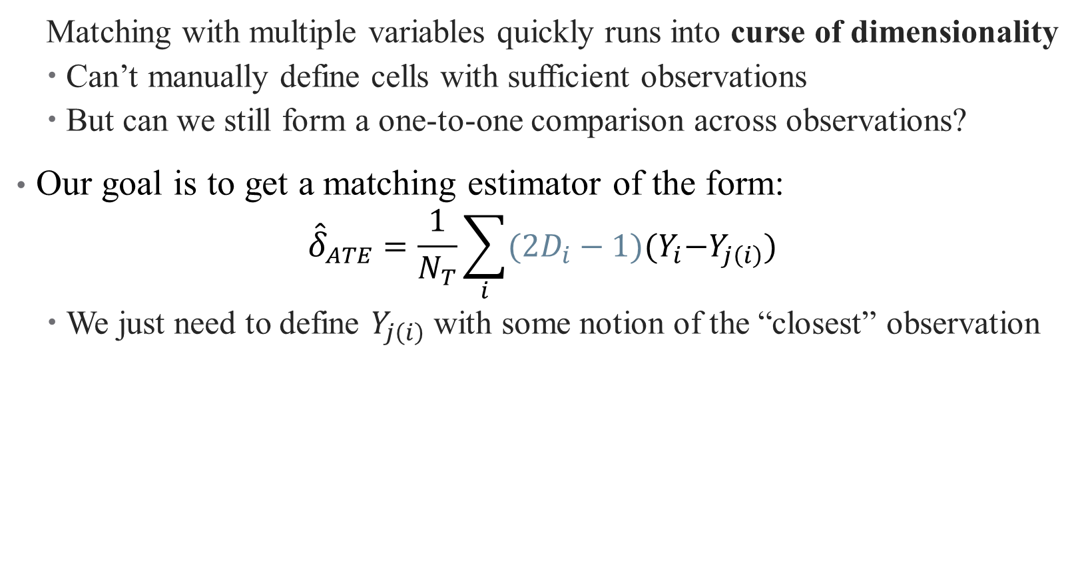
Exact Matching
Matching with multiple variables quickly runs into curse of dimensionality
Can’t manually define cells with sufficient observations
But can we still form a one-to-one comparison across observations?
Our goal is to get a matching estimator of the form:
$${\hat{δ}}_{ATE}=\frac{1}{N_{T}}\sum_{i}{(2D_{i}−1){(Y}_{i}−Y_{j\left(i\right)})}$$
We just need to define $Y_{j\left(i\right)}$ with some notion of the “closest” observation
Notes:
Note something about the 2D_i-1 notation

Slide 32
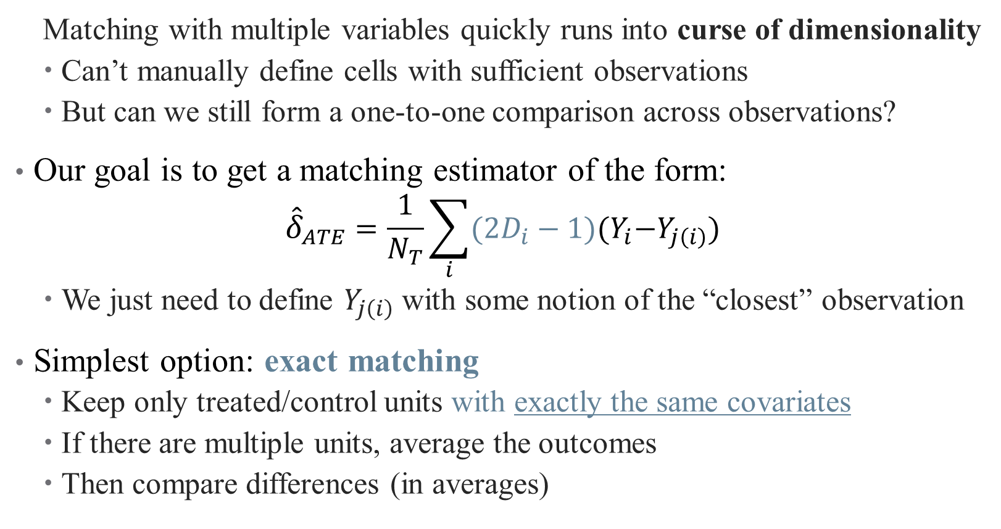
Exact Matching
Matching with multiple variables quickly runs into curse of dimensionality
Can’t manually define cells with sufficient observations
But can we still form a one-to-one comparison across observations?
Our goal is to get a matching estimator of the form:
$${\hat{δ}}_{ATE}=\frac{1}{N_{T}}\sum_{i}{(2D_{i}−1){(Y}_{i}−Y_{j\left(i\right)})}$$
We just need to define $Y_{j\left(i\right)}$ with some notion of the “closest” observation
Simplest option: exact matching
Keep only treated/control units with exactly the same covariates
If there are multiple units, average the outcomes
Then compare differences (in averages)

Slide 33
Exact Matching: Problems
Exact matching has its own problems:
Small sample sizes (few matches)
Continuous matching variables
Inconsistent averages over a few observations (within cells)
What if the people you are throwing out matter?
Generalize again! This time to approximate matching:
Nearest Neighbor Methods (NN)
Propensity Score Matching (PSM)
Inverse Probability Weighting (IPW)

Slide 34
Approximate Matching: Nearest Neighbor
When exact matches aren’t possible, rely on collection of neighbors
What does it mean to be a neighbor with multiple variables?

Slide 35
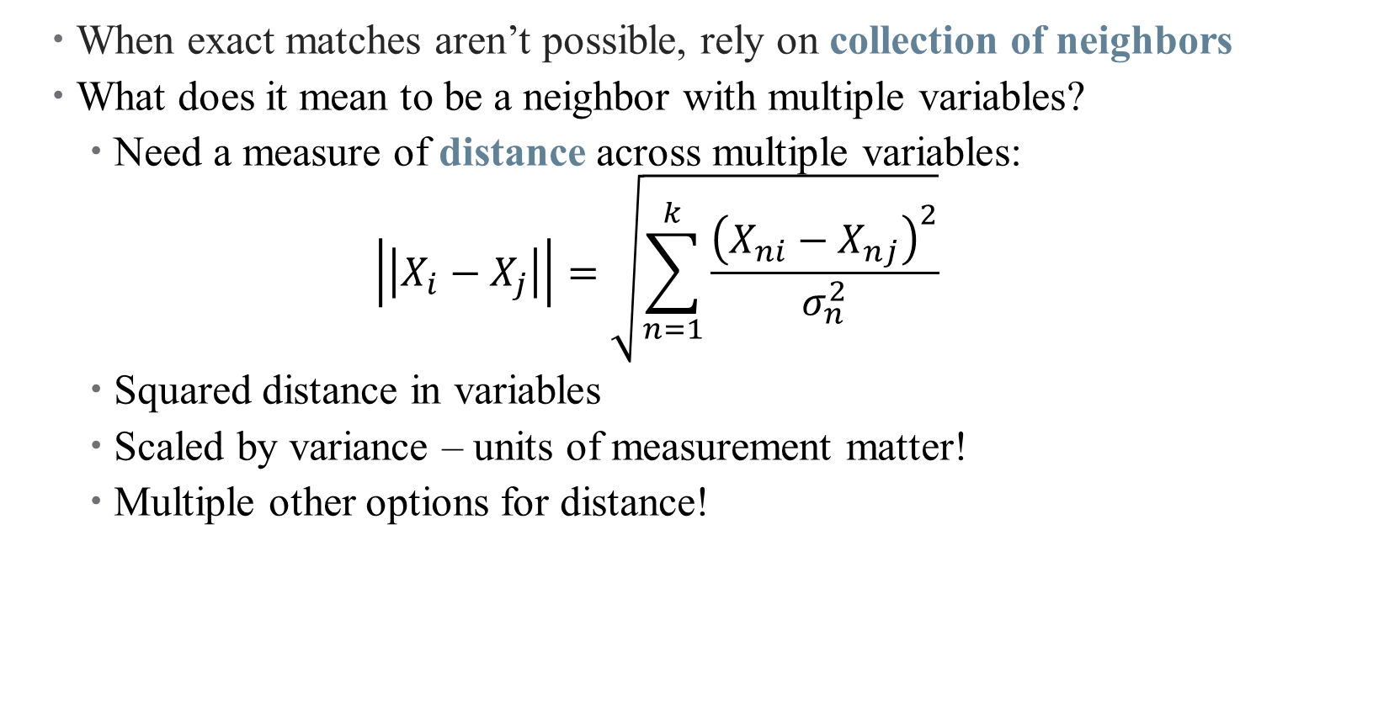
Approximate Matching: Nearest Neighbor
When exact matches aren’t possible, rely on collection of neighbors
What does it mean to be a neighbor with multiple variables?
Need a measure of distance across multiple variables:
$$\left|\left|X_{i}−X_{j}\right|\right|=\sqrt{\sum_{n=1}^{k}{\frac{{\left(X_{ni}−X_{nj}\right)}^{2}}{σ_{n}^{2}}}}$$
Squared distance in variables
Scaled by variance – units of measurement matter!
Multiple other options for distance!

Slide 36
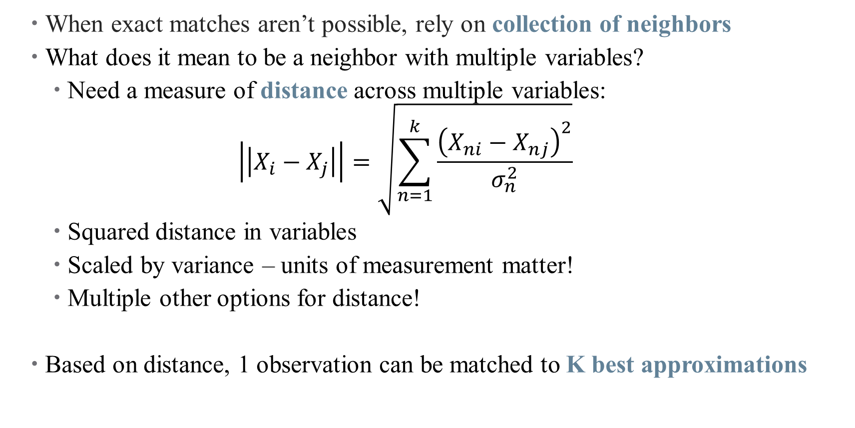
Approximate Matching: Nearest Neighbor
When exact matches aren’t possible, rely on collection of neighbors
What does it mean to be a neighbor with multiple variables?
Need a measure of distance across multiple variables:
$$\left|\left|X_{i}−X_{j}\right|\right|=\sqrt{\sum_{n=1}^{k}{\frac{{\left(X_{ni}−X_{nj}\right)}^{2}}{σ_{n}^{2}}}}$$
Squared distance in variables
Scaled by variance – units of measurement matter!
Multiple other options for distance!
Based on distance, 1 observation can be matched to K best approximations

Slide 37
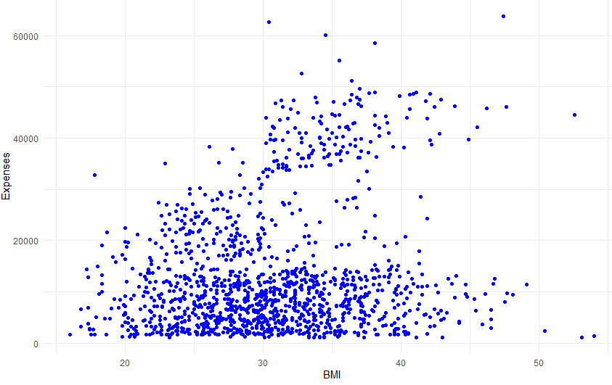
Nearest Neighbor Matching

Slide 38
Nearest Neighbor Matching

Slide 39
Nearest Neighbor Matching

Slide 40
Nearest Neighbor Matching

Slide 41
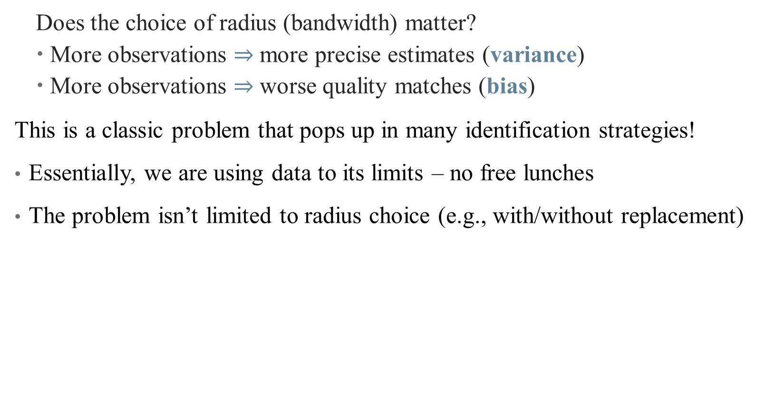
The Bias/Variance Tradeoff
Does the choice of radius (bandwidth) matter?
More observations $⇒$ more precise estimates (variance)
More observations $⇒$ worse quality matches (bias)
This is a classic problem that pops up in many identification strategies!
Essentially, we are using data to its limits – no free lunches
The problem isn’t limited to radius choice (e.g., with/without replacement)
Notes:
Is there a better way to solve these problems? Can we beat the curse of dimensionality? Is there an optimal bandwidth?

Slide 42
Approximate Matching: Propensity Score Matching
The propensity score is a powerful tool!
In fact, it can be used to match!
Observations are similar if they were equally likely to be treated
Steps for using a propensity score in matching
Select a model predicting treatment status (selection on observables)
Estimate a model for conditional probability of treatment
Use predicted values to construct propensity score

Slide 43
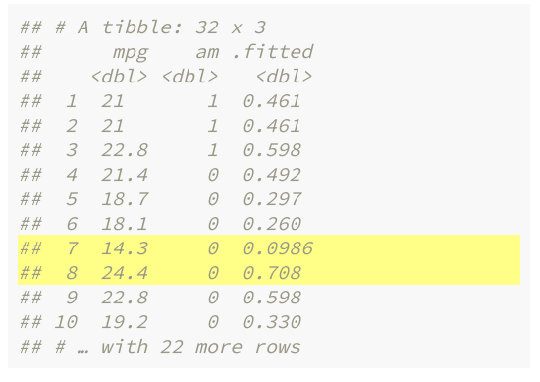

Propensity Score Matching
Goal: predict treatment status of each observation based on covariates
Use a nonlinear method (logit, probit, etc.)
This “first stage” regression predicts $\hat{y} (or \hat{D})$, not $\hat{β}$
This is the propensity score: $Pr⁡(D=1|X)$
Predicted treatment status gives you a single dimension on which to match
Notes:
We haven’t covered logit or probit yet, will in future lectures. If I have two observations with similar propensities but only one is treated, then differences across those observations are more likely to be treatment related, right? But the true propensity score is (of course) unknown

Slide 44
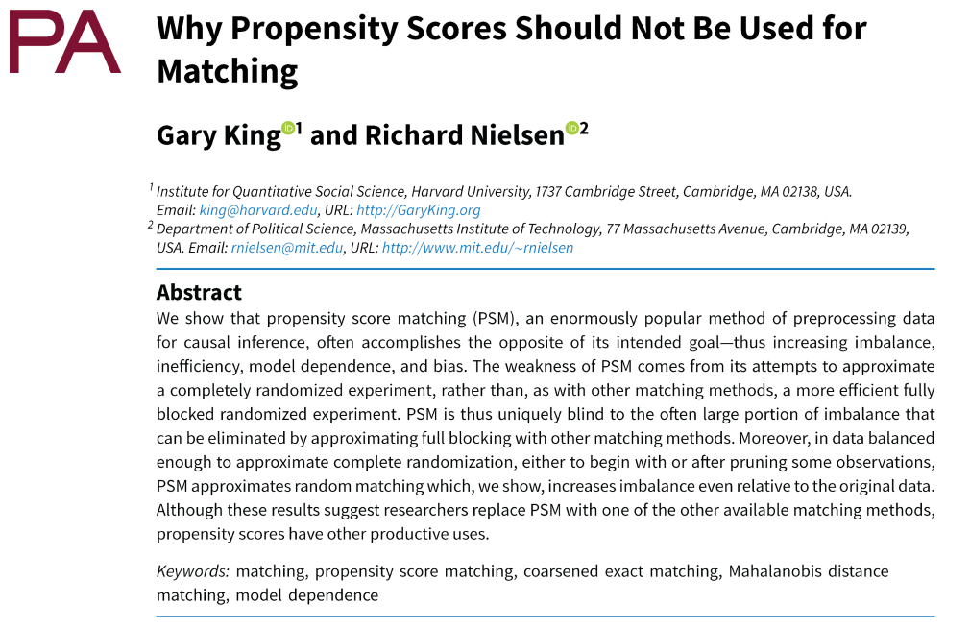



Propensity Score Matching: Identification Problems
Notes:
PSM isn’t a great matching technique, because it’s trying to randomize in the wrong way. PSM wants to fully randomize the experiment by collapsing all covariates into a single estimator – you’re better off doing a blocked experiment by matching on multiple variables without collapsing them. This takes us back to NN matching.

Slide 45
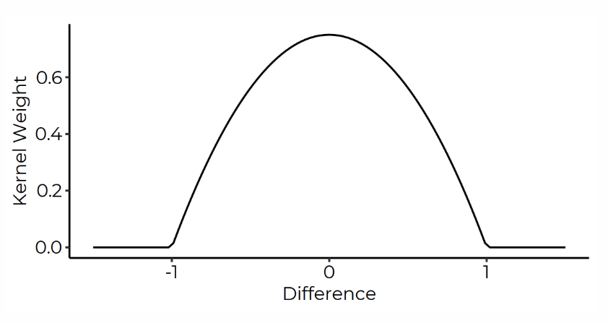
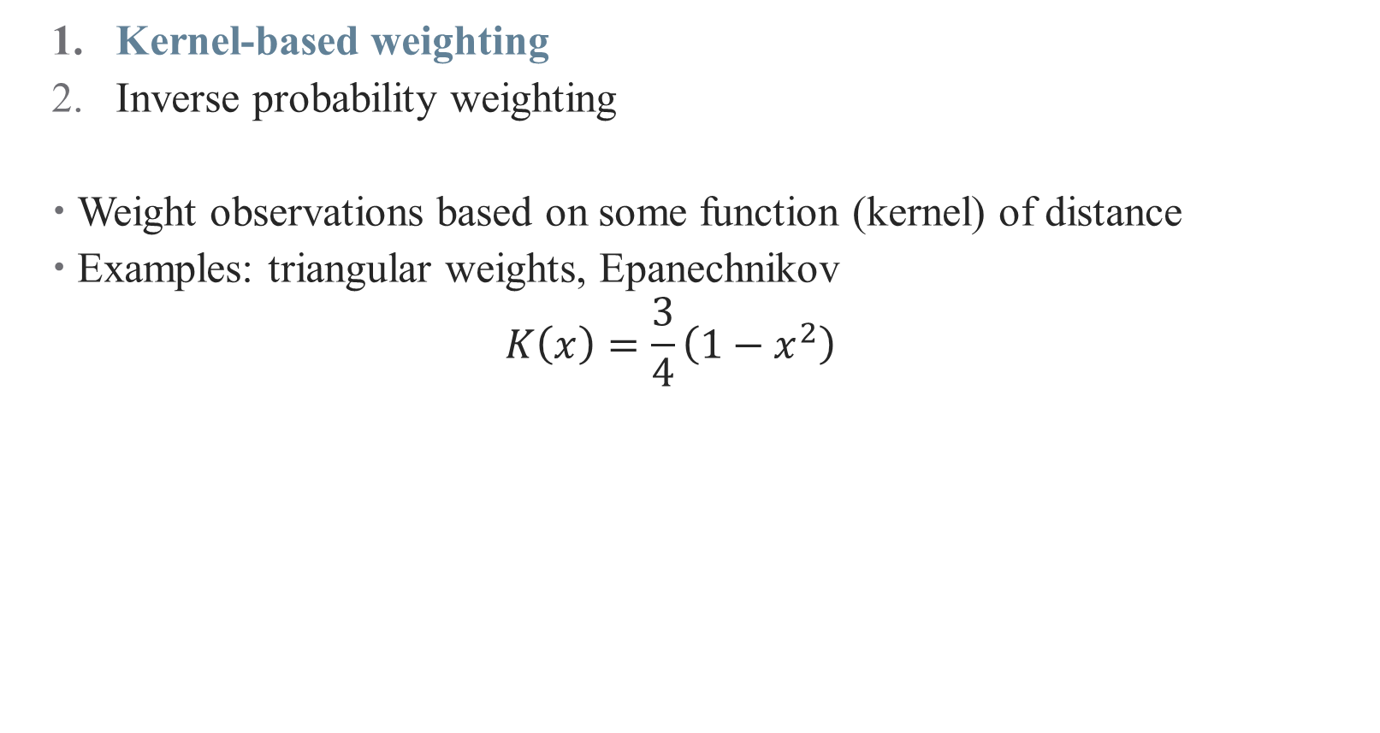
Alternative: Weighting Matched Observations
Kernel-based weighting
Inverse probability weighting
Weight observations based on some function (kernel) of distance
Examples: triangular weights, Epanechnikov
$$K\left(x\right)=\frac{3}{4}\left(1−x^{2}\right)$$
Notes:
Even though NN matching can be greedy (meaning low quality matches), PSM doesn’t work. A better approach is to weight your matches. Either pre-specify a kernel (lots of random functions like this) or …

Slide 46
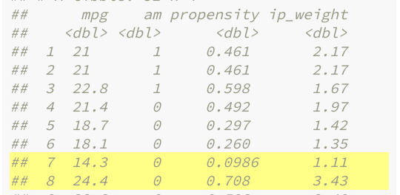
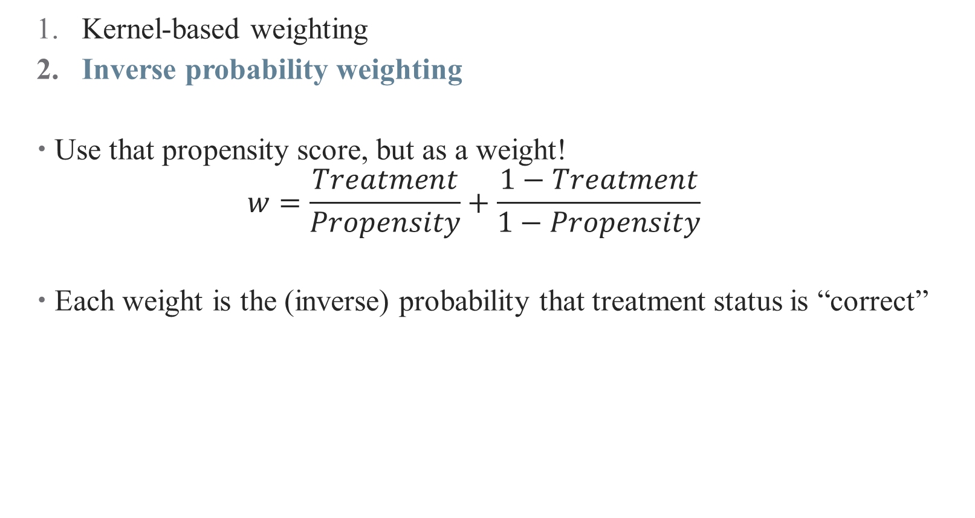
A Note on Weighting Matched Observations
Kernel-based weighting
Inverse probability weighting
Use that propensity score, but as a weight!
$$w=\frac{Treatment}{Propensity}+\frac{1−Treatment}{1−Propensity}$$
Each weight is the (inverse) probability that treatment status is “correct”
Notes:
… use the propensity score! (note that this is *not* using the PSM for matching). You’re weighting by how “weird” treatment assignment is (more weird → more weight) Why? Cause that’s the interesting stuff!

Slide 47
Matching in Practice

Slide 48
What do you do after you’ve matched?
Compare differences in means!
You should fix your standard errors
Matching can also be combined with regression approaches
Capture specific functional forms between treatment and outcome
E.g., interactions between treatment and other covariates
If you have a matched sample or weights, you can do regression with that sample (or using those weights)
You can also add the propensity score as a control variable
Notes:
Fix Ses to deal with preprocessing data. Not totally sure where we stand on using PS as a control variable; generally okay but you shouldn’t have to if your randomization is good.

Slide 49
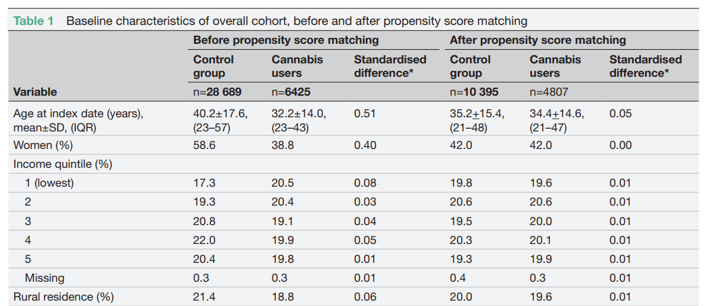
Some Matching Best Practices
Show balance after matching (balance table)
Source: Vozoris et al., 2022

Slide 50
Some Matching Best Practices
Show balance after matching (balance table)
Check if observations with similar propensity scores are balanced (stratification tests)
Show common support is valid in your setting

Slide 51
Some Matching Best Practices
Show balance after matching (balance table)
Check if observations with similar propensity scores are balanced (stratification tests)
Show common support is valid in your setting
Propensity scores close to 0 or 1 give large weights – trim data set
Try (and report) multiple bandwidths/approaches/replacement
You will need to argue CIA holds convincingly
Some more tips: blogs.worldbank/what-do-you-need-do-make-matching-estimator-convincing

Slide 52
Other Caveats
Economists tend to be more skeptical of all matching methods
Highly sensitive to both variables included and analysis sample used (Smith and Todd 2001, 2005)
Matching methods are also highly sensitive to omitted variable bias
We’re still shook from the PSM debaucle
You may be throwing away data and still left with biased estimates if imbalance remains
This is substantive of a larger critique: can we ever achieve the CIA with observational data?
Are we more worried about selection on observables? Or unobservables?
Notes:
If you can’t match on, say, ability, your matching might be making things worse.
PSM had its heyday, now we have problems with it.

Slide 53
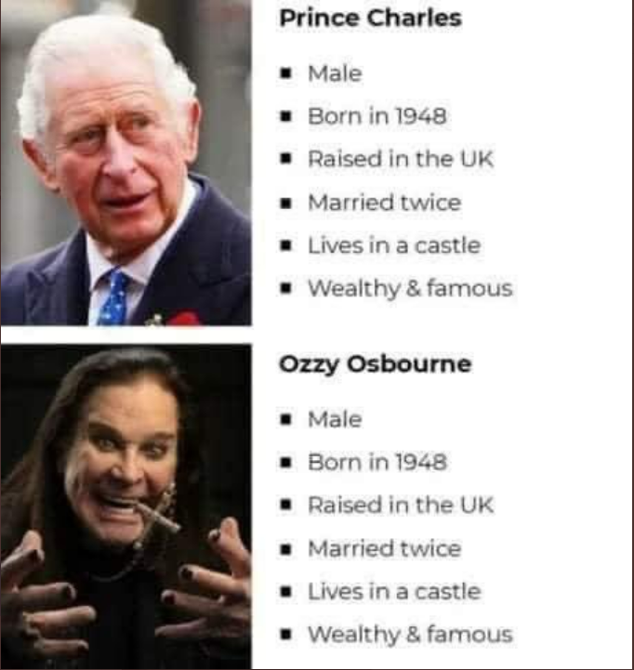
Problems of Unobservables

Slide 54
Problems of Unobservables

Slide 55
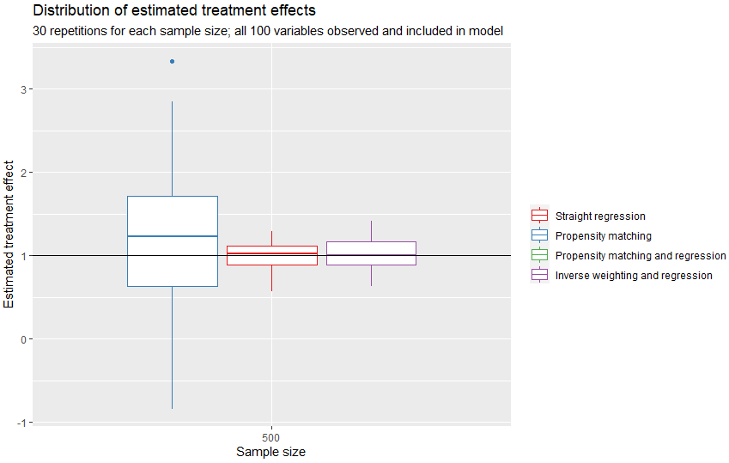
Matching Estimators with Omitted Covariates
An illustration: https://tinyurl.com/2dpkpad9
Notes:
Results of a MC simulation with different treatment effects (no omitted covariates) – note the performance of regression and IPW against PSM

Slide 56
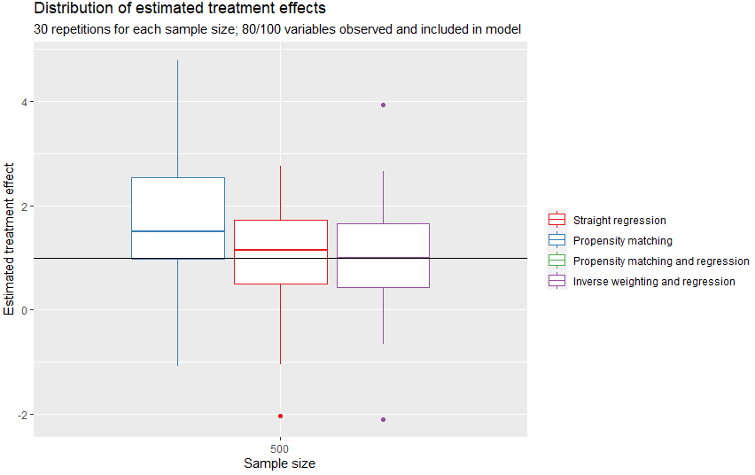
Matching Estimators with Omitted Covariates
An illustration: https://tinyurl.com/2dpkpad9
Notes:
If you leave out covariates, this gets worse (particularly for PSM – I trimmed out PSM with regression because there’s so much variation it’s impossible to see others)

Slide 57
Conclusion
Matching methods help to deal with imbalanced data
Helps you argue that your comparisons really are apples-to-apples
Matching relies on selection on observables –
Doesn’t help you if you don’t observe what’s driving the differences!
Propensity scores have deep roots (new Hull paper)

Slide 58
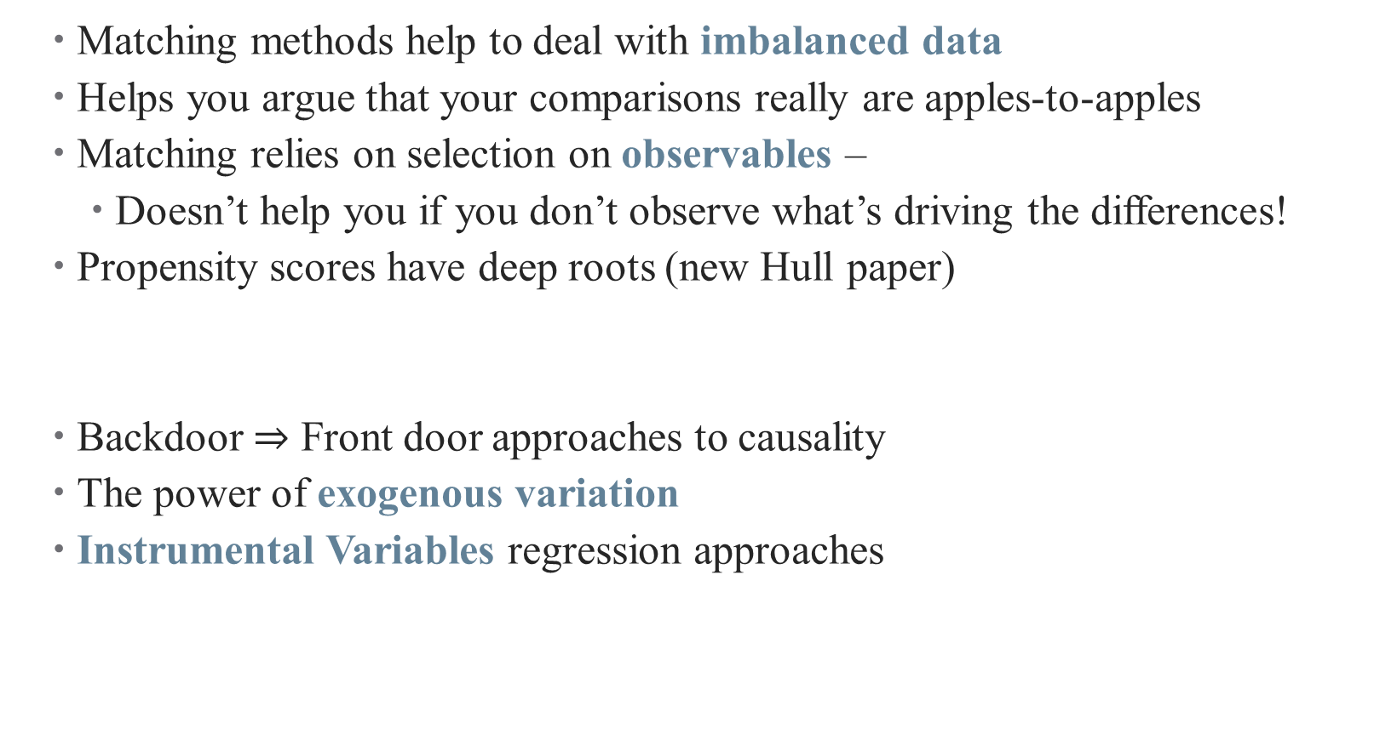
Conclusion
Matching methods help to deal with imbalanced data
Helps you argue that your comparisons really are apples-to-apples
Matching relies on selection on observables –
Doesn’t help you if you don’t observe what’s driving the differences!
Propensity scores have deep roots (new Hull paper)
Backdoor $⇒$ Front door approaches to causality
The power of exogenous variation
Instrumental Variables regression approaches
Next Time

