Slide 1
Health Econometrics I
Lecture 6: Endogeneity & Instrumental Variables
October 14, 2022
HAD5744 • Alex Hoagland, Ph.D.

Slide 2
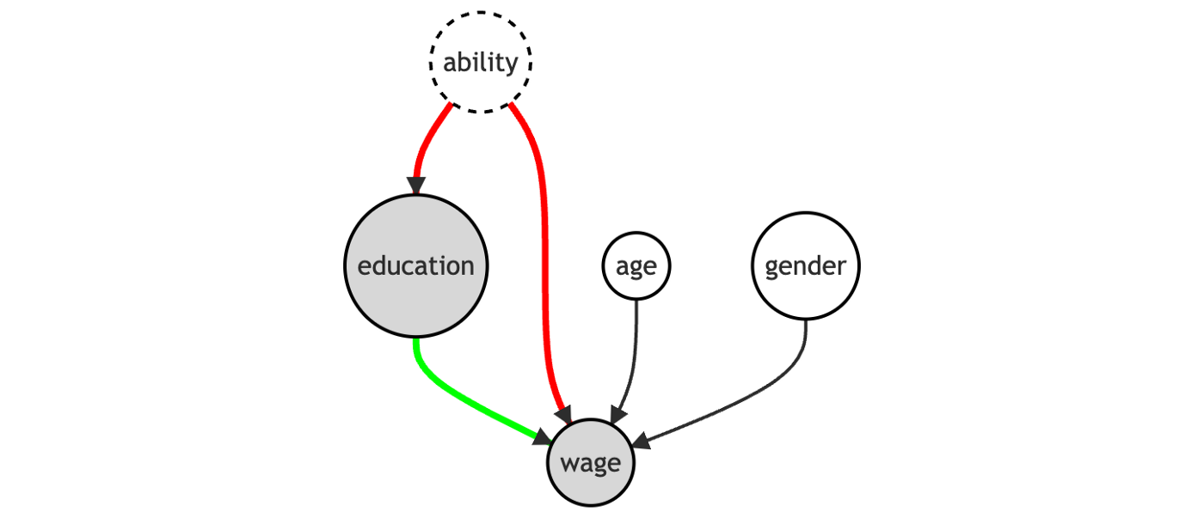
Last Time: Matching Approaches
Matching methods help to deal with imbalanced data
Helps you argue that your comparisons really are apples-to-apples
Matching relies on selection on observables
Propensity score, nearest neighbor techniques
Notes:
So far, we’ve focused on the backdoor criterion – can we close paths that stand in our way? Matching and controlling for covariates are two primary approaches.

Slide 3

Causal Inference: From Back Doors to Front
We can also isolate variation coming only through $X$
This is called a front door approach – mimics an experiment
Notes:
This dag cannot be addressed fully with a back-door approach (how do we ever measure ability)? The front door finds an instrument M such that there is no back door between education and M, and education blocks the only open back-door between M and wage (ability). This is an open door! Example of M: quarter of birth (Angrist and Kreuger, 1991). M goes behind education and connects to it.

Slide 4

Open up the (Right) Gates!
Notes:
Lots of frozen in our house these days, so I want this playing in all of our heads.

Slide 5
Endogeneity
Notes:
A more “economics”-y way to look at this is to think about what is exogenous and endogenous in a regression – what things directly lead to the outcome on their own, and what things are jointly determined in a more complex system?

Slide 6
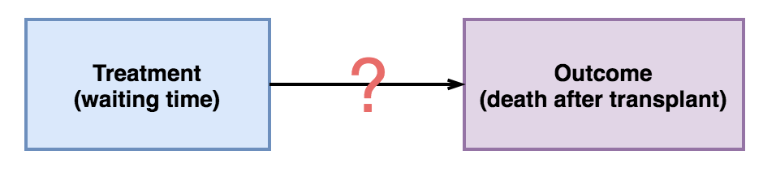
Example: Waiting Times and Transplantation Outcomes
Notes:
Suppose we want to know what’s the effect of shortening waiting times for transplants on positive outcomes. We can’t randomize this (why?)
But we also can’t just use observational data in a simple regression (why? – selection! patients who are more likely to have poor outcomes may also have different waiting times)

Slide 7
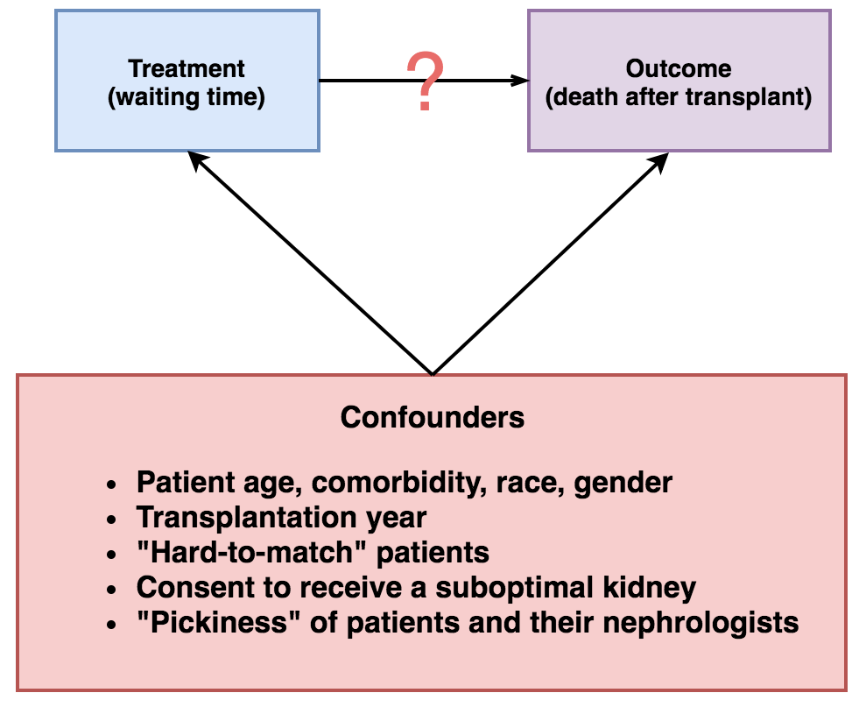
Example: Waiting Times and Transplantation Outcomes
Notes:
Examples of selection – note that not all of these confounders are things we can deal with.

Slide 8
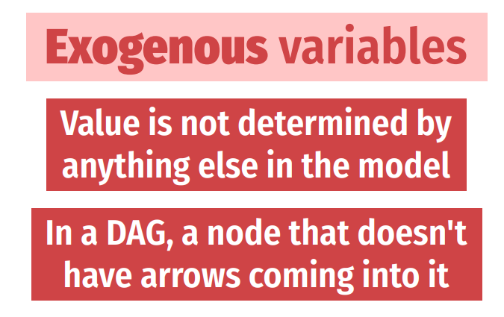
Exogeneity + Endogeneity
Notes:
Exogenous variables: age, demographics. What about education? Whether or not you need a transplant in the first place? This starts to become a gray area quickly.

Slide 9
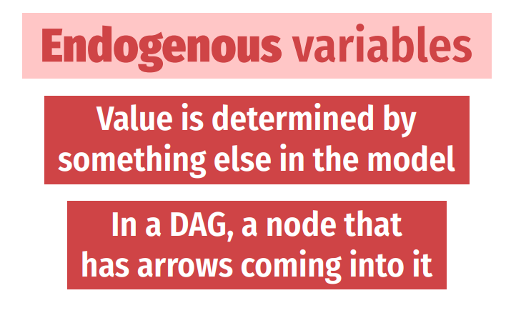
Exogeneity + Endogeneity
Notes:
Things that are almost surely endogenous: health outcomes, decision to seek care, etc. (any y of interest also)

Slide 10

Endogeneity
What is the consequence of ignoring backdoors?
C$onsider regression y=β_{0}+β_{1}x_{1}+…+β_{k}x_{k}+ε$
If an endogenous regressor $w$is ignored, $Cov\left(x_{j},ε\right)≠0$ for some $x_{j}$
Notes:
This is classic omitted variable bias – but the problem of endogeneity is bigger than that.

Slide 11
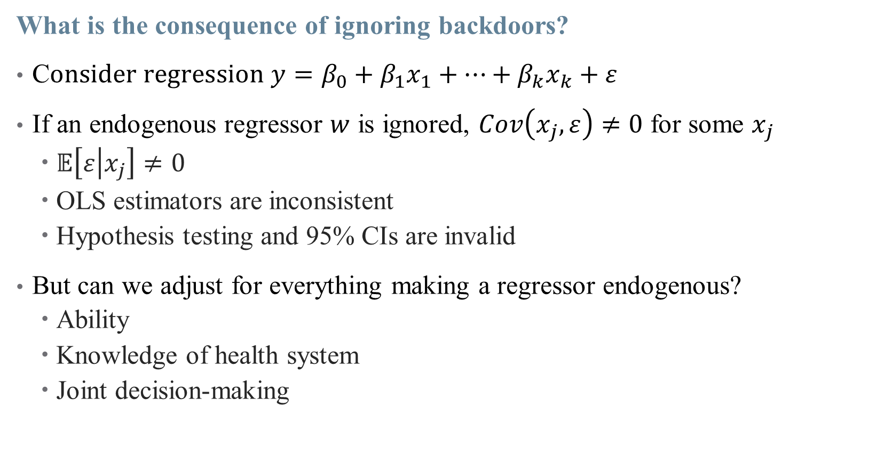
Endogeneity
What is the consequence of ignoring backdoors?
C$onsider regression y=β_{0}+β_{1}x_{1}+…+β_{k}x_{k}+ε$
If an endogenous regressor $w$ is ignored, $Cov\left(x_{j},ε\right)≠0$ for some $x_{j}$
$𝔼\left[ε | x_{j}\right]≠0$
OLS estimators are inconsistent
Hypothesis testing and 95% CIs are invalid
But can we adjust for everything making a regressor endogenous?
Ability
Knowledge of health system
Joint decision-making
Notes:
Moving health knowledge out of the error term could make decision to seek care an exogenous variable – but how do we measure that? But not all back doors can be closed! Without perfect data or randomization, we can’t make everything exogenous by shutting down a backdoor.

Slide 12
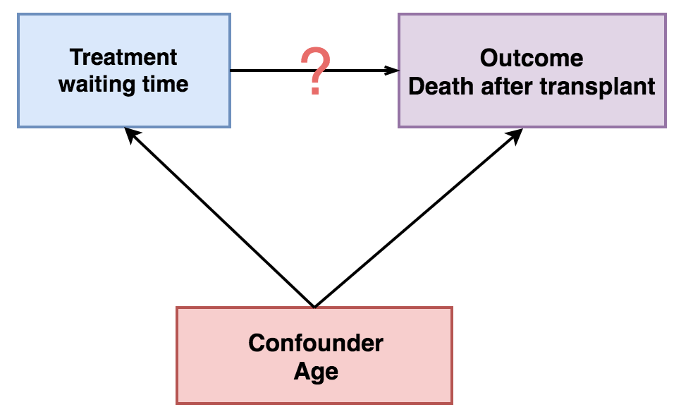

Exogeneity Example: Age
Age is correlated with both waiting time ($W)$ and outcome ($D$)
$D$is impacted by both $W$ and Age
Without closing back door, $\hat{β_{W}}≠β_{W}$

Slide 13
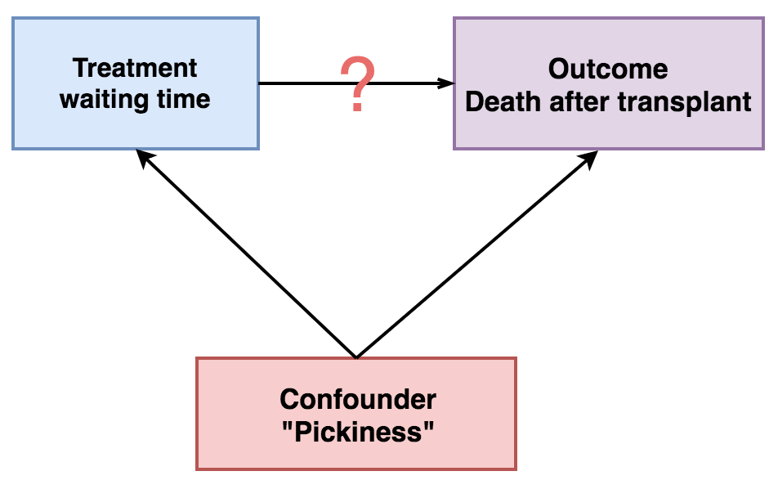

Endogeneity Example: “Pickiness”
Other variables are harder to control for
How “picky” a patient is may increase $W$ and $D$
Notes:
What do we do when endogeneity threatens our main treatment of interest? Our approach today is what we resort to when we can’t close all backdoors – we take a front door approach and simulate randomization

Slide 14
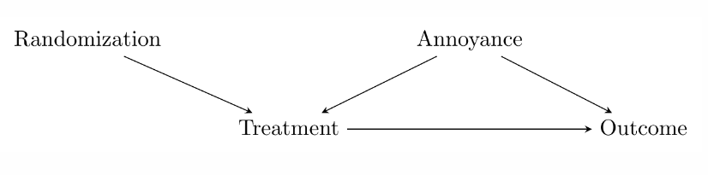
Causal Inference: From Back Doors to Front
Back door variation stands in the way of causal inference
But we can avoid that through careful randomization
Notes:
In an experiment, we generate variation (random assignment) and then just isolate the part of the treatment driven by that random variation (we compare across treatment and control groups). IV does the same, except isolating the part of the treatment driven by quasi-random, natural circumstances – the instrument.

Slide 15
Causal Inference: From Back Doors to Front
Back door variation stands in the way of causal inference
What if we didn’t assign randomization? Can we simulate it somehow?
Instrumental Variables looks for real-world (quasi)-randomization

Slide 16

Causal Inference: From Back Doors to Front
Note: (even perfect) randomization doesn’t absolve us of closing back doors!
But it does move the criterion from $Treatment$ to $Randomization$
This is usually easier to satisfy in practice
Notes:
So we: (1) use the instrument to explain the treatment, (2) focus only on the part of the treatment explained by the instrument, and (3) use that to look at the instrument-explained part of the outcome. Basically, we’re splitting the effect of treatment into its endogenous and exogenous parts, and isolating just the exogenous part.

Slide 17
Exploiting Quasi-Random Variation

Slide 18

Instrumenting for an Endogenous Variable
We are particularly concerned when our $Treatment$ variable is endogenous
How can we randomize?
Pick a suitable variable which is an instrument for randomization
Mimics an RCT

Slide 19
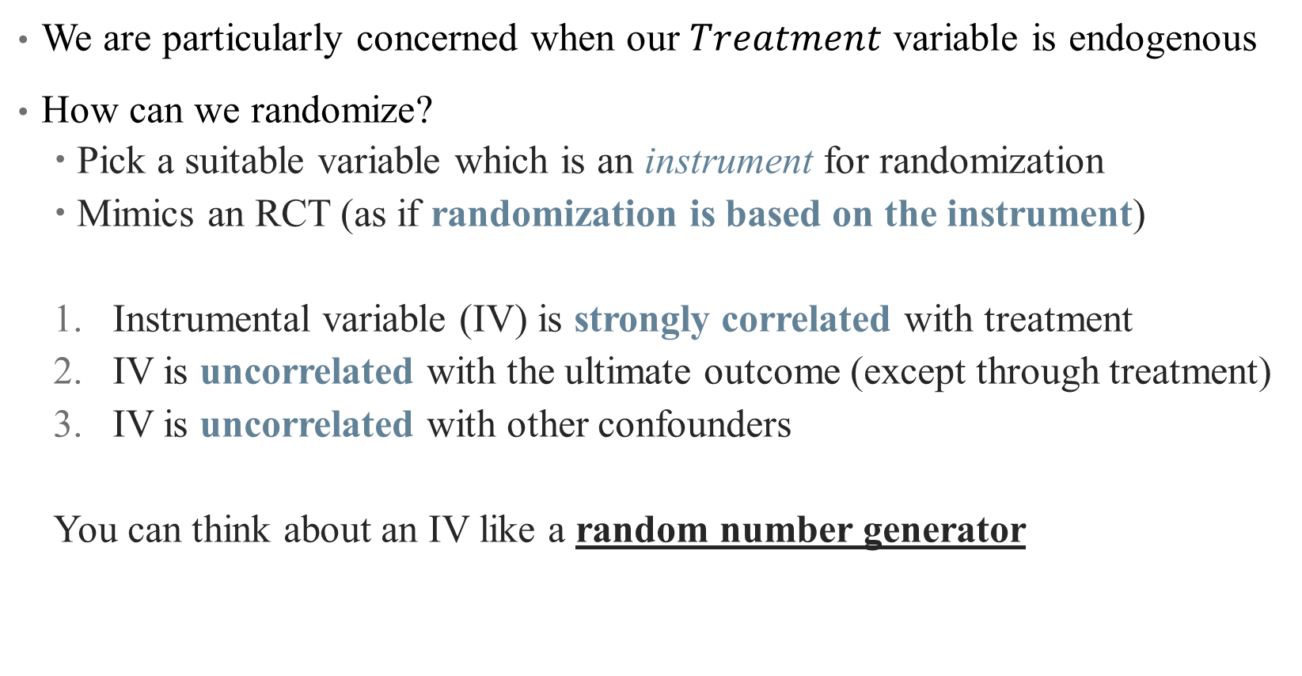
Instrumenting for an Endogenous Variable
We are particularly concerned when our $Treatment$ variable is endogenous
How can we randomize?
Pick a suitable variable which is an instrument for randomization
Mimics an RCT (as if randomization is based on the instrument)
Instrumental variable (IV) is strongly correlated with treatment
IV is uncorrelated with the ultimate outcome (except through treatment)
IV is uncorrelated with other confounders
You can think about an IV like a random number generator
Notes:
First condition is called relevance; second and third are validity – essentially that there are no open back doors of Z

Slide 20
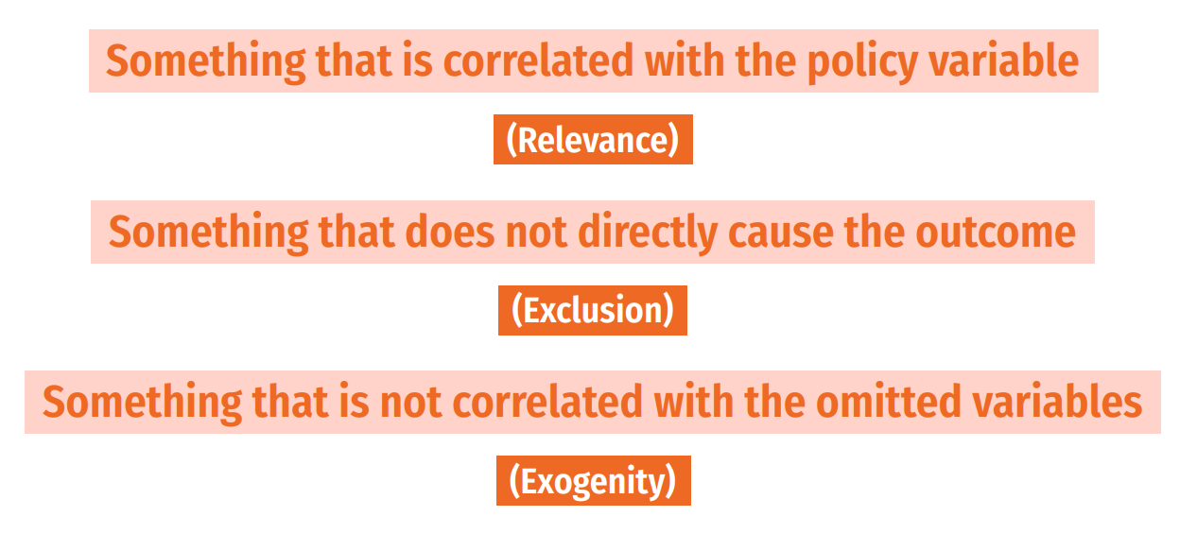
Instrumental Variables
Notes:
Another way to think about it

Slide 21
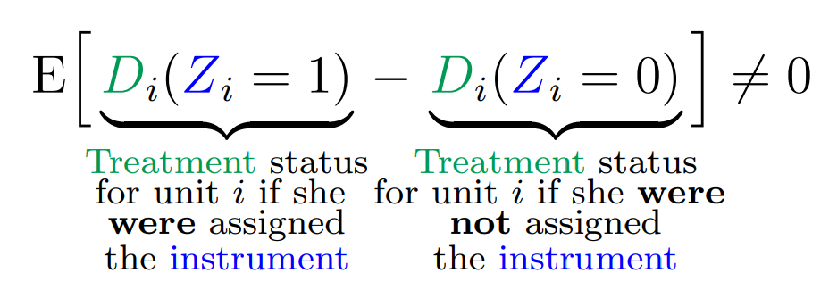
Instrumental Variables: Relevance
Notes:
Note: these come from really useful paper by Felton and Stewart.
Example of relevance: effect of going back home after prison on recidivism – use Hurricane Katrina in LA (does that change your decision to go home or not?)

Slide 22
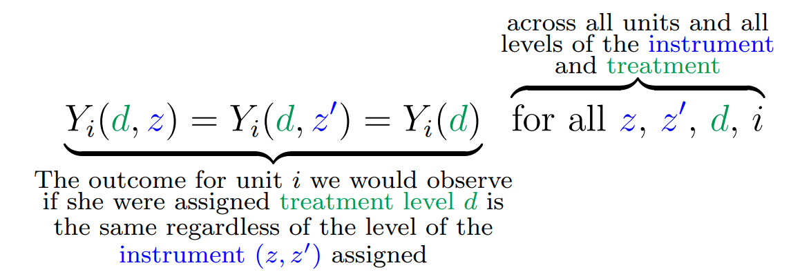
Instrumental Variables: Exclusion
Notes:
Example of exclusion: hurricane katrina can’t have affected recidivism in any other way except through residence change (can you think of violations to this?)

Slide 23
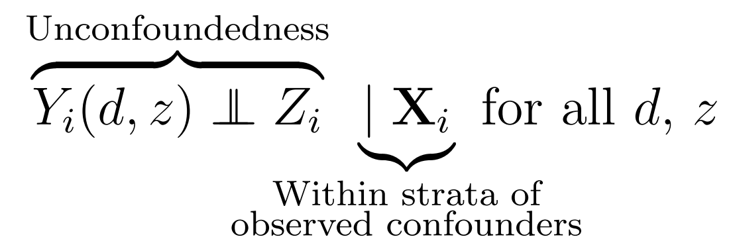
Instrumental Variables: Exogeneity
Notes:
Also called unconfoundedness. Note – treatment is confounded (that’s why we need IV in the first place) but hopefully IV isn’t. So if residence and recidivism are correlated (why would they be? Past history? Networks?), then Hurricane Katrina shouldn’t care about any of that

Slide 24
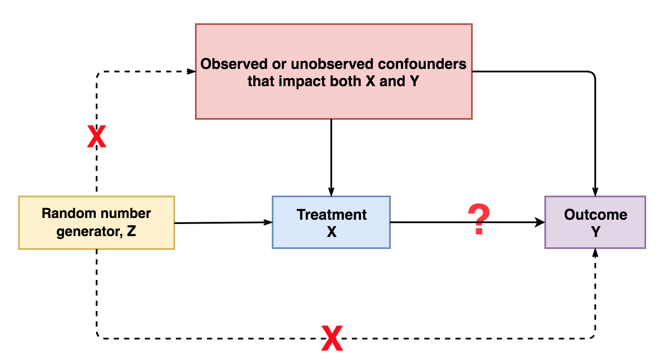
Notes:
Think first about just a random number generator. If that generator is used to assign treatment, then assumption 1 holds. If that random number isn’t used for anything else, then Z only affects Y through X (it doesn’t determine your pickiness or your age).

Slide 25
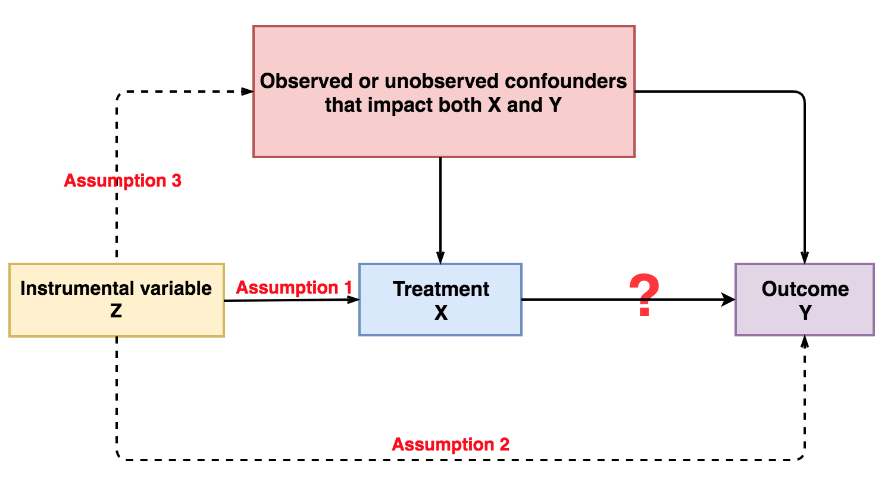
Notes:
So we want a variable like a random number generator. this is kind of the opposite of controlling for a variable: when we control for W, we use W to explain X and Y and remove those parts (to close a back door). But here, we are going to use Z as an instrument and remove the unexplained parts.

Slide 26
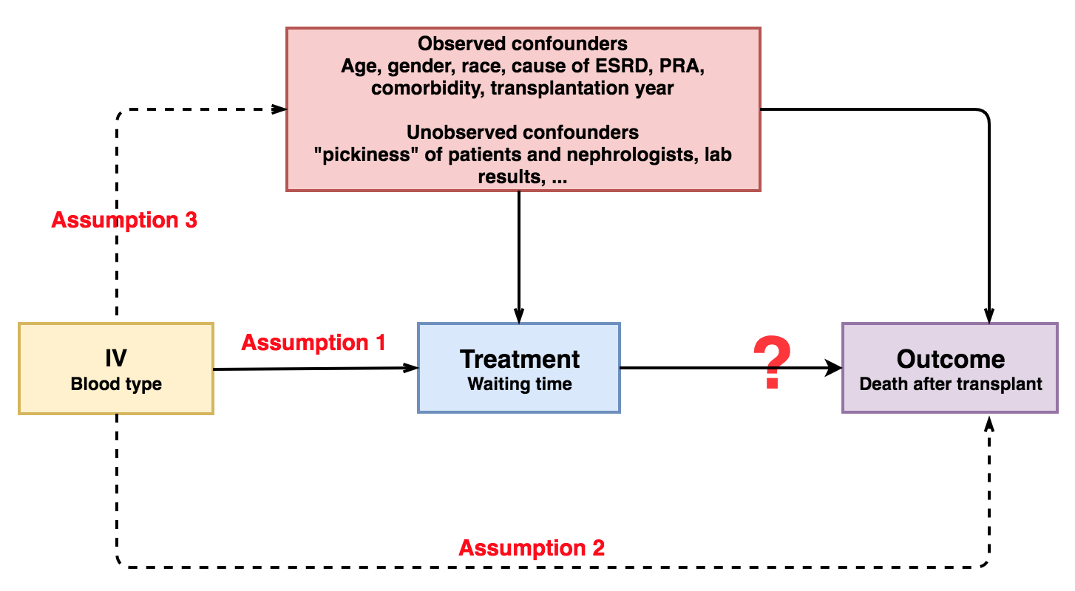
Example: Transfusions and Waiting Time
Consider blood type as a potential IV for waiting time
Notes:
Why is each assumption satisfied? Do we think this works? Can you think of any threats?

Slide 27
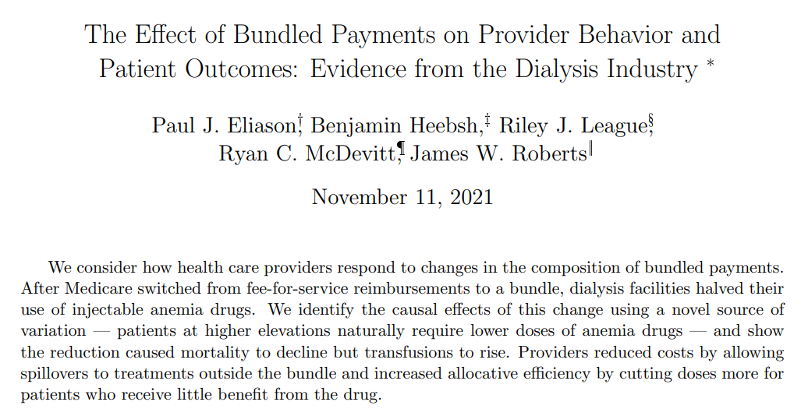
What’s the DAG here?
Notes:
More practice from abstract. Start with outcome variable (2), then exposure (bundled payment/use of drugs), then IV (altitude). What endogeneity are they dealing with (strategic decision-making on the part of the doctors). Are the assumptions satisfied? (1. abstract says yes, altitude affects drug use; 2. altitude shouldn’t affect mortality or transfusion rates; 3. altitude shouldn’t affect strategy).

Slide 28
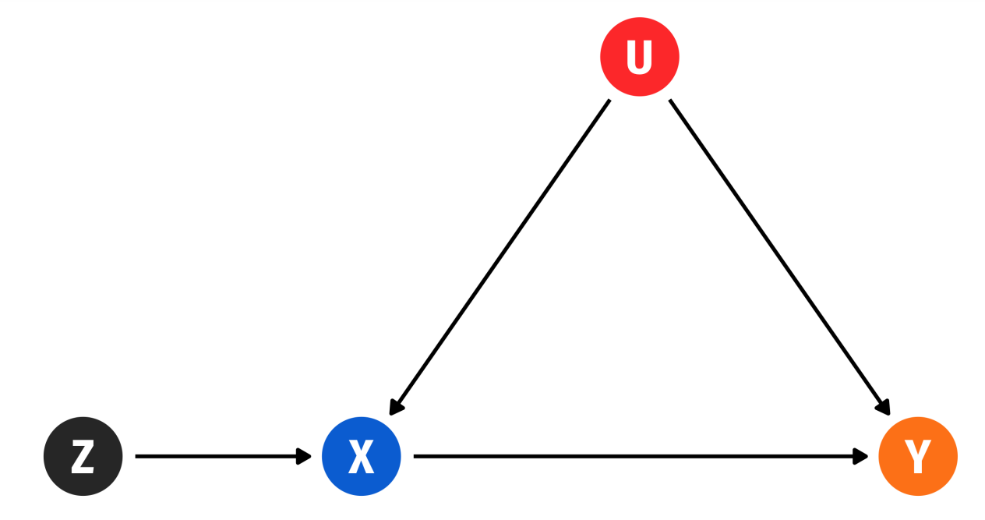

Other Popular IVs
Other popular IVs in the literature:
Cigarette tax for smoking $→$ physical function (Leigh and Schembri, 2003)
Prison overcrowding for prison populations $→$ crime rates (Levitt, 1997)
Electoral cycles in police hiring for police $→$ crime (Levitt, 1997)
Notes:
The basic DAG of an IV setup

Slide 29
Using IVs in Regression

Slide 30

Using IVs to back out treatment effects
With an IV $z$, we can calculate:
Effect of $z$ on $y=($effect of z on $x)$ * (effect of x on $y)$
Hence: effect of $x$ on $y=($effect of z on $y)$ / (effect of z on x$)$

Slide 31

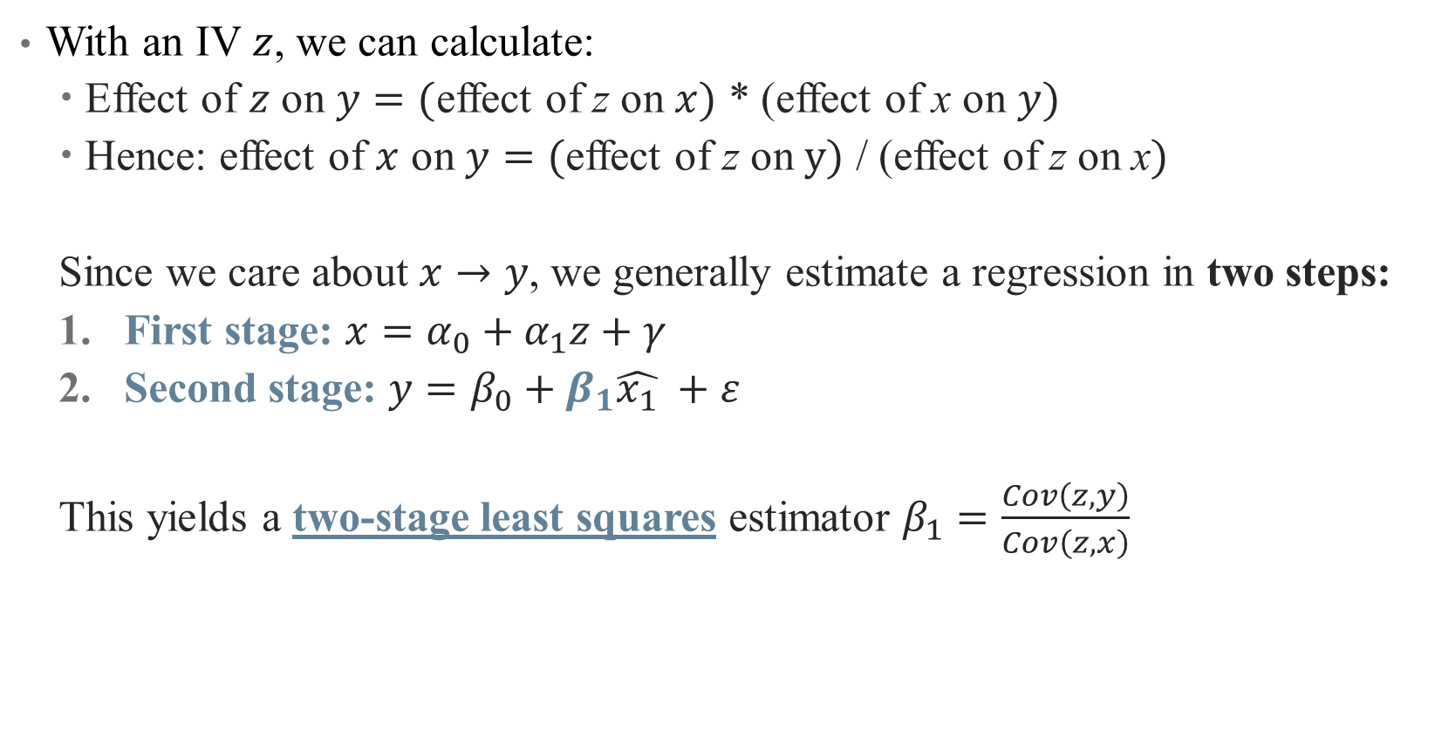
Using IVs to back out treatment effects
With an IV $z$, we can calculate:
Effect of $z$ on $y=($effect of z on $x)$ * (effect of x on $y)$
Hence: effect of $x$ on $y=($effect of z on $y)$ / (effect of z on x$)$
Since we care about $x→y$, we generally estimate a regression in two steps:
First stage: $x=α_{0}+α_{1}z+γ$
Second stage: $y=β_{0}+β_{1}\hat{x_{1}} +ε$
This yields a two-stage least squares estimator $β_{1}=\frac{Cov\left(z,y\right)}{Cov\left(z,x\right)}$
Notes:
Here, you can see why we need relevance condition; if Cov(z,x) = 0, then the 2sls doesn't return anything useful. Even if cov is small, we have problems (we'll return to this).

Slide 32
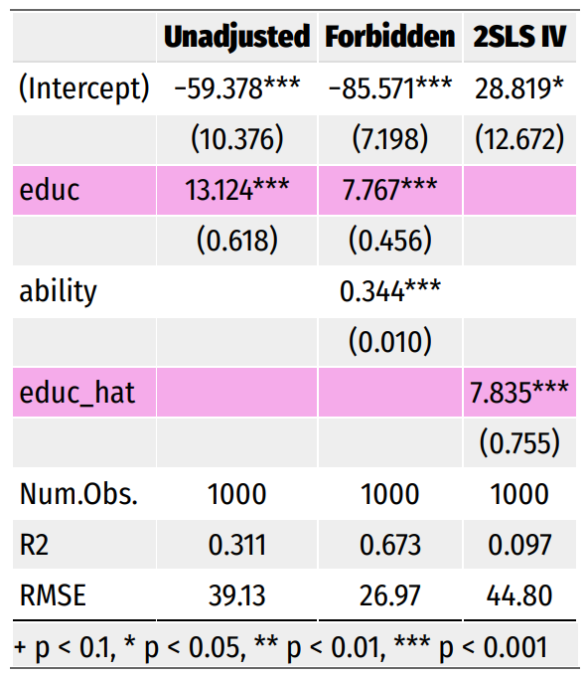

IV Regression: Illustration
Suppose we are after:
$$Earnings_{i}=β_{0}+β_{1}Education_{i}+ε_{i}$$
Why is this endogenous?
Notes:
Why is this endogenous? (We don’t have ability)

Slide 33

IV Regression: Illustration
Suppose we are after:
$$Earnings_{i}=β_{0}+β_{1}Education_{i}+ε_{i}$$
Why is this endogenous?
Suppose we had good data on ability
Is this enough?
Notes:
Yes, this is enough! We just can’t do this in the real world

Slide 34
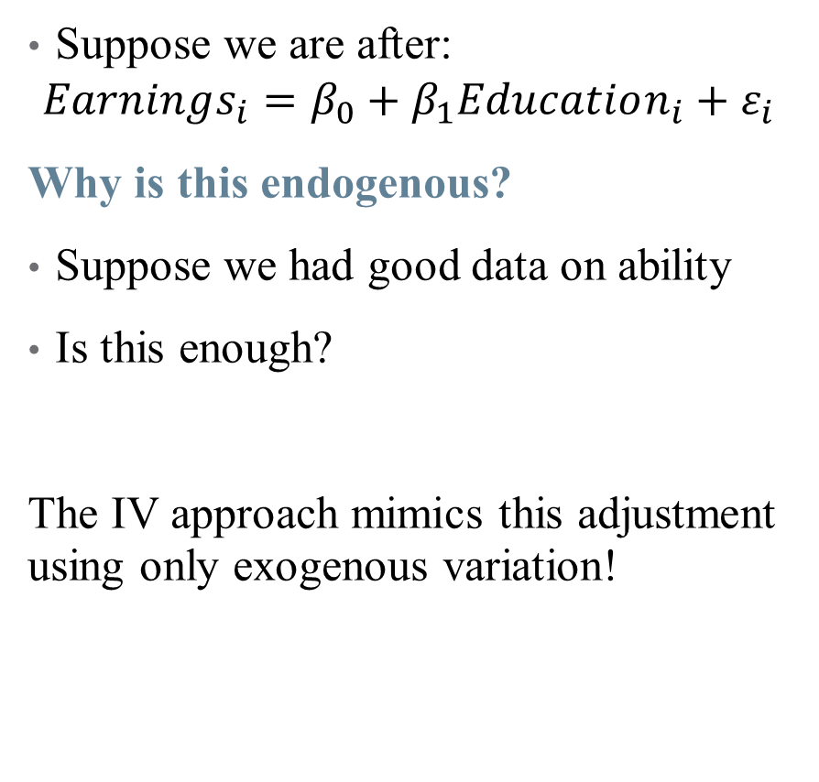
IV Regression: Illustration
Suppose we are after:
$$Earnings_{i}=β_{0}+β_{1}Education_{i}+ε_{i}$$
Why is this endogenous?
Suppose we had good data on ability
Is this enough?
The IV approach mimics this adjustment using only exogenous variation!
Notes:
In this case, the IV is your father’s education (a common but slightly dubious instrument – can talk about why if time)

Slide 35
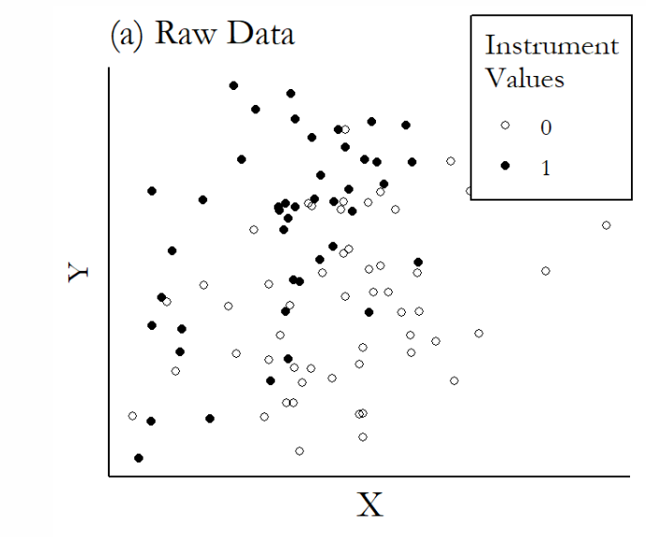
Graphical Illustration of IVs
Notes:
You can do these kind of quickly

Slide 36
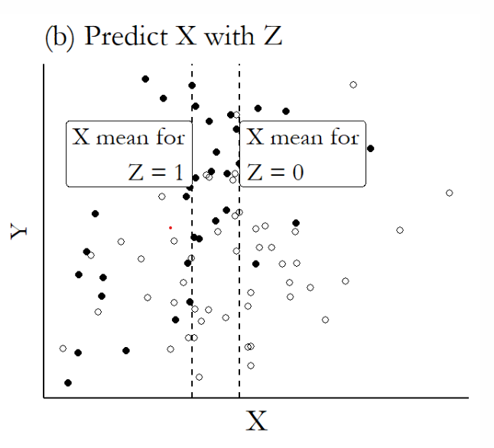
Graphical Illustration of IVs

Slide 37
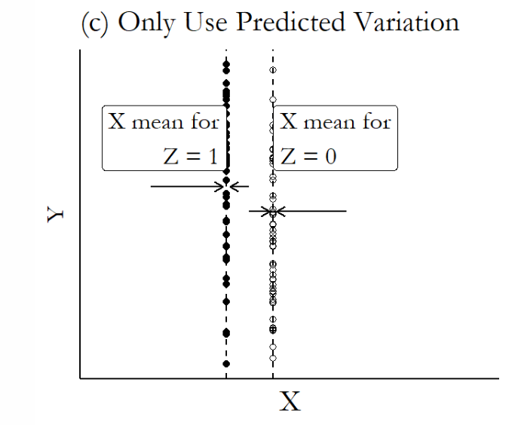
Graphical Illustration of IVs

Slide 38
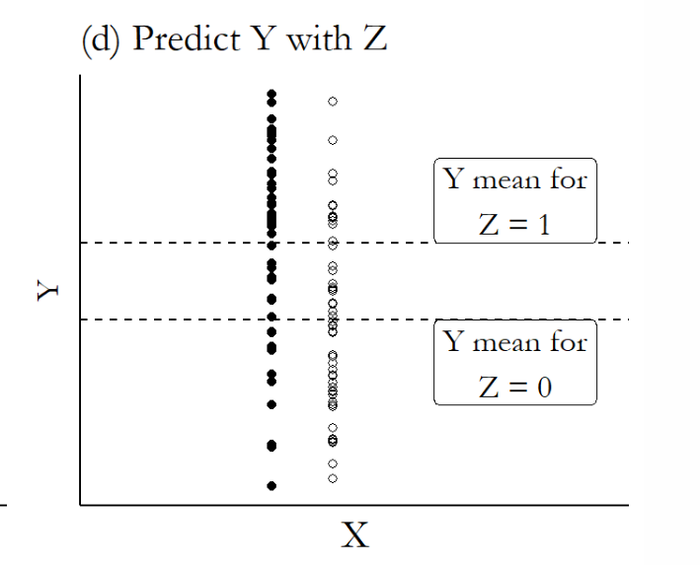
Graphical Illustration of IVs

Slide 39
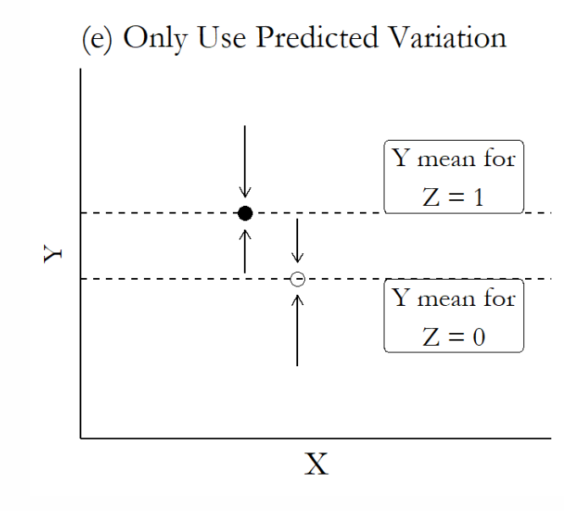
Graphical Illustration of IVs

Slide 40
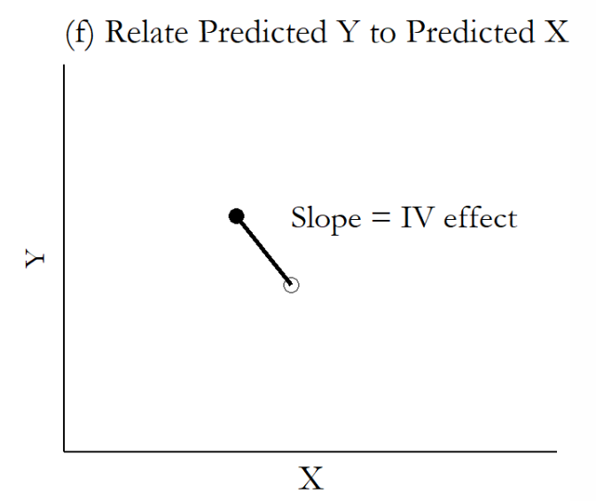
Graphical Illustration of IVs

Slide 41
Interpreting and Implementing IV

Slide 42
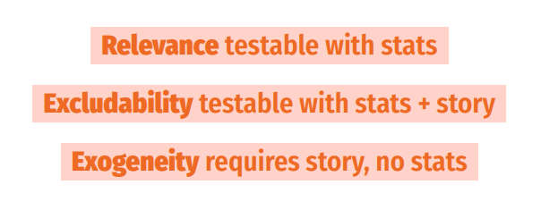
Using an IV: Testing Assumptions

Slide 43
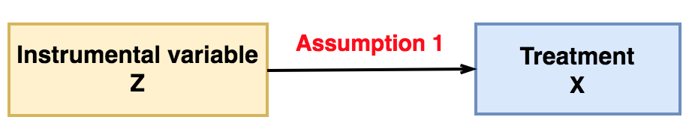
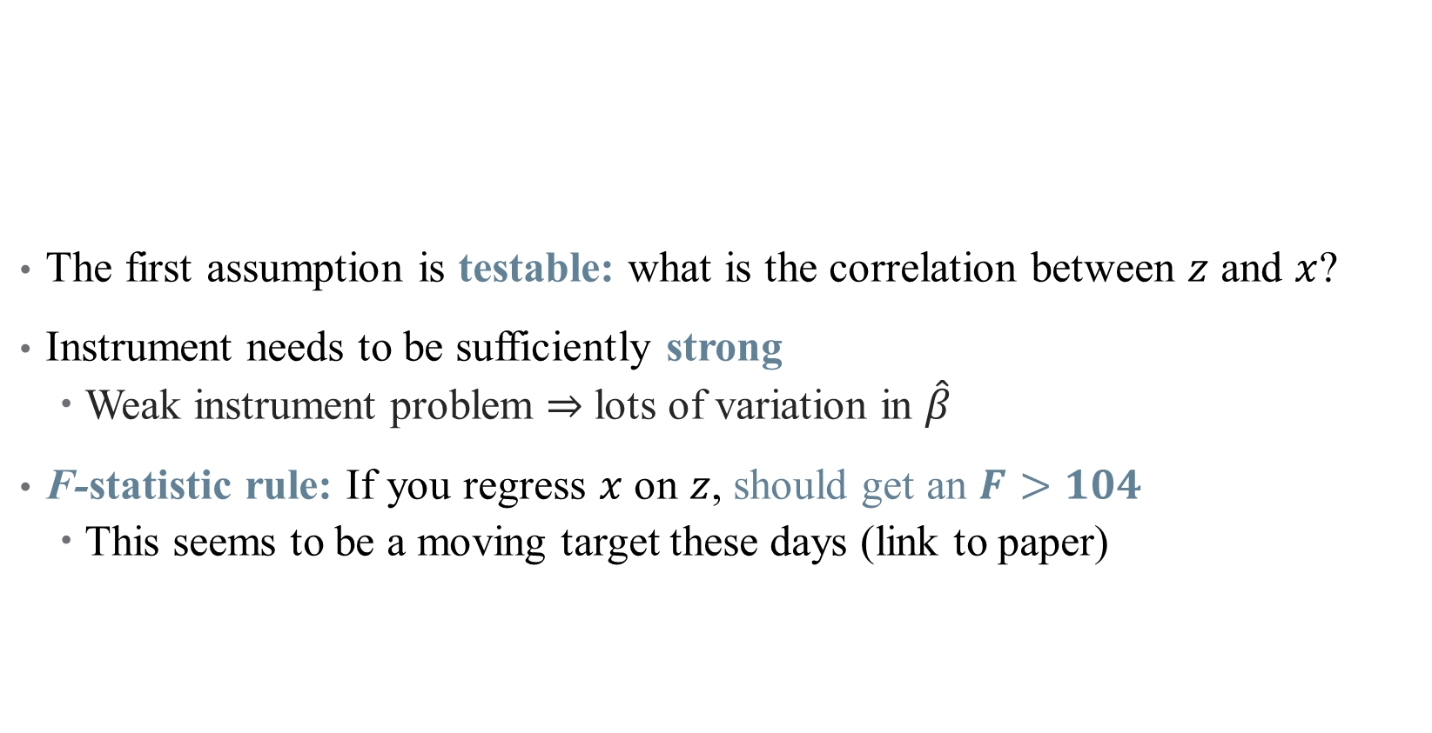
Using an IV: Testing Assumptions
The first assumption is testable: what is the correlation between $z$ and $x$?
Instrument needs to be sufficiently strong
Weak instrument problem $⇒$ lots of variation in $\hat{β}$
F-statistic rule: If you regress $x$ on $z$, should get an $F>104$
This seems to be a moving target these days (link to paper)
Notes:
You’ll have to talk about what an F stat is and how it relates to a t stat. See Felton and Stewart for what a weak IV can do, but basically exacerbates three problems: identification bias (parameter isn’t centered around truth), estimation bias (2SLS is “contaminated” by the confounding inherent in OLS, so 2SLS estimator gets “pulled” towards OLS estimator and away from truth), and Type M-error (publication bias – you have to have a super strong effect to have it show up significant with a weak IV; then, since insignificant estimates don’t get published, looking only at published work convinces you that the effect is *much* stronger than it really is)

Slide 44
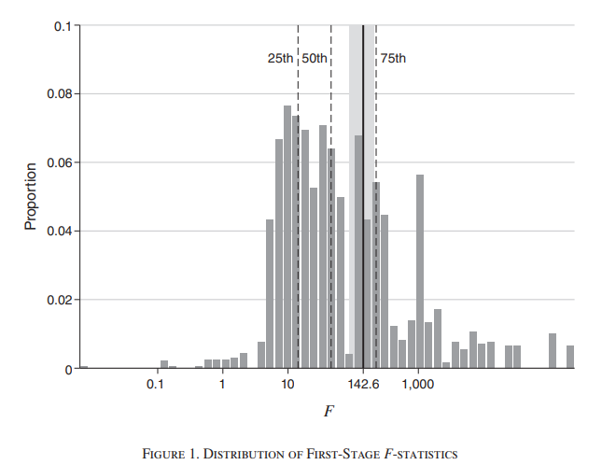
Current Research Alert: First-Stage Tests
Notes:
This comes from Lee et al, just published in AER this month. Here’s a log scale of the F-stats for IV papers in top econ journals (note scale is log). Most (75%) are bigger than 10, but not a lot get up to the new standard (here it’s slightly different). Thankfully, there is research linking the t stat with the F stat.

Slide 45
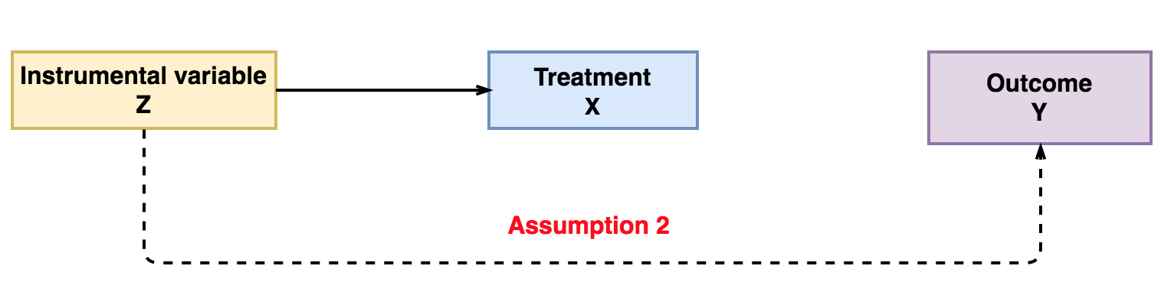

Using an IV: Testing Assumptions
The second assumption is not testable:
Why can’t we just regress $y$ on $z$?
Instead, need to argue (e.g., based on previous work) something about randomness
Notes:
You can show that Y depends on Z, but this doesn’t mean much because we want to know how it affects Y (e.g., only though tX)

Slide 46
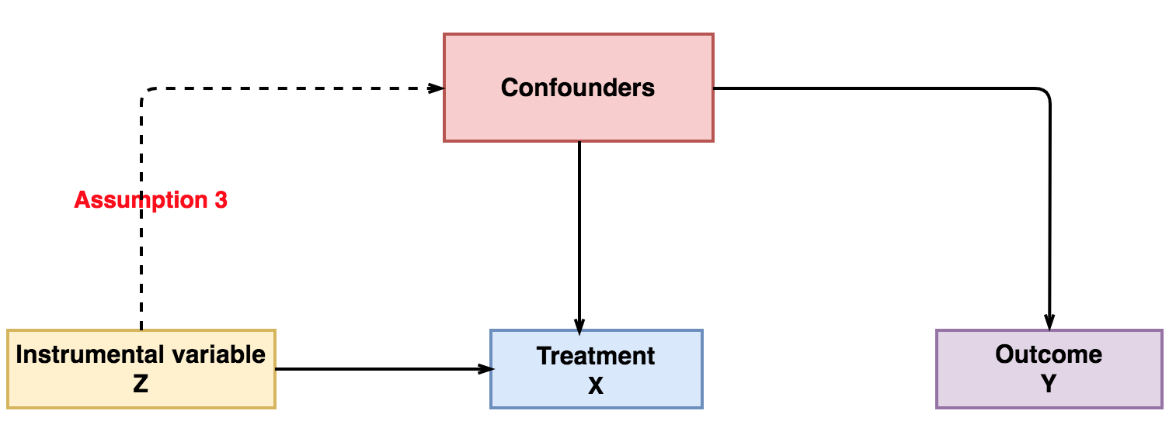
Using an IV: Testing Assumptions
The third assumption is not testable:
No data on confounders in the first place!
Again, based on argument about why this assumption is satisfied

Slide 47
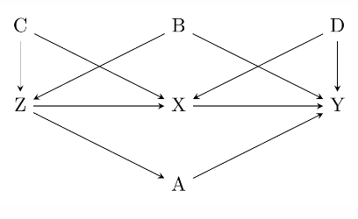
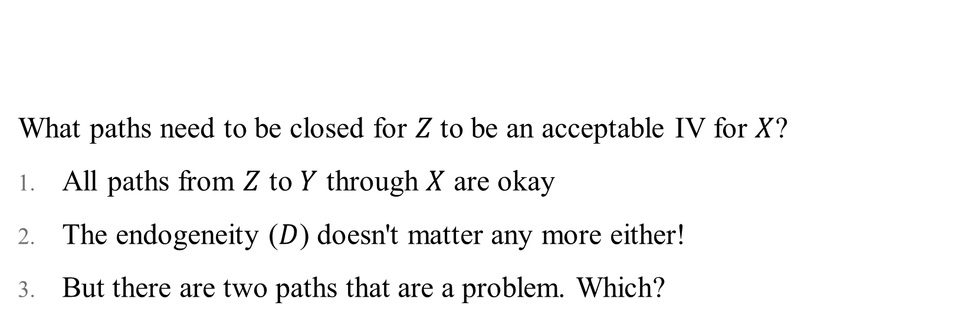
Visualizing Validity
What paths need to be closed for $Z$to be an acceptable IV for $X$?
All paths from $Z$ to $Y$ through $X$ are okay
The endogeneity ($D$) doesn't matter any more either!
But there are two paths that are a problem. Which?
Notes:
Note: we might not think Z – A – Y is a problem typically, but when Z is an IV, this confounds the effect of X on Y and the effect of A on Y! Can just control for A and B in order to close these paths.
Note 2: Controls should go in an IV regression as appropriate (not like matching)

Slide 48
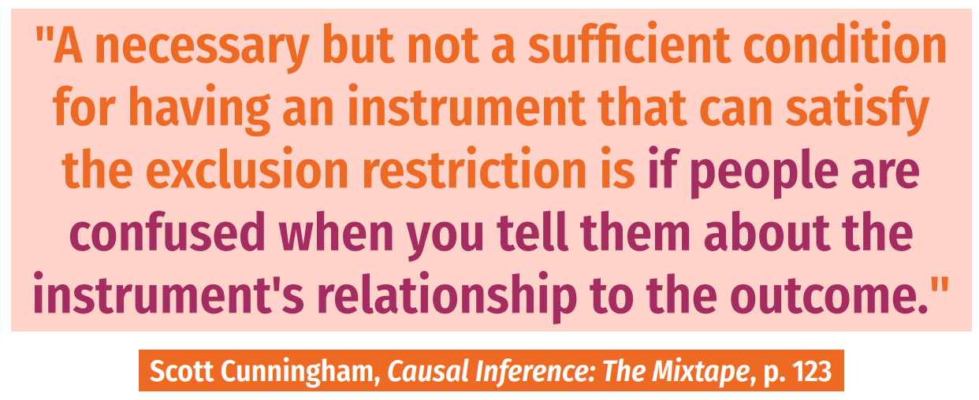
Using an IV: How do I come up with an IV?
Notes:
Instruments have to be weird!

Slide 49
Using an IV: How do I come up with an IV?
It is unlikely that any personal characteristic can be used as a strong instrumental variable
Most good instruments come from:
Real randomization (blood type)
“Mendelian randomization”: parent genes produce "random" children
Unexpected correlations – a variable you would never expect had anything to do with assigning treatment ("a good instrument should feel weird")
Think about regional characteristics (unemployment rate), policies (blood type; cigarette tax), “natural” features (proximity)
Clever instruments are likely to be extremely context-dependent!
Notes:
Example for Mendelian randomization: the sex of first two children determines whether parents are more likely to have a third child.

Slide 50
Using an IV: How do I defend an IV?
Report relevance:
Used to be F > 10, now is F > 104.7
Notes:
Large F stat is just for correcting t-tests for relationship between X and Y and X and Z – your CIs will be a tiny bit wrong. Generally, a large F will work (although closer to 10 still gives you problems). Remember that this is a scale, since we're concerned about weak instruments

Slide 51
Using an IV: How do I defend an IV?
Report relevance:
Used to be F > 10, now is F > 104.7
Correct for weak instrument problems
There are bias correction tests and methods
These corrections aren't universally accepted
Generally, they blow up your standard errors too much to be useful anyway

Slide 52
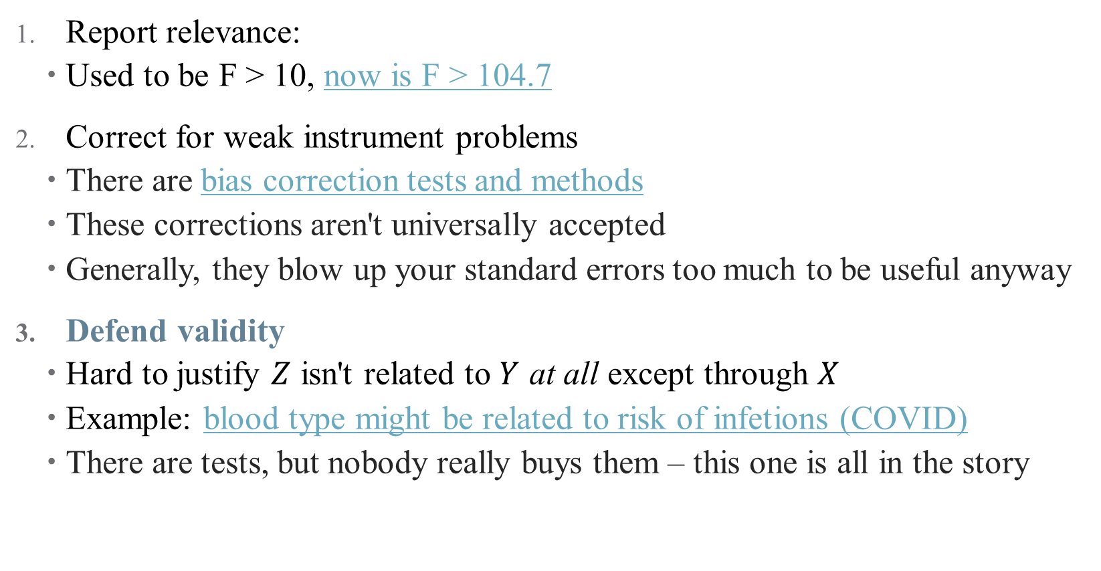
Using an IV: How do I defend an IV?
Report relevance:
Used to be F > 10, now is F > 104.7
Correct for weak instrument problems
There are bias correction tests and methods
These corrections aren't universally accepted
Generally, they blow up your standard errors too much to be useful anyway
Defend validity
Hard to justify $Z$ isn't related to $Y$ at all except through $X$
Example: blood type might be related to risk of infetions (COVID)
There are tests, but nobody really buys them – this one is all in the story
Notes:
Difficulty with defending validity just means that we need to be choosy, not give up on IV altogether. It's just like trying to convince a room your DAG is right! And bulk of evidence helps, here (many studies with different approaches)

Slide 53
Using an IV: What if I can’t defend my IV?
Many quasi-experimental approaches are very assumption dependent
IV is no exception!
Notes:
Come from Felton and Stewart (they call IV “fragile” – I don’t like that, it’s just kind of a “you get what you put into it” kind of thing – we’re doing QE variation with observational data, so there are limitations. Just need to be aware of them and report them honestly)

Slide 54
Using an IV: What if I can’t defend my IV?
Many quasi-experimental approaches are very assumption dependent
IV is no exception!
Some things to be aware of:
IV is (more) biased if you condition on post-instrument variables
IV must match measured treatments, not true treatment
Weak IVs can exacerbate even trivial assumption violations!
Small sample bias – your assumptions might be statistically violated at random
Notes:
Examples: can’t control for changes in employment post Hurricane Katrina (downstream outcome; we’ll talk about this one a lot in the course). Coarsened treatments are another example – if you have an IV that changes how people behave in Toronto but not North York, but then you only observe data for the whole GTA, this won’t work

Slide 55

Using an IV: What if I can’t defend my IV?
Many quasi-experimental approaches are very assumption dependent
IV is no exception!
Some things to be aware of:
IV is (more) biased if you condition on post-instrument variables
IV must match measured treatments, not true treatment
Weak IVs can exacerbate even trivial assumption violations!
Small sample bias – your assumptions might be statistically violated at
Notes:
Everyone should be following Khoa (Kwaa). If everything goes perfectly, IV is “approximately” unbiased – the biggest problem comes from weak instruments.

Slide 56
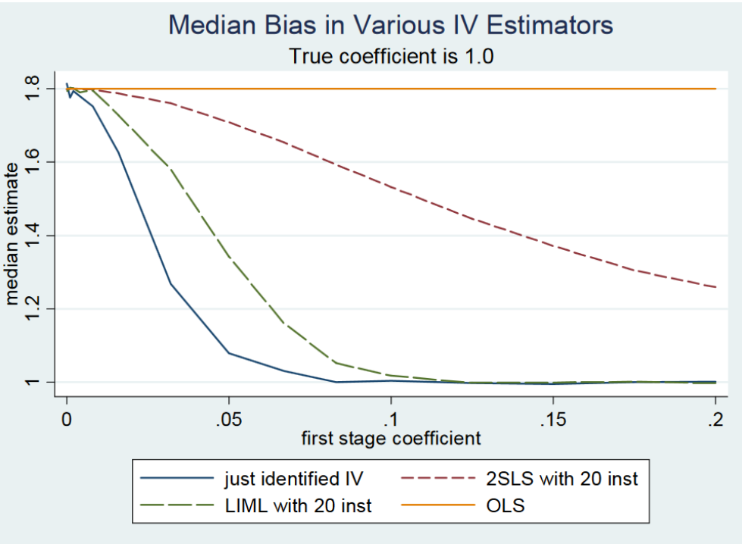
Weak IV Bias
Notes:
Results from a Monte Carlo survey (sorry for gross blue background). Suppose we have 20 IVS but only one is useful. If true coefficient is 1, these are bias of different approaches (note you’re better off just using the one true coefficient!)

Slide 57

Using an IV: Best Practices
Notes:
From Felton and Stewart (2022). One not on here: always use packages to get standard errors right

Slide 58

Using an IV: Best Practices
Notes:
Skipping over 3 because I don’t believe it (it says to assume the most conservative SE and report multiple Ses – I think you should pick your choice theoretically and use that one)

Slide 59

Using an IV: How do I interpret an IV?
IV's capture local average treatment effects (LATEs)
Notes:
Here’s a visualization of a LATE for a specific type of IV regression (fuzzy RDD, will do next semester). LATEs are just weighted ATEs that tell you something about a specific subset of the population (not the full pop)

Slide 60
Using an IV: How do I interpret an IV?
IV's capture local average treatment effects (LATEs)
The LATE from an IV is for compliers
Specifically, those influenced by the instruments you selected
Hence, LATE is instrument-specific

Slide 61
Using an IV: How do I interpret an IV?
IV's capture local average treatment effects (LATEs)
Easiest to understand in the case of a binary instrument
 |  | Treated?
 |  | No | Yes
Instrumented? | No | Never-takers + Compliers | Always-takers + Defiers
 | Yes | Never-takers + Defiers | Always-takers + Compliers

Slide 62

Using an IV: How do I interpret an IV?
IV's capture local average treatment effects (LATEs)
Easiest to understand in the case of a binary instrument:
IV identifies the treatment effect on those affected by the instrument
This does reduce the amount of variation/data used in identification
Identification rests on an assumption: no defiers (also called monotonicity)
Also, have to consider: is the LATE policy relevant? (ex: blood type)
Notes:
Monotonicity just means that the instrument moved people towards/away from treatment in the same way (an IV can't both incentivize treatment for one person and discourage it for another). Example of third child – is monotonicity satisfied here? Wrapped up in heterogeneous treatment effects.

Slide 63

Another Estimation Technique: GMM
Instead of 2SLS, can use a more general regression technique: the generalized method of moments (GMM)
Ordinary regression makes restrictions on the predicted values of a regression
GMM makes restrictions on the statistical moments of a regression
$$μ−𝔼\left(Y\right)=0$$
Then use sample data to satisfy condition (e.g., with $\hat{μ}$)
Notes:
Cover if you have time.

Slide 64

Another Estimation Technique: GMM
Instead of 2SLS, can use a more general regression technique: the generalized method of moments (GMM)
Ordinary regression makes restrictions on the predicted values of a regression
GMM makes restrictions on the statistical moments of a regression
$$μ−𝔼\left(Y\right)=0$$
Then use sample data to satisfy condition (e.g., with $\hat{μ}$)
In IV, the restriction is that $Cov\left(Z,ε\right)=0$ (which assumption is this?)
GMM lets you deal with overidentification – too many instruments
GMM will be more precise

Slide 65
Other Example Papers and Instruments
The Effect of Evictions on Opioid Mortality (Bradford and Bradford, Health Services Research 2020)
Notes:
Kind of a standard IV paper, good clinical journal style to read and mimic

Slide 66
Other Example Papers and Instruments
The Effect of Evictions on Opioid Mortality (Bradford and Bradford, Health Services Research 2020)
Other popular (and more generalizable) IV approaches:
Lotteries: experiment with voluntary participation
Oregon Medicaid Experiment: Finkelstein, Amy, Sarah Taubman, Bill Wright, Mira Bernstein, Jonathan Gruber, Joseph P. Newhouse, Heidi Allen, and Katherine Baicker. 2012. “The Oregon Health Insurance Experiment: Evidence from the First Year.” Quarterly Journal of Economics 127 (3): 1057–1106.
Baicker, Katherine, Sarah L. Taubman, Heidi L. Allen, Mira Bernstein, Jonathan Gruber, Joseph Newhouse, Eric Schneider, Bill Wright, Alam Zaslavsky, and Amy Finkelstein. 2013. “The Oregon Experiment – Effects of Medicaid on Clinical Outcomes.” New England Journal of Medicine 368 (May): 1713–22.
Notes:
Example from 1: in the 2000s, Oregon chose to expand its Medicaid program for poor adults by making it more generous. They used a lottery – this randomization can be an IV to back out LATE from ITT.

Slide 67
Other Example Papers and Instruments
The Effect of Evictions on Opioid Mortality (Bradford and Bradford, Health Services Research 2020)
Other popular (and more generalizable) IV approaches:
2. Judge Fixed Effects (also called leniency designs)
Narrow pipeline through which all individuals must pass
Individuals are randomly assigned a decision-maker
Decision-maker has discretion over final outcome
Then, random "judge" assignment can be used to instrument for outcomes
What are some health policy examples of this? Are they valid?
Bakx, Wouterse, van Doorslaer, and Wong (2020, JHE): "Better off at home? Effects of nursing home eligibility on costs, hospitalizations and survival"
Notes:
This is just really popular with judges, doesn't have to be criminal. Possible examples: FDA approval, physician decision-making. Some concerns: is assignment truly random? Is the pipeline really narrow? Can the discretion be chosen by the patient/entity? Paper uses differences in nursing home eligibility assessors to find that access to nursing homes lowers use of other kinds of care, but does not affect health spending or mortality meaningfully. Plenty of opportunities to implement this design more meaningfully.

Slide 68
Other Example Papers and Instruments
The Effect of Evictions on Opioid Mortality (Bradford and Bradford, Health Services Research 2020)
Other popular (and more generalizable) IV approaches:
3. Bartik/Shift-Share Instruments
A type of instrument which measures change in a region’s labor demand due to changes in the national demand for different industries’ products
Created by interacting initial “shares” of geographic regions with national growth rates (in immigration, manufacturing employment, etc.)
Example: Currie, Jin, and Schnell (2019): "U.S. Employment and Opioids: Is there a Connection?," Working paper.
Notes:
This is most useful when looking at regional market differences in health questions.

Slide 69
Conclusion
IV is a powerful design when data suffer from selection on unobservables.
Good front door approach!
Has limitations:
First, it only identifies the LATE, which may or may not be policy relevant
IV has up to five (untestable) assumptions!
IV tends to be less credible generally (too many unknowns)
But IV is an important strategy and sometimes the opportunity to use it will come along!
Build in-depth knowledge of institutional details -- familiarity is how you find instruments!
Notes:
This is most useful when looking at regional market differences in health questions.

