Slide 1
Health Econometrics I
Lecture 3: Multivariate OLS Regression
September 23, 2022
HAD5744 • Alex Hoagland, Ph.D.

Slide 2

Last time:
Probability, coding review
Introduction to linear regression
Single explanatory variable: $y=β_{0}+β_{1}x+ε$
Estimation: best linear fit through data
Assumptions required for unbiasedness, so that $𝔼\left[{\hat{β}}_{1}\right]=β_{1}$

Slide 3
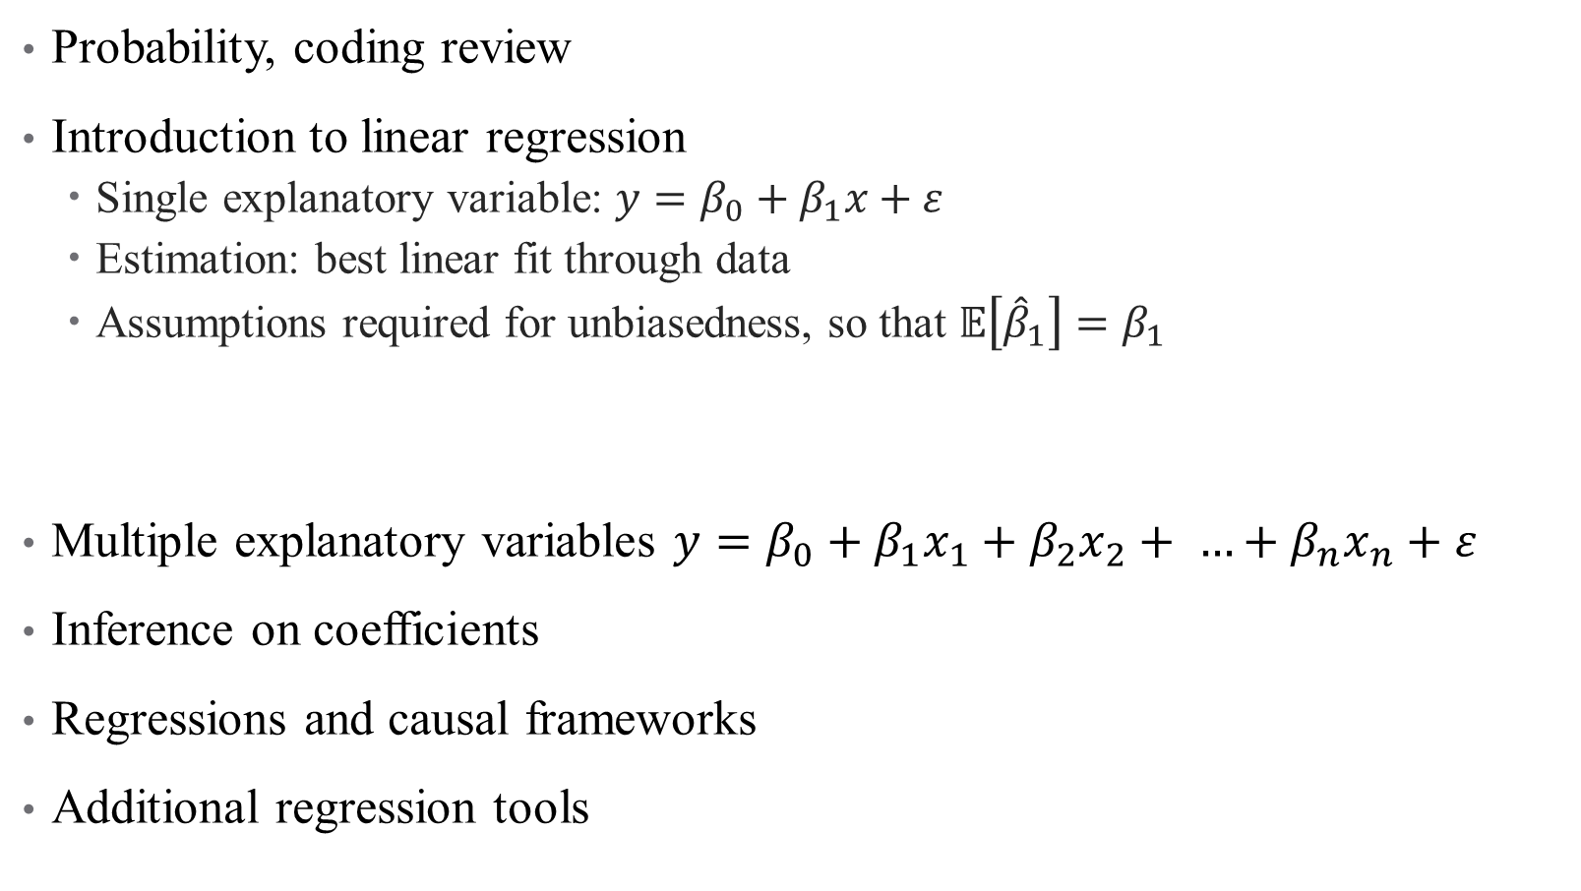
Last time:
Probability, coding review
Introduction to linear regression
Single explanatory variable: $y=β_{0}+β_{1}x+ε$
Estimation: best linear fit through data
Assumptions required for unbiasedness, so that $𝔼\left[{\hat{β}}_{1}\right]=β_{1}$
Multiple explanatory variables $y=β_{0}+β_{1}x_{1}+β_{2}x_{2}+ …+β_{n}x_{n}+ε$
Inference on coefficients
Regressions and causal frameworks
Additional regression tools
This time:

Slide 4
Multivariate Regression

Slide 5
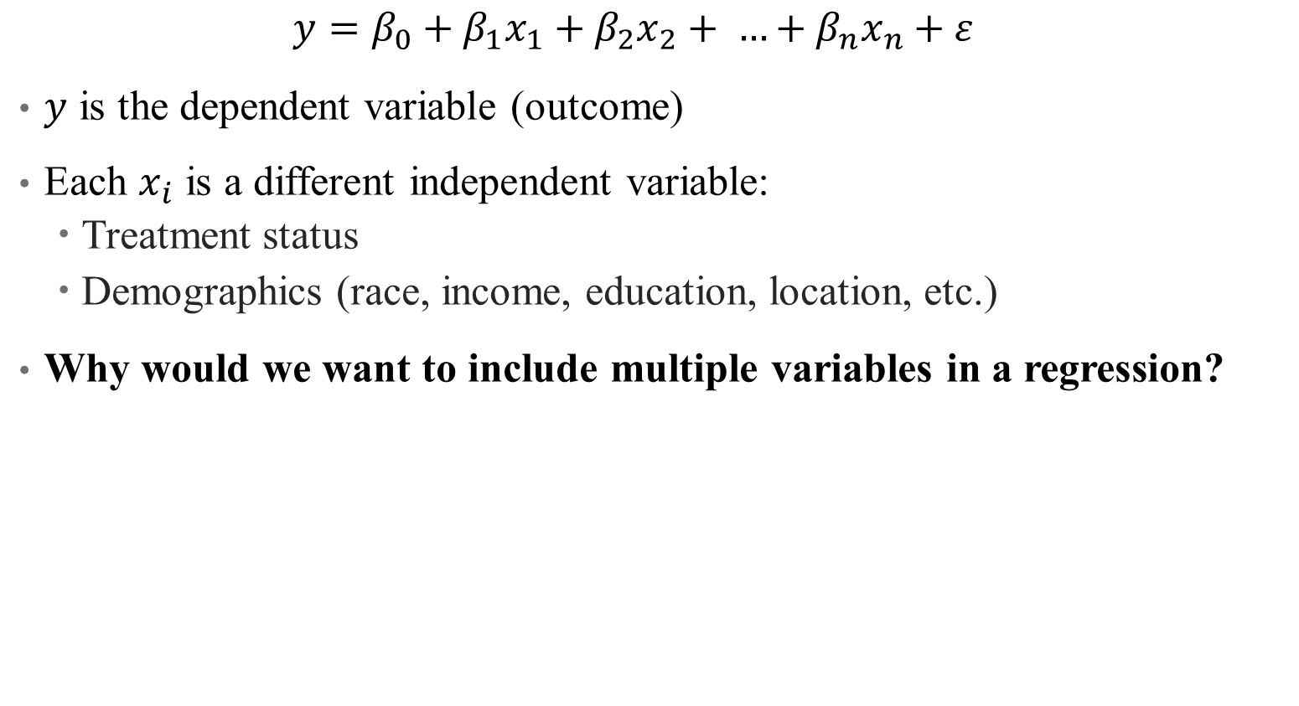
Population Model: Multiple Variables
$$y=β_{0}+β_{1}x_{1}+β_{2}x_{2}+ …+β_{n}x_{n}+ε$$
$y$ is the dependent variable (outcome)
Each $x_{i}$ is a different independent variable:
Treatment status
Demographics (race, income, education, location, etc.)
Why would we want to include multiple variables in a regression?
Notes:
This is not a trick question – think back to our frameworks!

Slide 6

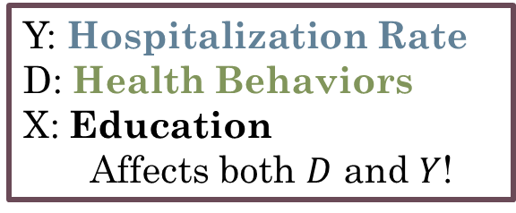


Population Model: Multiple Variables
$$y=β_{0}+β_{1}x_{1}+β_{2}x_{2}+ …+β_{n}x_{n}+ε$$
$y$ is the dependent variable (outcome)
Each $x_{i}$ is a different independent variable:
Treatment status
Demographics (race, income, education, location, etc.)
Why would we want to include multiple variables in a regression?
Y: Hospitalization Rate
D: Health Behaviors
X: Education
Affects both $D$ and $Y$!
$$D$$
$$Y$$
$$X$$

Slide 7
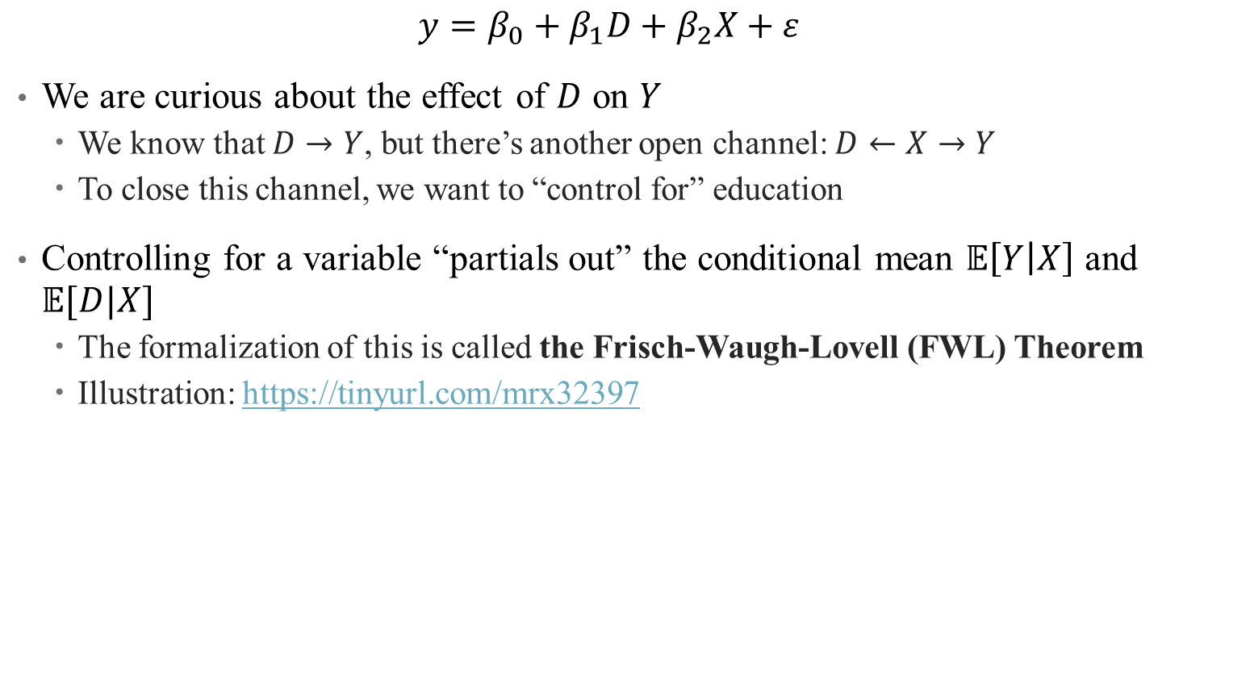
Controlling for Variables
$$y=β_{0}+β_{1}D+β_{2}X+ε$$
We are curious about the effect of $D$ on $Y$
We know that $D→Y$, but there’s another open channel: $D←X→Y$
To close this channel, we want to “control for” education
Controlling for a variable “partials out” the conditional mean $𝔼\left[Y | X\right]$ and $𝔼[D|X]$
The formalization of this is called the Frisch-Waugh-Lovell (FWL) Theorem
Illustration: https://tinyurl.com/mrx32397

Slide 8
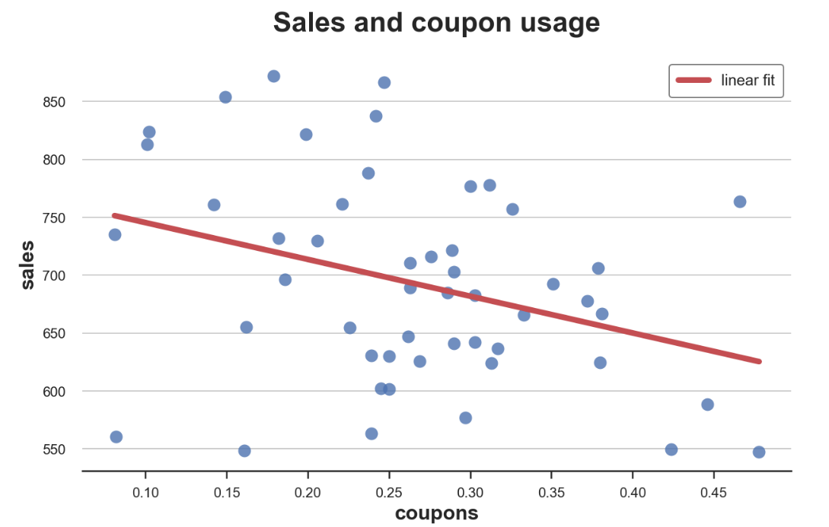

Controlling for Variables
Hospitalizations and Health Behavior (A1C check)
$$y=β_{0}+β_{1}D+β_{2}X+ε$$
Total Annual Diabetes Hospitalizations,
Regional Level
Rate of A1C checks per 1,000 diabetics

Slide 9
Controlling for Variables
Hospitalizations and Health Behavior (A1C check)
$$y=β_{0}+β_{1}D+β_{2}X+ε$$
But what about education? What drives health behaviors?
Total Annual Diabetes Hospitalizations,
Regional Level
Rate of A1C checks per 1,000 diabetics

Slide 10
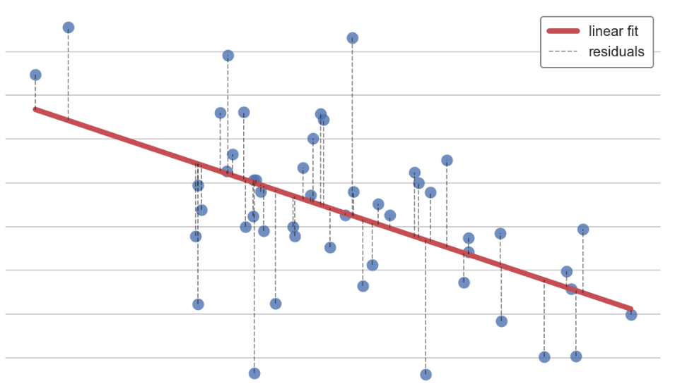

Controlling for Variables: A1Cs and Education
Health Behavior (A1C check) and Education
$$y=β_{0}+β_{1}D+β_{2}X+ε$$
Rate of A1C Checks per 1,000 Diabetics
Average Education in Region

Slide 11
Controlling for Variables: A1Cs and Education
Health Behavior (A1C check) and Education
$$y=β_{0}+β_{1}D+β_{2}X+ε$$
Rate of A1C Checks per 1,000 Diabetics
Controlling for education removes this linear trend, leaving only the residuals
Average Education in Region

Slide 12
Partialling out Education

Slide 13
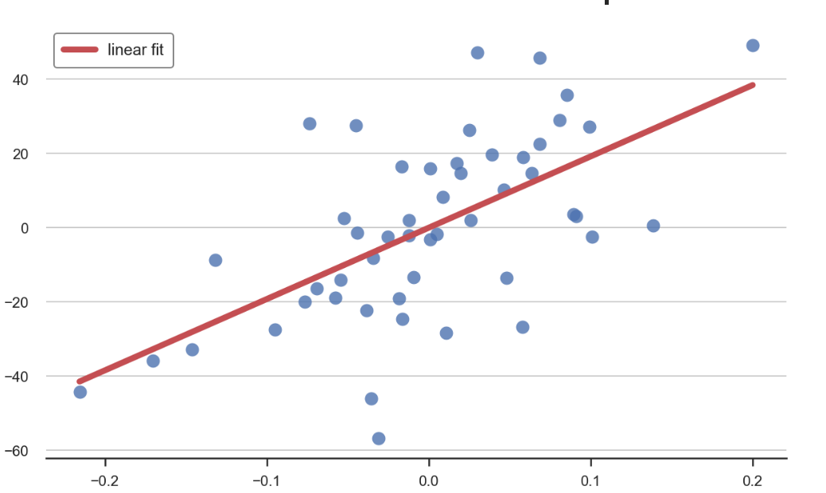

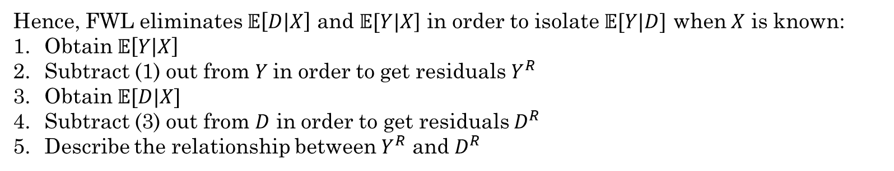
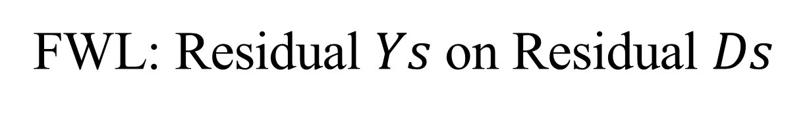
FWL: Residual $Ys$ on Residual $Ds$
Hence, FWL eliminates $𝔼\left[D | X\right]$ and $𝔼[Y|X$] in order to isolate $𝔼[Y|D]$ when $X$ is known:
Obtain $𝔼\left[Y | X\right]$
Subtract (1) out from $Y$in order to get residuals $Y^{R}$
Obtain $𝔼[D|X]$
Subtract (3) out from $D$ in order to get residuals $D^{R}$
Describe the relationship between $Y^{R}$ and $D^{R}$
Hospitalizations and Health Behavior (A1C check)
Residual Hospitalizations
Residual Rate of A1C checks

Slide 14
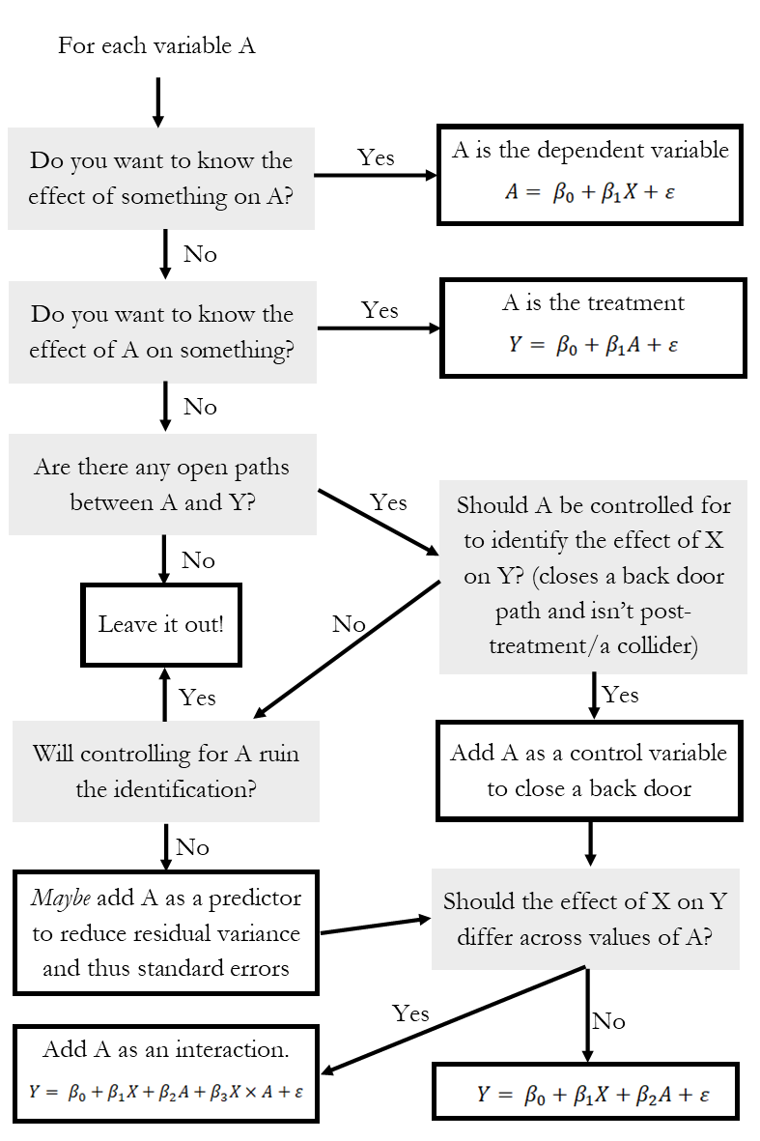
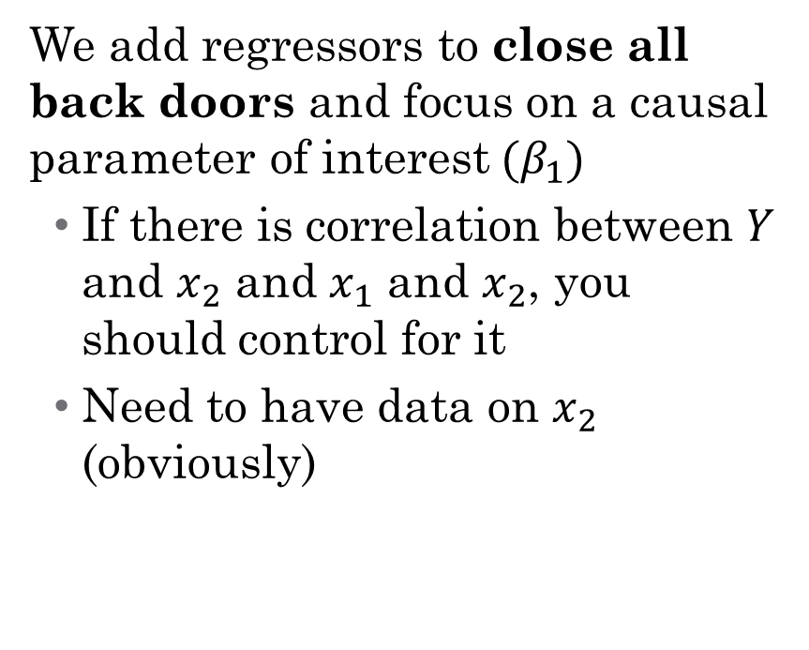
So what do I control for?
We add regressors to close all back doors and focus on a causal parameter of interest$(β_{1})$
If there is correlation between $Y$ and $x_{2}$ and $x_{1}$ and $x_{2}$, you should control for it
Need to have data on $x_{2}$ (obviously)

Slide 15
Inference on Regression Coefficients
Notes:
Here are two examples where assumption $E\left(ε|x\right)=0$, is violated.
Effect of Addiction on health (confounding): Here$E\left(ε|x\right)≠0$where there may be factors that are omitted that correlate with the included explanatory variables.
Censored data: Treatment effectiveness, Number of physician visits in claims data (sample selection): Wherein the observations on the explanatory variables may be correlated with the error term as a selection rule must be satisfied for observations to be observed.

Slide 16
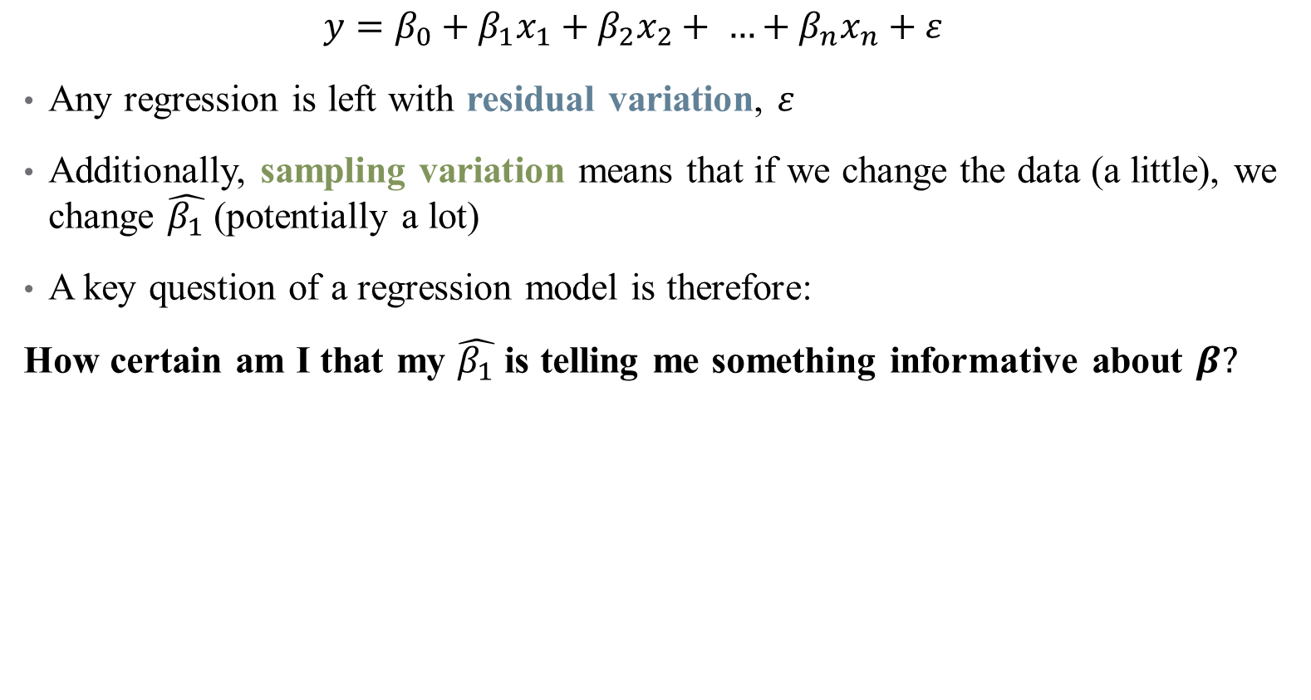
Inference: How well does our data answer our question?
$$y=β_{0}+β_{1}x_{1}+β_{2}x_{2}+ …+β_{n}x_{n}+ε$$
Any regression is left with residual variation, $ε$
Additionally, sampling variation means that if we change the data (a little), we change $\hat{β_{1}}$ (potentially a lot)
A key question of a regression model is therefore:
How certain am I that my $\hat{β_{1}}$ is telling me something informative about $β?$

Slide 17
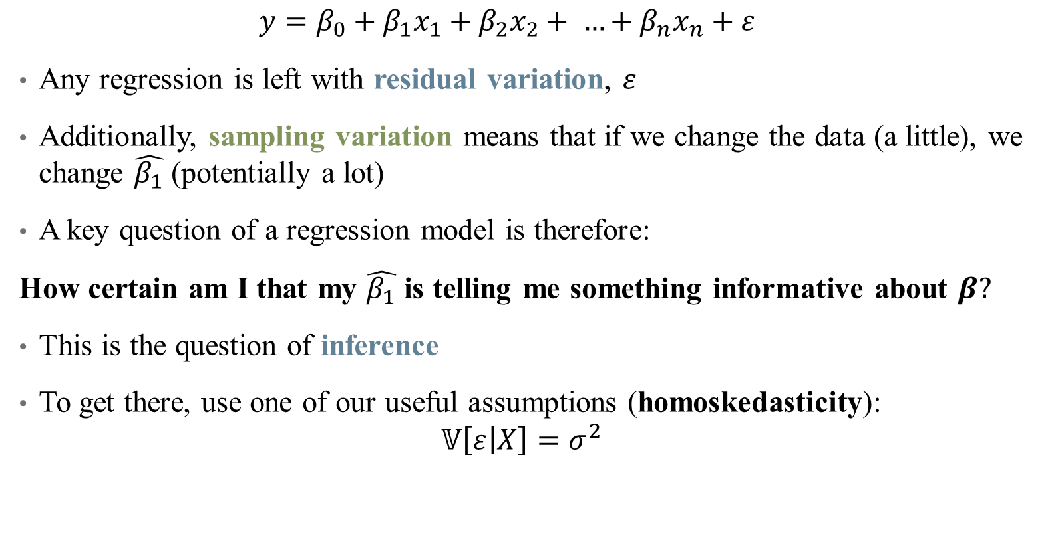
Inference: How well does our data answer our question?
$$y=β_{0}+β_{1}x_{1}+β_{2}x_{2}+ …+β_{n}x_{n}+ε$$
Any regression is left with residual variation, $ε$
Additionally, sampling variation means that if we change the data (a little), we change $\hat{β_{1}}$ (potentially a lot)
A key question of a regression model is therefore:
How certain am I that my $\hat{β_{1}}$ is telling me something informative about $β?$
This is the question of inference
To get there, use one of our useful assumptions (homoskedasticity):
$$𝕍\left[ε | X\right]=σ^{2}$$

Slide 18

Sampling Distribution of $\hat{β_{i}}$
$$y=β_{0}+β_{1}x_{1}+β_{2}x_{2}+ …+β_{n}x_{n}+ε$$
Under homoskedasticity, there is a nice sampling distribution for any coefficient
$$\hat{β_{i}}∼𝒩 \left(β,\frac{σ^{2}}{\sum_{\left\{i=1\right\}}^{n}{{\left(x_{i}−\overline{x}\right)}^{2}}}\right)=𝒩\left(β,\frac{σ^{2}}{SST_{x}}\right)$$

Slide 19
Sampling Distribution of $\hat{β_{i}}$
$$y=β_{0}+β_{1}x_{1}+β_{2}x_{2}+ …+β_{n}x_{n}+ε$$
Under homoskedasticity, there is a nice sampling distribution for any coefficient
$$\hat{β_{i}}∼𝒩 \left(β,\frac{σ^{2}}{\sum_{\left\{i=1\right\}}^{n}{{\left(x_{i}−\overline{x}\right)}^{2}}}\right)=𝒩\left(β,\frac{σ^{2}}{SST_{x}}\right)$$
Unbiasedness

Slide 20
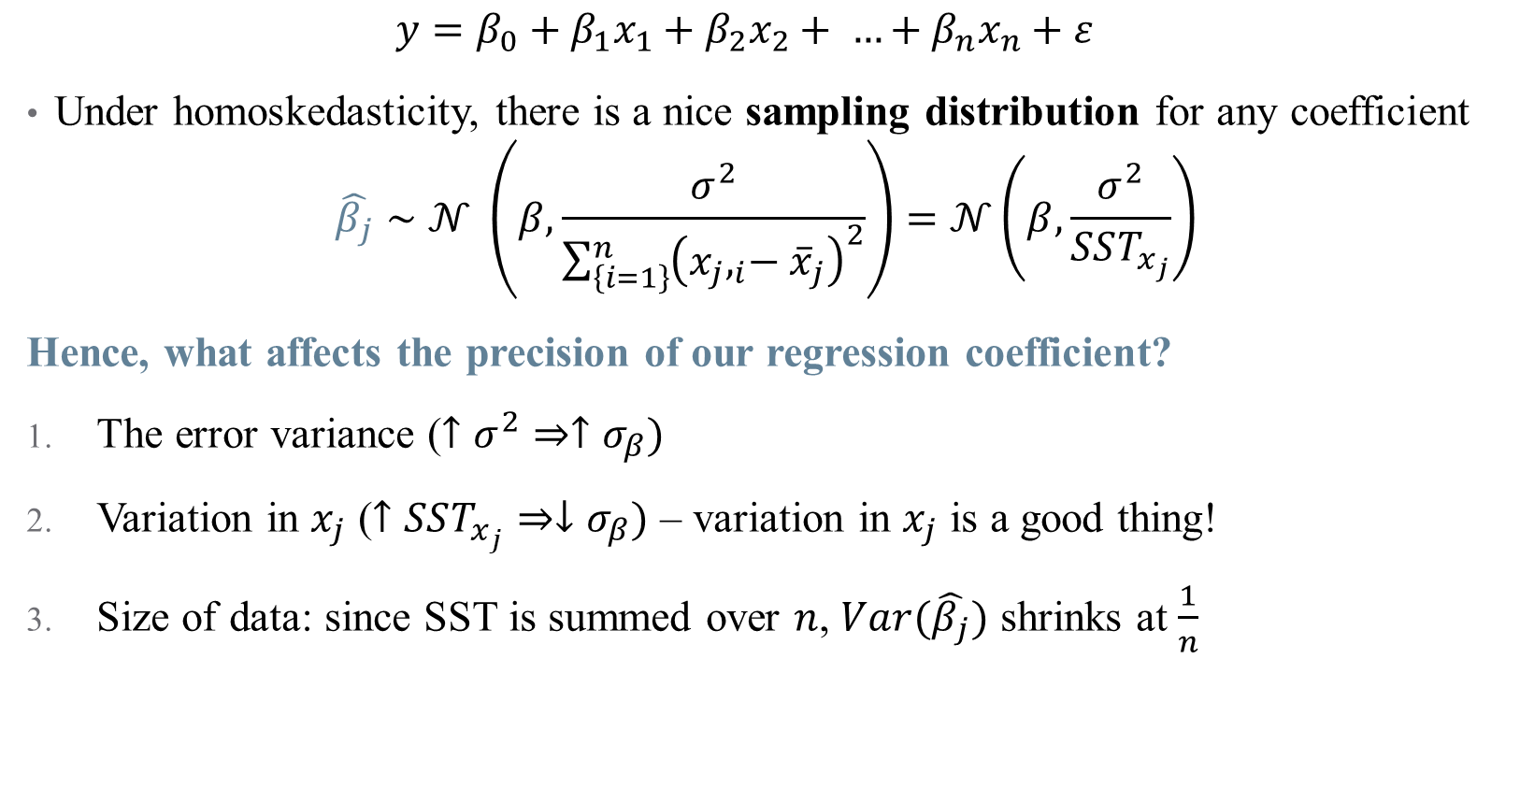
Sampling Distribution of $\hat{β_{i}}$
$$y=β_{0}+β_{1}x_{1}+β_{2}x_{2}+ …+β_{n}x_{n}+ε$$
Under homoskedasticity, there is a nice sampling distribution for any coefficient
$$\hat{β_{j}}∼𝒩 \left(β,\frac{σ^{2}}{\sum_{\left\{i=1\right\}}^{n}{{\left({x_{j},}_{i}−{\overline{x}}_{j}\right)}^{2}}}\right)=𝒩\left(β,\frac{σ^{2}}{SST_{x_{j}}}\right)$$
Hence, what affects the precision of our regression coefficient?
The error variance ($↑σ^{2}⇒↑σ_{β})$
Variation in $x_{j}$ ($↑SST_{x_{j}}⇒↓σ_{β})$ – variation in $x_{j}$ is a good thing!
Size of data: since SST is summed over $n$, $Var(\hat{β_{j}})$ shrinks at $\frac{1}{n}$

Slide 21

Standard Errors
$$y=β_{0}+β_{1}D+β_{2}X+ε$$
The standard deviation of an estimator is referred to as a standard error
Standard errors allow you to use what you observe in a regression to test hypotheses about the (unobserved) data generating process

Slide 22
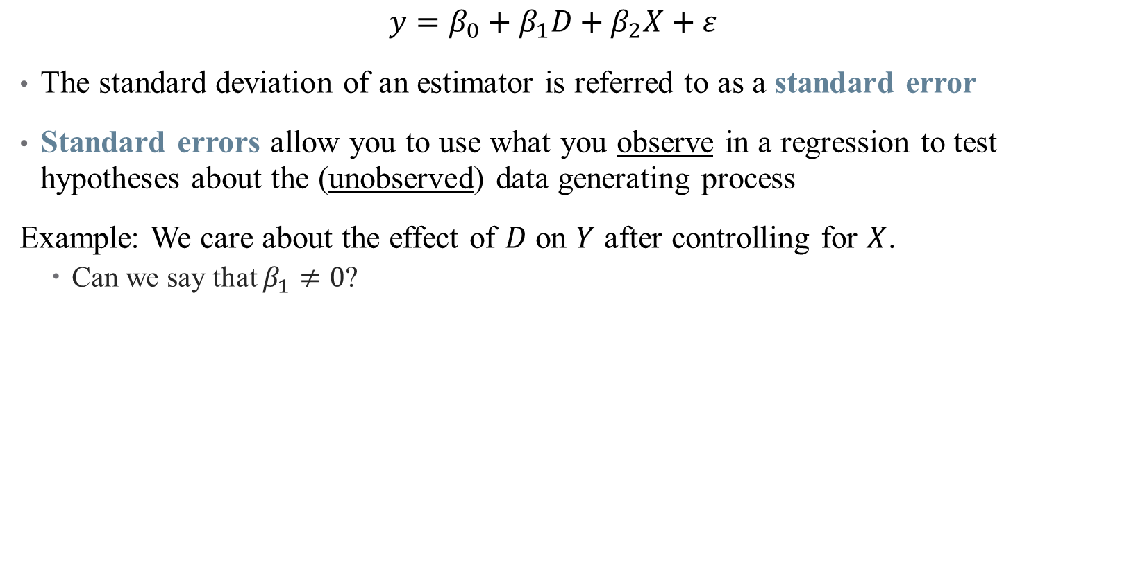
Standard Errors
$$y=β_{0}+β_{1}D+β_{2}X+ε$$
The standard deviation of an estimator is referred to as a standard error
Standard errors allow you to use what you observe in a regression to test hypotheses about the (unobserved) data generating process
Example: We care about the effect of $D$ on $Y$ after controlling for $X$.
Can we say that $β_{1}≠0$?

Slide 23
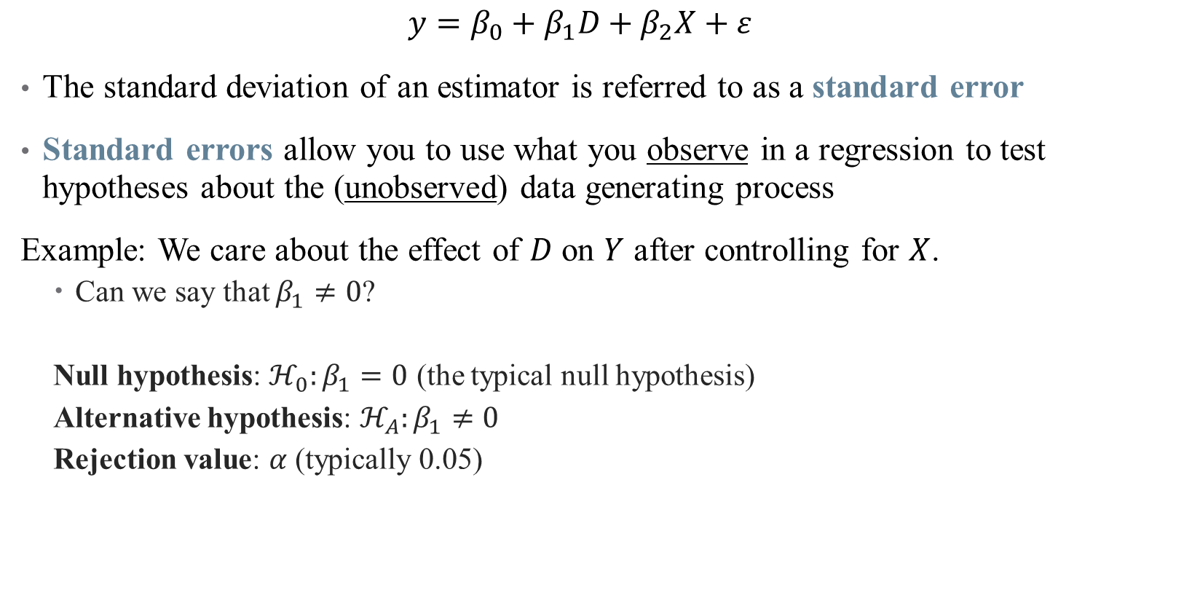
Standard Errors
$$y=β_{0}+β_{1}D+β_{2}X+ε$$
The standard deviation of an estimator is referred to as a standard error
Standard errors allow you to use what you observe in a regression to test hypotheses about the (unobserved) data generating process
Example: We care about the effect of $D$ on $Y$ after controlling for $X$.
Can we say that $β_{1}≠0$?
Null hypothesis: $ℋ_{0}:β_{1}=0$ (the typical null hypothesis)
Alternative hypothesis: $ℋ_{A}:β_{1}≠0$
Rejection value: $α$ (typically 0.05)

Slide 24
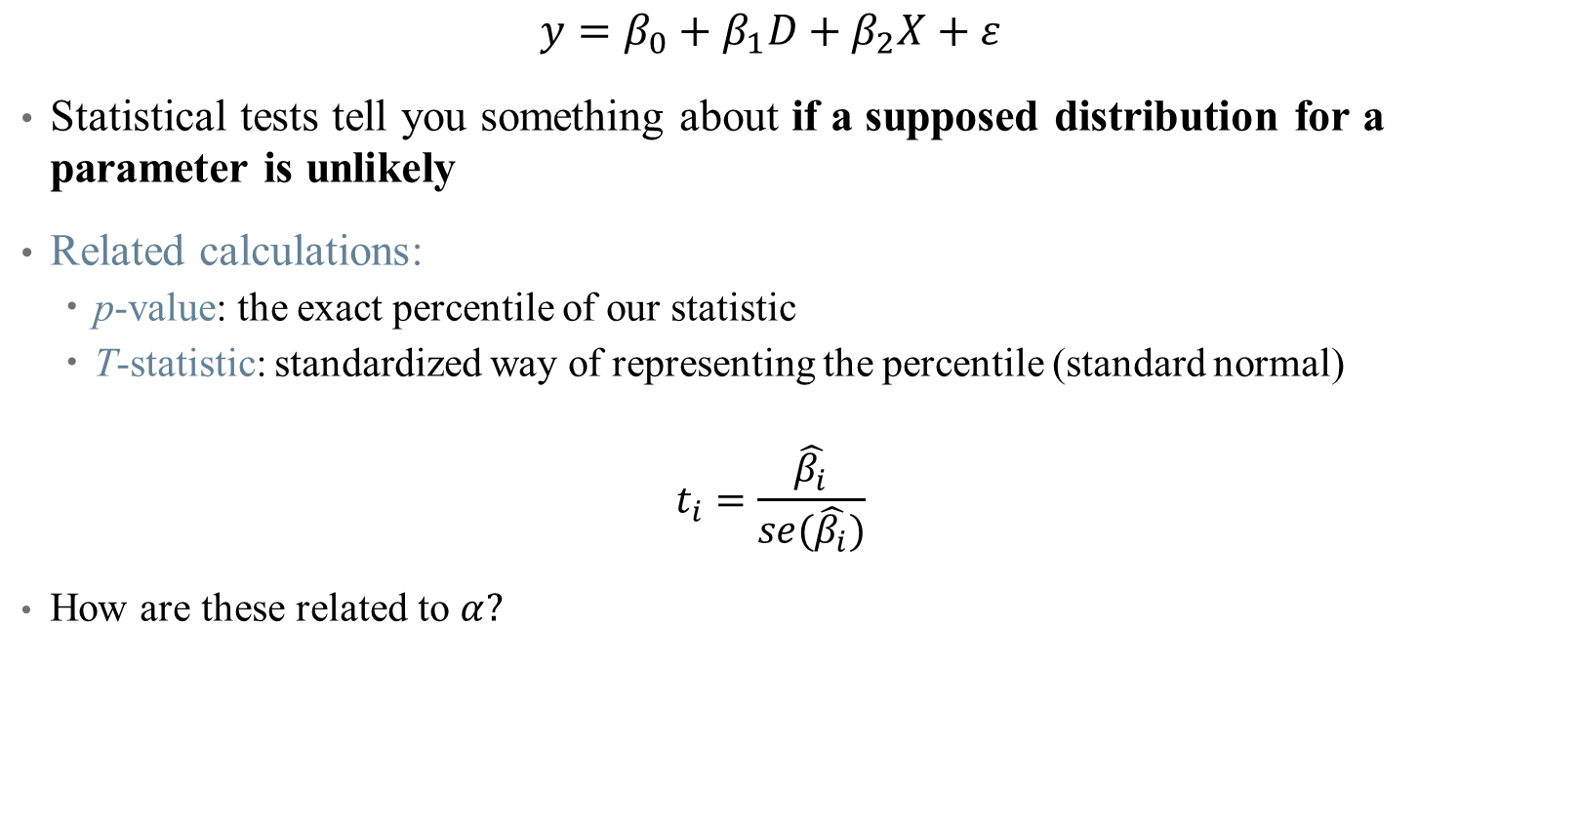
Statistical Tests on Coefficients
$$y=β_{0}+β_{1}D+β_{2}X+ε$$
Statistical tests tell you something about if a supposed distribution for a parameter is unlikely
Related calculations:
p-value: the exact percentile of our statistic
T-statistic: standardized way of representing the percentile (standard normal)
$$t_{i}=\frac{\hat{β_{i}}}{se(\hat{β_{i}})}$$
How are these related to $α?$

Slide 25
Notes on Statistical Significance
What does significance mean?
Something that isn’t significant isn’t wrong – just insignificant
Precise nulls are of research interest
A model should never be modified ex-post to obtain significant results!

Slide 26
Notes on Statistical Significance
What does significance mean?
Something that isn’t significant isn’t wrong – just insignificant
Precise nulls are of research interest
A model should never be modified ex-post to obtain significant results!
One test is rarely sufficient to come to a conclusion
This is why economics papers are typically 50+ pages plus appendix

Slide 27
Notes on Statistical Significance
What does significance mean?
Something that isn’t significant isn’t wrong – just insignificant
Precise nulls are of research interest
A model should never be modified ex-post to obtain significant results!
One test is rarely sufficient to come to a conclusion
This is why economics papers are typically 50+ pages plus appendix
Difference between statistical significance and economic significance
What does your result mean?
What does it mean to be statistically significant in this context?
What does the estimated coefficient imply about policy? Welfare? Etc.?

Slide 28
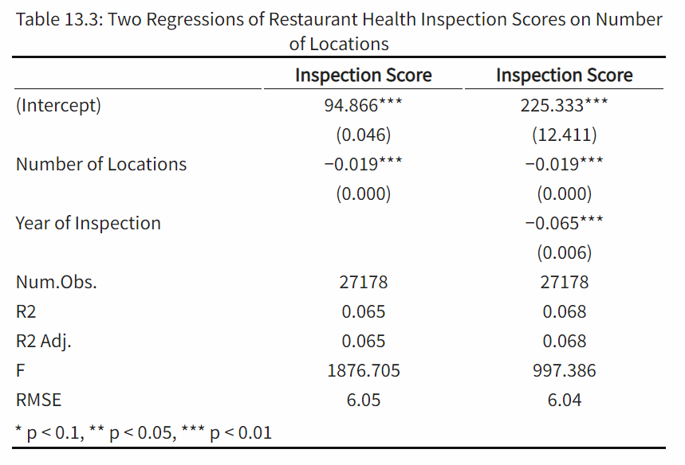
Reading & Constructing a Regression Table
Concise way to present multiple regressions
What should you look for when reading a table?
Key differences across models
Identify parameter authors care about
Look for changes across columns

Slide 29
Reading & Constructing a Regression Table
Concise way to present multiple regressions
What should you look for when reading a table?
Key differences across models
Identify parameter authors care about
Look for changes across columns
Other notes:
Asterisks and standard errors

Slide 30
Reading & Constructing a Regression Table
Concise way to present multiple regressions
What should you look for when reading a table?
Key differences across models
Identify parameter authors care about
Look for changes across columns
Other notes:
Asterisks and standard errors
N

Slide 31
Reading & Constructing a Regression Table
Concise way to present multiple regressions
What should you look for when reading a table?
Key differences across models
Identify parameter authors care about
Look for changes across columns
Other notes:
Asterisks and standard errors
N
Overall model performance

Slide 32
Reading & Constructing a Regression Table
Interpreting Results
Think “A 1-unit change in x…”
Economic vs. statistical significance
Causality or association?

Slide 33
Reading & Constructing a Regression Table
Interpreting Results
Think “A 1-unit change in x…”
Economic vs. statistical significance
Causality or association?
How do you make the table?

Slide 34
Summary
Regression is a very powerful tool (use it well)
Importance of controlling for colliders/covariates
Inference and uncertainty of a regression
Interpreting regression coefficients and tables
Presenting your results
Next time: getting fancier with regression
Types of variables you can use
Interaction effects
(Some) Nonlinear models

Slide 35
Summary
Put this TRIPOD checklist somewhere:
https://www.tripod-statement.org/wp-content/uploads/2020/01/Tripod-Checlist-Prediction-Model-Development.pdf

