Slide 1
Health Econometrics I
Lecture 5: Matching Methods
October 7, 2022
HAD5744 • Alex Hoagland, Ph.D.

Slide 2
Last Time: Multivariate OLS and Specification Issues
Flexibility of regression:
Options for variables (binary variables, scaling, transformations)
Interactions
Nonlinear effects which are linear in parameters
Standard errors:
Heteroskedasticity
Autocorrelation
Clustering
Bootstrapping
Other features:
Omitted Variable Bias
Measurement Error
Collinearity

Slide 3
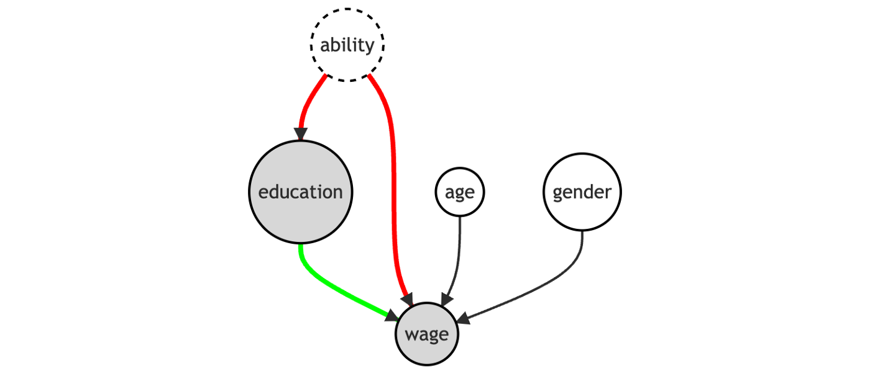

Causal Inference: Satisfying the Backdoor Criterion
If we want the effect of $X$ on $Y$, we need to satisfy the backdoor criterion
\

Slide 4
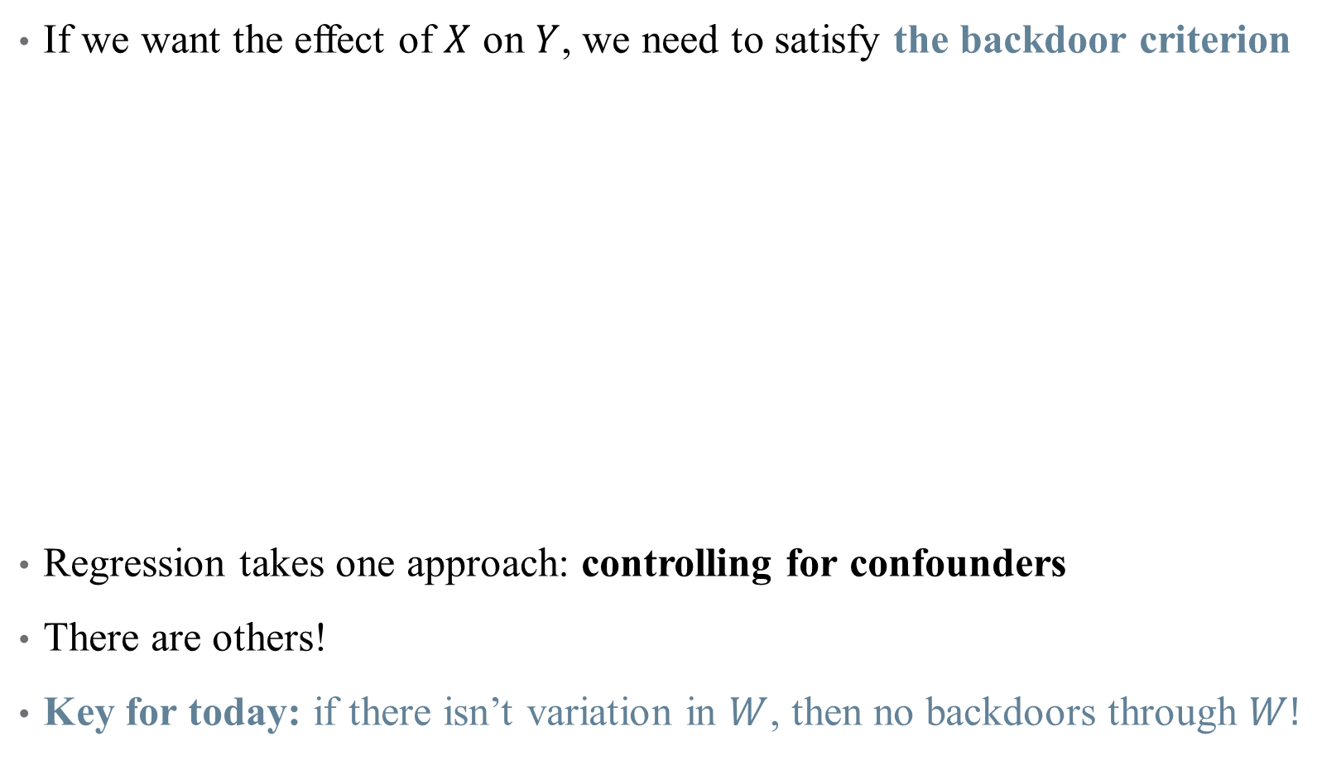
Causal Inference: Satisfying the Backdoor Criterion
If we want the effect of $X$ on $Y$, we need to satisfy the backdoor criterion
Regression takes one approach: controlling for confounders
There are others!
Key for today: if there isn’t variation in $W$, then no backdoors through $W!$

Slide 5
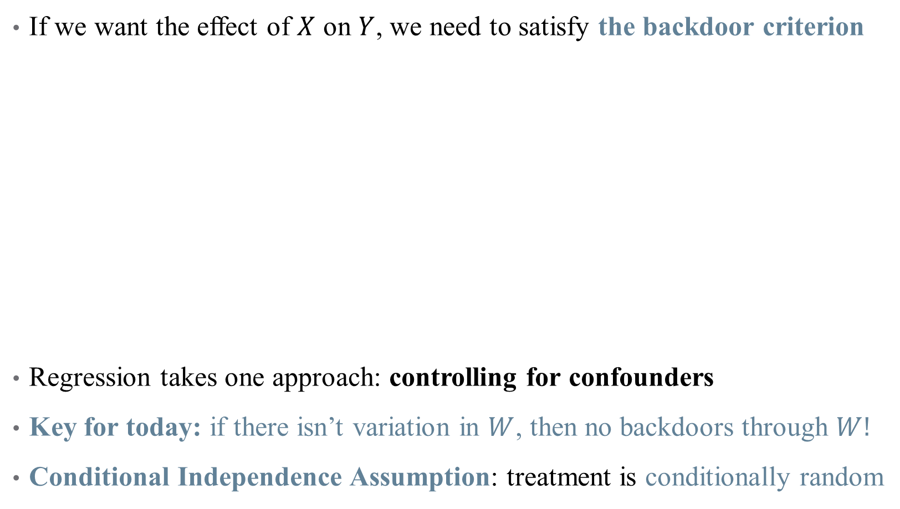
Causal Inference: Satisfying the Backdoor Criterion
If we want the effect of $X$ on $Y$, we need to satisfy the backdoor criterion
Regression takes one approach: controlling for confounders
Key for today: if there isn’t variation in $W$, then no backdoors through $W!$
Conditional Independence Assumption: treatment is conditionally random

Slide 6
Today: Matching
Matching methods are used to balance groups along observable characteristics

Slide 7
Today: Matching
Matching methods are used to balance groups along observable characteristics
Matching in Concept
Single-Variable Matching Strategies:
Subclassification
Exact matching
Approximate matching
Multiple Matching Variables
Propensity score matching
Assumptions and Caveats

Slide 8
Matching in Concept

Slide 9

What do we want to do with matching?
Example: what is the effect of health insurance take-up on health outcomes?
Specifically, how does having health insurance affect expenditures?
Let’s look at a simple regression
What could contribute to differences in expenses?

Slide 10
What do we want to do with matching?
Example: what is the effect of health insurance take-up on health outcomes?
Specifically, how does having health insurance affect expenses?
Let’s look at a simple regression
What could contribute to differences in expenses?
Initial health state
Education
Income
Etc.
Matching helps to “balance out” these covariates

Slide 11
What do we want to do with matching?
Main matching algorithm
We want to match treated observations to similar control observations
What will our matching criteria be? (what is similar?)
Are we assigning matches or weights?
How many matches will we select?
How will weights decay with distance?
What is the worst acceptable match?

Slide 12

How is this different than controlling in OLS?
Intuitively, differences lie in how we deal with backdoor paths:
Regression removes all variation in $X→Y$ associated with variation in $W$
Matching chooses a sample in which there is no variation in $W$

Slide 13
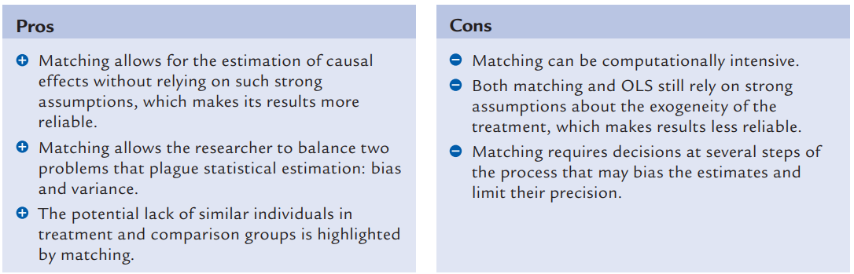

How is this different than controlling in OLS?
Intuitively, differences lie in how we deal with backdoor paths:
Regression removes all variation in $X→Y$ associated with variation in $W$
Matching chooses a sample in which there is no variation in $W$
Pros and cons of matching (Black 2015)
Notes:
Also note that the OLS assigns weights to observations that may bias your estimate of ATE or ATT, particularly if (1) probability of treatment varies with x and (2) E(Y_1-Y_0|x) varies in x

Slide 14
Matching Techniques: Single Variable

Slide 15
Subclassification
We are worried about differences in health status affecting our estimates
In practice, the treatment and control groups are not balanced
Subclassification is a matching strategy to “smooth out” differences:
Notes:
Subclassification is a simplistic form of matching, used to give intuition here.

Slide 16
Subclassification
We are worried about differences in health status affecting our estimates
In practice, the treatment and control groups are not balanced
Subclassification is a matching strategy to “smooth out” differences:
Create bins (based on BMI)
In each bin, identify the “treatment effect” of insurance
Construct strata-specific weights:
Likelihood of being in each bin across treatment/control groups
Calculate the weighted average effect of insurance using weights in (3)

Slide 17
Subclassification
We are worried about differences in health status affecting our estimates
Subclassification is a matching strategy to “smooth out” differences:
Create bins (based on BMI)
In each bin, identify the “treatment effect” of insurance
Construct strata-specific weights:
Likelihood of being in each bin across treatment/control groups
Calculate the weighted average effect of insurance using weights in (3)
A note on packages in R
Notes:
Packages: good, but make sure you know what is happening under the hood! If you can code up your own estimator, do. Otherwise, cite your packages!

Slide 18
Curse of Dimensionality
Subclassification works great when you are stratifying with few cells
Few variables, or binary variables
What happens if you want to stratify with too many cells?
Sparsity problems: observations may not match effectively
Many cells may contain either only treatment units or only control units

Slide 19
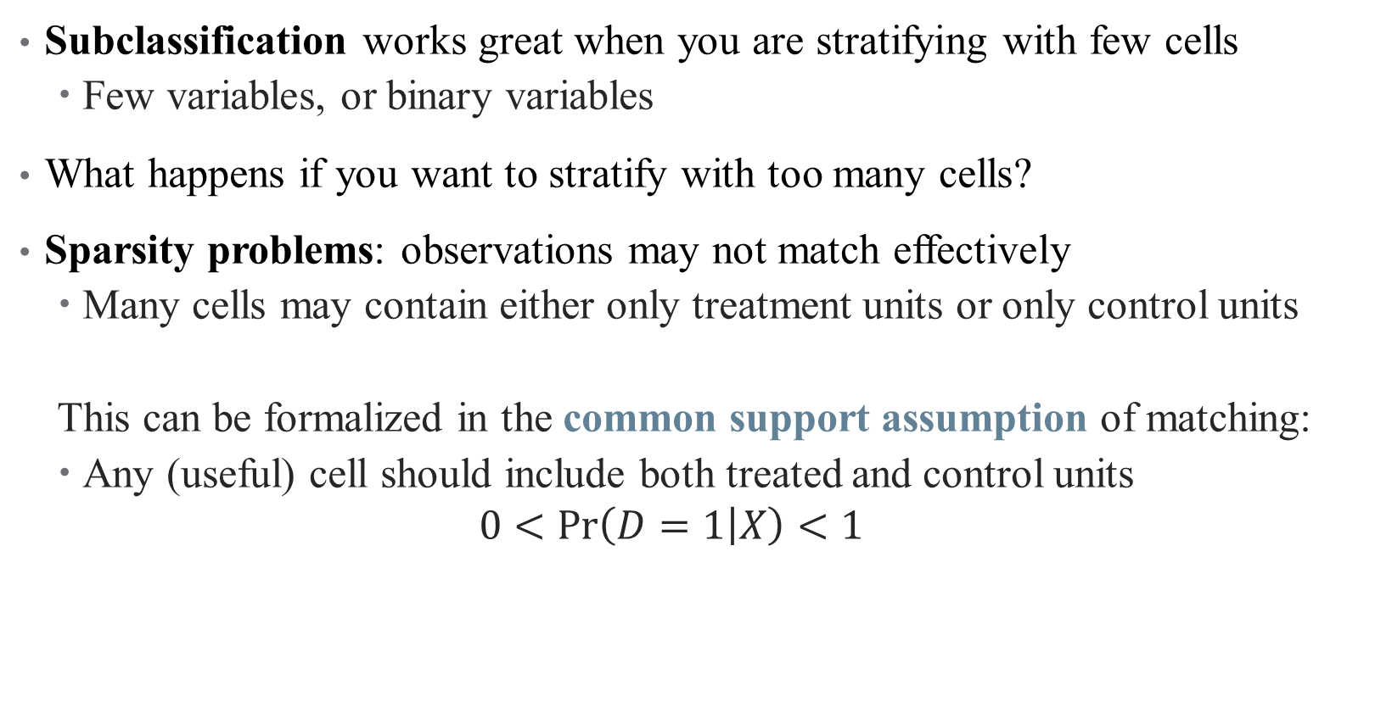
Curse of Dimensionality
Subclassification works great when you are stratifying with few cells
Few variables, or binary variables
What happens if you want to stratify with too many cells?
Sparsity problems: observations may not match effectively
Many cells may contain either only treatment units or only control units
This can be formalized in the common support assumption of matching:
Any (useful) cell should include both treated and control units
$$0<\operatorname{Pr}\left(D=1 | X\right)<1$$

Slide 20
Matching Techniques: Multiple Variables

Slide 21
Exact Matching
Matching with multiple variables quickly runs into curse of dimensionality
Can’t manually define cells with sufficient observations
But can we still form a one-to-one comparison across observations?

Slide 22
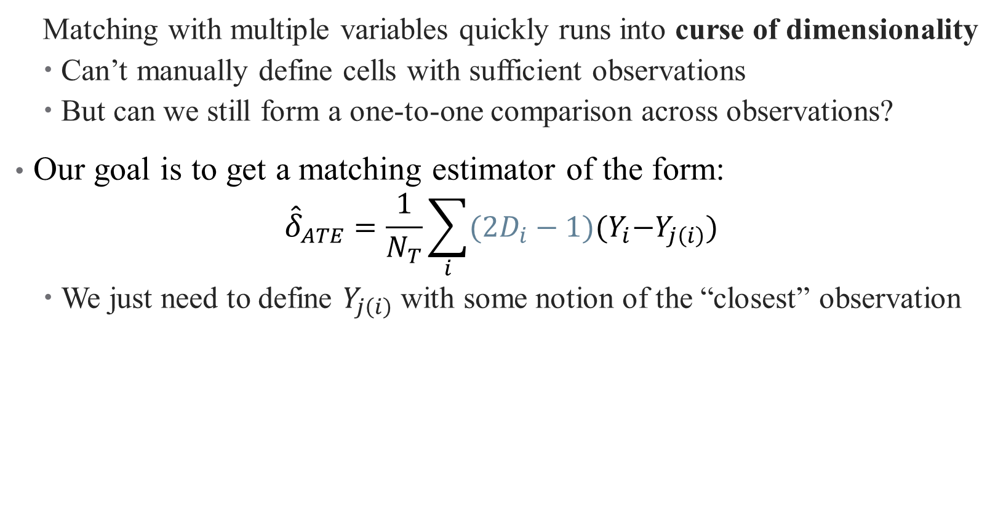
Exact Matching
Matching with multiple variables quickly runs into curse of dimensionality
Can’t manually define cells with sufficient observations
But can we still form a one-to-one comparison across observations?
Our goal is to get a matching estimator of the form:
$${\hat{δ}}_{ATE}=\frac{1}{N_{T}}\sum_{i}{(2D_{i}−1){(Y}_{i}−Y_{j\left(i\right)})}$$
We just need to define $Y_{j\left(i\right)}$ with some notion of the “closest” observation
Notes:
Note something about the 2D_i-1 notation

Slide 23
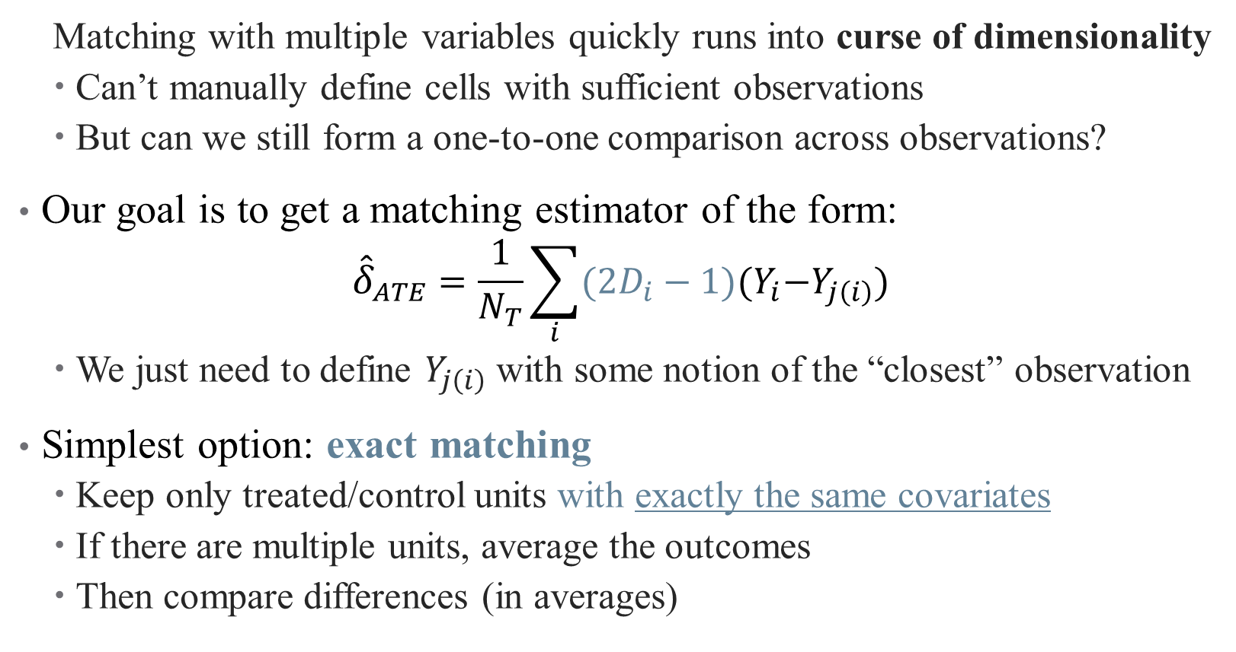
Exact Matching
Matching with multiple variables quickly runs into curse of dimensionality
Can’t manually define cells with sufficient observations
But can we still form a one-to-one comparison across observations?
Our goal is to get a matching estimator of the form:
$${\hat{δ}}_{ATE}=\frac{1}{N_{T}}\sum_{i}{(2D_{i}−1){(Y}_{i}−Y_{j\left(i\right)})}$$
We just need to define $Y_{j\left(i\right)}$ with some notion of the “closest” observation
Simplest option: exact matching
Keep only treated/control units with exactly the same covariates
If there are multiple units, average the outcomes
Then compare differences (in averages)

Slide 24
Exact Matching: Problems
Exact matching has its own problems:
Small sample sizes (few matches)
Continuous matching variables
Inconsistent averages over a few observations (within cells)
What if the people you are throwing out matter?
Generalize again! This time to approximate matching:
Nearest Neighbor Methods
Propensity Score Matching

Slide 25
Approximate Matching: Nearest Neighbor
When exact matches aren’t possible, rely on collection of neighbors
What does it mean to be a neighbor with multiple variables?

Slide 26
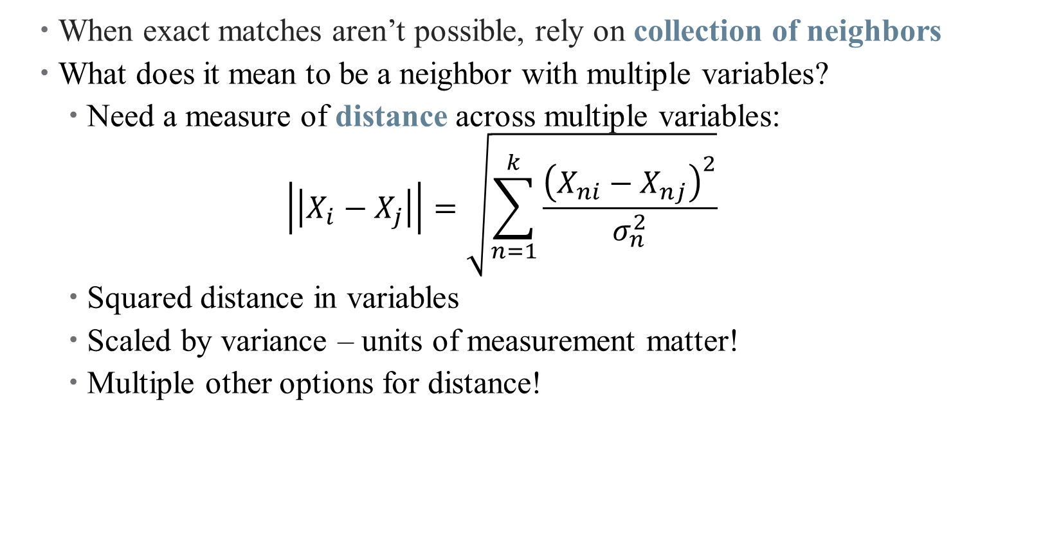
Approximate Matching: Nearest Neighbor
When exact matches aren’t possible, rely on collection of neighbors
What does it mean to be a neighbor with multiple variables?
Need a measure of distance across multiple variables:
$$\left|\left|X_{i}−X_{j}\right|\right|=\sqrt{\sum_{n=1}^{k}{\frac{{\left(X_{ni}−X_{nj}\right)}^{2}}{σ_{n}^{2}}}}$$
Squared distance in variables
Scaled by variance – units of measurement matter!
Multiple other options for distance!

Slide 27
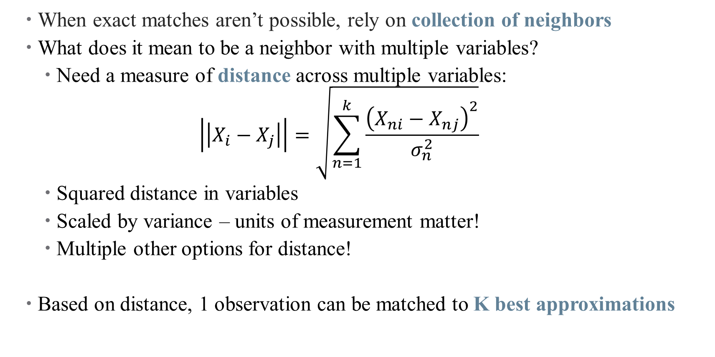
Approximate Matching: Nearest Neighbor
When exact matches aren’t possible, rely on collection of neighbors
What does it mean to be a neighbor with multiple variables?
Need a measure of distance across multiple variables:
$$\left|\left|X_{i}−X_{j}\right|\right|=\sqrt{\sum_{n=1}^{k}{\frac{{\left(X_{ni}−X_{nj}\right)}^{2}}{σ_{n}^{2}}}}$$
Squared distance in variables
Scaled by variance – units of measurement matter!
Multiple other options for distance!
Based on distance, 1 observation can be matched to K best approximations

Slide 28
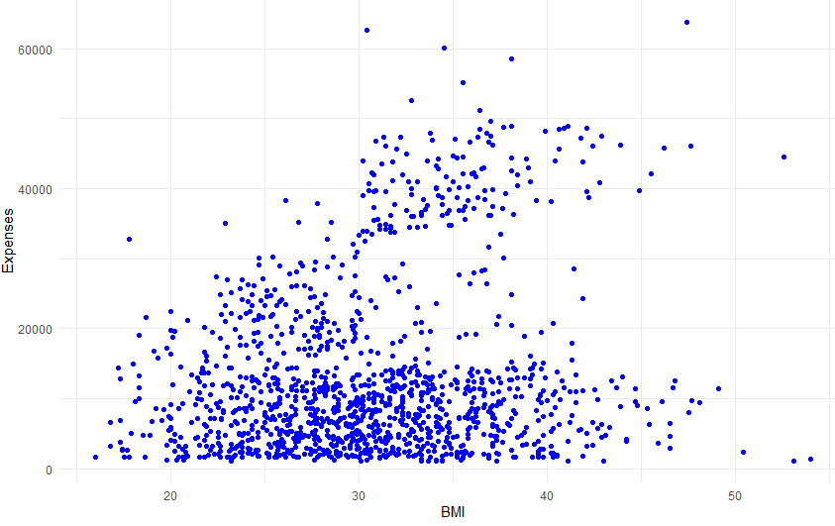
Nearest Neighbor Matching

Slide 29
Nearest Neighbor Matching

Slide 30
Nearest Neighbor Matching

Slide 31
Nearest Neighbor Matching

Slide 32
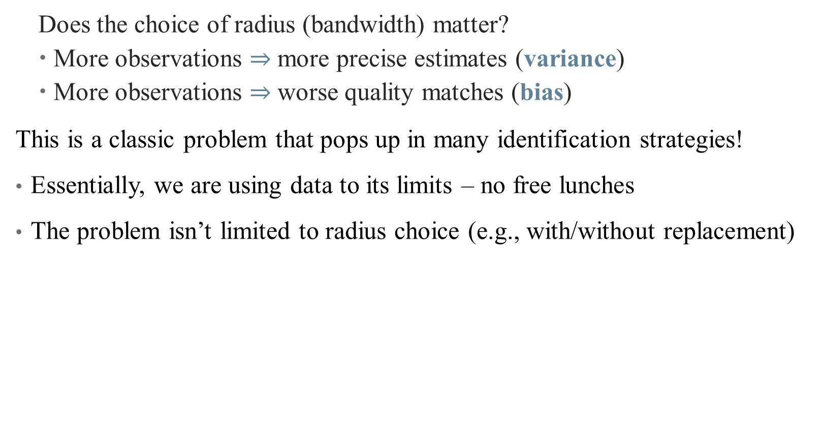
The Bias/Variance Tradeoff
Does the choice of radius (bandwidth) matter?
More observations $⇒$ more precise estimates (variance)
More observations $⇒$ worse quality matches (bias)
This is a classic problem that pops up in many identification strategies!
Essentially, we are using data to its limits – no free lunches
The problem isn’t limited to radius choice (e.g., with/without replacement)

Slide 33
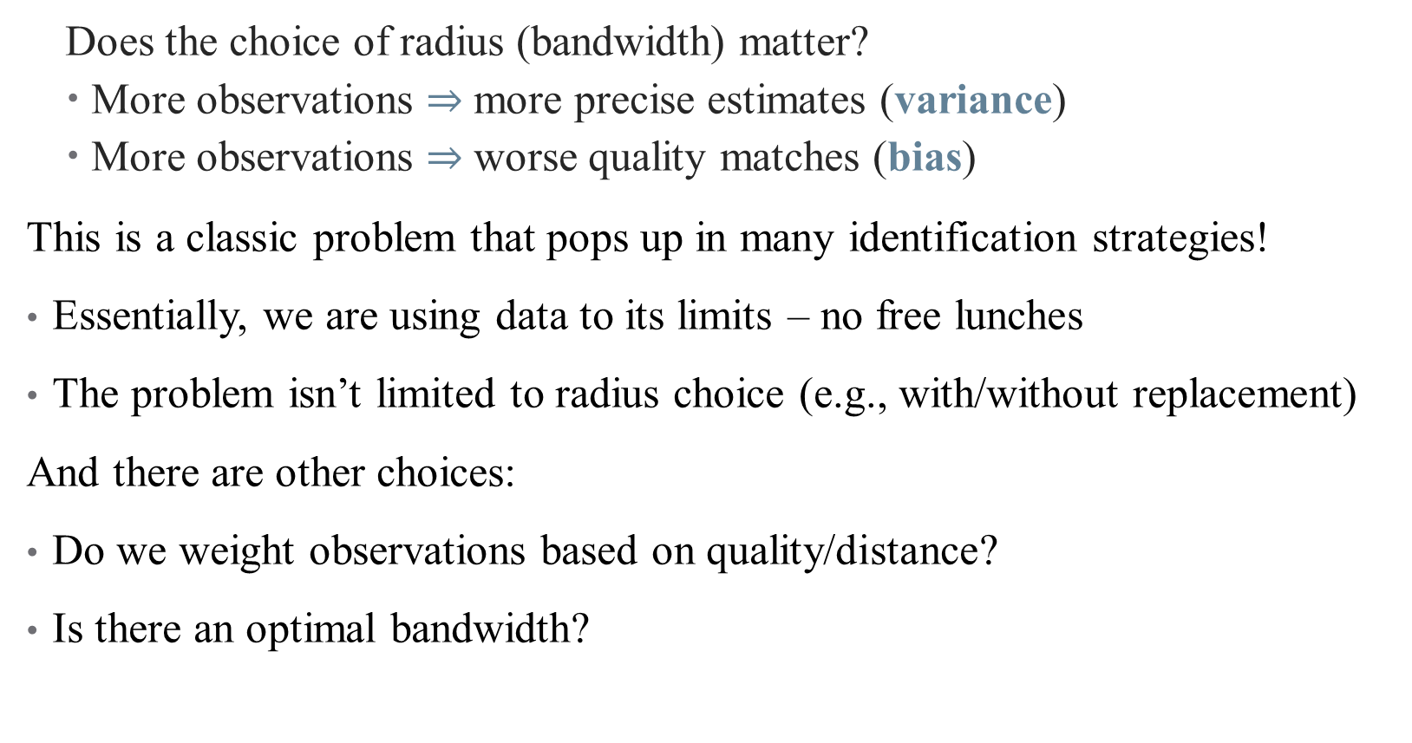
The Bias/Variance Tradeoff
Does the choice of radius (bandwidth) matter?
More observations $⇒$ more precise estimates (variance)
More observations $⇒$ worse quality matches (bias)
This is a classic problem that pops up in many identification strategies!
Essentially, we are using data to its limits – no free lunches
The problem isn’t limited to radius choice (e.g., with/without replacement)
And there are other choices:
Do we weight observations based on quality/distance?
Is there an optimal bandwidth?

Slide 34
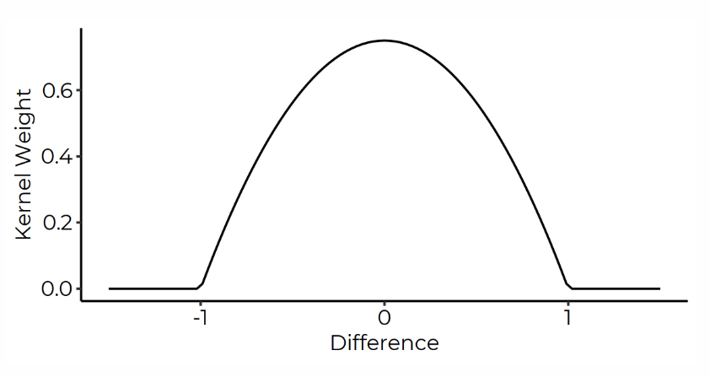
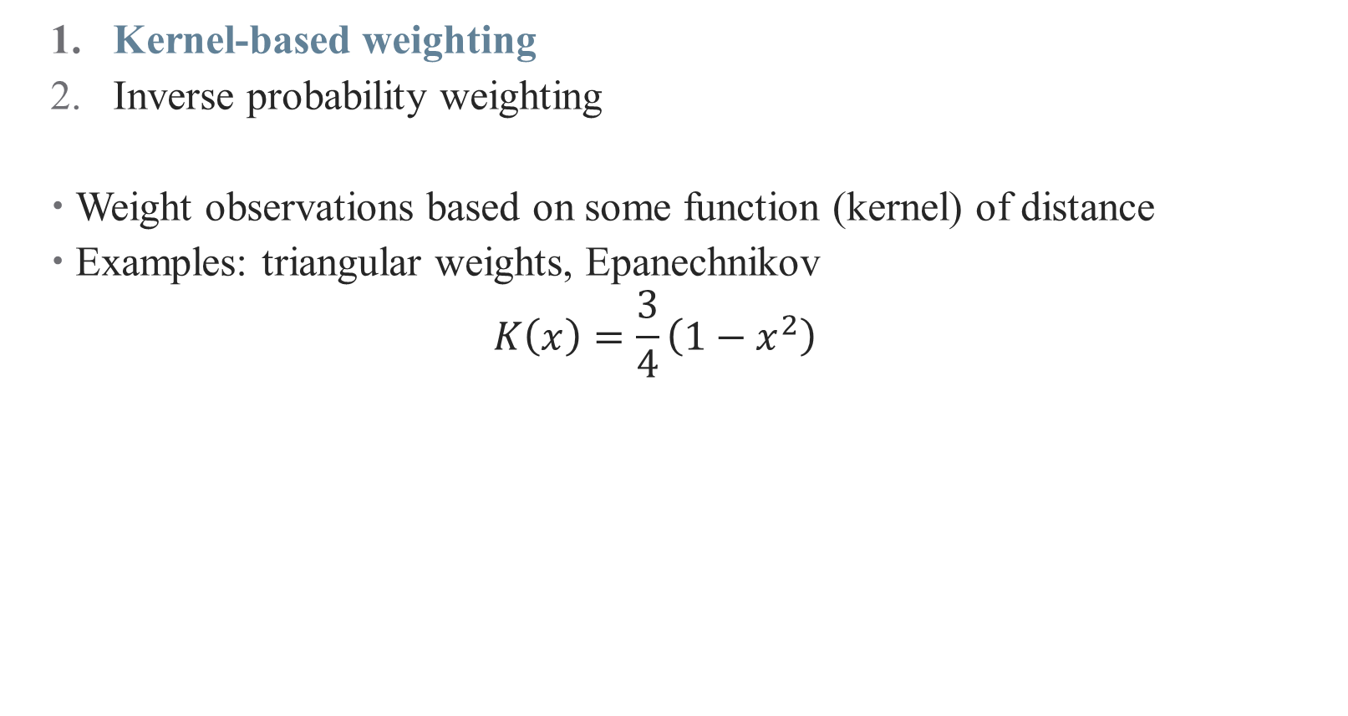
A Note on Weighting Matched Observations
Kernel-based weighting
Inverse probability weighting
Weight observations based on some function (kernel) of distance
Examples: triangular weights, Epanechnikov
$$K\left(x\right)=\frac{3}{4}\left(1−x^{2}\right)$$

Slide 35
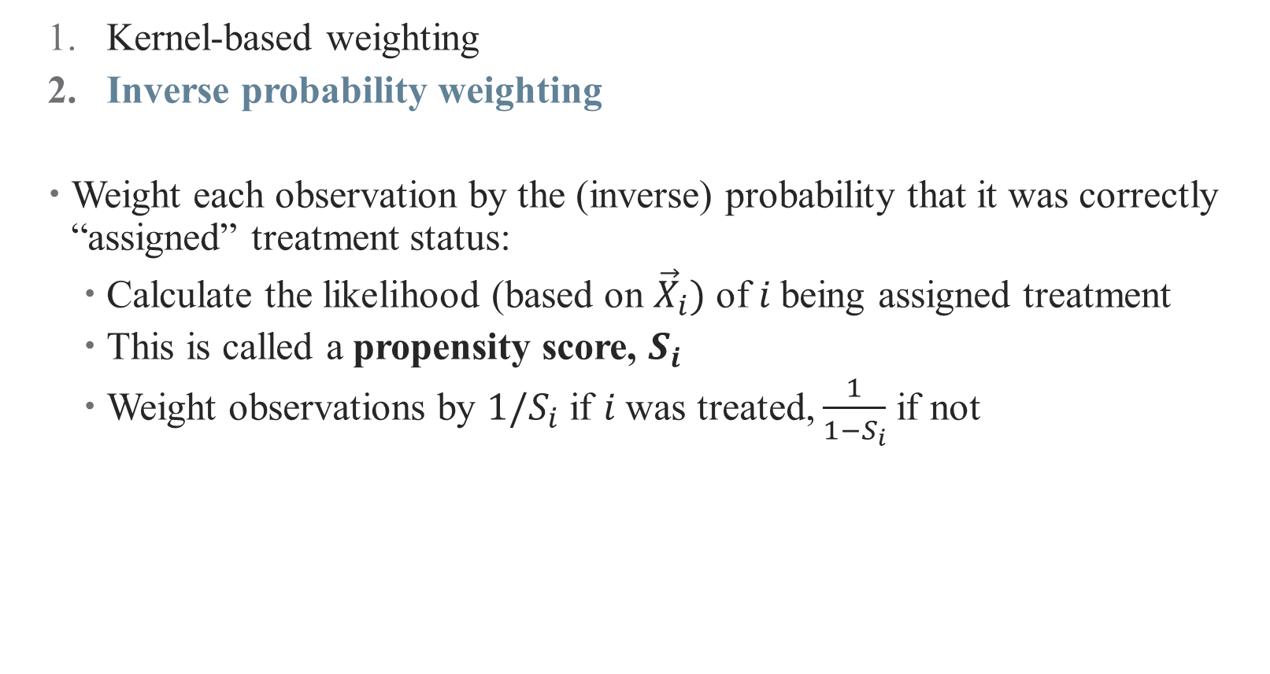
A Note on Weighting Matched Observations
Kernel-based weighting
Inverse probability weighting
Weight each observation by the (inverse) probability that it was correctly “assigned” treatment status:
Calculate the likelihood (based on ${\vec{X}}_{i})$ of $i$being assigned treatment
This is called a propensity score, $S_{i}$
Weight observations by $1/S_{i}$ if $i$was treated, $\frac{1}{1−S_{i}}$ if not

Slide 36
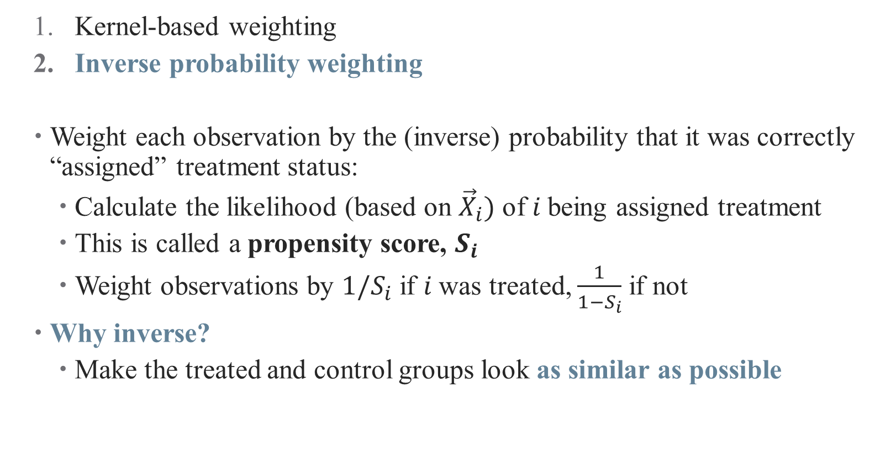
A Note on Weighting Matched Observations
Kernel-based weighting
Inverse probability weighting
Weight each observation by the (inverse) probability that it was correctly “assigned” treatment status:
Calculate the likelihood (based on ${\vec{X}}_{i})$ of $i$being assigned treatment
This is called a propensity score, $S_{i}$
Weight observations by $1/S_{i}$ if $i$was treated, $\frac{1}{1−S_{i}}$ if not
Why inverse?
Make the treated and control groups look as similar as possible

Slide 37
Approximate Matching: Propensity Score Matching
The propensity score is a powerful tool!
In fact, it can be used to match!
Observations are similar if they were equally likely to be treated
Steps for using a propensity score in matching
Select a model predicting treatment status (selection on observables)
Estimate a model for conditional probability of treatment
Use predicted values to construct propensity score

Slide 38
Matching in Practice

Slide 39
What do you do after you’ve matched?
Get the weighted mean of the outcome for the treated and control groups and compare them
There are standard error adjustments to be made
Deal with the preprocessing of data
Matching can be combined with regression approaches
Capture specific functional forms between treatment and outcome
E.g., interactions between treatment and other covariates
If you have a matched sample or weights, you can do regression with that sample (or using those weights)
You can also add the propensity score as a control variable

Slide 40
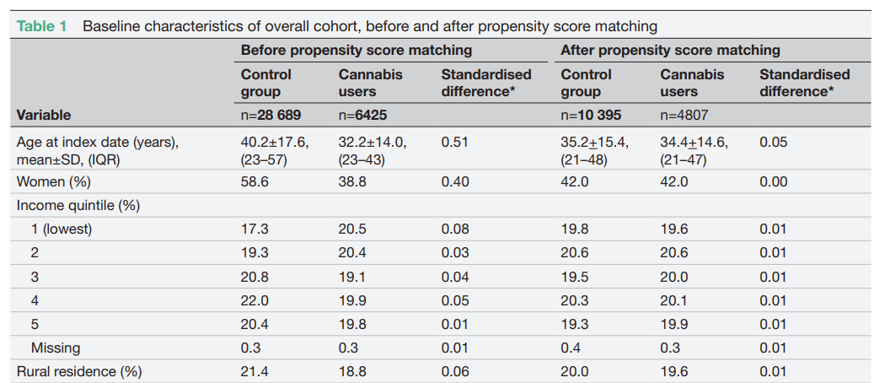
Some Matching Best Practices
Show balance after matching (balance table)
Source: Vozoris et al., 2022

Slide 41
Some Matching Best Practices
Show balance after matching (balance table)
Check if observations with similar propensity scores are balanced (stratification tests)
Show common support is valid in your setting

Slide 42
Some Matching Best Practices
Show balance after matching (balance table)
Check if observations with similar propensity scores are balanced (stratification tests)
Show common support is valid in your setting
Propensity scores close to 0 or 1 give large weights – trim data set
Try (and report) multiple bandwidths/approaches/replacement
You will need to argue CIA holds convincingly

Slide 43
Other Caveats
Economists tend to be more skeptical of PSM matching methods
Highly sensitive to both variables included and analysis sample used (Smith and Todd 2001, 2005)
Main weakness: PSM attempts to approximate a completely randomized experiment, rather than a more efficient fully blocked randomized experiment (King and Nielsen 2019)
This is substantive of a larger critique: can we ever achieve the CIA with observational data?
Are we more worried about selection on observables? Or unobservables?

Slide 44
Conclusion
Matching methods help to deal with imbalanced data
Helps you argue that your comparisons really are apples-to-apples
Matching relies on selection on observables –
Doesn’t help you if you don’t observe what’s driving the differences!
Propensity scores have deep roots (new Hull paper)

Slide 45
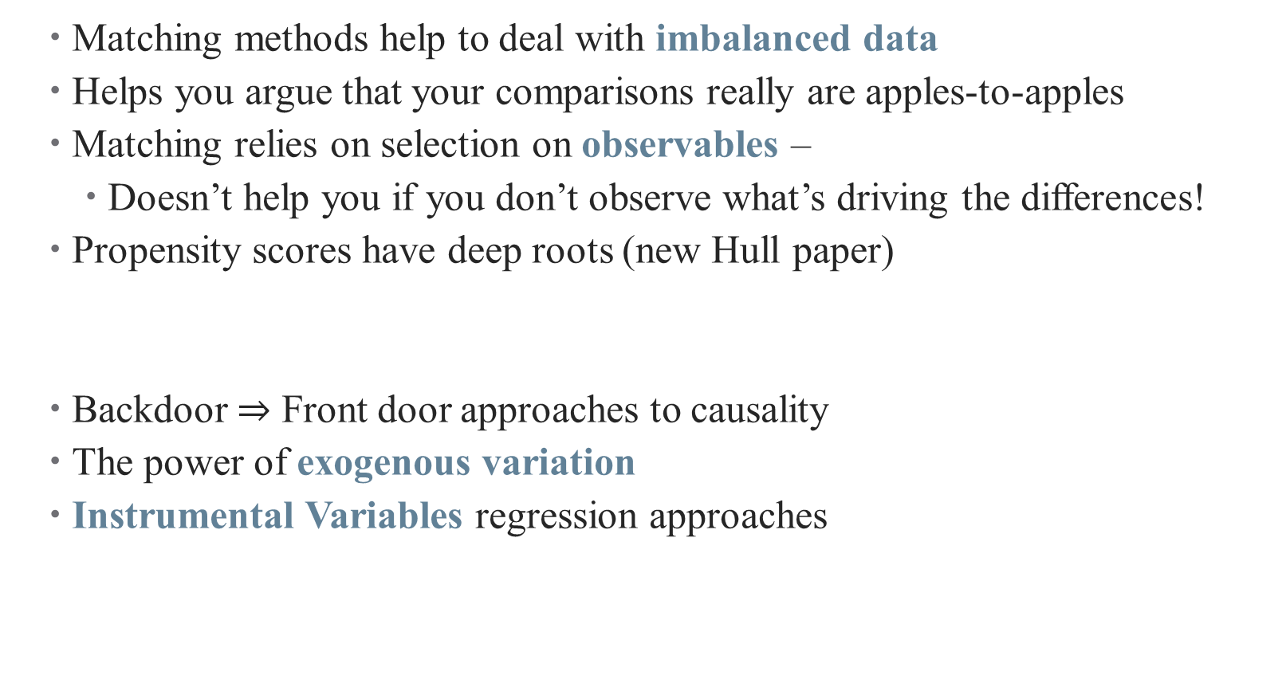
Conclusion
Matching methods help to deal with imbalanced data
Helps you argue that your comparisons really are apples-to-apples
Matching relies on selection on observables –
Doesn’t help you if you don’t observe what’s driving the differences!
Propensity scores have deep roots (new Hull paper)
Backdoor $⇒$ Front door approaches to causality
The power of exogenous variation
Instrumental Variables regression approaches
Next Time

