Slide 1
Health Econometrics I
Lecture 4: Getting Fancier with Regression
September 30, 2022
HAD5744 • Alex Hoagland, Ph.D.

Slide 2
Other Options with Regressions
There are multiple other things that can be done with a regression
Regression is a very flexible tool
In class, we’ll cover:
Options for variables (scaling & transformations)
Interactions
Nonlinear effects which are linear in parameters
Later, we’ll cover more nonlinear regression options:
Binary outcome variables (probit/logit)
General nonparametric approaches

Slide 3
Variable Selection: Transformations

Slide 4
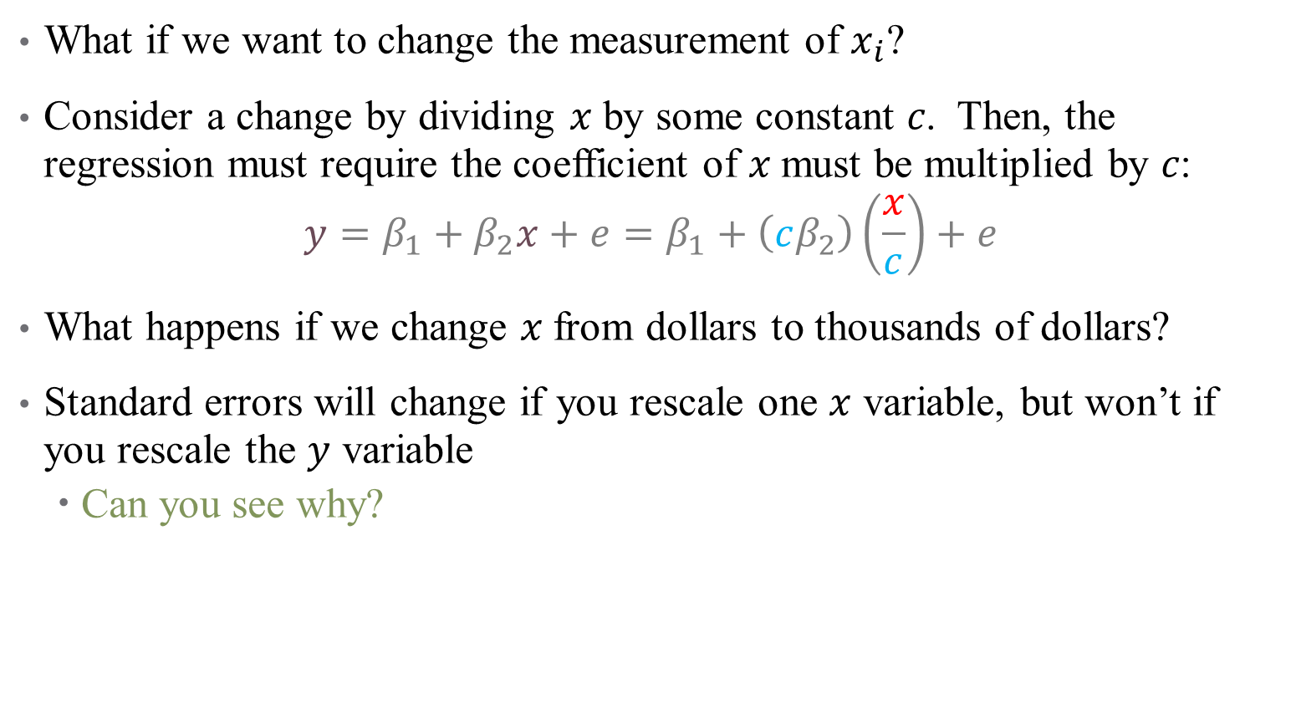
Scaling Regressors
What if we want to change the measurement of $x_{i}$?
Consider a change by dividing 𝑥 by some constant 𝑐. Then, the regression must require the coefficient of 𝑥 must be multiplied by 𝑐:
$$y=β_{1}+β_{2}x+e=β_{1}+\left(cβ_{2}\right)\left(\frac{x}{c}\right)+e$$
What happens if we change 𝑥 from dollars to thousands of dollars?
Standard errors will change if you rescale one $x$ variable, but won’t if you rescale the $y$ variable
Can you see why?

Slide 5

Nonlinear Transformations
Scaling is a form of a linear transformation
Since our regression is linear, transformations are mathematically redundant
It might also make sense to make a nonlinear transformation:
$$y=β_{0}+β_{1}x_{1}+β_{2}ln\left(x_{2}\right)+ε$$
Where ln($x_{2})$ is the natural log or log base “$e$”

Slide 6
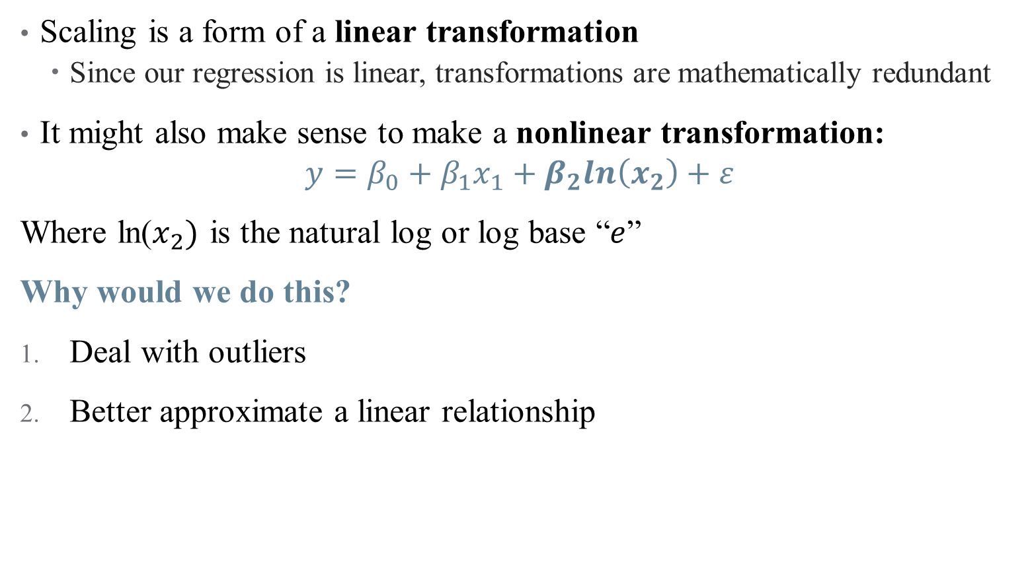
Nonlinear Transformations
Scaling is a form of a linear transformation
Since our regression is linear, transformations are mathematically redundant
It might also make sense to make a nonlinear transformation:
$$y=β_{0}+β_{1}x_{1}+β_{2}ln\left(x_{2}\right)+ε$$
Where ln($x_{2})$ is the natural log or log base “$e$”
Why would we do this?
Deal with outliers
Better approximate a linear relationship

Slide 7
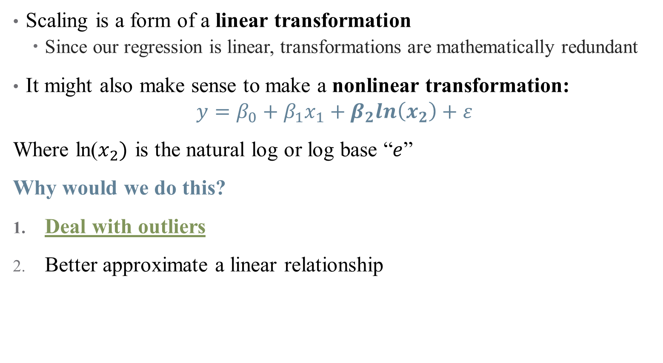
Nonlinear Transformations
Scaling is a form of a linear transformation
Since our regression is linear, transformations are mathematically redundant
It might also make sense to make a nonlinear transformation:
$$y=β_{0}+β_{1}x_{1}+β_{2}ln\left(x_{2}\right)+ε$$
Where ln($x_{2})$ is the natural log or log base “$e$”
Why would we do this?
Deal with outliers
Better approximate a linear relationship

Slide 8
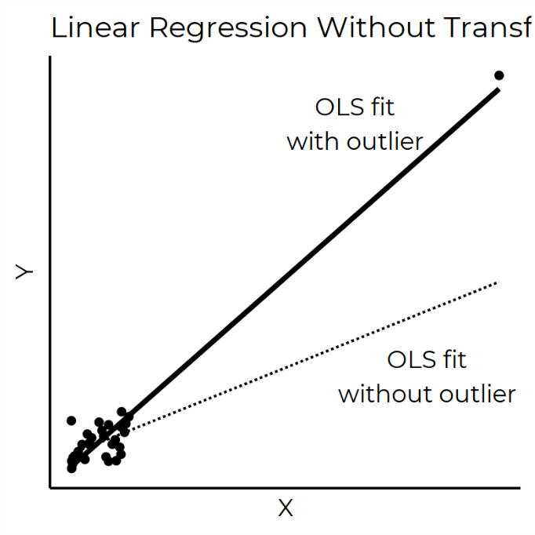

Nonlinear Transformations: Outliers
Data may be highly skewed, or influenced by the presence of regressors
Example: income distribution
These outliers generate large variations in the estimate of a $β_{i}$

Slide 9
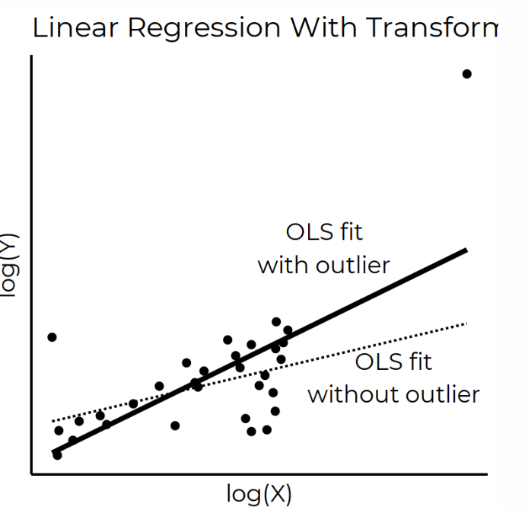

Nonlinear Transformations: Outliers
Data may be highly skewed, or influenced by the presence of regressors
Example: income distribution
These outliers generate large variations in the estimate of a $β_{i}$
Option 1: throw them out
Option 2: “scrunch them down”

Slide 10
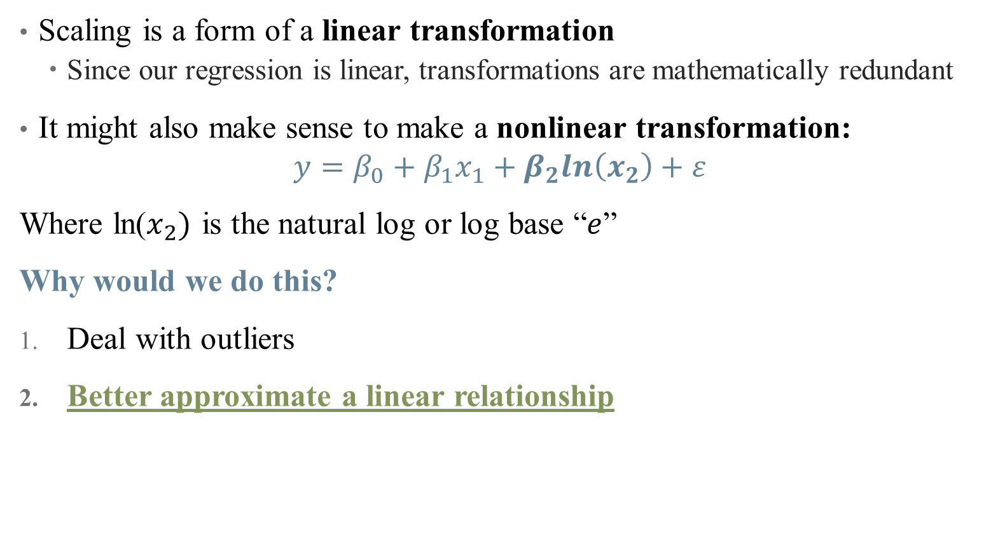
Nonlinear Transformations
Scaling is a form of a linear transformation
Since our regression is linear, transformations are mathematically redundant
It might also make sense to make a nonlinear transformation:
$$y=β_{0}+β_{1}x_{1}+β_{2}ln\left(x_{2}\right)+ε$$
Where ln($x_{2})$ is the natural log or log base “$e$”
Why would we do this?
Deal with outliers
Better approximate a linear relationship

Slide 11

Nonlinear Transformations: Achieving Linearity
Remember that OLS only fits linear relationships (in parameters)
So what kind of model are you trying to fit?
Should a 1-unit increase in $x$ correspond to a $β_{1}$-unit increase in $y$? (levels)
Or should a 1-unit increase in $x$ correspond to a $β_{1}$% increase in $y$?
Or should a 1% increase in $x$ correspond to a $β_{1}$% increase in $y$?

Slide 12
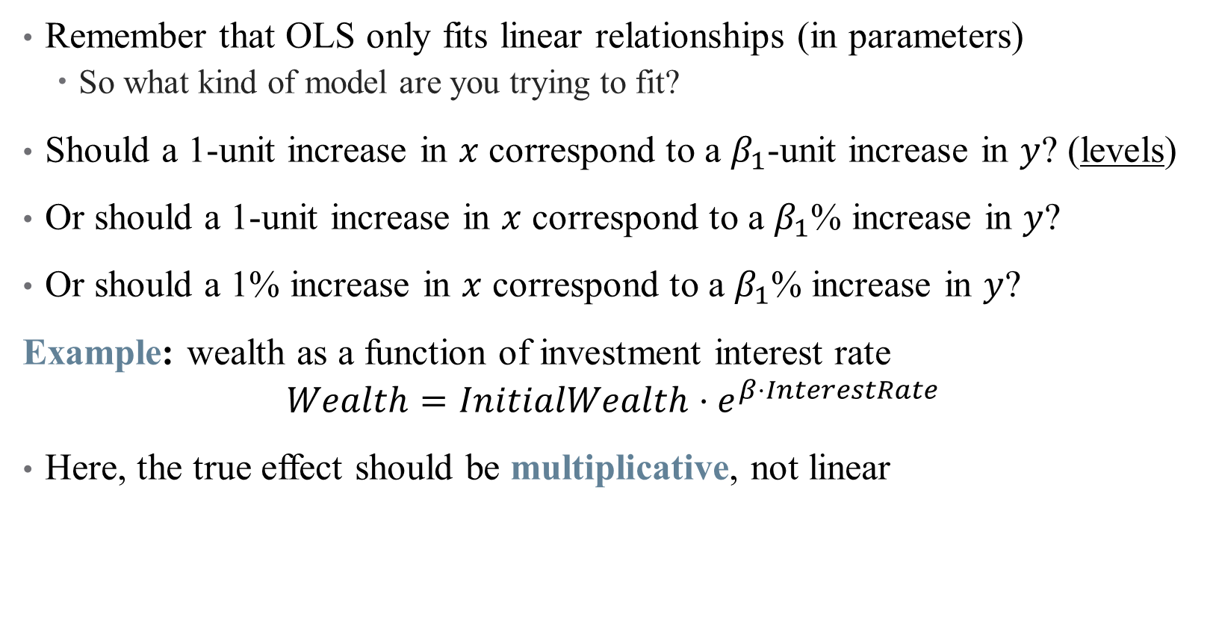
Nonlinear Transformations: Achieving Linearity
Remember that OLS only fits linear relationships (in parameters)
So what kind of model are you trying to fit?
Should a 1-unit increase in $x$ correspond to a $β_{1}$-unit increase in $y$? (levels)
Or should a 1-unit increase in $x$ correspond to a $β_{1}$% increase in $y$?
Or should a 1% increase in $x$ correspond to a $β_{1}$% increase in $y$?
Example: wealth as a function of investment interest rate
$$Wealth=InitialWealth⋅e^{β⋅InterestRate}$$
Here, the true effect should be multiplicative, not linear

Slide 13
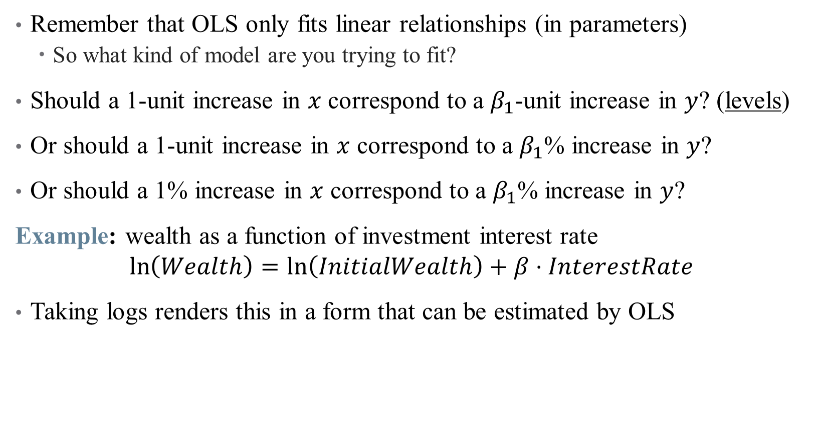
Nonlinear Transformations: Achieving Linearity
Remember that OLS only fits linear relationships (in parameters)
So what kind of model are you trying to fit?
Should a 1-unit increase in $x$ correspond to a $β_{1}$-unit increase in $y$? (levels)
Or should a 1-unit increase in $x$ correspond to a $β_{1}$% increase in $y$?
Or should a 1% increase in $x$ correspond to a $β_{1}$% increase in $y$?
Example: wealth as a function of investment interest rate
$$\ln\left(Wealth\right)=\ln\left(InitialWealth\right)+β⋅InterestRate$$
Taking logs renders this in a form that can be estimated by OLS

Slide 14
What kinds of transformations exist?
See “The Effect” for a (more) exhaustive list (pg. 214)
Natural Log – tried and true
But, recall that ln(0) is undefined – what if we have zero-valued data?

Slide 15

What kinds of transformations exist?
See “The Effect” for a (more) exhaustive list (pg. 214)
Natural Log – tried and true
But, recall that ln(0) is undefined – what if we have zero-valued data?
The Cheater: $ln\left(x+1\right)$
Common workaround, but loses some useful properties of the log

Slide 16
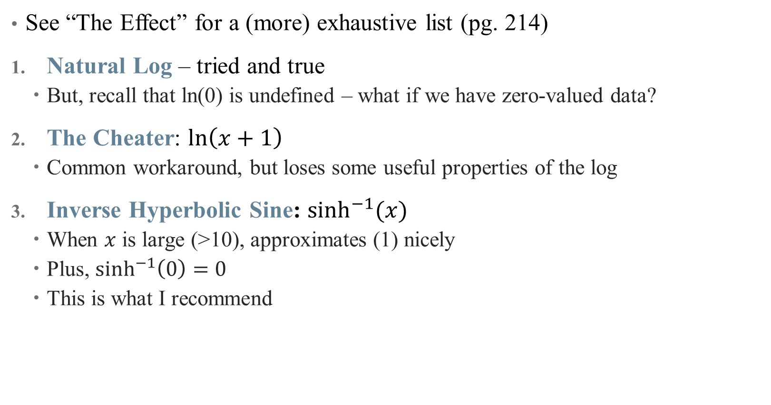
What kinds of transformations exist?
See “The Effect” for a (more) exhaustive list (pg. 214)
Natural Log – tried and true
But, recall that ln(0) is undefined – what if we have zero-valued data?
The Cheater: $ln\left(x+1\right)$
Common workaround, but loses some useful properties of the log
Inverse Hyperbolic Sine: $\sinh^{−1}{(x)}$
When $x$ is large (>10), approximates (1) nicely
Plus, $\sinh^{−1}\left(0\right)=0$
This is what I recommend

Slide 17
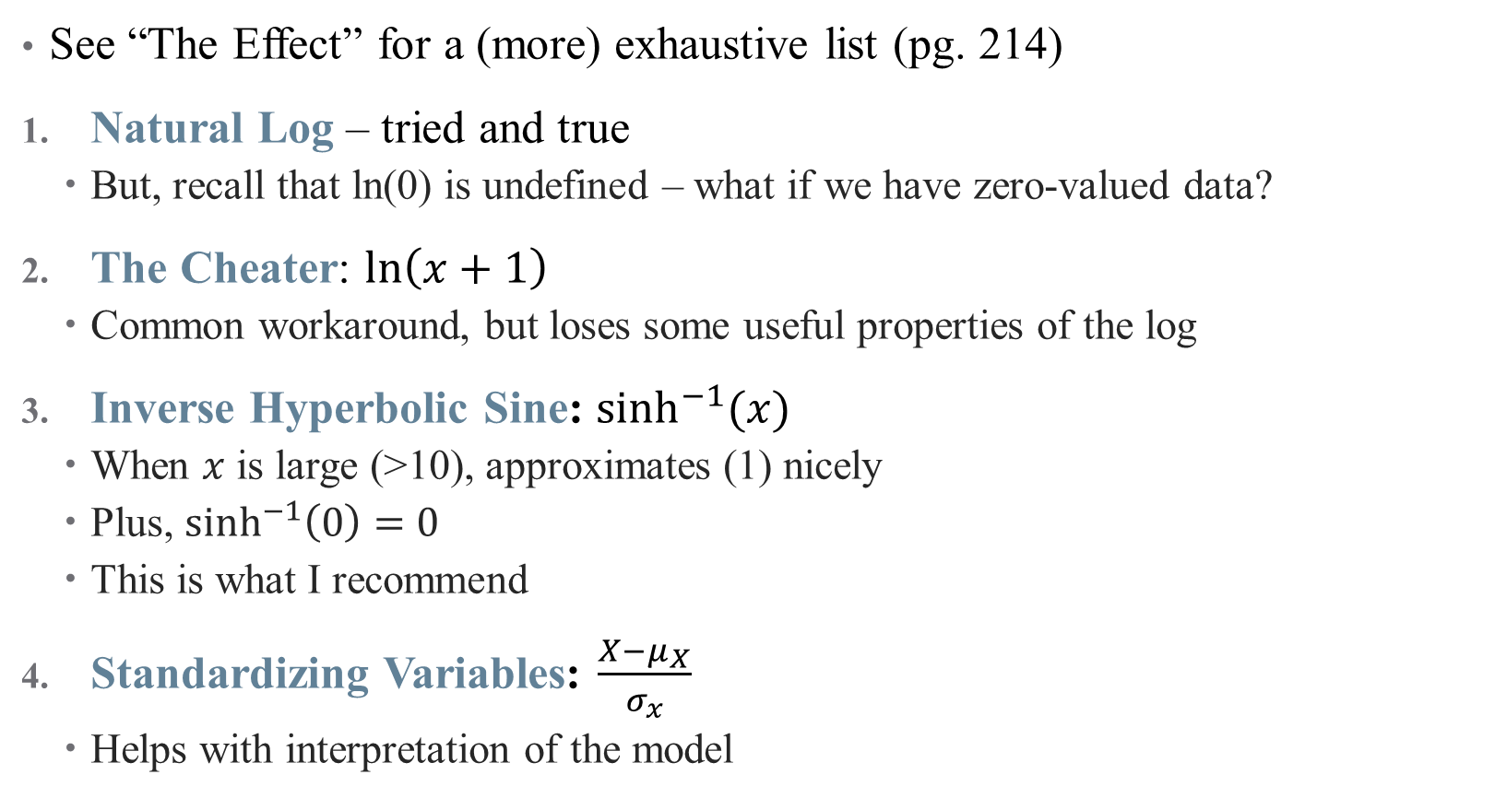
What kinds of transformations exist?
See “The Effect” for a (more) exhaustive list (pg. 214)
Natural Log – tried and true
But, recall that ln(0) is undefined – what if we have zero-valued data?
The Cheater: $ln\left(x+1\right)$
Common workaround, but loses some useful properties of the log
Inverse Hyperbolic Sine: $\sinh^{−1}{(x)}$
When $x$ is large (>10), approximates (1) nicely
Plus, $\sinh^{−1}\left(0\right)=0$
This is what I recommend
Standardizing Variables: $\frac{X−μ_{X}}{σ_{x}}$
Helps with interpretation of the model

Slide 18

How to interpret coefficients on transformed variables?
Let’s focus on $ln⁡(x)$ for now: $y=β_{0}+β_{1}\ln\left(x_{1}\right)+ε$
If $\ln\left(x_{1}\right)$ goes up by $1$, then $y$ increases by $β_{1}$
Okay, but what does it mean for ln$\left(x_{1}\right)$ to change by a certain amount?
It’s helpful to think about percentage changes in $x_{1}$

Slide 19
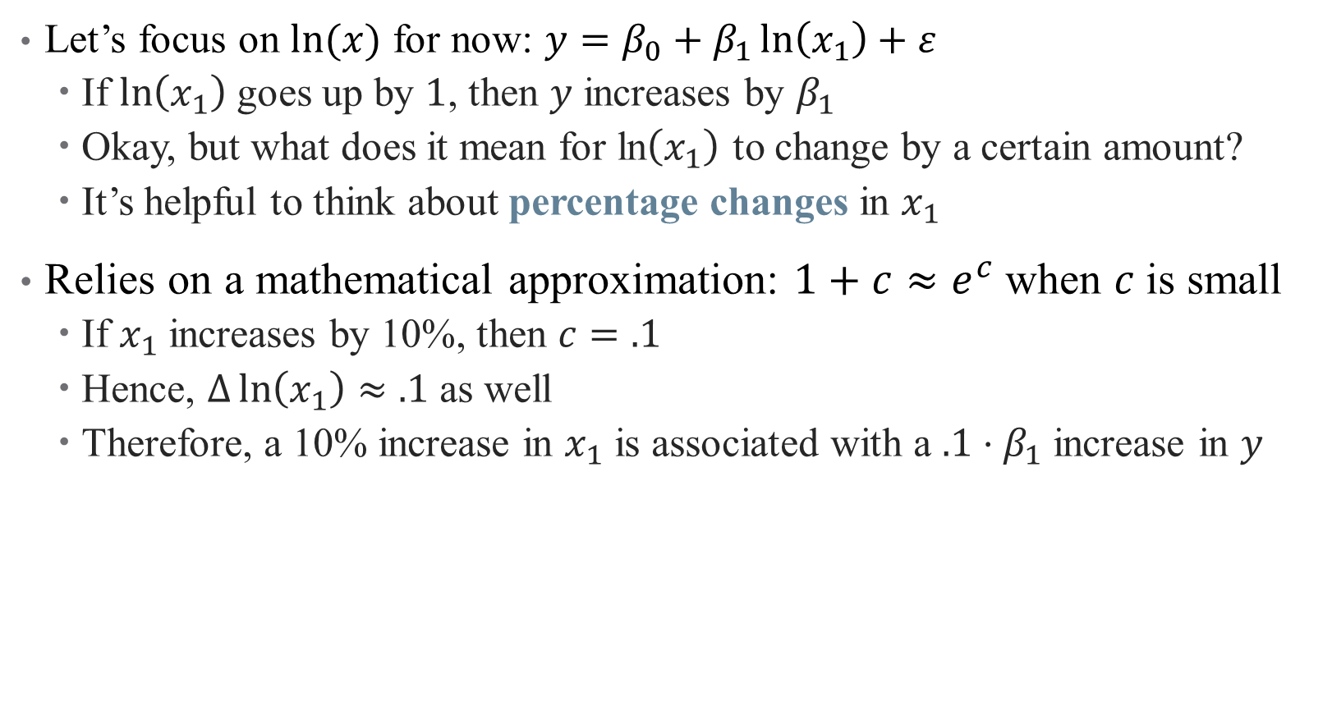
How to interpret coefficients on transformed variables?
Let’s focus on $ln⁡(x)$ for now: $y=β_{0}+β_{1}\ln\left(x_{1}\right)+ε$
If $\ln\left(x_{1}\right)$ goes up by $1$, then $y$ increases by $β_{1}$
Okay, but what does it mean for ln$\left(x_{1}\right)$ to change by a certain amount?
It’s helpful to think about percentage changes in $x_{1}$
Relies on a mathematical approximation: $1+c≈e^{c}$when $c$is small
If $x_{1}$ increases by 10%, then $c=.1$
Hence, $Δ\ln\left(x_{1}\right)≈.1$ as well
Therefore, a 10% increase in $x_{1}$ is associated with a $.1⋅β_{1}$ increase in $y$

Slide 20
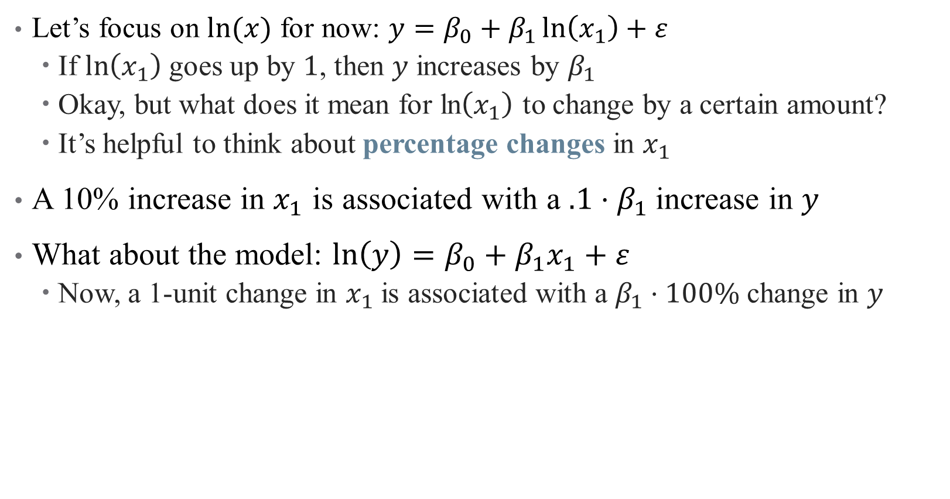
How to interpret coefficients on transformed variables?
Let’s focus on $ln⁡(x)$ for now: $y=β_{0}+β_{1}\ln\left(x_{1}\right)+ε$
If $\ln\left(x_{1}\right)$ goes up by $1$, then $y$ increases by $β_{1}$
Okay, but what does it mean for ln$\left(x_{1}\right)$ to change by a certain amount?
It’s helpful to think about percentage changes in $x_{1}$
A 10% increase in $x_{1}$ is associated with a $.1⋅β_{1}$ increase in $y$
What about the model: $ln\left(y\right)=β_{0}+β_{1}x_{1}+ε$
Now, a 1-unit change in $x_{1}$ is associated with a $β_{1}⋅100\%$ change in $y$

Slide 21
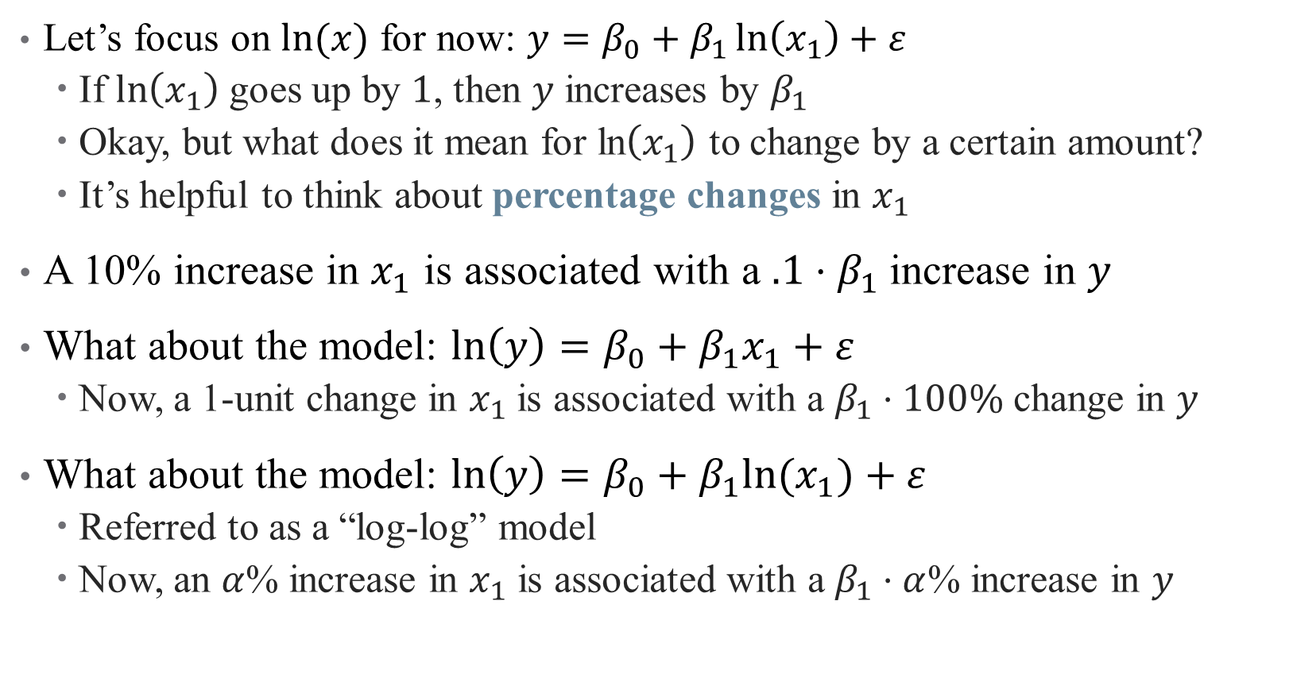
How to interpret coefficients on transformed variables?
Let’s focus on $ln⁡(x)$ for now: $y=β_{0}+β_{1}\ln\left(x_{1}\right)+ε$
If $\ln\left(x_{1}\right)$ goes up by $1$, then $y$ increases by $β_{1}$
Okay, but what does it mean for ln$\left(x_{1}\right)$ to change by a certain amount?
It’s helpful to think about percentage changes in $x_{1}$
A 10% increase in $x_{1}$ is associated with a $.1⋅β_{1}$ increase in $y$
What about the model: $ln\left(y\right)=β_{0}+β_{1}x_{1}+ε$
Now, a 1-unit change in $x_{1}$ is associated with a $β_{1}⋅100\%$ change in $y$
What about the model: $ln\left(y\right)=β_{0}+β_{1}{ln⁡(x}_{1})+ε$
Referred to as a “log-log” model
Now, an $α$% increase in $x_{1}$ is associated with a $β_{1}⋅α$% increase in $y$

Slide 22
Interaction Effects

Slide 23

What is an Interaction?
Suppose we want to know the effect of $X$ on $Y$ specific to groups $D$
Examples: what is the effect of radiology on survival?

Slide 24

What is an Interaction?
Suppose we want to know the effect of $X$ on $Y$ specific to groups $D$
Examples: what is the effect of radiology on survival?
Well, for those with cancer, or for those without?
We want to flexibly model how a relationship between two variables may depend on the levels of a third
$$Y=β_{0}+β_{1}X+β_{2}Z+β_{3}\left(X⋅Z\right)+ε$$

Slide 25
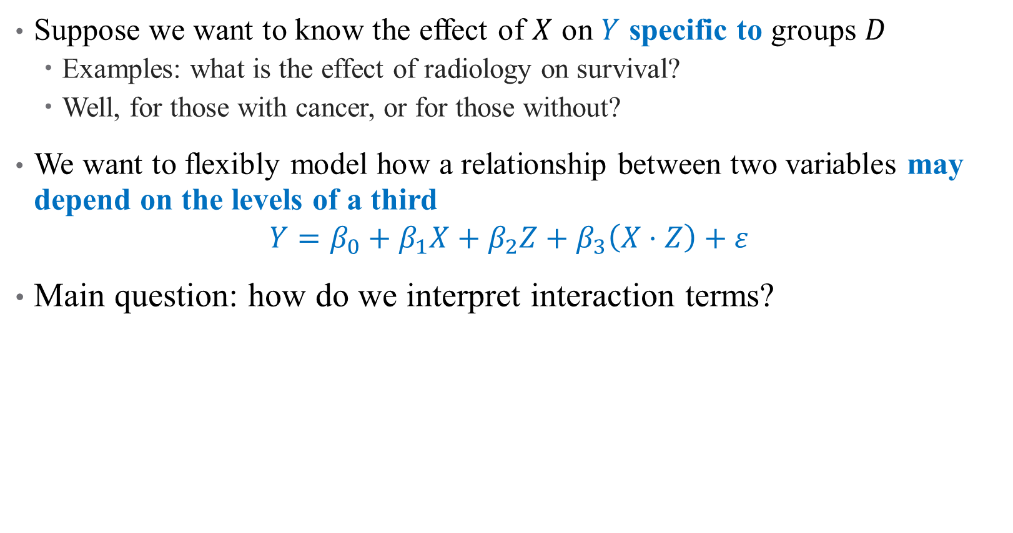
What is an Interaction?
Suppose we want to know the effect of $X$ on $Y$ specific to groups $D$
Examples: what is the effect of radiology on survival?
Well, for those with cancer, or for those without?
We want to flexibly model how a relationship between two variables may depend on the levels of a third
$$Y=β_{0}+β_{1}X+β_{2}Z+β_{3}\left(X⋅Z\right)+ε$$
Main question: how do we interpret interaction terms?

Slide 26
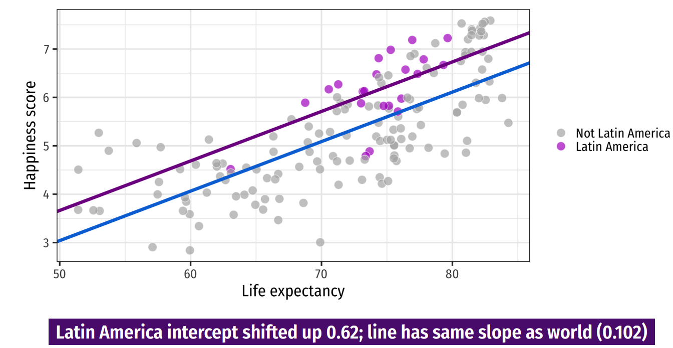
Discrete Regressors
Notes:
This is from last time – the impact of including a dummy is an intercept shift

Slide 27
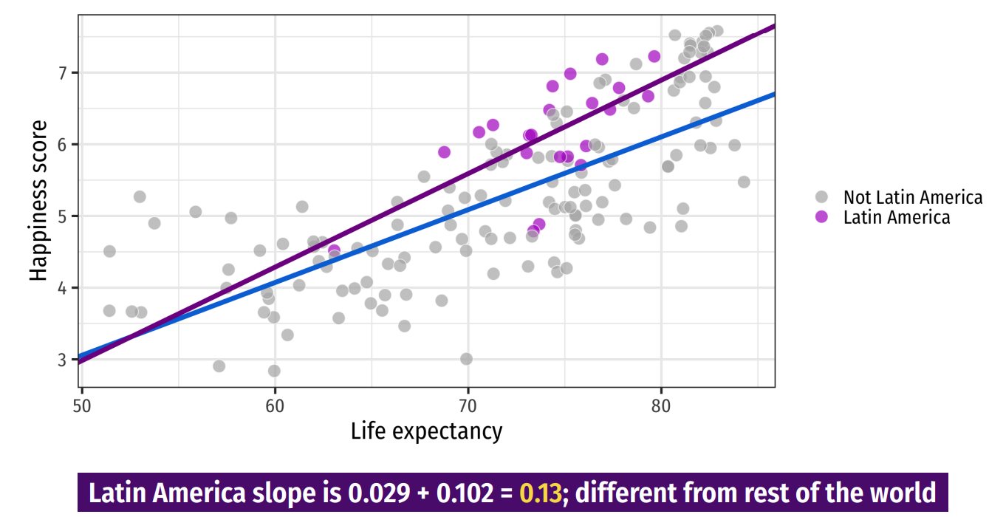
Discrete Regressors
Notes:
An interaction is a change in slope for two groups

Slide 28
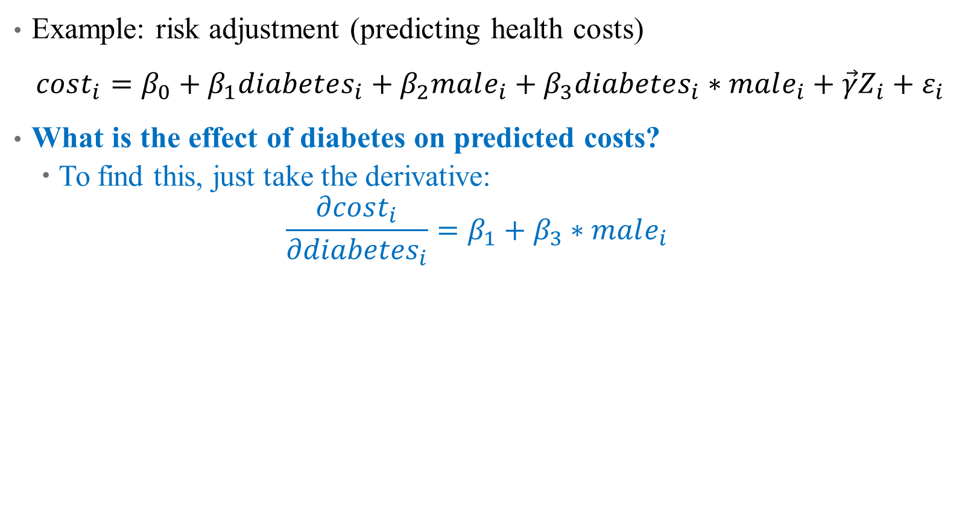
How do we Interpret Interaction Terms?
Example: risk adjustment (predicting health costs)
$cost_{i}=β_{0}+β_{1}diabetes_{i}+β_{2}male_{i}+β_{3}diabetes_{i}∗male_{i}+\vec{γ}Z_{i}+ε_{i}$
What is the effect of diabetes on predicted costs?
To find this, just take the derivative:
$$\frac{∂cost_{i}}{∂diabetes_{i}}=β_{1}+β_{3}∗male_{i}$$

Slide 29
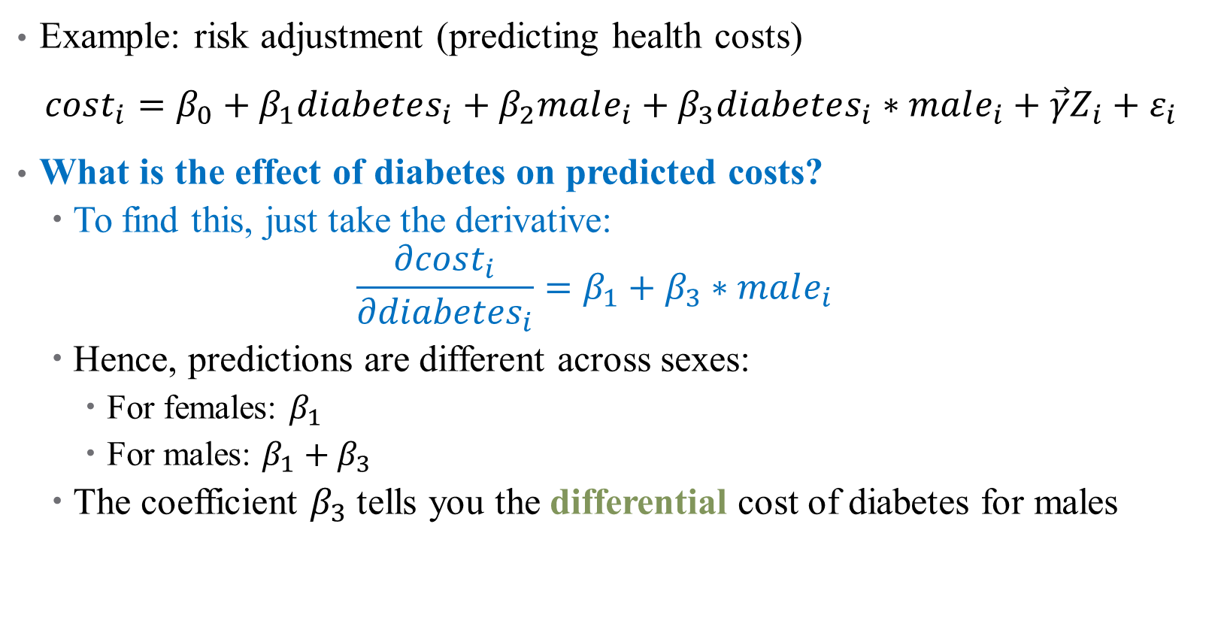
How do we Interpret Interaction Terms?
Example: risk adjustment (predicting health costs)
$cost_{i}=β_{0}+β_{1}diabetes_{i}+β_{2}male_{i}+β_{3}diabetes_{i}∗male_{i}+\vec{γ}Z_{i}+ε_{i}$
What is the effect of diabetes on predicted costs?
To find this, just take the derivative:
$$\frac{∂cost_{i}}{∂diabetes_{i}}=β_{1}+β_{3}∗male_{i}$$
Hence, predictions are different across sexes:
For females: $β_{1}$
For males: $β_{1}+β_{3}$
The coefficient $β_{3}$ tells you the differential cost of diabetes for males

Slide 30
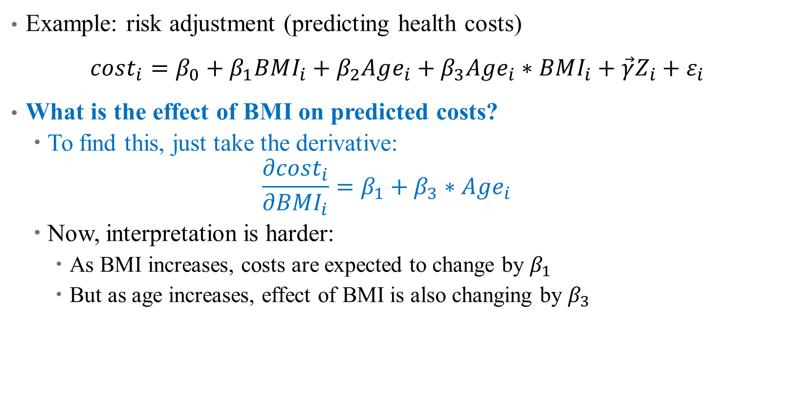
What about Continuous Interactions?
Example: risk adjustment (predicting health costs)
$cost_{i}=β_{0}+β_{1}BMI_{i}+β_{2}Age_{i}+β_{3}Age_{i}∗BMI_{i}+\vec{γ}Z_{i}+ε_{i}$
What is the effect of BMI on predicted costs?
To find this, just take the derivative:
$$\frac{∂cost_{i}}{∂BMI_{i}}=β_{1}+β_{3}∗Age_{i}$$
Now, interpretation is harder:
As BMI increases, costs are expected to change by $β_{1}$
But as age increases, effect of BMI is also changing by $β_{3}$

Slide 31
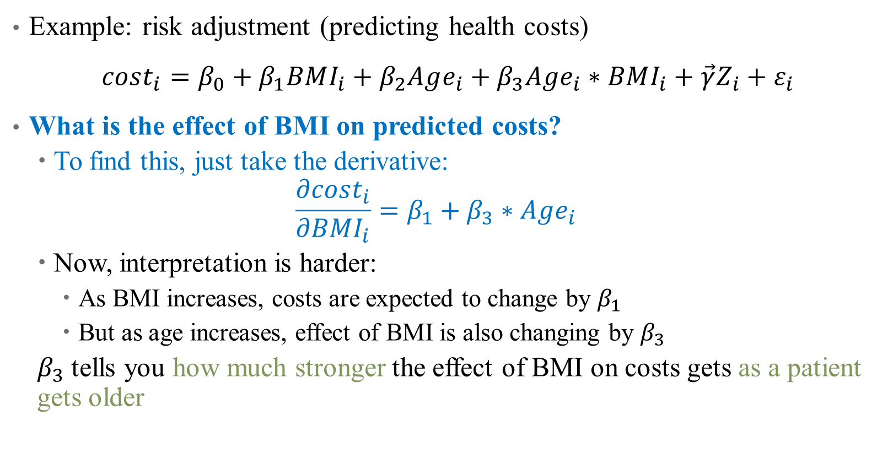
What about Continuous Interactions?
Example: risk adjustment (predicting health costs)
$cost_{i}=β_{0}+β_{1}BMI_{i}+β_{2}Age_{i}+β_{3}Age_{i}∗BMI_{i}+\vec{γ}Z_{i}+ε_{i}$
What is the effect of BMI on predicted costs?
To find this, just take the derivative:
$$\frac{∂cost_{i}}{∂BMI_{i}}=β_{1}+β_{3}∗Age_{i}$$
Now, interpretation is harder:
As BMI increases, costs are expected to change by $β_{1}$
But as age increases, effect of BMI is also changing by $β_{3}$
$β_{3}$ tells you how much stronger the effect of BMI on costs gets as a patient gets older

Slide 32
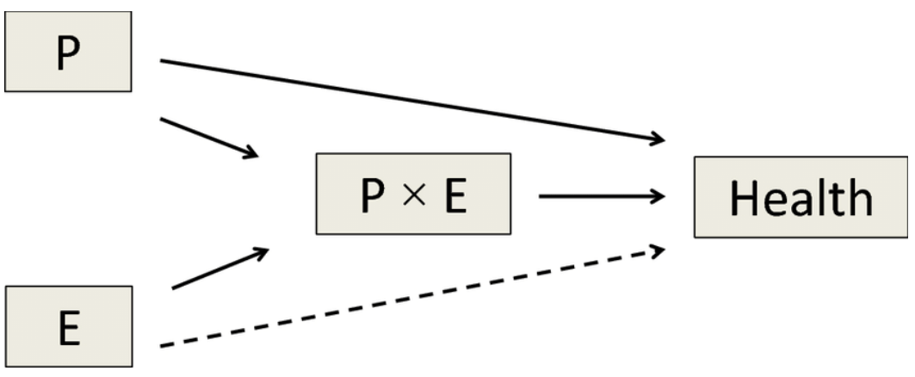

Interactions in Practice
Always include all pieces of an interaction in the full model
Much harder to interpret
Have a strong theoretical reason to justify inclusion
Too easy to get false positives
Effects are generally noisy
You’re exploiting variation across 2 noisy variables already
Will need large sample size
Notes:
Note on 1 – R will mostly do this for you, but don’t leave it up to chance

Slide 33
Nonlinear Models (pt. 1)

Slide 34
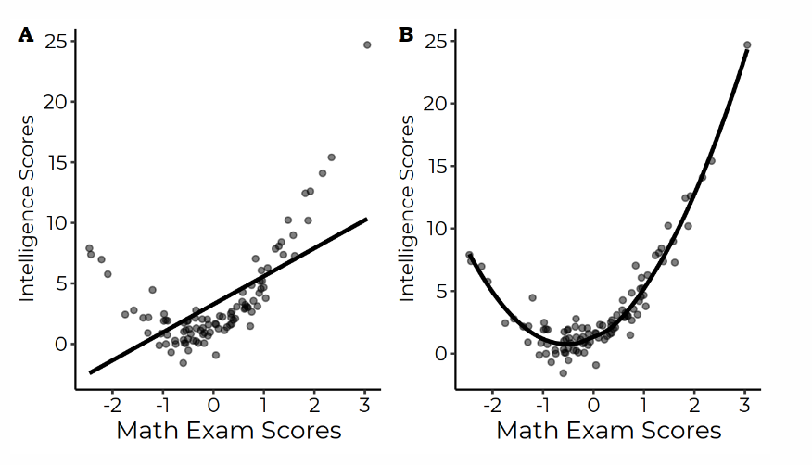
Nonlinearities
Sometimes, a linear model isn’t enough

Slide 35
Could we transform this data?
When data can be transformed to accommodate linear relationships, do it
Otherwise, add polynomial terms!

Slide 36

Choosing a Functional Form
OLS can accommodate regressions of the form:
$$y=β_{0}+β_{1}x+β_{2}x^{2}+β_{3}x^{3}+ …+\vec{γ}Z+ε$$
Still linear in parameters
As in interaction terms, never omit an intermediate power
That is, don’t add a cubic term without a quadratic one

Slide 37
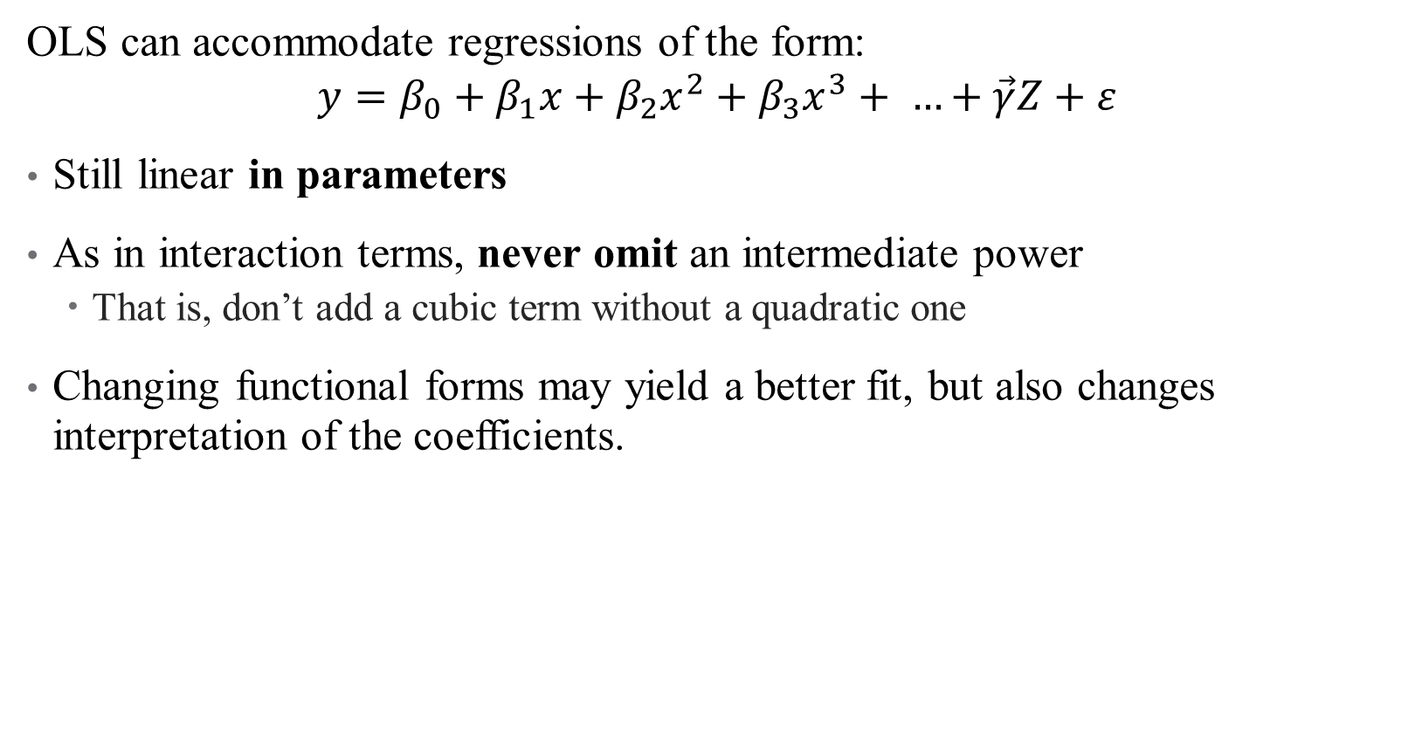
Choosing a Functional Form
OLS can accommodate regressions of the form:
$$y=β_{0}+β_{1}x+β_{2}x^{2}+β_{3}x^{3}+ …+\vec{γ}Z+ε$$
Still linear in parameters
As in interaction terms, never omit an intermediate power
That is, don’t add a cubic term without a quadratic one
Changing functional forms may yield a better fit, but also changes interpretation of the coefficients.

Slide 38
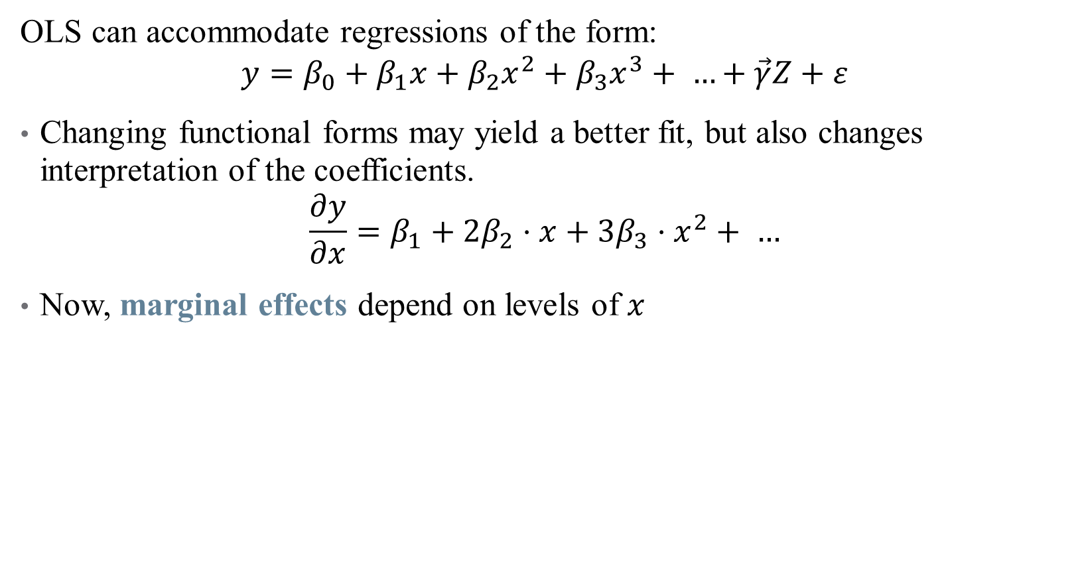
How do we Interpret Coefficients?
OLS can accommodate regressions of the form:
$$y=β_{0}+β_{1}x+β_{2}x^{2}+β_{3}x^{3}+ …+\vec{γ}Z+ε$$
Changing functional forms may yield a better fit, but also changes interpretation of the coefficients.
$$\frac{∂y}{∂x}=β_{1}+2β_{2}⋅x+3β_{3}⋅x^{2}+ …$$
Now, marginal effects depend on levels of $x$

Slide 39
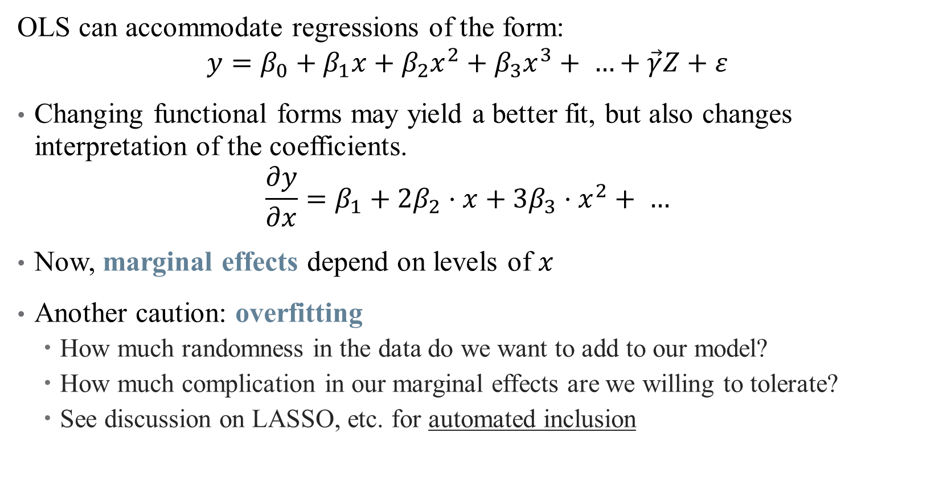
How do we Interpret Coefficients?
OLS can accommodate regressions of the form:
$$y=β_{0}+β_{1}x+β_{2}x^{2}+β_{3}x^{3}+ …+\vec{γ}Z+ε$$
Changing functional forms may yield a better fit, but also changes interpretation of the coefficients.
$$\frac{∂y}{∂x}=β_{1}+2β_{2}⋅x+3β_{3}⋅x^{2}+ …$$
Now, marginal effects depend on levels of $x$
Another caution: overfitting
How much randomness in the data do we want to add to our model?
How much complication in our marginal effects are we willing to tolerate?
See discussion on LASSO, etc. for automated inclusion

Slide 40
Getting the “Right” Standard Errors

Slide 41
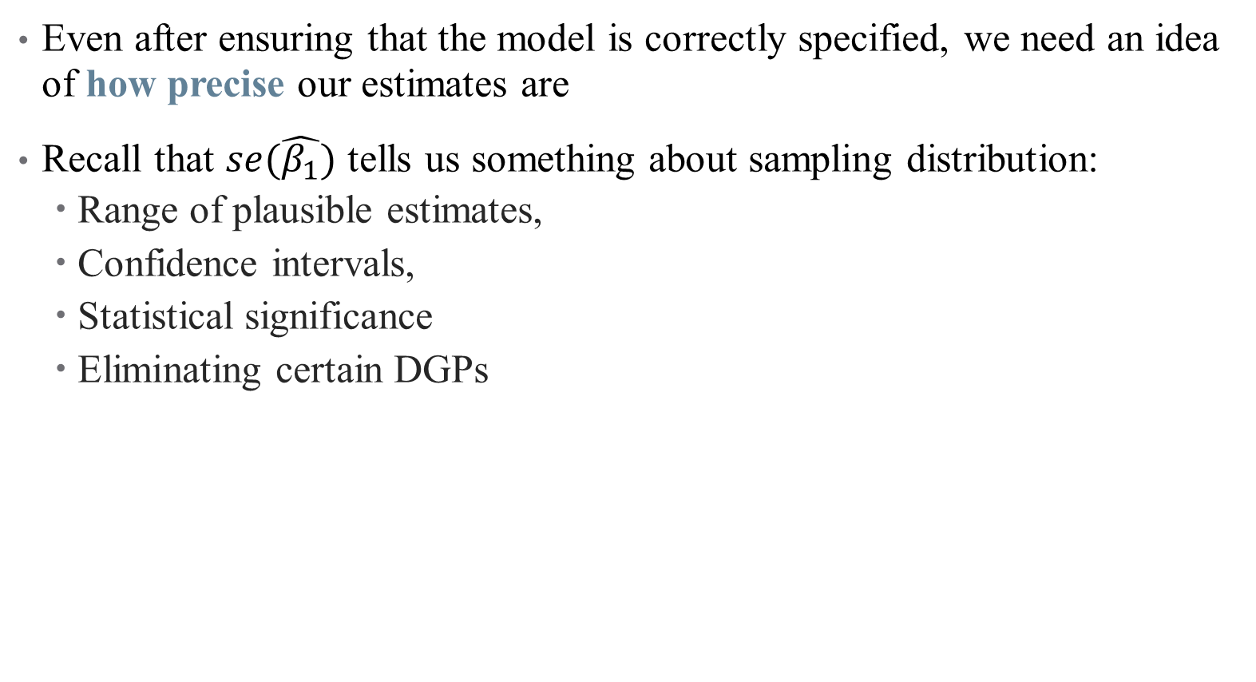
Standard Errors
Even after ensuring that the model is correctly specified, we need an idea of how precise our estimates are
Recall that $se(\hat{β_{1}})$ tells us something about sampling distribution:
Range of plausible estimates,
Confidence intervals,
Statistical significance
Eliminating certain DGPs

Slide 42
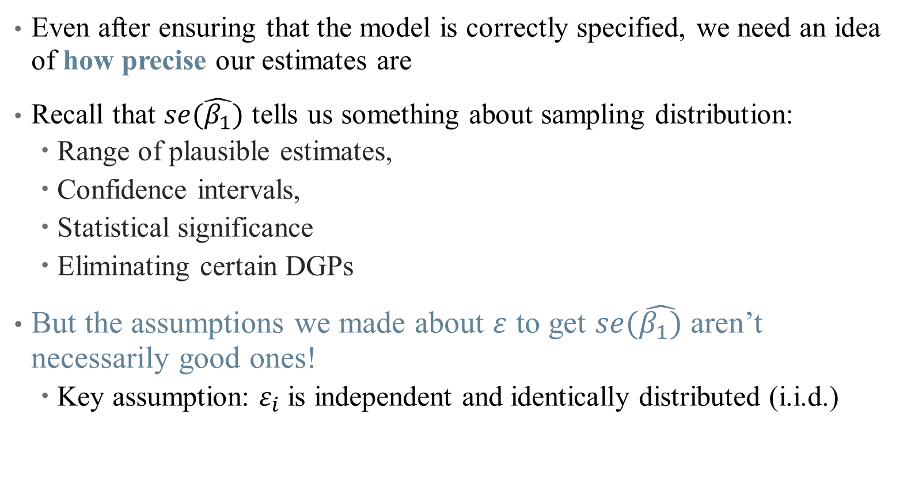
Standard Errors
Even after ensuring that the model is correctly specified, we need an idea of how precise our estimates are
Recall that $se(\hat{β_{1}})$ tells us something about sampling distribution:
Range of plausible estimates,
Confidence intervals,
Statistical significance
Eliminating certain DGPs
But the assumptions we made about $ε$ to get $se(\hat{β_{1})}$ aren’t necessarily good ones!
Key assumption: $ε_{i}$ is independent and identically distributed (i.i.d.)

Slide 43
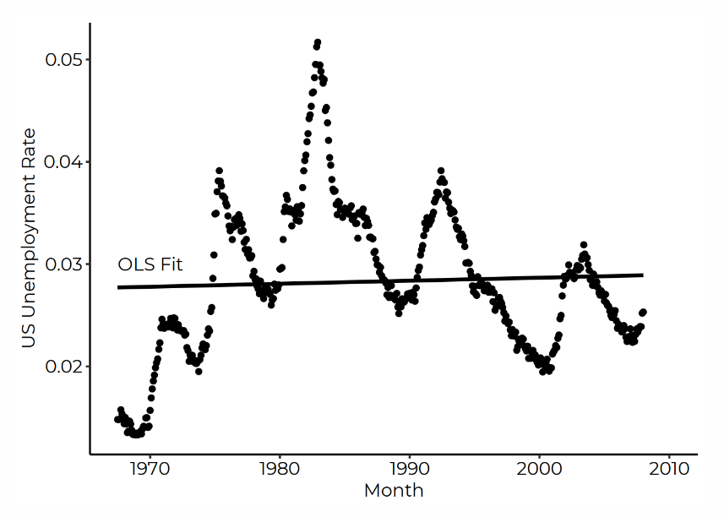
Are my error terms i.i.d.?
Autocorrelation: “Shock” of today is correlated with “shock” from yesterday

Slide 44
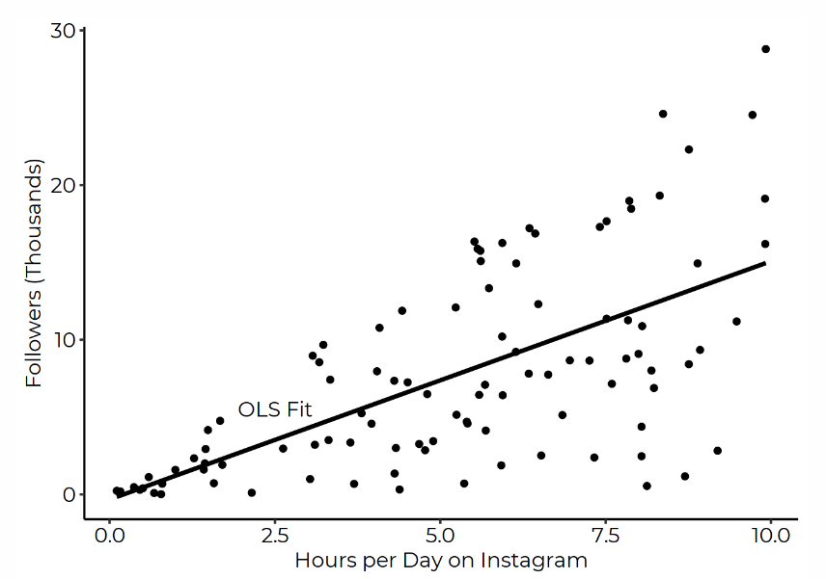

Are my error terms i.i.d.?
Heteroskedasticity: Variance of distribution depends on $x$

Slide 45

Are my error terms i.i.d.?
Autocorrelation: Today’s “shock” today is correlated with yesterday’s
Heteroskedasticity: Variance of distribution depends on $x$
Others: Correlation within groups, multiple testing, sampling errors, etc.
Failure of $ε$ to be i.i.d. means that $se\left(\hat{β_{1}}\right)≠\sqrt{\frac{σ^{2}}{var\left(x\right)n}}$

Slide 46
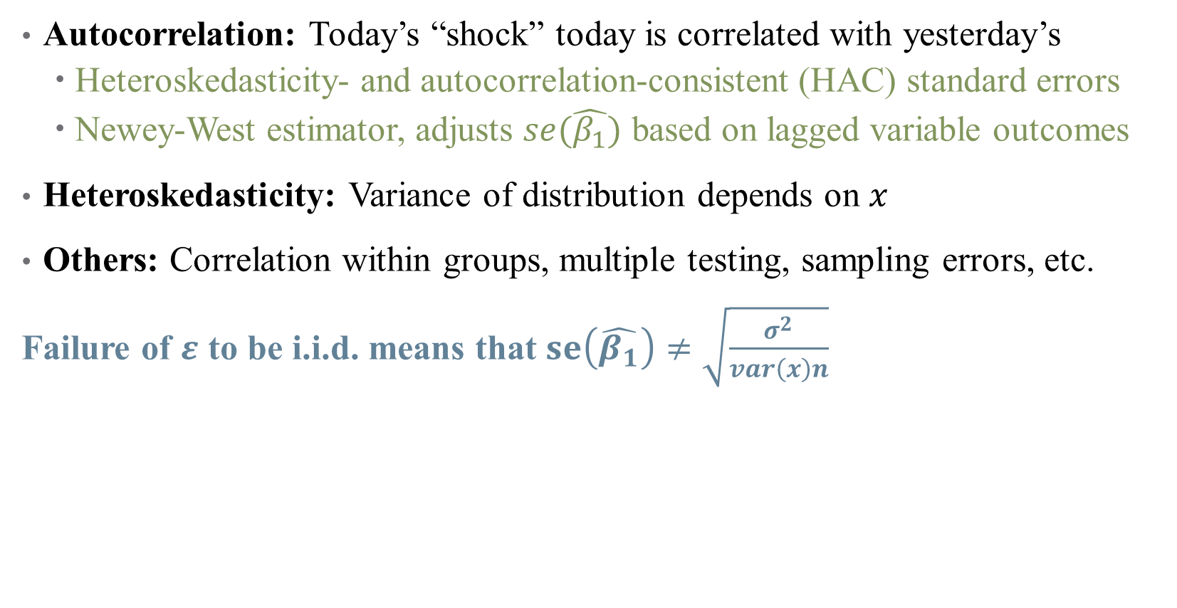
Are my error terms i.i.d.?
Autocorrelation: Today’s “shock” today is correlated with yesterday’s
Heteroskedasticity- and autocorrelation-consistent (HAC) standard errors
Newey-West estimator, adjusts $se(\hat{β_{1}})$ based on lagged variable outcomes
Heteroskedasticity: Variance of distribution depends on $x$
Others: Correlation within groups, multiple testing, sampling errors, etc.
Failure of $ε$ to be i.i.d. means that $se\left(\hat{β_{1}}\right)≠\sqrt{\frac{σ^{2}}{var\left(x\right)n}}$

Slide 47
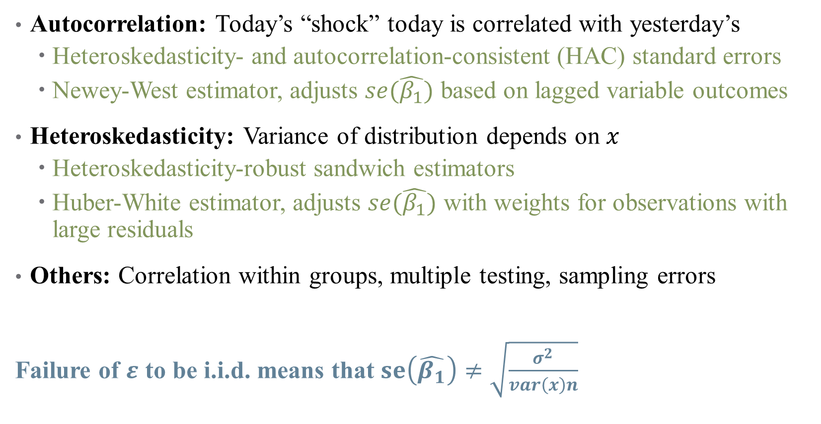
Are my error terms i.i.d.?
Autocorrelation: Today’s “shock” today is correlated with yesterday’s
Heteroskedasticity- and autocorrelation-consistent (HAC) standard errors
Newey-West estimator, adjusts $se(\hat{β_{1}})$ based on lagged variable outcomes
Heteroskedasticity: Variance of distribution depends on $x$
Heteroskedasticity-robust sandwich estimators
Huber-White estimator, adjusts $se(\hat{β_{1}})$ with weights for observations with large residuals
Others: Correlation within groups, multiple testing, sampling errors
Failure of $ε$ to be i.i.d. means that $se\left(\hat{β_{1}}\right)≠\sqrt{\frac{σ^{2}}{var\left(x\right)n}}$

Slide 48
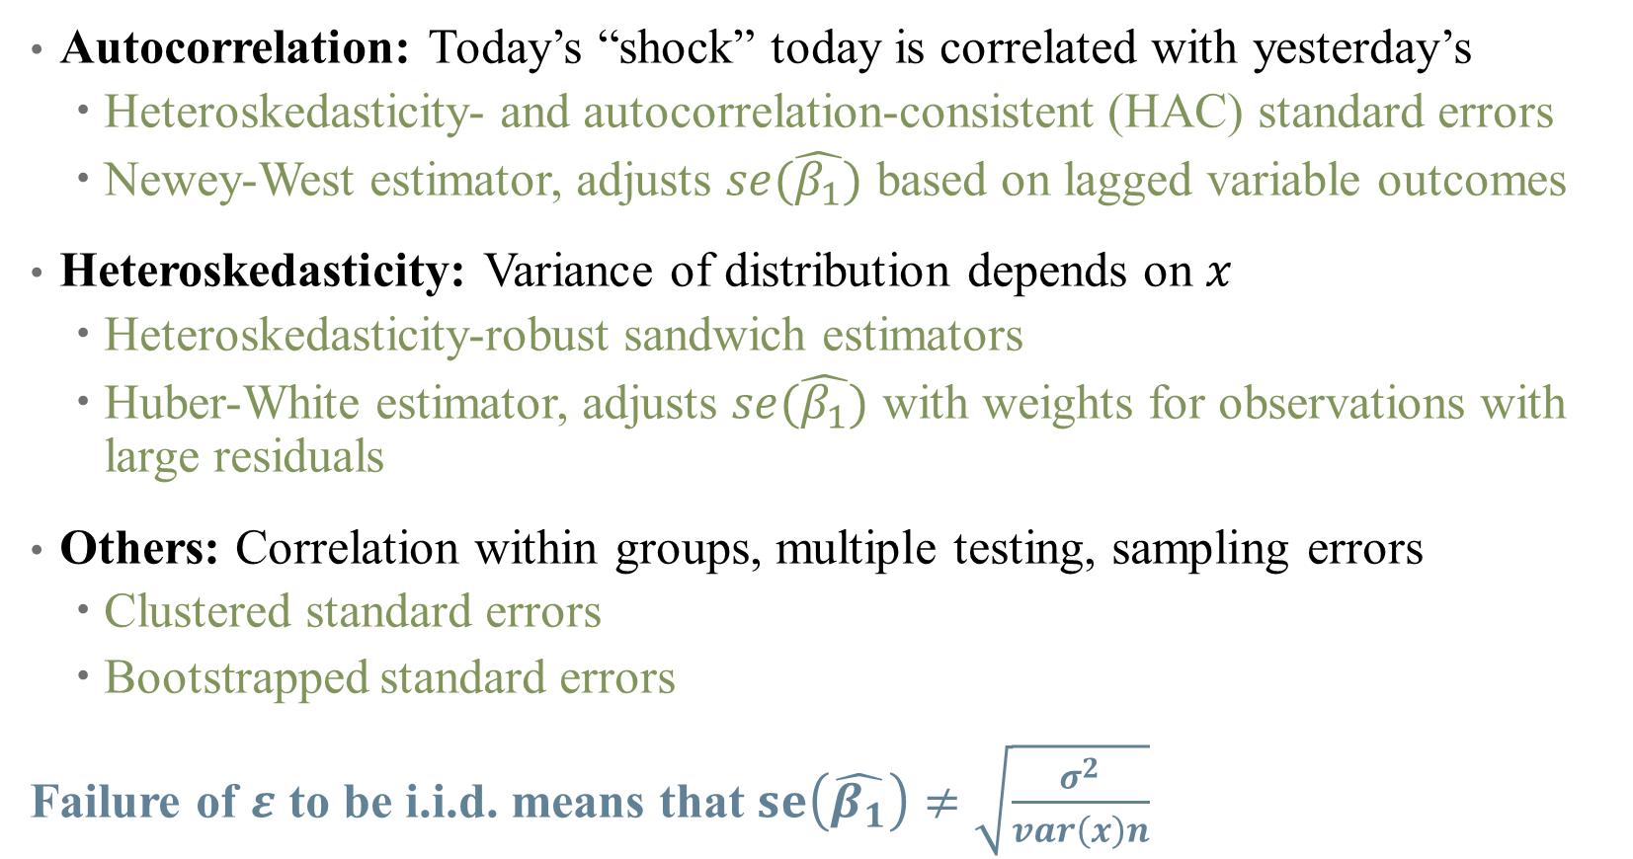
Are my error terms i.i.d.?
Autocorrelation: Today’s “shock” today is correlated with yesterday’s
Heteroskedasticity- and autocorrelation-consistent (HAC) standard errors
Newey-West estimator, adjusts $se(\hat{β_{1}})$ based on lagged variable outcomes
Heteroskedasticity: Variance of distribution depends on $x$
Heteroskedasticity-robust sandwich estimators
Huber-White estimator, adjusts $se(\hat{β_{1}})$ with weights for observations with large residuals
Others: Correlation within groups, multiple testing, sampling errors
Clustered standard errors
Bootstrapped standard errors
Failure of $ε$ to be i.i.d. means that $se\left(\hat{β_{1}}\right)≠\sqrt{\frac{σ^{2}}{var\left(x\right)n}}$

Slide 49
Clustered Standard Errors
Errors might be correlated in a hierarchical structure
Example: effect of a health intervention across villages in rural area?
Different village structures mean people in same village have similar “shocks”
Errors might be correlated within villages

Slide 50
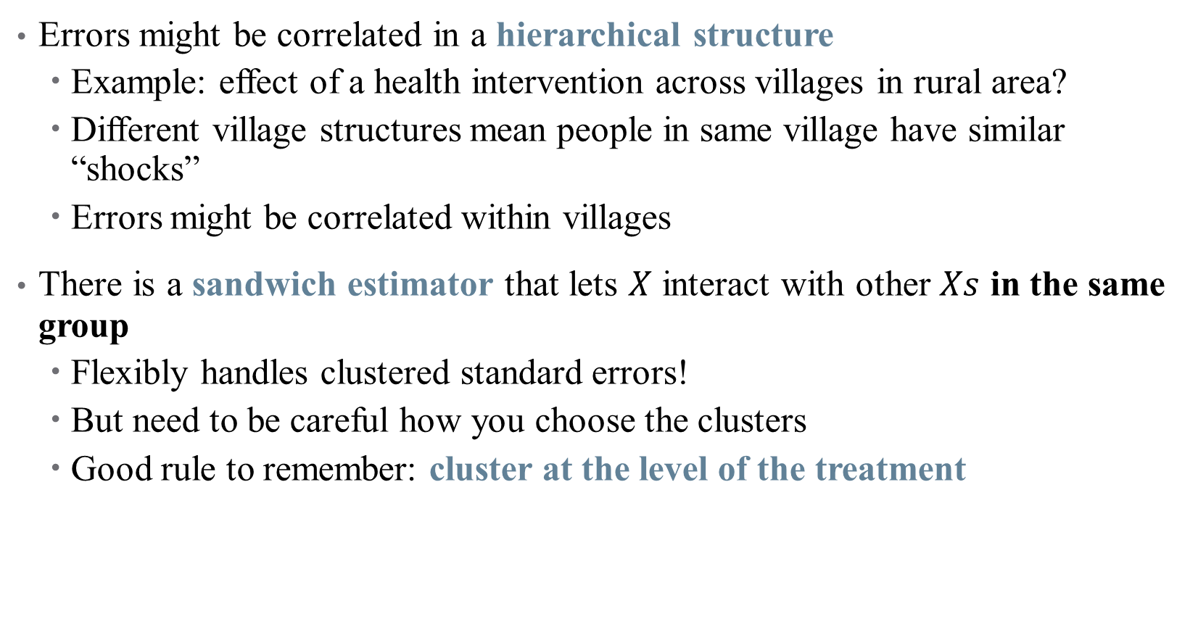
Clustered Standard Errors
Errors might be correlated in a hierarchical structure
Example: effect of a health intervention across villages in rural area?
Different village structures mean people in same village have similar “shocks”
Errors might be correlated within villages
There is a sandwich estimator that lets $X$ interact with other $Xs$ in the same group
Flexibly handles clustered standard errors!
But need to be careful how you choose the clusters
Good rule to remember: cluster at the level of the treatment

Slide 51
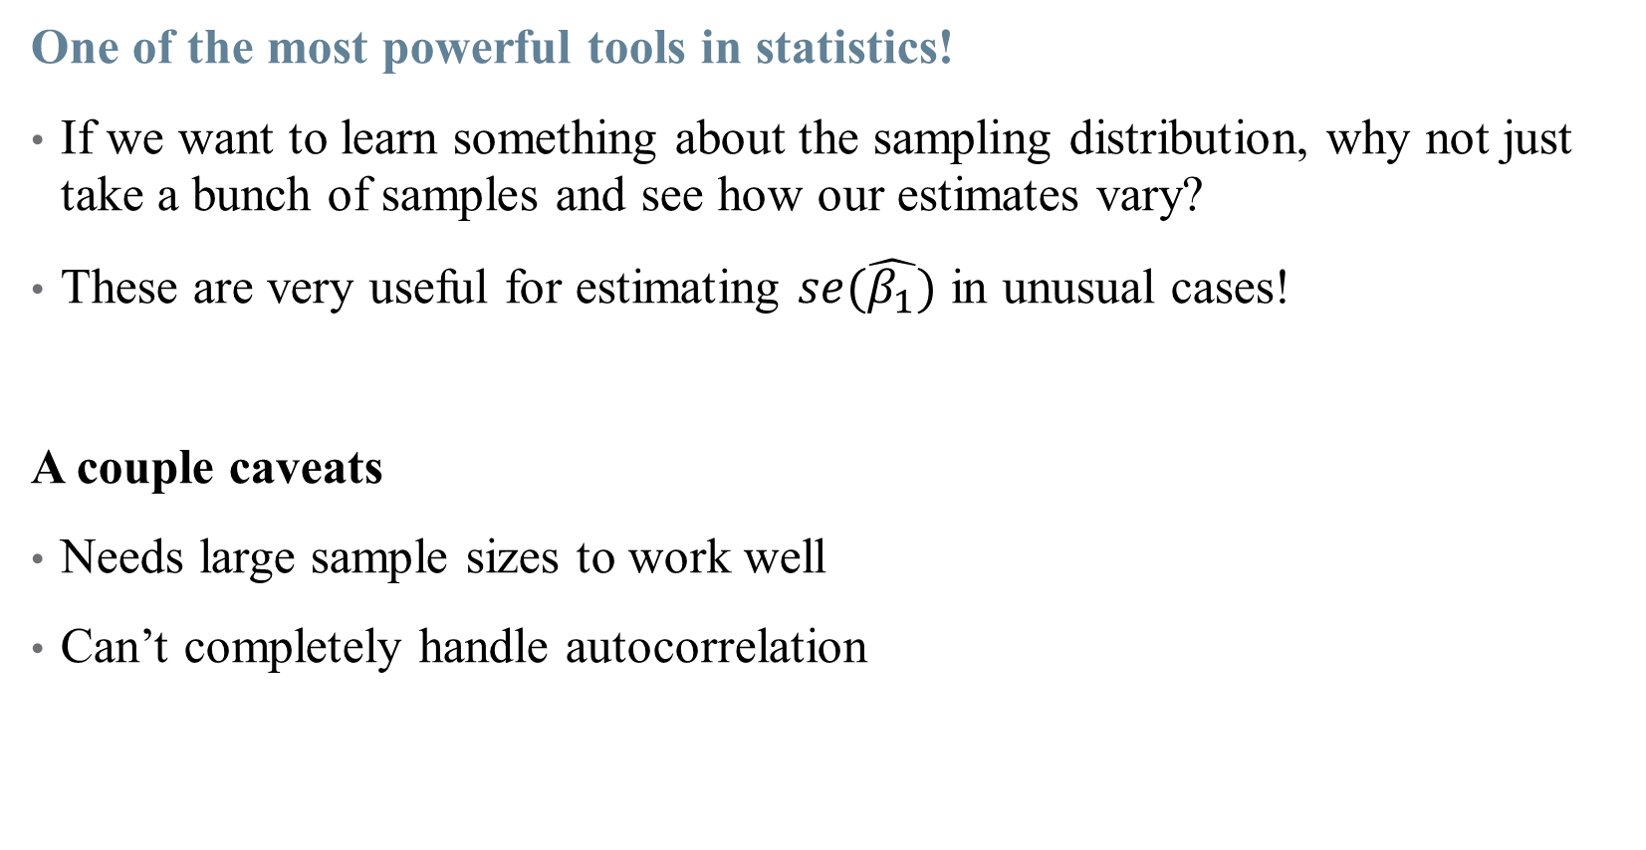
Bootstrapped Standard Errors
One of the most powerful tools in statistics!
If we want to learn something about the sampling distribution, why not just take a bunch of samples and see how our estimates vary?
These are very useful for estimating $se(\hat{β_{1}})$ in unusual cases!
A couple caveats
Needs large sample sizes to work well
Can’t completely handle autocorrelation

Slide 52
Bootstrapped Standard Errors
One of the most powerful tools in statistics!
Start with a data set with observations.
Randomly sample observations from that data set, allowing the same observation to be drawn more than once. This is a “bootstrap sample.”
Estimate our statistic of interest using the bootstrap sample.
Repeat steps 1-3 a whole bunch of times.
Look at the distribution of estimates from across all the times we repeated steps 1-3. The standard deviation of that distribution is the standard error of the estimate. The 2.5th and 97.5th percentiles show the 95% confidence interval, and so on.

Slide 53
Notes on Causality and Bias

Slide 54
Interpreting your results causally (One more time)
Remember that causality is hard!
Even after specifying your model, other things could go wrong:
Omitted Variables: missing data can bias your estimates
Measurement Error: mismeasured data can bias your estimates
Collinearity: correlation between variables can limit inferences
Notes:
We’re gonna touch on more threats to internal validity now.

Slide 55


Omitted Variables
Maybe you didn’t have data on a specific variable $z$
But if $Corr\left(x,z\right)≠0$, then omitting $z$ means $E\left(ε|x\right)≠0$
X
D
$$Y$$
R

Slide 56


Omitted Variables
Maybe you didn’t have data on a specific variable $z$
But if $Corr\left(x,z\right)≠0$, then omitting $z$ means $E\left(ε|x\right)≠0$
This leads to bias in your estimates:
$$bias\left(\hat{β_{1}}\right)=𝔼\left[\hat{β_{1}}\right]−β_{1}$$
$$=Corr\left(x,z\right)\frac{σ_{ε}}{σ_{x}}$$

Slide 57

Measurement Error
Imprecision in your data also leads to biased estimates
Suppose that we don’t observe $x$, but rather $\tilde{x}=x+ζ$, where $ζ∼N(0,1)$
In this (classical) sense, this kind of error attenuates a regression coefficient
Notes:
Attenuation is a common refrain in published papers, but measurement error is more complicated than that!

Slide 58
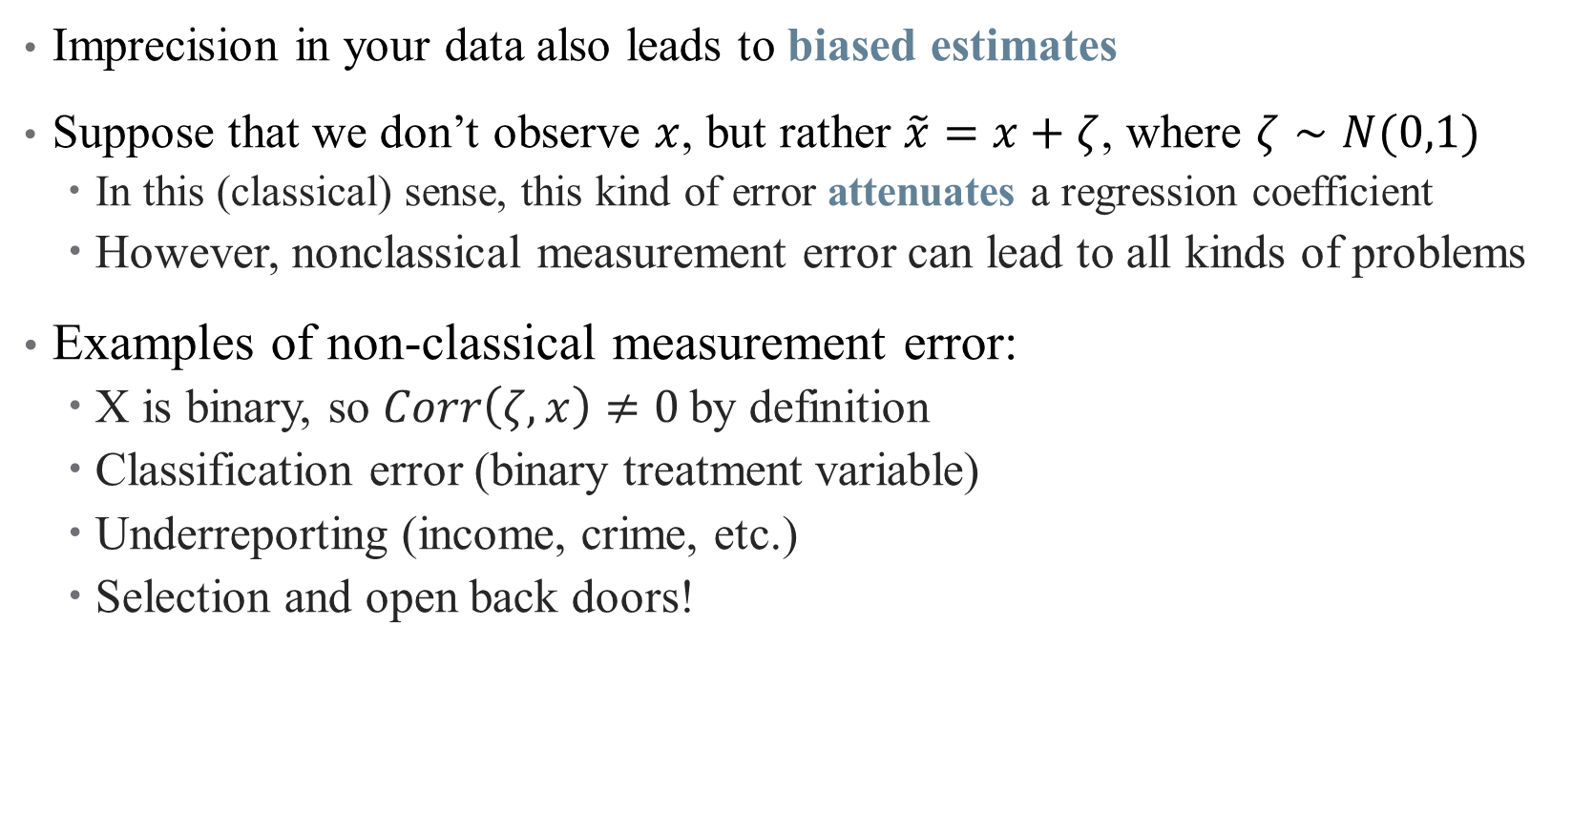
Measurement Error
Imprecision in your data also leads to biased estimates
Suppose that we don’t observe $x$, but rather $\tilde{x}=x+ζ$, where $ζ∼N(0,1)$
In this (classical) sense, this kind of error attenuates a regression coefficient
However, nonclassical measurement error can lead to all kinds of problems
Examples of non-classical measurement error:
X is binary, so $Corr\left(ζ, x\right)≠0$by definition
Classification error (binary treatment variable)
Underreporting (income, crime, etc.)
Selection and open back doors!

Slide 59

Non-Classical Measurement Error: Examples
Notes:
Measurement error can be the result of an open back door, or selection – what health examples are there?

Slide 60

Non-Classical Measurement Error: Examples
Effect of hospital quality on patient outcomes $⇒$
What about the hospitals that attract the riskiest patients?
Notes:
A whole literature on risk adjustment exists to solve this issue!

Slide 61

Collinearity and Causality
Some (explanatory) variables are highly correlated, complicating inference

Slide 62

Collinearity and Causality
Some (explanatory) variables are highly correlated, complicating inference
Inclusion of irrelevant variables tends to inflate the SEs for other estimates
What’s more, if variables are too highly correlated, their effects are indistinguishable
We’ve already run into the problem of perfect collinearity
A much harder problem is near-collinearity, where $\left|ρ\left(x_{1},x_{2}\right)\right|≈1$
This is especially problematic when we care about $β_{1}$or $β_{2}$, but not both

Slide 63

Collinearity and Causality
Some (explanatory) variables are highly correlated, complicating inference
Inclusion of irrelevant variables tends to inflate the SEs for other estimates
What’s more, if variables are too highly correlated, their effects are indistinguishable
We’ve already run into the problem of perfect collinearity
A much harder problem is near-collinearity, where $\left|ρ\left(x_{1},x_{2}\right)\right|≈1$
This is especially problematic when we care about $β_{1}$or $β_{2}$, but not both
How to diagnose this?
Look at correlation matrix of independent variables
Think about which correlations mess with your DAG

