Slide 1
Health Econometrics I
Lecture 11: New Developments in Staggered Adoption Designs
November 25, 2022
HAD5744 • Alex Hoagland, Ph.D.

Slide 2
Two Way Fixed Effects
Estimates dynamic treatment effects
Lets us pool multiple treated units potentially with differential timing of treatment (staggered adoption)
Very commonly used!
Notes:
26 of 100 most cited 2015-2019 AER papers estimate TWFE

Slide 3

Two Way Fixed Effects
Estimates dynamic treatment effects
Lets us pool multiple treated units potentially with differential timing of treatment (staggered adoption)
Very commonly used…incorrectly!

Slide 4
Session Outline
TWFE with Staggered Adoption: Review
Contamination in TWFE
Goodman-Bacon Decomposition
Robust Estimators
Alternative Frameworks
Notes:
4 is how to fix the problems without ditching a PTA – 5 is something completely different (?)

Slide 5
Contamination in TWFE
Notes:
Some people say synthetic control, but I like the plural – reminds me of the construction of the control group

Slide 6

Remember: Quasi-Experimental Variation
Notes:
In DiD we talked about exploiting time. The tricky thing here is that with federalism, things happen slowly over time

Slide 7
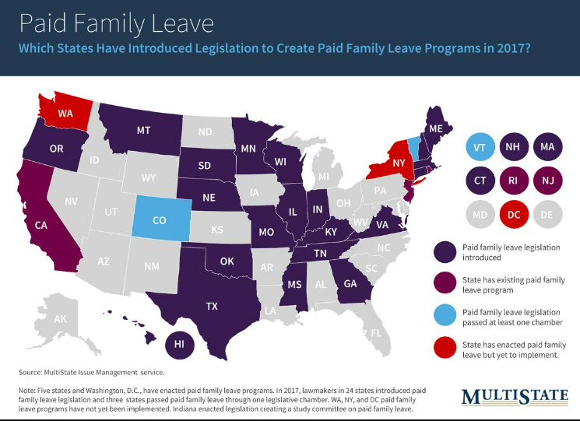
Remember: Quasi-Experimental Variation
Notes:
Each policy looks different and is enacted at different times. But we want power, right! Want to generalize and have external validity as well? These are good reasons for stacking.

Slide 8
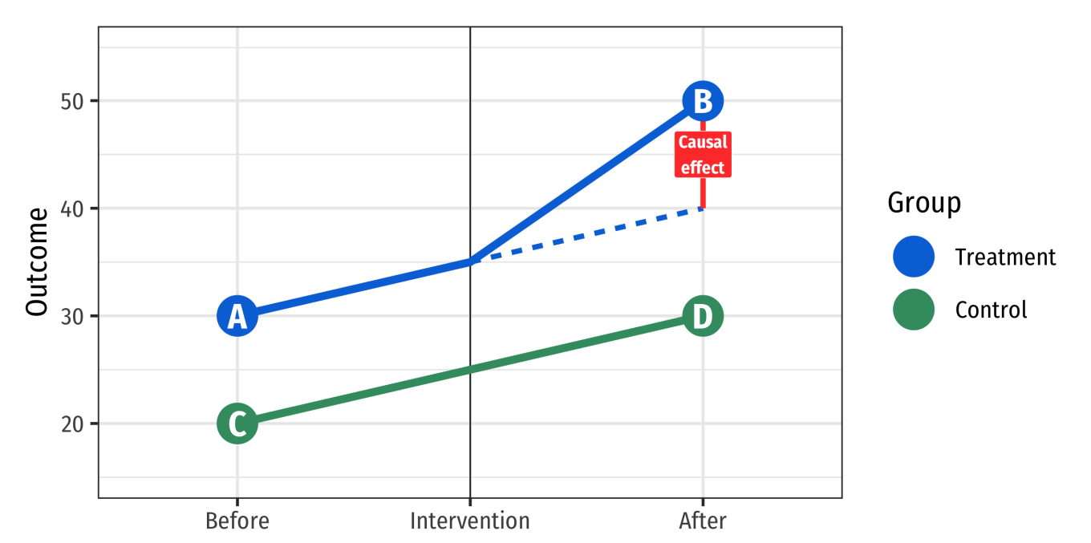
The Strategy Behind Difference-in-Differences (DID)
Notes:
General DID strategy – comparison and treatment

Slide 9

TWFE Regressions
$$y_{gt}=α_{g}+τ_{t}+{γ_{t}\sum_{t}{Treated_{g}×E_{t}}}_{}+ε_{gt}$$
Some estimation notes:
$E_{t}$ is a dummy variable for each (relative) time dummy
When can we say that TWFE = DID?

Slide 10
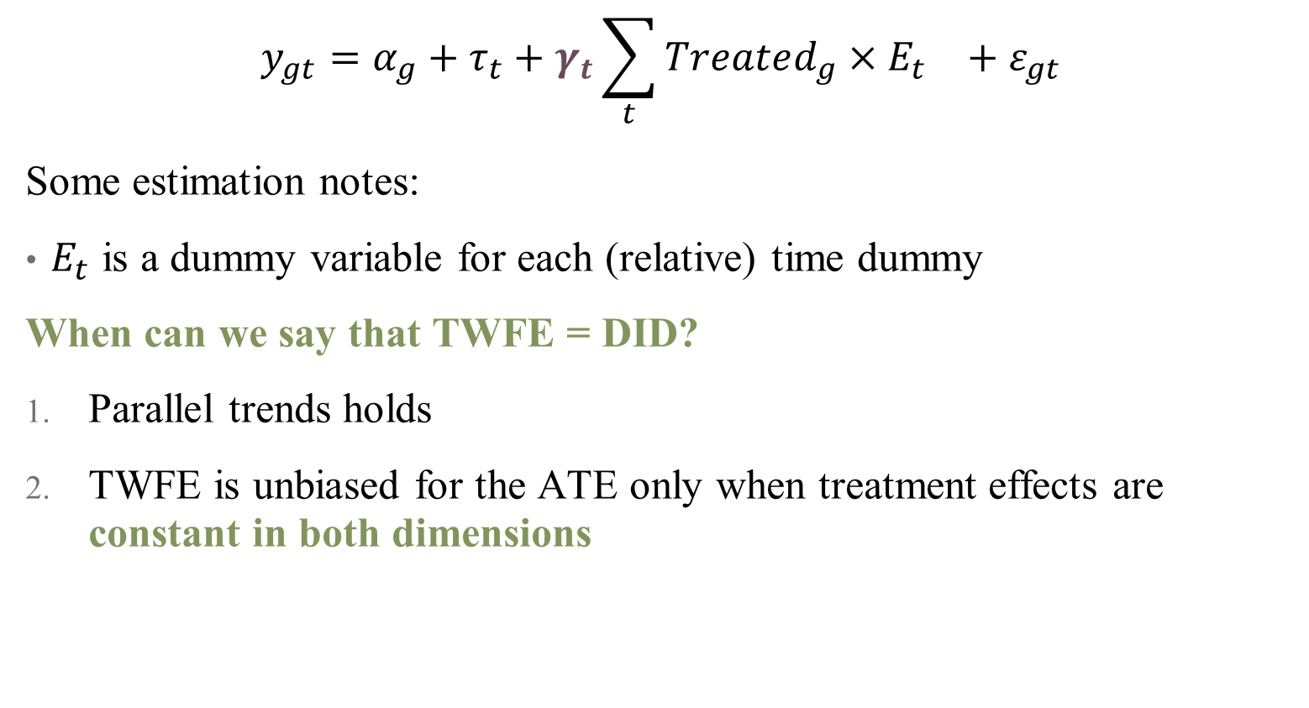
TWFE Regressions
$$y_{gt}=α_{g}+τ_{t}+{γ_{t}\sum_{t}{Treated_{g}×E_{t}}}_{}+ε_{gt}$$
Some estimation notes:
$E_{t}$ is a dummy variable for each (relative) time dummy
When can we say that TWFE = DID?
Parallel trends holds
TWFE is unbiased for the ATE only when treatment effects are constant in both dimensions
Notes:
Number 2 is frequently implausible!

Slide 11
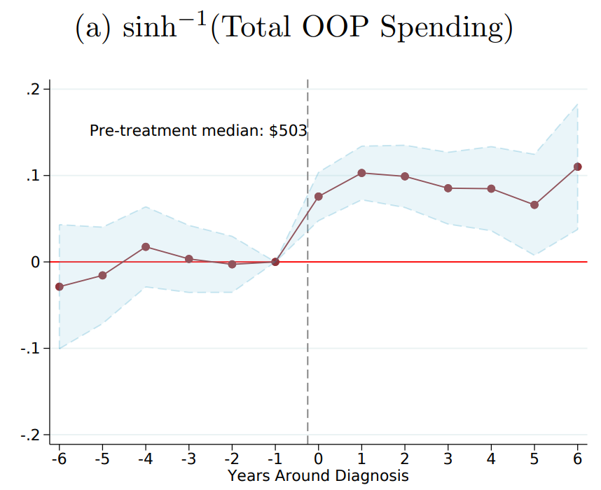
Dynamic Treatment Effects in TWFE
Notes:
This is what we hope to see when we run a TWFE – you can see why this is appealing (pre- and post-trend; tells you how long an effect sticks around, etc. )

Slide 12
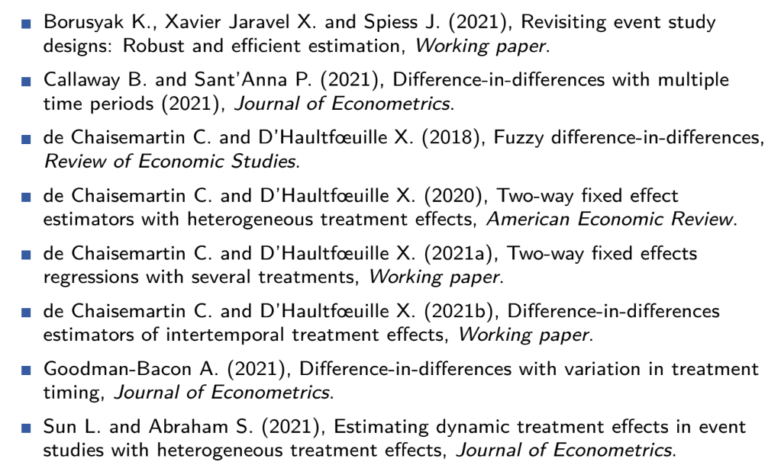
TWFE: A Flurry of Problems (2021)
Notes:
Lots of recent work on the problems of TWFE!

Slide 13
TWFE: A Flurry of Problems (2022)
“Two-way fixed effects and differences-in-differences with heterogeneous treatment effects: A survey” (De Chaisemartin & D'Haultfoeuille)
“Econometrics strikes back: GMM and two-way fixed effects” (Pinzon)
“Estimation of Heterogeneous Treatment Effects Using Quantile Regression with Interactive Fixed Effects” (Ruofan Xu, Jiti Gao, Tatsushi Oka, & Yoon–Jae Whang)
“Interactions in Fixed Effects Regression Models” (Marco Giesselmann & Alexander W. Schmidt-Catran)
“Contamination bias in linear regressions” (Paul Goldsmith-Pinkham, Peter Hull, & Michal Kolesár)
More here: https://asjadnaqvi.github.io/DiD/docs/resources
Notes:
Problems are both getting better and worse as we understand this issue more (it might be in OLS, and PSM? It might be fixable with GMM? This is a rapidly evolving field)

Slide 14

Primary Problem: Weighting
Event studies are pooling multiple DiDs
At their core, each individual DiD can be framed as a 2-by-2 comparison
TWFE takes each comparison and weights them
$$𝔼\left[{\hat{β}}_{fe}\right]=𝔼[\sum_{g,t}{W_{g,t} TE_{g,t}]}$$

Slide 15

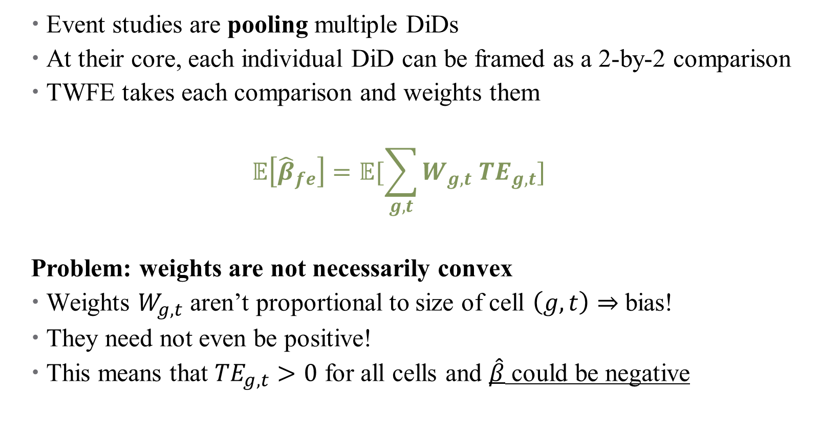
Primary Problem: Weighting
Event studies are pooling multiple DiDs
At their core, each individual DiD can be framed as a 2-by-2 comparison
TWFE takes each comparison and weights them
$$𝔼\left[{\hat{β}}_{fe}\right]=𝔼[\sum_{g,t}{W_{g,t} TE_{g,t}]}$$
Problem: weights are not necessarily convex
Weights $W_{g,t}$ aren’t proportional to size of cell $\left(g,t\right)⇒$ bias!
They need not even be positive!
This means that $TE_{g,t}>0$ for all cells and $\hat{β}$ could be negative
Notes:
Weights kind of come out of nowhere – they don’t match cell sizes, and they aren’t even “weights” in a sense of the word

Slide 16
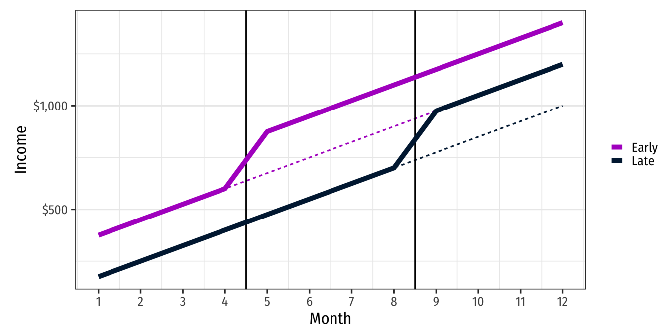
TWFE and Weighting Problems
Notes:
Suppose we have two treated units – one early and one late. Notice that the effect looks the same (and positive) for both groups

Slide 17
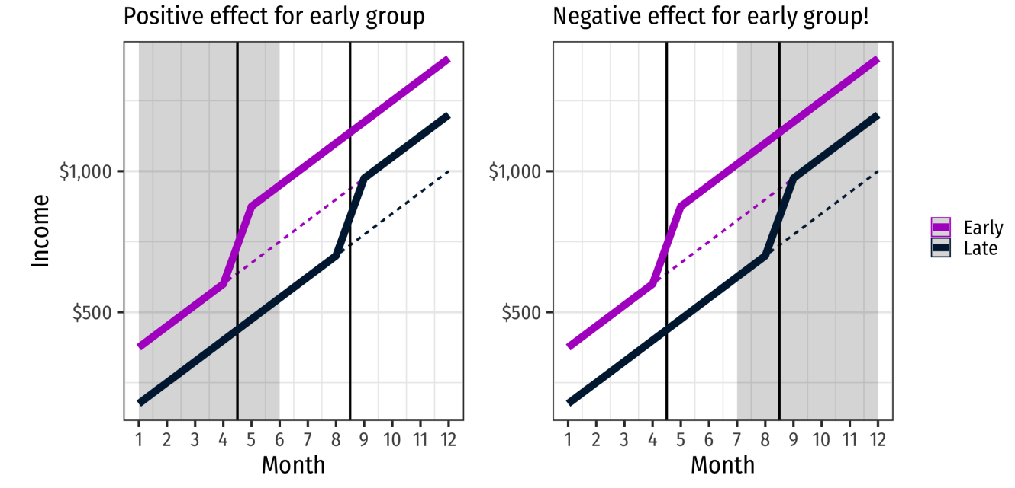
TWFE and Weighting Problems
Notes:
Here, in initial months around treatment for early group, we see positive increase, as expected; but if we look at dynamic treatment effects, then when late “turns on” it will look like early has gone down – what will the ES plot look like here?

Slide 18
Where do Negative Weights Come From?
Goodman-Bacon (2021) shows that event studies conflate two types of two-period DiDs:
Comparing a switching group to an unswitched group (untreated)
Comparing a switching group to an already treated unswitched group
This is where the negative weights come from!
Notes:
Remember each comparison is a 2-by-2 cell, so only two time periods and one control group. .

Slide 19
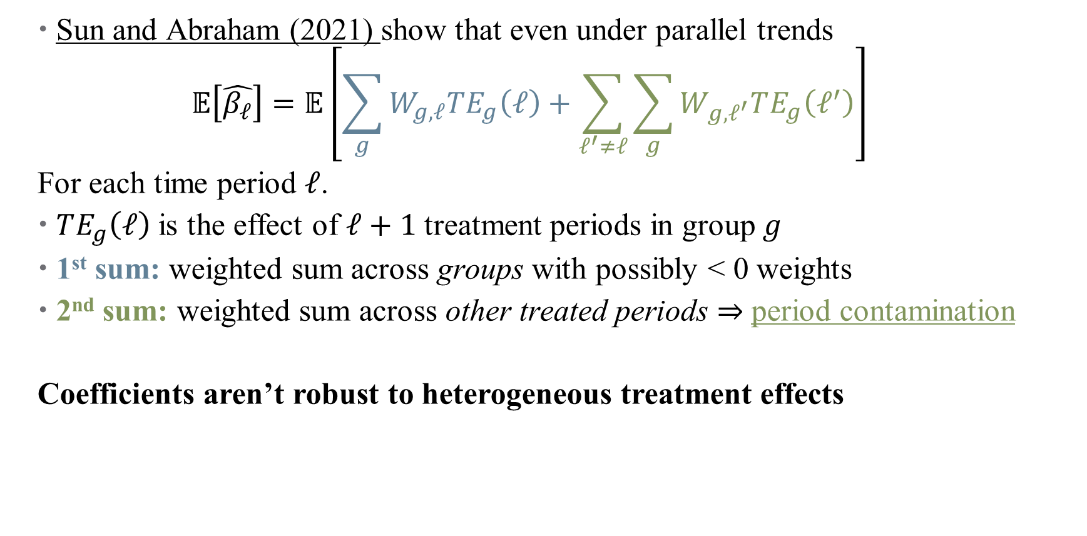
Another Problem: Heterogeneous Treatment Effects
Sun and Abraham (2021) show that even under parallel trends
$$𝔼\left[\hat{β_{ℓ}}\right]=𝔼\left[\sum_{g}{W_{g,ℓ}TE_{g}\left(ℓ\right)+\sum_{ℓ^{′}≠ℓ}{\sum_{g}{W_{g,ℓ^{′}}TE_{g}\left(ℓ^{′}\right)}}}\right]$$
For each time period $ℓ$.
$TE_{g}\left(ℓ\right)$ is the effect of $ℓ+1$ treatment periods in group $g$
1st sum: weighted sum across groups with possibly < 0 weights
2nd sum: weighted sum across other treated periods $⇒$ period contamination
Coefficients aren’t robust to heterogeneous treatment effects
Notes:
Sorry to switch from t to l here. Why ell + 1 – reference group category. This is true even for our pre-trend coefficients.

Slide 20
Alternatives to TWFE
Notes:
Largely comes from Section 3 of the JEL paper by two French authors whose names I really need to learn to pronounce (de Chaisemartin and d'haultfoeuille)

Slide 21
Two main approaches:
Imputation estimators
Fits a TWFE regression in the sample of untreated observations
Uses that regression to predict the counterfactual outcome of treated observations
Most efficient estimation for large samples
Notes:
All estimators here carefully construct comparisons between treatment and control groups that don’t have contamination (unlike TWFE).

Slide 22
Two main approaches:
Imputation estimators
Fits a TWFE regression in the sample of untreated observations
Uses that regression to predict the counterfactual outcome of treated observations
Most efficient estimation for large samples
2. Doubly-robust estimators
Separate models predicting weights (across cells)
Attractive feature: unbiased even if model is misspecified
Also good if you need to condition on covariates for parallel pre-trends
Notes:
Note that here, no “forbidden comparisons” are made.

Slide 23
Two main approaches:
Imputation estimators
Fits a TWFE regression in the sample of untreated observations
Uses that regression to predict the counterfactual outcome of treated observations
Most efficient estimation for large samples
2. Doubly-robust estimators
Separate models predicting weights (across cells)
Attractive feature: unbiased even if model is misspecified
Also good if you need to condition on covariates for parallel pre-trends
3. Alternatives not covered here:
Randomized timing (Athey and Imbens, 2022; Roth and Sant’Anna, 2021)
Sequential treatment randomization (Bojinov et al., 2021)
Non-binary/multiple treatments (de Chaisemartin and D’Haultfoeuille, 202)
Notes:
Note that here, no “forbidden comparisons” are made.

Slide 24
Estimators Everywhere!
did_multiplegt
csdid
did_imputation
eventsutdyinteract
stackedev
did2s
sdid
Important question to consider: what is our estimand?
A handy resource: https://asjadnaqvi.github.io/DiD/docs/code/06_twfe/
Notes:
Estimand means: what parameter are we after (e.g., ATT, ATE, something else?) Has good code examples for all relevant estimators

Slide 25
Estimators Everywhere!
did_multiplegt (de Chaisemartin and D’Haultfoeuille, 2020, Imai and Kim, 2021)
csdid (Callaway and Sant’Anna, 2021)
did_imputation (Borusyak et al., 2021; Liu et al., 2021; Gardner, 2021; Wooldridge 2021)
eventsutdyinteract (Sun and Abraham, 2021)
stackedev (Cunningham, 2021; Baker, 2021)
did2s (Gardner, 2021)
sdid (Arkhangelsky et al, 2019)
Important question to consider: what is our estimand?
A handy resource: https://asjadnaqvi.github.io/DiD/docs/code/06_twfe/
Notes:
We’ll do these three for now. Sun and Abraham is very similar to csdid. Stackedev (stacked did) is too transparent as to be inefficient, so less desirable – others have a direct model of counterfactual for untreated observations (PTA) that increases efficiency. Note: did_imputation and did2s are equivalent without covariates, but the did2s package works better/faster in R. synthetic did is newer and may have weaker parallel trends assumptions, but hasn’t really taken off yet.

Slide 26

If you are willing to rule out dynamic effects…
$DID_{M}$ estimator (de Chaisemartin and D’Haultfoeuille, 2020, Imai and Kim, 2021)
Direct comparison of
The $t−1$ to $t$ outcome evolution for $untreated→treated$groups
Groups untreated at both $t−1$ and $t$
Note: If you also have “switchers out” of treatment, can include these
Can test parallel trends assumptions with placebos
Estimated in R package DIDmultiplegt (Zhang and de Chaisemartin 2020)
Notes:
Section 3.1. Hint – this is basically just a DiD, with potentially multiple treated groups and staggered adoption. Shut down anything that looks like contamination.

Slide 27
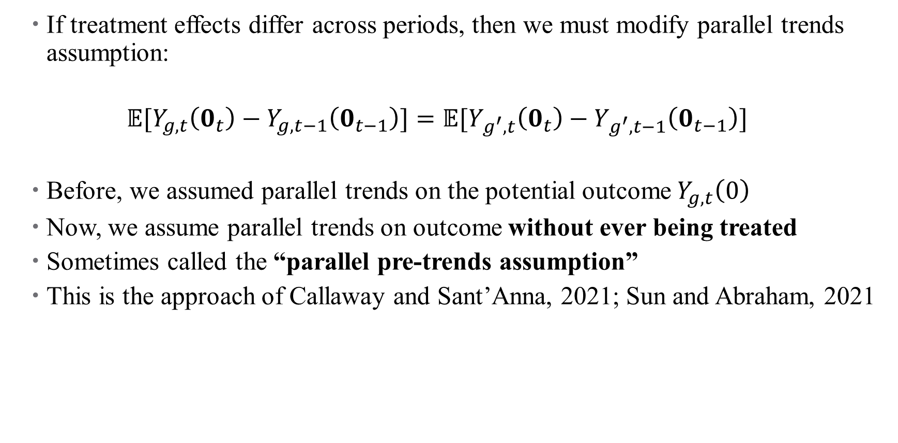
…but we want dynamic effects!
If treatment effects differ across periods, then we must modify parallel trends assumption:
$$𝔼[Y_{g,t}\left(0_{t}\right)−Y_{g,t−1}\left(0_{t−1}\right)]=𝔼[Y_{g^{′},t}\left(0_{t}\right)−Y_{g^{′},t−1}\left(0_{t−1}\right)]$$
Before, we assumed parallel trends on the potential outcome $Y_{g,t}\left(0\right)$
Now, we assume parallel trends on outcome without ever being treated
Sometimes called the “parallel pre-trends assumption”
This is the approach of Callaway and Sant’Anna, 2021; Sun and Abraham, 2021
Notes:
Here, bold 0 is a vector of t 0s, and we assume that these are two different groups (g \neq g’).

Slide 28

Callaway and Sant’Anna (2021)
Goal: recover cohort-period-specific treatment effect $TE_{c, c+ℓ}$
For each cohort $c$ that received treatment at a specific year (not relative)
Allow treatment effects to vary across periods $ℓ$ (now relative)
To do this, aggregate treated units into cohorts
Each $TE_{c,c+ℓ}$is a comparison of cohort $c^{′}s$ evolution from $c−1$ to $c+ℓ$, compared against never-treated units
Notes:
Note the difference in estimand here – aggregate, period-specific treatment effect.

Slide 29
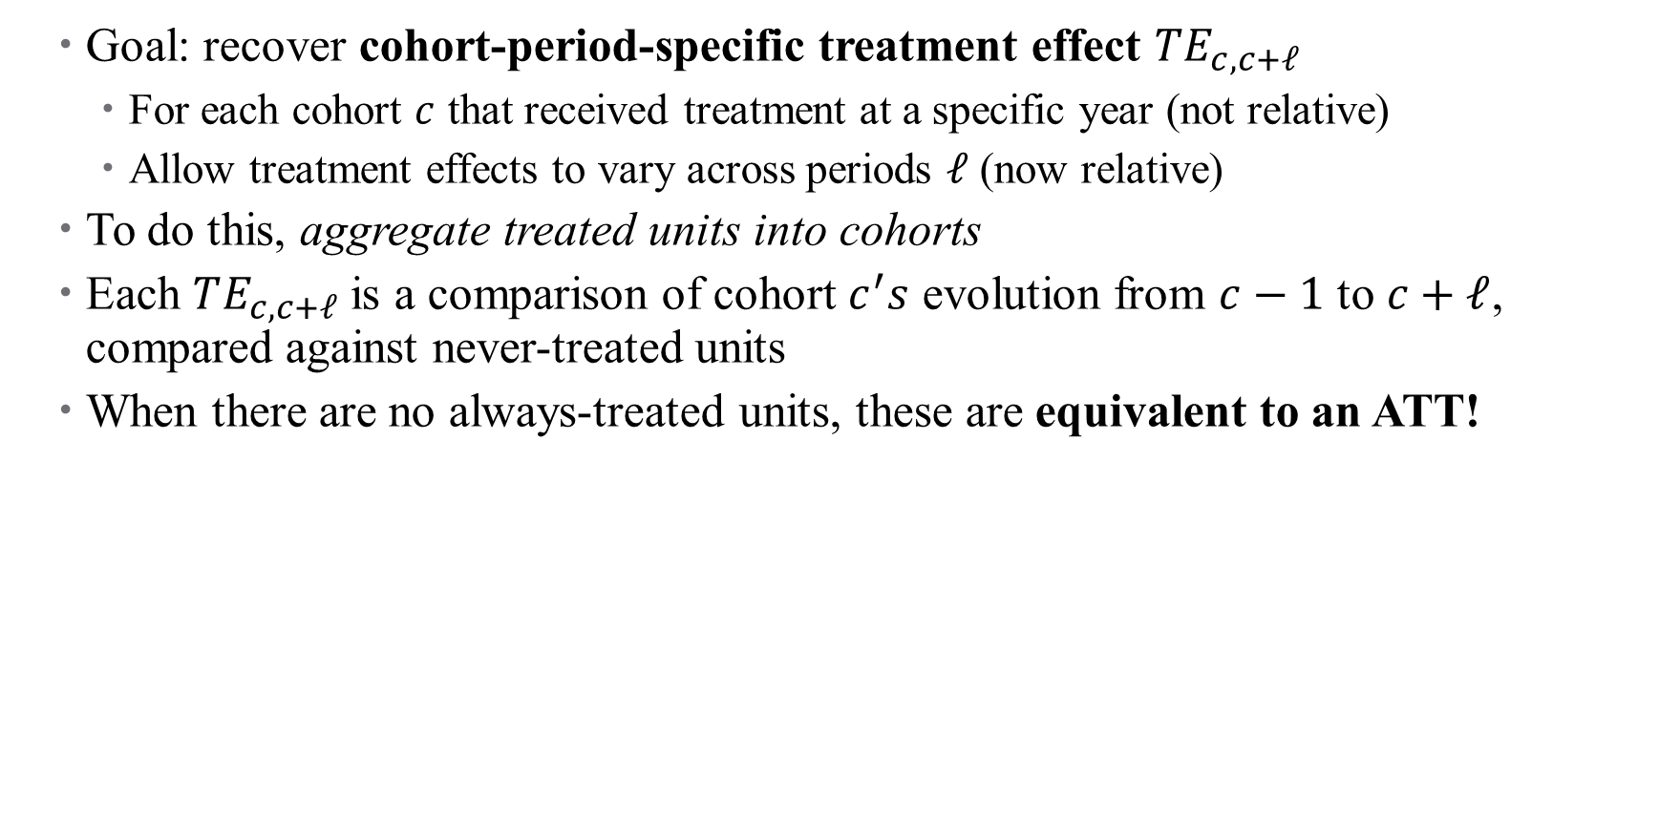
Callaway and Sant’Anna (2021)
Goal: recover cohort-period-specific treatment effect $TE_{c, c+ℓ}$
For each cohort $c$ that received treatment at a specific year (not relative)
Allow treatment effects to vary across periods $ℓ$ (now relative)
To do this, aggregate treated units into cohorts
Each $TE_{c,c+ℓ}$is a comparison of cohort $c^{′}s$ evolution from $c−1$ to $c+ℓ$, compared against never-treated units
When there are no always-treated units, these are equivalent to an ATT!
Notes:
Notice that this depends on there being never-treated units; what if we don’t have them? Also side note – we need never-treated units in order to pin down year fixed effects.

Slide 30
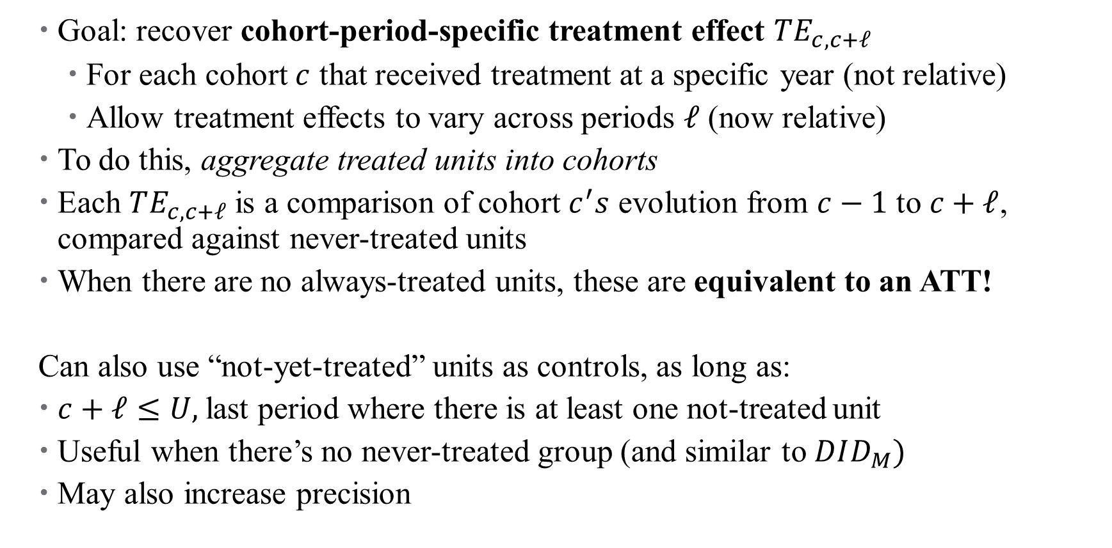
Callaway and Sant’Anna (2021)
Goal: recover cohort-period-specific treatment effect $TE_{c, c+ℓ}$
For each cohort $c$ that received treatment at a specific year (not relative)
Allow treatment effects to vary across periods $ℓ$ (now relative)
To do this, aggregate treated units into cohorts
Each $TE_{c,c+ℓ}$is a comparison of cohort $c^{′}s$ evolution from $c−1$ to $c+ℓ$, compared against never-treated units
When there are no always-treated units, these are equivalent to an ATT!
Can also use “not-yet-treated” units as controls, as long as:
$c+ℓ≤U,$last period where there is at least one not-treated unit
Useful when there’s no never-treated group (and similar to $DID_{M})$
May also increase precision
Notes:
Note – also can use “conditional parallel trends”, so you can use controls that give you parallel trends (e.g., condition on fraction of college grads in a zip code in order to estimate impact of minimum wage).
Note 2: Sun and Abraham have a very similar approach, but also allow for using last-treated units as a control group if needed.

Slide 31
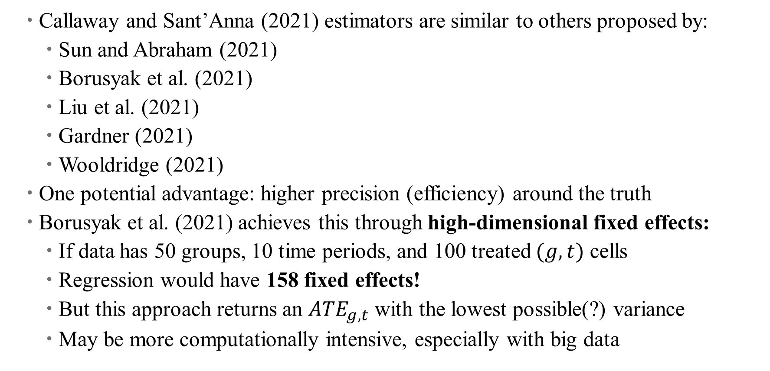
Increasing Efficiency: Borusyak et al., 2021
Callaway and Sant’Anna (2021) estimators are similar to others proposed by:
Sun and Abraham (2021)
Borusyak et al. (2021)
Liu et al. (2021)
Gardner (2021)
Wooldridge (2021)
One potential advantage: higher precision (efficiency) around the truth
Borusyak et al. (2021) achieves this through high-dimensional fixed effects:
If data has 50 groups, 10 time periods, and 100 treated $(g,t)$ cells
Regression would have 158 fixed effects!
But this approach returns an $ATE_{g,t}$ with the lowest possible(?) variance
May be more computationally intensive, especially with big data
Notes:
Not gonna cover this one in depth – efficiency gains can also happen by using big data. Not doubly robust, but fast implementation using the package from Gardner, 2021 (did2s)

Slide 32

So What’s the Difference?
Parallel Trends Assumptions differ:
Borusyak et al. require PTA for every group + every pair of consecutive periods
Callaway and Sant’Anna impose a weaker assumption:
Cohort $c$ must be on same trend as never-treated groups only from period $c$ on
Also allows for conditional PTA (covariates)
Notes:
Need to think carefully about what you’re after

Slide 33
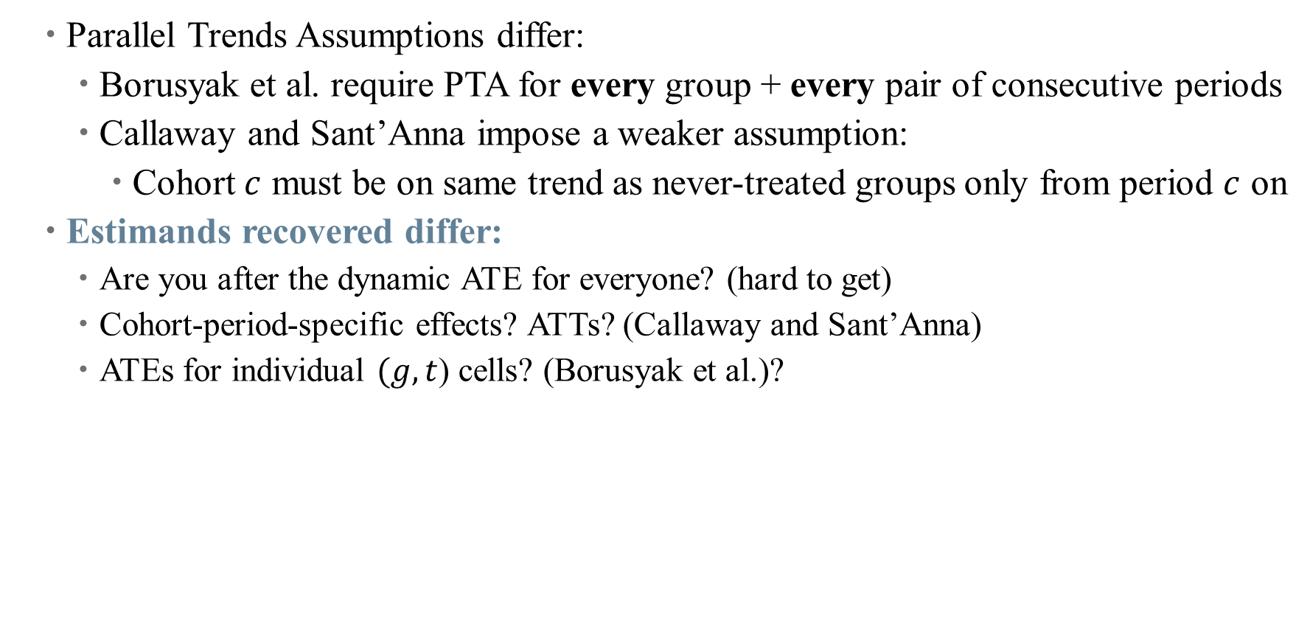
So What’s the Difference?
Parallel Trends Assumptions differ:
Borusyak et al. require PTA for every group + every pair of consecutive periods
Callaway and Sant’Anna impose a weaker assumption:
Cohort $c$ must be on same trend as never-treated groups only from period $c$ on
Estimands recovered differ:
Are you after the dynamic ATE for everyone? (hard to get)
Cohort-period-specific effects? ATTs? (Callaway and Sant’Anna)
ATEs for individual $(g,t$) cells? (Borusyak et al.)?

Slide 34
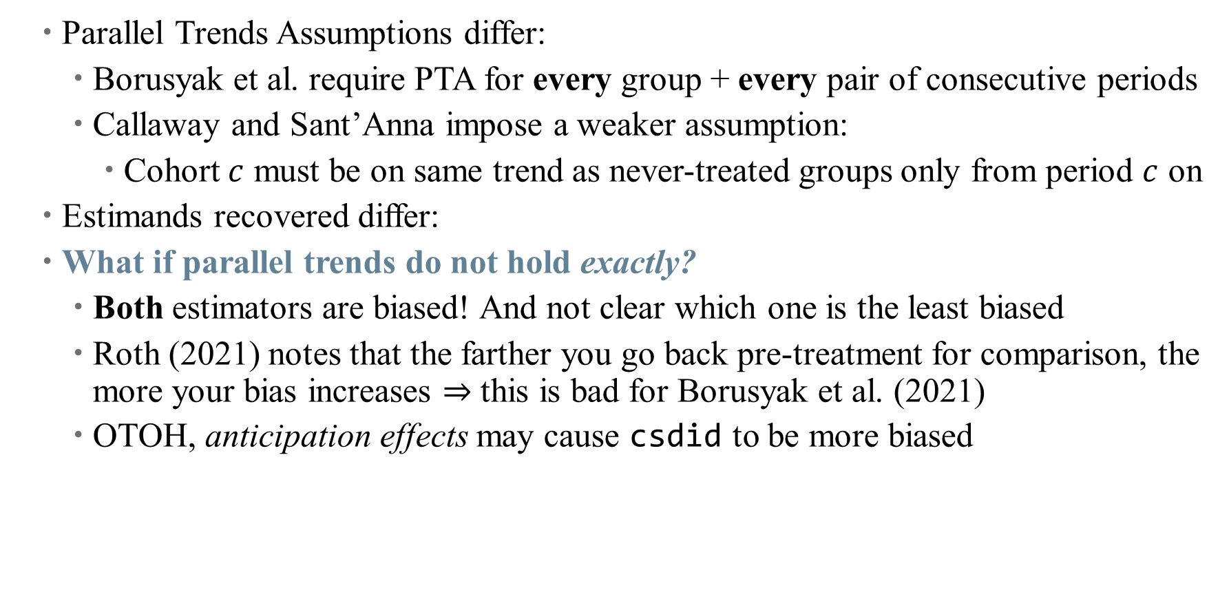
So What’s the Difference?
Parallel Trends Assumptions differ:
Borusyak et al. require PTA for every group + every pair of consecutive periods
Callaway and Sant’Anna impose a weaker assumption:
Cohort $c$ must be on same trend as never-treated groups only from period $c$ on
Estimands recovered differ:
What if parallel trends do not hold exactly?
Both estimators are biased! And not clear which one is the least biased
Roth (2021) notes that the farther you go back pre-treatment for comparison, the more your bias increases $⇒$ this is bad for Borusyak et al. (2021)
OTOH, anticipation effects may cause csdid to be more biased
Notes:
Need to think carefully about your setting and implement that one. Good paper on placebo tests by Roth and Rambachan (2019).

Slide 35
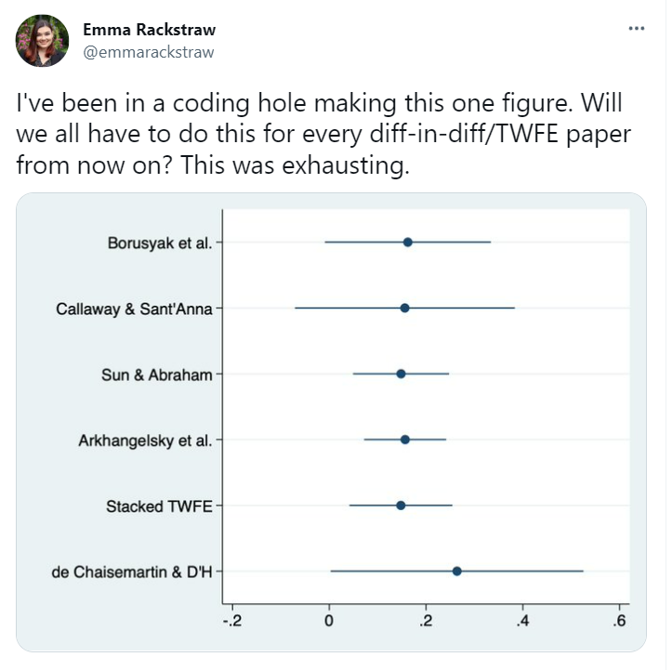
Do I have to run them all?
Notes:
Sometimes it feels (and you might even be asked to) like you have to run every single one of these – don’t! If you can help it.

Slide 36
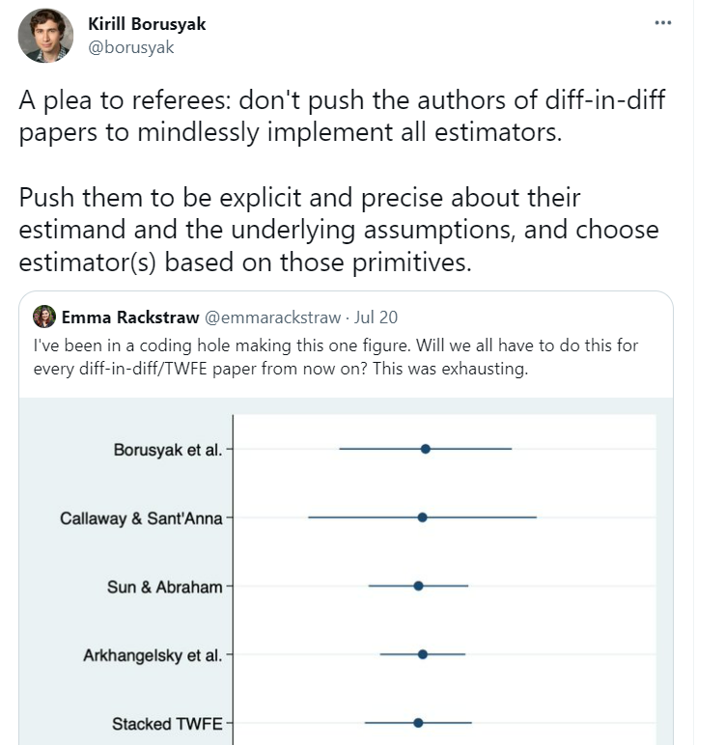
Do I have to run them all?
Notes:
Do this instead. And note: there are extensions if there are multiple treatments, or non-binary (discrete or continuous) treatments. Things get more complicated, of course. There is, of course, a way to put them all together, which I’ll show you just in case you’re referee asks for it.

Slide 37
Are we thinking about this all wrong?
Mundlak Regressions and Nonlinear DiD
Notes:
Both ideas from Wooldridge

Slide 38
Wooldridge’s Takes
The blame may actually be on us for imposing a very restrictive idea of a dynamic treatment effect, and then expecting TWFE to recover it for us!
Cover two-way mundlak paper
Cover nonlinear DID paper if there’s time.
Notes:
Need to think carefully about your setting and implement that one. Good paper on placebo tests by Roth and Rambachan (2019).

