Slide 1
Health Econometrics I
Lecture 9: Regressions with Limited Dependent Variables
November 4, 2022
HAD5744 • Alex Hoagland, Ph.D.

Slide 2
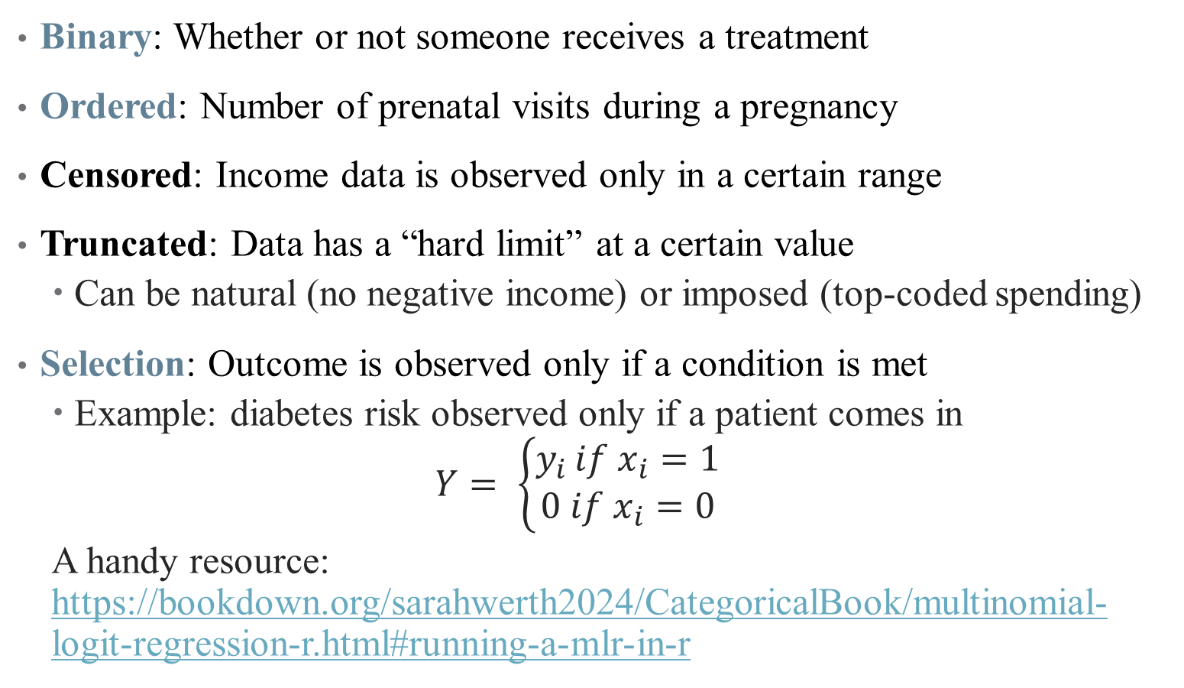
Last Time: Limited Dependent Variables
Binary: Whether or not someone receives a treatment
Ordered: Number of prenatal visits during a pregnancy
Censored: Income data is observed only in a certain range
Truncated: Data has a “hard limit” at a certain value
Can be natural (no negative income) or imposed (top-coded spending)
Selection: Outcome is observed only if a condition is met
Example: diabetes risk observed only if a patient comes in
$$Y= \left\{\begin{aligned}y_{i }if x_{i}=1 \\ 0 if x_{i}=0\end{aligned}\right.$$
A handy resource: https://bookdown.org/sarahwerth2024/CategoricalBook/multinomial-logit-regression-r.html#running-a-mlr-in-r
Notes:
Focusing only on these three for today. Also will include an extension of ordered that highlights choices between competing options.

Slide 3
Synthetic Control

Slide 4
Other types of controls: Synthetic Controls
Suppose that we observe J + 1 units in periods 1,2,…,T.
Region “one" is exposed to the intervention during periods T₀ ₊ ₁,…,T.
Let $Y_{it}^{N}$ be the outcome that would be observed for unit i at time t
in the absence of the intervention.
Let $Y_{it}^{l}$be the outcome that would be observed for unit i at time t if
unit i is exposed to the intervention in periods T₀ ₊ ₁ to T.
We aim to estimate the effect of the intervention on the treated unit

Slide 6
Note: Factor loadings are standardized regression coefficients or regression weights

Slide 8
Application: California’s Proposition 99
In 1988, California first passed comprehensive tobacco control legislation:
increased cigarette tax by 25 cents/pack
earmarked tax revenues to health and anti-smoking budgets
funded anti-smoking media campaigns
spurred clean-air ordinances throughout the state
produced more than $100 million per year in anti-tobacco projects
Other states that subsequently passed control programs are excluded from donor pool of controls (AK, AZ, FL, HA, MA, MD, MI, NJ, NY, OR, WA,DC)

Slide 9
Cigarette Consumption: CA and Rest of the U.S.A.

Slide 10
Cigarette Consumption: CA and synthetic CA

Slide 11
Predictor Means: Actual vs. Synthetic California

Slide 12
Smoking Gap Between CA and synthetic CA

Slide 13
Inference

Slide 14
Smoking Gap for CA and 38 control states

Slide 15
Quantile Regression

Slide 16

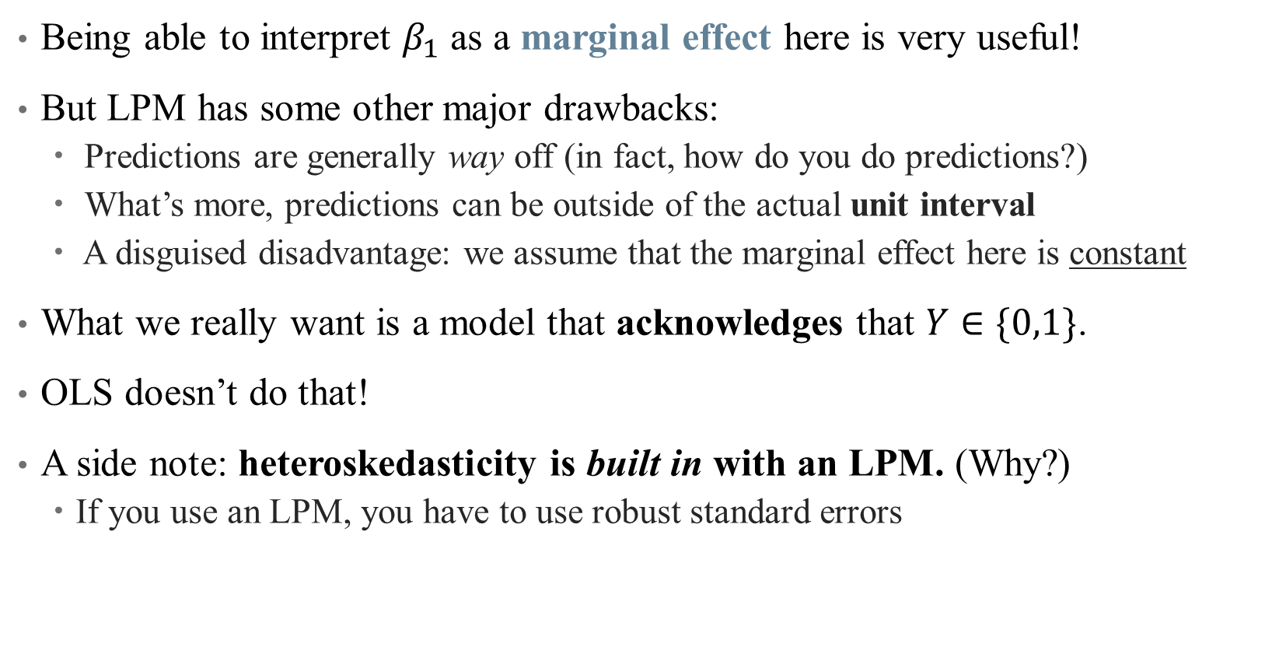
Advantages and disadvantages of LPM
Being able to interpret $β_{1}$ as a marginal effect here is very useful!
But LPM has some other major drawbacks:
Predictions are generally way off (in fact, how do you do predictions?)
What’s more, predictions can be outside of the actual unit interval
A disguised disadvantage: we assume that the marginal effect here is constant
What we really want is a model that acknowledges that $Y∈\{0,1\}$.
OLS doesn’t do that!
A side note: heteroskedasticity is built in with an LPM. (Why?)
If you use an LPM, you have to use robust standard errors

