Slide 1
Intermediate Statistics
Lecture 1: Introduction
January 9, 2025
HAD5772 • Alex Hoagland, Ph.D.

Slide 2

Introductions
Notes:
Some of my “get to know you” answers:

Slide 3
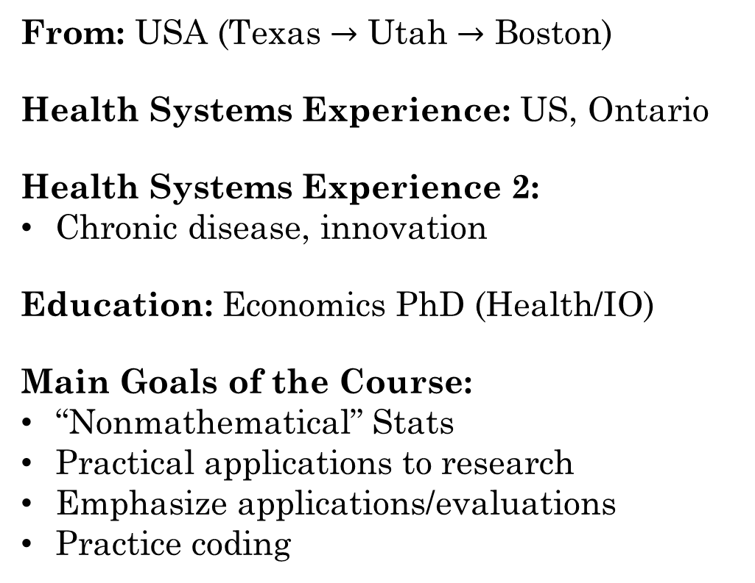
Introductions
From: USA (Texas $→$ Utah $→$ Boston)
Health Systems Experience: US, Ontario
Health Systems Experience 2:
Chronic disease, innovation
Education: Economics PhD (Health/IO)
Main Goals of the Course:
“Nonmathematical” Stats
Practical applications to research
Emphasize applications/evaluations
Practice coding
Notes:
Some of my “get to know you” answers:

Slide 4
Introductions: Backgrounds
Notes:
Some of your answers to the survey (if you haven’t taken it, please do! For my own info at least). We have both Master’s and PhD students with all kinds of interests (here are just a few – can remain anonymous if desired)

Slide 5
Introductions: Math levels
Notes:
A lot of people interested/worried about math levels – here is where we are starting

Slide 6
Introductions: Coding levels
Notes:
A lot of people interested/worried about coding levels – here is where we are starting

Slide 7
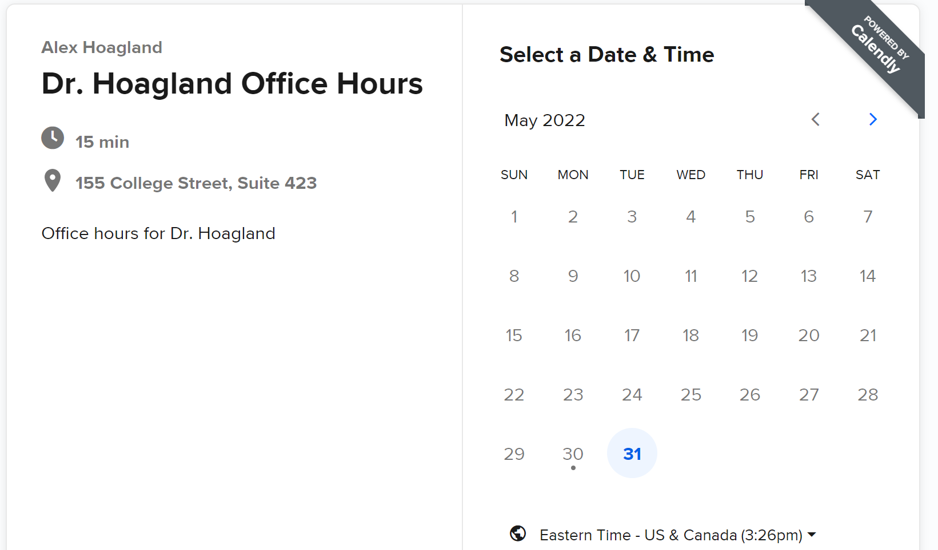
Introduction & Syllabus
Booking office hours: calendly.com/Hoagland-office-hours/
Zoom: Thursdays and Fridays, 10-12
In person if needed, but arrange in advance please!

Slide 8
Introduction & Syllabus
Evaluation Criteria
6 short (group) assignments, worth 60% of the final grade.
1 final (group) project, worth 40% of the final grade.
Evaluations focus on practical applications (e.g., coding)
Final project guidelines/rubric available on GitHub
Notes:
Instructions are on each assignment for submission. There is a 10 (percentage point) penalty for each late day. Can work together, but each must submit their own copy (and copy/paste for code isn’t a great way to learn). We will talk more about the final project throughout the semester, but you can find the requirements/rubric on GitHub now – your own (simple) data analysis, description, and quant research (correlations, etc.)

Slide 9

Introduction & Syllabus
Software.
We will use R.
You are welcome to use other software, but check with me
R is free! Download R here and an interface RStudio here
Training sessions offered in department in early Jan.
Notes:
Lots of online resources – I’m going to try to cover things in real time, as that has been the most helpful way I’ve learned R. Group work is encouraged, Github discussions, office hours, etc.

Slide 10
Introduction & Syllabus
Software.
We will use R.
You are welcome to use other software, but check with me
R is free! Download R here and an interface RStudio here
Training sessions offered in department in early Jan.
Github repo
Contains all relevant course materials
Notes:
Group work is encouraged, Github discussions, office hours, etc. Talk about sample papers and reading materials (useful as you prep your final paper; treat this course as an intro to a lot of methods but you should take a deep dive into methods you care more about.)

Slide 11
Installing R, RStudio, and Copilot
First step: install R
1. Visit the R Project's official website: https://cran.r-project.org/
2. Click “Download R” for your operating system
3. Follow the installation instructions. During this stage, you may be asked to select something called a “CRAN mirror.” It’s not important what this is, but you should pick one that looks geographically proximate to where you currently are. For example, if you are in Toronto, I recommend picking the MBNI University of Michigan mirror (https://repo.miserver.it.umich.edu/cran/). Doing so will make your installation a few seconds faster, at least; otherwise, it shouldn’t matter too much.
4. You do not need to open R once it is installed (see below).
Notes:
Please do this before next week, if you haven’t already!

Slide 12
Installing R, RStudio, and Copilot
Second: install RStudio
1. Go to the RStudio official website: https://posit.co/download/rstudio-desktop/. Note that it has a big button with a #1 on it that says “1: Install R.” You’ve already done that!
2. Use the big button “2: Install RStudio” to select the appropriate RStudio version for your operating system.
3. Follow the installation instructions.

Slide 13
Installing R, RStudio, and Copilot
What is Copilot?
Installation Prerequisites:
1. Make sure you have a (free!) GitHub account. You can sign up here: https://GitHub.com/join.
2. Apply for the GitHub Student Developer Pack here: https://education.GitHub.com/pack. You have to provide a picture of your student ID or some other proof you’re a student, and approval can take a few days, so the sooner the better!

Slide 14
Installing R, RStudio, and Copilot
How do I get Copilot into RStudio?
Step 1: Accessing GitHub Copilot. Visit the GitHub Copilot page (once signed in): https://GitHub.com/features/copilot. Follow the instructions to enable Copilot for your account.
Step 2: Integrating GitHub with RStudio
1. After completing the above, open RStudio and go to `Tools` > `Global Options`
2. At the very bottom left, click the “Copilot” button with the GitHub cat icon
3. Check the “Enable GitHub Copilot" button. You will need to sign into your GitHub account again and give permission for communication between RStudio and GitHub.

Slide 15
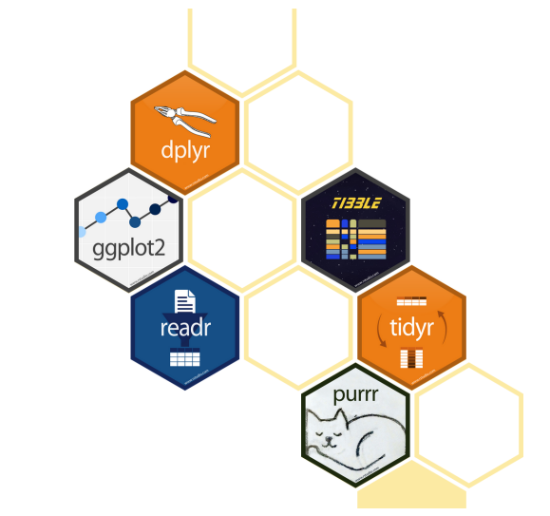
Using R
We will use the tidyverse
Notes:
Tidyverse: set of packages to make R code more readable. We’ll spend some time at the end of class today with a simple R exercise and more next lecture.

Slide 16
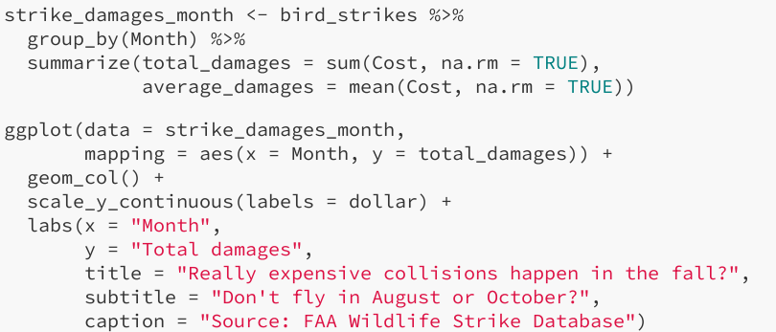
Using R
We will use the tidyverse
Makes R code read more like English!
Notes:
Tidyverse: set of packages to make R code more readable.

Slide 17
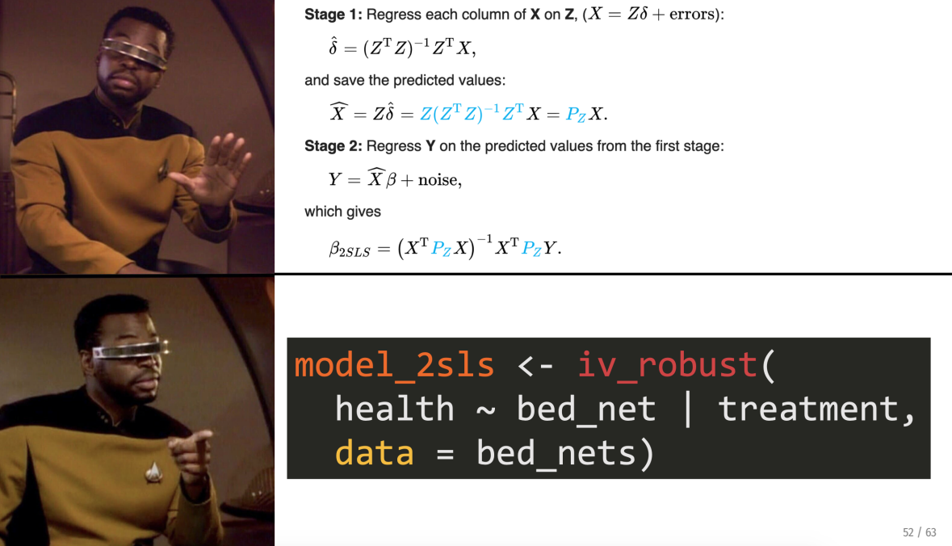
Using R
We will use the tidyverse
Makes R code read more like English!
Emphasize practical applications over theory
Notes:
Note: there will still be some theory, but less

Slide 18
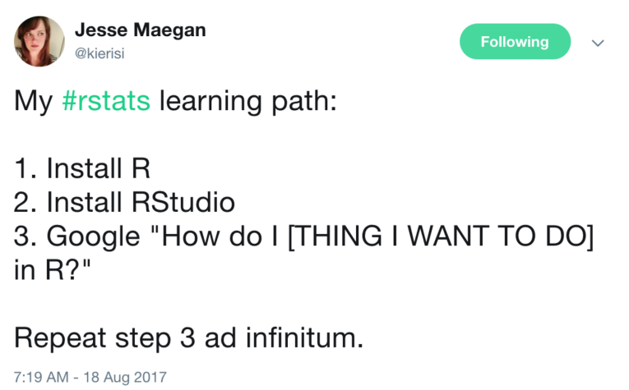
Using R: A Trial of Patience/Faith/Etc.
Mini-modules: https://jacobjameson.github.io/Intro%20R.html
Notes:
To add next time: https://www.tiktok.com/t/ZTRxhLa7B/. It can be a pain to learn R – but the best way to learn really is trial by error. Note that there’s some literature/ideas out there that it’s good to suck at something (it’s the first step to being good at something), but I don’t want you to feel like you are sucking! Come to me with questions, but don’t be stressed if you are feeling frustrated. These are tools that will serve you well, invest in them.

Slide 19

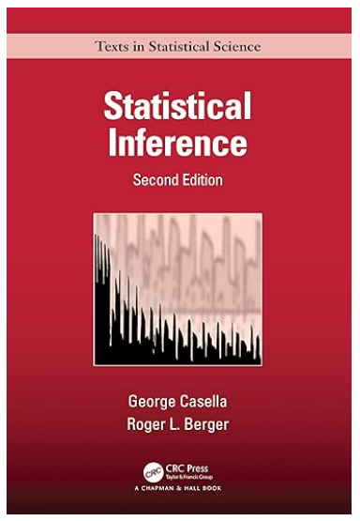
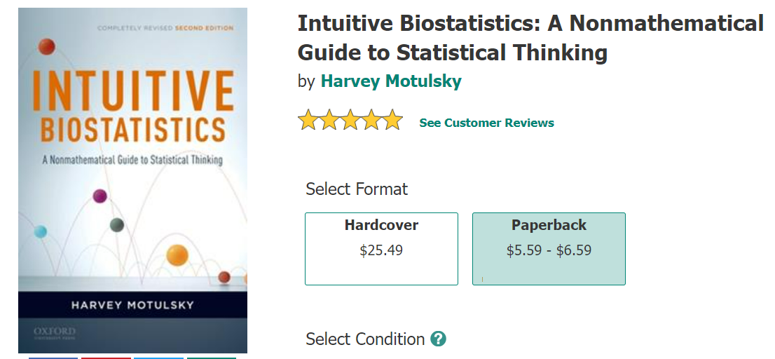
Introduction & Syllabus
Notes:
Cheap, great resource. Other options listed on syllabus. Not required, any edition will work.

Slide 20
Introduction & Syllabus
Course outline:
Data visualization (and introduction to R)
Descriptive statistics
Standard errors and other measures of uncertainty
Hypothesis Testing
Linear Regression
RCT Evaluations
Causal Inference
Survival Analysis, Mixed Methods
Notes:
This course should prepare you to specialize within your emphasis – econometrics if you’re in HE, other biostats classes for ClinEpi, etc.

Slide 21
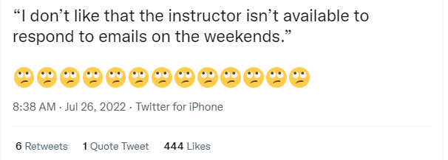
One Pet Peeve:
Introduction & Syllabus
Notes:
There are no real-time emergencies in a university class setting – send me an email, and please be respectful of my time. Likewise, I will be respectful of yours.

Slide 22
Why do we need statistics?

Slide 23

Hardwired Brains
We tend to jump to conclusions from limited data
Imagine a child meets a doctor

Slide 24
Hardwired Brains
We tend to jump to conclusions from limited data
Imagine a child meets a doctor, then another

Slide 25
Hardwired Brains
We tend to jump to conclusions from limited data
Imagine a child meets a doctor, then another, then another
What gender do you have to be to be a doctor?
How many women doctors do you have to meet before you are 100% certain of your answer? 95%? 90%?
Notes:
Statistics helps us generalize from limited n to a population *while being explicit* about the inherent uncertainty of doing so.

Slide 26
If you think answering a question is hard, …
Accurately quantifying the uncertainty around the answer is even harder
Example: 90% confident. Can you make a range that you think is 90% likely to include:
The year Genghis Khan died
The size of a COVID-19 virus (in nanometers)
Diameter of Neptune (in kilometers)
Notes:
Do one for the whole class – should be that 90% of the intervals include the true amount, but in general, people are too narrow (overconfident)
Answers:
1227
100 nanometers
49244 km

Slide 27
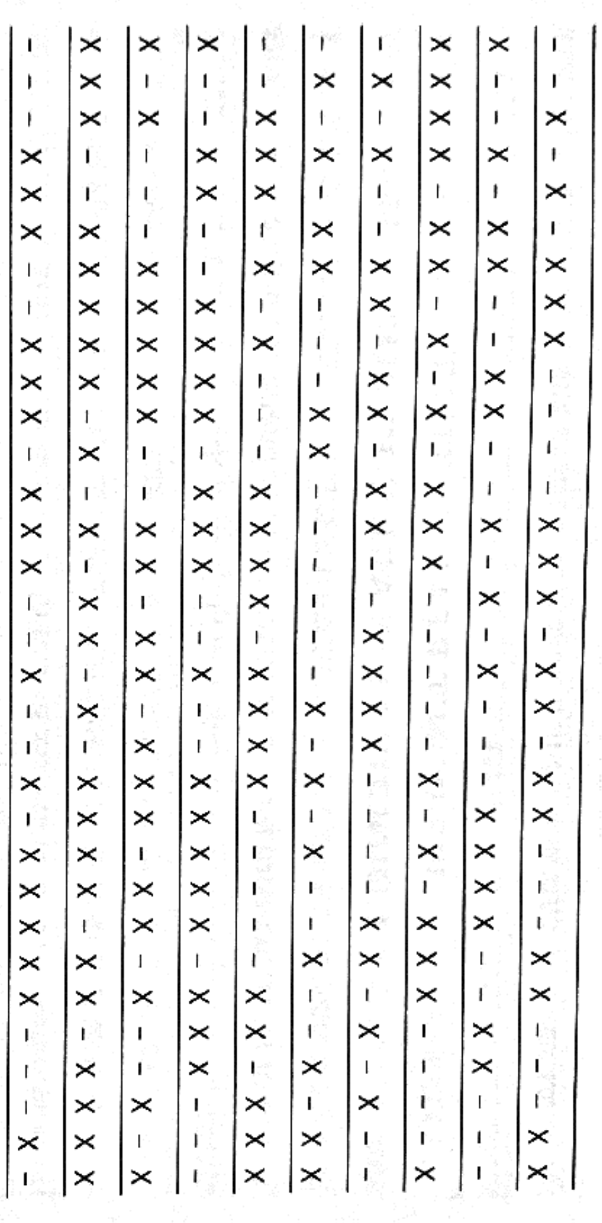
What about identifying patterns?
Notes:
Who’s on a “hot streak” here? Is there any player here whose chance of making the next shot (moving to the right) depends on the number of successful prior shots? (Note: all are random)

Slide 28
Biases to overcome
Coincidences are more common than we think
Maybe the chance of a single coincidence is tiny, but the chance that a set of “coincidental events” will occur is large!
Our intuitions about probability are often terrible
Especially with lab experiments (many people prefer a bowl with 93 red jelly beans and 7 white ones to a bowl with 9 red ones and 1 white one, even after doing math!)
Combining probabilities is trickier (Monty Hall problem)
Ambiguity is even harder
Do you prefer an urn with 50 red and 50 black jelly beans, or an urn with 100 jelly beans and some combination of red and black?

Slide 29

Final Examples: Ontario Health + Astrology
Main question: do people of different astrological signs have different likelihood for hospital admissions?

Slide 30
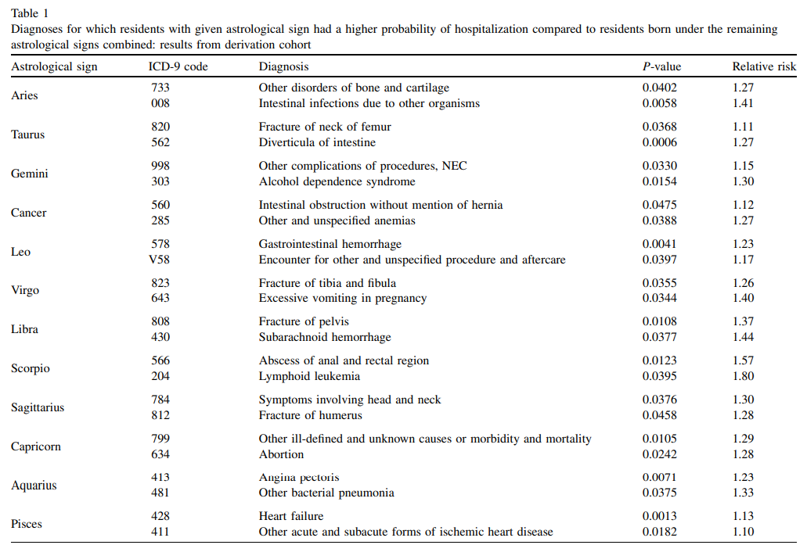




Final Examples: Ontario Health + Astrology
Main question: do people of different astrological signs have different likelihood for hospital admissions?
Notes:
What does this mean? But if there are 223 admissions and 12 signs, that’s 2,676 distinct comparisons! Given a threshold of 5%, we should expect about 134 significant associations by chance (the authors found 72).

Slide 31
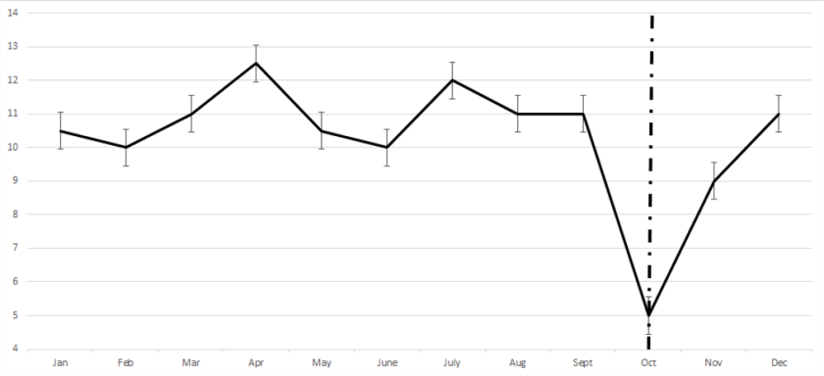
Final Examples: Regression to the Mean
One of the trickiest concepts: things tend to go back to the “center” of a distribution over time
Notes:
Someone visits the doctor once a month, and in October has terrible blood pressure. MD prescribes a medication – is this a sign that the medication worked? Why/why not?

Slide 32
What does statistics do?

Slide 33
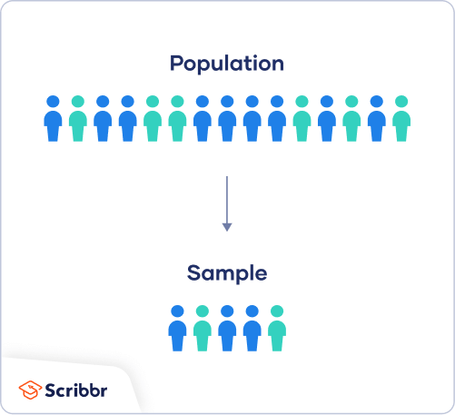
Generalizing with caution
Probability (is a sample representative/balanced?)

Slide 34
Generalizing with caution
Statistics

Slide 35
What statistics can do
For a defined population of interest,
Notes:
Go through these one by one. For this one – say you want to know about the effectiveness of a drug to treat cancer. The population we really care about is all patients (including those who have cancer now but also everyone who might get cancer). But how do we get data?

Slide 36
What statistics can do
For a defined population of interest,
With an appropriately selected random sample,
Notes:
You may be limited in your data (e.g., lung cancer patients in Ontario). Have to think about how that affects the (1) you can speak to.

Slide 37
What statistics can do
For a defined population of interest,
With an appropriately selected random sample,
And a well-measured variable of interest,
Notes:
Say we’re interested in “effectiveness.” what does that mean? % of patients in remission? Patient well-being? Years of life gained?

Slide 38
What statistics can do
For a defined population of interest,
With an appropriately selected random sample,
And a well-measured variable of interest,
Under the appropriate assumptions:
Notes:
Other assumptions we need to make: is treatment randomly assigned? What if we have observational data? Etc.

Slide 39
What statistics can do
For a defined population of interest,
With an appropriately selected random sample,
And a well-measured variable of interest,
Under the appropriate assumptions:
One can make inferences about the (changes in) distribution of the variable in the population given the sample
Notes:
Statistics requires us to carefully think about each of these steps and honestly address how our research fits in given these limitations.

Slide 40
What statistics cannot do (well)
Go from a limited sample to a (even related) population
Generalize from non-random samples
Handle “latent” variables (qualitative research?)
Deal with measurement error
Notes:
There are ML and econometric/causal inference methods to deal with these, but stats alone is not enough. Tradeoffs between assumptions and usefulness of results.

Slide 41
Summary
Statistical thinking has a lot to offer
But we have to be careful how we apply it
Quantifying uncertainty is vital for good research and understanding the world
Next Time
Visualizing our data
Thinking about correlations
IntRoduction to R

