Slide 1
Intermediate Statistics
Lecture 2: Programming in R + Descriptive Statistics
January 16, 2025
HAD5772 • Alex Hoagland, Ph.D.

Slide 2
Last Time
Statistical thinking has a lot to offer
But we have to be careful how we apply it
Quantifying uncertainty is vital for good research and understanding the world
This Time
IntRoduction to R
Describing our data

Slide 3
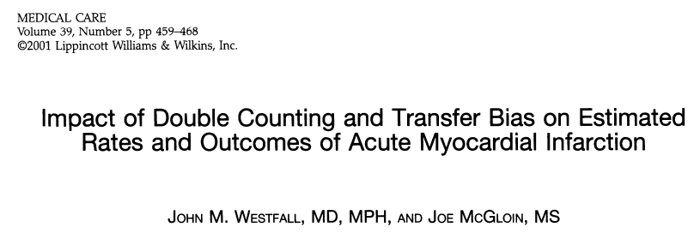


But first: Double Counting in the Wild
Notes:
This comes up in two places in HSR: estimating prevalences and cost/benefit or cost/utility analysis. Examples:
First, AMI patients who are transferred from rural to urban centres may be counted twice. Double count may have been as large as 15% -- correcting leads to lower prevalence but greater mortality rates.
Suppose we want to estimate disease burden on cost/utility. We count lost work hours as “loss productivity time” and so as part of the economic burden of a disease. But this may be double-counted because lost work hours also lead to worse wages, so we’re “over-counting” the loss in some sense. Additionally, utility may not be linear, so reductions in hours may lead to an overstatement in loss of estimated utility. (How do we think about this with regards to non-medical expenditures?)

Slide 4
Programming in R

Slide 5
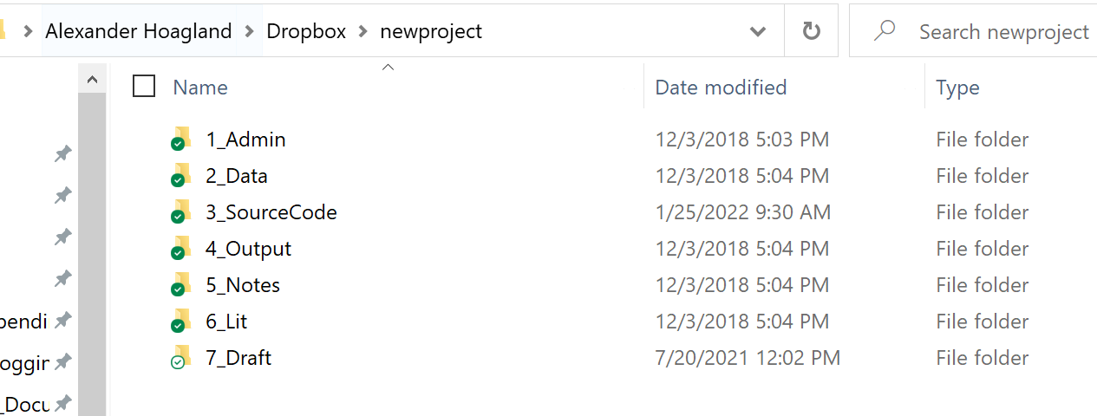
Project Management: Folder Organizations
Project file structure
File template
Headers
Comment, comment, comment!
Notes:
Apparently folders are going out of vogue – I will fight to save these till my dying breath! Urge you to start your shared projects using a structure like this (and Github and/or Dropbox and/or Overleaf and/or Trello – the dream team). Also have your Rproject here, so that you can have raw data (which you don’t touch), analytical data, code, and outputs all in separate places. Then draft can either be Rmd or Latex, Word, etc.

Slide 6
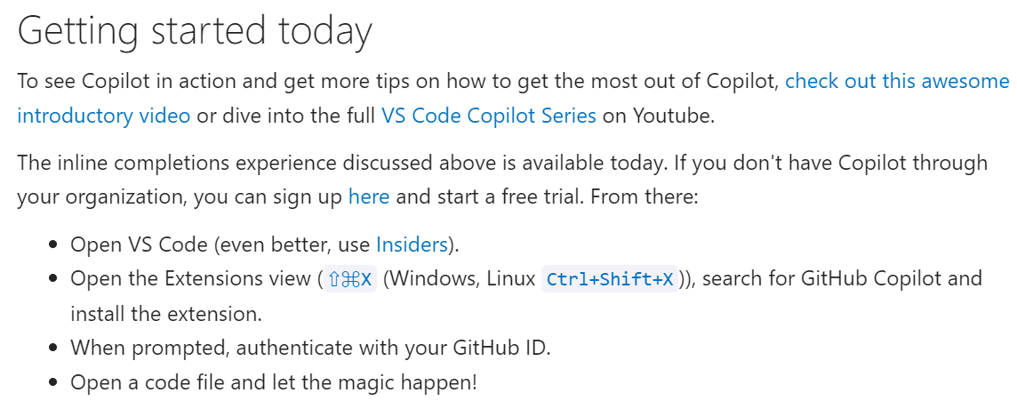

Project Management: Workflow
Setting up copilot in Microsoft VSC
Code editors
Projects + files (next slide)
Notes:
Talk about VSC + copilot → Rstudio → R project → Rmd and R folders (next slide)
Links: https://code.visualstudio.com/blogs/2023/03/30/vscode-copilot.

Slide 7
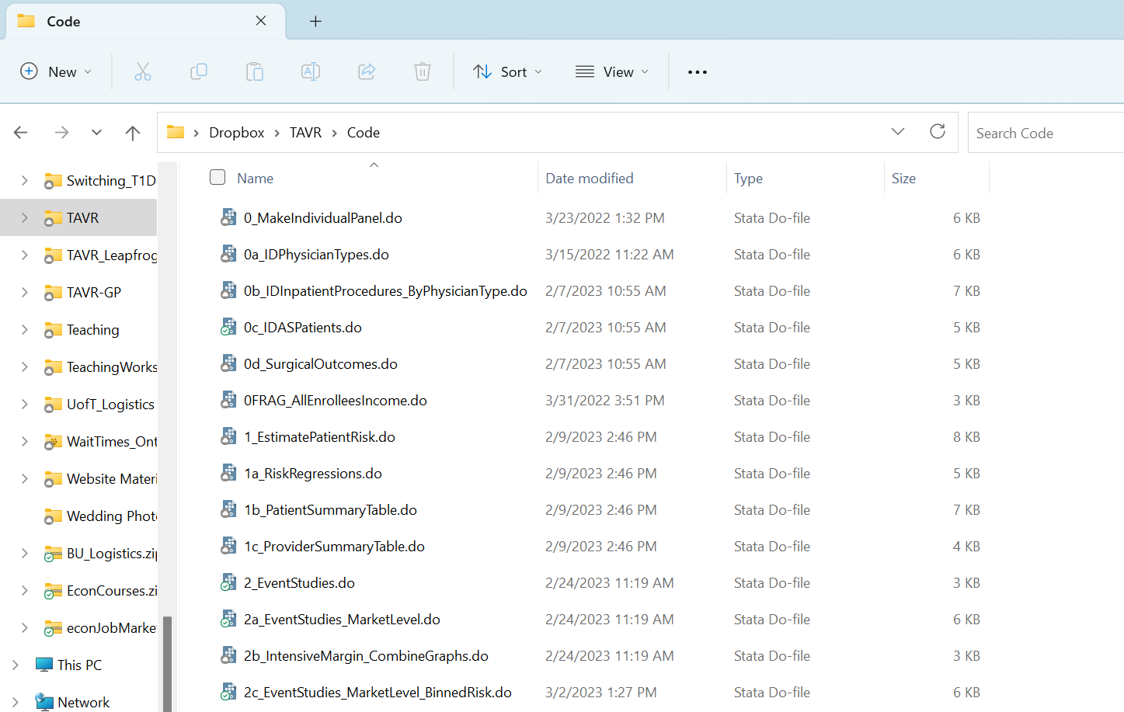
Project Management: File Organization
Project file structure
File template
Headers
Comment, comment, comment!
Notes:
What to have within files. File chunks with one master file to run them all. Here we will use R projects and R markdown files.

Slide 8
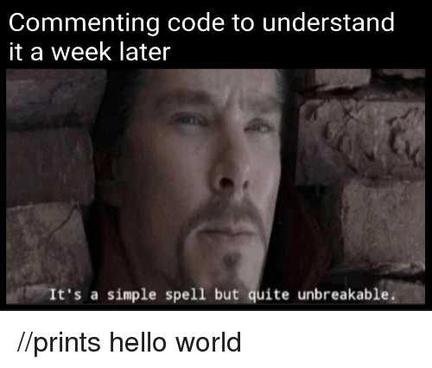
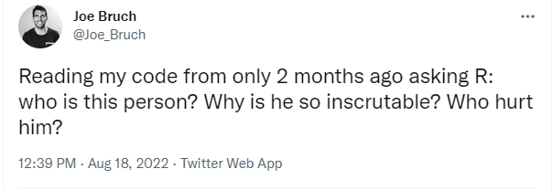
Project Management: Commenting code
Comments are your friend!
Notes:
In all seriousness your projects may go on for years, and then you’ll get requests for replication code pulls years after publication – you want to be able to explain your own reasoning years from now (and you want others to follow it as well)

Slide 9
What does it look like to use RStudio?
4 panes (each of them useful)!
Create a new .Rmd file (`File` > `New File` > `R Markdown`, and save it (preferably in a separate folder for this class)
Visual mode for .Rmd files
Why use .Rmd files?
How to separate (and name!) code chunks and text
How to incorporate Copilot (test it out: type # Calculate the mean of the variable myvar into a code chunk)
How to run a code chunk (just one!)
Eventually, we’ll talk about how to knit the whole file
Notes:
What does R look like? Talk about the Assignment1_StartHere.Rmd file on GitHub if needed.

Slide 10
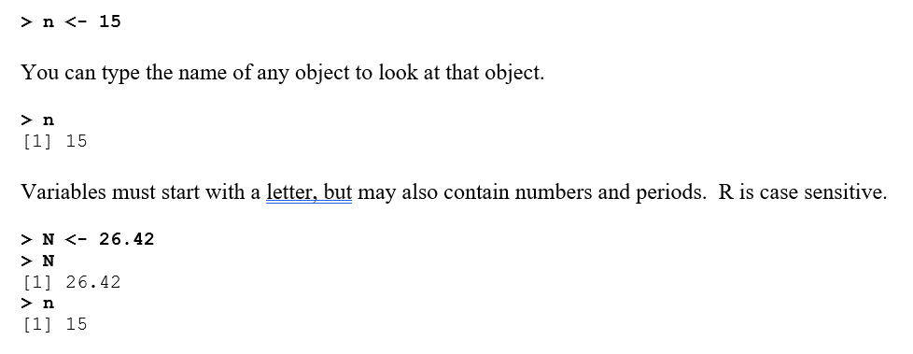
Assigning variables in R
R can handle multiple objects all at once:
Datasets
Functions
Integers/scalars
Lists
Etc.!
To assign an object:

Slide 11
Data types in R
Not all data is numeric! Some of the key data types you’ll encounter are:
Numeric
Character
Logical/Boolean
Factors
We’ll talk about each of these (and especially, how to convert them into the quantitative variables we would use in this course

Slide 12
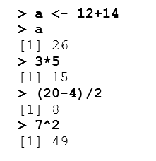
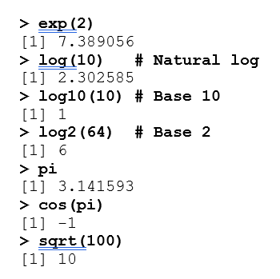
Calculations in R
R can work just like any calculator:

Slide 13
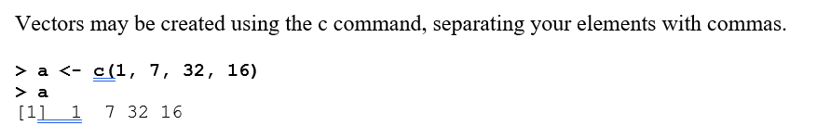
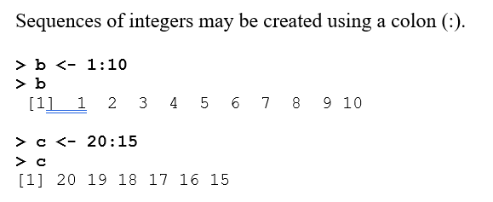
Other objects in R
Let’s try creating some vectors and lists

Slide 14
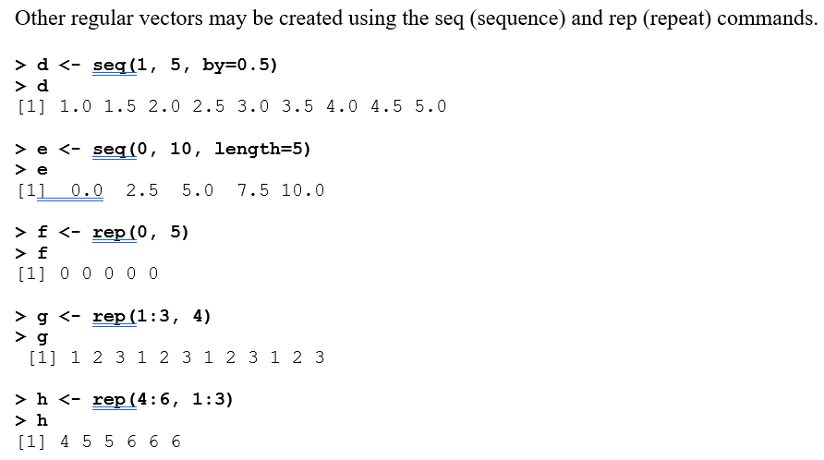
Other objects in R
Let’s try creating some vectors and lists

Slide 15
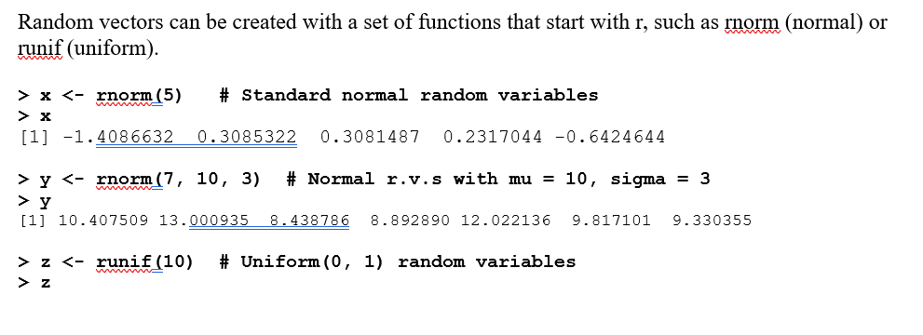
Other objects in R
Let’s try creating some vectors and lists

Slide 16
What can you do with vectors?
Do arithmetic/math element-by-element
Combine them element-by-element
Repeat these over multiple lists with different lengths (loops; not commonly used)
Linear algebra (dot products)
Subset vectors
Find the vector’s length, mean, median, mode (we’ll discuss these again in the next hour)
Note: Use the str() function (for “structure”) to learn more about an object you’re working with. You can read more about it here: https://www.r-bloggers.com/2023/08/exploring-rs-versatile-str-function-unraveling-your-data-with-ease/amp/

Slide 17
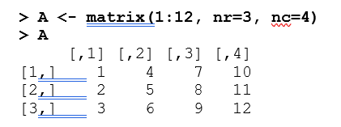
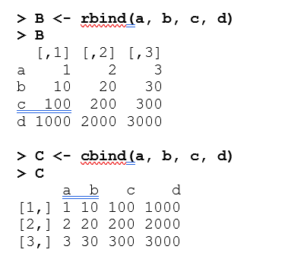
Combining vectors: matrices
You can make matrices manually
Or by combining elements (more common in our case)

Slide 18
What do you do with a matrix?
Subset (now by rows or columns)
Matrix algebra
Loop functions over columns or rows using the apply function (we’ll show you an easier way to do things like this)
Or…convert it to data!

Slide 19
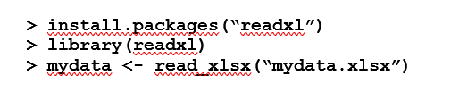
Data frames: our bread and butter
How do we get one from a matrix?
Better yet, how do we read in one from another file?
.csv
.xlsx
.txt
From open source datasets linked into R
This will be our first use (of many!) of packages:
Notes:
The first line installs the package you want to use – you only need to run this once on your computer (and don’t forget the quotation marks). Then, each time you open RStudio, you need to “call” the package (think about this like inviting the vampire into your house, but in a nice way). That’s done on the second line. Then, the third line uses the command “read_xlsx” from the readxl package to load your dataset.

Slide 20

Data frames: our bread and butter
It’s easy to summarize information in a data frame
names(df)
mean(df)
df %>% head()
df %>% summarize()
This is where we get to the tidyverse

Slide 21
Using the tidyverse
Tidyverse uses pipe operators (%>%) to flow from the starting point (your data) to an end point (your output).
If we want to get total count by category for example, we would:
Start with ungrouped data %>%
Group by category %>%
Calculate counts within each group
Let’s try to use some of the common functions we’ll use in class:
Filter
Select
Mutate
Group_by
Summarize

Slide 22
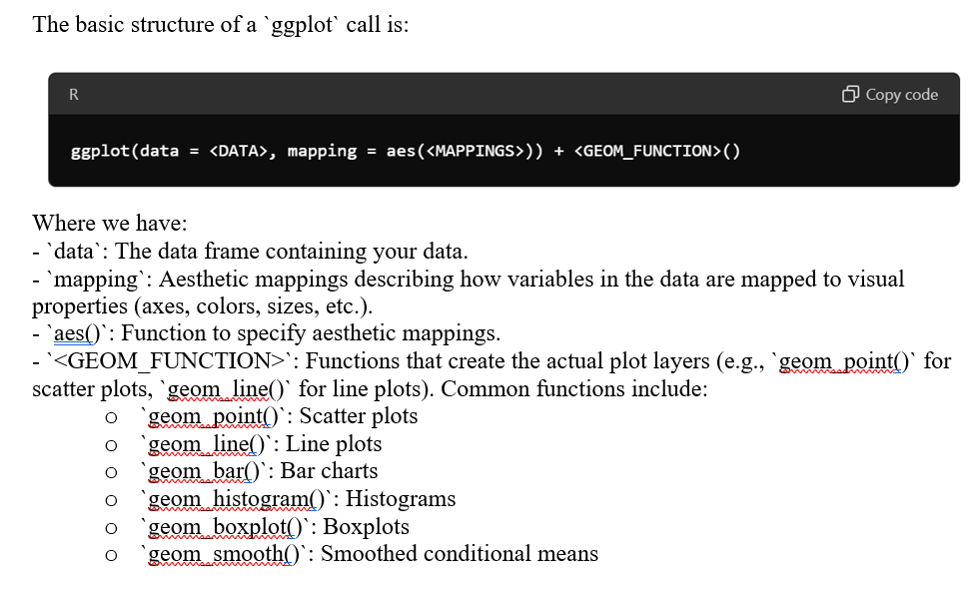
Ggplot: a companion to the tidyverse
Tidyverse also has a helpful tool for visualizing data

Slide 23
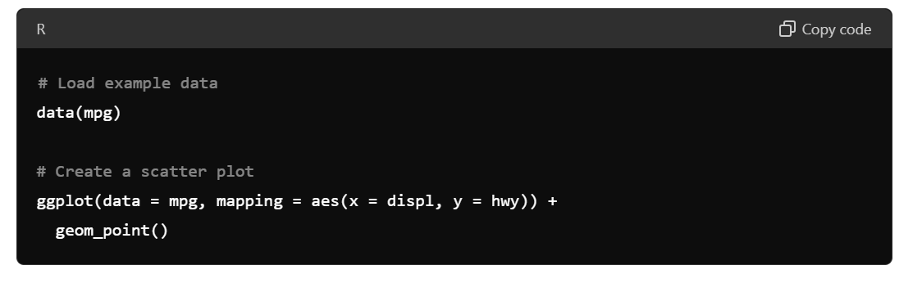
Ggplot: a companion to the tidyverse
Tidyverse also has a helpful tool for visualizing data
We’ll cover this more next time!
For now, here’s an example:

Slide 24
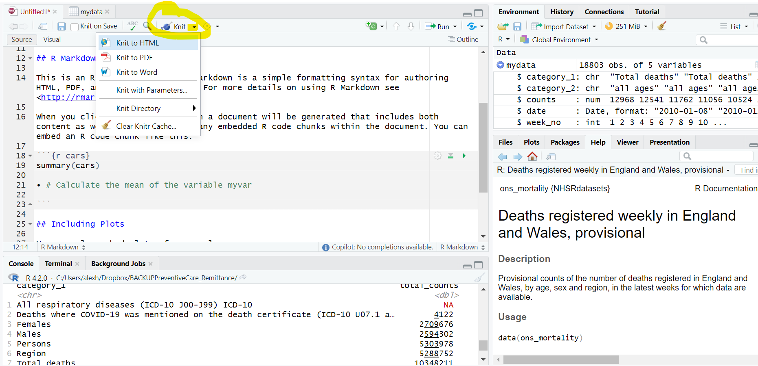
Knitting/Compiling your file
What do you do when you’re done?
Knitting the file combines your text, code, and outputs into a single document!
Notes:
Most of the time, you want to “Knit to Word.” Once you click this, your .Rmd file will run all code in your document and then produce a Word file with the outputs of your code and the text you wrote to describe it. In order to knit, your R software will start entirely from scratch. This means that every line of code you needed to complete the analysis must be in your .Rmd file. Frequently, we switch to the console to play around or test/debug something we’re trying to do. If you do this, you have to make sure your code ends up back in the .Rmd file or your file will not knit.

Slide 25
Additional R Resources
Appendix C in Motulsky:
R Markdown Cheat Sheet: https://www.rstudio.com/wp-content/uploads/2015/02/rmarkdown-cheatsheet.pdf
Ggplot Cheat Sheet: https://www.maths.usyd.edu.au/u/UG/SM/STAT3022/r/current/Misc/data-visualization-2.1.pdf
Great book on data visualization: “Data Visualization: A Practical Introduction”
Library of Statistical Techniques (LOST)
Google! Lots and lots of Google! (Stack Overflow)
Notes:
If you find a source that’s really helpful to you, send it my way! Want to include it here. Crowd-sourcing is what R is built on after all.

Slide 26
Descriptive Statistics

Slide 28
This Time
Programming in R
Descriptive Statistics
Next Time
Data visualization
Measuring correlations and covariances
Quantifying uncertainty

