Slide 1
Intermediate Statistics
Lecture 3: Correlations + Data Visualization
January 23, 2025
HAD5772 • Alex Hoagland, Ph.D.

Slide 2
Last Time
Programming in R
Descriptive Statistics
This Time
Visualizing our data
Thinking about correlations

Slide 3
Data Visualization

Slide 4
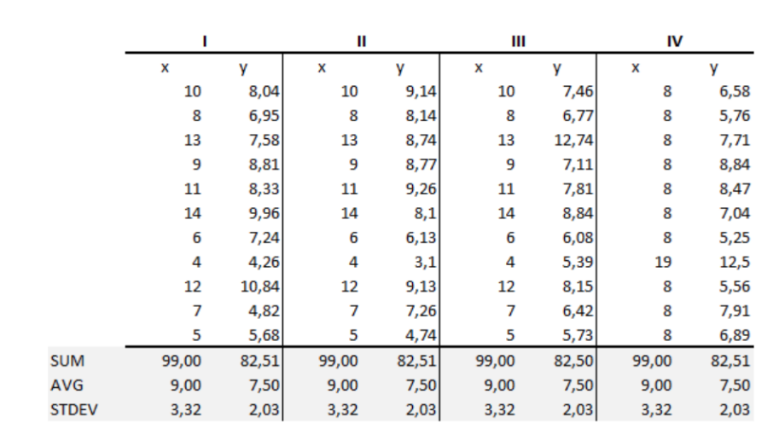
Seeing Data Matters: Anscombe’s Quartet
Notes:
Can you tell me the similarities and difference in these data sets?

Slide 5
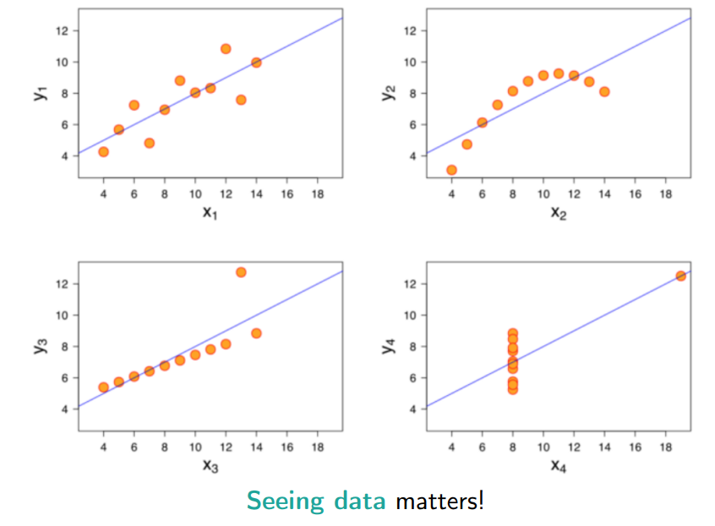
Seeing Data Matters: Anscombe’s Quartet
Notes:
Now can you tell me the difference?

Slide 6
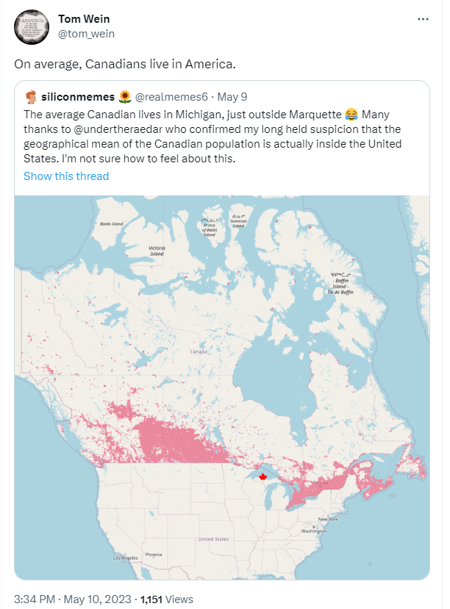
Choose Visualizations Carefully
Not everything is informative
Some can be downright misleading
Notes:
Not all averages are useful.

Slide 7

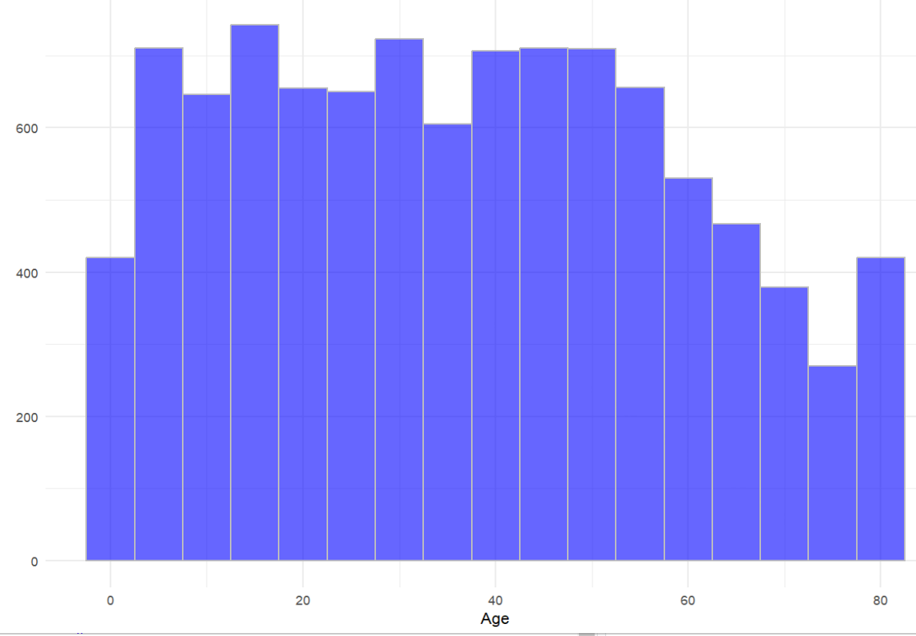
Visualizing Data: Histograms
Histograms are useful for immediately visualizing the whole distribution
Can easily “eyeball” mean, median, skew, quantiles
Notes:
Reminder from last time – we have a lot of “power” as the researcher. Example from data. Take all data and put it all into bins.

Slide 8
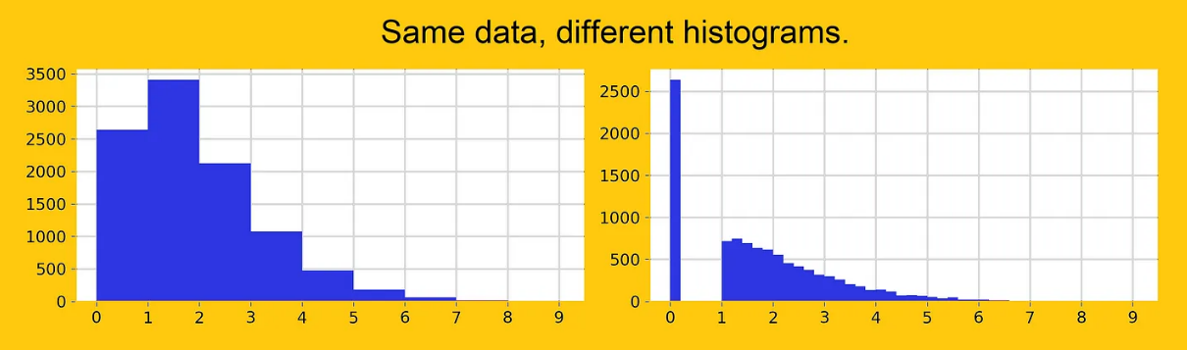
Visualizing Data: Histograms
Histograms are useful for immediately visualizing the whole distribution
Can easily “eyeball” mean, median, skew, quantiles
Downsides:
Easily changed by bin widths
Notes:
Source: https://towardsdatascience.com/6-reasons-why-you-should-stop-using-histograms-and-which-plot-you-should-use-instead-31f937a0a81c. (Note: I don’t think you should stop using histograms).

Slide 9
Visualizing Data: Histograms
Histograms are useful for immediately visualizing the whole distribution
Can easily “eyeball” mean, median, skew, quantiles
Downsides:
Easily changed by bin widths: see this site
This is a form of “data smoothing,” which falls into the bucket of “data massage”
This is a helpful part of data cleaning! We can’t visualize every point of a 1M observation data set with 50+ variables
But we do need to watch out for:
“Sense checks” where we drop nonsense values
Ignoring missing data
Adjusting data (inflation, normalizing, etc. )
Dividing by zero! (happens more than you think – e.g., ratios)

Slide 10
Diagnostic Visualization
One of the most helpful types of visualization is not confirmatory (pretty figures) but exploratory (data cleaning)
Example: suppose we have data on how children reason about fairness across cultures
We have some experimental lab data
But what kind of data do we actually have? Let’s make some histograms! And think about how these should influence our research choices.
Notes:
Source: Blake, McAuliffe, and colleagues (2015) in their article “Ontogeny of Fairness in Seven Societies.”

Slide 11
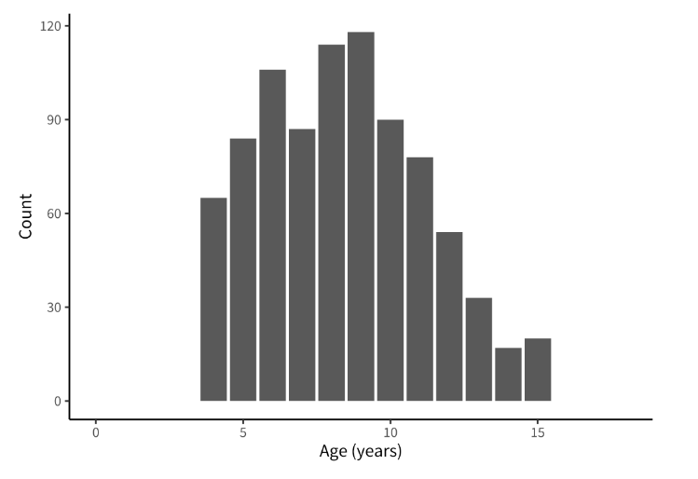
Diagnostic Visualization
One of the most helpful types of visualization is not confirmatory (pretty figures) but exploratory (data cleaning)
Example: suppose we have data on how children reason about fairness across cultures
We have some experimental lab data
But what kind of data do we actually have? Let’s make some histograms! And think about how these should influence our research choices.
Notes:
Source: Blake, McAuliffe, and colleagues (2015) in their article “Ontogeny of Fairness in Seven Societies.”

Slide 12
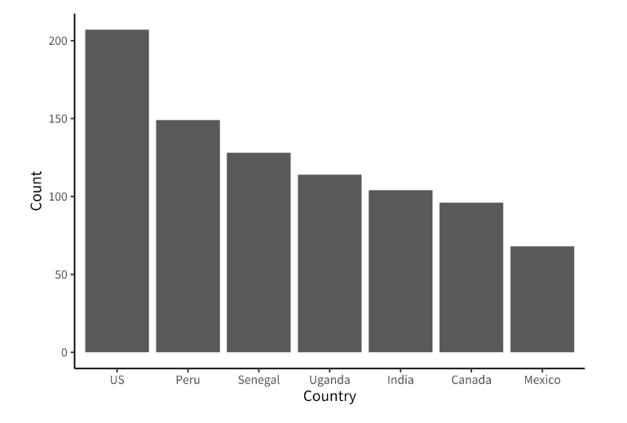
Diagnostic Visualization
One of the most helpful types of visualization is not confirmatory (pretty figures) but exploratory (data cleaning)
Example: suppose we have data on how children reason about fairness across cultures
We have some experimental lab data
But what kind of data do we actually have? Let’s make some histograms! And think about how these should influence our research choices.
Notes:
This one tells me we better adjust for country in some way – otherwise our sample will be largely US!

Slide 13
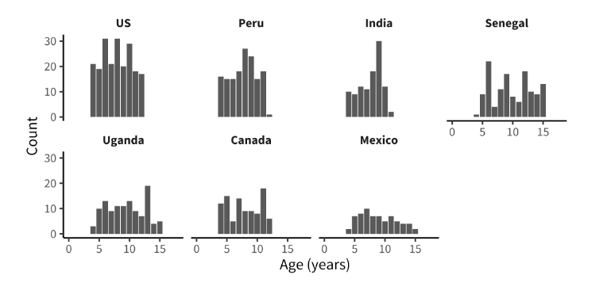
Diagnostic Visualization
One of the most helpful types of visualization is not confirmatory (pretty figures) but exploratory (data cleaning)
Example: suppose we have data on how children reason about fairness across cultures
We have some experimental lab data
But what kind of data do we actually have? Let’s make some histograms! And think about how these should influence our research choices.
Notes:
For example, we can see that age ranges differ somewhat across sites: the maximum age is 11 in India but 15 in Mexico. We can also see that age groups are fairly imbalanced: in Canada, there are 18 eleven-year-olds but only 5 six-year-olds.

Slide 14
Visualization Across Groups
Lots of ways to do this!
Bar charts
Time series/line charts
Area charts
Heat maps
Treemaps
On and on and on!
If you’re interested, Zahra Shakeri teaches a great class on this
Notes:
Now picking up where we left off last time. Lots of the others can be made by Google. Note that we’re saving viz across dimensions (scatter plots) until after we do correlations/covariance.

Slide 15

What story are we trying to tell?
A lot of times, the variation we want to highlight should ultimately motivate our research questions:
How does $y$ differ across groups?
What is the effect of $x$ on $y$?
What might confound the effect of $x$ on $y$?
Notes:
We’re going to be talking about confounding a lot today, so pay attention to that word

Slide 16
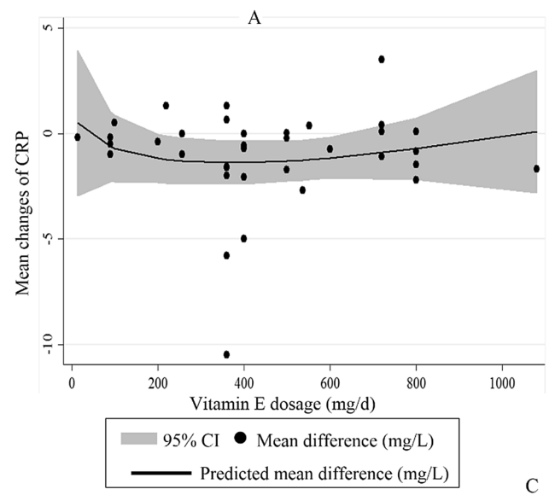
What story are we trying to tell?
A lot of times, the variation we want to highlight should ultimately motivate our research questions:
Example: what is the effect of taking vitamin E on health?
Notes:
We’re going to be talking about confounding a lot today, so pay attention to that word. Start with a scatterplot for a hypothesis (2 variables). Here CRP is serum C-reactive protein, a biomarker for inflammation. What do we see here?

Slide 17
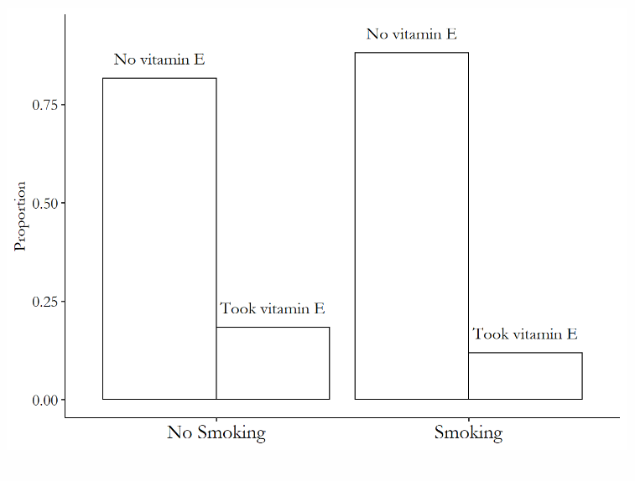
What story are we trying to tell?
Example: what is the effect of taking vitamin E on health?
Are there confounding variables?
Notes:
Now we’ve added a third dimension, but not in a confusing way! What is the figure saying?

Slide 18
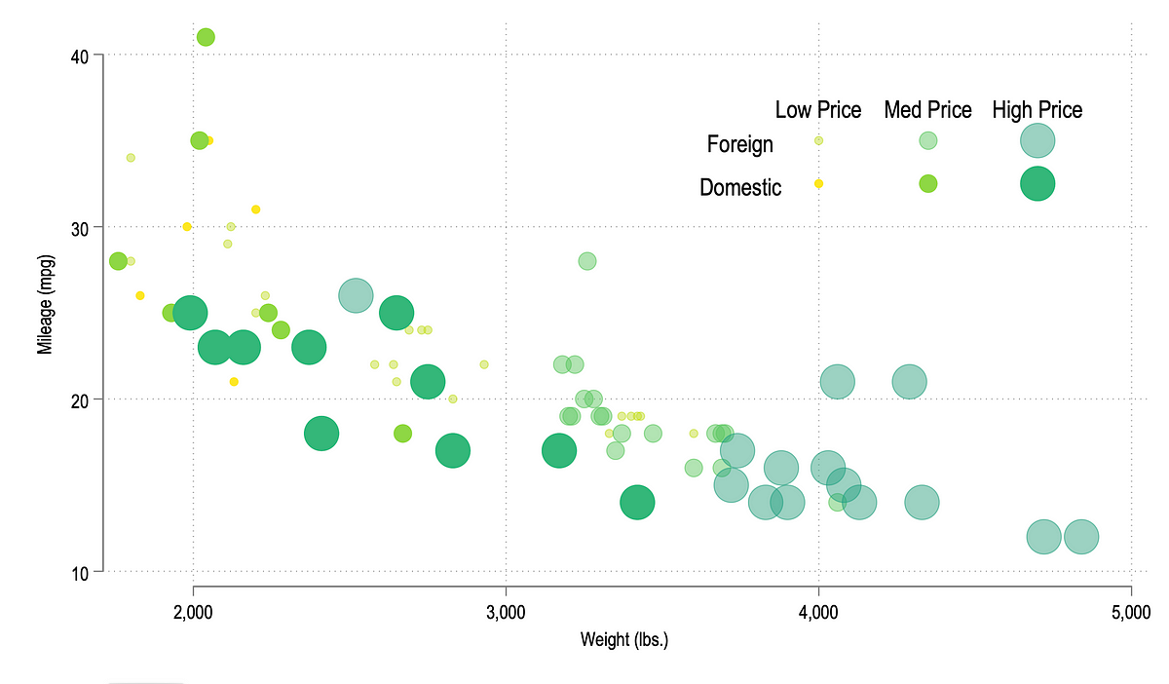
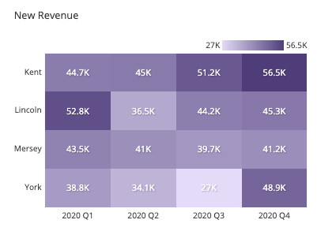
Visualization Across Dimensions
Scatterplots
Bubble chart (weighted scatterplot)
Heatmap
Notes:
Now coming back to how to visualize this – best for continuous data. https://chartio.com/learn/charts/how-to-choose-data-visualization/

Slide 19
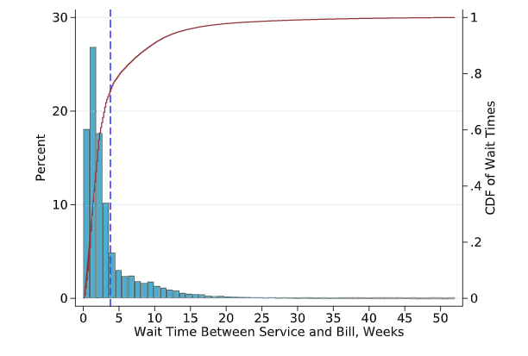
Follow your Nose
Your hypotheses can be tested in the raw data even before you get too into data cleaning and research designs
Example: how does waiting for a medical bill affect your spending?
Is there actual variation in waiting times?
Notes:
Source: https://www.sciencedirect.com/science/article/pii/S0047272724000884

Slide 20
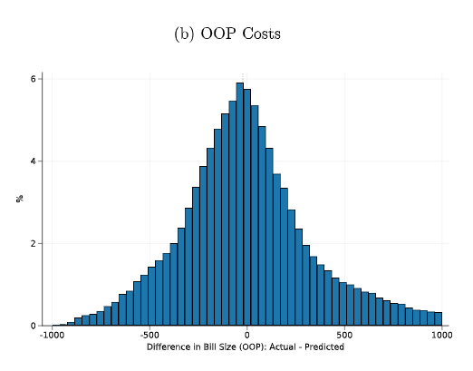
Follow your Nose
Your hypotheses can be tested in the raw data even before you get too into data cleaning and research designs
Example: how does waiting for a medical bill affect your spending?
Is there actual variation in waiting times?
Is a bill “informative” about spending?
Notes:
Source: https://www.sciencedirect.com/science/article/pii/S0047272724000884

Slide 21
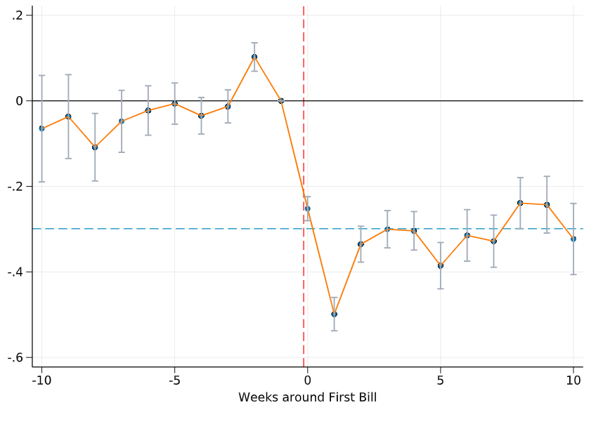
Follow your Nose
Your hypotheses can be tested in the raw data even before you get too into data cleaning and research designs
Example: how does waiting for a medical bill affect your spending?
Is there actual variation in waiting times?
Is a bill “informative” about spending?
Then, the research question: how do bills affect spending?
Notes:
Source: https://www.sciencedirect.com/science/article/pii/S0047272724000884

Slide 22
Data Visualization
Some practical tips
Notes:
Main thing: people will mainly focus on visualizations and maybe 5-10% of your text. So make the visualizations sing!

Slide 23
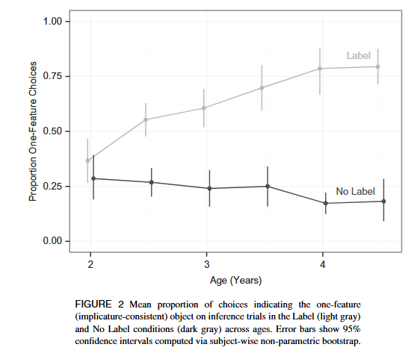
Principle 1: Show the design
If your paper has a causal component, or a regression, or a stratification, your descriptive work should highlight that feature in the raw data.
Example: how do children learn from context clues as they grow?
Notes:
A lot of this comes from https://experimentology.io/015-viz.html. The important thing is, *you don’t have to know much about the question or the design here to get the gist*. That’s good descriptive work.

Slide 24
Principle 1: Show the design
If your paper has a causal component, or a regression, or a stratification, your descriptive work should highlight that feature in the raw data.
Example: how do children learn from context clues as they grow?
1. Primary independent variable: age
Notes:
So this is shown on the x-axis. In other designs, this could be time, or what else?

Slide 25
Principle 1: Show the design
If your paper has a causal component, or a regression, or a stratification, your descriptive work should highlight that feature in the raw data.
Example: how do children learn from context clues as they grow?
Primary independent variable: age
Primary outcome variable: % answered correctly
Notes:
So this is shown on the y-axis. In other designs, this could be practically anything (and you may have several in your paper, so what’s the *most important one*?)

Slide 26
Principle 1: Show the design
If your paper has a causal component, or a regression, or a stratification, your descriptive work should highlight that feature in the raw data.
Example: how do children learn from context clues as they grow?
Primary independent variable: age
Primary outcome variable: % answered correctly
Principal exposure/groups/etc.
Notes:
How else could this be visualized? What other variations on this could you imagine? What does the shading tell you here? What story are the authors conveying?

Slide 27
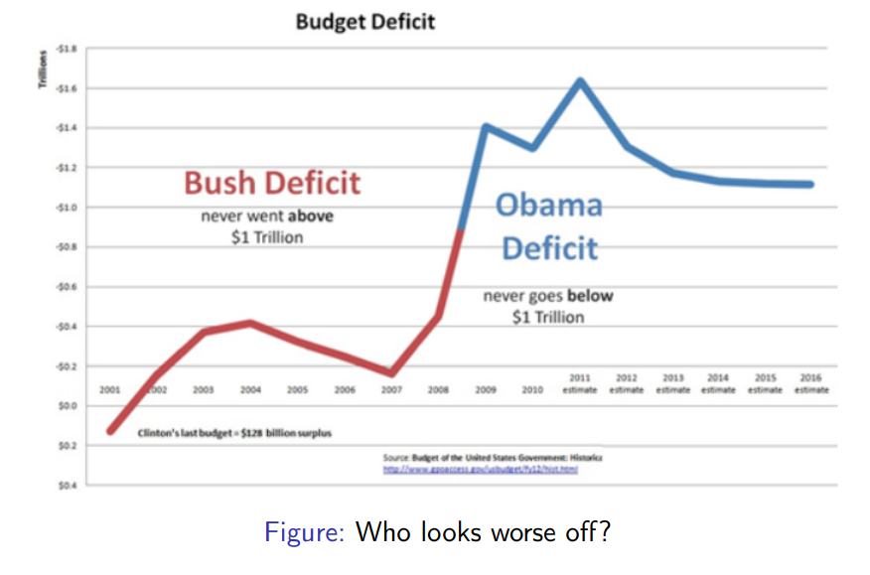
Honest Visualization
Who looks worse off here? How about if you stare at it for a minute?
What drives this?
Notes:
Color, text, etc. *how do we want to facilitate comparison*?

Slide 28
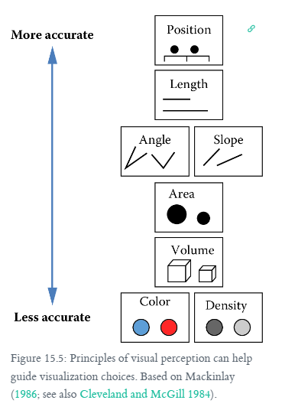
Principle 2: Facilitate comparison
Which of these helps you make the right conclusions from the study?
Notes:
In a paper, we are comparing things (treatment to control, across groups, etc.). So how should we prioritize that?

Slide 29
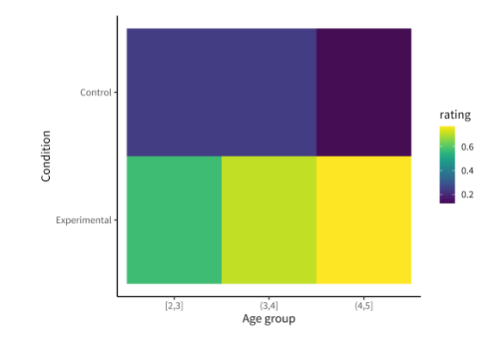
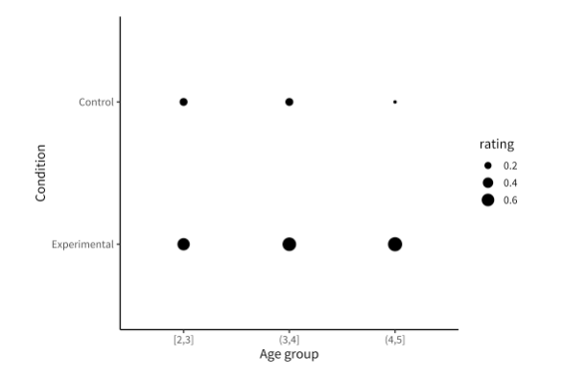
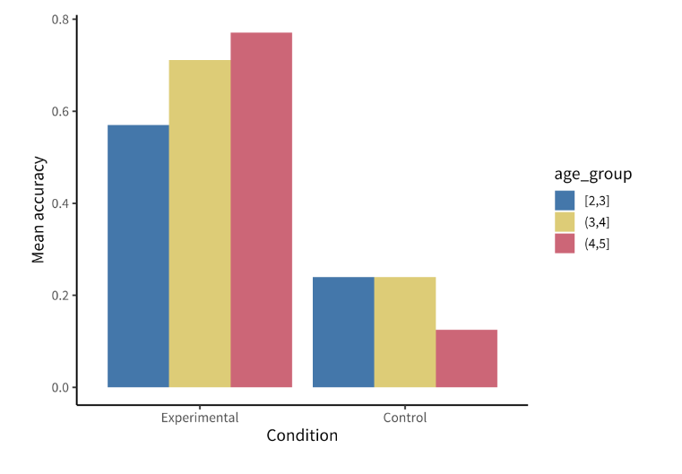
Principle 2: Facilitate comparison
Which of these helps you make the right conclusions from the study?
Notes:
Each of these is the same data. Which one works? What does it highlight? *Note: a good figure usually does more than one thing*.

Slide 30
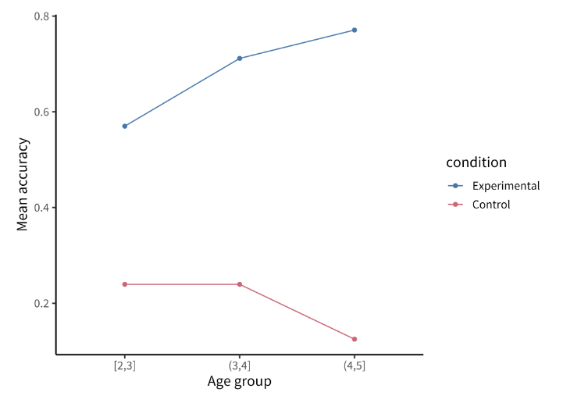
Principle 2: Facilitate comparison
Which of these helps you make the right conclusions from the study?
Notes:
Once you’ve got a winner, try to simplify it

Slide 31
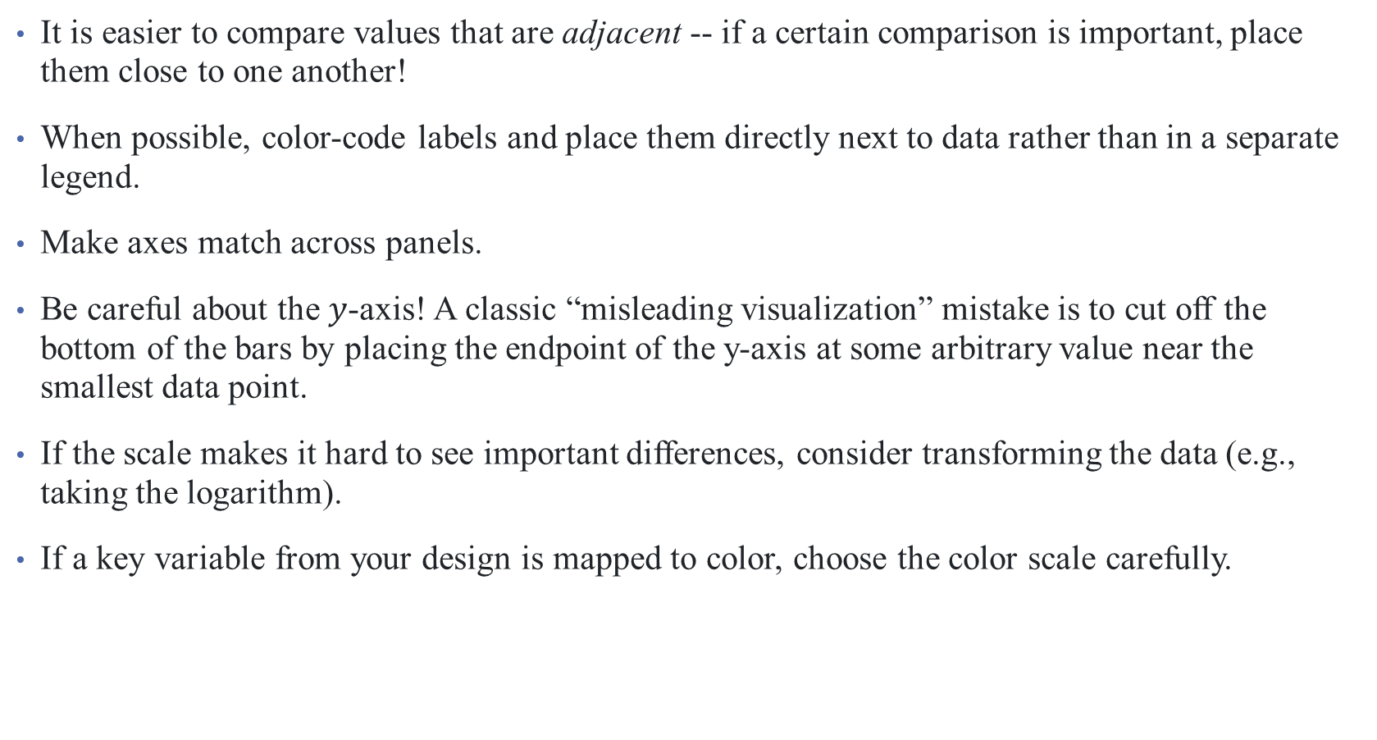
Principle 2: Facilitate comparison
It is easier to compare values that are adjacent -- if a certain comparison is important, place them close to one another!
When possible, color-code labels and place them directly next to data rather than in a separate legend.
Make axes match across panels.
Be careful about the $y$-axis! A classic “misleading visualization” mistake is to cut off the bottom of the bars by placing the endpoint of the y-axis at some arbitrary value near the smallest data point.
If the scale makes it hard to see important differences, consider transforming the data (e.g., taking the logarithm).
If a key variable from your design is mapped to color, choose the color scale carefully.
Notes:
* Don’t sort things alphabetically (default for software)
Legends force readers to glance back and forth to remember what different colors or lines mean.
This is misleading because people interpret bar plots in terms of the relative area of the bars (i.e., the amount of ink taken up by the bar), not just their absolute y-values.
For example, if the variable is binary or categorical, choose visually distinct colors to maximize contrast (e.g., black, blue, and orange). If the variable is ordinal or continuous, use a color gradient. If there is a natural midpoint (e.g., if some values are negative and some are positive), consider using a diverging scale (e.g., different colors at each extreme). Remember also that a portion of your audience may be colorblind.²

Slide 32
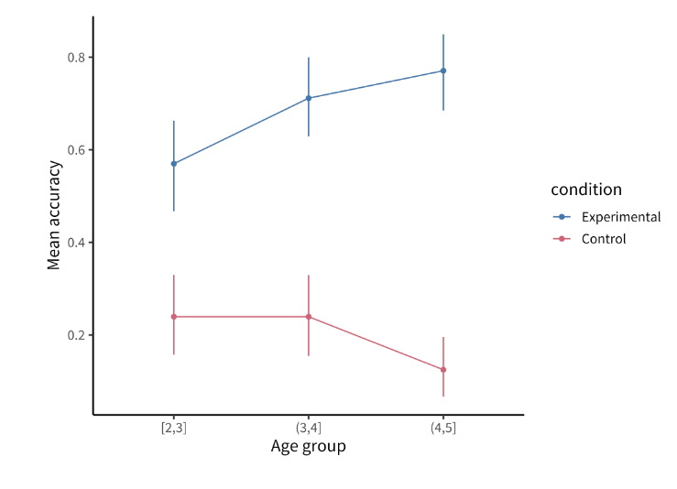
Principle 3: Show the data (and its variability)
What’s the difference here? Why is it important?
Notes:
We’ll start talking more about testing next time.

Slide 33
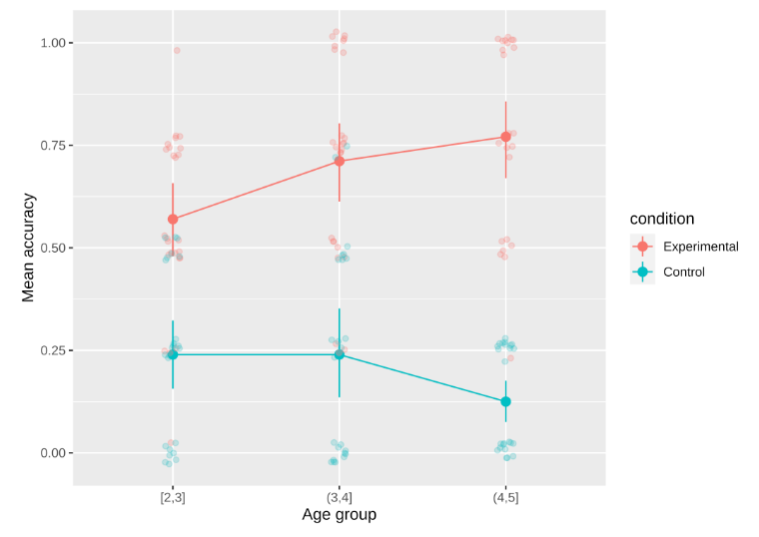
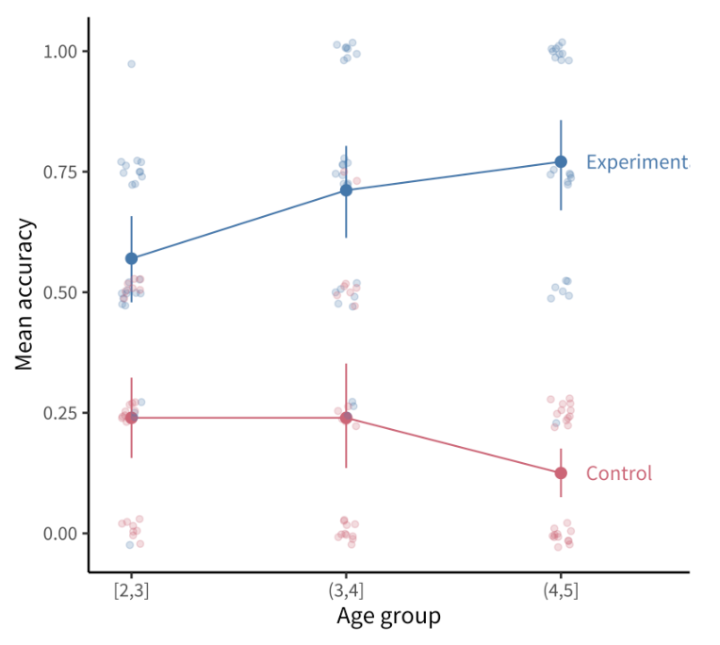
Principle 4: Maximize information, minimize ink
What’s the difference here? Why is it important?
Before After
Notes:
Let’s play “spot the differences”. Why are they important?

Slide 34
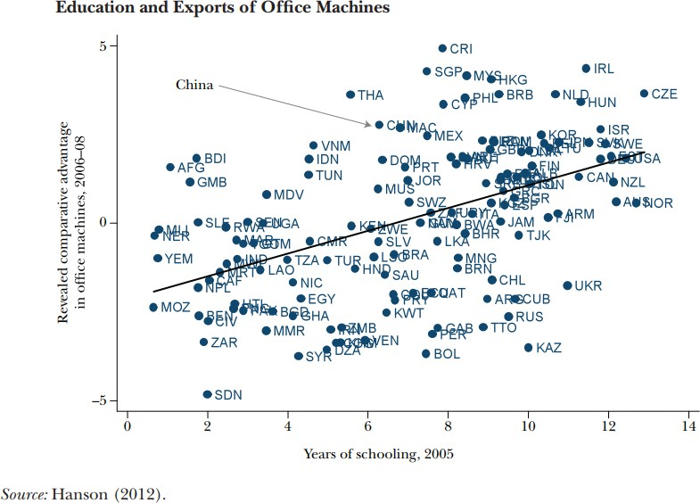
Other Notes on Data Visualization
1 Keep it simple

Slide 35
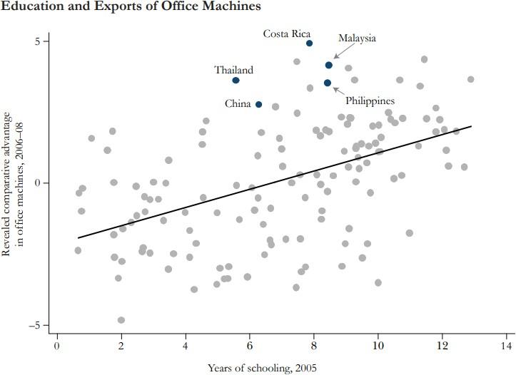
Other Notes on Data Visualization
1 Keep it simple

Slide 36
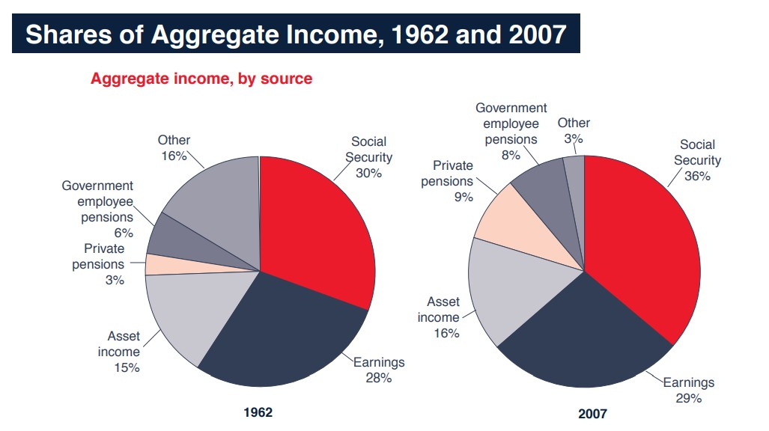
Other Notes on Data Visualization
Keep it simple
Pie charts are dead

Slide 37
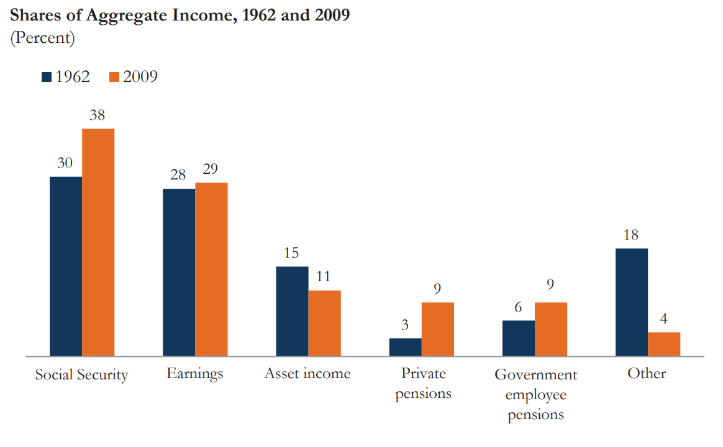
Other Notes on Data Visualization
Keep it simple
Pie charts are dead

Slide 38
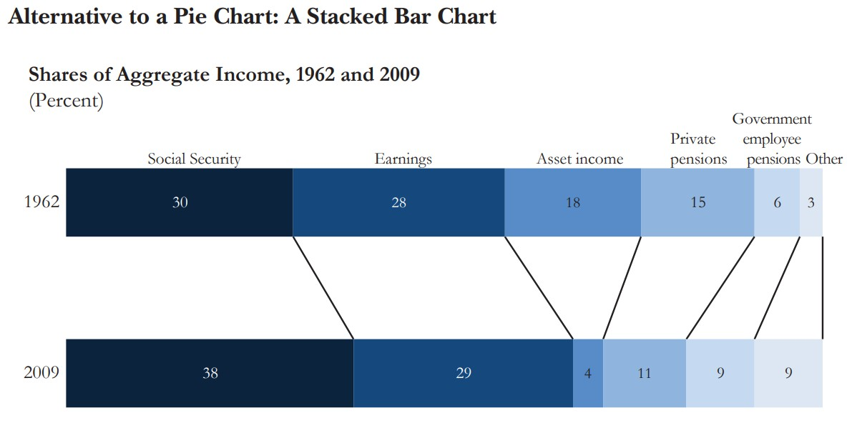
Other Notes on Data Visualization
Keep it simple
Pie charts are dead

Slide 39
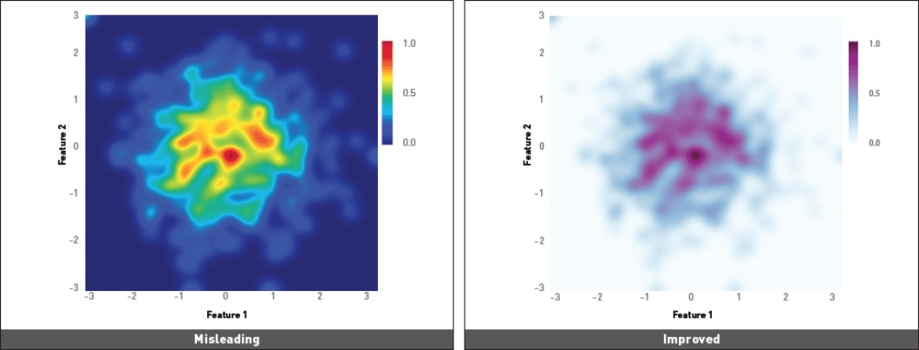
Other Notes on Data Visualization
Keep it simple
Pie charts are dead
Don’t even think about donut charts
So are 3D plots
Too many hues create false divisions/skew differences

Slide 40
Principle 4: Maximize information, minimize ink
Make sure fonts are legible and not too small!
You may need to prioritize legibility over, for example, showing all of the data.
Fix the axis labels! A common mistake is to keep the default shorthand you used to name variables in your plotting software instead of more descriptive labels (e.g., “RT” instead of “Reaction Time”). Use consistent terminology for different manipulations and measures in the main text and figures. If anything might be unclear in the figure, explain it in the caption.
Different audiences may require different levels of detail. Sometimes it is better to collapse over secondary variables (even if they are included in your statistical models) in order to control the density of the figure and draw attention to the key question of interest.

Slide 41
Correlations, Covariances, & Causation (oh my!)

Slide 42
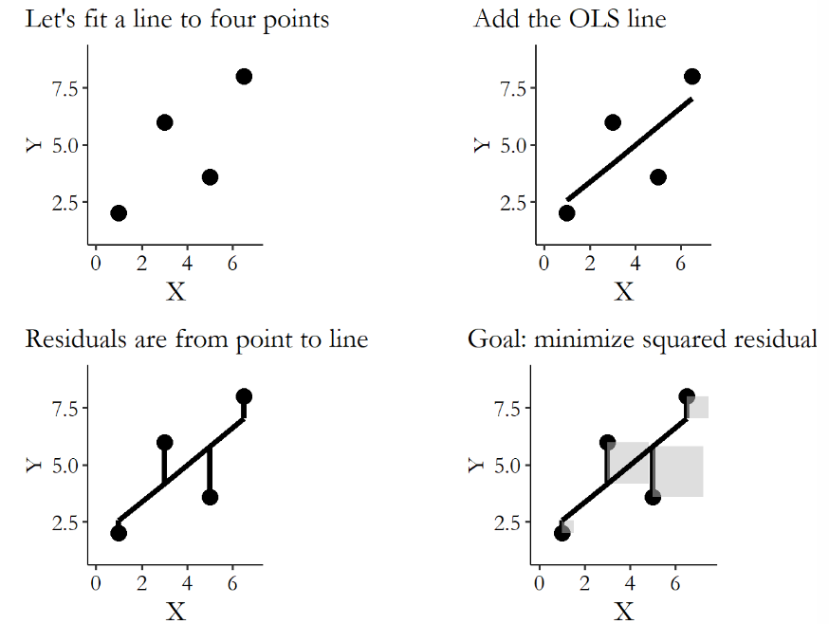
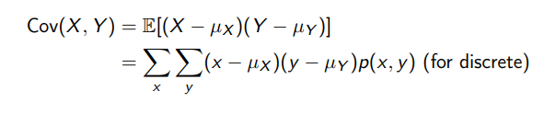
How much do your variables move together?
Just as we calculated variance last time, we can also measure the way two variables co-move
Notes:
We’ll cover regression more in future lectures, but the idea behind regression is a visual use of covariance. We want to measure strength of relationship between X and Y , or the direction of the linear relationship • If X and Y have a strong positive relationship (high X ⇔ high Y ), then x > µX ⇔ y > µY —hence, Cov(X, Y ) will be strongly positive

Slide 43

Covariances & Correlations
How do we make sense of the relationships between variables?
Variables can be independent (uncorrelated) if one contains no information of the other. Formally:
$$𝔼\left[X⋅Y\right]=Pr\left(X and Y\right)=\operatorname{Pr}\left(X\right)Pr⁡(Y)$$
Otherwise we measure covariance:
Notes:
Yremember that to calculate the variance of X, we: (a) subtracted the mean of X from X, (b) squared the result, (c) added up the result across all the observations, and (d) divided by the sample size minus one. The resulting variance shows how much a variable actually varies.
The covariance is the exact same thing, except that in step (a) you subtract the mean from two separate variables, and in step (b) you multiply the result from one variable by the result from the other. The resulting covariance shows how much two variables move together or apart. If they tend to be above average at the same time or below average at the same time, then multiplying one by the other will produce a positive result for most observations, increasing the covariance. If they have nothing to do with each other, then multiplying one by the other will give a positive result about half the time and a negative result the other half, canceling out in step (c) and give you a covariance of 0.

Slide 44
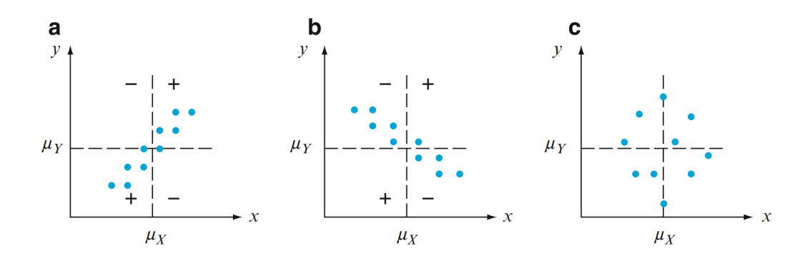
Covariances & Correlations
How do we make sense of the relationships between variables?
Variables can be independent (uncorrelated) if one contains no information of the other. Formally:
$$𝔼\left[X⋅Y\right]=Pr\left(X and Y\right)=\operatorname{Pr}\left(X\right)Pr⁡(Y)$$
Otherwise we measure covariance:
Notes:
Intuition

Slide 45
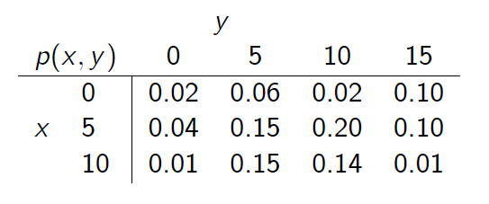
Covariances & Correlations
Example:
Notes:
Take it as given that xbar = 5.55 and ybar = 8.55.

Slide 46
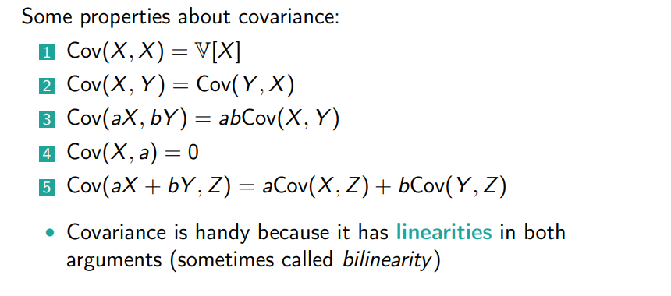
Covariances & Correlations
But this makes covariance unit sensitive!
Notes:
Skip if needed for time. This also makes covariance

Slide 47
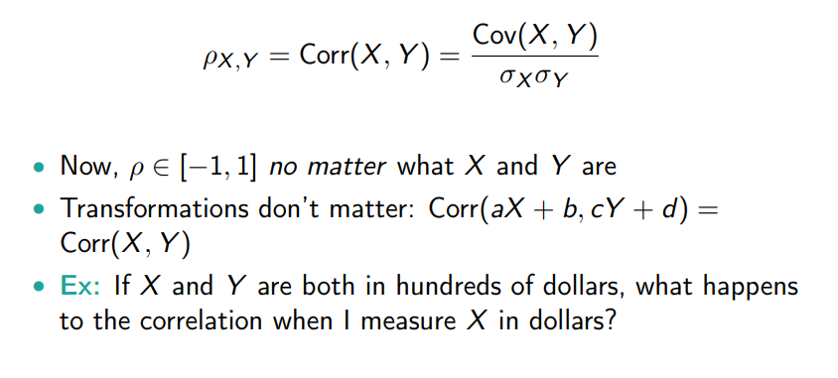
Covariances & Correlations
We use correlations as a unitless measure of covariance!

Slide 48
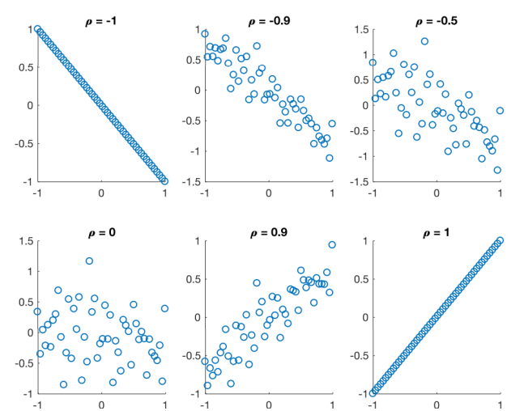
Covariances & Correlations
We use correlations as a unitless measure of covariance!
Notes:
Note that when two variables are independent, rho = 0. Is the reverse true?

Slide 49
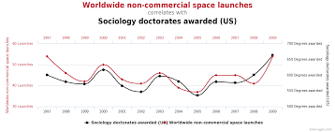
Correlation and Causation
The adage is true – need careful causal inference and econometrics to land on causal answers to questions
Notes:
Correlation does not imply causation and the reverse is true as well (causation does not imply correlation; otherwise stated, no correlation does not imply no causation). Causal inference is where it’s at (more than just stats).

Slide 50
A primer on identification
Notes:
We’ll return to this more later in the semester. Draw from HK chapter 5 here.

Slide 51
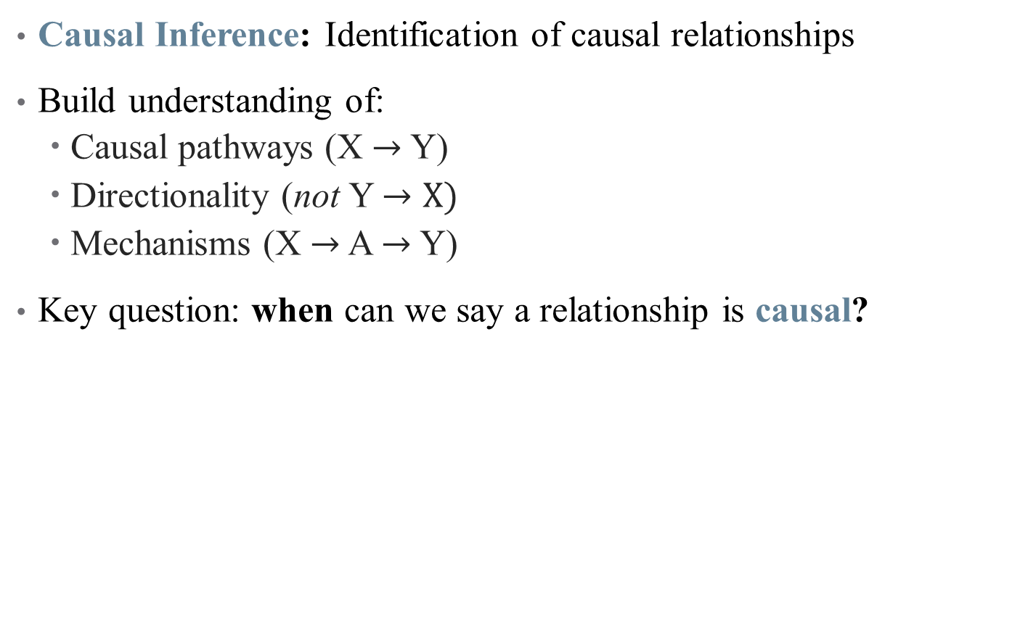
Goal of Econometric Analysis
Causal Inference: Identification of causal relationships
Build understanding of:
Causal pathways (X $→$ Y)
Directionality (not Y $→X)$
Mechanisms (X $→$ A $→$ Y)
Key question: when can we say a relationship is causal?
Notes:
Our goal is to understand a DGP – what gives rise to the data we see in the world? Example: being sick and going to the doctor.

Slide 52
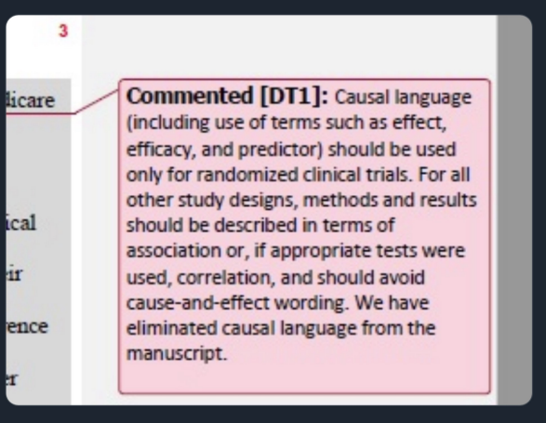
All that glitters is an RCT?
Can we only believe randomized control trials?
Notes:
But gold standard has been taken over by medical journals in particular.

Slide 53
All that glitters is an RCT?
Can we only believe randomized control trials?
RCTs are useful in some settings, but what are some problems with them?
Notes:
Gol standard of med research is RCT – is that all we can use?

Slide 54
All that glitters is an RCT?
Can we only believe randomized control trials?
RCTs are useful in some settings, but what are some problems with them?
Not always feasible
Implicit biases
Can’t always detect negative side effects
Problems with external validity, scaling, etc.
Econometric analysis helps identify real world patterns from real world data
Notes:
Decades of research goes into understanding how real data can give us (some) real answers. There are more assumptions and some limits on the parameters you return, but that’s a tradeoff worth taking.

Slide 55

All that glitters is an RCT?
Notes:
Policies are not all based on RCTs -- many rely on real-world data and causal inference. The questions are: (1) is that causal inference sound? And (2) more philosophically – to what extent should all policy be built on evidence vs. art/craft/intuition? Do we need more evidence about drinking age, for example?

Slide 56
Econometric approach
Observational data: retrospective, “real-world” data
Not (typically) collected in a lab setting
Surveys, claims, tax records, etc.
What created that data?
Data Generating Process: what unique collection of characteristics, events, and randomness coalesced to form the data we are looking at?
Our objective is to use the data available to try and establish the nature of the true DGP.
But many different DGPs are possible, and many may yield very similar patterns!
Notes:
Example: Suppose we are making a diagnosis: How helpful is knowing a patient has a fever? Must consider all symptoms together → this requires us to build a *model*

Slide 57

Why do we need causal inference?
Notes:
What would we say to this headline? Easy to just say correlation doesn’t imply causation – except that it *can*, so this isn’t enough of a response (and it kills conversation). Instead, we want to know *why* this result isn’t good enough to say it’s causal.

Slide 58
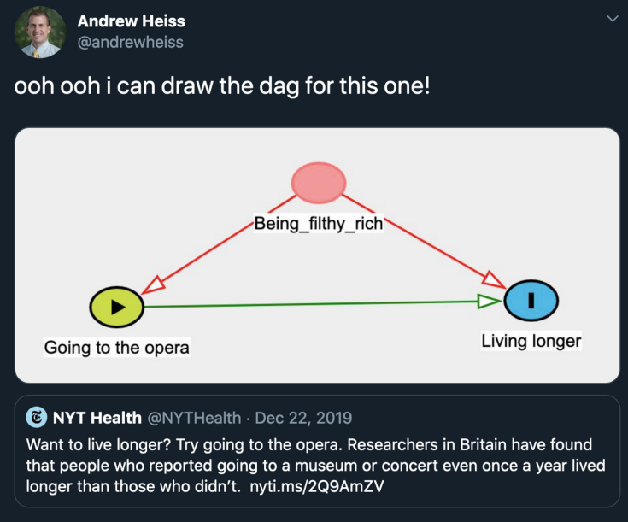
Why do we need causal inference?
Notes:
Instead, we want to know *why* this result isn’t good enough to say it’s causal.

Slide 59
This Time
Data visualization is a powerful tool: use it well
Measuring correlations and covariances (but not causation – yet!)
Quantifying (some) uncertainty: standard deviations
Next Time
Quantifying (more) uncertainty
Standard errors
Confidence Intervals

