Slide 1
Assignment 2 Notes
2/27/2025
Notes:
Logistics notes:
Assignment 3 due March 6
How are we doing with final projects?
Last unit: regression, causal inference, RCTs, and evaluating research (applications if we have time).
If you have anything you’d like to see, let me know!

Slide 2
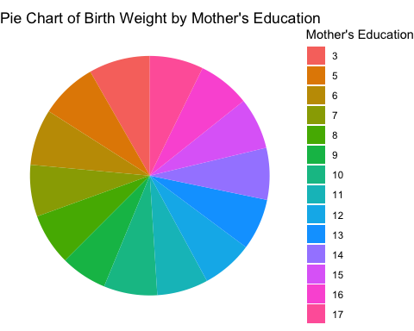
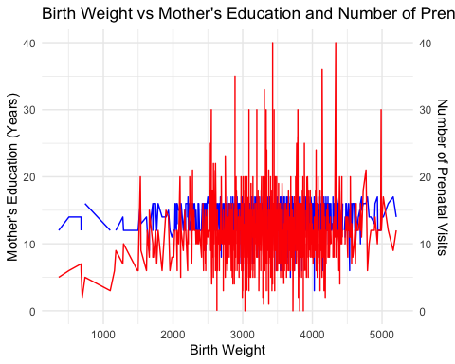
Bad Figures!

Slide 3
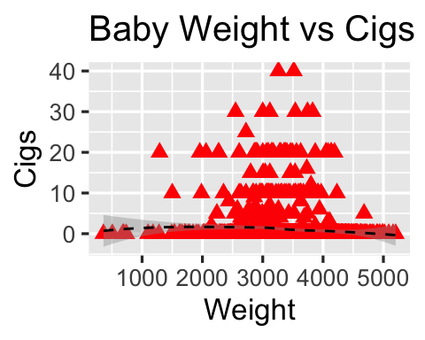
Bad Figures!

Slide 4
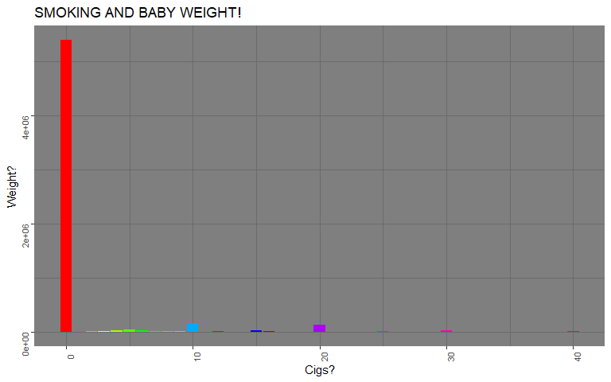
Bad Figures

Slide 5
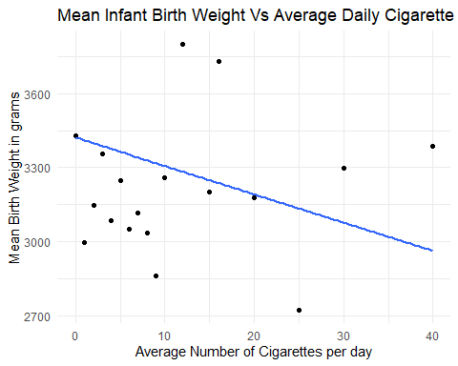
Good Figures
Notes:
This is kind of the standard question people tackled.

Slide 6
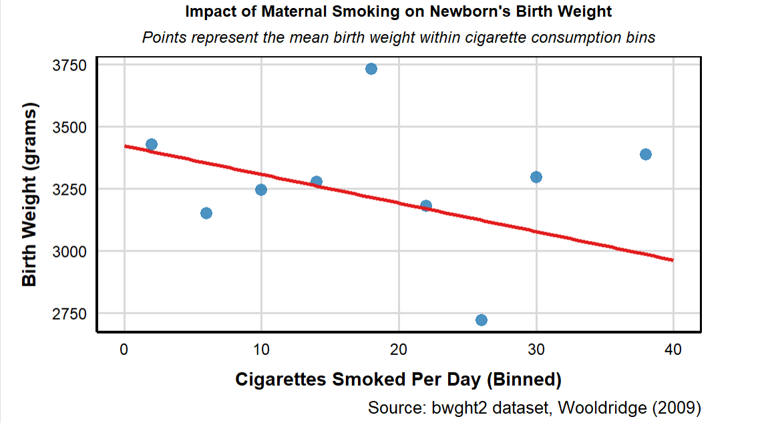
Good Figures

Slide 7
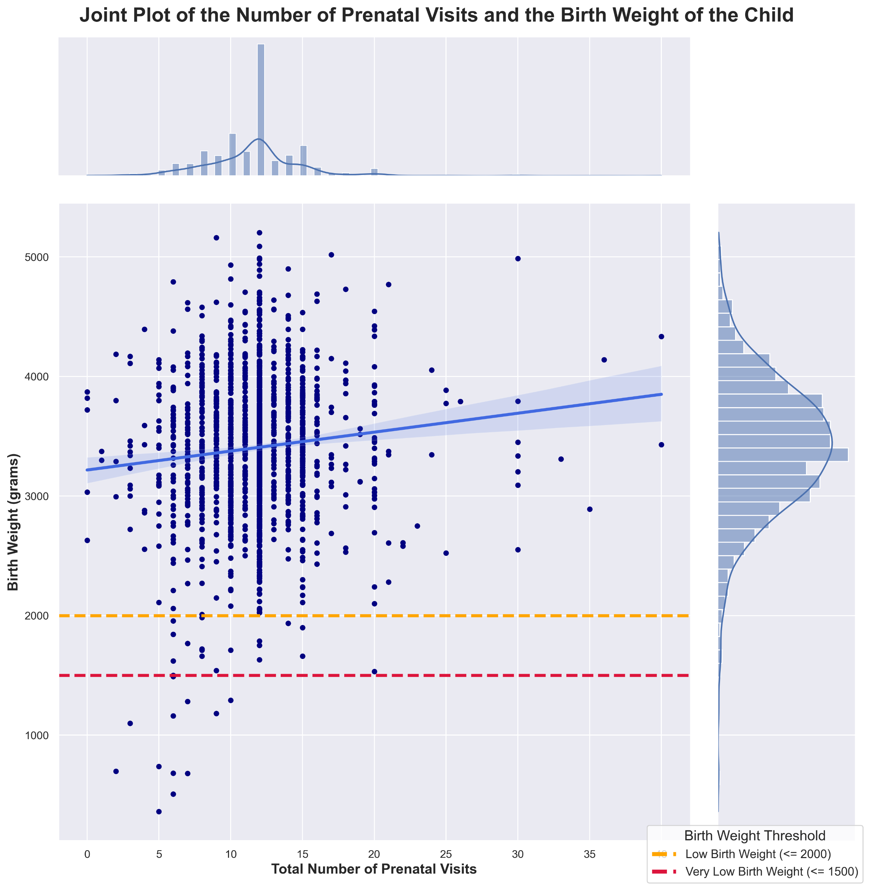
Good Figures

Slide 8
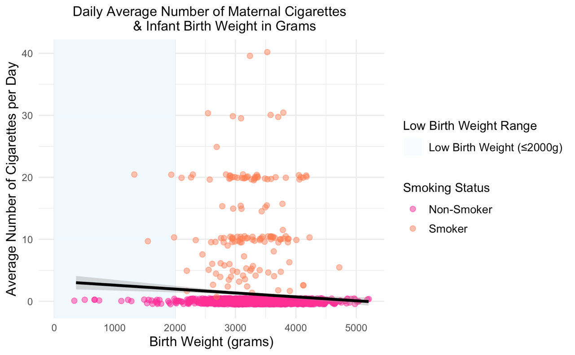
Good Figures

Slide 9
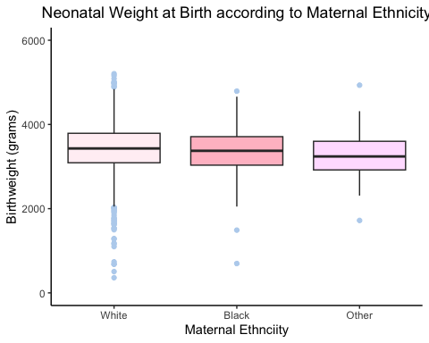
Good Figures

Slide 10
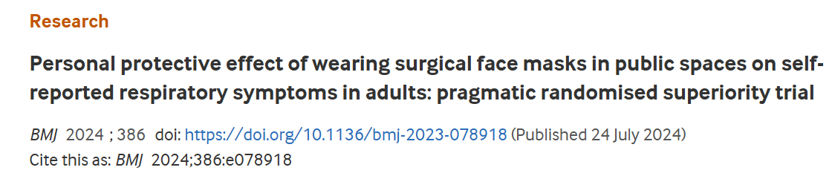
Case Study
Notes:
Goal is to refresh ourselves on the hypothesis testing framework and think about type 1 and type 2 error rates. What’s something this study does well? What is something it does poorly?

Slide 11
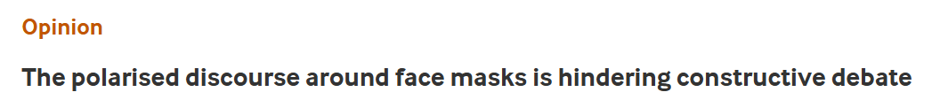
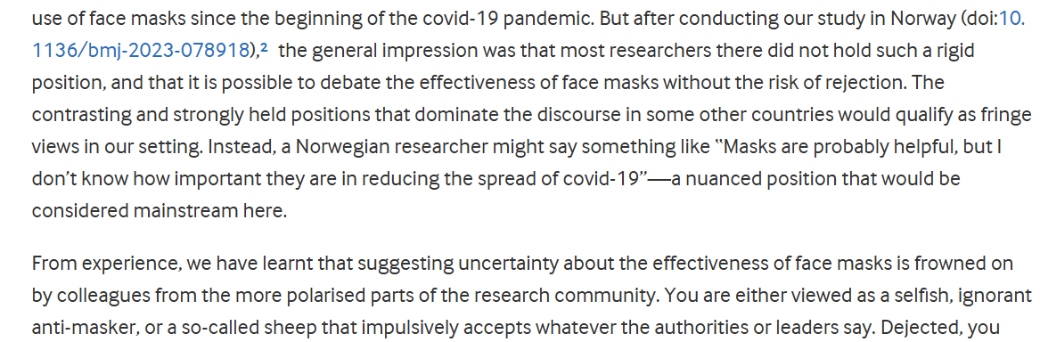
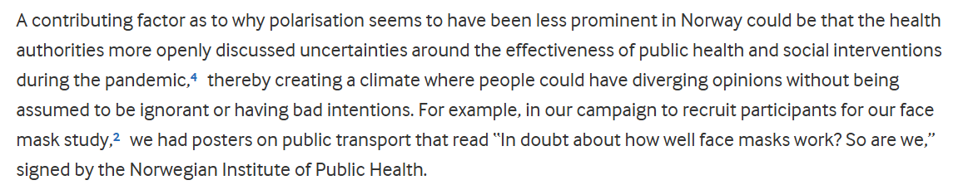
Notes:
From a linked op-ed

Slide 12
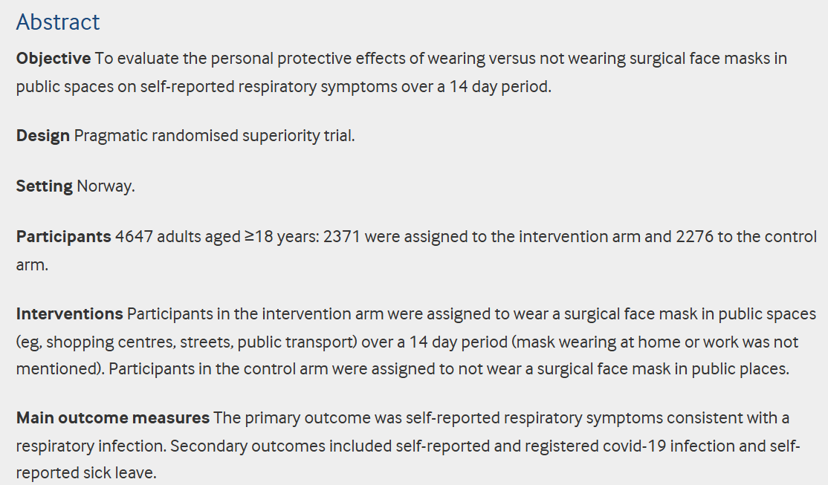
Context
Notes:
Here’s our context – go through each of these. So what is the testing procedure? Write it on the board. What kind of test do we need to perform?

Slide 13
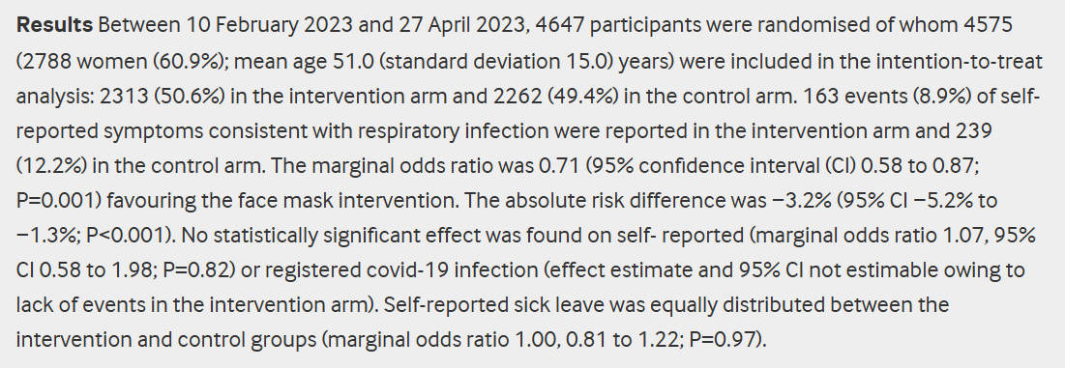
Results
Notes:
So let’s take this a bit at a time:
Did we have good participation? (What does this say about internal and external validity?)
What is the estimator for the primary outcome? What would a test look like?
What do we find for the other outcomes?

Slide 14
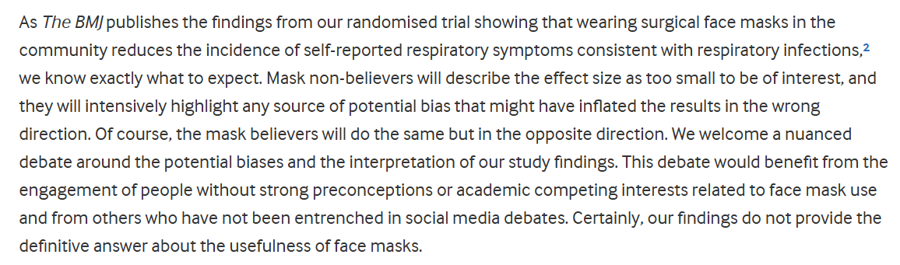
Conclusions
Notes:
Let’s think about errors here:
What is a type 1 error here? What would be the (potentially negative result)?
What is a type 2 error here? What would be the (potentially negative result)?
What other things do we need to be worried about? Multiple hypothesis testing? Patient selection? External validity? Severity? Costs and benefits?

