Slide 1
Intermediate Statistics
Lecture 1: Introduction
January 9, 2025
HAD5772 • Alex Hoagland, Ph.D.

Slide 2


Introductions
Introductions
From: USA (Texas $→$ Utah $→$ Boston)
Health Systems Experience: US, Ontario
Health Systems Experience 2:
Chronic disease, innovation
Education: Economics PhD (Health/IO)
Main Goals of the Course:
“Nonmathematical” Stats
Practical applications to research
Emphasize applications/evaluations
Practice coding

Slide 3
Introductions: Backgrounds
Most have backgrounds in mixed methods or qualitative work
Notes:
Some of your answers to the survey (if you haven’t taken it, please do! For my own info at least). We have both Master’s and PhD students with all kinds of interests (here are just a few – can remain anonymous if desired)

Slide 4
Introductions: Backgrounds
Most have backgrounds in mixed methods or qualitative work
I currently work as a head and neck surgical oncologist at mount Sinai hospital
I work as a research coordinator in the Indigenous Cancer Screening Research program at Sunnybrook Research Institute
Most recently employed by a company that specializes in medical chatbots
Senior Instructor at an academic institute in my home country
Notes:
Some of your answers to the survey (if you haven’t taken it, please do! For my own info at least). We have both Master’s and PhD students with all kinds of interests (here are just a few – can remain anonymous if desired)

Slide 5
Introductions: Coding levels
no coding only simple stats - I usually consult statisticians
Don't know anything about R - I am very anxious about this course
I have never heard of R before and am nervous but excited to learn about it.
I often find myself unsure about which specific analyses are appropriate for different conditions or research questions.
However, I primarily used Excel to track and run descriptive statistics.
Notes:
A lot of people interested/worried about coding levels – here is where we are starting

Slide 6
Introductions: Course Expectations
My goal is to become comfortable as a mixed methods researcher by the end of this program and I see this course as a first step towards that.
I hope to walk away feeling more comfortable using R to do my own analysis.
I've heard it is a "get out of it what you put in" class.
I have used R before and am comfortable with basic statistics and regression analysis. However, I often find myself unsure about which specific analyses are appropriate for different conditions or research questions. I'm excited to deepen my understanding of how to choose the right methods for various situations, as I’d like to be able to decipher which statistical approaches best address different research goals.
Notes:
A lot of people interested/worried about coding levels – here is where we are starting

Slide 7
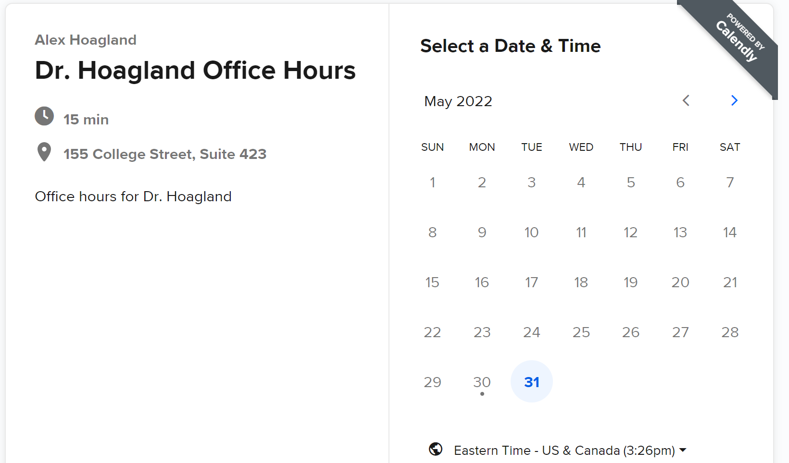
Introduction & Syllabus
Booking office hours: calendly.com/Hoagland-office-hours/
Zoom: Thursdays, 10-11:30
In person if needed, but arrange in advance please!

Slide 8
Introduction & Syllabus
Evaluation Criteria
5 short (group) assignments, worth 60% of the final grade.
1 final (group) project, worth 40% of the final grade.
Evaluations focus on practical applications (e.g., coding)
Final project guidelines/rubric available on GitHub
Notes:
Instructions are on each assignment for submission. There is a 10 (percentage point) penalty for each late day. Can work together, but each must submit their own copy (and copy/paste for code isn’t a great way to learn). We will talk more about the final project throughout the semester, but you can find the requirements/rubric on GitHub now – your own (simple) data analysis, description, and quant research (correlations, etc.)

Slide 9

Introduction & Syllabus
Software.
We will use R.
You are welcome to use other software, but check with me
R is free! Download R here and an interface RStudio here
Training sessions offered in department on Jan. 17
Notes:
Lots of online resources – I’m going to try to cover things in real time, as that has been the most helpful way I’ve learned R. Group work is encouraged, Github discussions, office hours, etc.

Slide 10
Introduction & Syllabus
Software.
We will use R.
You are welcome to use other software, but check with me
R is free! Download R here and an interface RStudio here
Training sessions offered in department in early Jan.
Github repo
Contains all relevant course materials
Notes:
Group work is encouraged, Github discussions, office hours, etc. Talk about sample papers and reading materials (useful as you prep your final paper; treat this course as an intro to a lot of methods but you should take a deep dive into methods you care more about.)

Slide 11
Installing R, RStudio, and Copilot
First step: install R
1. Visit the R Project's official website: https://cran.r-project.org/
2. Click “Download R” for your operating system
3. Follow the installation instructions. During this stage, you may be asked to select something called a “CRAN mirror.” It’s not important what this is, but you should pick one that looks geographically proximate to where you currently are. For example, if you are in Toronto, I recommend picking the MBNI University of Michigan mirror (https://repo.miserver.it.umich.edu/cran/). Doing so will make your installation a few seconds faster, at least; otherwise, it shouldn’t matter too much.
4. You do not need to open R once it is installed (see below).
Notes:
Please do this before next week, if you haven’t already!

Slide 12
Installing R, RStudio, and Copilot
Second: install RStudio
1. Go to the RStudio official website: https://posit.co/download/rstudio-desktop/. Note that it has a big button with a #1 on it that says “1: Install R.” You’ve already done that!
2. Use the big button “2: Install RStudio” to select the appropriate RStudio version for your operating system.
3. Follow the installation instructions.

Slide 13
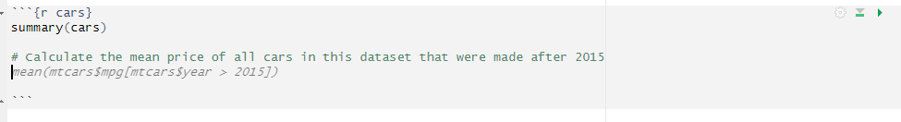
Installing R, RStudio, and Copilot
What is Copilot?
Installation Prerequisites:
Notes:
A resource: https://www.youtube.com/watch?v=t7NrkAeosog&ab_channel=MelissaVanBussel%28ggnot2%29.

Slide 14
Installing R, RStudio, and Copilot
What is Copilot?
Installation Prerequisites:
1. Make sure you have a (free!) GitHub account. You can sign up here: https://GitHub.com/join.
2. Apply for the GitHub Student Developer Pack here: https://education.GitHub.com/pack. You have to provide a picture of your student ID or some other proof you’re a student, and approval can take a few days, so the sooner the better!
Notes:
A resource: https://www.youtube.com/watch?v=t7NrkAeosog&ab_channel=MelissaVanBussel%28ggnot2%29.

Slide 15
Installing R, RStudio, and Copilot
How do I get Copilot into RStudio?
Step 1: Accessing GitHub Copilot. Visit the GitHub Copilot page (once signed in): https://GitHub.com/features/copilot. Follow the instructions to enable Copilot for your account.
Step 2: Integrating GitHub with RStudio
1. After completing the above, open RStudio and go to `Tools` > `Global Options`
2. At the very bottom left, click the “Copilot” button with the GitHub cat icon
3. Check the “Enable GitHub Copilot" button. You will need to sign into your GitHub account again and give permission for communication between RStudio and GitHub.

Slide 16
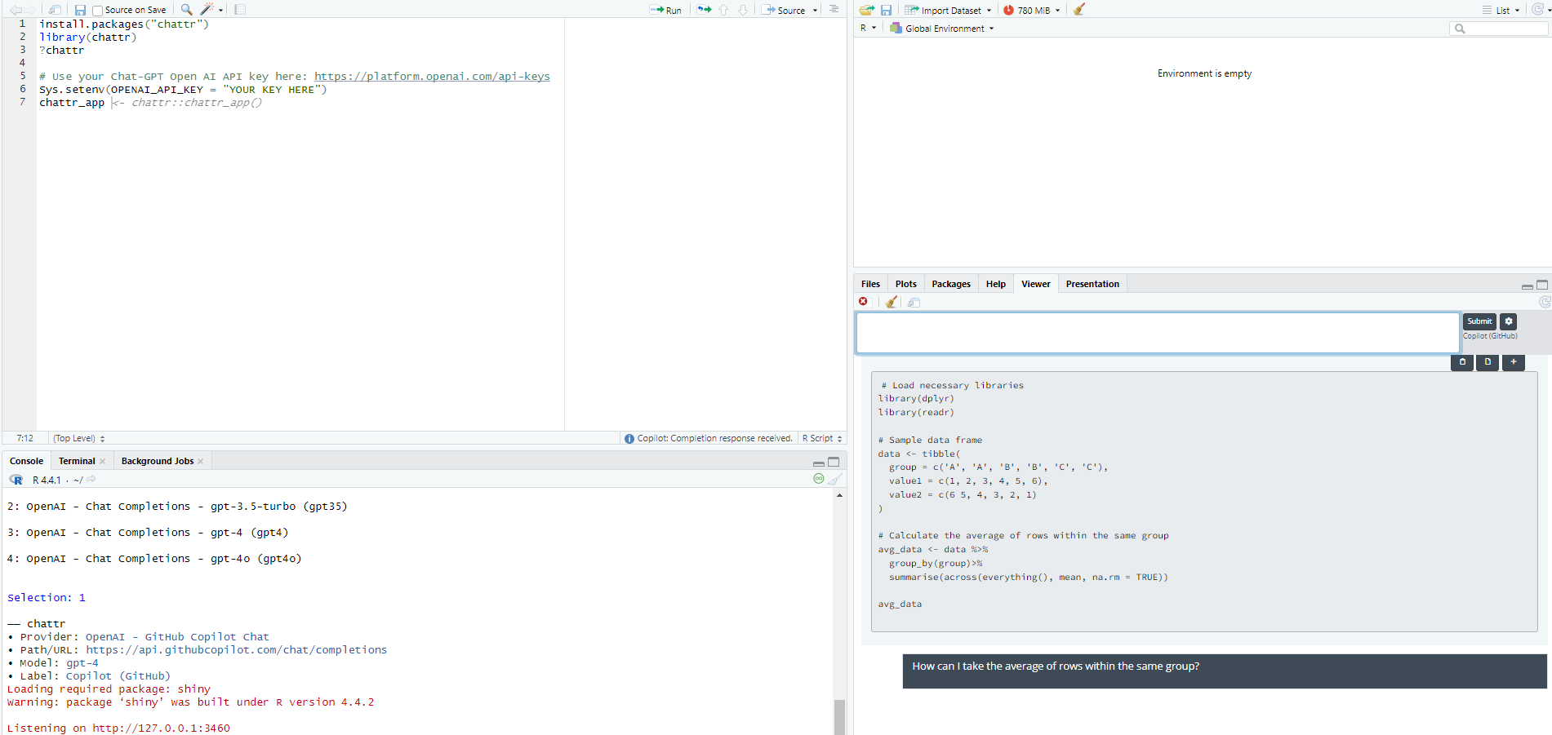
What about Chat-GPT?
Course policy on generative AI: use it carefully, take responsibility for your work (and learning), and do not plagiarize
Generative AI has strengths and weaknesses in quant research
Notes:
One thing it’s good at (ish) – coding! Here is how you can integrate with R Studio and ask questions. Remember that the more detailed the question, the better the answer. (Note that this will only give you coding help, but there’s a reason you should do it this way – it will see your code and history!)

Slide 17
What about Chat-GPT?
Course policy on generative AI: use it carefully, take responsibility for your work (and learning), and do not plagiarize
Generative AI has strengths and weaknesses in quant research
Q: Why are confidence intervals narrower when sample size increases?
A: Confidence intervals become narrower as the sample size increases because larger sample sizes reduce the standard error of the estimated parameter, which directly affects the width of the confidence interval.
Standard Error Decreases with Larger Samples
The standard error (SE) measures the variability or uncertainty in the estimate of a parameter (e.g., the mean or regression coefficient). For a sample mean, the formula for the standard error is:
SE=σnSE = \frac{\sigma}{\sqrt{n}}
Where:
σ\sigma is the population standard deviation (assumed constant),
\sqrt{n} is the sample size.
As the sample size n increases, the denominator \sqrt{n} becomes larger, causing the standard error to decrease. A smaller standard error means that the estimate is more precise.
Intuition: More Data Reduces Uncertainty
Larger sample sizes provide more information about the population, reducing uncertainty about the parameter being estimated. This greater precision is reflected in narrower confidence intervals.
Notes:
It’s *much* more variable at interpreting statistics. For example, this is good – although erring on the side of too much information. A worse outcome is this one: https://chatgpt.com/share/677d4e1b-46f0-8000-9cd8-e09f628f7795.
Not really engaging in the context discussion
Missing some obvious things (yes, a doubling of head trauma rates is serious)
Provides too much information – you risk losing points for going on tangents that aren’t related to the question
Ultimately, you take your learning into your hands. How could you use this in an assignment?
If I feel it’s plagiarized, then it’s plagiarized.

Slide 18
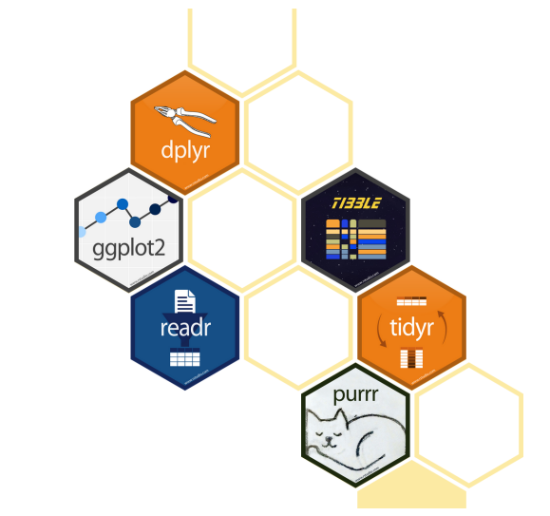
Using R
We will use the tidyverse
Notes:
Tidyverse: set of packages to make R code more readable. We’ll spend some time at the end of class today with a simple R exercise and more next lecture.

Slide 19
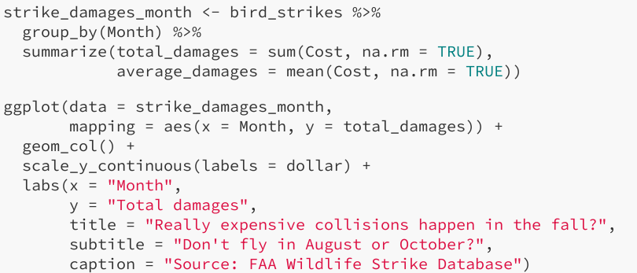
Using R
We will use the tidyverse
Makes R code read more like English!
Notes:
Tidyverse: set of packages to make R code more readable.

Slide 20
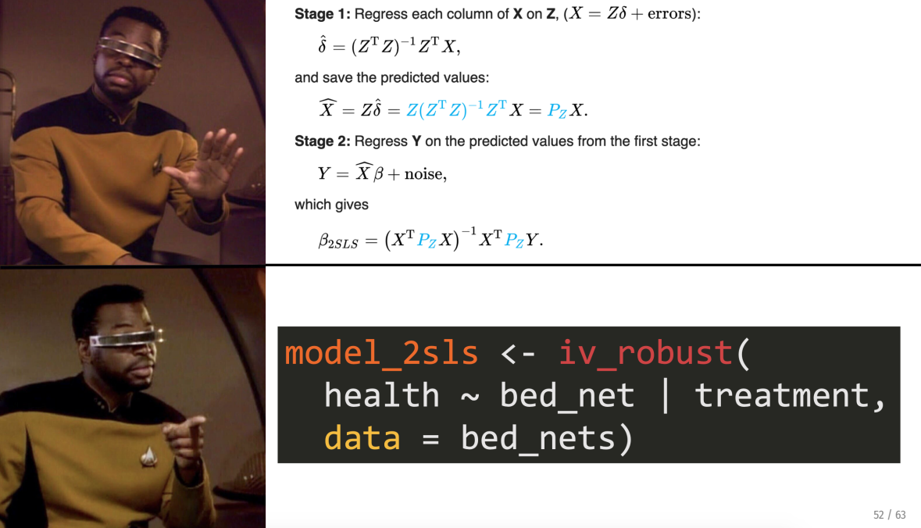
Using R
We will use the tidyverse
Makes R code read more like English!
Emphasize practical applications over theory
Notes:
Note: there will still be some theory, but less

Slide 21
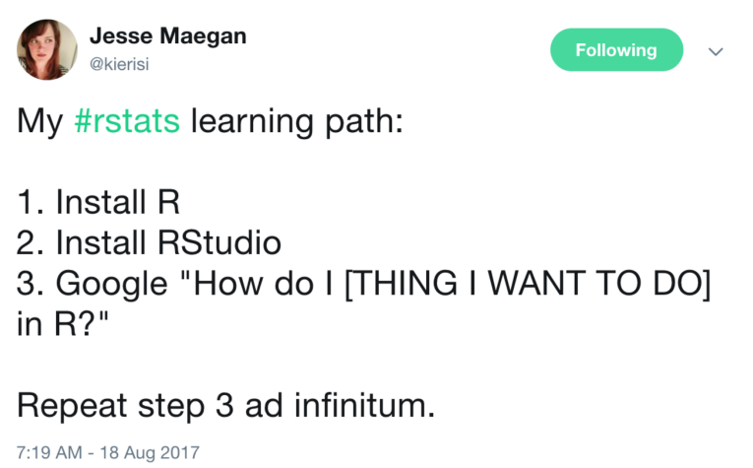
Using R: A Trial of Patience/Faith/Etc.
Mini-modules: https://jacobjameson.github.io/Intro%20R.html
Notes:
To add next time: https://www.tiktok.com/t/ZTRxhLa7B/. It can be a pain to learn R – but the best way to learn really is trial by error. Note that there’s some literature/ideas out there that it’s good to suck at something (it’s the first step to being good at something), but I don’t want you to feel like you are sucking! Come to me with questions, but don’t be stressed if you are feeling frustrated. These are tools that will serve you well, invest in them.

Slide 22

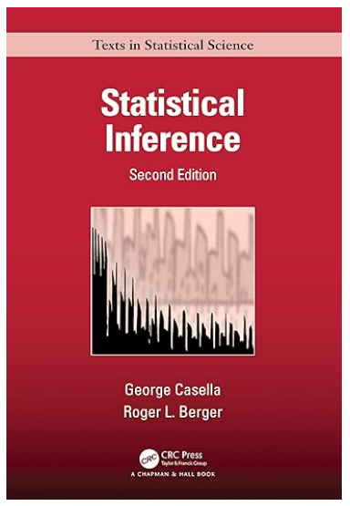
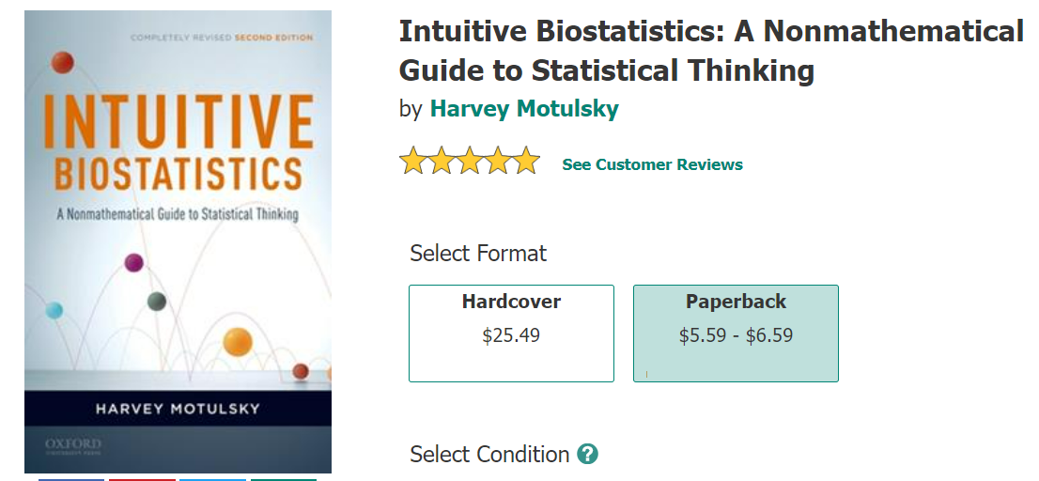
Introduction & Syllabus
Notes:
Cheap, great resource. Other options listed on syllabus. Not required, any edition will work.
Finish the rest of the syllabus review here.

Slide 23
Why do we need statistics?

Slide 24

Hardwired Brains
We tend to jump to conclusions from limited data
Imagine a child meets a doctor

Slide 25
Hardwired Brains
We tend to jump to conclusions from limited data
Imagine a child meets a doctor, then another

Slide 26
Hardwired Brains
We tend to jump to conclusions from limited data
Imagine a child meets a doctor, then another, then another
What gender do you have to be to be a doctor?
How many women doctors do you have to meet before you are 100% certain of your answer? 95%? 90%?
Notes:
Statistics helps us generalize from limited n to a population *while being explicit* about the inherent uncertainty of doing so.

Slide 27
If you think answering a question is hard, …
Accurately quantifying the uncertainty around the answer is even harder
Example: 90% confident. Can you make a range that you think is 90% likely to include:
The year Genghis Khan died
The size of a COVID-19 virus (in nanometers)
Diameter of Neptune (in kilometers)
Notes:
Do one for the whole class – should be that 90% of the intervals include the true amount, but in general, people are too narrow (overconfident)
Answers:
1227
100 nanometers
49244 km

Slide 28
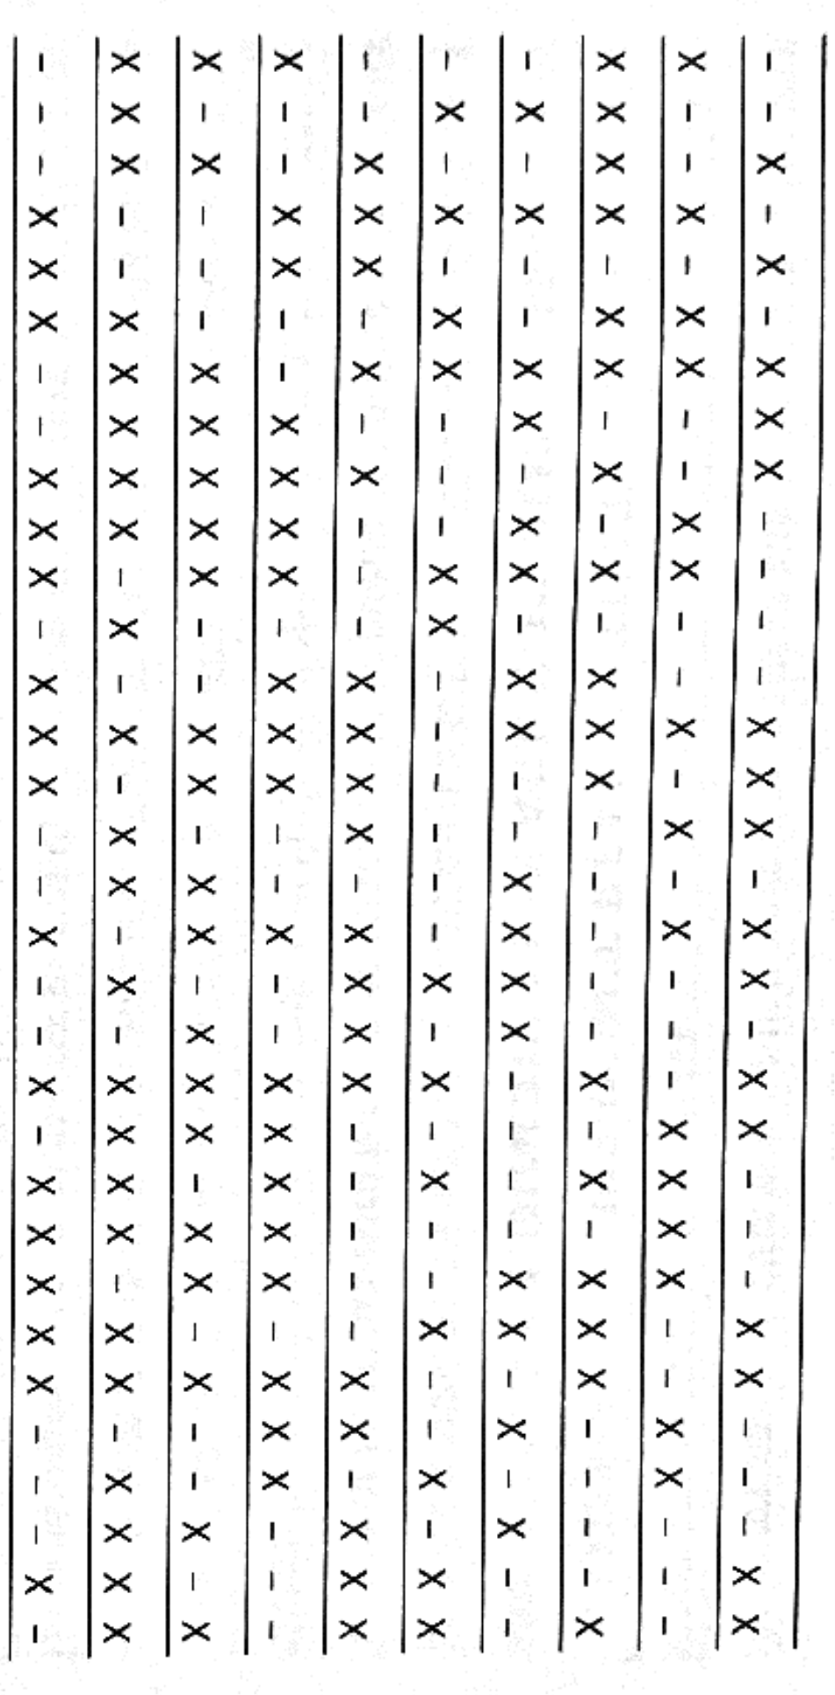
What about identifying patterns?
Notes:
Who’s on a “hot streak” here? Is there any player here whose chance of making the next shot (moving to the right) depends on the number of successful prior shots? (Note: all are random)

Slide 29
Biases to overcome
Coincidences are more common than we think
Maybe the chance of a single coincidence is tiny, but the chance that a set of “coincidental events” will occur is large!
Our intuitions about probability are often terrible
Especially with lab experiments (many people prefer a bowl with 93 red jelly beans and 7 white ones to a bowl with 9 red ones and 1 white one, even after doing math!)
Combining probabilities is trickier (Monty Hall problem)
Ambiguity is even harder
Do you prefer an urn with 50 red and 50 black jelly beans, or an urn with 100 jelly beans and some combination of red and black?

Slide 30
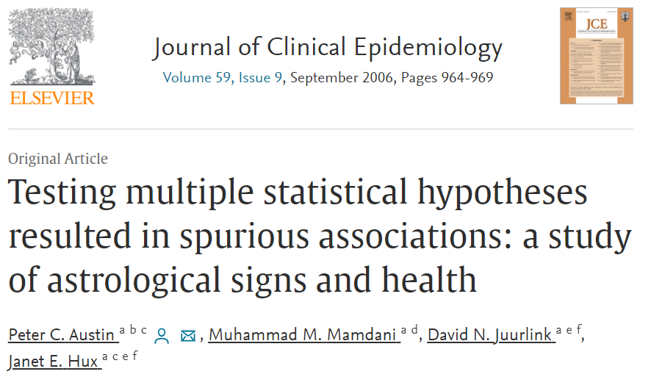
Final Examples: Ontario Health + Astrology
Main question: do people of different astrological signs have different likelihood for hospital admissions?

Slide 31
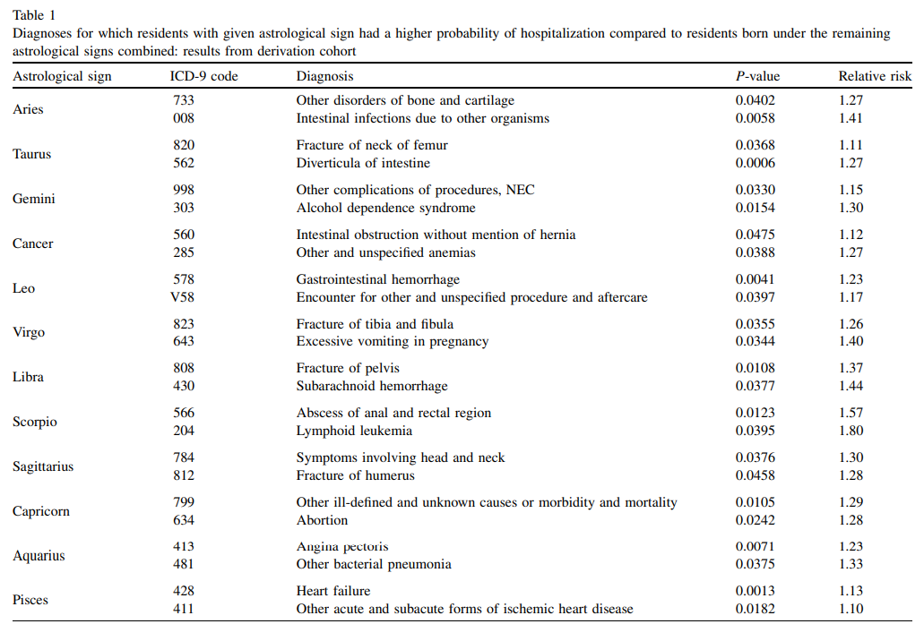




Final Examples: Ontario Health + Astrology
Main question: do people of different astrological signs have different likelihood for hospital admissions?
Notes:
What does this mean? But if there are 223 admissions and 12 signs, that’s 2,676 distinct comparisons! Given a threshold of 5%, we should expect about 134 significant associations by chance (the authors found 72).

Slide 32
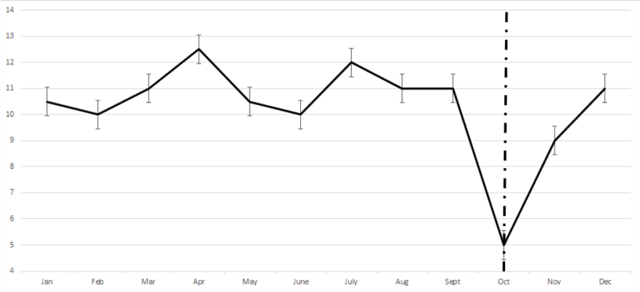
Final Examples: Regression to the Mean
One of the trickiest concepts: things tend to go back to the “center” of a distribution over time
Notes:
Someone visits the doctor once a month, and in October has terrible blood pressure. MD prescribes a medication – is this a sign that the medication worked? Why/why not?

Slide 33
What does statistics do?

Slide 34
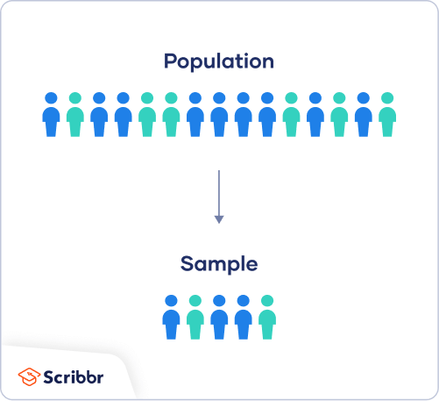
Generalizing with caution
Probability (is a sample representative/balanced?)

Slide 35
Generalizing with caution
Statistics

Slide 36
What statistics can do
For a defined population of interest,
Notes:
Go through these one by one. For this one – say you want to know about the effectiveness of a drug to treat cancer. The population we really care about is all patients (including those who have cancer now but also everyone who might get cancer). But how do we get data?

Slide 37
What statistics can do
For a defined population of interest,
With an appropriately selected random sample,
Notes:
You may be limited in your data (e.g., lung cancer patients in Ontario). Have to think about how that affects the (1) you can speak to.

Slide 38
What statistics can do
For a defined population of interest,
With an appropriately selected random sample,
And a well-measured variable of interest,
Notes:
Say we’re interested in “effectiveness.” what does that mean? % of patients in remission? Patient well-being? Years of life gained?

Slide 39
What statistics can do
For a defined population of interest,
With an appropriately selected random sample,
And a well-measured variable of interest,
Under the appropriate assumptions:
Notes:
Other assumptions we need to make: is treatment randomly assigned? What if we have observational data? Etc.

Slide 40
What statistics can do
For a defined population of interest,
With an appropriately selected random sample,
And a well-measured variable of interest,
Under the appropriate assumptions:
One can make inferences about the (changes in) distribution of the variable in the population given the sample
Notes:
Statistics requires us to carefully think about each of these steps and honestly address how our research fits in given these limitations.

Slide 41
What statistics cannot do (well)
Go from a limited sample to a (even related) population
Generalize from non-random samples
Handle “latent” variables (qualitative research?)
Deal with measurement error
Notes:
There are ML and econometric/causal inference methods to deal with these, but stats alone is not enough. Tradeoffs between assumptions and usefulness of results.

Slide 42
Probability
The language of statistics
Notes:
These are available on a separate .pdf but we will hit the high points (paper copy)

Slide 43
Summary
Statistical thinking has a lot to offer
But we have to be careful how we apply it
Quantifying uncertainty is vital for good research and understanding the world
Next Time
Visualizing our data
Thinking about correlations
IntRoduction to R

