Slide 1
Advanced Health Economics
Lecture 10: Behavioral Health Economics
DATE
HAD 6750 • Alex Hoagland, Ph.D.

Slide 2
Last time: Individual Health Behaviors
Notes?

Slide 3
Last time: Individual Health Behaviors
Notes?
This time: Behavioral Health Economics
Patients act weird!
Lots of things we could cover, but today we will focus on three:
Addiction
Insurance choices
Screening/Preventive care decisions

Slide 4
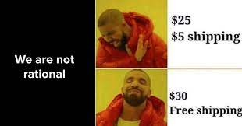
Summary of Behavioral Econ
Notes:
Quick introduction

Slide 5
Behavioral vs. Neoclassical – where’s the line?
Notes:
Quick introduction

Slide 6
Handel and Kolstad (2015)
Handel (2013)
“Adverse selection and switching costs in health insurance markets: When nudging hurts”
American Economic Review
“Health Insurance for ‘Humans’: Information Frictions, Plan Choice, and Consumer Welfare”
American Economic Review
Notes:
Continue with a little bit of structural modeling – how do humans differ from robots? Follow the methodology outlined in Chandra et al.’s review paper.

Slide 7
Baicker, Mullainathan, & Schwartzstein (2015)
“Behavioral Hazard in Health Insurance”
The Quarterly Journal of Economics
Notes:
Again, follow handbook chapter – go through examples

Slide 8
Summary of Empirical Work
Notes:
If you have time. Discuss Galizzi’s paper on experiments (note: not assigned as reading)

Slide 9
Presentations

Slide 10
Summary
Moral hazard in health care
Additional work: talk about some of your own work.
Next time: adverse selection
What happens when people have private information about type?
How does this affect health choices?

