Slide 1
Advanced Health Economics
Lecture 5: Patient-Provider Interactions
February 7, 2025
HAD 6750 • Alex Hoagland, Ph.D.
Notes:
To add: health care is a credence good (like going to a mechanic) from Tal’s book. Also chapter 8.
To consider for next time: hospital quality competition based on heterogeneous patients: https://repositorium.uminho.pt/bitstream/1822/79916/1/WP-07.2022.pdf. (Esteves et al., “Quality discrimination in healthcare markets”)

Slide 2
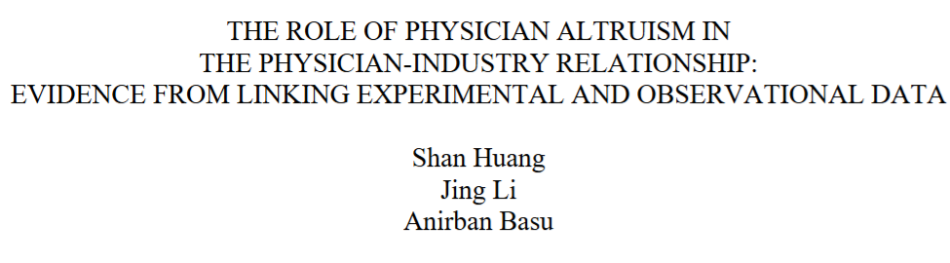
Last time: Provider Payment
Thinking about supply of healthcare rather than demand
How do physicians respond to incentives?
Notes:
Here’s a 2025 NBER Working paper on altruism and pharma payments. Main question: what is the effect of industry payments on use of pharmaceuticals in the US (high)? Who drives this? The non-altruistic physicians!
There’s a really nice model here I suggest working through
How is altruism elicited? A lab experiment where the physician makes 50 independent decisions on how to allocate wealth between themselves and their patients.

Slide 3
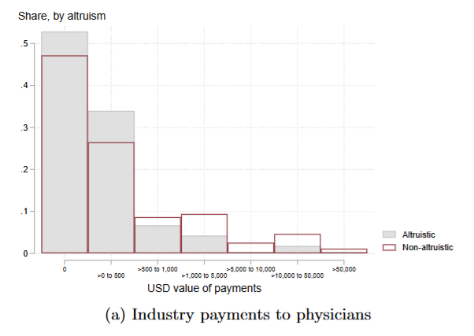
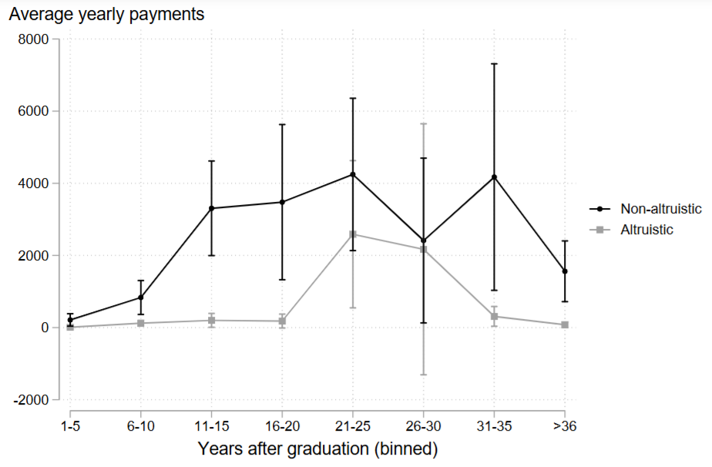
Last time: Provider Payment
Thinking about supply of healthcare rather than demand
How do physicians respond to incentives?

Slide 4
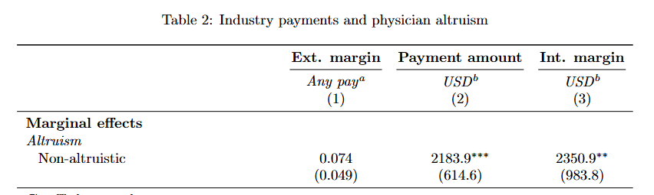
Last time: Provider Payment
Thinking about supply of healthcare rather than demand
How do physicians respond to incentives?

Slide 5
Last time: Provider Payment
Thinking about supply of healthcare rather than demand
How do physicians respond to incentives?
This time: More Provider Incentives
How do doctors influence treatment decisions?
How does variation in utilization patterns arise?
This is a very rich literature!
Covered today: demand inducement, returns to specialization, teams (Eric)
Not covered: learning, innovation adoption, testing decisions, report cards, etc.!

Slide 6
Dranove (1988)
“Demand Inducement and the Physician/Patient Relationship.” Economic Inquiry
Notes:
Key papers don’t always publish well immediately!

Slide 7
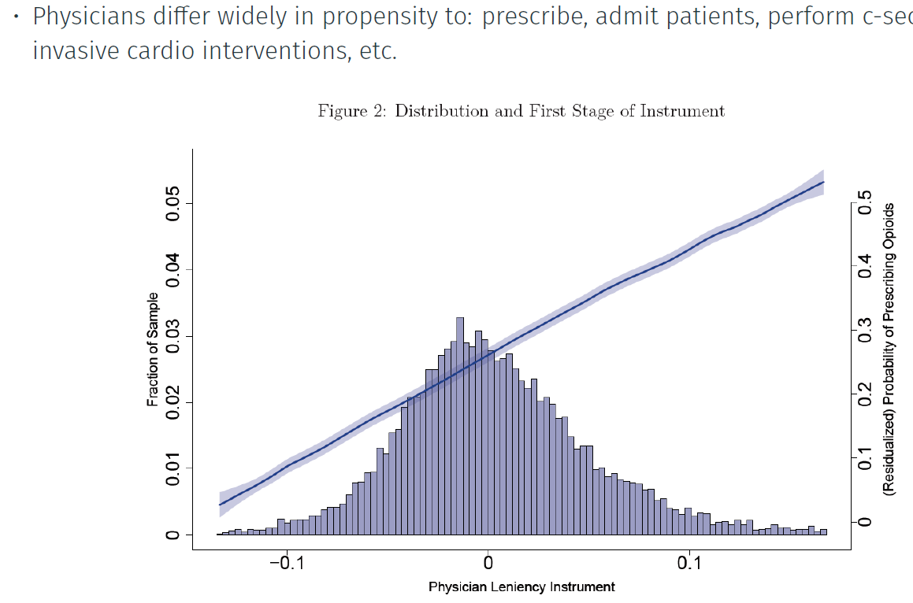
Can a physician induce demand?
Source: Alexander (2020, JPE)
5
Notes:
So what’s the story – is this entirely patient selection, or does the MD have control? Think back to leniency IV from last semester!

Slide 8
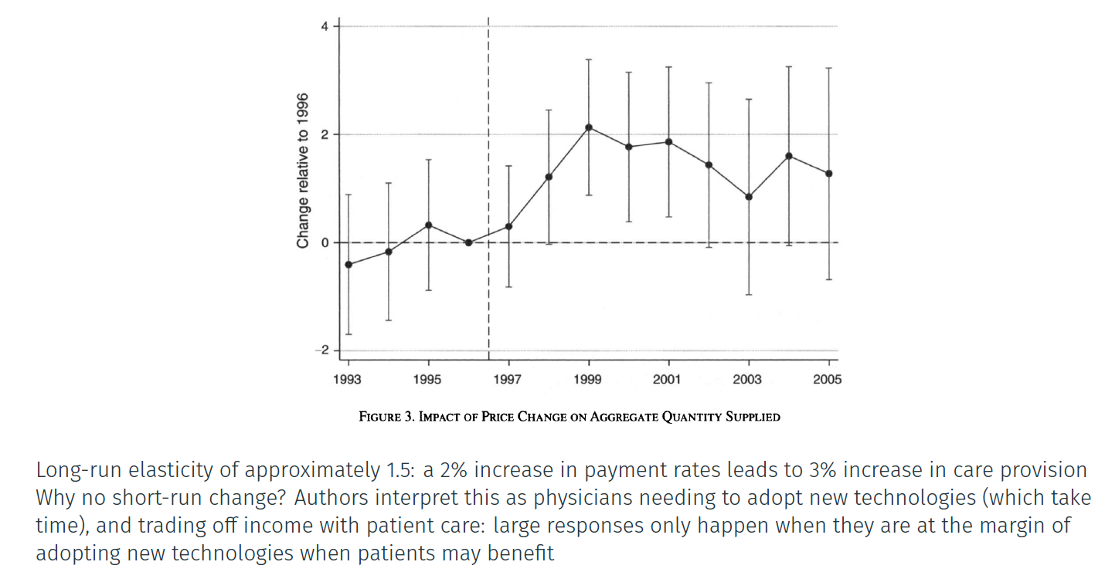
Physicians are also price responsive
Source: Clemens & Gottlieb (2014, AER)
5
Notes:
So what’s the story? And what kind of responses do we have here – is it tech adoption? Is it profit maximization?

Slide 9
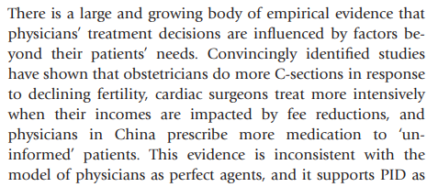
Classic paper: Physician-induced demand
One hypothesis: profit-maximizing physicians persuade patients to consume “excess” care
Providers exploit their medical information asymmetry to increase profits
How plausible do we think this is?
5
Notes:
We’ll come back to this question – source Johnson 2014 (“Physician-Induced Demand”)

Slide 10
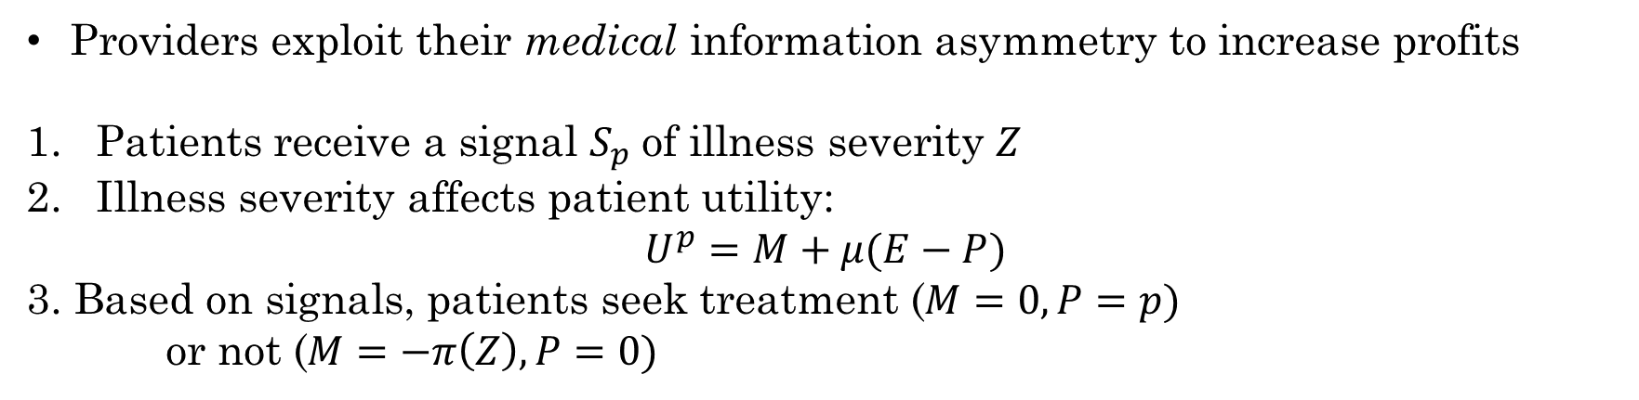
Model Setup: Patients
Providers exploit their medical information asymmetry to increase profits
Patients receive a signal $S_{p}$of illness severity $Z$
Illness severity affects patient utility:
$$U^{p}=M+μ(E−P)$$
3. Based on signals, patients seek treatment ($M=0,P=p)$ or not ($M=−π\left(Z\right),P=0)$
5
Notes:
What is the comparison of utilities in both states? –pi(Z)+mu(E) in one state and mu(E-P) in another

Slide 11
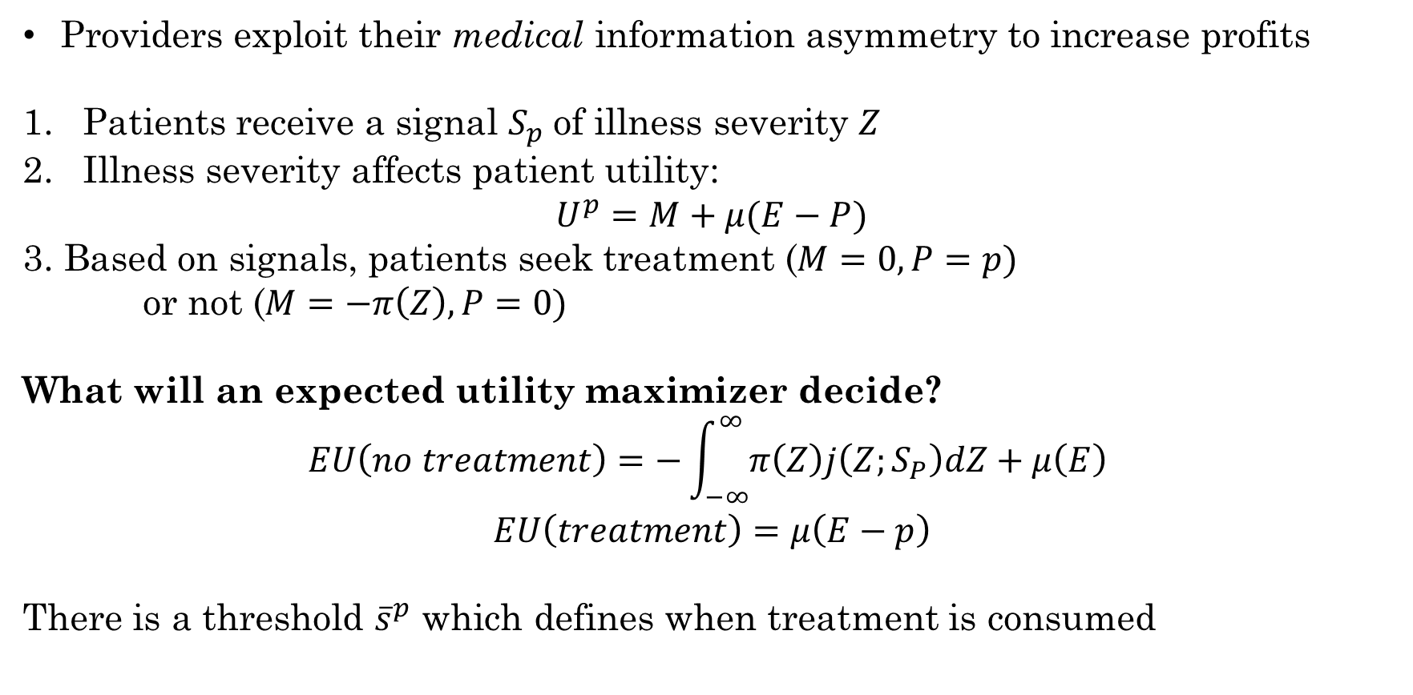
Model Setup: Patients
Providers exploit their medical information asymmetry to increase profits
Patients receive a signal $S_{p}$of illness severity $Z$
Illness severity affects patient utility:
$$U^{p}=M+μ(E−P)$$
3. Based on signals, patients seek treatment ($M=0,P=p)$ or not ($M=−π\left(Z\right),P=0)$
What will an expected utility maximizer decide?
$$EU\left(no treatment\right)=−\int_{−∞}^{∞}{π\left(Z\right)j\left(Z;S_{P}\right)dZ+μ\left(E\right) }$$
$$EU\left(treatment\right)=μ\left(E−p\right)$$
There is a threshold ${\overline{s}}^{p}$ which defines when treatment is consumed
5
Notes:
Now expected utilities are integrals over the distribution of illness states

Slide 12




Example: Fever
At what temperature do you go to the doctor?
5
Notes:
This is similar to hurdle models in last semester! Here we are modeling the decision of seeking care, and then in the second stage we will discuss the model for how much treatment is consumed

Slide 13
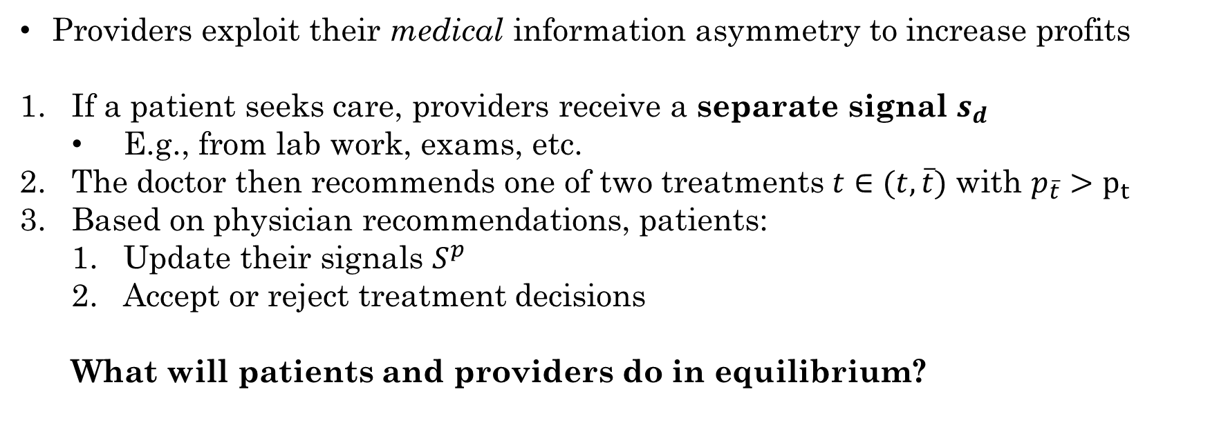
Model Setup: Providers
Providers exploit their medical information asymmetry to increase profits
If a patient seeks care, providers receive a separate signal $s_{d}$
E.g., from lab work, exams, etc.
The doctor then recommends one of two treatments $t∈(t,\overline{t})$ with $p_{\overline{t}}>p_{t}$
Based on physician recommendations, patients:
Update their signals $S^{p}$
Accept or reject treatment decisions
What will patients and providers do in equilibrium?
5
Notes:
Why only two treatments? Tractability. Note that still, without making some assumptions, solution is very complicated (triple integrals!)

Slide 14
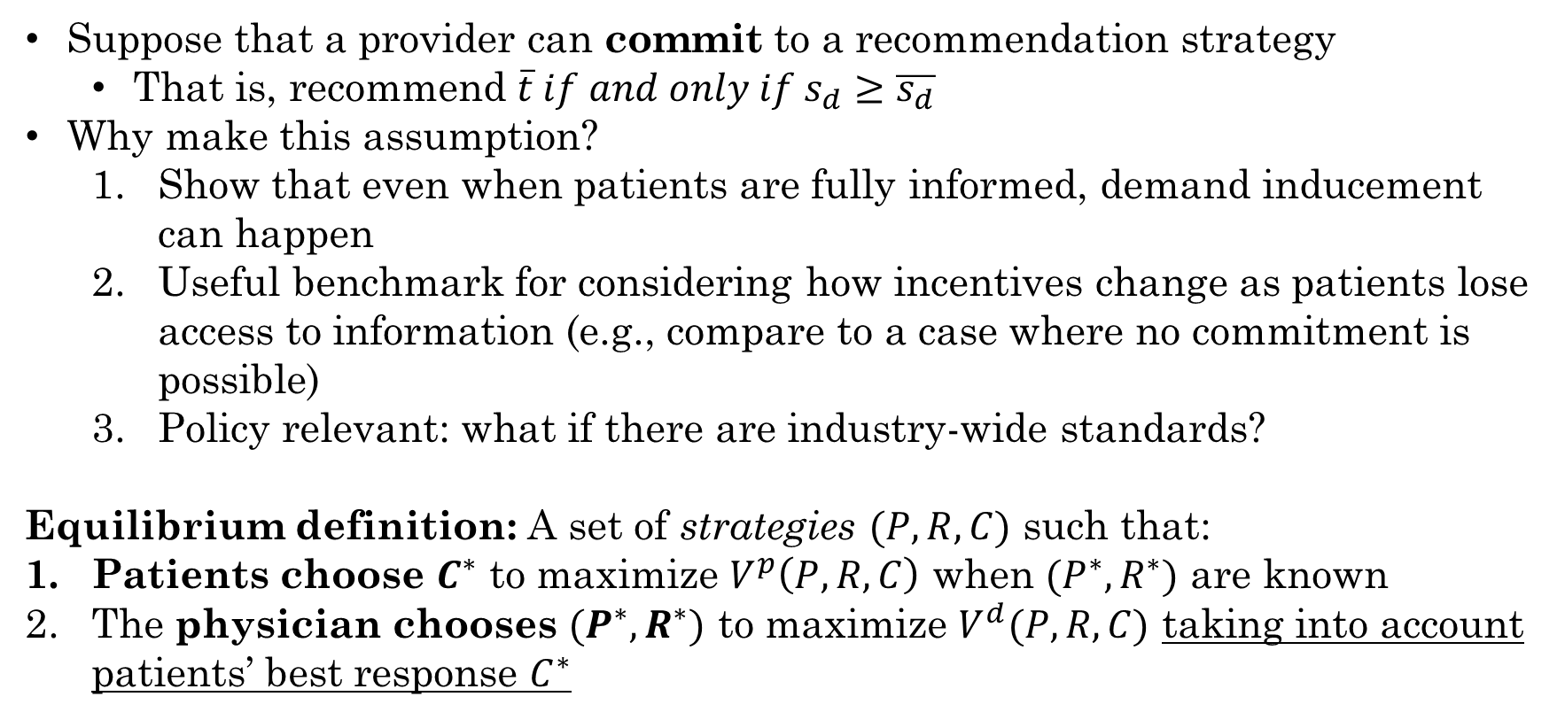
Simple Equilibrium: Commitment
Suppose that a provider can commit to a recommendation strategy
That is, recommend $\overline{t} if and only if s_{d}≥\overline{s_{d}}$
Why make this assumption?
Show that even when patients are fully informed, demand inducement can happen
Useful benchmark for considering how incentives change as patients lose access to information (e.g., compare to a case where no commitment is possible)
Policy relevant: what if there are industry-wide standards?
Equilibrium definition: A set of strategies $(P,R,C)$ such that:
Patients choose $C^{∗}$ to maximize $V^{p}\left(P,R,C\right)$ when $(P^{∗},R^{∗})$ are known
The physician chooses $(P^{∗},R^{∗})$ to maximize $V^{d}(P,R,C)$ taking into account patients’ best response $C^{∗}$
5
Notes:
Price, recommendation strategy, and acceptance strategy – this is a Nash equilibrium (game theory)

Slide 15
Solving for the Equilibrium: Backward Induction
A common strategy to solve for such an equilibrium is backward induction
Solve the physician’s problem first
Solve the patient’s problem conditional on physicians’ best-response
5

Slide 16
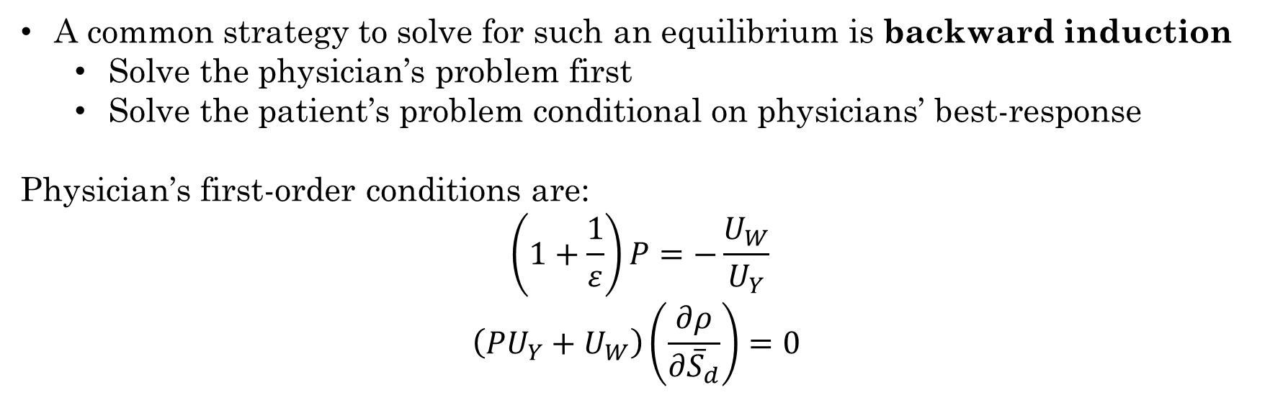
Solving for the Equilibrium: Backward Induction
A common strategy to solve for such an equilibrium is backward induction
Solve the physician’s problem first
Solve the patient’s problem conditional on physicians’ best-response
Physician’s first-order conditions are:
$$\left(1+\frac{1}{ε}\right)P=−\frac{U_{W}}{U_{Y}}$$
$$\left(PU_{Y}+U_{W}\right)\left(\frac{∂ρ}{∂{\overline{S}}_{d}}\right)=0$$
5
Notes:
Ignore the involved utility function here. Y is income, W is work (disutility), epsilon is patient elasticity of demand. Rho is the fraction of patients who receive treatment.

Slide 17
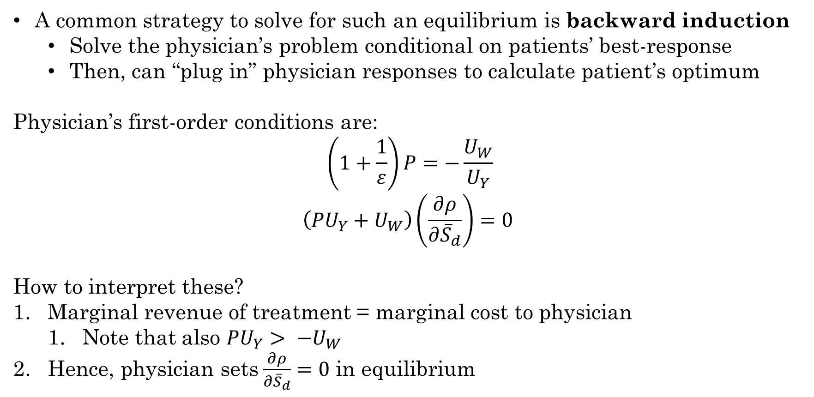
Solving for the Equilibrium: Backward Induction
A common strategy to solve for such an equilibrium is backward induction
Solve the physician’s problem conditional on patients’ best-response
Then, can “plug in” physician responses to calculate patient’s optimum
Physician’s first-order conditions are:
$$\left(1+\frac{1}{ε}\right)P=−\frac{U_{W}}{U_{Y}}$$
$$\left(PU_{Y}+U_{W}\right)\left(\frac{∂ρ}{∂{\overline{S}}_{d}}\right)=0$$
How to interpret these?
Marginal revenue of treatment = marginal cost to physician
Note that also $PU_{Y}> −U_{W}$
Hence, physician sets$\frac{∂ρ}{∂{\overline{S}}_{d}}=0$ in equilibrium
5
Notes:
Strong intuition here – if the physician can change their utility from changing cutoff and performing additional treatments (since derivative is nonzero). This increases physician utility since marginal benefit outweighs marginal costs. Inducing demand to the maximum!

Slide 18
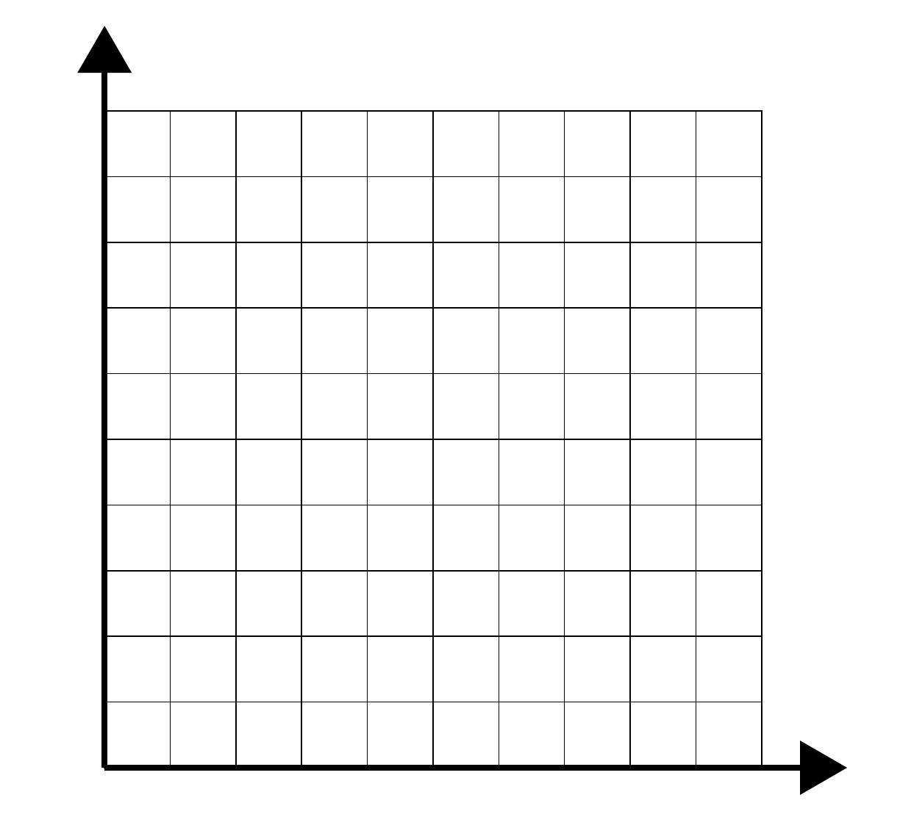



Equilibrium Intuition
$$s_{p}$$
5
Notes:
Physician has a cutoff rule that is known, remember

Slide 19
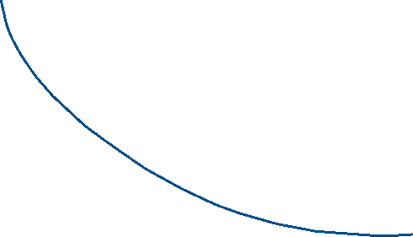


Equilibrium Intuition
$$s_{p}$$
5
Notes:
Patient’s rule has a cutoff that internalizes the physicians’ signal (observed only as treatment decisions) as well. The steepness of the curve is patient elasticity, or “resistance” to inducement – steeper curves mean patients prioritize their own signal and are less responsive to providers’ signals.

Slide 20


Equilibrium Intuition
$$s_{p}$$
5
Notes:
Treatment occurs only in highlighted region – when patient signal is enough to seek treatment and doctor signal is enough to recommend treatment (this is the probability that takes a triple integral to calculate)

Slide 21

Can providers change cutoff rule?
$$s_{p}$$
$${\overline{s}}_{d}−δ$$
5
Notes:
First, provider changes their rule by delta

Slide 22










Can providers change cutoff rule?
$$s_{p}$$
$${\overline{s}}_{d}−δ$$
5
Notes:
Now patients update their rule, and you get new treatment in pink (people leaving in orange b/c physician is seen as an over-prescriber). Hence, providers induce if pink > orange (reputation effects limit inducement, but do not eliminate it)

Slide 23
Ways to Enrich the Model
What if physician diagnoses are costly to the physician?
What about noise in patient/provider signals?
What about physician competition for patients? (Rochaix, 1989)
What if providers can’t commit?
5
Notes:
Experience and search goods are known before, now we’re introducing a third

Slide 24

Ways to Enrich the Model
What if physician diagnoses are costly to the physician?
What about noise in patient/provider signals?
What about physician competition for patients? (Rochaix, 1989)
What if providers can’t commit?
New (ish) literature on credence goods:
Experience goods: don’t know quality until after consumption (sushi)
Search goods: you only know what you’re buying once you’ve bought it (auctions)
Credence goods: you can’t know quality even after consumption
Is it the doctor’s fault I’m still sick? Did that drug cure me or did my body heal itself?
5
Notes:
Experience and search goods are known before, now we’re introducing a third

Slide 25
Do people like the SID hypothesis?
No
5
Notes:
There are obvious policy implications here, like reigning in physicians with insurers (prior authorization grew out of this). Is this really what we think is going on, especially for the most expensive types of care?

Slide 26
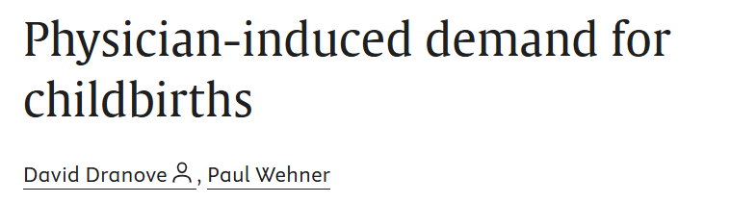
Do people like the SID hypothesis?
No
5
Notes:
JHE 1994 – points out empirical puzzle for SID.
basically, you used to “estimate” SID by a 2SLS to account for physician supply and use of a procedure (which is potentially endogenous)
Use some excluded instruments that are related to supply of physicians but not demand for procedures (e.g., hotel receipts per capita)
Why should this work in “theory”?
But what do they see? Even if you look in a spot where inducement is likely not possible (remember this is the 90s) then there’s still SID!
What do we conclude?

Slide 27
Literature Extensions
What if patients search for their doctors (Rochaix, 1989)?
What about altruistic doctor preferences? What about Hippocratic Oath? (Chone et al., 2011)
How should this affect cost-sharing (Jack, 2005)?
What about risk preferences versus underlying patient riskiness (Fang & Wu, 2018)?
What about multiple treatment methods?
5
Notes:
Lots of directions for research! Can’t focus on all of them here

Slide 28
Chandra and Staiger (2007)
“Productivity Spillovers in Health Care: Evidence from the Treatment of Heart Attacks.” Journal of Political Economy.

Slide 29
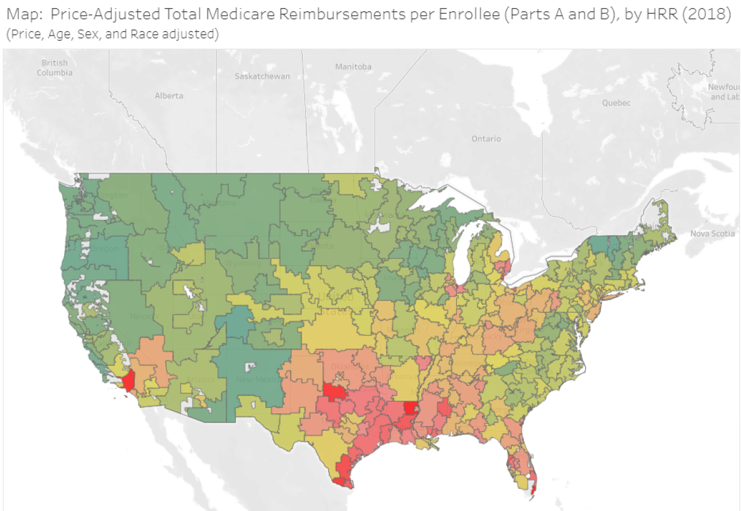
Motivation: Geographic Variation in Care
Why are there geographic disparities in health utilization/spending?
5
Notes:
Sure this is similar for Canada but no good data

Slide 30
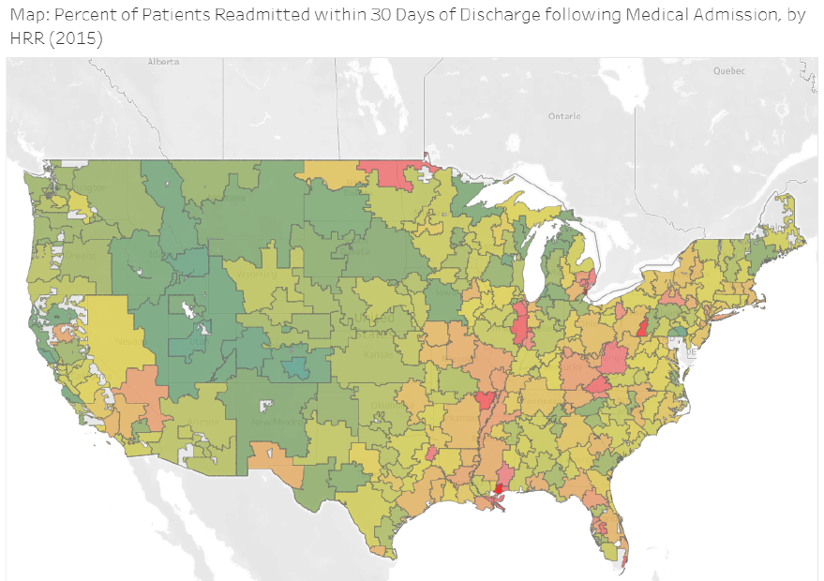
Motivation: Geographic Variation in Care
Why are (might?) there geographic disparities in quality?
5
Notes:
Surprisingly, the use of more intensive procedures is not associated with improved satisfaction, outcomes, or survival but is associated with significantly higher costs

Slide 31
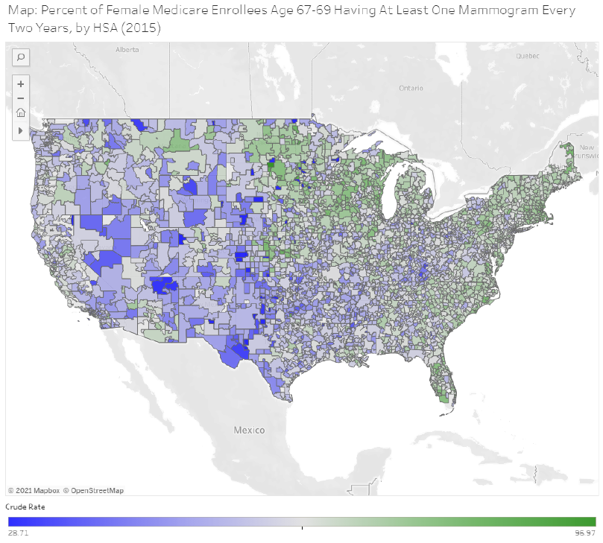
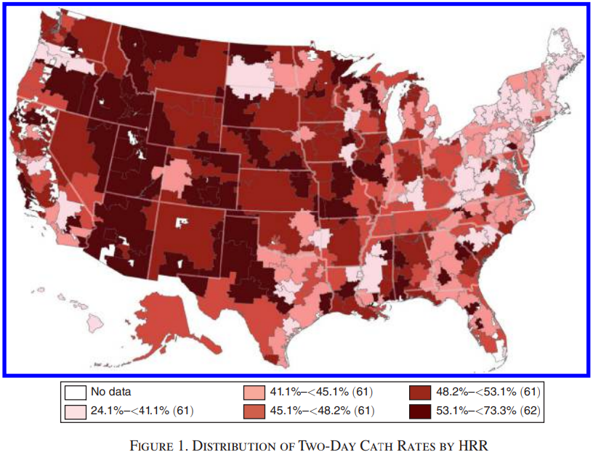
Motivation: Geographic Variation in Care
Why are (might?) there geographic disparities in quality?
5
Notes:
Is it due to:
• Demand-side factors: patients preferences and sickness varies across space
• Supply-side factors: healthcare access, clinician practice styles vary across space, regional policy/law
• Controlling for patient demographics only gets you so far.. what about unobservables?

Slide 32
Productivity Spillovers
One hypothesis: “flat of the curve” medicine
Is there wasteful utilization? Too much demand-inducement?
5

Slide 33
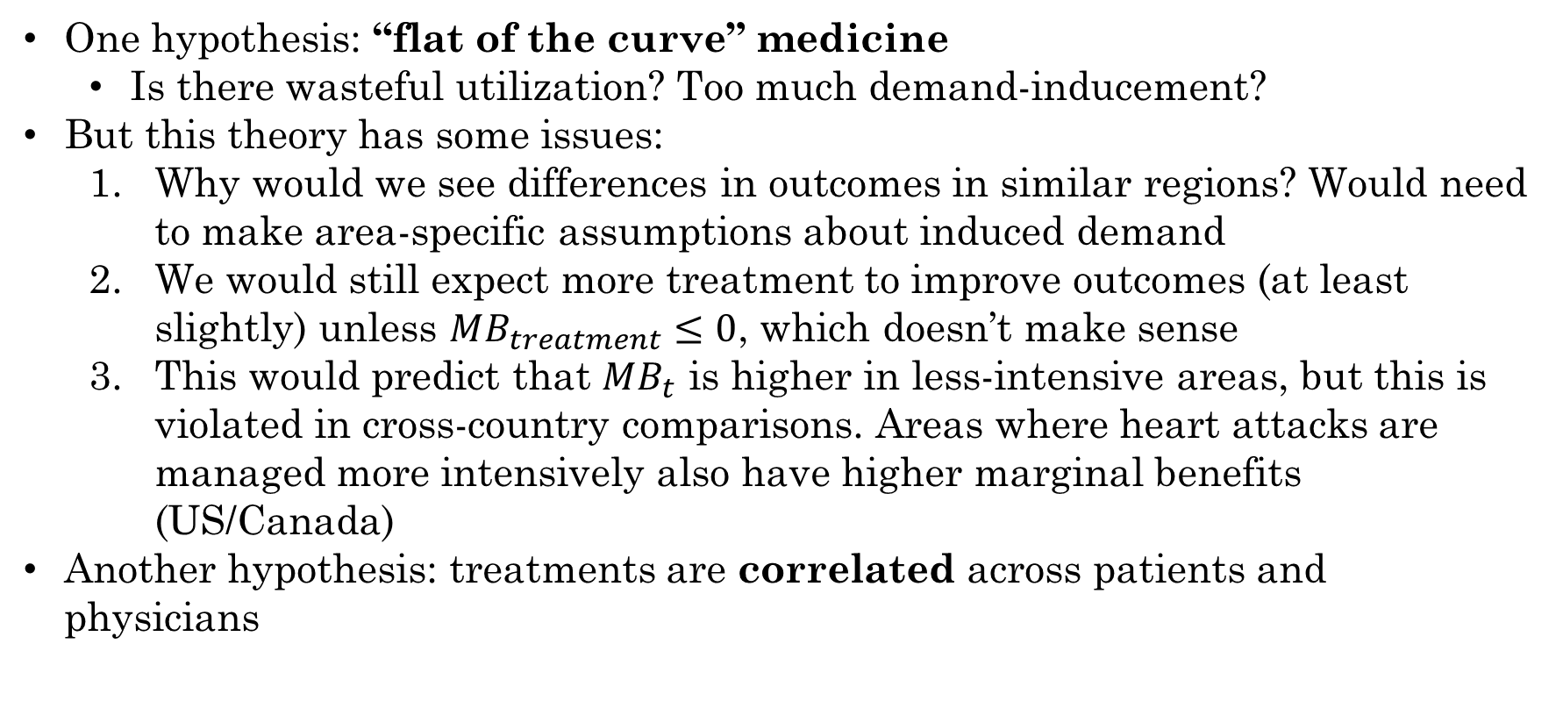
Productivity Spillovers
One hypothesis: “flat of the curve” medicine
Is there wasteful utilization? Too much demand-inducement?
But this theory has some issues:
Why would we see differences in outcomes in similar regions? Would need to make area-specific assumptions about induced demand
We would still expect more treatment to improve outcomes (at least slightly) unless $MB_{treatment}≤0$, which doesn’t make sense
This would predict that $MB_{t}$ is higher in less-intensive areas, but this is violated in cross-country comparisons. Areas where heart attacks are managed more intensively also have higher marginal benefits (US/Canada)
Another hypothesis: treatments are correlated across patients and physicians
5

Slide 34
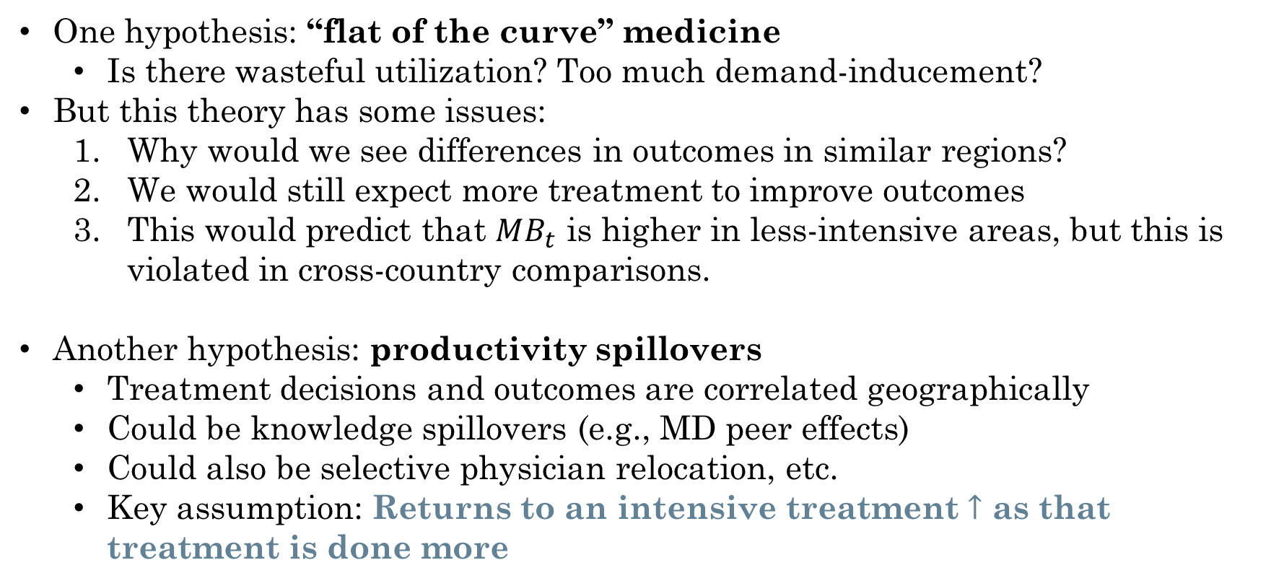
Productivity Spillovers
One hypothesis: “flat of the curve” medicine
Is there wasteful utilization? Too much demand-inducement?
But this theory has some issues:
Why would we see differences in outcomes in similar regions?
We would still expect more treatment to improve outcomes
This would predict that $MB_{t}$ is higher in less-intensive areas, but this is violated in cross-country comparisons.
Another hypothesis: productivity spillovers
Treatment decisions and outcomes are correlated geographically
Could be knowledge spillovers (e.g., MD peer effects)
Could also be selective physician relocation, etc.
Key assumption: Returns to an intensive treatment $↑$ as that treatment is done more
5
Notes:
We’ll come back to this question

Slide 35
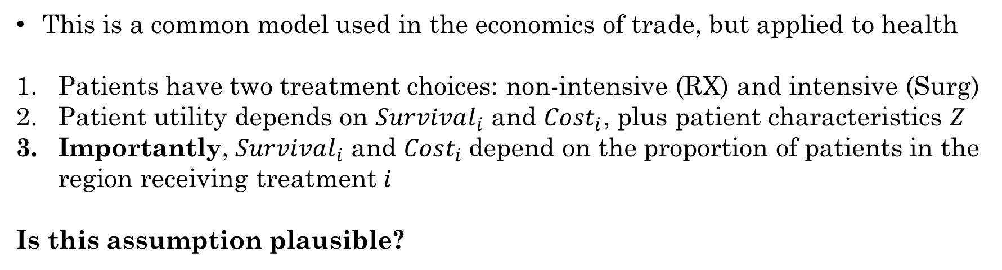
Model Setup: Roy Model
This is a common model used in the economics of trade, but applied to health
Patients have two treatment choices: non-intensive (RX) and intensive (Surg)
Patient utility depends on $Survival_{i}$ and $Cost_{i}$, plus patient characteristics $Z$
Importantly, $Survival_{i}$ and $Cost_{i}$depend on the proportion of patients in the region receiving treatment $i$
Is this assumption plausible?
5
Notes:
Roy model: one of comparative advantage. Roy's original paper deals with workers selecting into fishing and hunting professions, where there is no uncertainty about the amount of goods (fish or rabbits) that will be caught in a given period, but fishing is more costly as it requires more skill. The central question that Roy tries to answer in the original paper is whether the best hunters will hunt and the best fishermen will fish.

Slide 36
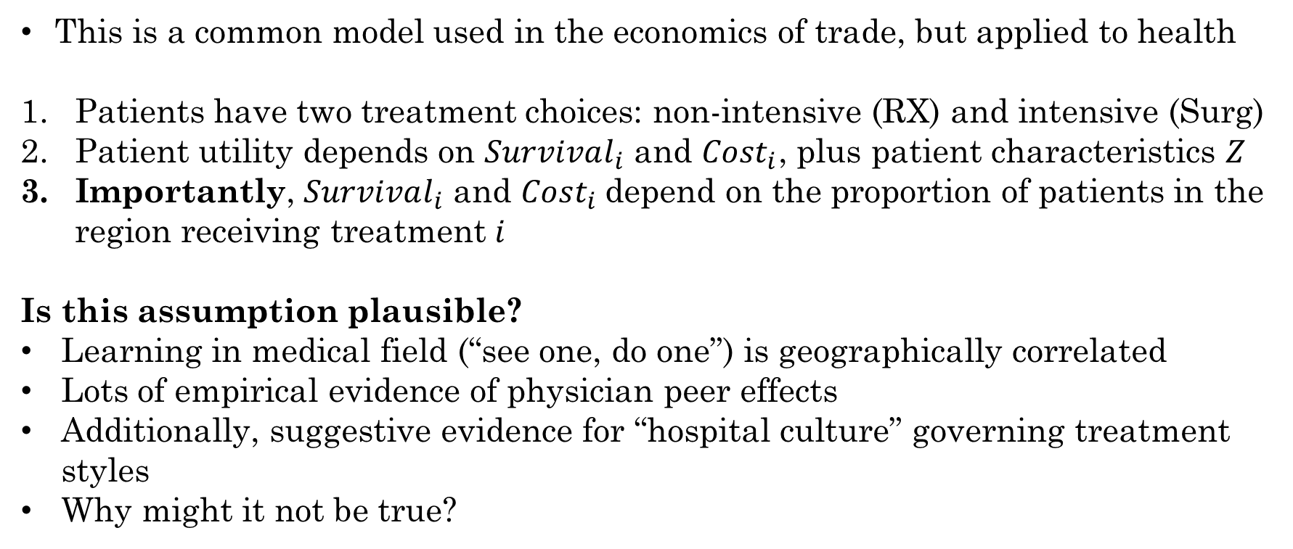
Model Setup: Roy Model
This is a common model used in the economics of trade, but applied to health
Patients have two treatment choices: non-intensive (RX) and intensive (Surg)
Patient utility depends on $Survival_{i}$ and $Cost_{i}$, plus patient characteristics $Z$
Importantly, $Survival_{i}$ and $Cost_{i}$depend on the proportion of patients in the region receiving treatment $i$
Is this assumption plausible?
Learning in medical field (“see one, do one”) is geographically correlated
Lots of empirical evidence of physician peer effects
Additionally, suggestive evidence for “hospital culture” governing treatment styles
Why might it not be true?
5
Notes:
Roy model: one of comparative advantage. Roy's original paper deals with workers selecting into fishing and hunting professions, where there is no uncertainty about the amount of goods (fish or rabbits) that will be caught in a given period, but fishing is more costly as it requires more skill. The central question that Roy tries to answer in the original paper is whether the best hunters will hunt and the best fishermen will fish.

Slide 37
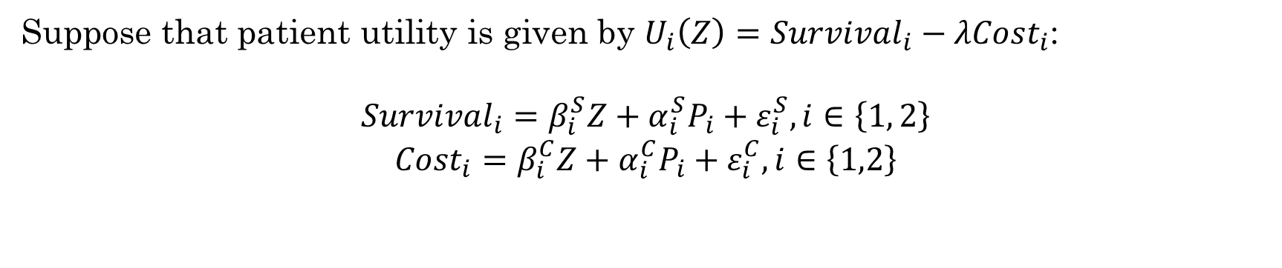
Model Setup: Patient Utility
Suppose that patient utility is given by $U_{i}\left(Z\right)=Survival_{i}−λCost_{i}$:
$$Survival_{i}=β_{i}^{S}Z+α_{i}^{S}P_{i}+ε_{i}^{S}, i∈\left\{1, 2\right\}$$
$$Cost_{i}=β_{i}^{C}Z+α_{i}^{C}P_{i}+ε_{i}^{C}, i∈\left\{1,2\right\}$$
5
Notes:
What are the key parameters here? The alphas – what does it mean if they are positive? Negative? What does lambda mean? The value of life (relating survival to cost in same units – can largely ignore this). Lambda has been estimated around $100,000/life-year , but lambda could be much smaller, even 0, if patients/MDs aren’t paying for treatment themselves.

Slide 38
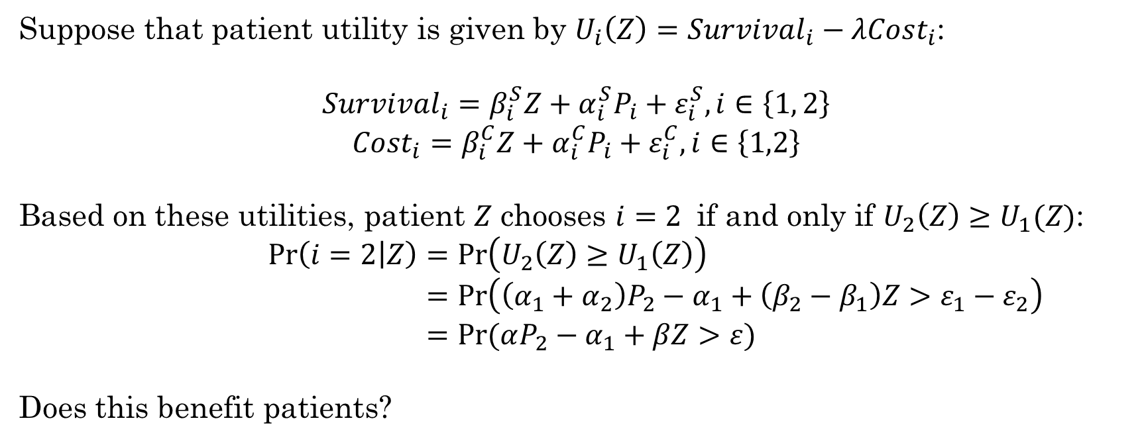
Model Setup: Physician Choice
Suppose that patient utility is given by $U_{i}\left(Z\right)=Survival_{i}−λCost_{i}$:
$$Survival_{i}=β_{i}^{S}Z+α_{i}^{S}P_{i}+ε_{i}^{S}, i∈\left\{1, 2\right\}$$
$$Cost_{i}=β_{i}^{C}Z+α_{i}^{C}P_{i}+ε_{i}^{C}, i∈\left\{1,2\right\}$$
Based on these utilities, patient $Z$ chooses $i=2$ if and only if $U_{2}\left(Z\right)≥U_{1}(Z)$:
$$\operatorname{Pr}\left(i=2 | Z\right)=\operatorname{Pr}\left(U_{2}\left(Z\right)≥U_{1}\left(Z\right)\right) \\ =\operatorname{Pr}\left(\left(α_{1}+α_{2}\right)P_{2}−α_{1}+\left(β_{2}−β_{1}\right)Z>ε_{1}−ε_{2}\right) \\ =Pr⁡(αP_{2}−α_{1}+βZ>ε)$$
Does this benefit patients?
5
Notes:
Defining alpha, beta, epsilon as sums and differences

Slide 39
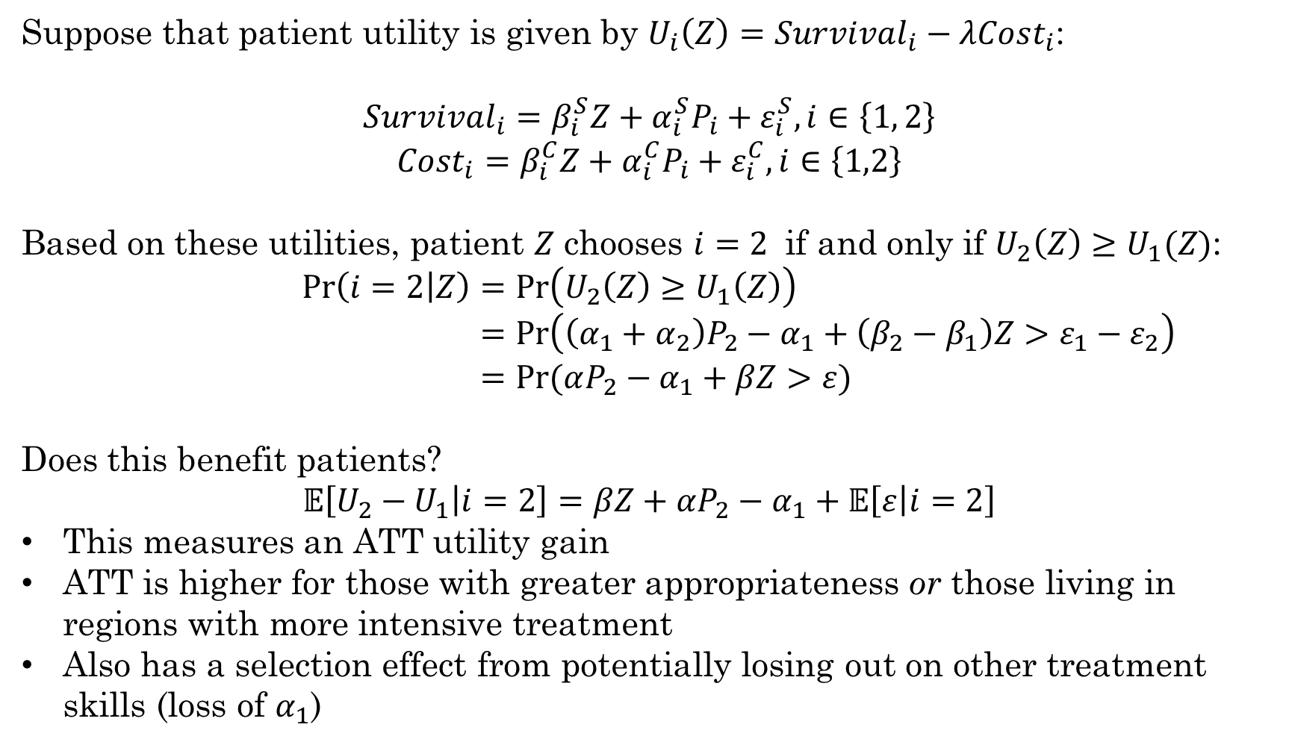
Model Setup: Physician Choice
Suppose that patient utility is given by $U_{i}\left(Z\right)=Survival_{i}−λCost_{i}$:
$$Survival_{i}=β_{i}^{S}Z+α_{i}^{S}P_{i}+ε_{i}^{S}, i∈\left\{1, 2\right\}$$
$$Cost_{i}=β_{i}^{C}Z+α_{i}^{C}P_{i}+ε_{i}^{C}, i∈\left\{1,2\right\}$$
Based on these utilities, patient $Z$ chooses $i=2$ if and only if $U_{2}\left(Z\right)≥U_{1}(Z)$:
$$\operatorname{Pr}\left(i=2 | Z\right)=\operatorname{Pr}\left(U_{2}\left(Z\right)≥U_{1}\left(Z\right)\right) \\ =\operatorname{Pr}\left(\left(α_{1}+α_{2}\right)P_{2}−α_{1}+\left(β_{2}−β_{1}\right)Z>ε_{1}−ε_{2}\right) \\ =Pr⁡(αP_{2}−α_{1}+βZ>ε)$$
Does this benefit patients?
$$𝔼\left[U_{2}−U_{1} | i=2\right]=βZ+αP_{2}−α_{1}+𝔼\left[ε | i=2\right]$$
This measures an ATT utility gain
ATT is higher for those with greater appropriateness or those living in regions with more intensive treatment
Also has a selection effect from potentially losing out on other treatment skills (loss of $α_{1}$)
5
Notes:
Defining alpha, beta, epsilon as sums and differences

Slide 40
Equilibrium
What do we need for this system of equations (utility, treatment choice, ATT) to be an equilibrium?
5
Notes:
Equilibriums: all objects are endogenous (no incentive to deviate). Remember that what we’re trying to measure here are the (P_1, P_2) in equilibrium

Slide 41
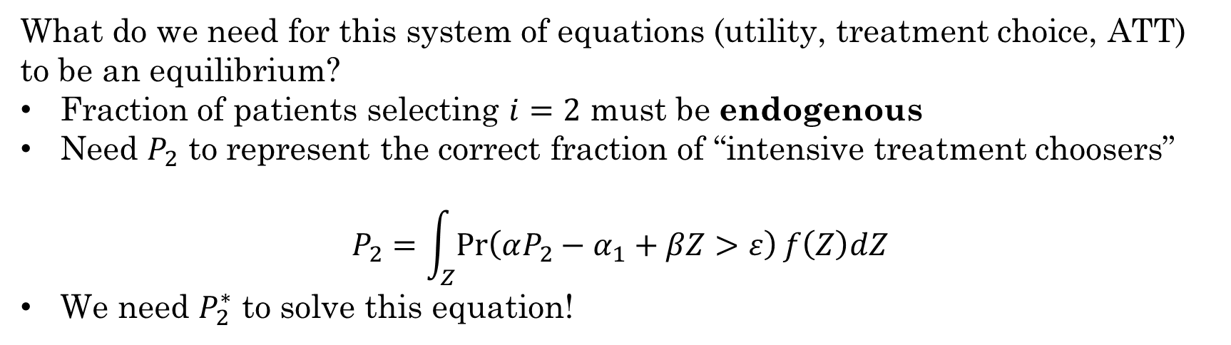
Equilibrium
What do we need for this system of equations (utility, treatment choice, ATT) to be an equilibrium?
Fraction of patients selecting $i=2$ must be endogenous
Need $P_{2}$ to represent the correct fraction of “intensive treatment choosers”
$$P_{2}=\int_{Z}{\operatorname{Pr}\left(αP_{2}−α_{1}+βZ>ε\right)f\left(Z\right)dZ}$$
We need $P_{2}^{∗}$ to solve this equation!
5
Notes:
Equilibriums: all objects are endogenous (no incentive to deviate). In other words, in equilibrium the proportion of patients choosing the intensive treatment must generate benefits to intensive treatment that are consistent with this proportion actually choosing the treatment. For example, if all patients choose the intensive treatment but this generates utility benefits such that some patients would prefer the nonintensive treatment, then rates of intensive treatment will decline – this is a deviation which is not an equilibrium.

Slide 42
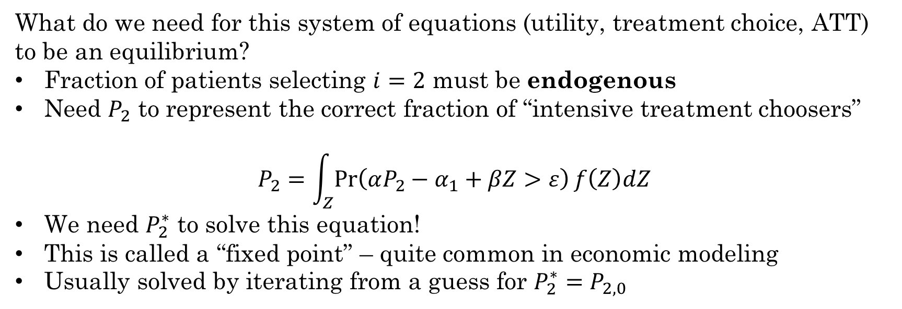
Equilibrium
What do we need for this system of equations (utility, treatment choice, ATT) to be an equilibrium?
Fraction of patients selecting $i=2$ must be endogenous
Need $P_{2}$ to represent the correct fraction of “intensive treatment choosers”
$$P_{2}=\int_{Z}{\operatorname{Pr}\left(αP_{2}−α_{1}+βZ>ε\right)f\left(Z\right)dZ}$$
We need $P_{2}^{∗}$ to solve this equation!
This is called a “fixed point” – quite common in economic modeling
Usually solved by iterating from a guess for $P_{2}^{∗}=P_{2,0}$
5
Notes:
As fewer patients choose the intensive treatment, costs will rise and survival will fall (through the spillover mechanism), further lowering the benefits to intensive treatment. This process continues until we reach an equilibrium in which only the most appropriate patients are left receiving the intensive treatment. Thus cost and quality of care determine demand for each treatment option and adjust to equilibrate the market.

Slide 43
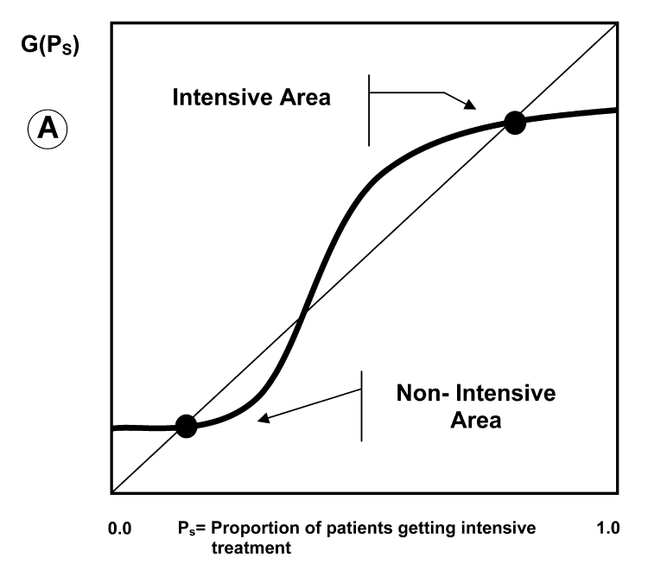
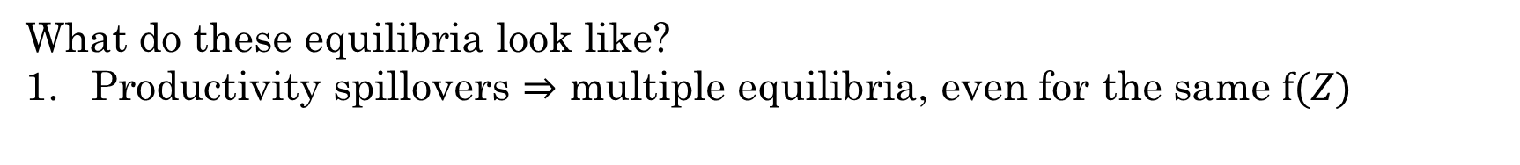
Model Implications
What do these equilibria look like?
Productivity spillovers $⇒$ multiple equilibria, even for the same $f(Z)$
5
Notes:
Suppose that different regions have different distributions F(Z).

Slide 44
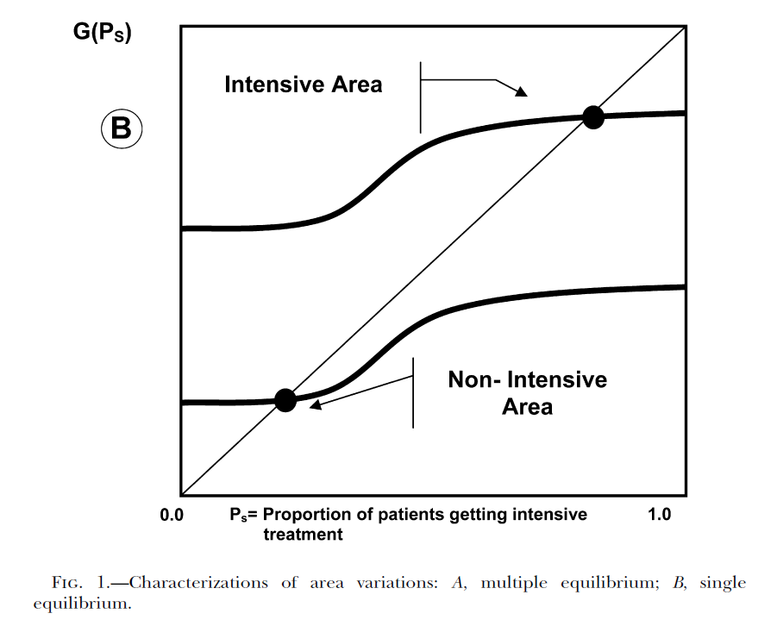
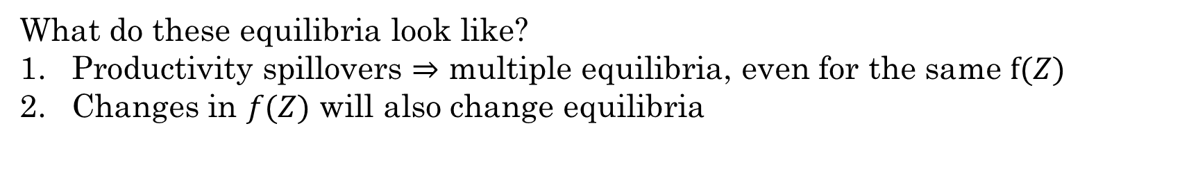
Model Implications
What do these equilibria look like?
Productivity spillovers $⇒$ multiple equilibria, even for the same $f(Z)$
Changes in $f(Z)$ will also change equilibria
5
Notes:
Suppose that different regions have different distributions F(Z).

Slide 45
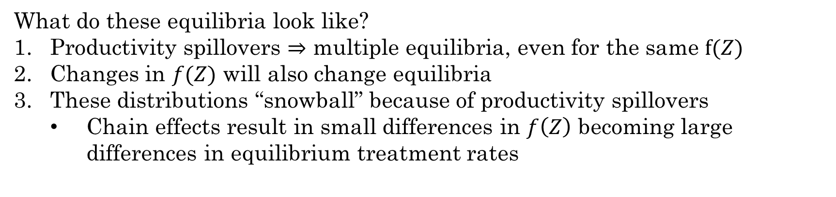
Model Implications
What do these equilibria look like?
Productivity spillovers $⇒$ multiple equilibria, even for the same $f(Z)$
Changes in $f(Z)$ will also change equilibria
These distributions “snowball” because of productivity spillovers
Chain effects result in small differences in $f\left(Z\right)$ becoming large differences in equilibrium treatment rates
5
Notes:
Preferences of the population have spillovers on the choice
of an individual.

Slide 46
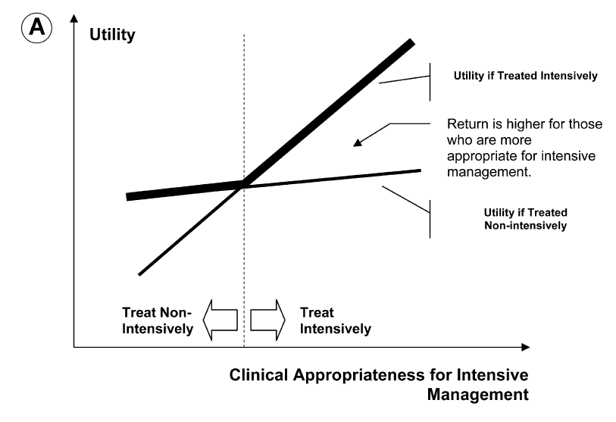
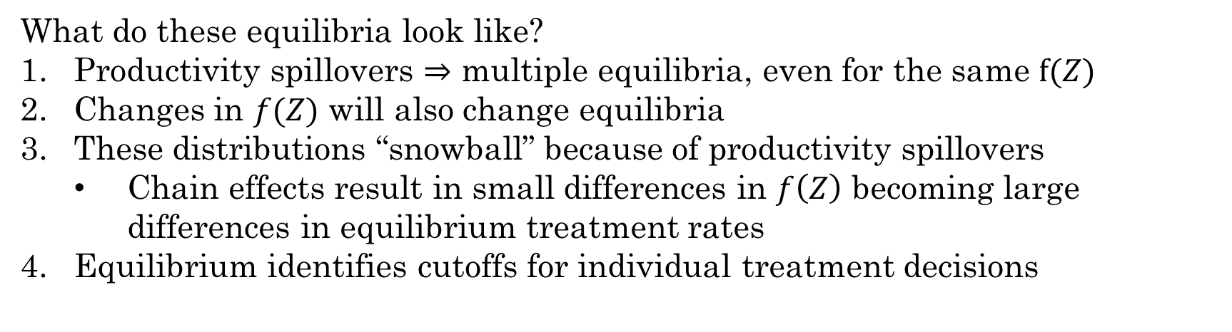
Model Implications
What do these equilibria look like?
Productivity spillovers $⇒$ multiple equilibria, even for the same $f(Z)$
Changes in $f(Z)$ will also change equilibria
These distributions “snowball” because of productivity spillovers
Chain effects result in small differences in $f\left(Z\right)$ becoming large differences in equilibrium treatment rates
Equilibrium identifies cutoffs for individual treatment decisions
5
Notes:
Just like in Dranove!

Slide 47
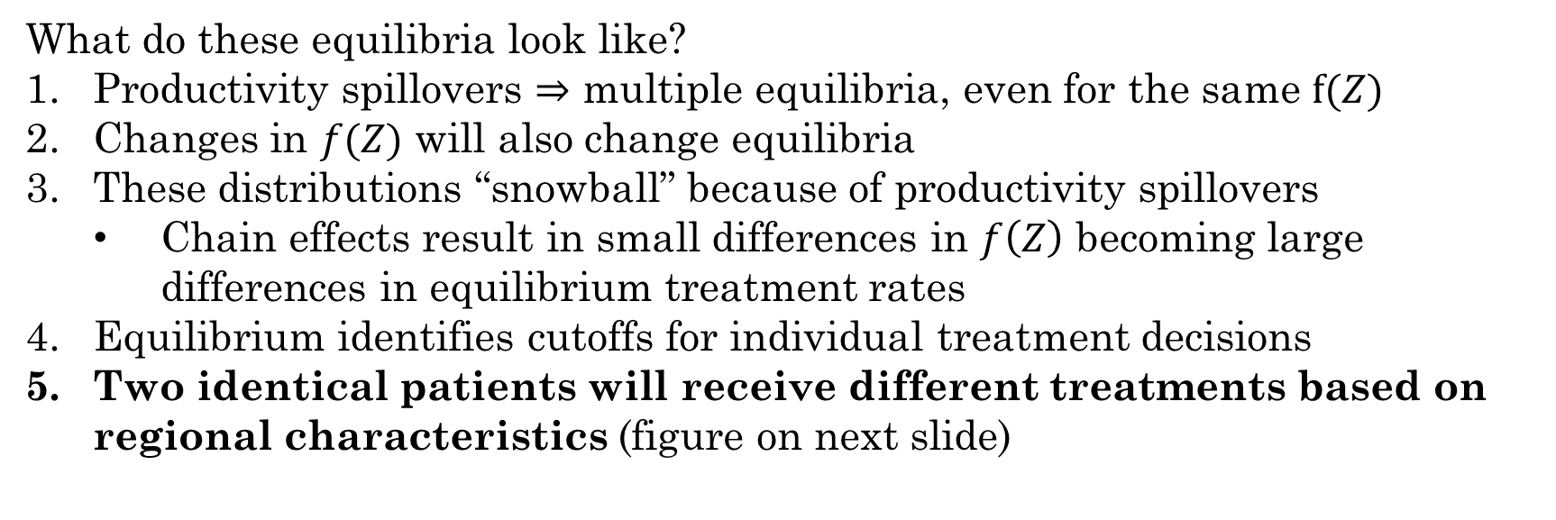
Model Implications
What do these equilibria look like?
Productivity spillovers $⇒$ multiple equilibria, even for the same $f(Z)$
Changes in $f(Z)$ will also change equilibria
These distributions “snowball” because of productivity spillovers
Chain effects result in small differences in $f\left(Z\right)$ becoming large differences in equilibrium treatment rates
Equilibrium identifies cutoffs for individual treatment decisions
Two identical patients will receive different treatments based on regional characteristics (figure on next slide)
5
Notes:
Preferences of society affect individual. This is the kicker figure

Slide 48
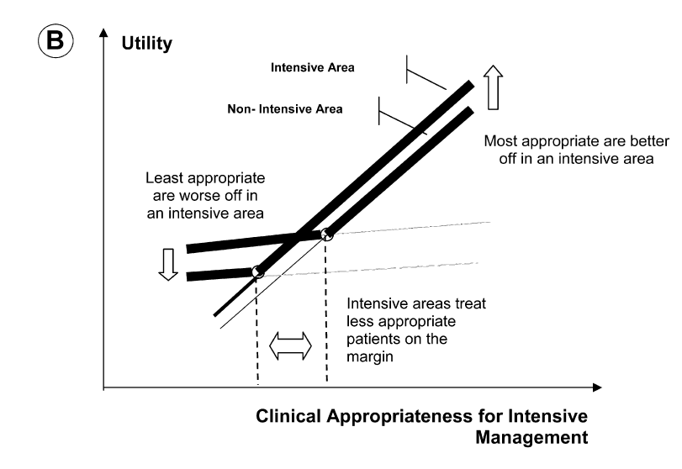
Model Implications
5
Notes:
Preferences of society affect individual. This is the kicker figure – different areas treat marginal patients differently.

Slide 49
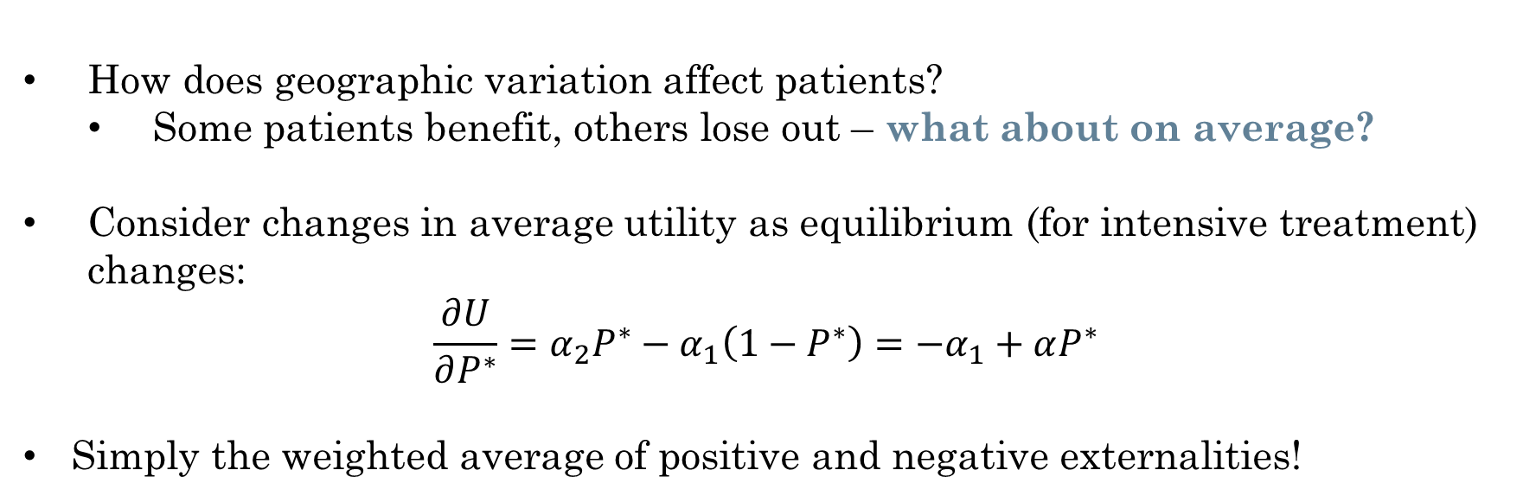
Welfare Implications
How does geographic variation affect patients?
Some patients benefit, others lose out – what about on average?
Consider changes in average utility as equilibrium (for intensive treatment) changes:
$$\frac{∂U}{∂P^{∗}}=α_{2}P^{∗}−α_{1}\left(1−P^{∗}\right)=−α_{1}+αP^{∗}$$
Simply the weighted average of positive and negative externalities!
5
Notes:
What is the comparison of utilities in both states? –pi(Z)+mu(E) in one state and mu(E-P) in another

Slide 50
Empirical Predictions of the Model
Utility of nonintensive management is worse in areas that are intensive
There should be a negative relationship between intensity of treatment on average and quality of non-intensive treatment in a region
That is: intensive treatment crowds out good medical management
Comparing intensive to minimalist regions:
Patient utility for riskiest patients will be higher
Patient utility for least risky patients will be lower
Benefit from receiving intervention is higher (ATT is higher)
Marginal patients receiving treatment in intensive areas will be less clinically appropriate for the intervention
How are these tested in the paper? Is it convincing?
5
Notes:
Walk through empirics if there is time – especially equation 8, table 1, figure 3

Slide 51
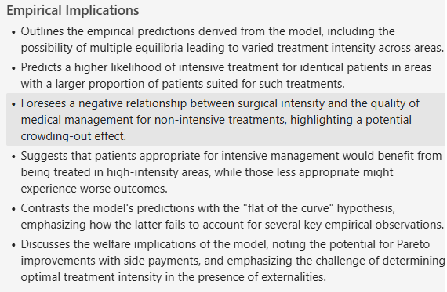
Empirical Predictions of the Model
Utility of nonintensive management is worse in areas that are intensive
There should be a negative relationship between intensity of treatment on average and quality of non-intensive treatment in a region
That is: intensive treatment crowds out good medical management
Comparing intensive to minimalist regions:
Patient utility for riskiest patients will be higher
Patient utility for least risky patients will be lower
Benefit from receiving intervention is higher (ATT is higher)
Marginal patients receiving treatment in intensive areas will be less clinically appropriate for the intervention
5
Notes:
Walk through empirics if there is time – especially equation 8, table 1, figure 3

Slide 52
Presentations

Slide 53
Liu and Ma (2013)
“Health insurance, treatment plan, and delegation to altruistic physician”
Journal of Economic Behavior & Organization
Notes:
Do this part if there’s time?

