Slide 1
Advanced Health Economics
Lecture 8: Health Equity and Discrimination
DATE
HAD 6750 • Alex Hoagland, Ph.D.

Slide 2
Last time: Competition and Markets
Notes?

Slide 3
Last time: Competition and Markets
Notes?
This time: Equity and Discrimination
Notes

Slide 4
Things to have in intro
Some empirical evidence (Williams slides, Chandra/Skinner paper)
Two types of models:
Taste-based (Becker 1957): Some people are “willing to pay” to be with a certain group (e.g., act as if blacks are more expensive to hire because of implicit association cost)
Standard models here predict prejudice should be run out of the market in long run
Is this observed? Not really
Statistical (Phelps ‘72, Arrow ’73, Aigner-Cain ‘77): employers have less reliable information about certain groups
E.g., believe that signals of labor productivity are noisier for women than for men
In health: Balsa and McGuire (2001)
Can also account for bad priors (stereotypes)
How has modeling changed with time?

Slide 5
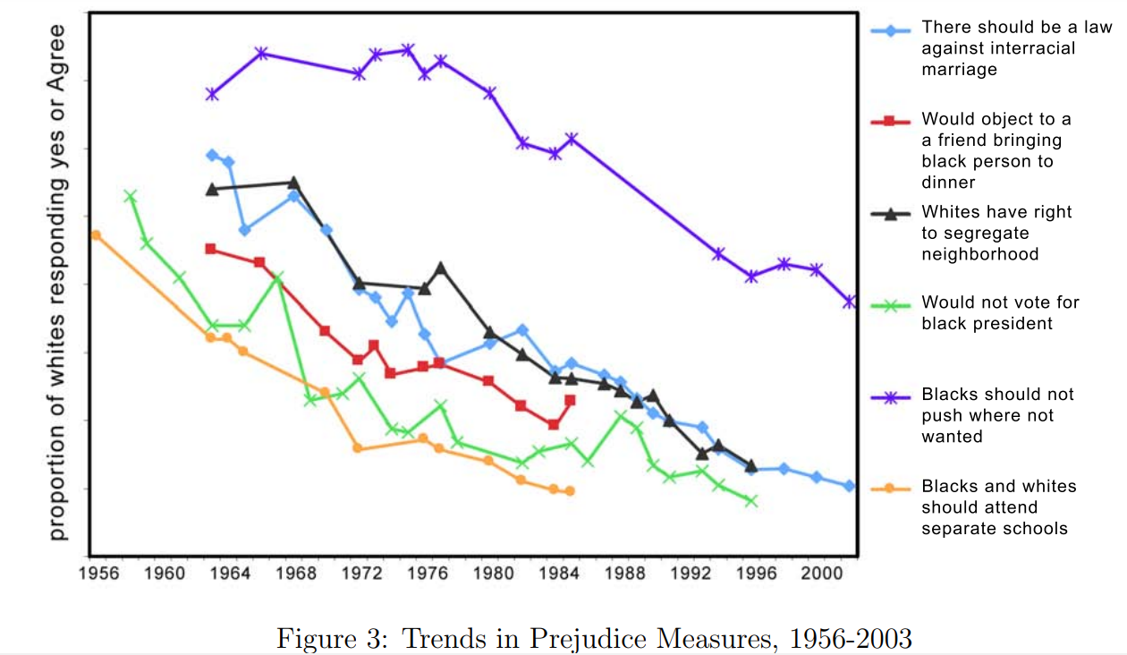
Things to have in intro: update this figure?

Slide 6
Becker (1957)
The Economics of Discrimination.
Notes:
Classic taste-based discrimination model : becker. Can use Williams slides or Lang/Lehman to present this model. Then present how Lang-Leman search model discussion could apply to health? (Ask people to read this before hand and think about a model here?)

Slide 7
Balsa and McGuire (2003)
Balsa and McGuire (2001)
“Statistical Discrimination in Health Care”
Journal of Health Economics
“Prejudice, clinical uncertainty and stereotyping as sources of health disparities”
Journal of Health Economics

Slide 8
Baicker, Chandra, & Skinner (2005)
“Geographic variation in health care and the problem of measuring racial disparities”
Perspectives in Biology and Medicine.
Notes:
Cover if time. Also add more empirical findings here (mention your own work)

Slide 9
Audit Studies and Equity
Notes:
Cover if time. Look at Lang-Lehman’s discussion on this in Section 7. How does this fit into the theory? Also base off of Angerer et al (2019) even though you didn’t assign this as reading.

Slide 10
Presentations

Slide 11
Summary
Moral hazard in health care
Additional work: talk about some of your own work.
Next time: adverse selection
What happens when people have private information about type?
How does this affect health choices?

